Slide 1
CSCE 658: Randomized Algorithms
Lecture 6
Samson Zhou

Slide 2
Class Logistics
MUST e-mail me to set up research meeting by next week if you’re interested in doing final project
Everyone else will be opting into the final exam

Slide 3
Recall: Concentration Inequalities
Concentration inequalities bound the probability that a random variable is “far away” from its expectation
Looking at the $kth$ moment for sufficiently high $k$ gives a number of very strong (and useful!) concentration inequalities with exponential tail bounds
Chernoff bounds, Bernstein’s inequality, Hoeffding’s inequality, etc.

Slide 4
Recall: Concentration Inequalities
Suppose we flip a fair coin $n=100$ times and let $H$ be the total number of heads
Markov’s inequality: $Pr\left[H≥60\right]≤0.833$
Chebyshev’s inequality: $Pr\left[H≥60\right]≤0.25$
$4th$ moment: $Pr\left[H≥60\right]≤0.186$
Bernstein’s inequality: $Pr\left[H≥60\right]≤0.15$
Truth: $Pr\left[H≥60\right]≈0.0284$

Slide 5
Last Time: Chernoff Bounds
Useful variant of Bernstein’s inequality when the random variables are binary
Chernoff bounds: Let $X_{1},…,X_{n}∈\{0, 1\}$ be independent random variables and let ${X=X}_{1}+…+X_{n}$ have mean $μ$. Then for any $δ≥0$:
$$Pr\left[\left|X−μ\right|≥δμ\right]≤2\exp\left(−\frac{δ^{2}μ}{2+δ}\right)$$

Slide 6
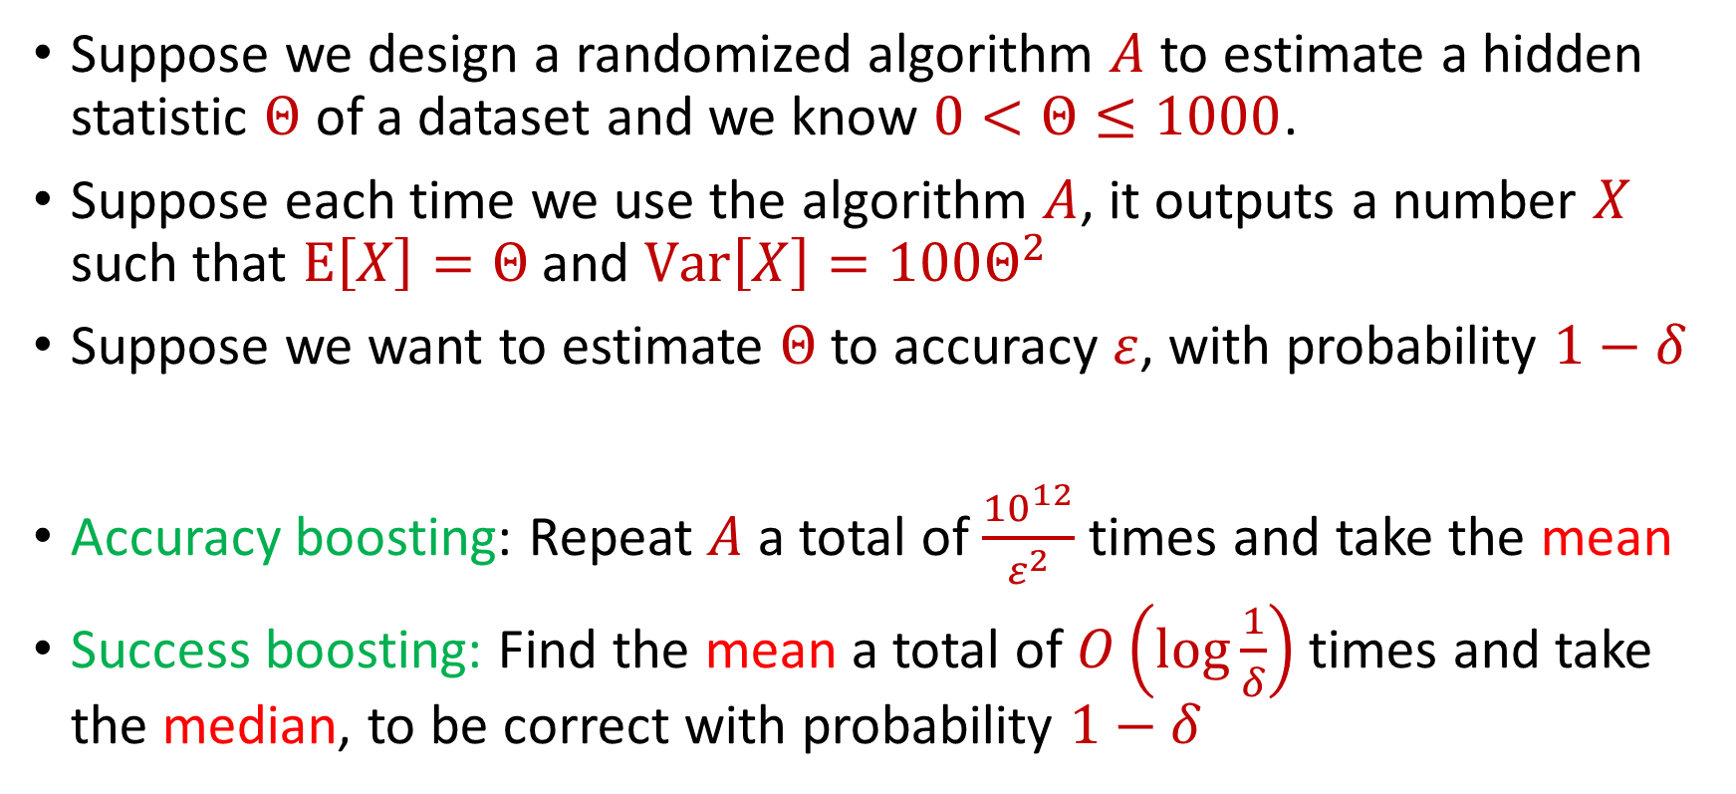
Last Time: Median-of-Means Framework
Suppose we design a randomized algorithm $A$ to estimate a hidden statistic $Θ$ of a dataset and we know $0<Θ≤1000$.
Suppose each time we use the algorithm $A$, it outputs a number $X$ such that $E\left[X\right]=Θ$ and $Var\left[X\right]=100Θ^{2}$
Suppose we want to estimate $Θ$ to accuracy $ε$, with probability $1−δ$
Accuracy boosting: Repeat $A$ a total of $\frac{{10}^{12}}{ε^{2}}$ times and take the mean
Success boosting: Find the mean a total of $O\left(\log{\frac{1}{δ}}\right)$ times and take the median, to be correct with probability $1−δ$

Slide 7
Trivia Question #3 (Max Load)
Suppose we have a fair $n$-sided die that we roll $n$ times. “On average”, what is the largest number of times any outcome is rolled? Example: $1$, $5$, $2$, $4$, $1$, $3$, $1$ for $n=7$
$Θ(1)$
$\tilde{Θ}(\log{n})$
$\tilde{Θ}(\sqrt{n})$
$\tilde{Θ}(n)$

Slide 8
Last Time: Max Load
Recall we fixed a value $k∈[n]$
$Pr\left[X≥3 log{n}\right]≤\frac{1}{n^{2}}$ means that with probability at least $1−\frac{1}{n^{2}}$, we will get fewer than $3 log{n}$ rolls with value $k$
Union bound: With probability at least $1−\frac{1}{n}$, no outcome will be rolled more than $3\log{n}$ times

Slide 9
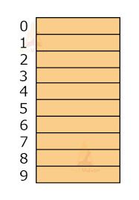
Hashing
Suppose we have a number of files, how do we consistently store them in memory?
$$h\left(x\right)$$
Vaibhav Bajaj
If we hash $n$ items, we require $Θ(n^{2})$ slots to avoid collisions
Jubey Garza
Tejas Kakad
Zeling Li
Vidith Madhu
Tong Wu

Slide 10

Dealing with Collisions
Suppose we store multiple items in the same location as a linked list
If the maximum number of collisions in a location is $c$, then could traverse a linked list of size $c$ for a query
Query runtime: $O(c)$
$$h(\text{Tejas} \text{Kakad})$$
$$Zeling Li$$
Tejas Kakad

Slide 11

Collisions and Max Load
With probability at least $1−\frac{1}{n}$, no outcome will be rolled more than $3\log{n}$ times
Worst case query time: $O(\log{n})$
$$Zeling Li$$
Tejas Kakad

Slide 12

Hashing
For $O(1)$ query time, use $Θ(n^{2})$ slots to avoid collisions
For $O(\log{n})$ query time, use $Θ(n)$ slots with linked lists
$$h\left(x\right)$$
Vaibhav Bajaj
Jubey Garza
Tejas Kakad
Zeling Li
Vidith Madhu
Tong Wu

Slide 13
End of Probability Unit

Slide 14
Dimensionality Reduction
Many images from:
Cameron Musco’s
COMPSCI 514: Algorithms for Data Science

Slide 15
Big Data
Not only many data points, but also many measurements per data point, i.e., very high dimensional data

Slide 16
Big Data
Not only many data points, but also many measurements per data point, i.e., very high dimensional data
Twitter has 450 million active monthly users (as of 2022), records (tens of) thousands of measurements per user: who they follow, who follows them, when they last visited the site, timestamps for specific interactions, how many tweets they have sent, the text of those tweets, etc...

Slide 17
Big Data
Not only many data points, but also many measurements per data point, i.e., very high dimensional data
A 3 minute Youtube clip with a resolution of 500 x 500 pixels at 15 frames/second with 3 color channels is a recording of 2 billion pixel values. Even a 500 x 500 pixel color image has 750,000 pixel values

Slide 18
Big Data
Not only many data points, but also many measurements per data point, i.e., very high dimensional data
The human genome contains 3 billion+ base pairs. Genetic datasets often contain information on 100s of thousands+ mutations and genetic markers

Slide 19
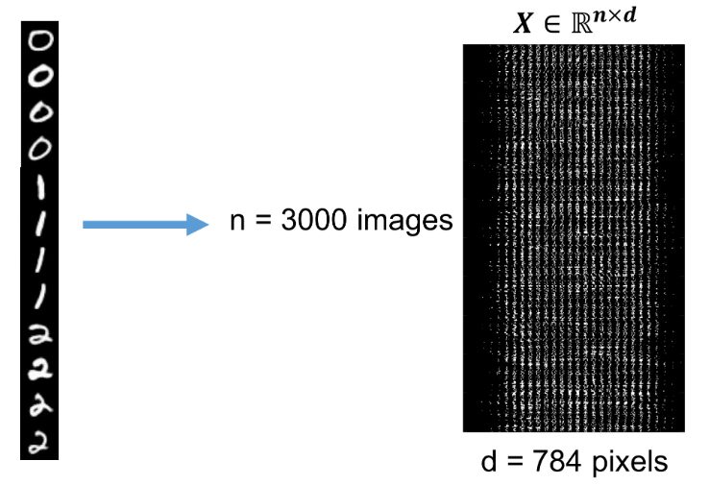
Visualizing Big Data
Data points are interpreted as high dimensional vectors, with real valued entries: $x_{1},…,x_{n}∈R^{d}$
Dataset is interpreted as a matrix: $X∈R^{n×d}$ with $k$-th row $x_{k}$

Slide 20

Dimensionality Reduction
Dimensionality Reduction: Transform the data points so that they have much smaller dimension
Transformation should still capture the key aspects of $x_{1},…,x_{n}$
$x_{1},…,x_{n}$ $∈R^{d}$
$y_{1},…,y_{n}$ $∈R^{m}$
for $m≪d$
$$x_{i}=(0, 1, 0, 0, 1, 0, 1, 1)$$
$$y_{i}=(−1, 2, 1)$$

Slide 21

Low Distortion Embedding
Given $x_{1},…,x_{n}$ $∈R^{d}$, a distance function $D$, and an accuracy parameter $ε∈(0,1)$, a low-distortion embedding of $x_{1},…,x_{n}$ is a set of points $y_{1},…,y_{n}$, and a distance function $D′$ such that for all $i,j∈[n]$
$$\left(1−ε\right)D\left(x_{i},x_{j}\right)≤D^{′}\left(y_{i},y_{j}\right)≤\left(1+ε\right)D\left(x_{i}, x_{j}\right)$$

Slide 22
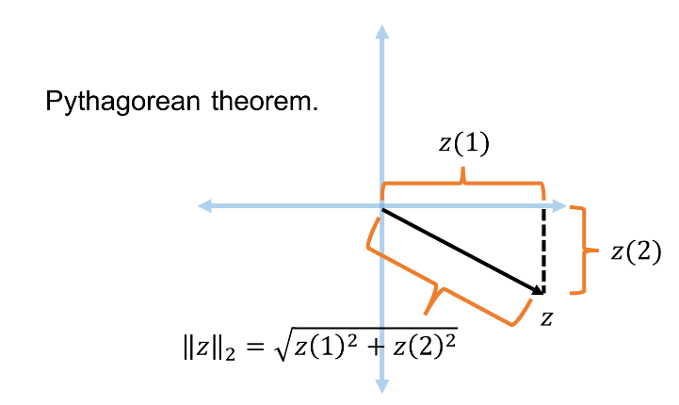
Euclidean Space
For $z$ $∈R^{d}$, the $ℓ_{2}$ norm of $z$ is denoted by ${\left\|z\right\|}_{2}$ and defined as:
$${\left\|z\right\|}_{2}=\sqrt{z_{1}^{2}+z_{2}^{2}+…+z_{d}^{2}}$$

Slide 23
Euclidean Space
For $z$ $∈R^{d}$, the $ℓ_{2}$ norm of $z$ is denoted by ${\left\|z\right\|}_{2}$ and defined as:
$${\left\|z\right\|}_{2}=\sqrt{z_{1}^{2}+z_{2}^{2}+…+z_{d}^{2}}$$
For $x,y$ $∈R^{d}$, the distance function $D$ is denoted by ${\left\|⋅\right\|}_{2}$ and defined as ${\left\|x−y\right\|}_{2}$

Slide 24
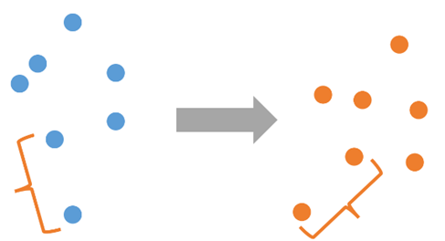

Low Distortion Embedding for Euclidean Space
Given $x_{1},…,x_{n}$ $∈R^{d}$ and an accuracy parameter $ε∈(0,1)$, a low-distortion embedding of $x_{1},…,x_{n}$ is a set of points $y_{1},…,y_{n}$ such that for all $i,j∈[n]$
$$\left(1−ε\right){\left\|x_{i}−x_{j}\right\|}_{2}≤{\left\|y_{i}−y_{j}\right\|}_{2}≤\left(1+ε\right){\left\|x_{i}−x_{j}\right\|}_{2}$$
$${\left\|x_{i}−x_{j}\right\|}_{2}$$
$${\left\|y_{i}−y_{j}\right\|}_{2}$$

Slide 25
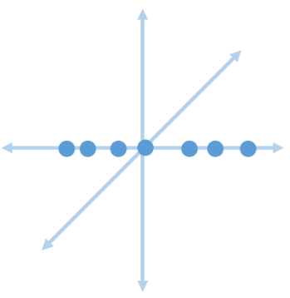
Examples: Embeddings for Euclidean Space
Suppose $x_{1},…,x_{n}$ $∈R^{d}$ all lie on the $1$^{st} - axis
Take $m=1$ and $y_{i}$ to be the first coordinate of $x_{i}$
Then ${\left\|y_{i}−y_{j}\right\|}_{2}={\left\|x_{i}−x_{j}\right\|}_{2}$ for all $i,j∈[n]$
Embedding has no distortion

Slide 26
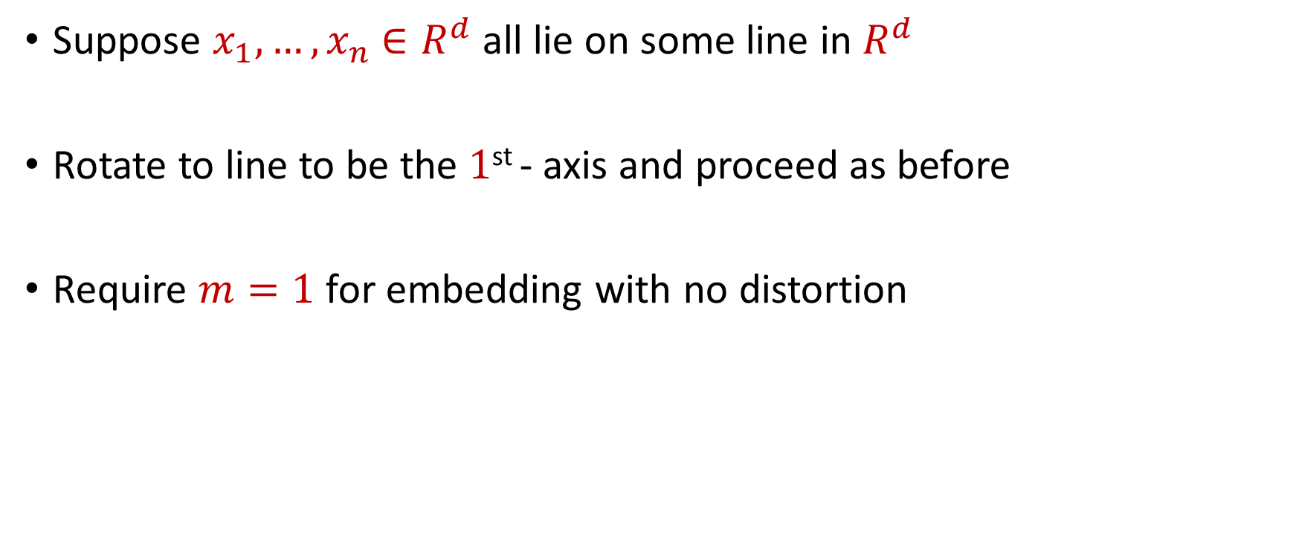
Examples: Embeddings for Euclidean Space
Suppose $x_{1},…,x_{n}$ $∈R^{d}$ all lie on some line in $R^{d}$
Rotate to line to be the $1$^{st} - axis and proceed as before
Require $m=1$ for embedding with no distortion

Slide 27
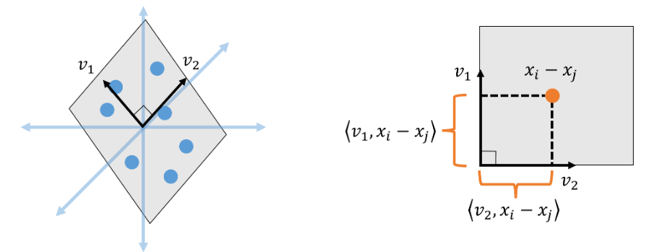
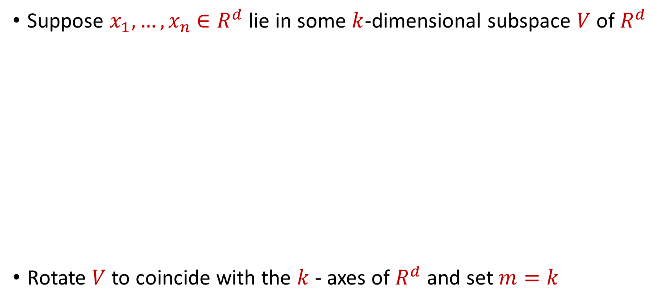
Examples: Embeddings for Euclidean Space
Suppose $x_{1},…,x_{n}$ $∈R^{d}$ lie in some $k$-dimensional subspace $V$ of $R^{d}$
Rotate $V$ to coincide with the $k$- axes of $R^{d}$ and set $m=k$

Slide 28

Embeddings for Euclidean Space
Given $x_{1},…,x_{n}$ $∈R^{d}$ that lie in general position, does there exist an embedding with no distortion?

Slide 29
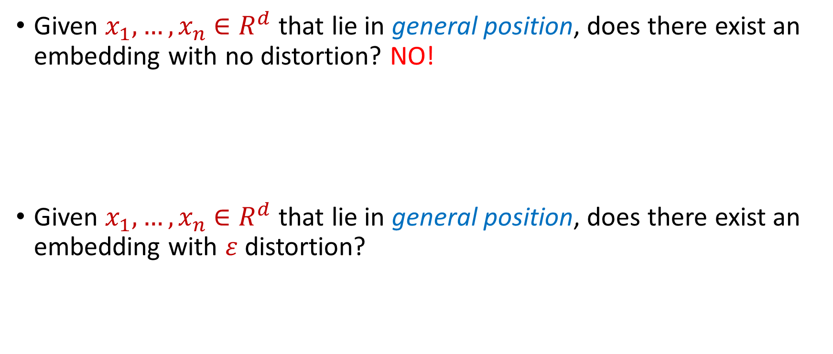
Embeddings for Euclidean Space
Given $x_{1},…,x_{n}$ $∈R^{d}$ that lie in general position, does there exist an embedding with no distortion? NO!
Given $x_{1},…,x_{n}$ $∈R^{d}$ that lie in general position, does there exist an embedding with $ε$ distortion?

Slide 30
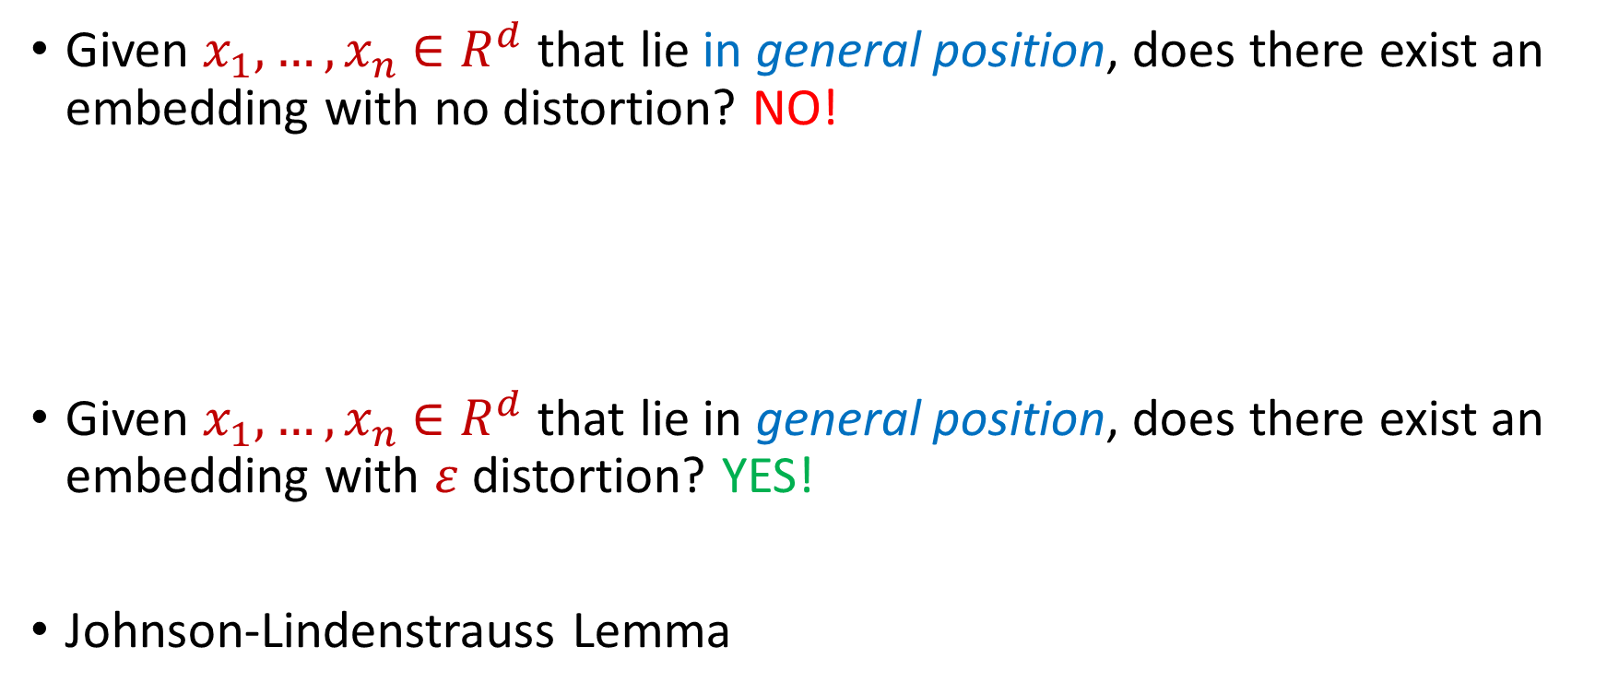
Embeddings for Euclidean Space
Given $x_{1},…,x_{n}$ $∈R^{d}$ that lie in general position, does there exist an embedding with no distortion? NO!
Given $x_{1},…,x_{n}$ $∈R^{d}$ that lie in general position, does there exist an embedding with $ε$ distortion? YES!
Johnson-Lindenstrauss Lemma

Slide 31

Johnson-Lindenstrauss Lemma
Johnson-Lindenstrauss Lemma: Given $x_{1},…,x_{n}$ $∈R^{d}$ and an accuracy parameter $ε∈(0,1)$, there exists a linear map $Π:R^{d}→R^{m}$ with $m=O\left(\frac{\log{n}}{ε^{2}}\right)$ so that if $y_{i}=Πx_{i}$, then for all $i,j∈[n]$:
$$\left(1−ε\right){\left\|x_{i}−x_{j}\right\|}_{2}≤{\left\|y_{i}−y_{j}\right\|}_{2}≤\left(1+ε\right){\left\|x_{i}−x_{j}\right\|}_{2}$$

Slide 32
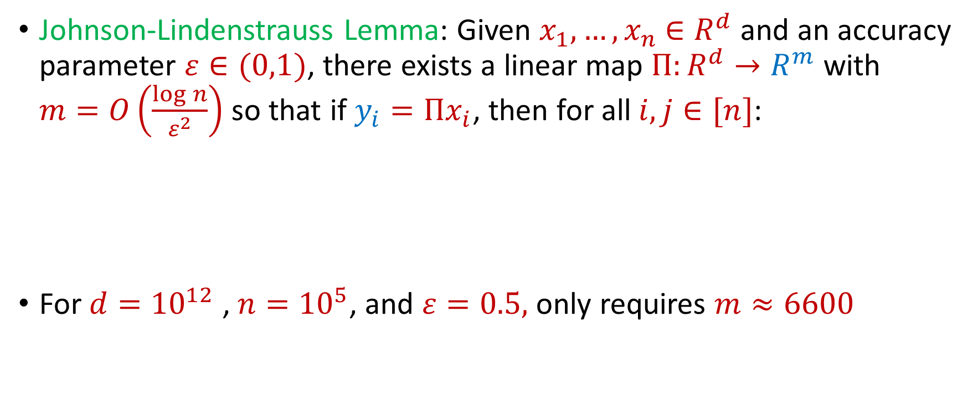
Johnson-Lindenstrauss Lemma
Johnson-Lindenstrauss Lemma: Given $x_{1},…,x_{n}$ $∈R^{d}$ and an accuracy parameter $ε∈(0,1)$, there exists a linear map $Π:R^{d}→R^{m}$ with $m=O\left(\frac{\log{n}}{ε^{2}}\right)$ so that if $y_{i}=Πx_{i}$, then for all $i,j∈[n]$:
For $d={10}^{12}$ , $n={10}^{5}$, and $ε=0.5,$ only requires $m≈6600$
$$\left(1−ε\right){\left\|x_{i}−x_{j}\right\|}_{2}≤{\left\|y_{i}−y_{j}\right\|}_{2}≤\left(1+ε\right){\left\|x_{i}−x_{j}\right\|}_{2}$$

Slide 33
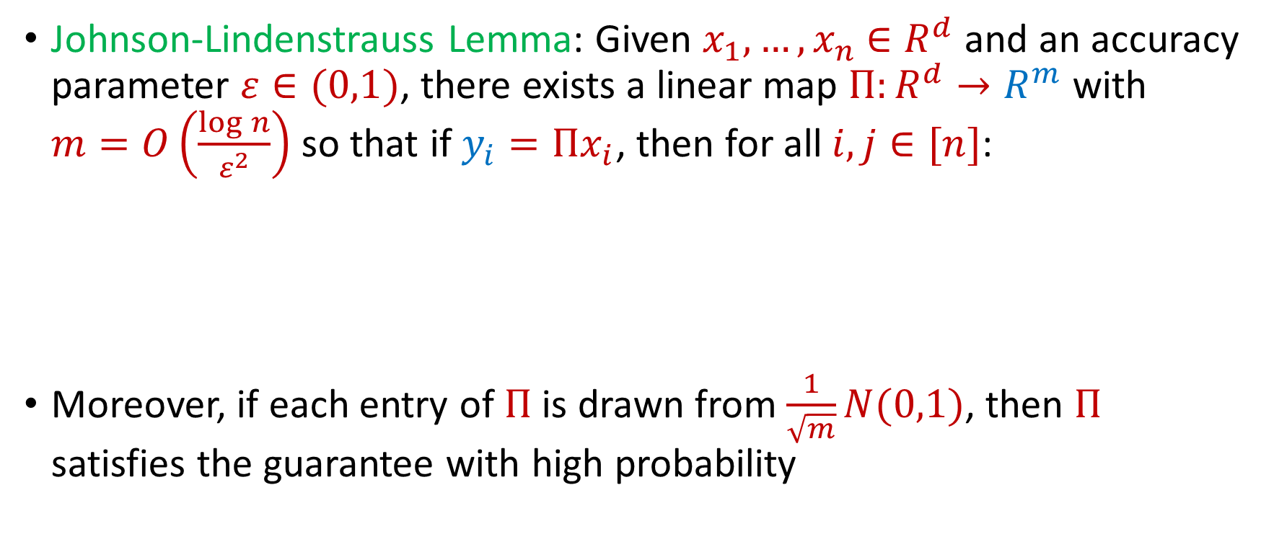
Johnson-Lindenstrauss Lemma
Johnson-Lindenstrauss Lemma: Given $x_{1},…,x_{n}$ $∈R^{d}$ and an accuracy parameter $ε∈(0,1)$, there exists a linear map $Π:R^{d}→R^{m}$ with $m=O\left(\frac{\log{n}}{ε^{2}}\right)$ so that if $y_{i}=Πx_{i}$, then for all $i,j∈[n]$:
Moreover, if each entry of $Π$ is drawn from $\frac{1}{\sqrt{m}}N(0,1)$, then $Π$ satisfies the guarantee with high probability
$$\left(1−ε\right){\left\|x_{i}−x_{j}\right\|}_{2}≤{\left\|y_{i}−y_{j}\right\|}_{2}≤\left(1+ε\right){\left\|x_{i}−x_{j}\right\|}_{2}$$

Slide 34
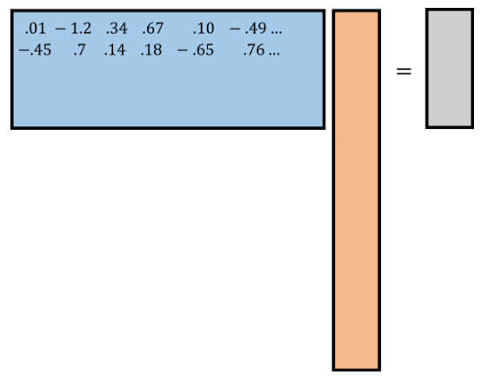
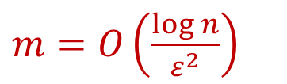
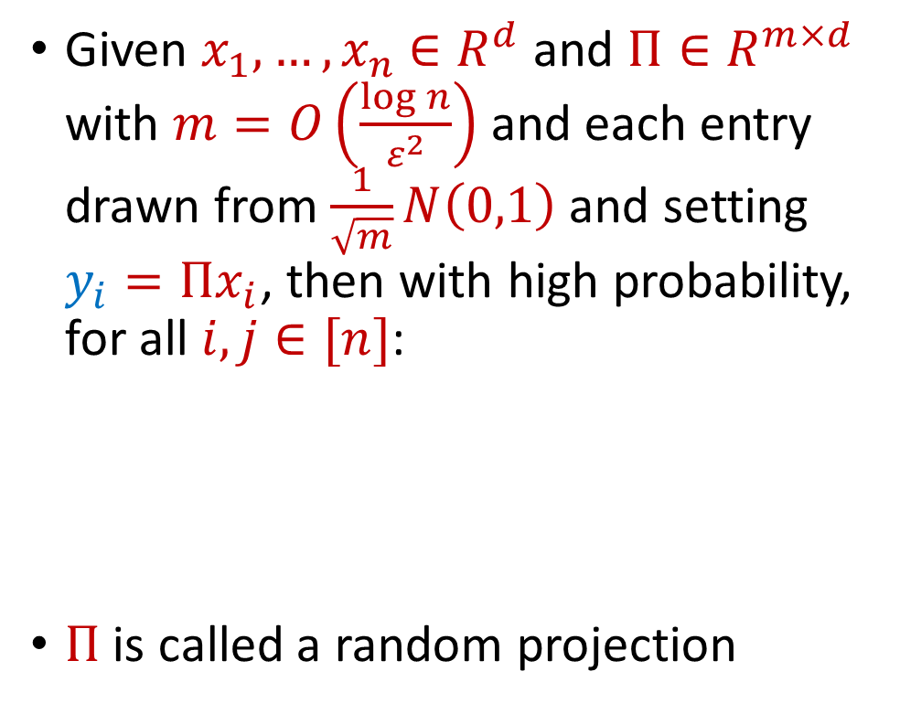






Johnson-Lindenstrauss Lemma
$$R^{m×d}$$
$$R^{d}$$
$$R^{m}$$
Given $x_{1},…,x_{n}$ $∈R^{d}$ and $Π∈R^{m×d}$ with $m=O\left(\frac{\log{n}}{ε^{2}}\right)$ and each entry drawn from $\frac{1}{\sqrt{m}}N\left(0,1\right)$ and setting $y_{i}=Πx_{i}$, then with high probability, for all $i,j∈[n]$:
$Π$ is called a random projection
$$y_{i}$$
$$Π$$
$m=O\left(\frac{\log{n}}{ε^{2}}\right)$
$$x_{i}$$
$$\left(1−ε\right){\left\|x_{i}−x_{j}\right\|}_{2}≤{\left\|y_{i}−y_{j}\right\|}_{2}≤\left(1+ε\right){\left\|x_{i}−x_{j}\right\|}_{2}$$

Slide 35
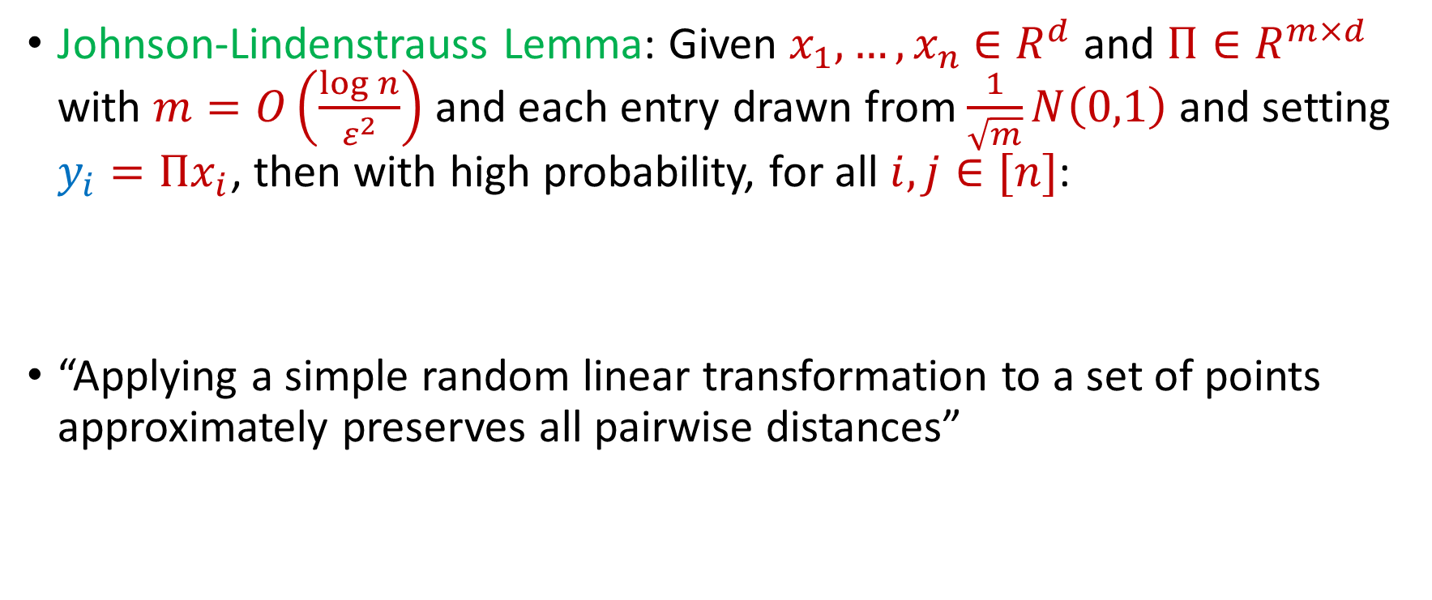
Johnson-Lindenstrauss Lemma
Johnson-Lindenstrauss Lemma: Given $x_{1},…,x_{n}$ $∈R^{d}$ and $Π∈R^{m×d}$ with $m=O\left(\frac{\log{n}}{ε^{2}}\right)$ and each entry drawn from $\frac{1}{\sqrt{m}}N\left(0,1\right)$ and setting $y_{i}=Πx_{i}$, then with high probability, for all $i,j∈[n]$:
“Applying a simple random linear transformation to a set of points approximately preserves all pairwise distances”
$$\left(1−ε\right){\left\|x_{i}−x_{j}\right\|}_{2}≤{\left\|y_{i}−y_{j}\right\|}_{2}≤\left(1+ε\right){\left\|x_{i}−x_{j}\right\|}_{2}$$

Slide 36

Johnson-Lindenstrauss Lemma
Distributional Johnson-Lindenstrauss Lemma: Given $Π∈R^{m×d}$ with $m=O\left(\frac{\log{1/δ}}{ε^{2}}\right)$ and each entry drawn from $\frac{1}{\sqrt{m}}N\left(0,1\right)$, then for any $x∈R^{d}$ and setting $y=Πx$, then with probability at least $1−δ$
$$\left(1−ε\right){\left\|x\right\|}_{2}≤{\left\|y\right\|}_{2}≤\left(1+ε\right){\left\|x\right\|}_{2}$$

Slide 37
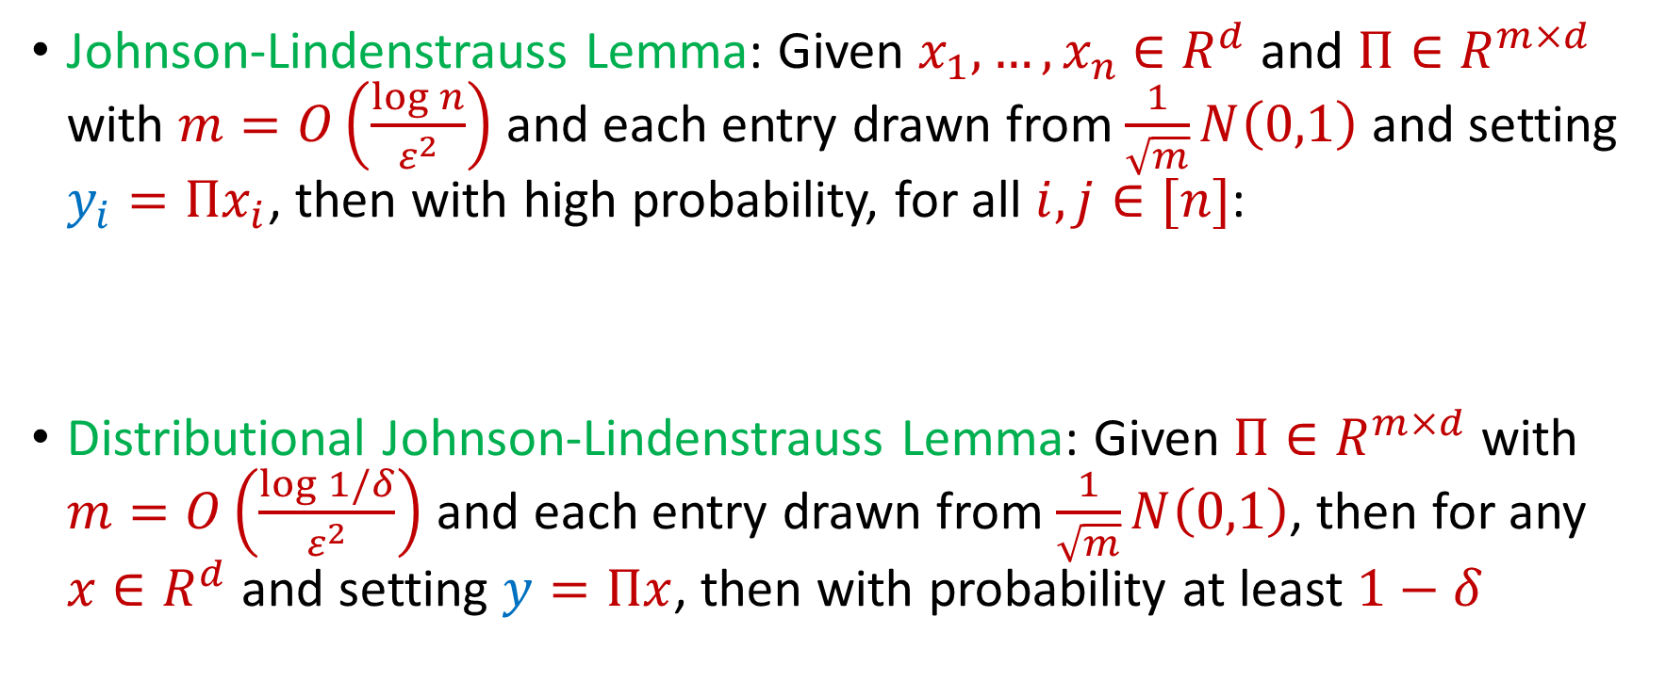
Johnson-Lindenstrauss Lemma
Johnson-Lindenstrauss Lemma: Given $x_{1},…,x_{n}$ $∈R^{d}$ and $Π∈R^{m×d}$ with $m=O\left(\frac{\log{n}}{ε^{2}}\right)$ and each entry drawn from $\frac{1}{\sqrt{m}}N\left(0,1\right)$ and setting $y_{i}=Πx_{i}$, then with high probability, for all $i,j∈[n]$:
Distributional Johnson-Lindenstrauss Lemma: Given $Π∈R^{m×d}$ with $m=O\left(\frac{\log{1/δ}}{ε^{2}}\right)$ and each entry drawn from $\frac{1}{\sqrt{m}}N\left(0,1\right)$, then for any $x∈R^{d}$ and setting $y=Πx$, then with probability at least $1−δ$
$$\left(1−ε\right){\left\|x_{i}−x_{j}\right\|}_{2}≤{\left\|y_{i}−y_{j}\right\|}_{2}≤\left(1+ε\right){\left\|x_{i}−x_{j}\right\|}_{2}$$
$$\left(1−ε\right){\left\|x\right\|}_{2}≤{\left\|y\right\|}_{2}≤\left(1+ε\right){\left\|x\right\|}_{2}$$

Slide 38
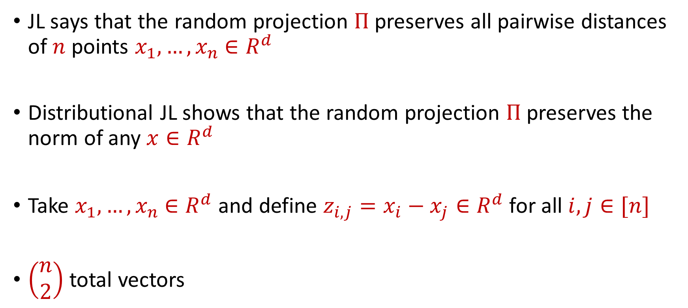
Johnson-Lindenstrauss Lemma
JL says that the random projection $Π$ preserves all pairwise distances of $n$ points $x_{1},…,x_{n}$ $∈R^{d}$
Distributional JL shows that the random projection $Π$ preserves the norm of any $x∈R^{d}$
Take $x_{1},…,x_{n}$ $∈R^{d}$ and define $z_{i,j}=x_{i}−x_{j}∈R^{d}$ for all $i,j∈[n]$
$\left(\begin{aligned}n \\ 2\end{aligned}\right)$ total vectors

Slide 39
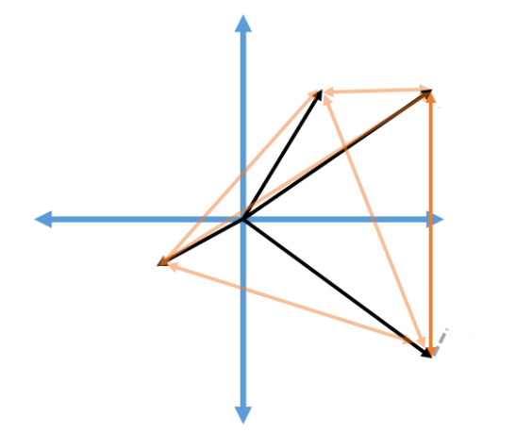






Johnson-Lindenstrauss Lemma
Take $x_{1},…,x_{n}$ $∈R^{d}$ and define $z_{i,j}=x_{i}−x_{j}∈R^{d}$ for all $i,j∈[n]$
$\left(\begin{aligned}n \\ 2\end{aligned}\right)$ total vectors
$$x_{1}$$
$$x_{2}$$
$$z_{2.4}$$
$$x_{3}$$
$$x_{4}$$

Slide 40
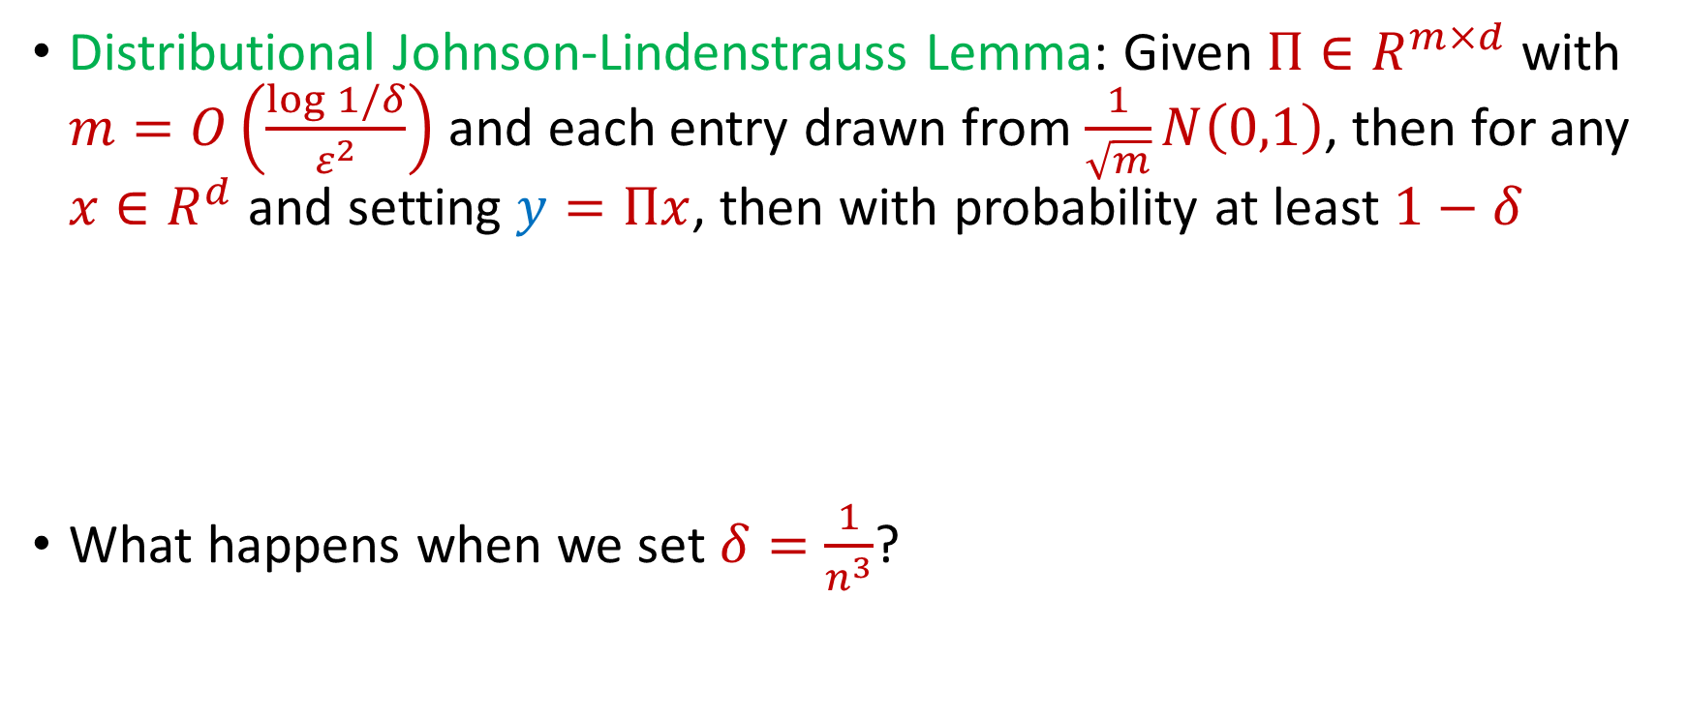
Johnson-Lindenstrauss Lemma
Distributional Johnson-Lindenstrauss Lemma: Given $Π∈R^{m×d}$ with $m=O\left(\frac{\log{1/δ}}{ε^{2}}\right)$ and each entry drawn from $\frac{1}{\sqrt{m}}N\left(0,1\right)$, then for any $x∈R^{d}$ and setting $y=Πx$, then with probability at least $1−δ$
What happens when we set $δ=\frac{1}{n^{3}}$?
$$\left(1−ε\right){\left\|x\right\|}_{2}≤{\left\|y\right\|}_{2}≤\left(1+ε\right){\left\|x\right\|}_{2}$$

Slide 41
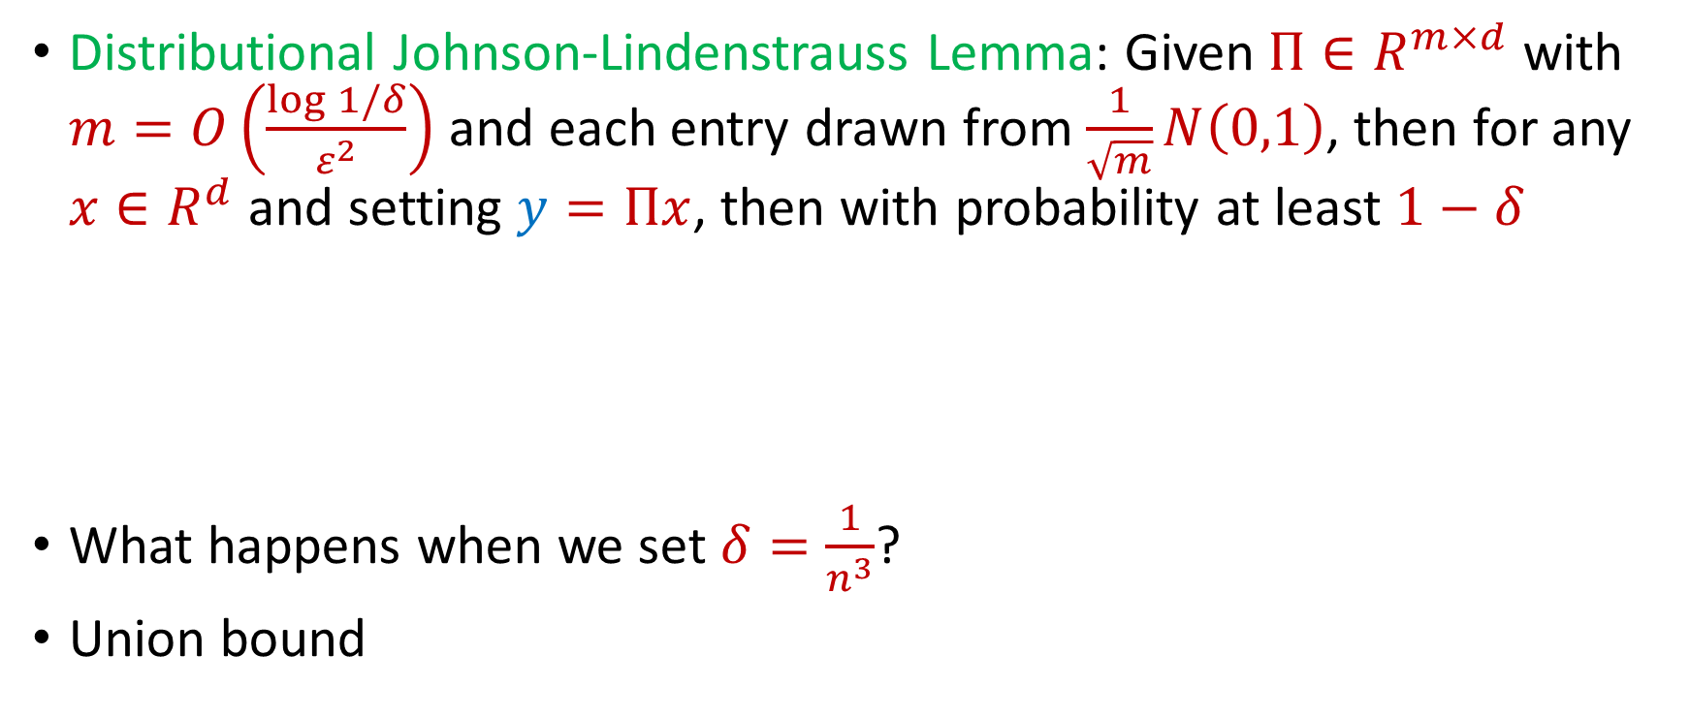
Johnson-Lindenstrauss Lemma
Distributional Johnson-Lindenstrauss Lemma: Given $Π∈R^{m×d}$ with $m=O\left(\frac{\log{1/δ}}{ε^{2}}\right)$ and each entry drawn from $\frac{1}{\sqrt{m}}N\left(0,1\right)$, then for any $x∈R^{d}$ and setting $y=Πx$, then with probability at least $1−δ$
What happens when we set $δ=\frac{1}{n^{3}}$?
Union bound
$$\left(1−ε\right){\left\|x\right\|}_{2}≤{\left\|y\right\|}_{2}≤\left(1+ε\right){\left\|x\right\|}_{2}$$

Slide 42
Johnson-Lindenstrauss Lemma
Distributional Johnson-Lindenstrauss Lemma: Given $Π∈R^{m×d}$ with $m=O\left(\frac{\log{1/δ}}{ε^{2}}\right)$ and each entry drawn from $\frac{1}{\sqrt{m}}N\left(0,1\right)$, then for any $x∈R^{d}$ and setting $y=Πx$, then with probability at least $1−δ$
$$\left(1−ε\right){\left\|x\right\|}_{2}≤{\left\|y\right\|}_{2}≤\left(1+ε\right){\left\|x\right\|}_{2}$$

Slide 43




Johnson-Lindenstrauss Lemma
Distributional Johnson-Lindenstrauss Lemma: Given $Π∈R^{m×d}$ with $m=O\left(\frac{\log{1/δ}}{ε^{2}}\right)$ and each entry drawn from $\frac{1}{\sqrt{m}}N\left(0,1\right)$, then for any $x∈R^{d}$ and setting $y=Πx$, then with probability at least $1−δ$
(Here $x_{1}$ is the first coordinate of $x$)
$$\left(1−ε\right){\left\|x\right\|}_{2}≤{\left\|y\right\|}_{2}≤\left(1+ε\right){\left\|x\right\|}_{2}$$
$$x_{1}$$
$$⋮$$
$$⋮$$
$$⋮$$
$$x_{d}$$
$$y_{1}$$
$$⋮$$
$$y_{m}$$
$$Π$$

Slide 44

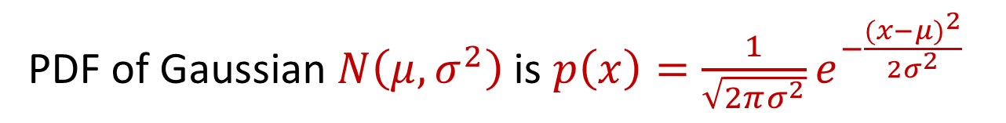
Trivia Question #5 (Gaussian Behavior)
Let $x∼N\left(μ,σ^{2}\right)$. What is $E\left[x\right]$ and what is $E\left[{\left|x−μ\right|}^{2}\right]$?
$\left(0, 1\right)$
$(0, σ)$
$(μ,σ)$
$(μ,σ^{2})$
PDF of Gaussian $N\left(μ,σ^{2}\right)$is $p\left(x\right)=\frac{1}{\sqrt{2πσ^{2}}}e^{−\frac{({x−μ)}^{2}}{2σ^{2}}}$
Notes:
0, 1, 3, 6

Slide 45
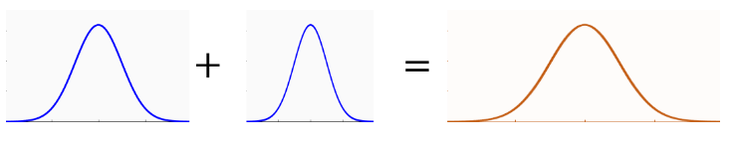
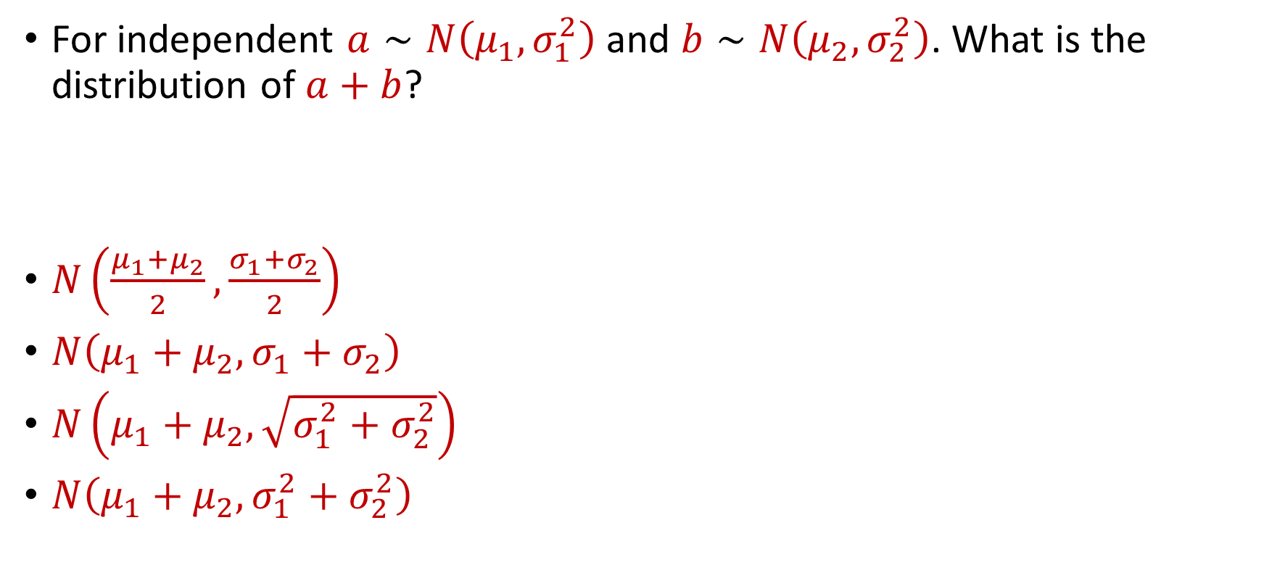
Trivia Question #6 (Gaussian Stability)
For independent $a∼N\left(μ_{1},σ_{1}^{2}\right)$ and $b∼N\left(μ_{2},σ_{2}^{2}\right)$. What is the distribution of $a+b$?
$N\left(\frac{μ_{1}+μ_{2}}{2}, \frac{σ_{1}+σ_{2}}{2}\right)$
$N\left(μ_{1}+μ_{2}, σ_{1}+σ_{2}\right)$
$N\left(μ_{1}+μ_{2},\sqrt{σ_{1}^{2}+σ_{2}^{2}}\right)$
$N\left(μ_{1}+μ_{2},σ_{1}^{2}+σ_{2}^{2}\right)$

Slide 46
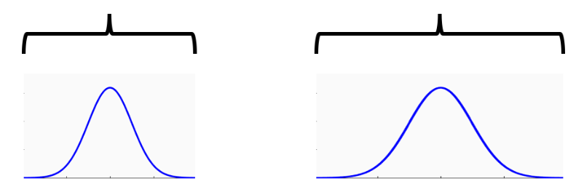




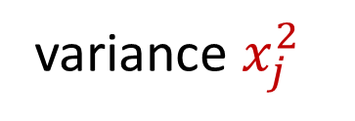
Johnson-Lindenstrauss Lemma
$y_{i}=\left\langle Π_{i},x\right\rangle =\frac{1}{\sqrt{m}}\sum_{j=1}^{d}{g_{j}⋅x_{j}}$ for $g_{j}∼N\left(0, 1\right)$
$g_{j}⋅x_{j}$ $∼N\left(0,x_{j}^{2}\right)$, normal random variable with variance $x_{j}^{2}$
variance $1$
variance $x_{j}^{2}$
$$g_{j}$$
$g_{j}⋅x_{j}$

Slide 47
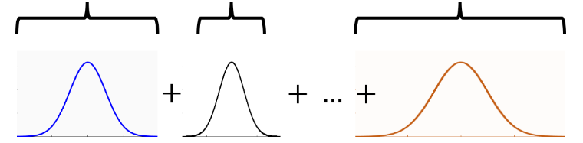
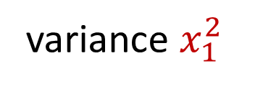

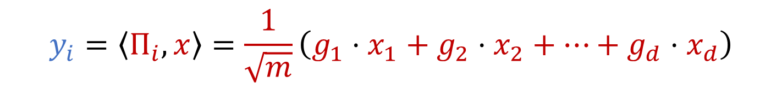
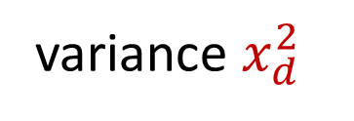
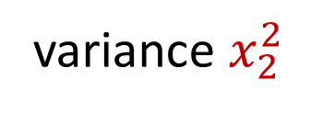
Gaussian Stability
variance $x_{1}^{2}$
variance $x_{2}^{2}$
variance $x_{d}^{2}$
$$y_{i}=\left\langle Π_{i},x\right\rangle =\frac{1}{\sqrt{m}}\left(g_{1}⋅x_{1}+g_{2}⋅x_{2}+…+g_{d}⋅x_{d}\right)$$
What is the distribution of $y_{i}$?

Slide 48

Gaussian Stability
For independent $a∼N\left(μ_{1},σ_{1}^{2}\right)$ and $b∼N\left(μ_{2},σ_{2}^{2}\right)$, we have
$$a+b∼N\left(μ_{1}+μ_{2},σ_{1}^{2}+σ_{2}^{2}\right)$$

Slide 49

Gaussian Stability
For independent $a∼N\left(μ_{1},σ_{1}^{2}\right)$ and $b∼N\left(μ_{2},σ_{2}^{2}\right)$, we have
$$a+b∼N\left(μ_{1}+μ_{2},σ_{1}^{2}+σ_{2}^{2}\right)$$
$$y_{i}=\left\langle Π_{i},x\right\rangle =\frac{1}{\sqrt{m}}\left(g_{1}⋅x_{1}+g_{2}⋅x_{2}+…+g_{d}⋅x_{d}\right)$$
$y_{i}∼$ $N\left(0,{\frac{1}{m}\left\|x\right\|}_{2}^{2}\right)$

Slide 50
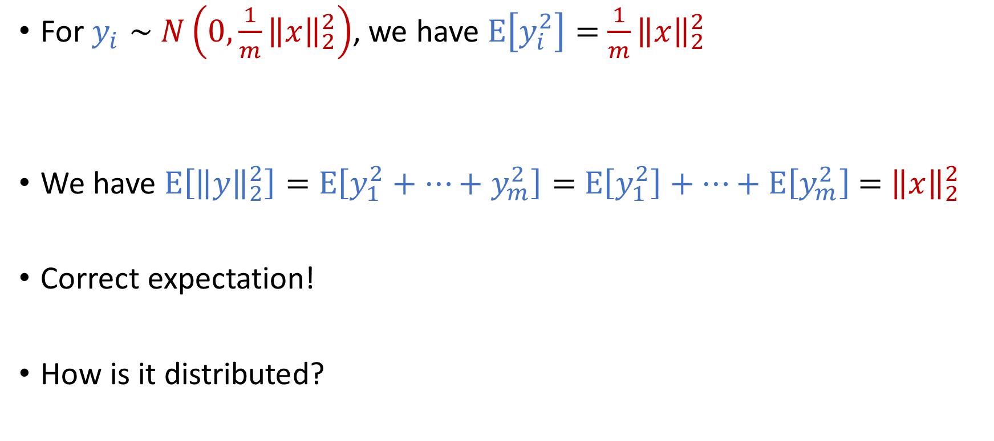
Gaussian Stability
For $y_{i}∼$ $N\left(0,{\frac{1}{m}\left\|x\right\|}_{2}^{2}\right)$, we have $E\left[y_{i}^{2}\right]=$ ${\frac{1}{m}\left\|x\right\|}_{2}^{2}$
We have $E\left[{\left\|y\right\|}_{2}^{2}\right]=$ $E\left[y_{1}^{2}+…+y_{m}^{2}\right]=$ $E\left[y_{1}^{2}\right]+…+E\left[y_{m}^{2}\right]$ $=$ ${\left\|x\right\|}_{2}^{2}$
Correct expectation!
How is it distributed?

Slide 51
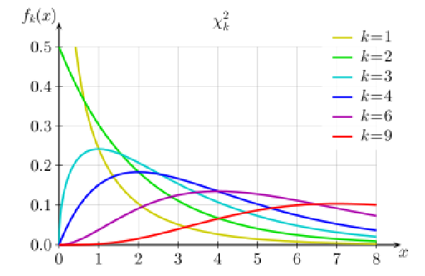

Johnson-Lindenstrauss Lemma
${\left\|y\right\|}_{2}^{2}$ is distributed as Chi-Squared random variable with $m$ degrees of freedom (sum of $m$ squared independent Gaussians)

Slide 52
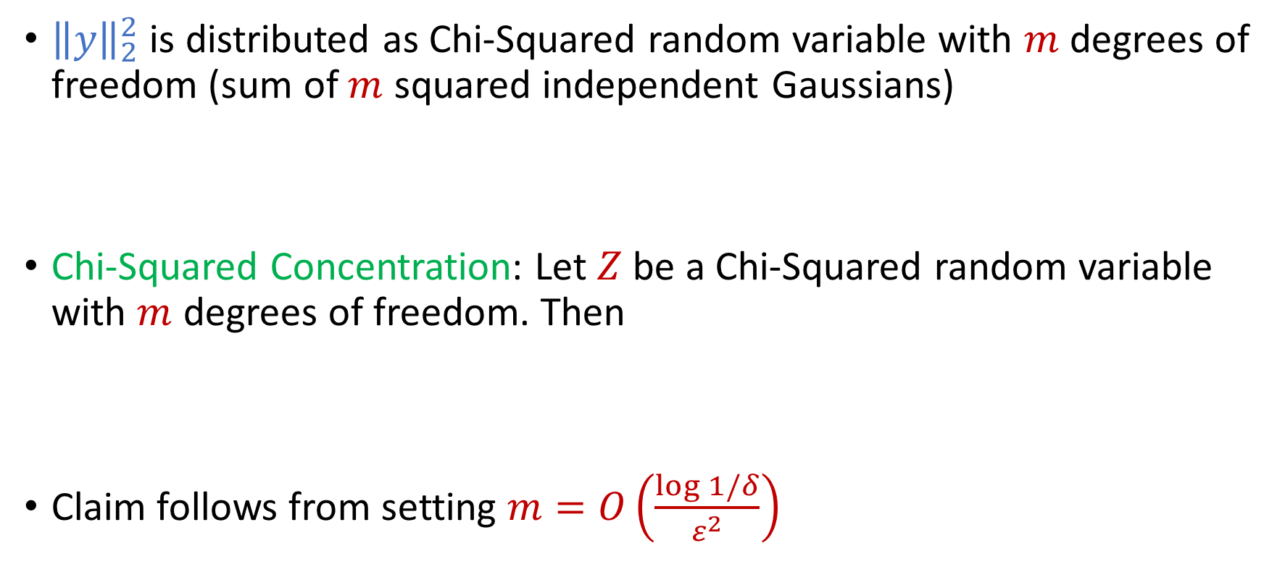
Johnson-Lindenstrauss Lemma
${\left\|y\right\|}_{2}^{2}$ is distributed as Chi-Squared random variable with $m$ degrees of freedom (sum of $m$ squared independent Gaussians)
Chi-Squared Concentration: Let $Z$ be a Chi-Squared random variable with $m$ degrees of freedom. Then
Claim follows from setting $m=O\left(\frac{\log{1/δ}}{ε^{2}}\right)$
$$Pr\left[\left|Z−E[Z]\right|≥ε⋅E[Z]\right]≤2e^{−mε^{2}/8}$$

