Slide 1
CSCE 658: Randomized Algorithms
Lecture 20
Samson Zhou

Slide 2
Relevant Supplementary Material
Chapter 1-3 of “The Algorithmic Foundations of Differential Privacy”, by Cynthia Dwork and Aaron Roth (https://www.cis.upenn.edu/~aaroth/Papers/privacybook.pdf)

Slide 3




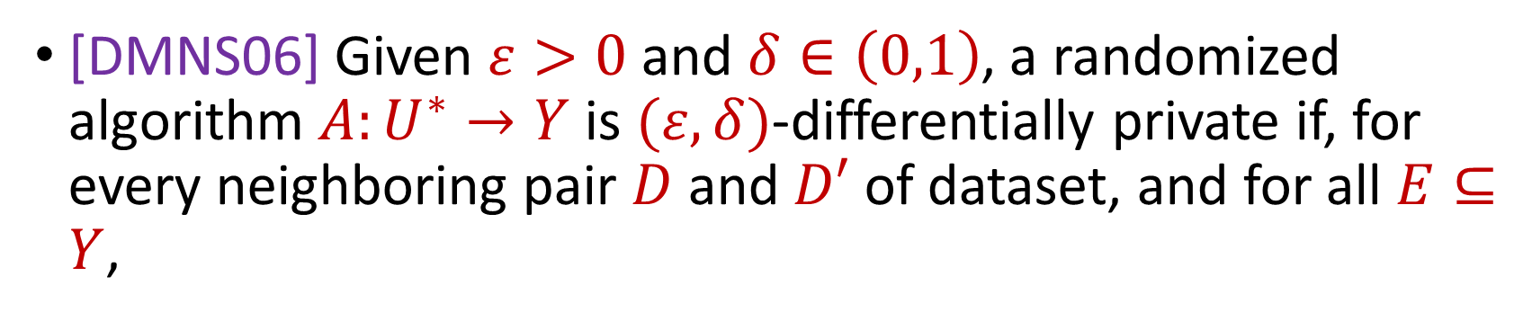

Last Time: Differential Privacy
[DMNS06] Given $ε>0$and $δ∈\left(0,1\right)$, a randomized algorithm $A:U^{∗}→Y$ is $(ε,δ)$-differentially private if, for every neighboring pair $D$ and $D′$ of dataset, and for all $E⊆Y$,
$$Pr\left[A\left(D\right)∈E\right]≤e^{ε}⋅Pr\left[A\left(D^{′}\right)∈E\right]+δ$$
$$A\left( \right)≈A\left( \right)$$
Notes:
[DworkMcSherryNissimSmith06]

Slide 4


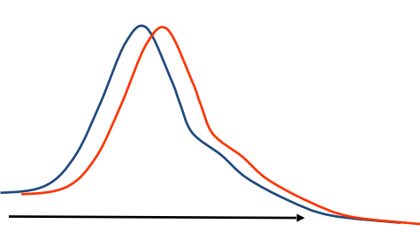
Last Time: Differential Privacy
[DMNS06] Given $ε>0$and $δ∈\left(0,1\right)$, a randomized algorithm $A:U^{∗}→Y$ is $(ε,δ)$-differentially private if, for every neighboring pair $D$ and $D′$ of dataset, and for all $E⊆Y$,
$$Pr\left[A\left(D\right)∈E\right]≤e^{ε}⋅Pr\left[A\left(D^{′}\right)∈E\right]+δ$$
Sensitive dataset
Algorithm
Output distribution
Notes:
[DworkMcSherryNissimSmith06]

Slide 5
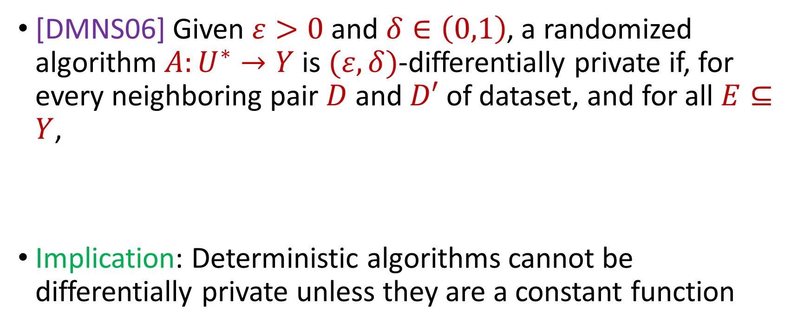
Last Time: Differential Privacy
[DMNS06] Given $ε>0$and $δ∈\left(0,1\right)$, a randomized algorithm $A:U^{∗}→Y$ is $(ε,δ)$-differentially private if, for every neighboring pair $D$ and $D′$ of dataset, and for all $E⊆Y$,
Implication: Deterministic algorithms cannot be differentially private unless they are a constant function
$$Pr\left[A\left(D\right)∈E\right]≤e^{ε}⋅Pr\left[A\left(D^{′}\right)∈E\right]+δ$$
Notes:
[DworkMcSherryNissimSmith06]

Slide 6
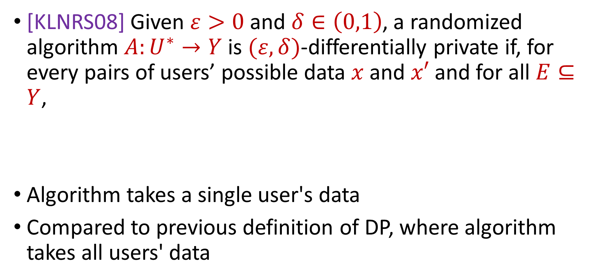
Last Time: Local Differential Privacy (LDP)
[KLNRS08] Given $ε>0$and $δ∈\left(0,1\right)$, a randomized algorithm $A:U^{∗}→Y$ is $(ε,δ)$-differentially private if, for every pairs of users’ possible data $x$ and $x′$ and for all $E⊆Y$,
Algorithm takes a single user's data
Compared to previous definition of DP, where algorithm takes all users' data
$$Pr\left[A\left(x\right)∈E\right]≤e^{ε}⋅Pr\left[A\left(x^{′}\right)∈E\right]+δ$$
Notes:
[DworkMcSherryNissimSmith06]

Slide 7

Randomized Response, Revisisted
How many people in this class have a pet?
Generate a random integer:
If it is even, answer truthfully
Otherwise, proceed below
Generate another random integer:
If it is even, answer YES
Otherwise if it is odd, answer NO
Notes:
[DworkMcSherryNissimSmith06]

Slide 8
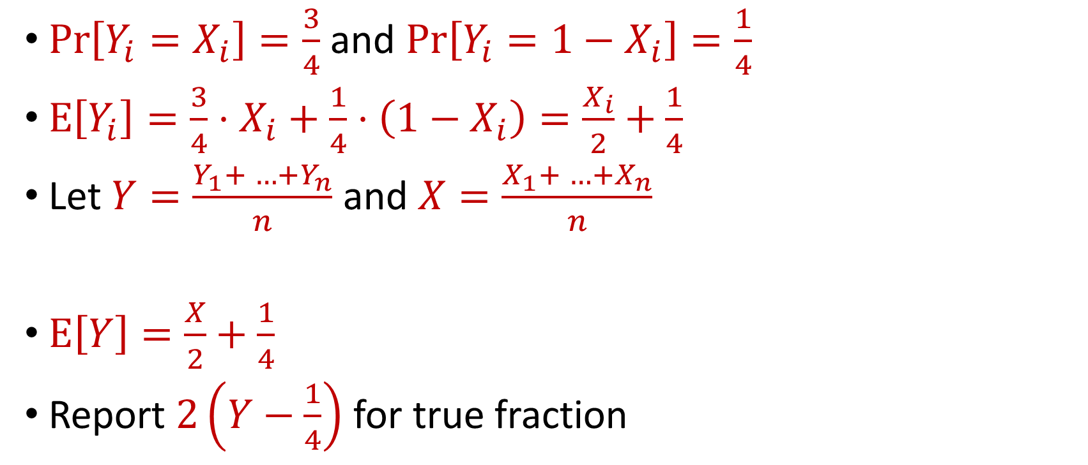
Randomized Response, Revisisted
$\operatorname{Pr}\left[Y_{i}=X_{i}\right]=\frac{3}{4}$ and $\operatorname{Pr}\left[Y_{i}=1−X_{i}\right]=\frac{1}{4}$
$E\left[Y_{i}\right]=\frac{3}{4}⋅X_{i}+\frac{1}{4}⋅\left(1−X_{i}\right)=\frac{X_{i}}{2}+\frac{1}{4}$
Let $Y=\frac{Y_{1}+ …+Y_{n}}{n}$ and $X=\frac{X_{1}+ …+X_{n}}{n}$
$E\left[Y\right]=\frac{X}{2}+\frac{1}{4}$
Report $2\left(Y−\frac{1}{4}\right)$ for true fraction
Notes:
[DworkMcSherryNissimSmith06]

Slide 9

Randomized Response, Revisisted
Answer is correct in expectation, but what is its variance?
Each answer is incorrect with probability $\frac{1}{4}$
The variance is $O(n)$
Notes:
[DworkMcSherryNissimSmith06]

Slide 10
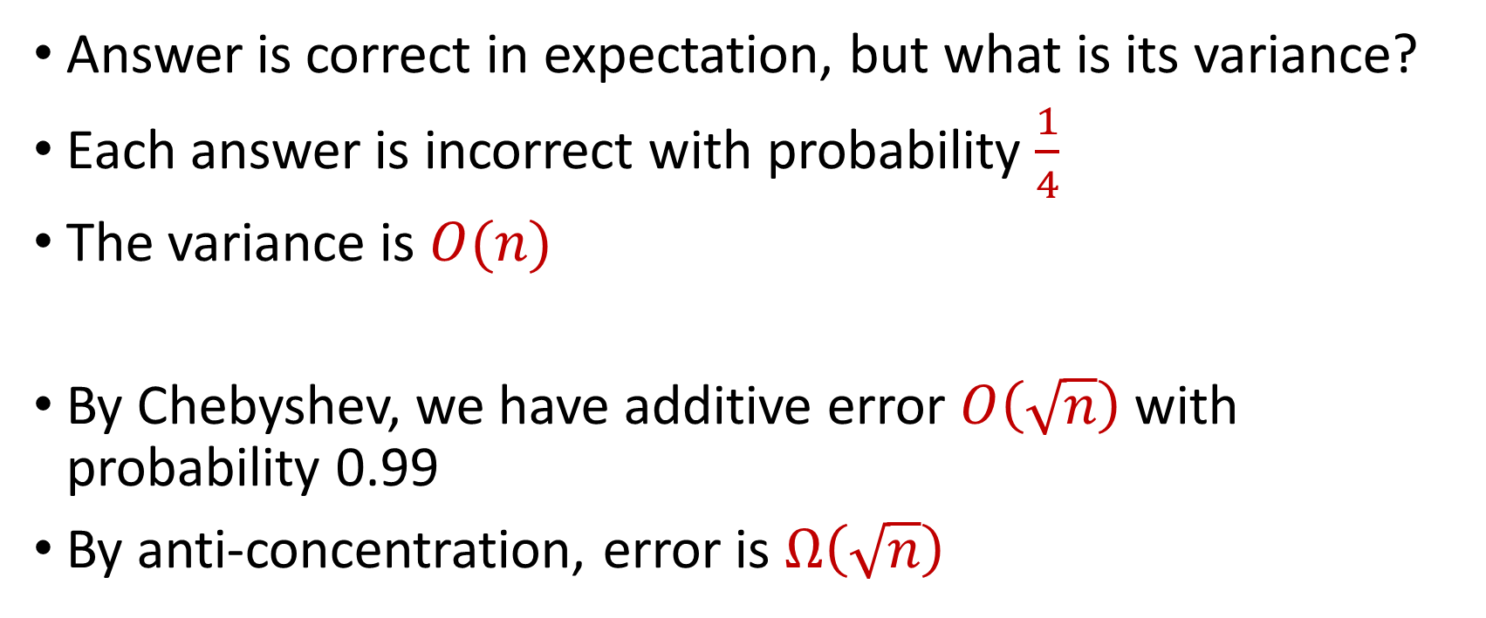
Randomized Response, Revisisted
Answer is correct in expectation, but what is its variance?
Each answer is incorrect with probability $\frac{1}{4}$
The variance is $O(n)$
By Chebyshev, we have additive error $O\left(\sqrt{n}\right)$ with probability 0.99
By anti-concentration, error is $Ω\left(\sqrt{n}\right)$
Notes:
[DworkMcSherryNissimSmith06]

Slide 11






Privacy and Noise
$$Z$$
Random noise
$$x=x_{1},…,x_{n}$$
$$A(x)$$
$$A\left(x\right)=f\left(x\right)+Z$$
$$f(x)$$
Input
Algorithm
Output distribution
Notes:
[DworkMcSherryNissimSmith06]

Slide 12
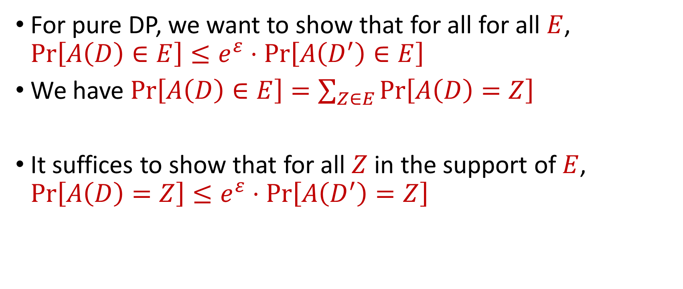
Proving Differential Privacy
For pure DP, we want to show that for all for all $E$, $Pr\left[A\left(D\right)∈E\right]≤e^{ε}⋅Pr\left[A\left(D^{′}\right)∈E\right]$
We have $Pr\left[A\left(D\right)∈E\right]=\sum_{Z∈E}{Pr\left[A\left(D\right)=Z\right]}$
It suffices to show that for all $Z$ in the support of $E$, $Pr\left[A\left(D\right)=Z\right]≤e^{ε}⋅Pr\left[A\left(D^{′}\right)=Z\right]$
Notes:
[DworkMcSherryNissimSmith06]

Slide 13
Differential Privacy Properties
What properties would we like from a rigorous definition of privacy?
Notes:
[DworkMcSherryNissimSmith06]

Slide 14

Post-processing of Differential Privacy
Ability to handle post-processing
If mechanism $A$ has privacy loss $ε$ and we release $g\left(A(D)\right)$, then we have privacy loss $ε$
Notes:
[DworkMcSherryNissimSmith06]

Slide 15
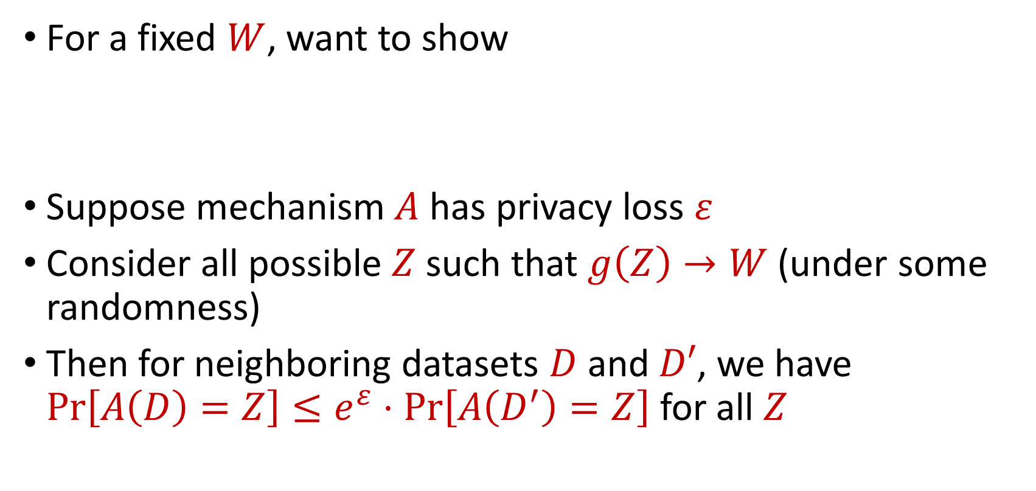
Post-processing of Differential Privacy
For a fixed $W$, want to show
Suppose mechanism $A$ has privacy loss $ε$
Consider all possible $Z$ such that $g\left(Z\right)→W$ (under some randomness)
Then for neighboring datasets $D$ and $D′$, we have $Pr\left[A\left(D\right)=Z\right]≤e^{ε}⋅Pr\left[A\left(D^{′}\right)=Z\right]$ for all $Z$
$$Pr\left[g\left(A\left(D\right)\right)=W\right]≤e^{ε}⋅Pr\left[g\left(A\left(D^{′}\right)\right)=W\right]$$
Notes:
[DworkMcSherryNissimSmith06]

Slide 16
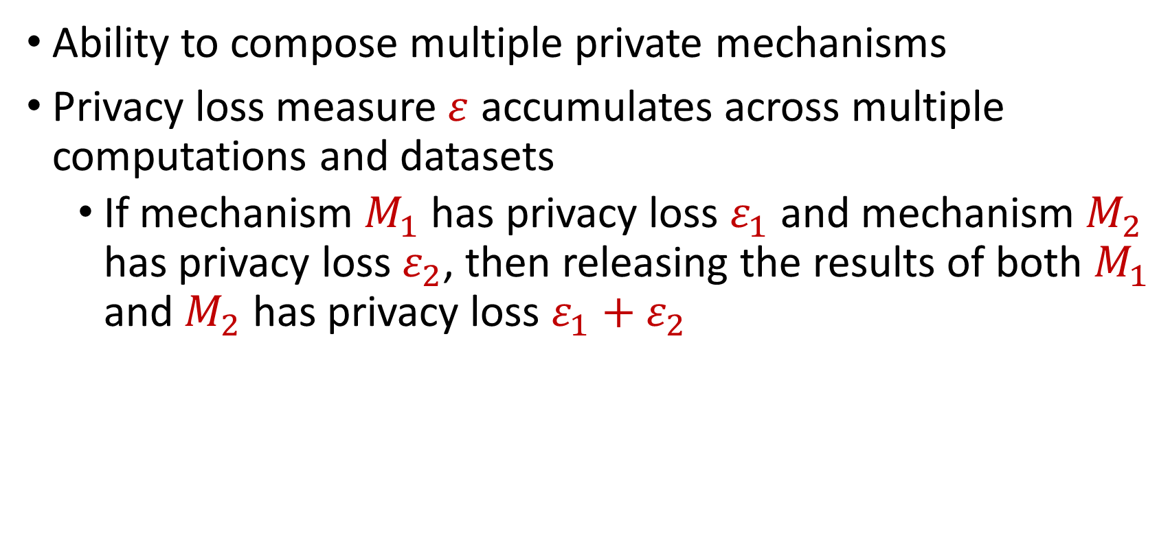
Composition of Differential Privacy
Ability to compose multiple private mechanisms
Privacy loss measure $ε$ accumulates across multiple computations and datasets
If mechanism $M_{1}$ has privacy loss $ε_{1}$ and mechanism $M_{2}$ has privacy loss $ε_{2}$, then releasing the results of both $M_{1}$ and $M_{2}$ has privacy loss $ε_{1}+ε_{2}$
Notes:
[DworkMcSherryNissimSmith06]

Slide 17
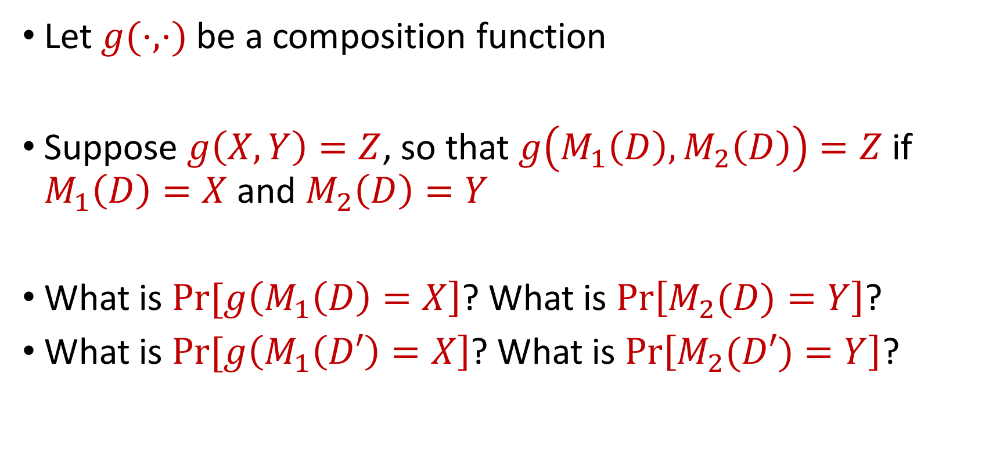
Composition of Differential Privacy
Let $g(⋅,⋅)$ be a composition function
Suppose $g\left(X,Y\right)=Z$, so that $g\left(M_{1}\left(D\right),M_{2}\left(D\right)\right)=Z$ if $M_{1}\left(D\right)=X$ and $M_{2}\left(D\right)=Y$
What is $Pr[g\left(M_{1}\left(D\right)=X\right]$? What is $Pr\left[M_{2}(D)=Y\right]$?
What is $Pr[g\left(M_{1}\left(D′\right)=X\right]$? What is $Pr\left[M_{2}(D′)=Y\right]$?
Notes:
[DworkMcSherryNissimSmith06]

Slide 18
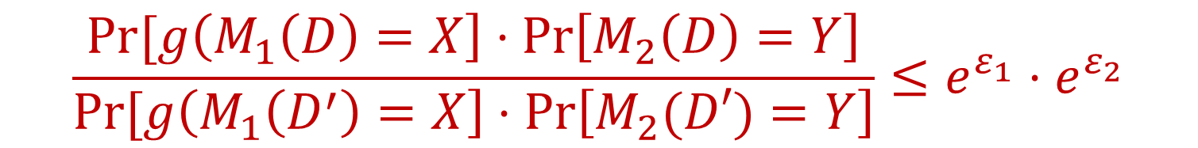
Composition of Differential Privacy
We have:
So:
$$\frac{Pr[g\left(M_{1}\left(D\right)=X\right]⋅Pr\left[M_{2}\left(D\right)=Y\right]}{Pr[g\left(M_{1}\left(D^{′}\right)=X\right]⋅Pr\left[M_{2}(D′)=Y\right]}≤e^{ε_{1}}⋅e^{ε_{2}}$$
$$Pr\left[g\left(M_{1}\left(D\right),M_{2}\left(D\right)\right)=Z\right]≤e^{ε_{1}+ε_{2}}⋅Pr\left[g\left(M_{1}\left(D\right),M_{2}\left(D\right)\right)=Z\right]$$
Notes:
[DworkMcSherryNissimSmith06]

Slide 19

Basic Composition of Differential Privacy
If mechanisms $M_{1},…,M_{k}$ are $\left(ε_{1},δ_{1}\right),…,(ε_{k},δ_{k})$-DP, then for any function $g$, then the composition mechanism $g\left(M_{1},…,M_{k}\right)$ is $\left(ε_{1}+…+ε_{k},δ_{1}+…+δ_{k}\right)$-DP
Notes:
[DworkMcSherryNissimSmith06]

Slide 20
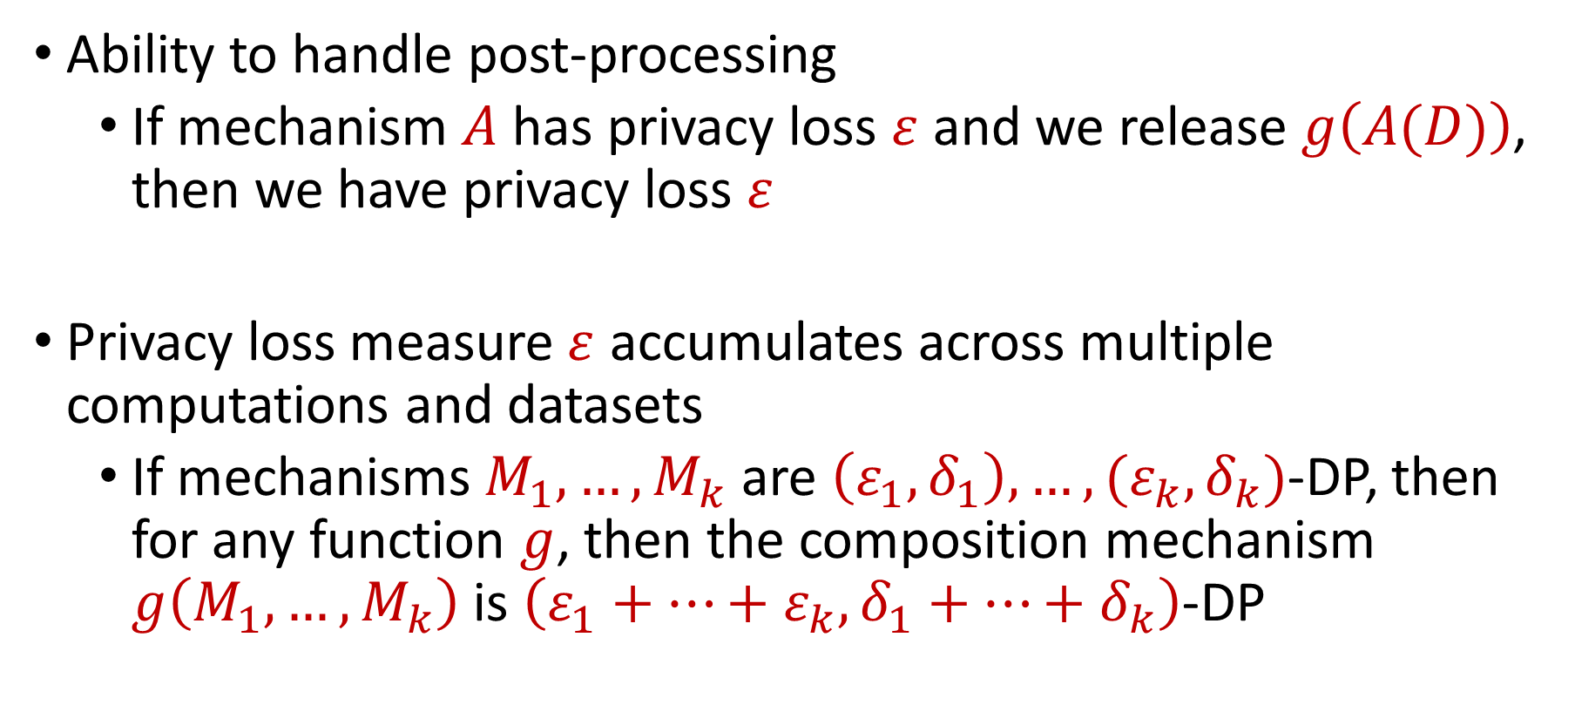
Differential Privacy Properties
Ability to handle post-processing
If mechanism $A$ has privacy loss $ε$ and we release $g\left(A(D)\right)$, then we have privacy loss $ε$
Privacy loss measure $ε$ accumulates across multiple computations and datasets
If mechanisms $M_{1},…,M_{k}$ are $\left(ε_{1},δ_{1}\right),…,(ε_{k},δ_{k})$-DP, then for any function $g$, then the composition mechanism $g\left(M_{1},…,M_{k}\right)$ is $\left(ε_{1}+…+ε_{k},δ_{1}+…+δ_{k}\right)$-DP
Notes:
[DworkMcSherryNissimSmith06]

Slide 21
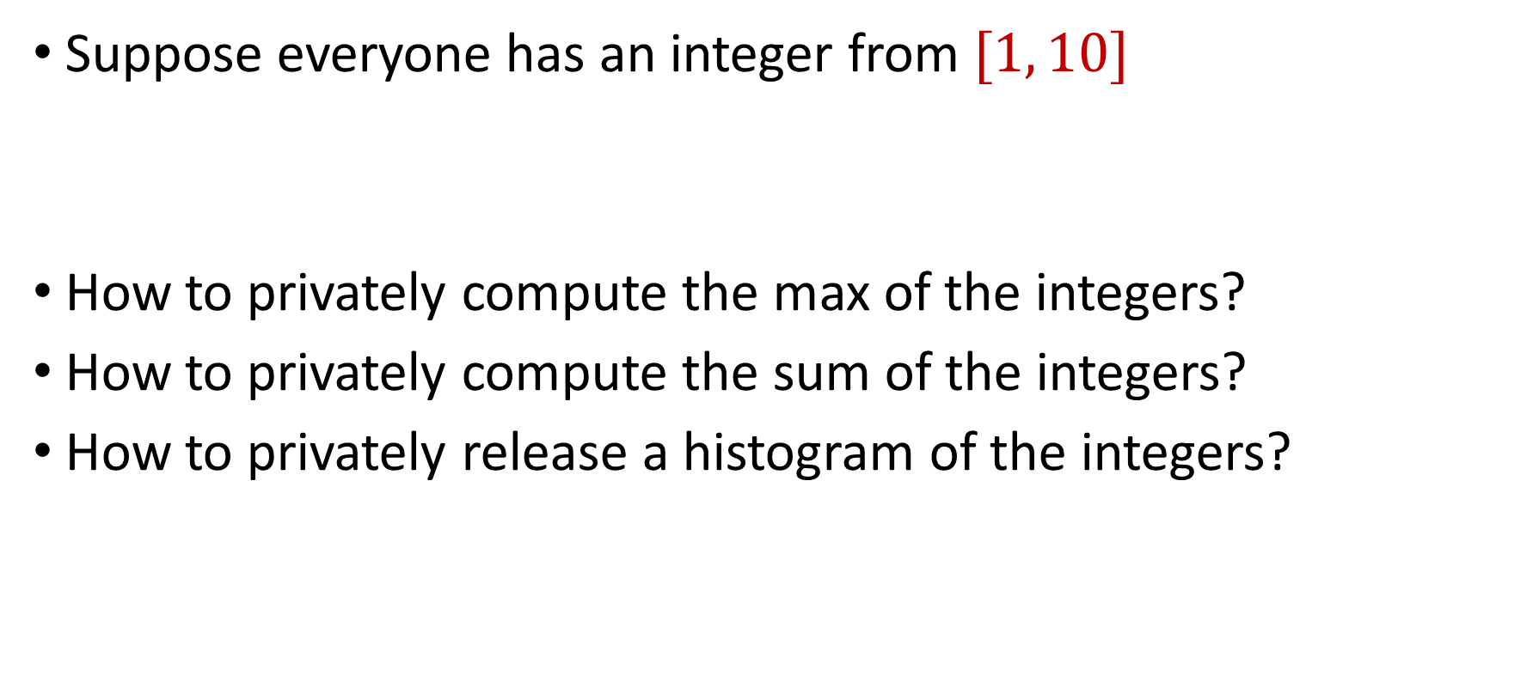
Towards Differential Privacy
Suppose everyone has an integer from $[1, 10]$
How to privately compute the max of the integers?
How to privately compute the sum of the integers?
How to privately release a histogram of the integers?
Notes:
[DworkMcSherryNissimSmith06]

Slide 22
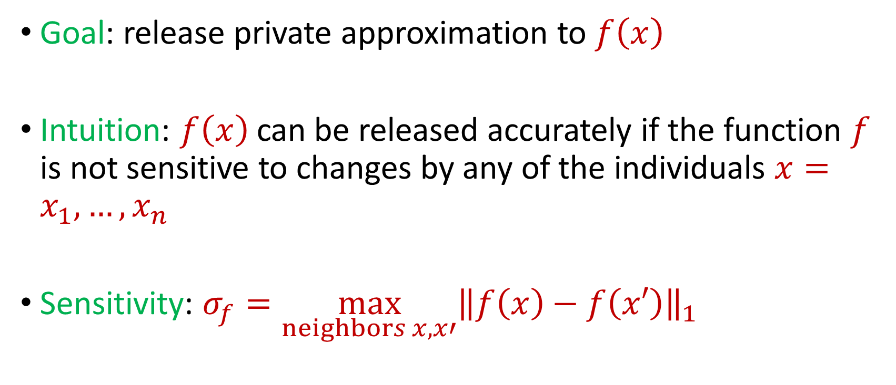
Privacy and Noise
Goal: release private approximation to $f\left(x\right)$
Intuition: $f\left(x\right)$ can be released accurately if the function $f$ is not sensitive to changes by any of the individuals $x=x_{1},…,x_{n}$
Sensitivity: $σ_{f}=\max_{neighbors x,x′}{\left\|f\left(x\right)−f\left(x′\right)\right\|}_{1}$
Notes:
[DworkMcSherryNissimSmith06]

Slide 23
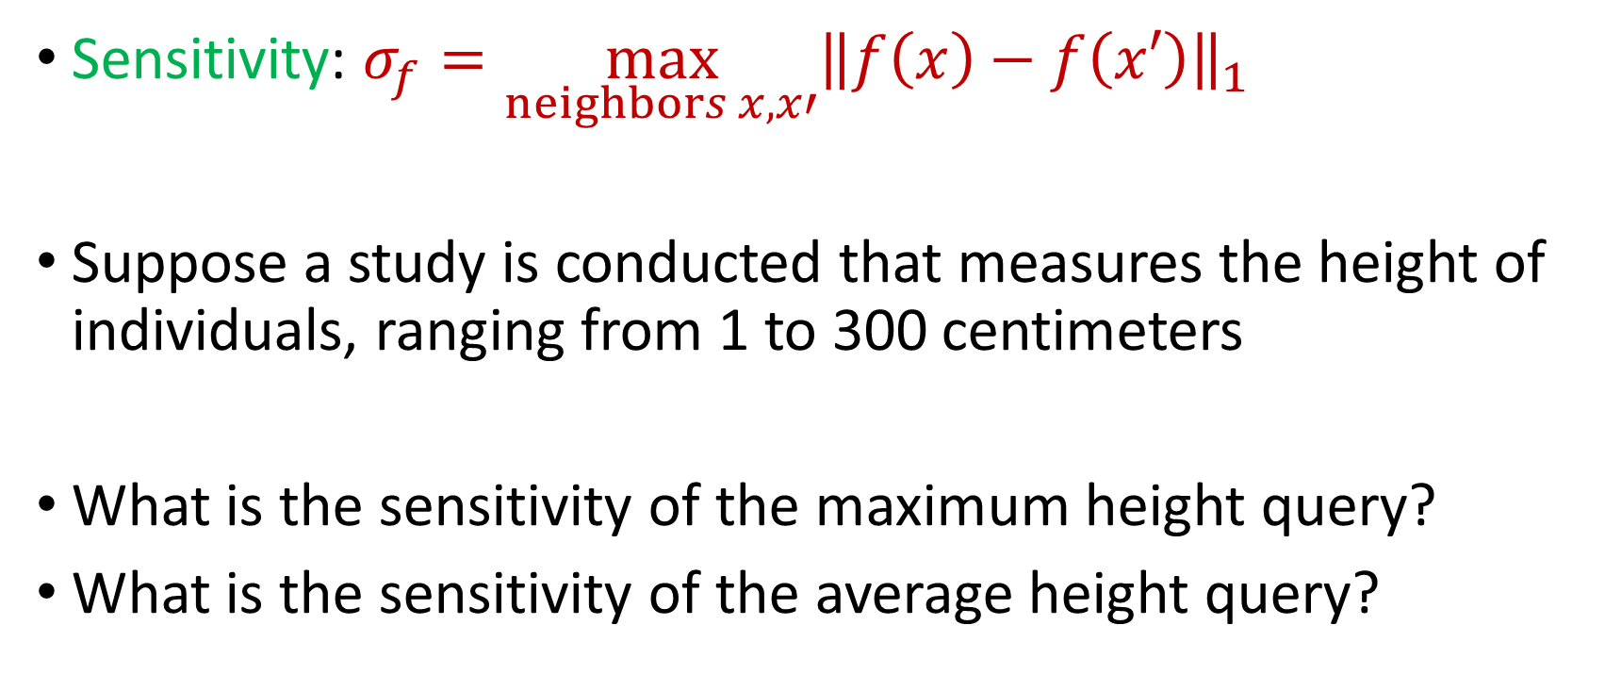
Sensitivity
Sensitivity: $σ_{f}=\max_{neighbors x,x′}{\left\|f\left(x\right)−f\left(x′\right)\right\|}_{1}$
Suppose a study is conducted that measures the height of individuals, ranging from 1 to 300 centimeters
What is the sensitivity of the maximum height query?
What is the sensitivity of the average height query?
Notes:
[DworkMcSherryNissimSmith06]

Slide 24
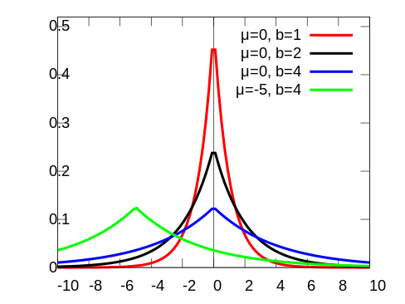
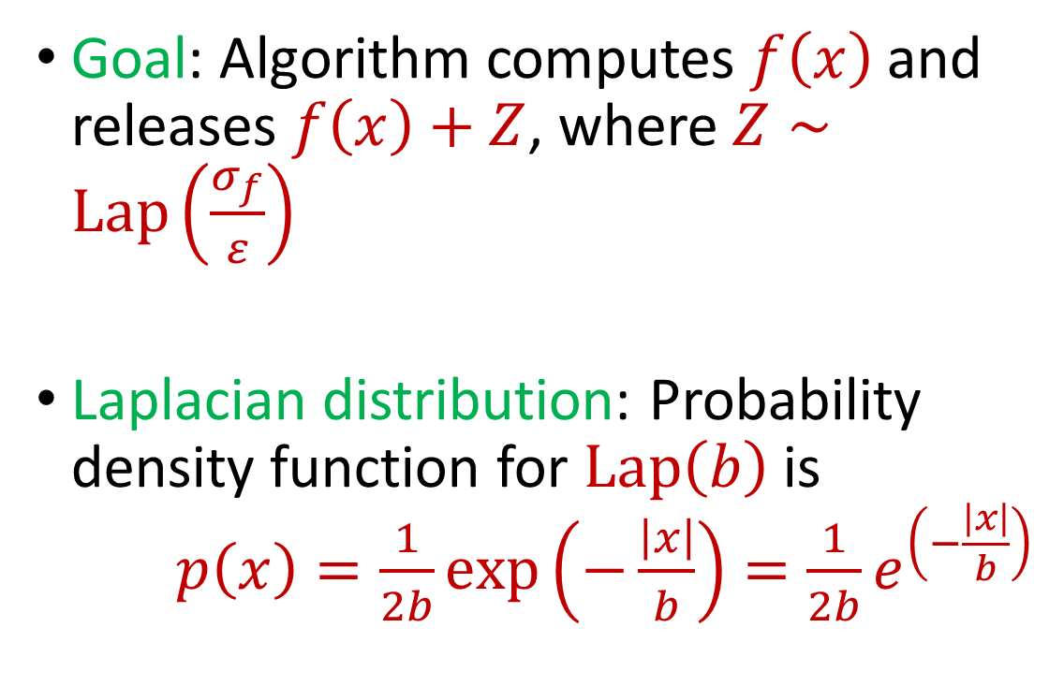
Laplace Mechanism
Goal: Algorithm computes $f\left(x\right)$ and releases $f\left(x\right)+Z$, where $Z∼Lap\left(\frac{σ_{f}}{ε}\right)$
Laplacian distribution: Probability density function for $Lap\left(b\right)$ is $p\left(x\right)=\frac{1}{2b}exp\left(−\frac{\left|x\right|}{b}\right)=\frac{1}{2b}e^{\left(−\frac{\left|x\right|}{b}\right)}$
Notes:
[DworkMcSherryNissimSmith06]

Slide 25
Laplace Mechanism
What does the Laplace mechanism do in the following cases?
Suppose a study is conducted that measures the height of individuals, ranging from 1 to 300 centimeters
What is the sensitivity of the maximum height query?
What is the sensitivity of the average height query?
Notes:
[DworkMcSherryNissimSmith06]

Slide 26

Laplace Mechanism
Theorem: Laplace mechanism is $ε$-differentially private (pure DP)
Notes:
[DworkMcSherryNissimSmith06]

Slide 27
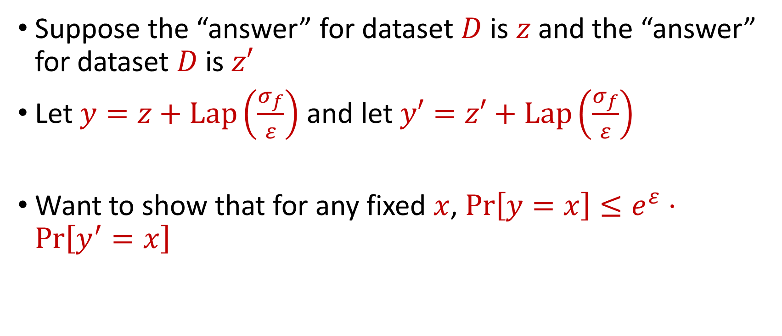
Laplace Mechanism
Suppose the “answer” for dataset $D$ is $z$ and the “answer” for dataset $D$ is $z′$
Let $y=z+Lap\left(\frac{σ_{f}}{ε}\right)$ and let $y′=z′+Lap\left(\frac{σ_{f}}{ε}\right)$
Want to show that for any fixed $x$, $Pr\left[y=x\right]≤e^{ε}⋅Pr\left[y^{′}=x\right]$
Notes:
[DworkMcSherryNissimSmith06]

Slide 28
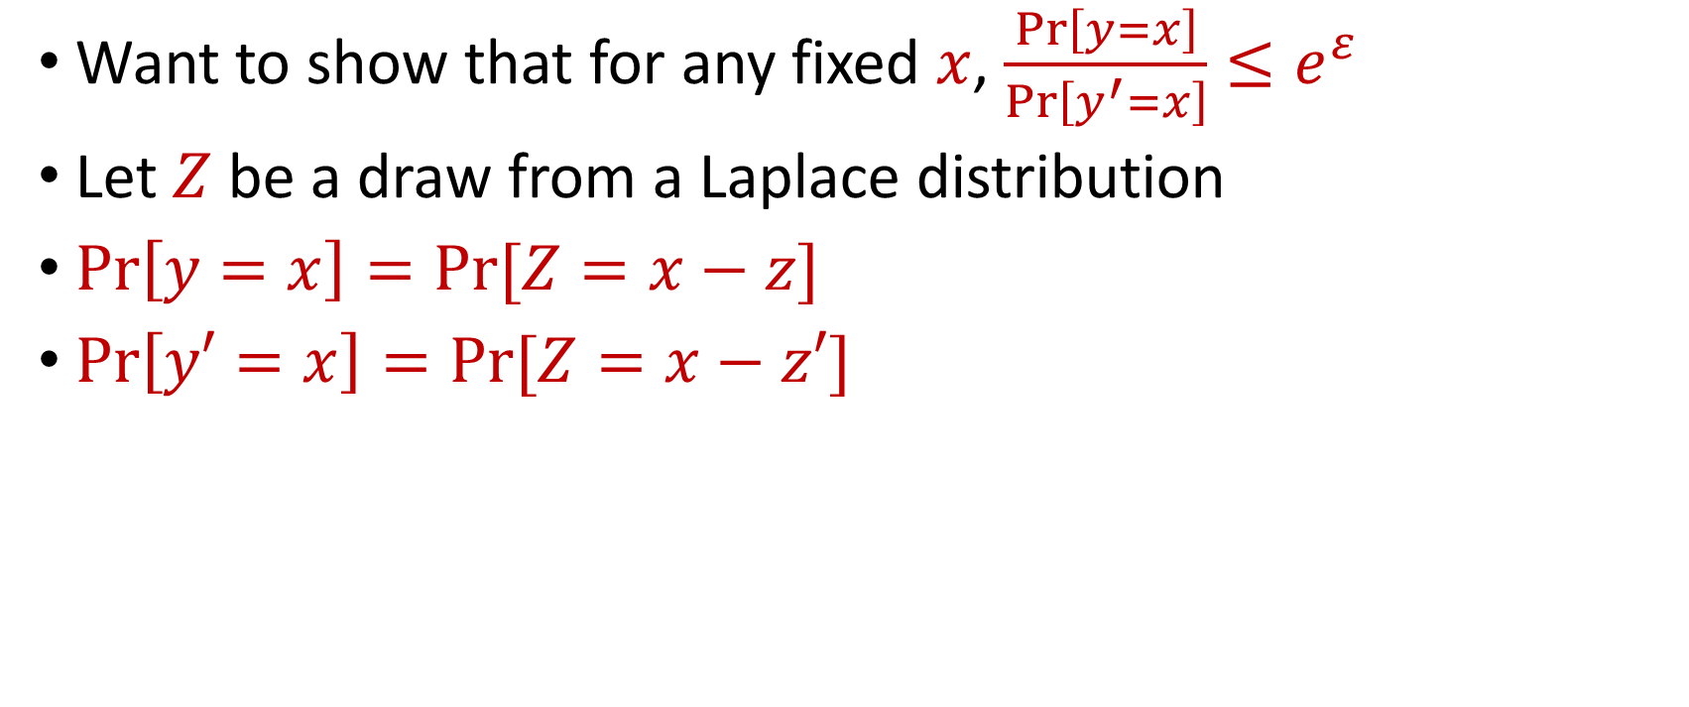
Laplace Mechanism
Want to show that for any fixed $x$, $\frac{Pr\left[y=x\right]}{Pr\left[y^{′}=x\right]}≤e^{ε}$
Let $Z$ be a draw from a Laplace distribution
$Pr\left[y=x\right]=Pr[Z=x−z]$
$Pr\left[y′=x\right]=Pr[Z=x−z′]$
Notes:
[DworkMcSherryNissimSmith06]

Slide 29
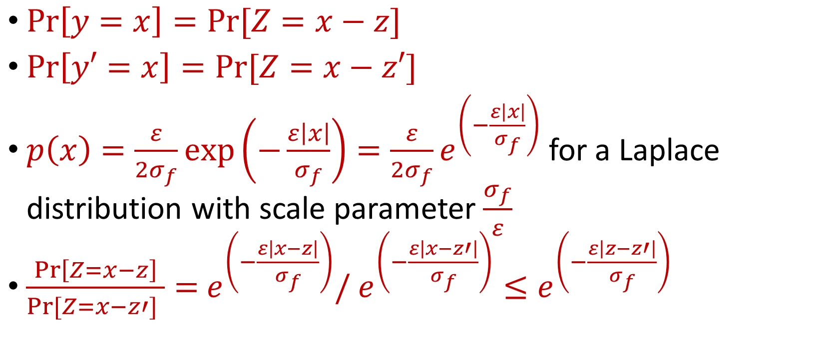
Laplace Mechanism
$Pr\left[y=x\right]=Pr[Z=x−z]$
$Pr\left[y′=x\right]=Pr[Z=x−z′]$
$p\left(x\right)=\frac{ε}{2σ_{f}}exp\left(−\frac{ε\left|x\right|}{σ_{f}}\right)=\frac{ε}{2σ_{f}}e^{\left(−\frac{ε\left|x\right|}{σ_{f}}\right)}$ for a Laplace distribution with scale parameter $\frac{σ_{f}}{ε}$
$\frac{Pr\left[Z=x−z\right]}{Pr[Z=x−z′] }=$ $e^{\left(−\frac{ε\left|x−z\right|}{σ_{f}}\right)}/$ $e^{\left(−\frac{ε\left|x−z′\right|}{σ_{f}}\right)}≤e^{\left(−\frac{ε\left|z−z′\right|}{σ_{f}}\right)}$
Notes:
[DworkMcSherryNissimSmith06]

Slide 30
Differential Privacy from Laplace Mechanism
Suppose everyone has an integer from $[1, 10]$
How to privately compute the max of the integers?
How to privately compute the sum of the integers?
How to privately release a histogram of the integers?
Notes:
[DworkMcSherryNissimSmith06]

Slide 31
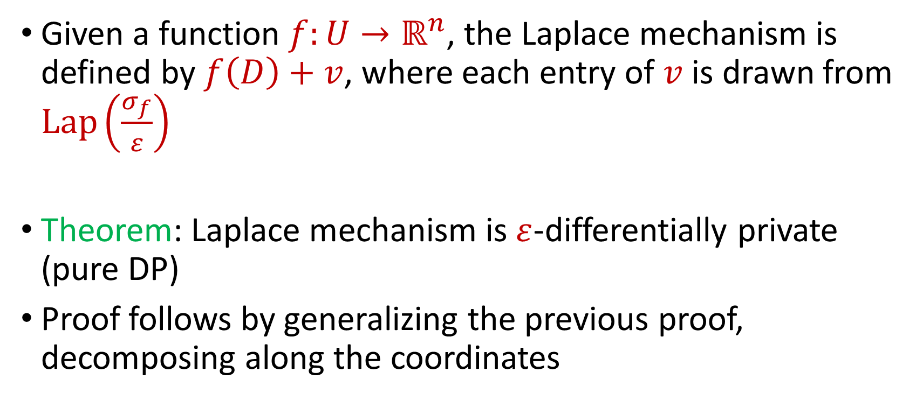
Laplace Mechanism for Vectors
Given a function $f:U→ℝ^{n}$, the Laplace mechanism is defined by $f\left(D\right)+v$, where each entry of $v$ is drawn from $Lap\left(\frac{σ_{f}}{ε}\right)$
Theorem: Laplace mechanism is $ε$-differentially private (pure DP)
Proof follows by generalizing the previous proof, decomposing along the coordinates
Notes:
[DworkMcSherryNissimSmith06]

Slide 32
Beyond Laplace Mechanism
What if we want to output the “best” answer, but noise can significantly destroy the answer?
Example: Suppose we have a large number of apples, and A, B, C each bid $1.00 and D bids $4.01. What is the optimal price?
At $4.01 the revenue, the revenue is $4.01, at $4.00 and at $1.00 the revenue is $4.00, but at $3.02 the revenue is zero!
Notes:
[DworkMcSherryNissimSmith06]

Slide 33
Beyond Laplace Mechanism
Example: Suppose a study is conducted that finds the current location of individuals, in the two-dimensional plane
Who is the closest individual to a query location?
Notes:
[DworkMcSherryNissimSmith06]

Slide 34
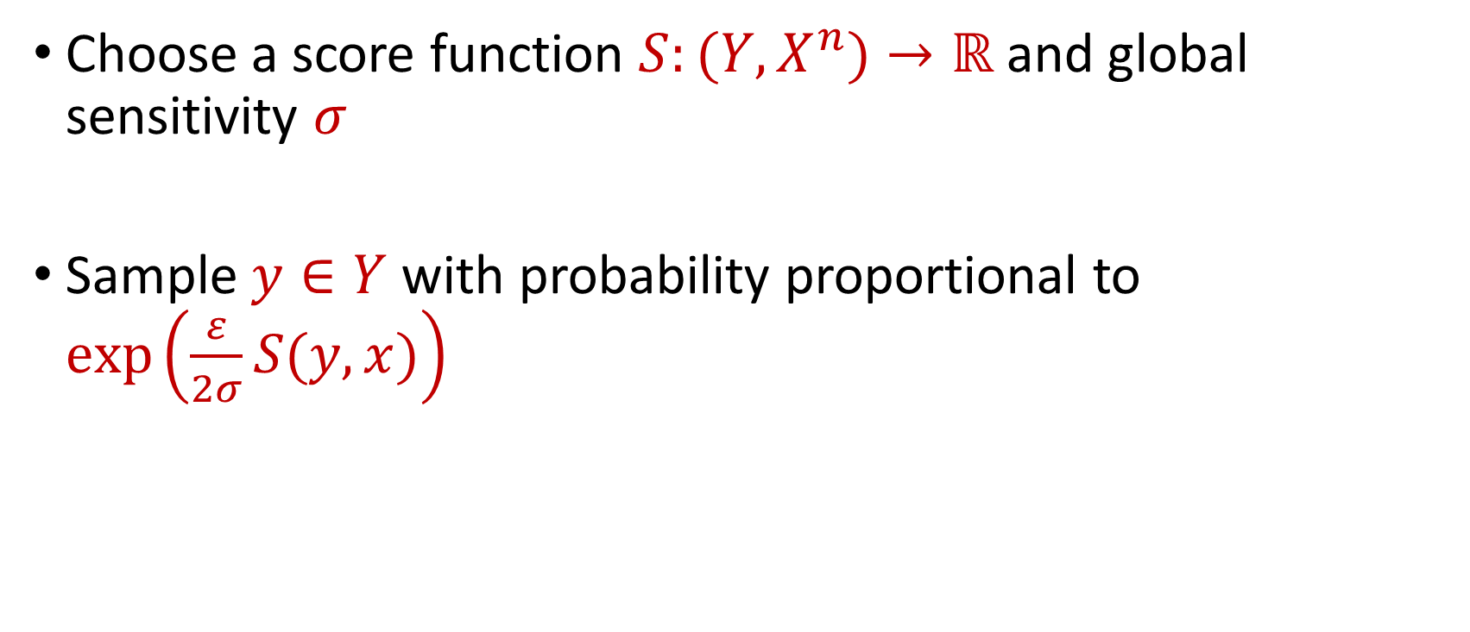
Exponential Mechanism
Choose a score function $S:(Y,X^{n})→ℝ$ and global sensitivity $σ$
Sample $y∈Y$ with probability proportional to $\exp\left(\frac{ε}{2σ}S(y,x)\right)$
Notes:
[DworkMcSherryNissimSmith06]

Slide 35
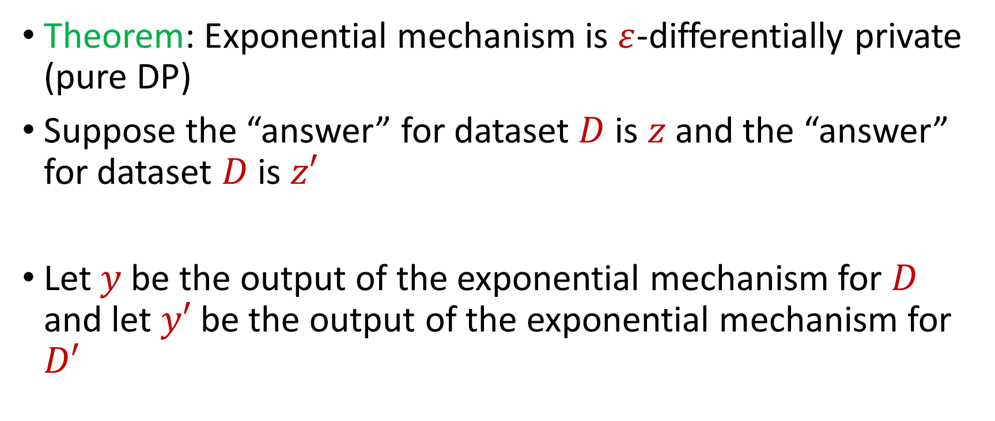
Exponential Mechanism
Theorem: Exponential mechanism is $ε$-differentially private (pure DP)
Suppose the “answer” for dataset $D$ is $z$ and the “answer” for dataset $D$ is $z′$
Let $y$ be the output of the exponential mechanism for $D$ and let $y′$ be the output of the exponential mechanism for $D′$
Notes:
[DworkMcSherryNissimSmith06]

Slide 36

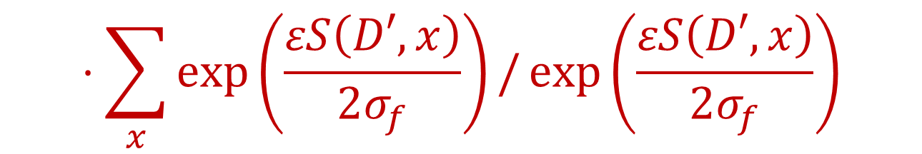

Exponential Mechanism
Want to show that for any fixed $x$, $\frac{Pr\left[y=x\right]}{Pr\left[y^{′}=x\right]}≤e^{ε}$
$$\frac{Pr\left[y=x\right]}{Pr\left[y^{′}=x\right]}≤\exp\left(\frac{εS\left(D,x\right)}{2σ_{f}}\right)/\sum_{x}{\exp\left(\frac{εS\left(D,x\right)}{2σ_{f}}\right)}$$
$$⋅\sum_{x}{\exp\left(\frac{εS\left(D′,x\right)}{2σ_{f}}\right)}/\exp\left(\frac{εS\left(D′,x\right)}{2σ_{f}}\right)$$
Notes:
[DworkMcSherryNissimSmith06]

Slide 37
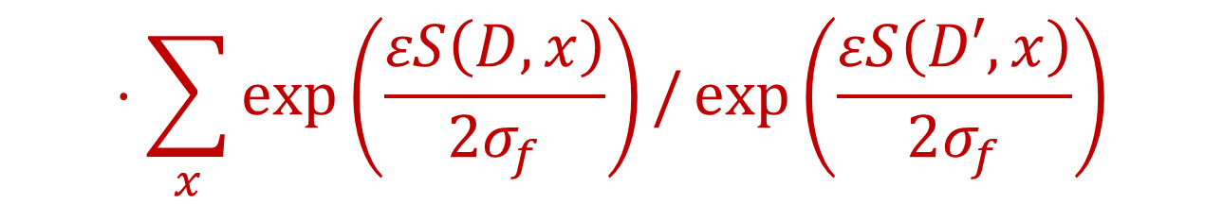

Exponential Mechanism
Want to show that for any fixed $x$, $\frac{Pr\left[y=x\right]}{Pr\left[y^{′}=x\right]}≤e^{ε}$
$$\frac{Pr\left[y=x\right]}{Pr\left[y^{′}=x\right]}≤\exp\left(\frac{ε(S\left(D,x\right)−S\left(D^{′},x\right))}{2σ_{f}}\right)$$
$$⋅\sum_{x}{\exp\left(\frac{εS\left(D,x\right)}{2σ_{f}}\right)}/\exp\left(\frac{εS\left(D′,x\right)}{2σ_{f}}\right)$$
Notes:
[DworkMcSherryNissimSmith06]

Slide 38

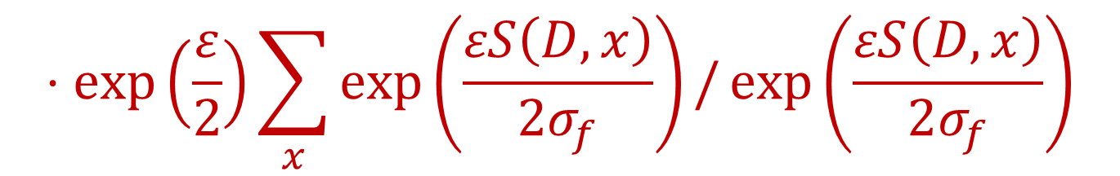
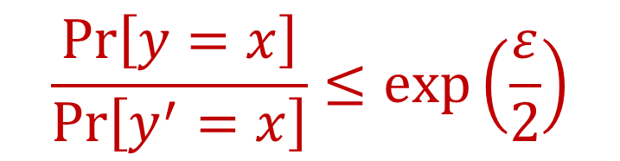
Exponential Mechanism
Want to show that for any fixed $x$, $\frac{Pr\left[y=x\right]}{Pr\left[y^{′}=x\right]}≤e^{ε}$
$$\frac{Pr\left[y=x\right]}{Pr\left[y^{′}=x\right]}≤\exp\left(\frac{ε}{2}\right)$$
$$⋅\exp\left(\frac{ε}{2}\right)\sum_{x}{\exp\left(\frac{εS\left(D,x\right)}{2σ_{f}}\right)}/\exp\left(\frac{εS\left(D,x\right)}{2σ_{f}}\right)$$
$$=\exp\left(ε\right)$$
Notes:
[DworkMcSherryNissimSmith06]

Slide 39
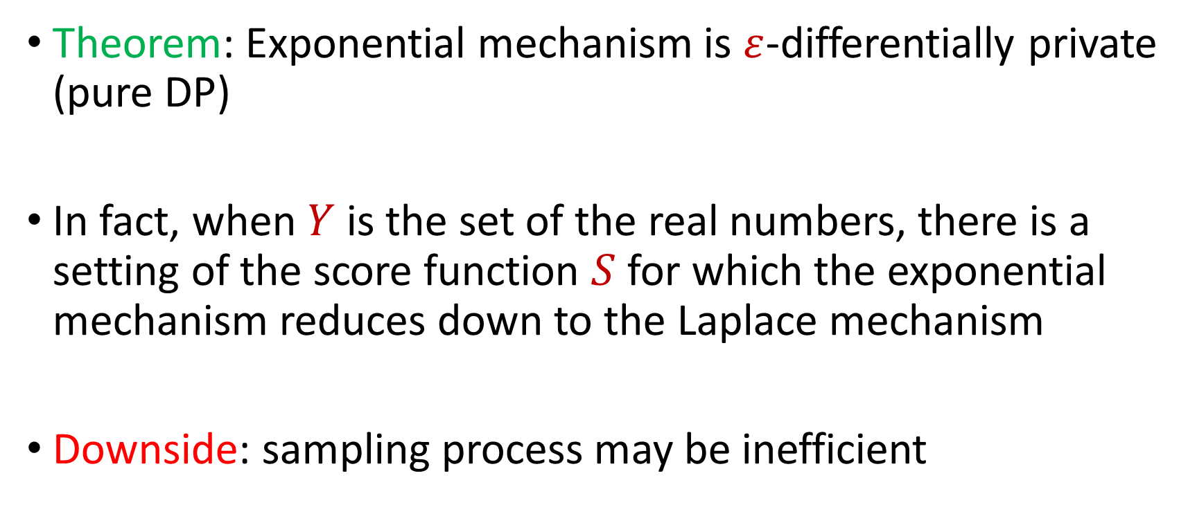
Exponential Mechanism
Theorem: Exponential mechanism is $ε$-differentially private (pure DP)
In fact, when $Y$ is the set of the real numbers, there is a setting of the score function $S$ for which the exponential mechanism reduces down to the Laplace mechanism
Downside: sampling process may be inefficient
Notes:
[DworkMcSherryNissimSmith06]

