Slide 1
CSCE 689: Special Topics in Modern Algorithms for Data Science
Lecture 21
Samson Zhou

Slide 2
Presentation Schedule
November 27: Chunkai, Jung, Galaxy AI
November 29: STMI, Anmol, Jason
December 1: Bokun, Ayesha, Dawei, Lipai

Slide 3
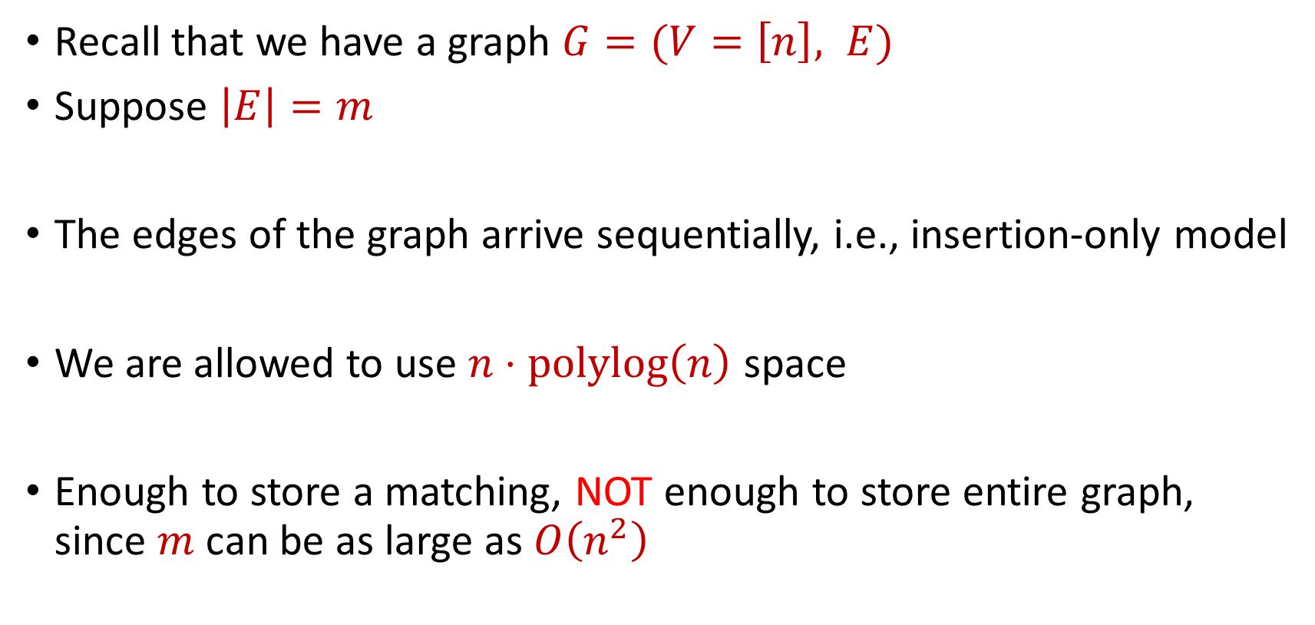
Previously: Semi-streaming Model
Recall that we have a graph $G=(V=\left[n\right], E)$
Suppose $\left|E\right|=m$
The edges of the graph arrive sequentially, i.e., insertion-only model
We are allowed to use $n⋅polylog\left(n\right)$ space
Enough to store a matching, NOT enough to store entire graph, since $m$ can be as large as $O\left(n^{2}\right)$

Slide 4
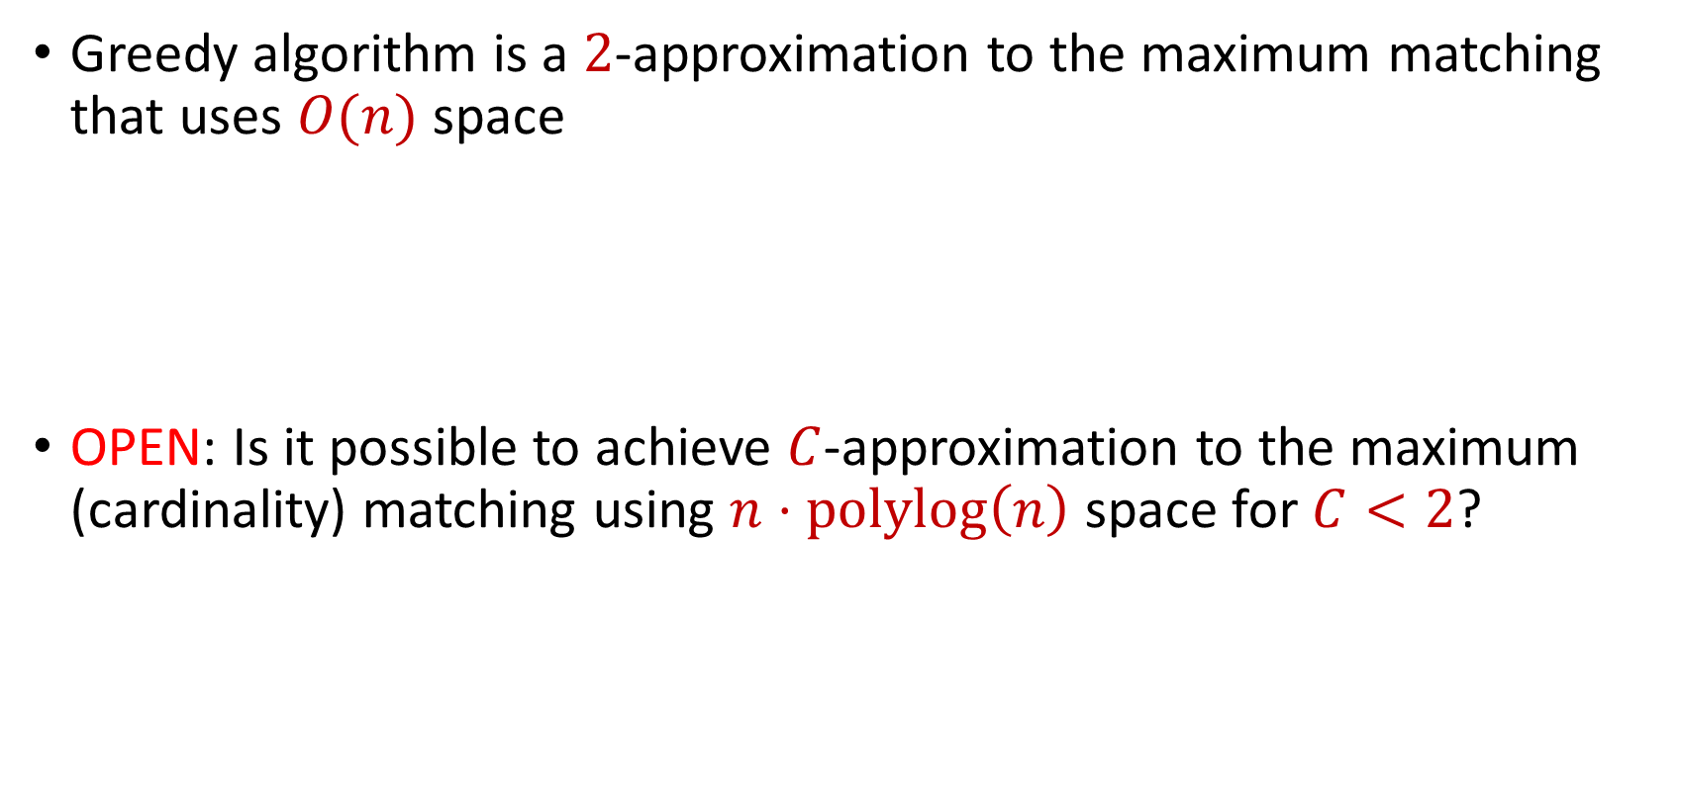
Last Time: Maximum Matching
Greedy algorithm is a $2$-approximation to the maximum matching that uses $O(n)$ space
OPEN: Is it possible to achieve $C$-approximation to the maximum (cardinality) matching using $n⋅polylog\left(n\right)$ space for $C<2$?

Slide 5
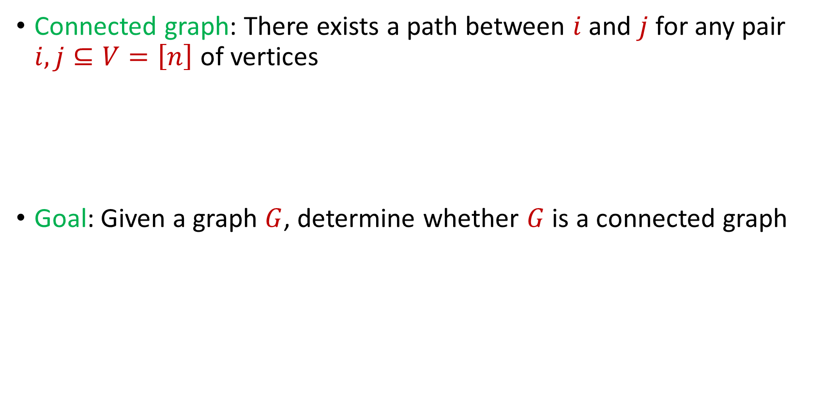
Last Time: Connectivity
Connected graph: There exists a path between $i$ and $j$ for any pair $i,j⊆V=\left[n\right]$ of vertices
Goal: Given a graph $G$, determine whether $G$ is a connected graph

Slide 6
Last Time: Spanning Tree
How to find a spanning tree in the offline setting?
Minimum spanning tree algorithms (Kruskal, Prim)
Kruskal: Greedily add minimum weight edge to spanning forest
Prim: Greedily grow minimum spanning tree

Slide 7
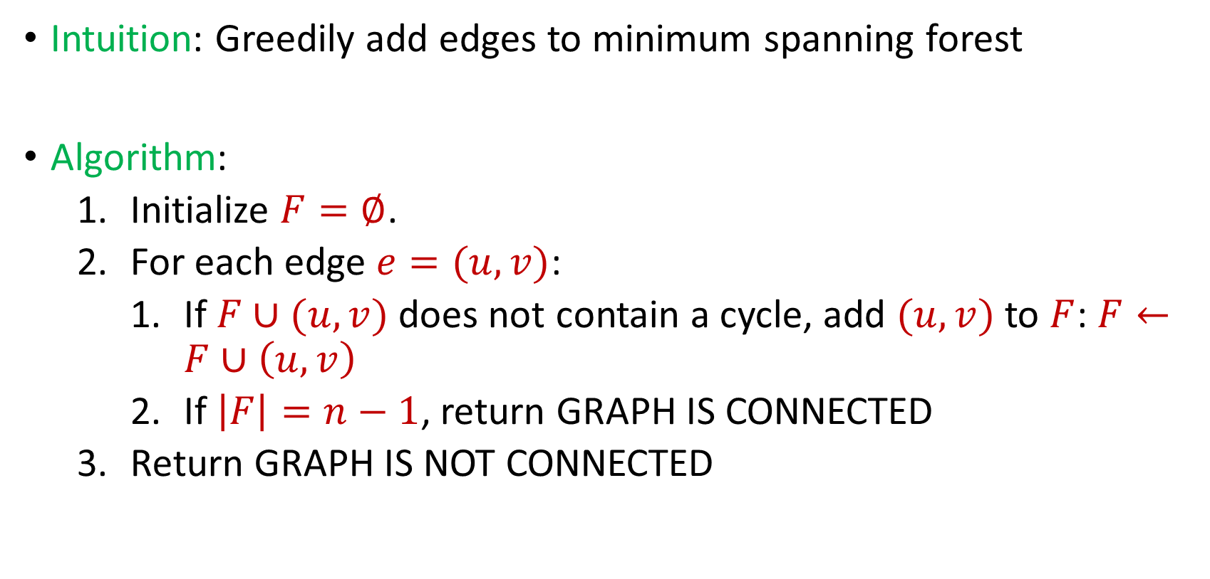
Last Time: Connectivity
Intuition: Greedily add edges to minimum spanning forest
Algorithm:
Initialize $F=∅$.
For each edge $e=(u,v)$:
If $F∪(u,v)$ does not contain a cycle, add $(u,v)$ to $F$: $F←F∪\left(u,v\right)$
If $\left|F\right|=n−1$, return GRAPH IS CONNECTED
Return GRAPH IS NOT CONNECTED

Slide 8

Last Time: Connectivity
Algorithm can keep at most $n$ edges, so the total space usage is $O(n)$ words of space.

Slide 9

Bipartiteness
Bipartite graph: Graph can be partitioned into two disjoint sets $L$ and $R$ so that every edge is between a vertex in $L$ and a vertex in $R$
Goal: Given a graph $G$, determine whether $G$ is a bipartite graph

Slide 10






$$1$$
$$2$$
$$5$$
$$6$$
$$4$$
$$3$$

Slide 11






$$2$$
$$1$$
$$6$$
$$4$$
$$5$$
$$3$$

Slide 12
$$1$$
$$2$$
$$5$$
$$6$$
$$4$$
$$3$$

Slide 13
$$1$$
$$2$$
$$5$$
$$6$$
$$4$$
$$3$$

Slide 14
Bipartiteness
What is a necessary and sufficient condition for bipartiteness?

Slide 15
Bipartiteness
What is a necessary and sufficient condition for bipartiteness?
A graph is bipartite if and only if it can be colored using two colors (a coloring of a graph is an assignment of colors to vertices such that no two vertices share the same color)
A graph is bipartite if and only if it has no odd cycles

Slide 16
Bipartiteness
How to perform bipartiteness testing in the central setting?

Slide 17
Bipartiteness
How to perform bipartiteness testing in the central setting?
Start at arbitrary vertex, run BFS, and assign alternating levels to different side until there is a contradiction

Slide 18
$$1$$
$$2$$
$$5$$
$$6$$
$$4$$
$$3$$

Slide 19
$$1$$
$$2$$
$$5$$
$$6$$
$$4$$
$$3$$

Slide 20






$$1$$
$$2$$
$$5$$
$$6$$
$$3$$
$$4$$

Slide 21
$$1$$
$$2$$
$$5$$
$$6$$
$$3$$
$$4$$

Slide 22
Bipartiteness in the Streaming Model
Bipartiteness is a monotone property, i.e., additional edges to a graph that is not bipartite will result in a graph that is not bipartite

Slide 23
Bipartiteness in the Streaming Model
Bipartiteness is a monotone property, i.e., additional edges to a graph that is not bipartite will result in a graph that is not bipartite

Slide 24
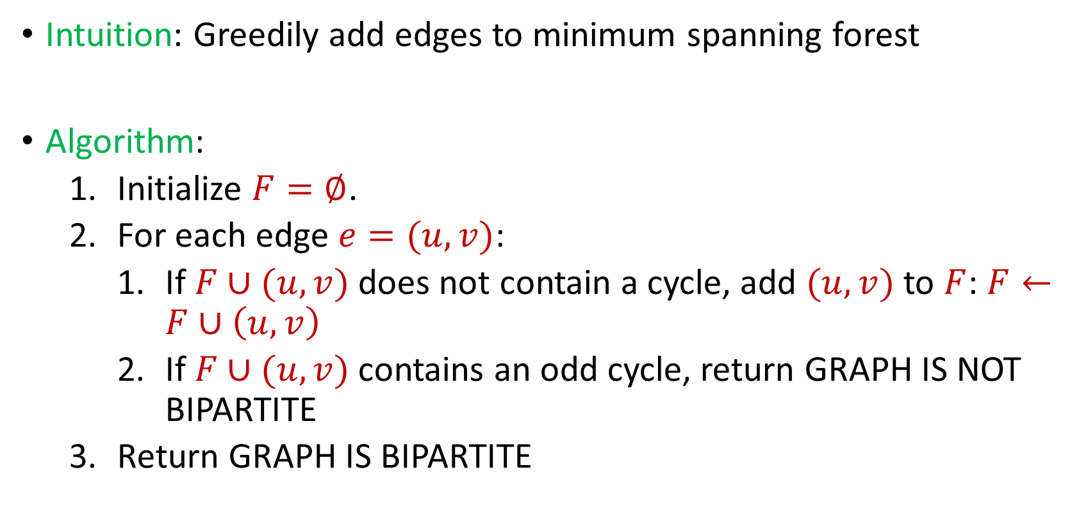
Bipartiteness in the Streaming Model
Intuition: Greedily add edges to minimum spanning forest
Algorithm:
Initialize $F=∅$.
For each edge $e=(u,v)$:
If $F∪(u,v)$ does not contain a cycle, add $(u,v)$ to $F$: $F←F∪\left(u,v\right)$
If $F∪(u,v)$ contains an odd cycle, return GRAPH IS NOT BIPARTITE
Return GRAPH IS BIPARTITE

Slide 25
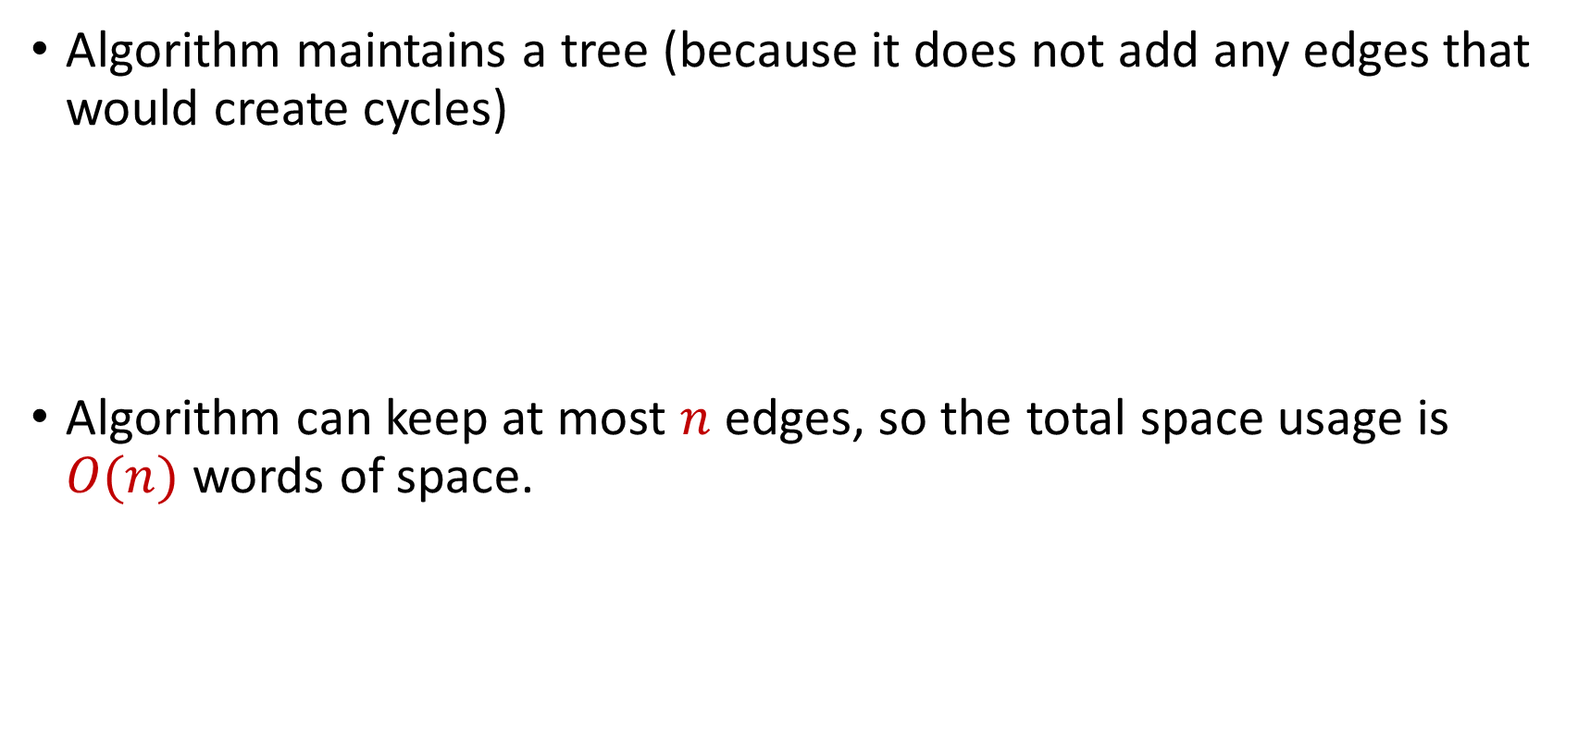
Bipartiteness in the Streaming Model
Algorithm maintains a tree (because it does not add any edges that would create cycles)
Algorithm can keep at most $n$ edges, so the total space usage is $O(n)$ words of space.

Slide 26
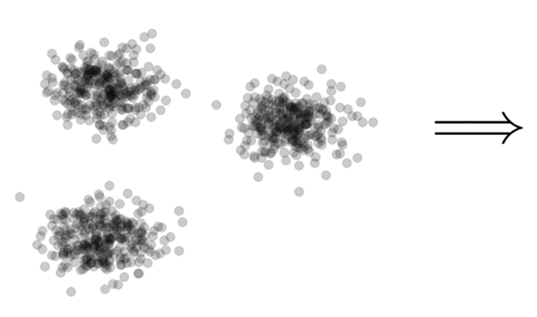

Clustering
Goal: Given input dataset $X$, partition $X$ so that “similar” points are in the same cluster and “different” points are in different clusters

Slide 27
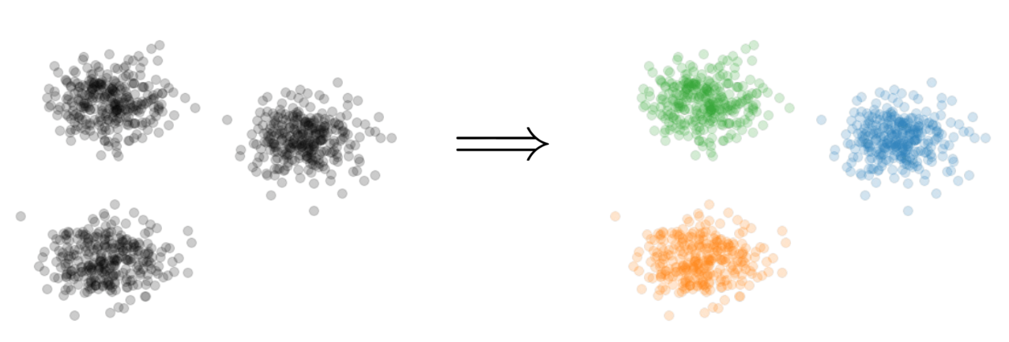
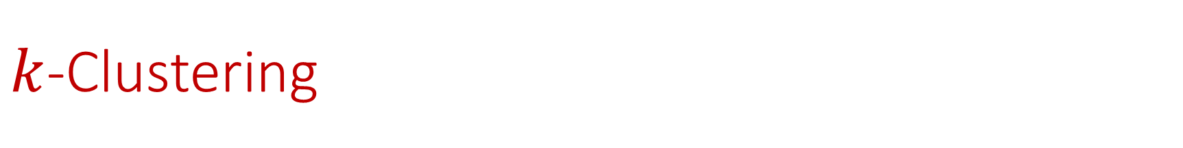

$k$-Clustering
Goal: Given input dataset $X$, partition $X$ so that “similar” points are in the same cluster and “different” points are in different clusters
There can be at most $k$ different clusters
$$k=3$$

Slide 28
$k$-Clustering
Question: How do we measure the “quality” of each clustering?
$$k=3$$

Slide 29
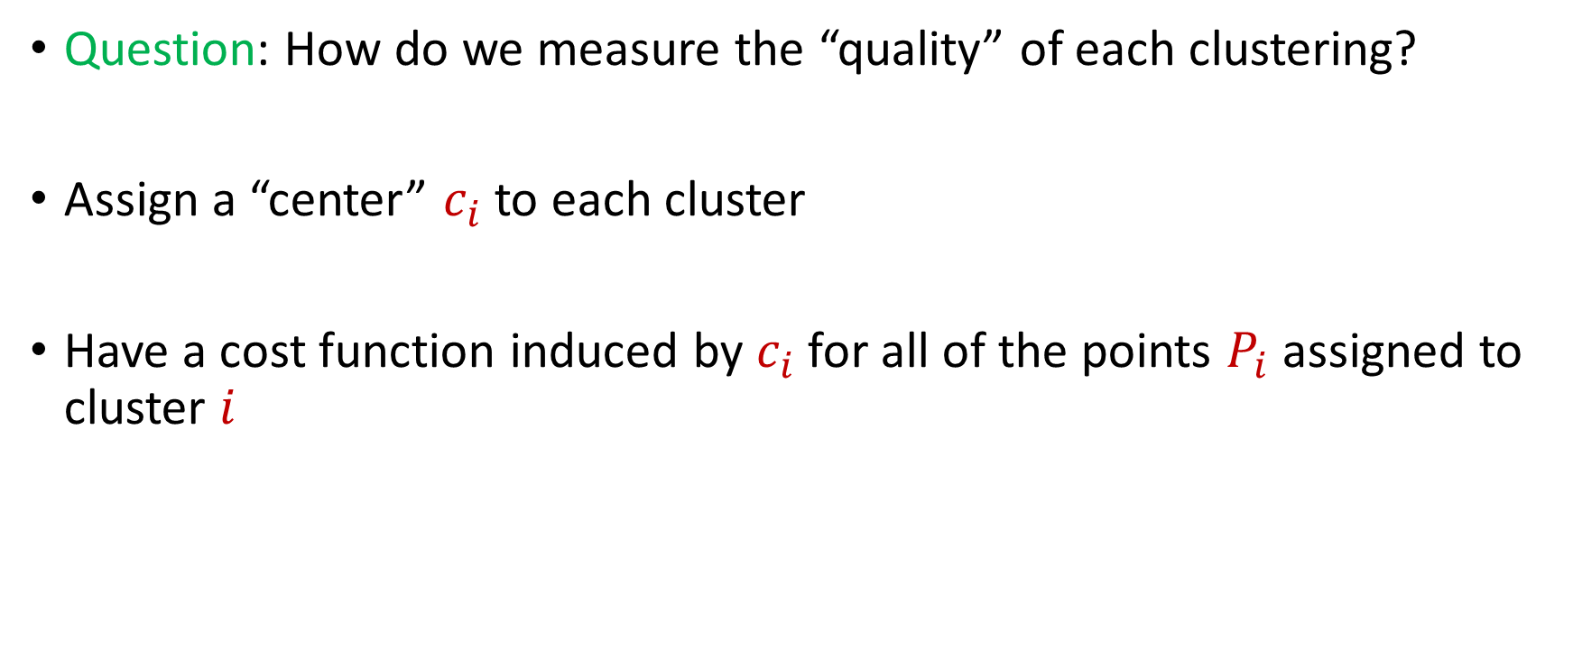
$k$-Clustering
Question: How do we measure the “quality” of each clustering?
Assign a “center” $c_{i}$ to each cluster
Have a cost function induced by $c_{i}$ for all of the points $P_{i}$ assigned to cluster $i$

Slide 30
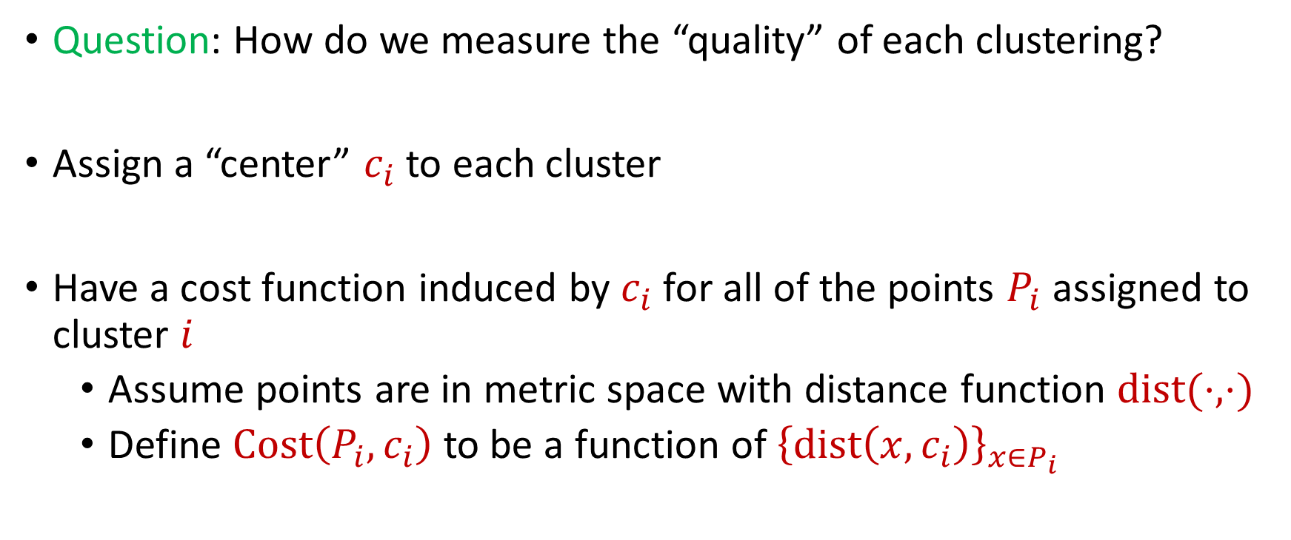
$k$-Clustering
Question: How do we measure the “quality” of each clustering?
Assign a “center” $c_{i}$ to each cluster
Have a cost function induced by $c_{i}$ for all of the points $P_{i}$ assigned to cluster $i$
Assume points are in metric space with distance function $dist(⋅,⋅)$
Define $Cost\left(P_{i},c_{i}\right)$ to be a function of ${\left\{dist\left(x,c_{i}\right)\right\}}_{x∈P_{i}}$

Slide 31
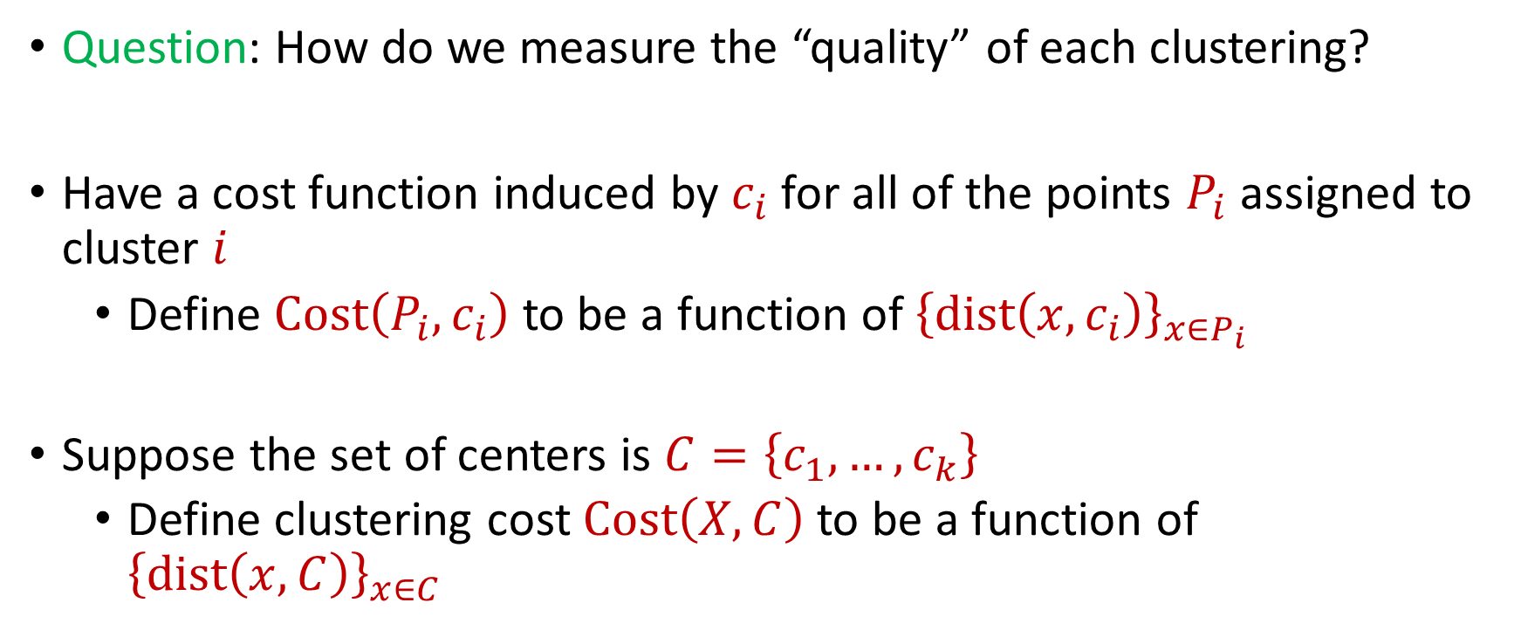
$k$-Clustering
Question: How do we measure the “quality” of each clustering?
Have a cost function induced by $c_{i}$ for all of the points $P_{i}$ assigned to cluster $i$
Define $Cost\left(P_{i},c_{i}\right)$ to be a function of ${\left\{dist\left(x,c_{i}\right)\right\}}_{x∈P_{i}}$
Suppose the set of centers is $C=\left\{c_{1},…, c_{k}\right\}$
Define clustering cost $Cost\left(X,C\right)$ to be a function of ${\left\{dist\left(x,C\right)\right\}}_{x∈C}$

Slide 32

$k$-Clustering
Define clustering cost $Cost\left(X,C\right)$ to be a function of ${\left\{dist\left(x,C\right)\right\}}_{x∈C}$

Slide 33
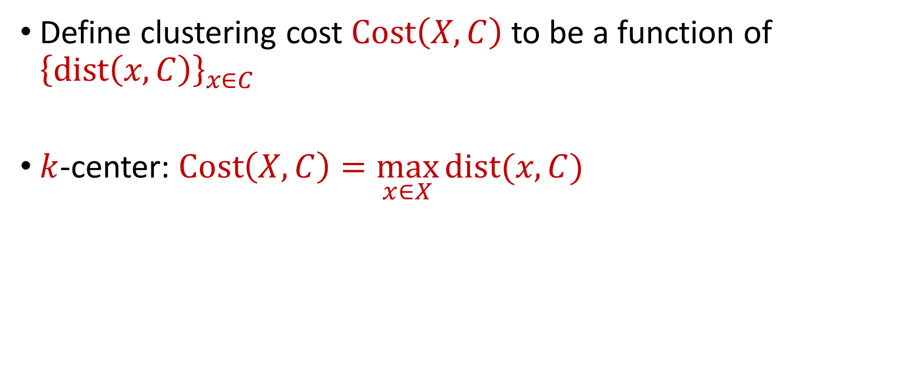
$k$-Clustering
Define clustering cost $Cost\left(X,C\right)$ to be a function of ${\left\{dist\left(x,C\right)\right\}}_{x∈C}$
$k$-center: $Cost\left(X,C\right)=\max_{x∈X}{dist(x,C)}$

Slide 34
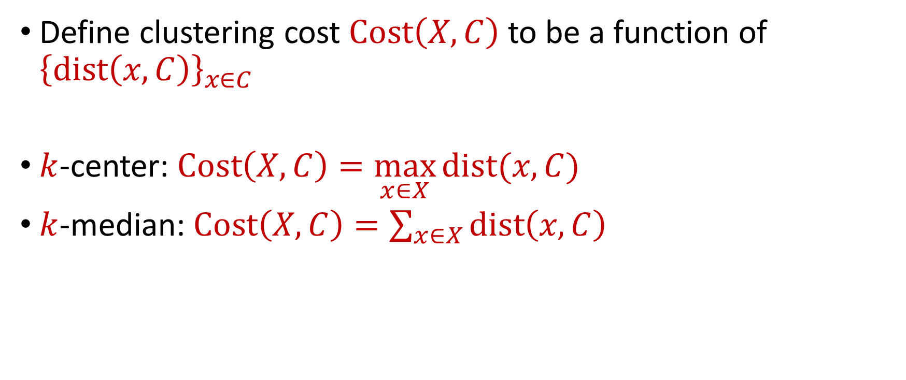
$k$-Clustering
Define clustering cost $Cost\left(X,C\right)$ to be a function of ${\left\{dist\left(x,C\right)\right\}}_{x∈C}$
$k$-center: $Cost\left(X,C\right)=\max_{x∈X}{dist(x,C)}$
$k$-median: $Cost\left(X,C\right)=\sum_{x∈X}{dist\left(x,C\right)}$

Slide 35

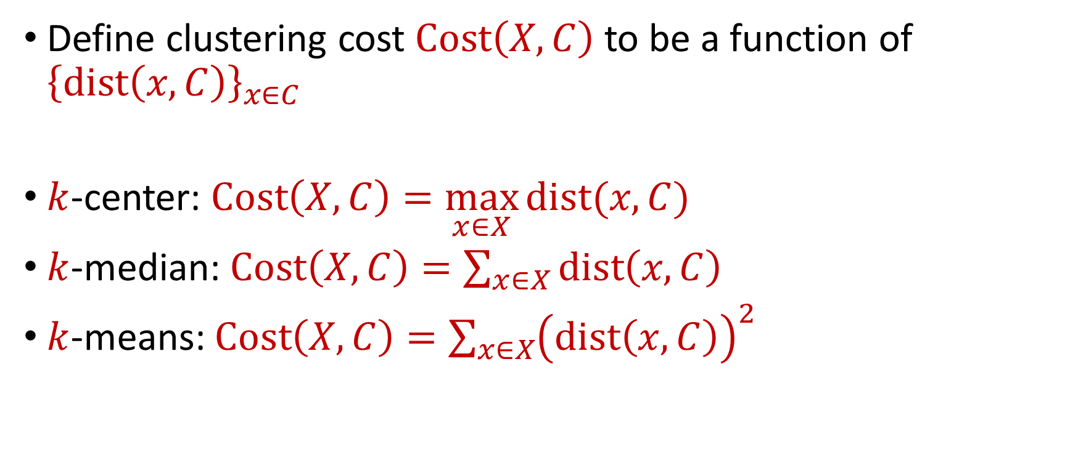






$k$-Clustering
Define clustering cost $Cost\left(X,C\right)$ to be a function of ${\left\{dist\left(x,C\right)\right\}}_{x∈C}$
$k$-center: $Cost\left(X,C\right)=\max_{x∈X}{dist(x,C)}$
$k$-median: $Cost\left(X,C\right)=\sum_{x∈X}{dist\left(x,C\right)}$
$k$-means: $Cost\left(X,C\right)=\sum_{x∈X}{{\left(dist\left(x,C\right)\right)}^{2}}$
$${\left(⋅\right)}^{2}$$
$${\left(⋅\right)}^{2}$$
$${\left(⋅\right)}^{2}$$
$${\left(⋅\right)}^{2}$$
$${\left(⋅\right)}^{2}$$
$${\left(⋅\right)}^{2}$$
$${\left(⋅\right)}^{2}$$

Slide 36

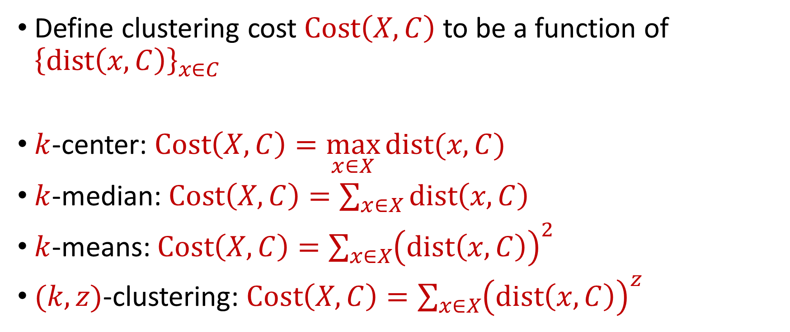






$k$-Clustering
Define clustering cost $Cost\left(X,C\right)$ to be a function of ${\left\{dist\left(x,C\right)\right\}}_{x∈C}$
$k$-center: $Cost\left(X,C\right)=\max_{x∈X}{dist(x,C)}$
$k$-median: $Cost\left(X,C\right)=\sum_{x∈X}{dist\left(x,C\right)}$
$k$-means: $Cost\left(X,C\right)=\sum_{x∈X}{{\left(dist\left(x,C\right)\right)}^{2}}$
$(k,z)$-clustering: $Cost\left(X,C\right)=\sum_{x∈X}{{\left(dist\left(x,C\right)\right)}^{z}}$
$${\left(⋅\right)}^{z}$$
$${\left(⋅\right)}^{z}$$
$${\left(⋅\right)}^{z}$$
$${\left(⋅\right)}^{z}$$
$${\left(⋅\right)}^{z}$$
$${\left(⋅\right)}^{z}$$
$${\left(⋅\right)}^{z}$$

Slide 37
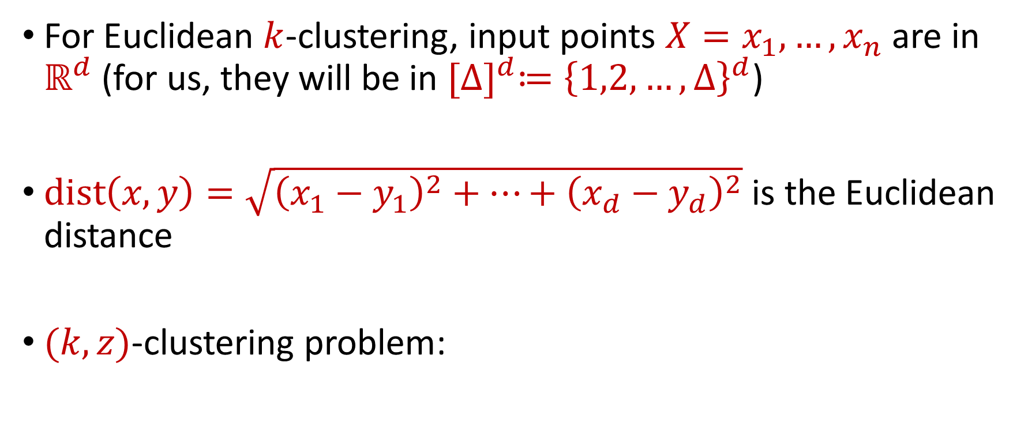


Euclidean $k$-Clustering
For Euclidean $k$-clustering, input points $X=x_{1},…,x_{n}$ are in $ℝ^{d}$ (for us, they will be in ${[Δ]}^{d}≔{\left\{1,2,…,Δ\right\}}^{d}$)
$dist\left(x,y\right)=\sqrt{{\left(x_{1}−y_{1}\right)}^{2}+…+{\left(x_{d}−y_{d}\right)}^{2}}$ is the Euclidean distance
$(k,z)$-clustering problem:
$$\min_{C:\left|C\right|≤k} Cost\left(X,C\right)=\min_{C:\left|C\right|≤k}{Σ_{x∈X}\left(dist\left(x,C\right)\right)}^{z}$$

Slide 38






$$(−8, 4)$$
$$(−4, 3)$$
$$(4, 3)$$
$$(−3, 0)$$
$$(−11, −4)$$
$$(0, −4)$$

Slide 39


$$(−8, 4)$$
$$(−4, 3)$$
$$(4, 3)$$
$$(−8, 0)$$
$$(−3, 0)$$
$$(0, 0)$$
$$(−11, −4)$$
$$(0, −4)$$

Slide 40






$$(−8, 4)$$
$$(−4, 3)$$
$$(4, 3)$$
$$4$$
$$5$$
$$5$$
$$3$$
$$(−8, 0)$$
$$(−3, 0)$$
$$(0, 0)$$
$$5$$
$$4$$
$$(−11, −4)$$
$$(0, −4)$$

Slide 41
$k$-center: $Cost\left(X,C\right)=\max_{x∈X}{dist\left(x,C\right)=5}$
$$(−8, 4)$$
$$(−4, 3)$$
$$(4, 3)$$
$$4$$
$$5$$
$$5$$
$$3$$
$$(−8, 0)$$
$$(−3, 0)$$
$$(0, 0)$$
$$5$$
$$4$$
$$(−11, −4)$$
$$(0, −4)$$

Slide 42
$k$-median: $Cost\left(X,C\right)=\sum_{x∈X}{dist\left(x,C\right)}=4+5+5+3+4+5=26$
$$(−8, 4)$$
$$(−4, 3)$$
$$(4, 3)$$
$$4$$
$$5$$
$$5$$
$$3$$
$$(−8, 0)$$
$$(−3, 0)$$
$$(0, 0)$$
$$5$$
$$4$$
$$(−11, −4)$$
$$(0, −4)$$

Slide 43

$k$-means: $Cost\left(X,C\right)=\sum_{x∈X}{{\left(dist\left(x,C\right)\right)}^{2}} =16+25+25+9+16+25$
$$(−8, 4)$$
$$=116$$
$$(−4, 3)$$
$$(4, 3)$$
$$4$$
$$5$$
$$5$$
$$3$$
$$(−8, 0)$$
$$(−3, 0)$$
$$(0, 0)$$
$$5$$
$$4$$
$$(−11, −4)$$
$$(0, −4)$$

Slide 44
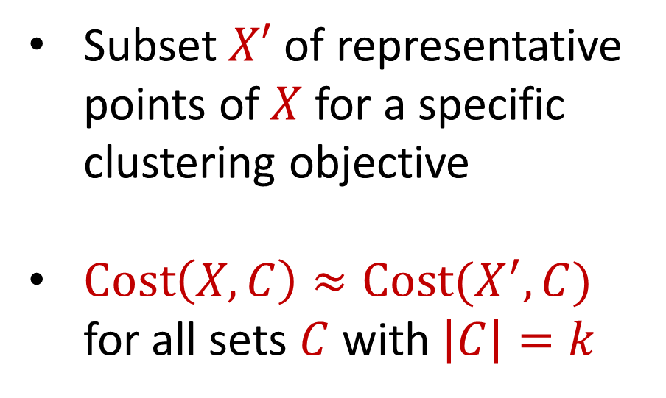
Coreset
Subset $X′$ of representative points of $X$ for a specific clustering objective
$Cost\left(X,C\right)≈Cost(X^{′},C)$ for all sets $C$ with $\left|C\right|=k$

Slide 45
Coreset
Subset $X′$ of representative points of $X$ for a specific clustering objective
$Cost\left(X,C\right)≈Cost(X^{′},C)$ for all sets $C$ with $\left|C\right|=k$

Slide 46
Coreset
Subset $X′$ of representative points of $X$ for a specific clustering objective
$Cost\left(X,C\right)≈Cost(X^{′},C)$ for all sets $C$ with $\left|C\right|=k$

Slide 47

Coreset (Formal Definition)
Given a set $X$ and an accuracy parameter $ε>0$, we say a set $X′$ with weight function $w$is an $(1+ε)$-multiplicative coreset for a cost function $Cost$, if for all queries $C$ with $\left|C\right|≤k$, we have
$$\left(1−ε\right)Cost(X,C)≤Cost(X′,C,w)≤\left(1+ε\right)Cost(X,C)$$
$(k,z)$-clustering: $Cost\left(X^{′},C,w\right)=\sum_{x∈X′}{{w\left(x\right)⋅\left(dist\left(x,C\right)\right)}^{z}}$

Slide 48
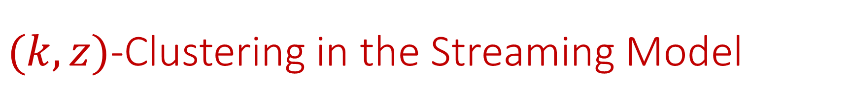

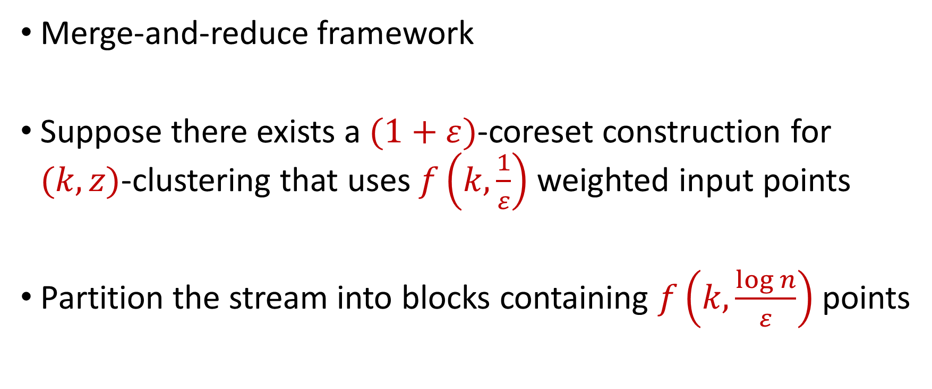
$(k,z)$-Clustering in the Streaming Model
Merge-and-reduce framework
Suppose there exists a $(1+ε)$-coreset construction for $(k,z)$-clustering that uses $f\left(k,\frac{1}{ε}\right)$ weighted input points
Partition the stream into blocks containing $f\left(k,\frac{\log{n}}{ε}\right)$ points
$$\tilde{O}\left(\frac{k^{2}}{ε^{2}}\right)$$

Slide 49
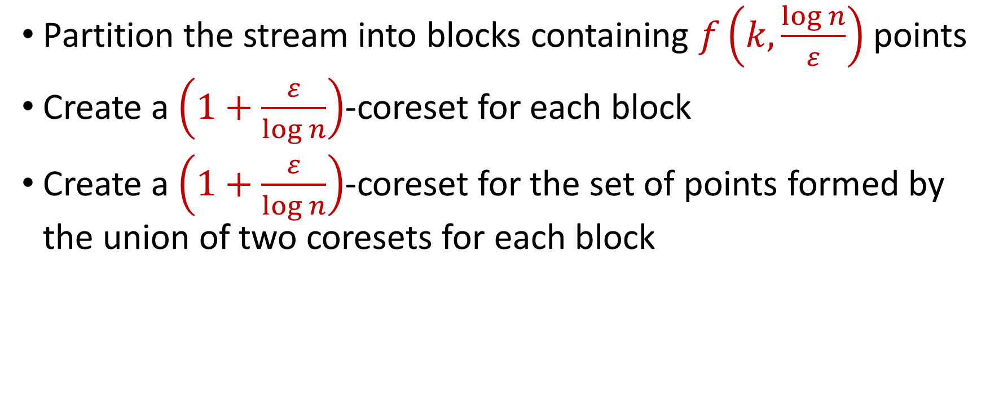
$(k,z)$-Clustering in the Streaming Model
Partition the stream into blocks containing $f\left(k,\frac{\log{n}}{ε}\right)$ points
Create a $\left(1+\frac{ε}{\log{n}}\right)$-coreset for each block
Create a $\left(1+\frac{ε}{\log{n}}\right)$-coreset for the set of points formed by the union of two coresets for each block
Reduce
Merge

Slide 50
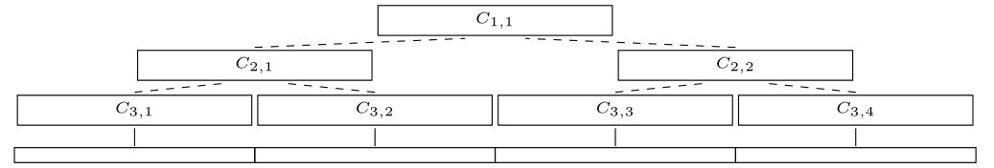
$(k,z)$-Clustering in the Streaming Model
Partition the stream into blocks containing $f\left(k,\frac{\log{n}}{ε}\right)$ points
Create a $\left(1+\frac{ε}{\log{n}}\right)$-coreset for each block
Create a $\left(1+\frac{ε}{\log{n}}\right)$-coreset for the set of points formed by the union of two coresets for each block

Slide 51
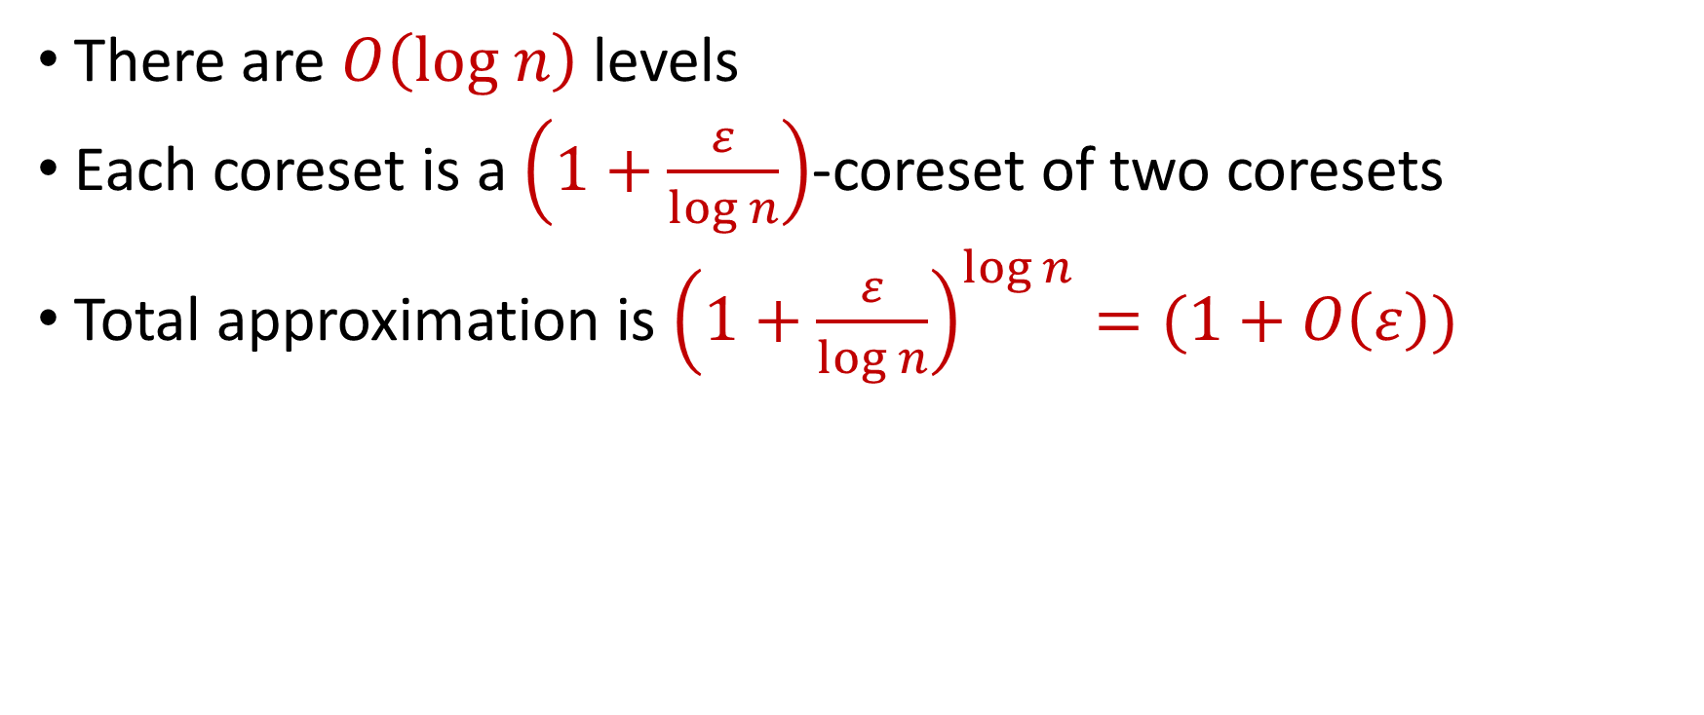
$(k,z)$-Clustering in the Streaming Model
There are $O\left(log n\right)$ levels
Each coreset is a $\left(1+\frac{ε}{\log{n}}\right)$-coreset of two coresets
Total approximation is ${\left(1+\frac{ε}{\log{n}}\right)}^{\log{n}}=(1+O\left(ε\right))$

Slide 52
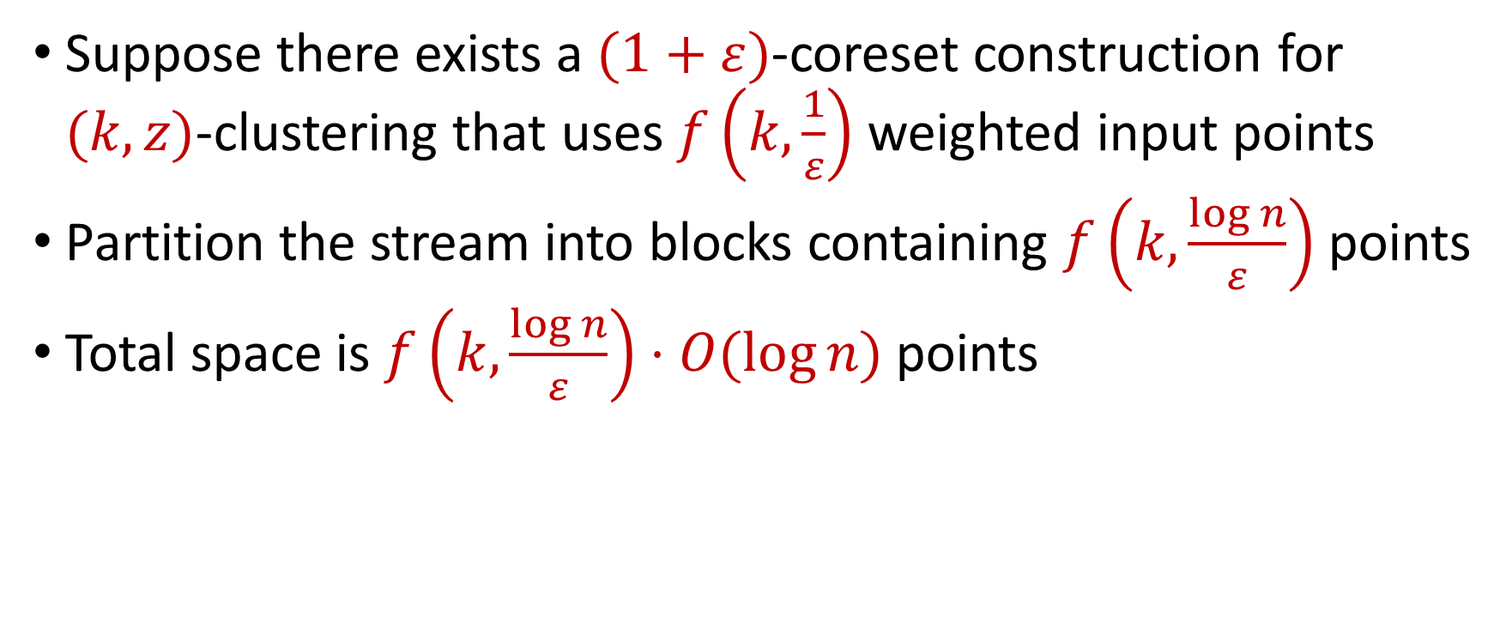
$(k,z)$-Clustering in the Streaming Model
Suppose there exists a $(1+ε)$-coreset construction for $(k,z)$-clustering that uses $f\left(k,\frac{1}{ε}\right)$ weighted input points
Partition the stream into blocks containing $f\left(k,\frac{\log{n}}{ε}\right)$ points
Total space is $f\left(k,\frac{\log{n}}{ε}\right)⋅O(log{n)}$ points
For $k$-means clustering, this is $\tilde{O}\left(\frac{k}{ε^{2}}⋅\log^{3}{n}\right)$ points

Slide 53

Clustering
Goal: Given input dataset $P$, partition $P$ so that “similar” points are in the same cluster and “different” points are in different clusters

Slide 54

$k$-Clustering
Goal: Given input dataset $P$, partition $P$ so that “similar” points are in the same cluster and “different” points are in different clusters
There can be at most $k$ different clusters
$$k=3$$

Slide 55
$k$-Clustering
Question: How do we measure the “quality” of each clustering?
$$k=3$$

Slide 56
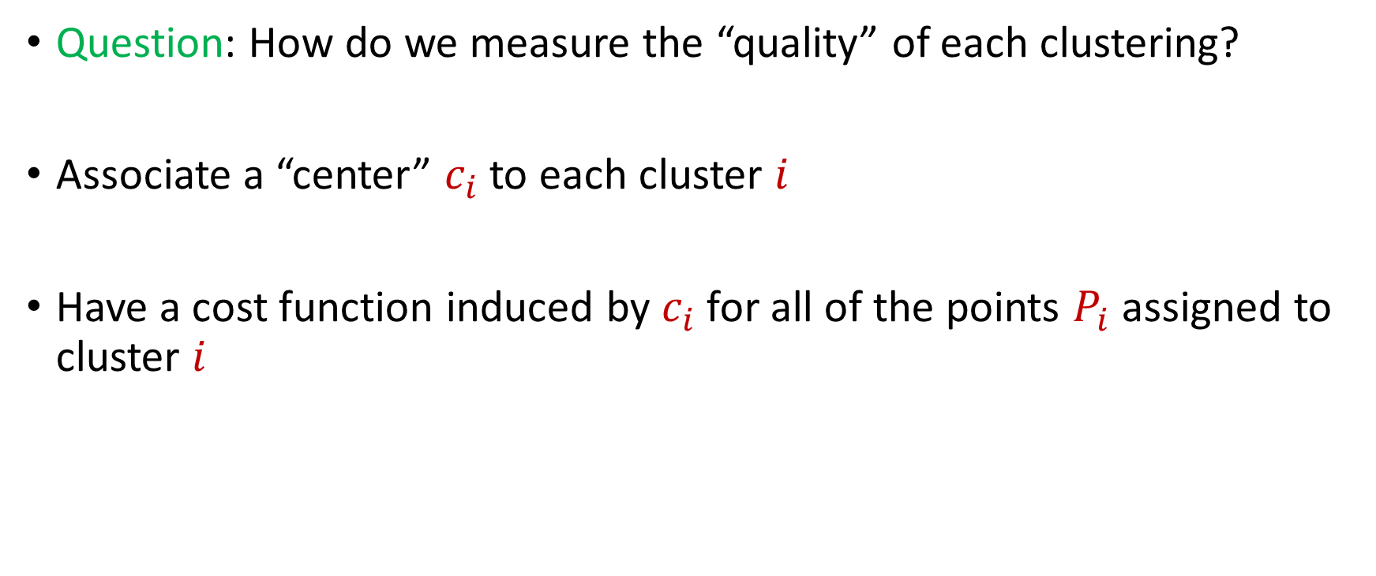
$k$-Clustering
Question: How do we measure the “quality” of each clustering?
Associate a “center” $c_{i}$ to each cluster $i$
Have a cost function induced by $c_{i}$ for all of the points $P_{i}$ assigned to cluster $i$
$$Cost\left(P_{i}, c_{i}\right)$$

Slide 59





1 0 3 0 1 1
1 1 0 0 2 8
2 0 1 3 0 8
1 1 0 0 0 8
0 0 0 7 0 0
7 0 0 8 0 0
3 4 1 1 0 2
4 2 0 1 0 1
9 1 0 0 3 2
1 1 6 0 0 0
8 1 0 1 2 0
1
1
2
1
0
7
3
4
9
1
8
$$n$$
$$A$$
$$b$$
$$d$$
$$1$$

Slide 60




$$x$$
$$n$$
$$A$$
$$≈$$
$$b$$
$$d$$
$$1$$

Slide 61




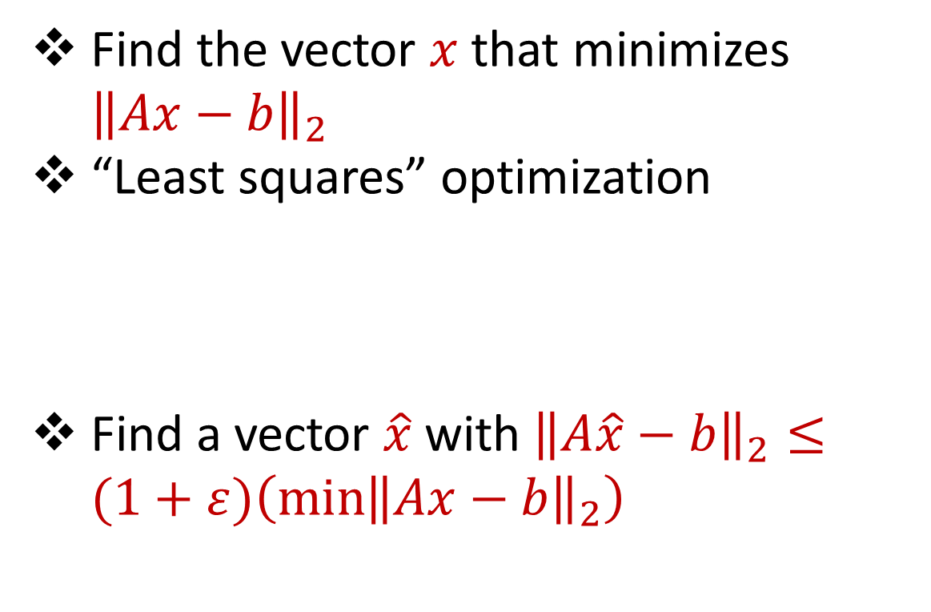






Linear Regression
Find the vector $x$ that minimizes ${\left\|Ax−b\right\|}_{2}$
“Least squares” optimization
Find a vector $\hat{x}$ with ${\left\|A\hat{x}−b\right\|}_{2}≤(1+ε)\left(\min{{\left\|Ax−b\right\|}_{2}}\right)$
$$d$$
$$x$$
$$≈$$
$$n$$
$$A$$
$$n$$
$$b$$
$$1$$
$$d$$
$$1$$

Slide 62




Dimensionality Reduction
Reduce $d$
Reduce $n$
Application depends on task!
Sampling, Sketching, Johnson-Lindenstrauss, IsoMap
$$n$$
$$A$$
Sampling, Sketching
$$d$$

Slide 63


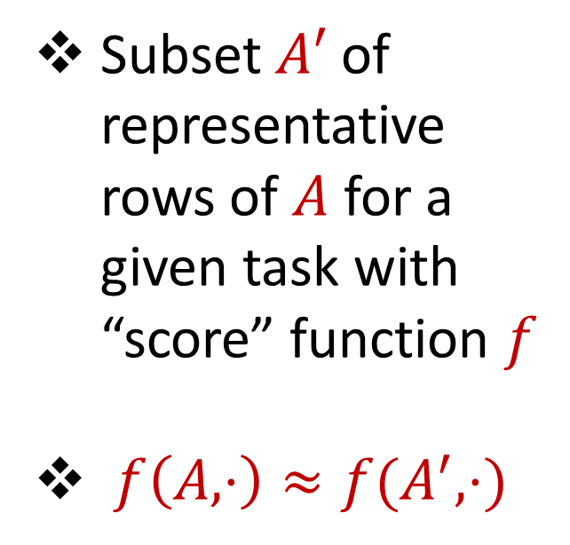



Coreset
Subset $A′$ of representative rows of $A$ for a given task with “score” function $f$
$f\left(A,⋅\right)≈f(A^{′},⋅)$
$$n$$
$$A$$
$$A′$$
$$d$$
$$d$$

Slide 64
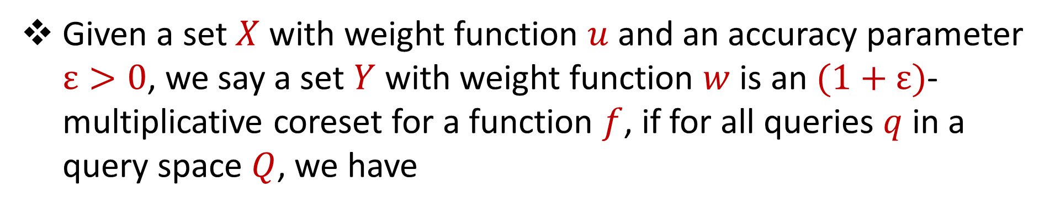
Coreset (Formal Definition)
Given a set $X$ with weight function $u$ and an accuracy parameter $ε>0$, we say a set $Y$ with weight function $w$is an $(1+ε)$-multiplicative coreset for a function $f$, if for all queries $q$ in a query space $Q$, we have
$$\left(1−ε\right)f\left(Y,q,w\right)≤f\left(X,q,u\right)≤\left(1+ε\right)f(Y,q,w)$$

Slide 65
Coreset
Lots of different constructions with various tradeoffs
Size vs. accuracy
Size vs. computation time
Size vs. interpretability
Average-case vs. worst-case performance

Slide 66
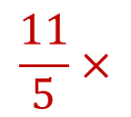
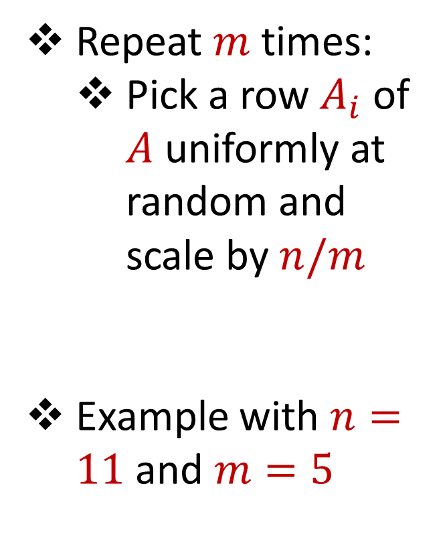
Uniform Sampling
1 0 3 0 1 1
1 1 0 0 2 8
2 0 1 3 0 8
1 1 0 0 0 8
0 0 0 7 0 0
7 0 0 8 0 0
3 4 1 1 0 2
4 2 0 1 0 1
9 1 0 0 3 2
1 1 6 0 0 0
8 1 0 1 2 0
Repeat $m$ times:
Pick a row $A_{i}$ of $A$ uniformly at random and scale by $n/m$
Example with $n=11$ and $m=5$
$$n$$
$$A$$
1 0 3 0 1 1
1 1 0 0 0 8
3 4 1 1 0 2
8 1 0 1 2 0
3 4 1 1 0 2
$$\frac{11}{5}×$$
$$A′$$
$$d$$
$$d$$

Slide 67

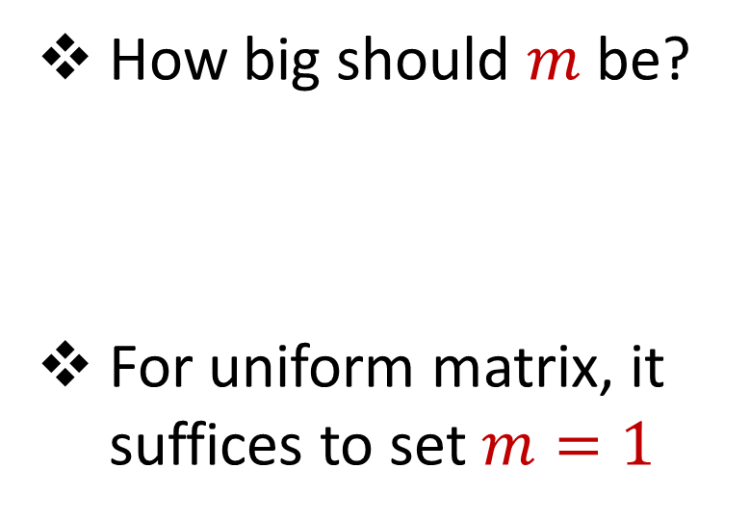


Uniform Sampling
1 0 0 0 0 0
1 0 0 0 0 0
1 0 0 0 0 0
1 0 0 0 0 0
1 0 0 0 0 0
1 0 0 0 0 0
1 0 0 0 0 0
1 0 0 0 0 0
1 0 0 0 0 0
1 0 0 0 0 0
1 0 0 0 0 0
How big should $m$ be?
For uniform matrix, it suffices to set $m=1$
$$n$$
$$A$$
$$d$$

Slide 68
Uniform Sampling
1 0 0 0 0 0
1 0 0 0 0 0
1 0 0 0 0 0
1 0 0 0 0 0
1 0 0 0 0 0
1 0 0 0 0 0
1 0 0 0 0 0
1 0 0 0 0 0
1 0 0 0 0 0
1 0 0 0 0 0
1 0 0 0 0 0
How big should $m$ be?
For uniform matrix, it suffices to set $m=1$
$$n$$
$$A$$
1 0 0 0 0 0
1 0 0 0 0 0
1 0 0 0 0 0
1 0 0 0 0 0
1 0 0 0 0 0
$$\frac{11}{5}×$$
$$A′$$
$$d$$
$$d$$

Slide 69
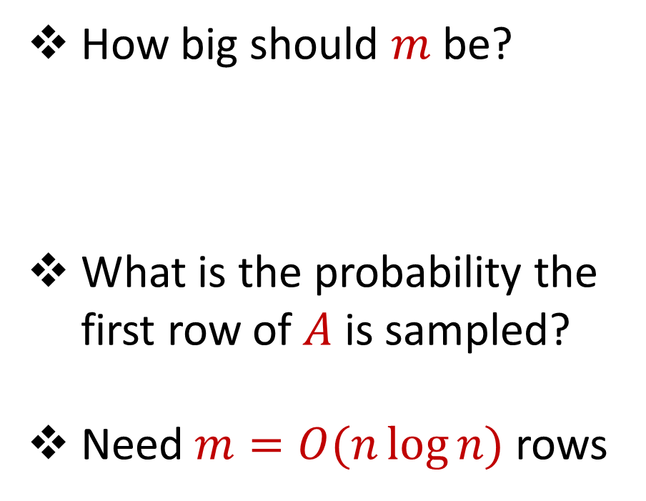
Uniform Sampling
0 0 0 0 0 1
1 0 0 0 0 0
1 0 0 0 0 0
1 0 0 0 0 0
1 0 0 0 0 0
1 0 0 0 0 0
1 0 0 0 0 0
1 0 0 0 0 0
1 0 0 0 0 0
1 0 0 0 0 0
1 0 0 0 0 0
How big should $m$ be?
What is the probability the first row of $A$ is sampled?
Need $m=O(n\log{n})$ rows
$$n$$
$$A$$
$$d$$

Slide 70
Uniform Sampling
Pros: intuitively simple, simple to implement, fast, good on uniform or “average-case” data
Cons: bad on “worst-case” data

Slide 71
Importance Sampling
1 0 0 0 0 0
1 0 0 0 0 0
1 0 0 0 0 0
1 0 0 0 0 0
1 0 0 0 0 0
1 0 0 0 0 0
0 0 0 0 0 1
1 0 0 0 0 0
1 0 0 0 0 0
1 0 0 0 0 0
1 0 0 0 0 0
What if we do not sample uniformly at random?
What is the probability that each row should be sampled?
$$n$$
$$A$$

Slide 72
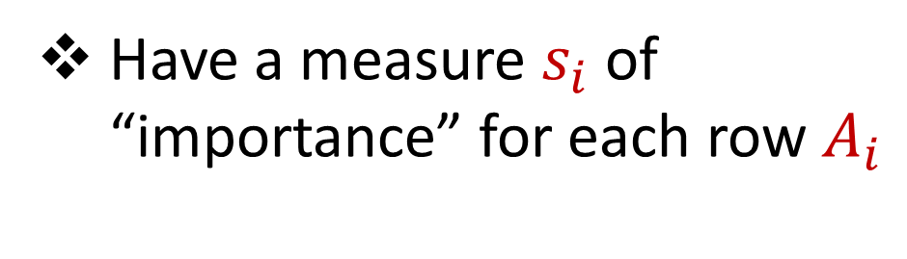
Importance Sampling
1 0 0 0 0 0
1 0 0 0 0 0
1 0 0 0 0 0
1 0 0 0 0 0
1 0 0 0 0 0
1 0 0 0 0 0
0 0 0 0 0 1
1 0 0 0 0 0
1 0 0 0 0 0
1 0 0 0 0 0
1 0 0 0 0 0
Have a measure $s_{i}$ of “importance” for each row $A_{i}$
$$n$$
$$A$$

Slide 73

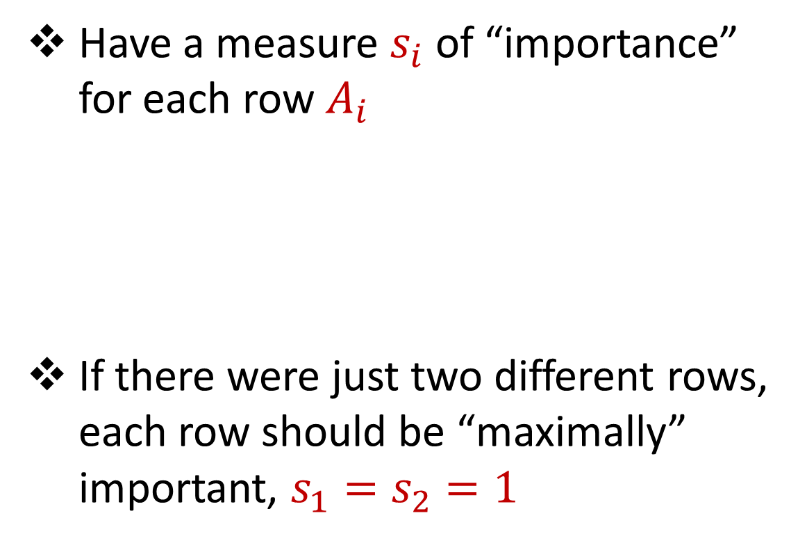



Importance Sampling
1 0 0 0 0 0
1 0 0 0 0 0
1 0 0 0 0 0
1 0 0 0 0 0
1 0 0 0 0 0
1 0 0 0 0 0
0 0 0 0 0 1
1 0 0 0 0 0
1 0 0 0 0 0
1 0 0 0 0 0
1 0 0 0 0 0
Have a measure $s_{i}$ of “importance” for each row $A_{i}$
If there were just two different rows, each row should be “maximally” important, $s_{1}=s_{2}=1$
$$n$$
$$A$$
1 0 0 0 0 0
0 0 0 0 0 1
$$n$$
$$A$$

Slide 74
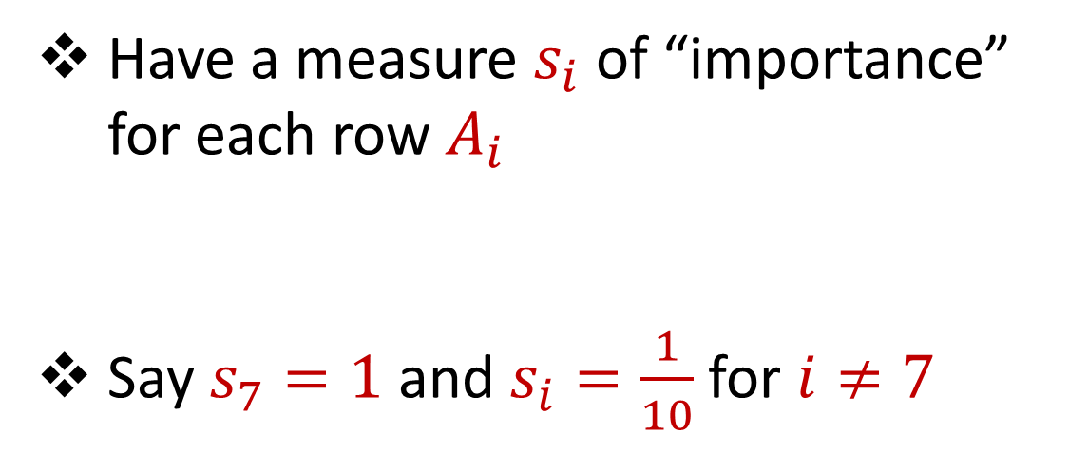
Importance Sampling
1 0 0 0 0 0
1 0 0 0 0 0
1 0 0 0 0 0
1 0 0 0 0 0
1 0 0 0 0 0
1 0 0 0 0 0
0 0 0 0 0 1
1 0 0 0 0 0
1 0 0 0 0 0
1 0 0 0 0 0
1 0 0 0 0 0
Have a measure $s_{i}$ of “importance” for each row $A_{i}$
Say $s_{7}=1$ and $s_{i}=\frac{1}{10}$ for $i≠7$
$$n$$
$$A$$

Slide 75
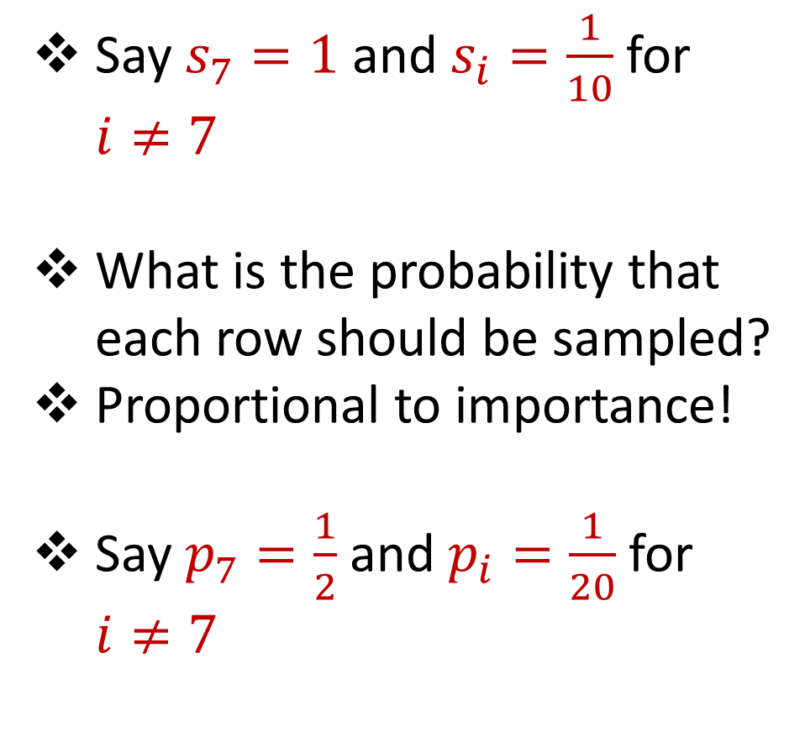
Importance Sampling
1 0 0 0 0 0
1 0 0 0 0 0
1 0 0 0 0 0
1 0 0 0 0 0
1 0 0 0 0 0
1 0 0 0 0 0
0 0 0 0 0 1
1 0 0 0 0 0
1 0 0 0 0 0
1 0 0 0 0 0
1 0 0 0 0 0
Say $s_{7}=1$ and $s_{i}=\frac{1}{10}$ for $i≠7$
What is the probability that each row should be sampled?
Proportional to importance!
Say $p_{7}=\frac{1}{2}$ and $p_{i}=\frac{1}{20}$ for $i≠7$
$$n$$
$$A$$

Slide 76
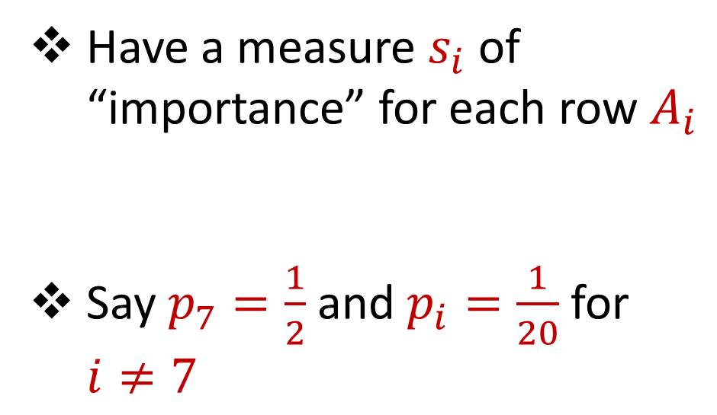
Importance Sampling
1 0 0 0 0 0
1 0 0 0 0 0
1 0 0 0 0 0
1 0 0 0 0 0
1 0 0 0 0 0
1 0 0 0 0 0
0 0 0 0 0 1
1 0 0 0 0 0
1 0 0 0 0 0
1 0 0 0 0 0
1 0 0 0 0 0
Have a measure $s_{i}$ of “importance” for each row $A_{i}$
Say $p_{7}=\frac{1}{2}$ and $p_{i}=\frac{1}{20}$ for $i≠7$
$$n$$
$$A$$

Slide 77

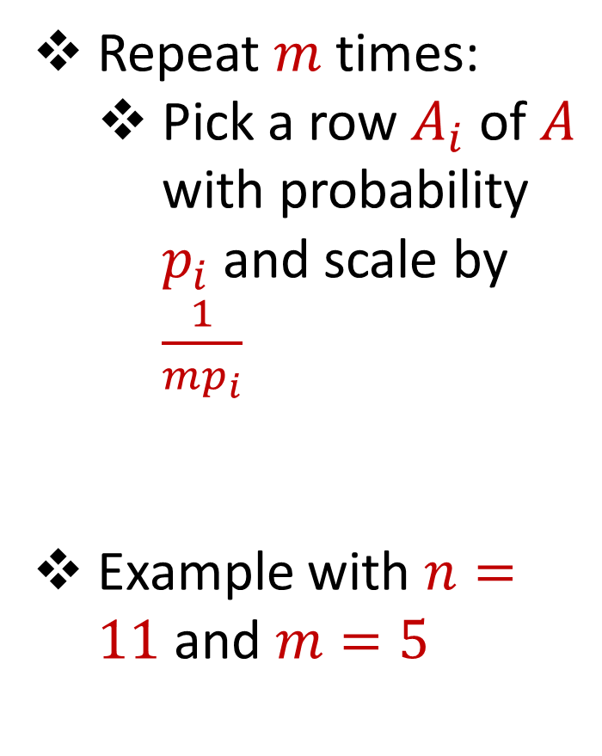

Importance Sampling
1 0 0 0 0 0
1 0 0 0 0 0
1 0 0 0 0 0
1 0 0 0 0 0
1 0 0 0 0 0
1 0 0 0 0 0
0 0 0 0 0 1
1 0 0 0 0 0
1 0 0 0 0 0
1 0 0 0 0 0
1 0 0 0 0 0
Repeat $m$ times:
Pick a row $A_{i}$ of $A$ with probability $p_{i}$and scale by $\frac{1}{mp_{i}}$
Example with $n=11$ and $m=5$
$$n$$
$$A$$
4 0 0 0 0 0
4 0 0 0 0 0
0 0 0 0 0 $\frac{2}{5}$
4 0 0 0 0 0
0 0 0 0 0 $\frac{2}{5}$
$$A′$$
$$d$$
$$d$$

Slide 78
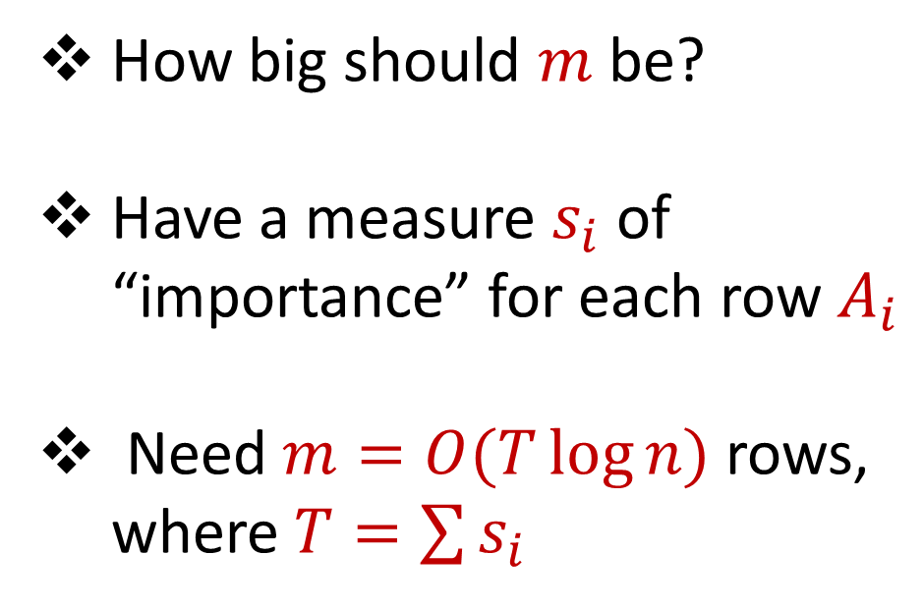
Importance Sampling
0 0 0 0 0 1
1 0 0 0 0 0
1 0 0 0 0 0
1 0 0 0 0 0
1 0 0 0 0 0
1 0 0 0 0 0
1 0 0 0 0 0
1 0 0 0 0 0
1 0 0 0 0 0
1 0 0 0 0 0
1 0 0 0 0 0
How big should $m$ be?
Have a measure $s_{i}$ of “importance” for each row $A_{i}$
Need $m=O(T\log{n})$ rows, where $T=\sum{s_{i}}$
$$n$$
$$A$$
$$d$$

Slide 79
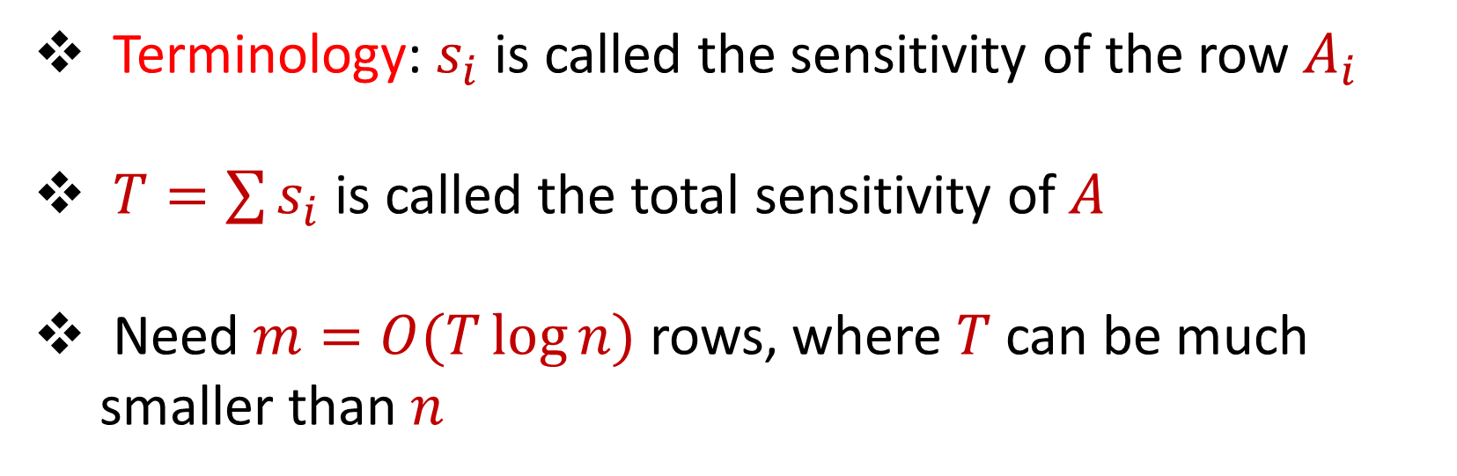
Sensitivity Sampling
Terminology: $s_{i}$ is called the sensitivity of the row $A_{i}$
$T=\sum{s_{i}}$ is called the total sensitivity of $A$
Need $m=O(T\log{n})$ rows, where $T$ can be much smaller than $n$

Slide 80

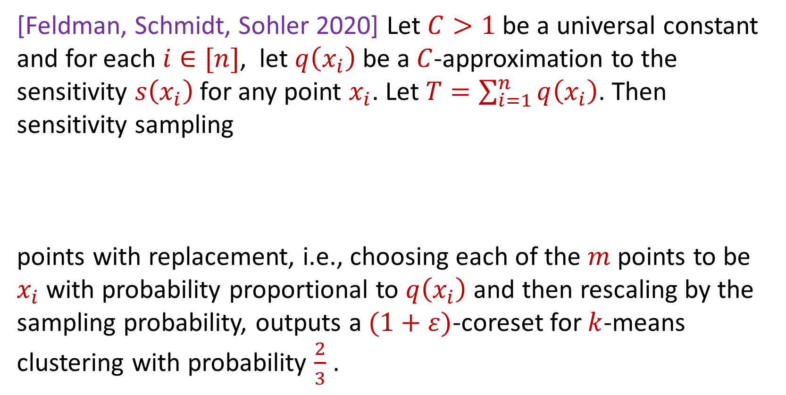
Sensitivity Sampling (Formal Theorem)
[Feldman, Schmidt, Sohler 2020] Let $C>1$ be a universal constant and for each $i∈[n]$, let $q\left(x_{i}\right)$ be a $C$-approximation to the sensitivity $s\left(x_{i}\right)$for any point $x_{i}$. Let $T=\sum_{i=1}^{n}{q\left(x_{i}\right)}$. Then sensitivity sampling
points with replacement, i.e., choosing each of the $m$ points to be $x_{i}$with probability proportional to $q\left(x_{i}\right)$ and then rescaling by the sampling probability, outputs a $(1+ε)$-coreset for $k$-means clustering with probability $\frac{2}{3}$ .
$$m=O\left(\frac{Tk}{ε^{2}}\log^{2}{k}\right)$$

Slide 81
Sensitivity Sampling
Pros: size is always better than uniform sampling and MUCH better on “worst-case” data
Cons: estimating the sensitivities can be a difficult design choice, computing the total sensitivity can be mathematically challenging, larger runtime

Slide 82
 | Uniform Sampling | Sensitivity Sampling
Average-case size | X | X
Worst-case size |  | X
Ease of implementation Computation of probabilities | X
Interpretability |  | X

Slide 83



Group / Stratified Sampling
0 0 0 0 0 1
1 0 0 0 0 0
1 0 0 0 0 0
1 0 0 0 0 0
1 0 0 0 0 0
1 0 0 0 0 0
1 0 0 0 0 0
1 0 0 0 0 0
1 0 0 0 0 0
1 0 0 0 0 0
1 0 0 0 0 0
Separate the data into “groups” and then perform uniform sampling on each group
If the data is uniform in each group, this is essentially sensitivity sampling
$$n$$
$$A$$
$$d$$

Slide 85
Coresets
Where to apply them?
Which sampling approach to use?
Worst-case mathematical bounds

Slide 86

Coresets
Where to apply them?

Slide 87


Coresets
Which sampling approach to use?

Slide 88

Coresets
Worst-case mathematical bounds

