Slide 1
CSCE 658: Randomized Algorithms
Lecture 17
Samson Zhou

Slide 2
Relevant Supplementary Material
Lecture 13 of “Advanced Algorithms” Course Notes (http://www.cs.cmu.edu/afs/cs.cmu.edu/academic/class/15850-f20/www/notes/lec14.pdf), by Anupam Gupta

Slide 3
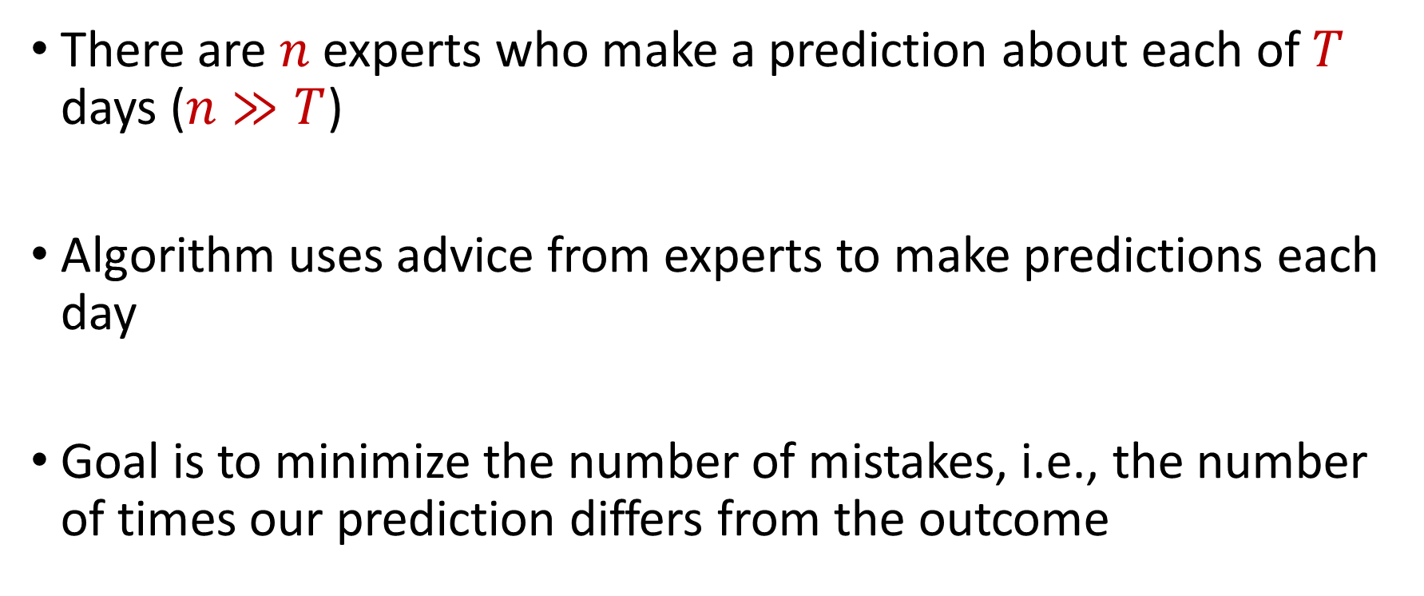
Online Learning
There are $n$ experts who make a prediction about each of $T$ days ($n≫T$)
Algorithm uses advice from experts to make predictions each day
Goal is to minimize the number of mistakes, i.e., the number of times our prediction differs from the outcome

Slide 4






Prediction with Expert Advice
a fundamental problem of sequential prediction
Day
You
Actual outcome
1
?
2
?
3
?
4
?

Slide 5
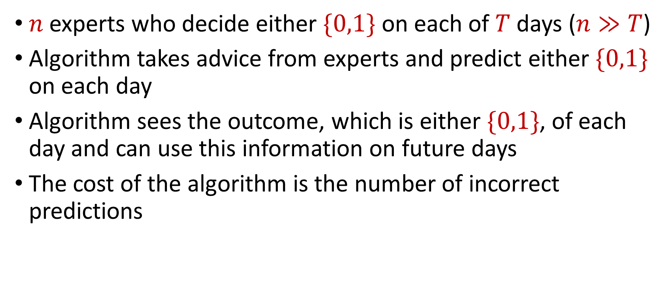
The Online Learning with Experts Problem
$n$ experts who decide either $\{0,1\}$ on each of $T$ days ($n≫T$)
Algorithm takes advice from experts and predict either $\{0,1\}$ on each day
Algorithm sees the outcome, which is either $\{0,1\}$, of each day and can use this information on future days
The cost of the algorithm is the number of incorrect predictions

Slide 6
Prediction with Expert Advice
a fundamental problem of sequential prediction
Day
You
Actual outcome
1
2
Algorithm makes 2 mistakes
3
Best expert makes 1 mistake
4

Slide 7
Applications of the Experts Problem
Ensemble learning, e.g., AdaBoost
Forecast and portfolio optimization
Special case of online convex optimization

Slide 8
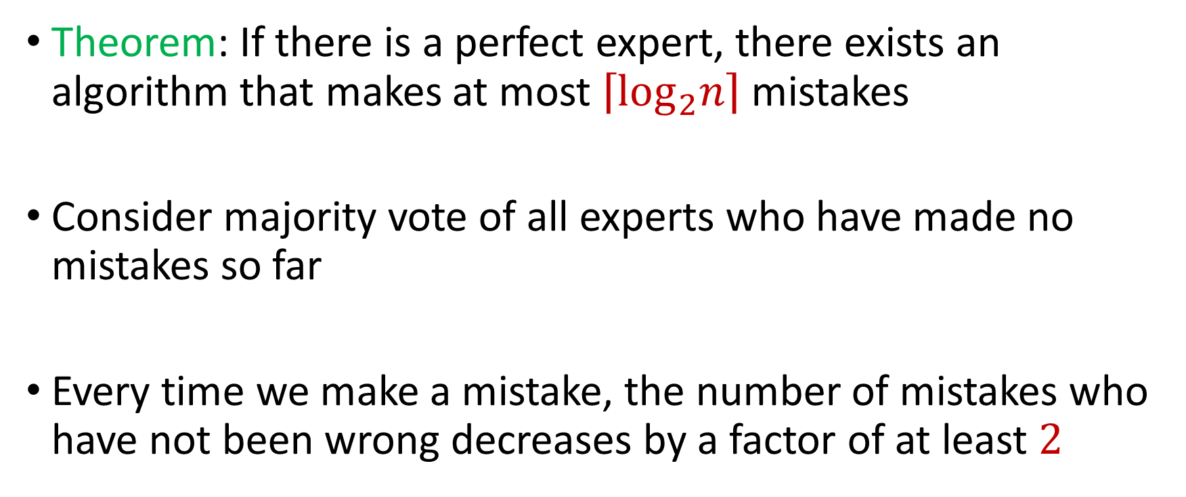
Perfect Expert
Theorem: If there is a perfect expert, there exists an algorithm that makes at most $\left\lceil \log_{2}n\right\rceil$ mistakes
Consider majority vote of all experts who have made no mistakes so far
Every time we make a mistake, the number of mistakes who have not been wrong decreases by a factor of at least $2$

Slide 9
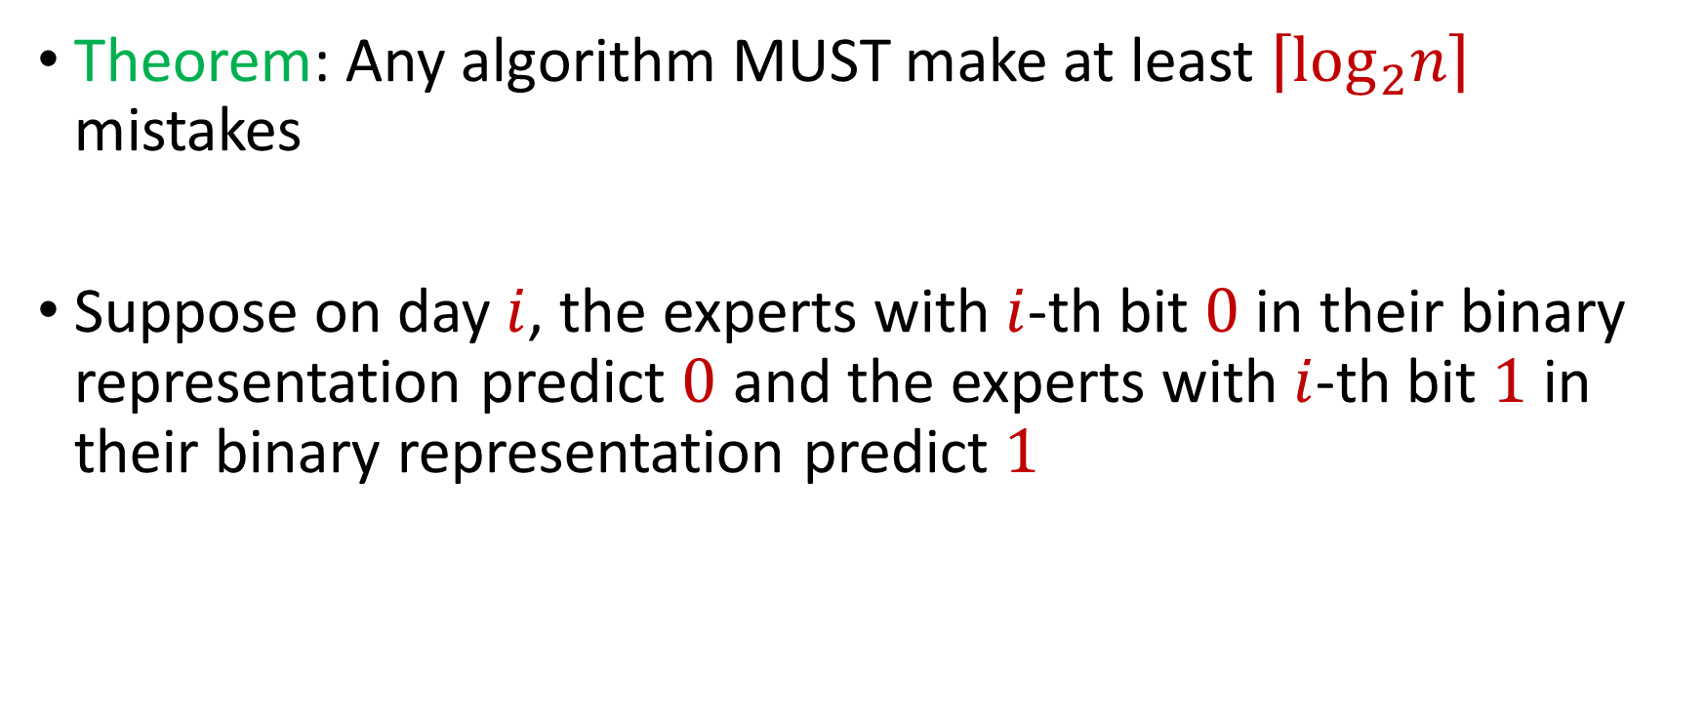
Errors by Algorithm
Theorem: Any algorithm MUST make at least $\left\lceil \log_{2}n\right\rceil$ mistakes
Suppose on day $i$, the experts with $i$-th bit $0$ in their binary representation predict $0$ and the experts with $i$-th bit $1$ in their binary representation predict $1$

Slide 10

Algorithms for Online Learning
Theorem: There exists an algorithm that makes $M≤m^{∗}\left(\left\lceil \log_{2}n\right\rceil +1\right)+\left\lceil \log_{2}n\right\rceil$ mistakes, where $m^{∗}$ is the number of mistakes made by the best expert

Slide 11
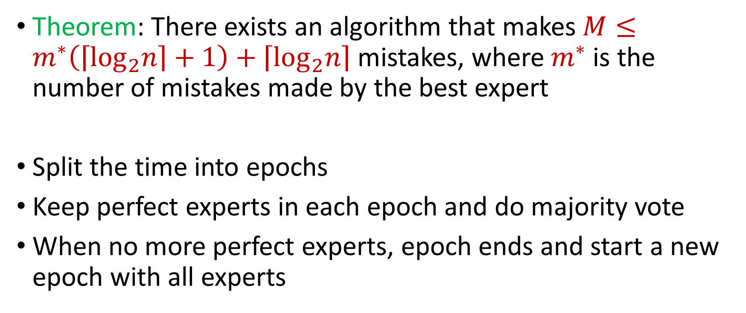
Algorithms for Online Learning
Theorem: There exists an algorithm that makes $M≤m^{∗}\left(\left\lceil \log_{2}n\right\rceil +1\right)+\left\lceil \log_{2}n\right\rceil$ mistakes, where $m^{∗}$ is the number of mistakes made by the best expert
Split the time into epochs
Keep perfect experts in each epoch and do majority vote
When no more perfect experts, epoch ends and start a new epoch with all experts

Slide 12
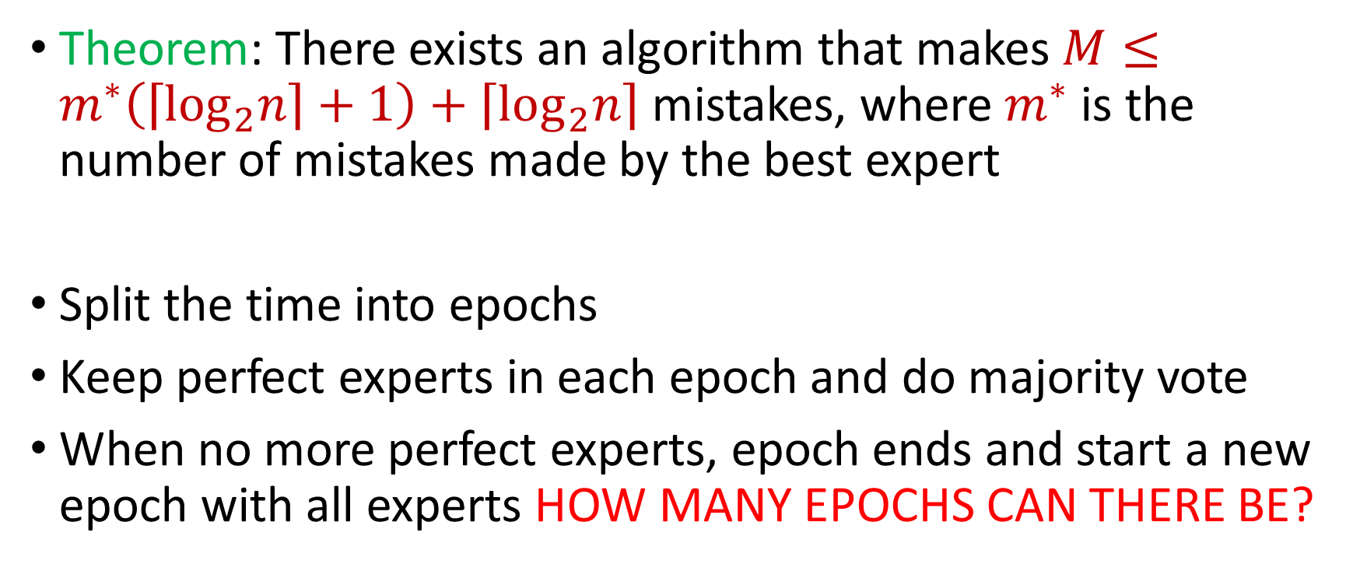
Algorithms for Online Learning
Theorem: There exists an algorithm that makes $M≤m^{∗}\left(\left\lceil \log_{2}n\right\rceil +1\right)+\left\lceil \log_{2}n\right\rceil$ mistakes, where $m^{∗}$ is the number of mistakes made by the best expert
Split the time into epochs
Keep perfect experts in each epoch and do majority vote
When no more perfect experts, epoch ends and start a new epoch with all experts HOW MANY EPOCHS CAN THERE BE?

Slide 13
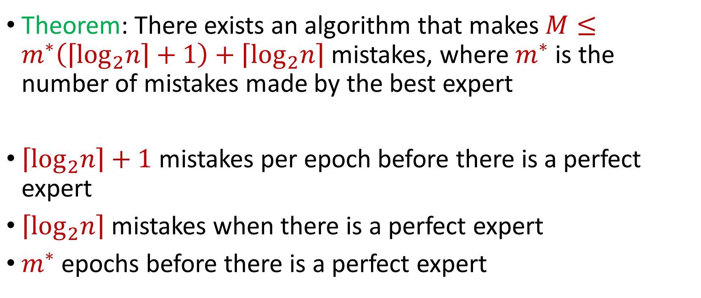
Algorithms for Online Learning
Theorem: There exists an algorithm that makes $M≤m^{∗}\left(\left\lceil \log_{2}n\right\rceil +1\right)+\left\lceil \log_{2}n\right\rceil$ mistakes, where $m^{∗}$ is the number of mistakes made by the best expert
$\left\lceil \log_{2}n\right\rceil +1$ mistakes per epoch before there is a perfect expert
$\left\lceil \log_{2}n\right\rceil$ mistakes when there is a perfect expert
$m^{∗}$ epochs before there is a perfect expert

Slide 14
Weighted Majority (Littlestone, Warmuth 89)
Day
Algorithm
Actual outcome
weights
1
1
1
1
1
1
1/2
1
1
2
1
1/2
1/2
1
3
1/2
1/2
1/4
1/2
4
1/2
1/4
1/4
1/4

Slide 15
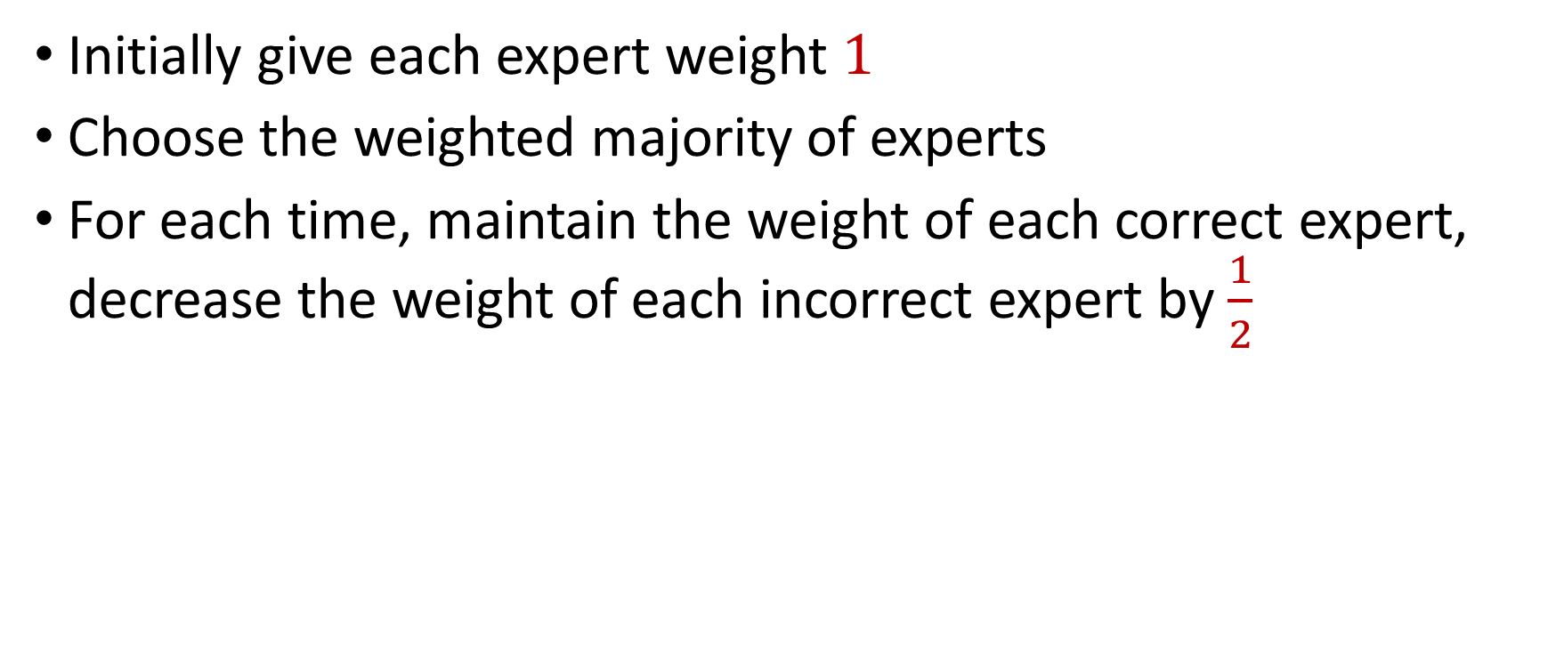
Weighted Majority (Littlestone, Warmuth 89)
Initially give each expert weight $1$
Choose the weighted majority of experts
For each time, maintain the weight of each correct expert, decrease the weight of each incorrect expert by $\frac{1}{2}$

Slide 16
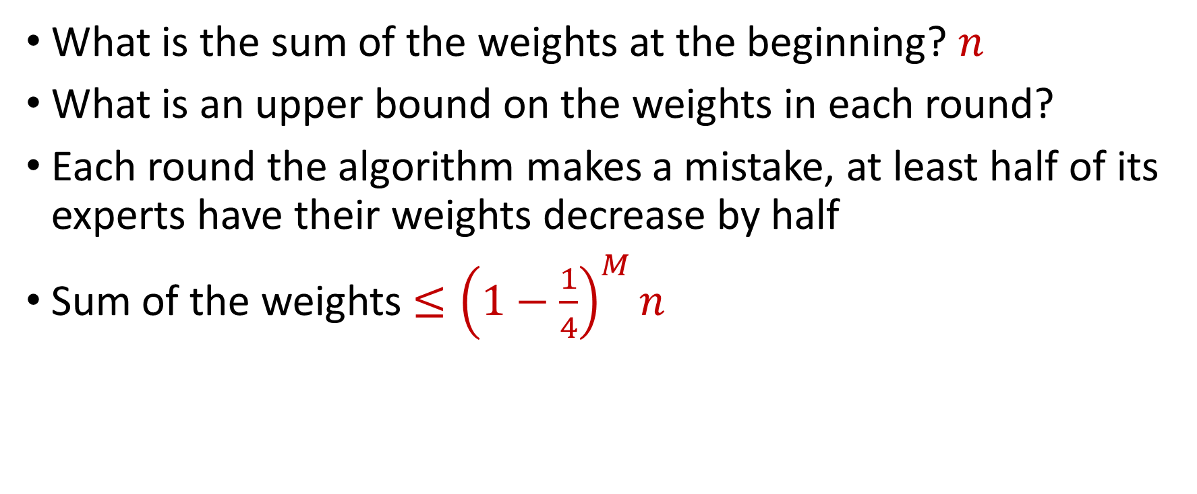
Guarantee for Weighted Majority
What is the sum of the weights at the beginning? $n$
What is an upper bound on the weights in each round?
Each round the algorithm makes a mistake, at least half of its experts have their weights decrease by half
Sum of the weights $≤{\left(1−\frac{1}{4}\right)}^{M}n$

Slide 17
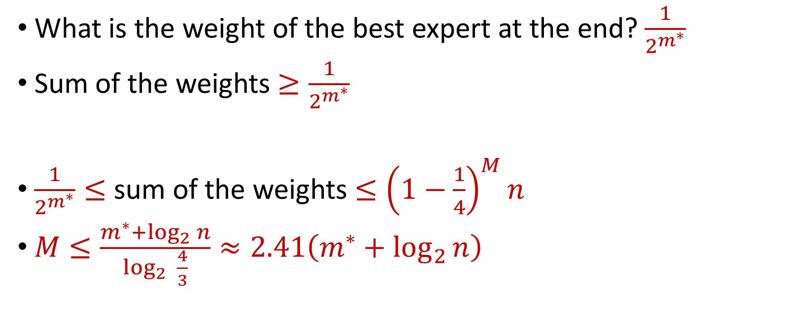
Guarantee for Weighted Majority
What is the weight of the best expert at the end? $\frac{1}{2^{m^{∗}}}$
Sum of the weights $≥\frac{1}{2^{m^{∗}}}$
$\frac{1}{2^{m^{∗}}}≤$ sum of the weights $≤{\left(1−\frac{1}{4}\right)}^{M}n$
$M≤\frac{m^{∗}+\log_{2}{n}}{\log_{2}{ \frac{4}{3}}}≈2.41\left(m^{∗}+\log_{2}{n}\right)$

Slide 18
Weighted Majority (Littlestone, Warmuth 89)
Day
Algorithm
Actual outcome
weights
1
1
1
1
1
1
1/2
1
1
2
1
1/2
1/2
1
3
1/2
1/2
1/4
1/2
4
1/2
1/4
1/4
1/4

Slide 19
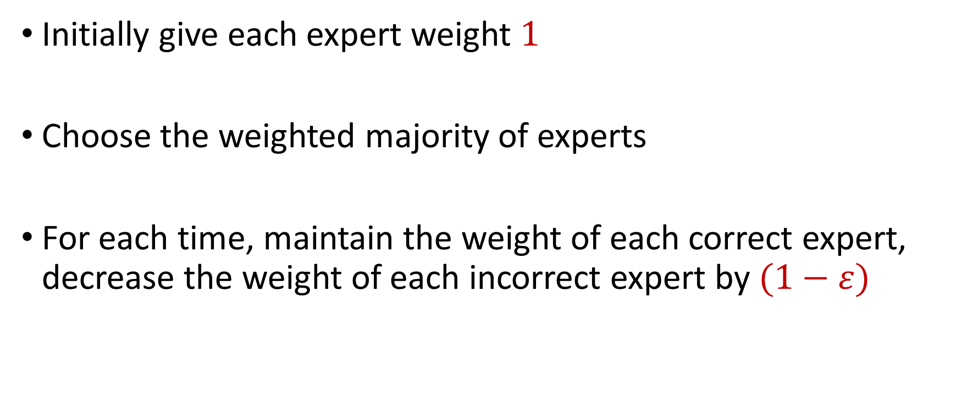
Weighted Majority (Littlestone, Warmuth 89)
Initially give each expert weight $1$
Choose the weighted majority of experts
For each time, maintain the weight of each correct expert, decrease the weight of each incorrect expert by $(1−ε)$

Slide 20











Weighted Majority (Littlestone, Warmuth 89)
Day
Algorithm
Actual outcome
weights
1
1
1
1
1
1
$$1−ε$$
1
1
2
1
$$1−ε$$
$$1−ε$$
1
3
$$1−ε$$
$$1−ε$$
$${\left(1−ε\right)}^{2}$$
$$1−ε$$
4
$$1−ε$$
$${\left(1−ε\right)}^{2}$$
$${\left(1−ε\right)}^{2}$$
$${\left(1−ε\right)}^{2}$$

Slide 21
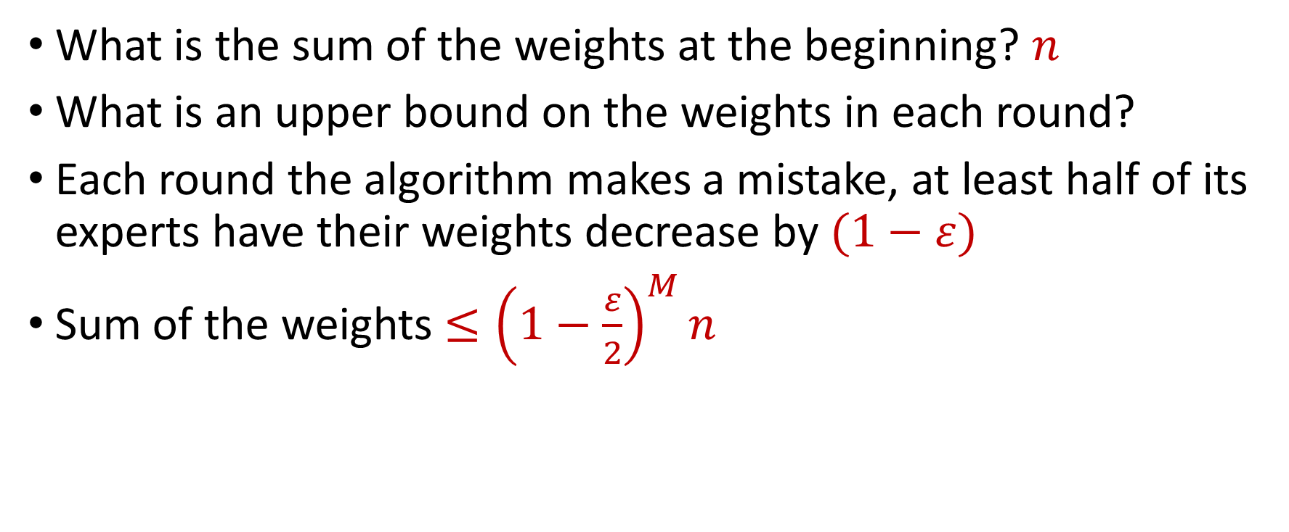
Guarantee for Weighted Majority
What is the sum of the weights at the beginning? $n$
What is an upper bound on the weights in each round?
Each round the algorithm makes a mistake, at least half of its experts have their weights decrease by $(1−ε)$
Sum of the weights $≤{\left(1−\frac{ε}{2}\right)}^{M}n$

Slide 22
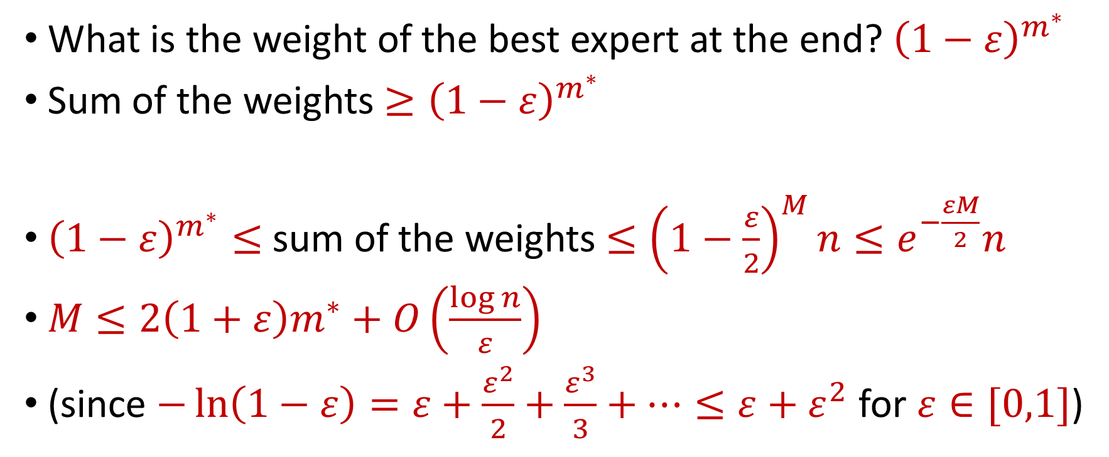
Guarantee for Weighted Majority
What is the weight of the best expert at the end? ${\left(1−ε\right)}^{m^{∗}}$
Sum of the weights $≥{\left(1−ε\right)}^{m^{∗}}$
${\left(1−ε\right)}^{m^{∗}}≤$ sum of the weights $≤{\left(1−\frac{ε}{2}\right)}^{M}n≤e^{−\frac{εM}{2}}n$
$M≤2\left(1+ε\right)m^{∗}+O\left(\frac{\log{n}}{ε}\right)$
(since $−\ln\left(1−ε\right)=ε+\frac{ε^{2}}{2}+\frac{ε^{3}}{3}+…≤ε+ε^{2}$ for $ε∈[0,1]$)

Slide 23
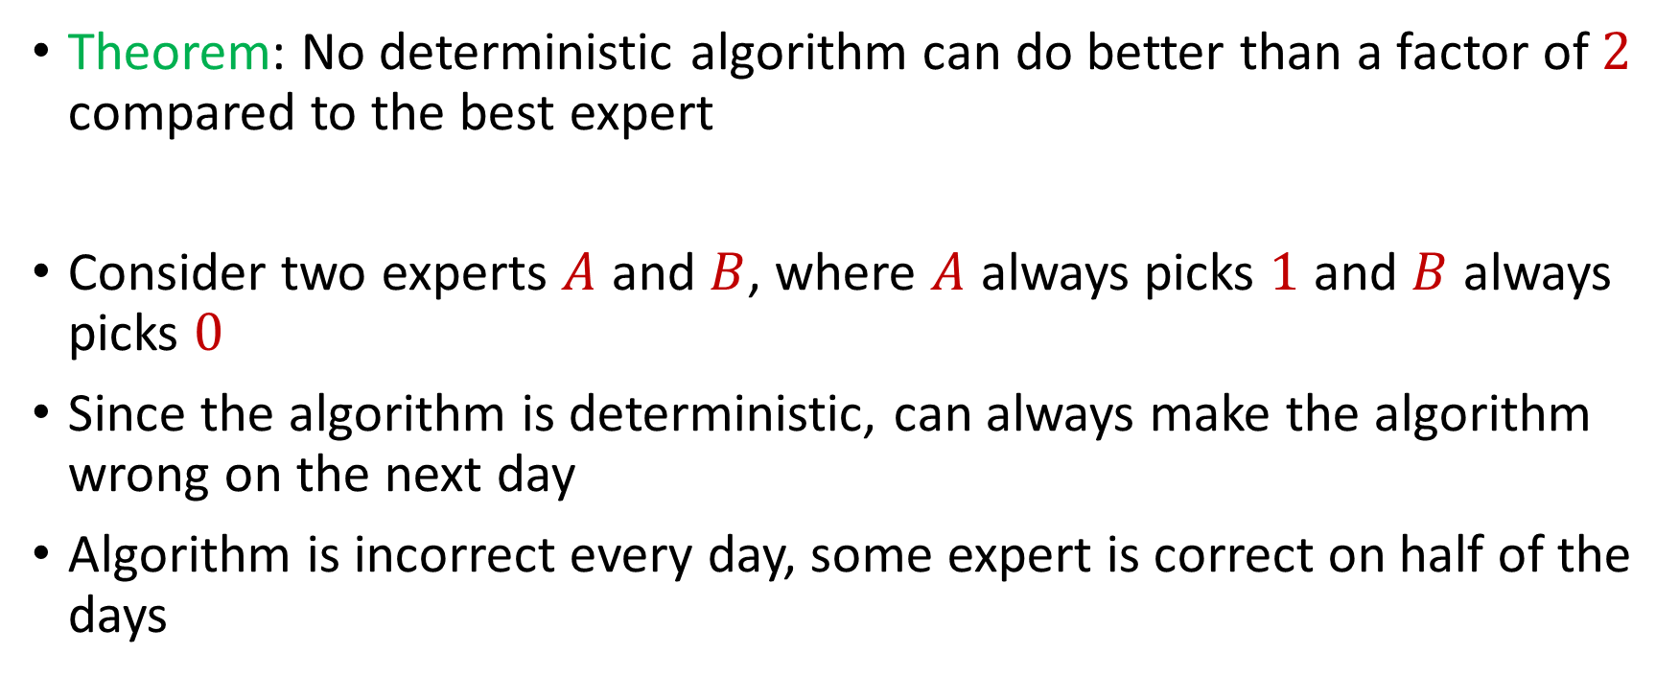
Deterministic Algorithm Error
Theorem: No deterministic algorithm can do better than a factor of $2$ compared to the best expert
Consider two experts $A$ and $B$, where $A$ always picks $1$ and $B$ always picks $0$
Since the algorithm is deterministic, can always make the algorithm wrong on the next day
Algorithm is incorrect every day, some expert is correct on half of the days

Slide 24
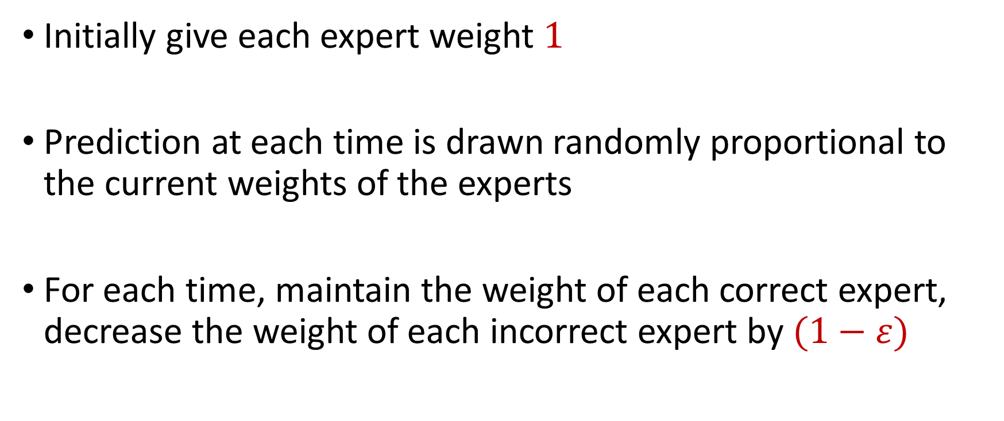
Randomized Weighted Majority (Littlestone, Warmuth 89)
Initially give each expert weight $1$
Prediction at each time is drawn randomly proportional to the current weights of the experts
For each time, maintain the weight of each correct expert, decrease the weight of each incorrect expert by $(1−ε)$

Slide 25
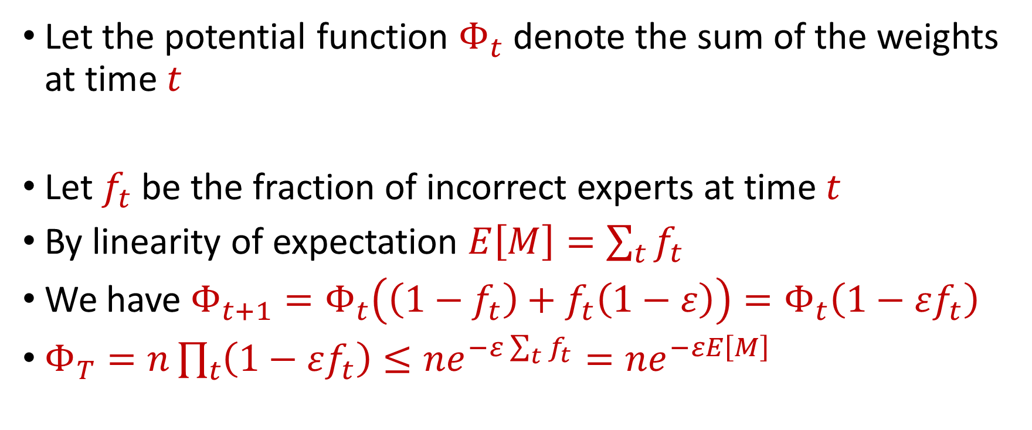
Randomized Weighted Majority (Littlestone, Warmuth 89)
Let the potential function $Φ_{t}$ denote the sum of the weights at time $t$
Let $f_{t}$ be the fraction of incorrect experts at time $t$
By linearity of expectation $E\left[M\right]=\sum_{t}{f_{t}}$
We have $Φ_{t+1}=Φ_{t}\left(\left(1−f_{t}\right)+f_{t}\left(1−ε\right)\right)=Φ_{t}\left(1−εf_{t}\right)$
$Φ_{T}=n\prod_{t}{\left(1−εf_{t}\right)}≤ne^{−ε\sum_{t}{f_{t}}}=ne^{−εE\left[M\right]}$

Slide 26

Randomized Weighted Majority (Littlestone, Warmuth 89)
We have $Φ_{T}≤ne^{−εE\left[M\right]}$
We also have ${\left(1−ε\right)}^{m^{∗}}≤Φ_{T}$
Then $E\left[M\right]≤m^{∗}\left(1+ε\right)+\frac{\ln{n}}{ε}$ by using $−\ln\left(1−ε\right)≤ε+ε^{2}$

Slide 27
Randomized Weighted Majority (Littlestone, Warmuth 89)
Initially give each expert weight $1$
Prediction at each time is drawn randomly proportional to the current weights of the experts
For each time, maintain the weight of each correct expert, decrease the weight of each incorrect expert by $(1−ε)$

Slide 28
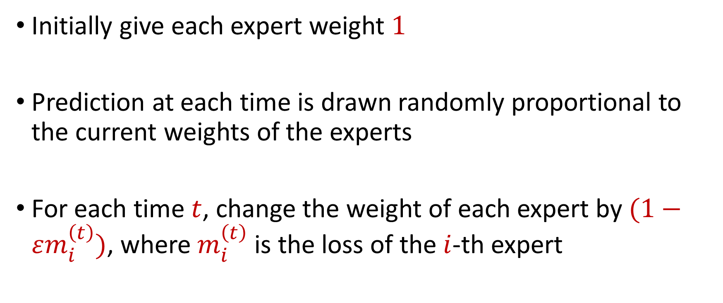
Multiplicative Weights
Initially give each expert weight $1$
Prediction at each time is drawn randomly proportional to the current weights of the experts
For each time $t$, change the weight of each expert by $(1−εm_{i}^{\left(t\right)})$, where $m_{i}^{\left(t\right)}$ is the loss of the $i$-th expert

Slide 29
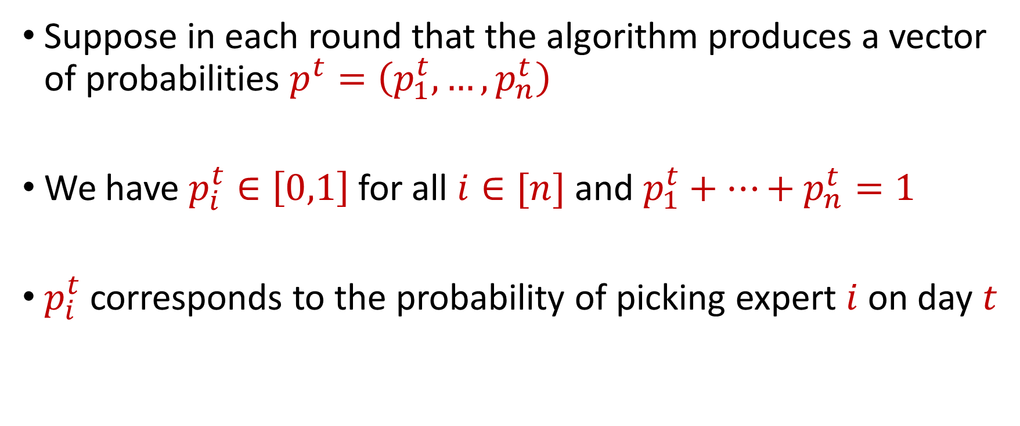
An Alternate Perspective
Suppose in each round that the algorithm produces a vector of probabilities $p^{t}=\left(p_{1}^{t},…,p_{n}^{t}\right)$
We have $p_{i}^{t}∈\left[0,1\right]$ for all $i∈[n]$ and $p_{1}^{t}+…+p_{n}^{t}=1$
$p_{i}^{t}$corresponds to the probability of picking expert $i$ on day $t$

Slide 30
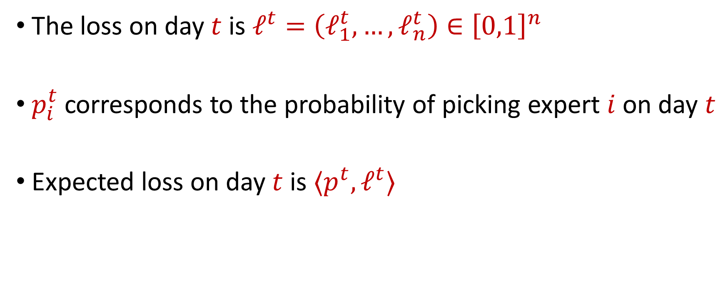
An Alternate Perspective
The loss on day $t$ is $ℓ^{t}=\left(ℓ_{1}^{t},…,ℓ_{n}^{t}\right)∈{\left[0,1\right]}^{n}$
$p_{i}^{t}$corresponds to the probability of picking expert $i$ on day $t$
Expected loss on day $t$ is $⟨p^{t}, ℓ^{t}⟩$

Slide 31
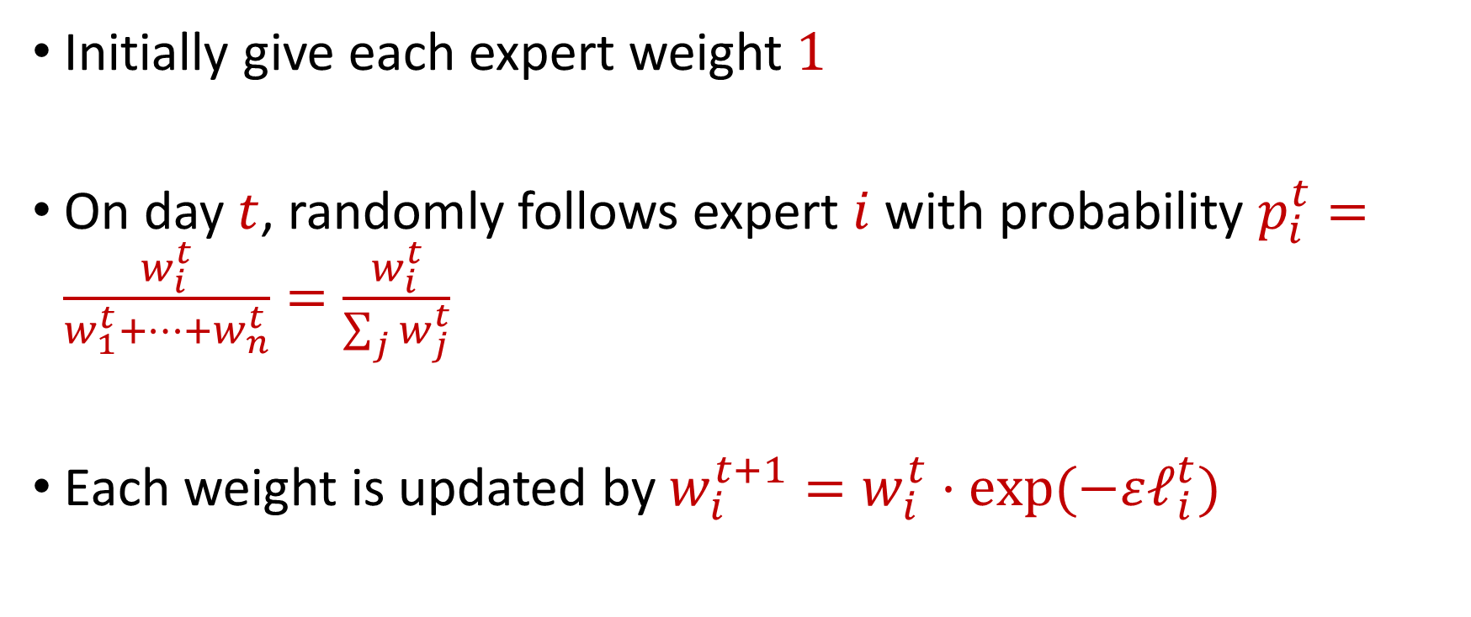
Hedge Algorithm
Initially give each expert weight $1$
On day $t$, randomly follows expert $i$ with probability $p_{i}^{t}=\frac{w_{i}^{t}}{w_{1}^{t}+…+w_{n}^{t}}=\frac{w_{i}^{t}}{\sum_{j}{w_{j}^{t}}}$
Each weight is updated by $w_{i}^{t+1}=w_{i}^{t}⋅exp⁡(−εℓ_{i}^{t})$

Slide 32
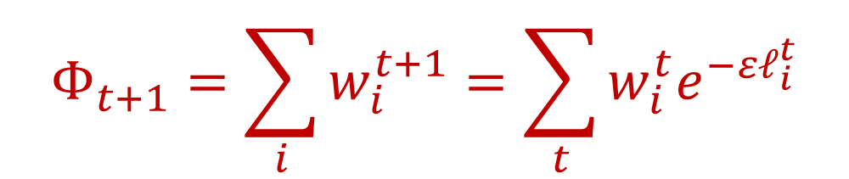


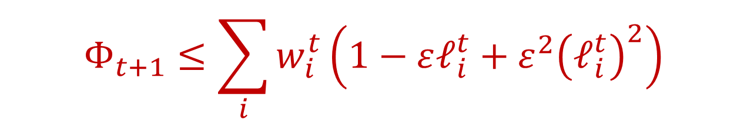
Hedge Algorithm
Let the potential function $Φ_{t}$ denote the sum of the weights at time $t$
We have:
Since $e^{x}≤1+x+x^{2}$ for $x∈[−1,1]$ and also $\left|ℓ_{i}^{t}\right|≤1$, we have
$$Φ_{t+1}=\sum_{i}{w_{i}^{t+1}=\sum_{t}{w_{i}^{t}e^{−εℓ_{i}^{t}}}}$$
$$Φ_{t+1}≤\sum_{i}{w_{i}^{t}\left(1−εℓ_{i}^{t}+ε^{2}{\left(ℓ_{i}^{t}\right)}^{2}\right)}$$
$$≤\sum_{i}{w_{i}^{t}\left(1+ε^{2}\right)−ε\sum_{i}{w_{i}^{t}ℓ_{i}^{t}}}$$

Slide 33

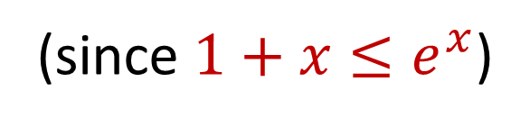

Hedge Algorithm
$$Φ_{t+1}≤\sum_{i}{w_{i}^{t}\left(1+ε^{2}\right)−ε\sum_{i}{w_{i}^{t}ℓ_{i}^{t}}}$$
We have
Since $w_{i}^{t}=p_{i}^{t}⋅Φ^{t}$, then
$$Φ_{t+1}≤\left(1+ε^{2}\right)Φ^{t}−εΦ^{t}\left\langle p^{t},ℓ^{t}\right\rangle$$
$$=Φ^{t}\left(1+ε^{2}−ε\left\langle p^{t},ℓ^{t}\right\rangle \right)$$
(since $1+x≤e^{x}$)
$$≤Φ^{t}\exp\left(ε^{2}−ε\left\langle p^{t},ℓ^{t}\right\rangle \right)$$

Slide 34
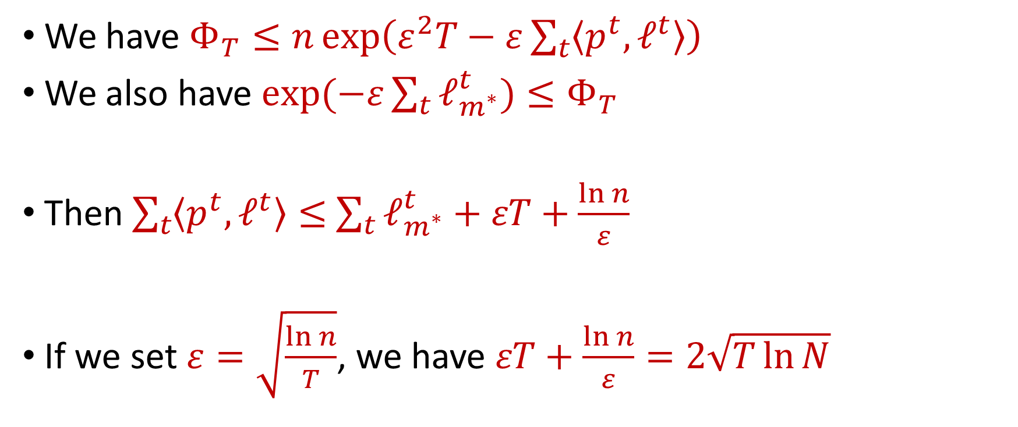
Hedge Algorithm
We have $Φ_{T}≤n\exp\left(ε^{2}T−ε\sum_{t}{\left\langle p^{t},ℓ^{t}\right\rangle }\right)$
We also have $\exp{(−ε\sum_{t}{ℓ_{m^{∗}}^{t})}}≤Φ_{T}$
Then $\sum_{t}{\left\langle p^{t},ℓ^{t}\right\rangle }≤$ $\sum_{t}{ℓ_{m^{∗}}^{t}}+εT+\frac{\ln{n}}{ε}$
If we set $ε=\sqrt{\frac{\ln{n}}{T}}$, we have $εT+\frac{\ln{n}}{ε}=2\sqrt{T\ln{N}}$

Slide 35
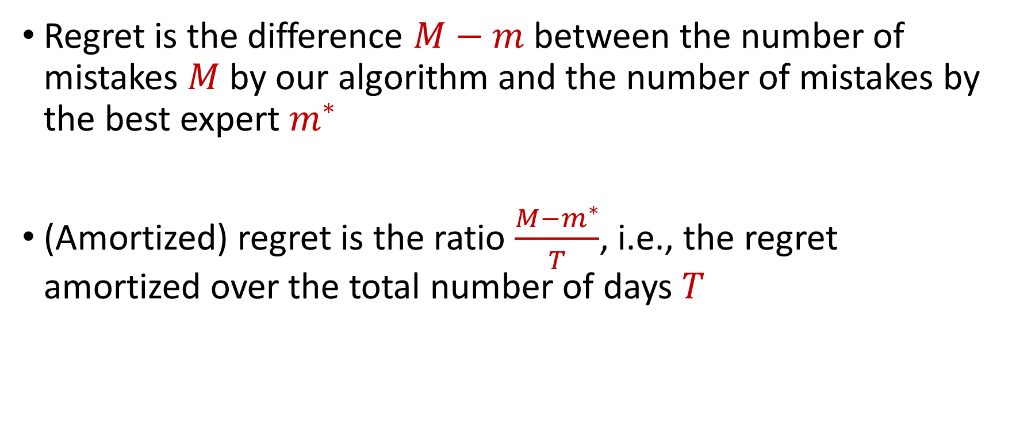
Regret
Regret is the difference $M−m$between the number of mistakes $M$by our algorithm and the number of mistakes by the best expert $m^{∗}$
(Amortized) regret is the ratio $\frac{{M−m}^{∗}}{T}$, i.e., the regret amortized over the total number of days $T$

Slide 36
Prediction with Expert Advice
a fundamental problem of sequential prediction
Day
You
Actual outcome
1
2
Algorithm makes 2 mistakes
3
Best expert makes 1 mistake
4

Slide 37
Prediction with Expert Advice
a fundamental problem of sequential prediction
Day
You
Actual outcome
1
1 Regret
2
Algorithm makes 2 mistakes
3
Best expert makes 1 mistake
4

Slide 38
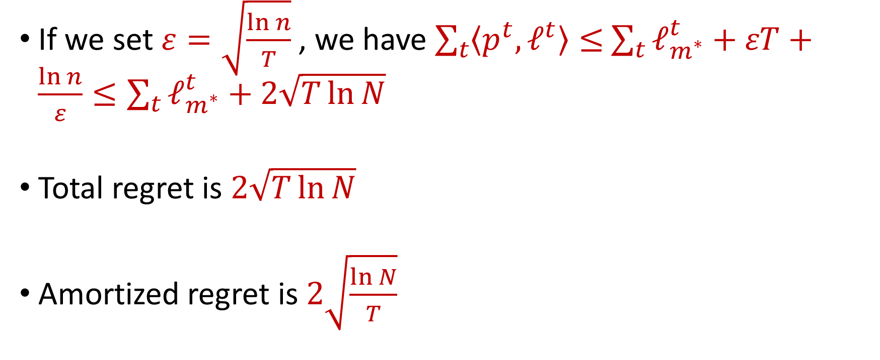
Hedge Algorithm
If we set $ε=\sqrt{\frac{\ln{n}}{T}}$, we have $\sum_{t}{\left\langle p^{t},ℓ^{t}\right\rangle }≤$ $\sum_{t}{ℓ_{m^{∗}}^{t}}+εT+\frac{\ln{n}}{ε}≤\sum_{t}{ℓ_{m^{∗}}^{t}}+2\sqrt{T\ln{N}}$
Total regret is $2\sqrt{T\ln{N}}$
Amortized regret is $2\sqrt{\frac{\ln{N}}{T}}$

