Slide 1
CSCE 689: Special Topics in Modern Algorithms for Data Science
Lecture 5
Samson Zhou

Slide 2
Present and Future
Today: Discuss potential project groups
Friday: Email me the members/group name
Future: Set up meetings to discuss proposed projects

Slide 3
Recall: Concentration Inequalities
Concentration inequalities bound the probability that a random variable is “far away” from its expectation
Often used in understanding the performance of statistical tests, the behavior of data sampled from various distributions, and for our purposes, the guarantees of randomized algorithms

Slide 4


Last Time: Moments
For $p>0$, the $p$-th moment of a random variable $X$ over $Ω$ is:
$$E\left[X^{p}\right]=\sum_{x∈Ω}{Pr\left[X=x\right]⋅x^{p}}$$

Slide 5
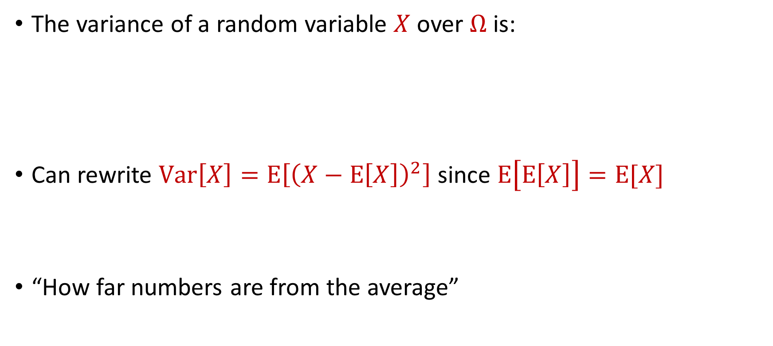
Last Time: Variance
The variance of a random variable $X$ over $Ω$ is:
Can rewrite $Var\left[X\right]=E\left[{\left(X−E\left[X\right]\right)}^{2}\right]$ since $E\left[E\left[X\right]\right]=E[X]$
“How far numbers are from the average”
$$Var\left[X\right]=E\left[X^{2}\right]−{\left(E\left[X\right]\right)}^{2}$$

Slide 6

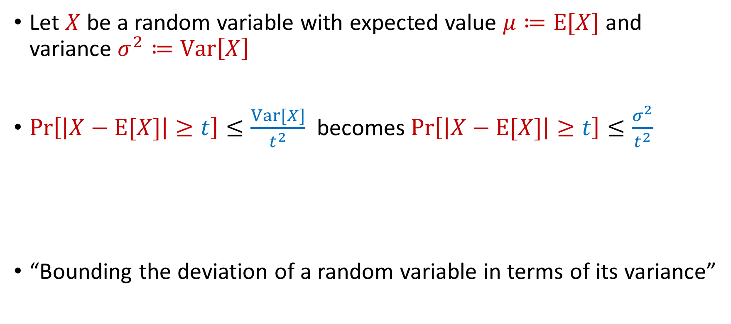
Last Time: Chebyshev’s Inequality
Let $X$ be a random variable with expected value $μ≔E[X]$ and variance $σ^{2}≔Var\left[X\right]$
$Pr\left[\left|X−E[X]\right|≥t\right]≤\frac{Var[X]}{t^{2}}$ becomes $Pr\left[\left|X−E[X]\right|≥t\right]≤\frac{σ^{2}}{t^{2}}$
“Bounding the deviation of a random variable in terms of its variance”
$$Pr\left[\left|X−μ\right|≥kσ\right]≤\frac{1}{k^{2}}$$

Slide 7
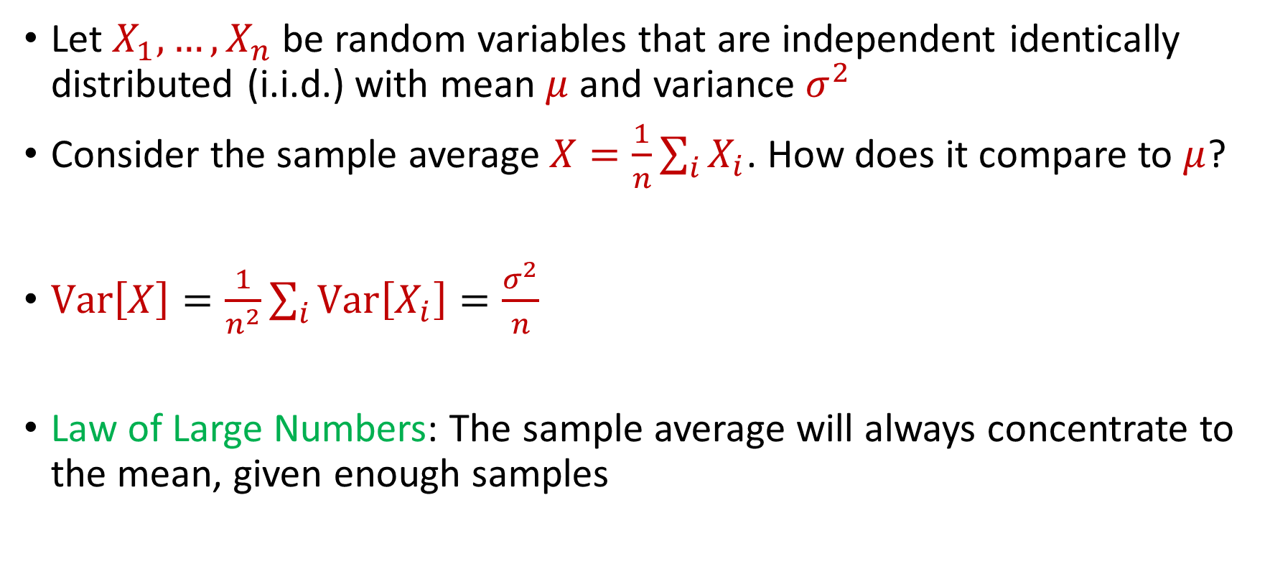
Last Time: Law of Large Numbers
Let $X_{1},…,X_{n}$ be random variables that are independent identically distributed (i.i.d.) with mean $μ$ and variance $σ^{2}$
Consider the sample average $X=\frac{1}{n}\sum_{i}{X_{i}}$. How does it compare to $μ$?
$Var\left[X\right]=\frac{1}{n^{2}}\sum_{i}{Var\left[X_{i}\right]}=\frac{σ^{2}}{n}$
Law of Large Numbers: The sample average will always concentrate to the mean, given enough samples

Slide 8
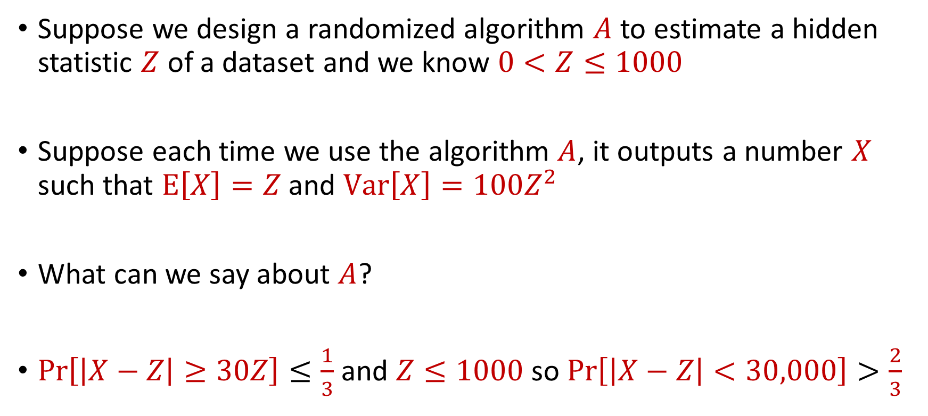
Use Case
Suppose we design a randomized algorithm $A$ to estimate a hidden statistic $Z$ of a dataset and we know $0<Z≤1000$
Suppose each time we use the algorithm $A$, it outputs a number $X$ such that $E\left[X\right]=Z$ and $Var\left[X\right]=100Z^{2}$
What can we say about $A$?
$Pr\left[\left|X−Z\right|≥30Z\right]≤\frac{1}{3}$ and $Z≤1000$ so $Pr\left[\left|X−Z\right|<30,000\right]>\frac{2}{3}$

Slide 9

Accuracy Boosting
How can we use $A$ to get additive error $ε$?

Slide 10
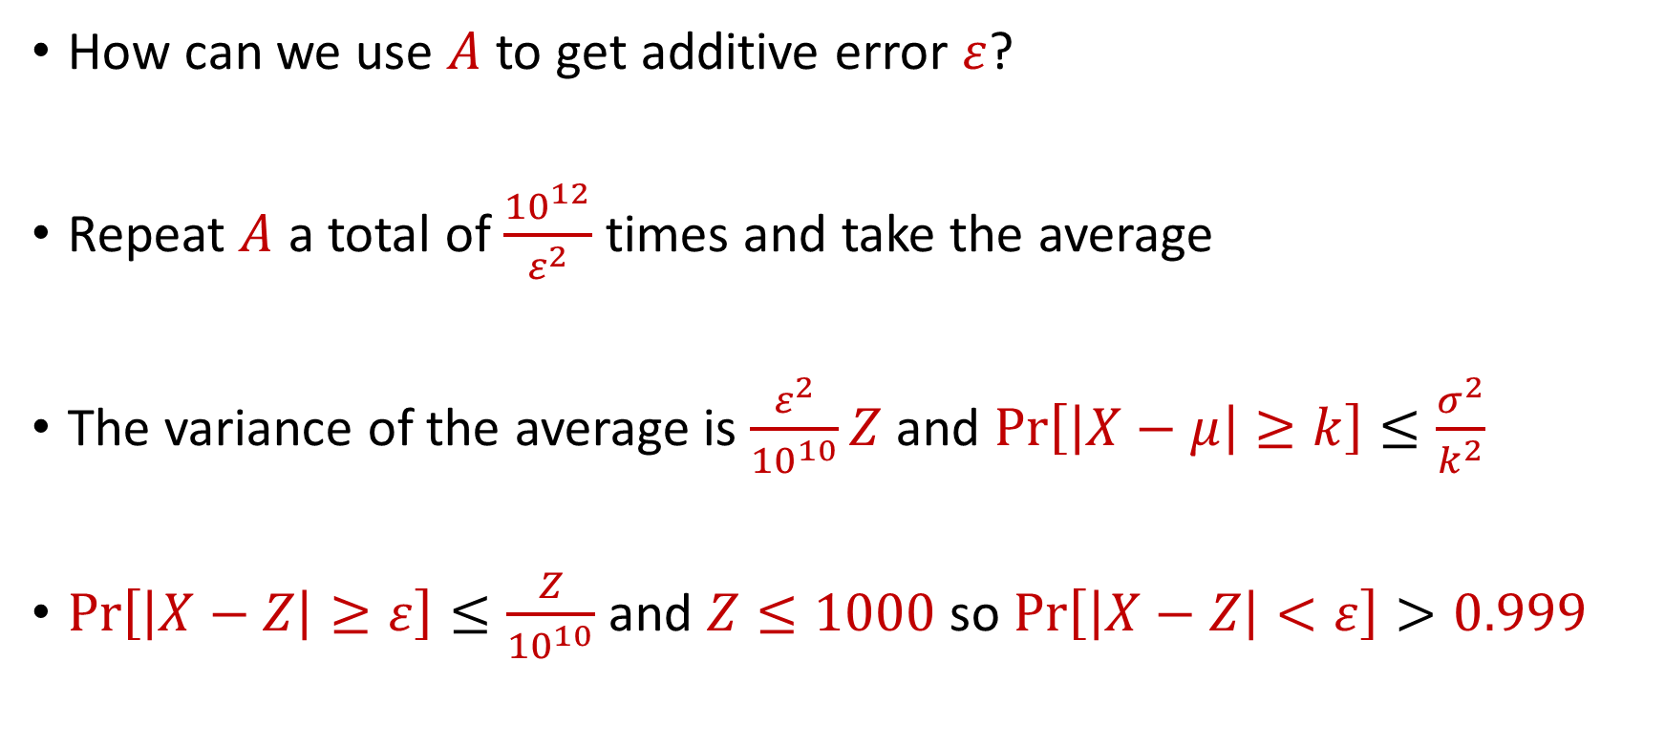
Accuracy Boosting
How can we use $A$ to get additive error $ε$?
Repeat $A$ a total of $\frac{{10}^{12}}{ε^{2}}$ times and take the average
The variance of the average is $\frac{ε^{2}}{{10}^{10}}Z$ and $Pr\left[\left|X−μ\right|≥k\right]≤\frac{σ^{2}}{k^{2}}$
$Pr\left[\left|X−Z\right|≥ε\right]≤\frac{Z}{{10}^{10}}$ and $Z≤1000$ so $Pr\left[\left|X−Z\right|<ε\right]>0.999$

Slide 11
Accuracy Boosting
Algorithmic consequence of Law of Large Numbers
To improve the accuracy of your algorithm, run it many times independently and take the average

Slide 12
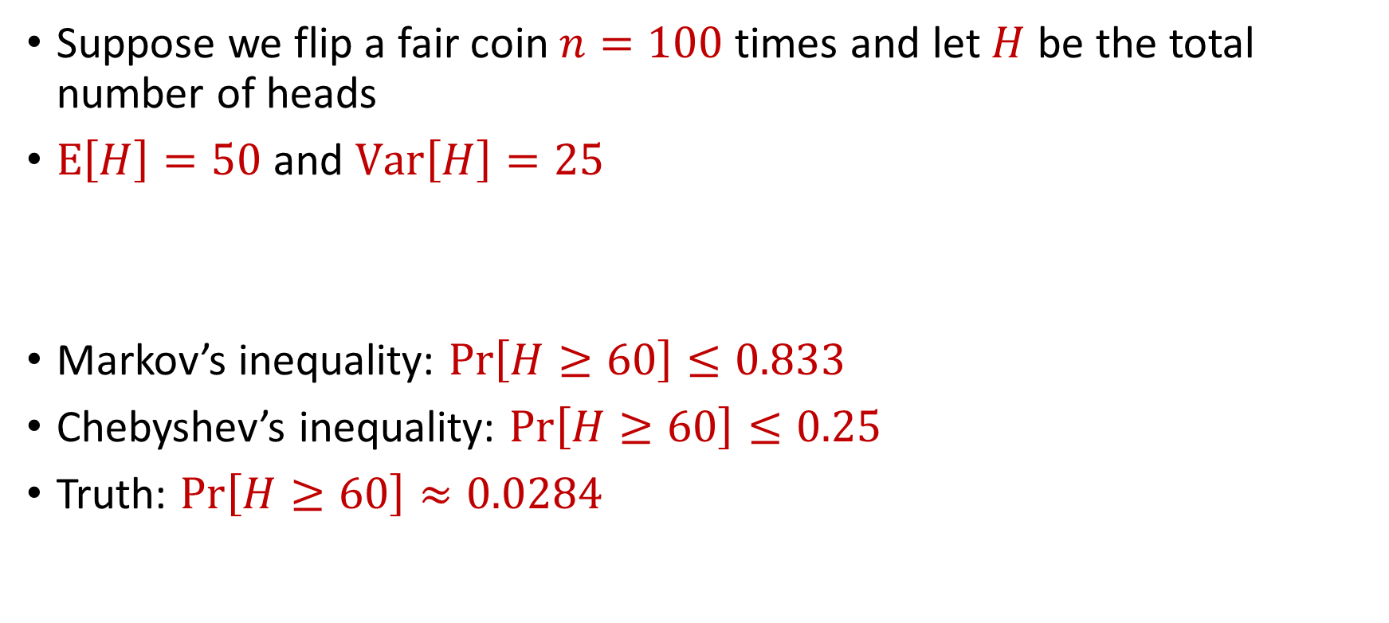
Limitations
Suppose we flip a fair coin $n=100$ times and let $H$ be the total number of heads
$E\left[H\right]=50$ and $Var\left[H\right]=25$
Markov’s inequality: $Pr\left[H≥60\right]≤0.833$
Chebyshev’s inequality: $Pr\left[H≥60\right]≤0.25$
Truth: $Pr\left[H≥60\right]≈0.0284$

Slide 13
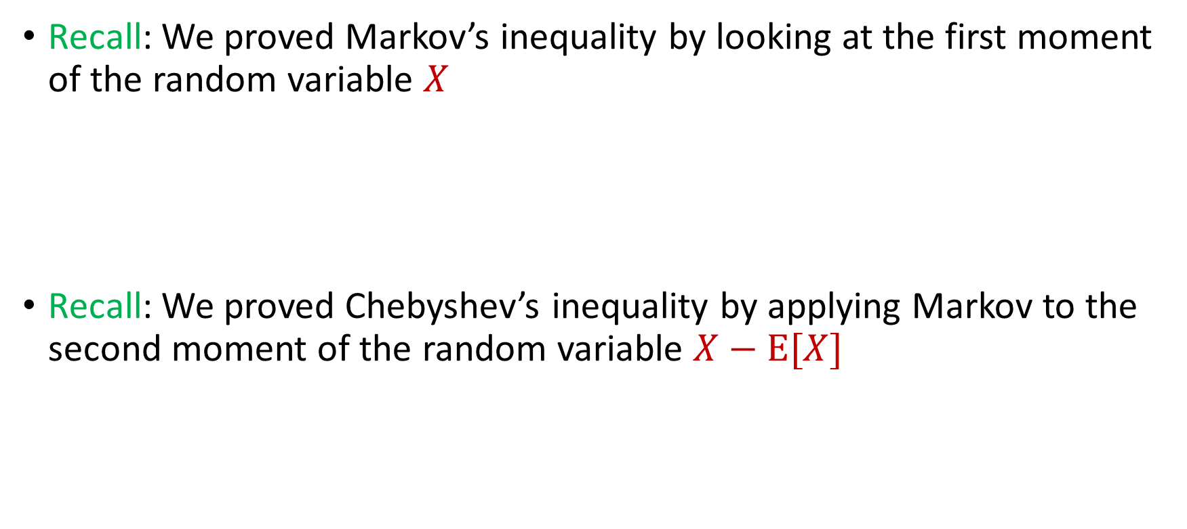

Intuition for Previous Inequalities
Recall: We proved Markov’s inequality by looking at the first moment of the random variable $X$
Recall: We proved Chebyshev’s inequality by applying Markov to the second moment of the random variable $X−E[X]$
$$Pr\left[X≥t⋅E[X]\right]≤\frac{1}{t}$$
$$Pr\left[\left|X−E[X]\right|≥t\right]=Pr\left[{\left|X−E\left[X\right]\right|}^{2}≥t^{2}\right]≤\frac{Var[X]}{t^{2}}$$

Slide 14
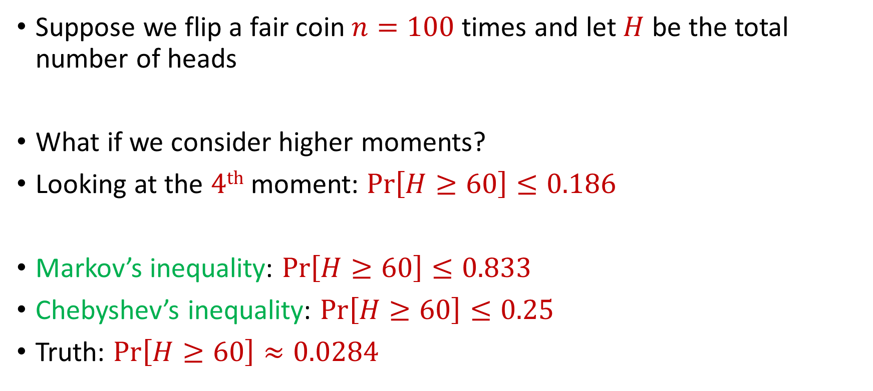
Generalizations
Suppose we flip a fair coin $n=100$ times and let $H$ be the total number of heads
What if we consider higher moments?
Looking at the $4th$ moment: $Pr\left[H≥60\right]≤0.186$
Markov’s inequality: $Pr\left[H≥60\right]≤0.833$
Chebyshev’s inequality: $Pr\left[H≥60\right]≤0.25$
Truth: $Pr\left[H≥60\right]≈0.0284$

Slide 15
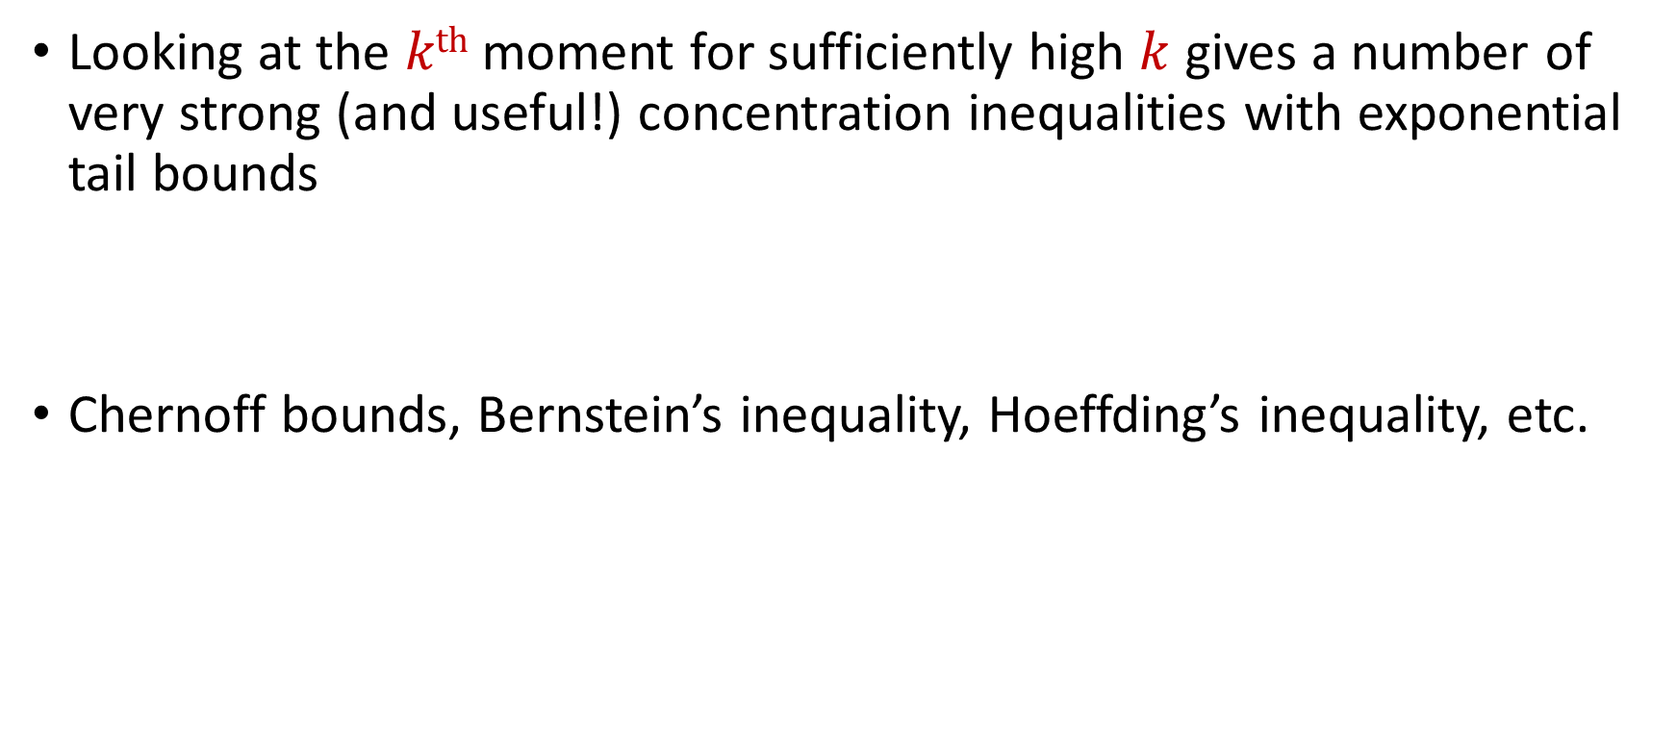
Concentration Inequalities
Looking at the $kth$ moment for sufficiently high $k$ gives a number of very strong (and useful!) concentration inequalities with exponential tail bounds
Chernoff bounds, Bernstein’s inequality, Hoeffding’s inequality, etc.

Slide 16
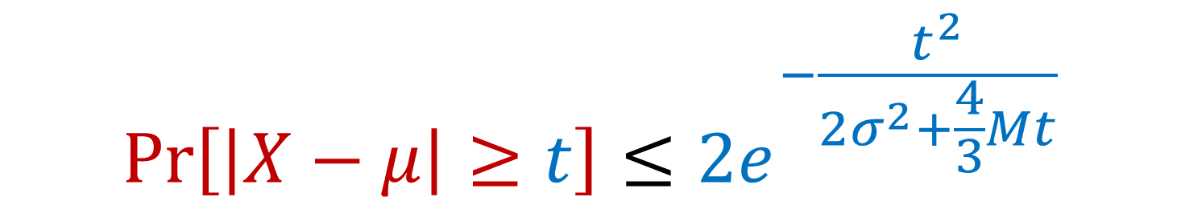

Bernstein’s Inequality
Berstein’s inequality: Let $X_{1},…,X_{n}∈[−M,M]$ be independent random variables and let ${X=X}_{1}+…+X_{n}$ have mean $μ$ and variance $σ^{2}$. Then for any $t≥0$:
$$Pr\left[\left|X−μ\right|≥t\right]≤2e^{−\frac{t^{2}}{2σ^{2}+\frac{4}{3}Mt}}$$

Slide 17


Bernstein’s Inequality
Berstein’s inequality: Let $X_{1},…,X_{n}∈[−M,M]$ be independent random variables and let ${X=X}_{1}+…+X_{n}$ have mean $μ$ and variance $σ^{2}$. Then for any $t≥0$:
Example: Suppose $M=1$ and let $t=kσ$. Then
$$Pr\left[\left|X−μ\right|≥t\right]≤2e^{−\frac{t^{2}}{2σ^{2}+\frac{4}{3}Mt}}$$
$$Pr\left[\left|X−μ\right|≥kσ\right]≤2exp\left(−\frac{k^{2}}{4}\right)$$

Slide 18



Bernstein’s Inequality
Suppose $M=1$ and let $t=kσ$. Then
Compare to Chebyshev’s inequality:
Exponential improvement!
$$Pr\left[\left|X−μ\right|≥kσ\right]≤2exp\left(−\frac{k^{2}}{4}\right)$$
$$Pr\left[\left|X−μ\right|≥kσ\right]≤\frac{1}{k^{2}}$$

Slide 19
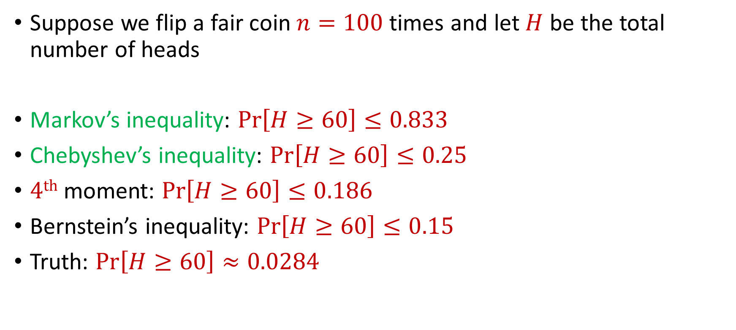
Bernstein’s Inequality
Suppose we flip a fair coin $n=100$ times and let $H$ be the total number of heads
Markov’s inequality: $Pr\left[H≥60\right]≤0.833$
Chebyshev’s inequality: $Pr\left[H≥60\right]≤0.25$
$4th$ moment: $Pr\left[H≥60\right]≤0.186$
Bernstein’s inequality: $Pr\left[H≥60\right]≤0.15$
Truth: $Pr\left[H≥60\right]≈0.0284$

Slide 20
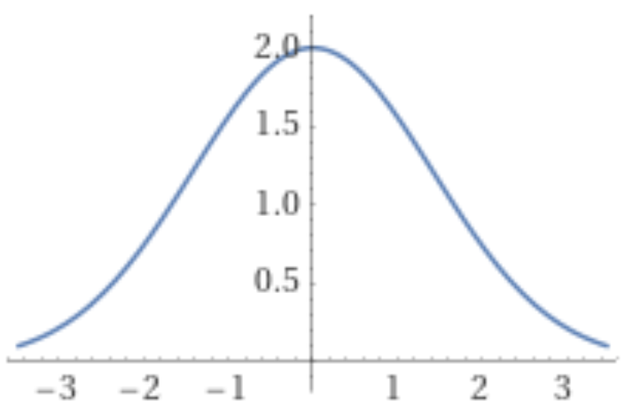
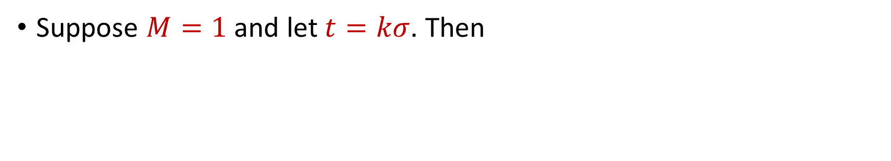
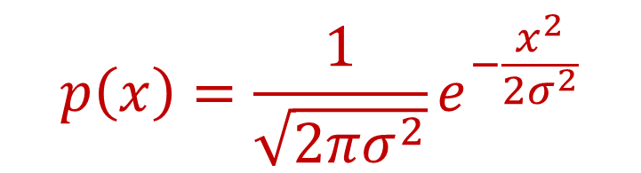
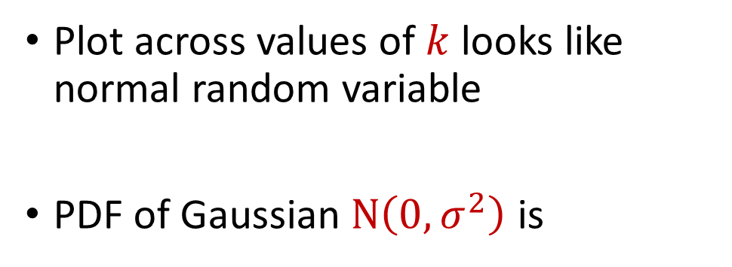
Bernstein’s Inequality
Suppose $M=1$ and let $t=kσ$. Then
$$Pr\left[\left|X−μ\right|≥kσ\right]≤2exp\left(−\frac{k^{2}}{4}\right)$$
Plot across values of $k$ looks like normal random variable
PDF of Gaussian $N\left(0,σ^{2}\right)$ is
$$p\left(x\right)=\frac{1}{\sqrt{2πσ^{2}}}e^{−\frac{x^{2}}{2σ^{2}}}$$

Slide 21
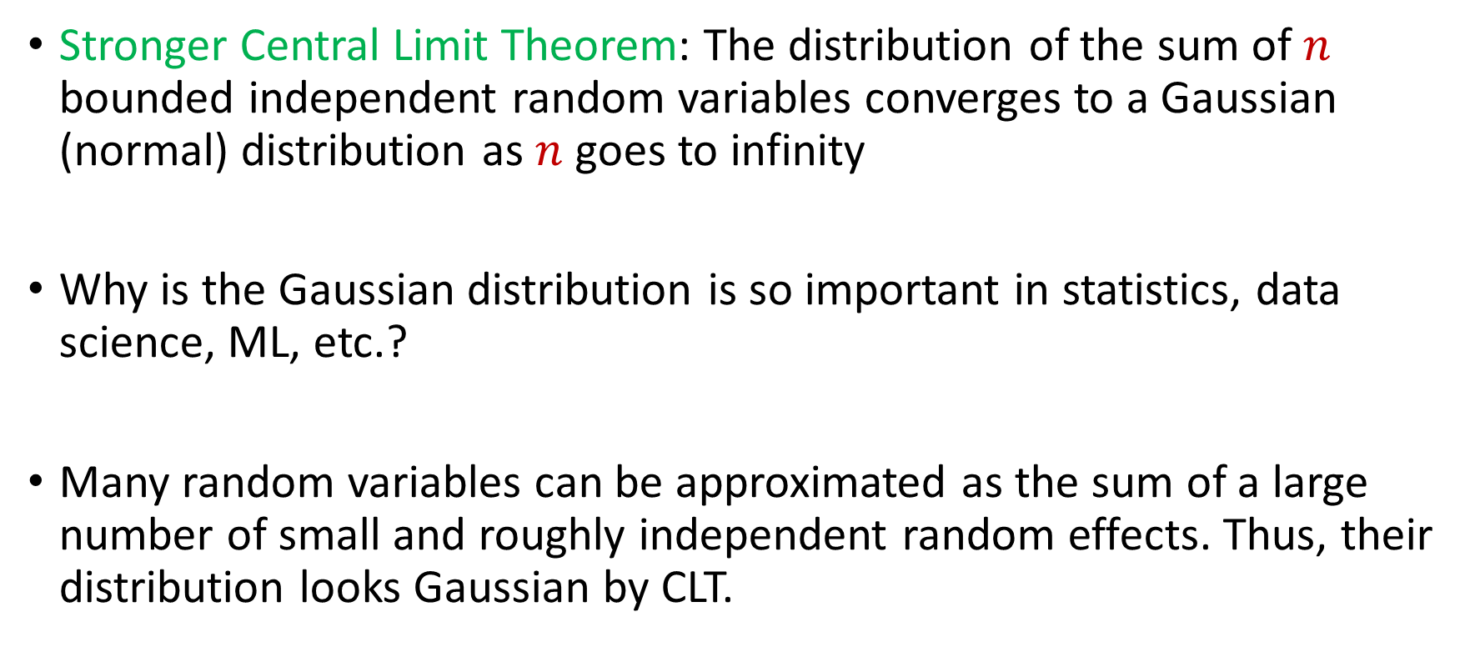
Central Limit Theorem
Stronger Central Limit Theorem: The distribution of the sum of $n$ bounded independent random variables converges to a Gaussian (normal) distribution as $n$ goes to infinity
Why is the Gaussian distribution is so important in statistics, data science, ML, etc.?
Many random variables can be approximated as the sum of a large number of small and roughly independent random effects. Thus, their distribution looks Gaussian by CLT.

Slide 22


Chernoff Bounds
Useful variant of Bernstein’s inequality when the random variables are binary
Chernoff bounds: Let $X_{1},…,X_{n}∈\{0, 1\}$ be independent random variables and let ${X=X}_{1}+…+X_{n}$ have mean $μ$. Then for any $δ≥0$:
$$Pr\left[\left|X−μ\right|≥δμ\right]≤2\exp\left(−\frac{δ^{2}μ}{2+δ}\right)$$

Slide 23




Multiplicative Error Chernoff Bounds
Chernoff bounds: Let $X_{1},…,X_{n}∈\{0, 1\}$ be independent random variables and let ${X=X}_{1}+…+X_{n}$ have mean $μ$. For $δ∈\left(0,1\right)$:
$$Pr\left[X≥\left(1+δ\right)μ\right]≤2\exp\left(−\frac{δ^{2}μ}{2+δ}\right)$$
$$Pr\left[X≤\left(1−δ\right)μ\right]≤\exp\left(−\frac{δ^{2}μ}{2}\right)$$
$$Pr\left[\left|X−μ\right|≥δμ\right]≤2\exp\left(−\frac{δ^{2}μ}{3}\right)$$

Slide 24
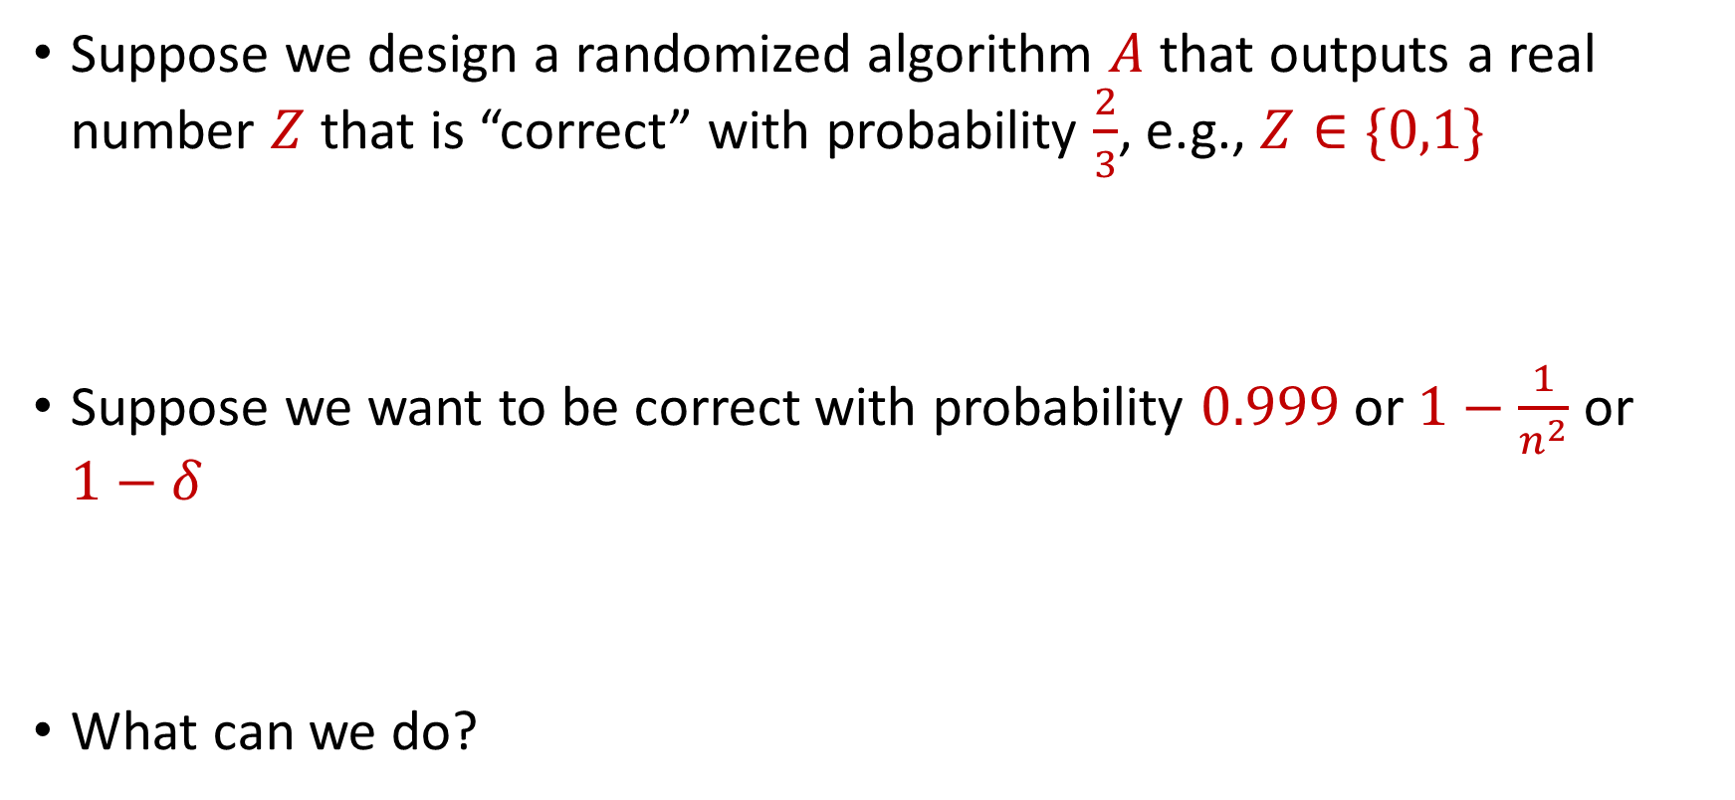
Use Case
Suppose we design a randomized algorithm $A$ that outputs a real number $Z$ that is “correct” with probability $\frac{2}{3}$, e.g., $Z∈\{0,1\}$
Suppose we want to be correct with probability $0.999$ or $1−\frac{1}{n^{2}}$ or $1−δ$
What can we do?

Slide 25

Success Boosting
Chernoff bounds: Run the algorithm $A$ a total of $O\left(\log{\frac{1}{δ}}\right)$ times and take the median. It will be correct with probability $1−δ$

Slide 26

Median-of-Means Framework
Suppose we design a randomized algorithm $A$ to estimate a hidden statistic $Z$ of a dataset and we know $0<Z≤1000$.
Suppose each time we use the algorithm $A$, it outputs a number $X$ such that $E\left[X\right]=Z$ and $Var\left[X\right]=100Z^{2}$
Suppose we want to estimate $Z$ to accuracy $ε$, with probability $1−δ$

Slide 27
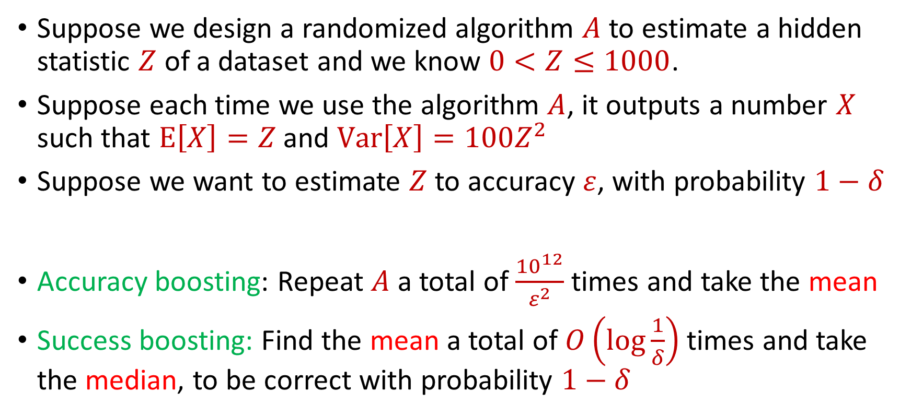
Median-of-Means Framework
Suppose we design a randomized algorithm $A$ to estimate a hidden statistic $Z$ of a dataset and we know $0<Z≤1000$.
Suppose each time we use the algorithm $A$, it outputs a number $X$ such that $E\left[X\right]=Z$ and $Var\left[X\right]=100Z^{2}$
Suppose we want to estimate $Z$ to accuracy $ε$, with probability $1−δ$
Accuracy boosting: Repeat $A$ a total of $\frac{{10}^{12}}{ε^{2}}$ times and take the mean
Success boosting: Find the mean a total of $O\left(\log{\frac{1}{δ}}\right)$ times and take the median, to be correct with probability $1−δ$

Slide 28
CSCE 689: Special Topics in Modern Algorithms for Data Science
Lecture 5
Samson Zhou

Slide 29
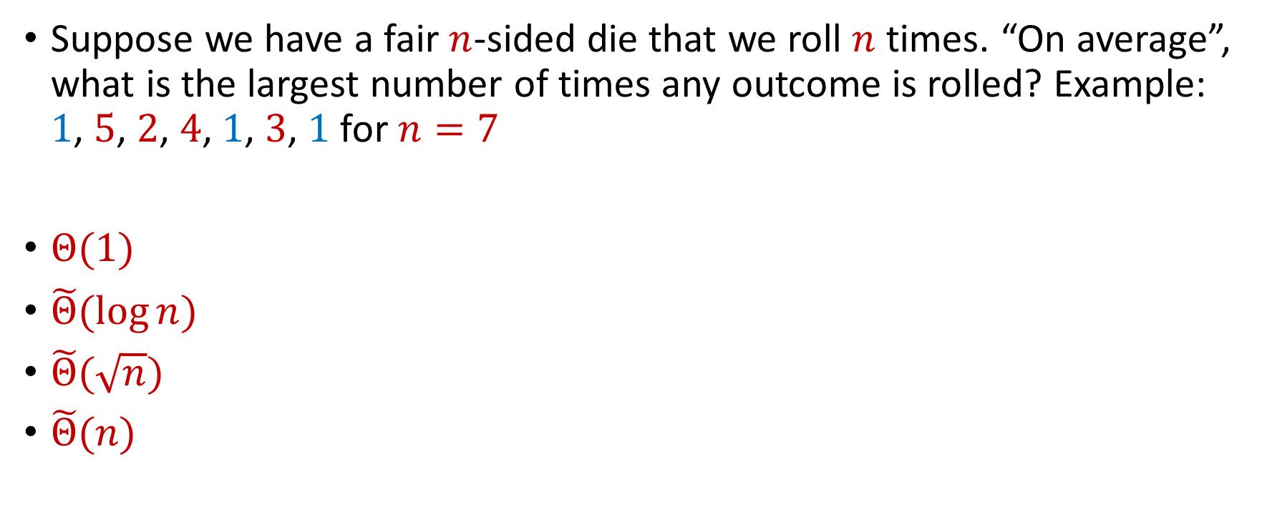
Trivia Question #3 (Max Load)
Suppose we have a fair $n$-sided die that we roll $n$ times. “On average”, what is the largest number of times any outcome is rolled? Example: $1$, $5$, $2$, $4$, $1$, $3$, $1$ for $n=7$
$Θ(1)$
$\tilde{Θ}(\log{n})$
$\tilde{Θ}(\sqrt{n})$
$\tilde{Θ}(n)$

Slide 30
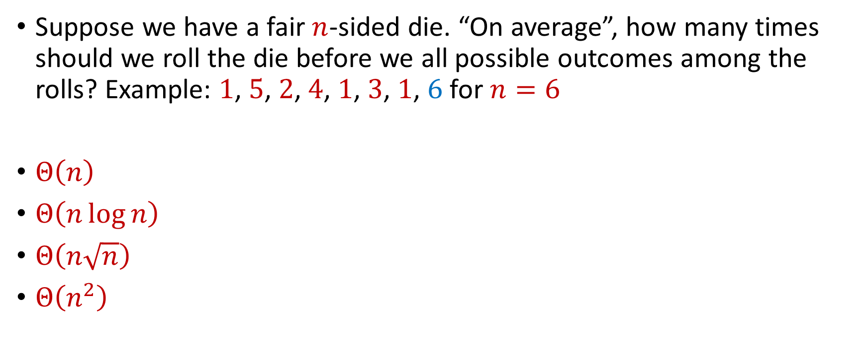
Trivia Question #4 (Coupon Collector)
Suppose we have a fair $n$-sided die. “On average”, how many times should we roll the die before we all possible outcomes among the rolls? Example: $1$, $5$, $2$, $4$, $1$, $3$, $1$, $6$ for $n=6$
$Θ\left(n\right)$
$Θ\left(n\log{n}\right)$
$Θ\left(n\sqrt{n}\right)$
$Θ\left(n^{2}\right)$

Slide 31
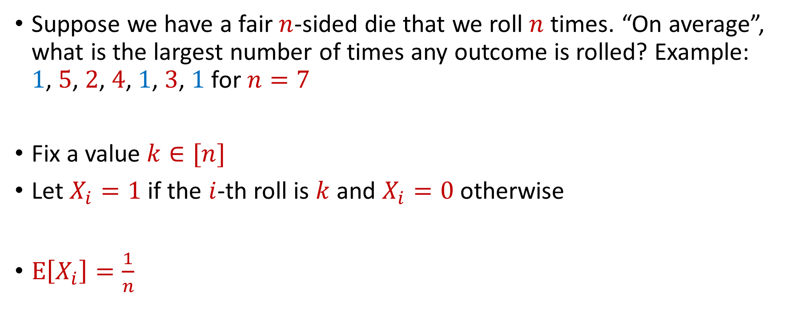
Max Load
Suppose we have a fair $n$-sided die that we roll $n$ times. “On average”, what is the largest number of times any outcome is rolled? Example: $1$, $5$, $2$, $4$, $1$, $3$, $1$ for $n=7$
Fix a value $k∈[n]$
Let $X_{i}=1$ if the $i$-th roll is $k$ and $X_{i}=0$ otherwise
$E\left[X_{i}\right]=\frac{1}{n}$

Slide 32


Max Load
The total number of rolls with value $k$ is $X=X_{1}+…+X_{n}$
$E\left[X\right]=1$
Recall Chernoff bounds:
$Pr\left[X≥3 log{n}\right]≤\frac{1}{n^{2}}$
$$Pr\left[X≥\left(1+δ\right)μ\right]≤2\exp\left(−\frac{δ^{2}μ}{2+δ}\right)$$

Slide 33
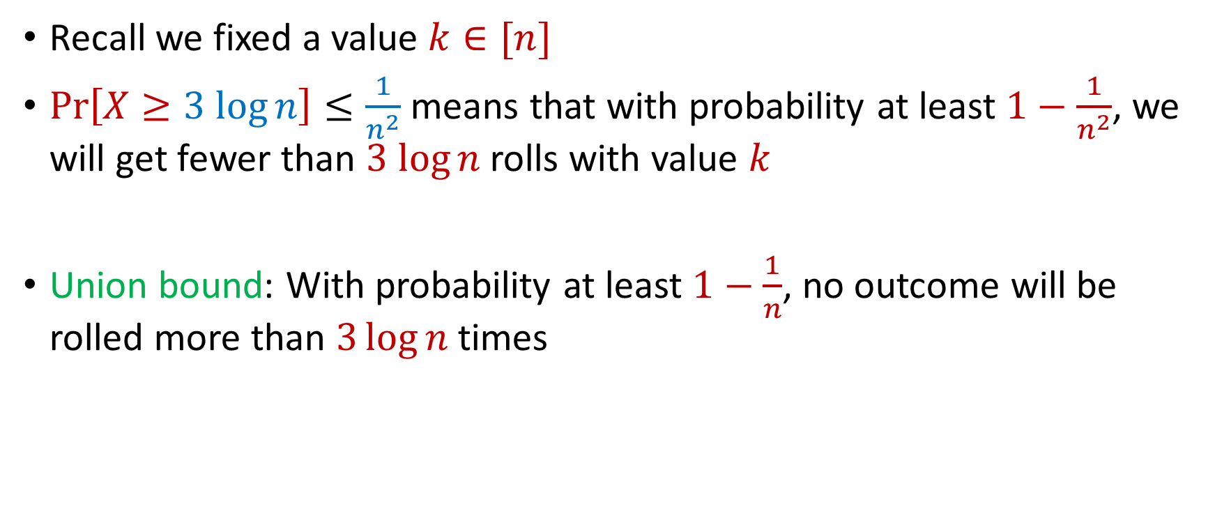
Max Load
Recall we fixed a value $k∈[n]$
$Pr\left[X≥3 log{n}\right]≤\frac{1}{n^{2}}$ means that with probability at least $1−\frac{1}{n^{2}}$, we will get fewer than $3 log{n}$ rolls with value $k$
Union bound: With probability at least $1−\frac{1}{n}$, no outcome will be rolled more than $3\log{n}$ times

Slide 34
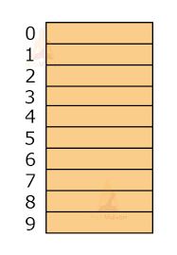

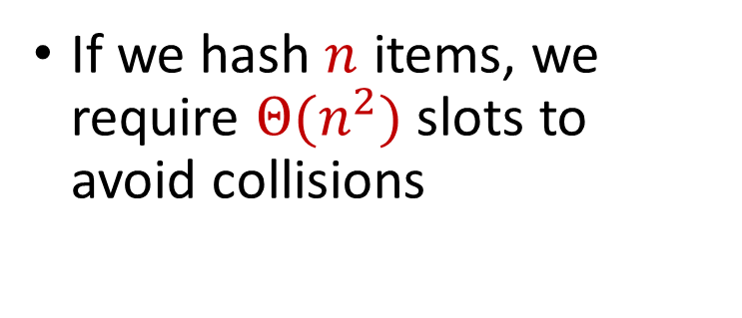
Hashing
Suppose we have a number of files, how do we consistently store them in memory?
$$h\left(x\right)$$
Wenjing Chen
If we hash $n$ items, we require $Θ(n^{2})$ slots to avoid collisions
Chunkai Fu
Ayesha Qamar
Shima Salehi
David Xiang
Shuo Xing

Slide 35

Dealing with Collisions
Suppose we store multiple items in the same location as a linked list
If the maximum number of collisions in a location is $c$, then could traverse a linked list of size $c$ for a query
Query runtime: $O(c)$
$$h(Matthew Chang)$$
$$Jung Seo$$
Matthew Chang

Slide 36
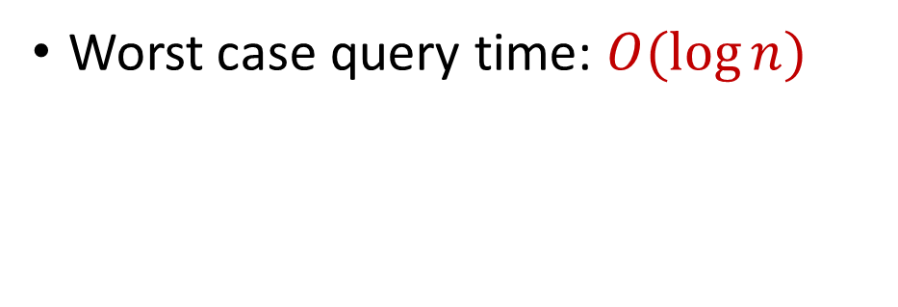
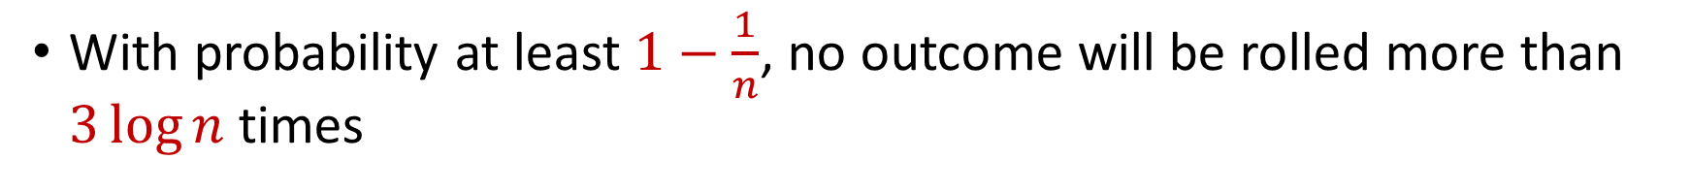

Collisions and Max Load
With probability at least $1−\frac{1}{n}$, no outcome will be rolled more than $3\log{n}$ times
Worst case query time: $O(\log{n})$
$$Jung Seo$$
Matthew Chang

Slide 37

Hashing
For $O(1)$ query time, use $Θ(n^{2})$ slots to avoid collisions
For $O(\log{n})$ query time, use $Θ(n)$ slots with linked lists
$$h\left(x\right)$$
Wenjing Chen
Chunkai Fu
Ayesha Qamar
Shima Salehi
David Xiang
Shuo Xing

Slide 38
Big Data
Not only many data points, but also many measurements per data point, i.e., very high dimensional data

Slide 39
Big Data
Not only many data points, but also many measurements per data point, i.e., very high dimensional data
Twitter has 450 million active monthly users (as of 2022), records (tens of) thousands of measurements per user: who they follow, who follows them, when they last visited the site, timestamps for specific interactions, how many tweets they have sent, the text of those tweets, etc...

Slide 40
Big Data
Not only many data points, but also many measurements per data point, i.e., very high dimensional data
A 3 minute Youtube clip with a resolution of 500 x 500 pixels at 15 frames/second with 3 color channels is a recording of 2 billion pixel values. Even a 500 x 500 pixel color image has 750, 000 pixel values

Slide 41
Big Data
Not only many data points, but also many measurements per data point, i.e., very high dimensional data
The human genome contains 3 billion+ base pairs. Genetic datasets often contain information on 100s of thousands+ mutations and genetic markers

