Slide 1
CSCE 689: Special Topics in Modern Algorithms for Data Science
Lecture 18
Samson Zhou

Slide 2
Presentation Schedule
November 29: Chunkai, Jung, STMI
December 1: Galaxy AI, Anmol, Jason
December 4: Bokun, Team DAP

Slide 3
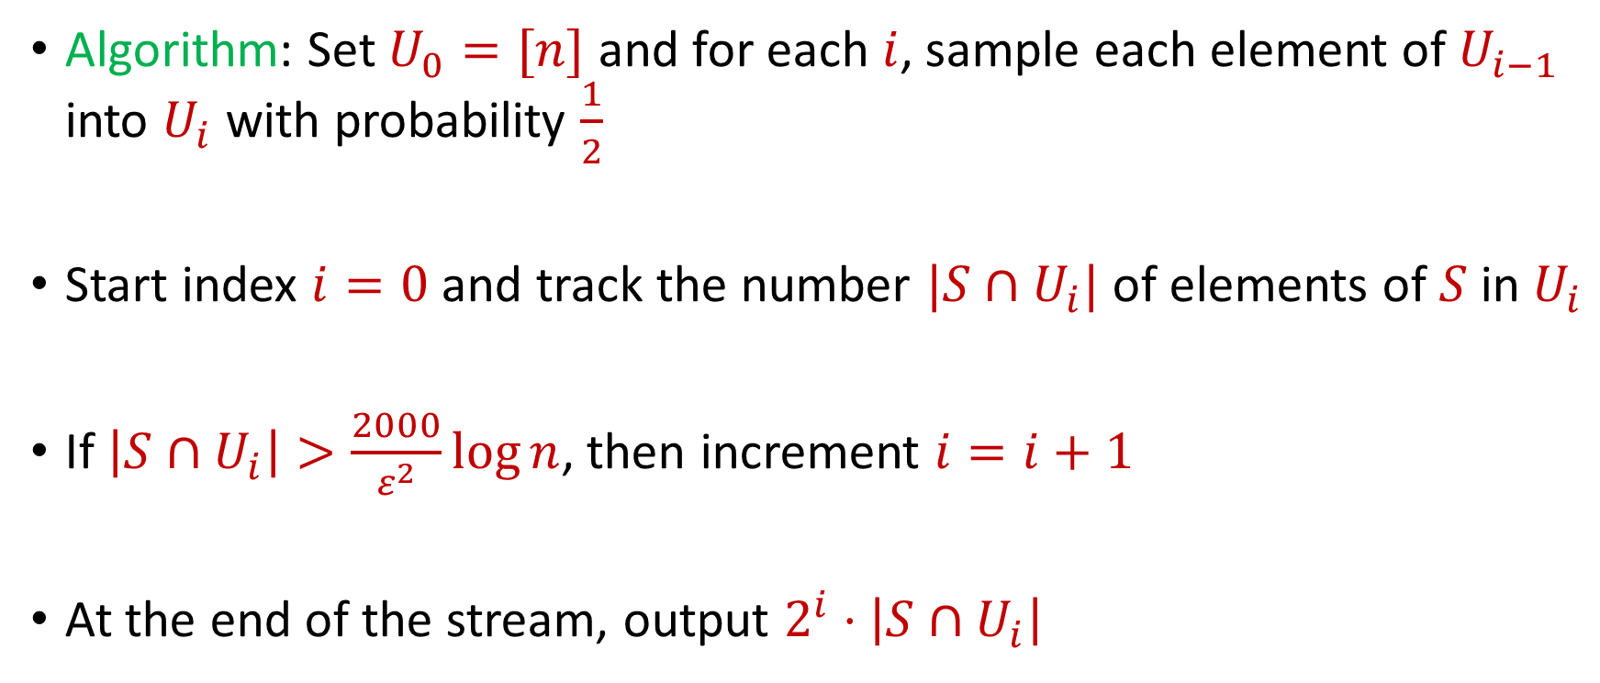

Previously: Distinct Elements ($F_{0}$ Estimation)
Algorithm: Set $U_{0}=[n]$ and for each $i$, sample each element of $U_{i−1}$ into $U_{i}$ with probability $\frac{1}{2}$
Start index $i=0$ and track the number $|S∩U_{i}|$ of elements of $S$ in $U_{i}$
If $\left|S∩U_{i}\right|>\frac{2000}{ε^{2}}\log{n}$, then increment $i=i+1$
At the end of the stream, output $2^{i}⋅\left|S∩U_{i}\right|$

Slide 4


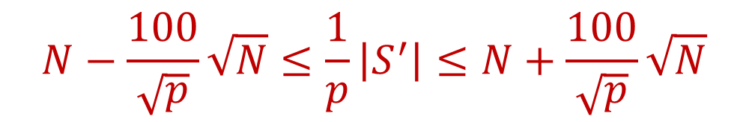
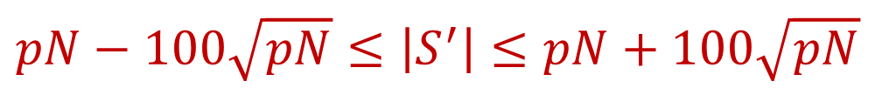
Previously: Distinct Elements ($F_{0}$ Estimation)
($S′$ is formed by sampling each item of $S$ with probability $p$) With probability at least $\frac{9}{10}$,
Thus with probability at least $\frac{9}{10}$,
$$pN−100\sqrt{pN}≤\left|S^{′}\right|≤pN+100\sqrt{pN}$$
$$N−\frac{100}{\sqrt{p}}\sqrt{N}≤\frac{1}{p}\left|S^{′}\right|≤N+\frac{100}{\sqrt{p}}\sqrt{N}$$

Slide 5
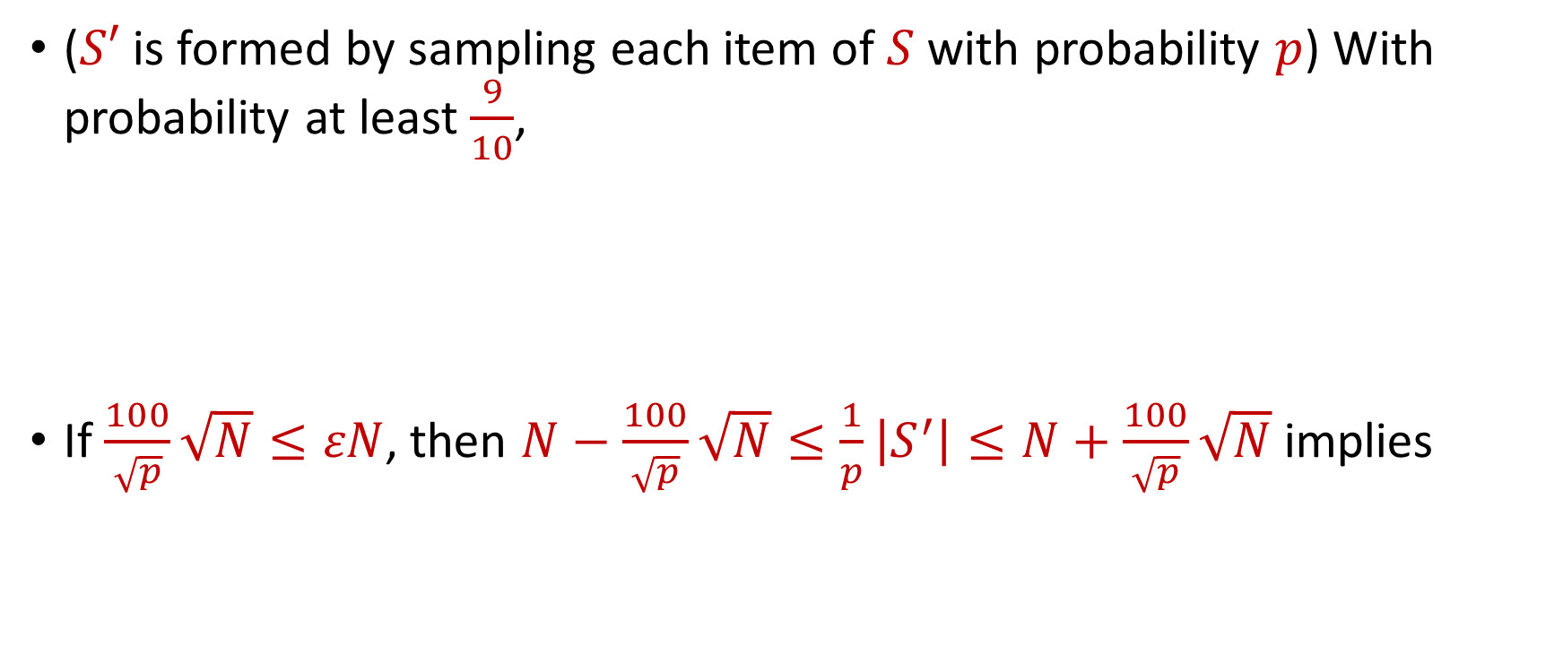

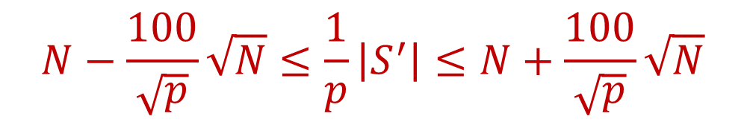
Previously: Distinct Elements ($F_{0}$ Estimation)
($S′$ is formed by sampling each item of $S$ with probability $p$) With probability at least $\frac{9}{10}$,
If $\frac{100}{\sqrt{p}}\sqrt{N}≤εN$, then $N−\frac{100}{\sqrt{p}}\sqrt{N}≤\frac{1}{p}\left|S^{′}\right|≤N+\frac{100}{\sqrt{p}}\sqrt{N}$ implies
$$N−\frac{100}{\sqrt{p}}\sqrt{N}≤\frac{1}{p}\left|S^{′}\right|≤N+\frac{100}{\sqrt{p}}\sqrt{N}$$
$$\left(1−ε\right)N≤\frac{1}{p}\left|S^{′}\right|≤\left(1+ε\right)N$$

Slide 6

Last Time: Sparse Recovery
Suppose we have an insertion-deletion stream of length $m=Θ\left(n\right)$ and at the end we are promised there are at most $k$ nonzero coordinates
Goal: Recover the $k$ nonzero coordinates and their frequencies

Slide 7
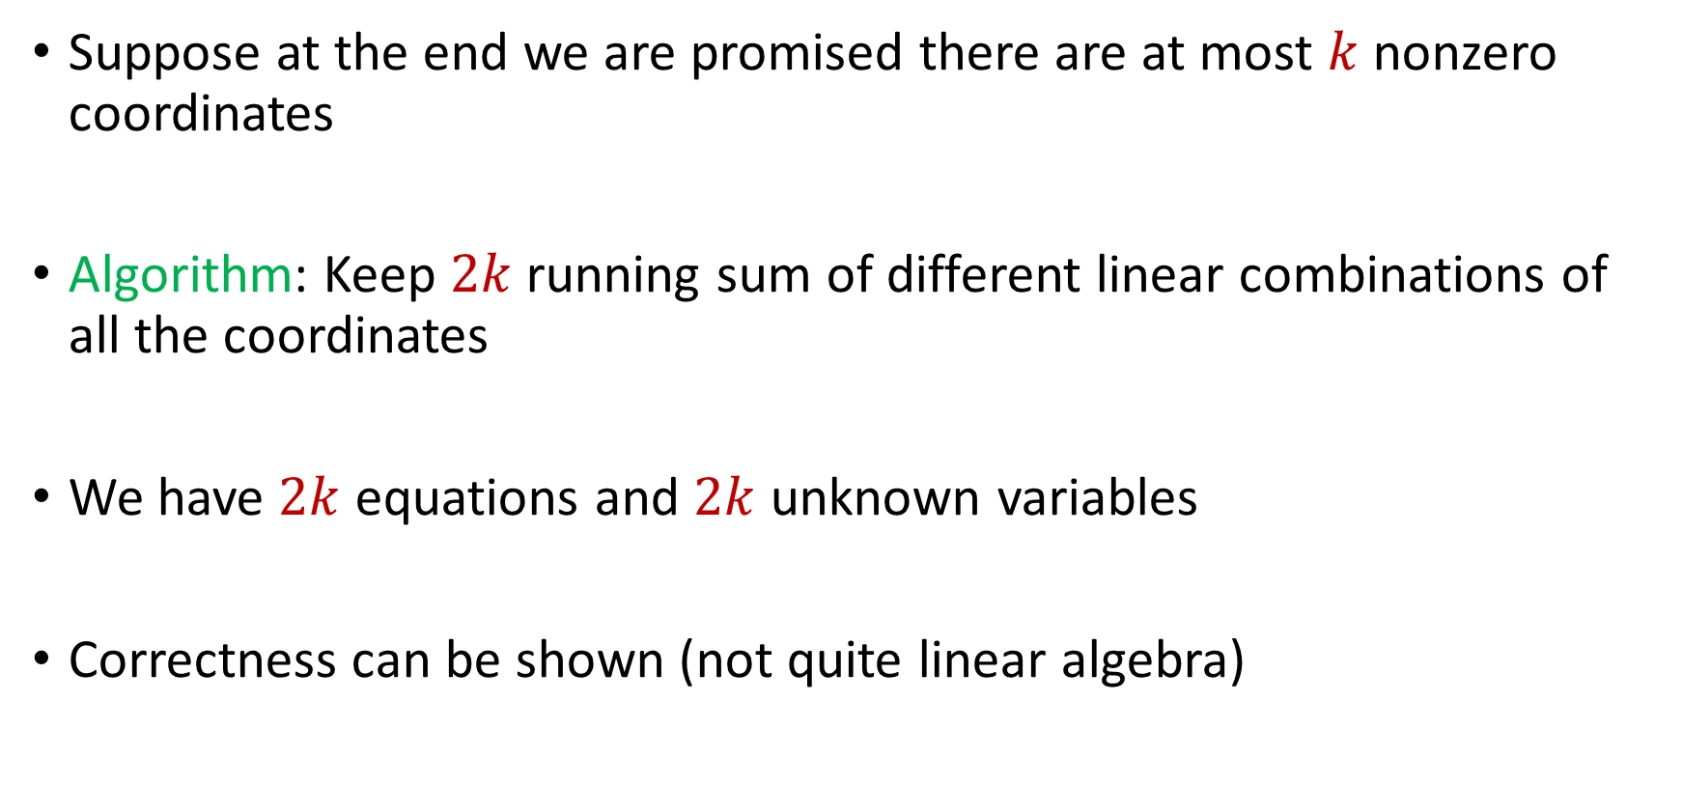
Last Time: Sparse Recovery
Suppose at the end we are promised there are at most $k$ nonzero coordinates
Algorithm: Keep $2k$running sum of different linear combinations of all the coordinates
We have $2k$ equations and $2k$ unknown variables
Correctness can be shown (not quite linear algebra)

Slide 8
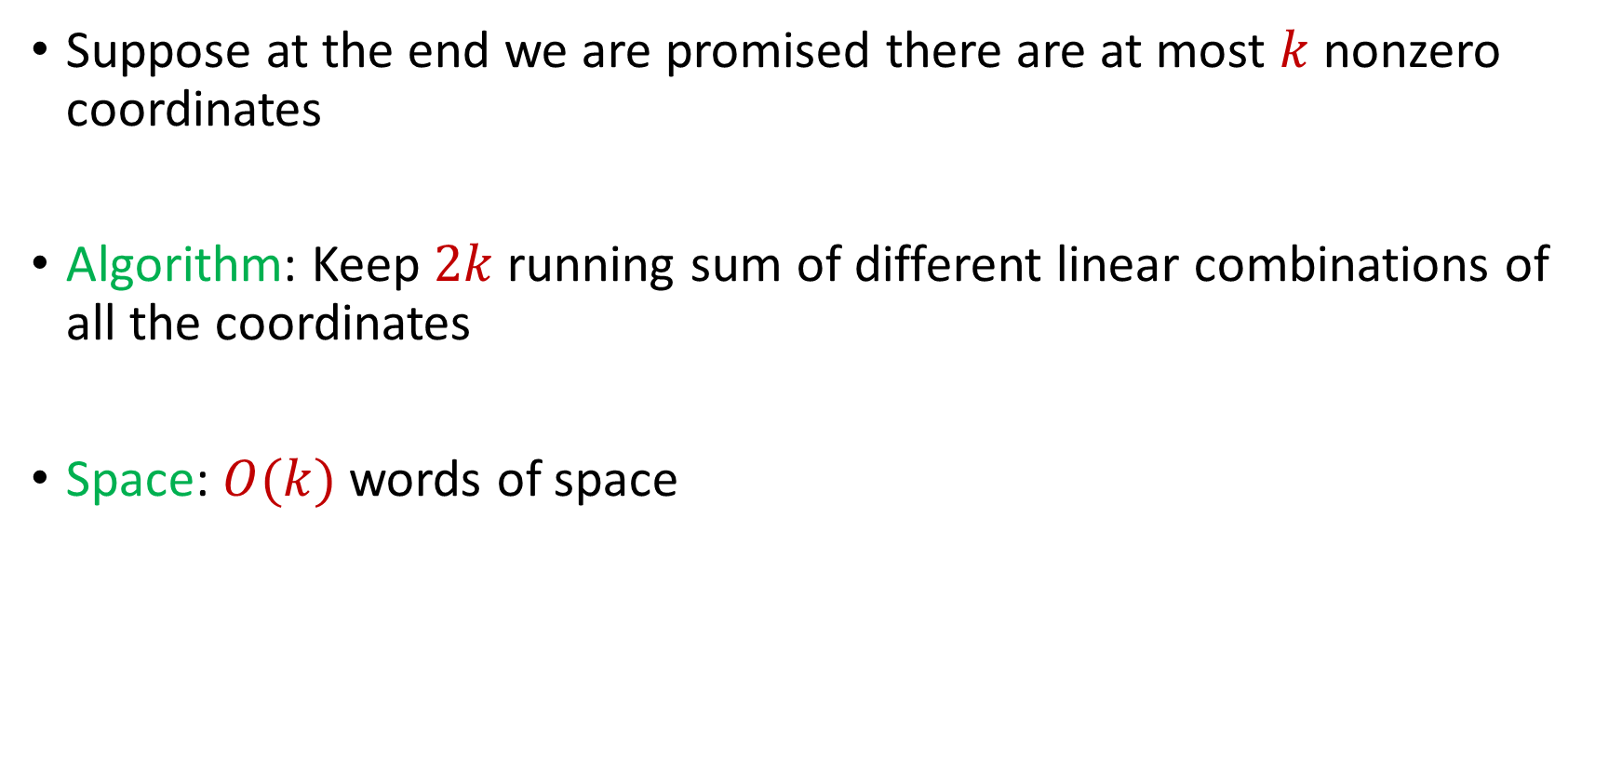
Last Time: Sparse Recovery
Suppose at the end we are promised there are at most $k$ nonzero coordinates
Algorithm: Keep $2k$running sum of different linear combinations of all the coordinates
Space: $O(k)$ words of space

Slide 9
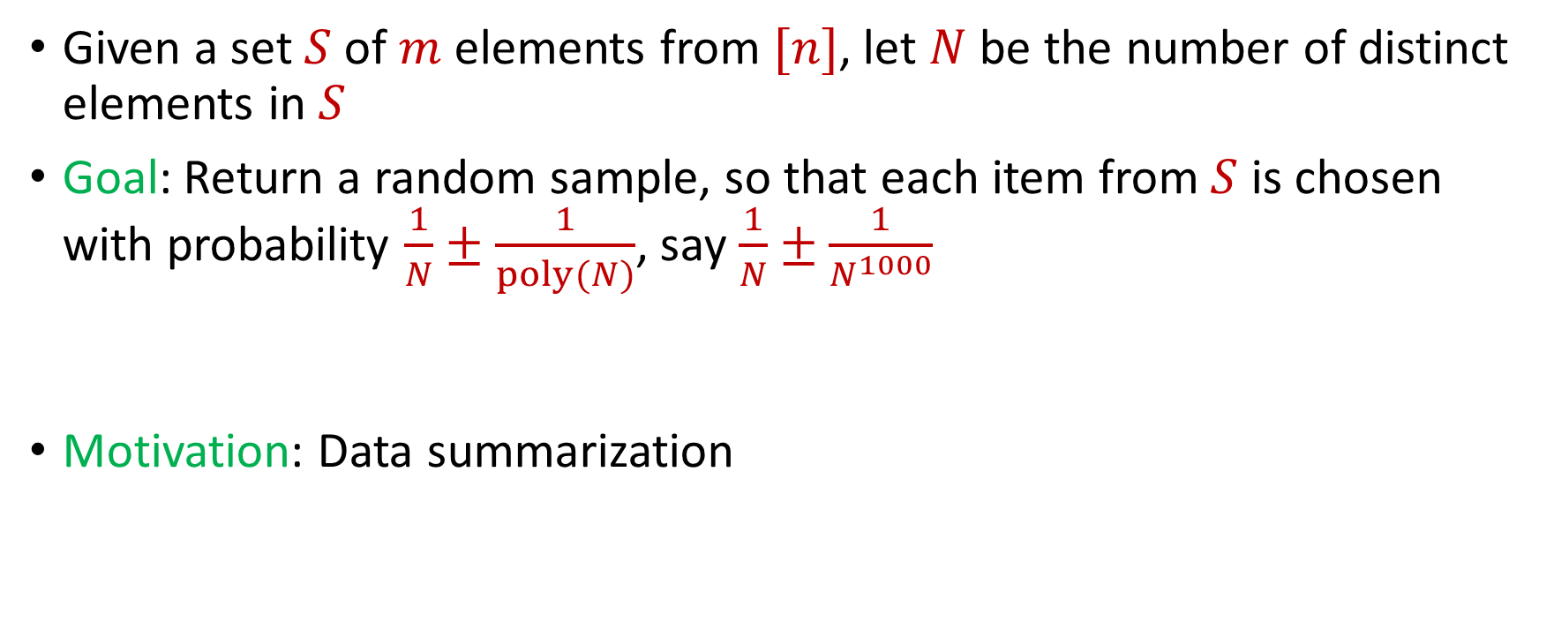

$L_{0}$ Sampling
Given a set $S$ of $m$ elements from $[n]$, let $N$ be the number of distinct elements in $S$
Goal: Return a random sample, so that each item from $S$ is chosen with probability $\frac{1}{N}±\frac{1}{poly(N)}$, say $\frac{1}{N}±\frac{1}{N^{1000}}$
Motivation: Data summarization

Slide 10
$L_{0}$ Sampling
Remember reservoir sampling? Does that work?

Slide 11
$L_{0}$ Sampling
Remember reservoir sampling? Does that work? NO!
1 2 2 2 2 2 2 2 2 2 2 2 2 2 2 2 2 2 2 2 2

Slide 12
$L_{0}$ Sampling
Algorithm: What techniques have we learned? What is a good starting point?

Slide 13
Previously: Distinct Elements ($F_{0}$ Estimation)
Algorithm: Set $U_{0}=[n]$ and for each $i$, sample each element of $U_{i−1}$ into $U_{i}$ with probability $\frac{1}{2}$
Start index $i=0$ and track the number $|S∩U_{i}|$ of elements of $S$ in $U_{i}$
If $\left|S∩U_{i}\right|>\frac{2000}{ε^{2}}\log{n}$, then increment $i=i+1$
At the end of the stream, output $2^{i}⋅\left|S∩U_{i}\right|$

Slide 14

$L_{0}$ Sampling
Algorithm: Run distinct elements algorithm and at the end of the stream, output a random element of $S∩U_{i}$

Slide 15

Insertion-Deletion Streams
How to perform $L_{0}$ estimation?
How to perform $L_{0}$ sampling?

Slide 16

Distinct Elements ($F_{0}$ Estimation)
Different, simpler algorithm on insertion-only streams

Slide 17





Distinct Elements ($F_{0}$ Estimation)
Let $h:[n]→[0,1]$ be a random hash function with a real-valued output
Initialize $s=1$
For $x_{1},…,x_{m}$:
$s←min\left(s, h\left(x_{i}\right)\right)$
Return $Z=\frac{1}{s}−1$
$$s$$
$$0$$
$$1$$

Slide 18

Distinct Elements ($F_{0}$ Estimation)
Let $h:[n]→[0,1]$ be a random hash function with a real-valued output
Initialize $s=1$
For $x_{1},…,x_{m}$:
$s←min\left(s, h\left(x_{i}\right)\right)$
Return $Z=\frac{1}{s}−1$
$$s$$
$$h\left(x_{1}\right)$$
$$0$$
$$1$$

Slide 19

Distinct Elements ($F_{0}$ Estimation)
Let $h:[n]→[0,1]$ be a random hash function with a real-valued output
Initialize $s=1$
For $x_{1},…,x_{m}$:
$s←min\left(s, h\left(x_{i}\right)\right)$
Return $Z=\frac{1}{s}−1$
$$s$$
$$h\left(x_{1}\right)$$
$$0$$
$$1$$

Slide 20

Distinct Elements ($F_{0}$ Estimation)
Let $h:[n]→[0,1]$ be a random hash function with a real-valued output
Initialize $s=1$
For $x_{1},…,x_{m}$:
$s←min\left(s, h\left(x_{i}\right)\right)$
Return $Z=\frac{1}{s}−1$
$$s$$
$$h\left(x_{2}\right)$$
$$h\left(x_{1}\right)$$
$$0$$
$$1$$

Slide 21

Distinct Elements ($F_{0}$ Estimation)
Let $h:[n]→[0,1]$ be a random hash function with a real-valued output
Initialize $s=1$
For $x_{1},…,x_{m}$:
$s←min\left(s, h\left(x_{i}\right)\right)$
Return $Z=\frac{1}{s}−1$
$$s$$
$$h\left(x_{2}\right)$$
$$h\left(x_{1}\right)$$
$$0$$
$$1$$

Slide 22

Distinct Elements ($F_{0}$ Estimation)
Let $h:[n]→[0,1]$ be a random hash function with a real-valued output
Initialize $s=1$
For $x_{1},…,x_{m}$:
$s←min\left(s, h\left(x_{i}\right)\right)$
Return $Z=\frac{1}{s}−1$
$$s$$
$$h\left(x_{2}\right)$$
$$h\left(x_{3}\right)$$
$$h\left(x_{1}\right)$$
$$0$$
$$1$$

Slide 23

Distinct Elements ($F_{0}$ Estimation)
Let $h:[n]→[0,1]$ be a random hash function with a real-valued output
Initialize $s=1$
For $x_{1},…,x_{m}$:
$s←min\left(s, h\left(x_{i}\right)\right)$
Return $Z=\frac{1}{s}−1$
$$s$$
$$h\left(x_{4}\right)$$
$$h\left(x_{2}\right)$$
$$h\left(x_{3}\right)$$
$$h\left(x_{1}\right)$$
$$0$$
$$1$$

Slide 24

Distinct Elements ($F_{0}$ Estimation)
Let $h:[n]→[0,1]$ be a random hash function with a real-valued output
Initialize $s=1$
For $x_{1},…,x_{m}$:
$s←min\left(s, h\left(x_{i}\right)\right)$
Return $Z=\frac{1}{s}−1$
$$s$$
$$h\left(x_{4}\right)$$
$$h\left(x_{2}\right)$$
$$h\left(x_{3}\right)$$
$$h\left(x_{1}\right)$$
$$0$$
$$1$$

Slide 25

Distinct Elements ($F_{0}$ Estimation)
Let $h:[n]→[0,1]$ be a random hash function with a real-valued output
Initialize $s=1$
For $x_{1},…,x_{m}$:
$s←min\left(s, h\left(x_{i}\right)\right)$
Return $Z=\frac{1}{s}−1$
$$s$$
$$h\left(x_{4}\right)$$
$$h\left(x_{5}\right)$$
$$h\left(x_{2}\right)$$
$$h\left(x_{3}\right)$$
$$h\left(x_{1}\right)$$
$$0$$
$$1$$

Slide 26
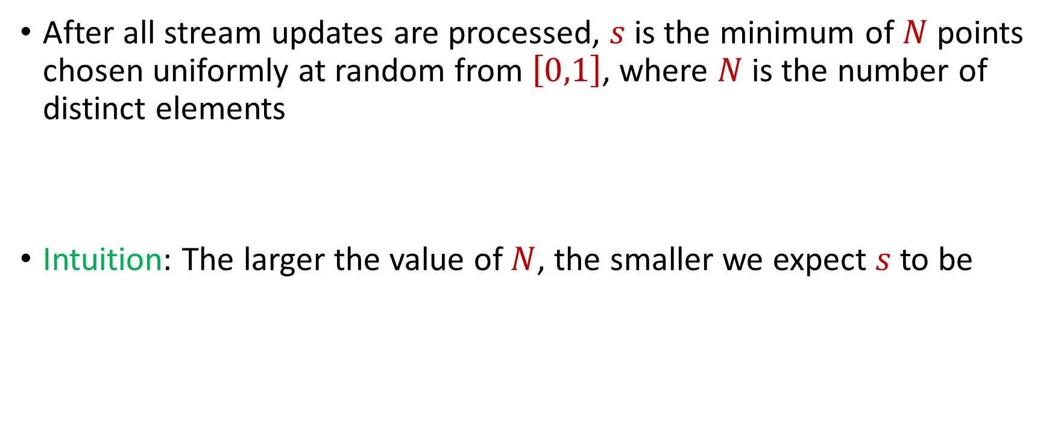
Distinct Elements ($F_{0}$ Estimation)
After all stream updates are processed, $s$ is the minimum of $N$ points chosen uniformly at random from $\left[0,1\right]$, where $N$ is the number of distinct elements
Intuition: The larger the value of $N$, the smaller we expect $s$ to be

Slide 27
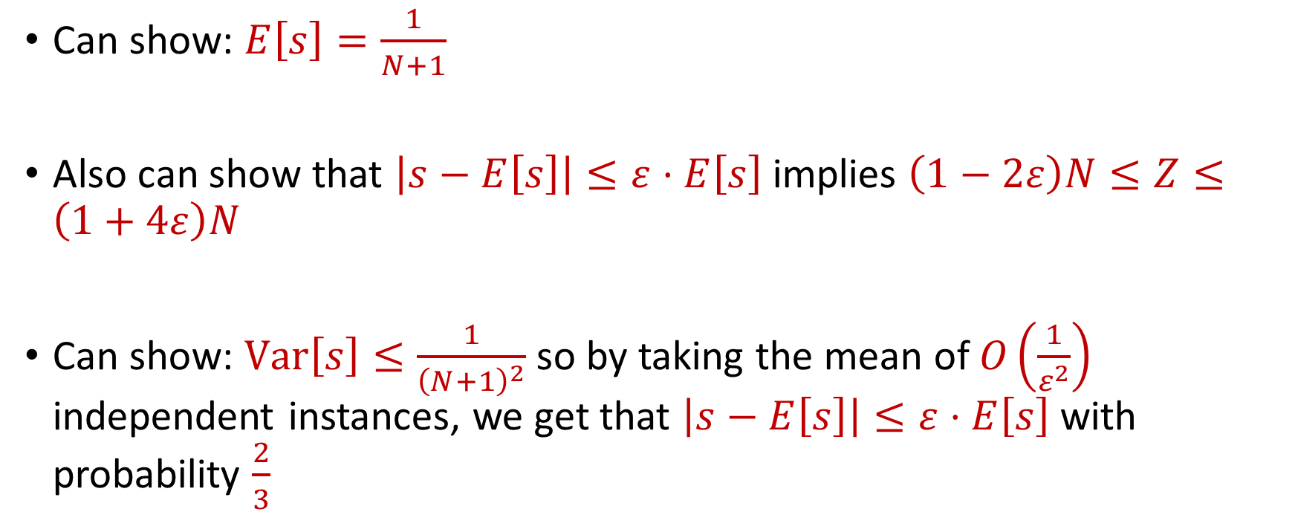
Distinct Elements ($F_{0}$ Estimation)
Can show: $E\left[s\right]=\frac{1}{N+1}$
Also can show that $\left|s−E\left[s\right]\right|≤ε⋅E\left[s\right]$ implies $\left(1−2ε\right)N≤Z≤\left(1+4ε\right)N$
Can show: $Var\left[s\right]≤\frac{1}{{\left(N+1\right)}^{2}}$ so by taking the mean of $O\left(\frac{1}{ε^{2}}\right)$ independent instances, we get that $\left|s−E\left[s\right]\right|≤ε⋅E\left[s\right]$ with probability $\frac{2}{3}$

Slide 28

Distinct Elements ($F_{0}$ Estimation)
Space guarantee: $O\left(\frac{1}{ε^{2}}\right)$ independent instance, each independent instance keeps a single word of space

