Slide 1
CSCE 689: Special Topics in Modern Algorithms for Data Science
Lecture 19
Samson Zhou

Slide 2
Previously in the Streaming Model
Reservoir sampling
Heavy-hitters
Misra-Gries
CountMin
CountSketch
Moment estimation
AMS algorithm
Sparse recovery
Distinct elements estimation

Slide 3

Reservoir Sampling
Suppose we see a stream of elements from $[n]$. How do we uniformly sample one of the positions of the stream?
47 72 81 10 14 33 51 29 54 9 36 46 10

Slide 4
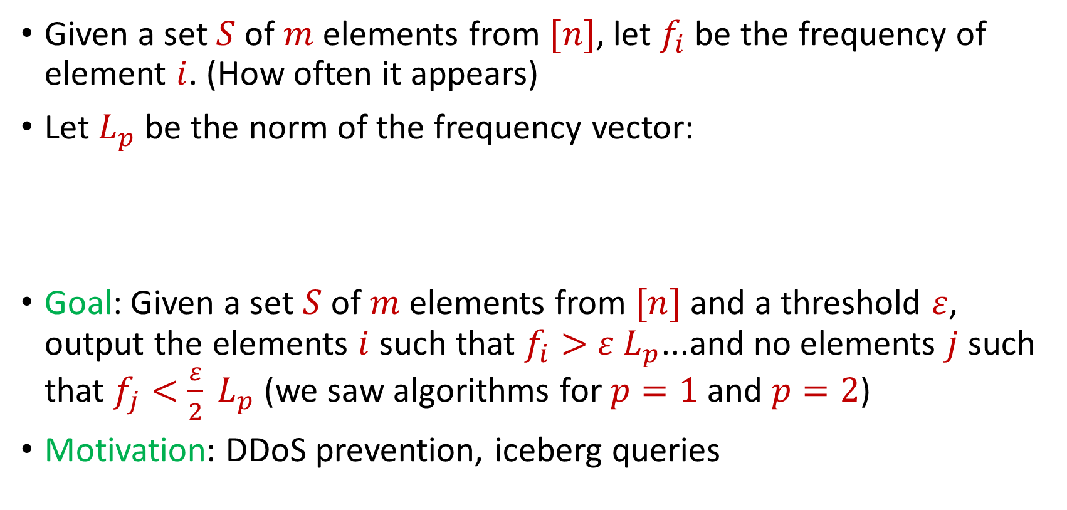
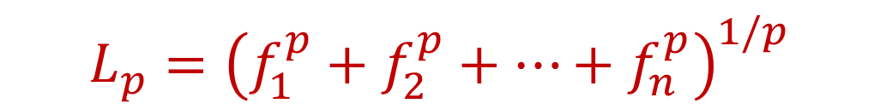
Heavy-Hitters (Frequent Items)
Given a set $S$ of $m$ elements from $[n]$, let $f_{i}$ be the frequency of element $i$. (How often it appears)
Let $L_{p}$ be the norm of the frequency vector:
Goal: Given a set $S$ of $m$ elements from $[n]$ and a threshold $ε$, output the elements $i$ such that $f_{i}>$ $ε L_{p}$...and no elements $j$ such that $f_{j}<$ $\frac{ε}{2} L_{p}$ (we saw algorithms for $p=1$ and $p=2$)
Motivation: DDoS prevention, iceberg queries
$$L_{p}={\left(f_{1}^{p}+f_{2}^{p}+…+f_{n}^{p}\right)}^{1/p}$$

Slide 5
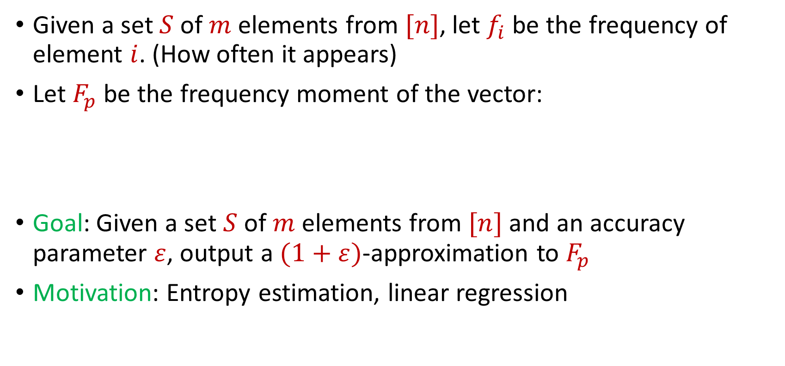
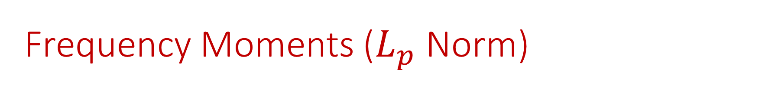
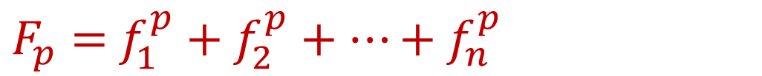
Frequency Moments ($L_{p}$ Norm)
Given a set $S$ of $m$ elements from $[n]$, let $f_{i}$ be the frequency of element $i$. (How often it appears)
Let $F_{p}$ be the frequency moment of the vector:
Goal: Given a set $S$ of $m$ elements from $[n]$ and an accuracy parameter $ε$, output a $(1+ε)$-approximation to $F_{p}$
Motivation: Entropy estimation, linear regression
$F_{p}=$ $f_{1}^{p}+f_{2}^{p}+…+f_{n}^{p}$

Slide 6
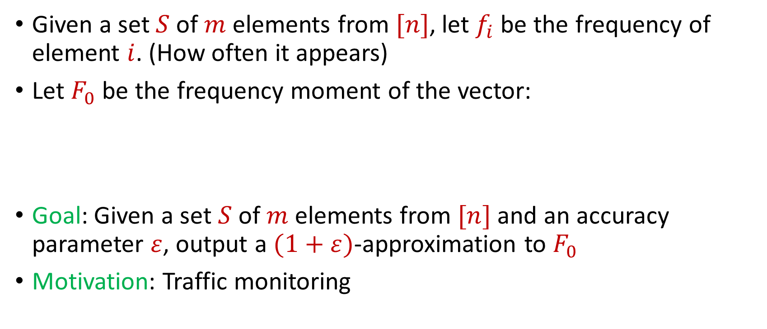
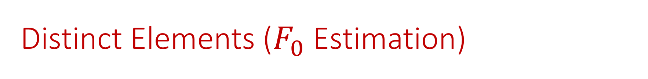
Distinct Elements ($F_{0}$ Estimation)
Given a set $S$ of $m$ elements from $[n]$, let $f_{i}$ be the frequency of element $i$. (How often it appears)
Let $F_{0}$ be the frequency moment of the vector:
Goal: Given a set $S$ of $m$ elements from $[n]$ and an accuracy parameter $ε$, output a $(1+ε)$-approximation to $F_{0}$
Motivation: Traffic monitoring
$F_{0}=$ $|\{i :f_{i}≠0\}|$

Slide 7

Sparse Recovery
Suppose we have an insertion-deletion stream of length $m=Θ\left(n\right)$ and at the end we are promised there are at most $k$ nonzero coordinates
Goal: Recover the $k$ nonzero coordinates and their frequencies

Slide 8
The Streaming Model
So far, all questions have been statistical
What other questions can be asked? (Think in general, outside of the streaming model)

Slide 9
The Streaming Model
So far, all questions have been statistical
What other questions can be asked? (Think in general, outside of the streaming model)
Algebraic, geometric

Slide 10
The Streaming Model
So far, all questions have been statistical
What other questions can be asked? (Think in general, outside of the streaming model)
Algebraic, geometric
TODAY

Slide 11
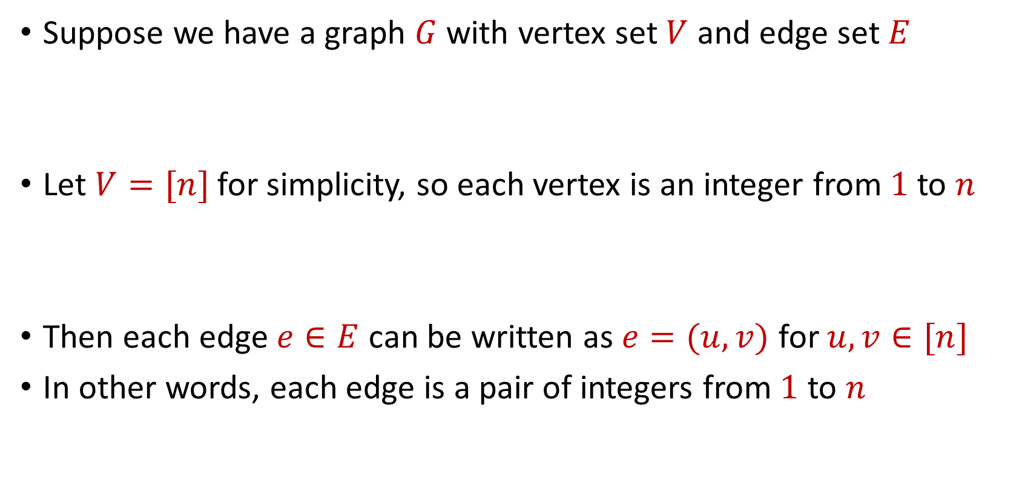
Graph Theory
Suppose we have a graph $G$ with vertex set $V$ and edge set $E$
Let $V=[n]$ for simplicity, so each vertex is an integer from $1$ to $n$
Then each edge $e∈E$ can be written as $e=(u,v)$ for $u,v∈[n]$
In other words, each edge is a pair of integers from $1$ to $n$

Slide 12
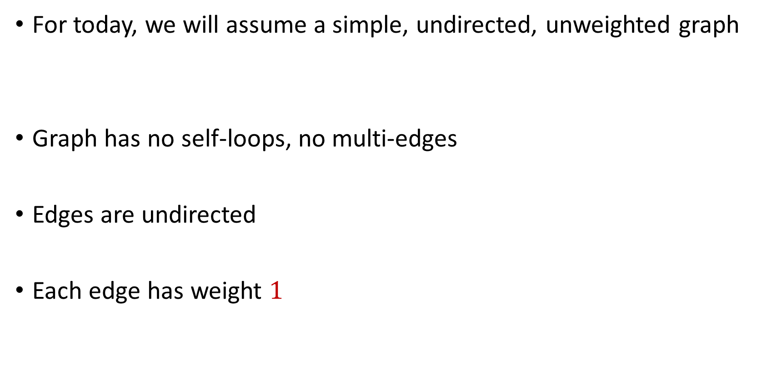
Graph Theory
For today, we will assume a simple, undirected, unweighted graph
Graph has no self-loops, no multi-edges
Edges are undirected
Each edge has weight $1$

Slide 13






$$1$$
$$2$$
$$5$$
$$6$$
$$4$$
$$3$$

Slide 14

Matchings
A matching $M$ is a subset of edges of $E$ such that no two edges share a common vertex

Slide 15
$$1$$
$$2$$
$$5$$
$$6$$
$$4$$
$$3$$

Slide 16
$$1$$
$$2$$
$$5$$
$$6$$
$$4$$
$$3$$

Slide 17

Maximal Matching
A matching $M$ of $G$ such that any additional edges would no longer be a matching

Slide 18
$$1$$
$$2$$
$$5$$
$$6$$
$$4$$
$$3$$

Slide 19

Maximum Matching
Find a matching $M$ of $G$ with the largest possible number of edges

Slide 20
$$1$$
$$2$$
$$5$$
$$6$$
$$4$$
$$3$$

Slide 21
$$1$$
$$2$$
$$5$$
$$6$$
$$4$$
$$3$$

Slide 22
Maximum Matching
How to find maximum matching?
An augmenting path is any path of edges that does not start and does not end at a vertex in the matching
“Flipping” all the edges in an augmenting path increases the matching size

Slide 23
$$1$$
$$2$$
$$5$$
$$6$$
$$4$$
$$3$$

Slide 24
$$1$$
$$2$$
$$5$$
$$6$$
$$4$$
$$3$$

Slide 25
$$1$$
$$2$$
$$5$$
$$6$$
$$4$$
$$3$$

Slide 26
Maximum Matching
It turns out repeatedly finding augmenting paths is sufficient for finding a maximum matching
Formally: If a matching is not a maximum matching, there exists an augmenting path to the matching
Algorithms by Hopcroft and Karp (1973) and Edmonds (1965) for finding augmenting paths – can be done in polynomial time

Slide 27
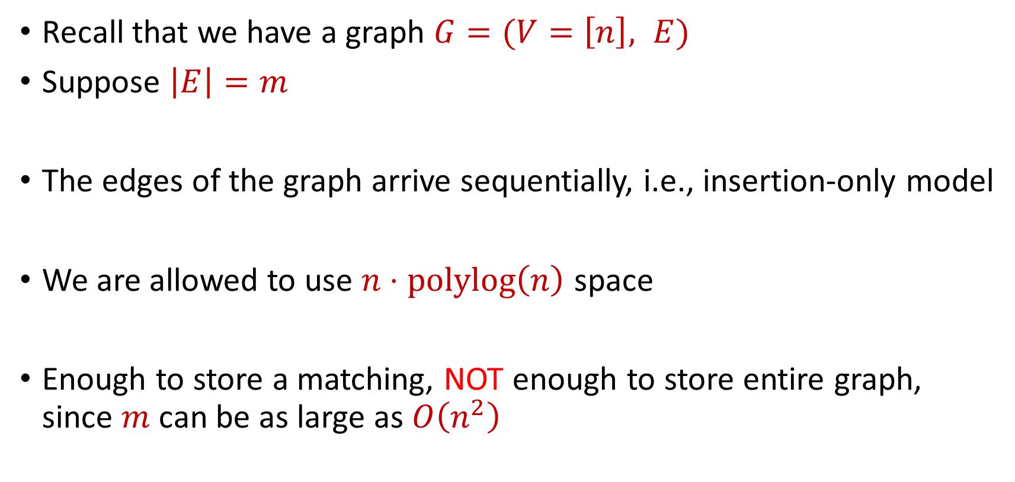
Semi-streaming Model
Recall that we have a graph $G=(V=\left[n\right], E)$
Suppose $\left|E\right|=m$
The edges of the graph arrive sequentially, i.e., insertion-only model
We are allowed to use $n⋅polylog\left(n\right)$ space
Enough to store a matching, NOT enough to store entire graph, since $m$ can be as large as $O\left(n^{2}\right)$

Slide 28
Semi-streaming Model
Can we run the augmenting paths algorithm?

Slide 29
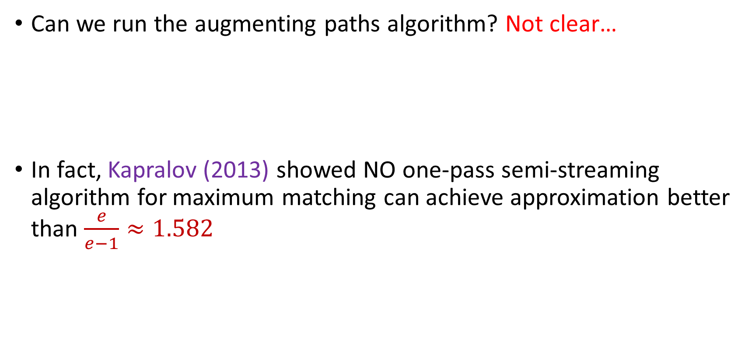
Semi-streaming Model
Can we run the augmenting paths algorithm? Not clear…
In fact, Kapralov (2013) showed NO one-pass semi-streaming algorithm for maximum matching can achieve approximation better than $\frac{e}{e−1}≈1.582$

Slide 30
Maximum Matching
What if we just wanted to find a maximal matching?

Slide 31
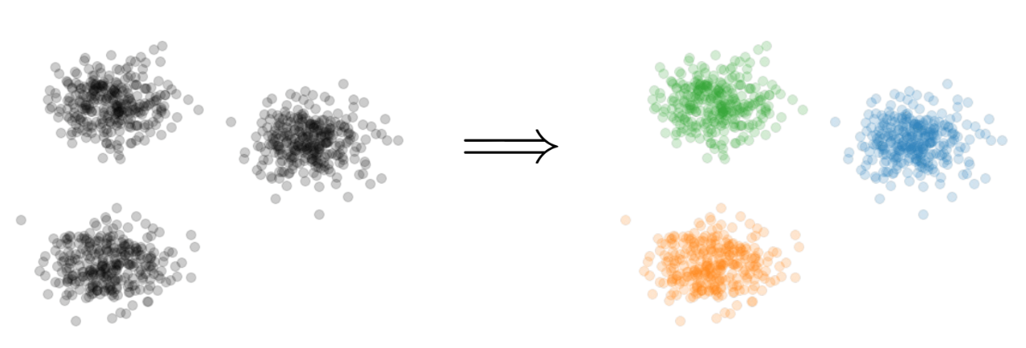

Clustering
Goal: Given input dataset $P$, partition $P$ so that “similar” points are in the same cluster and “different” points are in different clusters

Slide 32
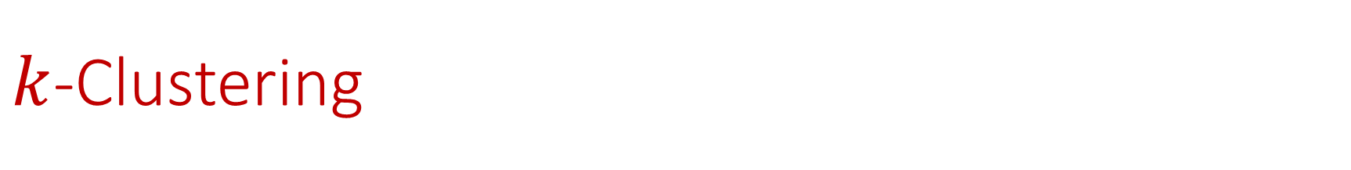

$k$-Clustering
Goal: Given input dataset $P$, partition $P$ so that “similar” points are in the same cluster and “different” points are in different clusters
There can be at most $k$ different clusters
$$k=3$$

Slide 33
$k$-Clustering
Question: How do we measure the “quality” of each clustering?
$$k=3$$

Slide 34
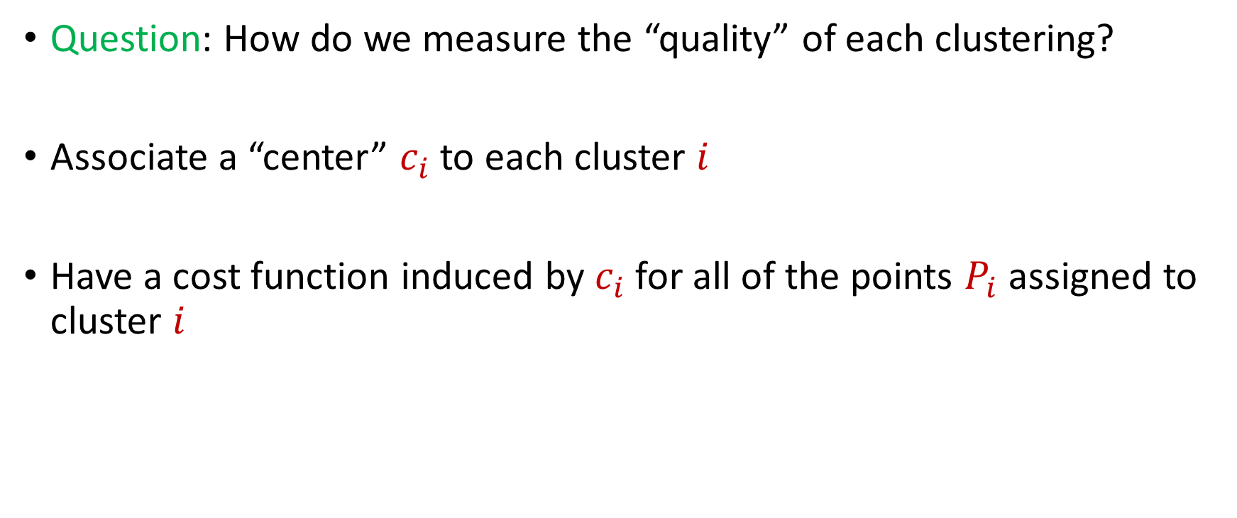
$k$-Clustering
Question: How do we measure the “quality” of each clustering?
Associate a “center” $c_{i}$ to each cluster $i$
Have a cost function induced by $c_{i}$ for all of the points $P_{i}$ assigned to cluster $i$
$$Cost\left(P_{i}, c_{i}\right)$$

Slide 37





1 0 3 0 1 1
1 1 0 0 2 8
2 0 1 3 0 8
1 1 0 0 0 8
0 0 0 7 0 0
7 0 0 8 0 0
3 4 1 1 0 2
4 2 0 1 0 1
9 1 0 0 3 2
1 1 6 0 0 0
8 1 0 1 2 0
1
1
2
1
0
7
3
4
9
1
8
$$n$$
$$A$$
$$b$$
$$d$$
$$1$$

Slide 38




$$x$$
$$n$$
$$A$$
$$≈$$
$$b$$
$$d$$
$$1$$

Slide 39




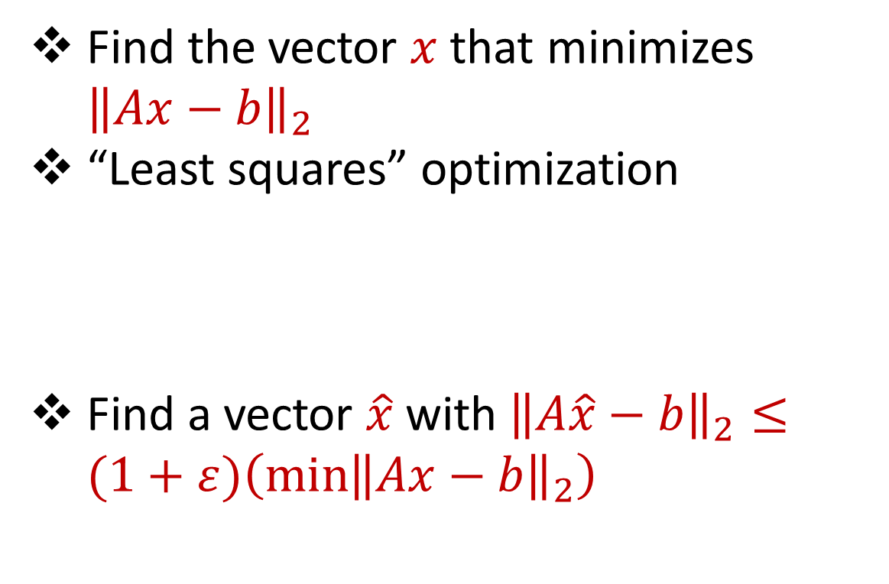






Linear Regression
Find the vector $x$ that minimizes ${\left\|Ax−b\right\|}_{2}$
“Least squares” optimization
Find a vector $\hat{x}$ with ${\left\|A\hat{x}−b\right\|}_{2}≤(1+ε)\left(\min{{\left\|Ax−b\right\|}_{2}}\right)$
$$d$$
$$x$$
$$≈$$
$$n$$
$$A$$
$$n$$
$$b$$
$$1$$
$$d$$
$$1$$

Slide 40




Dimensionality Reduction
Reduce $d$
Reduce $n$
Application depends on task!
Sampling, Sketching, Johnson-Lindenstrauss, IsoMap
$$n$$
$$A$$
Sampling, Sketching
$$d$$

Slide 41


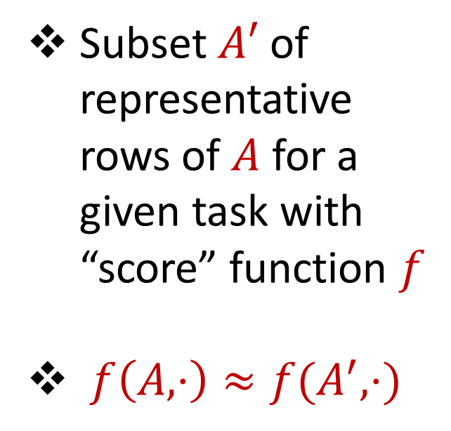



Coreset
Subset $A′$ of representative rows of $A$ for a given task with “score” function $f$
$f\left(A,⋅\right)≈f(A^{′},⋅)$
$$n$$
$$A$$
$$A′$$
$$d$$
$$d$$

Slide 42
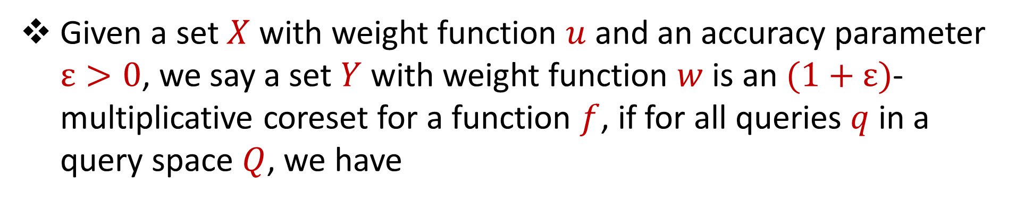
Coreset (Formal Definition)
Given a set $X$ with weight function $u$ and an accuracy parameter $ε>0$, we say a set $Y$ with weight function $w$is an $(1+ε)$-multiplicative coreset for a function $f$, if for all queries $q$ in a query space $Q$, we have
$$\left(1−ε\right)f\left(Y,q,w\right)≤f\left(X,q,u\right)≤\left(1+ε\right)f(Y,q,w)$$

Slide 43
Coreset
Lots of different constructions with various tradeoffs
Size vs. accuracy
Size vs. computation time
Size vs. interpretability
Average-case vs. worst-case performance

Slide 44
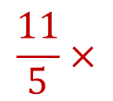
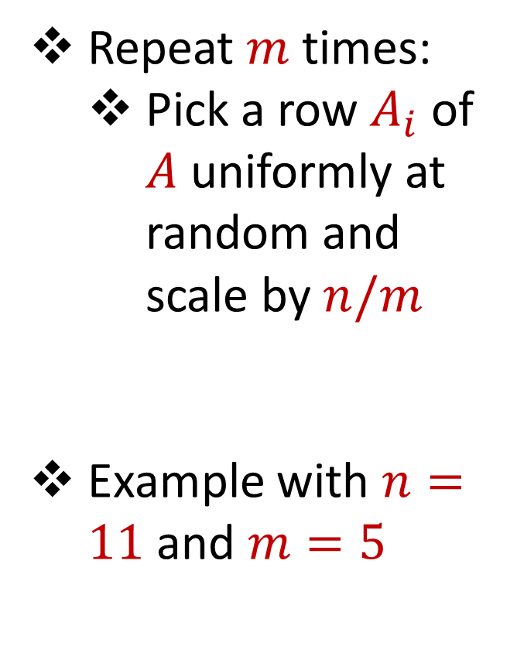
Uniform Sampling
1 0 3 0 1 1
1 1 0 0 2 8
2 0 1 3 0 8
1 1 0 0 0 8
0 0 0 7 0 0
7 0 0 8 0 0
3 4 1 1 0 2
4 2 0 1 0 1
9 1 0 0 3 2
1 1 6 0 0 0
8 1 0 1 2 0
Repeat $m$ times:
Pick a row $A_{i}$ of $A$ uniformly at random and scale by $n/m$
Example with $n=11$ and $m=5$
$$n$$
$$A$$
1 0 3 0 1 1
1 1 0 0 0 8
3 4 1 1 0 2
8 1 0 1 2 0
3 4 1 1 0 2
$$\frac{11}{5}×$$
$$A′$$
$$d$$
$$d$$

Slide 45

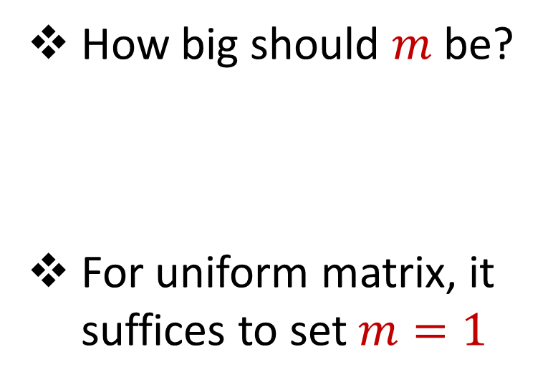


Uniform Sampling
1 0 0 0 0 0
1 0 0 0 0 0
1 0 0 0 0 0
1 0 0 0 0 0
1 0 0 0 0 0
1 0 0 0 0 0
1 0 0 0 0 0
1 0 0 0 0 0
1 0 0 0 0 0
1 0 0 0 0 0
1 0 0 0 0 0
How big should $m$ be?
For uniform matrix, it suffices to set $m=1$
$$n$$
$$A$$
$$d$$

Slide 46
Uniform Sampling
1 0 0 0 0 0
1 0 0 0 0 0
1 0 0 0 0 0
1 0 0 0 0 0
1 0 0 0 0 0
1 0 0 0 0 0
1 0 0 0 0 0
1 0 0 0 0 0
1 0 0 0 0 0
1 0 0 0 0 0
1 0 0 0 0 0
How big should $m$ be?
For uniform matrix, it suffices to set $m=1$
$$n$$
$$A$$
1 0 0 0 0 0
1 0 0 0 0 0
1 0 0 0 0 0
1 0 0 0 0 0
1 0 0 0 0 0
$$\frac{11}{5}×$$
$$A′$$
$$d$$
$$d$$

Slide 47
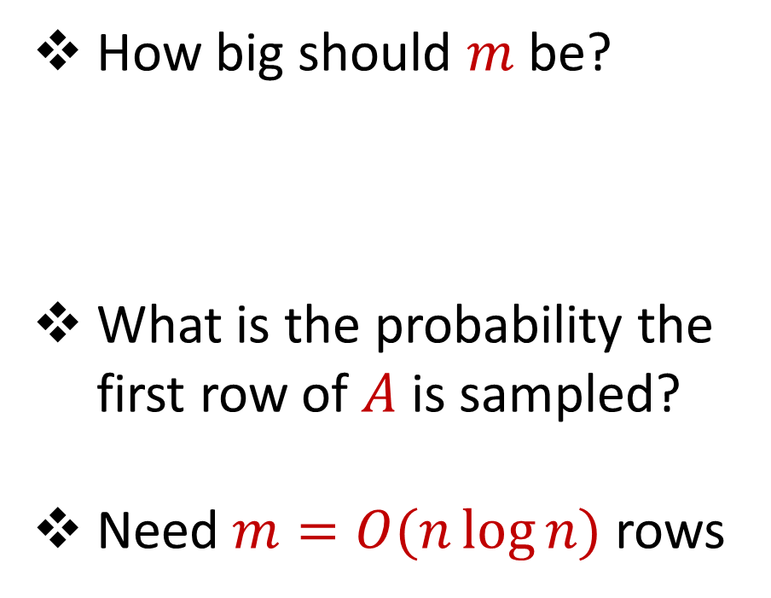
Uniform Sampling
0 0 0 0 0 1
1 0 0 0 0 0
1 0 0 0 0 0
1 0 0 0 0 0
1 0 0 0 0 0
1 0 0 0 0 0
1 0 0 0 0 0
1 0 0 0 0 0
1 0 0 0 0 0
1 0 0 0 0 0
1 0 0 0 0 0
How big should $m$ be?
What is the probability the first row of $A$ is sampled?
Need $m=O(n\log{n})$ rows
$$n$$
$$A$$
$$d$$

Slide 48
Uniform Sampling
Pros: intuitively simple, simple to implement, fast, good on uniform or “average-case” data
Cons: bad on “worst-case” data

Slide 49
Importance Sampling
1 0 0 0 0 0
1 0 0 0 0 0
1 0 0 0 0 0
1 0 0 0 0 0
1 0 0 0 0 0
1 0 0 0 0 0
0 0 0 0 0 1
1 0 0 0 0 0
1 0 0 0 0 0
1 0 0 0 0 0
1 0 0 0 0 0
What if we do not sample uniformly at random?
What is the probability that each row should be sampled?
$$n$$
$$A$$

Slide 50
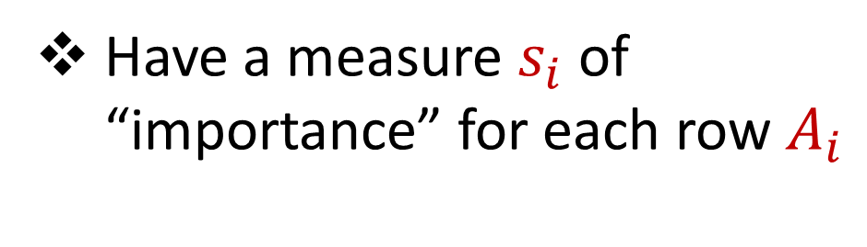
Importance Sampling
1 0 0 0 0 0
1 0 0 0 0 0
1 0 0 0 0 0
1 0 0 0 0 0
1 0 0 0 0 0
1 0 0 0 0 0
0 0 0 0 0 1
1 0 0 0 0 0
1 0 0 0 0 0
1 0 0 0 0 0
1 0 0 0 0 0
Have a measure $s_{i}$ of “importance” for each row $A_{i}$
$$n$$
$$A$$

Slide 51

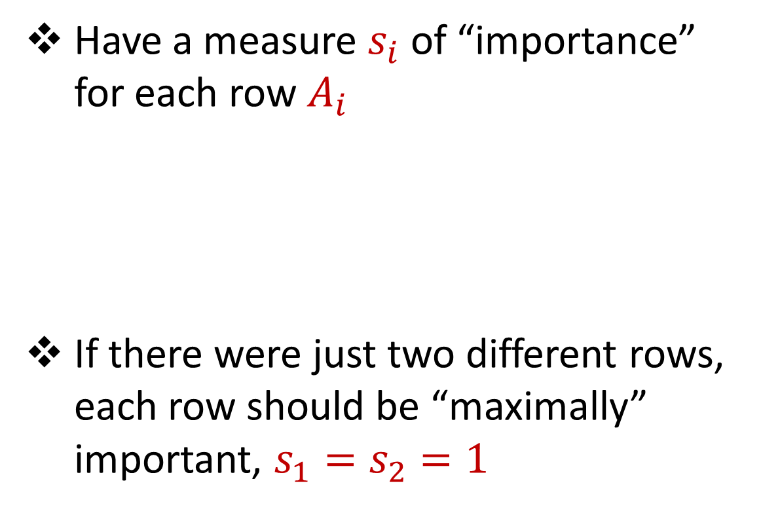



Importance Sampling
1 0 0 0 0 0
1 0 0 0 0 0
1 0 0 0 0 0
1 0 0 0 0 0
1 0 0 0 0 0
1 0 0 0 0 0
0 0 0 0 0 1
1 0 0 0 0 0
1 0 0 0 0 0
1 0 0 0 0 0
1 0 0 0 0 0
Have a measure $s_{i}$ of “importance” for each row $A_{i}$
If there were just two different rows, each row should be “maximally” important, $s_{1}=s_{2}=1$
$$n$$
$$A$$
1 0 0 0 0 0
0 0 0 0 0 1
$$n$$
$$A$$

Slide 52
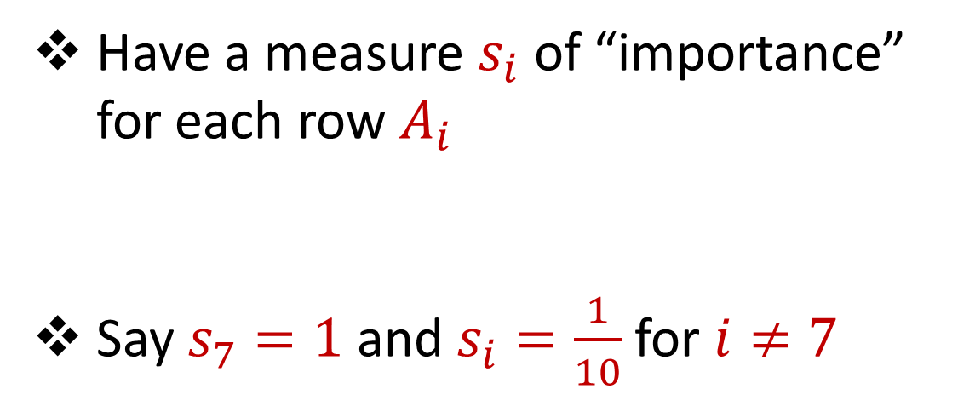
Importance Sampling
1 0 0 0 0 0
1 0 0 0 0 0
1 0 0 0 0 0
1 0 0 0 0 0
1 0 0 0 0 0
1 0 0 0 0 0
0 0 0 0 0 1
1 0 0 0 0 0
1 0 0 0 0 0
1 0 0 0 0 0
1 0 0 0 0 0
Have a measure $s_{i}$ of “importance” for each row $A_{i}$
Say $s_{7}=1$ and $s_{i}=\frac{1}{10}$ for $i≠7$
$$n$$
$$A$$

Slide 53
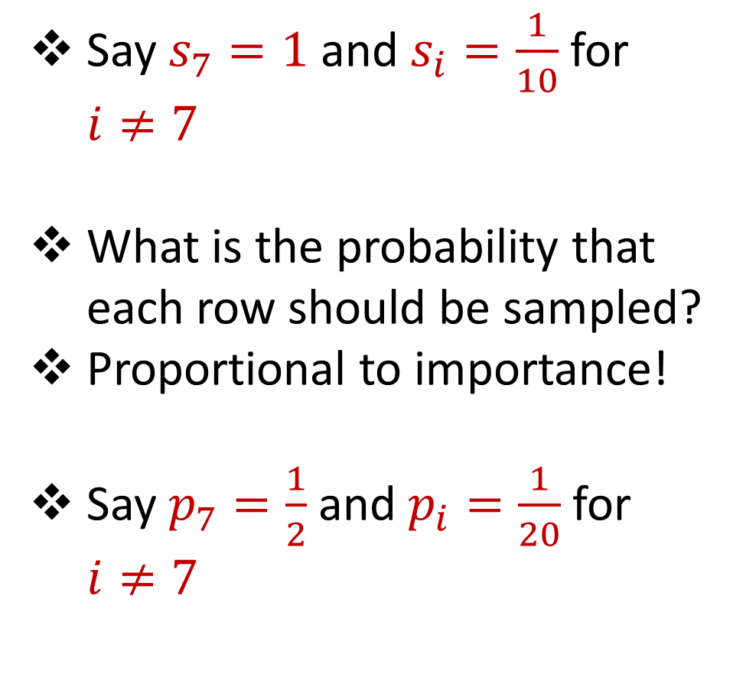
Importance Sampling
1 0 0 0 0 0
1 0 0 0 0 0
1 0 0 0 0 0
1 0 0 0 0 0
1 0 0 0 0 0
1 0 0 0 0 0
0 0 0 0 0 1
1 0 0 0 0 0
1 0 0 0 0 0
1 0 0 0 0 0
1 0 0 0 0 0
Say $s_{7}=1$ and $s_{i}=\frac{1}{10}$ for $i≠7$
What is the probability that each row should be sampled?
Proportional to importance!
Say $p_{7}=\frac{1}{2}$ and $p_{i}=\frac{1}{20}$ for $i≠7$
$$n$$
$$A$$

Slide 54
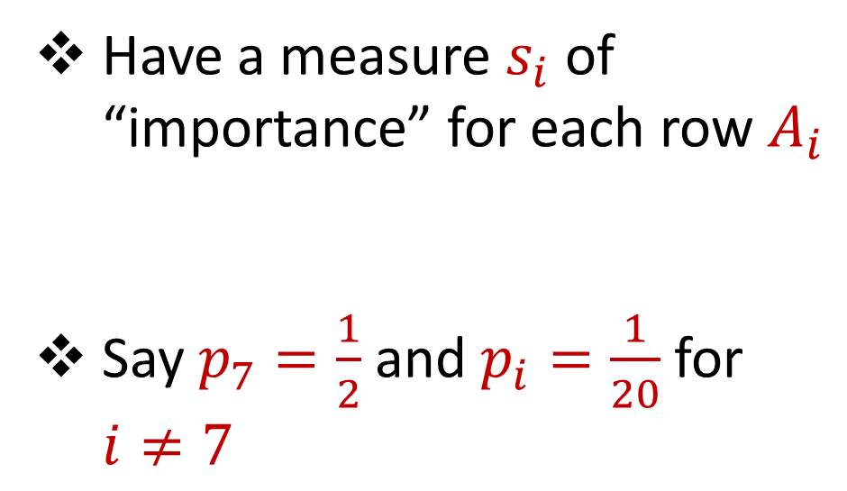
Importance Sampling
1 0 0 0 0 0
1 0 0 0 0 0
1 0 0 0 0 0
1 0 0 0 0 0
1 0 0 0 0 0
1 0 0 0 0 0
0 0 0 0 0 1
1 0 0 0 0 0
1 0 0 0 0 0
1 0 0 0 0 0
1 0 0 0 0 0
Have a measure $s_{i}$ of “importance” for each row $A_{i}$
Say $p_{7}=\frac{1}{2}$ and $p_{i}=\frac{1}{20}$ for $i≠7$
$$n$$
$$A$$

Slide 55

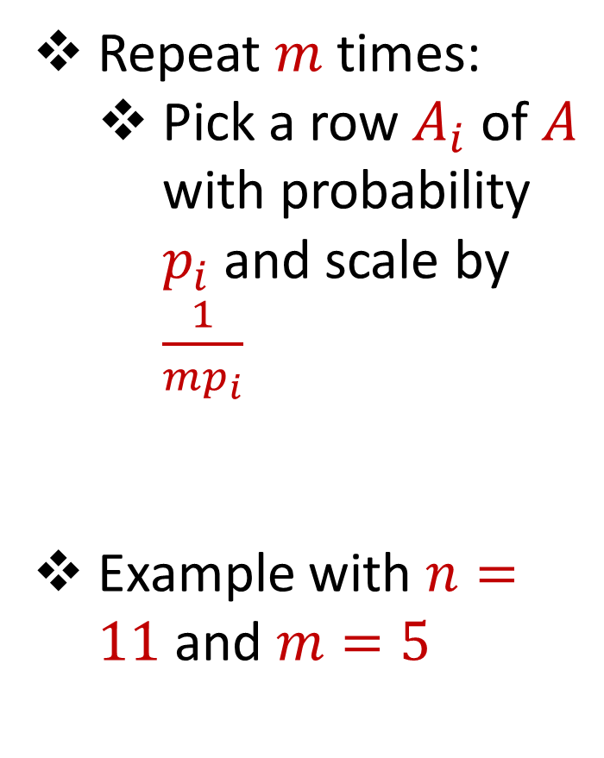

Importance Sampling
1 0 0 0 0 0
1 0 0 0 0 0
1 0 0 0 0 0
1 0 0 0 0 0
1 0 0 0 0 0
1 0 0 0 0 0
0 0 0 0 0 1
1 0 0 0 0 0
1 0 0 0 0 0
1 0 0 0 0 0
1 0 0 0 0 0
Repeat $m$ times:
Pick a row $A_{i}$ of $A$ with probability $p_{i}$and scale by $\frac{1}{mp_{i}}$
Example with $n=11$ and $m=5$
$$n$$
$$A$$
4 0 0 0 0 0
4 0 0 0 0 0
0 0 0 0 0 $\frac{2}{5}$
4 0 0 0 0 0
0 0 0 0 0 $\frac{2}{5}$
$$A′$$
$$d$$
$$d$$

Slide 56
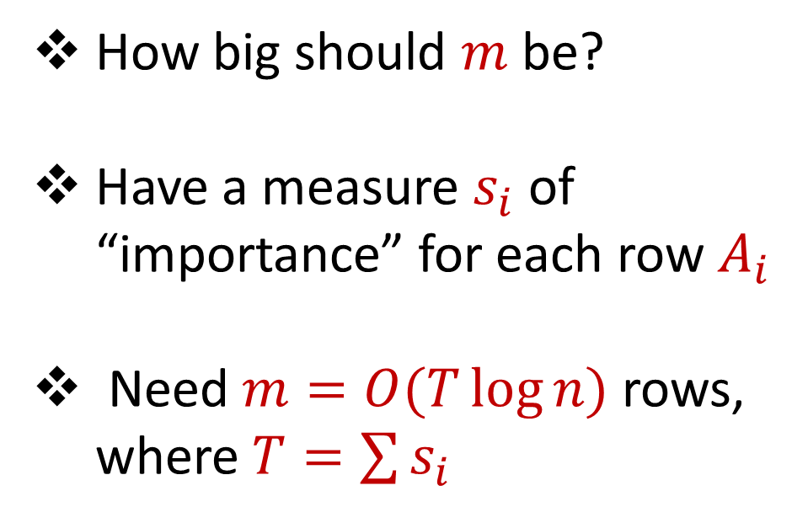
Importance Sampling
0 0 0 0 0 1
1 0 0 0 0 0
1 0 0 0 0 0
1 0 0 0 0 0
1 0 0 0 0 0
1 0 0 0 0 0
1 0 0 0 0 0
1 0 0 0 0 0
1 0 0 0 0 0
1 0 0 0 0 0
1 0 0 0 0 0
How big should $m$ be?
Have a measure $s_{i}$ of “importance” for each row $A_{i}$
Need $m=O(T\log{n})$ rows, where $T=\sum{s_{i}}$
$$n$$
$$A$$
$$d$$

Slide 57
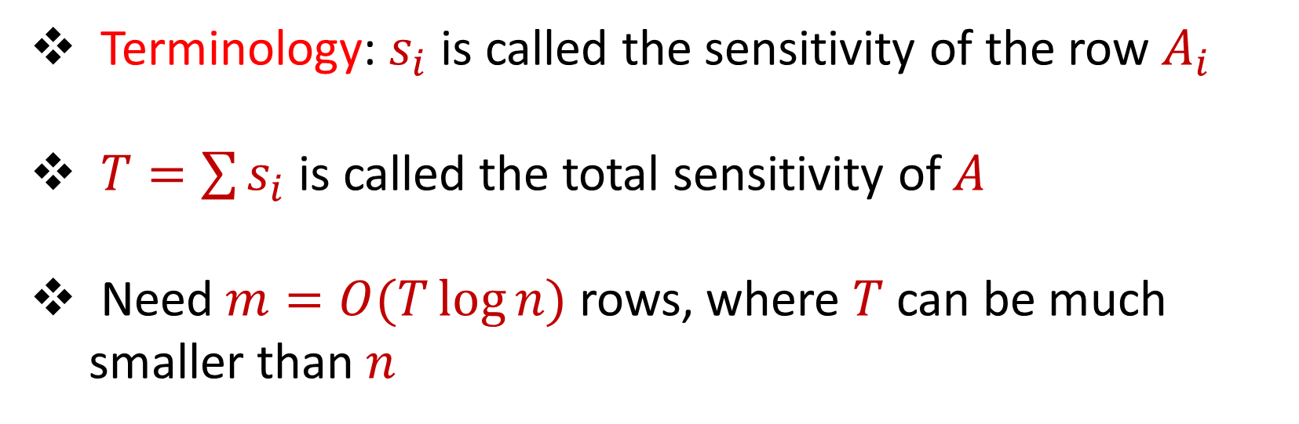
Sensitivity Sampling
Terminology: $s_{i}$ is called the sensitivity of the row $A_{i}$
$T=\sum{s_{i}}$ is called the total sensitivity of $A$
Need $m=O(T\log{n})$ rows, where $T$ can be much smaller than $n$

Slide 58

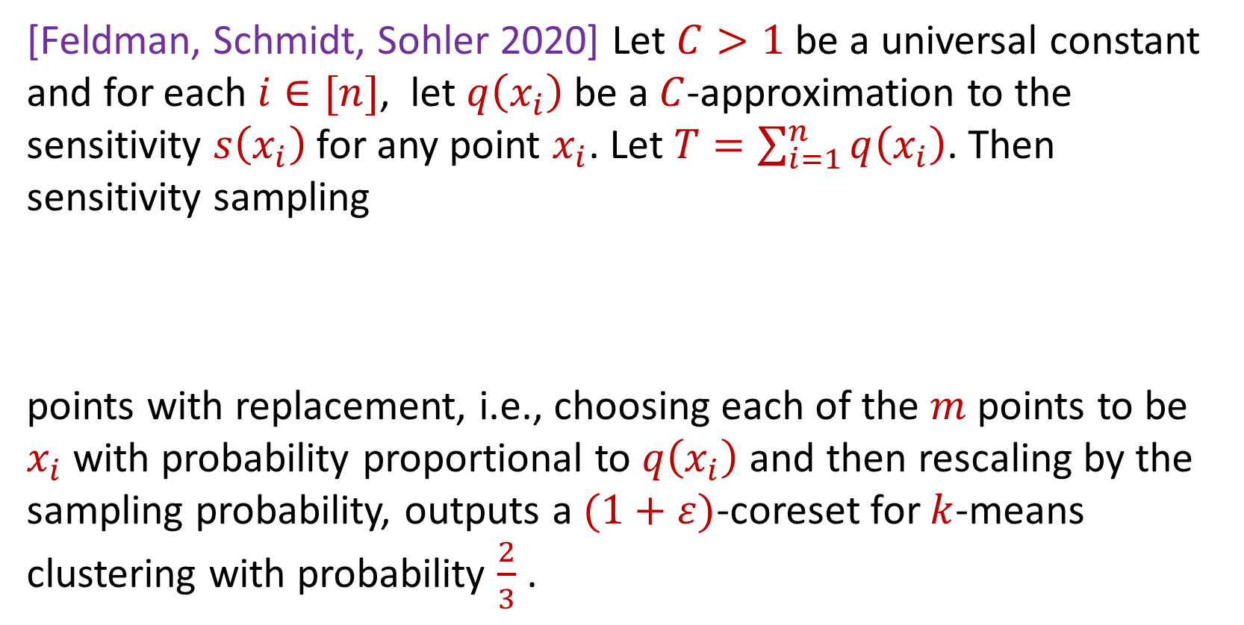
Sensitivity Sampling (Formal Theorem)
[Feldman, Schmidt, Sohler 2020] Let $C>1$ be a universal constant and for each $i∈[n]$, let $q\left(x_{i}\right)$ be a $C$-approximation to the sensitivity $s\left(x_{i}\right)$for any point $x_{i}$. Let $T=\sum_{i=1}^{n}{q\left(x_{i}\right)}$. Then sensitivity sampling
points with replacement, i.e., choosing each of the $m$ points to be $x_{i}$with probability proportional to $q\left(x_{i}\right)$ and then rescaling by the sampling probability, outputs a $(1+ε)$-coreset for $k$-means clustering with probability $\frac{2}{3}$ .
$$m=O\left(\frac{Tk}{ε^{2}}\log^{2}{k}\right)$$

Slide 59
Sensitivity Sampling
Pros: size is always better than uniform sampling and MUCH better on “worst-case” data
Cons: estimating the sensitivities can be a difficult design choice, computing the total sensitivity can be mathematically challenging, larger runtime

Slide 60
 | Uniform Sampling | Sensitivity Sampling
Average-case size | X | X
Worst-case size |  | X
Ease of implementation Computation of probabilities | X
Interpretability |  | X

Slide 61



Group / Stratified Sampling
0 0 0 0 0 1
1 0 0 0 0 0
1 0 0 0 0 0
1 0 0 0 0 0
1 0 0 0 0 0
1 0 0 0 0 0
1 0 0 0 0 0
1 0 0 0 0 0
1 0 0 0 0 0
1 0 0 0 0 0
1 0 0 0 0 0
Separate the data into “groups” and then perform uniform sampling on each group
If the data is uniform in each group, this is essentially sensitivity sampling
$$n$$
$$A$$
$$d$$

Slide 63
Coresets
Where to apply them?
Which sampling approach to use?
Worst-case mathematical bounds

Slide 64
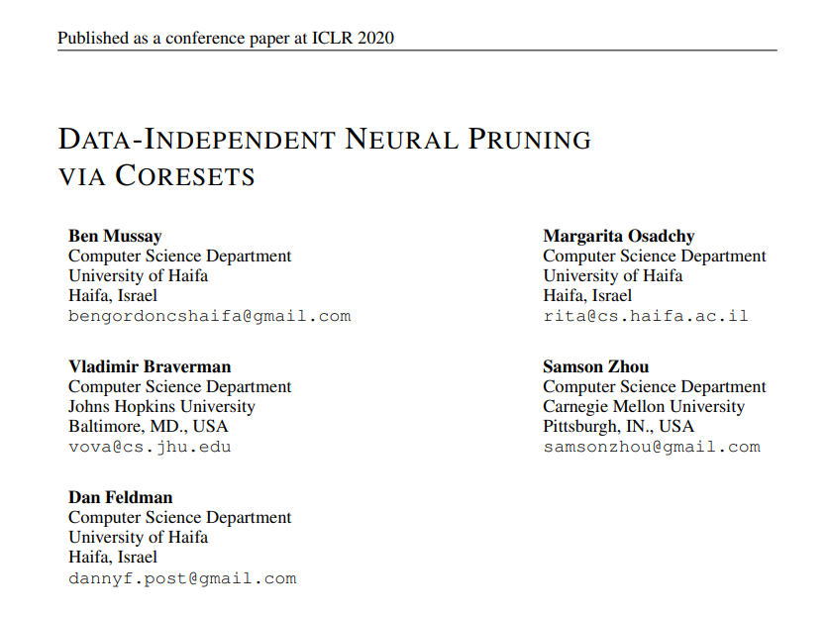
Coresets
Where to apply them?

Slide 65
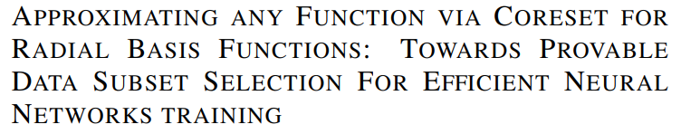
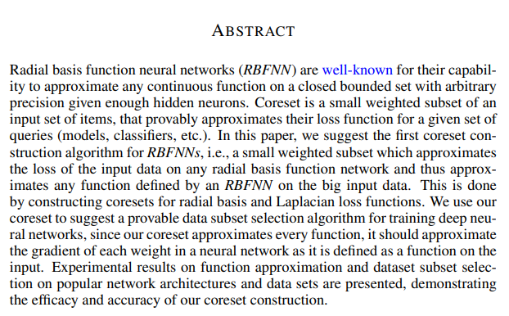
Coresets
Which sampling approach to use?

Slide 66
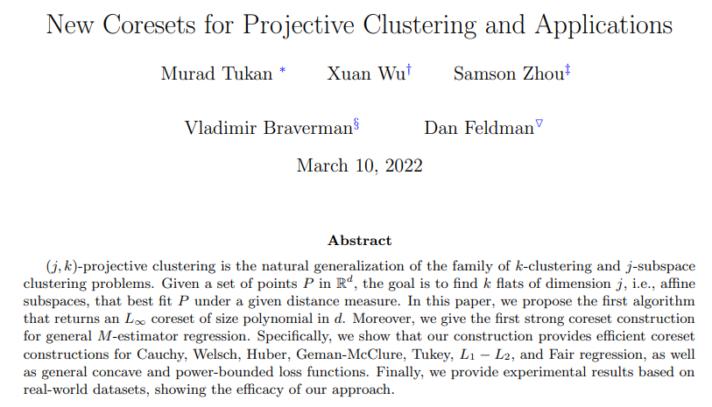
Coresets
Worst-case mathematical bounds

