Slide 1
CSCE 658: Randomized Algorithms
Lecture 15
Samson Zhou

Slide 2
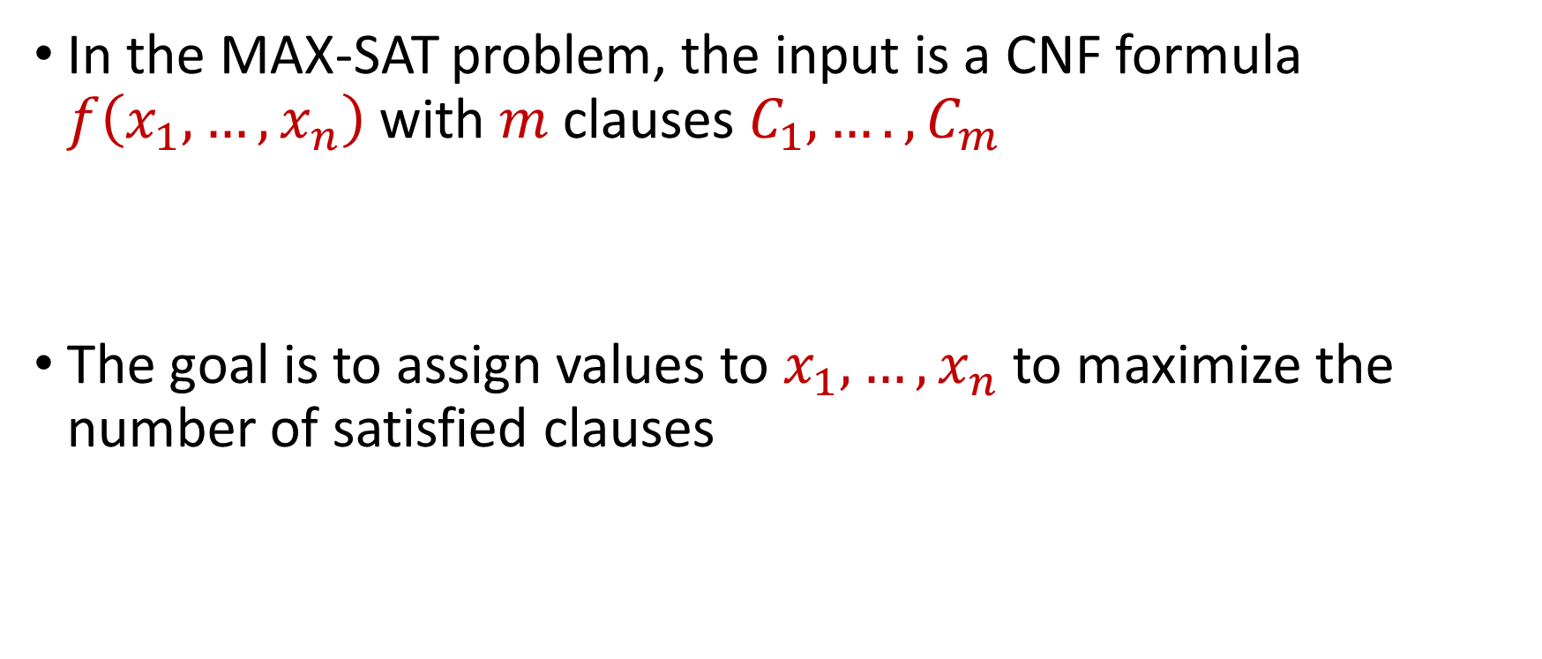
MAX-SAT
In the MAX-SAT problem, the input is a CNF formula $f\left(x_{1},…,x_{n}\right)$ with $m$ clauses $C_{1},….,C_{m}$
The goal is to assign values to $x_{1},…,x_{n}$ to maximize the number of satisfied clauses

Slide 3
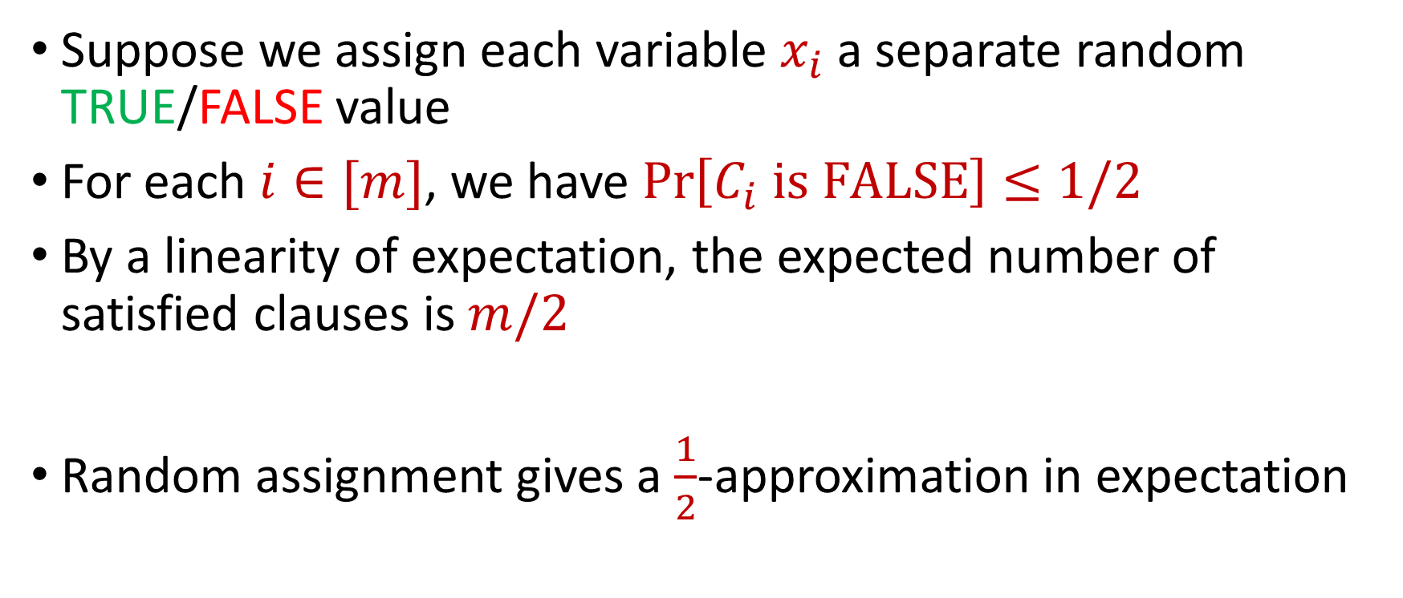
MAX-SAT
Suppose we assign each variable $x_{i}$ a separate random TRUE/FALSE value
For each $i∈[m]$, we have $\operatorname{Pr}\left[C_{i} is FALSE\right]≤1/2$
By a linearity of expectation, the expected number of satisfied clauses is $m/2$
Random assignment gives a $\frac{1}{2}$-approximation in expectation

Slide 4
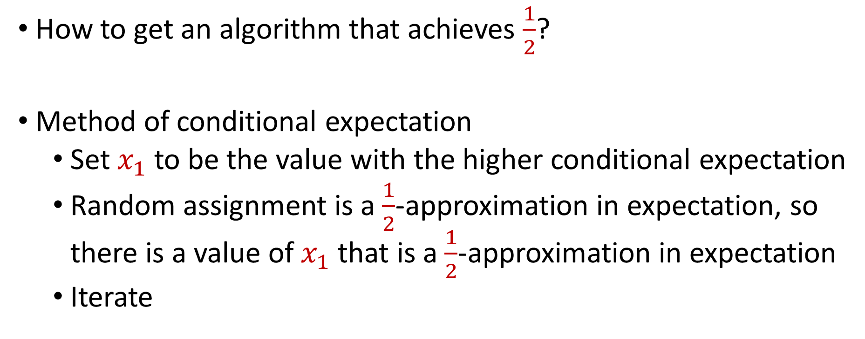
Derandomization of MAX-SAT
How to get an algorithm that achieves $\frac{1}{2}$?
Method of conditional expectation
Set $x_{1}$ to be the value with the higher conditional expectation
Random assignment is a $\frac{1}{2}$-approximation in expectation, so there is a value of $x_{1}$ that is a $\frac{1}{2}$-approximation in expectation
Iterate

Slide 5
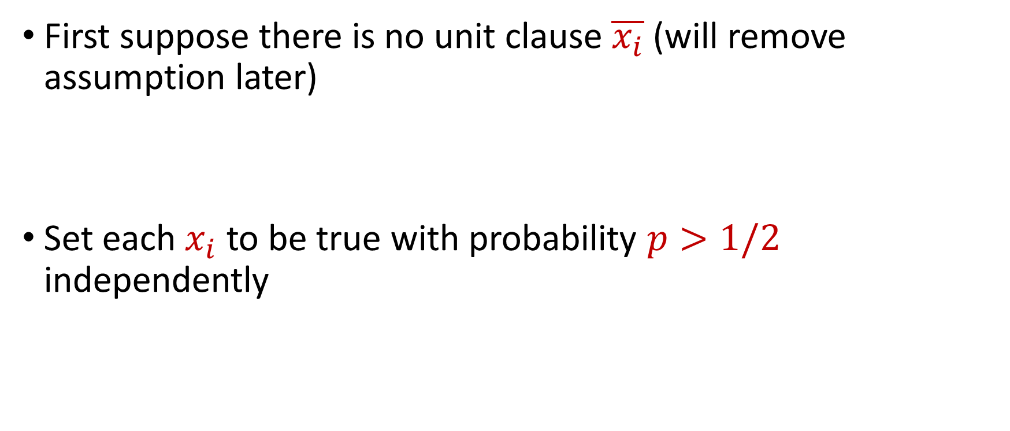
Better Algorithm for MAX-SAT
First suppose there is no unit clause $\overline{x_{i}}$ (will remove assumption later)
Set each $x_{i}$ to be true with probability $p>1/2$ independently

Slide 6
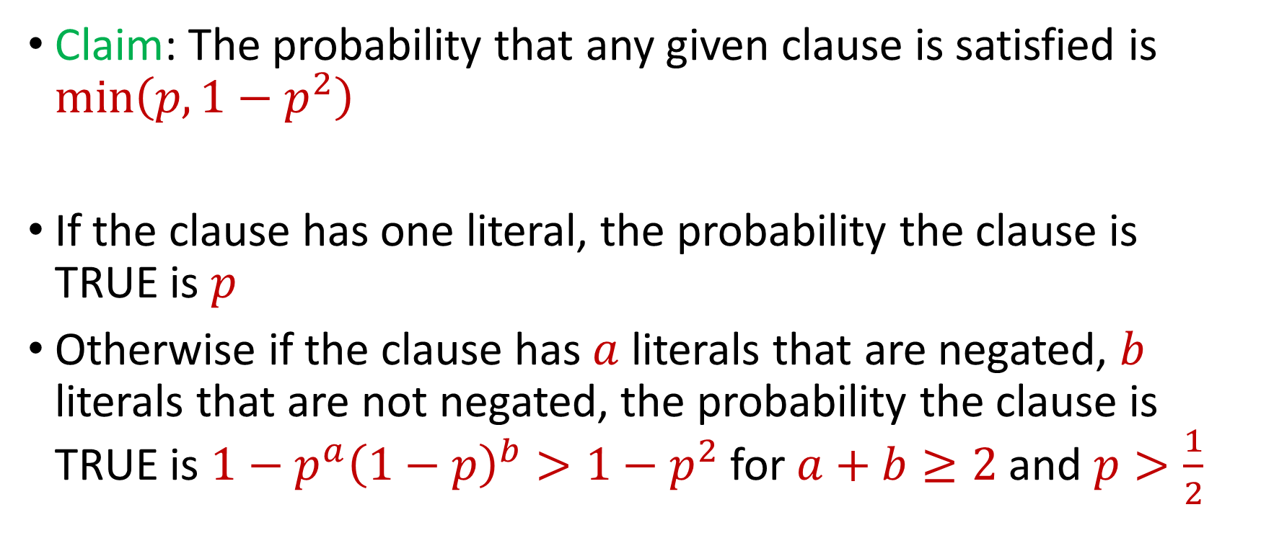
Better Algorithm for MAX-SAT
Claim: The probability that any given clause is satisfied is $\min\left(p,1−p^{2}\right)$
If the clause has one literal, the probability the clause is TRUE is $p$
Otherwise if the clause has $a$ literals that are negated, $b$ literals that are not negated, the probability the clause is TRUE is $1−p^{a}{\left(1−p\right)}^{b}>1−p^{2}$ for $a+b≥2$and $p>\frac{1}{2}$

Slide 7
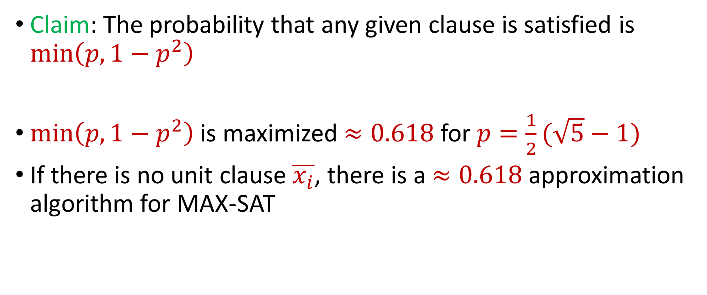
Better Algorithm for MAX-SAT
Claim: The probability that any given clause is satisfied is $\min\left(p,1−p^{2}\right)$
$\min\left(p,1−p^{2}\right)$ is maximized $≈0.618$for $p=\frac{1}{2}(\sqrt{5}−1)$
If there is no unit clause $\overline{x_{i}}$, there is a $≈0.618$ approximation algorithm for MAX-SAT

Slide 8
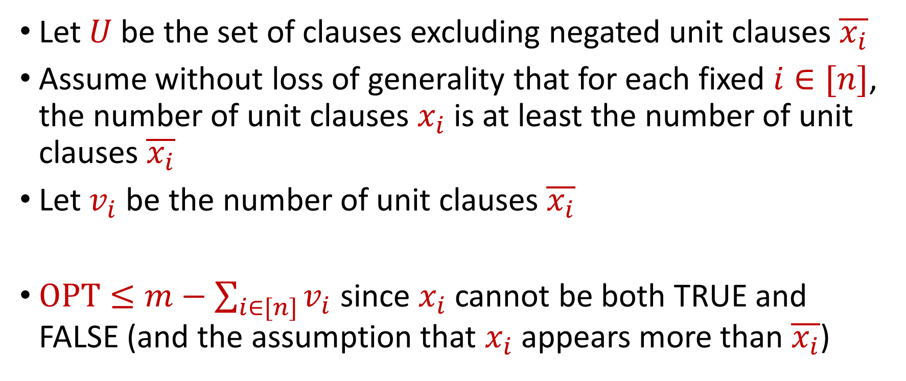
Better Algorithm for MAX-SAT
Let $U$be the set of clauses excluding negated unit clauses $\overline{x_{i}}$
Assume without loss of generality that for each fixed $i∈[n]$, the number of unit clauses $x_{i}$ is at least the number of unit clauses $\overline{x_{i}}$
Let $v_{i}$ be the number of unit clauses $\overline{x_{i}}$
$OPT≤m−\sum_{i∈[n]}{v_{i}}$ since $x_{i}$ cannot be both TRUE and FALSE (and the assumption that $x_{i}$appears more than $\overline{x_{i}}$)

Slide 9
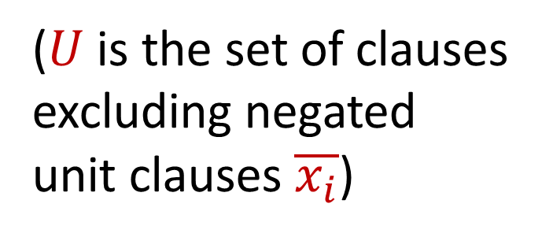

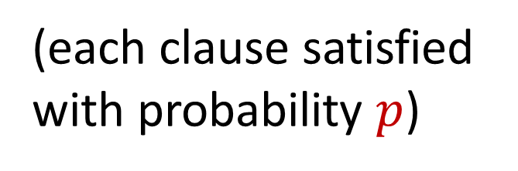

Better Algorithm for MAX-SAT
$$\sum_{j∈\left[m\right]}{Pr\left[C_{j} is satisfied\right]}=\sum_{j∈U}{Pr\left[C_{j} is satisfied\right]}$$
(each clause satisfied with probability $p$)
$$≥p|U|$$
($U$is the set of clauses excluding negated unit clauses $\overline{x_{i}}$)
$$=p\left(m−\sum_{i∈\left[n\right]}{v_{i}}\right)$$
$$≥p⋅OPT$$

Slide 10
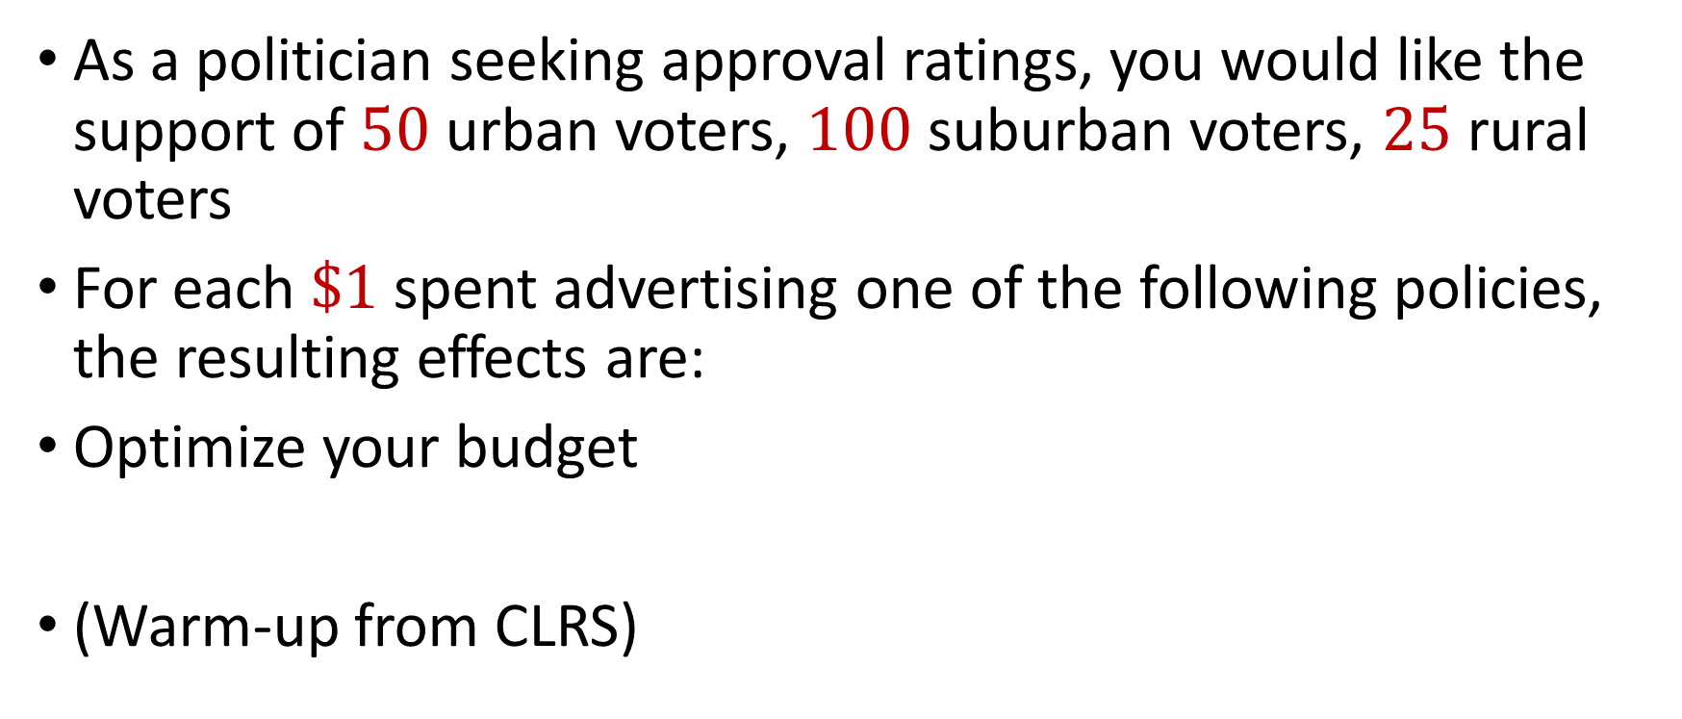
Political Problems…
As a politician seeking approval ratings, you would like the support of $50$ urban voters, $100$ suburban voters, $25$ rural voters
For each $\$1$ spent advertising one of the following policies, the resulting effects are:
Optimize your budget
(Warm-up from CLRS)
Policy | Urban | Suburban | Rural
Zombie apocalypse | -2 | +5 | -3
Sharks with lasers | +8 | +2 | -5
Flying cars roads | 0 | 0 | +10
Dolphins voting | +10 | 0 | -2

Slide 11

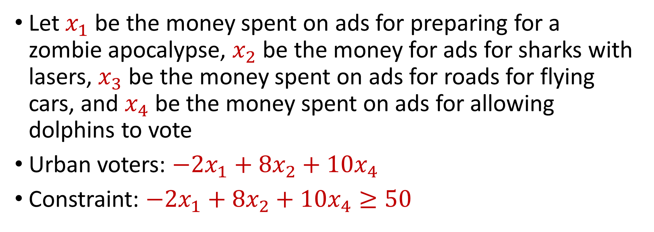
Political Problems…
Policy | Urban | Suburban | Rural
Zombie apocalypse | -2 | +5 | -3
Sharks with lasers | +8 | +2 | -5
Flying cars roads | 0 | 0 | +10
Dolphins voting | +10 | 0 | -2
You seek $50$ urban voters, $100$ suburban voters, $25$ rural voters
Let $x_{1}$ be the money spent on ads for preparing for a zombie apocalypse, $x_{2}$ be the money for ads for sharks with lasers, $x_{3}$ be the money spent on ads for roads for flying cars, and $x_{4}$ be the money spent on ads for allowing dolphins to vote
Urban voters: $−2x_{1}+8x_{2}+10x_{4}$
Constraint: $−2x_{1}+8x_{2}+10x_{4}≥50$

Slide 12
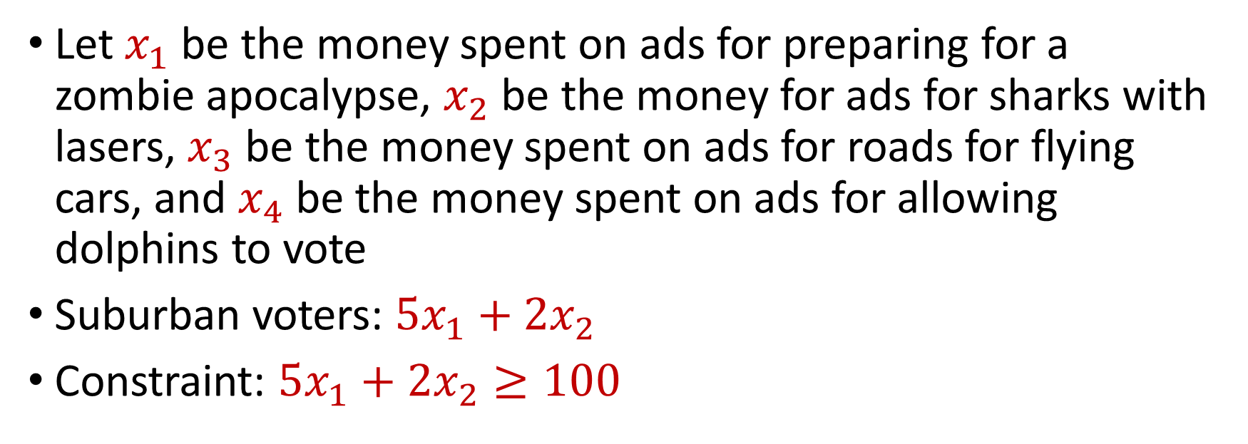
Political Problems…
Policy | Urban | Suburban | Rural
Zombie apocalypse | -2 | +5 | -3
Sharks with lasers | +8 | +2 | -5
Flying cars roads | 0 | 0 | +10
Dolphins voting | +10 | 0 | -2
You seek $50$ urban voters, $100$ suburban voters, $25$ rural voters
Let $x_{1}$ be the money spent on ads for preparing for a zombie apocalypse, $x_{2}$ be the money for ads for sharks with lasers, $x_{3}$ be the money spent on ads for roads for flying cars, and $x_{4}$ be the money spent on ads for allowing dolphins to vote
Suburban voters: $5x_{1}+2x_{2}$
Constraint: $5x_{1}+2x_{2}≥100$

Slide 13
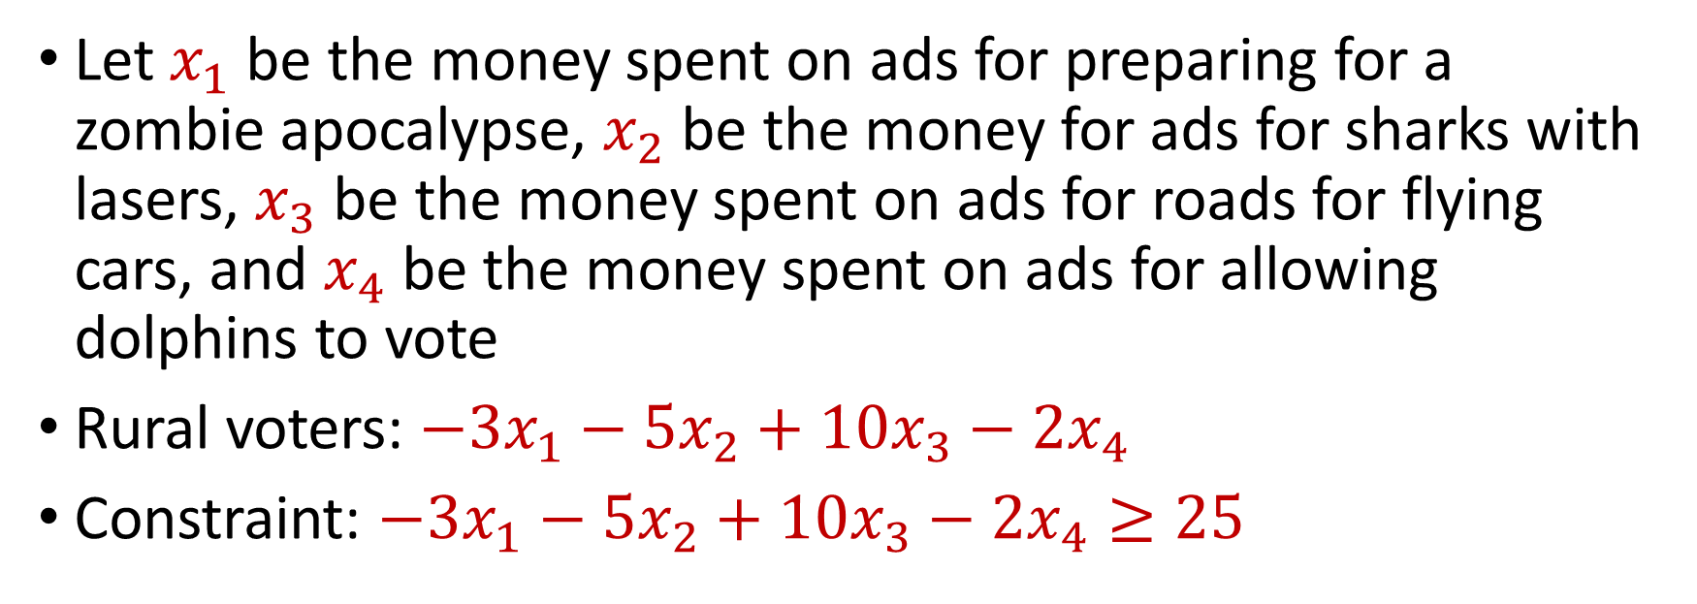
Political Problems…
Policy | Urban | Suburban | Rural
Zombie apocalypse | -2 | +5 | -3
Sharks with lasers | +8 | +2 | -5
Flying cars roads | 0 | 0 | +10
Dolphins voting | +10 | 0 | -2
You seek $50$ urban voters, $100$ suburban voters, $25$ rural voters
Let $x_{1}$ be the money spent on ads for preparing for a zombie apocalypse, $x_{2}$ be the money for ads for sharks with lasers, $x_{3}$ be the money spent on ads for roads for flying cars, and $x_{4}$ be the money spent on ads for allowing dolphins to vote
Rural voters: $−3x_{1}−5x_{2}+10x_{3}−2x_{4}$
Constraint: $−3x_{1}−5x_{2}+10x_{3}−2x_{4}≥25$

Slide 14
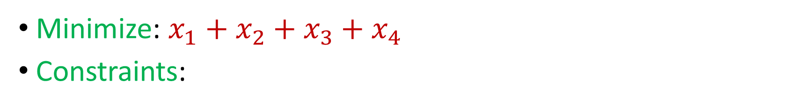
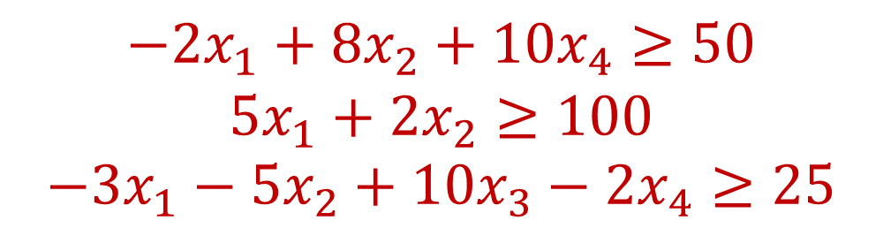
Minimization Problem
Policy | Urban | Suburban | Rural
Zombie apocalypse | -2 | +5 | -3
Sharks with lasers | +8 | +2 | -5
Flying cars roads | 0 | 0 | +10
Dolphins voting | +10 | 0 | -2
You seek $50$ urban voters, $100$ suburban voters, $25$ rural voters
Minimize: $x_{1}+x_{2}+x_{3}+x_{4}$
Constraints:
$$−2x_{1}+8x_{2}+10x_{4}≥50$$
$$5x_{1}+2x_{2}≥100$$
$$−3x_{1}−5x_{2}+10x_{3}−2x_{4}≥25$$

Slide 15
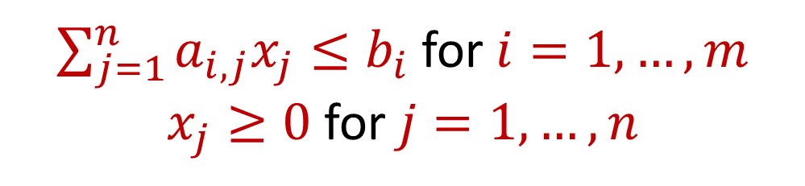
Linear Programming
Maximize a linear objective function:
Subject to constraints:
$$f\left(x_{1},…,x_{n}\right)=c_{1}x_{1}+…+c_{n}x_{n}$$
$\sum_{j=1}^{n}{a_{i,j}x_{j}≤b_{i}}$ for $i=1,…,m$
$x_{j}≥0$ for $j=1,…,n$

Slide 16
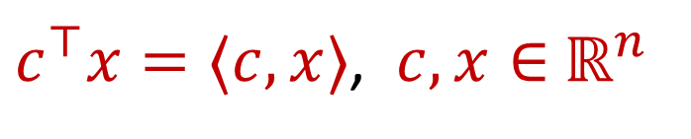
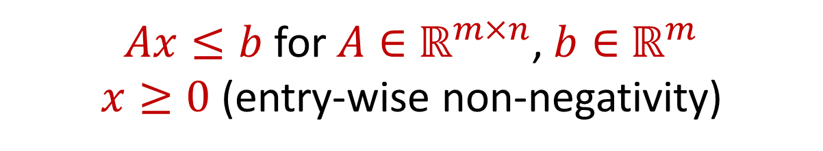
Linear Programming (Standard Form)
Maximize a linear objective function:
Subject to constraints:
$c^{⊤}x=⟨c,x⟩$, $c,x∈$ $ℝ^{n}$
$Ax≤b$ for $A∈$ $ℝ^{m×n}$, $b∈$ $ℝ^{m}$
$x≥0$ (entry-wise non-negativity)

Slide 17
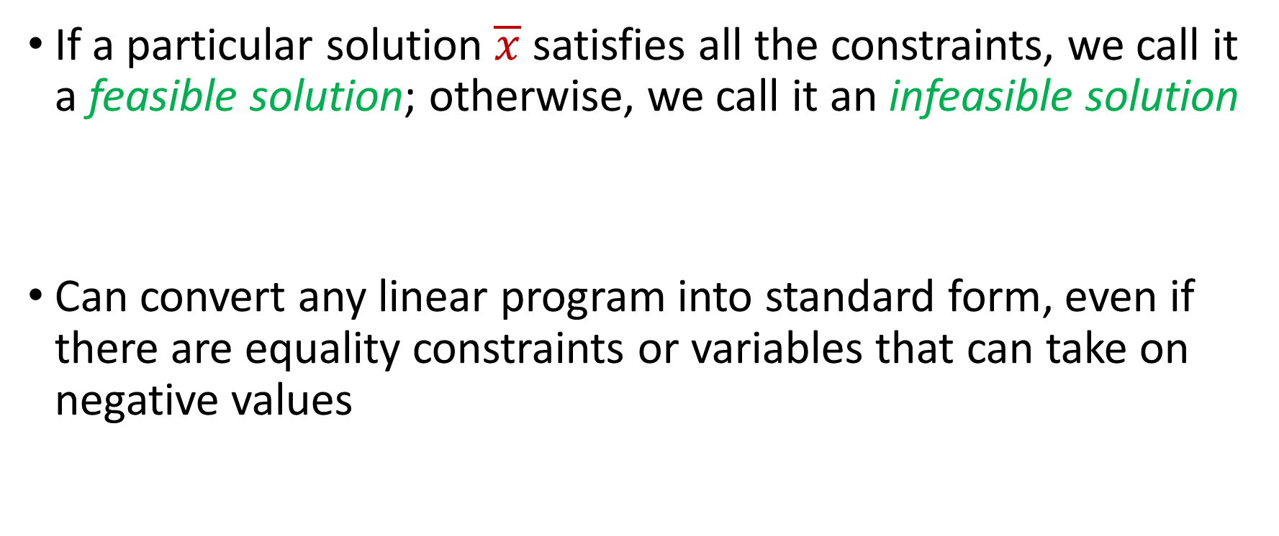
Linear Programming (Standard Form)
If a particular solution $\overline{x}$ satisfies all the constraints, we call it a feasible solution; otherwise, we call it an infeasible solution
Can convert any linear program into standard form, even if there are equality constraints or variables that can take on negative values

Slide 18


Linear Programming
Minimize: $x_{1}+x_{2}$
Subject to:
$$4x_{1}−x_{2}≤8$$
$$2x_{1}+x_{2}≤10$$
$$5x_{1}−{2x}_{2}≤−2$$
$$x_{1},x_{2}≥0$$

Slide 19
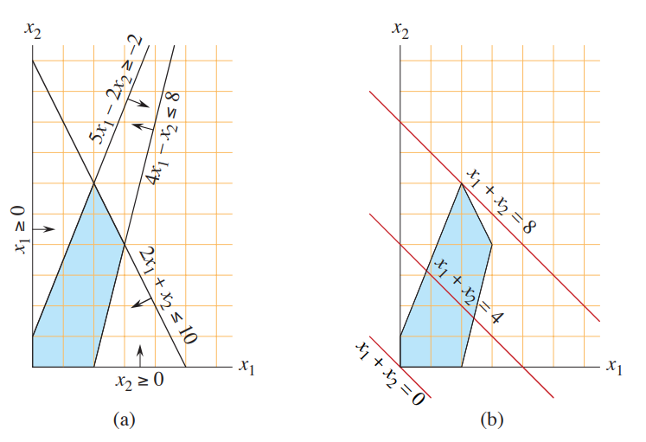
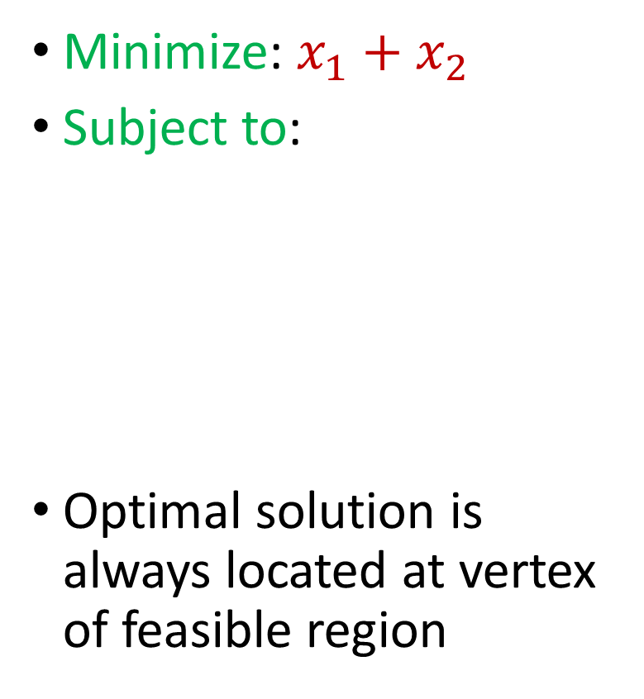
Linear Programming
Minimize: $x_{1}+x_{2}$
Subject to:
Optimal solution is always located at vertex of feasible region
$$4x_{1}−x_{2}≤8$$
$$2x_{1}+x_{2}≤10$$
$$5x_{1}−{2x}_{2}≤−2$$
$$x_{1},x_{2}≥0$$

Slide 20
Linear Programming
Simplex algorithm: finds a feasible solution at a vertex of the polytope and then searches along the edges to vertices with non-decreasing values
Good in practice but exponential time in the worst-case

Slide 21
Linear Programming
Ellipsoid algorithm: iterative algorithm that generates a sequence of smaller ellipsoids, each of which separate the current iterate with the optimal solution
Requires a separation oracle
Polynomial time algorithm in theory but inefficient in practice and can suffer from numerical instability

Slide 22


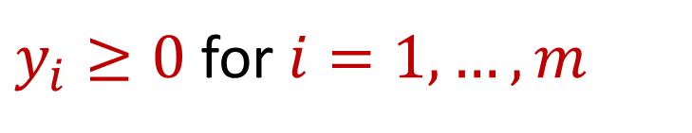
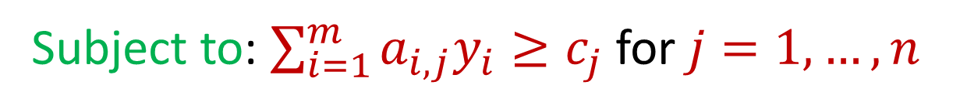
Duality
Maximize $c_{1}x_{1}+…+c_{n}x_{n}$ subject to $\sum_{j=1}^{n}{a_{i,j}x_{j}≤b_{i}}$ for $i=1,…,m$ and $x_{j}≥0$ for $j=1,…,n$
For the above linear program, its dual is
Minimize: $b_{1}y_{1}+…+b_{m}y_{m}$
Subject to: $\sum_{i=1}^{m}{a_{i,j}y_{i}≥c_{j}}$ for $j=1,…,n$
$y_{i}≥0$ for $i=1,…,m$

Slide 23

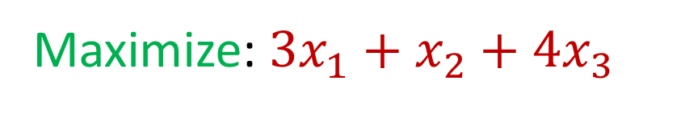



Duality
What is its dual program? (Williamson-Shmoys)
Maximize: $3x_{1}+x_{2}+4x_{3}$
Subject to: $x_{1}+x_{2}+3x_{3}≤30$
$$2x_{1}+2x_{2}+5x_{3}≤24$$
$$4x_{1}+x_{2}+2x_{3}≤36$$
$$x_{1},x_{2},x_{3} ≥0$$

Slide 24

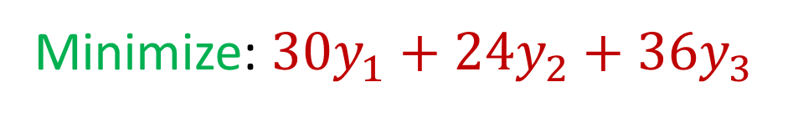



Duality
Minimize: $30y_{1}+24y_{2}+36y_{3}$
Subject to: $y_{1}+2y_{2}+4y_{3}≥3$
$$y_{1}+2y_{2}+y_{3}≥1$$
$$3y_{1}+5y_{2}+2y_{3}≥4$$
$$y_{1},y_{2},y_{3} ≥0$$

Slide 25

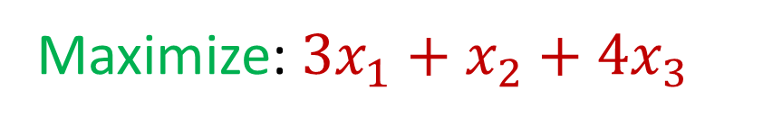



Duality
Intuition: What if we take the original constraints and add the first two constraints?
Maximize: $3x_{1}+x_{2}+4x_{3}$
Subject to: $x_{1}+x_{2}+3x_{3}≤30$
$$2x_{1}+2x_{2}+5x_{3}≤24$$
$$4x_{1}+x_{2}+2x_{3}≤36$$
$$x_{1},x_{2},x_{3} ≥0$$

Slide 26
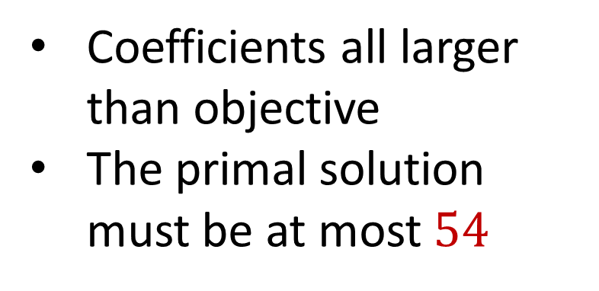

Duality
Intuition: What if we take the original constraints and add the first two constraints?
$$3x_{1}+3x_{2}+8x_{3}≤54$$
Maximize: $3x_{1}+x_{2}+4x_{3}$
Coefficients all larger than objective
The primal solution must be at most $54$
Subject to: $x_{1}+x_{2}+3x_{3}≤30$
$$2x_{1}+2x_{2}+5x_{3}≤24$$
$$4x_{1}+x_{2}+2x_{3}≤36$$
$$x_{1},x_{2},x_{3} ≥0$$

Slide 27
Duality
Intuition: What if we take the original constraints and add the first two constraints?
Maximize: $3x_{1}+x_{2}+4x_{3}$
Can we find a linear combination of the equations that exactly matches the objective?
Subject to: $x_{1}+x_{2}+3x_{3}≤30$
$$2x_{1}+2x_{2}+5x_{3}≤24$$
$$4x_{1}+x_{2}+2x_{3}≤36$$
$$x_{1},x_{2},x_{3} ≥0$$

Slide 28
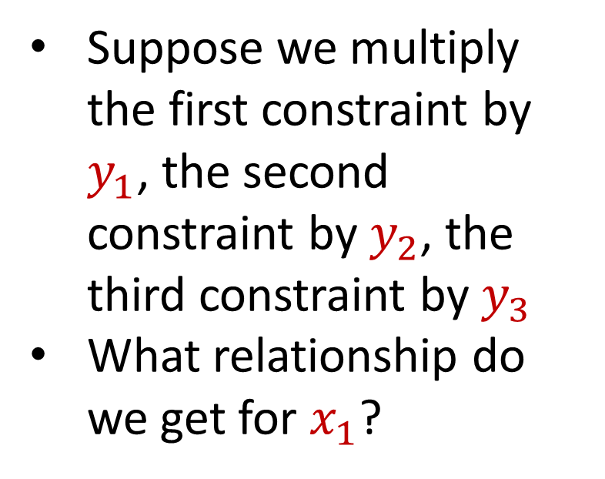
Duality
Intuition: What if we take the original constraints and add the first two constraints?
Suppose we multiply the first constraint by $y_{1}$, the second constraint by $y_{2}$, the third constraint by $y_{3}$
What relationship do we get for $x_{1}$?
Maximize: $3x_{1}+x_{2}+4x_{3}$
Subject to: $x_{1}+x_{2}+3x_{3}≤30$
$$2x_{1}+2x_{2}+5x_{3}≤24$$
$$4x_{1}+x_{2}+2x_{3}≤36$$
$$x_{1},x_{2},x_{3} ≥0$$

Slide 29
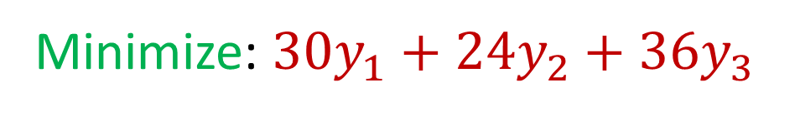
Duality
The dual is exactly this program
Minimize: $30y_{1}+24y_{2}+36y_{3}$
Subject to: $y_{1}+2y_{2}+4y_{3}≥3$
$$y_{1}+2y_{2}+y_{3}≥1$$
$$3y_{1}+5y_{2}+2y_{3}≥4$$
$$y_{1},y_{2},y_{3} ≥0$$
Notes:
https://cs.stackexchange.com/questions/128959/how-to-prove-that-the-dual-linear-program-of-the-max-flow-linear-program-indeed

Slide 30
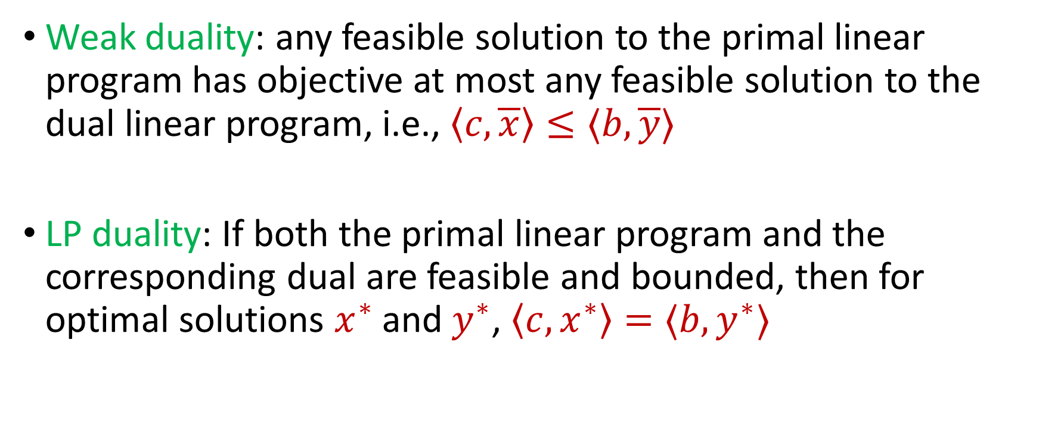
Duality
Weak duality: any feasible solution to the primal linear program has objective at most any feasible solution to the dual linear program, i.e., $\left\langle c, \overline{x}\right\rangle ≤⟨b,\overline{y}⟩$
LP duality: If both the primal linear program and the corresponding dual are feasible and bounded, then for optimal solutions $x^{∗}$ and $y^{∗}$, $\left\langle c, x^{∗}\right\rangle =⟨b, y^{∗}⟩$

Slide 31
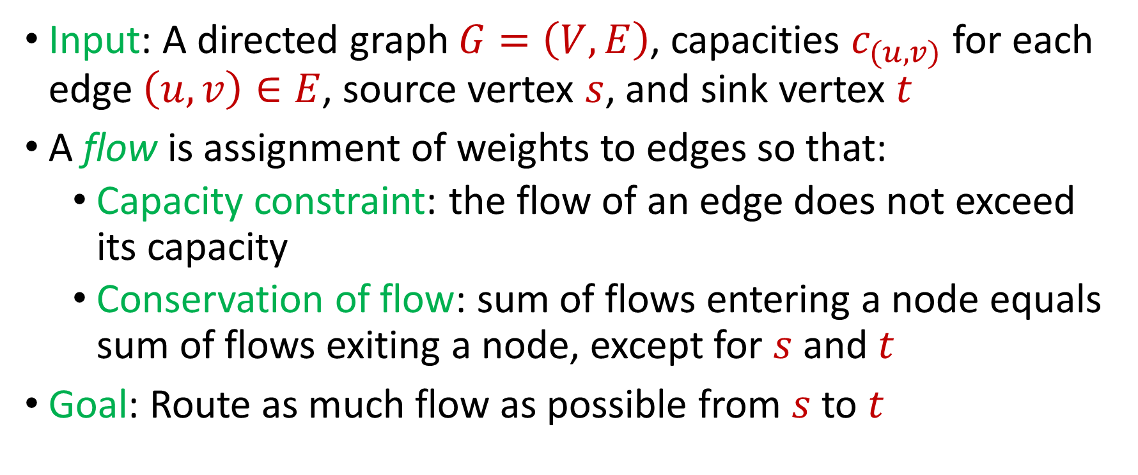

Max $s−t$Flow in a Directed Graph
Input: A directed graph $G=\left(V,E\right)$, capacities $c_{(u,v)}$ for each edge $\left(u,v\right)∈E$, source vertex $s$, and sink vertex $t$
A flow is assignment of weights to edges so that:
Capacity constraint: the flow of an edge does not exceed its capacity
Conservation of flow: sum of flows entering a node equals sum of flows exiting a node, except for $s$ and $t$
Goal: Route as much flow as possible from $s$ to $t$

Slide 32















Max $s−t$Flow in a Directed Graph
$$a$$
$$4$$
$$b$$
$$6$$
$$1$$
$$5$$
$$s$$
$$t$$
$$5$$
$$4$$
$$6$$
$$6$$
$$c$$
$$3$$
$$d$$

Slide 33

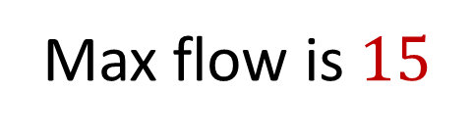








Max $s−t$Flow in a Directed Graph
$$a$$
$$4/4$$
$$b$$
$$6/6$$
$$1/1$$
$$5/5$$
$$s$$
$$t$$
$$5/5$$
$$3/4$$
$$2/6$$
$$5/6$$
Max flow is $15$
$$c$$
$$3/3$$
$$d$$

Slide 34
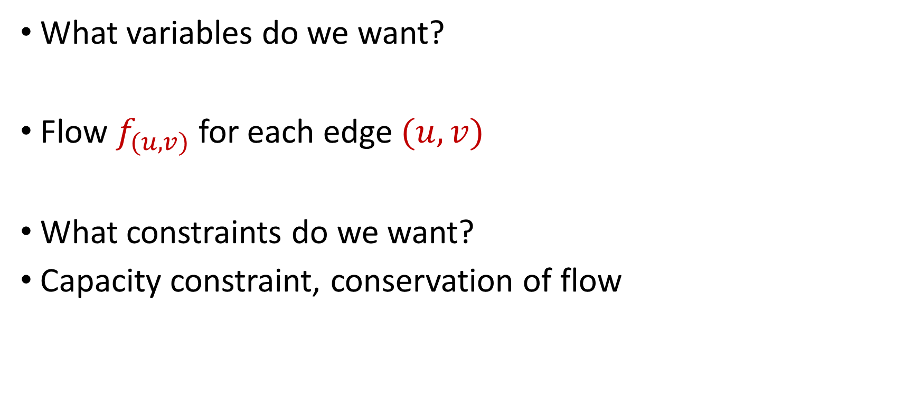
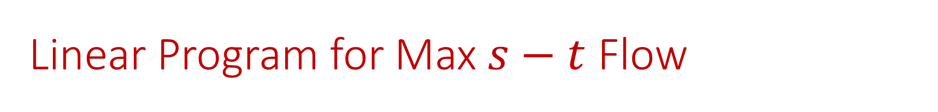
Linear Program for Max $s−t$ Flow
What variables do we want?
Flow $f_{(u,v)}$ for each edge $(u,v)$
What constraints do we want?
Capacity constraint, conservation of flow

Slide 35

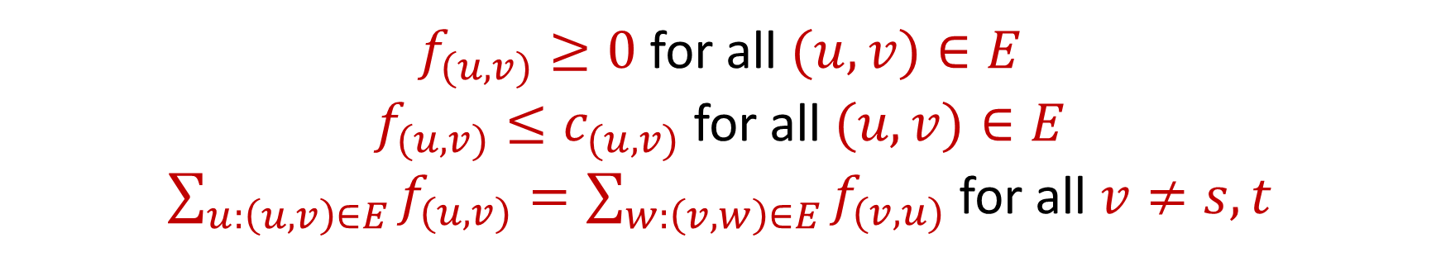
Linear Program for Max $s−t$ Flow
Maximize: $\sum_{v:\left(s,v\right)∈E}{f_{(s,v)}}−\sum_{v:\left(v,s\right)∈E}{f_{(v,s)}}$
Subject to:
$f_{(u,v)}≥0$ for all $(u,v)∈E$
$f_{(u,v)}≤c_{(u,v)}$ for all $(u,v)∈E$
$\sum_{u:\left(u,v\right)∈E}{f_{(u,v)}}=\sum_{w:\left(v,w\right)∈E}{f_{(v,u)}}$ for all $v≠s,t$

Slide 36


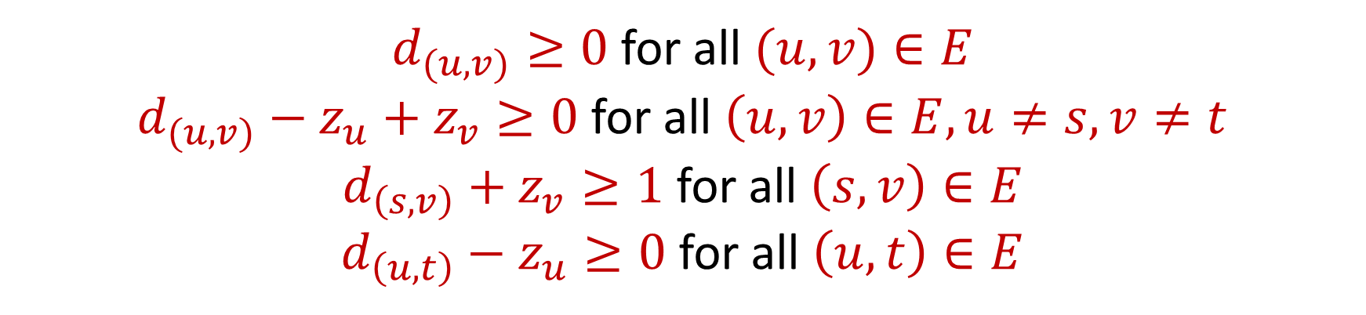
Dual Program for Max $s−t$ Flow
Minimize: $\sum_{v:\left(u,v\right)∈E}{c_{(u,v)}d_{(u,v)}}$, where $d_{(u,v)}$ indicates whether $\left(u,v\right)$crosses the cut, $c_{(u,v)}$ is the capacity of $\left(u,v\right)$
Subject to:
$d_{(u,v)}≥0$ for all $(u,v)∈E$
$d_{(u,v)}−z_{u}+z_{v}≥0$ for all $\left(u,v\right)∈E,u≠s,v≠t$
$d_{\left(s,v\right)}+z_{v}≥1$ for all $\left(s,v\right)∈E$
$d_{\left(u,t\right)}−z_{u}≥0$ for all $\left(u,t\right)∈E$

Slide 37
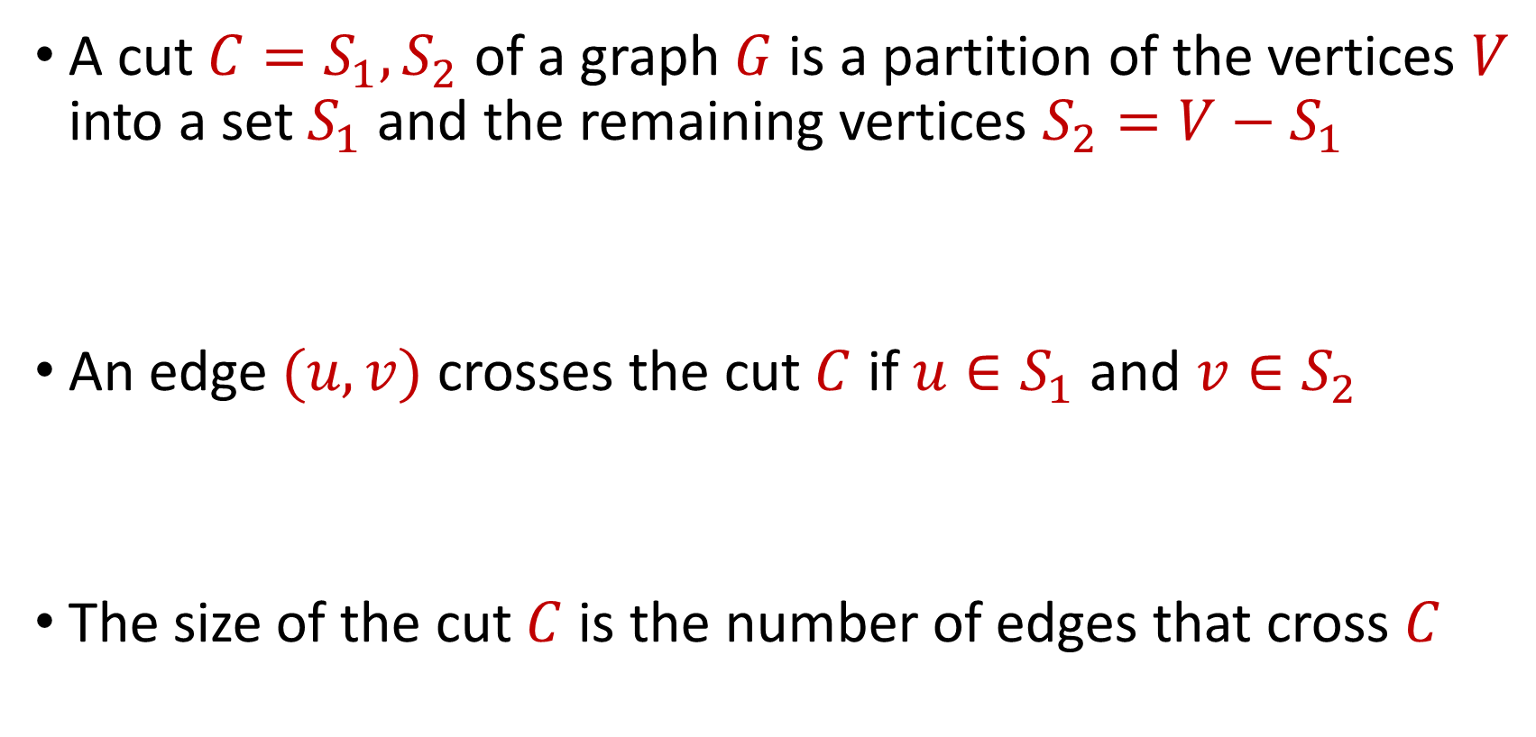
Cuts
A cut $C=S_{1},S_{2}$ of a graph $G$ is a partition of the vertices $V$ into a set $S_{1}$ and the remaining vertices $S_{2}=V−S_{1}$
An edge $(u,v)$ crosses the cut $C$ if $u∈S_{1}$ and $v∈S_{2}$
The size of the cut $C$ is the number of edges that cross $C$

Slide 38

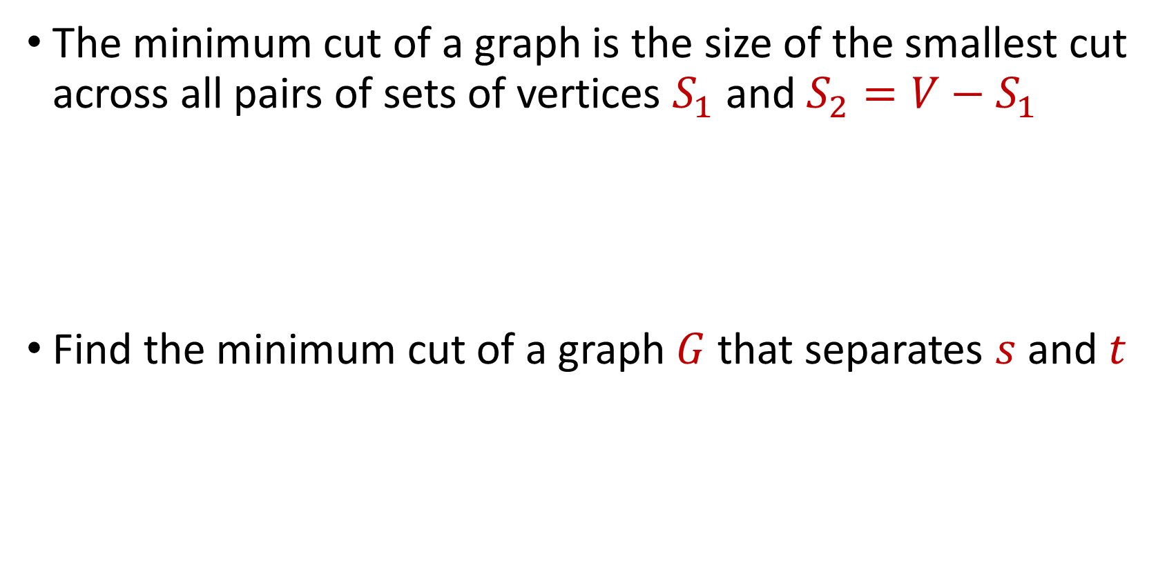
Minimum $s−t$ Cut
The minimum cut of a graph is the size of the smallest cut across all pairs of sets of vertices $S_{1}$ and $S_{2}=V−S_{1}$
Find the minimum cut of a graph $G$ that separates $s$ and $t$

Slide 39
What is the minimum $s−t$ cut of the graph?
$$a$$
$$4$$
$$b$$
$$6$$
$$1$$
$$5$$
$$s$$
$$t$$
$$5$$
$$4$$
$$6$$
$$6$$
$$c$$
$$3$$
$$d$$

Slide 40
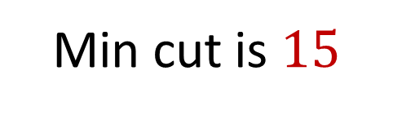

What is the minimum $s−t$ cut of the graph?
$$a$$
$$4$$
$$b$$
$$6$$
$$1$$
$$5$$
$$s$$
$$t$$
$$5$$
$$4$$
$$6$$
$$6$$
Min cut is $15$
$$c$$
$$3$$
$$d$$

Slide 41
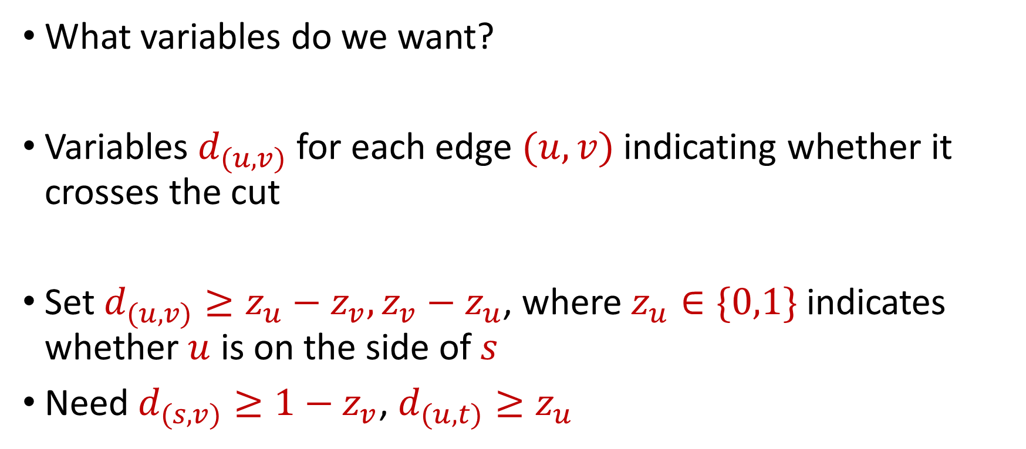
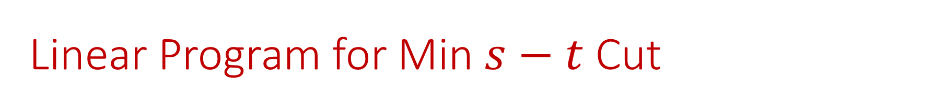
Linear Program for Min $s−t$ Cut
What variables do we want?
Variables $d_{(u,v)}$ for each edge $(u,v)$ indicating whether it crosses the cut
Set $d_{(u,v)}≥z_{u}−z_{v}, z_{v}−z_{u}$, where $z_{u}∈\{0,1\}$ indicates whether $u$ is on the side of $s$
Need $d_{(s,v)}≥1−z_{v}$, $d_{(u,t)}≥z_{u}$

Slide 42
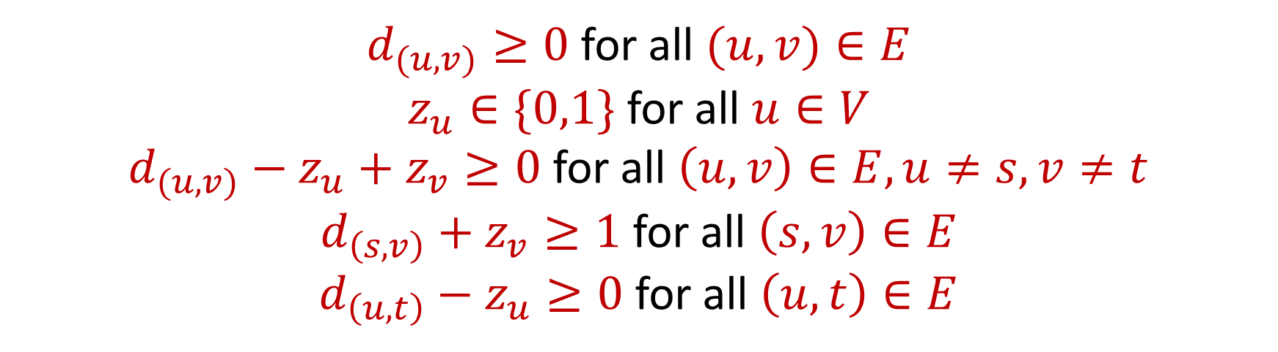
Linear Program for Min $s−t$ Cut
Minimize: $\sum_{v:\left(u,v\right)∈E}{c_{(u,v)}d_{(u,v)}}$, where $d_{(u,v)}$ indicates whether $\left(u,v\right)$crosses the cut, $c_{(u,v)}$ is the capacity of $\left(u,v\right)$
Subject to:
$d_{(u,v)}≥0$ for all $(u,v)∈E$
$z_{u}∈\{0,1\}$ for all $u∈V$
$d_{(u,v)}−z_{u}+z_{v}≥0$ for all $\left(u,v\right)∈E,u≠s,v≠t$
$d_{\left(s,v\right)}+z_{v}≥1$ for all $\left(s,v\right)∈E$
$d_{\left(u,t\right)}−z_{u}≥0$ for all $\left(u,t\right)∈E$

Slide 43
Dual Program for Max $s−t$ Flow
Minimize: $\sum_{v:\left(u,v\right)∈E}{c_{(u,v)}d_{(u,v)}}$, where $d_{(u,v)}$ indicates whether $\left(u,v\right)$crosses the cut, $c_{(u,v)}$ is the capacity of $\left(u,v\right)$
Subject to:
$d_{(u,v)}≥0$ for all $(u,v)∈E$
$d_{(u,v)}−z_{u}+z_{v}≥0$ for all $\left(u,v\right)∈E,u≠s,v≠t$
$d_{\left(s,v\right)}+z_{v}≥1$ for all $\left(s,v\right)∈E$
$d_{\left(u,t\right)}−z_{u}≥0$ for all $\left(u,t\right)∈E$

Slide 44
Min Cut-Max Flow Theorem?
Recall: the max-flow min-cut theorem states the maximum flow through any graph between any fixed source and sink is exactly equal to the minimum cut
However, the dual LP to the max-flow problem is a fractional problem, while the LP for the min-cut problem requires integral solutions

Slide 45
Linear Programming (Standard Form)
Maximize a linear objective function:
Subject to constraints:
$c^{⊤}x=⟨c,x⟩$, $c,x∈$ $ℝ^{n}$
$Ax≤b$ for $A∈$ $ℝ^{m×n}$, $b∈$ $ℝ^{m}$
$x≥0$ (entry-wise non-negativity)

Slide 46
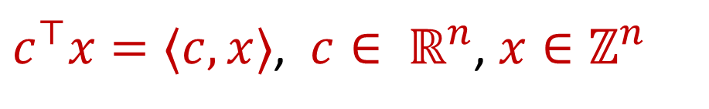
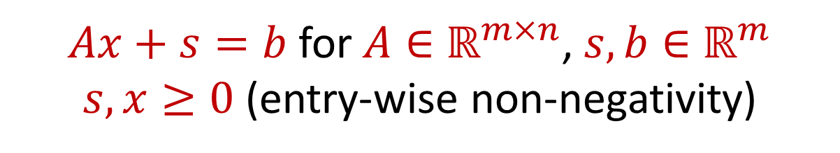
Integer Linear Programming (Standard Form)
Maximize a linear objective function:
Subject to constraints:
$c^{⊤}x=⟨c,x⟩$, $c∈ ℝ^{n}$, $x∈ℤ^{n}$
$Ax+s=b$ for $A∈$ $ℝ^{m×n}$, $s,b∈$ $ℝ^{m}$
$s,x≥0$ (entry-wise non-negativity)

Slide 47

Integer Linear Programming (Standard Form)
Integer linear programming is NP-hard (solves vertex cover)
When constraint is $Ax=b$, the matrix $A$ and the vector $b$ all have integer entries, and $A$ is totally unimodular (every square submatrix has determinant $−1,0,1$), then the vertices of the LP polytope are integers
Can use standard LP algorithms

Slide 48
MAX-SAT Revisited
In the MAX-SAT problem, the input is a CNF formula $f\left(x_{1},…,x_{n}\right)$ with $m$ clauses $C_{1},….,C_{m}$
The goal is to assign values to $x_{1},…,x_{n}$ to maximize the number of satisfied clauses

Slide 49


MAX-SAT Revisited (Integer Program)
Maximize: $\sum_{j∈[m]}{Z_{j}}$
Subject to:
$\sum_{i:y_{i}∈C_{j}}{y_{i}}+\sum_{i:\overline{x_{i}}∈C_{j}}{(1−y_{i})}≥Z_{j}$ for all $j∈[m]$
$0≤Z_{j}≤1$ for all $j∈[m]$
$y_{i}∈\{0,1\}$ for all $i∈[n]$

Slide 50

MAX-SAT Revisited (LP Relaxation)
Maximize: $\sum_{j∈[m]}{Z_{j}}$
Subject to:
$\sum_{i:y_{i}∈C_{j}}{y_{i}}+\sum_{i:\overline{x_{i}}∈C_{j}}{(1−y_{i})}≥Z_{j}$ for all $j∈[m]$
$0≤Z_{j}≤1$ for all $j∈[m]$
$0≤y_{i}≤1$ for all $i∈[n]$

Slide 51

Randomized Rounding for MAX-SAT
Let $y_{i}^{∗}$ and $z_{j}^{∗}$ be the optimal solution to the LP relaxation
Set $x_{i}=1$ with probability $y_{i}^{∗}$
$Pr\left[C_{j} is not satisfied\right]=\prod_{i∈P_{j}}{\left(1−y_{i}^{∗}\right)}\prod_{i∈N_{j}}{y_{i}^{∗}}$, where we split clause $C_{j}$into positive literals $P_{j}$ and negative literals $N_{j}$

Slide 52



Randomized Rounding for MAX-SAT
$Pr\left[C_{j} is not satisfied\right]=\prod_{i∈P_{j}}{\left(1−y_{i}^{∗}\right)}\prod_{i∈N_{j}}{y_{i}^{∗}}$
$≤{\left[\frac{1}{\left|C_{j}\right|}\left(\sum_{i∈P_{j}}{(1−y_{i}^{∗})}+\sum_{i∈N_{j}}{y_{i}^{∗}}\right)\right]}^{|C_{j}|}$
(AM-GM)
$={\left[1−\frac{1}{\left|C_{j}\right|}\left(\sum_{i∈P_{j}}{y_{i}^{∗}}+\sum_{i∈N_{j}}{(1−y_{i}^{∗})}\right)\right]}^{|C_{j}|}$
$$={\left[1−\frac{z_{j}^{∗}}{\left|C_{j}\right|}\right]}^{|C_{j}|}$$

Slide 53



Randomized Rounding for MAX-SAT
$$Pr\left[C_{j} is satisfied\right]≥{1−\left[1−\frac{z_{j}^{∗}}{\left|C_{j}\right|}\right]}^{|C_{j}|}$$
$≥{1−\left[1−\frac{1}{\left|C_{j}\right|}\right]}^{|C_{j}|}$ $z_{j}^{∗}$
(concavity)
$$≥\left(1−\frac{1}{e}\right)z_{j}^{∗}$$

Slide 54

Randomized Rounding for MAX-SAT
Let $y_{i}^{∗}$ and $z_{j}^{∗}$ be the optimal solution to the LP relaxation
Set $x_{i}=1$ with probability $y_{i}^{∗}$
$\left(1−\frac{1}{e}\right)≈0.6321$-approximation algorithm

Slide 55


MAX-SAT Summary
Random assignment gives $≈0.618$-approximation
Randomized rounding gives $≈0.6321$-approximation
$Pr\left[C_{j} is satisfied\right]≥\left(1−2^{−\left|C_{j}\right|}\right)≥z_{j}^{∗}$ $\left(1−2^{−\left|C_{j}\right|}\right)$
$$Pr\left[C_{j} is satisfied\right]≥z_{j}^{∗}\left({1−\left[1−\frac{1}{\left|C_{j}\right|}\right]}^{\left|C_{j}\right|}\right)$$

Slide 56


MAX-SAT Summary
Random assignment gives $≈0.618$-approximation
Randomized rounding gives $≈0.6321$-approximation
$Pr\left[C_{j} is satisfied\right]≥\left(1−2^{−\left|C_{j}\right|}\right)≥z_{j}^{∗}$ $\left(1−2^{−\left|C_{j}\right|}\right)$
$$Pr\left[C_{j} is satisfied\right]≥z_{j}^{∗}\left({1−\left[1−\frac{1}{\left|C_{j}\right|}\right]}^{\left|C_{j}\right|}\right)$$

Slide 57

MAX-SAT Summary
Random assignment gives $≈0.618$-approximation
Randomized rounding gives $≈0.6321$-approximation
How do these behave across values of $\left|C_{j}\right|$?
$Pr\left[C_{j} is satisfied\right]≥\left(1−2^{−\left|C_{j}\right|}\right)≥z_{j}^{∗}$ $\left(1−2^{−\left|C_{j}\right|}\right)$
$$Pr\left[C_{j} is satisfied\right]≥z_{j}^{∗}\left({1−\left[1−\frac{1}{\left|C_{j}\right|}\right]}^{\left|C_{j}\right|}\right)$$

Slide 58

MAX-SAT Summary
When $\left|C_{j}\right|$ is small, $\left(1−2^{−\left|C_{j}\right|}\right)$ is small and $\left({1−\left[1−\frac{1}{\left|C_{j}\right|}\right]}^{\left|C_{j}\right|}\right)$is large
When $\left|C_{j}\right|$ is large, $\left(1−2^{−\left|C_{j}\right|}\right)$ is large and $\left({1−\left[1−\frac{1}{\left|C_{j}\right|}\right]}^{\left|C_{j}\right|}\right)$is small

Slide 59


Choosing the Better of Two Solutions
Run randomized rounding and random assignment and take the better of the two solutions
We have $max\left(a,b\right)≥\frac{a+b}{2}$
$$Pr\left[C_{j} is satisfied\right]≥z_{j}^{∗}\max\left(\left(1−2^{−\left|C_{j}\right|}\right),\left({1−\left[1−\frac{1}{\left|C_{j}\right|}\right]}^{\left|C_{j}\right|}\right)\right)$$

Slide 60


Choosing the Better of Two Solutions
Run randomized rounding and random assignment and take the better of the two solutions
For $\left|C_{j}\right|=1$, $\frac{1}{2}\left(\left(1−2^{−\left|C_{j}\right|}\right)+\left({1−\left[1−\frac{1}{\left|C_{j}\right|}\right]}^{\left|C_{j}\right|}\right)\right)=\frac{3}{4}$
$$Pr\left[C_{j} is satisfied\right]≥z_{j}^{∗}⋅\frac{1}{2}\left(\left(1−2^{−\left|C_{j}\right|}\right)+\left({1−\left[1−\frac{1}{\left|C_{j}\right|}\right]}^{\left|C_{j}\right|}\right)\right)$$

Slide 61

Choosing the Better of Two Solutions
Run randomized rounding and random assignment and take the better of the two solutions
For $\left|C_{j}\right|=2$, $\frac{1}{2}\left(\left(1−2^{−\left|C_{j}\right|}\right)+\left({1−\left[1−\frac{1}{\left|C_{j}\right|}\right]}^{\left|C_{j}\right|}\right)\right)=\frac{3}{4}$
$$Pr\left[C_{j} is satisfied\right]≥z_{j}^{∗}⋅\frac{1}{2}\left(\left(1−2^{−\left|C_{j}\right|}\right)+\left({1−\left[1−\frac{1}{\left|C_{j}\right|}\right]}^{\left|C_{j}\right|}\right)\right)$$

Slide 62



Choosing the Better of Two Solutions
For $\left|C_{j}\right|≥3$:
$$\frac{1}{2}\left(\left(1−2^{−\left|C_{j}\right|}\right)+\left({1−\left[1−\frac{1}{\left|C_{j}\right|}\right]}^{\left|C_{j}\right|}\right)\right)≥\frac{1}{2}\left(1−\frac{1}{e}\right)+\frac{1}{2}⋅\frac{7}{8}$$
$$≈0.753≥\frac{3}{4}$$

Slide 63

Choosing the Better of Two Solutions
Run randomized rounding and random assignment and take the better of the two solutions
By linearity of expectation, $\frac{3}{4}$-approximation algorithm
$$Pr\left[C_{j} is satisfied\right]≥\frac{3}{4}⋅z_{j}^{∗}$$

Slide 64

Nonlinear Randomized Rounding for MAX-SAT
Let $y_{i}^{∗}$ and $z_{j}^{∗}$ be the optimal solution to the LP relaxation
Previously: Set $x_{i}=1$ with probability $y_{i}^{∗}$
What if we set $x_{i}=1$ with probability ${f(y}_{i}^{∗})$?
$Pr\left[C_{j} is not satisfied\right]=\prod_{i∈P_{j}}{\left(1−{f(y}_{i}^{∗})\right)}\prod_{i∈N_{j}}{{f(y}_{i}^{∗})}$, where we split clause $C_{j}$into positive literals $P_{j}$ and negative literals $N_{j}$

Slide 65




Nonlinear Randomized Rounding for MAX-SAT
$Pr\left[C_{j} is not satisfied\right]=\prod_{i∈P_{j}}{\left(1−{f(y}_{i}^{∗})\right)}\prod_{i∈N_{j}}{{f(y}_{i}^{∗})}$
Suppose we set $1−4^{−x}≤f\left(x\right)≤4^{x−1}$
$Pr\left[C_{j} is not satisfied\right]=\prod_{i∈P_{j}}{4^{−y_{i}^{∗}}}\prod_{i∈N_{j}}{4^{y_{i}^{∗}−1}}$
$$=4^{−\left(\sum_{i∈P_{j}}{y_{i}^{∗}+\sum_{i∈N_{j}}{(1−y_{i}^{∗})}}\right)}$$
$$≤4^{−z_{j}^{∗}}$$
$$≤\frac{1}{4}$$

Slide 66

Nonlinear Randomized Rounding for MAX-SAT
Let $y_{i}^{∗}$ and $z_{j}^{∗}$ be the optimal solution to the LP relaxation
Set $x_{i}=1$ with probability ${f(y}_{i}^{∗})$
By linearity of expectation, $\frac{3}{4}$-approximation algorithm

