Slide 1
CSCE 689: Special Topics in Modern Algorithms for Data Science
Lecture 30
Samson Zhou

Slide 2
Presentation Schedule
November 27: Chunkai, Jung, Galaxy AI
November 29: STMI, Anmol, Jason
December 1: Bokun, Ayesha, Dawei, Lipai

Slide 3






Linear Algebra Review
For $y=Ax$, we have $y_{i}=⟨a_{i}, x⟩$
$$A$$
$$x$$
$$d$$
$$n$$
$$d$$

Slide 4


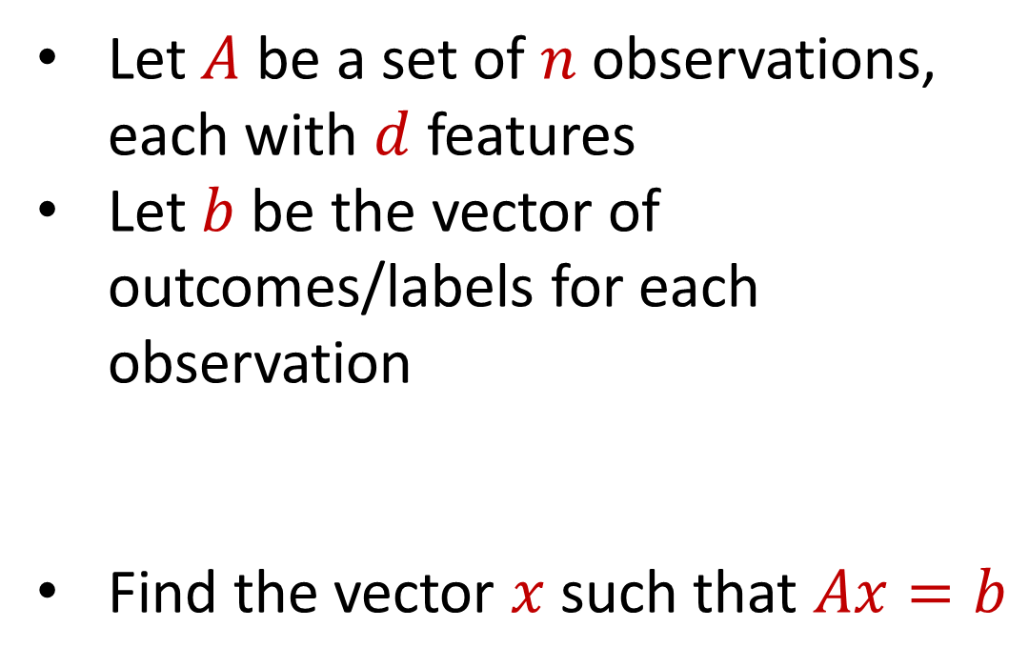



Regression
Let $A$ be a set of $n$ observations, each with $d$ features
Let $b$ be the vector of outcomes/labels for each observation
Find the vector $x$ such that $Ax=b$
$$d$$
$$x$$
$$=$$
$$n$$
$$A$$
$$n$$
$$b$$
$$1$$
$$d$$
$$1$$

Slide 5
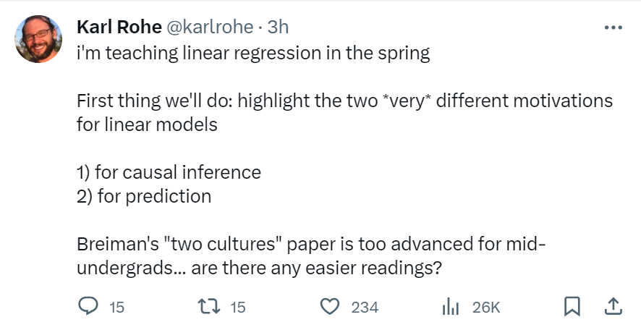

Slide 6


Regression
Economics and Finance:
Stock price prediction: Predict stock prices based on historical data and other relevant factors.
Econometric analysis: Study the relationships between economic variables like GDP, inflation, and interest rates.

Slide 7

Regression
Medicine and Healthcare:
Medical research: Understand the relationship between factors such as age, genetics, and lifestyle on health outcomes.
Disease prediction: Predicting the probability of disease occurrence based on risk factors like smoking, diet, and exercise.

Slide 8


Regression
Sports Analytics:
Player performance forecast: Predicting player performance in sports like baseball, basketball, or soccer based on historical data.
Game outcome prediction: Predicting the outcome of games based on team statistics and other factors.

Slide 9

Regression
Environmental Science:
Climate modeling: Model climate change variables like temperature, precipitation, and sea levels.
Pollution analysis: Analyze the relationship between pollution levels and various factors like industrial activity and population.

Slide 10
Regression
Let $A$ be a set of $n$ observations, each with $d$ features
Let $b$ be the vector of outcomes/labels for each observation
Find the vector $x$ such that $Ax=b$
$$d$$
$$x$$
$$=$$
$$n$$
$$A$$
$$n$$
$$b$$
$$1$$
$$d$$
$$1$$

Slide 11
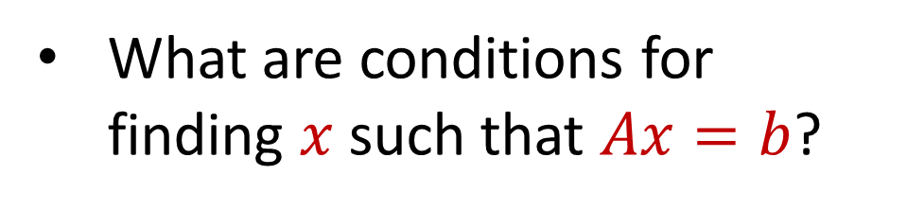
Linear Algebra Review
What are conditions for finding $x$ such that $Ax=b$?
$$d$$
$$x$$
$$=$$
$$n$$
$$A$$
$$n$$
$$b$$
$$1$$
$$d$$
$$1$$

Slide 12
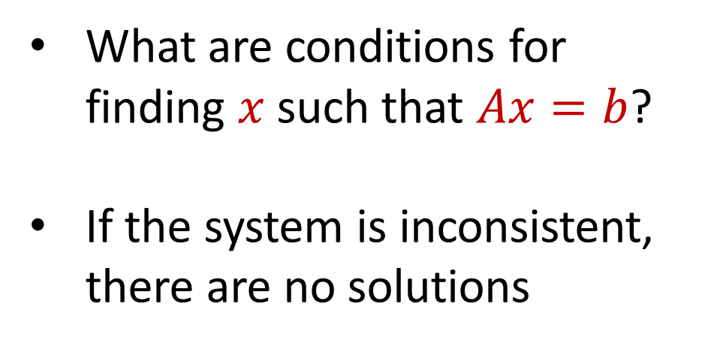
Linear Algebra Review
What are conditions for finding $x$ such that $Ax=b$?
If the system is inconsistent, there are no solutions
$$d$$
$$x$$
$$=$$
$$n$$
$$A$$
$$n$$
$$b$$
$$1$$
$$d$$
$$1$$

Slide 13
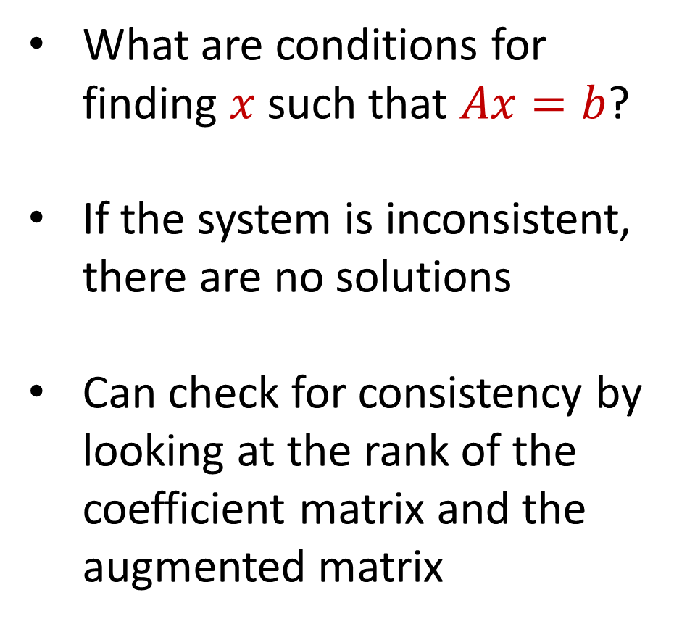
Linear Algebra Review
What are conditions for finding $x$ such that $Ax=b$?
If the system is inconsistent, there are no solutions
Can check for consistency by looking at the rank of the coefficient matrix and the augmented matrix
$$d$$
$$x$$
$$=$$
$$n$$
$$A$$
$$n$$
$$b$$
$$1$$
$$d$$
$$1$$

Slide 14
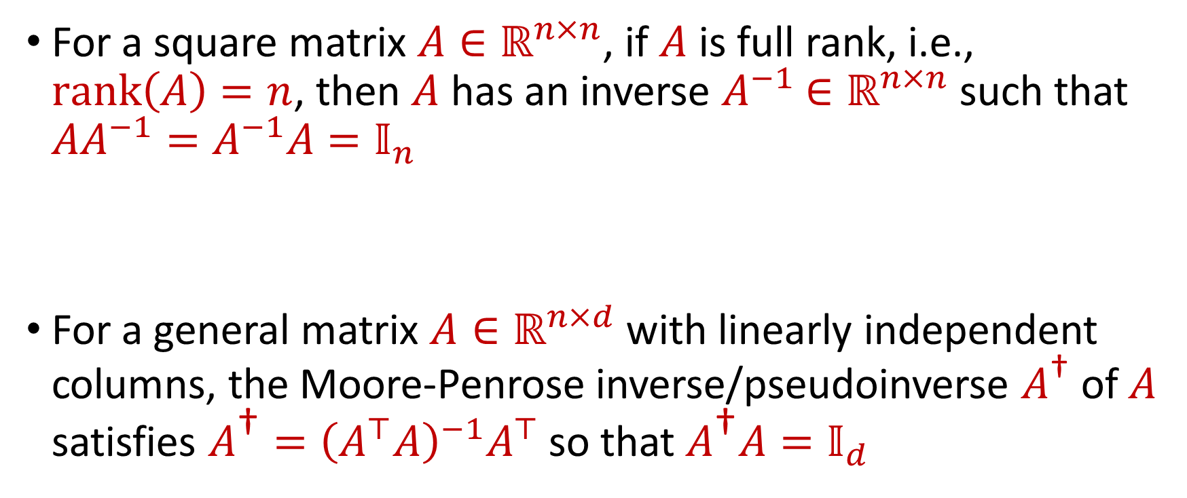
Linear Algebra Review
For a square matrix $A∈ℝ^{n×n}$, if $A$ is full rank, i.e., $rank\left(A\right)=n$, then $A$ has an inverse $A^{−1}$ $∈ℝ^{n×n}$ such that $AA^{−1}=A^{−1}A=𝕀_{n}$
For a general matrix $A∈ℝ^{n×d}$ with linearly independent columns, the Moore-Penrose inverse/pseudoinverse $A^{\text{†}}$ of $A$ satisfies $A^{\text{†}}={\left(A^{⊤}A\right)}^{−1}A^{⊤}$ so that $A^{\text{†}}A=𝕀_{d}$

Slide 15
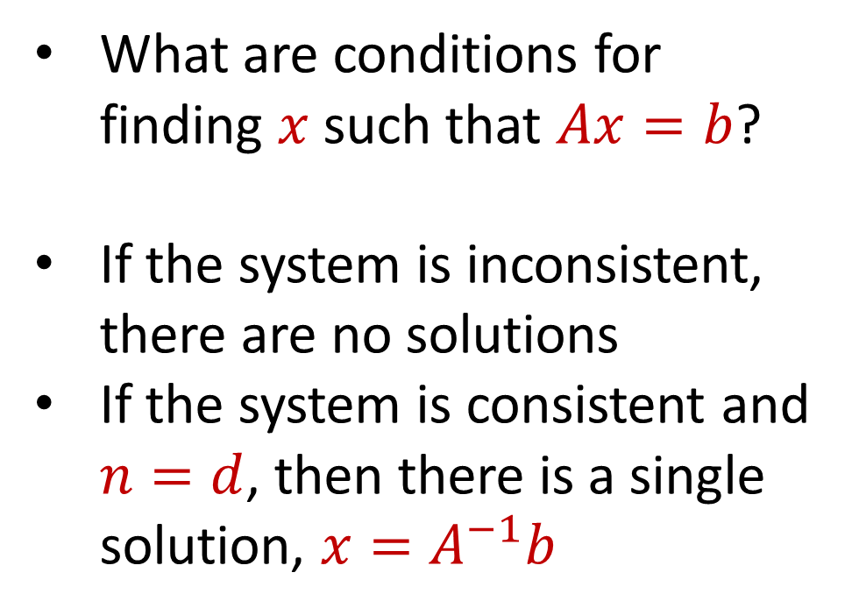
Linear Algebra Review
What are conditions for finding $x$ such that $Ax=b$?
If the system is inconsistent, there are no solutions
If the system is consistent and $n=d$, then there is a single solution, $x=A^{−1}b$
$$d$$
$$x$$
$$=$$
$$n$$
$$A$$
$$n$$
$$b$$
$$1$$
$$d$$
$$1$$

Slide 16
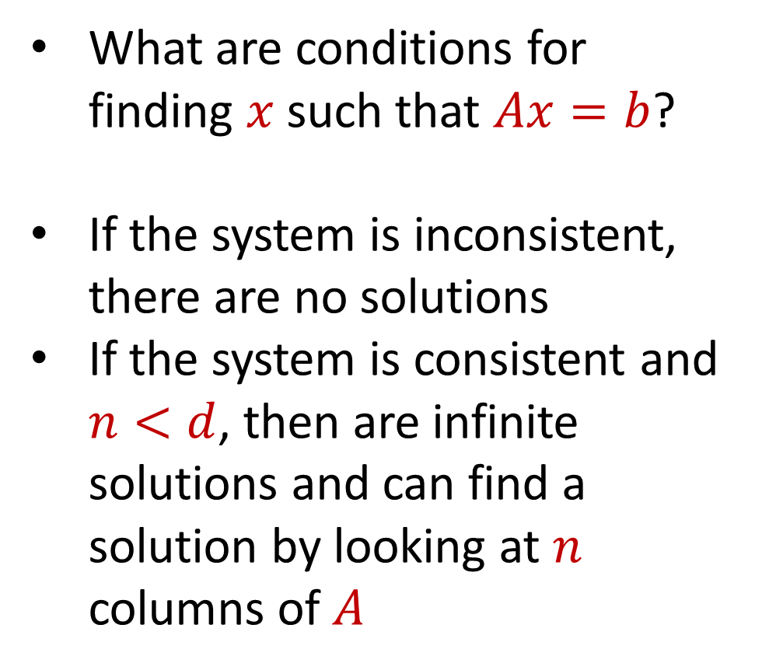
Linear Algebra Review
What are conditions for finding $x$ such that $Ax=b$?
If the system is inconsistent, there are no solutions
If the system is consistent and $n<d$, then are infinite solutions and can find a solution by looking at $n$ columns of $A$
$$d$$
$$x$$
$$=$$
$$n$$
$$A$$
$$n$$
$$b$$
$$1$$
$$d$$
$$1$$

Slide 17
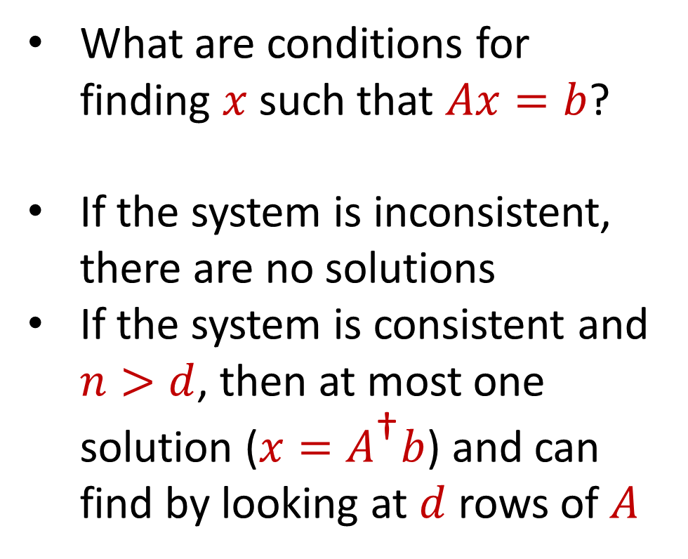
Linear Algebra Review
What are conditions for finding $x$ such that $Ax=b$?
If the system is inconsistent, there are no solutions
If the system is consistent and $n>d$, then at most one solution ($x=A^{\text{†}}b$) and can find by looking at $d$ rows of $A$
$$d$$
$$x$$
$$=$$
$$n$$
$$A$$
$$n$$
$$b$$
$$1$$
$$d$$
$$1$$

Slide 18
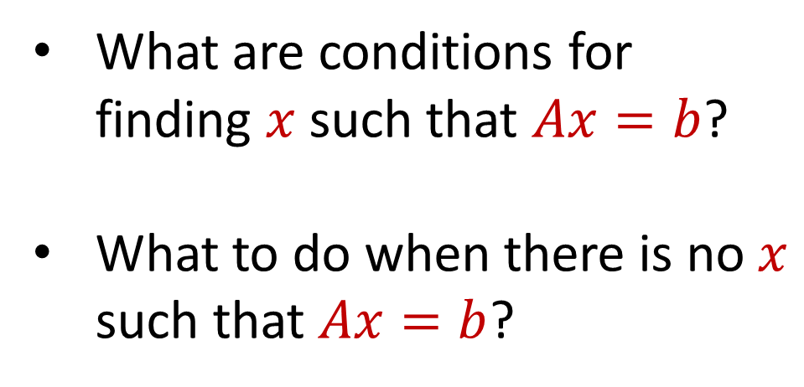
Regression
What are conditions for finding $x$ such that $Ax=b$?
What to do when there is no $x$ such that $Ax=b$?
$$d$$
$$x$$
$$=$$
$$n$$
$$A$$
$$n$$
$$b$$
$$1$$
$$d$$
$$1$$

Slide 19
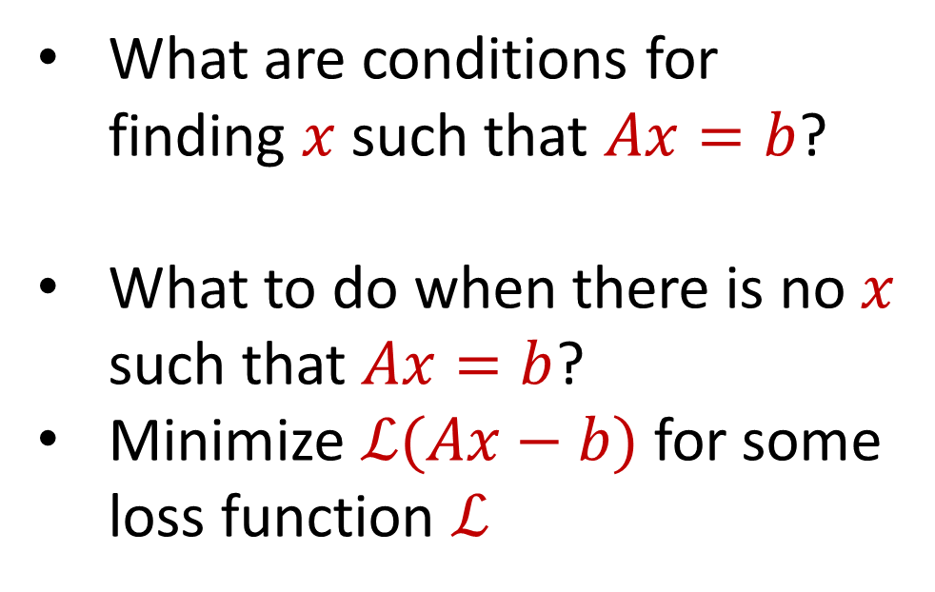
Regression
What are conditions for finding $x$ such that $Ax=b$?
What to do when there is no $x$ such that $Ax=b$?
Minimize $ℒ(Ax−b)$ for some loss function $ℒ$
$$d$$
$$x$$
$$=$$
$$n$$
$$A$$
$$n$$
$$b$$
$$1$$
$$d$$
$$1$$

Slide 20
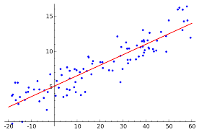
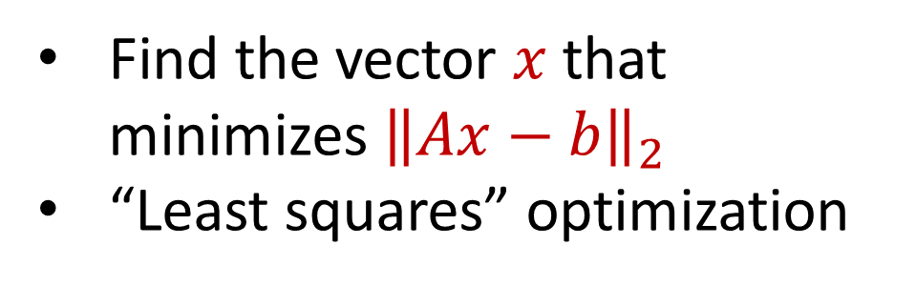
Linear Regression
Find the vector $x$ that minimizes ${\left\|Ax−b\right\|}_{2}$
“Least squares” optimization
$$d$$
$$x$$
$$≈$$
$$n$$
$$A$$
$$n$$
$$b$$
$$1$$
$$d$$
$$1$$

Slide 21
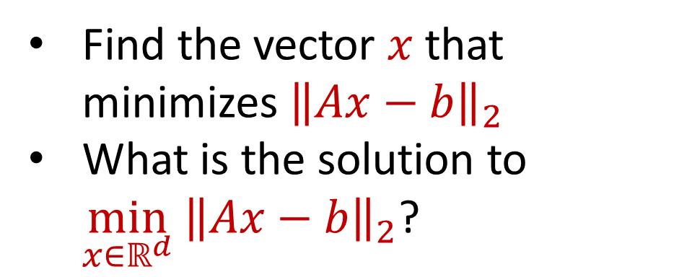
Linear Regression
Find the vector $x$ that minimizes ${\left\|Ax−b\right\|}_{2}$
What is the solution to $\min_{x∈ℝ^{d}} {\left\|Ax−b\right\|}_{2}$?
$$d$$
$$x$$
$$≈$$
$$n$$
$$A$$
$$n$$
$$b$$
$$1$$
$$d$$
$$1$$

Slide 22
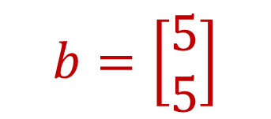
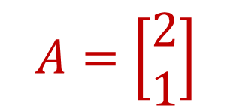

Linear Regression
$$b=\left[\begin{aligned}5 \\ 5\end{aligned}\right]$$
$$A=\left[\begin{aligned}2 \\ 1\end{aligned}\right]$$
Find $x$ that minimizes ${\left\|Ax−b\right\|}_{2}$

Slide 23

Linear Regression
$$b=\left[\begin{aligned}5 \\ 5\end{aligned}\right]$$
$$\left[\begin{aligned}6 \\ 3\end{aligned}\right]$$
$$A=\left[\begin{aligned}2 \\ 1\end{aligned}\right]$$
Find $x$ that minimizes ${\left\|Ax−b\right\|}_{2}$

Slide 24
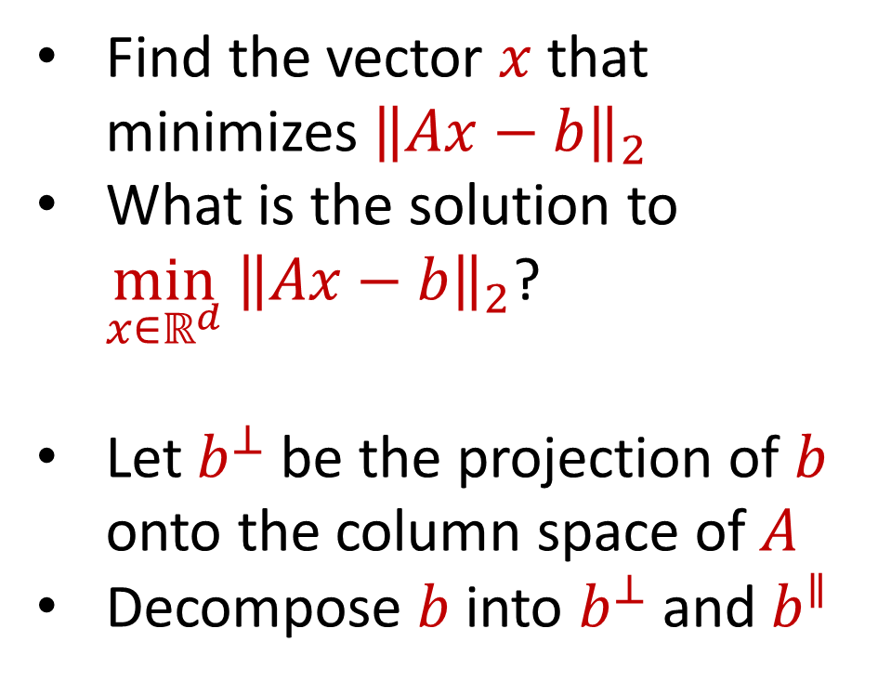
Linear Regression
Find the vector $x$ that minimizes ${\left\|Ax−b\right\|}_{2}$
What is the solution to $\min_{x∈ℝ^{d}} {\left\|Ax−b\right\|}_{2}$?
Let $b^{⊥}$ be the projection of $b$ onto the column space of $A$
Decompose $b$ into $b^{⊥}$ and $b^{∥}$
$$d$$
$$x$$
$$≈$$
$$n$$
$$A$$
$$n$$
$$b$$
$$1$$
$$d$$
$$1$$

Slide 25

Linear Regression
We have $\arg{\min_{x∈ℝ^{d}} {\left\|Ax−b\right\|}_{2} }=\arg{\min_{x∈ℝ^{d}} {\left\|Ax−b\right\|}_{2}^{2} }$
${\left\|Ax−b\right\|}_{2}^{2}={\left\|Ax−b^{⊥}−b^{∥}\right\|}_{2}^{2}$

Slide 26
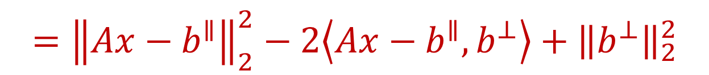
Linear Regression
We have $\arg{\min_{x∈ℝ^{d}} {\left\|Ax−b\right\|}_{2} }=\arg{\min_{x∈ℝ^{d}} {\left\|Ax−b\right\|}_{2}^{2} }$
${\left\|Ax−b\right\|}_{2}^{2}={\left\|Ax−b^{⊥}−b^{∥}\right\|}_{2}^{2}$
$$={\left\|Ax−b^{∥}\right\|}_{2}^{2}−2\left\langle Ax−b^{∥},b^{⊥}\right\rangle +{\left\|b^{⊥}\right\|}_{2}^{2}$$

Slide 27
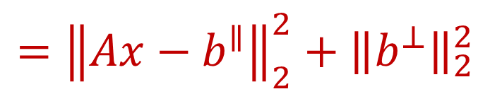
Linear Regression
We have $\arg{\min_{x∈ℝ^{d}} {\left\|Ax−b\right\|}_{2} }=\arg{\min_{x∈ℝ^{d}} {\left\|Ax−b\right\|}_{2}^{2} }$
${\left\|Ax−b\right\|}_{2}^{2}={\left\|Ax−b^{⊥}−b^{∥}\right\|}_{2}^{2}$
$$={\left\|Ax−b^{∥}\right\|}_{2}^{2}−2\left\langle Ax−b^{∥},b^{⊥}\right\rangle +{\left\|b^{⊥}\right\|}_{2}^{2}$$
$$={\left\|Ax−b^{∥}\right\|}_{2}^{2}+{\left\|b^{⊥}\right\|}_{2}^{2}$$

Slide 28
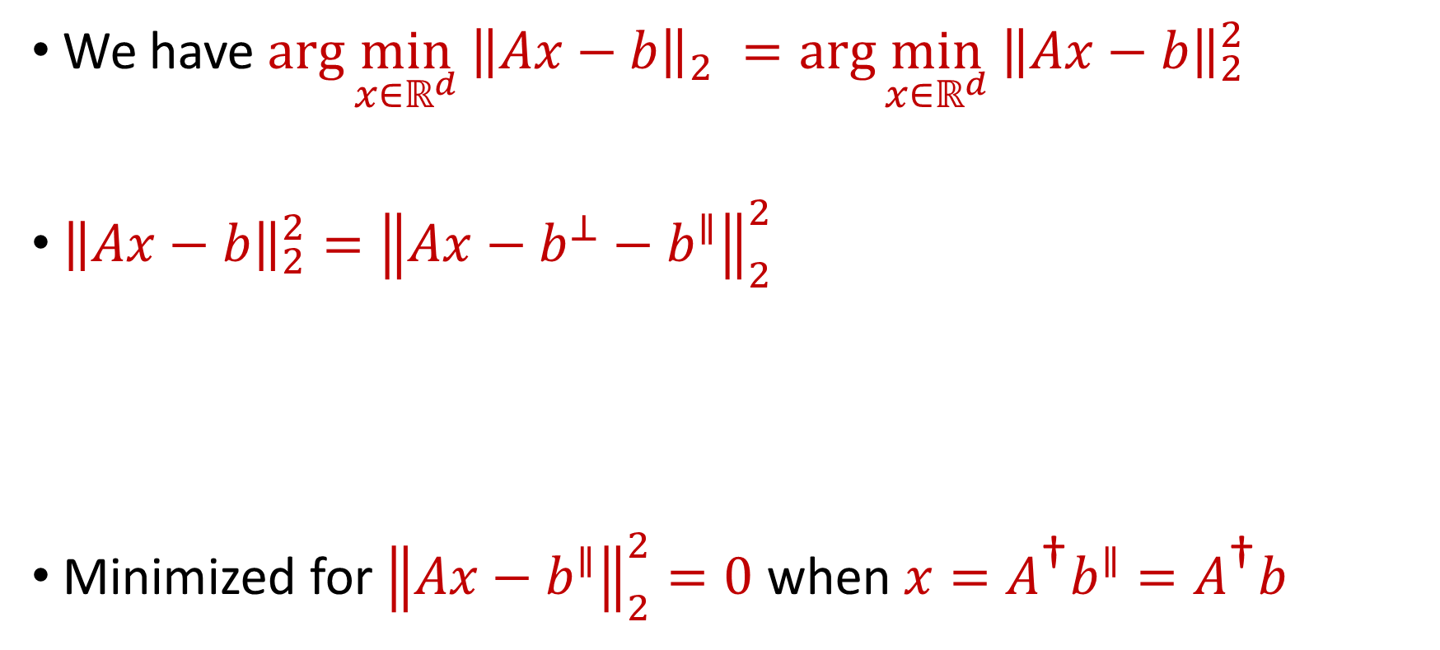
Linear Regression
We have $\arg{\min_{x∈ℝ^{d}} {\left\|Ax−b\right\|}_{2} }=\arg{\min_{x∈ℝ^{d}} {\left\|Ax−b\right\|}_{2}^{2} }$
${\left\|Ax−b\right\|}_{2}^{2}={\left\|Ax−b^{⊥}−b^{∥}\right\|}_{2}^{2}$
Minimized for ${\left\|Ax−b^{∥}\right\|}_{2}^{2}=0$ when $x=A^{\text{†}}b^{∥}=A^{\text{†}}b$
$$={\left\|Ax−b^{∥}\right\|}_{2}^{2}−2\left\langle Ax−b^{∥},b^{⊥}\right\rangle +{\left\|b^{⊥}\right\|}_{2}^{2}$$
$$={\left\|Ax−b^{∥}\right\|}_{2}^{2}+{\left\|b^{⊥}\right\|}_{2}^{2}$$

Slide 29
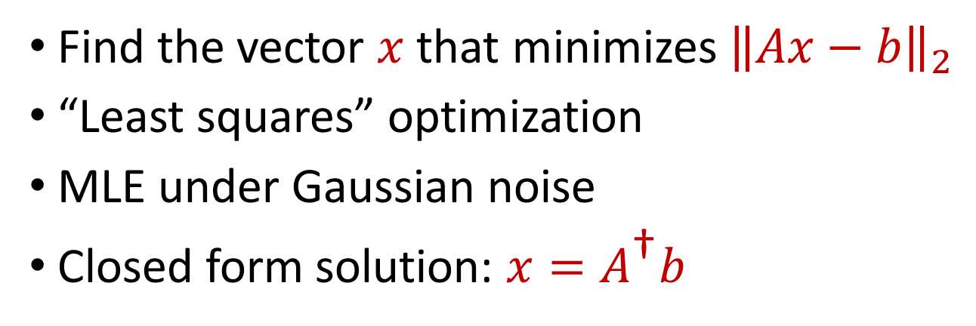
Linear Regression
Find the vector $x$ that minimizes ${\left\|Ax−b\right\|}_{2}$
“Least squares” optimization
MLE under Gaussian noise
Closed form solution: $x=A^{\text{†}}b$
$$d$$
$$x$$
$$≈$$
$$n$$
$$A$$
$$n$$
$$b$$
$$1$$
$$d$$
$$1$$

