Slide 1
CSCE 689: Special Topics in Modern Algorithms for Data Science
Lecture 31
Samson Zhou

Slide 2
Presentation Schedule
November 27: Chunkai, Jung, Galaxy AI
November 29: STMI, Anmol, Jason
December 1: Bokun, Ayesha, Dawei, Lipai

Slide 3
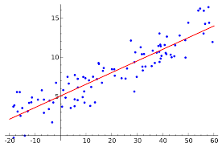


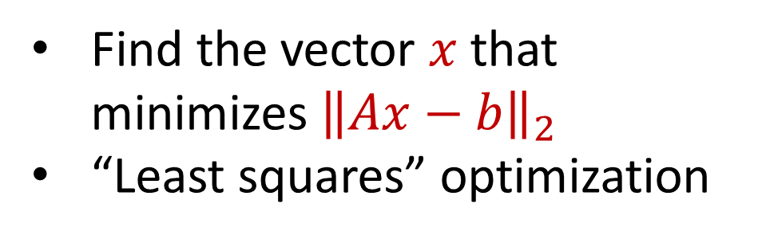


Last Time: Linear Regression
Find the vector $x$ that minimizes ${\left\|Ax−b\right\|}_{2}$
“Least squares” optimization
$$d$$
$$x$$
$$≈$$
$$n$$
$$A$$
$$n$$
$$b$$
$$1$$
$$d$$
$$1$$

Slide 4
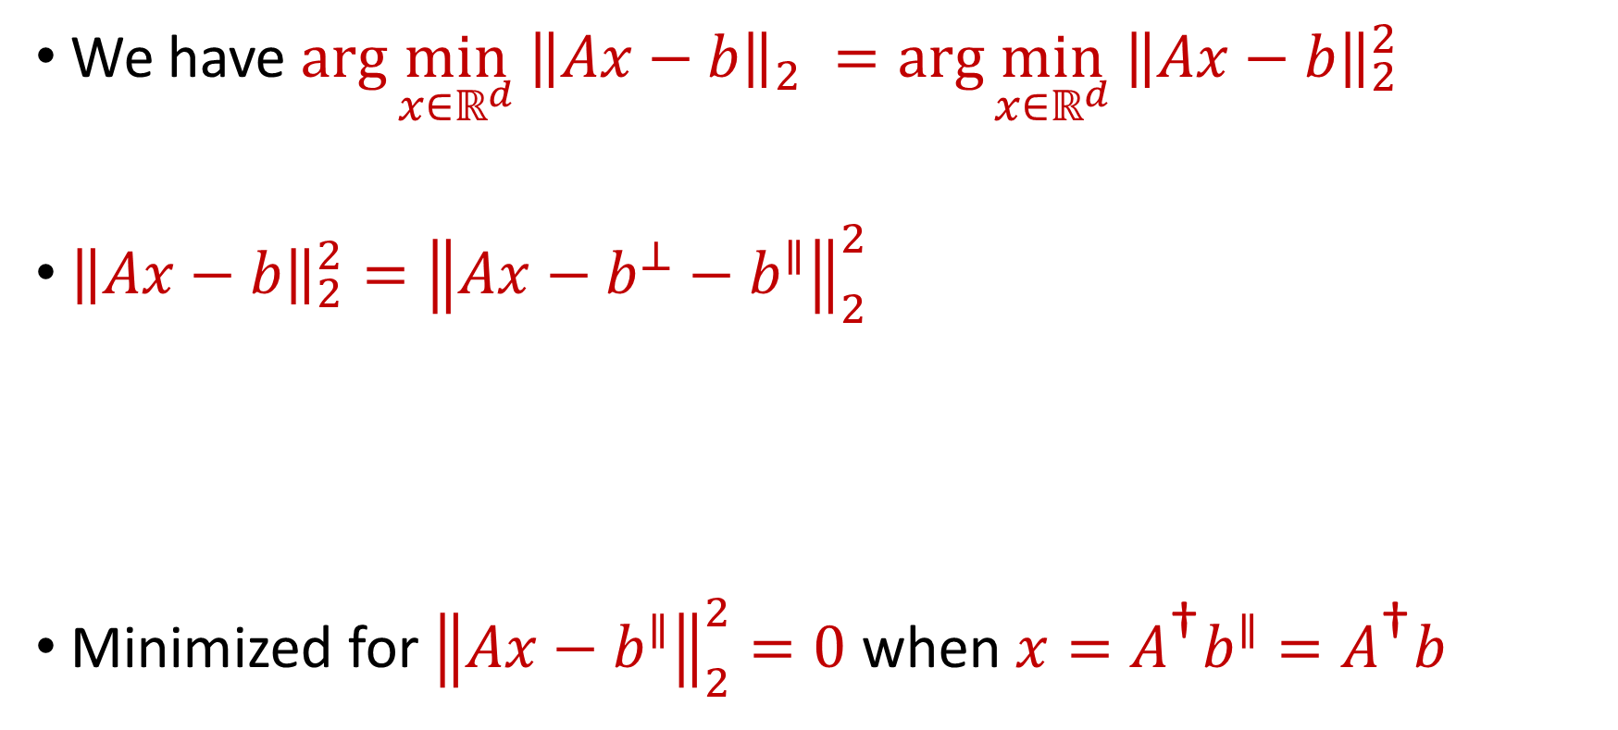
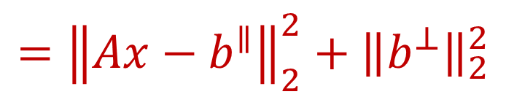
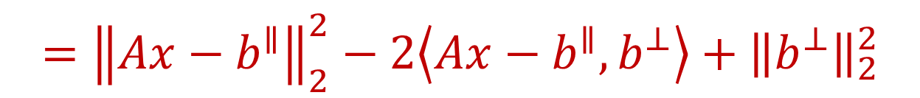
Last Time: Linear Regression
We have $\arg{\min_{x∈ℝ^{d}} {\left\|Ax−b\right\|}_{2} }=\arg{\min_{x∈ℝ^{d}} {\left\|Ax−b\right\|}_{2}^{2} }$
${\left\|Ax−b\right\|}_{2}^{2}={\left\|Ax−b^{⊥}−b^{∥}\right\|}_{2}^{2}$
Minimized for ${\left\|Ax−b^{∥}\right\|}_{2}^{2}=0$ when $x=A^{\text{†}}b^{∥}=A^{\text{†}}b$
$$={\left\|Ax−b^{∥}\right\|}_{2}^{2}−2\left\langle Ax−b^{∥},b^{⊥}\right\rangle +{\left\|b^{⊥}\right\|}_{2}^{2}$$
$$={\left\|Ax−b^{∥}\right\|}_{2}^{2}+{\left\|b^{⊥}\right\|}_{2}^{2}$$

Slide 5
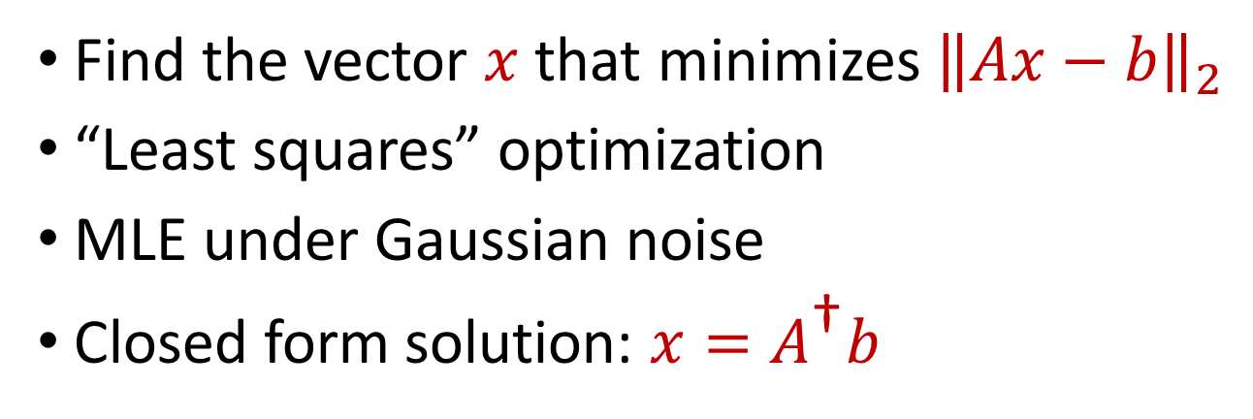
Last Time: Linear Regression
Find the vector $x$ that minimizes ${\left\|Ax−b\right\|}_{2}$
“Least squares” optimization
MLE under Gaussian noise
Closed form solution: $x=A^{\text{†}}b$
$$d$$
$$x$$
$$≈$$
$$n$$
$$A$$
$$n$$
$$b$$
$$1$$
$$d$$
$$1$$

Slide 6

Previously: Coreset Construction and Sampling
Importance sampling only needs $X′$ to have size $O\left(\frac{1}{ε^{2}}\right)$ to achieve $\left(1+ε\right)$-approximation to $Cost(X,C)$
To handle all possible sets of $k$ centers:
Need to sample each point $x$ with probability $\max_{C}\frac{Cost\left(x,C\right)}{Cost\left(X,C\right)}$ instead of $\frac{Cost\left(x,C\right)}{Cost\left(X,C\right)}$
Need to union bound over a net of all possible sets of $k$ centers
Net with size ${\left(\frac{nΔ}{ε}\right)}^{O(kd)}$

Slide 7
Previously: Sensitivity Sampling
The quantity $s\left(x\right)=\max_{C}\frac{Cost\left(x,C\right)}{Cost\left(X,C\right)}$ is called the sensitivity of $x$ and intuitively measures how “important” the point $x$ is
The total sensitivity of $X$ is $\sum_{x∈X}{s(x)}$ and quantifies how many points will be sampled into $X′$ through importance/sensitivity sampling (before the union bound)

Slide 8
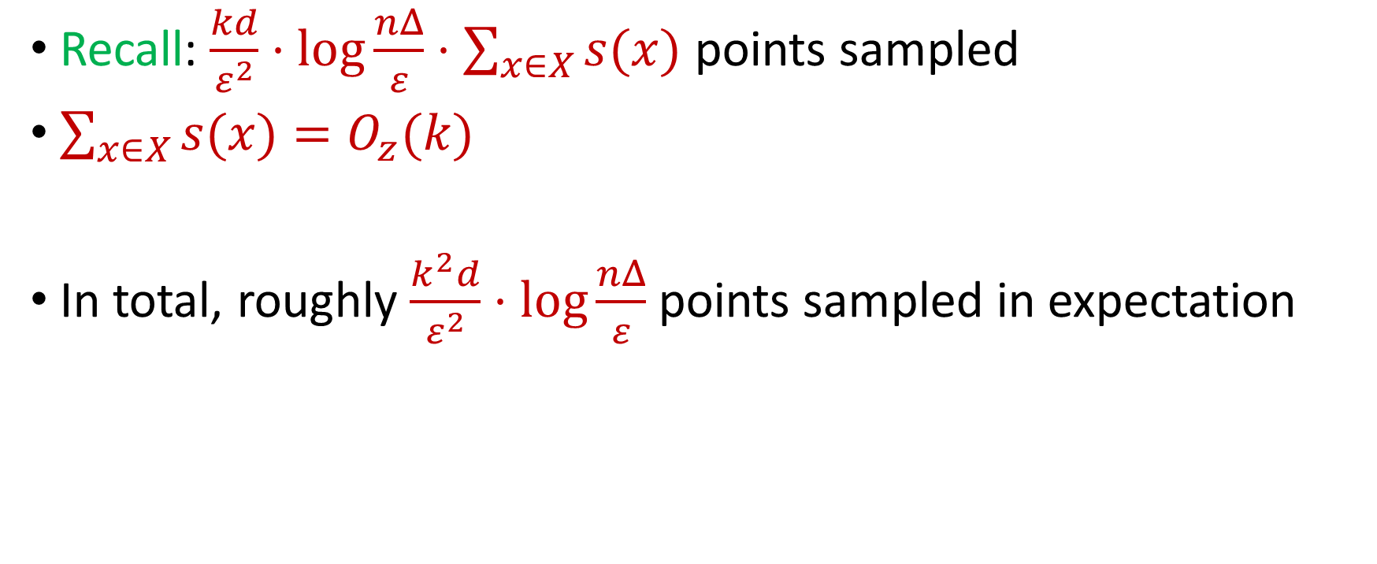
Previously: Sensitivity Sampling
Recall: $\frac{kd}{ε^{2}}⋅\log{\frac{nΔ}{ε}}⋅\sum_{x∈X}{s(x)}$ points sampled
$\sum_{x∈X}{s(x)}=O_{z}(k)$
In total, roughly $\frac{k^{2}d}{ε^{2}}⋅\log{\frac{nΔ}{ε}}$ points sampled in expectation

Slide 9






Linear Algebra Review
For $y=Ax$, we have $y_{i}=⟨a_{i}, x⟩$
${\left\|Ax\right\|}_{2}^{2}={\left\langle a_{1}, x\right\rangle }^{2}+…+{\left\langle a_{n}, x\right\rangle }^{2}$
$$A$$
$$x$$
$$d$$
$$n$$
$$d$$

Slide 10
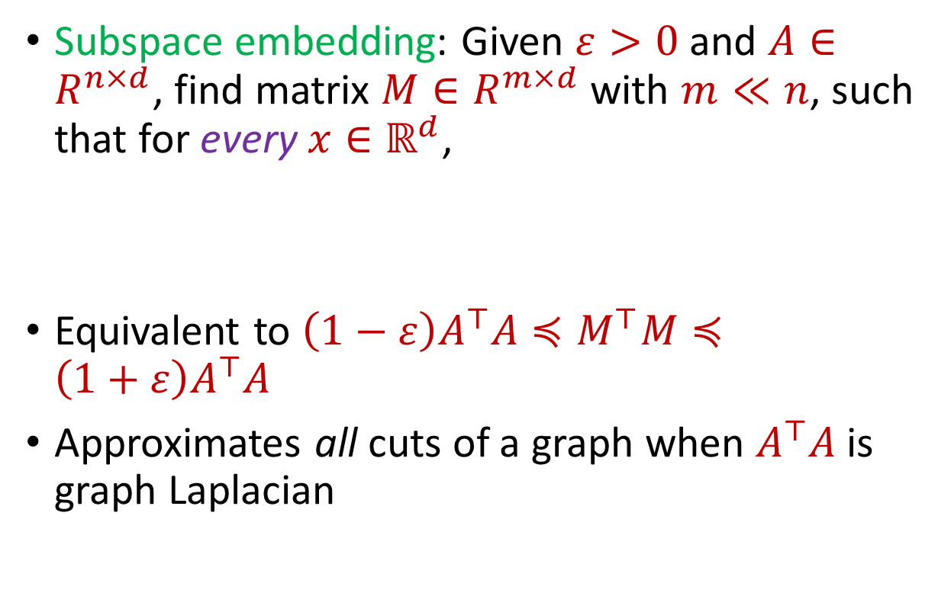

Subspace Embedding
Subspace embedding: Given $ε>0$ and $A∈R^{n×d}$, find matrix $M∈R^{m×d}$ with $m≪n$, such that for every $x∈ℝ^{d}$,
Equivalent to $\left(1−ε\right)A^{⊤}A≼M^{⊤}M≼\left(1+ε\right)A^{⊤}A$
Approximates all cuts of a graph when $A^{⊤}A$ is graph Laplacian
$$A$$
$$x$$
$$n$$
$$\left(1−ε\right){\left\|Ax\right\|}_{2}≤{\left\|Mx\right\|}_{2}≤\left(1+ε\right){\left\|Ax\right\|}_{2}$$
$$d$$

Slide 11
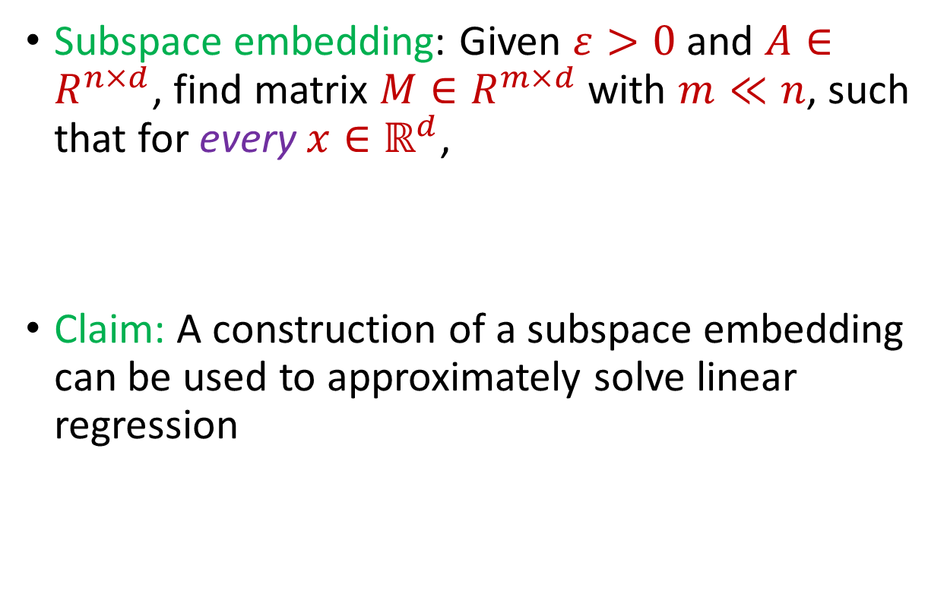
Subspace Embedding
Subspace embedding: Given $ε>0$ and $A∈R^{n×d}$, find matrix $M∈R^{m×d}$ with $m≪n$, such that for every $x∈ℝ^{d}$,
Claim: A construction of a subspace embedding can be used to approximately solve linear regression
$$A$$
$$x$$
$$n$$
$$\left(1−ε\right){\left\|Ax\right\|}_{2}≤{\left\|Mx\right\|}_{2}≤\left(1+ε\right){\left\|Ax\right\|}_{2}$$
$$d$$

Slide 12
















Regression and Subspace Embeddings
Recall: Goal is to find $x$ that minimizes ${\left\|Ax−b\right\|}_{2}$
$$−$$
$$A$$
$$x$$
$$b$$
$$A$$
$$b$$
$$x$$
$$n$$
$$n$$
$$n$$
$$−1$$
$$d$$
$$1$$
$$d$$
$$1$$

Slide 13




Regression and Subspace Embeddings
Recall: Goal is to find $x$ that minimizes ${\left\|Ax−b\right\|}_{2}$
$$B$$
$$y$$
$$A$$
$$b$$
$$x$$
$$n$$
$$n$$
$$−1$$
$$d+1$$
$$d$$
$$1$$

Slide 14

Regression and Subspace Embeddings
Recall: Goal is to find $x$ that minimizes ${\left\|Ax−b\right\|}_{2}$
$$B$$
$$y$$
$$A$$
$$b$$
$$x$$
$$n$$
$$n$$
$$−1$$
$${\left\|By\right\|}_{2}≈{\left\|Ax−b\right\|}_{2}$$
$$d+1$$
$$d$$
$$1$$

Slide 15
Previously: Coreset Construction and Sampling
Importance sampling only needs $X′$ to have size $O\left(\frac{1}{ε^{2}}\right)$ to achieve $\left(1+ε\right)$-approximation to $Cost(X,C)$
To handle all possible sets of $k$ centers:
Need to sample each point $x$ with probability $\max_{C}\frac{Cost\left(x,C\right)}{Cost\left(X,C\right)}$ instead of $\frac{Cost\left(x,C\right)}{Cost\left(X,C\right)}$
Need to union bound over a net of all possible sets of $k$ centers
Net with size ${\left(\frac{nΔ}{ε}\right)}^{O(kd)}$

Slide 16
Previously: Sensitivity Sampling
The quantity $s\left(x\right)=\max_{C}\frac{Cost\left(x,C\right)}{Cost\left(X,C\right)}$ is called the sensitivity of $x$ and intuitively measures how “important” the point $x$ is
The total sensitivity of $X$ is $\sum_{x∈X}{s(x)}$ and quantifies how many points will be sampled into $X′$ through importance/sensitivity sampling (before the union bound)

Slide 17
Previously: Sensitivity Sampling
Recall: $\frac{kd}{ε^{2}}⋅\log{\frac{nΔ}{ε}}⋅\sum_{x∈X}{s(x)}$ points sampled
$\sum_{x∈X}{s(x)}=O_{z}(k)$
In total, roughly $\frac{k^{2}d}{ε^{2}}⋅\log{\frac{nΔ}{ε}}$ points sampled in expectation

Slide 18

Subspace Embedding
Subspace embedding: Given $ε>0$ and $A∈ℝ^{n×d}$, find matrix $M∈ℝ^{m×d}$ with $m≪n$, such that for every $x∈ℝ^{d}$,
$$A$$
$$x$$
$$n$$
$$\left(1−ε\right){\left\|Ax\right\|}_{2}≤{\left\|Mx\right\|}_{2}≤\left(1+ε\right){\left\|Ax\right\|}_{2}$$
$$d$$

Slide 19
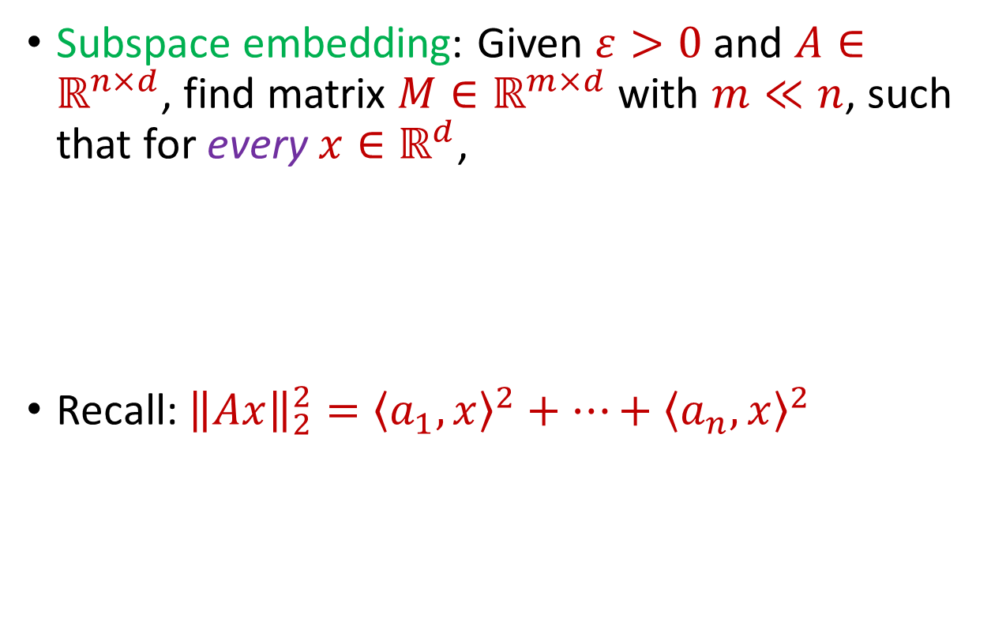
Subspace Embedding
Subspace embedding: Given $ε>0$ and $A∈ℝ^{n×d}$, find matrix $M∈ℝ^{m×d}$ with $m≪n$, such that for every $x∈ℝ^{d}$,
Recall: ${\left\|Ax\right\|}_{2}^{2}={\left\langle a_{1}, x\right\rangle }^{2}+…+{\left\langle a_{n}, x\right\rangle }^{2}$
$$A$$
$$x$$
$$n$$
$$\left(1−ε\right){\left\|Ax\right\|}_{2}^{2}≤{\left\|Mx\right\|}_{2}^{2}≤\left(1+ε\right){\left\|Ax\right\|}_{2}^{2}$$
$$d$$

Slide 20
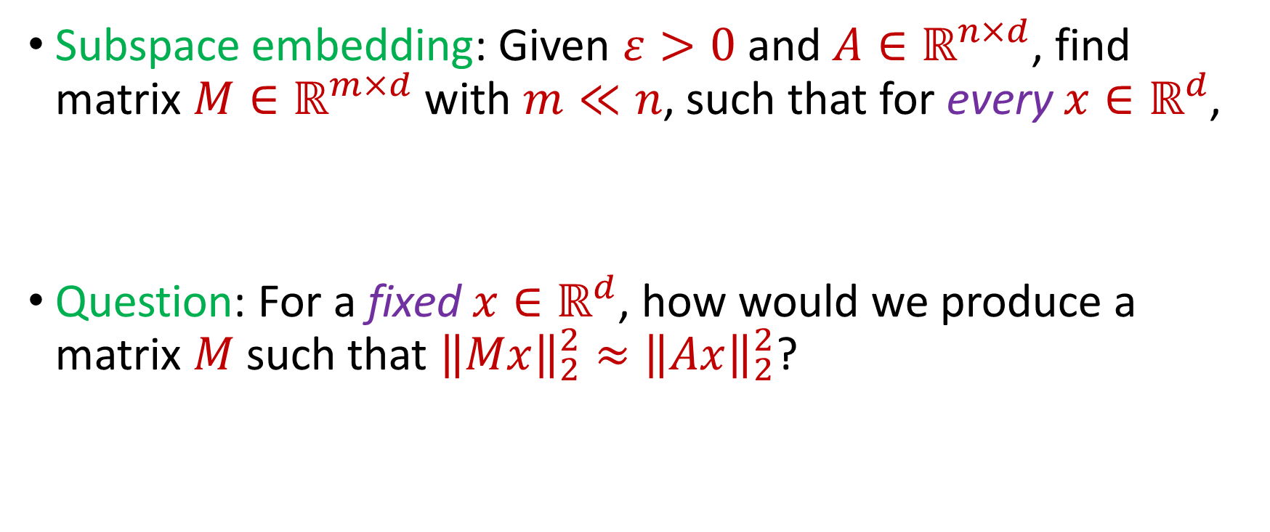
Subspace Embedding
Subspace embedding: Given $ε>0$ and $A∈ℝ^{n×d}$, find matrix $M∈ℝ^{m×d}$ with $m≪n$, such that for every $x∈ℝ^{d}$,
Question: For a fixed $x∈ℝ^{d}$, how would we produce a matrix $M$ such that ${\left\|Mx\right\|}_{2}^{2}≈{\left\|Ax\right\|}_{2}^{2}$?
$$\left(1−ε\right){\left\|Ax\right\|}_{2}^{2}≤{\left\|Mx\right\|}_{2}^{2}≤\left(1+ε\right){\left\|Ax\right\|}_{2}^{2}$$

Slide 21
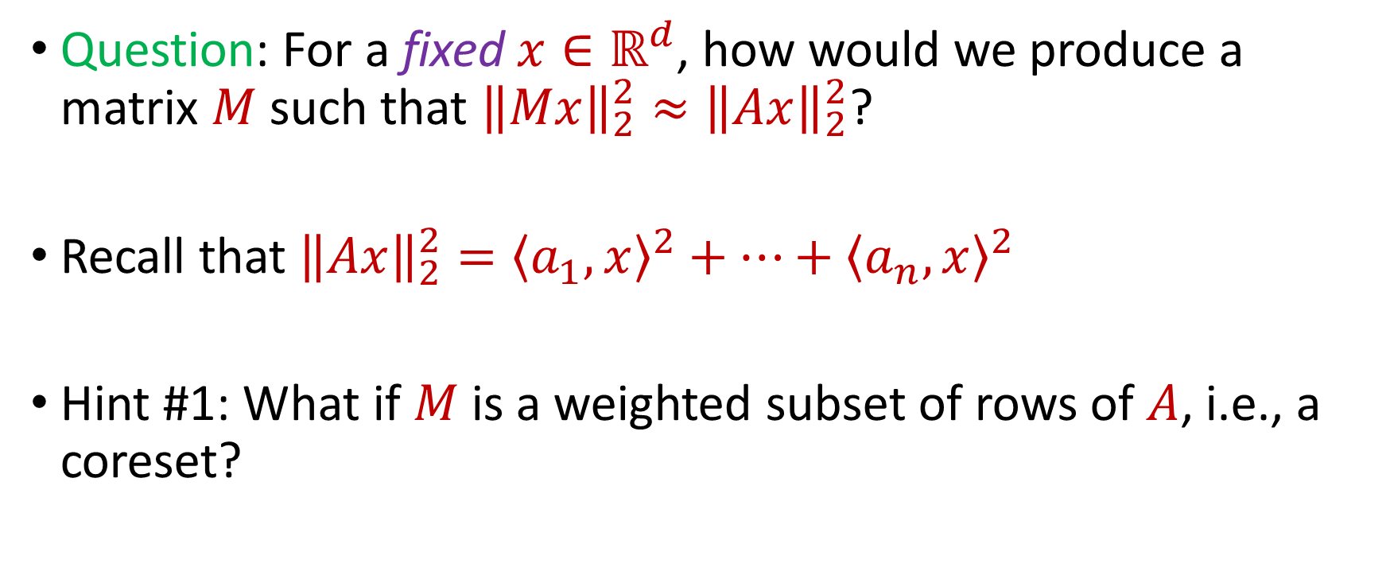
Subspace Embedding
Question: For a fixed $x∈ℝ^{d}$, how would we produce a matrix $M$ such that ${\left\|Mx\right\|}_{2}^{2}≈{\left\|Ax\right\|}_{2}^{2}$?
Recall that ${\left\|Ax\right\|}_{2}^{2}={\left\langle a_{1}, x\right\rangle }^{2}+…+{\left\langle a_{n}, x\right\rangle }^{2}$
Hint #1: What if $M$ is a weighted subset of rows of $A$, i.e., a coreset?

Slide 22
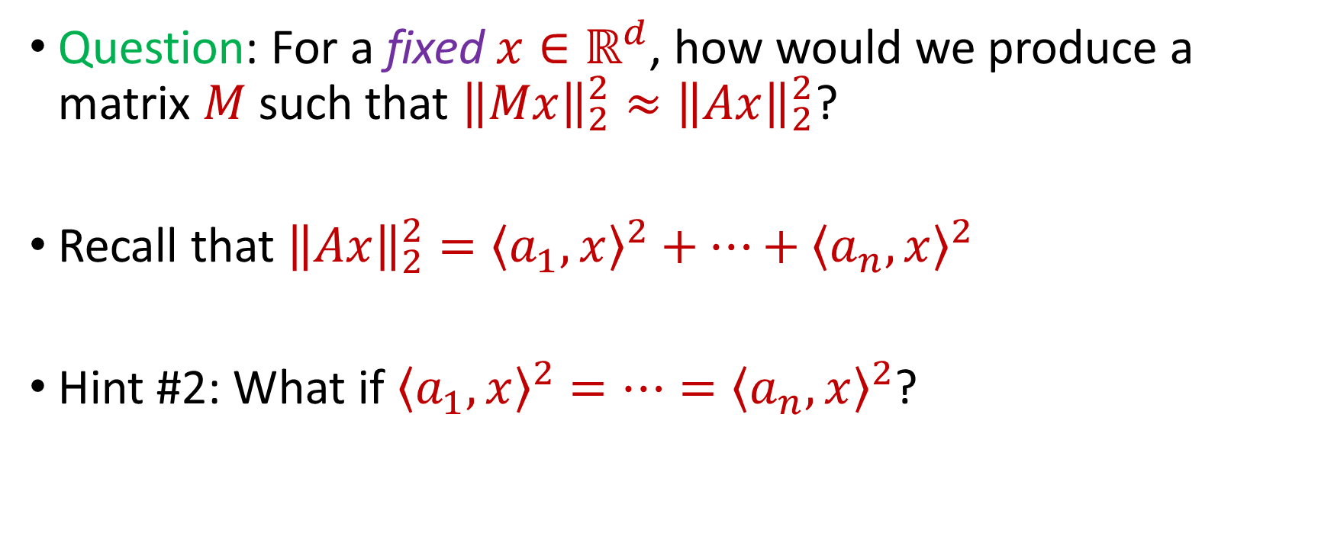
Subspace Embedding
Question: For a fixed $x∈ℝ^{d}$, how would we produce a matrix $M$ such that ${\left\|Mx\right\|}_{2}^{2}≈{\left\|Ax\right\|}_{2}^{2}$?
Recall that ${\left\|Ax\right\|}_{2}^{2}={\left\langle a_{1}, x\right\rangle }^{2}+…+{\left\langle a_{n}, x\right\rangle }^{2}$
Hint #2: What if ${\left\langle a_{1}, x\right\rangle }^{2}=…={\left\langle a_{n}, x\right\rangle }^{2}$?

Slide 23


Bernstein’s Inequality
Bernstein’s inequality: Let $y_{1},…,y_{n}∈[−M,M]$ be independent random variables and let ${y=y}_{1}+…+y_{n}$ have mean $μ$ and variance $σ^{2}$. Then for any $t≥0$:
$$Pr\left[\left|y−μ\right|≥t\right]≤2e^{−\frac{t^{2}}{2σ^{2}+\frac{4}{3}Mt}}$$

Slide 24
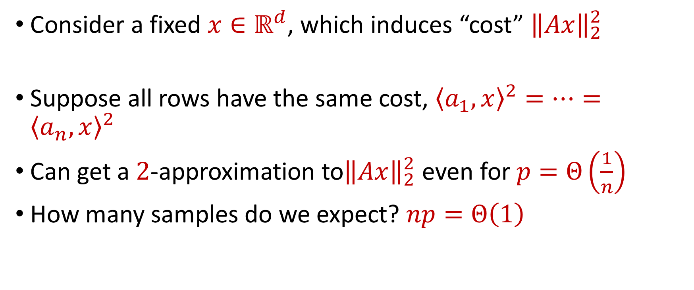
Coreset Construction and Uniform Sampling
Consider a fixed $x∈ℝ^{d}$, which induces “cost” ${\left\|Ax\right\|}_{2}^{2}$
Suppose all rows have the same cost, ${\left\langle a_{1}, x\right\rangle }^{2}=…={\left\langle a_{n}, x\right\rangle }^{2}$
Can get a $2$-approximation to${\left\|Ax\right\|}_{2}^{2}$ even for $p=Θ\left(\frac{1}{n}\right)$
How many samples do we expect? $np=Θ\left(1\right)$

Slide 25
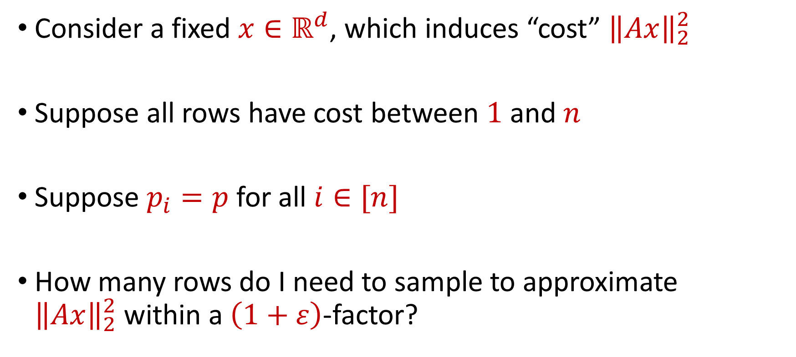
Coreset Construction and Uniform Sampling
Consider a fixed $x∈ℝ^{d}$, which induces “cost” ${\left\|Ax\right\|}_{2}^{2}$
Suppose all rows have cost between $1$ and $n$
Suppose $p_{i}=p$ for all $i∈[n]$
How many rows do I need to sample to approximate ${\left\|Ax\right\|}_{2}^{2}$within a $\left(1+ε\right)$-factor?

Slide 26
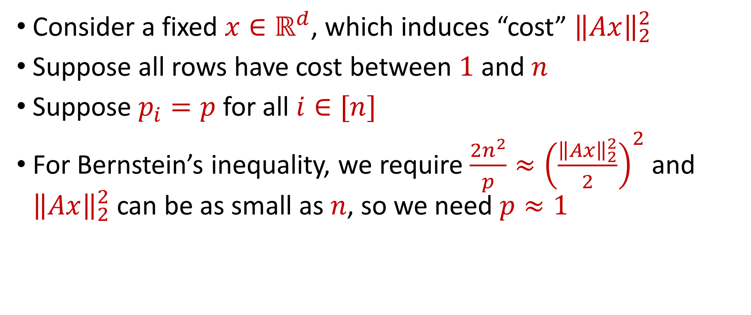
Uniform Sampling for Subspace Embedding
Consider a fixed $x∈ℝ^{d}$, which induces “cost” ${\left\|Ax\right\|}_{2}^{2}$
Suppose all rows have cost between $1$ and $n$
Suppose $p_{i}=p$ for all $i∈[n]$
For Bernstein’s inequality, we require $\frac{2n^{2}}{p}≈{\left(\frac{{\left\|Ax\right\|}_{2}^{2}}{2}\right)}^{2}$ and ${\left\|Ax\right\|}_{2}^{2}$ can be as small as $n$, so we need $p≈1$

Slide 27
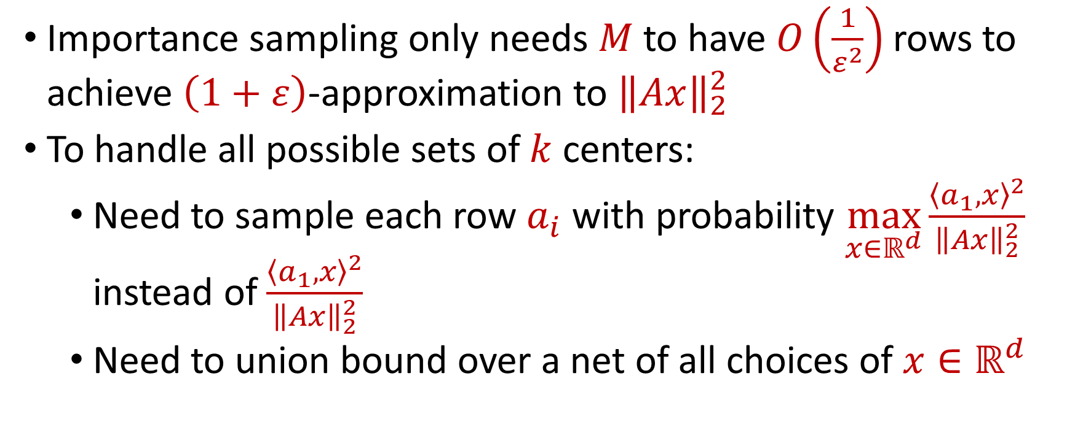
Coreset Construction and Sampling
Importance sampling only needs $M$ to have $O\left(\frac{1}{ε^{2}}\right)$ rows to achieve $\left(1+ε\right)$-approximation to ${\left\|Ax\right\|}_{2}^{2}$
To handle all possible sets of $k$ centers:
Need to sample each row $a_{i}$ with probability $\max_{x∈ℝ^{d}}\frac{{\left\langle a_{1}, x\right\rangle }^{2}}{{\left\|Ax\right\|}_{2}^{2}}$ instead of $\frac{{\left\langle a_{1}, x\right\rangle }^{2}}{{\left\|Ax\right\|}_{2}^{2}}$
Need to union bound over a net of all choices of $x∈ℝ^{d}$

Slide 28
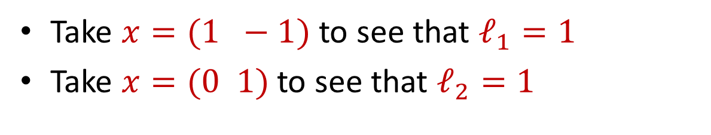
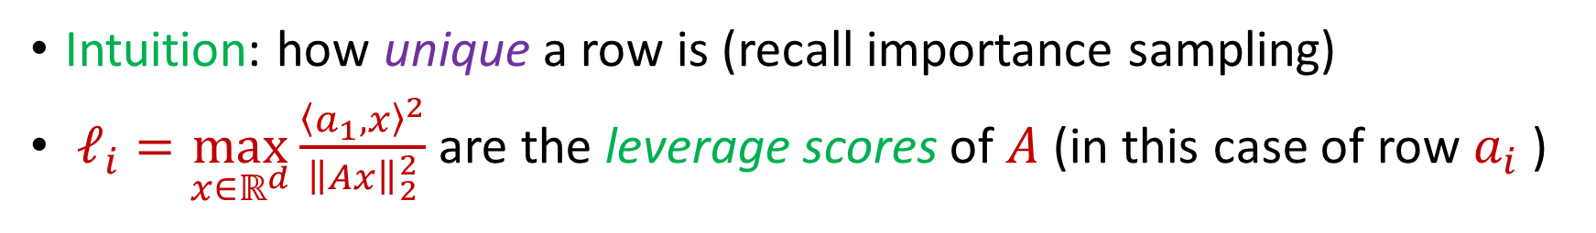
Leverage Scores
Intuition: how unique a row is (recall importance sampling)
$ℓ_{i}=\max_{x∈ℝ^{d}}\frac{{\left\langle a_{1}, x\right\rangle }^{2}}{{\left\|Ax\right\|}_{2}^{2}}$ are the leverage scores of $A$ (in this case of row $a_{i}$ )
Take $x=(1 −1)$ to see that $ℓ_{1}=1$
Take $x=(0 1)$ to see that $ℓ_{2}=1$
1 0
1 1
$ℓ_{i}=a_{i}{\left(A^{⊤}A\right)}^{−1}a_{i}^{⊤}$, ${∑ℓ}_{i}=d$
$$A$$
$$a_{i}$$

