Slide 1
CSCE 689: Special Topics in Modern Algorithms for Data Science
Lecture 33
Samson Zhou

Slide 2
Presentation Schedule
November 27: Chunkai, Jung, Galaxy AI
November 29: STMI, Anmol, Jason
December 1: Bokun, Ayesha, Dawei, Lipai

Slide 3
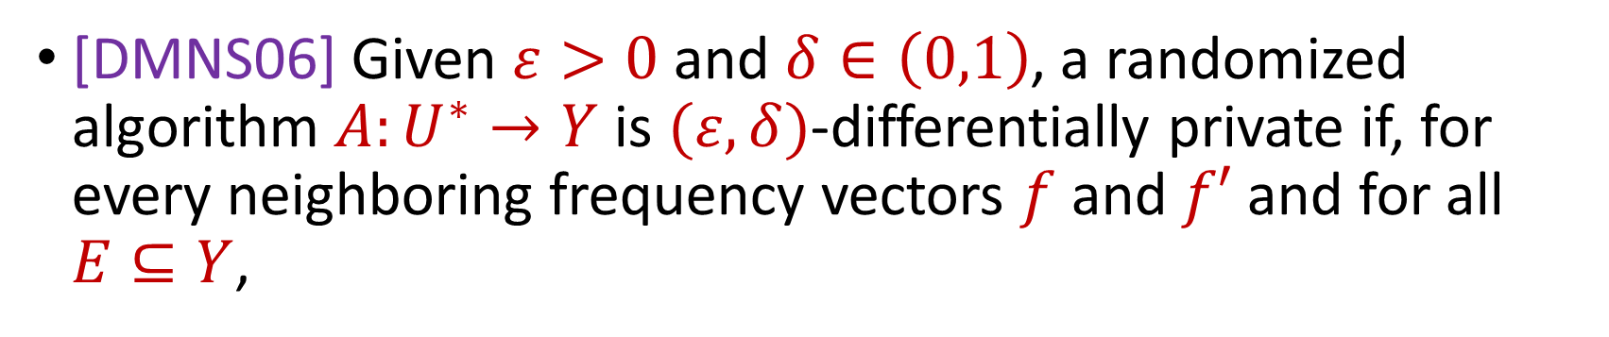
Last Time: Differential Privacy
[DMNS06] Given $ε>0$and $δ∈\left(0,1\right)$, a randomized algorithm $A:U^{∗}→Y$ is $(ε,δ)$-differentially private if, for every neighboring frequency vectors $f$ and $f′$ and for all $E⊆Y$,
$$Pr\left[A\left(f\right)∈E\right]≤e^{ε}⋅Pr\left[A\left(f^{′}\right)∈E\right]+δ$$
Notes:
[DworkMcSherryNissimSmith06]

Slide 4


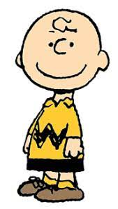


Last Time: Differential Privacy
[DMNS06] Given $ε>0$and $δ∈\left(0,1\right)$, a randomized algorithm $A:U^{∗}→Y$ is $(ε,δ)$-differentially private if, for every neighboring frequency vectors $f$ and $f′$ and for all $E⊆Y$,
$$Pr\left[A\left(f\right)∈E\right]≤e^{ε}⋅Pr\left[A\left(f^{′}\right)∈E\right]+δ$$
$$A\left( \right)≈A\left( \right)$$
Notes:
[DworkMcSherryNissimSmith06]

Slide 5
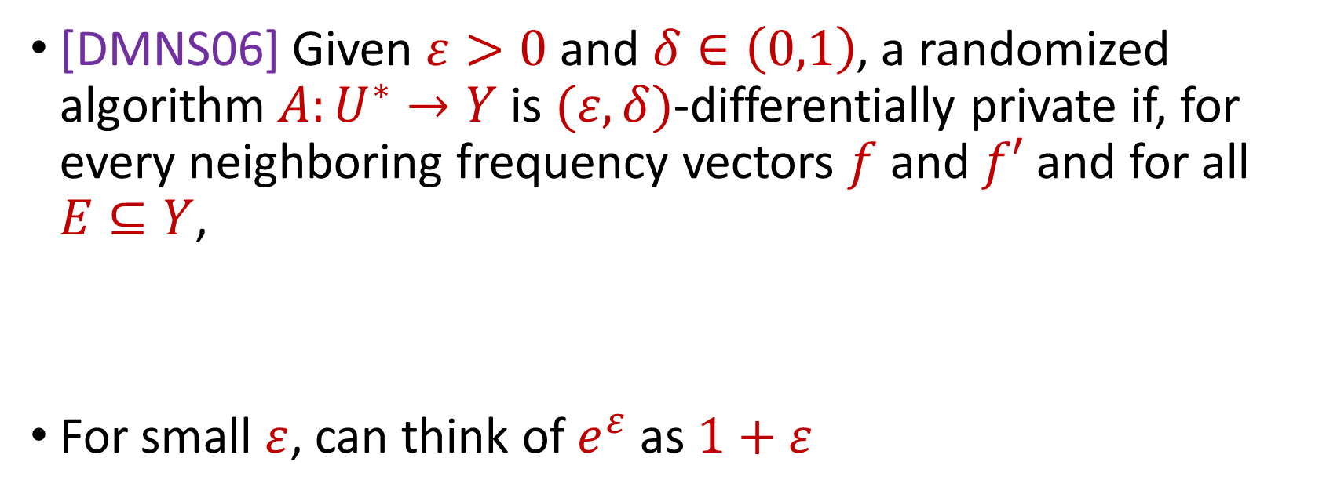
Last Time: Differential Privacy
[DMNS06] Given $ε>0$and $δ∈\left(0,1\right)$, a randomized algorithm $A:U^{∗}→Y$ is $(ε,δ)$-differentially private if, for every neighboring frequency vectors $f$ and $f′$ and for all $E⊆Y$,
For small $ε$, can think of $e^{ε}$ as $1+ε$
$$Pr\left[A\left(f\right)∈E\right]≤e^{ε}⋅Pr\left[A\left(f^{′}\right)∈E\right]+δ$$
$$Pr\left[A\left(f\right)∈E\right]≤\left(1+ε\right)⋅Pr\left[A\left(f^{′}\right)∈E\right]+δ$$
Notes:
[DworkMcSherryNissimSmith06]

Slide 6


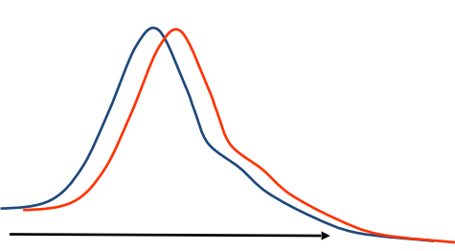
Last Time: Differential Privacy
[DMNS06] Given $ε>0$and $δ∈\left(0,1\right)$, a randomized algorithm $A:U^{∗}→Y$ is $(ε,δ)$-differentially private if, for every neighboring frequency vectors $f$ and $f′$ and for all $E⊆Y$,
$$Pr\left[A\left(f\right)∈E\right]≤e^{ε}⋅Pr\left[A\left(f^{′}\right)∈E\right]+δ$$
Sensitive dataset
Algorithm
Output distribution
Notes:
[DworkMcSherryNissimSmith06]

Slide 7
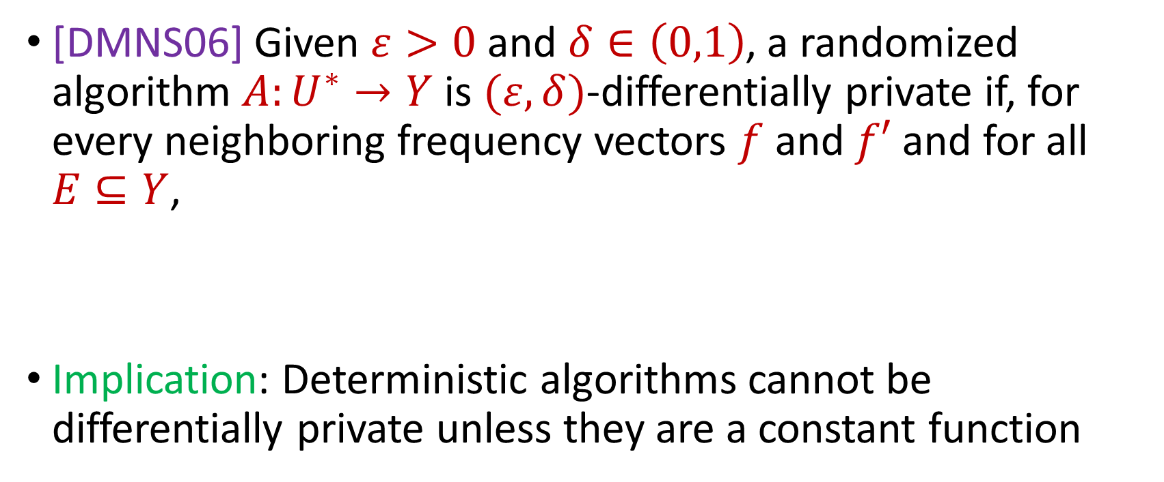
Last Time: Differential Privacy
[DMNS06] Given $ε>0$and $δ∈\left(0,1\right)$, a randomized algorithm $A:U^{∗}→Y$ is $(ε,δ)$-differentially private if, for every neighboring frequency vectors $f$ and $f′$ and for all $E⊆Y$,
Implication: Deterministic algorithms cannot be differentially private unless they are a constant function
$$Pr\left[A\left(f\right)∈E\right]≤e^{ε}⋅Pr\left[A\left(f^{′}\right)∈E\right]+δ$$
Notes:
[DworkMcSherryNissimSmith06]

Slide 8
Differential Privacy Properties
What properties would we like from a rigorous definition of privacy?
Notes:
[DworkMcSherryNissimSmith06]

Slide 9
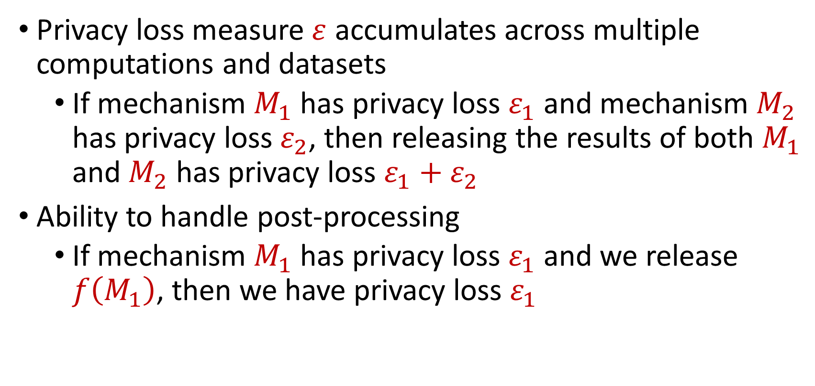
Differential Privacy Properties
Privacy loss measure $ε$ accumulates across multiple computations and datasets
If mechanism $M_{1}$ has privacy loss $ε_{1}$ and mechanism $M_{2}$ has privacy loss $ε_{2}$, then releasing the results of both $M_{1}$ and $M_{2}$ has privacy loss $ε_{1}+ε_{2}$
Ability to handle post-processing
If mechanism $M_{1}$ has privacy loss $ε_{1}$ and we release $f\left(M_{1}\right)$, then we have privacy loss $ε_{1}$
Notes:
[DworkMcSherryNissimSmith06]

Slide 10
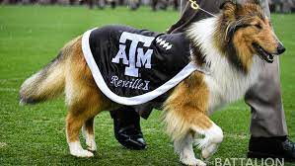
Counting
How many people in the population satisfy some property?
How many people in this class have a pet?
Notes:
[DworkMcSherryNissimSmith06]

Slide 11
Counting
How many people in this class have a pet?
What happens if each person answers with their truth?
Notes:
[DworkMcSherryNissimSmith06]

Slide 12
Counting
How many people in this class have a pet?
What happens if each person flips a coin and answers with the coin flip?
Think of your favorite (integer) number:
If it is even, answer YES
Otherwise if it is odd, answer NO
Notes:
[DworkMcSherryNissimSmith06]

Slide 13
Counting
How many people in this class have a pet?
Think of your home address:
If it is even, answer truthfully
Otherwise, proceed below
Think of your phone number:
If it is even, answer YES
Otherwise if it is odd, answer NO
Notes:
[DworkMcSherryNissimSmith06]

Slide 14
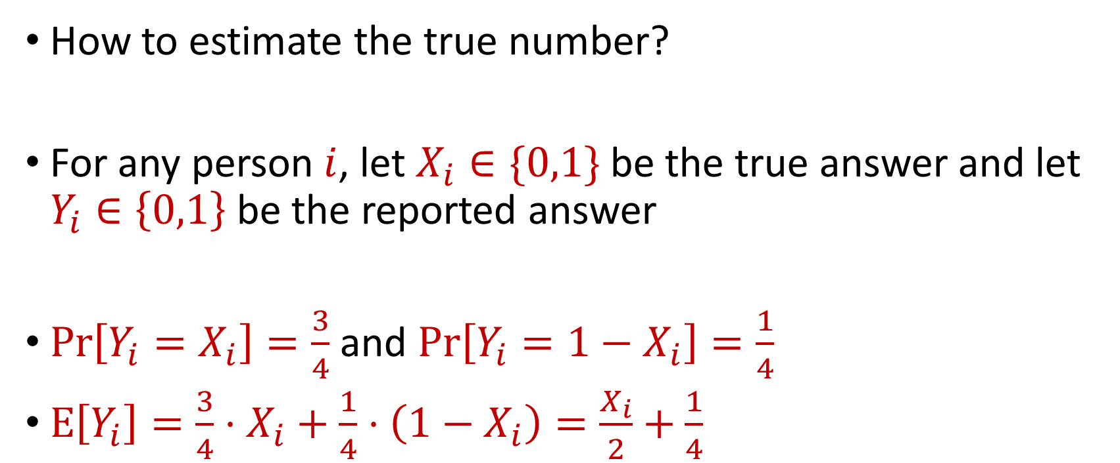
Counting
How to estimate the true number?
For any person $i$, let $X_{i}∈\{0,1\}$ be the true answer and let $Y_{i}∈\left\{0,1\right\}$ be the reported answer
$\operatorname{Pr}\left[Y_{i}=X_{i}\right]=\frac{3}{4}$ and $\operatorname{Pr}\left[Y_{i}=1−X_{i}\right]=\frac{1}{4}$
$E\left[Y_{i}\right]=\frac{3}{4}⋅X_{i}+\frac{1}{4}⋅\left(1−X_{i}\right)=\frac{X_{i}}{2}+\frac{1}{4}$
Notes:
[DworkMcSherryNissimSmith06]

Slide 15
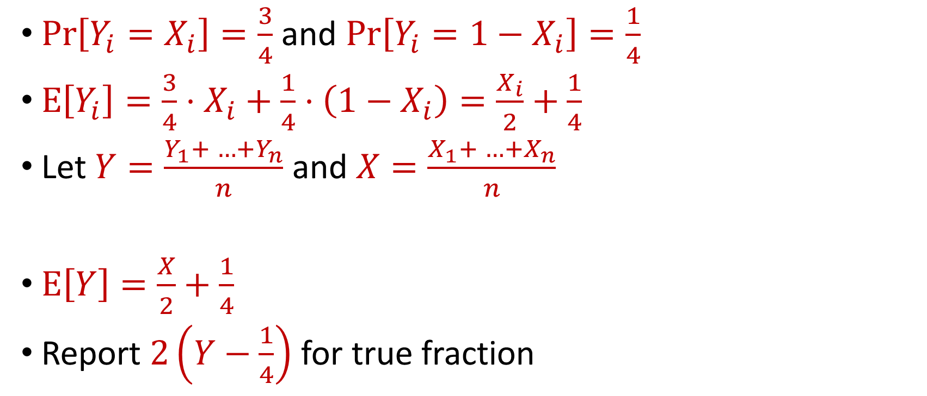
Counting
$\operatorname{Pr}\left[Y_{i}=X_{i}\right]=\frac{3}{4}$ and $\operatorname{Pr}\left[Y_{i}=1−X_{i}\right]=\frac{1}{4}$
$E\left[Y_{i}\right]=\frac{3}{4}⋅X_{i}+\frac{1}{4}⋅\left(1−X_{i}\right)=\frac{X_{i}}{2}+\frac{1}{4}$
Let $Y=\frac{Y_{1}+ …+Y_{n}}{n}$ and $X=\frac{X_{1}+ …+X_{n}}{n}$
$E\left[Y\right]=\frac{X}{2}+\frac{1}{4}$
Report $2\left(Y−\frac{1}{4}\right)$ for true fraction
Notes:
[DworkMcSherryNissimSmith06]

Slide 16
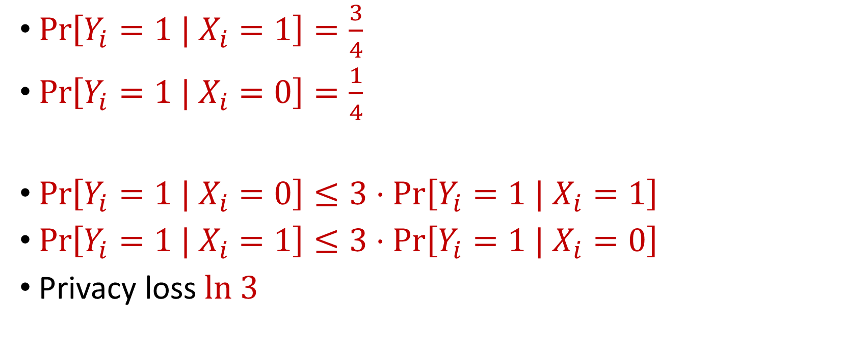
Randomized Response
$\operatorname{Pr}\left[Y_{i}=1 | X_{i}=1\right]=\frac{3}{4}$
$\operatorname{Pr}\left[Y_{i}=1 | X_{i}=0\right]=\frac{1}{4}$
$\operatorname{Pr}\left[Y_{i}=1 | X_{i}=0\right]≤3⋅\operatorname{Pr}\left[Y_{i}=1 | X_{i}=1\right]$
$\operatorname{Pr}\left[Y_{i}=1 | X_{i}=1\right]≤3⋅\operatorname{Pr}\left[Y_{i}=1 | X_{i}=0\right]$
Privacy loss $ln 3$
Notes:
[DworkMcSherryNissimSmith06]

Slide 17
Differential Privacy
[DMNS06] Given $ε>0$and $δ∈\left(0,1\right)$, a randomized algorithm $A:U^{∗}→Y$ is $(ε,δ)$-differentially private if, for every neighboring frequency vectors $f$ and $f′$ and for all $E⊆Y$,
$$Pr\left[A\left(f\right)∈E\right]≤e^{ε}⋅Pr\left[A\left(f^{′}\right)∈E\right]+δ$$
Notes:
[DworkMcSherryNissimSmith06]

Slide 18
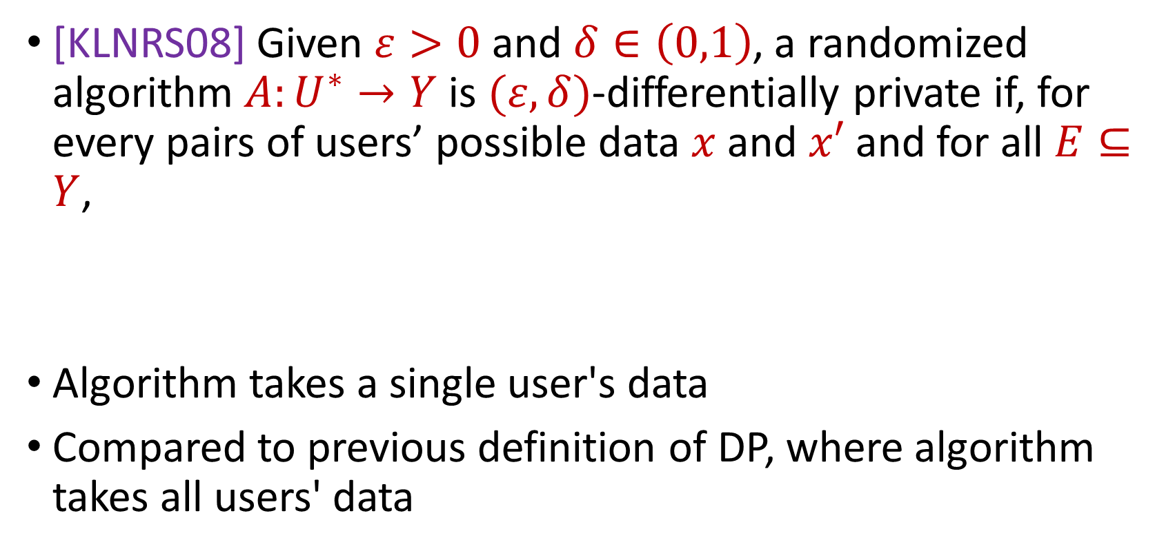
Local Differential Privacy (LDP)
[KLNRS08] Given $ε>0$and $δ∈\left(0,1\right)$, a randomized algorithm $A:U^{∗}→Y$ is $(ε,δ)$-differentially private if, for every pairs of users’ possible data $x$ and $x′$ and for all $E⊆Y$,
Algorithm takes a single user's data
Compared to previous definition of DP, where algorithm takes all users' data
$$Pr\left[A\left(x\right)∈E\right]≤e^{ε}⋅Pr\left[A\left(x^{′}\right)∈E\right]+δ$$
Notes:
[DworkMcSherryNissimSmith06]

Slide 19
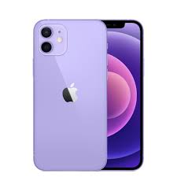
Local Differential Privacy (LDP)
Mobile Data Analytics: LDP can be applied to data collected from mobile devices to allow analysis of aggregate movement patterns and trends without compromising the privacy of individual users
Location-based services
User behavior analysis
Notes:
[DworkMcSherryNissimSmith06]

Slide 20






Privacy and Noise
$$Z$$
Random noise
$$x=x_{1},…,x_{n}$$
$$A(x)$$
$$A\left(x\right)=f\left(x\right)+Z$$
$$f(x)$$
Input
Algorithm
Output distribution
Notes:
[DworkMcSherryNissimSmith06]

Slide 21
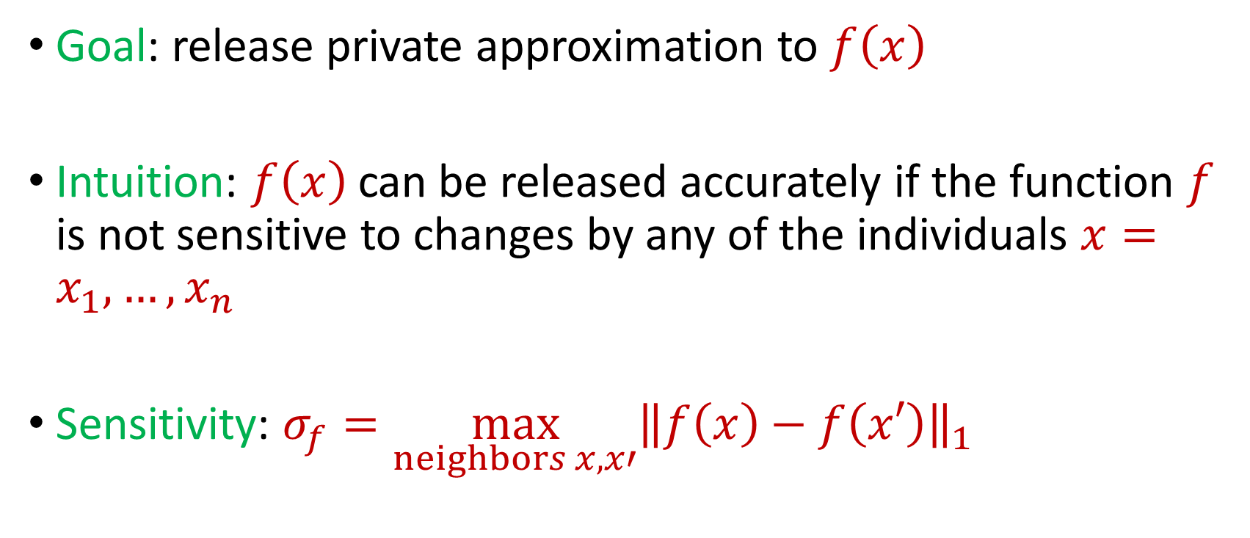
Privacy and Noise
Goal: release private approximation to $f\left(x\right)$
Intuition: $f\left(x\right)$ can be released accurately if the function $f$ is not sensitive to changes by any of the individuals $x=x_{1},…,x_{n}$
Sensitivity: $σ_{f}=\max_{neighbors x,x′}{\left\|f\left(x\right)−f\left(x′\right)\right\|}_{1}$
Notes:
[DworkMcSherryNissimSmith06]

Slide 22
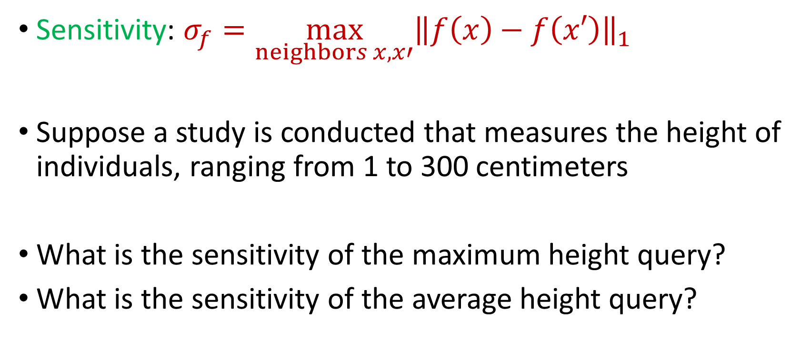
Sensitivity
Sensitivity: $σ_{f}=\max_{neighbors x,x′}{\left\|f\left(x\right)−f\left(x′\right)\right\|}_{1}$
Suppose a study is conducted that measures the height of individuals, ranging from 1 to 300 centimeters
What is the sensitivity of the maximum height query?
What is the sensitivity of the average height query?
Notes:
[DworkMcSherryNissimSmith06]

Slide 23
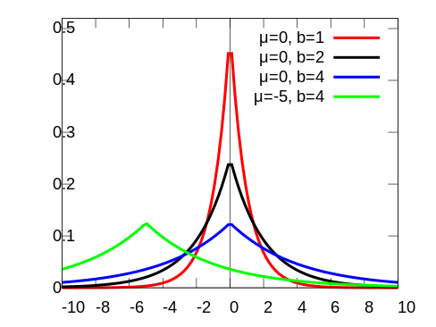
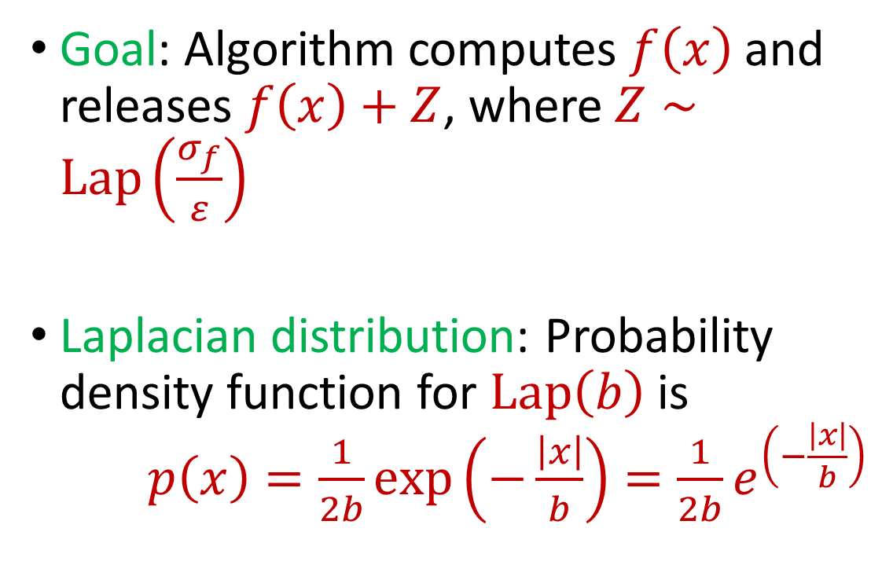
Laplace Mechanism
Goal: Algorithm computes $f\left(x\right)$ and releases $f\left(x\right)+Z$, where $Z∼Lap\left(\frac{σ_{f}}{ε}\right)$
Laplacian distribution: Probability density function for $Lap\left(b\right)$ is $p\left(x\right)=\frac{1}{2b}exp\left(−\frac{\left|x\right|}{b}\right)=\frac{1}{2b}e^{\left(−\frac{\left|x\right|}{b}\right)}$
Notes:
[DworkMcSherryNissimSmith06]

Slide 24
Laplace Mechanism
What does the Laplace mechanism do in the following cases?
Suppose a study is conducted that measures the height of individuals, ranging from 1 to 300 centimeters
What is the sensitivity of the maximum height query?
What is the sensitivity of the average height query?
Notes:
[DworkMcSherryNissimSmith06]

Slide 25

Laplace Mechanism
Theorem: Laplace mechanism is $ε$-differentially private (pure DP)
Notes:
[DworkMcSherryNissimSmith06]

Slide 26

Beyond Laplace Mechanism
What if the output is not a scalar, e.g., a vector?
Suppose the outputs lie in some space $Y$
Notes:
[DworkMcSherryNissimSmith06]

Slide 27
Beyond Laplace Mechanism
Suppose a study is conducted that finds the current location of individuals, in the two-dimensional plane
Who is the closest individual to a query location?
Notes:
[DworkMcSherryNissimSmith06]

Slide 28
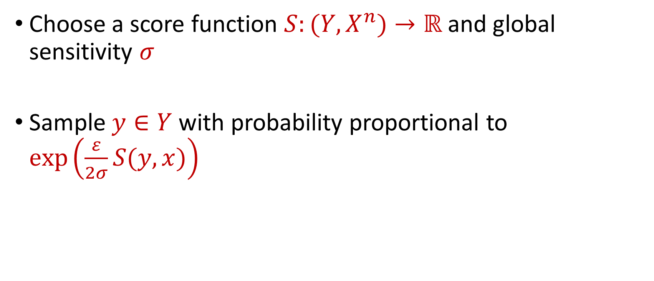
Exponential Mechanism
Choose a score function $S:(Y,X^{n})→ℝ$ and global sensitivity $σ$
Sample $y∈Y$ with probability proportional to $\exp\left(\frac{ε}{2σ}S(y,x)\right)$
Notes:
[DworkMcSherryNissimSmith06]

Slide 29
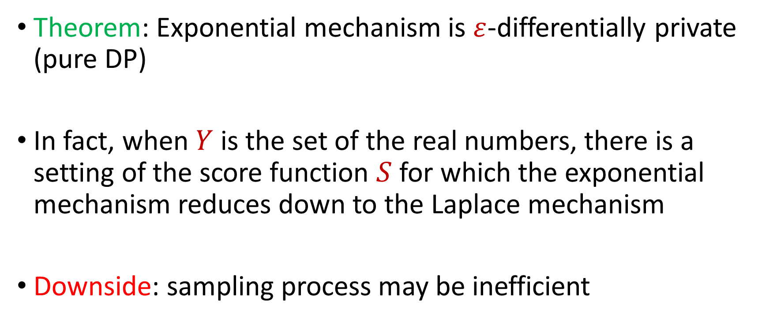
Exponential Mechanism
Theorem: Exponential mechanism is $ε$-differentially private (pure DP)
In fact, when $Y$ is the set of the real numbers, there is a setting of the score function $S$ for which the exponential mechanism reduces down to the Laplace mechanism
Downside: sampling process may be inefficient
Notes:
[DworkMcSherryNissimSmith06]

