Slide 1
CSCE 689: Special Topics in Modern Algorithms for Data Science
Lecture 19
Samson Zhou

Slide 2
Presentation Schedule
November 27: Chunkai, Jung, Galaxy AI
November 29: STMI, Anmol, Jason
December 1: Bokun, Ayesha, Dawei, Lipai

Slide 3
Previously in the Streaming Model
Reservoir sampling
Heavy-hitters
Misra-Gries
CountMin
CountSketch
Moment estimation
AMS algorithm
Sparse recovery
Distinct elements estimation

Slide 4

Reservoir Sampling
Suppose we see a stream of elements from $[n]$. How do we uniformly sample one of the positions of the stream?
47 72 81 10 14 33 51 29 54 9 36 46 10

Slide 5
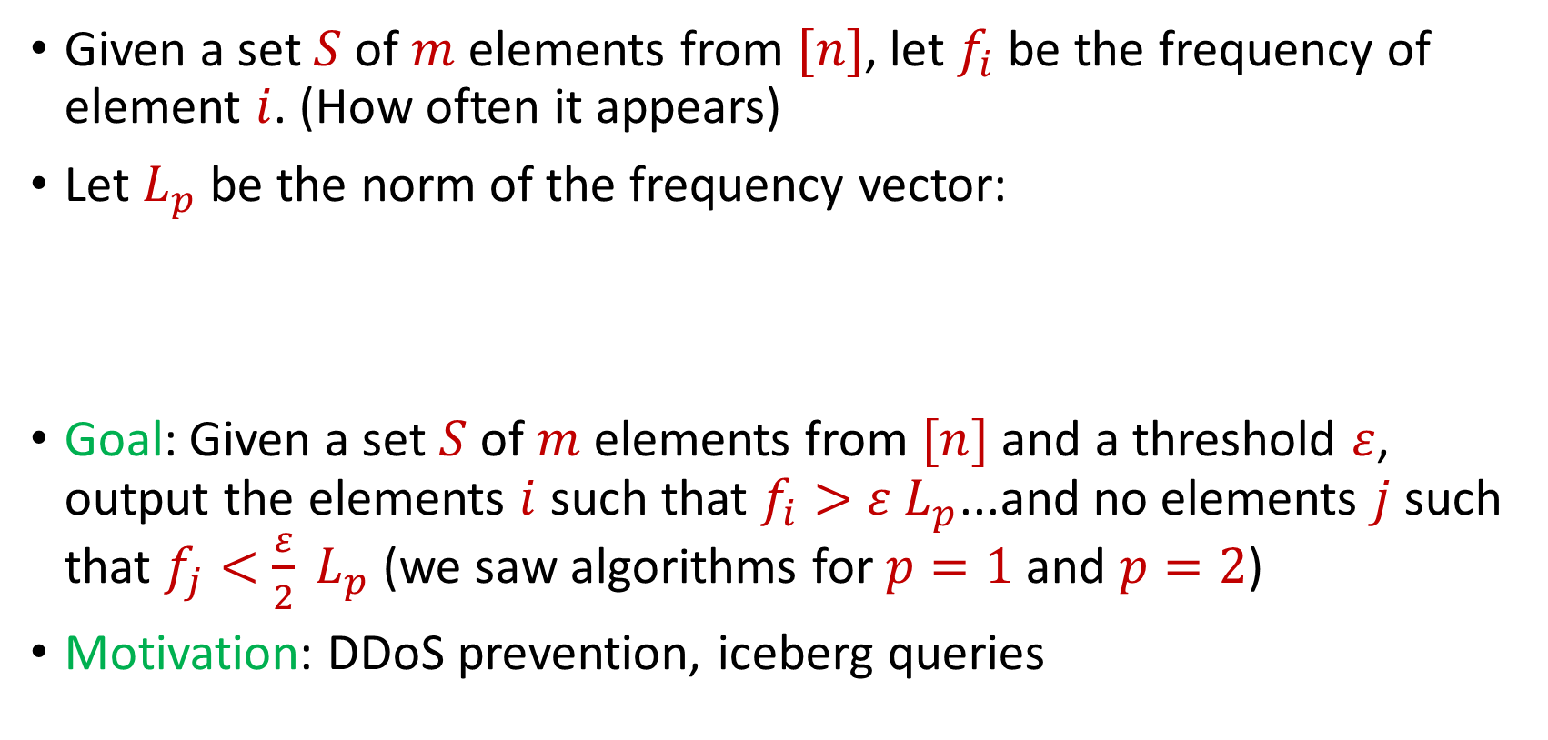
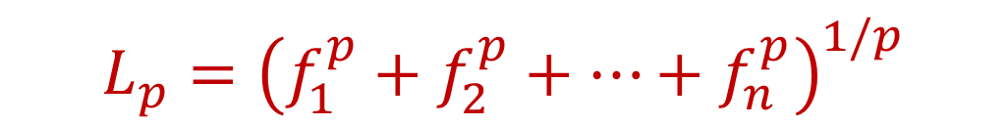
Heavy-Hitters (Frequent Items)
Given a set $S$ of $m$ elements from $[n]$, let $f_{i}$ be the frequency of element $i$. (How often it appears)
Let $L_{p}$ be the norm of the frequency vector:
Goal: Given a set $S$ of $m$ elements from $[n]$ and a threshold $ε$, output the elements $i$ such that $f_{i}>$ $ε L_{p}$...and no elements $j$ such that $f_{j}<$ $\frac{ε}{2} L_{p}$ (we saw algorithms for $p=1$ and $p=2$)
Motivation: DDoS prevention, iceberg queries
$$L_{p}={\left(f_{1}^{p}+f_{2}^{p}+…+f_{n}^{p}\right)}^{1/p}$$

Slide 6
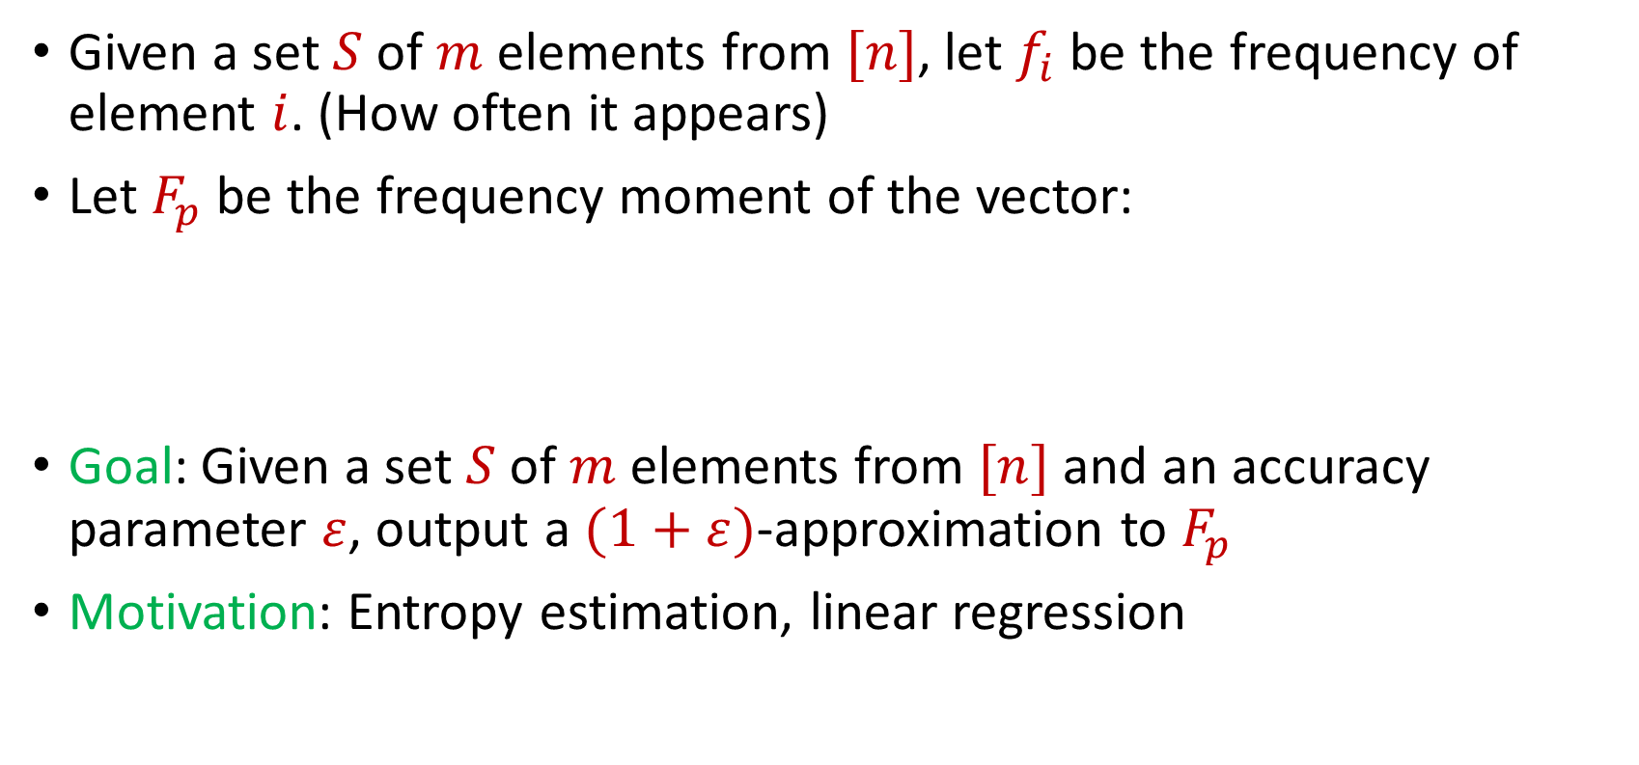
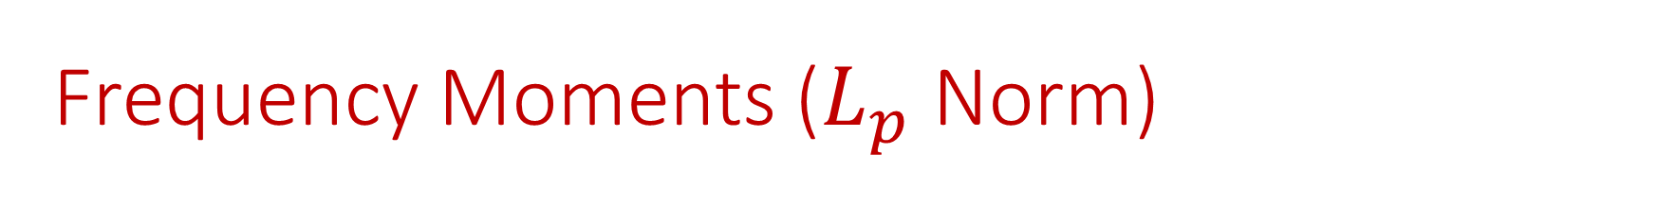
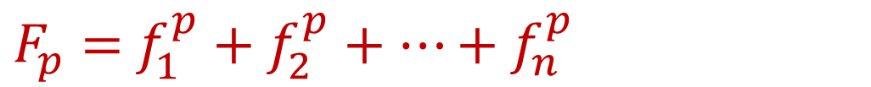
Frequency Moments ($L_{p}$ Norm)
Given a set $S$ of $m$ elements from $[n]$, let $f_{i}$ be the frequency of element $i$. (How often it appears)
Let $F_{p}$ be the frequency moment of the vector:
Goal: Given a set $S$ of $m$ elements from $[n]$ and an accuracy parameter $ε$, output a $(1+ε)$-approximation to $F_{p}$
Motivation: Entropy estimation, linear regression
$F_{p}=$ $f_{1}^{p}+f_{2}^{p}+…+f_{n}^{p}$

Slide 7
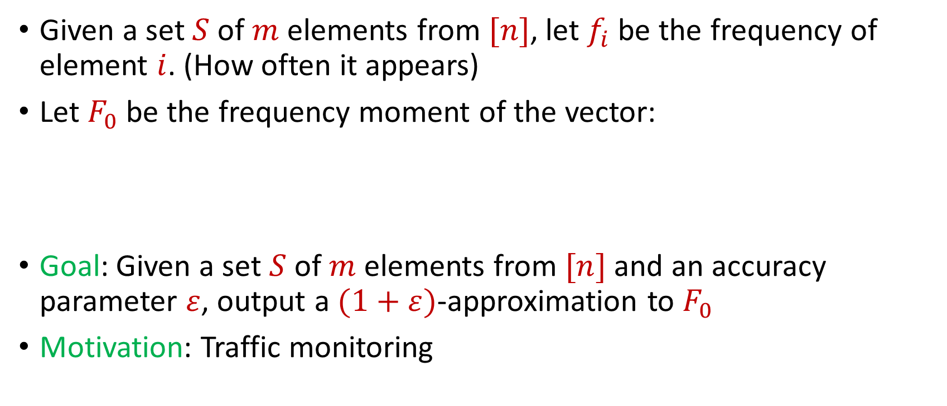

Distinct Elements ($F_{0}$ Estimation)
Given a set $S$ of $m$ elements from $[n]$, let $f_{i}$ be the frequency of element $i$. (How often it appears)
Let $F_{0}$ be the frequency moment of the vector:
Goal: Given a set $S$ of $m$ elements from $[n]$ and an accuracy parameter $ε$, output a $(1+ε)$-approximation to $F_{0}$
Motivation: Traffic monitoring
$F_{0}=$ $|\{i :f_{i}≠0\}|$

Slide 8

Sparse Recovery
Suppose we have an insertion-deletion stream of length $m=Θ\left(n\right)$ and at the end we are promised there are at most $k$ nonzero coordinates
Goal: Recover the $k$ nonzero coordinates and their frequencies

Slide 9
The Streaming Model
So far, all questions have been statistical
What other questions can be asked? (Think in general, outside of the streaming model)

Slide 10
The Streaming Model
So far, all questions have been statistical
What other questions can be asked? (Think in general, outside of the streaming model)
Algebraic, geometric

Slide 11
The Streaming Model
So far, all questions have been statistical
What other questions can be asked? (Think in general, outside of the streaming model)
Algebraic, geometric
TODAY

Slide 12
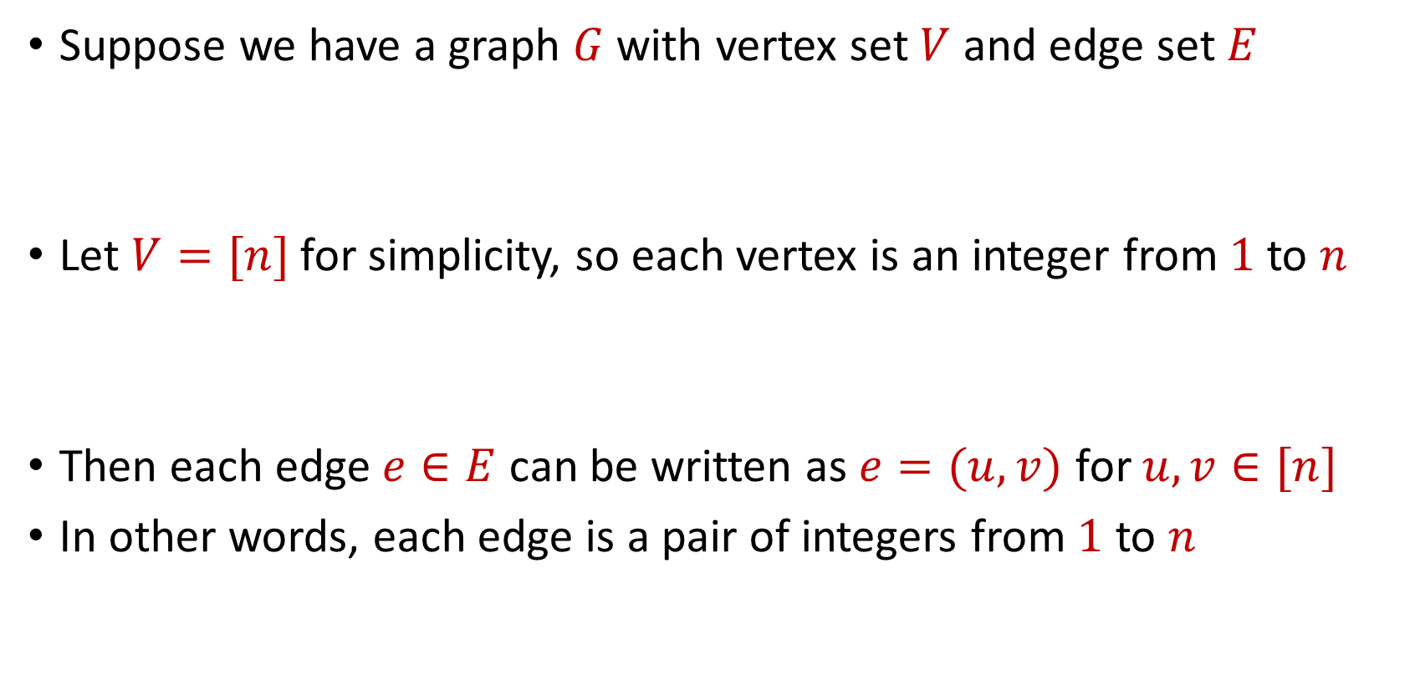
Graph Theory
Suppose we have a graph $G$ with vertex set $V$ and edge set $E$
Let $V=[n]$ for simplicity, so each vertex is an integer from $1$ to $n$
Then each edge $e∈E$ can be written as $e=(u,v)$ for $u,v∈[n]$
In other words, each edge is a pair of integers from $1$ to $n$

Slide 13
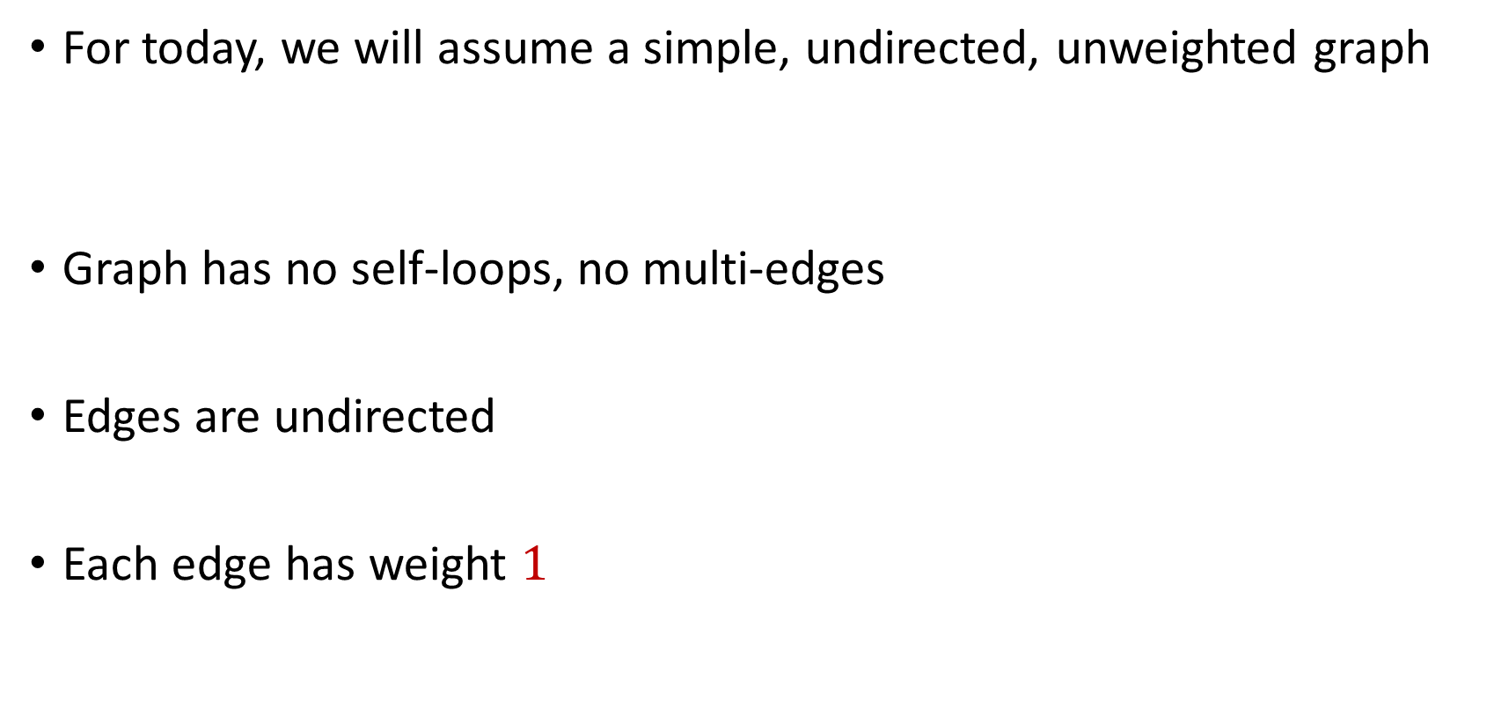
Graph Theory
For today, we will assume a simple, undirected, unweighted graph
Graph has no self-loops, no multi-edges
Edges are undirected
Each edge has weight $1$

Slide 14






$$1$$
$$2$$
$$5$$
$$6$$
$$4$$
$$3$$

Slide 15

Matchings
A matching $M$ is a subset of edges of $E$ such that no two edges share a common vertex

Slide 16
$$1$$
$$2$$
$$5$$
$$6$$
$$4$$
$$3$$

Slide 17
$$1$$
$$2$$
$$5$$
$$6$$
$$4$$
$$3$$

Slide 18

Maximal Matching
A maximal matching $M$ of $G$ such that any additional edges would no longer be a matching

Slide 19
$$1$$
$$2$$
$$5$$
$$6$$
$$4$$
$$3$$

Slide 20

Maximum Matching
Find a matching $M$ of $G$ with the largest possible number of edges

Slide 21
$$1$$
$$2$$
$$5$$
$$6$$
$$4$$
$$3$$

Slide 22
$$1$$
$$2$$
$$5$$
$$6$$
$$4$$
$$3$$

Slide 23


Applications for Maximum Matching
Fill the largest number of positions with applicants across a system

Slide 24
Maximum Matching
How to find maximum matching?
An alternating path is any path of edges that alternates between edges in and not in the matching
An augmenting path is any alternating path of edges that does not start and does not end at a vertex in the matching
“Flipping” all the edges in an augmenting path increases the matching size

Slide 25
$$1$$
$$2$$
$$5$$
$$6$$
$$4$$
$$3$$

Slide 26
$$1$$
$$2$$
$$5$$
$$6$$
$$4$$
$$3$$

Slide 27
$$1$$
$$2$$
$$5$$
$$6$$
$$4$$
$$3$$

Slide 28
Maximum Matching
It turns out repeatedly finding augmenting paths is sufficient for finding a maximum matching
Formally: If a matching is not a maximum matching, there exists an augmenting path to the matching
Algorithms by Hopcroft and Karp (1973) and Edmonds (1965) for finding augmenting paths – can be done in polynomial time

Slide 29
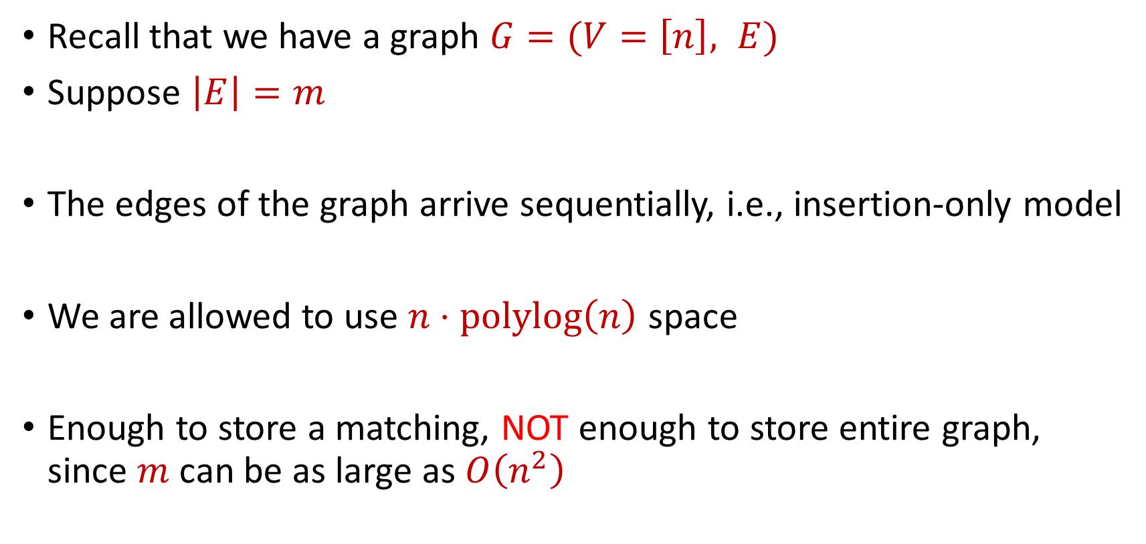
Semi-streaming Model
Recall that we have a graph $G=(V=\left[n\right], E)$
Suppose $\left|E\right|=m$
The edges of the graph arrive sequentially, i.e., insertion-only model
We are allowed to use $n⋅polylog\left(n\right)$ space
Enough to store a matching, NOT enough to store entire graph, since $m$ can be as large as $O\left(n^{2}\right)$

Slide 30
Semi-streaming Model
Can we run the augmenting paths algorithm?

Slide 31
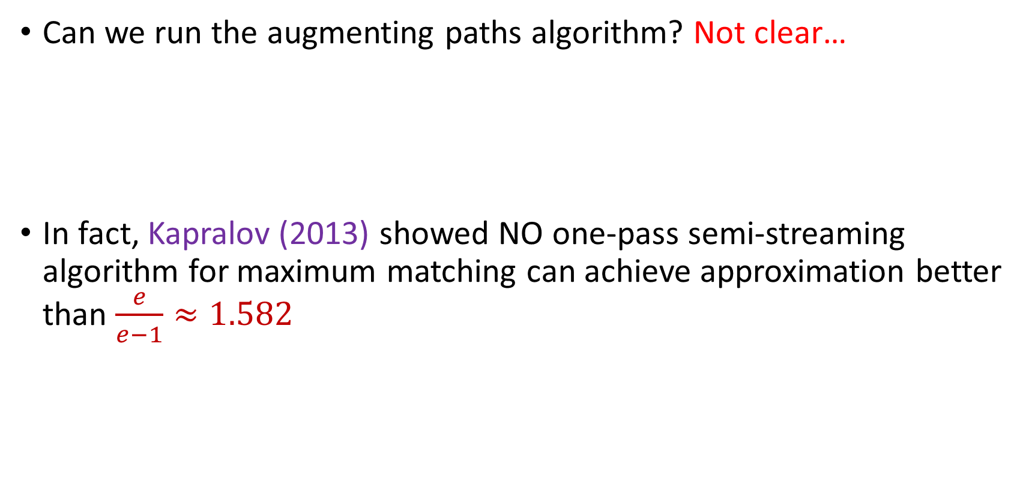
Semi-streaming Model
Can we run the augmenting paths algorithm? Not clear…
In fact, Kapralov (2013) showed NO one-pass semi-streaming algorithm for maximum matching can achieve approximation better than $\frac{e}{e−1}≈1.582$

Slide 32
Maximal Matching
What if we just wanted to find a maximal matching?

Slide 33

Maximal Matching
What if we just wanted to find a maximal matching?
Greedy algorithm: Add each unmatched edge $e$in the stream to the matching $M$

