Slide 1
CSCE 689: Special Topics in Modern Algorithms for Data Science
Lecture 13
Samson Zhou

Slide 2
Presentation Schedule
September 25: Team DAP, Team Bokun, Team Jason
September 27: Galaxy AI, Team STMI
September 29: Jung, Anmol, Chunkai

Slide 3
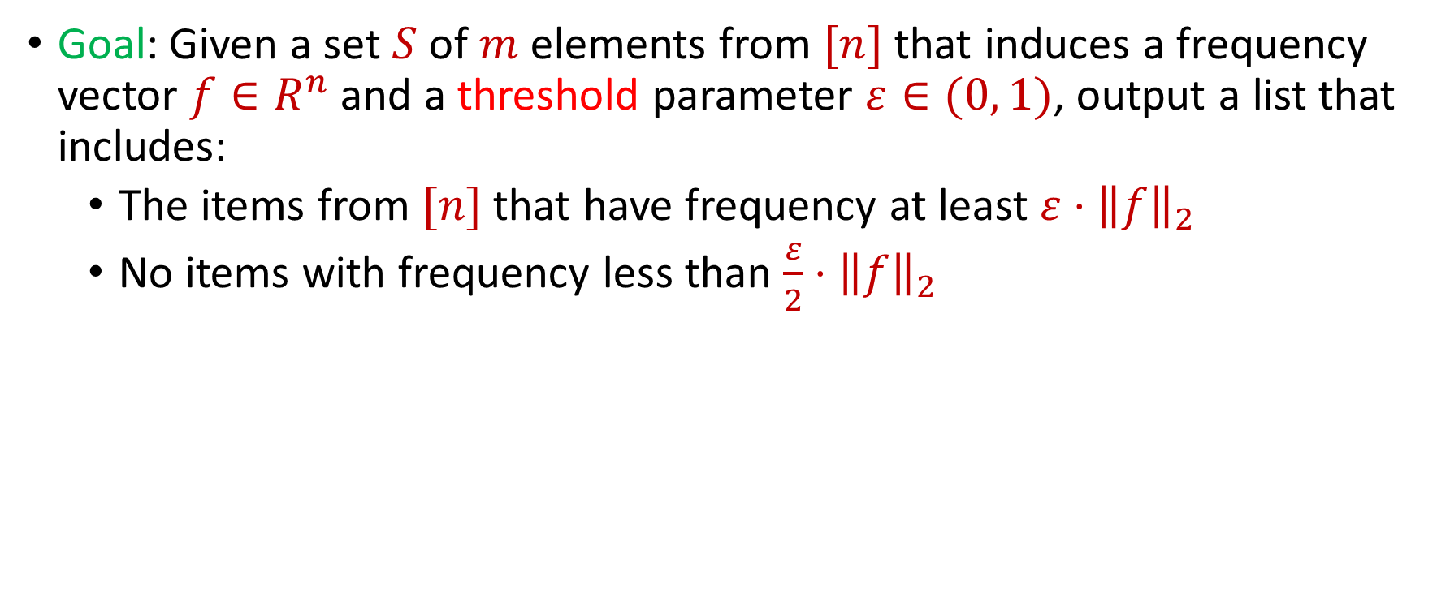

Last Time: $L_{2}$ Heavy-Hitters
Goal: Given a set $S$ of $m$ elements from $[n]$ that induces a frequency vector $f∈R^{n}$ and a threshold parameter $ε∈(0, 1)$, output a list that includes:
The items from $[n]$ that have frequency at least $ε⋅{\left\|f\right\|}_{2}$
No items with frequency less than $\frac{ε}{2}⋅{\left\|f\right\|}_{2}$

Slide 4
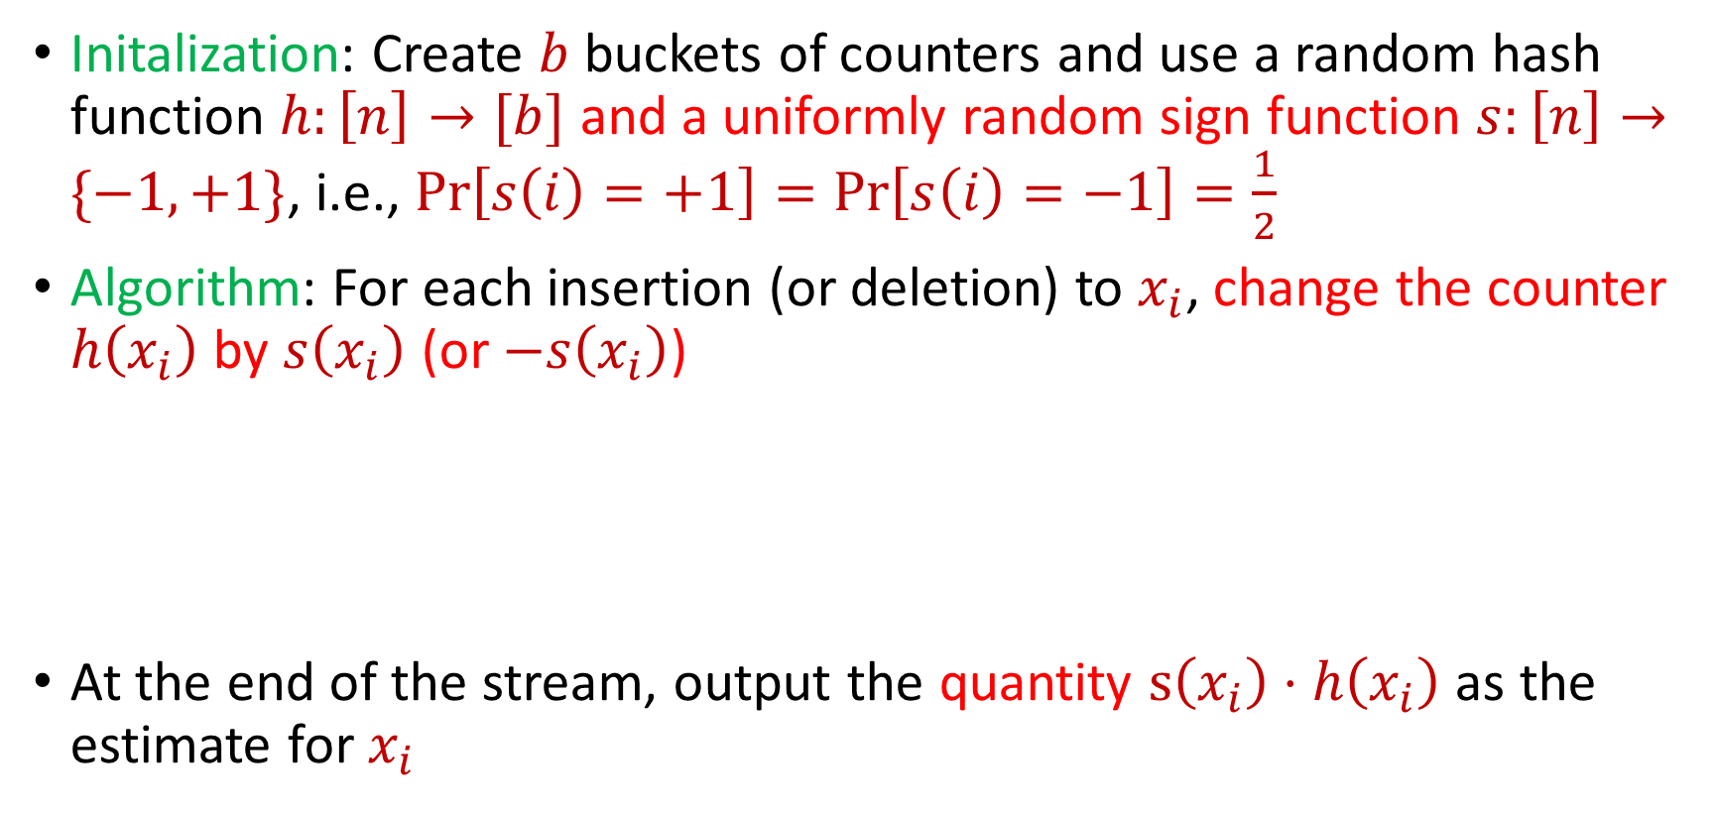
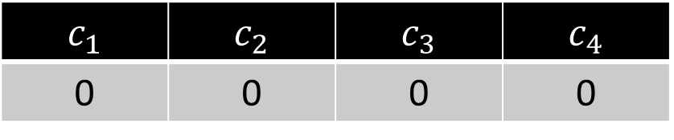
Last Time: CountSketch, i.e., CountMin and the Power of Random Signs
Initalization: Create $b$ buckets of counters and use a random hash function $h:\left[n\right]→[b]$ and a uniformly random sign function $s:\left[n\right]→\{−1,+1\}$, i.e., $Pr\left[s\left(i\right)=+1\right]=Pr\left[s\left(i\right)=−1\right]=\frac{1}{2}$
Algorithm: For each insertion (or deletion) to $x_{i}$, change the counter $h\left(x_{i}\right)$ by $s\left(x_{i}\right)$ (or $−s\left(x_{i}\right)$)
At the end of the stream, output the quantity $s\left(x_{i}\right)⋅h\left(x_{i}\right)$ as the estimate for $x_{i}$
$c_{1}$ | $c_{2}$ | $c_{3}$ | $c_{4}$
0 | 0 | 0 | 0

Slide 5
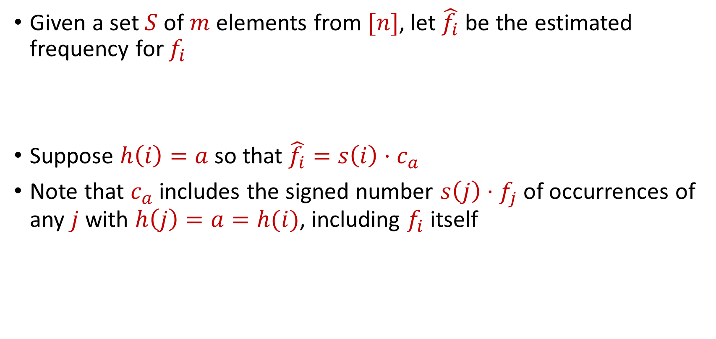
CountSketch
Given a set $S$ of $m$ elements from $[n]$, let $\hat{f_{i}}$ be the estimated frequency for $f_{i}$
Suppose $h\left(i\right)=a$ so that $\hat{f_{i}}=s\left(i\right)⋅c_{a}$
Note that $c_{a}$ includes the signed number $s\left(j\right)⋅f_{j}$of occurrences of any $j$ with $h\left(j\right)=a=h(i)$, including $f_{i}$ itself

Slide 6
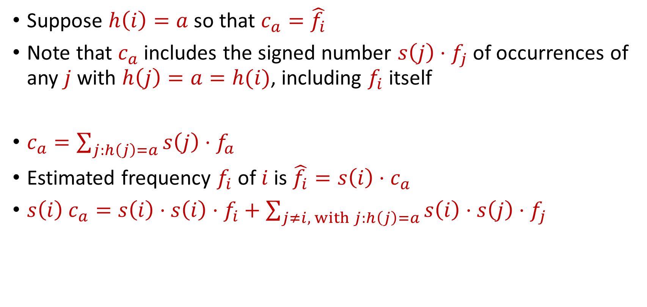
CountSketch
Suppose $h\left(i\right)=a$ so that $c_{a}=\hat{f_{i}}$
Note that $c_{a}$ includes the signed number $s\left(j\right)⋅f_{j}$of occurrences of any $j$ with $h\left(j\right)=a=h(i)$, including $f_{i}$ itself
$c_{a}=\sum_{j:h\left(j\right)=a}{s\left(j\right)⋅f_{a}}$
Estimated frequency $f_{i}$ of $i$ is $\hat{f_{i}}=s\left(i\right)⋅c_{a}$
$s\left(i\right) c_{a}=s\left(i\right)⋅s\left(i\right)⋅f_{i}+\sum_{j≠i, with j:h\left(j\right)=a}{s\left(i\right)⋅s\left(j\right)⋅f_{j}}$

Slide 7

CountSketch Error Analysis
$c_{a}=s\left(i\right)⋅s\left(i\right)⋅f_{i}+\sum_{j≠i, with j:h\left(j\right)=a}{s\left(i\right)⋅s\left(j\right)⋅f_{j}}$
Since $s\left(i\right)∈\{−1,+1\}$, we have $s\left(i\right)⋅s\left(i\right)=1$
What is the expected error for $f_{i}$?

Slide 8

CountSketch Error Analysis
$c_{a}=s\left(i\right)⋅s\left(i\right)⋅f_{i}+\sum_{j≠i, with j:h\left(j\right)=a}{s\left(i\right)⋅s\left(j\right)⋅f_{j}}$
What is the expectation of the error term for $f_{i}$?
$E\left[\sum_{j≠i, with j:h\left(j\right)=a}{{s\left(i\right)⋅s\left(j\right)⋅f}_{j}}\right]=Σ_{j≠i}E\left[{s\left(i\right)⋅s\left(j\right)⋅f}_{j}⋅I_{h\left(j\right)=h(i)}\right]$

Slide 9

CountSketch Error Analysis
$c_{a}=s\left(i\right)⋅s\left(i\right)⋅f_{i}+\sum_{j≠i, with j:h\left(j\right)=a}{s\left(i\right)⋅s\left(j\right)⋅f_{j}}$
What is the expectation of the error term for $f_{i}$?
$E\left[\sum_{j≠i, with j:h\left(j\right)=a}{{s\left(i\right)⋅s\left(j\right)⋅f}_{j}}\right]=0$

Slide 10

CountSketch Error Analysis
$c_{a}=s\left(i\right)⋅s\left(i\right)⋅f_{i}+\sum_{j≠i, with j:h\left(j\right)=a}{s\left(i\right)⋅s\left(j\right)⋅f_{j}}$
What is the expectation of the error term for $f_{i}$?
$E\left[\sum_{j≠i, with j:h\left(j\right)=a}{{s\left(i\right)⋅s\left(j\right)⋅f}_{j}}\right]=0$
What is the variance of the error term for $f_{i}$?

Slide 11

CountSketch Error Analysis
Variance is at most the 2nd moment of the error term
$E\left[{\left(\sum_{j≠i, with j:h\left(j\right)=a}{{s\left(i\right)⋅s\left(j\right)⋅f}_{j}}\right)}^{2}\right]$

Slide 12

CountSketch Error Analysis
Variance is at most the 2nd moment of the error term
$E\left[{\left(\sum_{j≠i, with j:h\left(j\right)=a}{{s\left(i\right)⋅s\left(j\right)⋅f}_{j}}\right)}^{2}\right]=Σ_{j≠i}E\left[{\left|f_{j}\right|}^{2}⋅I_{h\left(j\right)=h(i)}\right]$

Slide 13

CountSketch Error Analysis
Variance is at most the 2nd moment of the error term
$E\left[{\left(\sum_{j≠i, with j:h\left(j\right)=a}{{s\left(i\right)⋅s\left(j\right)⋅f}_{j}}\right)}^{2}\right]=Σ_{j≠i}E\left[{\left|f_{j}\right|}^{2}⋅I_{h\left(j\right)=h(i)}\right]$
$$=Σ_{j≠i}E\left[I_{h\left(j\right)=h(i)}\right]⋅{\left|f_{j}\right|}^{2}$$

Slide 14

CountSketch Error Analysis
Variance is at most the 2nd moment of the error term
$E\left[{\left(\sum_{j≠i, with j:h\left(j\right)=a}{{s\left(i\right)⋅s\left(j\right)⋅f}_{j}}\right)}^{2}\right]=Σ_{j≠i}E\left[{\left|f_{j}\right|}^{2}⋅I_{h\left(j\right)=h(i)}\right]$
$$=Σ_{j≠i}E\left[I_{h\left(j\right)=h(i)}\right]⋅{\left|f_{j}\right|}^{2}$$
$$=Σ_{j≠i}Pr\left[h\left(j\right)=h(i)\right]⋅{\left|f_{j}\right|}^{2}$$

Slide 15

CountSketch Error Analysis
Variance is at most the 2nd moment of the error term
$E\left[{\left(\sum_{j≠i, with j:h\left(j\right)=a}{{s\left(i\right)⋅s\left(j\right)⋅f}_{j}}\right)}^{2}\right]=Σ_{j≠i}E\left[{\left|f_{j}\right|}^{2}⋅I_{h\left(j\right)=h(i)}\right]$
$$=Σ_{j≠i}E\left[I_{h\left(j\right)=h(i)}\right]⋅{\left|f_{j}\right|}^{2}$$
$$=Σ_{j≠i}Pr\left[h\left(j\right)=h(i)\right]⋅{\left|f_{j}\right|}^{2}$$
$$=Σ_{j≠i}\frac{1}{b}⋅{\left|f_{j}\right|}^{2}≤\frac{{\left\|f\right\|}_{2}^{2}}{b}$$

Slide 16
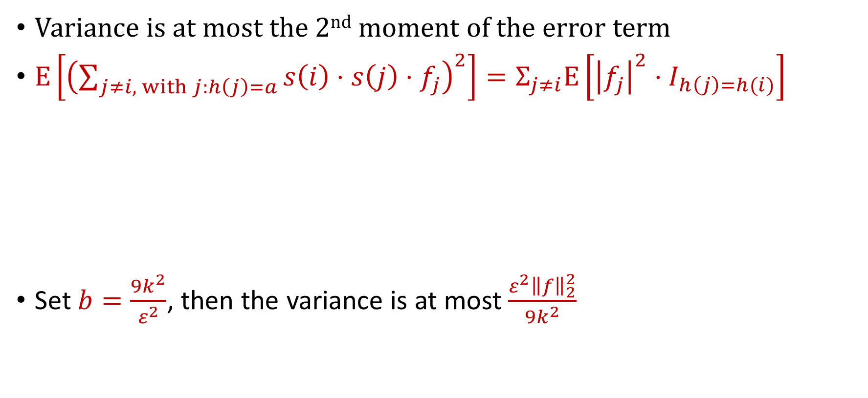
CountSketch Error Analysis
Variance is at most the 2nd moment of the error term
$E\left[{\left(\sum_{j≠i, with j:h\left(j\right)=a}{{s\left(i\right)⋅s\left(j\right)⋅f}_{j}}\right)}^{2}\right]=Σ_{j≠i}E\left[{\left|f_{j}\right|}^{2}⋅I_{h\left(j\right)=h(i)}\right]$
Set $b=\frac{9k^{2}}{ε^{2}}$, then the variance is at most $\frac{ε^{2}{\left\|f\right\|}_{2}^{2}}{9k^{2}}$
$$=Σ_{j≠i}E\left[I_{h\left(j\right)=h(i)}\right]⋅{\left|f_{j}\right|}^{2}$$
$$=Σ_{j≠i}Pr\left[h\left(j\right)=h(i)\right]⋅{\left|f_{j}\right|}^{2}$$
$$=Σ_{j≠i}\frac{1}{b}⋅{\left|f_{j}\right|}^{2}≤\frac{{\left\|f\right\|}_{2}^{2}}{b}$$

Slide 17
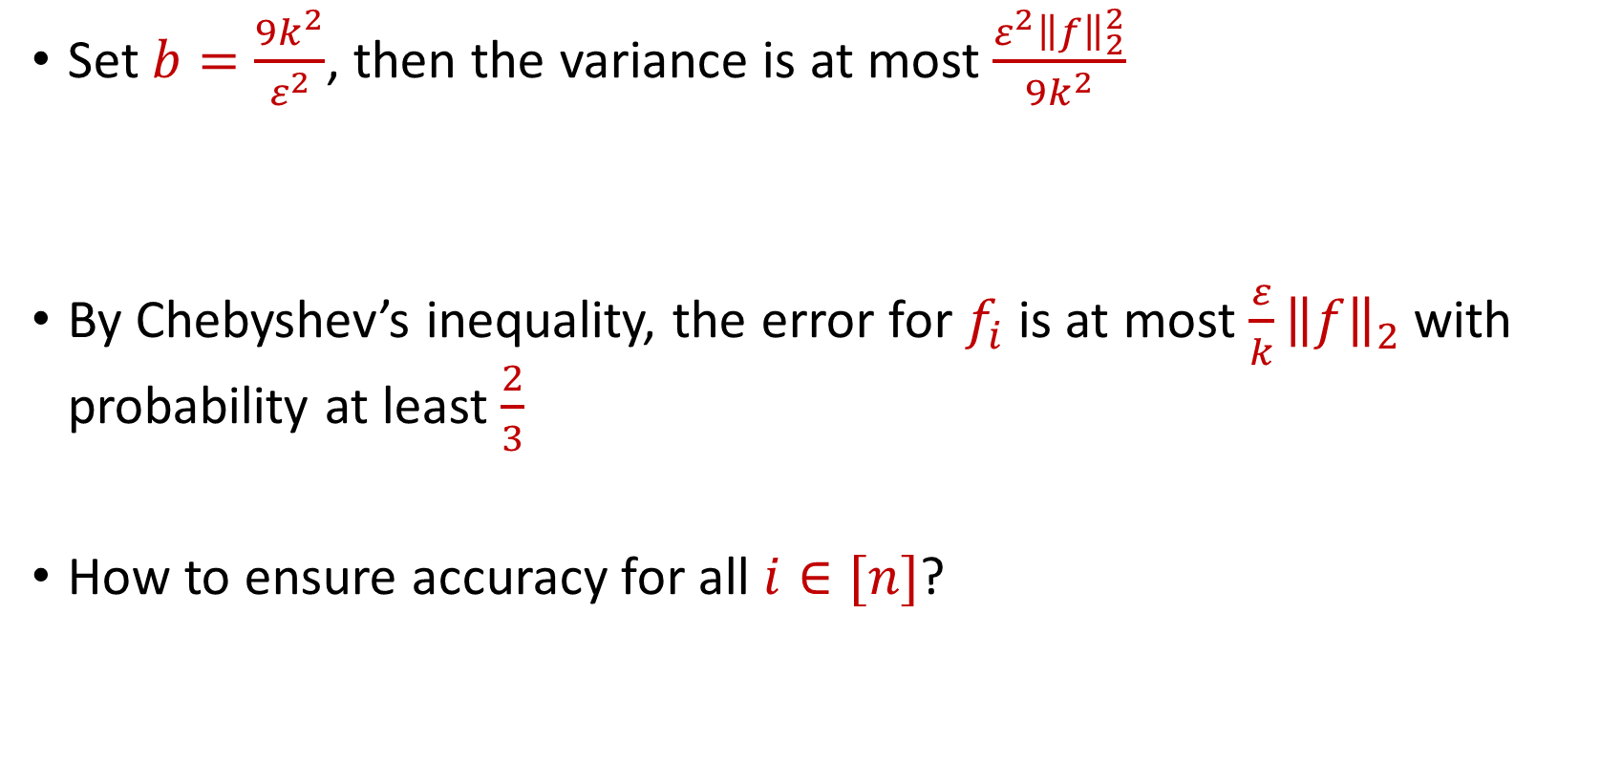
CountSketch Error Analysis
Set $b=\frac{9k^{2}}{ε^{2}}$, then the variance is at most $\frac{ε^{2}{\left\|f\right\|}_{2}^{2}}{9k^{2}}$
By Chebyshev’s inequality, the error for $f_{i}$ is at most $\frac{ε}{k}{\left\|f\right\|}_{2}$with probability at least $\frac{2}{3}$
How to ensure accuracy for all $i∈[n]$?

Slide 18
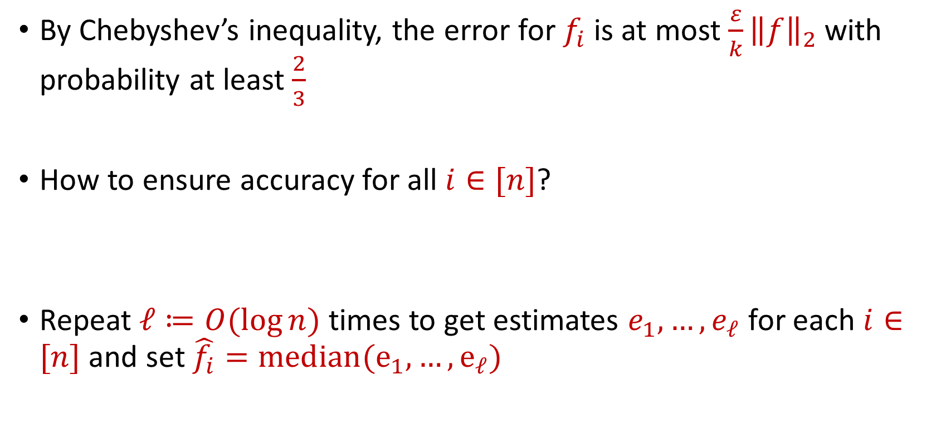
CountSketch Error Analysis
By Chebyshev’s inequality, the error for $f_{i}$ is at most $\frac{ε}{k}{\left\|f\right\|}_{2}$with probability at least $\frac{2}{3}$
How to ensure accuracy for all $i∈[n]$?
Repeat $ℓ≔O(\log{n)}$ times to get estimates $e_{1},…,e_{ℓ}$ for each $i∈[n]$ and set $\hat{f_{i}}=median(e_{1},…, e_{ℓ})$

Slide 19


CountSketch Error Analysis
Claim: For all estimated frequencies $\hat{f_{i}}$ by CountSketch, we have
$$f_{i}−\frac{ε{\left\|f\right\|}_{2}}{k}≤\hat{f_{i}}≤f_{i}+\frac{ε{\left\|f\right\|}_{2}}{k}$$

Slide 20
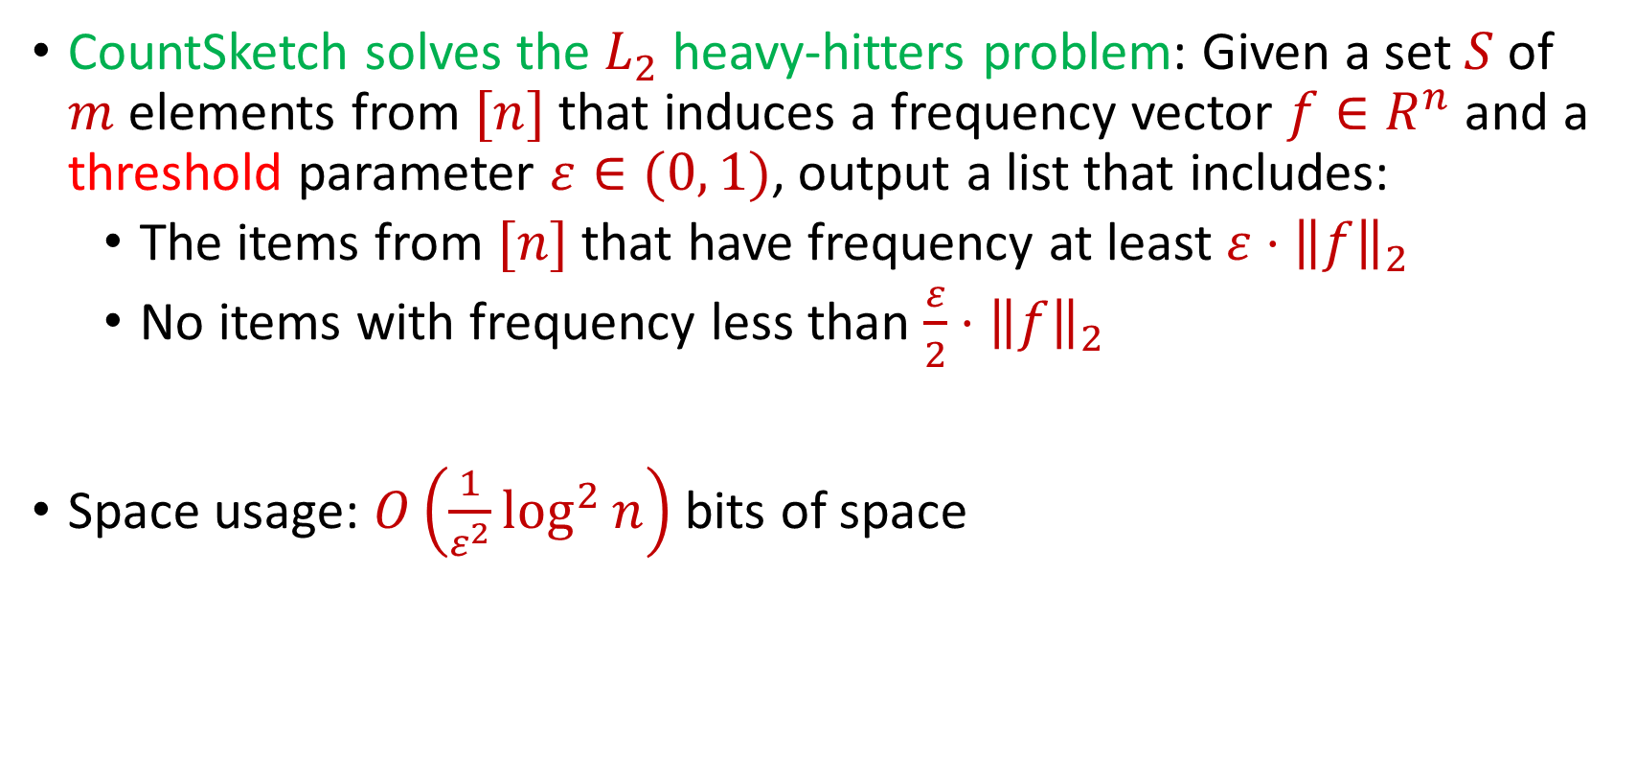
CountSketch Summary
CountSketch solves the $L_{2}$ heavy-hitters problem: Given a set $S$ of $m$ elements from $[n]$ that induces a frequency vector $f∈R^{n}$ and a threshold parameter $ε∈(0, 1)$, output a list that includes:
The items from $[n]$ that have frequency at least $ε⋅{\left\|f\right\|}_{2}$
No items with frequency less than $\frac{ε}{2}⋅{\left\|f\right\|}_{2}$
Space usage: $O\left(\frac{1}{ε^{2}}\log^{2}{n}\right)$ bits of space

