Slide 1


High Probability Streaming Lower Bounds for $F_{2}$ Estimation
William Swartworth
CMU
David P. Woodruff
CMU, Google Research
Samson Zhou
Texas A&M

Slide 2

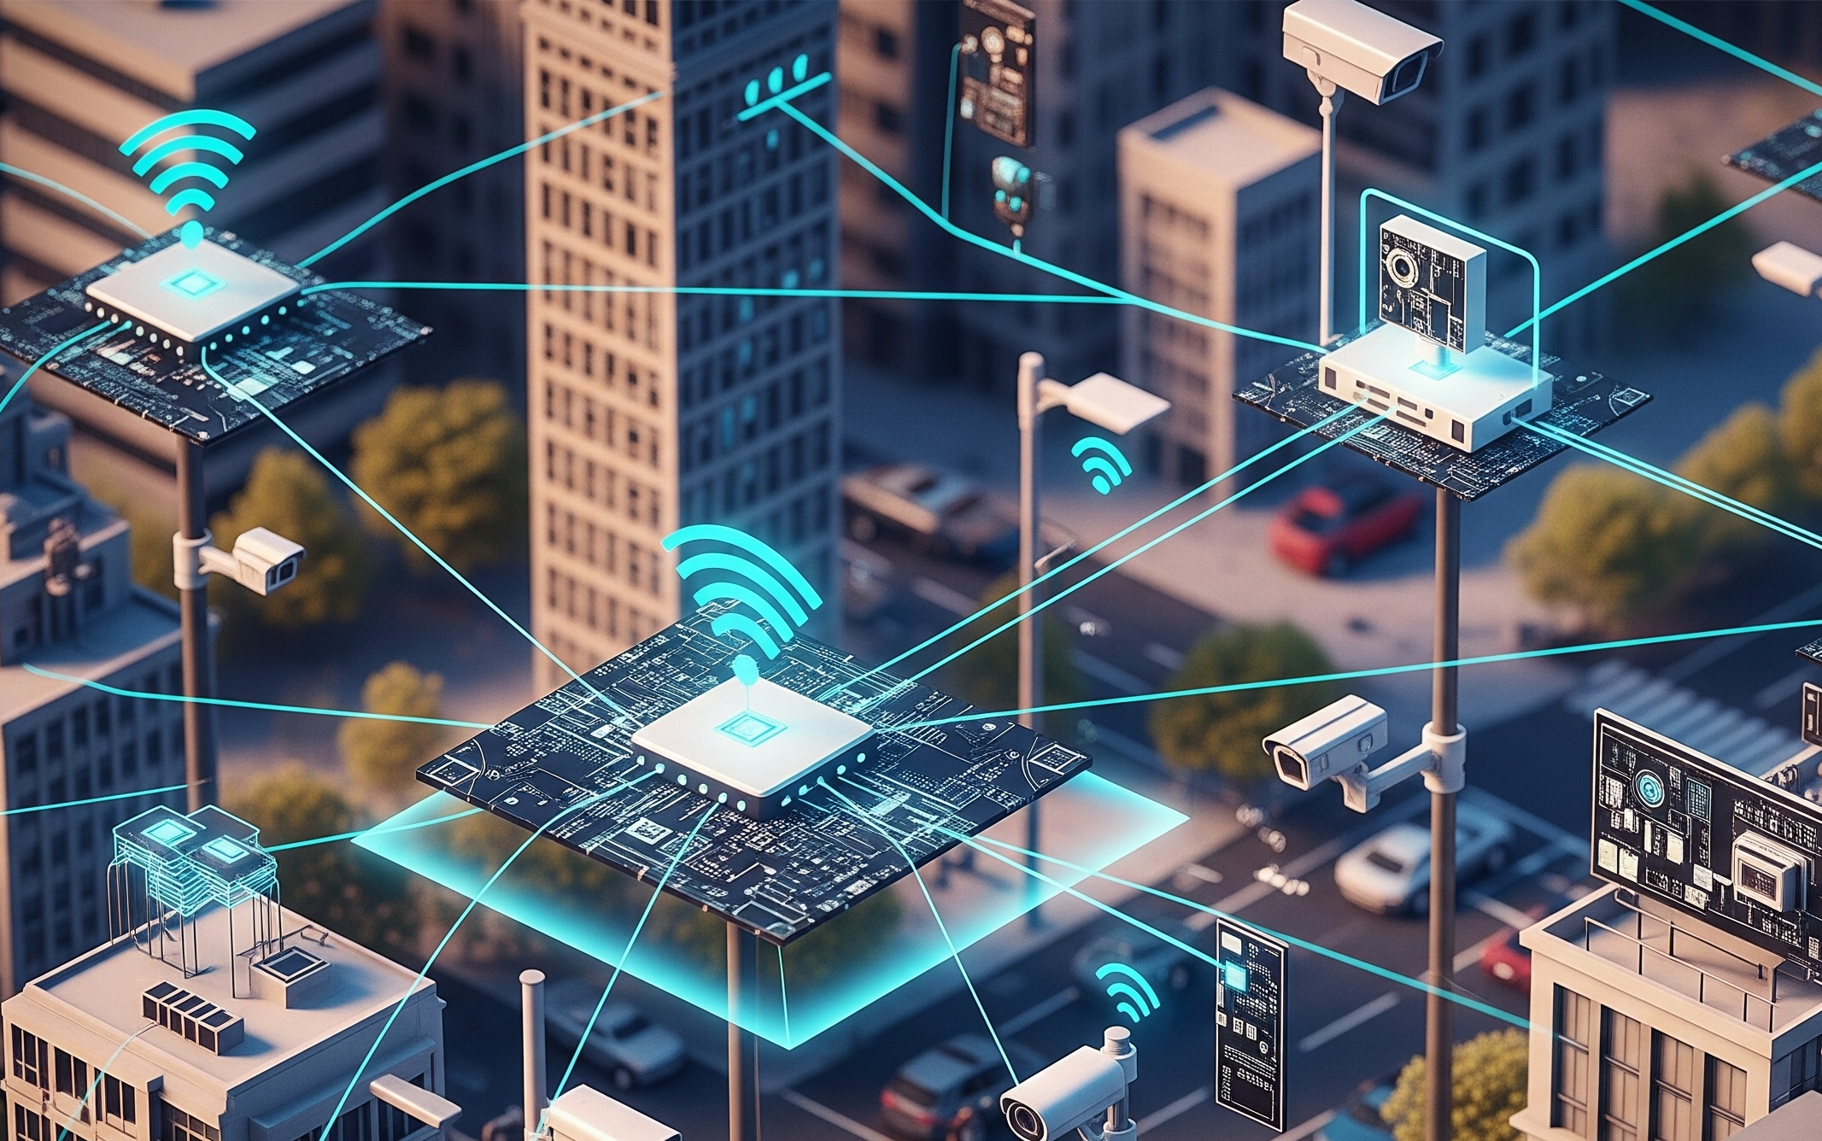


Streaming Model
Input: Elements of an underlying data set $S$, updates arrive sequentially
Output: Evaluation (or approximation) of a given function
Internet traffic
Sensor networks
Stock markets

Slide 3
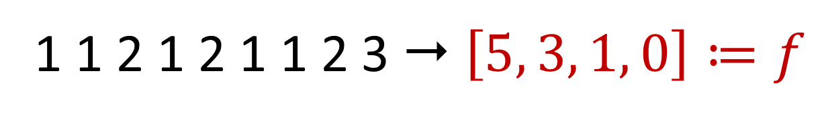
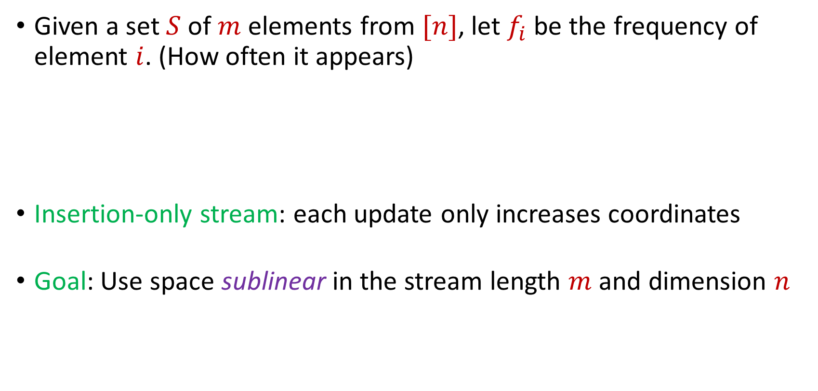
Frequency Vector
Given a set $S$ of $m$ elements from $[n]$, let $f_{i}$ be the frequency of element $i$. (How often it appears)
Insertion-only stream: each update only increases coordinates
Goal: Use space sublinear in the stream length $m$and dimension $n$
1 1 2 1 2 1 1 2 3  $\left[5, 3, 1, 0\right]≔f$

Slide 4
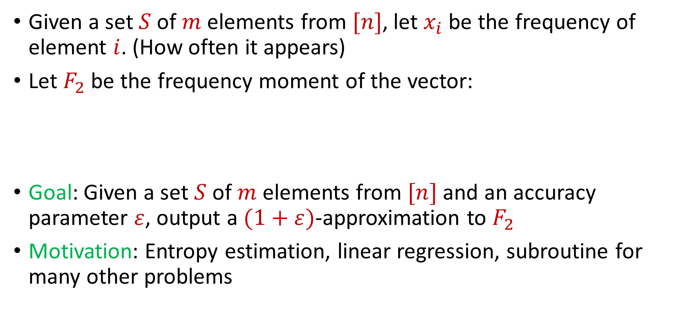
Frequency Moments
Given a set $S$ of $m$ elements from $[n]$, let $x_{i}$ be the frequency of element $i$. (How often it appears)
Let $F_{2}$ be the frequency moment of the vector:
Goal: Given a set $S$ of $m$ elements from $[n]$ and an accuracy parameter $ε$, output a $(1+ε)$-approximation to $F_{2}$
Motivation: Entropy estimation, linear regression, subroutine for many other problems
$$F_{2}={\left|x_{1}\right|}^{2}+{\left|x_{2}\right|}^{2}+ …+{\left|x_{n}\right|}^{2}$$

Slide 5
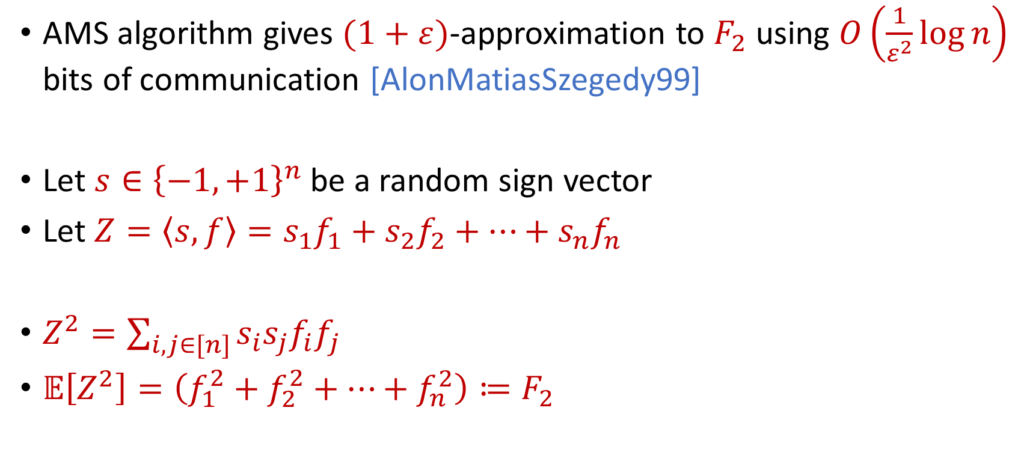
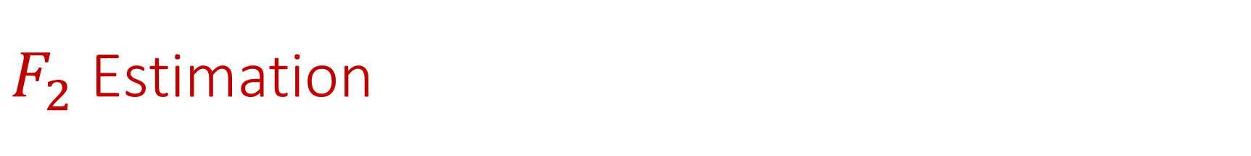
$F_{2}$ Estimation
AMS algorithm gives $(1+ε)$-approximation to $F_{2}$ using $O\left(\frac{1}{ε^{2}}\log{n}\right)$ bits of communication [AlonMatiasSzegedy99]
Let $s∈{\left\{−1,+1\right\}}^{n}$ be a random sign vector
Let $Z=\left\langle s,f\right\rangle =s_{1}f_{1}+s_{2}f_{2}+…+s_{n}f_{n}$
$Z^{2}=\sum_{i,j∈[n]}{s_{i}s_{j}f_{i}f_{j}}$
$𝔼\left[Z^{2}\right]=\left(f_{1}^{2}+f_{2}^{2}+…+f_{n}^{2}\right)≔F_{2}$

Slide 6
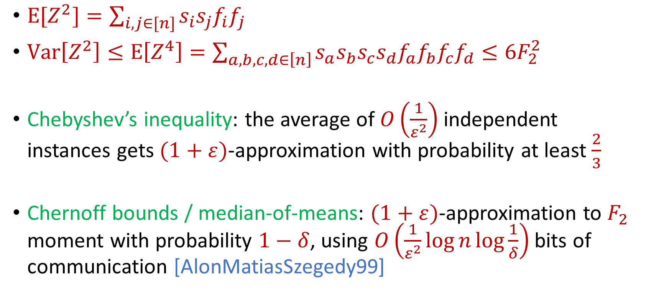
AMS Algorithm
$E[Z^{2}]=\sum_{i,j∈[n]}{s_{i}s_{j}f_{i}f_{j}}$
$Var\left[Z^{2}\right]≤E\left[Z^{4}\right]=\sum_{a,b,c,d∈\left[n\right]}{s_{a}s_{b}s_{c}s_{d}f_{a}f_{b}f_{c}f_{d}}≤6F_{2}^{2}$
Chebyshev’s inequality: the average of $O\left(\frac{1}{ε^{2}}\right)$ independent instances gets $(1+ε)$-approximation with probability at least $\frac{2}{3}$
Chernoff bounds / median-of-means: $(1+ε)$-approximation to $F_{2}$ moment with probability $1−δ$, using $O\left(\frac{1}{ε^{2}}\log{n}\log{\frac{1}{δ}}\right)$ bits of communication [AlonMatiasSzegedy99]

Slide 7
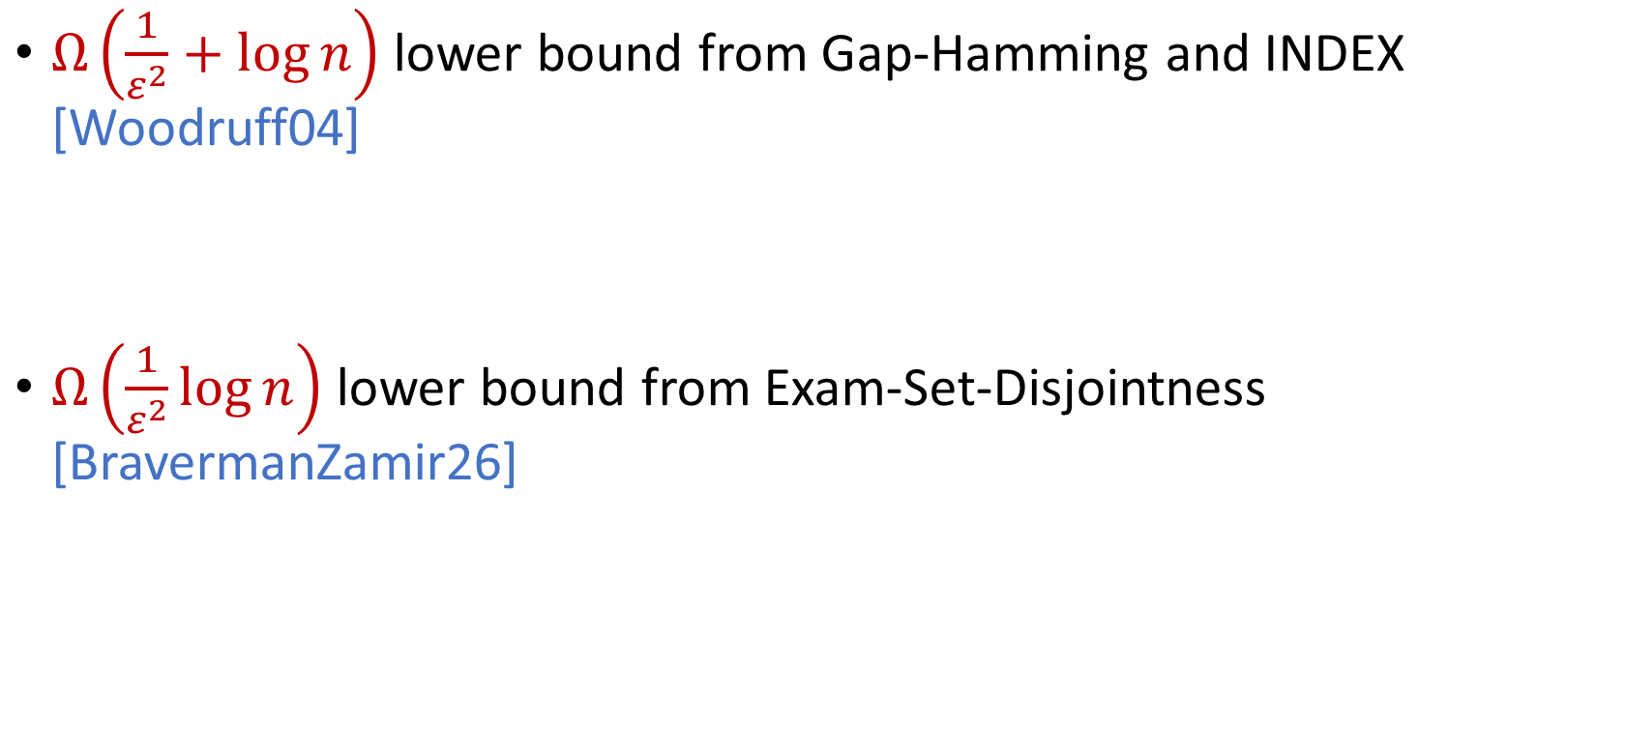
Lower Bounds
$Ω\left(\frac{1}{ε^{2}}+\log{n}\right)$ lower bound from Gap-Hamming and INDEX [Woodruff04]
$Ω\left(\frac{1}{ε^{2}}\log{n}\right)$ lower bound from Exam-Set-Disjointness [BravermanZamir26]

Slide 8
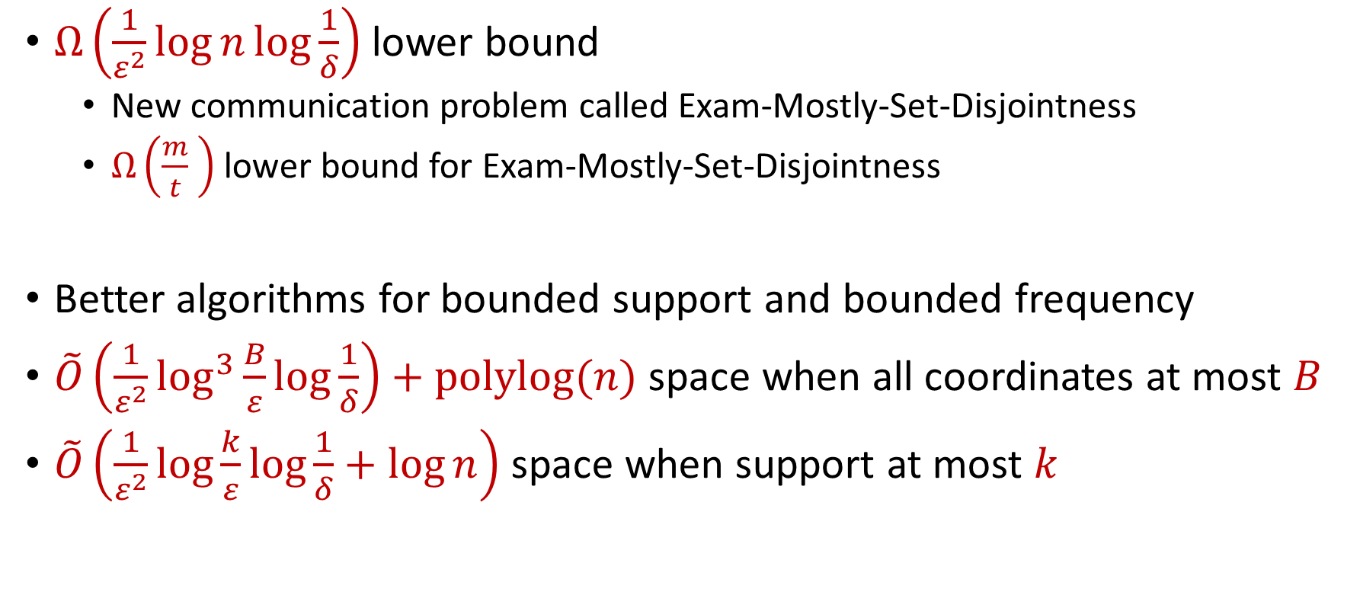
Our Results
$Ω\left(\frac{1}{ε^{2}}\log{n}\log{\frac{1}{δ}}\right)$ lower bound
New communication problem called Exam-Mostly-Set-Disjointness
$Ω\left(\frac{m}{t} \right)$ lower bound for Exam-Mostly-Set-Disjointness
Better algorithms for bounded support and bounded frequency
$\tilde{O}\left(\frac{1}{ε^{2}}\log^{3}{\frac{B}{ε}}\log{\frac{1}{δ}}\right)+polylog(n)$ space when all coordinates at most $B$
$\tilde{O}\left(\frac{1}{ε^{2}}\log{\frac{k}{ε}}\log{\frac{1}{δ}}+\log{n}\right)$ space when support at most $k$

Slide 9
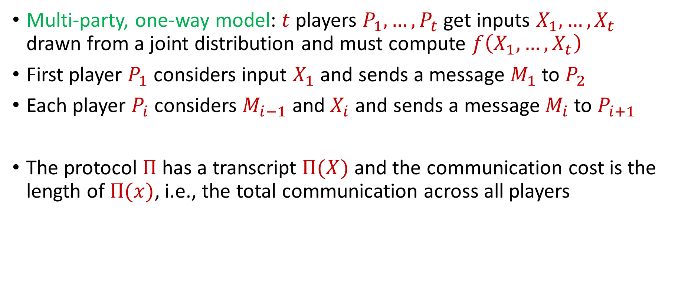
Communication Complexity
Multi-party, one-way model: $t$ players $P_{1},…,P_{t}$ get inputs $X_{1},…,X_{t}$ drawn from a joint distribution and must compute $f\left(X_{1},…, X_{t}\right)$
First player $P_{1}$ considers input $X_{1}$ and sends a message $M_{1}$ to $P_{2}$
Each player $P_{i}$ considers $M_{i−1}$ and $X_{i}$ and sends a message $M_{i}$ to $P_{i+1 }$
The protocol $Π$ has a transcript $Π(X)$ and the communication cost is the length of $Π(x)$, i.e., the total communication across all players

Slide 10
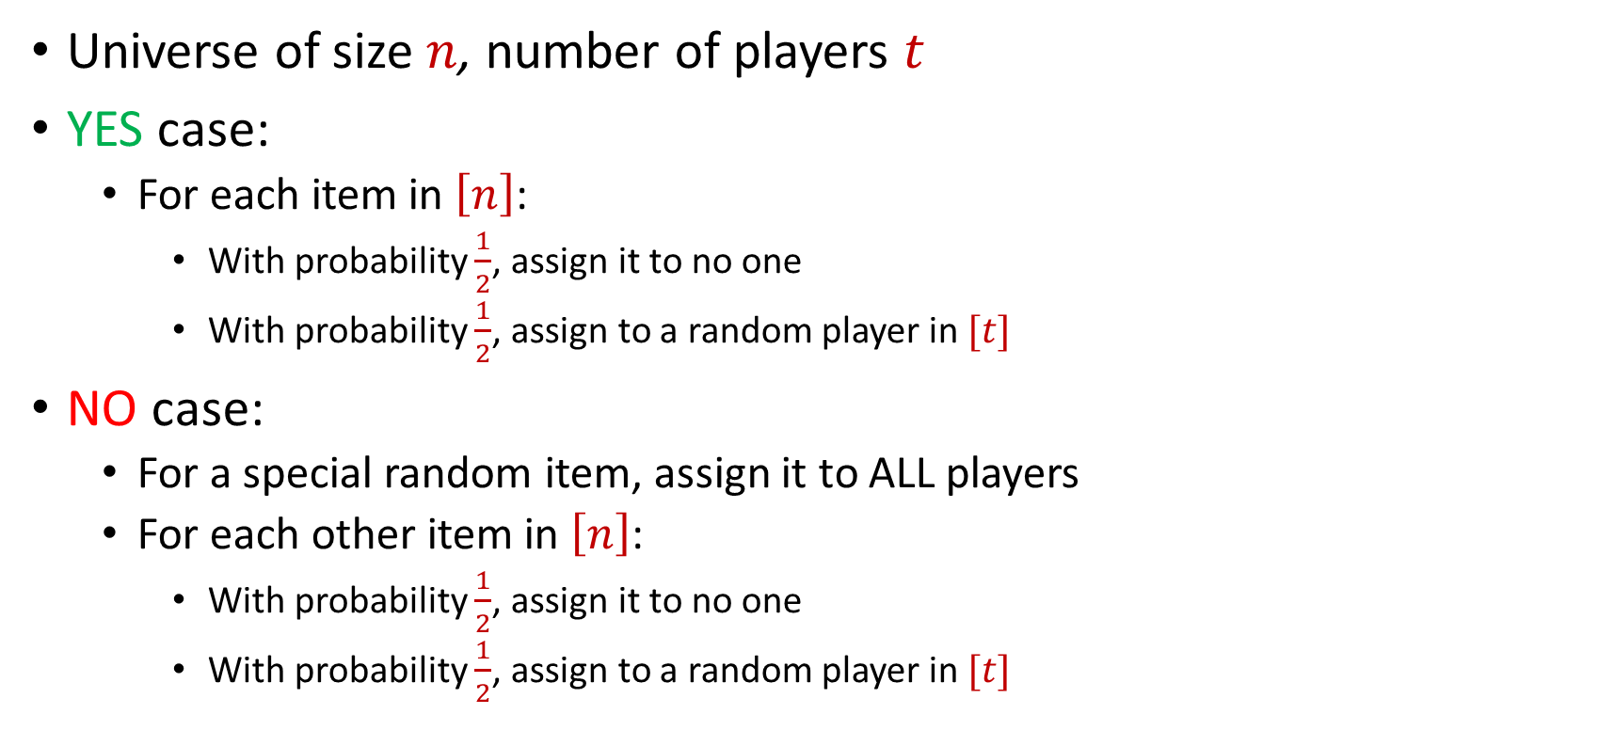
(Distributional) Set Disjointness
Universe of size $n$, number of players $t$
YES case:
For each item in $\left[n\right]$:
With probability $\frac{1}{2}$, assign it to no one
With probability $\frac{1}{2}$, assign to a random player in $[t]$
NO case:
For a special random item, assign it to ALL players
For each other item in $\left[n\right]$:
With probability $\frac{1}{2}$, assign it to no one
With probability $\frac{1}{2}$, assign to a random player in $[t]$

Slide 11
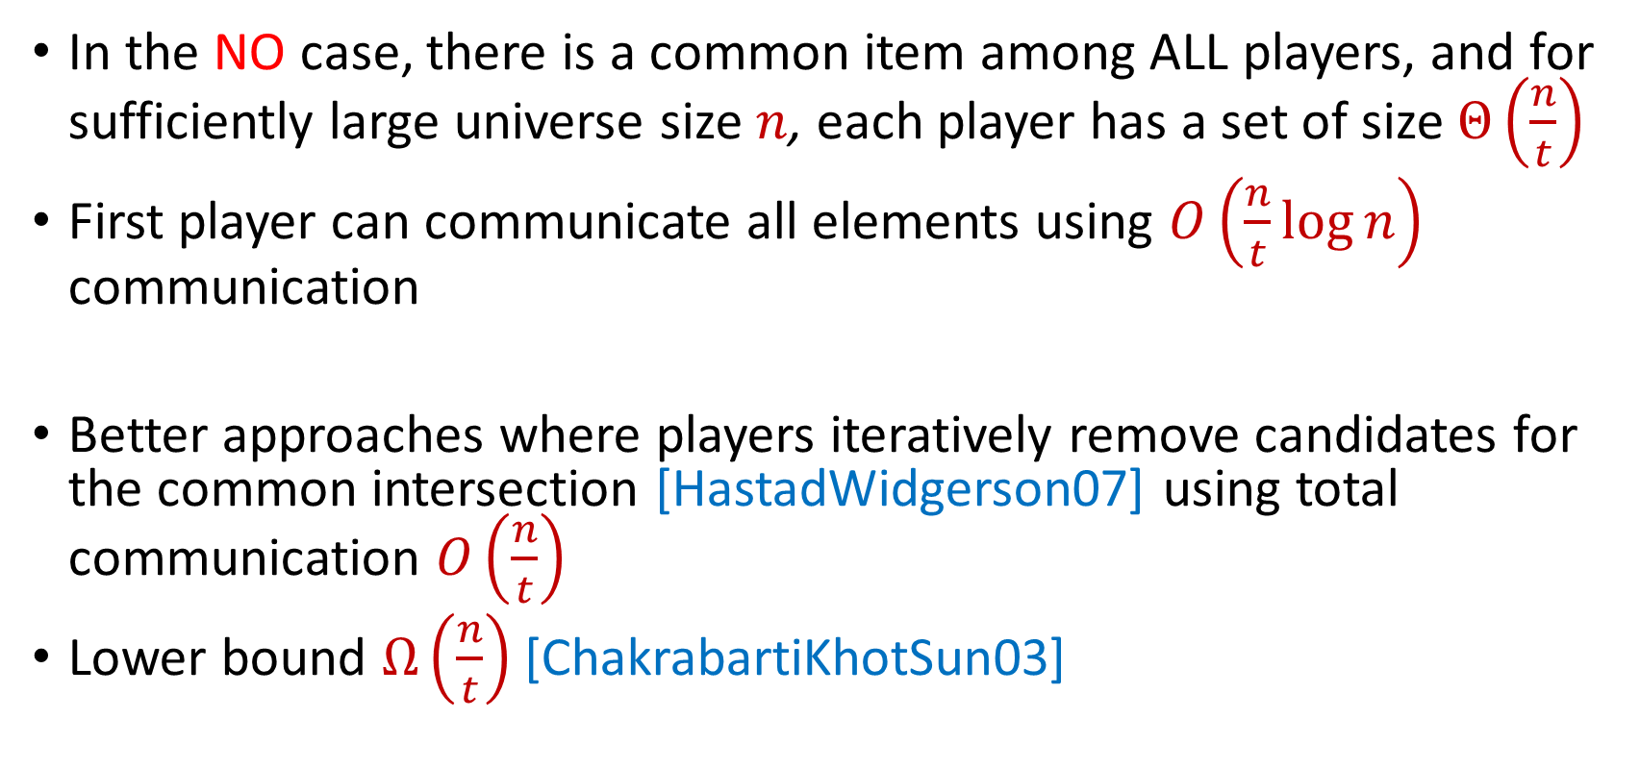
Complexity of Set Disjointness
In the NO case, there is a common item among ALL players, and for sufficiently large universe size $n$, each player has a set of size $Θ\left(\frac{n}{t}\right)$
First player can communicate all elements using $O\left(\frac{n}{t}\log{n}\right)$ communication
Better approaches where players iteratively remove candidates for the common intersection [HastadWidgerson07] using total communication $O\left(\frac{n}{t}\right)$
Lower bound $Ω\left(\frac{n}{t}\right)$ [ChakrabartiKhotSun03]

Slide 12
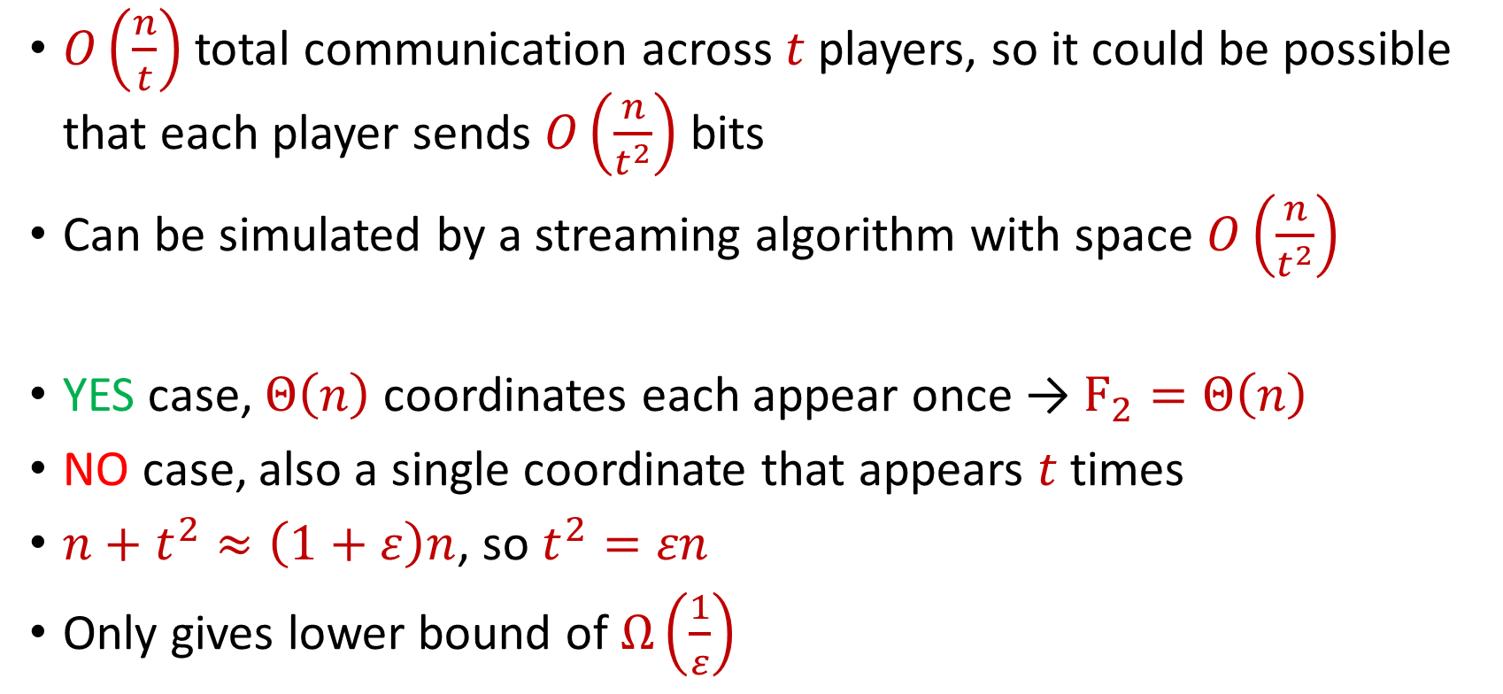

Set Disjointness and $F_{2}$
$O\left(\frac{n}{t}\right)$ total communication across $t$ players, so it could be possible that each player sends $O\left(\frac{n}{t^{2}}\right)$ bits
Can be simulated by a streaming algorithm with space $O\left(\frac{n}{t^{2}}\right)$
YES case, $Θ\left(n\right)$ coordinates each appear once → $F_{2}=Θ\left(n\right)$
NO case, also a single coordinate that appears $t$ times
$n+t^{2}≈\left(1+ε\right)n$, so $t^{2}=εn$
Only gives lower bound of $Ω\left(\frac{1}{ε}\right)$

Slide 13
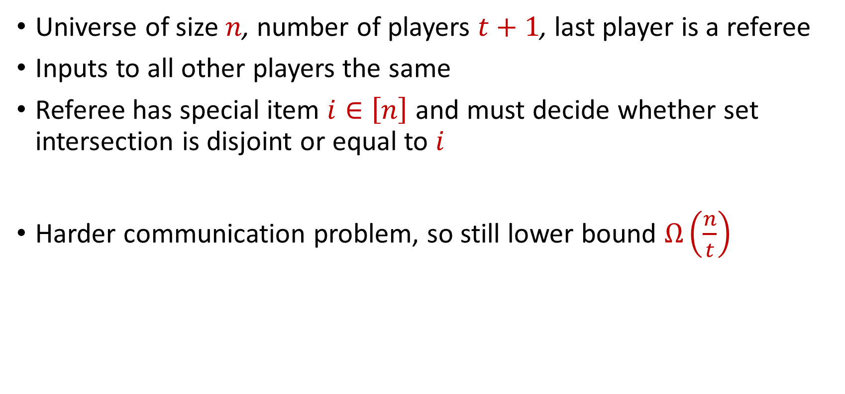
Exam Set Disjointness [BravermanZamir26]
Universe of size $n$, number of players $t+1$, last player is a referee
Inputs to all other players the same
Referee has special item $i∈\left[n\right]$ and must decide whether set intersection is disjoint or equal to $i$
Harder communication problem, so still lower bound $Ω\left(\frac{n}{t}\right)$

Slide 14
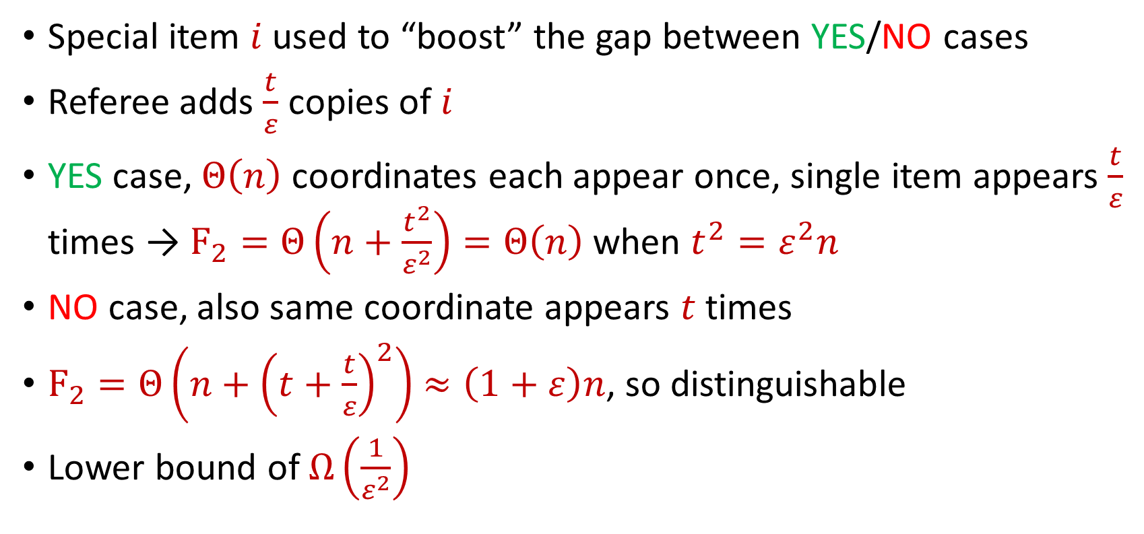
Boosting the Gap [BravermanZamir26]
Special item $i$ used to “boost” the gap between YES/NO cases
Referee adds $\frac{t}{ε}$ copies of $i$
YES case, $Θ\left(n\right)$ coordinates each appear once, single item appears $\frac{t}{ε}$ times → $F_{2}=Θ\left(n+\frac{t^{2}}{ε^{2}}\right)=Θ\left(n\right)$ when $t^{2}=ε^{2}n$
NO case, also same coordinate appears $t$ times
$F_{2}=Θ\left(n+{\left(t+\frac{t}{ε}\right)}^{2}\right)$ $≈\left(1+ε\right)n$, so distinguishable
Lower bound of $Ω\left(\frac{1}{ε^{2}}\right)$

Slide 15
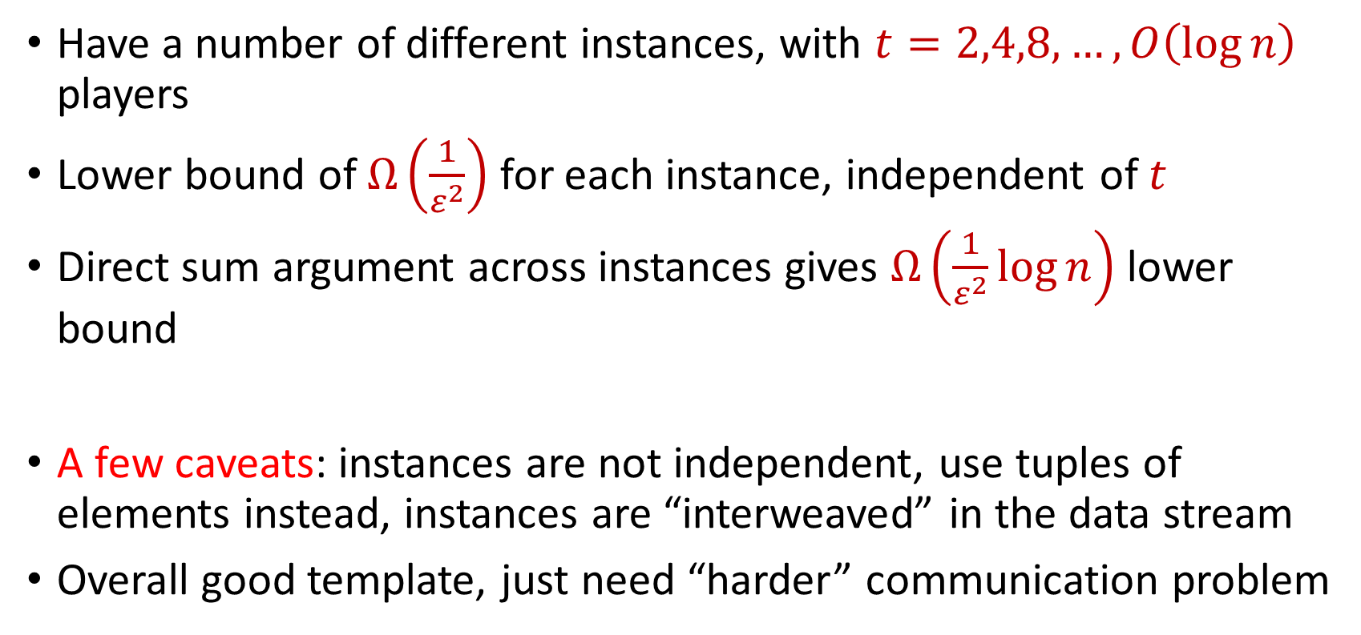
Packing Multiple Instances
Have a number of different instances, with $t=2,4,8,…,O\left(\log{n}\right)$ players
Lower bound of $Ω\left(\frac{1}{ε^{2}}\right)$ for each instance, independent of $t$
Direct sum argument across instances gives $Ω\left(\frac{1}{ε^{2}}\log{n}\right)$ lower bound
A few caveats: instances are not independent, use tuples of elements instead, instances are “interweaved” in the data stream
Overall good template, just need “harder” communication problem

Slide 16
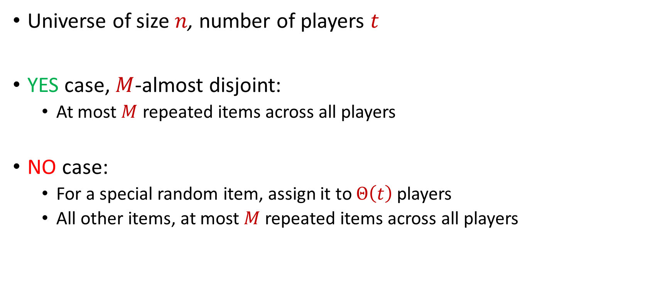
Mostly Set Disjointness
Universe of size $n$, number of players $t$
YES case, $M$-almost disjoint:
At most $M$ repeated items across all players
NO case:
For a special random item, assign it to $Θ\left(t\right)$ players
All other items, at most $M$ repeated items across all players

Slide 17
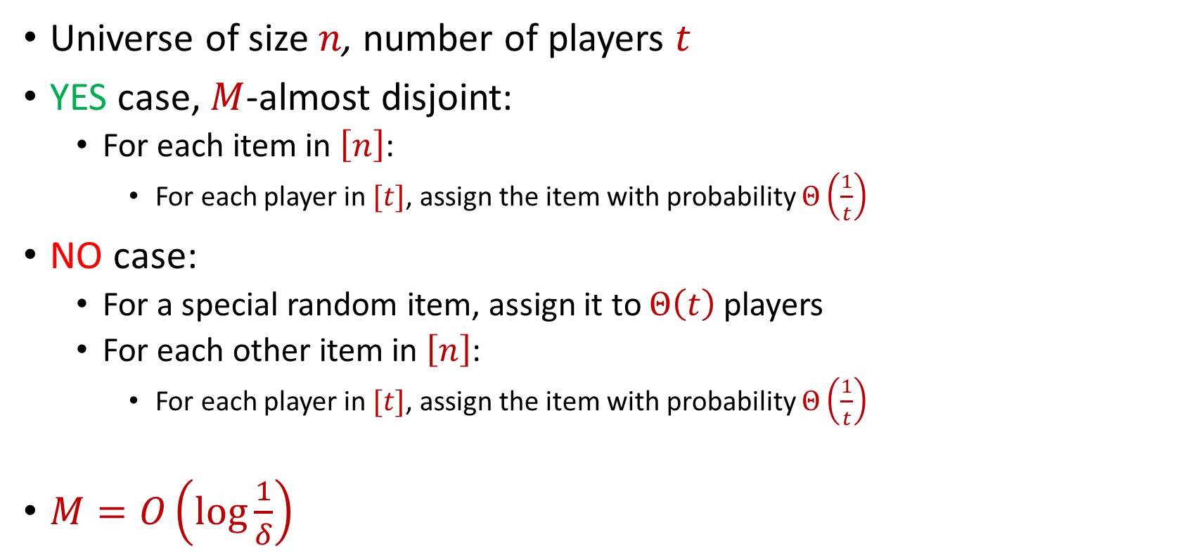
Mostly Set Disjointness
Universe of size $n$, number of players $t$
YES case, $M$-almost disjoint:
For each item in $\left[n\right]$:
For each player in $[t]$, assign the item with probability $Θ\left(\frac{1}{t}\right)$
NO case:
For a special random item, assign it to $Θ\left(t\right)$ players
For each other item in $\left[n\right]$:
For each player in $[t]$, assign the item with probability $Θ\left(\frac{1}{t}\right)$
$M=O\left(\log{\frac{1}{δ}}\right)$

Slide 18
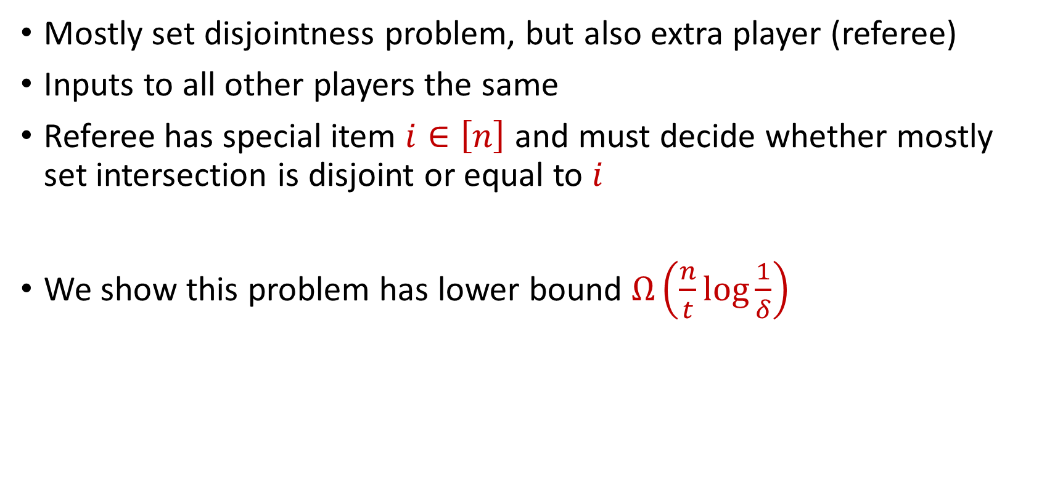
Exam Mostly Set Disjointness
Mostly set disjointness problem, but also extra player (referee)
Inputs to all other players the same
Referee has special item $i∈\left[n\right]$ and must decide whether mostly set intersection is disjoint or equal to $i$
We show this problem has lower bound $Ω\left(\frac{n}{t}\log{\frac{1}{δ}}\right)$

Slide 19
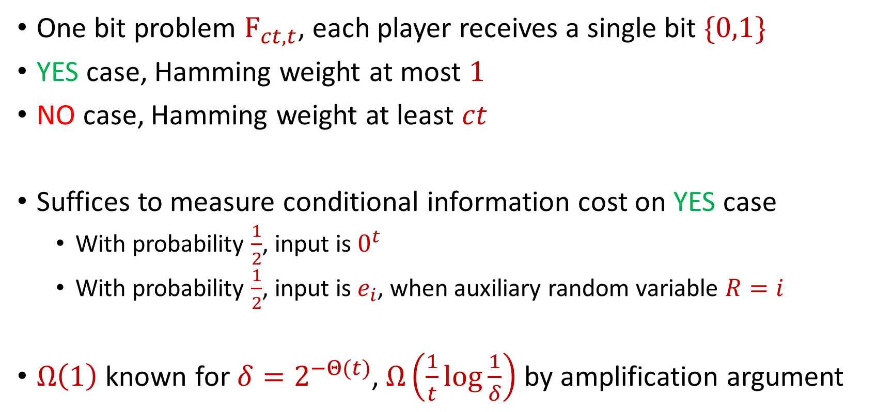
Exam Mostly Set Disjointness
One bit problem $F_{ct, t}$, each player receives a single bit $\{0,1\}$
YES case, Hamming weight at most $1$
NO case, Hamming weight at least $ct$
Suffices to measure conditional information cost on YES case
With probability $\frac{1}{2}$, input is $0^{t}$
With probability $\frac{1}{2}$, input is $e_{i}$, when auxiliary random variable $R=i$
$Ω\left(1\right)$ known for $δ=2^{−Θ(t)}$, $Ω\left(\frac{1}{t}\log{\frac{1}{δ}}\right)$ by amplification argument

Slide 20
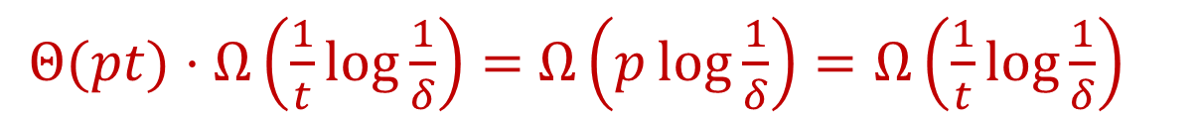
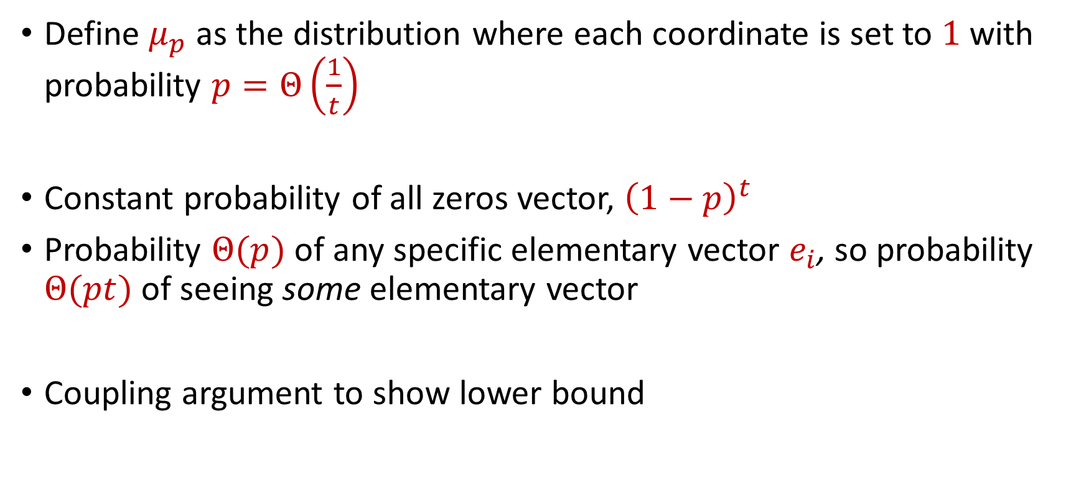
Hard Distribution to Product Distribution
Define $μ_{p}$ as the distribution where each coordinate is set to $1$ with probability $p=Θ\left(\frac{1}{t}\right)$
Constant probability of all zeros vector, ${\left(1−p\right)}^{t}$
Probability $Θ(p)$ of any specific elementary vector $e_{i}$, so probability $Θ(pt)$ of seeing some elementary vector
Coupling argument to show lower bound
$Θ(pt)⋅Ω\left(\frac{1}{t}\log{\frac{1}{δ}}\right)=$ $Ω\left(p\log{\frac{1}{δ}}\right)=Ω\left(\frac{1}{t}\log{\frac{1}{δ}}\right)$

Slide 21

Direct Sum
Universe size $n$
Single coordinate problem has information cost $Ω\left(\frac{1}{t}\log{\frac{1}{δ}}\right)$
Overall information cost $Ω\left(\frac{n}{t}\log{\frac{1}{δ}}\right)$

Slide 22

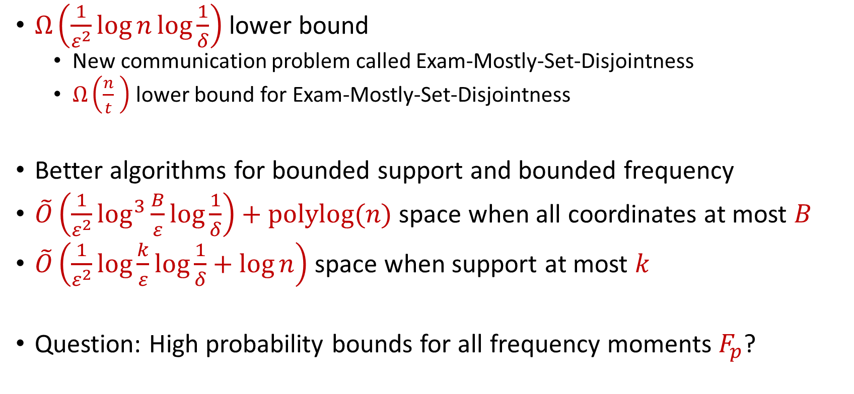
Summary and Next Directions
$Ω\left(\frac{1}{ε^{2}}\log{n}\log{\frac{1}{δ}}\right)$ lower bound
New communication problem called Exam-Mostly-Set-Disjointness
$Ω\left(\frac{n}{t} \right)$ lower bound for Exam-Mostly-Set-Disjointness
Better algorithms for bounded support and bounded frequency
$\tilde{O}\left(\frac{1}{ε^{2}}\log^{3}{\frac{B}{ε}}\log{\frac{1}{δ}}\right)+polylog(n)$ space when all coordinates at most $B$
$\tilde{O}\left(\frac{1}{ε^{2}}\log{\frac{k}{ε}}\log{\frac{1}{δ}}+\log{n}\right)$ space when support at most $k$
Question: High probability bounds for all frequency moments $F_{p}$?

