Slide 1
CSCE 689: Special Topics in Modern Algorithms for Data Science
Lecture 20
Samson Zhou

Slide 2
Presentation Schedule
November 27: Chunkai, Jung, Galaxy AI
November 29: STMI, Anmol, Jason
December 1: Bokun, Ayesha, Dawei, Lipai

Slide 3
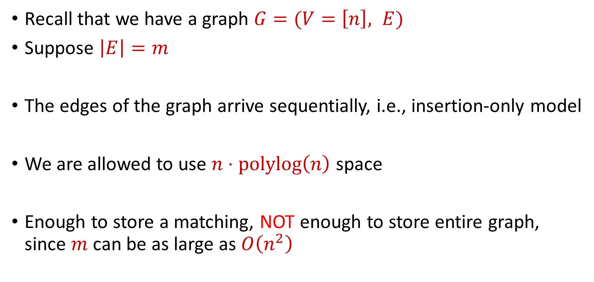
Last Time: Semi-streaming Model
Recall that we have a graph $G=(V=\left[n\right], E)$
Suppose $\left|E\right|=m$
The edges of the graph arrive sequentially, i.e., insertion-only model
We are allowed to use $n⋅polylog\left(n\right)$ space
Enough to store a matching, NOT enough to store entire graph, since $m$ can be as large as $O\left(n^{2}\right)$

Slide 4
Last Time: Maximum Matching
How to find maximum matching?
An alternating path is any path of edges that alternates between edges in and not in the matching
An augmenting path is any alternating path of edges that does not start and does not end at a vertex in the matching
“Flipping” all the edges in an augmenting path increases the matching size

Slide 5

Maximal Matching
A maximal matching is a matching $M$ of $G$ such that any additional edges would no longer be a matching

Slide 6

Maximal Matching
What if we just wanted to find a maximal matching?
Greedy algorithm: Add each unmatched edge $e$in the stream to the matching $M$

Slide 7

Maximal Matching
Claim: Each maximal matching is a $2$-approximation to the maximum matching

Slide 8






$$1$$
$$2$$
$$5$$
$$6$$
$$4$$
$$3$$

Slide 9
$$1$$
$$2$$
$$5$$
$$6$$
$$4$$
$$3$$

Slide 10
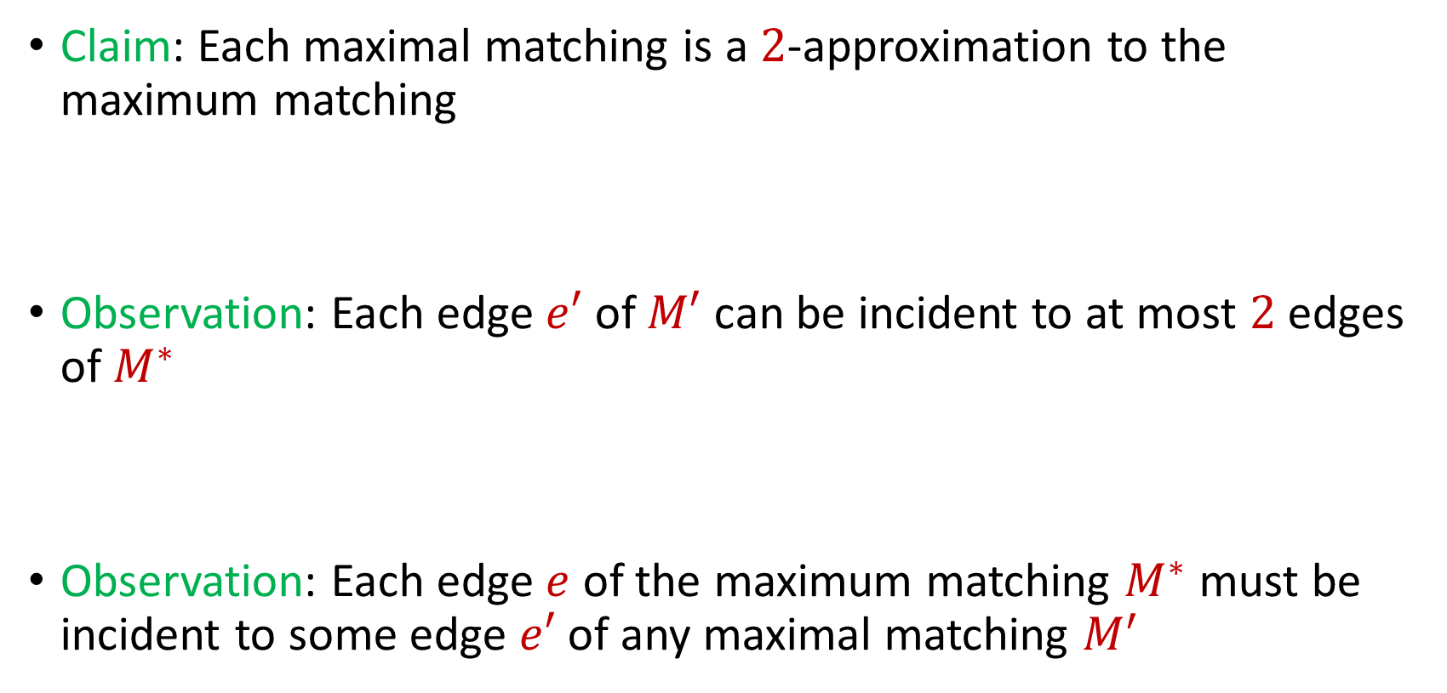
Maximal Matching
Claim: Each maximal matching is a $2$-approximation to the maximum matching
Observation: Each edge $e′$ of $M′$ can be incident to at most $2$ edges of $M^{∗}$
Observation: Each edge $e$ of the maximum matching $M^{∗}$ must be incident to some edge $e′$ of any maximal matching $M^{′}$

Slide 11
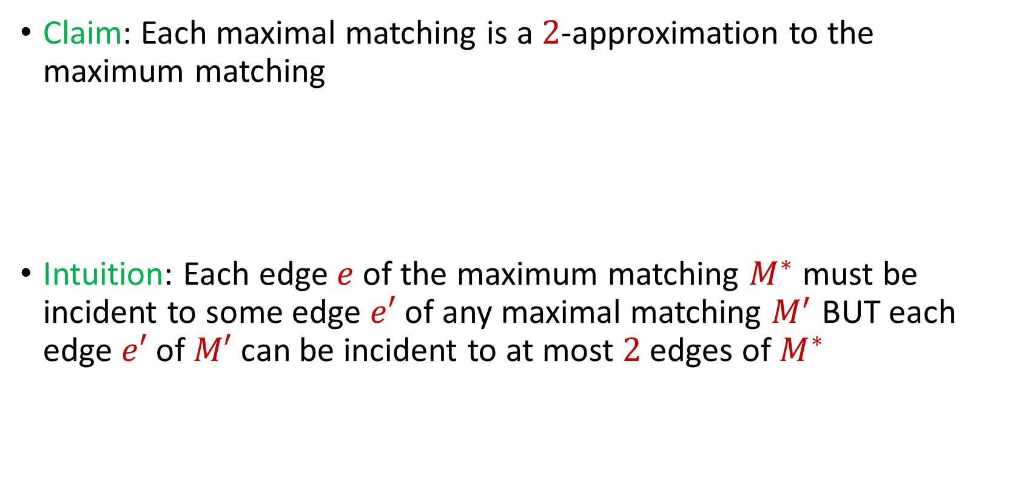
Maximal Matching
Claim: Each maximal matching is a $2$-approximation to the maximum matching
Intuition: Each edge $e$ of the maximum matching $M^{∗}$ must be incident to some edge $e′$ of any maximal matching $M^{′}$ BUT each edge $e′$ of $M′$ can be incident to at most $2$ edges of $M^{∗}$

Slide 12

Maximal Matching
Charging argument: Give each edge $e′$ of the maximal matching $M′$ two dollars

Slide 13
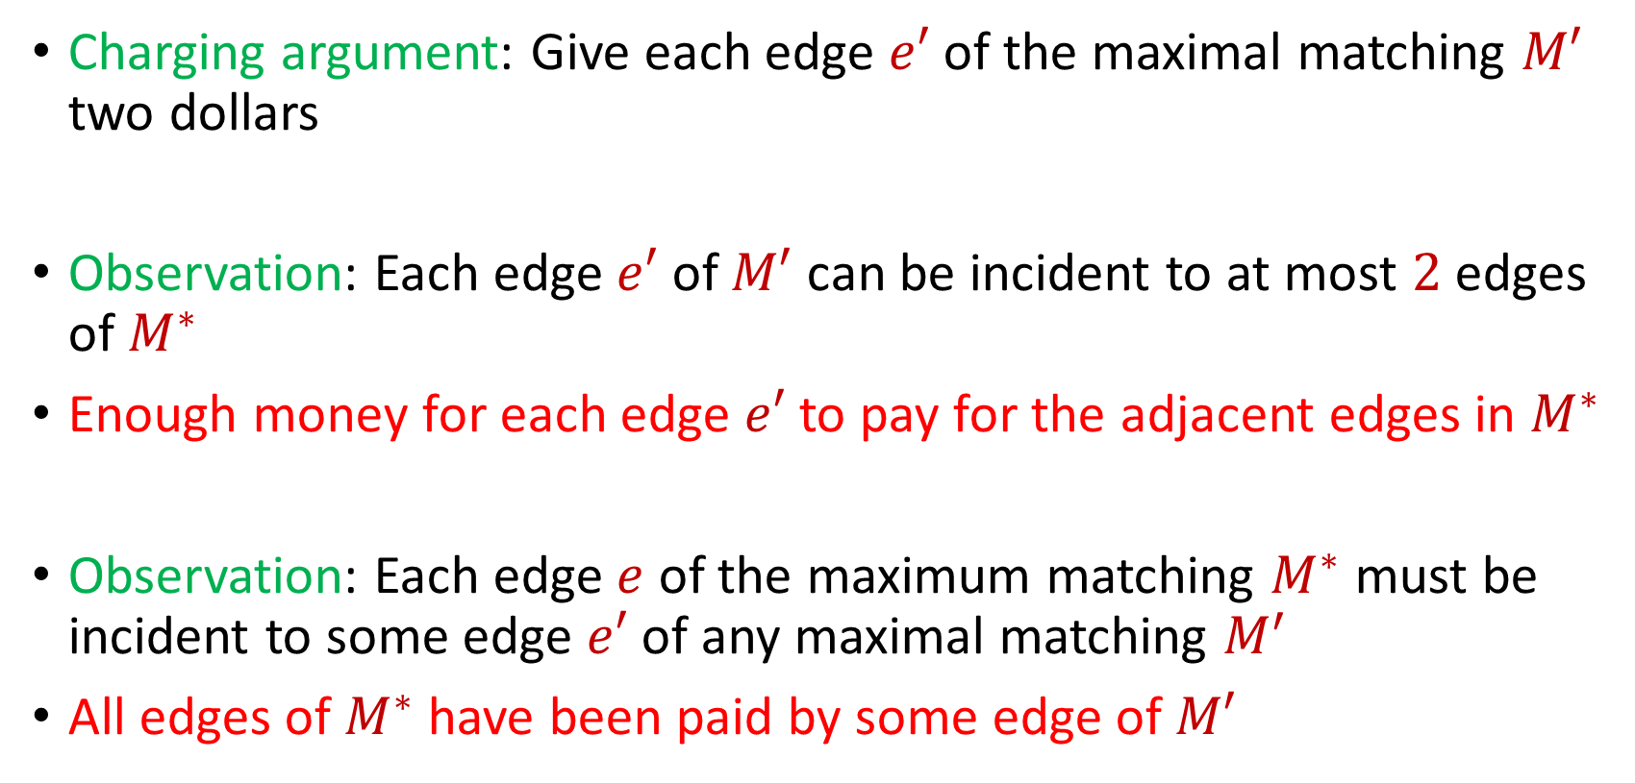
Maximal Matching
Charging argument: Give each edge $e′$ of the maximal matching $M′$ two dollars
Observation: Each edge $e′$ of $M′$ can be incident to at most $2$ edges of $M^{∗}$
Enough money for each edge $e′$ to pay for the adjacent edges in $M^{∗}$
Observation: Each edge $e$ of the maximum matching $M^{∗}$ must be incident to some edge $e′$ of any maximal matching $M^{′}$
All edges of $M^{∗}$ have been paid by some edge of $M′$

Slide 14
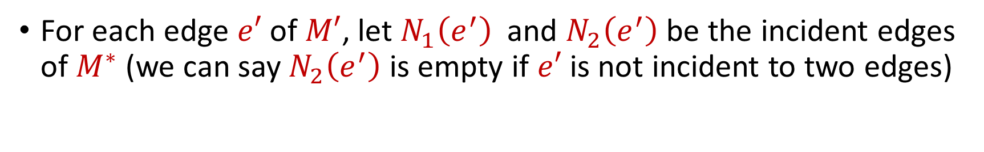

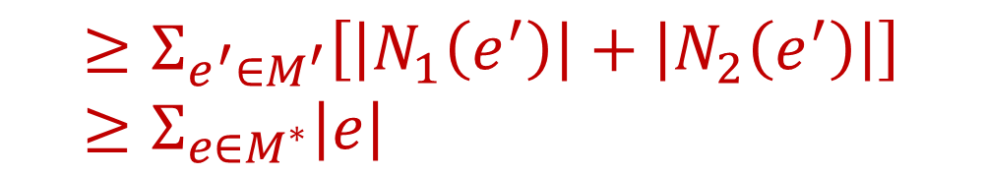

Maximal Matching
For each edge $e′$ of $M′$, let $N_{1}\left(e^{′}\right)$ and $N_{2}\left(e^{′}\right)$ be the incident edges of $M^{∗}$ (we can say $N_{2}\left(e^{′}\right)$ is empty if $e′$ is not incident to two edges)
$$2\left|M^{′}\right|=Σ_{e^{′}∈M^{′}}2\left|e′\right|$$
$$≥Σ_{e^{′}∈M^{′}}\left[\left|N_{1}\left(e^{′}\right)\right|+\left|N_{2}\left(e^{′}\right)\right|\right]≥Σ_{e∈M^{∗}}\left|e\right|$$
$$=|M^{∗}|$$

Slide 15

Matchings in the Semi-Streaming Model
Geedy algorithm is a $2$-approximation to the maximum matching that uses $O(n)$ space

Slide 16
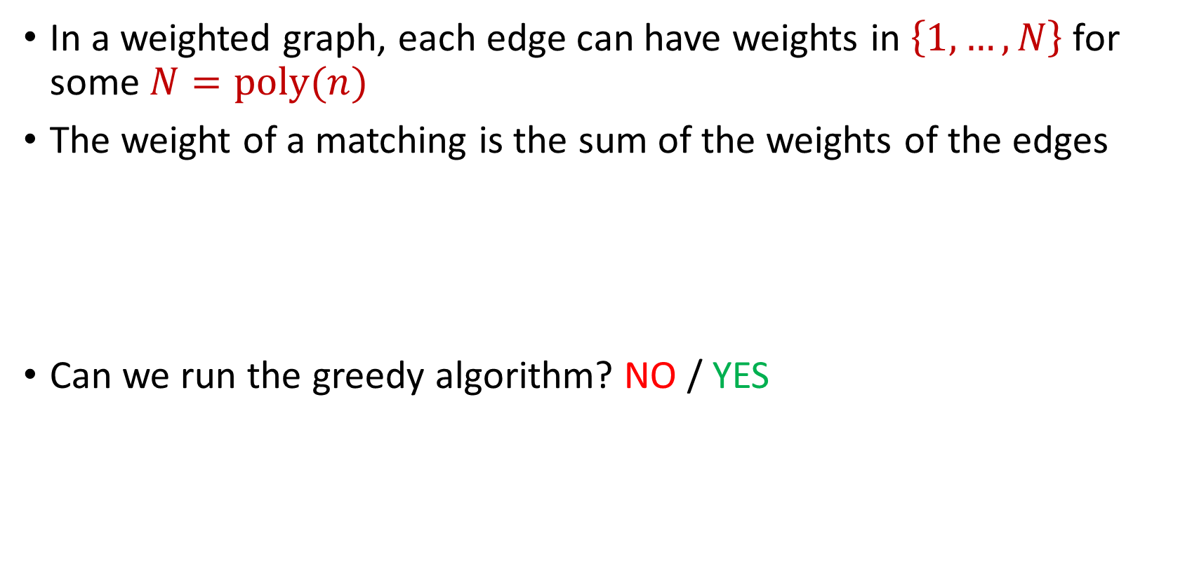
Matchings in the Semi-Streaming Model
In a weighted graph, each edge can have weights in $\left\{1,…,N\right\}$ for some $N=poly(n)$
The weight of a matching is the sum of the weights of the edges
Can we run the greedy algorithm? NO / YES

Slide 17
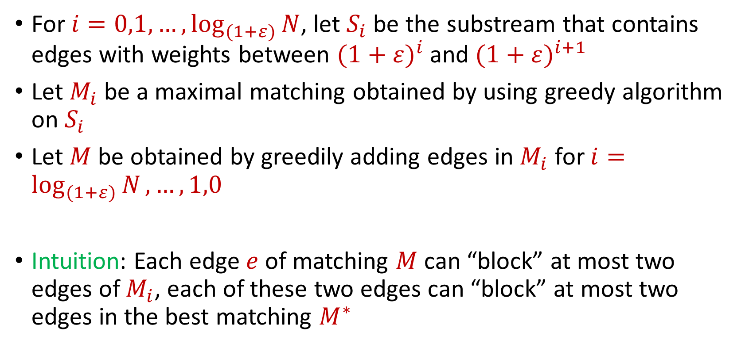
Matchings in the Semi-Streaming Model
For $i=0,1,…, \log_{(1+ε)}{N}$, let $S_{i}$ be the substream that contains edges with weights between ${(1+ε)}^{i}$ and ${(1+ε)}^{i+1}$
Let $M_{i}$ be a maximal matching obtained by using greedy algorithm on $S_{i}$
Let $M$ be obtained by greedily adding edges in $M_{i}$ for $i=\log_{(1+ε)}{N},…,1,0$
Intuition: Each edge $e$ of matching $M$ can “block” at most two edges of $M_{i}$, each of these two edges can “block” at most two edges in the best matching $M^{∗}$

Slide 18
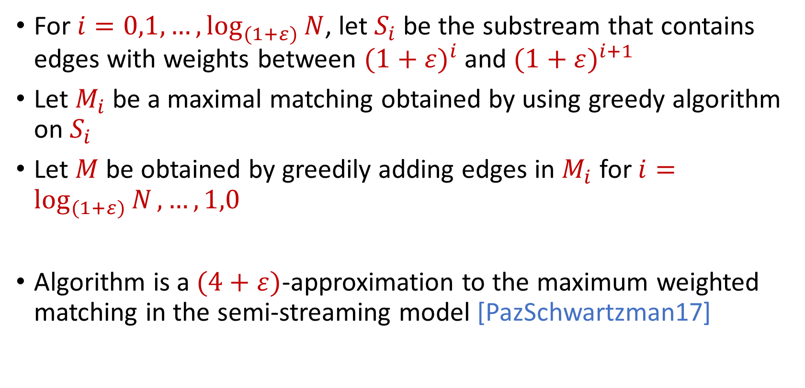
Matchings in the Semi-Streaming Model
For $i=0,1,…, \log_{(1+ε)}{N}$, let $S_{i}$ be the substream that contains edges with weights between ${(1+ε)}^{i}$ and ${(1+ε)}^{i+1}$
Let $M_{i}$ be a maximal matching obtained by using greedy algorithm on $S_{i}$
Let $M$ be obtained by greedily adding edges in $M_{i}$ for $i=\log_{(1+ε)}{N},…,1,0$
Algorithm is a $(4+ε)$-approximation to the maximum weighted matching in the semi-streaming model [PazSchwartzman17]

Slide 19
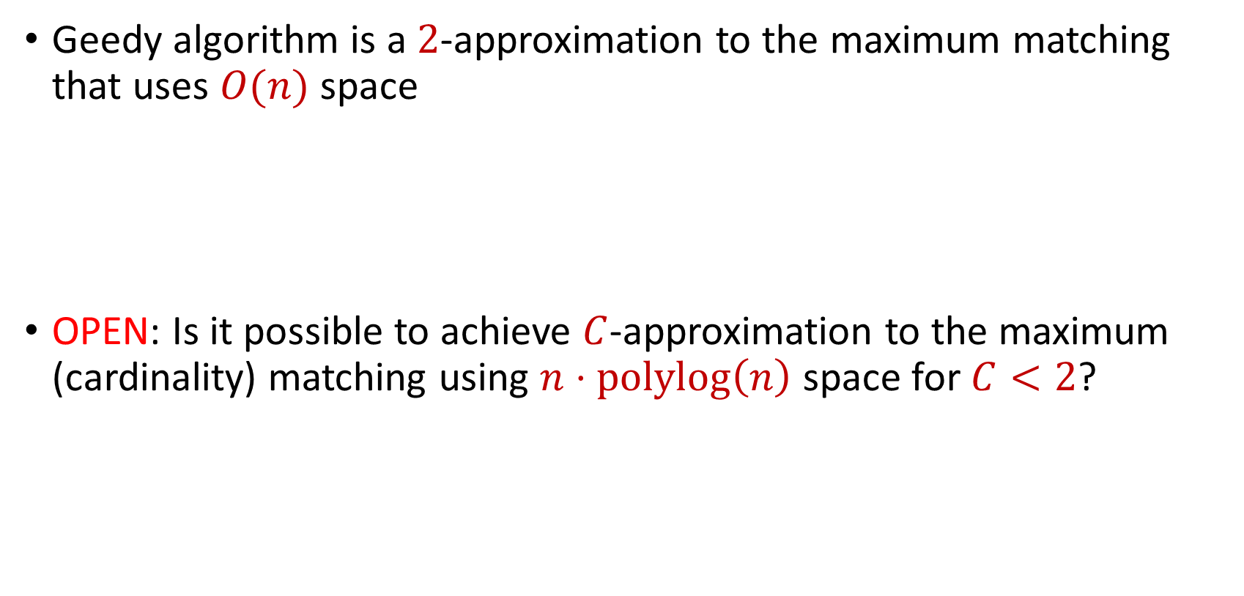
Matchings in the Semi-Streaming Model
Geedy algorithm is a $2$-approximation to the maximum matching that uses $O(n)$ space
OPEN: Is it possible to achieve $C$-approximation to the maximum (cardinality) matching using $n⋅polylog\left(n\right)$ space for $C<2$?

Slide 20
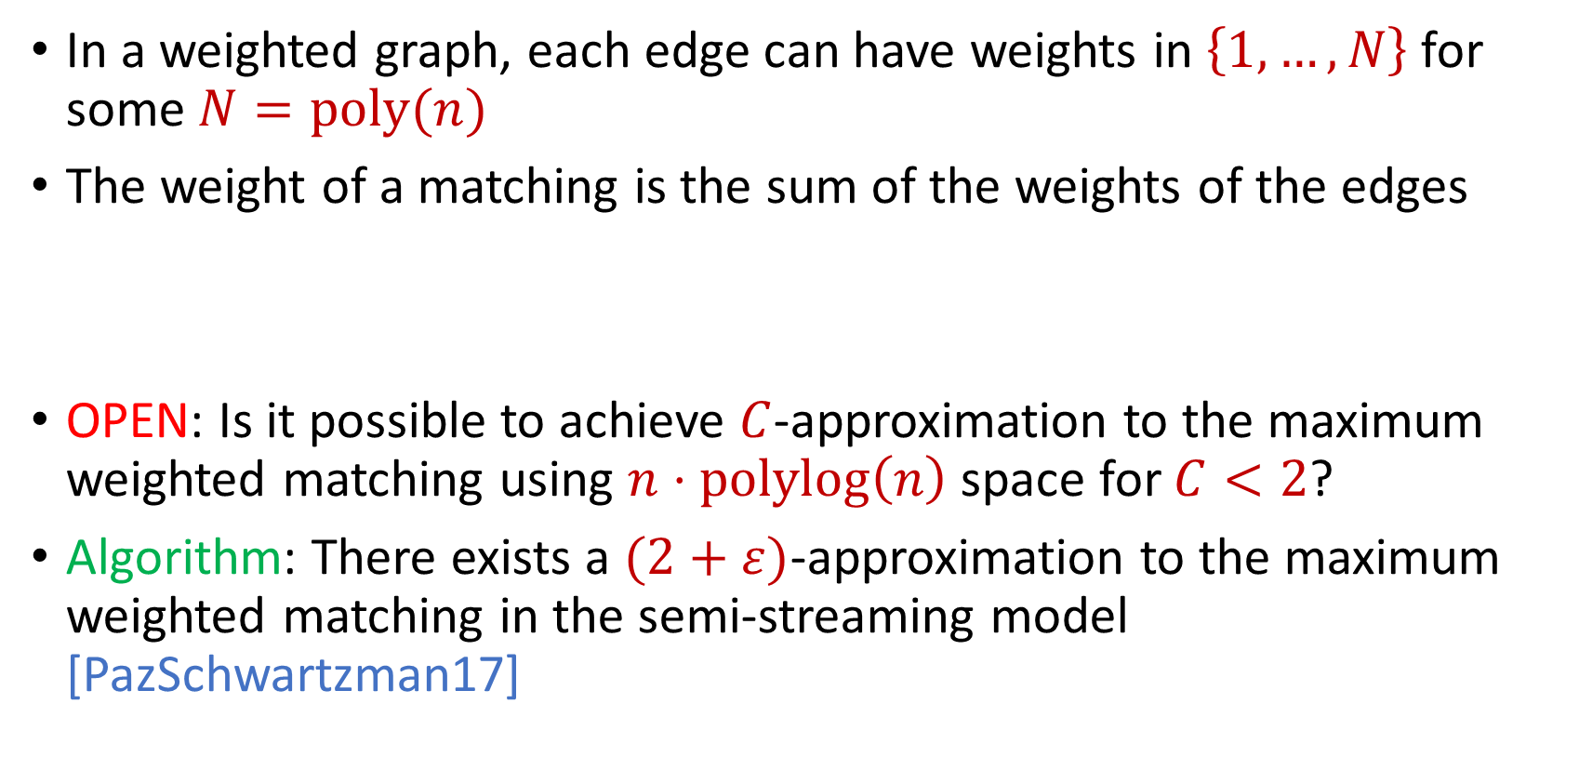
Matchings in the Semi-Streaming Model
In a weighted graph, each edge can have weights in $\left\{1,…,N\right\}$ for some $N=poly(n)$
The weight of a matching is the sum of the weights of the edges
OPEN: Is it possible to achieve $C$-approximation to the maximum weighted matching using $n⋅polylog\left(n\right)$ space for $C<2$?
Algorithm: There exists a $(2+ε)$-approximation to the maximum weighted matching in the semi-streaming model [PazSchwartzman17]

Slide 21
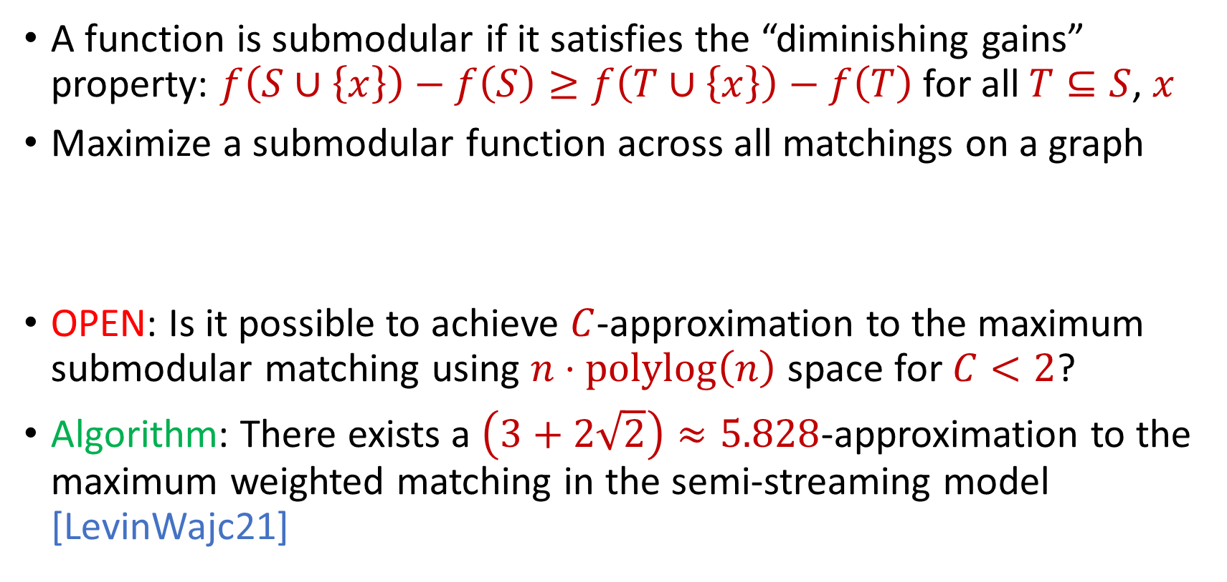
Matchings in the Semi-Streaming Model
A function is submodular if it satisfies the “diminishing gains” property: $f\left(S∪\left\{x\right\}\right)−f\left(S\right)≥f\left(T∪\left\{x\right\}\right)−f\left(T\right)$ for all $T⊆S$, $x$
Maximize a submodular function across all matchings on a graph
OPEN: Is it possible to achieve $C$-approximation to the maximum submodular matching using $n⋅polylog\left(n\right)$ space for $C<2$?
Algorithm: There exists a $\left(3+2\sqrt{2}\right)≈5.828$-approximation to the maximum weighted matching in the semi-streaming model [LevinWajc21]

Slide 22
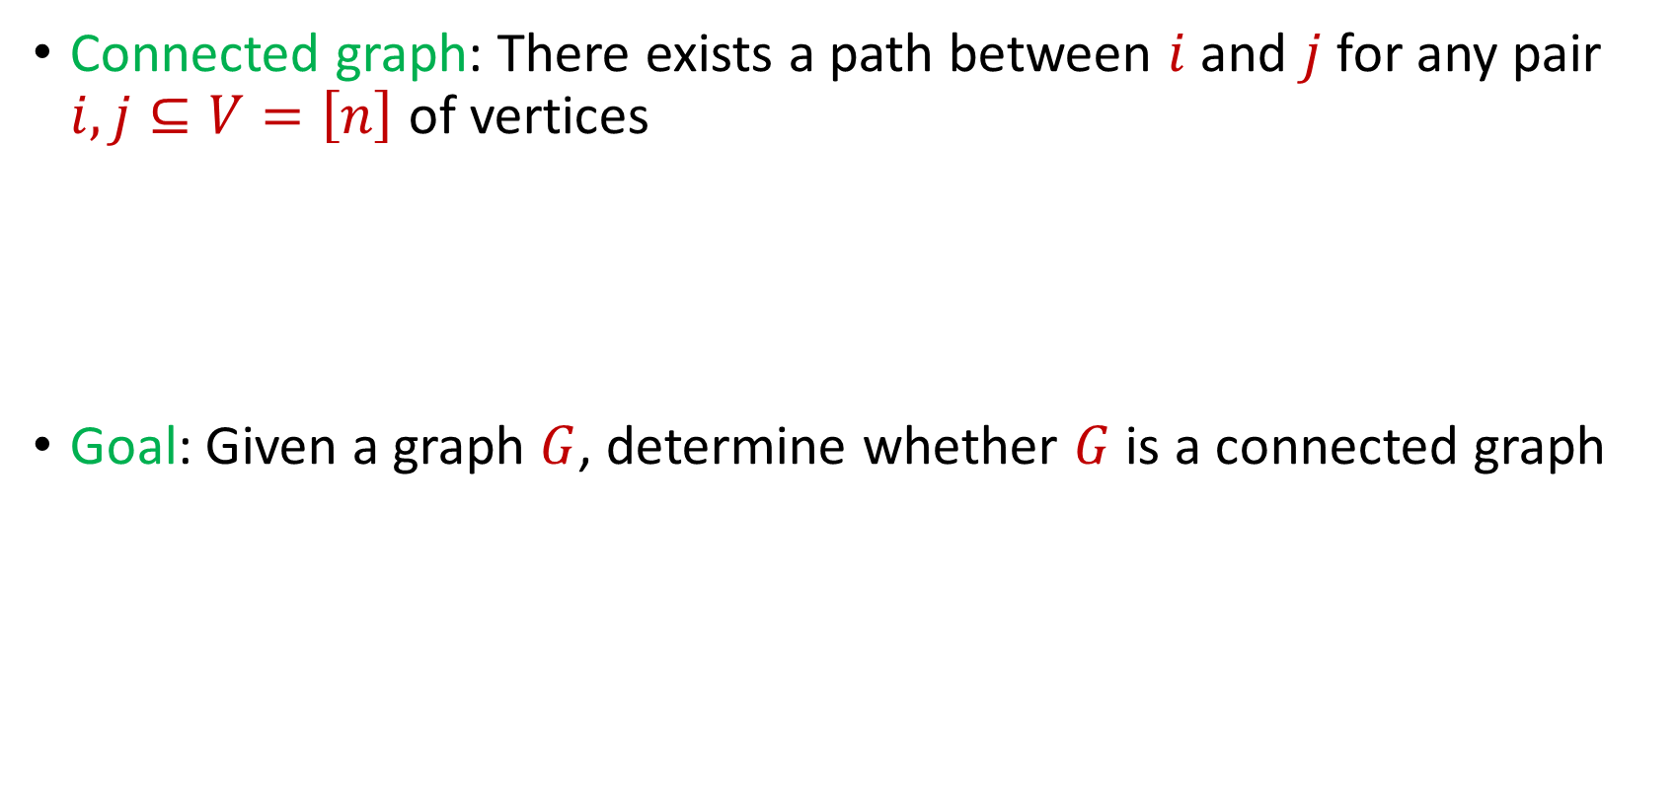
Connectivity
Connected graph: There exists a path between $i$ and $j$ for any pair $i,j⊆V=\left[n\right]$ of vertices
Goal: Given a graph $G$, determine whether $G$ is a connected graph

Slide 23
$$1$$
$$2$$
$$5$$
$$6$$
$$4$$
$$3$$

Slide 24
$$1$$
$$2$$
$$5$$
$$6$$
$$4$$
$$3$$

Slide 25
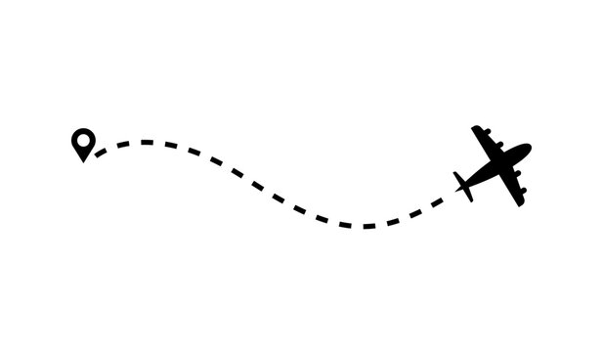
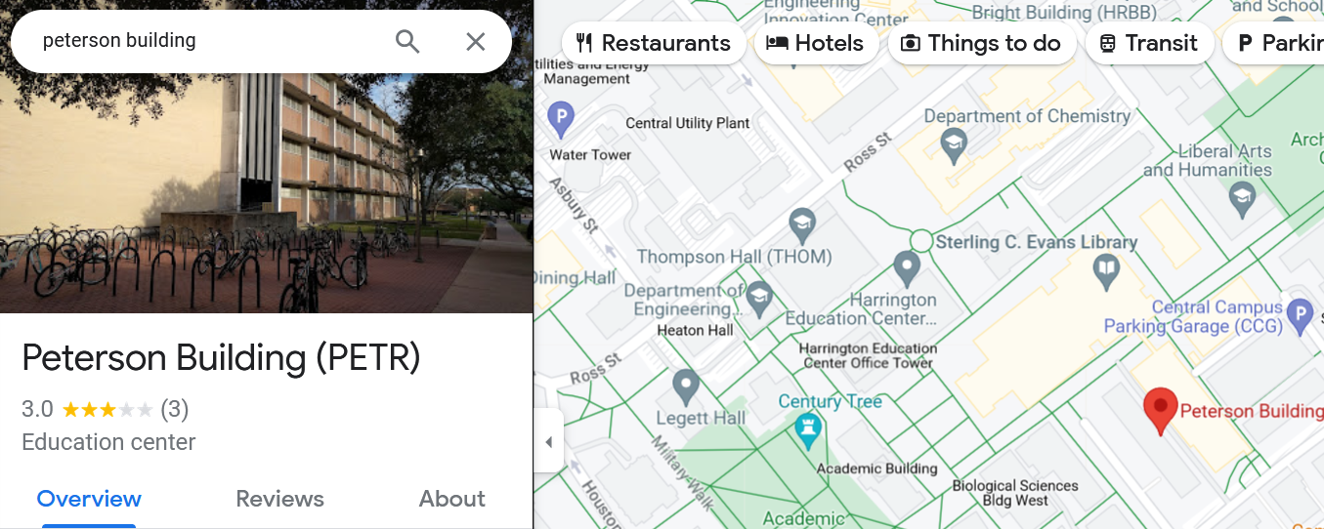
Connectivity
Transportation networks: Analyzing the connectivity of transportation networks, e.g., roads, railways, flight routes, is critical for optimizing routes, planning public transportation, identifying congested areas, and ensuring efficient travel

Slide 26
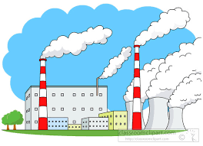

Connectivity
Electrical power grids: Determining the connectivity of an electric power grid is essential for ensuring a reliable and resilient power supply. Identifying isolated components helps in quickly restoring power after outages.

Slide 27

Spanning Forest
Spanning tree: A subgraph of $G$ that is a tree and contains all the vertices of the graph $G$
Spanning forest: A subgraph of $G$ that is a union of trees that contains all the vertices of the graph $G$

Slide 28
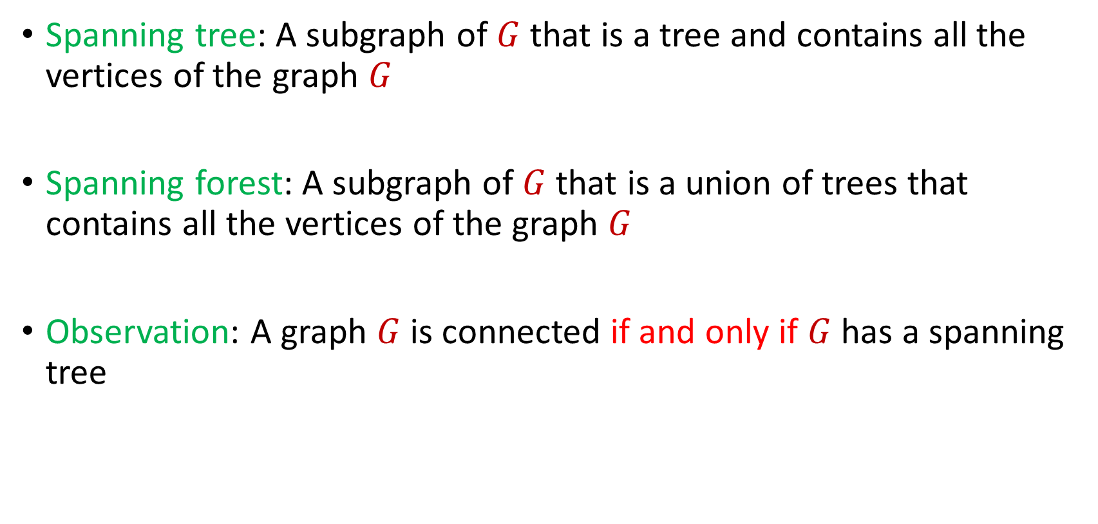
Spanning Forest
Spanning tree: A subgraph of $G$ that is a tree and contains all the vertices of the graph $G$
Spanning forest: A subgraph of $G$ that is a union of trees that contains all the vertices of the graph $G$
Observation: A graph $G$is connected if and only if $G$ has a spanning tree

Slide 29
$$1$$
$$2$$
$$5$$
$$6$$
$$4$$
$$3$$

Slide 30
$$1$$
$$2$$
$$5$$
$$6$$
$$4$$
$$3$$

Slide 31
$$1$$
$$2$$
$$5$$
$$6$$
$$4$$
$$3$$

Slide 32
Spanning Tree
How to find a spanning tree in the offline setting?

Slide 33
Spanning Tree
How to find a spanning tree in the offline setting?
Minimum spanning tree algorithms (Kruskal, Prim)
Kruskal: Greedily add minimum weight edge to spanning forest
Prim: Greedily grow minimum spanning tree

Slide 34
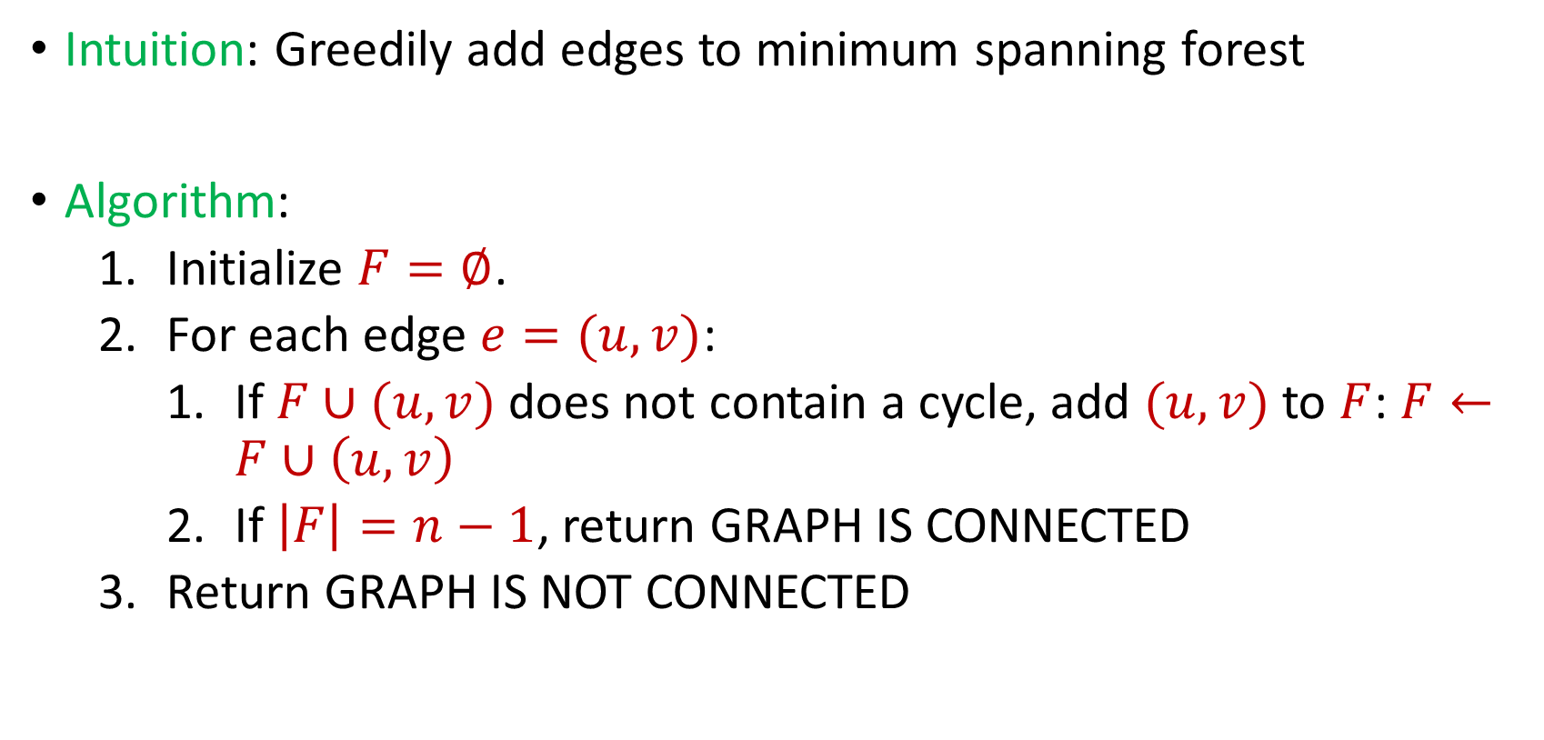
Connectivity
Intuition: Greedily add edges to minimum spanning forest
Algorithm:
Initialize $F=∅$.
For each edge $e=(u,v)$:
If $F∪(u,v)$ does not contain a cycle, add $(u,v)$ to $F$: $F←F∪\left(u,v\right)$
If $\left|F\right|=n−1$, return GRAPH IS CONNECTED
Return GRAPH IS NOT CONNECTED

Slide 35

Connectivity
Algorithm can keep at most $n$ edges, so the total space usage is $O(n)$ words of space.

Slide 36
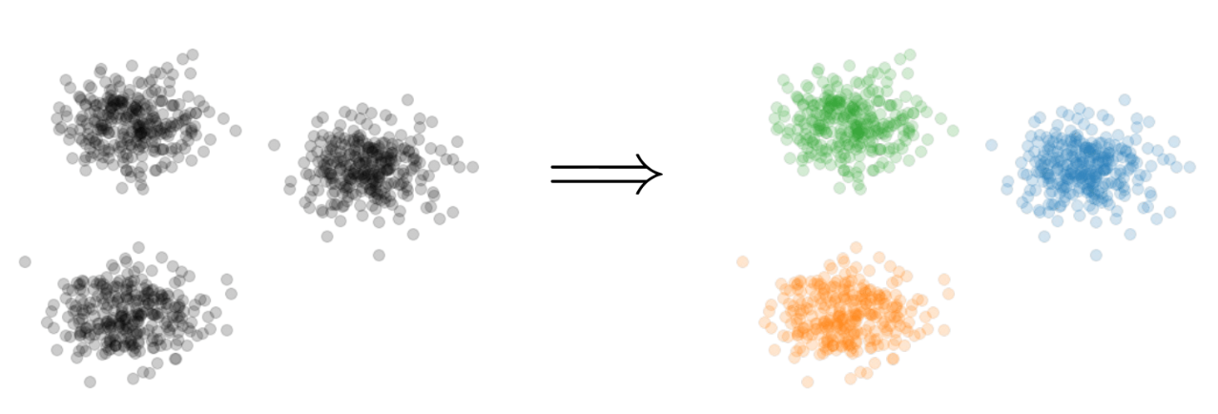

Clustering
Goal: Given input dataset $P$, partition $P$ so that “similar” points are in the same cluster and “different” points are in different clusters

Slide 37


$k$-Clustering
Goal: Given input dataset $P$, partition $P$ so that “similar” points are in the same cluster and “different” points are in different clusters
There can be at most $k$ different clusters
$$k=3$$

Slide 38
$k$-Clustering
Question: How do we measure the “quality” of each clustering?
$$k=3$$

Slide 39
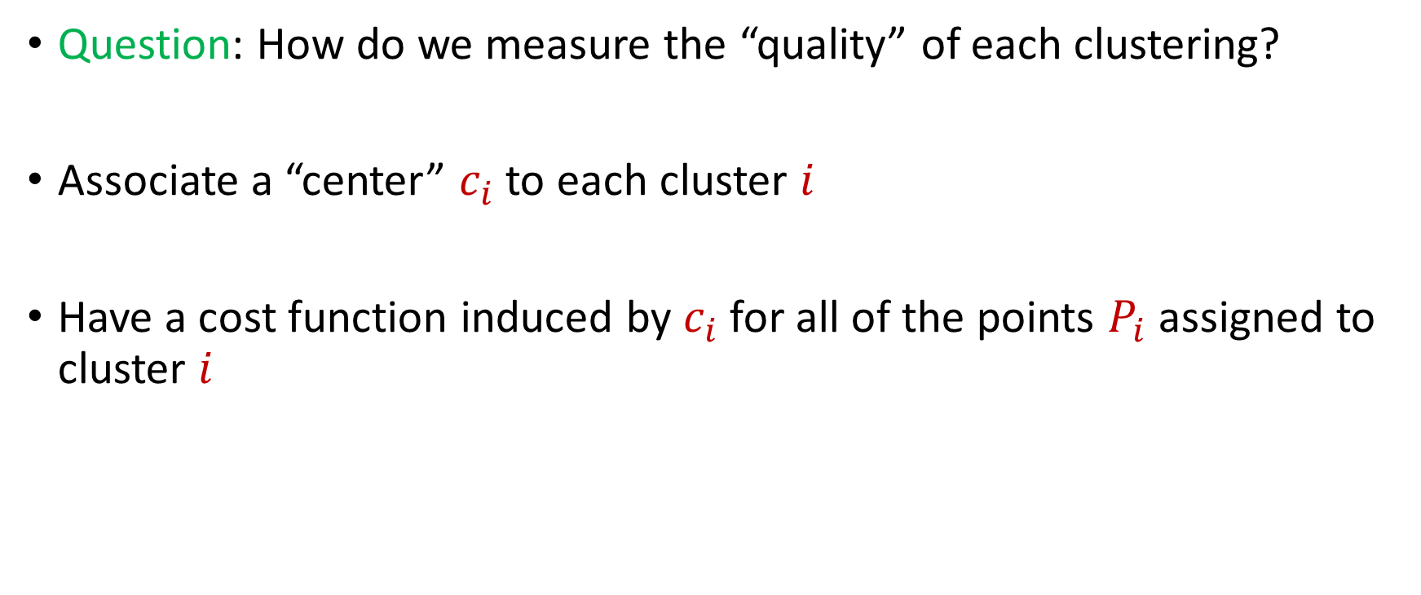
$k$-Clustering
Question: How do we measure the “quality” of each clustering?
Associate a “center” $c_{i}$ to each cluster $i$
Have a cost function induced by $c_{i}$ for all of the points $P_{i}$ assigned to cluster $i$
$$Cost\left(P_{i}, c_{i}\right)$$

Slide 42





1 0 3 0 1 1
1 1 0 0 2 8
2 0 1 3 0 8
1 1 0 0 0 8
0 0 0 7 0 0
7 0 0 8 0 0
3 4 1 1 0 2
4 2 0 1 0 1
9 1 0 0 3 2
1 1 6 0 0 0
8 1 0 1 2 0
1
1
2
1
0
7
3
4
9
1
8
$$n$$
$$A$$
$$b$$
$$d$$
$$1$$

Slide 43




$$x$$
$$n$$
$$A$$
$$≈$$
$$b$$
$$d$$
$$1$$

Slide 44




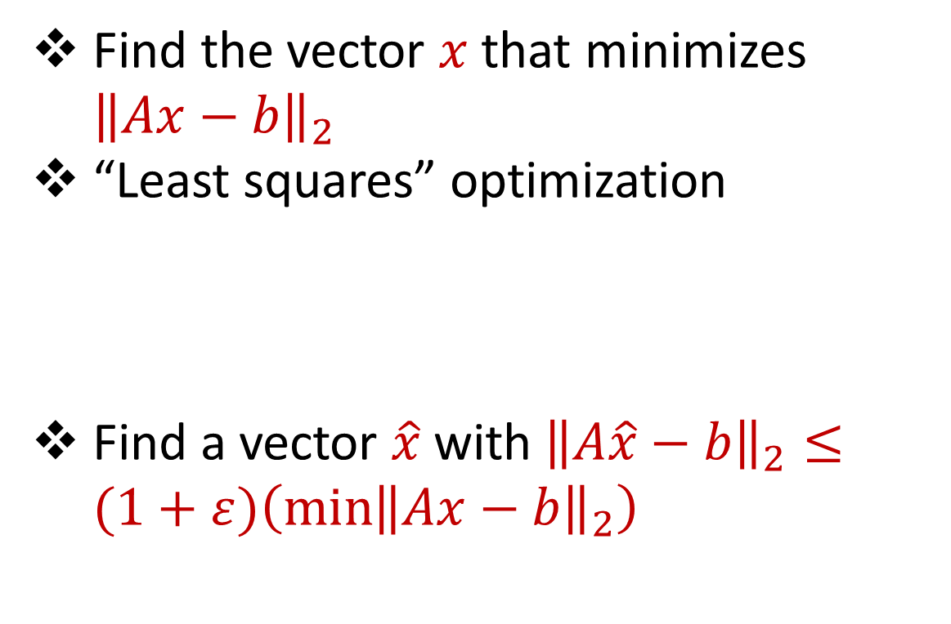






Linear Regression
Find the vector $x$ that minimizes ${\left\|Ax−b\right\|}_{2}$
“Least squares” optimization
Find a vector $\hat{x}$ with ${\left\|A\hat{x}−b\right\|}_{2}≤(1+ε)\left(\min{{\left\|Ax−b\right\|}_{2}}\right)$
$$d$$
$$x$$
$$≈$$
$$n$$
$$A$$
$$n$$
$$b$$
$$1$$
$$d$$
$$1$$

Slide 45




Dimensionality Reduction
Reduce $d$
Reduce $n$
Application depends on task!
Sampling, Sketching, Johnson-Lindenstrauss, IsoMap
$$n$$
$$A$$
Sampling, Sketching
$$d$$

Slide 46


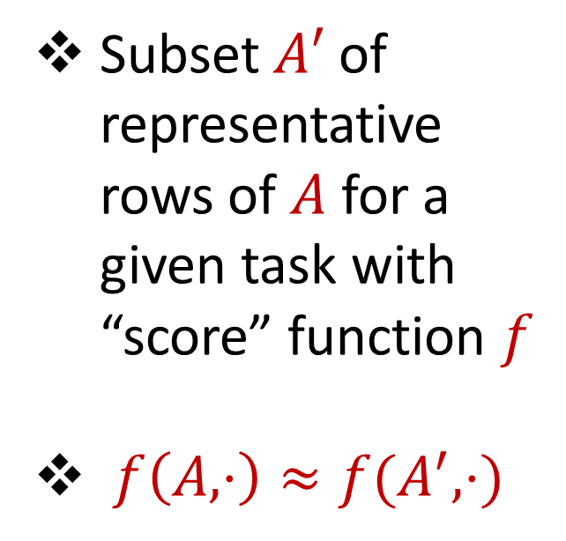



Coreset
Subset $A′$ of representative rows of $A$ for a given task with “score” function $f$
$f\left(A,⋅\right)≈f(A^{′},⋅)$
$$n$$
$$A$$
$$A′$$
$$d$$
$$d$$

Slide 47
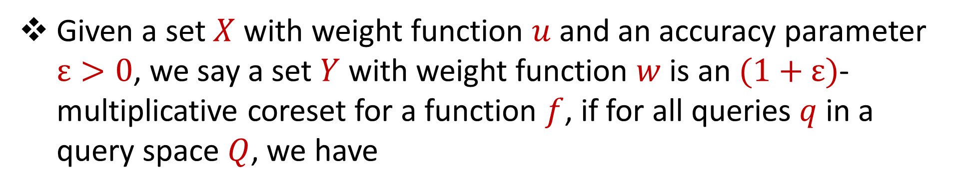
Coreset (Formal Definition)
Given a set $X$ with weight function $u$ and an accuracy parameter $ε>0$, we say a set $Y$ with weight function $w$is an $(1+ε)$-multiplicative coreset for a function $f$, if for all queries $q$ in a query space $Q$, we have
$$\left(1−ε\right)f\left(Y,q,w\right)≤f\left(X,q,u\right)≤\left(1+ε\right)f(Y,q,w)$$

Slide 48
Coreset
Lots of different constructions with various tradeoffs
Size vs. accuracy
Size vs. computation time
Size vs. interpretability
Average-case vs. worst-case performance

Slide 49
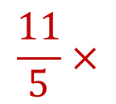
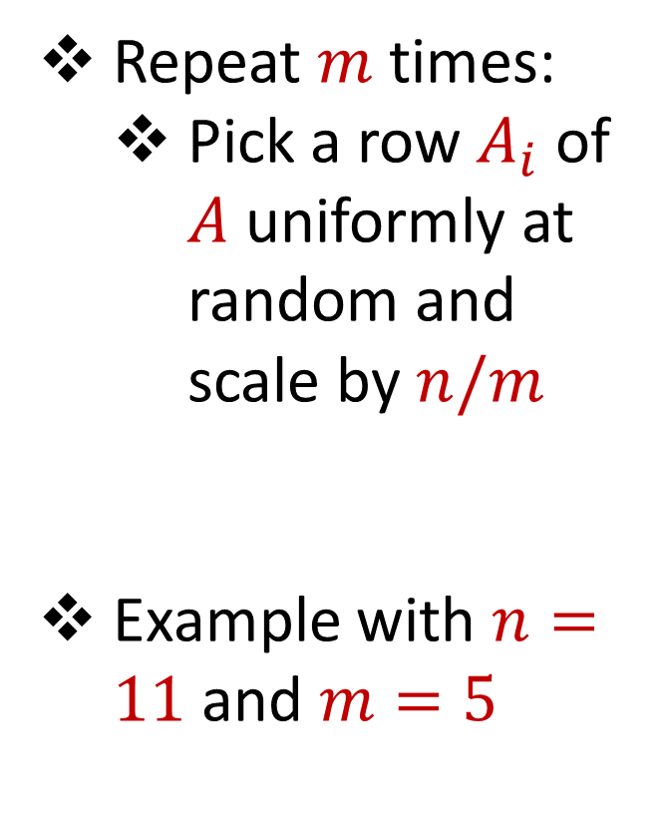
Uniform Sampling
1 0 3 0 1 1
1 1 0 0 2 8
2 0 1 3 0 8
1 1 0 0 0 8
0 0 0 7 0 0
7 0 0 8 0 0
3 4 1 1 0 2
4 2 0 1 0 1
9 1 0 0 3 2
1 1 6 0 0 0
8 1 0 1 2 0
Repeat $m$ times:
Pick a row $A_{i}$ of $A$ uniformly at random and scale by $n/m$
Example with $n=11$ and $m=5$
$$n$$
$$A$$
1 0 3 0 1 1
1 1 0 0 0 8
3 4 1 1 0 2
8 1 0 1 2 0
3 4 1 1 0 2
$$\frac{11}{5}×$$
$$A′$$
$$d$$
$$d$$

Slide 50

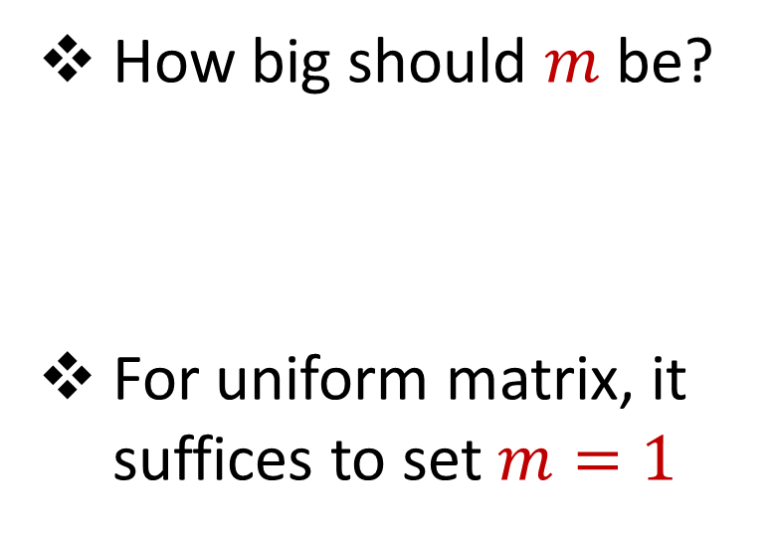


Uniform Sampling
1 0 0 0 0 0
1 0 0 0 0 0
1 0 0 0 0 0
1 0 0 0 0 0
1 0 0 0 0 0
1 0 0 0 0 0
1 0 0 0 0 0
1 0 0 0 0 0
1 0 0 0 0 0
1 0 0 0 0 0
1 0 0 0 0 0
How big should $m$ be?
For uniform matrix, it suffices to set $m=1$
$$n$$
$$A$$
$$d$$

Slide 51
Uniform Sampling
1 0 0 0 0 0
1 0 0 0 0 0
1 0 0 0 0 0
1 0 0 0 0 0
1 0 0 0 0 0
1 0 0 0 0 0
1 0 0 0 0 0
1 0 0 0 0 0
1 0 0 0 0 0
1 0 0 0 0 0
1 0 0 0 0 0
How big should $m$ be?
For uniform matrix, it suffices to set $m=1$
$$n$$
$$A$$
1 0 0 0 0 0
1 0 0 0 0 0
1 0 0 0 0 0
1 0 0 0 0 0
1 0 0 0 0 0
$$\frac{11}{5}×$$
$$A′$$
$$d$$
$$d$$

Slide 52
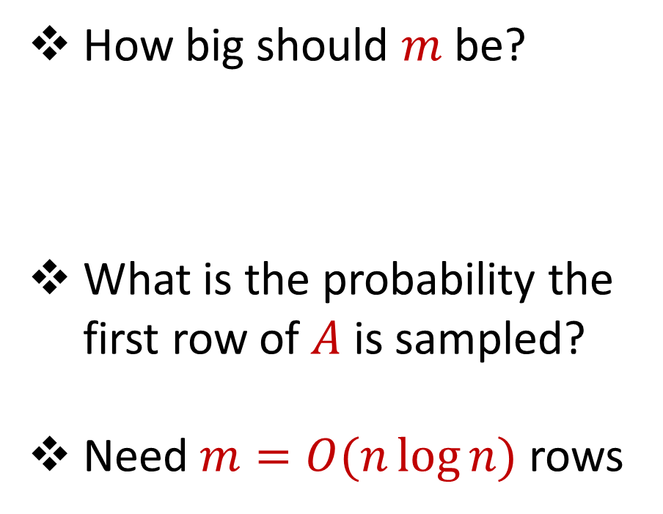
Uniform Sampling
0 0 0 0 0 1
1 0 0 0 0 0
1 0 0 0 0 0
1 0 0 0 0 0
1 0 0 0 0 0
1 0 0 0 0 0
1 0 0 0 0 0
1 0 0 0 0 0
1 0 0 0 0 0
1 0 0 0 0 0
1 0 0 0 0 0
How big should $m$ be?
What is the probability the first row of $A$ is sampled?
Need $m=O(n\log{n})$ rows
$$n$$
$$A$$
$$d$$

Slide 53
Uniform Sampling
Pros: intuitively simple, simple to implement, fast, good on uniform or “average-case” data
Cons: bad on “worst-case” data

Slide 54
Importance Sampling
1 0 0 0 0 0
1 0 0 0 0 0
1 0 0 0 0 0
1 0 0 0 0 0
1 0 0 0 0 0
1 0 0 0 0 0
0 0 0 0 0 1
1 0 0 0 0 0
1 0 0 0 0 0
1 0 0 0 0 0
1 0 0 0 0 0
What if we do not sample uniformly at random?
What is the probability that each row should be sampled?
$$n$$
$$A$$

Slide 55
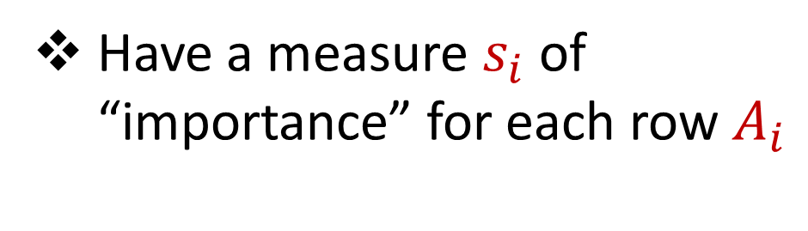
Importance Sampling
1 0 0 0 0 0
1 0 0 0 0 0
1 0 0 0 0 0
1 0 0 0 0 0
1 0 0 0 0 0
1 0 0 0 0 0
0 0 0 0 0 1
1 0 0 0 0 0
1 0 0 0 0 0
1 0 0 0 0 0
1 0 0 0 0 0
Have a measure $s_{i}$ of “importance” for each row $A_{i}$
$$n$$
$$A$$

Slide 56

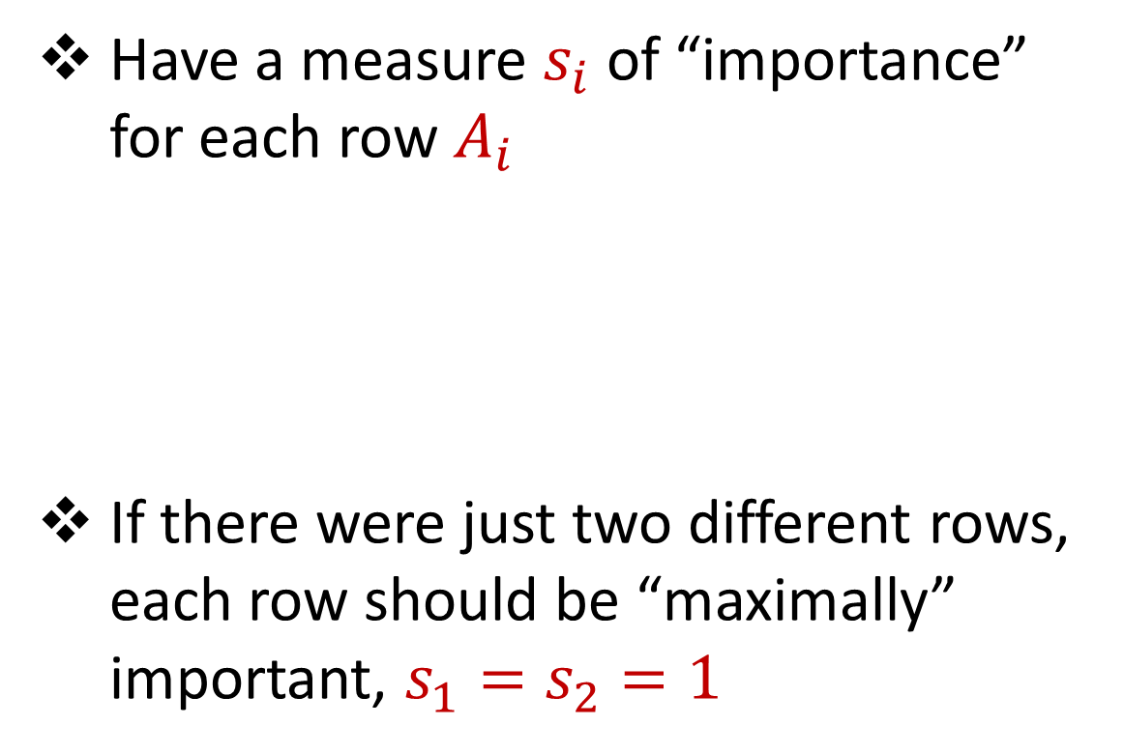



Importance Sampling
1 0 0 0 0 0
1 0 0 0 0 0
1 0 0 0 0 0
1 0 0 0 0 0
1 0 0 0 0 0
1 0 0 0 0 0
0 0 0 0 0 1
1 0 0 0 0 0
1 0 0 0 0 0
1 0 0 0 0 0
1 0 0 0 0 0
Have a measure $s_{i}$ of “importance” for each row $A_{i}$
If there were just two different rows, each row should be “maximally” important, $s_{1}=s_{2}=1$
$$n$$
$$A$$
1 0 0 0 0 0
0 0 0 0 0 1
$$n$$
$$A$$

Slide 57
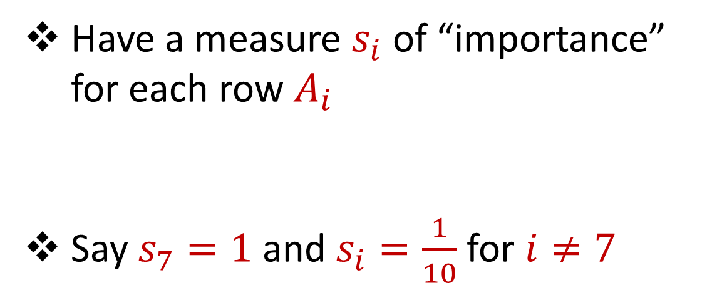
Importance Sampling
1 0 0 0 0 0
1 0 0 0 0 0
1 0 0 0 0 0
1 0 0 0 0 0
1 0 0 0 0 0
1 0 0 0 0 0
0 0 0 0 0 1
1 0 0 0 0 0
1 0 0 0 0 0
1 0 0 0 0 0
1 0 0 0 0 0
Have a measure $s_{i}$ of “importance” for each row $A_{i}$
Say $s_{7}=1$ and $s_{i}=\frac{1}{10}$ for $i≠7$
$$n$$
$$A$$

Slide 58
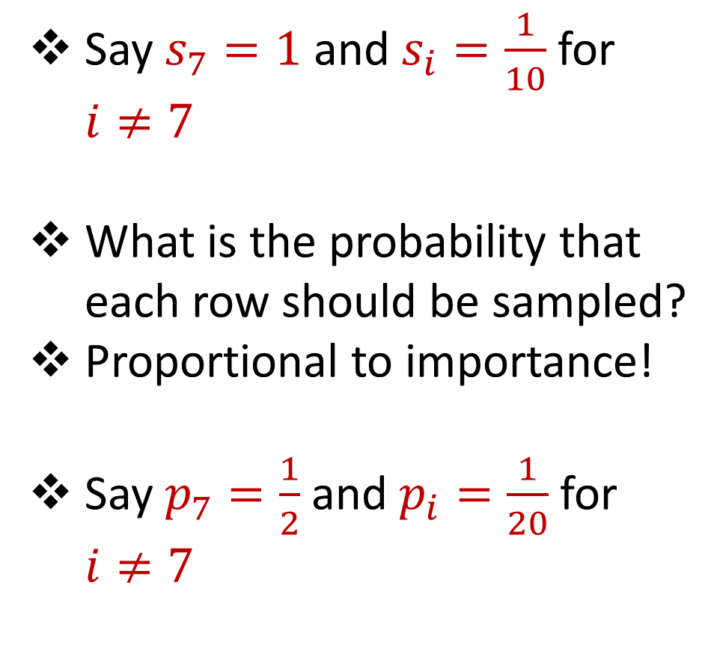
Importance Sampling
1 0 0 0 0 0
1 0 0 0 0 0
1 0 0 0 0 0
1 0 0 0 0 0
1 0 0 0 0 0
1 0 0 0 0 0
0 0 0 0 0 1
1 0 0 0 0 0
1 0 0 0 0 0
1 0 0 0 0 0
1 0 0 0 0 0
Say $s_{7}=1$ and $s_{i}=\frac{1}{10}$ for $i≠7$
What is the probability that each row should be sampled?
Proportional to importance!
Say $p_{7}=\frac{1}{2}$ and $p_{i}=\frac{1}{20}$ for $i≠7$
$$n$$
$$A$$

Slide 59
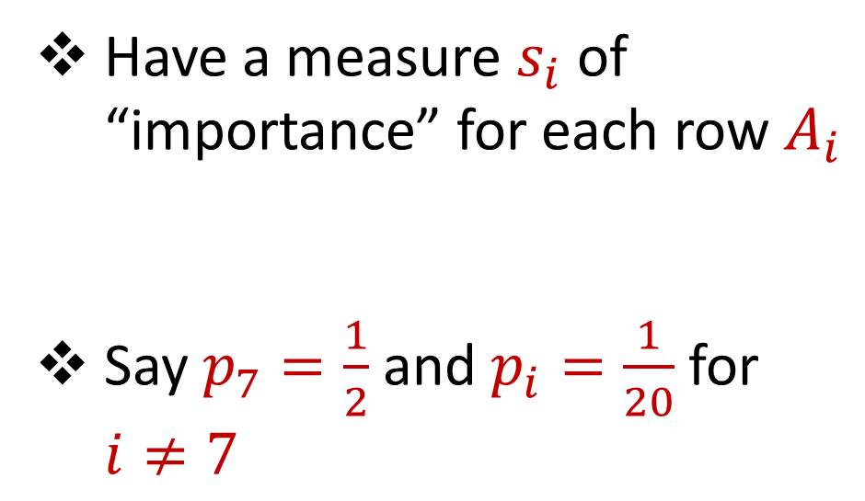
Importance Sampling
1 0 0 0 0 0
1 0 0 0 0 0
1 0 0 0 0 0
1 0 0 0 0 0
1 0 0 0 0 0
1 0 0 0 0 0
0 0 0 0 0 1
1 0 0 0 0 0
1 0 0 0 0 0
1 0 0 0 0 0
1 0 0 0 0 0
Have a measure $s_{i}$ of “importance” for each row $A_{i}$
Say $p_{7}=\frac{1}{2}$ and $p_{i}=\frac{1}{20}$ for $i≠7$
$$n$$
$$A$$

Slide 60

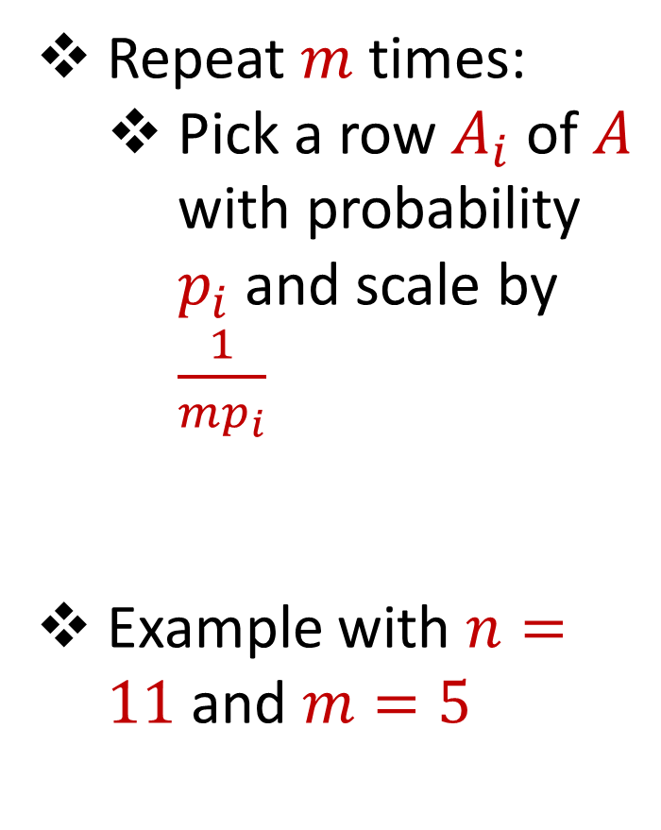

Importance Sampling
1 0 0 0 0 0
1 0 0 0 0 0
1 0 0 0 0 0
1 0 0 0 0 0
1 0 0 0 0 0
1 0 0 0 0 0
0 0 0 0 0 1
1 0 0 0 0 0
1 0 0 0 0 0
1 0 0 0 0 0
1 0 0 0 0 0
Repeat $m$ times:
Pick a row $A_{i}$ of $A$ with probability $p_{i}$and scale by $\frac{1}{mp_{i}}$
Example with $n=11$ and $m=5$
$$n$$
$$A$$
4 0 0 0 0 0
4 0 0 0 0 0
0 0 0 0 0 $\frac{2}{5}$
4 0 0 0 0 0
0 0 0 0 0 $\frac{2}{5}$
$$A′$$
$$d$$
$$d$$

Slide 61
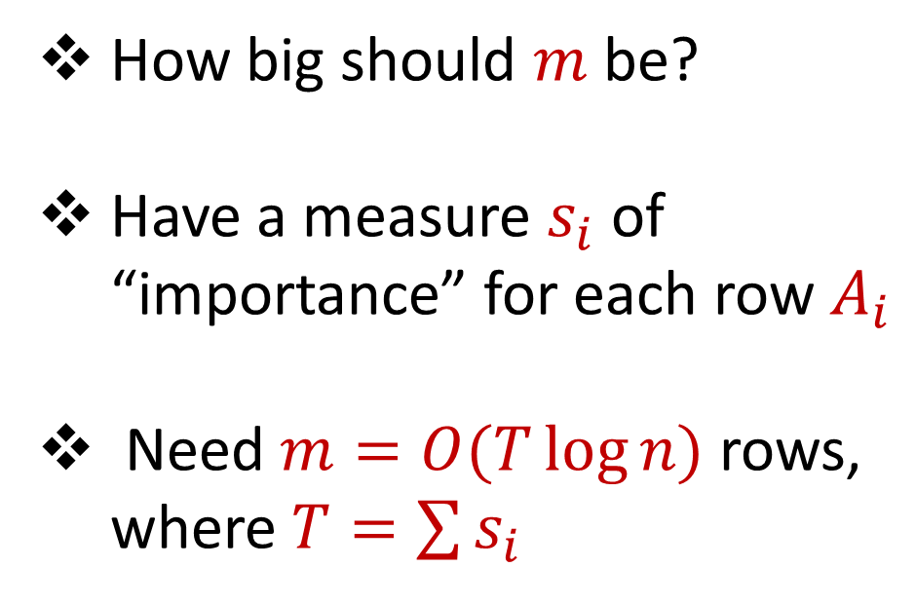
Importance Sampling
0 0 0 0 0 1
1 0 0 0 0 0
1 0 0 0 0 0
1 0 0 0 0 0
1 0 0 0 0 0
1 0 0 0 0 0
1 0 0 0 0 0
1 0 0 0 0 0
1 0 0 0 0 0
1 0 0 0 0 0
1 0 0 0 0 0
How big should $m$ be?
Have a measure $s_{i}$ of “importance” for each row $A_{i}$
Need $m=O(T\log{n})$ rows, where $T=\sum{s_{i}}$
$$n$$
$$A$$
$$d$$

Slide 62
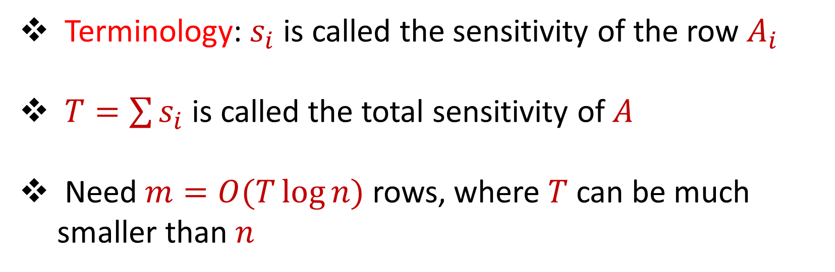
Sensitivity Sampling
Terminology: $s_{i}$ is called the sensitivity of the row $A_{i}$
$T=\sum{s_{i}}$ is called the total sensitivity of $A$
Need $m=O(T\log{n})$ rows, where $T$ can be much smaller than $n$

Slide 63

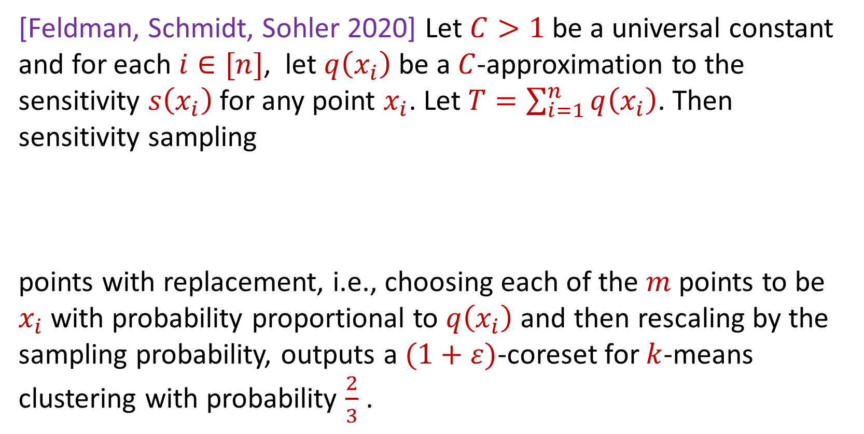
Sensitivity Sampling (Formal Theorem)
[Feldman, Schmidt, Sohler 2020] Let $C>1$ be a universal constant and for each $i∈[n]$, let $q\left(x_{i}\right)$ be a $C$-approximation to the sensitivity $s\left(x_{i}\right)$for any point $x_{i}$. Let $T=\sum_{i=1}^{n}{q\left(x_{i}\right)}$. Then sensitivity sampling
points with replacement, i.e., choosing each of the $m$ points to be $x_{i}$with probability proportional to $q\left(x_{i}\right)$ and then rescaling by the sampling probability, outputs a $(1+ε)$-coreset for $k$-means clustering with probability $\frac{2}{3}$ .
$$m=O\left(\frac{Tk}{ε^{2}}\log^{2}{k}\right)$$

Slide 64
Sensitivity Sampling
Pros: size is always better than uniform sampling and MUCH better on “worst-case” data
Cons: estimating the sensitivities can be a difficult design choice, computing the total sensitivity can be mathematically challenging, larger runtime

Slide 65
 | Uniform Sampling | Sensitivity Sampling
Average-case size | X | X
Worst-case size |  | X
Ease of implementation Computation of probabilities | X
Interpretability |  | X

Slide 66



Group / Stratified Sampling
0 0 0 0 0 1
1 0 0 0 0 0
1 0 0 0 0 0
1 0 0 0 0 0
1 0 0 0 0 0
1 0 0 0 0 0
1 0 0 0 0 0
1 0 0 0 0 0
1 0 0 0 0 0
1 0 0 0 0 0
1 0 0 0 0 0
Separate the data into “groups” and then perform uniform sampling on each group
If the data is uniform in each group, this is essentially sensitivity sampling
$$n$$
$$A$$
$$d$$

Slide 68
Coresets
Where to apply them?
Which sampling approach to use?
Worst-case mathematical bounds

Slide 69
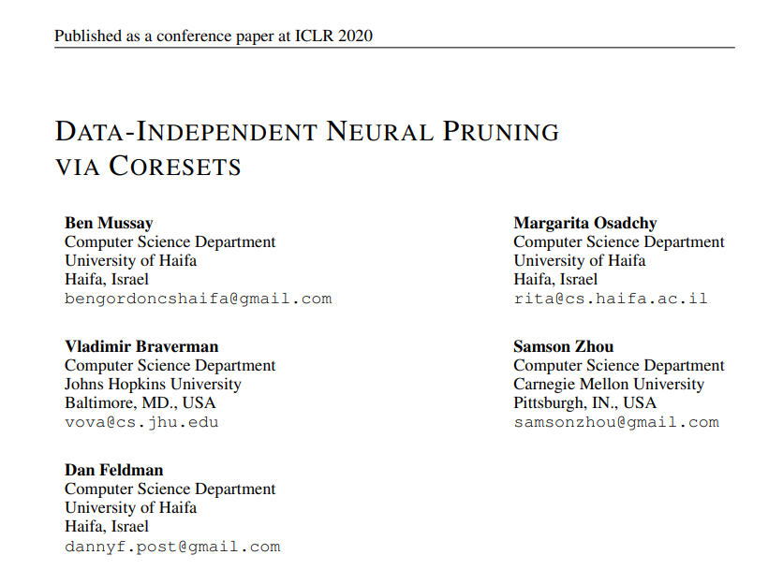
Coresets
Where to apply them?

Slide 70
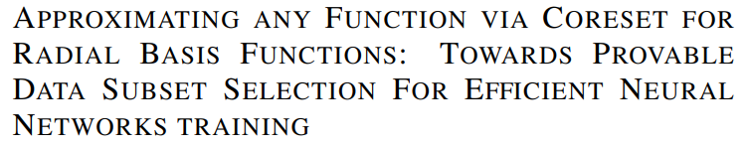
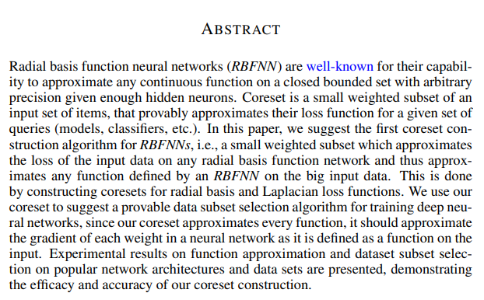
Coresets
Which sampling approach to use?

Slide 71

Coresets
Worst-case mathematical bounds

