Slide 1
CSCE 689: Special Topics in Modern Algorithms for Data Science
Lecture 16
Samson Zhou

Slide 2

Last Time: Sparse Recovery
Suppose we have an insertion-deletion stream of length $m=Θ\left(n\right)$ and at the end we are promised there are at most $k$ nonzero coordinates
Goal: Recover the $k$ nonzero coordinates and their frequencies

Slide 3
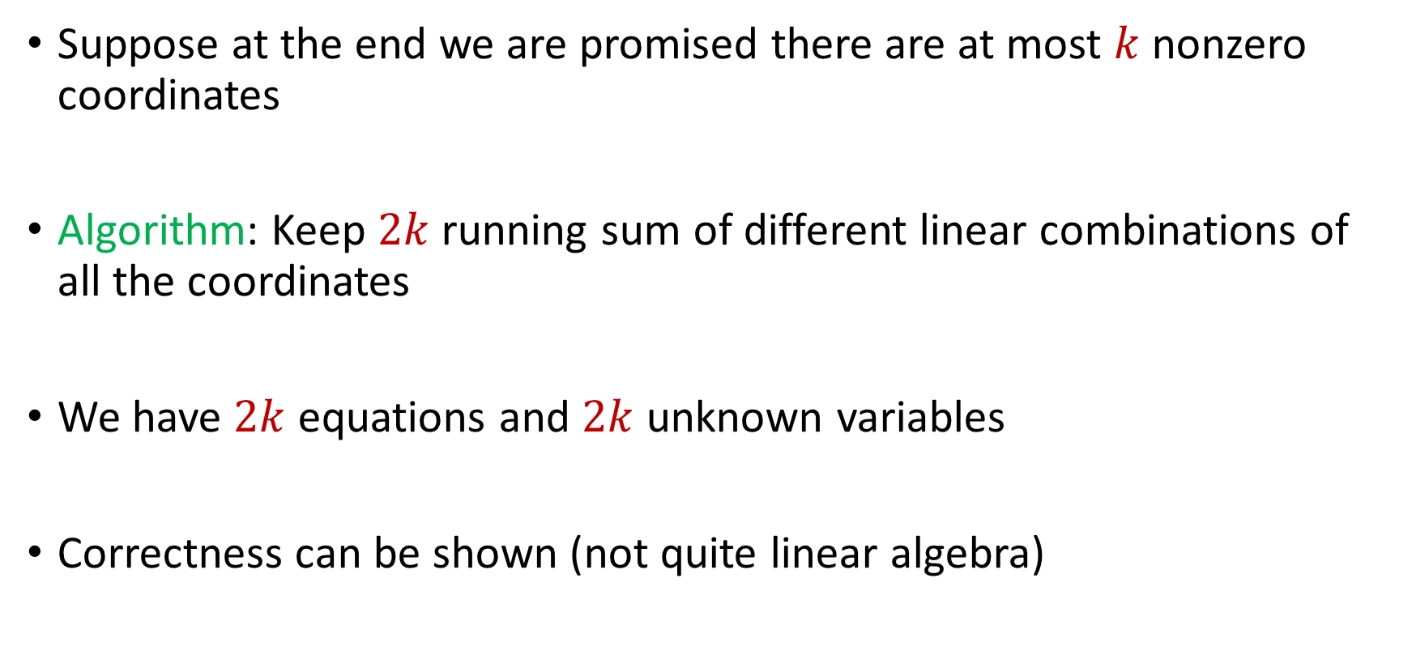
Last Time: Sparse Recovery
Suppose at the end we are promised there are at most $k$ nonzero coordinates
Algorithm: Keep $2k$running sum of different linear combinations of all the coordinates
We have $2k$ equations and $2k$ unknown variables
Correctness can be shown (not quite linear algebra)

Slide 4
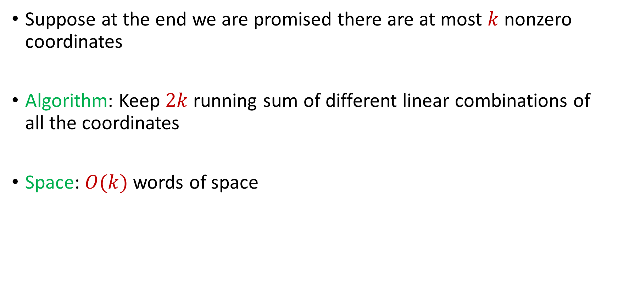
Last Time: Sparse Recovery
Suppose at the end we are promised there are at most $k$ nonzero coordinates
Algorithm: Keep $2k$running sum of different linear combinations of all the coordinates
Space: $O(k)$ words of space

Slide 5

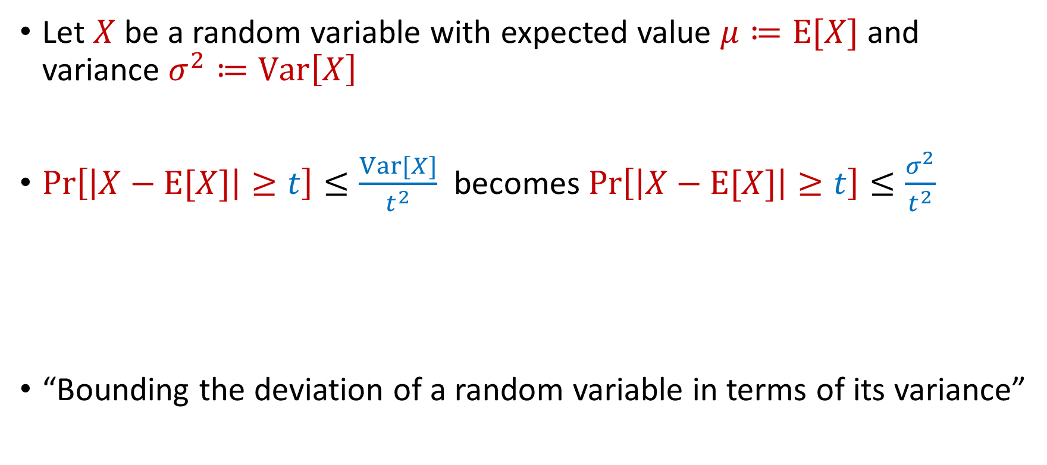
Previously: Chebyshev’s Inequality
Let $X$ be a random variable with expected value $μ≔E[X]$ and variance $σ^{2}≔Var\left[X\right]$
$Pr\left[\left|X−E[X]\right|≥t\right]≤\frac{Var[X]}{t^{2}}$ becomes $Pr\left[\left|X−E[X]\right|≥t\right]≤\frac{σ^{2}}{t^{2}}$
“Bounding the deviation of a random variable in terms of its variance”
$$Pr\left[\left|X−μ\right|≥kσ\right]≤\frac{1}{k^{2}}$$

Slide 6
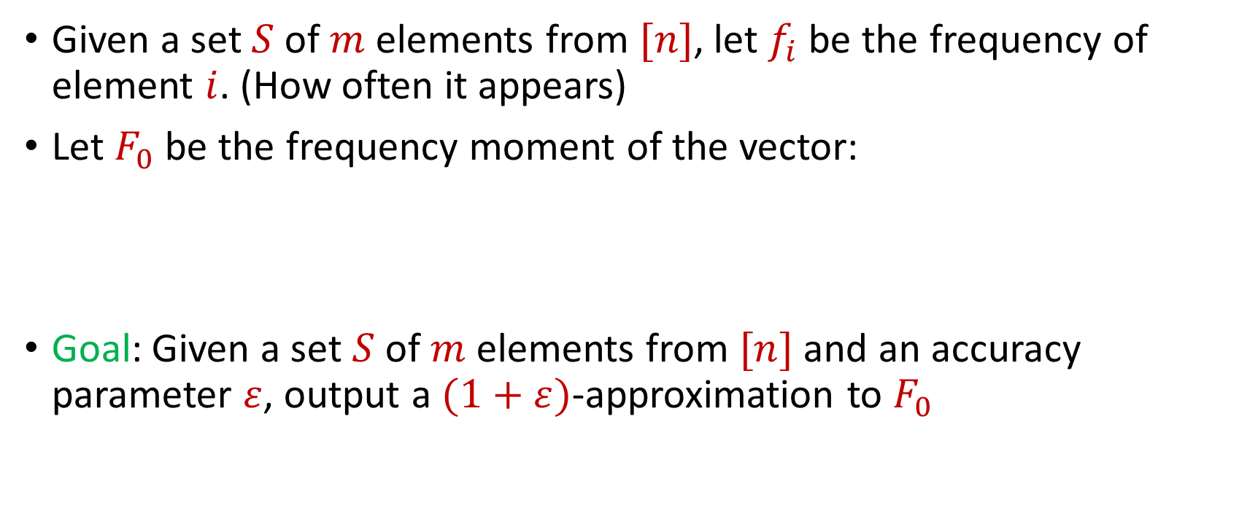

Distinct Elements ($F_{0}$ Estimation)
Given a set $S$ of $m$ elements from $[n]$, let $f_{i}$ be the frequency of element $i$. (How often it appears)
Let $F_{0}$ be the frequency moment of the vector:
Goal: Given a set $S$ of $m$ elements from $[n]$ and an accuracy parameter $ε$, output a $(1+ε)$-approximation to $F_{0}$
$F_{0}=$ $|\{i :f_{i}≠0\}|$

Slide 7



Slide 8


Slide 9


Slide 10


Slide 11


Slide 12


Slide 13


Slide 17


Slide 26


Slide 27
Distinct Elements ($F_{0}$ Estimation)
How many different fruits left in fruit basket?

Slide 28
Distinct Elements ($F_{0}$ Estimation)
How many different fruits left in fruit basket? 8

Slide 29

Distinct Elements ($F_{0}$ Estimation)
Ad allocation: Distinct IP addresses clicking an ad

Slide 30

Distinct Elements ($F_{0}$ Estimation)
Traffic monitoring: Distinct IP addresses visiting a site or number of unique search engine queries
3 billion monthly active users

Slide 31
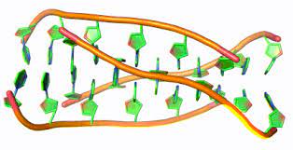
Distinct Elements ($F_{0}$ Estimation)
Computational biology: Counting number of distinct motifs in DNA sequencing
Sequence motifs are short, recurring patterns in DNA that are presumed to have a biological function

Slide 32

Distinct Elements ($F_{0}$ Estimation)
Let $S$ be a set of $N$ numbers
Suppose we form set $S′$ by sampling each item of $S$ with probability $\frac{1}{2}$
How many numbers are in $S′$?

Slide 33
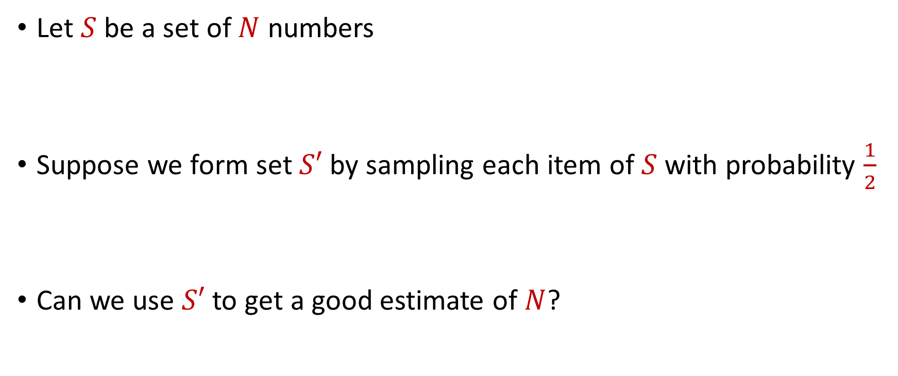
Distinct Elements ($F_{0}$ Estimation)
Let $S$ be a set of $N$ numbers
Suppose we form set $S′$ by sampling each item of $S$ with probability $\frac{1}{2}$
Can we use $S′$ to get a good estimate of $N$?

Slide 34
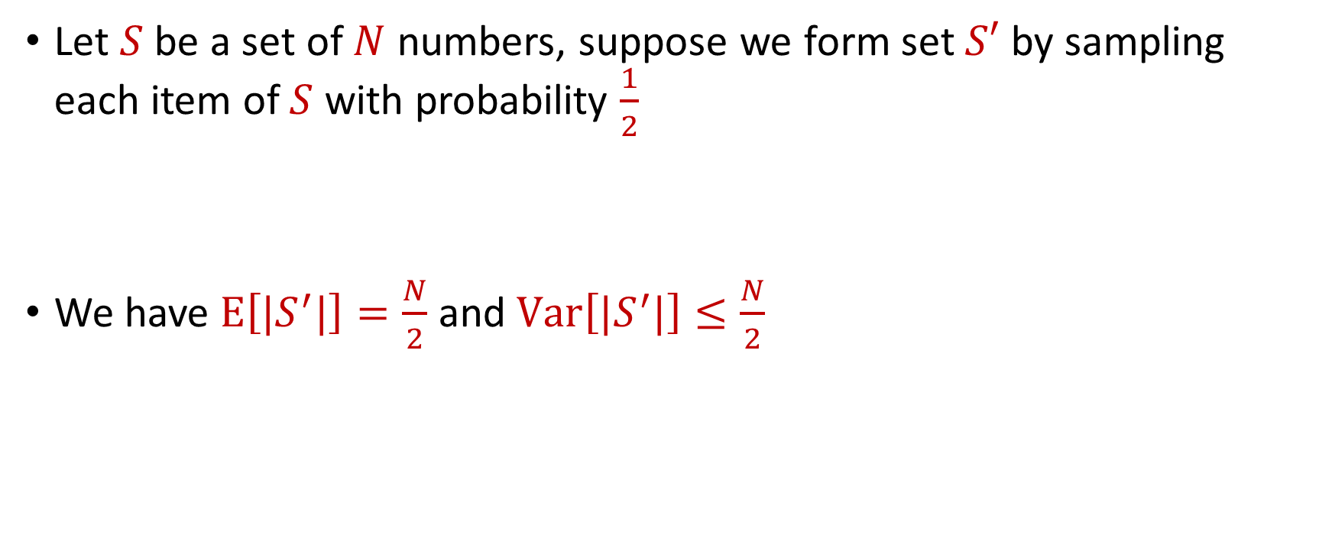
Distinct Elements ($F_{0}$ Estimation)
Let $S$ be a set of $N$ numbers, suppose we form set $S′$ by sampling each item of $S$ with probability $\frac{1}{2}$
We have $E\left[|S^{′}|\right]=\frac{N}{2}$ and $Var\left[|S^{′}|\right]≤\frac{N}{2}$

Slide 35

Distinct Elements ($F_{0}$ Estimation)
What can we say about $Pr\left[\left|\left|S^{′}\right|−\frac{N}{2}\right|≥t\right]$?
By Chebyshev’s inequality, we have $Pr\left[\left|\left|S^{′}\right|−\frac{N}{2}\right|≥100\sqrt{N}\right]≤\frac{1}{10}$

Slide 36
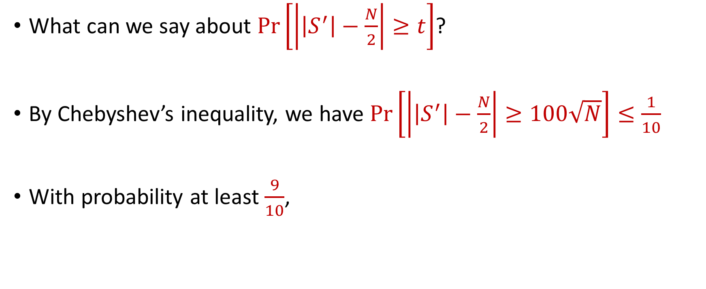
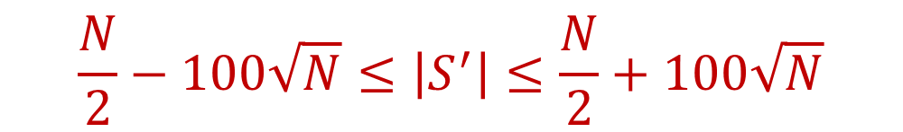
Distinct Elements ($F_{0}$ Estimation)
What can we say about $Pr\left[\left|\left|S^{′}\right|−\frac{N}{2}\right|≥t\right]$?
By Chebyshev’s inequality, we have $Pr\left[\left|\left|S^{′}\right|−\frac{N}{2}\right|≥100\sqrt{N}\right]≤\frac{1}{10}$
With probability at least $\frac{9}{10}$,
$$\frac{N}{2}−100\sqrt{N}≤\left|S^{′}\right|≤\frac{N}{2}+100\sqrt{N}$$

Slide 37

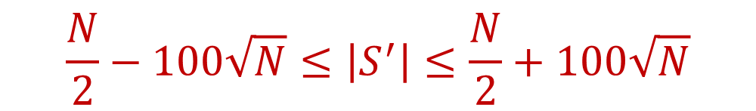
Distinct Elements ($F_{0}$ Estimation)
With probability at least $\frac{9}{10}$,
Thus with probability at least $\frac{9}{10}$,
$$\frac{N}{2}−100\sqrt{N}≤\left|S^{′}\right|≤\frac{N}{2}+100\sqrt{N}$$
$$N−200\sqrt{N}≤2\left|S^{′}\right|≤N+200\sqrt{N}$$

Slide 38

Distinct Elements ($F_{0}$ Estimation)
With probability at least $\frac{9}{10}$,
If $200\sqrt{N}≤\frac{N}{100}$, then $N−200\sqrt{N}≤2\left|S^{′}\right|≤N+200\sqrt{N}$ implies
Very good approximation to $N$
$$N−200\sqrt{N}≤2\left|S^{′}\right|≤N+200\sqrt{N}$$
$$0.99N≤2\left|S^{′}\right|≤1.01N$$

Slide 39
Distinct Elements ($F_{0}$ Estimation)
What algorithm does this suggest?

Slide 40
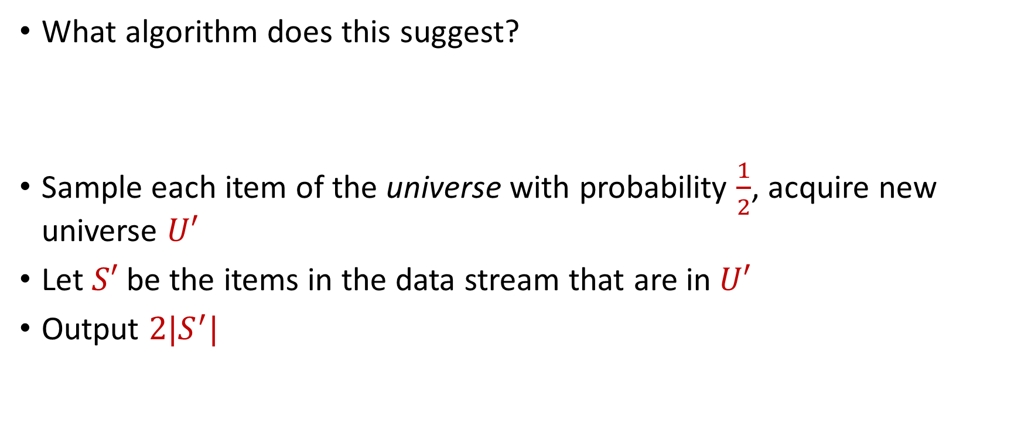
Distinct Elements ($F_{0}$ Estimation)
What algorithm does this suggest?
Sample each item of the universe with probability $\frac{1}{2}$, acquire new universe $U′$
Let $S′$ be the items in the data stream that are in $U′$
Output $2|S^{′}|$

Slide 41
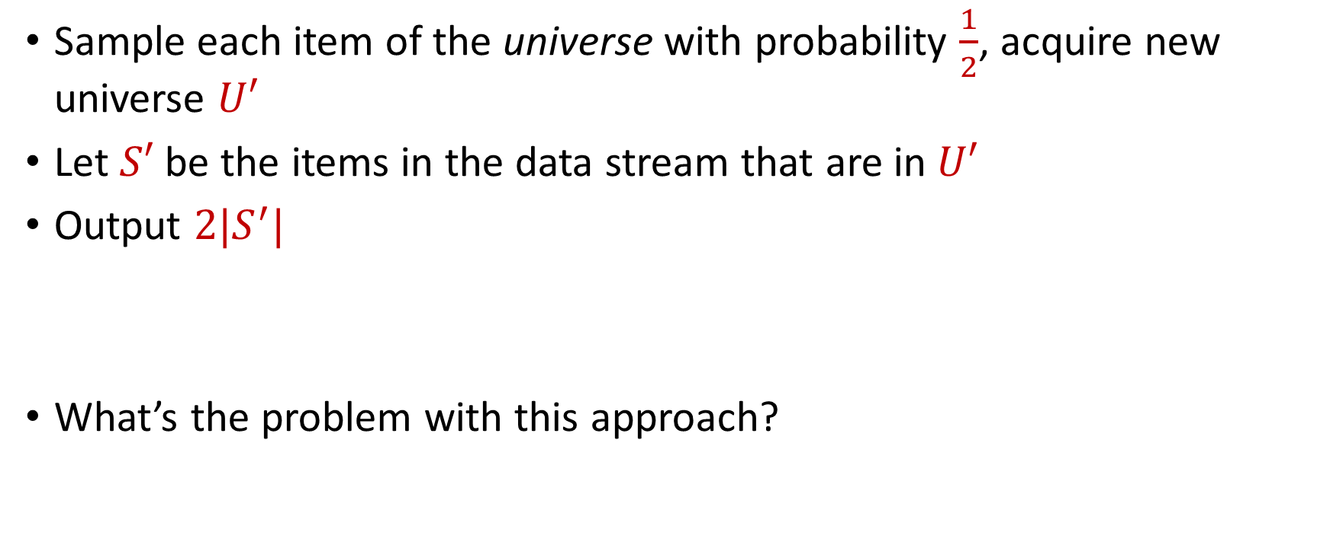
Distinct Elements ($F_{0}$ Estimation)
Sample each item of the universe with probability $\frac{1}{2}$, acquire new universe $U′$
Let $S′$ be the items in the data stream that are in $U′$
Output $2|S^{′}|$
What’s the problem with this approach?

Slide 42
Distinct Elements ($F_{0}$ Estimation)
Let $S$ be a set of $N$ numbers
Suppose we form set $S′$ by sampling each item of $S$ with probability $\frac{1}{2}$
Can we use $S′$ to get a good estimate of $N$?

Slide 43
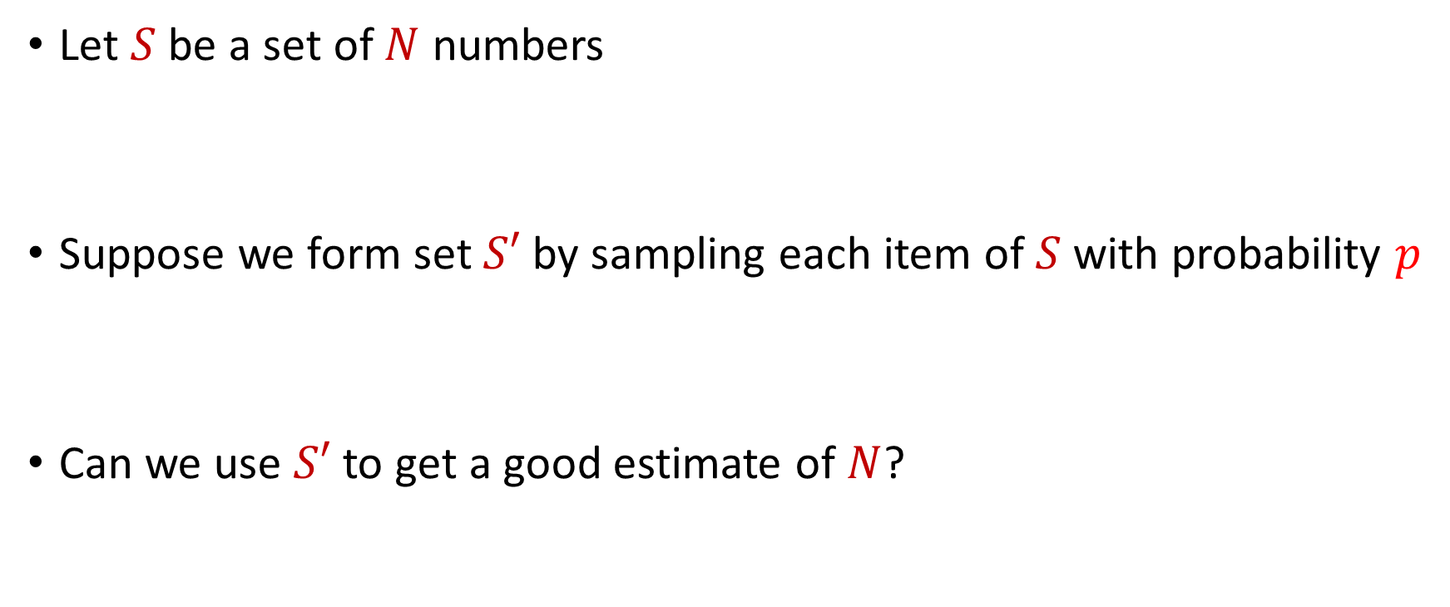
Distinct Elements ($F_{0}$ Estimation)
Let $S$ be a set of $N$ numbers
Suppose we form set $S′$ by sampling each item of $S$ with probability $p$
Can we use $S′$ to get a good estimate of $N$?

Slide 44
Distinct Elements ($F_{0}$ Estimation)
Let $S$ be a set of $N$ numbers, suppose we form set $S′$ by sampling each item of $S$ with probability $\frac{1}{2}$
We have $E\left[|S^{′}|\right]=\frac{N}{2}$ and $Var\left[|S^{′}|\right]≤\frac{N}{2}$

Slide 45
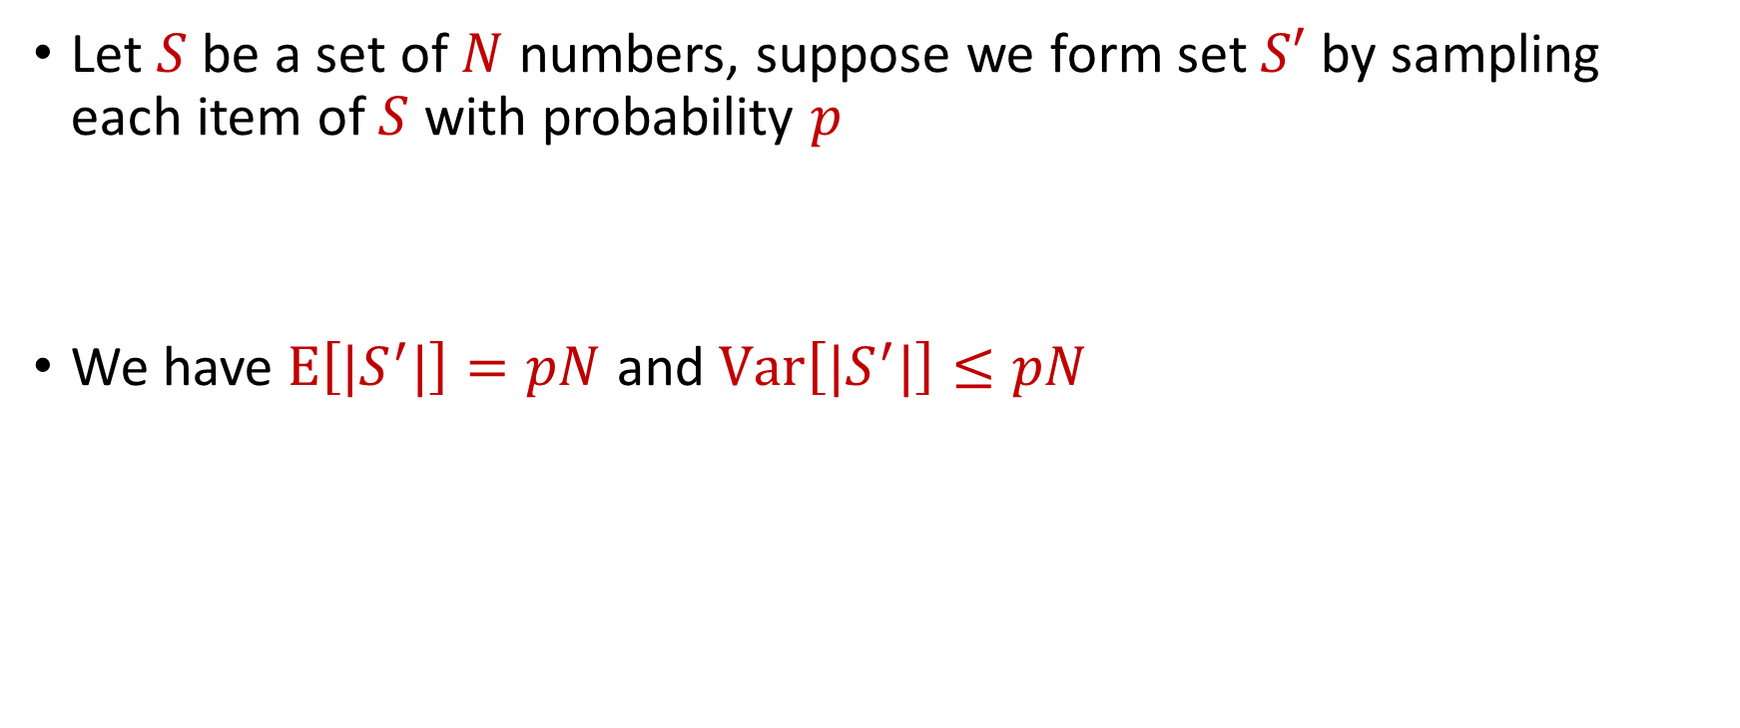
Distinct Elements ($F_{0}$ Estimation)
Let $S$ be a set of $N$ numbers, suppose we form set $S′$ by sampling each item of $S$ with probability $p$
We have $E\left[|S^{′}|\right]=pN$ and $Var\left[|S^{′}|\right]≤pN$

Slide 46

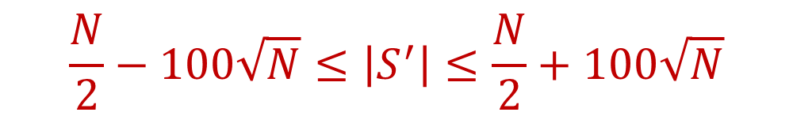
Distinct Elements ($F_{0}$ Estimation)
($S′$ is formed by sampling each item of $S$ with probability $\frac{1}{2}$ ) With probability at least $\frac{9}{10}$,
Thus with probability at least $\frac{9}{10}$,
$$\frac{N}{2}−100\sqrt{N}≤\left|S^{′}\right|≤\frac{N}{2}+100\sqrt{N}$$
$$N−200\sqrt{N}≤2\left|S^{′}\right|≤N+200\sqrt{N}$$

Slide 47

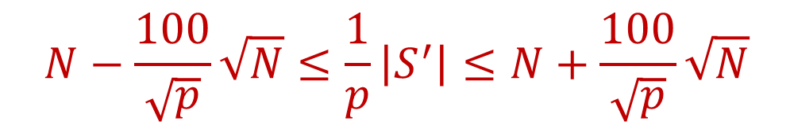
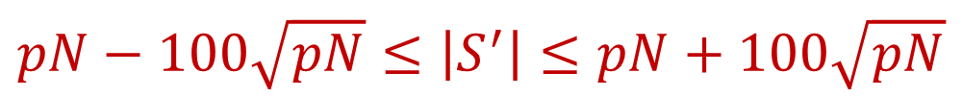
Distinct Elements ($F_{0}$ Estimation)
($S′$ is formed by sampling each item of $S$ with probability $p$) With probability at least $\frac{9}{10}$,
Thus with probability at least $\frac{9}{10}$,
$$pN−100\sqrt{pN}≤\left|S^{′}\right|≤pN+100\sqrt{pN}$$
$$N−\frac{100}{\sqrt{p}}\sqrt{N}≤\frac{1}{p}\left|S^{′}\right|≤N+\frac{100}{\sqrt{p}}\sqrt{N}$$

Slide 48
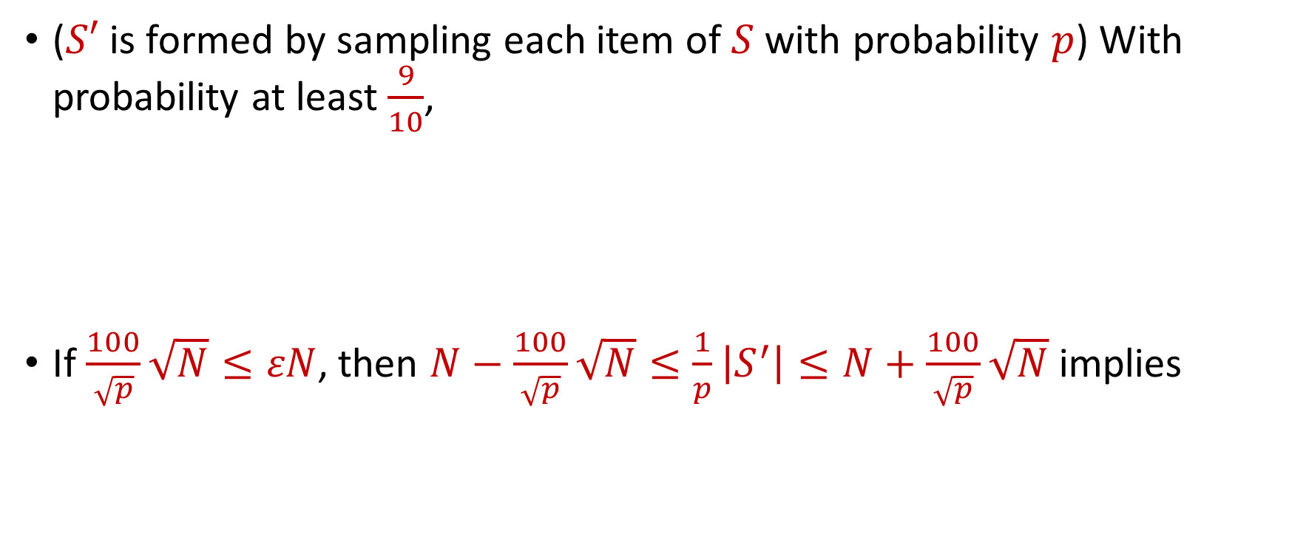

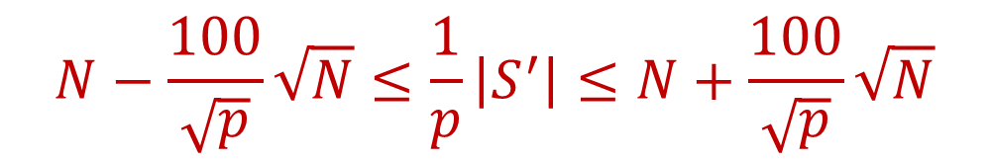
Distinct Elements ($F_{0}$ Estimation)
($S′$ is formed by sampling each item of $S$ with probability $p$) With probability at least $\frac{9}{10}$,
If $\frac{100}{\sqrt{p}}\sqrt{N}≤εN$, then $N−\frac{100}{\sqrt{p}}\sqrt{N}≤\frac{1}{p}\left|S^{′}\right|≤N+\frac{100}{\sqrt{p}}\sqrt{N}$ implies
$$N−\frac{100}{\sqrt{p}}\sqrt{N}≤\frac{1}{p}\left|S^{′}\right|≤N+\frac{100}{\sqrt{p}}\sqrt{N}$$
$$\left(1−ε\right)N≤\frac{1}{p}\left|S^{′}\right|≤\left(1+ε\right)N$$

Slide 49

Distinct Elements ($F_{0}$ Estimation)
In other words, with probability at least $\frac{9}{10}$, we have that $\frac{1}{p}\left|S^{′}\right|$ is a $\left(1+ε\right)$-approximation of $N$
What is $p$?

Slide 50
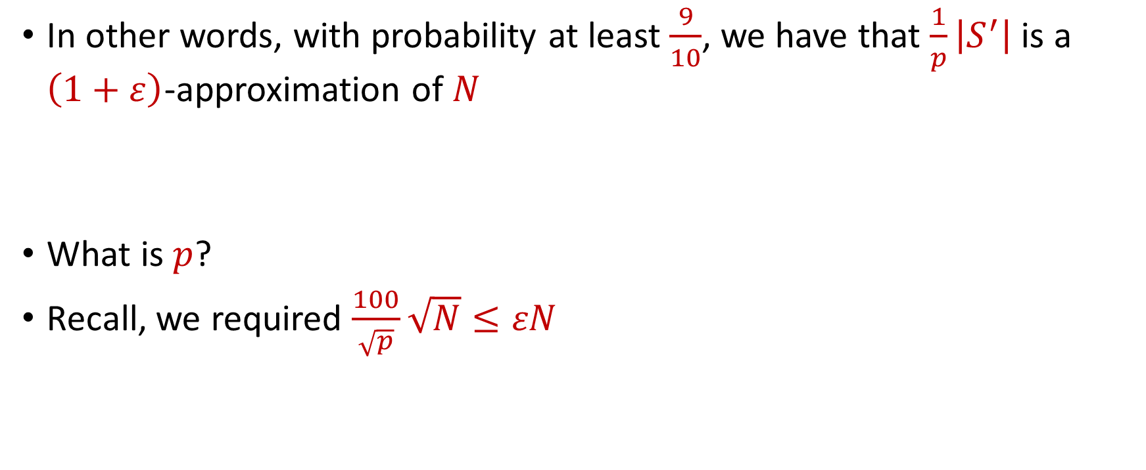
Distinct Elements ($F_{0}$ Estimation)
In other words, with probability at least $\frac{9}{10}$, we have that $\frac{1}{p}\left|S^{′}\right|$ is a $\left(1+ε\right)$-approximation of $N$
What is $p$?
Recall, we required $\frac{100}{\sqrt{p}}\sqrt{N}≤εN$

Slide 51
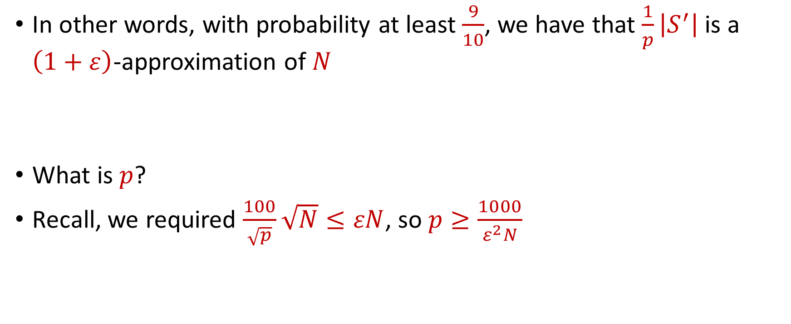
Distinct Elements ($F_{0}$ Estimation)
In other words, with probability at least $\frac{9}{10}$, we have that $\frac{1}{p}\left|S^{′}\right|$ is a $\left(1+ε\right)$-approximation of $N$
What is $p$?
Recall, we required $\frac{100}{\sqrt{p}}\sqrt{N}≤εN$, so $p≥\frac{1000}{ε^{2}N}$

Slide 52
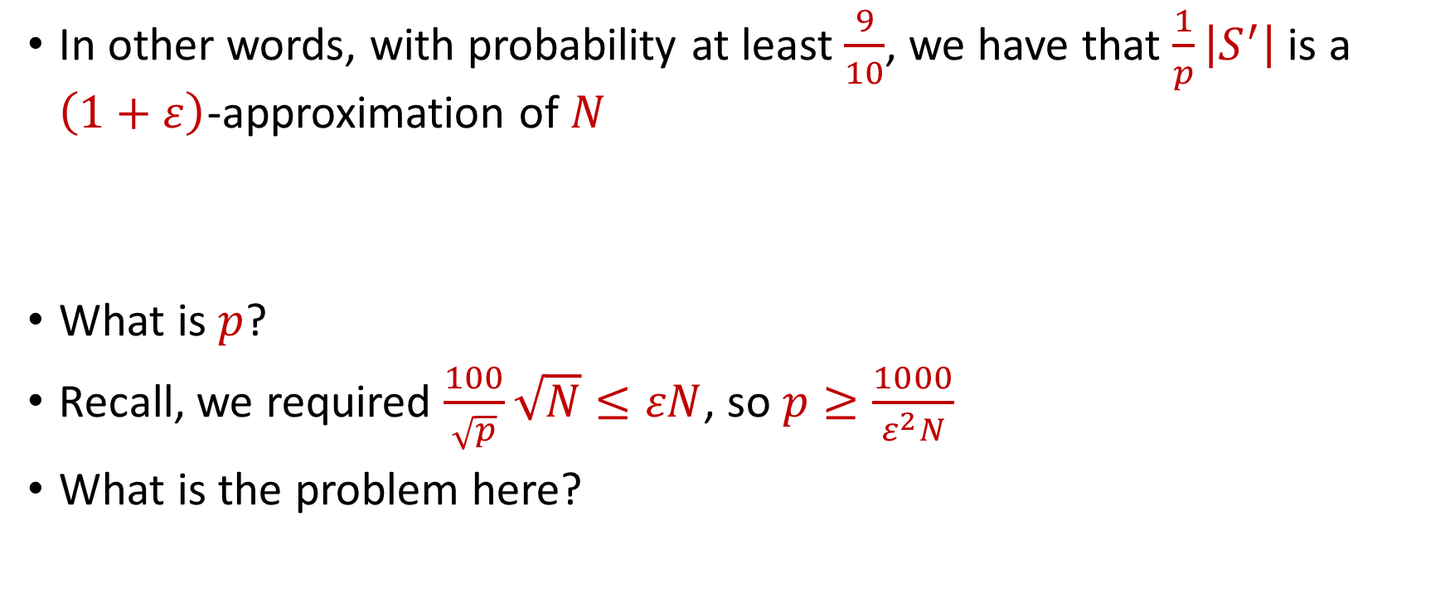
Distinct Elements ($F_{0}$ Estimation)
In other words, with probability at least $\frac{9}{10}$, we have that $\frac{1}{p}\left|S^{′}\right|$ is a $\left(1+ε\right)$-approximation of $N$
What is $p$?
Recall, we required $\frac{100}{\sqrt{p}}\sqrt{N}≤εN$, so $p≥\frac{1000}{ε^{2}N}$
What is the problem here?

Slide 53

Distinct Elements ($F_{0}$ Estimation)
In other words, with probability at least $\frac{9}{10}$, we have that $\frac{1}{p}\left|S^{′}\right|$ is a $\left(1+ε\right)$-approximation of $N$
What is $p$?
Recall, we required $\frac{100}{\sqrt{p}}\sqrt{N}≤εN$, so $p≥\frac{1000}{ε^{2}N}$
What is the problem here?
Must know $N$ to set $p$,
but the goal is to find $N$!

Slide 54

Distinct Elements ($F_{0}$ Estimation)
Observation: We do not need $p=\frac{1000}{ε^{2}N}$, it is also fine to have $p=\frac{2000}{ε^{2}N}$
How do we find a “good” $p$?

Slide 55


Finding $p$
Observation: We do not need $p=\frac{1000}{ε^{2}N}$, it is also fine to have $p=\frac{2000}{ε^{2}N}$
How do we find a “good” $p$?
What is a “good” $p$?

Slide 56
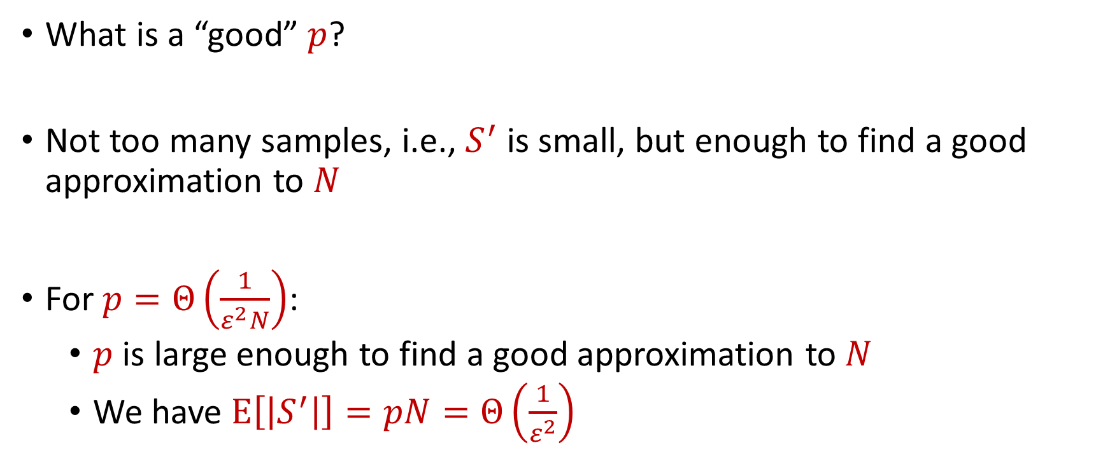
Finding $p$
What is a “good” $p$?
Not too many samples, i.e., $S^{′}$ is small, but enough to find a good approximation to $N$
For $p=Θ\left(\frac{1}{ε^{2}N}\right)$:
$p$ is large enough to find a good approximation to $N$
We have $E\left[\left|S^{′}\right|\right]=pN=Θ\left(\frac{1}{ε^{2}}\right)$

Slide 57
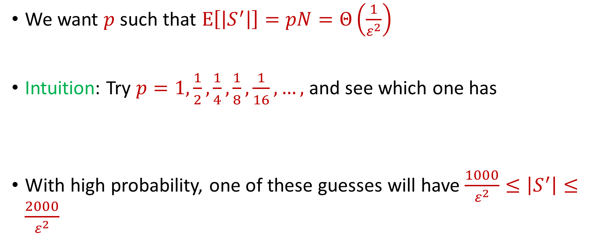

Finding $p$
We want $p$ such that $E\left[\left|S^{′}\right|\right]=pN=Θ\left(\frac{1}{ε^{2}}\right)$
Intuition: Try $p=1,\frac{1}{2},\frac{1}{4},\frac{1}{8},\frac{1}{16},…,$ and see which one has
With high probability, one of these guesses will have $\frac{1000}{ε^{2}}≤\left|S^{′}\right|≤\frac{2000}{ε^{2}}$
$$\frac{1000}{ε^{2}}≤\left|S^{′}\right|≤\frac{2000}{ε^{2}}$$

Slide 58


Finding $p$
Intuition: Try $p=1,\frac{1}{2},\frac{1}{4},\frac{1}{8},\frac{1}{16},…,$ and see which one has
However, the wrong guesses will have too many samples
$$\frac{1000}{ε^{2}}≤\left|S^{′}\right|≤\frac{2000}{ε^{2}}$$

Slide 59
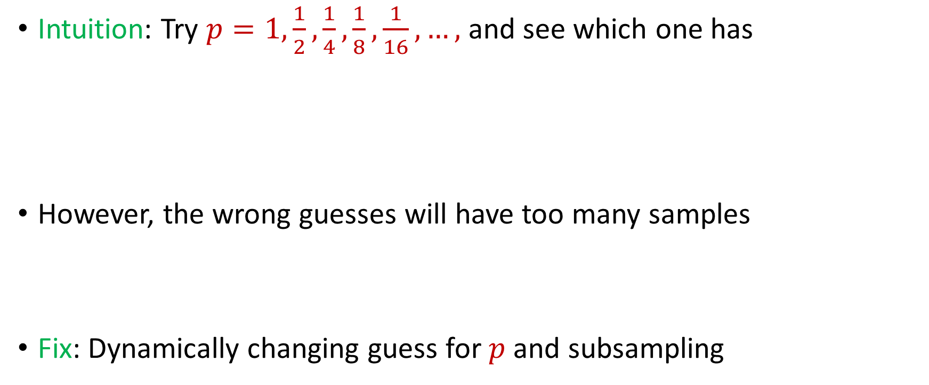
Finding $p$
Intuition: Try $p=1,\frac{1}{2},\frac{1}{4},\frac{1}{8},\frac{1}{16},…,$ and see which one has
However, the wrong guesses will have too many samples
Fix: Dynamically changing guess for $p$ and subsampling
$$\frac{1000}{ε^{2}}≤\left|S^{′}\right|≤\frac{2000}{ε^{2}}$$

Slide 60
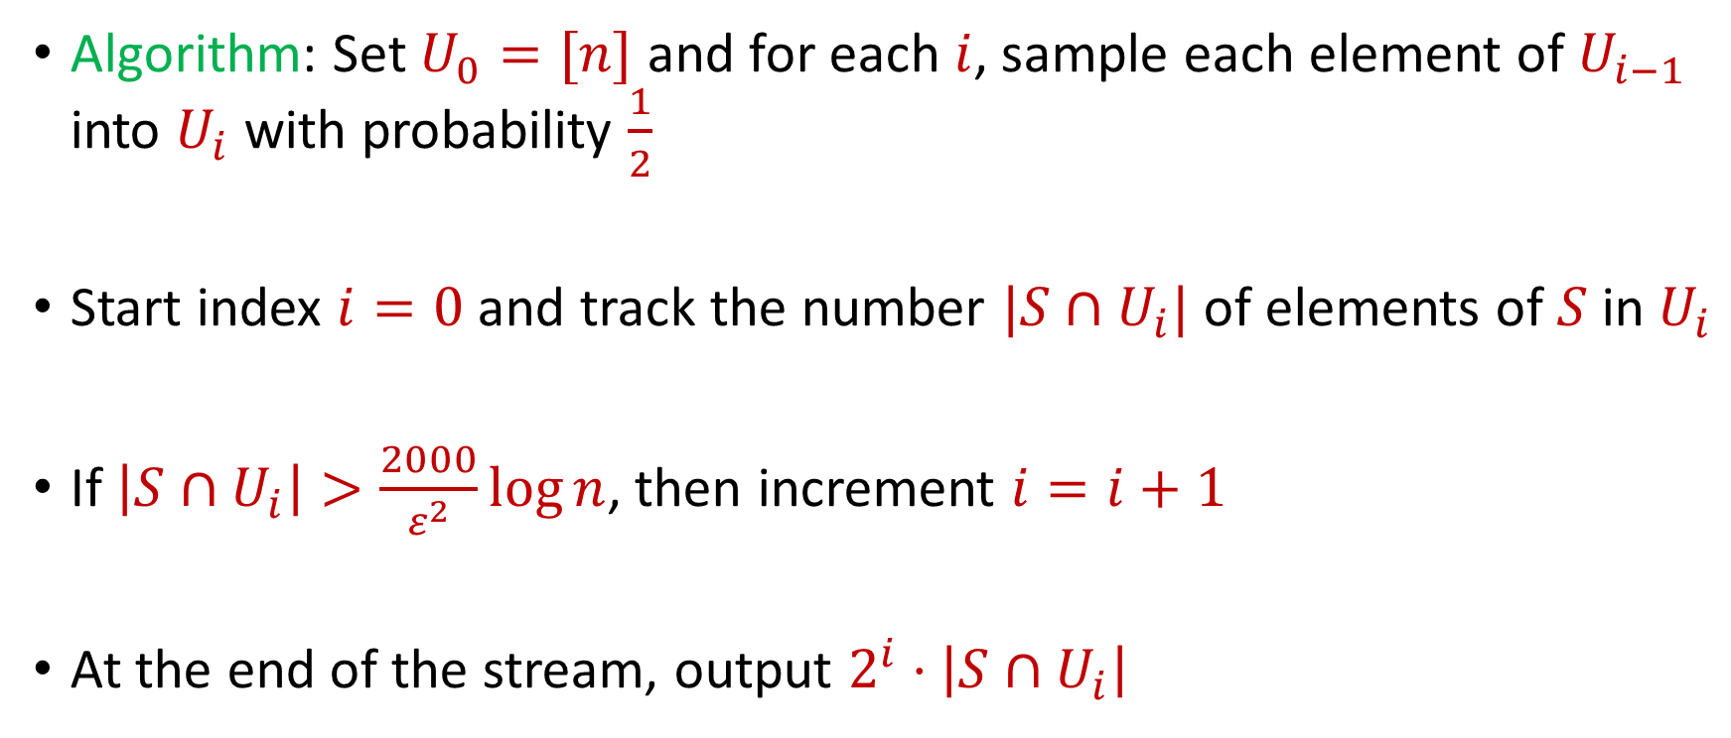
Finding $p$
Algorithm: Set $U_{0}=[n]$ and for each $i$, sample each element of $U_{i−1}$ into $U_{i}$ with probability $\frac{1}{2}$
Start index $i=0$ and track the number $|S∩U_{i}|$ of elements of $S$ in $U_{i}$
If $\left|S∩U_{i}\right|>\frac{2000}{ε^{2}}\log{n}$, then increment $i=i+1$
At the end of the stream, output $2^{i}⋅\left|S∩U_{i}\right|$

Slide 61


Finding $p$
Algorithm: Set $U_{0}=[n]$ and for each $i$, sample each element of $U_{i−1}$ into $U_{i}$ with probability $\frac{1}{2}$
Start index $i=0$ and track the number $|S∩U_{i}|$ of elements of $S$ in $U_{i}$
If $\left|S∩U_{i}\right|>\frac{2000}{ε^{2}}\log{n}$, then increment $i=i+1$
At the end of the stream, output $2^{i}⋅\left|S∩U_{i}\right|$
$$\frac{1}{p}$$
$\left|S^{′}\right|$

Slide 62

Finding $p$
Recall that $\frac{1}{p}\left|S^{′}\right|$ is a $\left(1+ε\right)$-approximation of $N$
$2^{i}⋅\left|S∩U_{i}\right|$ is a $\left(1+ε\right)$-approximation of $N$
At the end of the stream, output $2^{i}⋅\left|S∩U_{i}\right|$
$$\frac{1}{p}$$
$\left|S^{′}\right|$

Slide 63

Distinct Elements ($F_{0}$ Estimation)
Summary: Algorithm stores at most $\frac{2000}{ε^{2}}\log{n}$ elements from the stream, uses $Θ\left(\frac{1}{ε^{2}}\log{n}\right)$ words of space

Slide 64
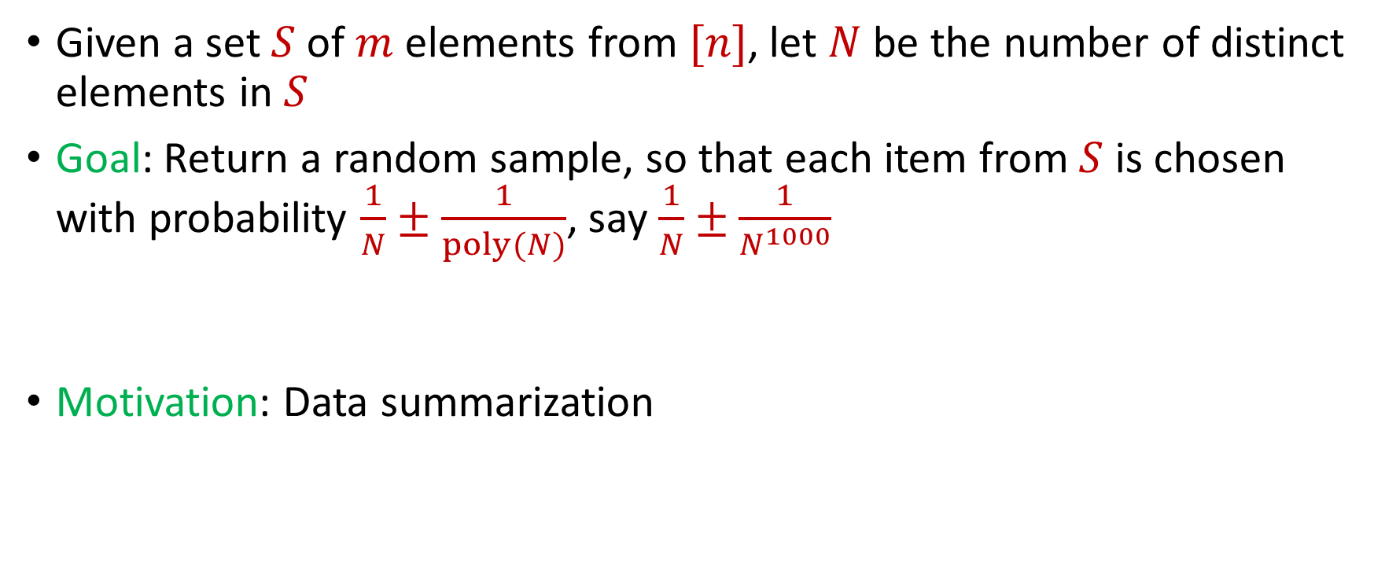

$L_{0}$ Sampling
Given a set $S$ of $m$ elements from $[n]$, let $N$ be the number of distinct elements in $S$
Goal: Return a random sample, so that each item from $S$ is chosen with probability $\frac{1}{N}±\frac{1}{poly(N)}$, say $\frac{1}{N}±\frac{1}{N^{1000}}$
Motivation: Data summarization

Slide 65
$L_{0}$ Sampling
Remember reservoir sampling? Does that work?

Slide 66
$L_{0}$ Sampling
Remember reservoir sampling? Does that work? NO!
1 2 2 2 2 2 2 2 2 2 2 2 2 2 2 2 2 2 2 2 2

Slide 67

$L_{0}$ Sampling
Algorithm: Modify $F_{0}$ estimation algorithm

Slide 68
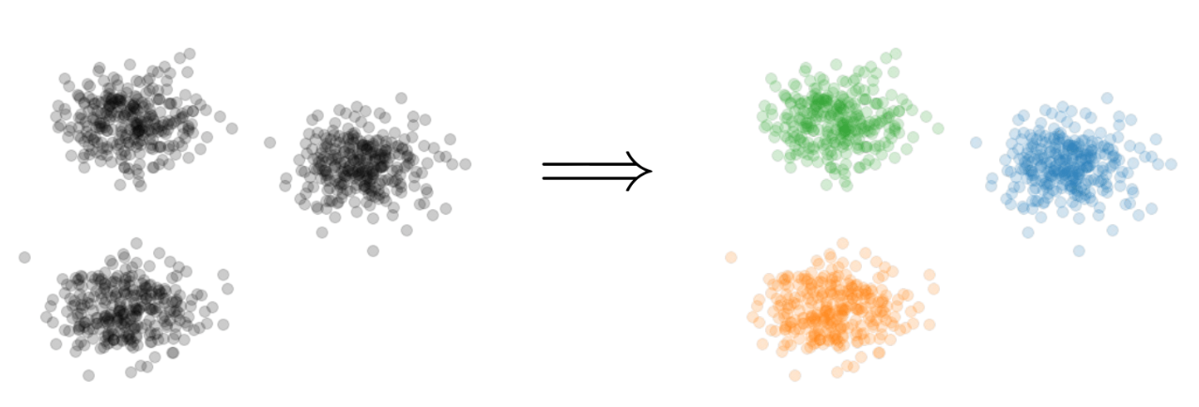

Clustering
Goal: Given input dataset $P$, partition $P$ so that “similar” points are in the same cluster and “different” points are in different clusters

Slide 69
Clustering
Question: How do we measure the “quality” of each clustering?

Slide 72





1 0 3 0 1 1
1 1 0 0 2 8
2 0 1 3 0 8
1 1 0 0 0 8
0 0 0 7 0 0
7 0 0 8 0 0
3 4 1 1 0 2
4 2 0 1 0 1
9 1 0 0 3 2
1 1 6 0 0 0
8 1 0 1 2 0
1
1
2
1
0
7
3
4
9
1
8
$$n$$
$$A$$
$$b$$
$$d$$
$$1$$

Slide 73




$$x$$
$$n$$
$$A$$
$$≈$$
$$b$$
$$d$$
$$1$$

Slide 74




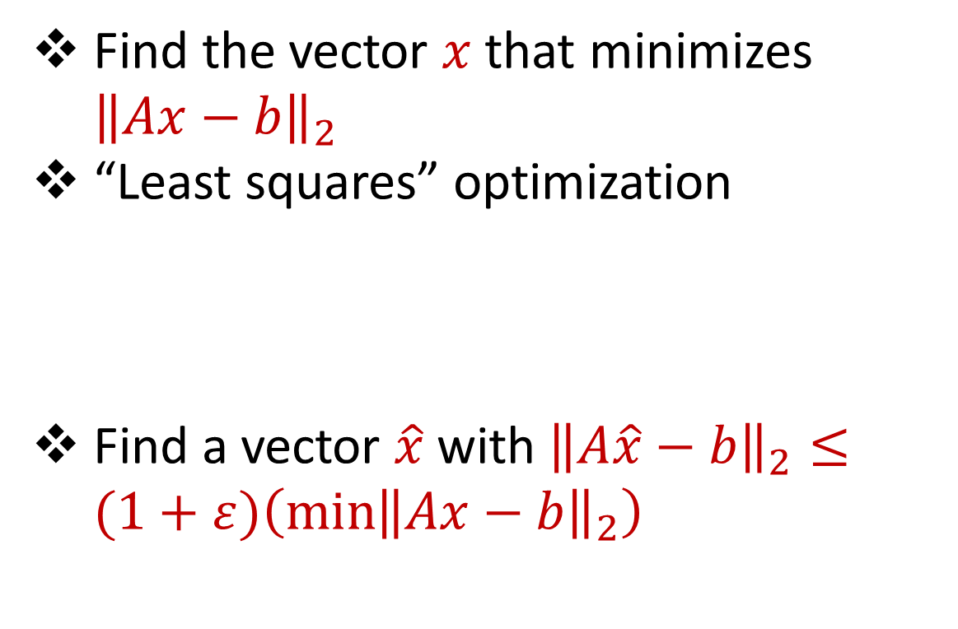






Linear Regression
Find the vector $x$ that minimizes ${\left\|Ax−b\right\|}_{2}$
“Least squares” optimization
Find a vector $\hat{x}$ with ${\left\|A\hat{x}−b\right\|}_{2}≤(1+ε)\left(\min{{\left\|Ax−b\right\|}_{2}}\right)$
$$d$$
$$x$$
$$≈$$
$$n$$
$$A$$
$$n$$
$$b$$
$$1$$
$$d$$
$$1$$

Slide 75




Dimensionality Reduction
Reduce $d$
Reduce $n$
Application depends on task!
Sampling, Sketching, Johnson-Lindenstrauss, IsoMap
$$n$$
$$A$$
Sampling, Sketching
$$d$$

Slide 76


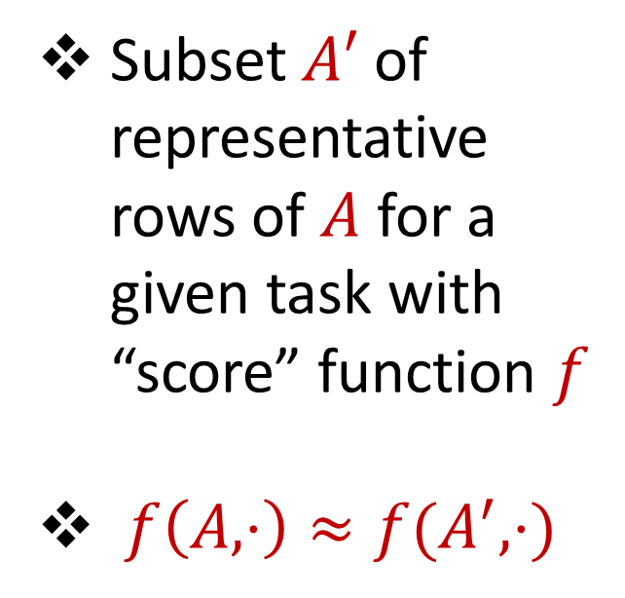



Coreset
Subset $A′$ of representative rows of $A$ for a given task with “score” function $f$
$f\left(A,⋅\right)≈f(A^{′},⋅)$
$$n$$
$$A$$
$$A′$$
$$d$$
$$d$$

Slide 77
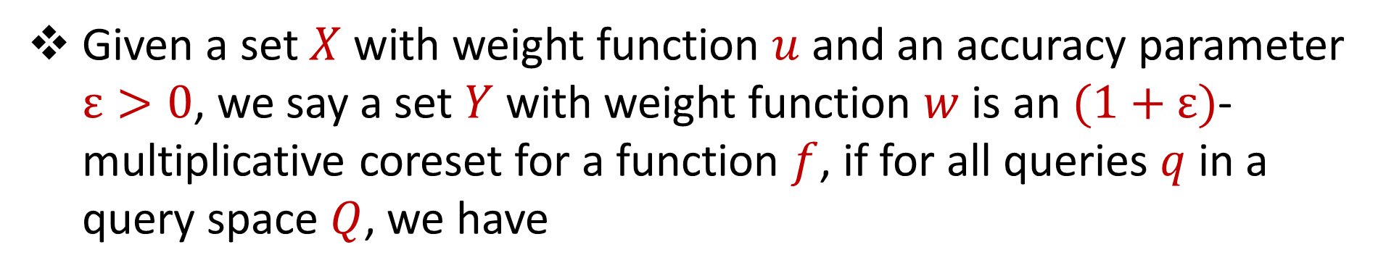
Coreset (Formal Definition)
Given a set $X$ with weight function $u$ and an accuracy parameter $ε>0$, we say a set $Y$ with weight function $w$is an $(1+ε)$-multiplicative coreset for a function $f$, if for all queries $q$ in a query space $Q$, we have
$$\left(1−ε\right)f\left(Y,q,w\right)≤f\left(X,q,u\right)≤\left(1+ε\right)f(Y,q,w)$$

Slide 78
Coreset
Lots of different constructions with various tradeoffs
Size vs. accuracy
Size vs. computation time
Size vs. interpretability
Average-case vs. worst-case performance

Slide 79
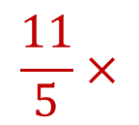

Uniform Sampling
1 0 3 0 1 1
1 1 0 0 2 8
2 0 1 3 0 8
1 1 0 0 0 8
0 0 0 7 0 0
7 0 0 8 0 0
3 4 1 1 0 2
4 2 0 1 0 1
9 1 0 0 3 2
1 1 6 0 0 0
8 1 0 1 2 0
Repeat $m$ times:
Pick a row $A_{i}$ of $A$ uniformly at random and scale by $n/m$
Example with $n=11$ and $m=5$
$$n$$
$$A$$
1 0 3 0 1 1
1 1 0 0 0 8
3 4 1 1 0 2
8 1 0 1 2 0
3 4 1 1 0 2
$$\frac{11}{5}×$$
$$A′$$
$$d$$
$$d$$

Slide 80




Uniform Sampling
1 0 0 0 0 0
1 0 0 0 0 0
1 0 0 0 0 0
1 0 0 0 0 0
1 0 0 0 0 0
1 0 0 0 0 0
1 0 0 0 0 0
1 0 0 0 0 0
1 0 0 0 0 0
1 0 0 0 0 0
1 0 0 0 0 0
How big should $m$ be?
For uniform matrix, it suffices to set $m=1$
$$n$$
$$A$$
$$d$$

Slide 81
Uniform Sampling
1 0 0 0 0 0
1 0 0 0 0 0
1 0 0 0 0 0
1 0 0 0 0 0
1 0 0 0 0 0
1 0 0 0 0 0
1 0 0 0 0 0
1 0 0 0 0 0
1 0 0 0 0 0
1 0 0 0 0 0
1 0 0 0 0 0
How big should $m$ be?
For uniform matrix, it suffices to set $m=1$
$$n$$
$$A$$
1 0 0 0 0 0
1 0 0 0 0 0
1 0 0 0 0 0
1 0 0 0 0 0
1 0 0 0 0 0
$$\frac{11}{5}×$$
$$A′$$
$$d$$
$$d$$

Slide 82

Uniform Sampling
0 0 0 0 0 1
1 0 0 0 0 0
1 0 0 0 0 0
1 0 0 0 0 0
1 0 0 0 0 0
1 0 0 0 0 0
1 0 0 0 0 0
1 0 0 0 0 0
1 0 0 0 0 0
1 0 0 0 0 0
1 0 0 0 0 0
How big should $m$ be?
What is the probability the first row of $A$ is sampled?
Need $m=O(n\log{n})$ rows
$$n$$
$$A$$
$$d$$

Slide 83
Uniform Sampling
Pros: intuitively simple, simple to implement, fast, good on uniform or “average-case” data
Cons: bad on “worst-case” data

Slide 84
Importance Sampling
1 0 0 0 0 0
1 0 0 0 0 0
1 0 0 0 0 0
1 0 0 0 0 0
1 0 0 0 0 0
1 0 0 0 0 0
0 0 0 0 0 1
1 0 0 0 0 0
1 0 0 0 0 0
1 0 0 0 0 0
1 0 0 0 0 0
What if we do not sample uniformly at random?
What is the probability that each row should be sampled?
$$n$$
$$A$$

Slide 85

Importance Sampling
1 0 0 0 0 0
1 0 0 0 0 0
1 0 0 0 0 0
1 0 0 0 0 0
1 0 0 0 0 0
1 0 0 0 0 0
0 0 0 0 0 1
1 0 0 0 0 0
1 0 0 0 0 0
1 0 0 0 0 0
1 0 0 0 0 0
Have a measure $s_{i}$ of “importance” for each row $A_{i}$
$$n$$
$$A$$

Slide 86





Importance Sampling
1 0 0 0 0 0
1 0 0 0 0 0
1 0 0 0 0 0
1 0 0 0 0 0
1 0 0 0 0 0
1 0 0 0 0 0
0 0 0 0 0 1
1 0 0 0 0 0
1 0 0 0 0 0
1 0 0 0 0 0
1 0 0 0 0 0
Have a measure $s_{i}$ of “importance” for each row $A_{i}$
If there were just two different rows, each row should be “maximally” important, $s_{1}=s_{2}=1$
$$n$$
$$A$$
1 0 0 0 0 0
0 0 0 0 0 1
$$n$$
$$A$$

Slide 87

Importance Sampling
1 0 0 0 0 0
1 0 0 0 0 0
1 0 0 0 0 0
1 0 0 0 0 0
1 0 0 0 0 0
1 0 0 0 0 0
0 0 0 0 0 1
1 0 0 0 0 0
1 0 0 0 0 0
1 0 0 0 0 0
1 0 0 0 0 0
Have a measure $s_{i}$ of “importance” for each row $A_{i}$
Say $s_{7}=1$ and $s_{i}=\frac{1}{10}$ for $i≠7$
$$n$$
$$A$$

Slide 88

Importance Sampling
1 0 0 0 0 0
1 0 0 0 0 0
1 0 0 0 0 0
1 0 0 0 0 0
1 0 0 0 0 0
1 0 0 0 0 0
0 0 0 0 0 1
1 0 0 0 0 0
1 0 0 0 0 0
1 0 0 0 0 0
1 0 0 0 0 0
Say $s_{7}=1$ and $s_{i}=\frac{1}{10}$ for $i≠7$
What is the probability that each row should be sampled?
Proportional to importance!
Say $p_{7}=\frac{1}{2}$ and $p_{i}=\frac{1}{20}$ for $i≠7$
$$n$$
$$A$$

Slide 89

Importance Sampling
1 0 0 0 0 0
1 0 0 0 0 0
1 0 0 0 0 0
1 0 0 0 0 0
1 0 0 0 0 0
1 0 0 0 0 0
0 0 0 0 0 1
1 0 0 0 0 0
1 0 0 0 0 0
1 0 0 0 0 0
1 0 0 0 0 0
Have a measure $s_{i}$ of “importance” for each row $A_{i}$
Say $p_{7}=\frac{1}{2}$ and $p_{i}=\frac{1}{20}$ for $i≠7$
$$n$$
$$A$$

Slide 90



Importance Sampling
1 0 0 0 0 0
1 0 0 0 0 0
1 0 0 0 0 0
1 0 0 0 0 0
1 0 0 0 0 0
1 0 0 0 0 0
0 0 0 0 0 1
1 0 0 0 0 0
1 0 0 0 0 0
1 0 0 0 0 0
1 0 0 0 0 0
Repeat $m$ times:
Pick a row $A_{i}$ of $A$ with probability $p_{i}$and scale by $\frac{1}{mp_{i}}$
Example with $n=11$ and $m=5$
$$n$$
$$A$$
4 0 0 0 0 0
4 0 0 0 0 0
0 0 0 0 0 $\frac{2}{5}$
4 0 0 0 0 0
0 0 0 0 0 $\frac{2}{5}$
$$A′$$
$$d$$
$$d$$

Slide 91

Importance Sampling
0 0 0 0 0 1
1 0 0 0 0 0
1 0 0 0 0 0
1 0 0 0 0 0
1 0 0 0 0 0
1 0 0 0 0 0
1 0 0 0 0 0
1 0 0 0 0 0
1 0 0 0 0 0
1 0 0 0 0 0
1 0 0 0 0 0
How big should $m$ be?
Have a measure $s_{i}$ of “importance” for each row $A_{i}$
Need $m=O(T\log{n})$ rows, where $T=\sum{s_{i}}$
$$n$$
$$A$$
$$d$$

Slide 92

Sensitivity Sampling
Terminology: $s_{i}$ is called the sensitivity of the row $A_{i}$
$T=\sum{s_{i}}$ is called the total sensitivity of $A$
Need $m=O(T\log{n})$ rows, where $T$ can be much smaller than $n$

Slide 93


Sensitivity Sampling (Formal Theorem)
[Feldman, Schmidt, Sohler 2020] Let $C>1$ be a universal constant and for each $i∈[n]$, let $q\left(x_{i}\right)$ be a $C$-approximation to the sensitivity $s\left(x_{i}\right)$for any point $x_{i}$. Let $T=\sum_{i=1}^{n}{q\left(x_{i}\right)}$. Then sensitivity sampling
points with replacement, i.e., choosing each of the $m$ points to be $x_{i}$with probability proportional to $q\left(x_{i}\right)$ and then rescaling by the sampling probability, outputs a $(1+ε)$-coreset for $k$-means clustering with probability $\frac{2}{3}$ .
$$m=O\left(\frac{Tk}{ε^{2}}\log^{2}{k}\right)$$

Slide 94
Sensitivity Sampling
Pros: size is always better than uniform sampling and MUCH better on “worst-case” data
Cons: estimating the sensitivities can be a difficult design choice, computing the total sensitivity can be mathematically challenging, larger runtime

Slide 95
 | Uniform Sampling | Sensitivity Sampling
Average-case size | X | X
Worst-case size |  | X
Ease of implementation Computation of probabilities | X
Interpretability |  | X

Slide 96



Group / Stratified Sampling
0 0 0 0 0 1
1 0 0 0 0 0
1 0 0 0 0 0
1 0 0 0 0 0
1 0 0 0 0 0
1 0 0 0 0 0
1 0 0 0 0 0
1 0 0 0 0 0
1 0 0 0 0 0
1 0 0 0 0 0
1 0 0 0 0 0
Separate the data into “groups” and then perform uniform sampling on each group
If the data is uniform in each group, this is essentially sensitivity sampling
$$n$$
$$A$$
$$d$$

Slide 98
Coresets
Where to apply them?
Which sampling approach to use?
Worst-case mathematical bounds

Slide 99

Coresets
Where to apply them?

Slide 100


Coresets
Which sampling approach to use?

Slide 101

Coresets
Worst-case mathematical bounds

Slide 102


Heavy-Hitters (Frequent Items)
Given a set $S$ of $m$ elements from $[n]$, let $f_{i}$ be the frequency of element $i$. (How often it appears)
Let $L_{2}$ be the norm of the frequency vector:
Goal: Given a set $S$ of $m$ elements from $[n]$ and a threshold $ε$, output the elements $i$ such that $f_{i}>$ $ε L_{2}$...and no elements $j$ such that $f_{j}<$ $\frac{ε}{16} L_{2}$
Motivation: DDoS prevention, iceberg queries
$$L_{2}=\sqrt{f_{1}^{2}+f_{2}^{2}+…+f_{n}^{2}}$$

Slide 103



Frequency Moments ($L_{p}$ Norm)
Given a set $S$ of $m$ elements from $[n]$, let $f_{i}$ be the frequency of element $i$. (How often it appears)
Let $F_{p}$ be the frequency moment of the vector:
Goal: Given a set $S$ of $m$ elements from $[n]$ and an accuracy parameter $ε$, output a $(1+ε)$-approximation to $F_{p}$
Motivation: Entropy estimation, linear regression
$F_{p}=$ $f_{1}^{p}+f_{2}^{p}+…+f_{n}^{p}$

Slide 104

Distinct Elements ($F_{0}$ Estimation)
Given a set $S$ of $m$ elements from $[n]$, let $f_{i}$ be the frequency of element $i$. (How often it appears)
Let $F_{0}$ be the frequency moment of the vector:
Goal: Given a set $S$ of $m$ elements from $[n]$ and an accuracy parameter $ε$, output a $(1+ε)$-approximation to $F_{0}$
Motivation: Traffic monitoring
$F_{0}=$ $|\{i :f_{i}≠0\}|$

