Slide 1
CSCE 658: Randomized Algorithms
Lecture 21
Samson Zhou

Slide 2
Relevant Supplementary Material
Chapter 3-4 of “The Algorithmic Foundations of Differential Privacy”, by Cynthia Dwork and Aaron Roth (https://www.cis.upenn.edu/~aaroth/Papers/privacybook.pdf)

Slide 3




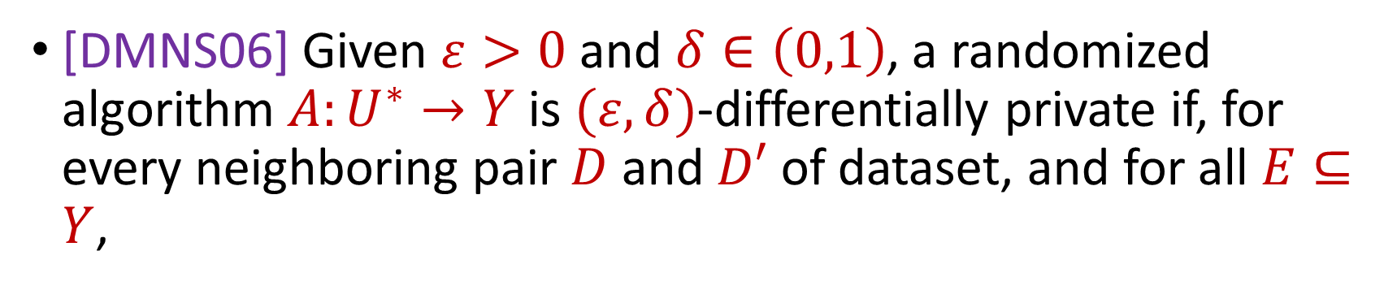

Last Time: Differential Privacy
[DMNS06] Given $ε>0$and $δ∈\left(0,1\right)$, a randomized algorithm $A:U^{∗}→Y$ is $(ε,δ)$-differentially private if, for every neighboring pair $D$ and $D′$ of dataset, and for all $E⊆Y$,
$$Pr\left[A\left(D\right)∈E\right]≤e^{ε}⋅Pr\left[A\left(D^{′}\right)∈E\right]+δ$$
$$A\left( \right)≈A\left( \right)$$
Notes:
[DworkMcSherryNissimSmith06]

Slide 4


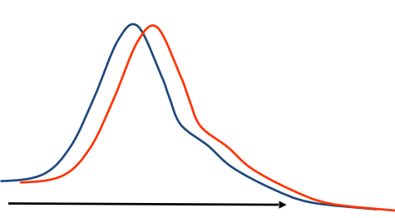
Last Time: Differential Privacy
[DMNS06] Given $ε>0$and $δ∈\left(0,1\right)$, a randomized algorithm $A:U^{∗}→Y$ is $(ε,δ)$-differentially private if, for every neighboring pair $D$ and $D′$ of dataset, and for all $E⊆Y$,
$$Pr\left[A\left(D\right)∈E\right]≤e^{ε}⋅Pr\left[A\left(D^{′}\right)∈E\right]+δ$$
Sensitive dataset
Algorithm
Output distribution
Notes:
[DworkMcSherryNissimSmith06]

Slide 5
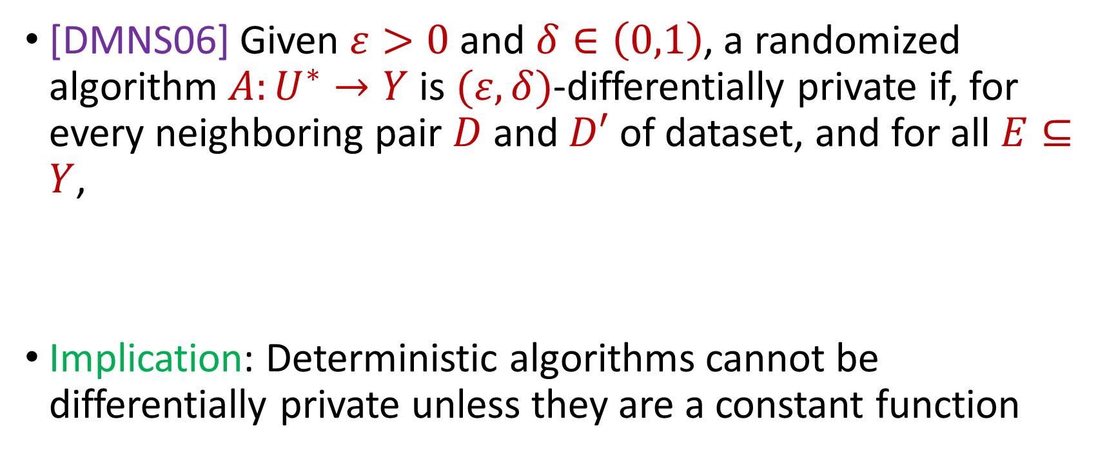
Last Time: Differential Privacy
[DMNS06] Given $ε>0$and $δ∈\left(0,1\right)$, a randomized algorithm $A:U^{∗}→Y$ is $(ε,δ)$-differentially private if, for every neighboring pair $D$ and $D′$ of dataset, and for all $E⊆Y$,
Implication: Deterministic algorithms cannot be differentially private unless they are a constant function
$$Pr\left[A\left(D\right)∈E\right]≤e^{ε}⋅Pr\left[A\left(D^{′}\right)∈E\right]+δ$$
Notes:
[DworkMcSherryNissimSmith06]

Slide 6
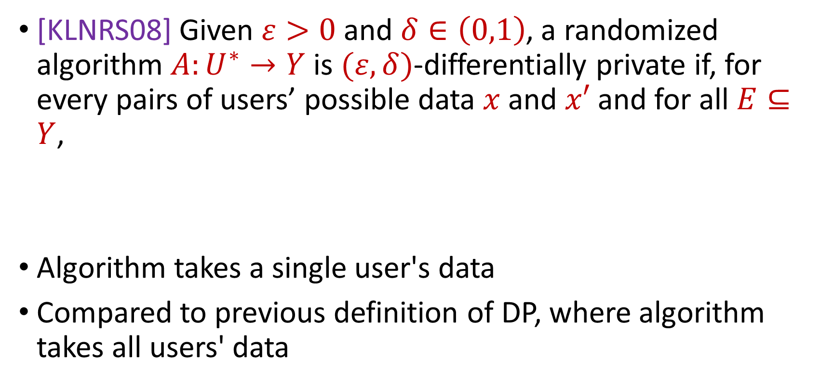
Last Time: Local Differential Privacy (LDP)
[KLNRS08] Given $ε>0$and $δ∈\left(0,1\right)$, a randomized algorithm $A:U^{∗}→Y$ is $(ε,δ)$-differentially private if, for every pairs of users’ possible data $x$ and $x′$ and for all $E⊆Y$,
Algorithm takes a single user's data
Compared to previous definition of DP, where algorithm takes all users' data
$$Pr\left[A\left(x\right)∈E\right]≤e^{ε}⋅Pr\left[A\left(x^{′}\right)∈E\right]+δ$$
Notes:
[DworkMcSherryNissimSmith06]

Slide 7
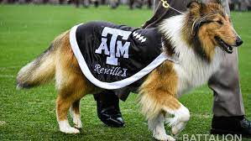
Last Time: Randomized Response, Revisisted
How many people in this class have a pet?
Generate a random integer:
If it is even, answer truthfully
Otherwise, proceed below
Generate another random integer:
If it is even, answer YES
Otherwise if it is odd, answer NO
Notes:
[DworkMcSherryNissimSmith06]

Slide 8
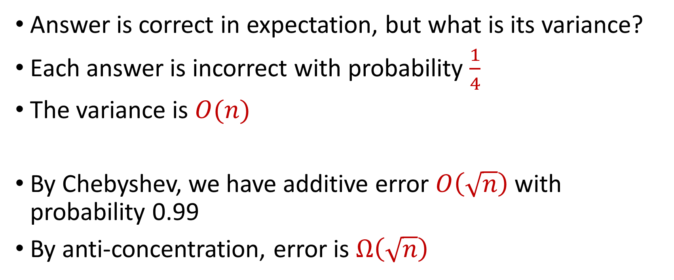
Last Time: Randomized Response, Revisisted
Answer is correct in expectation, but what is its variance?
Each answer is incorrect with probability $\frac{1}{4}$
The variance is $O(n)$
By Chebyshev, we have additive error $O\left(\sqrt{n}\right)$ with probability 0.99
By anti-concentration, error is $Ω\left(\sqrt{n}\right)$
Notes:
[DworkMcSherryNissimSmith06]

Slide 9
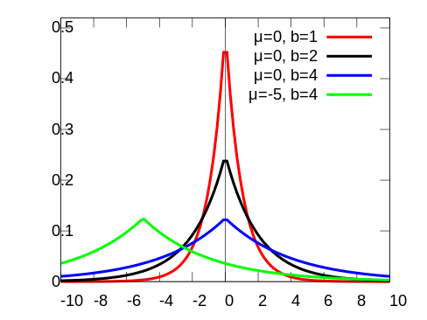
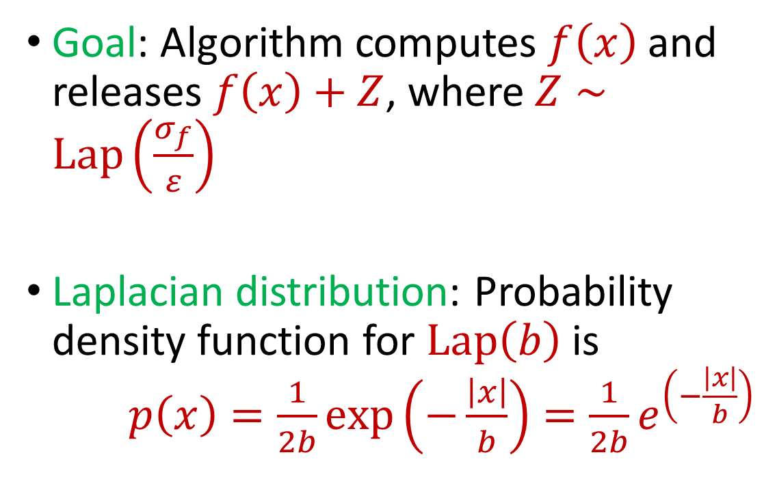
Last Time: Laplace Mechanism
Goal: Algorithm computes $f\left(x\right)$ and releases $f\left(x\right)+Z$, where $Z∼Lap\left(\frac{σ_{f}}{ε}\right)$
Laplacian distribution: Probability density function for $Lap\left(b\right)$ is $p\left(x\right)=\frac{1}{2b}exp\left(−\frac{\left|x\right|}{b}\right)=\frac{1}{2b}e^{\left(−\frac{\left|x\right|}{b}\right)}$
Notes:
[DworkMcSherryNissimSmith06]

Slide 10
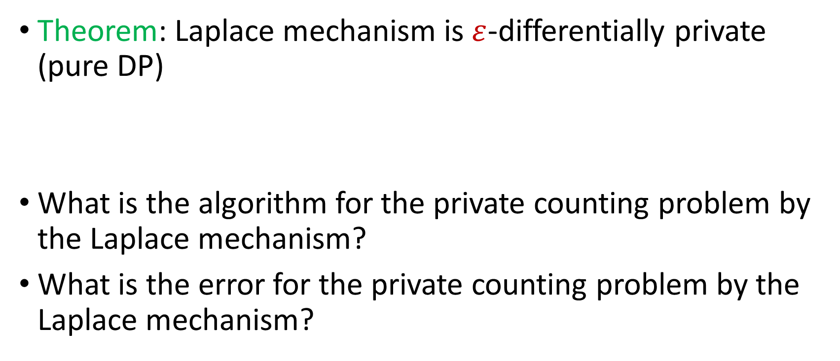
Laplace Mechanism
Theorem: Laplace mechanism is $ε$-differentially private (pure DP)
What is the algorithm for the private counting problem by the Laplace mechanism?
What is the error for the private counting problem by the Laplace mechanism?
Notes:
[DworkMcSherryNissimSmith06]

Slide 11
Beyond Laplace Mechanism
How do we answer non-numeric queries, e.g., selection?
Example: What is the most common eye color in the room?
Notes:
[DworkMcSherryNissimSmith06]

Slide 12
Beyond Laplace Mechanism
Example: Suppose a study is conducted that finds the current location of individuals, in the two-dimensional plane
Who is the closest individual to a query location?
Notes:
[DworkMcSherryNissimSmith06]

Slide 13
Beyond Laplace Mechanism
What if we want to output the “best” answer, but noise can significantly destroy the answer?
Example: Suppose we have a large number of apples, and A, B, C each bid $1.00 and D bids $4.01. What is the optimal price?
At $4.01 the revenue, the revenue is $4.01, at $4.00 and at $1.00 the revenue is $4.00, but at $3.02 the revenue is zero!
Notes:
[DworkMcSherryNissimSmith06]

Slide 14
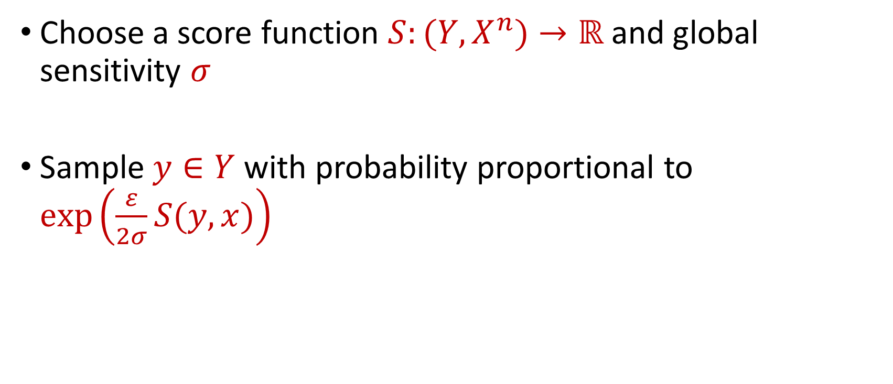
Exponential Mechanism
Choose a score function $S:(Y,X^{n})→ℝ$ and global sensitivity $σ$
Sample $y∈Y$ with probability proportional to $\exp\left(\frac{ε}{2σ}S(y,x)\right)$
Notes:
[DworkMcSherryNissimSmith06]

Slide 15
Beyond Laplace Mechanism
How do we answer non-numeric queries, e.g., selection?
Example: What is the most common eye color in the room?
Notes:
[DworkMcSherryNissimSmith06]

Slide 16
Beyond Laplace Mechanism
Example: Suppose a study is conducted that finds the current location of individuals, in the two-dimensional plane
Who is the closest individual to a query location?
Notes:
[DworkMcSherryNissimSmith06]

Slide 17
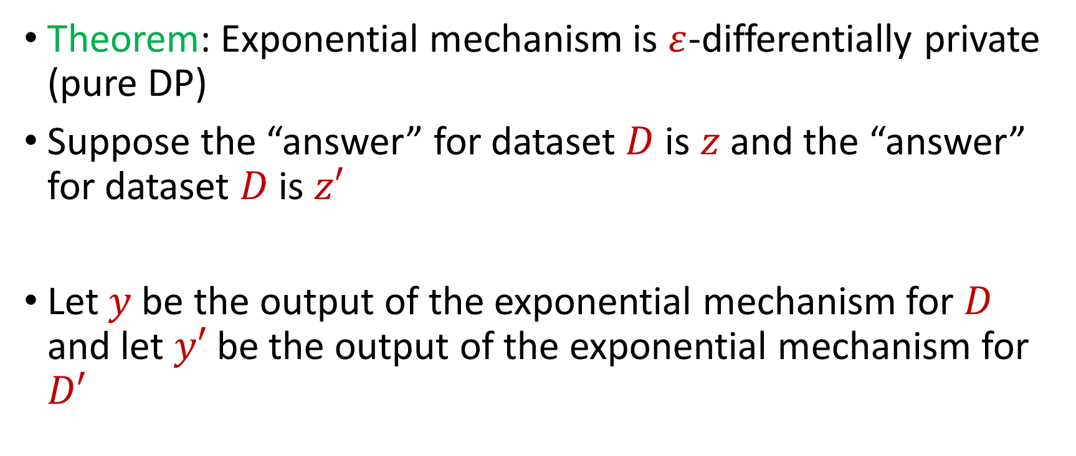
Exponential Mechanism
Theorem: Exponential mechanism is $ε$-differentially private (pure DP)
Suppose the “answer” for dataset $D$ is $z$ and the “answer” for dataset $D$ is $z′$
Let $y$ be the output of the exponential mechanism for $D$ and let $y′$ be the output of the exponential mechanism for $D′$
Notes:
[DworkMcSherryNissimSmith06]

Slide 18

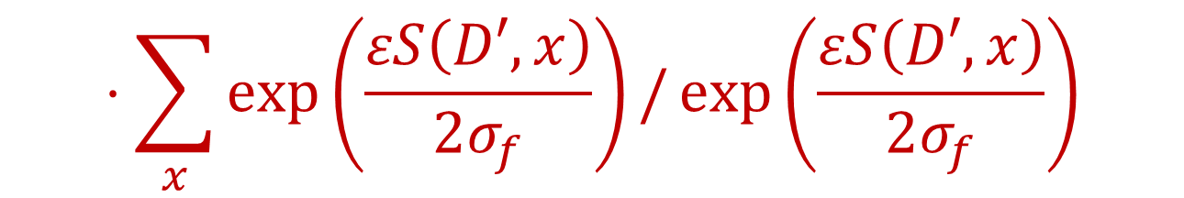

Exponential Mechanism
Want to show that for any fixed $x$, $\frac{Pr\left[y=x\right]}{Pr\left[y^{′}=x\right]}≤e^{ε}$
$$\frac{Pr\left[y=x\right]}{Pr\left[y^{′}=x\right]}≤\exp\left(\frac{εS\left(D,x\right)}{2σ_{f}}\right)/\sum_{x}{\exp\left(\frac{εS\left(D,x\right)}{2σ_{f}}\right)}$$
$$⋅\sum_{x}{\exp\left(\frac{εS\left(D′,x\right)}{2σ_{f}}\right)}/\exp\left(\frac{εS\left(D′,x\right)}{2σ_{f}}\right)$$
Notes:
[DworkMcSherryNissimSmith06]

Slide 19
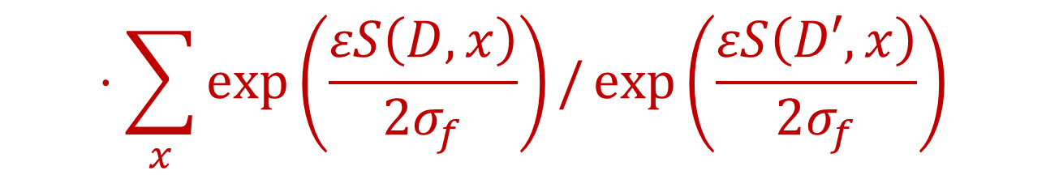

Exponential Mechanism
Want to show that for any fixed $x$, $\frac{Pr\left[y=x\right]}{Pr\left[y^{′}=x\right]}≤e^{ε}$
$$\frac{Pr\left[y=x\right]}{Pr\left[y^{′}=x\right]}≤\exp\left(\frac{ε(S\left(D,x\right)−S\left(D^{′},x\right))}{2σ_{f}}\right)$$
$$⋅\sum_{x}{\exp\left(\frac{εS\left(D,x\right)}{2σ_{f}}\right)}/\exp\left(\frac{εS\left(D′,x\right)}{2σ_{f}}\right)$$
Notes:
[DworkMcSherryNissimSmith06]

Slide 20

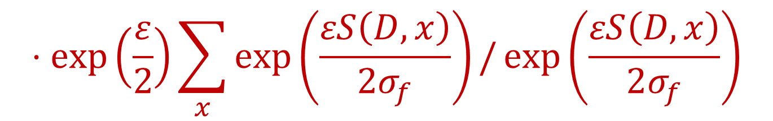
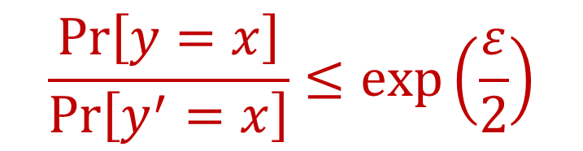
Exponential Mechanism
Want to show that for any fixed $x$, $\frac{Pr\left[y=x\right]}{Pr\left[y^{′}=x\right]}≤e^{ε}$
$$\frac{Pr\left[y=x\right]}{Pr\left[y^{′}=x\right]}≤\exp\left(\frac{ε}{2}\right)$$
$$⋅\exp\left(\frac{ε}{2}\right)\sum_{x}{\exp\left(\frac{εS\left(D,x\right)}{2σ_{f}}\right)}/\exp\left(\frac{εS\left(D,x\right)}{2σ_{f}}\right)$$
$$=\exp\left(ε\right)$$
Notes:
[DworkMcSherryNissimSmith06]

Slide 21
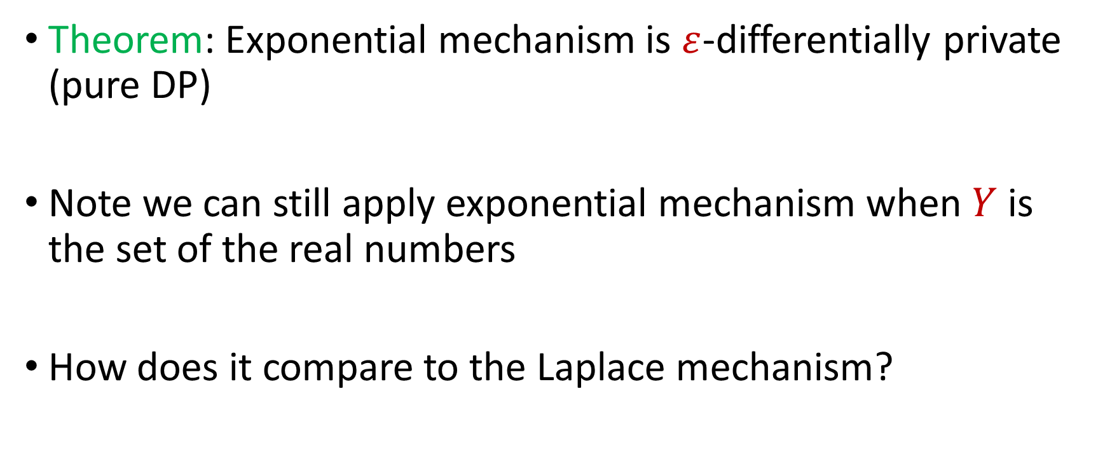
Exponential Mechanism
Theorem: Exponential mechanism is $ε$-differentially private (pure DP)
Note we can still apply exponential mechanism when $Y$ is the set of the real numbers
How does it compare to the Laplace mechanism?
Notes:
[DworkMcSherryNissimSmith06]

Slide 22
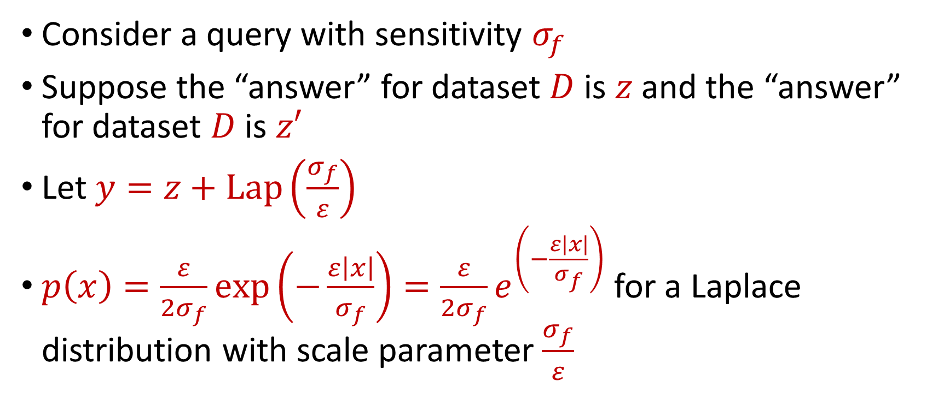
Mechanisms: Exponential vs. Laplace
Consider a query with sensitivity $σ_{f}$
Suppose the “answer” for dataset $D$ is $z$ and the “answer” for dataset $D$ is $z′$
Let $y=z+Lap\left(\frac{σ_{f}}{ε}\right)$
$p\left(x\right)=\frac{ε}{2σ_{f}}exp\left(−\frac{ε\left|x\right|}{σ_{f}}\right)=\frac{ε}{2σ_{f}}e^{\left(−\frac{ε\left|x\right|}{σ_{f}}\right)}$ for a Laplace distribution with scale parameter $\frac{σ_{f}}{ε}$
Notes:
[DworkMcSherryNissimSmith06]

Slide 23

Mechanisms: Exponential vs. Laplace
Laplace mechanism: Output $y=z+x$ with probability proportional to $\frac{ε}{2σ_{f}}e^{\left(−\frac{ε\left|x\right|}{σ_{f}}\right)}$
Notes:
[DworkMcSherryNissimSmith06]

Slide 24
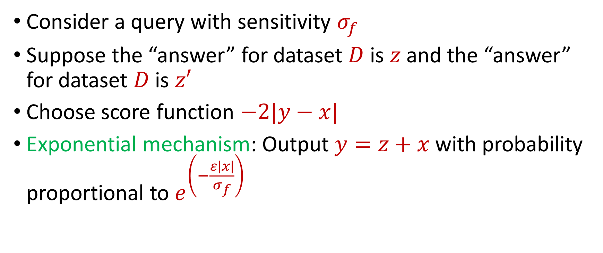
Mechanisms: Exponential vs. Laplace
Consider a query with sensitivity $σ_{f}$
Suppose the “answer” for dataset $D$ is $z$ and the “answer” for dataset $D$ is $z′$
Choose score function $−2|y−x|$
Exponential mechanism: Output $y=z+x$ with probability proportional to $e^{\left(−\frac{ε\left|x\right|}{σ_{f}}\right)}$
Notes:
[DworkMcSherryNissimSmith06]

Slide 25
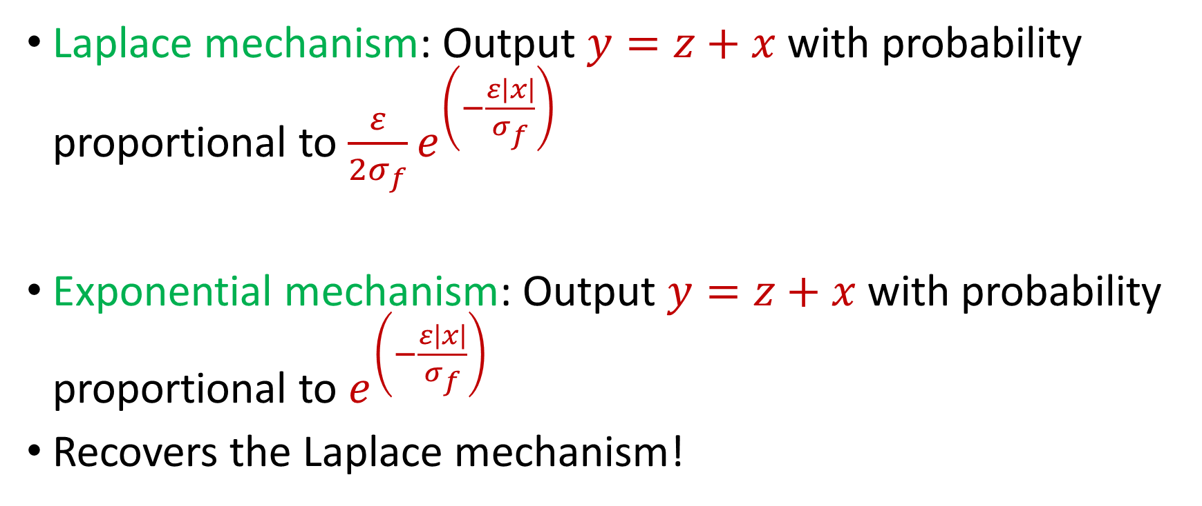
Mechanisms: Exponential vs. Laplace
Laplace mechanism: Output $y=z+x$ with probability proportional to $\frac{ε}{2σ_{f}}e^{\left(−\frac{ε\left|x\right|}{σ_{f}}\right)}$
Exponential mechanism: Output $y=z+x$ with probability proportional to $e^{\left(−\frac{ε\left|x\right|}{σ_{f}}\right)}$
Recovers the Laplace mechanism!
Notes:
[DworkMcSherryNissimSmith06]

Slide 26
Exponential Mechanism Drawbacks
Sampling process may be inefficient
Error can be large
Notes:
[DworkMcSherryNissimSmith06]

Slide 27
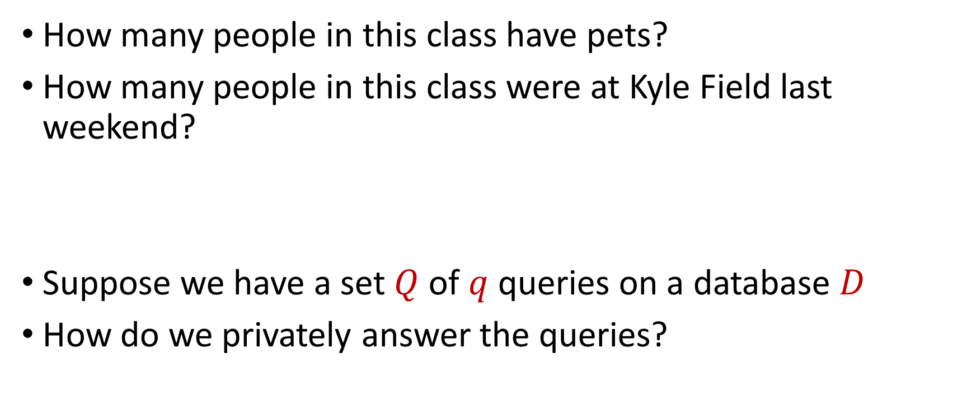
Counting Queries
How many people in this class have pets?
How many people in this class were at Kyle Field last weekend?
Suppose we have a set $Q$ of $q$ queries on a database $D$
How do we privately answer the queries?
Notes:
[DworkMcSherryNissimSmith06]

Slide 28
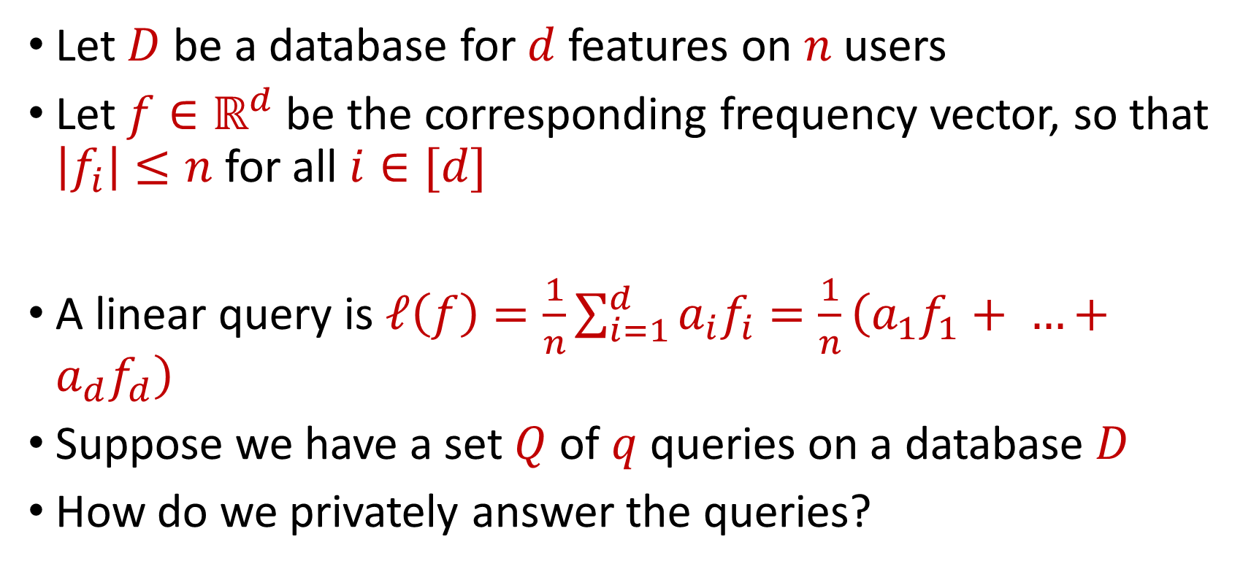
Linear Queries
Let $D$ be a database for $d$ features on $n$ users
Let $f∈ℝ^{d}$ be the corresponding frequency vector, so that $\left|f_{i}\right|≤n$ for all $i∈[d]$
A linear query is $ℓ\left(f\right)=\frac{1}{n}\sum_{i=1}^{d}{a_{i}f_{i}}=\frac{1}{n}\left(a_{1}f_{1}+ …+a_{d}f_{d}\right)$
Suppose we have a set $Q$ of $q$ queries on a database $D$
How do we privately answer the queries?
Notes:
[DworkMcSherryNissimSmith06]

Slide 29
Counting Queries
How many people in this class have pets?
How many people in this class besides the instructor have pets?
Intuition: we do not need to use additional privacy budget to answer the second query
Notes:
[DworkMcSherryNissimSmith06]

Slide 30
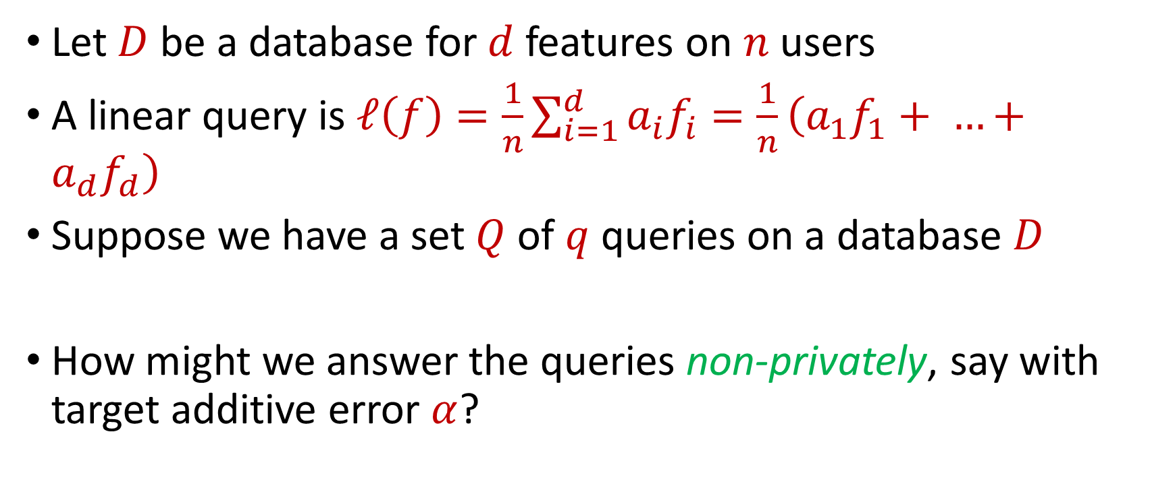
Linear Queries
Let $D$ be a database for $d$ features on $n$ users
A linear query is $ℓ\left(f\right)=\frac{1}{n}\sum_{i=1}^{d}{a_{i}f_{i}}=\frac{1}{n}\left(a_{1}f_{1}+ …+a_{d}f_{d}\right)$
Suppose we have a set $Q$ of $q$ queries on a database $D$
How might we answer the queries non-privately, say with target additive error $α$?
Notes:
[DworkMcSherryNissimSmith06]

Slide 31
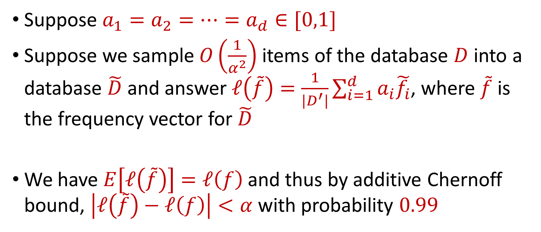
Linear Queries
Suppose $a_{1}=a_{2}=…=a_{d}∈[0,1]$
Suppose we sample $O\left(\frac{1}{α^{2}}\right)$ items of the database $D$ into a database $\tilde{D}$ and answer $ℓ\left(\tilde{f}\right)=\frac{1}{|D^{′}|}\sum_{i=1}^{d}{a_{i}\tilde{f_{i}}}$, where $\tilde{f}$ is the frequency vector for $\tilde{D}$
We have $E\left[ℓ\left(\tilde{f}\right)\right]=ℓ\left(f\right)$ and thus by additive Chernoff bound, $\left|ℓ\left(\tilde{f}\right)−ℓ\left(f\right)\right|<α$ with probability $0.99$
Notes:
[DworkMcSherryNissimSmith06]

Slide 32
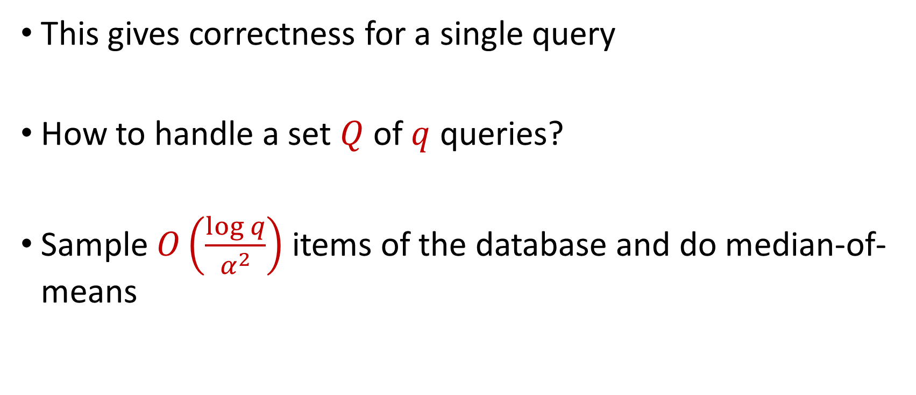
Linear Queries
This gives correctness for a single query
How to handle a set $Q$ of $q$ queries?
Sample $O\left(\frac{\log{q}}{α^{2}}\right)$ items of the database and do median-of-means
Notes:
[DworkMcSherryNissimSmith06]

Slide 33
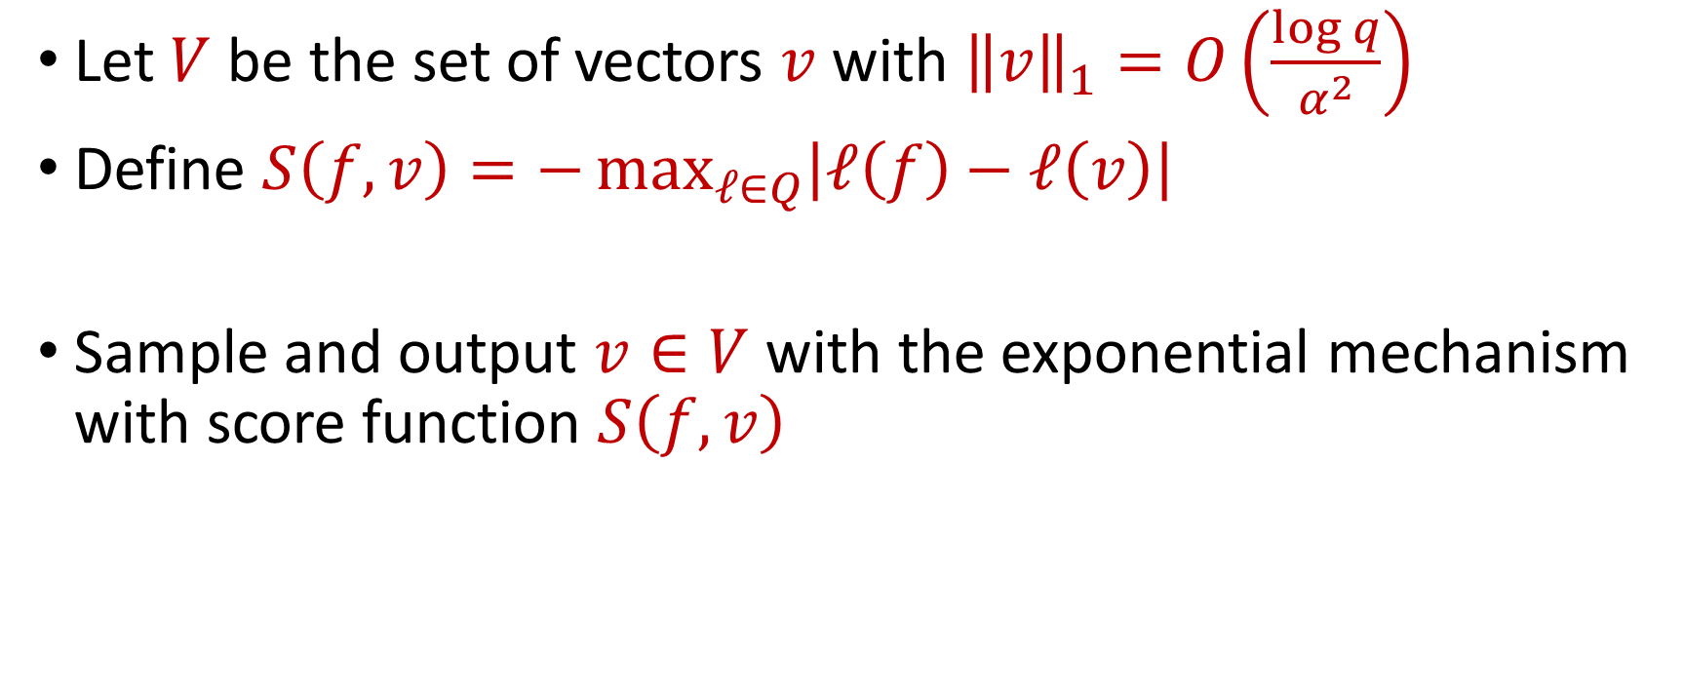
SmallDB Algorithm
Let $V$ be the set of vectors $v$with ${\left\|v\right\|}_{1}=O\left(\frac{\log{q}}{α^{2}}\right)$
Define $S\left(f,v\right)=−\max_{ℓ∈Q}\left|ℓ\left(f\right)−ℓ\left(v\right)\right|$
Sample and output $v∈V$ with the exponential mechanism with score function $S\left(f,v\right)$
Notes:
[DworkMcSherryNissimSmith06]

