Slide 1
CSCE 689: Special Topics in Modern Algorithms for Data Science
Lecture 22
Samson Zhou

Slide 2
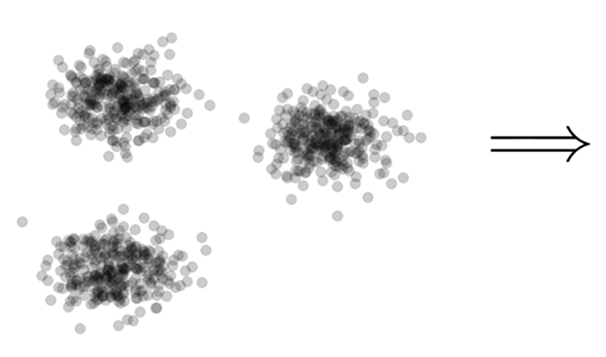

Clustering
Goal: Given input dataset $X$, partition $X$ so that “similar” points are in the same cluster and “different” points are in different clusters

Slide 3
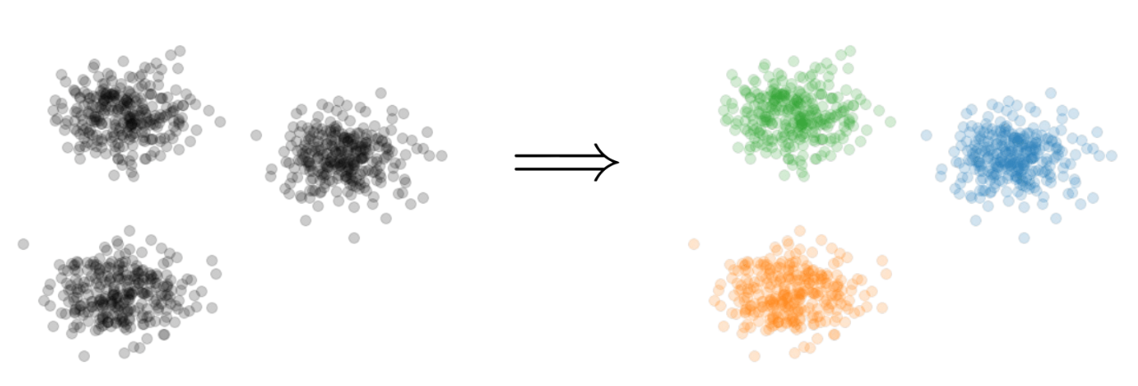
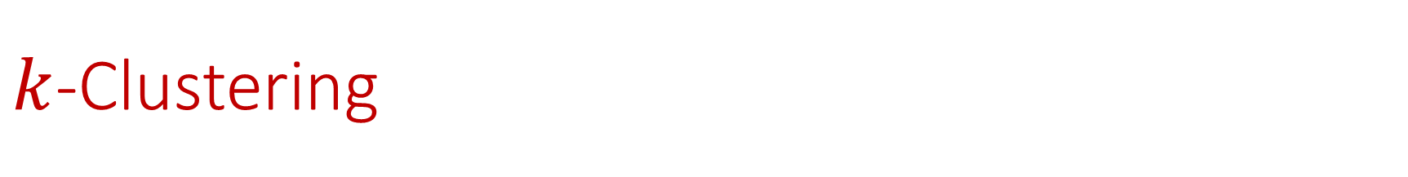

$k$-Clustering
Goal: Given input dataset $X$, partition $X$ so that “similar” points are in the same cluster and “different” points are in different clusters
There can be at most $k$ different clusters
$$k=3$$

Slide 4
$k$-Clustering
Question: How do we measure the “quality” of each clustering?
$$k=3$$

Slide 5
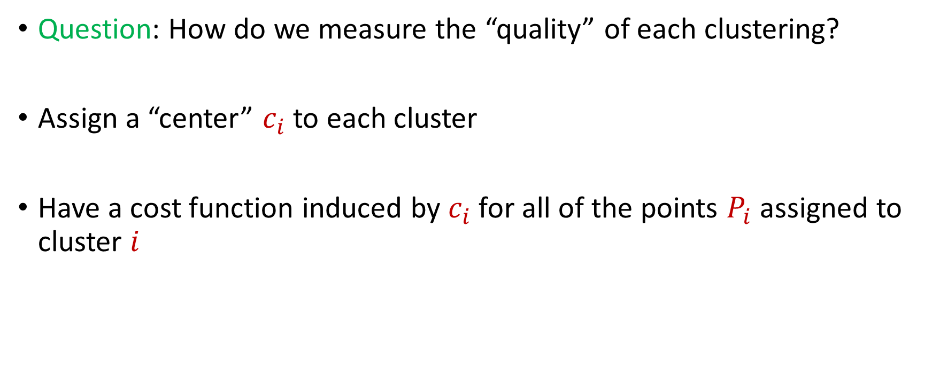
$k$-Clustering
Question: How do we measure the “quality” of each clustering?
Assign a “center” $c_{i}$ to each cluster
Have a cost function induced by $c_{i}$ for all of the points $P_{i}$ assigned to cluster $i$

Slide 6
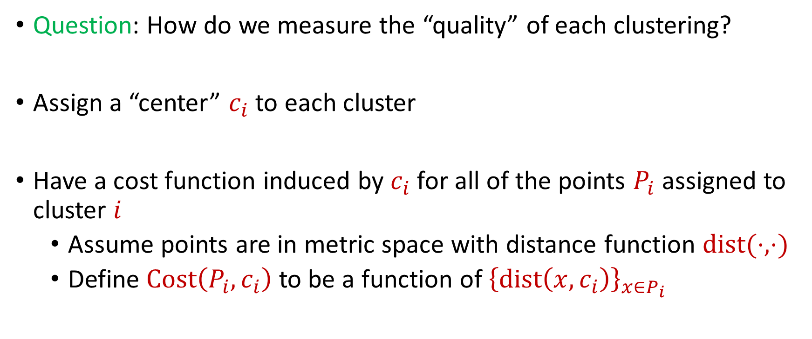
$k$-Clustering
Question: How do we measure the “quality” of each clustering?
Assign a “center” $c_{i}$ to each cluster
Have a cost function induced by $c_{i}$ for all of the points $P_{i}$ assigned to cluster $i$
Assume points are in metric space with distance function $dist(⋅,⋅)$
Define $Cost\left(P_{i},c_{i}\right)$ to be a function of ${\left\{dist\left(x,c_{i}\right)\right\}}_{x∈P_{i}}$

Slide 7
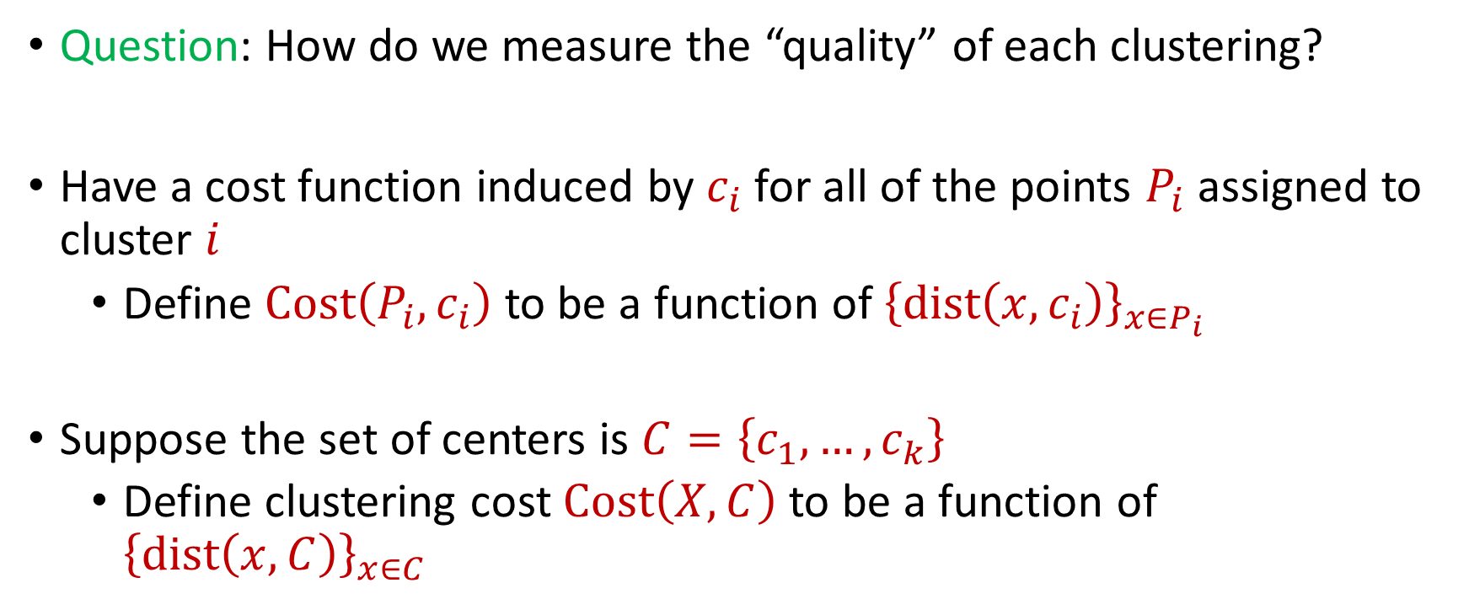
$k$-Clustering
Question: How do we measure the “quality” of each clustering?
Have a cost function induced by $c_{i}$ for all of the points $P_{i}$ assigned to cluster $i$
Define $Cost\left(P_{i},c_{i}\right)$ to be a function of ${\left\{dist\left(x,c_{i}\right)\right\}}_{x∈P_{i}}$
Suppose the set of centers is $C=\left\{c_{1},…, c_{k}\right\}$
Define clustering cost $Cost\left(X,C\right)$ to be a function of ${\left\{dist\left(x,C\right)\right\}}_{x∈C}$

Slide 8

$k$-Clustering
Define clustering cost $Cost\left(X,C\right)$ to be a function of ${\left\{dist\left(x,C\right)\right\}}_{x∈C}$

Slide 9
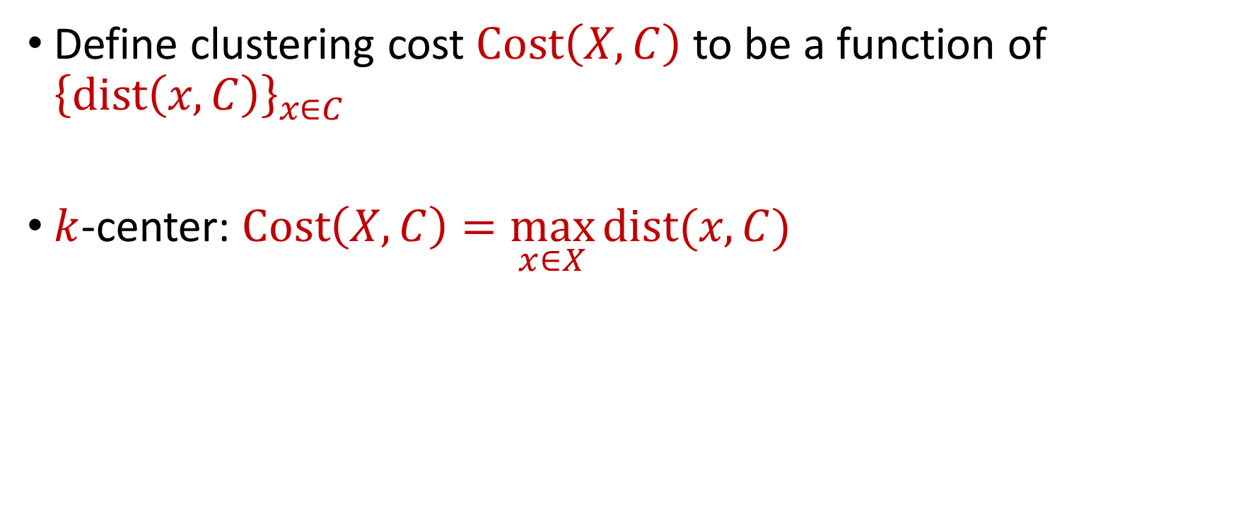
$k$-Clustering
Define clustering cost $Cost\left(X,C\right)$ to be a function of ${\left\{dist\left(x,C\right)\right\}}_{x∈C}$
$k$-center: $Cost\left(X,C\right)=\max_{x∈X}{dist(x,C)}$

Slide 10
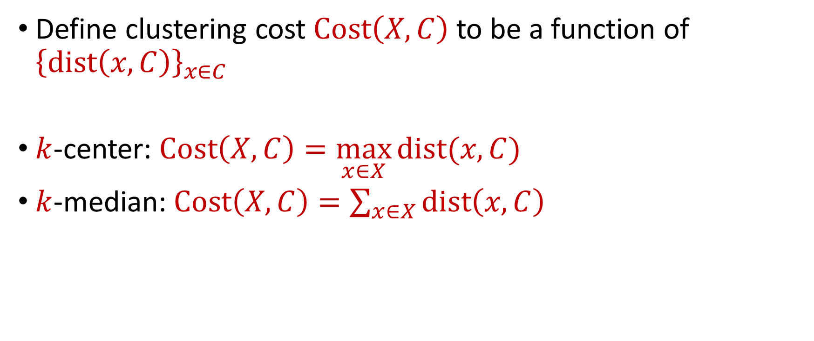
$k$-Clustering
Define clustering cost $Cost\left(X,C\right)$ to be a function of ${\left\{dist\left(x,C\right)\right\}}_{x∈C}$
$k$-center: $Cost\left(X,C\right)=\max_{x∈X}{dist(x,C)}$
$k$-median: $Cost\left(X,C\right)=\sum_{x∈X}{dist\left(x,C\right)}$

Slide 11

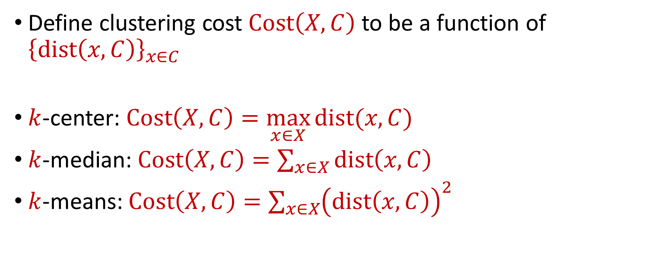






$k$-Clustering
Define clustering cost $Cost\left(X,C\right)$ to be a function of ${\left\{dist\left(x,C\right)\right\}}_{x∈C}$
$k$-center: $Cost\left(X,C\right)=\max_{x∈X}{dist(x,C)}$
$k$-median: $Cost\left(X,C\right)=\sum_{x∈X}{dist\left(x,C\right)}$
$k$-means: $Cost\left(X,C\right)=\sum_{x∈X}{{\left(dist\left(x,C\right)\right)}^{2}}$
$${\left(⋅\right)}^{2}$$
$${\left(⋅\right)}^{2}$$
$${\left(⋅\right)}^{2}$$
$${\left(⋅\right)}^{2}$$
$${\left(⋅\right)}^{2}$$
$${\left(⋅\right)}^{2}$$
$${\left(⋅\right)}^{2}$$

Slide 12

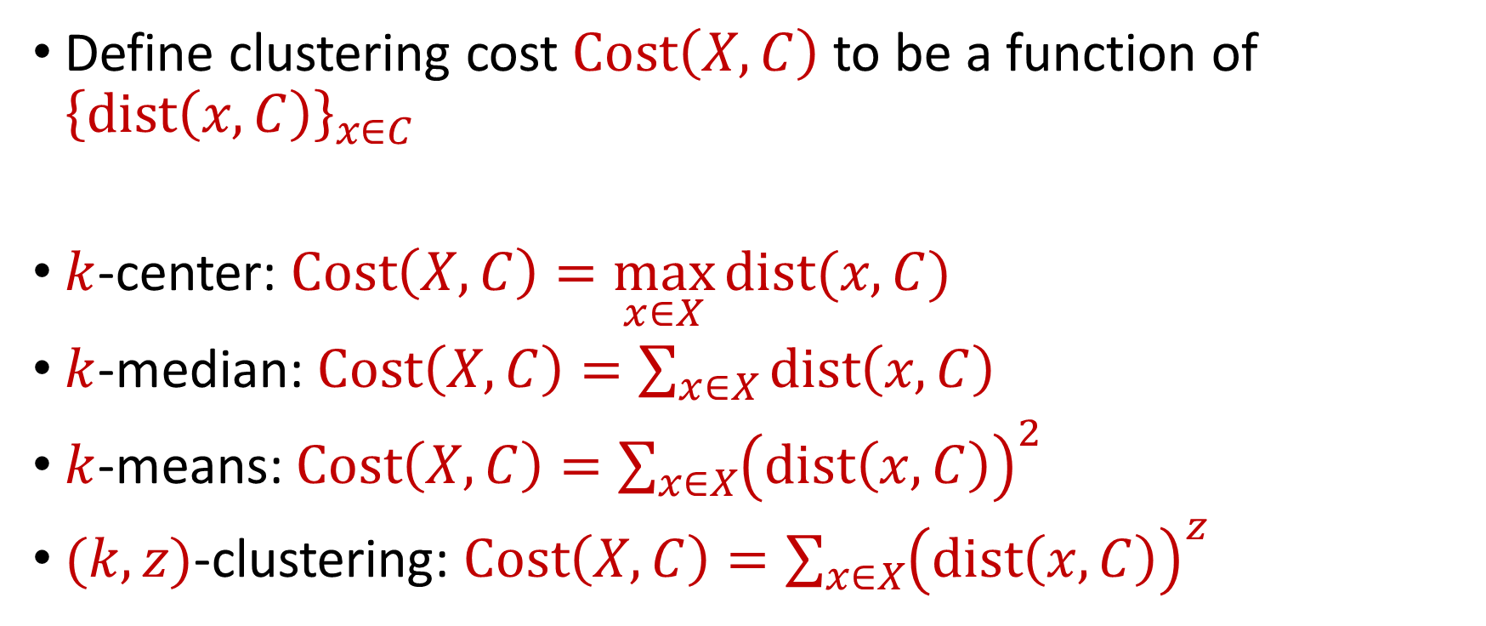






$k$-Clustering
Define clustering cost $Cost\left(X,C\right)$ to be a function of ${\left\{dist\left(x,C\right)\right\}}_{x∈C}$
$k$-center: $Cost\left(X,C\right)=\max_{x∈X}{dist(x,C)}$
$k$-median: $Cost\left(X,C\right)=\sum_{x∈X}{dist\left(x,C\right)}$
$k$-means: $Cost\left(X,C\right)=\sum_{x∈X}{{\left(dist\left(x,C\right)\right)}^{2}}$
$(k,z)$-clustering: $Cost\left(X,C\right)=\sum_{x∈X}{{\left(dist\left(x,C\right)\right)}^{z}}$
$${\left(⋅\right)}^{z}$$
$${\left(⋅\right)}^{z}$$
$${\left(⋅\right)}^{z}$$
$${\left(⋅\right)}^{z}$$
$${\left(⋅\right)}^{z}$$
$${\left(⋅\right)}^{z}$$
$${\left(⋅\right)}^{z}$$

Slide 13
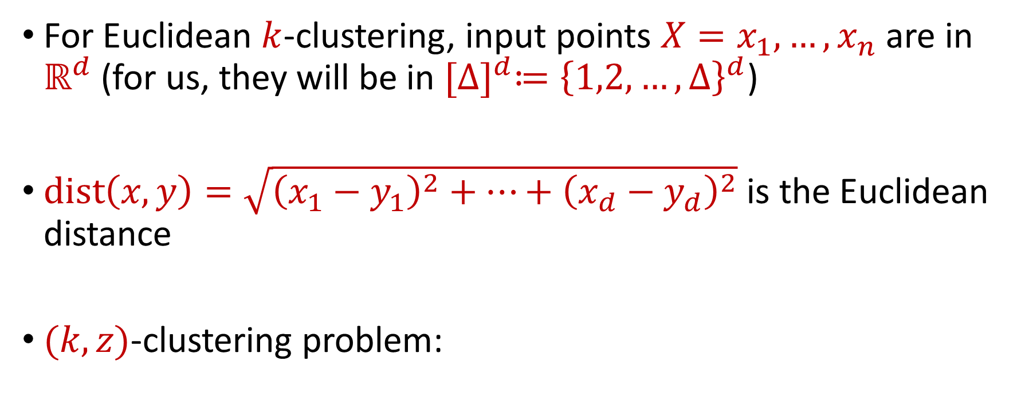


Euclidean $k$-Clustering
For Euclidean $k$-clustering, input points $X=x_{1},…,x_{n}$ are in $ℝ^{d}$ (for us, they will be in ${[Δ]}^{d}≔{\left\{1,2,…,Δ\right\}}^{d}$)
$dist\left(x,y\right)=\sqrt{{\left(x_{1}−y_{1}\right)}^{2}+…+{\left(x_{d}−y_{d}\right)}^{2}}$ is the Euclidean distance
$(k,z)$-clustering problem:
$$\min_{C:\left|C\right|≤k} Cost\left(X,C\right)=\min_{C:\left|C\right|≤k}{Σ_{x∈X}\left(dist\left(x,C\right)\right)}^{z}$$

Slide 14






$$(−8, 4)$$
$$(−4, 3)$$
$$(4, 3)$$
$$(−3, 0)$$
$$(−11, −4)$$
$$(0, −4)$$

Slide 15


$$(−8, 4)$$
$$(−4, 3)$$
$$(4, 3)$$
$$(−8, 0)$$
$$(−3, 0)$$
$$(0, 0)$$
$$(−11, −4)$$
$$(0, −4)$$

Slide 16






$$(−8, 4)$$
$$(−4, 3)$$
$$(4, 3)$$
$$4$$
$$5$$
$$5$$
$$3$$
$$(−8, 0)$$
$$(−3, 0)$$
$$(0, 0)$$
$$5$$
$$4$$
$$(−11, −4)$$
$$(0, −4)$$

Slide 17
$k$-center: $Cost\left(X,C\right)=\max_{x∈X}{dist\left(x,C\right)=5}$
$$(−8, 4)$$
$$(−4, 3)$$
$$(4, 3)$$
$$4$$
$$5$$
$$5$$
$$3$$
$$(−8, 0)$$
$$(−3, 0)$$
$$(0, 0)$$
$$5$$
$$4$$
$$(−11, −4)$$
$$(0, −4)$$

Slide 18
$k$-median: $Cost\left(X,C\right)=\sum_{x∈X}{dist\left(x,C\right)}=4+5+5+3+4+5=26$
$$(−8, 4)$$
$$(−4, 3)$$
$$(4, 3)$$
$$4$$
$$5$$
$$5$$
$$3$$
$$(−8, 0)$$
$$(−3, 0)$$
$$(0, 0)$$
$$5$$
$$4$$
$$(−11, −4)$$
$$(0, −4)$$

Slide 19

$k$-means: $Cost\left(X,C\right)=\sum_{x∈X}{{\left(dist\left(x,C\right)\right)}^{2}} =16+25+25+9+16+25$
$$(−8, 4)$$
$$=116$$
$$(−4, 3)$$
$$(4, 3)$$
$$4$$
$$5$$
$$5$$
$$3$$
$$(−8, 0)$$
$$(−3, 0)$$
$$(0, 0)$$
$$5$$
$$4$$
$$(−11, −4)$$
$$(0, −4)$$

Slide 20
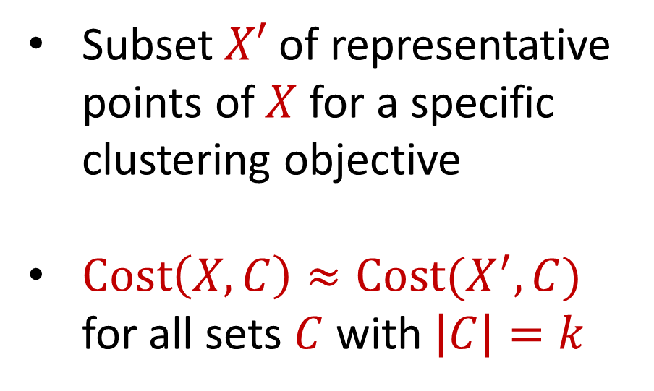
Coreset
Subset $X′$ of representative points of $X$ for a specific clustering objective
$Cost\left(X,C\right)≈Cost(X^{′},C)$ for all sets $C$ with $\left|C\right|=k$

Slide 21
Coreset
Subset $X′$ of representative points of $X$ for a specific clustering objective
$Cost\left(X,C\right)≈Cost(X^{′},C)$ for all sets $C$ with $\left|C\right|=k$

Slide 22
Coreset
Subset $X′$ of representative points of $X$ for a specific clustering objective
$Cost\left(X,C\right)≈Cost(X^{′},C)$ for all sets $C$ with $\left|C\right|=k$

Slide 23

Coreset (Formal Definition)
Given a set $X$ and an accuracy parameter $ε>0$, we say a set $X′$ with weight function $w$is an $(1+ε)$-multiplicative coreset for a cost function $Cost$, if for all queries $C$ with $\left|C\right|≤k$, we have
$$\left(1−ε\right)Cost(X,C)≤Cost(X′,C,w)≤\left(1+ε\right)Cost(X,C)$$
$(k,z)$-clustering: $Cost\left(X^{′},C,w\right)=\sum_{x∈X′}{{w\left(x\right)⋅\left(dist\left(x,C\right)\right)}^{z}}$

Slide 24
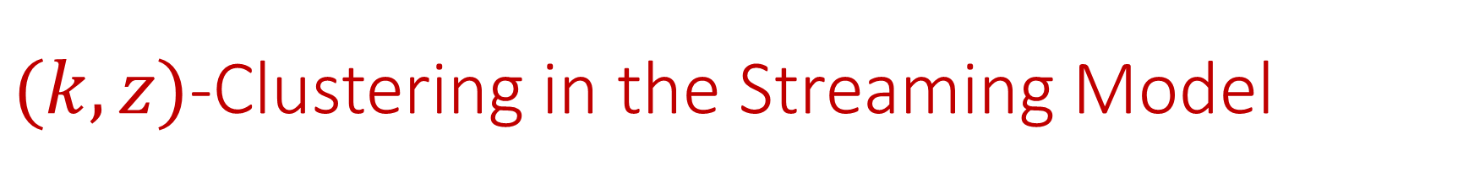

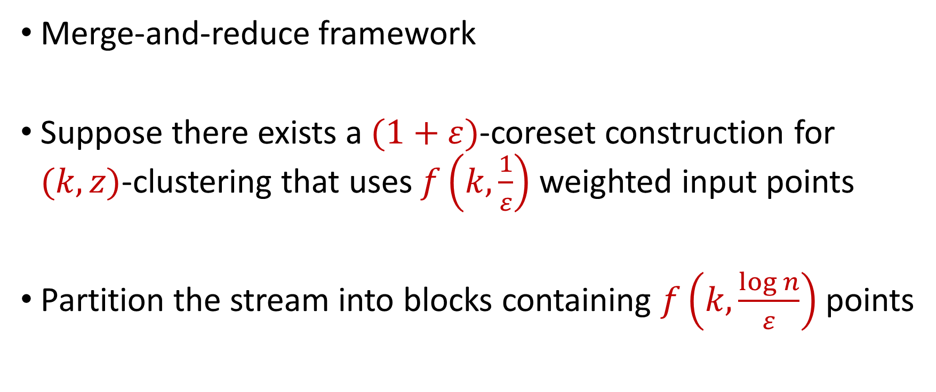
$(k,z)$-Clustering in the Streaming Model
Merge-and-reduce framework
Suppose there exists a $(1+ε)$-coreset construction for $(k,z)$-clustering that uses $f\left(k,\frac{1}{ε}\right)$ weighted input points
Partition the stream into blocks containing $f\left(k,\frac{\log{n}}{ε}\right)$ points
$$\tilde{O}\left(\frac{k^{2}}{ε^{2}}\right)$$

Slide 25
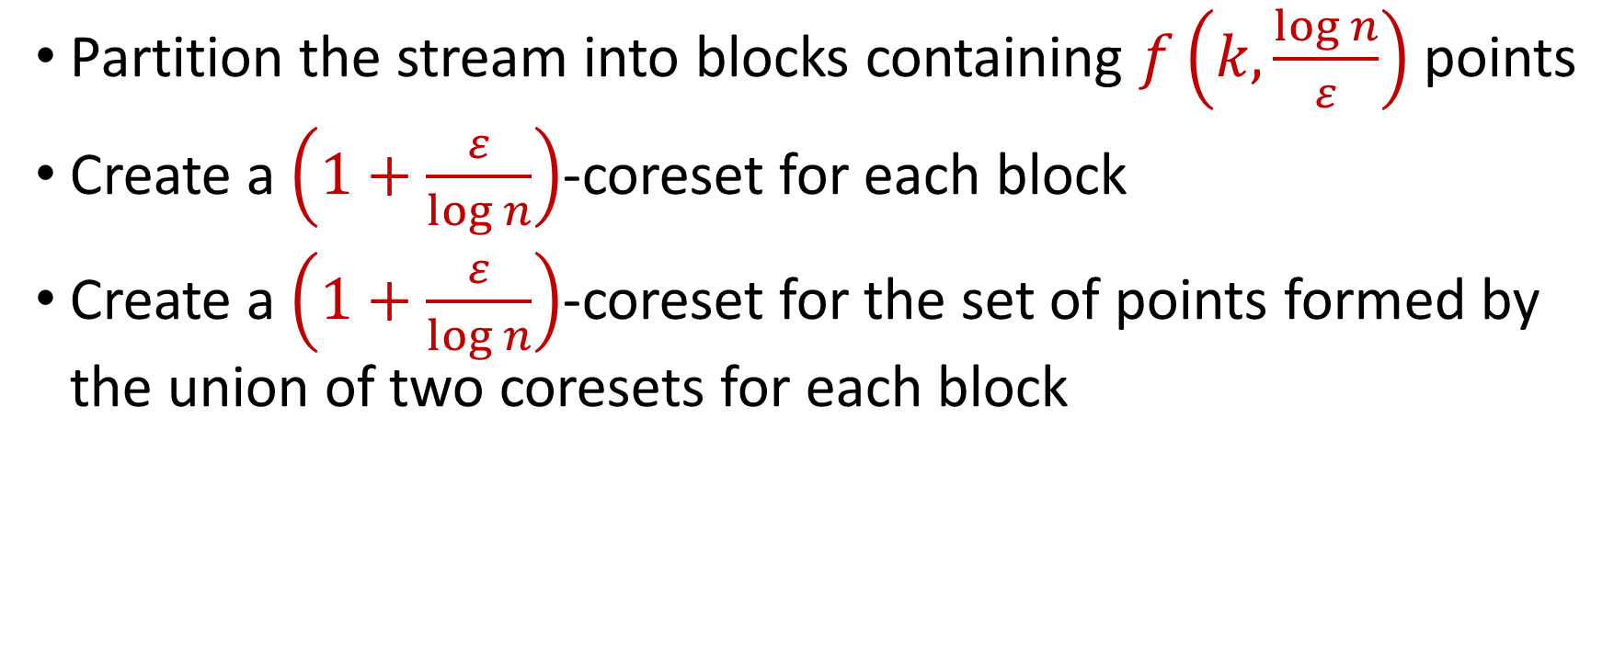
$(k,z)$-Clustering in the Streaming Model
Partition the stream into blocks containing $f\left(k,\frac{\log{n}}{ε}\right)$ points
Create a $\left(1+\frac{ε}{\log{n}}\right)$-coreset for each block
Create a $\left(1+\frac{ε}{\log{n}}\right)$-coreset for the set of points formed by the union of two coresets for each block
Reduce
Merge

Slide 26
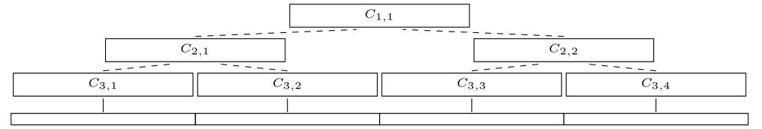
$(k,z)$-Clustering in the Streaming Model
Partition the stream into blocks containing $f\left(k,\frac{\log{n}}{ε}\right)$ points
Create a $\left(1+\frac{ε}{\log{n}}\right)$-coreset for each block
Create a $\left(1+\frac{ε}{\log{n}}\right)$-coreset for the set of points formed by the union of two coresets for each block

Slide 27
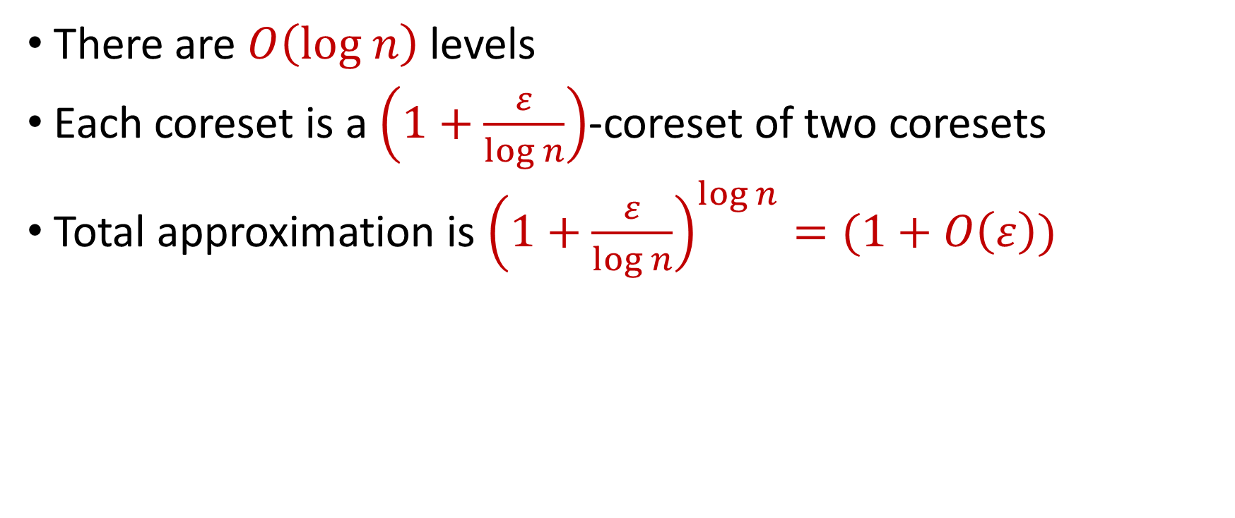
$(k,z)$-Clustering in the Streaming Model
There are $O\left(log n\right)$ levels
Each coreset is a $\left(1+\frac{ε}{\log{n}}\right)$-coreset of two coresets
Total approximation is ${\left(1+\frac{ε}{\log{n}}\right)}^{\log{n}}=(1+O\left(ε\right))$

Slide 28
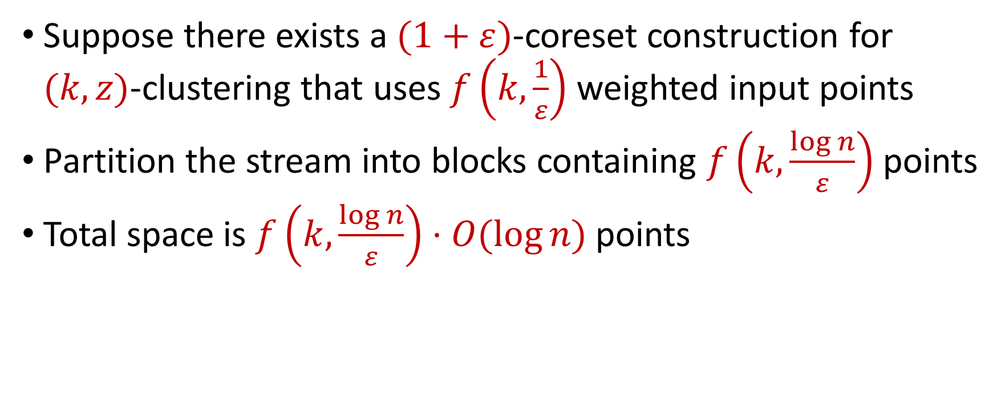
$(k,z)$-Clustering in the Streaming Model
Suppose there exists a $(1+ε)$-coreset construction for $(k,z)$-clustering that uses $f\left(k,\frac{1}{ε}\right)$ weighted input points
Partition the stream into blocks containing $f\left(k,\frac{\log{n}}{ε}\right)$ points
Total space is $f\left(k,\frac{\log{n}}{ε}\right)⋅O(log{n)}$ points
For $k$-means clustering, this is $\tilde{O}\left(\frac{k^{2}}{ε^{2}}⋅\log^{3}{n}\right)$ points

Slide 29
Coreset Construction and Sampling
Consider a fixed set $X$ and a fixed set $C$ of $k$ centers, which induces a fixed cost $Cost(X,C)$

Slide 30
Coreset Construction and Sampling
Consider a fixed set $X$ and a fixed set $C$ of $k$ centers, which induces a fixed cost $Cost(X,C)$
A simple way to obtain $X′$with $Cost\left(X^{′},C\right)≈Cost(X,C)$ is to uniformly sample points of $X$ into $X′$

Slide 31
Coreset Construction and Sampling
Consider a fixed set $X$ and a fixed set $C$ of $k$ centers, which induces a fixed cost $Cost(X,C)$
Uniform sampling needs a lot of samples if there is a single point that greatly contributes to $Cost(X,C)$

Slide 32
Coreset Construction and Sampling
Fix: Importance sampling, sample each point $x∈X$ into $X′$ with probability proportional $Cost(x,C)$, i.e., $Cost(x,C)/Cost(X,C)$

Slide 33
Coreset Construction and Sampling
Fix: Importance sampling, sample each point $x∈X$ into $X′$ with probability proportional $Cost(x,C)$, i.e., $Cost(x,C)/Cost(X,C)$
Importance sampling only needs $X′$ to have size $O\left(\frac{1}{ε^{2}}\right)$ to achieve $\left(1+ε\right)$-approximation to $Cost(X,C)$

Slide 34
Coreset Construction and Sampling
Importance sampling only needs $X′$ to have size $O\left(\frac{1}{ε^{2}}\right)$ to achieve $\left(1+ε\right)$-approximation to $Cost(X,C)$
What about a different choice $C$ of $k$ centers?

Slide 35
Coreset Construction and Sampling
Importance sampling only needs $X′$ to have size $O\left(\frac{1}{ε^{2}}\right)$ to achieve $\left(1+ε\right)$-approximation to $Cost(X,C)$
To handle all possible sets of $k$ centers:
Need to sample each point $x$ with probability $\max_{C}\frac{Cost\left(x,C\right)}{Cost\left(X,C\right)}$ instead of $\frac{Cost\left(x,C\right)}{Cost\left(X,C\right)}$
Need to union bound over a net of all possible sets of $k$ centers

Slide 36
Coreset Construction and Sampling
Importance sampling only needs $X′$ to have size $O\left(\frac{1}{ε^{2}}\right)$ to achieve $\left(1+ε\right)$-approximation to $Cost(X,C)$
To handle all possible sets of $k$ centers:
Need to sample each point $x$ with probability $\max_{C}\frac{Cost\left(x,C\right)}{Cost\left(X,C\right)}$ instead of $\frac{Cost\left(x,C\right)}{Cost\left(X,C\right)}$
Need to union bound over a net of all possible sets of $k$ centers
Net with size ${\left(\frac{nΔ}{ε}\right)}^{O(kd)}$

Slide 37
Sensitivity Sampling
The quantity $s\left(x\right)=\max_{C}\frac{Cost\left(x,C\right)}{Cost\left(X,C\right)}$ is called the sensitivity of $x$ and intuitively measures how “important” the point $x$ is
The total sensitivity of $X$ is $\sum_{x∈X}{s(x)}$ and quantifies how many points will be sampled into $X′$ through importance/sensitivity sampling (before the union bound)

Slide 38

$$s\left(x_{t}\right)=\max_{C:\left|C\right|≤k}{\frac{Cost\left(x_{t},C\right)}{Cost\left(X,C\right)}}=\max_{C:\left|C\right|≤k}{\frac{Cost\left(x_{t},C\right)}{\sum_{i=1}^{n}{Cost\left(x_{i},C\right)}}}$$

Slide 39
$$s\left(x_{t}\right)=\max_{C:\left|C\right|≤k}{\frac{Cost\left(x_{t},C\right)}{Cost\left(X,C\right)}}=\max_{C:\left|C\right|≤k}{\frac{Cost\left(x_{t},C\right)}{\sum_{i=1}^{n}{Cost\left(x_{i},C\right)}}}$$
Point has sensitivity $1$

Slide 40
$$s\left(x_{t}\right)=\max_{C:\left|C\right|≤k}{\frac{Cost\left(x_{t},C\right)}{Cost\left(X,C\right)}}=\max_{C:\left|C\right|≤k}{\frac{Cost\left(x_{t},C\right)}{\sum_{i=1}^{n}{Cost\left(x_{i},C\right)}}}$$
Point has sensitivity $1$
Point has sensitivity $1$

Slide 41
$$s\left(x_{t}\right)=\max_{C:\left|C\right|≤k}{\frac{Cost\left(x_{t},C\right)}{Cost\left(X,C\right)}}=\max_{C:\left|C\right|≤k}{\frac{Cost\left(x_{t},C\right)}{\sum_{i=1}^{n}{Cost\left(x_{i},C\right)}}}$$
Point has sensitivity $1$
Point has sensitivity $1$
Point has sensitivity $1$

Slide 42
$$s\left(x_{t}\right)=\max_{C:\left|C\right|≤k}{\frac{Cost\left(x_{t},C\right)}{Cost\left(X,C\right)}}=\max_{C:\left|C\right|≤k}{\frac{Cost\left(x_{t},C\right)}{\sum_{i=1}^{n}{Cost\left(x_{i},C\right)}}}$$
Point has sensitivity $1$
Point has sensitivity $1$
Point has sensitivity $1$
Point has sensitivity $1$

Slide 43
$$s\left(x_{t}\right)=\max_{C:\left|C\right|≤k}{\frac{Cost\left(x_{t},C\right)}{Cost\left(X,C\right)}}=\max_{C:\left|C\right|≤k}{\frac{Cost\left(x_{t},C\right)}{\sum_{i=1}^{n}{Cost\left(x_{i},C\right)}}}$$
Point has sensitivity $1$
Point has sensitivity $1$
Point has sensitivity $1$
Point has sensitivity $1$
Point has sensitivity $1$

Slide 44
$$s\left(x_{t}\right)=\max_{C:\left|C\right|≤k}{\frac{Cost\left(x_{t},C\right)}{Cost\left(X,C\right)}}=\max_{C:\left|C\right|≤k}{\frac{Cost\left(x_{t},C\right)}{\sum_{i=1}^{n}{Cost\left(x_{i},C\right)}}}$$
Point has sensitivity $1$
Point has sensitivity $1$
Point has sensitivity $1$
Point has sensitivity $1$
Point has sensitivity $1$
Point has sensitivity $1$

Slide 45
$$s\left(x_{t}\right)=\max_{C:\left|C\right|≤k}{\frac{Cost\left(x_{t},C\right)}{Cost\left(X,C\right)}}=\max_{C:\left|C\right|≤k}{\frac{Cost\left(x_{t},C\right)}{\sum_{i=1}^{n}{Cost\left(x_{i},C\right)}}}$$
Point has sensitivity $1$
Point has sensitivity $1$
Point has sensitivity $1$
Point has sensitivity $1$
Point has sensitivity $1$
Point has sensitivity $1$
Point has sensitivity $1$

Slide 46
Sum of Online Sensitivity
Sum of online sensitivities can be at least $k$
How large can it be?

Slide 47
$$s\left(x_{t}\right)=\max_{C:\left|C\right|≤k}{\frac{Cost\left(x_{t},C\right)}{Cost\left(X,C\right)}}=\max_{C:\left|C\right|≤k}{\frac{Cost\left(x_{t},C\right)}{\sum_{i=1}^{n}{Cost\left(x_{i},C\right)}}}$$

Slide 48
$$s\left(x_{t}\right)=\max_{C:\left|C\right|≤k}{\frac{Cost\left(x_{t},C\right)}{Cost\left(X,C\right)}}=\max_{C:\left|C\right|≤k}{\frac{Cost\left(x_{t},C\right)}{\sum_{i=1}^{n}{Cost\left(x_{i},C\right)}}}$$

Slide 49
$$s\left(x_{t}\right)=\max_{C:\left|C\right|≤k}{\frac{Cost\left(x_{t},C\right)}{Cost\left(X,C\right)}}=\max_{C:\left|C\right|≤k}{\frac{Cost\left(x_{t},C\right)}{\sum_{i=1}^{n}{Cost\left(x_{i},C\right)}}}$$

Slide 50
$$s\left(x_{t}\right)=\max_{C:\left|C\right|≤k}{\frac{Cost\left(x_{t},C\right)}{Cost\left(X,C\right)}}=\max_{C:\left|C\right|≤k}{\frac{Cost\left(x_{t},C\right)}{\sum_{i=1}^{n}{Cost\left(x_{i},C\right)}}}$$

Slide 51
$$s\left(x_{t}\right)=\max_{C:\left|C\right|≤k}{\frac{Cost\left(x_{t},C\right)}{Cost\left(X,C\right)}}=\max_{C:\left|C\right|≤k}{\frac{Cost\left(x_{t},C\right)}{\sum_{i=1}^{n}{Cost\left(x_{i},C\right)}}}$$
Partition the sum of the sensitivities by each cluster

Slide 52
$$s\left(x_{t}\right)=\max_{C:\left|C\right|≤k}{\frac{Cost\left(x_{t},C\right)}{Cost\left(X,C\right)}}=\max_{C:\left|C\right|≤k}{\frac{Cost\left(x_{t},C\right)}{\sum_{i=1}^{n}{Cost\left(x_{i},C\right)}}}$$
Charge to $OPT$
Charge to $OPT$

Slide 53
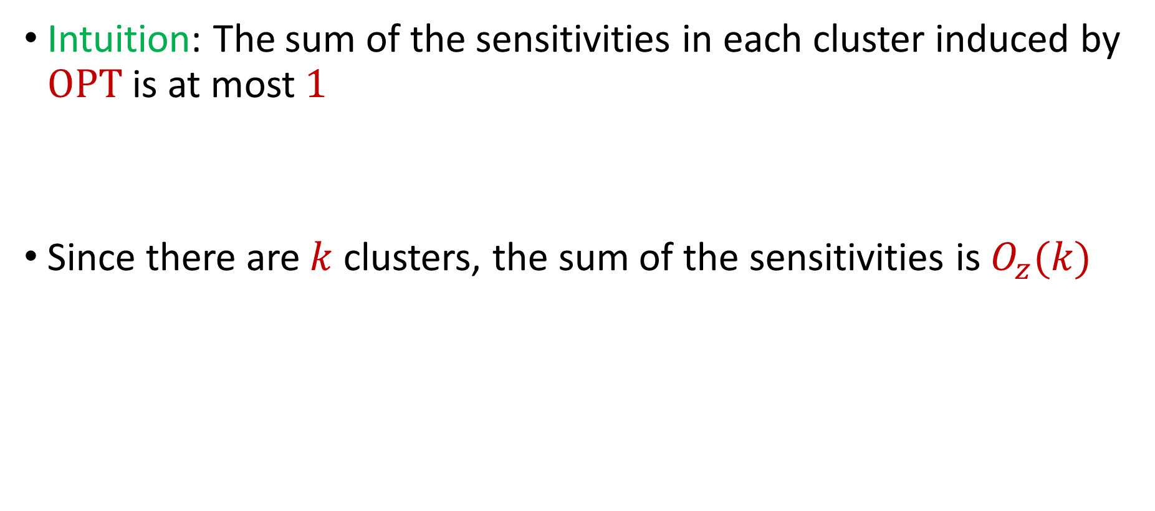
Sum of Online Sensitivity
Intuition: The sum of the sensitivities in each cluster induced by $OPT$ is at most $1$
Since there are $k$ clusters, the sum of the sensitivities is $O_{z}(k)$

