Slide 1
CSCE 689: Special Topics in Modern Algorithms for Data Science
Lecture 17
Samson Zhou

Slide 2
Previously: Variance
The variance of a random variable $X$ over $Ω$ is:
Linearity of variance for independent random variables: $Var\left[X+Y\right]=Var\left[X\right]+Var\left[Y\right]$
$$Var\left[X\right]=E\left[X^{2}\right]−{\left(E\left[X\right]\right)}^{2}$$

Slide 3

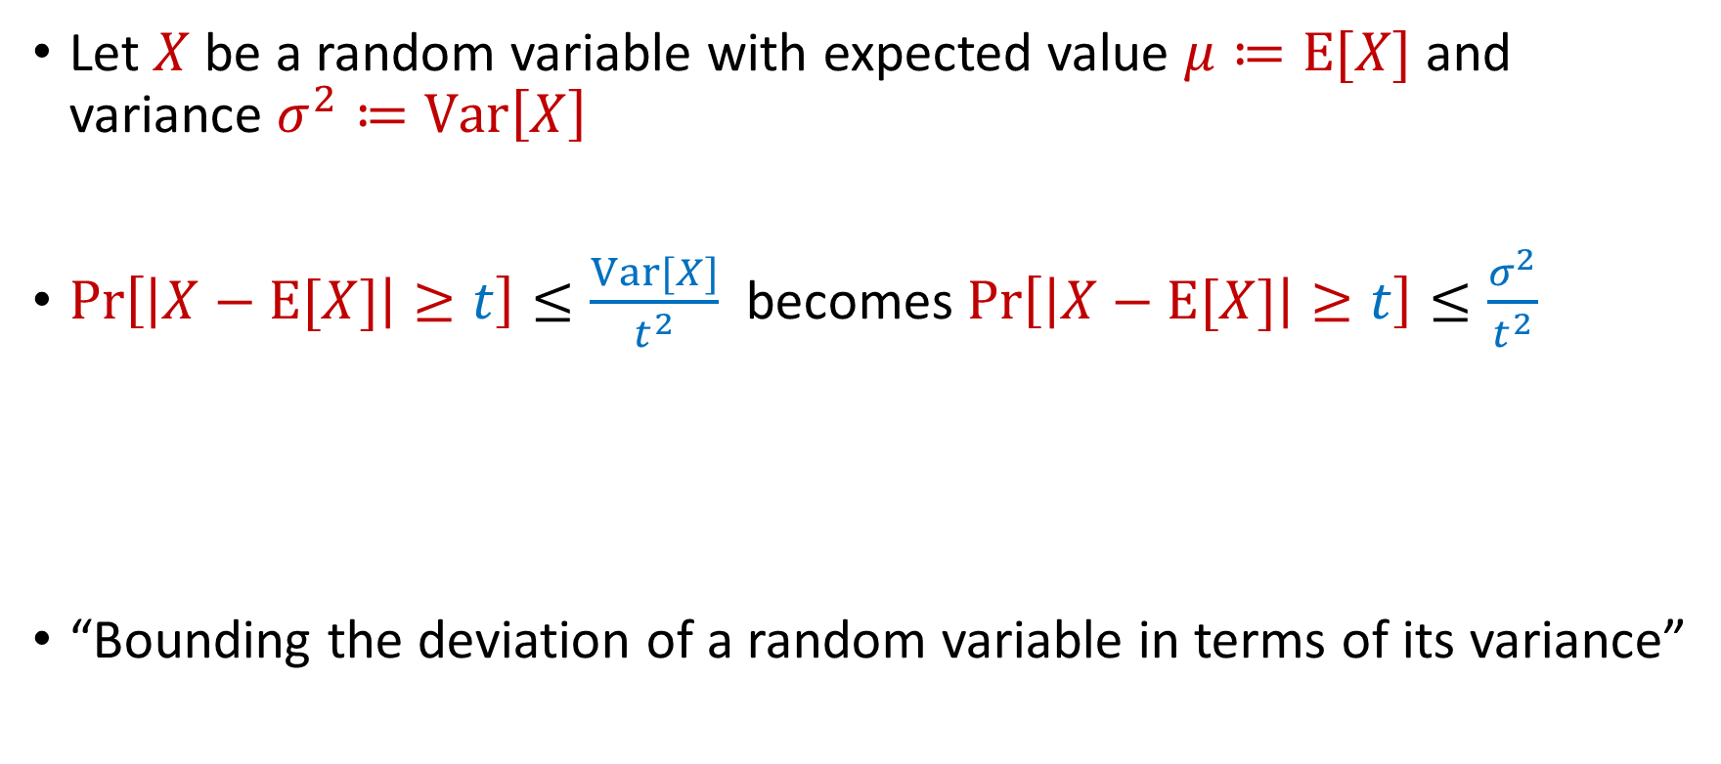
Previously: Chebyshev’s Inequality
Let $X$ be a random variable with expected value $μ≔E[X]$ and variance $σ^{2}≔Var\left[X\right]$
$Pr\left[\left|X−E[X]\right|≥t\right]≤\frac{Var[X]}{t^{2}}$ becomes $Pr\left[\left|X−E[X]\right|≥t\right]≤\frac{σ^{2}}{t^{2}}$
“Bounding the deviation of a random variable in terms of its variance”
$$Pr\left[\left|X−μ\right|≥kσ\right]≤\frac{1}{k^{2}}$$

Slide 4
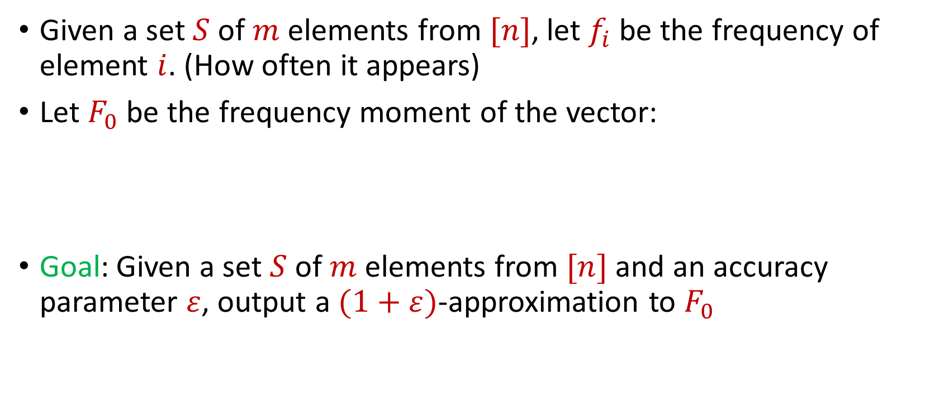

Last Time: Distinct Elements ($F_{0}$ Estimation)
Given a set $S$ of $m$ elements from $[n]$, let $f_{i}$ be the frequency of element $i$. (How often it appears)
Let $F_{0}$ be the frequency moment of the vector:
Goal: Given a set $S$ of $m$ elements from $[n]$ and an accuracy parameter $ε$, output a $(1+ε)$-approximation to $F_{0}$
$F_{0}=$ $|\{i :f_{i}≠0\}|$

Slide 5







Slide 6

Distinct Elements ($F_{0}$ Estimation)
Intuition: How is this done in practice?

Slide 7

Distinct Elements ($F_{0}$ Estimation)
Let $S$ be a set of $N$ numbers
Suppose we form set $S′$ by sampling each item of $S$ with probability $\frac{1}{2}$
How many numbers are in $S′$?

Slide 8
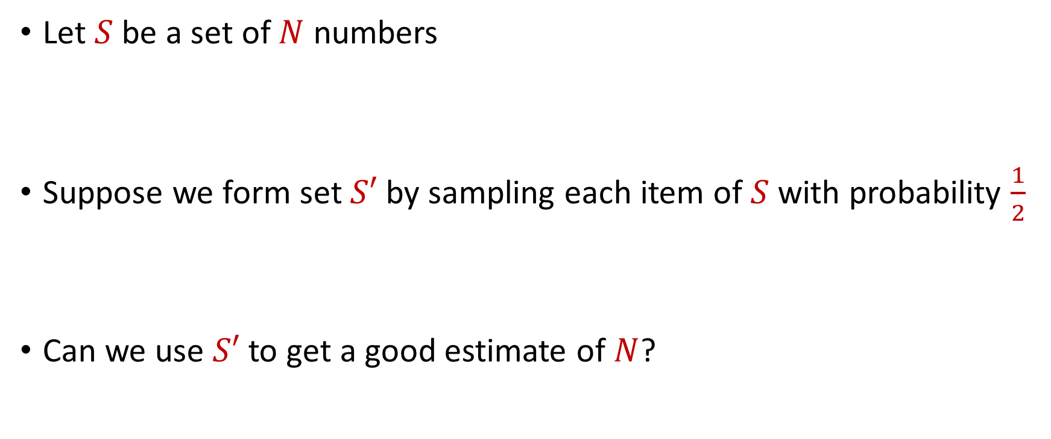
Distinct Elements ($F_{0}$ Estimation)
Let $S$ be a set of $N$ numbers
Suppose we form set $S′$ by sampling each item of $S$ with probability $\frac{1}{2}$
Can we use $S′$ to get a good estimate of $N$?

Slide 9
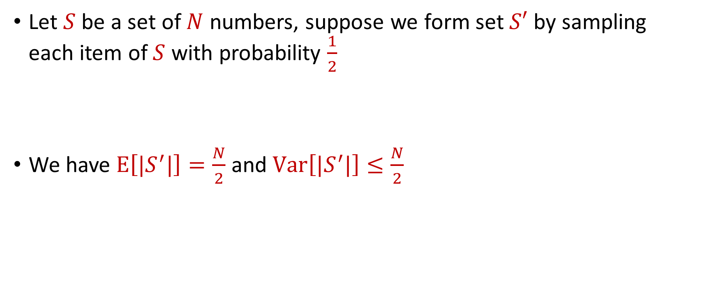
Distinct Elements ($F_{0}$ Estimation)
Let $S$ be a set of $N$ numbers, suppose we form set $S′$ by sampling each item of $S$ with probability $\frac{1}{2}$
We have $E\left[|S^{′}|\right]=\frac{N}{2}$ and $Var\left[|S^{′}|\right]≤\frac{N}{2}$

Slide 10

Distinct Elements ($F_{0}$ Estimation)
Claim: We have $Var\left[|S^{′}|\right]≤\frac{N}{2}$

Slide 11

Distinct Elements ($F_{0}$ Estimation)
Claim: We have $Var\left[|S^{′}|\right]≤\frac{N}{2}$
Let $X_{1},…, X_{N}$ be indicator random variables so that $X_{i}=1$ if the $i$-th element of $S$ is sampled into $S′$ and otherwise $X_{i}=0$

Slide 12

Distinct Elements ($F_{0}$ Estimation)
Claim: We have $Var\left[|S^{′}|\right]≤\frac{N}{2}$
Let $X_{1},…, X_{N}$ be indicator random variables so that $X_{i}=1$ if the $i$-th element of $S$ is sampled into $S′$ and otherwise $X_{i}=0$
Let $X=X_{1}+…+X_{N}$, so that $X=|S^{′}|$

Slide 13
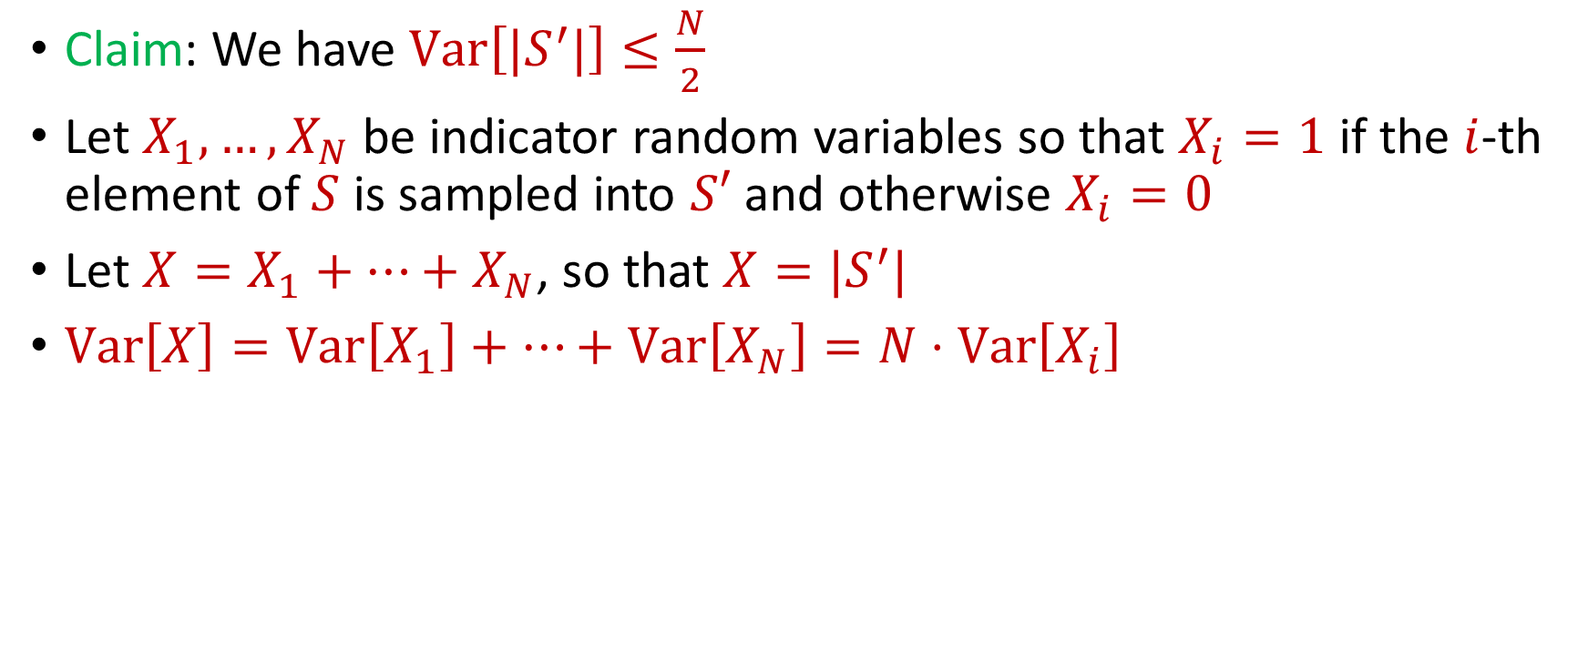
Distinct Elements ($F_{0}$ Estimation)
Claim: We have $Var\left[|S^{′}|\right]≤\frac{N}{2}$
Let $X_{1},…, X_{N}$ be indicator random variables so that $X_{i}=1$ if the $i$-th element of $S$ is sampled into $S′$ and otherwise $X_{i}=0$
Let $X=X_{1}+…+X_{N}$, so that $X=|S^{′}|$
$Var\left[X\right]=Var\left[X_{1}\right]+…+Var\left[X_{N}\right]=N⋅Var\left[X_{i}\right]$

Slide 14
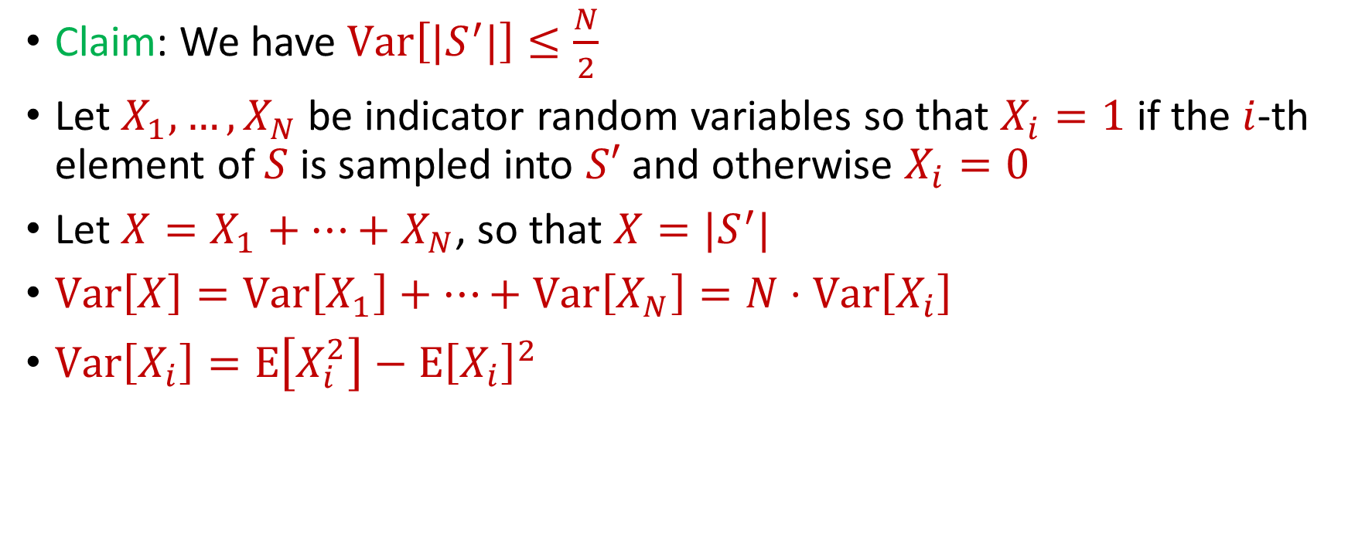
Distinct Elements ($F_{0}$ Estimation)
Claim: We have $Var\left[|S^{′}|\right]≤\frac{N}{2}$
Let $X_{1},…, X_{N}$ be indicator random variables so that $X_{i}=1$ if the $i$-th element of $S$ is sampled into $S′$ and otherwise $X_{i}=0$
Let $X=X_{1}+…+X_{N}$, so that $X=|S^{′}|$
$Var\left[X\right]=Var\left[X_{1}\right]+…+Var\left[X_{N}\right]=N⋅Var\left[X_{i}\right]$
$Var\left[X_{i}\right]=E\left[X_{i}^{2}\right]−E{\left[X_{i}\right]}^{2}$

Slide 15
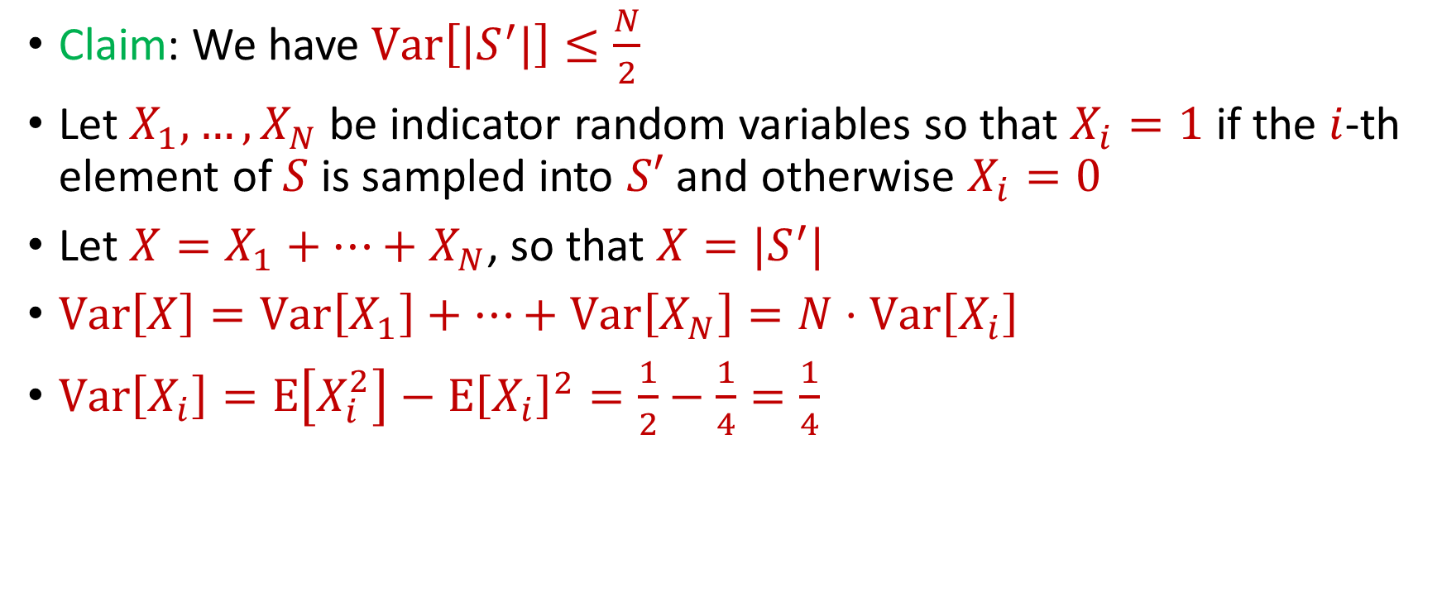
Distinct Elements ($F_{0}$ Estimation)
Claim: We have $Var\left[|S^{′}|\right]≤\frac{N}{2}$
Let $X_{1},…, X_{N}$ be indicator random variables so that $X_{i}=1$ if the $i$-th element of $S$ is sampled into $S′$ and otherwise $X_{i}=0$
Let $X=X_{1}+…+X_{N}$, so that $X=|S^{′}|$
$Var\left[X\right]=Var\left[X_{1}\right]+…+Var\left[X_{N}\right]=N⋅Var\left[X_{i}\right]$
$Var\left[X_{i}\right]=E\left[X_{i}^{2}\right]−E{\left[X_{i}\right]}^{2}=\frac{1}{2}−\frac{1}{4}=\frac{1}{4}$

Slide 16
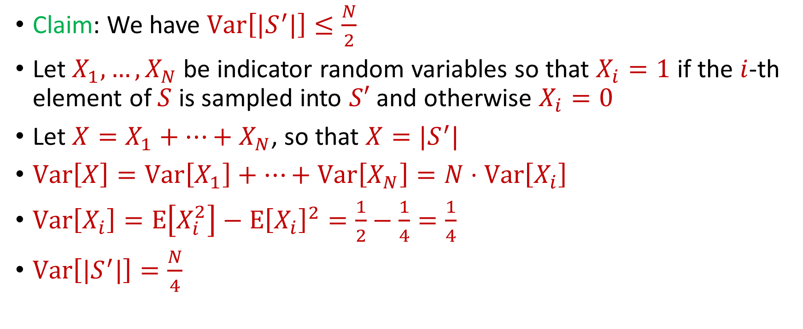
Distinct Elements ($F_{0}$ Estimation)
Claim: We have $Var\left[|S^{′}|\right]≤\frac{N}{2}$
Let $X_{1},…, X_{N}$ be indicator random variables so that $X_{i}=1$ if the $i$-th element of $S$ is sampled into $S′$ and otherwise $X_{i}=0$
Let $X=X_{1}+…+X_{N}$, so that $X=|S^{′}|$
$Var\left[X\right]=Var\left[X_{1}\right]+…+Var\left[X_{N}\right]=N⋅Var\left[X_{i}\right]$
$Var\left[X_{i}\right]=E\left[X_{i}^{2}\right]−E{\left[X_{i}\right]}^{2}=\frac{1}{2}−\frac{1}{4}=\frac{1}{4}$
$Var\left[|S^{′}|\right]=\frac{N}{4}$

Slide 17

Distinct Elements ($F_{0}$ Estimation)
What can we say about $Pr\left[\left|\left|S^{′}\right|−\frac{N}{2}\right|≥t\right]$?
By Chebyshev’s inequality, we have $Pr\left[\left|\left|S^{′}\right|−\frac{N}{2}\right|≥100\sqrt{N}\right]≤\frac{1}{10}$

Slide 18
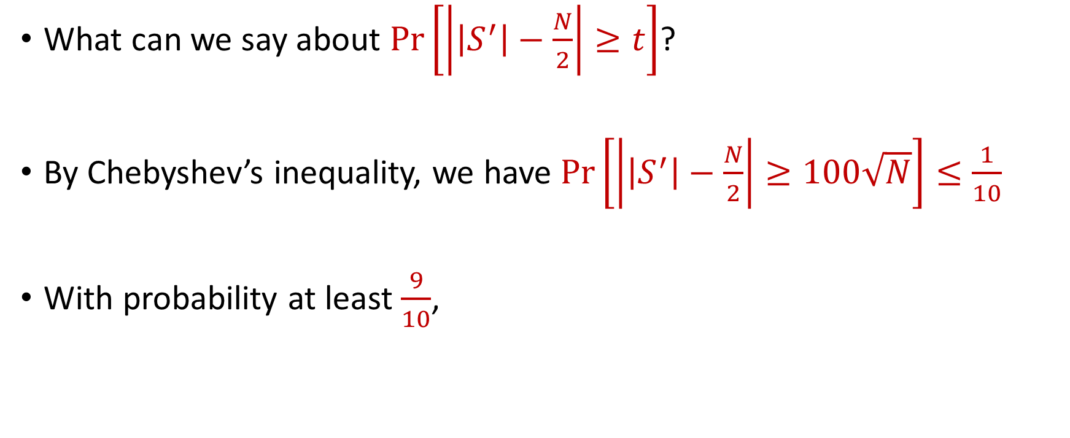
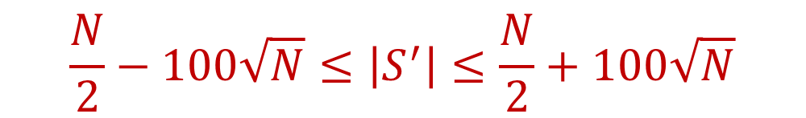
Distinct Elements ($F_{0}$ Estimation)
What can we say about $Pr\left[\left|\left|S^{′}\right|−\frac{N}{2}\right|≥t\right]$?
By Chebyshev’s inequality, we have $Pr\left[\left|\left|S^{′}\right|−\frac{N}{2}\right|≥100\sqrt{N}\right]≤\frac{1}{10}$
With probability at least $\frac{9}{10}$,
$$\frac{N}{2}−100\sqrt{N}≤\left|S^{′}\right|≤\frac{N}{2}+100\sqrt{N}$$

Slide 19

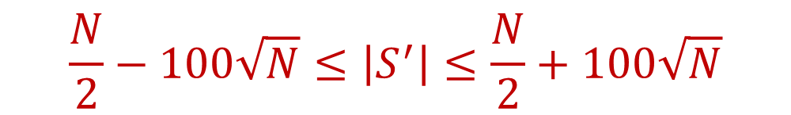
Distinct Elements ($F_{0}$ Estimation)
With probability at least $\frac{9}{10}$,
Thus, with probability at least $\frac{9}{10}$,
$$\frac{N}{2}−100\sqrt{N}≤\left|S^{′}\right|≤\frac{N}{2}+100\sqrt{N}$$
$$N−200\sqrt{N}≤2\left|S^{′}\right|≤N+200\sqrt{N}$$

Slide 20

Distinct Elements ($F_{0}$ Estimation)
With probability at least $\frac{9}{10}$,
If $200\sqrt{N}≤\frac{N}{100}$, then $N−200\sqrt{N}≤2\left|S^{′}\right|≤N+200\sqrt{N}$ implies
Very good approximation to $N$
$$N−200\sqrt{N}≤2\left|S^{′}\right|≤N+200\sqrt{N}$$
$$0.99N≤2\left|S^{′}\right|≤1.01N$$

Slide 21
Distinct Elements ($F_{0}$ Estimation)
What algorithm does this suggest?

Slide 22
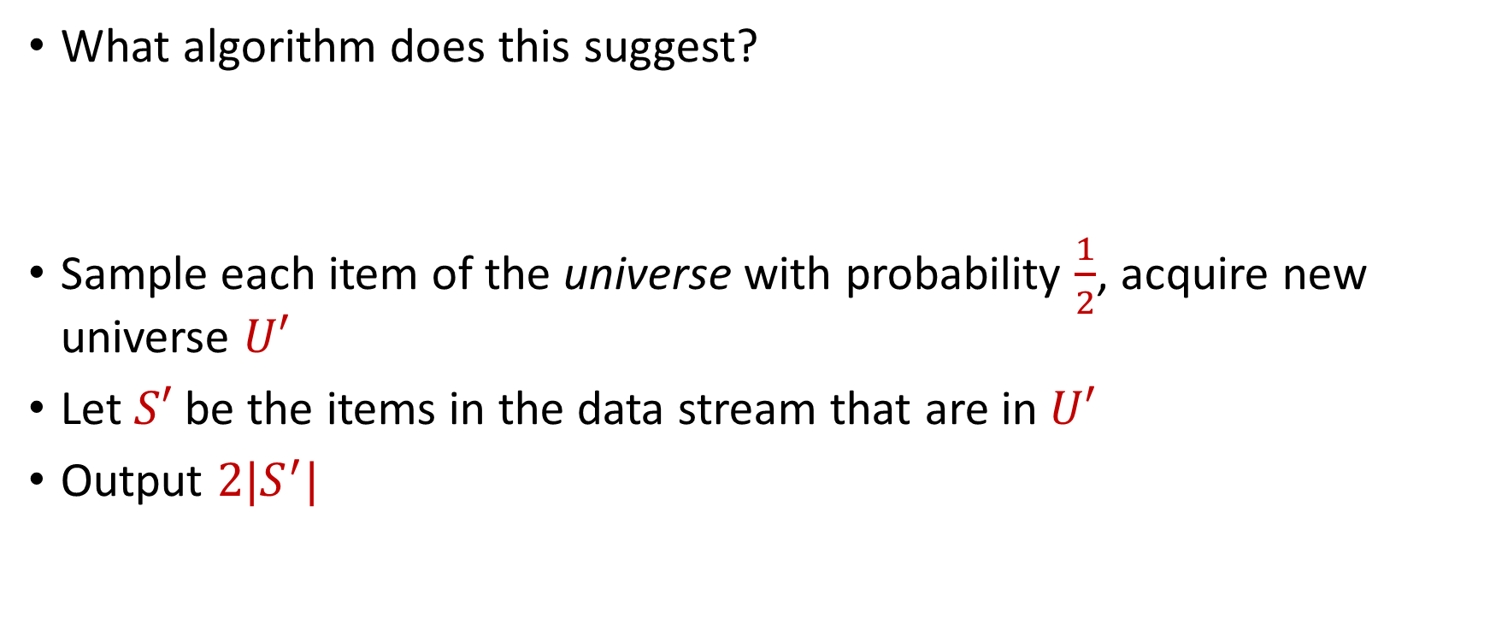
Distinct Elements ($F_{0}$ Estimation)
What algorithm does this suggest?
Sample each item of the universe with probability $\frac{1}{2}$, acquire new universe $U′$
Let $S′$ be the items in the data stream that are in $U′$
Output $2|S^{′}|$

Slide 23
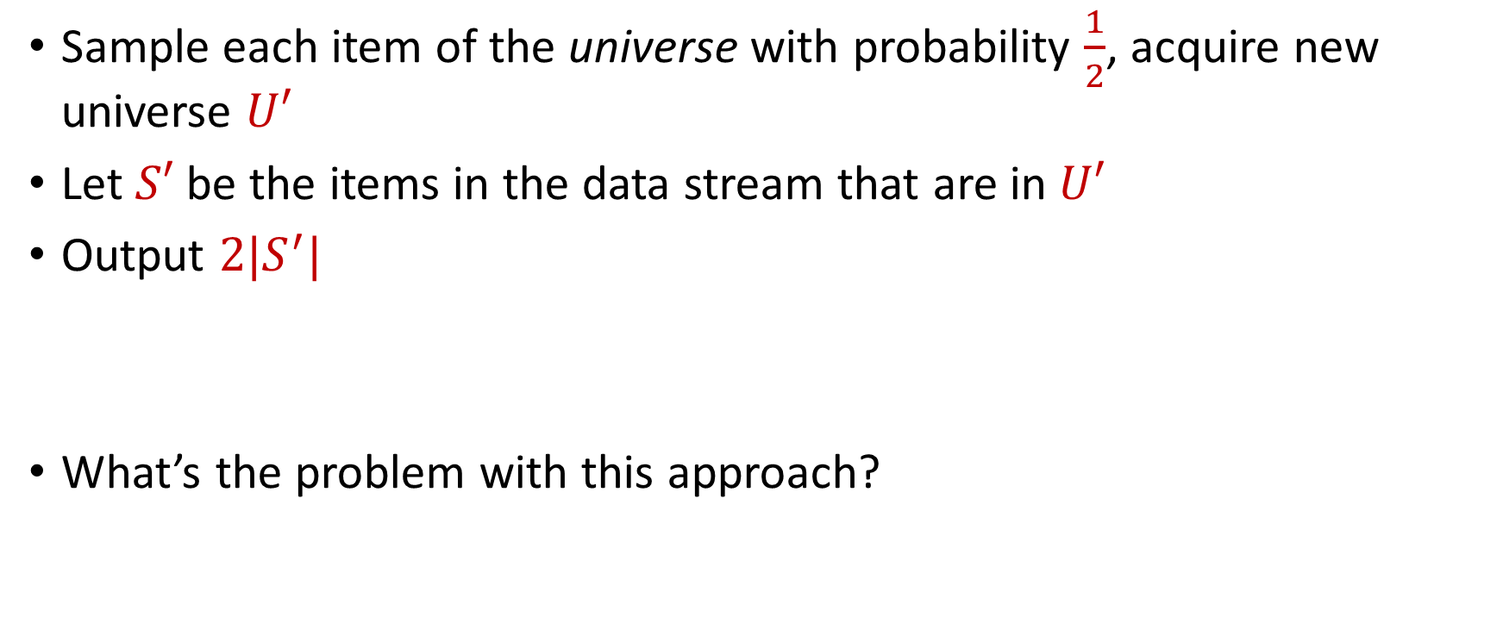
Distinct Elements ($F_{0}$ Estimation)
Sample each item of the universe with probability $\frac{1}{2}$, acquire new universe $U′$
Let $S′$ be the items in the data stream that are in $U′$
Output $2|S^{′}|$
What’s the problem with this approach?

Slide 24
Distinct Elements ($F_{0}$ Estimation)
Let $S$ be a set of $N$ numbers
Suppose we form set $S′$ by sampling each item of $S$ with probability $\frac{1}{2}$
Can we use $S′$ to get a good estimate of $N$?

Slide 25
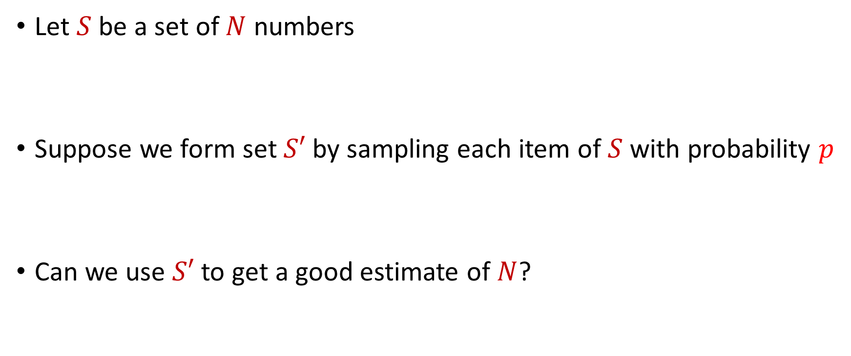
Distinct Elements ($F_{0}$ Estimation)
Let $S$ be a set of $N$ numbers
Suppose we form set $S′$ by sampling each item of $S$ with probability $p$
Can we use $S′$ to get a good estimate of $N$?

Slide 26
Distinct Elements ($F_{0}$ Estimation)
Let $S$ be a set of $N$ numbers, suppose we form set $S′$ by sampling each item of $S$ with probability $\frac{1}{2}$
We have $E\left[|S^{′}|\right]=\frac{N}{2}$ and $Var\left[|S^{′}|\right]≤\frac{N}{2}$

Slide 27
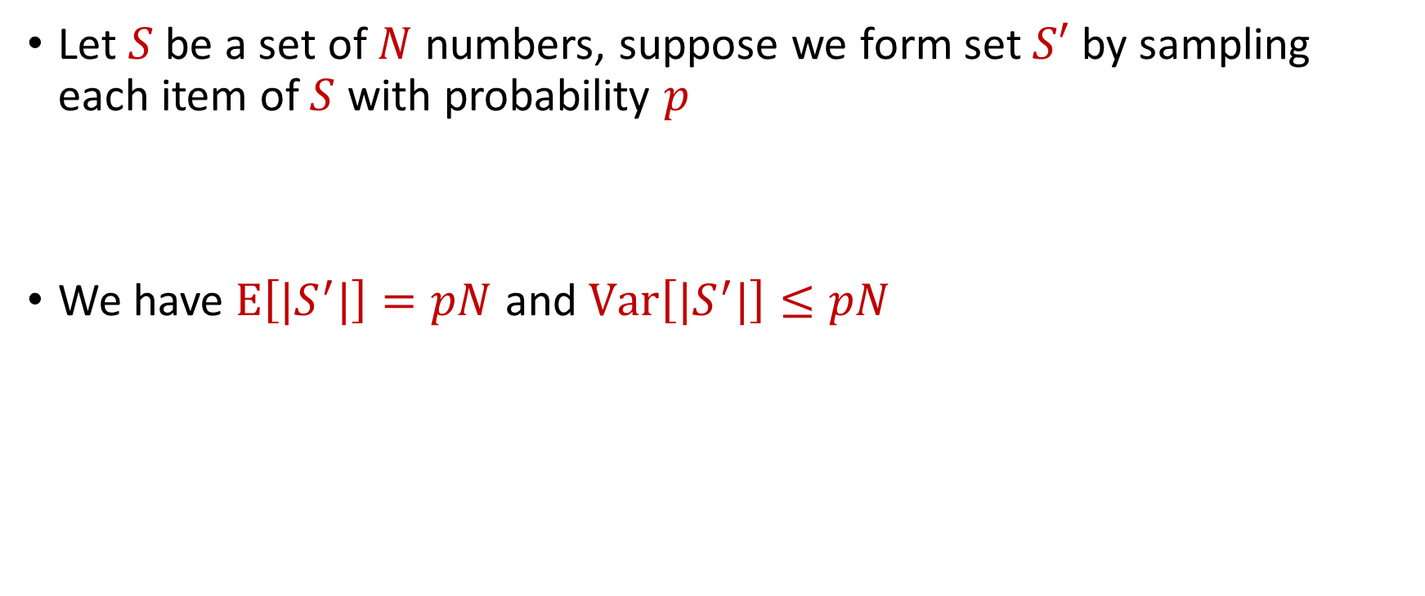
Distinct Elements ($F_{0}$ Estimation)
Let $S$ be a set of $N$ numbers, suppose we form set $S′$ by sampling each item of $S$ with probability $p$
We have $E\left[|S^{′}|\right]=pN$ and $Var\left[|S^{′}|\right]≤pN$

Slide 28

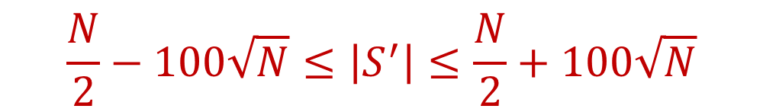
Distinct Elements ($F_{0}$ Estimation)
($S′$ is formed by sampling each item of $S$ with probability $\frac{1}{2}$ ) With probability at least $\frac{9}{10}$,
Thus with probability at least $\frac{9}{10}$,
$$\frac{N}{2}−100\sqrt{N}≤\left|S^{′}\right|≤\frac{N}{2}+100\sqrt{N}$$
$$N−200\sqrt{N}≤2\left|S^{′}\right|≤N+200\sqrt{N}$$

Slide 29

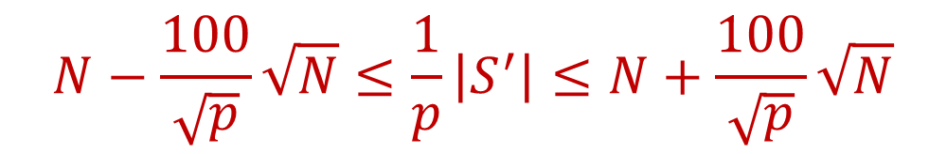
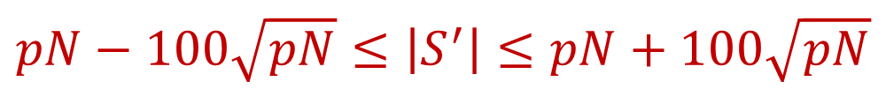
Distinct Elements ($F_{0}$ Estimation)
($S′$ is formed by sampling each item of $S$ with probability $p$) With probability at least $\frac{9}{10}$,
Thus with probability at least $\frac{9}{10}$,
$$pN−100\sqrt{pN}≤\left|S^{′}\right|≤pN+100\sqrt{pN}$$
$$N−\frac{100}{\sqrt{p}}\sqrt{N}≤\frac{1}{p}\left|S^{′}\right|≤N+\frac{100}{\sqrt{p}}\sqrt{N}$$

Slide 30
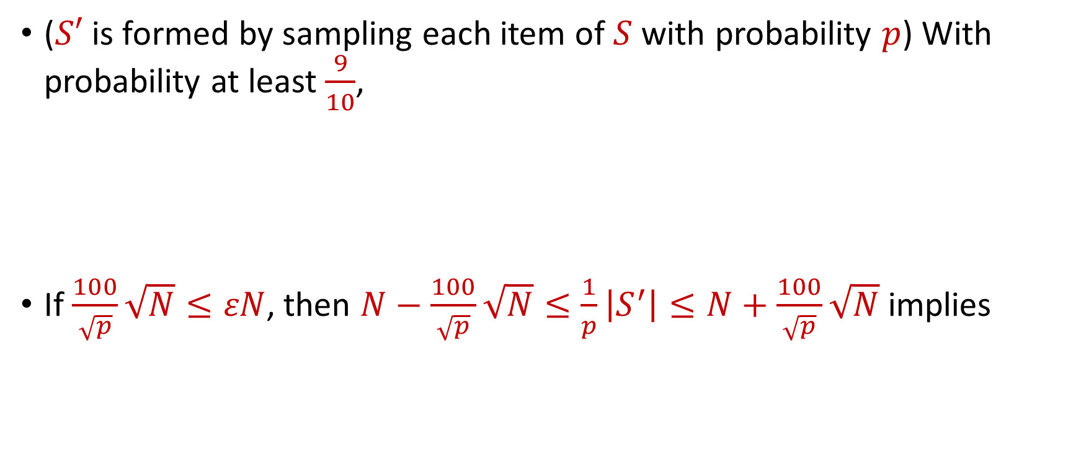

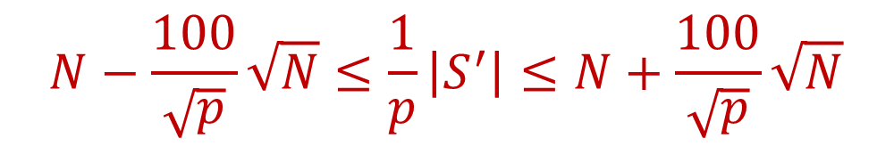
Distinct Elements ($F_{0}$ Estimation)
($S′$ is formed by sampling each item of $S$ with probability $p$) With probability at least $\frac{9}{10}$,
If $\frac{100}{\sqrt{p}}\sqrt{N}≤εN$, then $N−\frac{100}{\sqrt{p}}\sqrt{N}≤\frac{1}{p}\left|S^{′}\right|≤N+\frac{100}{\sqrt{p}}\sqrt{N}$ implies
$$N−\frac{100}{\sqrt{p}}\sqrt{N}≤\frac{1}{p}\left|S^{′}\right|≤N+\frac{100}{\sqrt{p}}\sqrt{N}$$
$$\left(1−ε\right)N≤\frac{1}{p}\left|S^{′}\right|≤\left(1+ε\right)N$$

Slide 31

Distinct Elements ($F_{0}$ Estimation)
In other words, with probability at least $\frac{9}{10}$, we have that $\frac{1}{p}\left|S^{′}\right|$ is a $\left(1+ε\right)$-approximation of $N$
What is $p$?

Slide 32
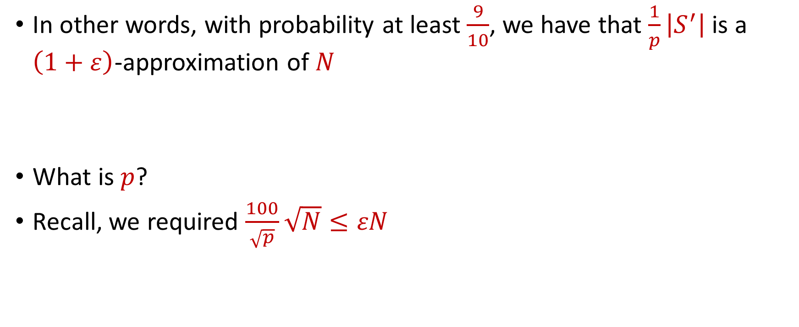
Distinct Elements ($F_{0}$ Estimation)
In other words, with probability at least $\frac{9}{10}$, we have that $\frac{1}{p}\left|S^{′}\right|$ is a $\left(1+ε\right)$-approximation of $N$
What is $p$?
Recall, we required $\frac{100}{\sqrt{p}}\sqrt{N}≤εN$

Slide 33
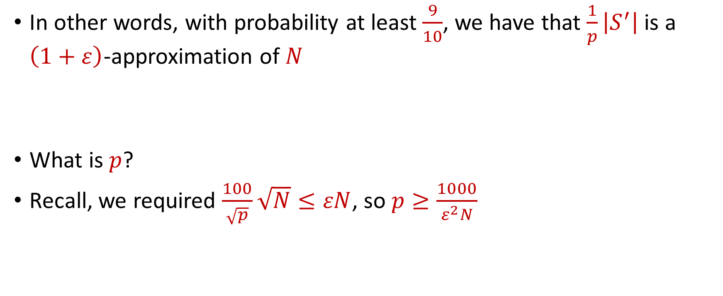
Distinct Elements ($F_{0}$ Estimation)
In other words, with probability at least $\frac{9}{10}$, we have that $\frac{1}{p}\left|S^{′}\right|$ is a $\left(1+ε\right)$-approximation of $N$
What is $p$?
Recall, we required $\frac{100}{\sqrt{p}}\sqrt{N}≤εN$, so $p≥\frac{1000}{ε^{2}N}$

Slide 34
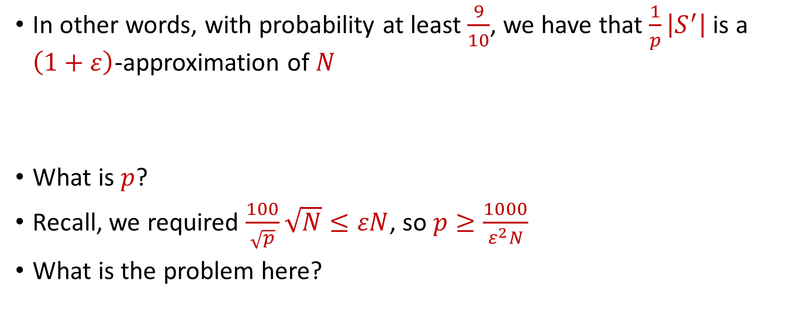
Distinct Elements ($F_{0}$ Estimation)
In other words, with probability at least $\frac{9}{10}$, we have that $\frac{1}{p}\left|S^{′}\right|$ is a $\left(1+ε\right)$-approximation of $N$
What is $p$?
Recall, we required $\frac{100}{\sqrt{p}}\sqrt{N}≤εN$, so $p≥\frac{1000}{ε^{2}N}$
What is the problem here?

Slide 35

Distinct Elements ($F_{0}$ Estimation)
In other words, with probability at least $\frac{9}{10}$, we have that $\frac{1}{p}\left|S^{′}\right|$ is a $\left(1+ε\right)$-approximation of $N$
What is $p$?
Recall, we required $\frac{100}{\sqrt{p}}\sqrt{N}≤εN$, so $p≥\frac{1000}{ε^{2}N}$
What is the problem here?
Must know $N$ to set $p$,
but the goal is to find $N$!

Slide 36

Distinct Elements ($F_{0}$ Estimation)
Observation: We do not need $p=\frac{1000}{ε^{2}N}$, it is also fine to have $p=\frac{2000}{ε^{2}N}$
How do we find a “good” $p$?

Slide 37


Finding $p$
Observation: We do not need $p=\frac{1000}{ε^{2}N}$, it is also fine to have $p=\frac{2000}{ε^{2}N}$
How do we find a “good” $p$?
What is a “good” $p$?

Slide 38
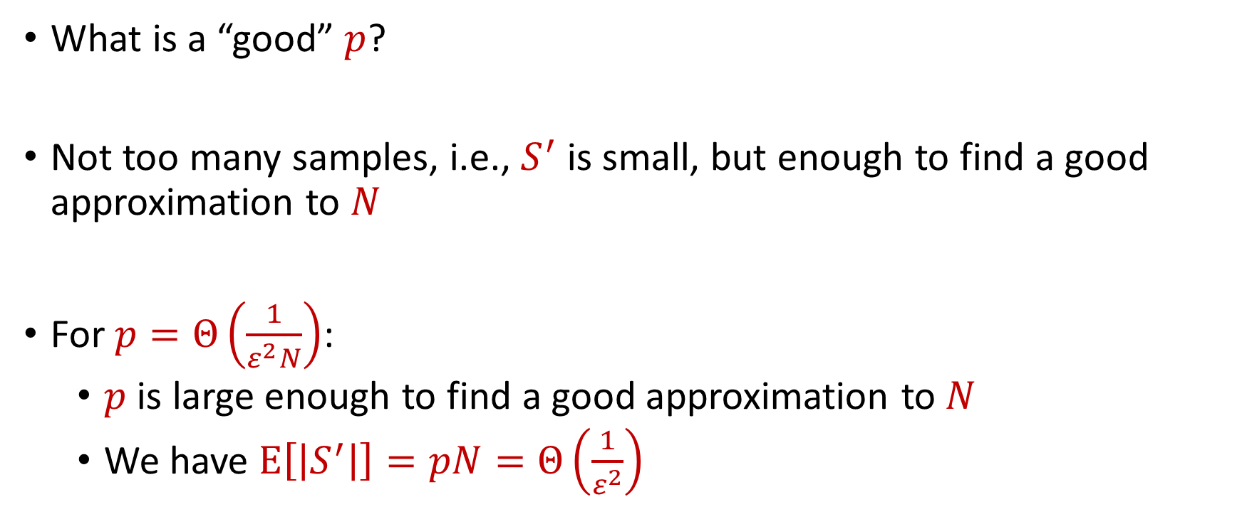
Finding $p$
What is a “good” $p$?
Not too many samples, i.e., $S^{′}$ is small, but enough to find a good approximation to $N$
For $p=Θ\left(\frac{1}{ε^{2}N}\right)$:
$p$ is large enough to find a good approximation to $N$
We have $E\left[\left|S^{′}\right|\right]=pN=Θ\left(\frac{1}{ε^{2}}\right)$

Slide 39
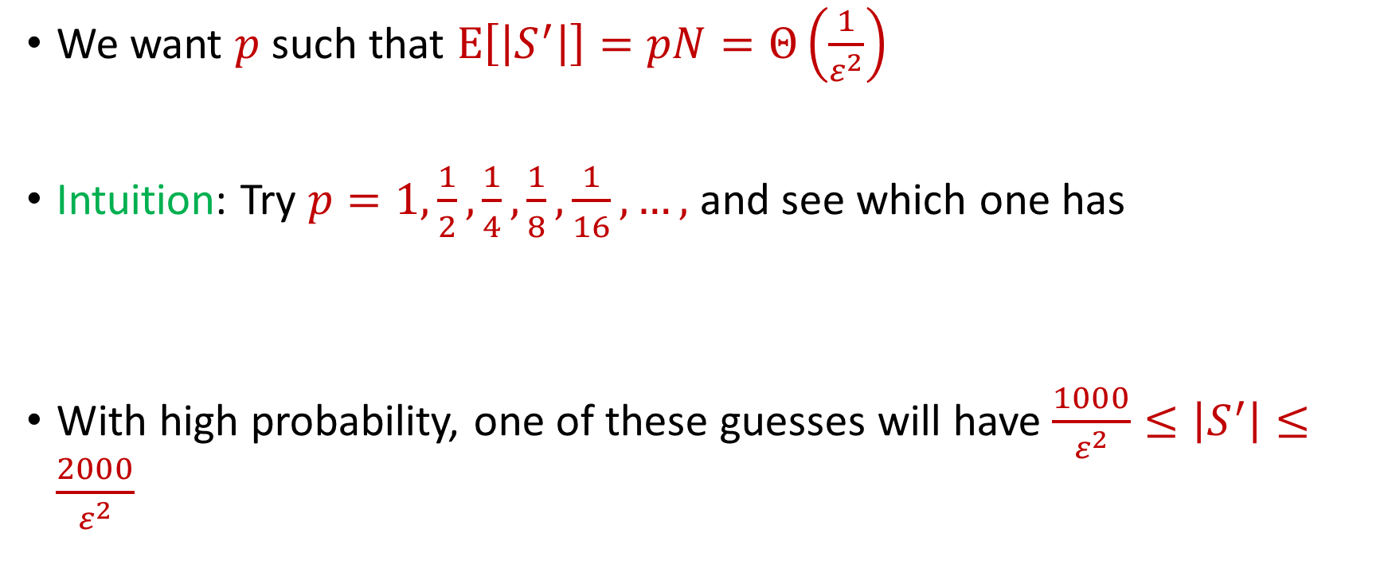

Finding $p$
We want $p$ such that $E\left[\left|S^{′}\right|\right]=pN=Θ\left(\frac{1}{ε^{2}}\right)$
Intuition: Try $p=1,\frac{1}{2},\frac{1}{4},\frac{1}{8},\frac{1}{16},…,$ and see which one has
With high probability, one of these guesses will have $\frac{1000}{ε^{2}}≤\left|S^{′}\right|≤\frac{2000}{ε^{2}}$
$$\frac{1000}{ε^{2}}≤\left|S^{′}\right|≤\frac{2000}{ε^{2}}$$

Slide 40


Finding $p$
Intuition: Try $p=1,\frac{1}{2},\frac{1}{4},\frac{1}{8},\frac{1}{16},…,$ and see which one has
However, the wrong guesses will have too many samples
$$\frac{1000}{ε^{2}}≤\left|S^{′}\right|≤\frac{2000}{ε^{2}}$$

Slide 41
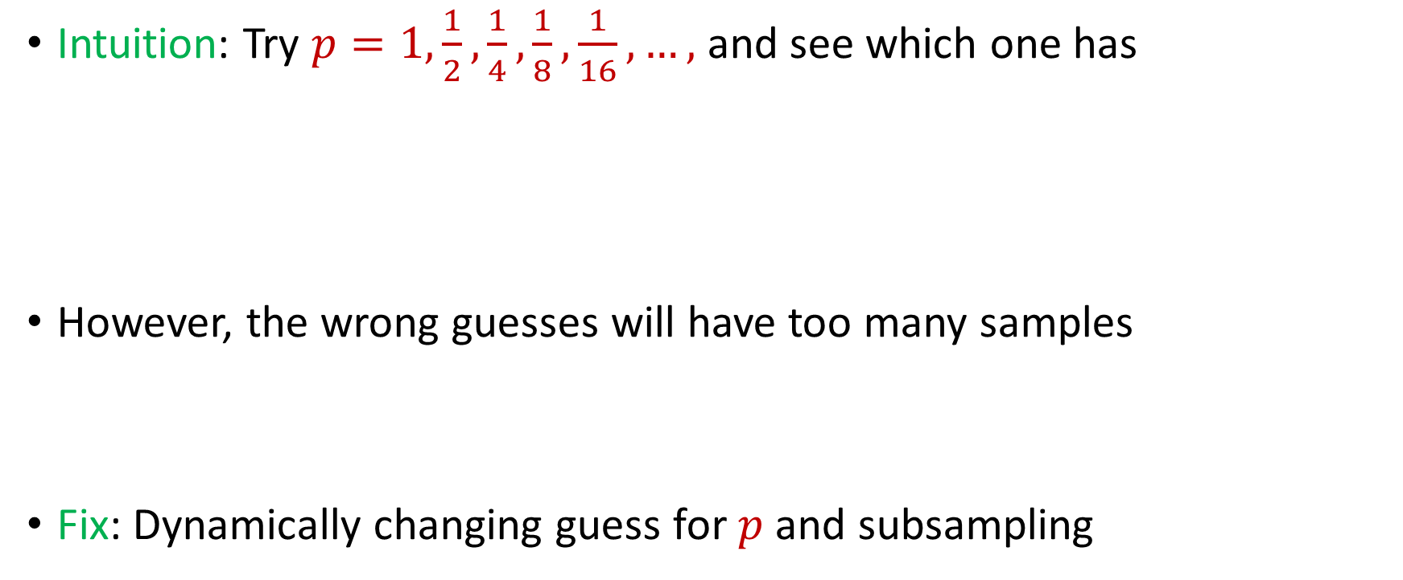
Finding $p$
Intuition: Try $p=1,\frac{1}{2},\frac{1}{4},\frac{1}{8},\frac{1}{16},…,$ and see which one has
However, the wrong guesses will have too many samples
Fix: Dynamically changing guess for $p$ and subsampling
$$\frac{1000}{ε^{2}}≤\left|S^{′}\right|≤\frac{2000}{ε^{2}}$$

Slide 42
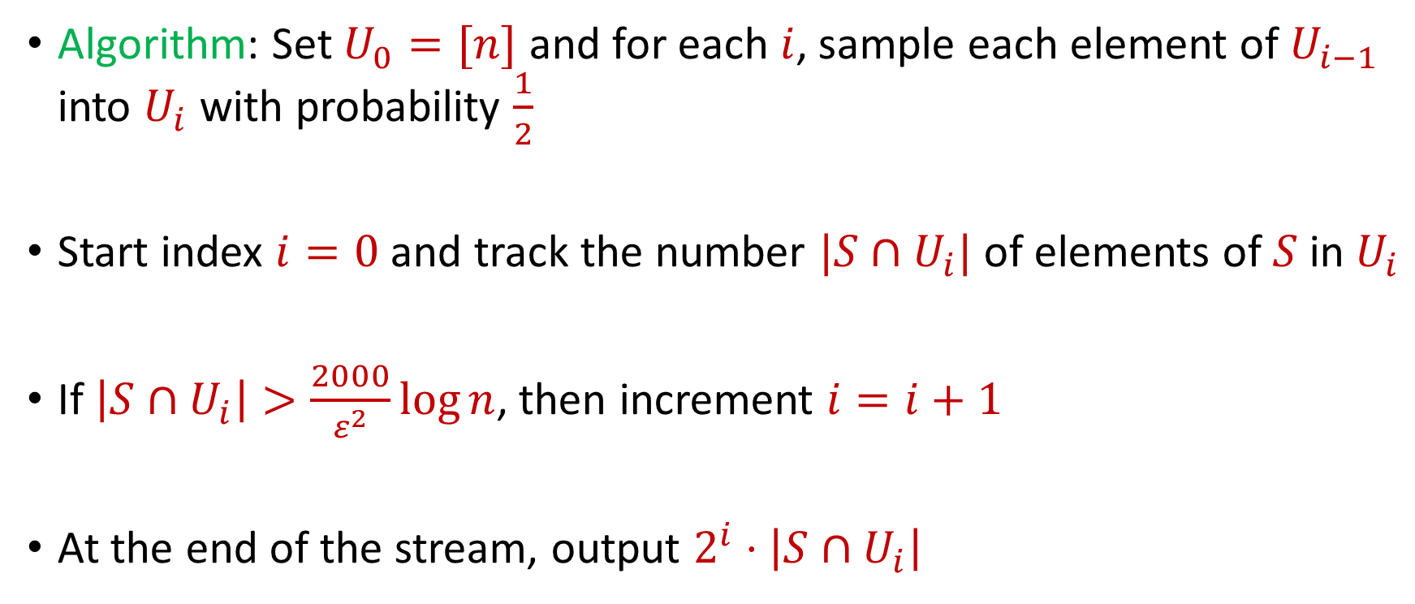
Finding $p$
Algorithm: Set $U_{0}=[n]$ and for each $i$, sample each element of $U_{i−1}$ into $U_{i}$ with probability $\frac{1}{2}$
Start index $i=0$ and track the number $|S∩U_{i}|$ of elements of $S$ in $U_{i}$
If $\left|S∩U_{i}\right|>\frac{2000}{ε^{2}}\log{n}$, then increment $i=i+1$
At the end of the stream, output $2^{i}⋅\left|S∩U_{i}\right|$

Slide 43


Finding $p$
Algorithm: Set $U_{0}=[n]$ and for each $i$, sample each element of $U_{i−1}$ into $U_{i}$ with probability $\frac{1}{2}$
Start index $i=0$ and track the number $|S∩U_{i}|$ of elements of $S$ in $U_{i}$
If $\left|S∩U_{i}\right|>\frac{2000}{ε^{2}}\log{n}$, then increment $i=i+1$
At the end of the stream, output $2^{i}⋅\left|S∩U_{i}\right|$
$$\frac{1}{p}$$
$\left|S^{′}\right|$

Slide 44

Finding $p$
Recall that $\frac{1}{p}\left|S^{′}\right|$ is a $\left(1+ε\right)$-approximation of $N$
$2^{i}⋅\left|S∩U_{i}\right|$ is a $\left(1+ε\right)$-approximation of $N$
At the end of the stream, output $2^{i}⋅\left|S∩U_{i}\right|$
$$\frac{1}{p}$$
$\left|S^{′}\right|$

Slide 45

Distinct Elements ($F_{0}$ Estimation)
Summary: Algorithm stores at most $\frac{2000}{ε^{2}}\log{n}$ elements from the stream, uses $Θ\left(\frac{1}{ε^{2}}\log{n}\right)$ words of space

Slide 46
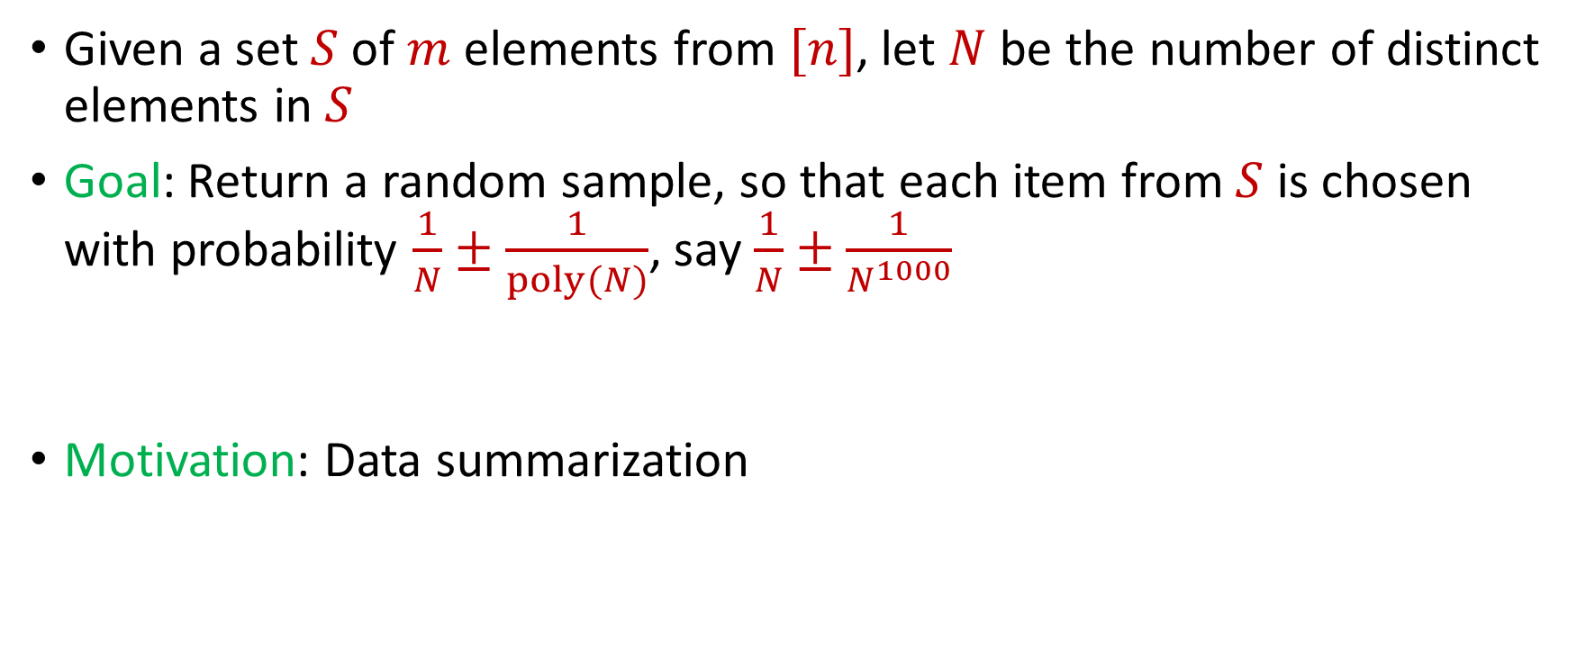

$L_{0}$ Sampling
Given a set $S$ of $m$ elements from $[n]$, let $N$ be the number of distinct elements in $S$
Goal: Return a random sample, so that each item from $S$ is chosen with probability $\frac{1}{N}±\frac{1}{poly(N)}$, say $\frac{1}{N}±\frac{1}{N^{1000}}$
Motivation: Data summarization

Slide 47
$L_{0}$ Sampling
Remember reservoir sampling? Does that work?

Slide 48
$L_{0}$ Sampling
Remember reservoir sampling? Does that work? NO!
1 2 2 2 2 2 2 2 2 2 2 2 2 2 2 2 2 2 2 2 2

Slide 49

$L_{0}$ Sampling
Algorithm: Modify $F_{0}$ estimation algorithm

