Slide 1
CSCE 658: Randomized Algorithms
Lecture 14
Samson Zhou

Slide 2
Probabilistic Method
Suppose we want to argue the existence of a certain desirable object
Existential argument, non-constructive
If there is an algorithm that can find it, it must exist!

Slide 3
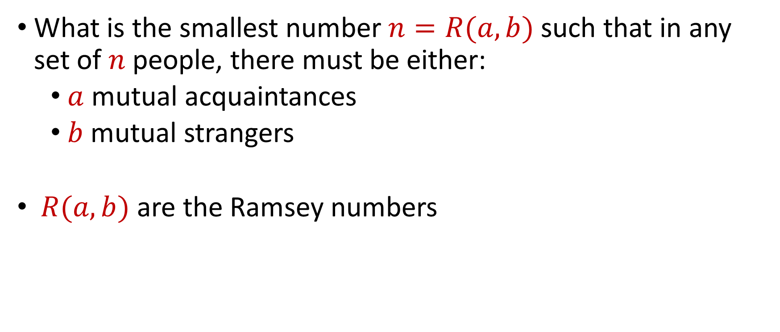
Ramsey Numbers
What is the smallest number $n=R(a,b)$ such that in any set of $n$ people, there must be either:
$a$ mutual acquaintances
$b$ mutual strangers
$R(a,b)$ are the Ramsey numbers

Slide 4
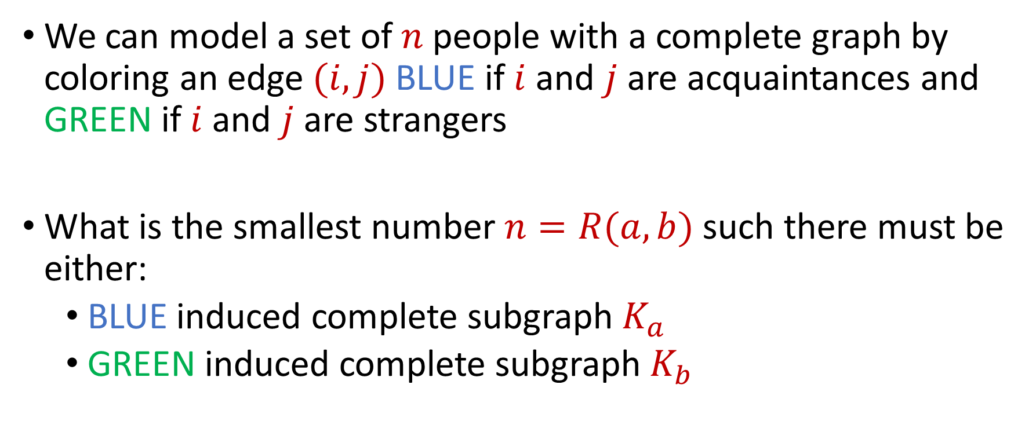
Ramsey Numbers
We can model a set of $n$ people with a complete graph by coloring an edge $(i,j)$ BLUE if $i$ and $j$ are acquaintances and GREEN if $i$ and $j$ are strangers
What is the smallest number $n=R(a,b)$ such there must be either:
BLUE induced complete subgraph $K_{a}$
GREEN induced complete subgraph $K_{b}$

Slide 5






Ramsey Numbers
$R\left(2,n\right)=n$
If no edges are green, then there exists blue $K_{n}$
$$1$$
$$2$$
$$5$$
$$4$$
$$3$$

Slide 6

Ramsey Numbers
$R\left(3,3\right)>5$
In fact, $R\left(3,3\right)=6$
$$1$$
$$2$$
$$5$$
$$4$$
$$3$$

Slide 7
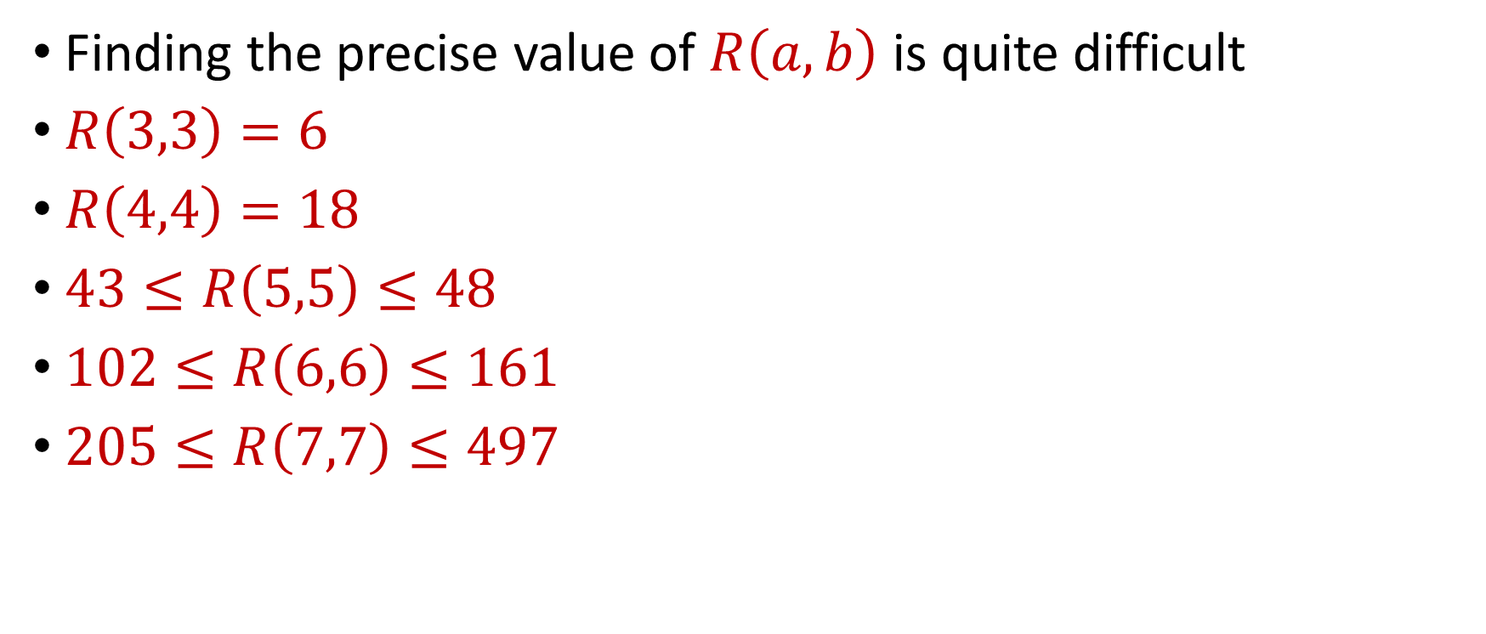
Ramsey Numbers
Finding the precise value of $R\left(a,b\right)$ is quite difficult
$R\left(3,3\right)=6$
$R\left(4,4\right)=18$
$43≤R\left(5,5\right)≤48$
$102≤R\left(6,6\right)≤161$
$205≤R\left(7,7\right)≤497$

Slide 8
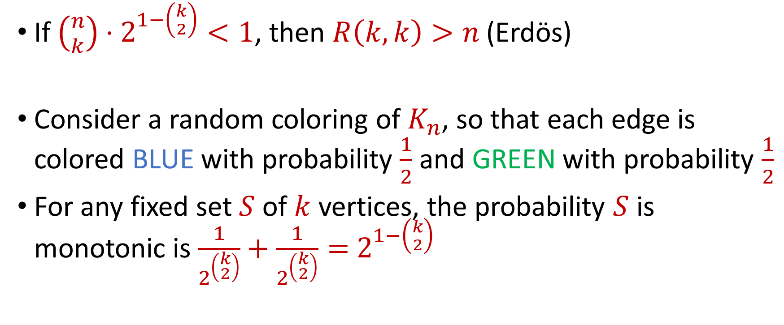
Probabilistic Method for Ramsey Numbers
If $\left({n \atop k}\right)⋅2^{1−\left({k \atop 2}\right)}<1$, then $R\left(k,k\right)>n$ (Erdös)
Consider a random coloring of $K_{n}$, so that each edge is colored BLUE with probability $\frac{1}{2}$ and GREEN with probability $\frac{1}{2}$
For any fixed set $S$ of $k$ vertices, the probability $S$ is monotonic is $\frac{1}{2^{\left({k \atop 2}\right)}}+\frac{1}{2^{\left({k \atop 2}\right)}}=$ $2^{1−\left({k \atop 2}\right)}$

Slide 9
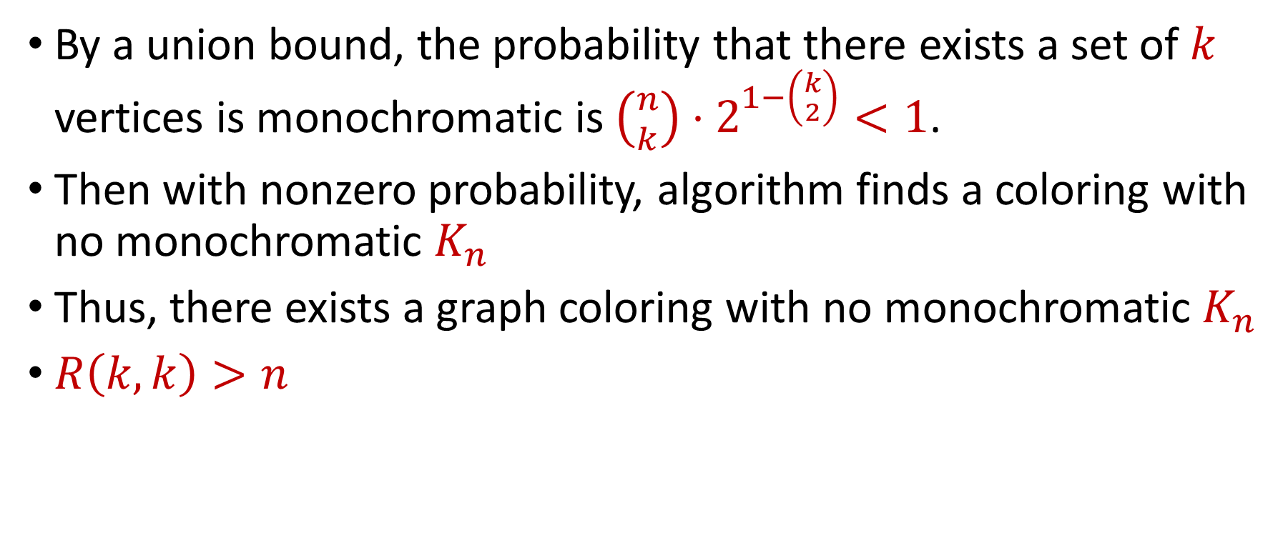
Probabilistic Method for Ramsey Numbers
By a union bound, the probability that there exists a set of $k$ vertices is monochromatic is $\left({n \atop k}\right)⋅2^{1−\left({k \atop 2}\right)}<1$.
Then with nonzero probability, algorithm finds a coloring with no monochromatic $K_{n}$
Thus, there exists a graph coloring with no monochromatic $K_{n}$
$R\left(k,k\right)>n$

Slide 10
Probabilistic Method
Suppose we want to argue the existence of a certain desirable object
Existential argument, non-constructive
If there is an algorithm that can find it, it must exist!

Slide 11
Probabilistic Method
Suppose we want to argue the existence of a certain desirable object
Existential argument, non-constructive
A random variable cannot always be less than its expected value
A random variable cannot always be more than its expected value

Slide 12
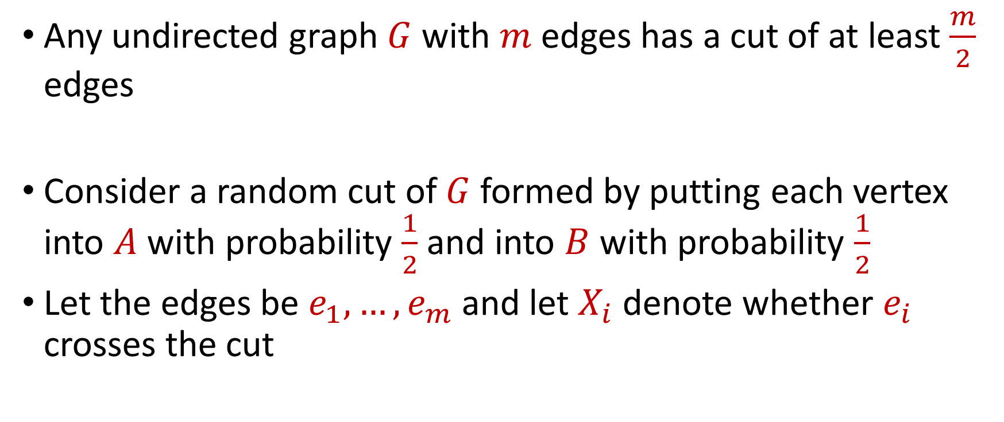
Probabilistic Method for Graph Cuts
Any undirected graph $G$ with $m$ edges has a cut of at least $\frac{m}{2}$ edges
Consider a random cut of $G$ formed by putting each vertex into $A$ with probability $\frac{1}{2}$ and into $B$ with probability $\frac{1}{2}$
Let the edges be $e_{1},…,e_{m}$ and let $X_{i}$ denote whether $e_{i}$ crosses the cut

Slide 13
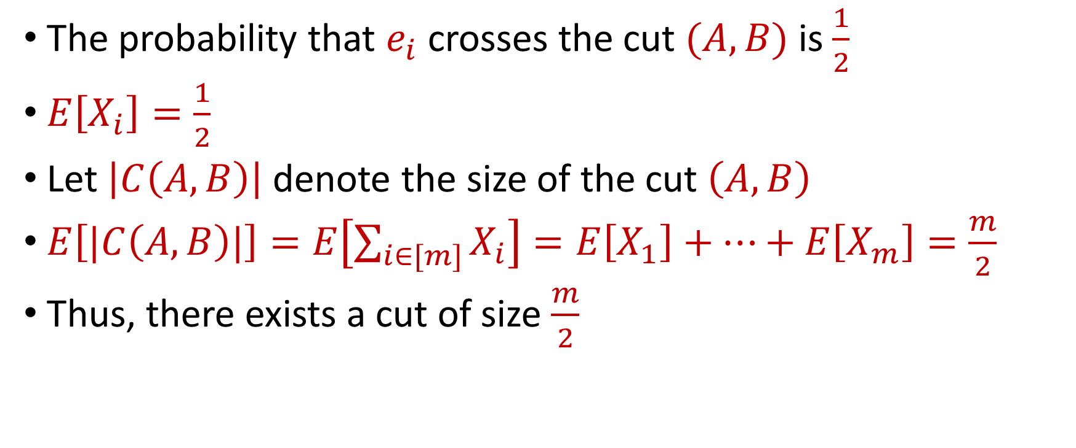
Probabilistic Method for Graph Cuts
The probability that $e_{i}$ crosses the cut $(A,B)$ is $\frac{1}{2}$
$E\left[X_{i}\right]=\frac{1}{2}$
Let $\left|C\left(A,B\right)\right|$ denote the size of the cut $\left(A,B\right)$
$E\left[|C\left(A,B\right)|\right]=E\left[\sum_{i∈[m]}{X_{i}}\right]=E\left[X_{1}\right]+…+E\left[X_{m}\right]=\frac{m}{2}$
Thus, there exists a cut of size $\frac{m}{2}$

Slide 14
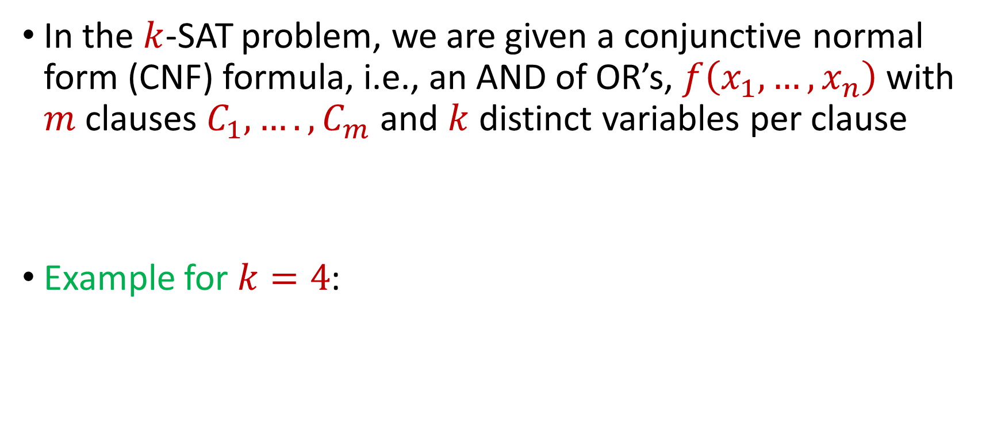

$k$-SAT
In the $k$-SAT problem, we are given a conjunctive normal form (CNF) formula, i.e., an AND of OR’s, $f\left(x_{1},…,x_{n}\right)$ with $m$ clauses $C_{1},….,C_{m}$ and $k$ distinct variables per clause
Example for $k=4$:
$$\left(x_{2}∨¬x_{4}∨x_{5}∨x_{7}\right)∧(x_{1}∨¬x_{3}∨x_{6}∨x_{8})$$

Slide 15


Probabilistic Method for $k$-SAT
Suppose $m<2^{k}$, we claim $f$ must be satisfiable!

Slide 16
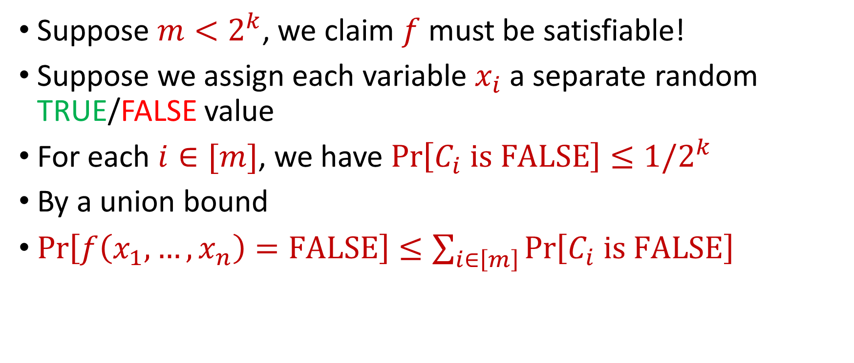

Probabilistic Method for $k$-SAT
Suppose $m<2^{k}$, we claim $f$ must be satisfiable!
Suppose we assign each variable $x_{i}$ a separate random TRUE/FALSE value
For each $i∈[m]$, we have $\operatorname{Pr}\left[C_{i} is FALSE\right]≤1/2^{k}$
By a union bound
$\operatorname{Pr}\left[f\left(x_{1},…,x_{n}\right)=FALSE\right]≤\sum_{i∈\left[m\right]}{\operatorname{Pr}\left[C_{i} is FALSE\right]}$
$$≤\frac{m}{2^{k}}<1$$

Slide 17
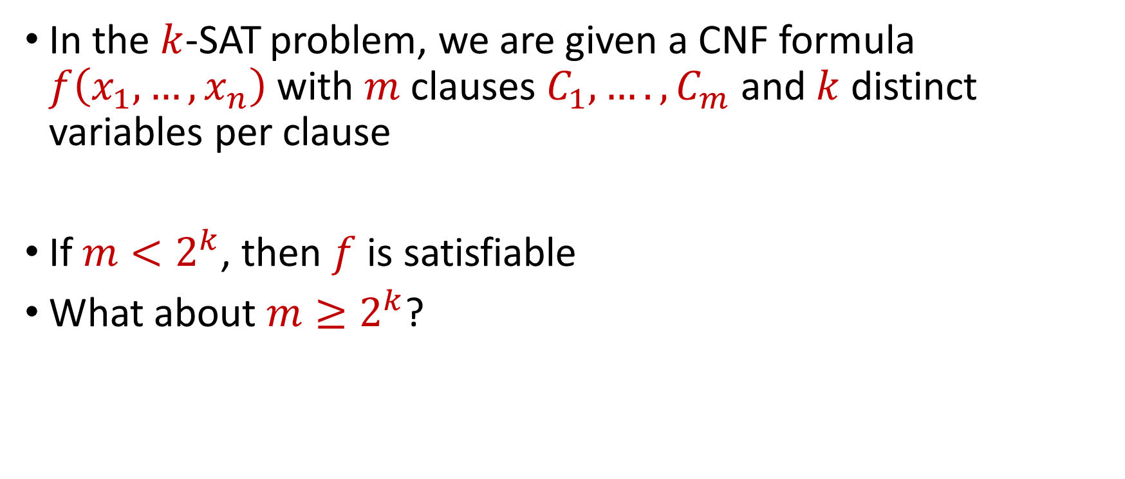
Probabilistic Method for $k$-SAT
In the $k$-SAT problem, we are given a CNF formula $f\left(x_{1},…,x_{n}\right)$ with $m$ clauses $C_{1},….,C_{m}$ and $k$ distinct variables per clause
If $m<2^{k}$, then $f$ is satisfiable
What about $m≥2^{k}$?

Slide 18
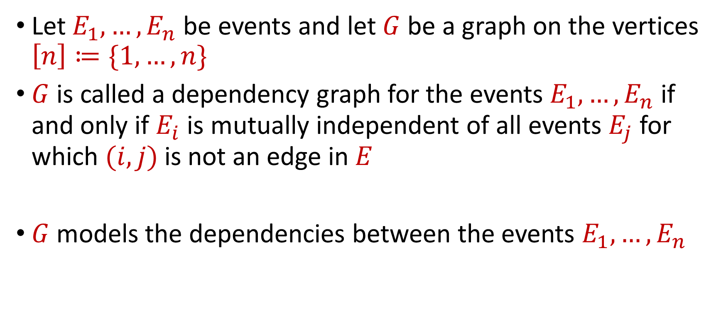
Dependency Graph
Let $E_{1},…,E_{n}$ be events and let $G$ be a graph on the vertices $\left[n\right]≔\{1,…,n\}$
$G$ is called a dependency graph for the events $E_{1},…,E_{n}$ if and only if $E_{i}$ is mutually independent of all events $E_{j}$ for which $(i,j)$ is not an edge in $E$
$G$ models the dependencies between the events $E_{1},…,E_{n}$

Slide 19
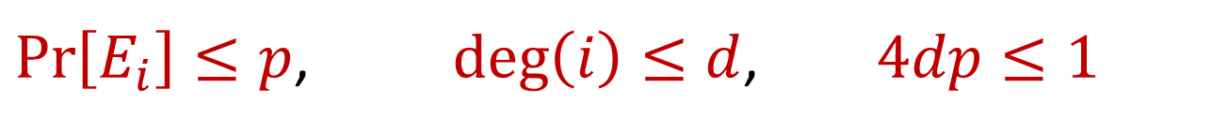
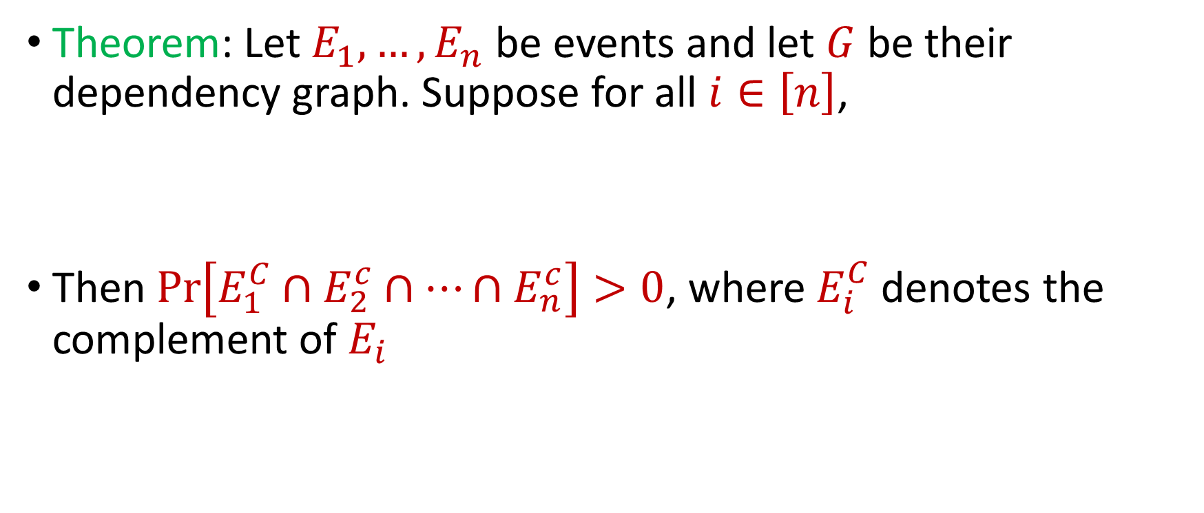
Lovász Local Lemma
Theorem: Let $E_{1},…,E_{n}$ be events and let $G$ be their dependency graph. Suppose for all $i∈\left[n\right]$,
Then $\operatorname{Pr}\left[E_{1}^{C}∩E_{2}^{c}∩…∩E_{n}^{c}\right]>0$, where $E_{i}^{C}$ denotes the complement of $E_{i}$
$\operatorname{Pr}\left[E_{i}\right]≤p$, $\deg\left(i\right)≤d$, $4dp≤1$

Slide 20

Lovász Local Lemma
To show $\operatorname{Pr}\left[E_{1}^{C}∩E_{2}^{c}∩…∩E_{n}^{c}\right]>0$, it suffices to show $\operatorname{Pr}\left[E_{i} | E_{1}^{C}∩E_{2}^{c}∩…∩E_{i−1}^{c}\right]≤2p$ for all $i∈\left[n\right]$.

Slide 21

Lovász Local Lemma
To show $\operatorname{Pr}\left[E_{1}^{C}∩E_{2}^{c}∩…∩E_{n}^{c}\right]>0$, it suffices to show $\operatorname{Pr}\left[E_{i} | E_{1}^{C}∩E_{2}^{c}∩…∩E_{i−1}^{c}\right]≤2p$ for all $i∈\left[n\right]$.
Indeed:
$$\operatorname{Pr}\left[E_{1}^{C}∩E_{2}^{c}∩…∩E_{n}^{c}\right]=Π_{i=1}^{n}\operatorname{Pr}\left[E_{i} | E_{1}^{C}∩E_{2}^{c}∩…∩E_{i−1}^{c}\right]$$
$$≥Π_{i=1}^{n}\left(1−2p\right)>0$$

Slide 22
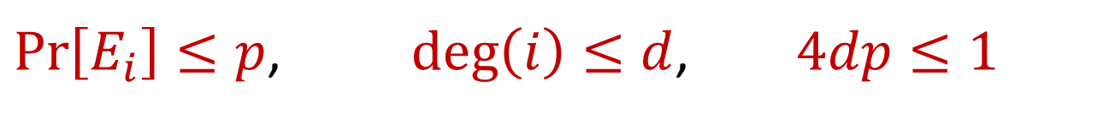
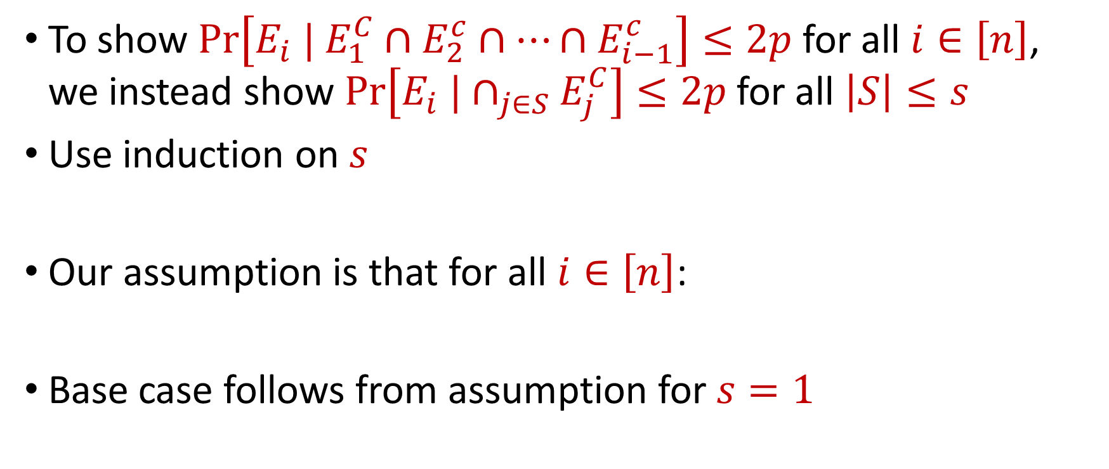
Lovász Local Lemma
To show $\operatorname{Pr}\left[E_{i} | E_{1}^{C}∩E_{2}^{c}∩…∩E_{i−1}^{c}\right]≤2p$ for all $i∈\left[n\right]$, we instead show $\operatorname{Pr}\left[E_{i} |∩_{j∈S}E_{j}^{C}\right]≤2p$ for all $\left|S\right|≤s$
Use induction on $s$
Our assumption is that for all $i∈\left[n\right]$:
Base case follows from assumption for $s=1$
$\operatorname{Pr}\left[E_{i}\right]≤p$, $\deg\left(i\right)≤d$, $4dp≤1$

Slide 23
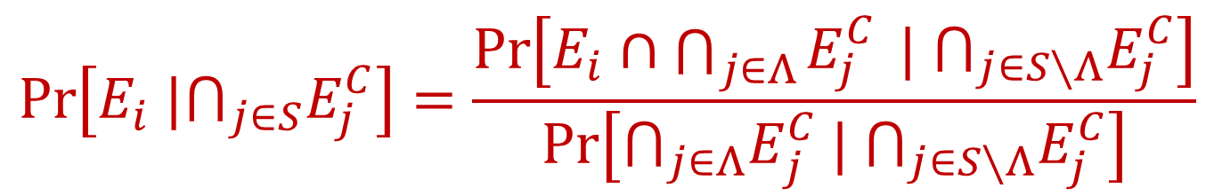

Lovász Local Lemma
Assume true for $s−1$, show $\operatorname{Pr}\left[E_{i} |∩_{j∈S}E_{j}^{C}\right]≤2p$ for all $\left|S\right|≤s$
Let $Λ$ be the neighbors of $i$ in $G$
By joint probability,
$$\operatorname{Pr}\left[E_{i} |⋂_{j∈S}E_{j}^{C}\right]=\frac{\operatorname{Pr}\left[E_{i}∩\bigcap_{j∈Λ}{E_{j}^{C}} | ⋂_{j∈S∖Λ}E_{j}^{C}\right]}{\operatorname{Pr}\left[{⋂_{j∈Λ}E}_{j}^{C} | ⋂_{j∈S∖Λ}E_{j}^{C}\right]}$$

Slide 24
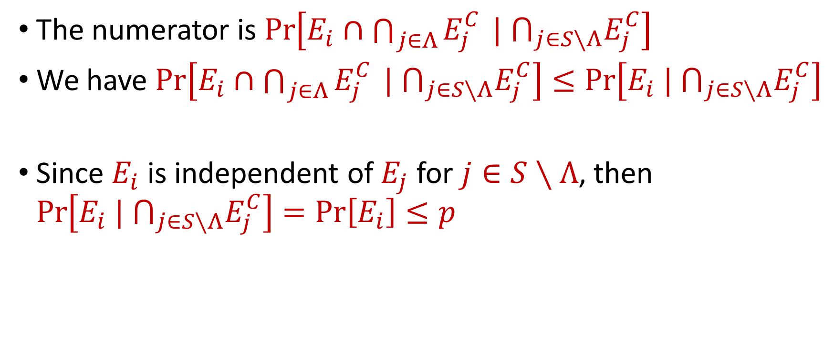
Lovász Local Lemma
The numerator is $\operatorname{Pr}\left[E_{i}∩\bigcap_{j∈Λ}{E_{j}^{C}} | ⋂_{j∈S∖Λ}E_{j}^{C}\right]$
We have $\operatorname{Pr}\left[E_{i}∩\bigcap_{j∈Λ}{E_{j}^{C}} | ⋂_{j∈S∖Λ}E_{j}^{C}\right]≤\operatorname{Pr}\left[E_{i} | ⋂_{j∈S∖Λ}E_{j}^{C}\right]$
Since $E_{i}$ is independent of $E_{j}$ for $j∈S∖Λ$, then $\operatorname{Pr}\left[E_{i} | ⋂_{j∈S∖Λ}E_{j}^{C}\right]=\operatorname{Pr}\left[E_{i}\right]≤p$

Slide 25
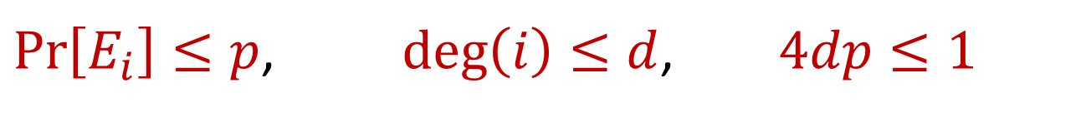

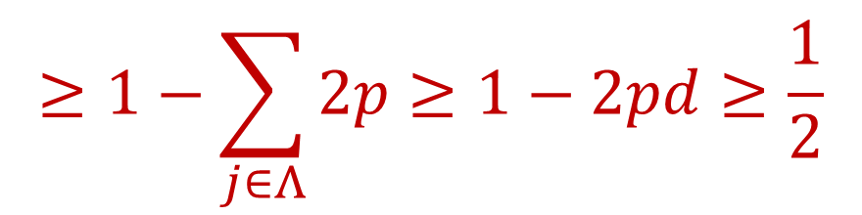

Lovász Local Lemma
The denominator is $\operatorname{Pr}\left[{⋂_{j∈Λ}E}_{j}^{C} | ⋂_{j∈S∖Λ}E_{j}^{C}\right]$
Our assumption is that for all $i∈\left[n\right]$:
By a union bound,
$\operatorname{Pr}\left[E_{i}\right]≤p$, $\deg\left(i\right)≤d$, $4dp≤1$
$$\operatorname{Pr}\left[{⋂_{j∈Λ}E}_{j}^{C} | ⋂_{j∈S∖Λ}E_{j}^{C}\right]≥1−\sum_{j∈Λ}{\operatorname{Pr}\left[E_{j}| ⋂_{j∈S∖Λ}E_{j}^{C}\right]}$$
$$≥1−\sum_{j∈Λ}{2p}≥1−2pd≥\frac{1}{2}$$

Slide 26
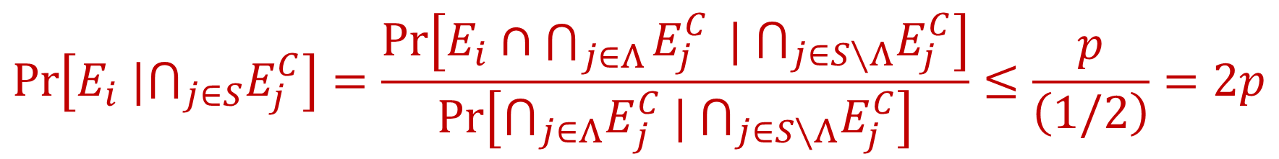

Lovász Local Lemma
Assume true for $s−1$, show $\operatorname{Pr}\left[E_{i} |∩_{j∈S}E_{j}^{C}\right]≤2p$ for all $\left|S\right|≤s$
Let $Λ$ be the neighbors of $i$ in $G$
By conditional probability,
$$\operatorname{Pr}\left[E_{i} |⋂_{j∈S}E_{j}^{C}\right]=\frac{\operatorname{Pr}\left[E_{i}∩\bigcap_{j∈Λ}{E_{j}^{C}} | ⋂_{j∈S∖Λ}E_{j}^{C}\right]}{\operatorname{Pr}\left[{⋂_{j∈Λ}E}_{j}^{C} | ⋂_{j∈S∖Λ}E_{j}^{C}\right]}≤\frac{p}{\left(1/2\right)}=2p$$

Slide 27
Lovász Local Lemma
Theorem: Let $E_{1},…,E_{n}$ be events and let $G$ be their dependency graph. Suppose for all $i∈\left[n\right]$,
Then $\operatorname{Pr}\left[E_{1}^{C}∩E_{2}^{c}∩…∩E_{n}^{c}\right]>0$, where $E_{i}^{C}$ denotes the complement of $E_{i}$
$\operatorname{Pr}\left[E_{i}\right]≤p$, $\deg\left(i\right)≤d$, $4dp≤1$

Slide 28
Probabilistic Method for $k$-SAT
In the $k$-SAT problem, we are given a CNF formula $f\left(x_{1},…,x_{n}\right)$ with $m$ clauses $C_{1},….,C_{m}$ and $k$ distinct variables per clause
If $m<2^{k}$, then $f$ is satisfiable
What about $m≥2^{k}$?

Slide 29
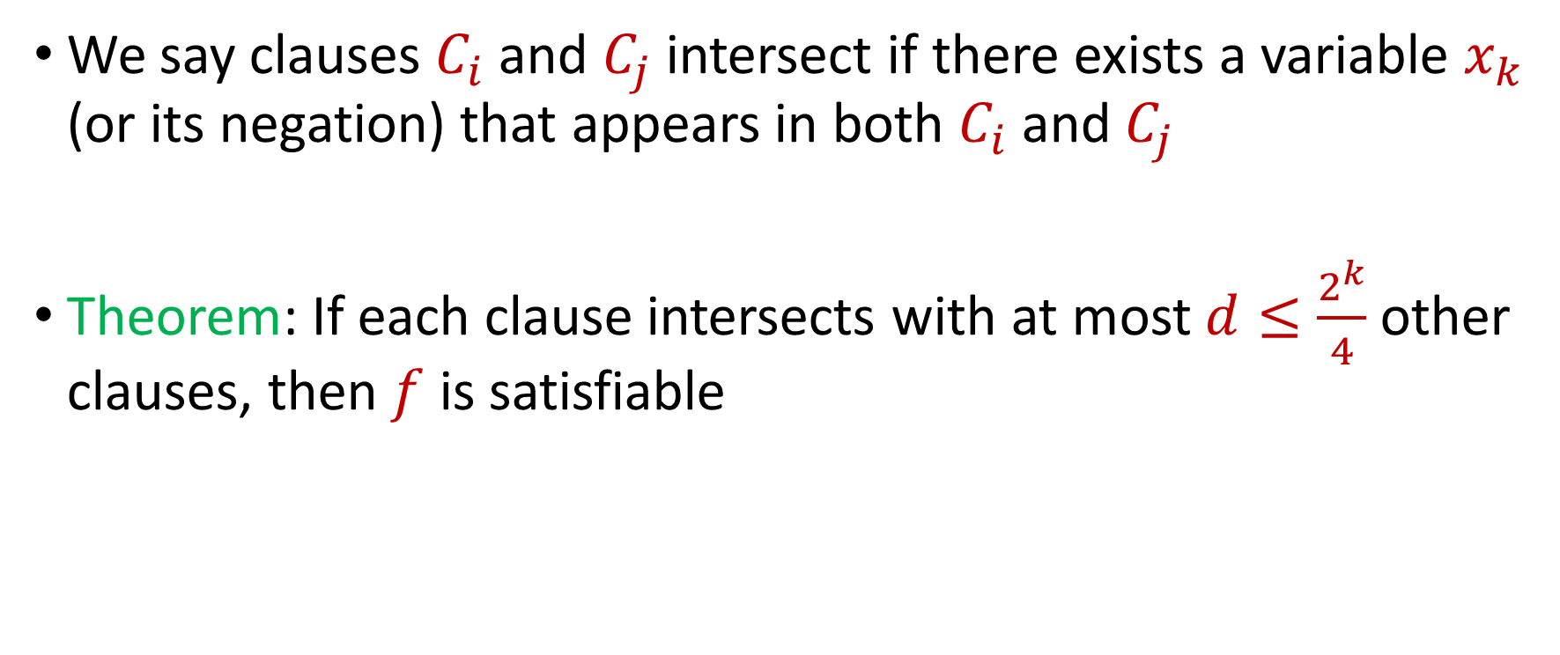

Resampling Algorithm for $k$-SAT
We say clauses $C_{i}$and $C_{j}$ intersect if there exists a variable $x_{k}$ (or its negation) that appears in both $C_{i}$and $C_{j}$
Theorem: If each clause intersects with at most $d≤\frac{2^{k}}{4}$ other clauses, then $f$ is satisfiable

Slide 30
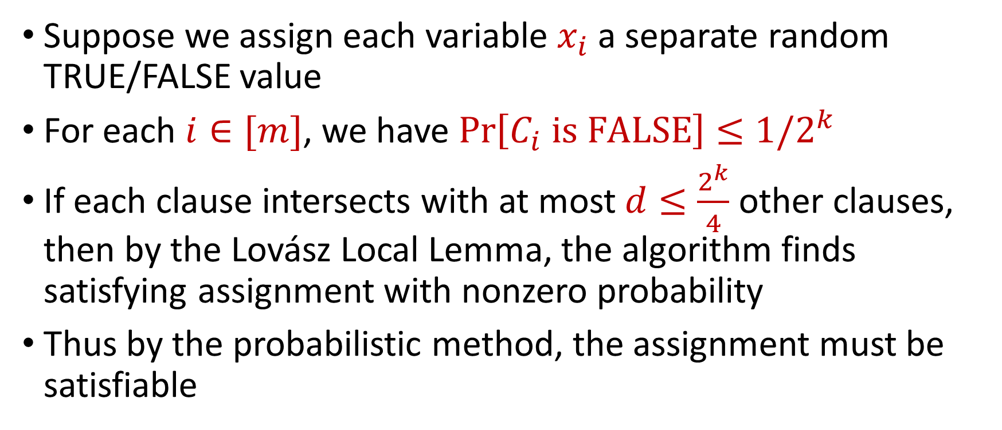
Resampling Algorithm for $k$-SAT
Suppose we assign each variable $x_{i}$ a separate random TRUE/FALSE value
For each $i∈[m]$, we have $\operatorname{Pr}\left[C_{i} is FALSE\right]≤1/2^{k}$
If each clause intersects with at most $d≤\frac{2^{k}}{4}$ other clauses, then by the Lovász Local Lemma, the algorithm finds satisfying assignment with nonzero probability
Thus by the probabilistic method, the assignment must be satisfiable

Slide 31
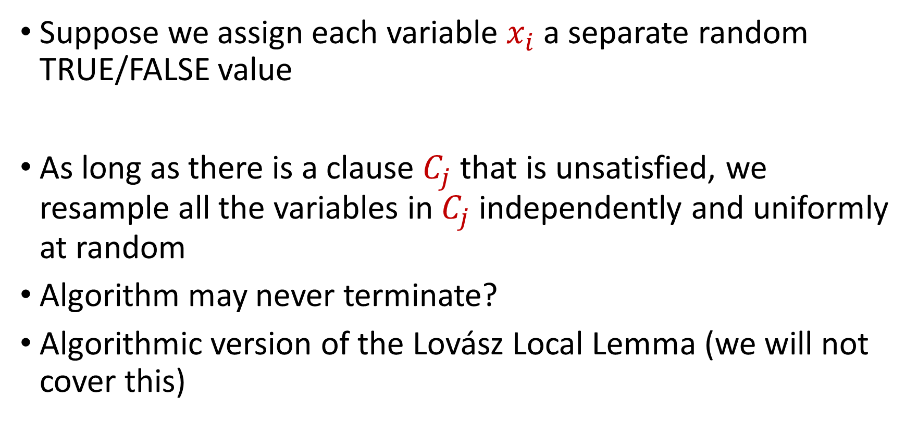
Resampling Algorithm for $k$-SAT
Suppose we assign each variable $x_{i}$ a separate random TRUE/FALSE value
As long as there is a clause $C_{j}$ that is unsatisfied, we resample all the variables in $C_{j}$ independently and uniformly at random
Algorithm may never terminate?
Algorithmic version of the Lovász Local Lemma (we will not cover this)

Slide 32
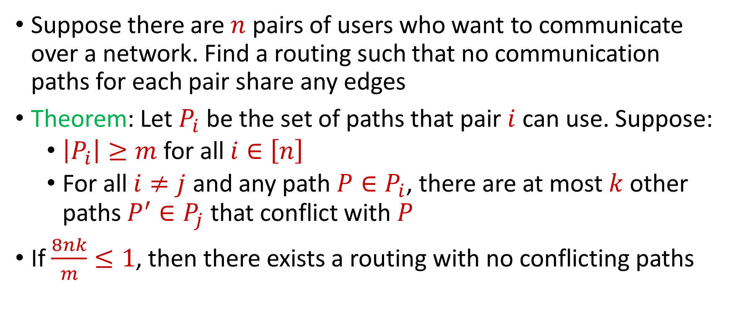
Edge-Disjoint Paths
Suppose there are $n$ pairs of users who want to communicate over a network. Find a routing such that no communication paths for each pair share any edges
Theorem: Let $P_{i}$ be the set of paths that pair $i$ can use. Suppose:
$\left|P_{i}\right|≥m$ for all $i∈\left[n\right]$
For all $i≠j$ and any path $P∈P_{i}$, there are at most $k$ other paths $P^{′}∈P_{j}$ that conflict with $P$
If $\frac{8nk}{m}≤1$, then there exists a routing with no conflicting paths

Slide 33
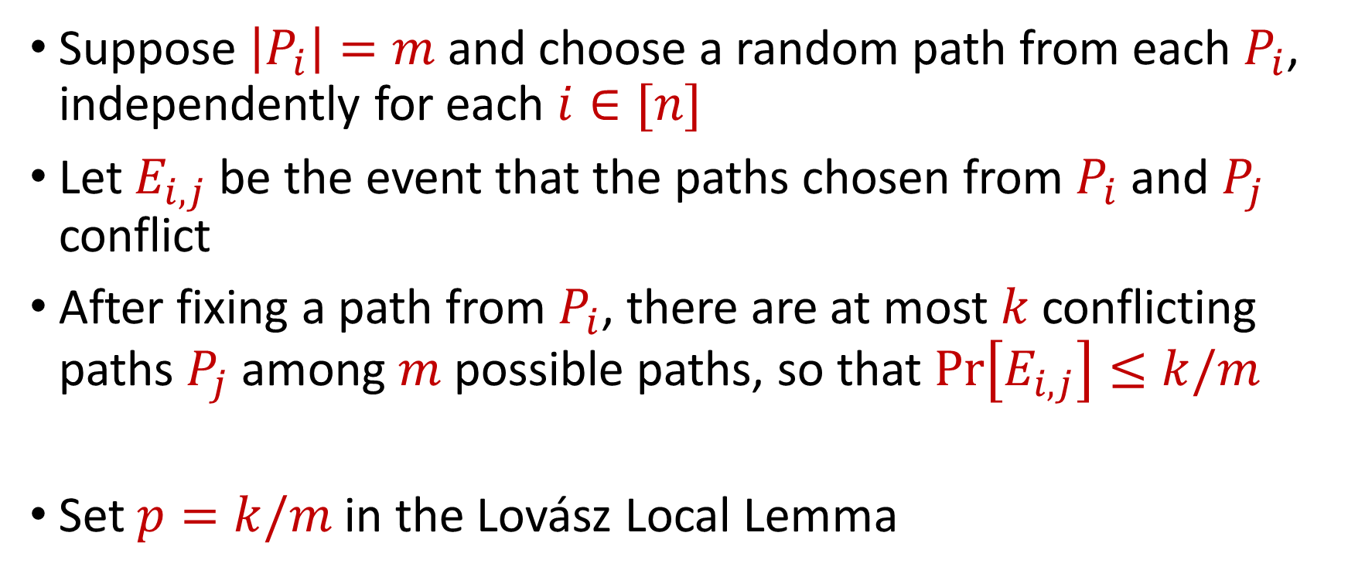
Edge-Disjoint Paths
Suppose $\left|P_{i}\right|=m$ and choose a random path from each $P_{i}$, independently for each $i∈[n]$
Let $E_{i,j}$ be the event that the paths chosen from $P_{i}$ and $P_{j}$ conflict
After fixing a path from $P_{i}$, there are at most $k$conflicting paths $P_{j}$ among $m$ possible paths, so that $\operatorname{Pr}\left[E_{i,j}\right]≤k/m$
Set $p=k/m$ in the Lovász Local Lemma

Slide 34
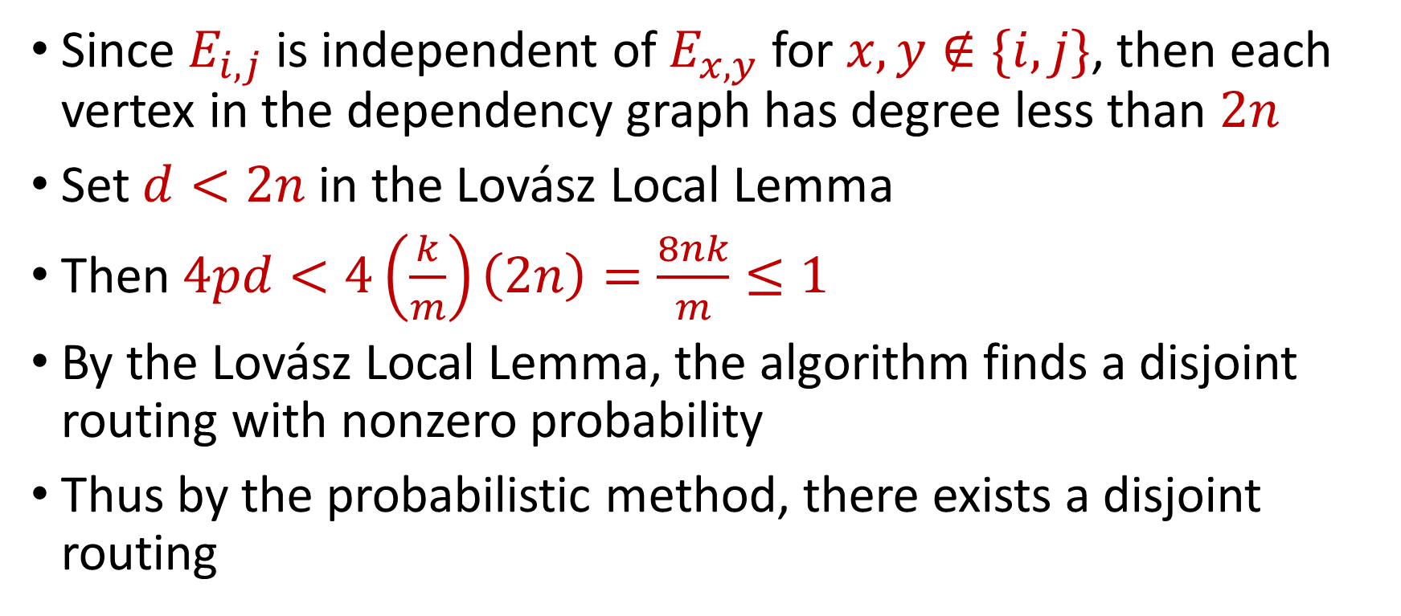
Edge-Disjoint Paths
Since $E_{i,j}$ is independent of $E_{x,y}$ for $x,y∉\{i,j\}$, then each vertex in the dependency graph has degree less than $2n$
Set $d<2n$ in the Lovász Local Lemma
Then $4pd<4\left(\frac{k}{m}\right)\left(2n\right)=\frac{8nk}{m}≤1$
By the Lovász Local Lemma, the algorithm finds a disjoint routing with nonzero probability
Thus by the probabilistic method, there exists a disjoint routing

