Slide 1
CSCE 658: Randomized Algorithms
Lecture 18
Samson Zhou

Slide 2
Relevant Supplementary Material
Lecture 14 of “Advanced Algorithms” Course Notes (http://www.cs.cmu.edu/afs/cs.cmu.edu/academic/class/15850-f20/www/notes/lec15.pdf), by Anupam Gupta

Slide 3






Last Time: Prediction with Expert Advice
a fundamental problem of sequential prediction
Day
You
Actual outcome
1
2
Algorithm makes 2 mistakes
3
Best expert makes 1 mistake
4

Slide 4
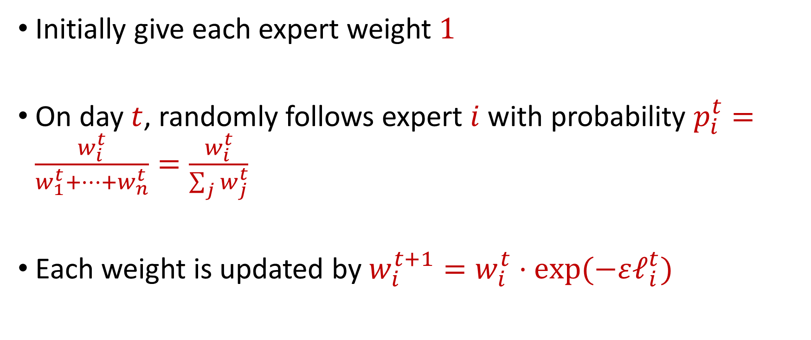
Last Time: Hedge Algorithm
Initially give each expert weight $1$
On day $t$, randomly follows expert $i$ with probability $p_{i}^{t}=\frac{w_{i}^{t}}{w_{1}^{t}+…+w_{n}^{t}}=\frac{w_{i}^{t}}{\sum_{j}{w_{j}^{t}}}$
Each weight is updated by $w_{i}^{t+1}=w_{i}^{t}⋅exp⁡(−εℓ_{i}^{t})$

Slide 5
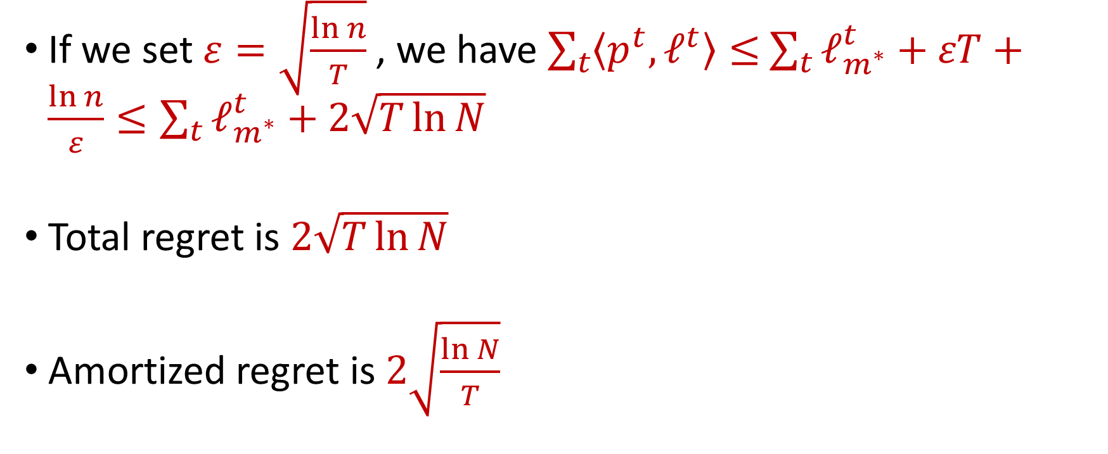
Last Time: Hedge Algorithm
If we set $ε=\sqrt{\frac{\ln{n}}{T}}$, we have $\sum_{t}{\left\langle p^{t},ℓ^{t}\right\rangle }≤$ $\sum_{t}{ℓ_{m^{∗}}^{t}}+εT+\frac{\ln{n}}{ε}≤\sum_{t}{ℓ_{m^{∗}}^{t}}+2\sqrt{T\ln{N}}$
Total regret is $2\sqrt{T\ln{N}}$
Amortized regret is $2\sqrt{\frac{\ln{N}}{T}}$

Slide 6
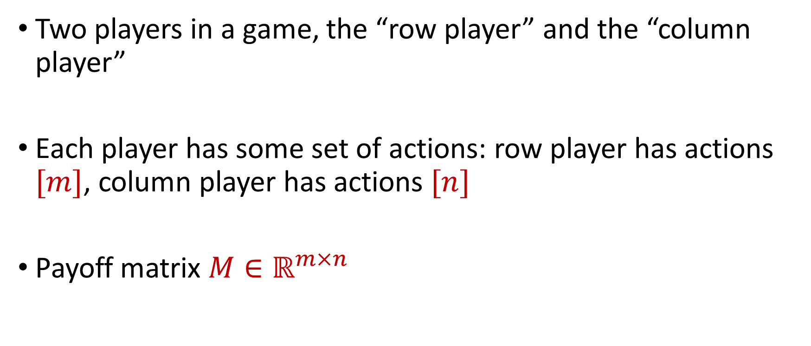
Two-Player Zero Sum Games
Two players in a game, the “row player” and the “column player”
Each player has some set of actions: row player has actions $[m]$, column player has actions $[n]$
Payoff matrix $M∈ℝ^{m×n}$

Slide 7
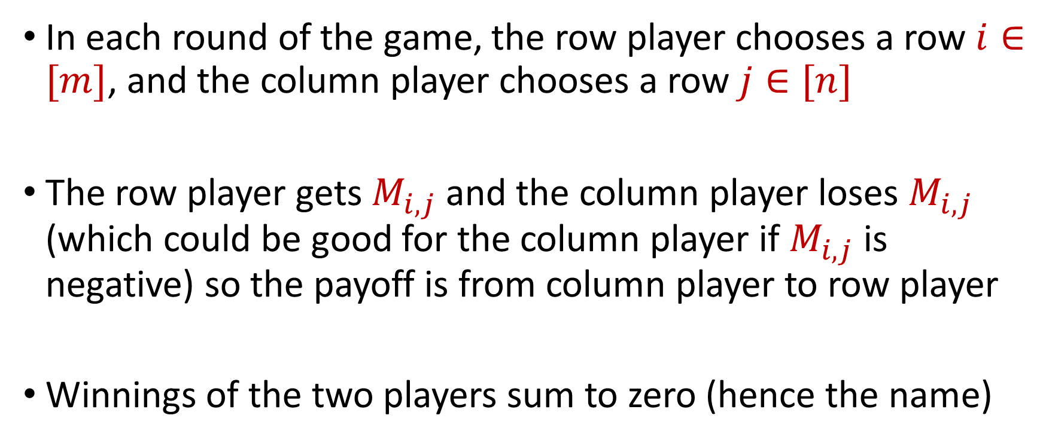
Two-Player Zero Sum Games
In each round of the game, the row player chooses a row $i∈[m]$, and the column player chooses a row $j∈[n]$
The row player gets $M_{i,j}$ and the column player loses $M_{i,j}$ (which could be good for the column player if $M_{i,j}$ is negative) so the payoff is from column player to row player
Winnings of the two players sum to zero (hence the name)

Slide 8

Two-Player Zero Sum Games
Row player wants to maximize $M_{i,j}$ and the column player wants to minimize $M_{i,j}$

Slide 9
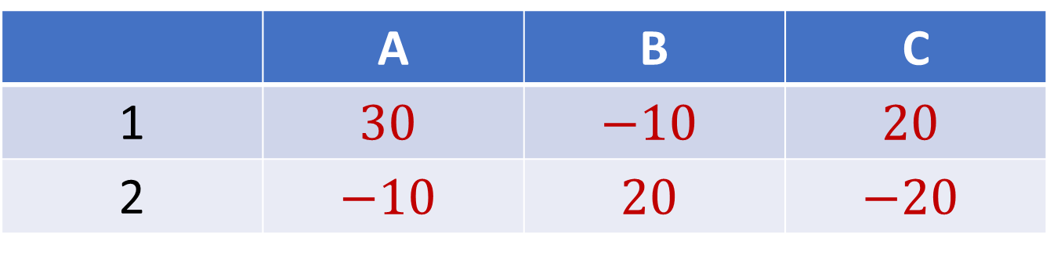
Two-Player Zero Sum Games
 | A | B | C
1 | $$30$$ | $$−10$$ | $$20$$
2 | $$−10$$ | $$20$$ | $$−20$$
What would you play as the row player?
What would you play as the column player?

Slide 10
Two-Player Zero Sum Games
 | A | B | C
1 | $$30$$ | $$−10$$ | $$20$$
2 | $$−10$$ | $$20$$ | $$−20$$
What would you play as the row player if column player played B?
What would you play as the column player if row player played 1?

Slide 11
Two-Player Zero Sum Games
 | A | B | C
1 | $$30$$ | $$−10$$ | $$20$$
2 | $$−10$$ | $$20$$ | $$−20$$
What would you play as the row player if you went first (and your choice is known)?
What would you play as the column player if you went first (and your choice is known)?

Slide 12
Two-Player Zero Sum Games
 | A | B | C
1 | $$30$$ | $$−10$$ | $$20$$
2 | $$−10$$ | $$20$$ | $$−20$$
What would you play as the row player if you went first? 1
What would you play as the column player if you went first? B or C

Slide 13
Best Strategies
Each player plays simultaneously and can have randomized strategies
Are there two-player games where randomized strategies are better than deterministic strategies?

Slide 14
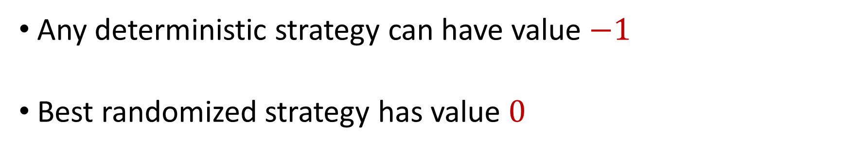
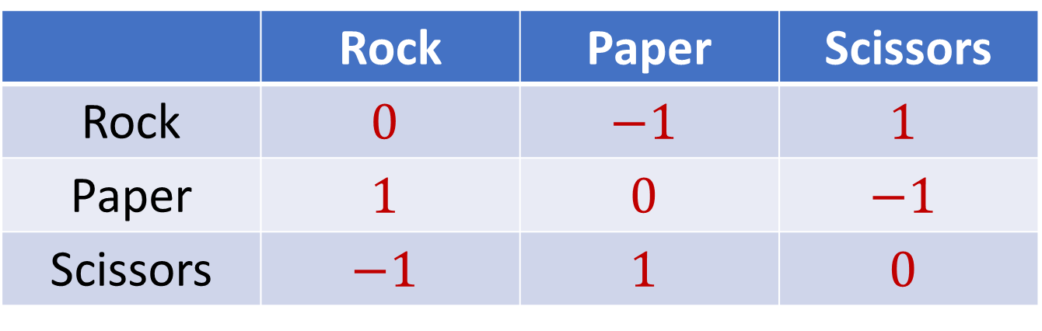
Rock-Paper-Scissors
 | Rock | Paper | Scissors
Rock | $$0$$ | $$−1$$ | $$1$$
Paper | $$1$$ | $$0$$ | $$−1$$
Scissors | $$−1$$ | $$1$$ | $$0$$
Any deterministic strategy can have value $−1$
Best randomized strategy has value $0$

Slide 15
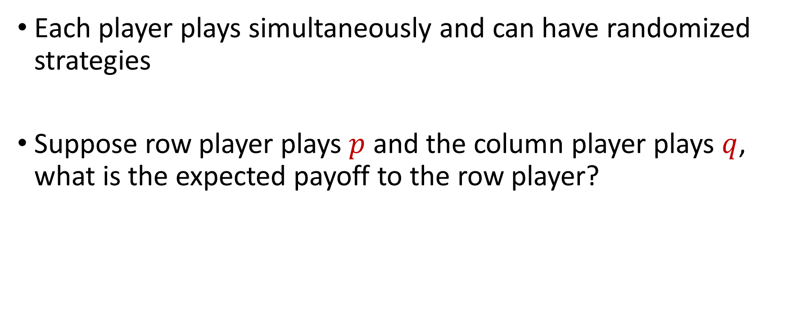
Best Strategies
Each player plays simultaneously and can have randomized strategies
Suppose row player plays $p$ and the column player plays $q$, what is the expected payoff to the row player?

Slide 16
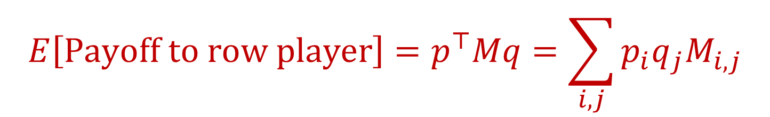
Best Strategies
Each player plays simultaneously and can have randomized strategies
Suppose row player plays $p$ and the column player plays $q$, what is the expected payoff to the row player?
$$E\left[Payoff to row player\right]=p^{⊤}Mq=\sum_{i,j}{p_{i}q_{j}M_{i,j}}$$

Slide 17
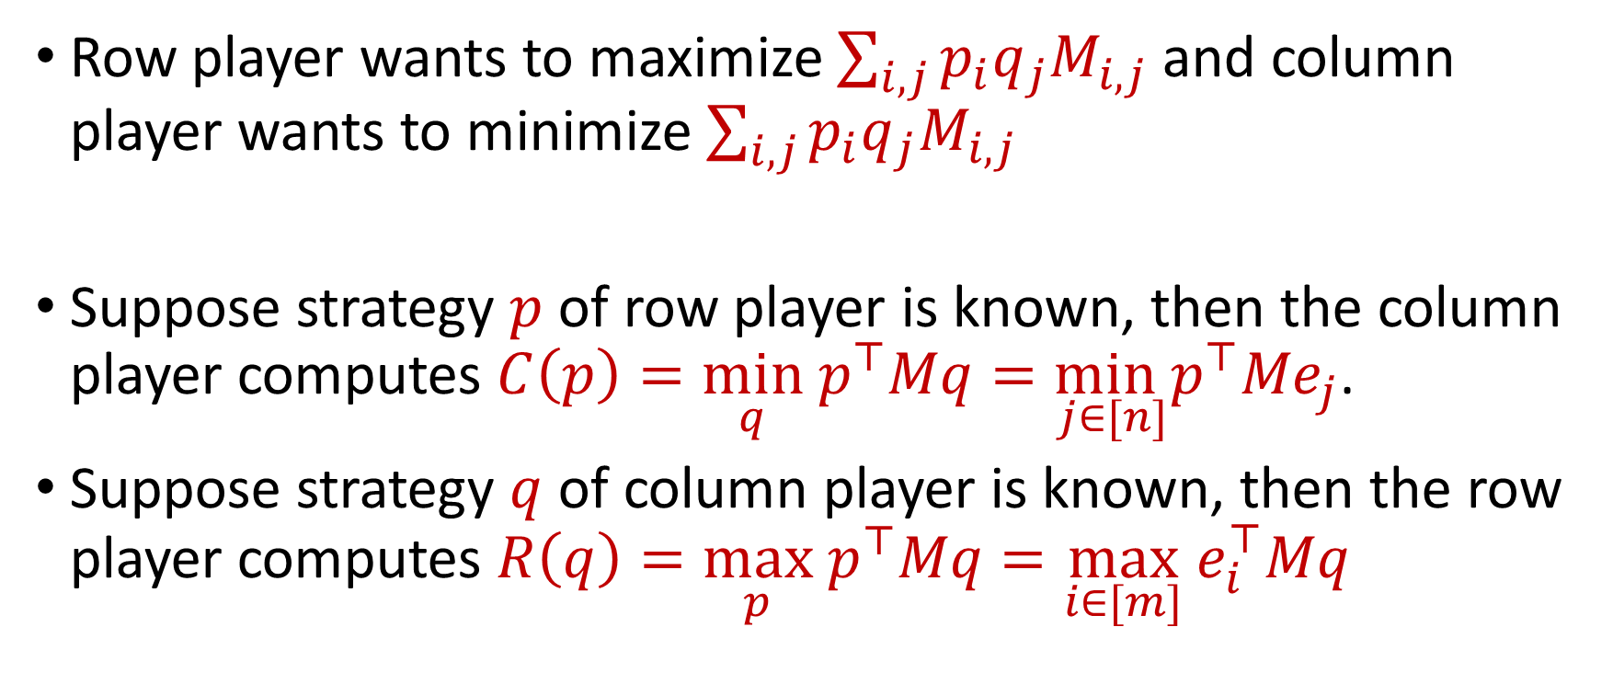
Best Strategies
Row player wants to maximize $\sum_{i,j}{p_{i}q_{j}M_{i,j}}$and column player wants to minimize $\sum_{i,j}{p_{i}q_{j}M_{i,j}}$
Suppose strategy $p$ of row player is known, then the column player computes $C\left(p\right)=\min_{q} p^{⊤}Mq=\min_{j∈[n]}p^{⊤}{Me}_{j}$.
Suppose strategy $q$ of column player is known, then the row player computes $R\left(q\right)=\max_{p} p^{⊤}Mq=\max_{i∈[m]} e_{i}^{⊤}Mq$

Slide 18
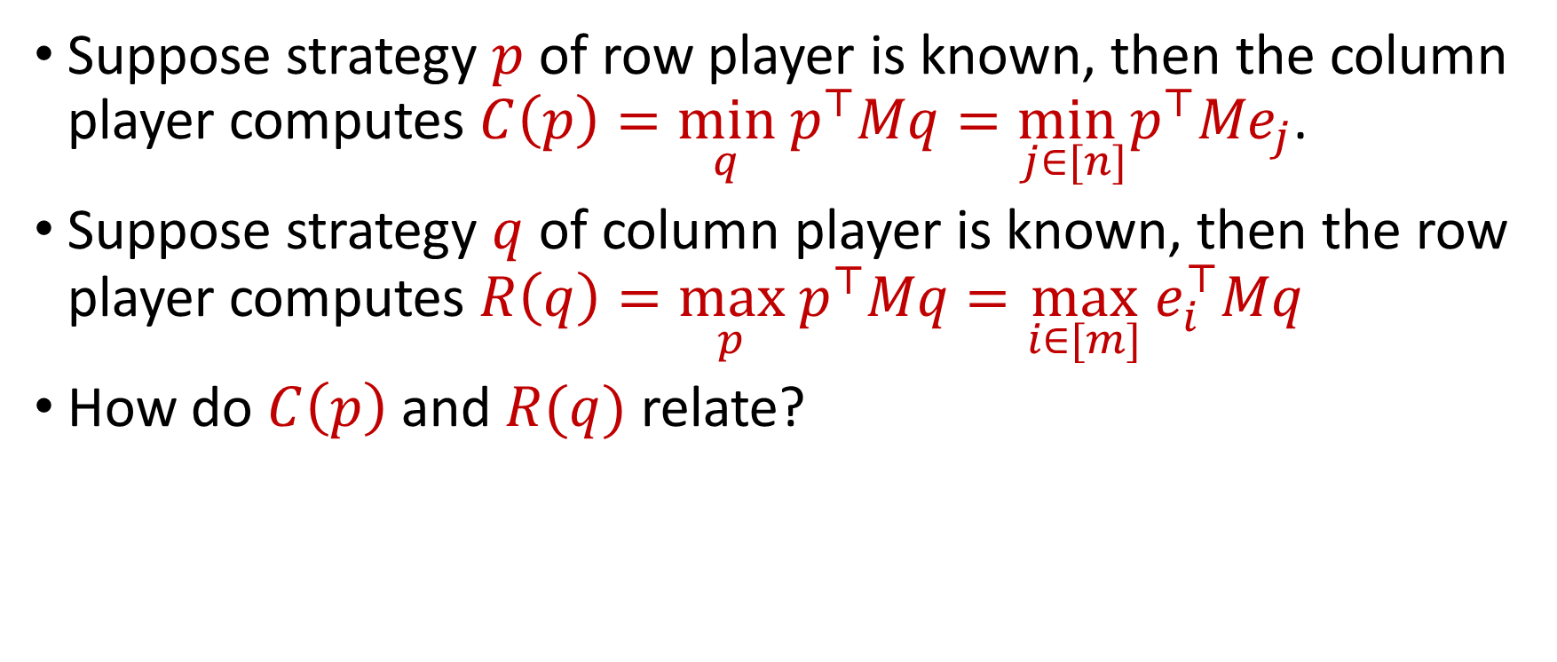
Best Strategies
Suppose strategy $p$ of row player is known, then the column player computes $C\left(p\right)=\min_{q} p^{⊤}Mq=\min_{j∈[n]}p^{⊤}{Me}_{j}$.
Suppose strategy $q$ of column player is known, then the row player computes $R\left(q\right)=\max_{p} p^{⊤}Mq=\max_{i∈[m]} e_{i}^{⊤}Mq$
How do $C\left(p\right)$ and $R(q)$ relate?

Slide 19
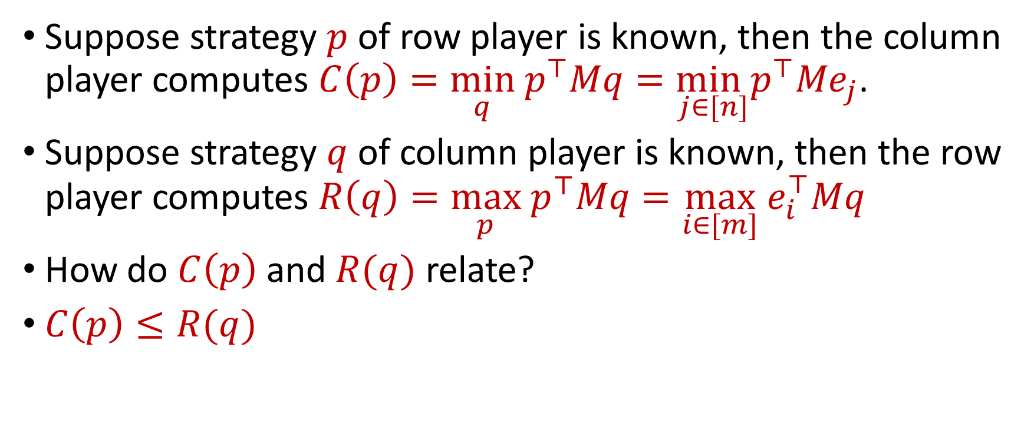
Best Strategies
Suppose strategy $p$ of row player is known, then the column player computes $C\left(p\right)=\min_{q} p^{⊤}Mq=\min_{j∈[n]}p^{⊤}{Me}_{j}$.
Suppose strategy $q$ of column player is known, then the row player computes $R\left(q\right)=\max_{p} p^{⊤}Mq=\max_{i∈[m]} e_{i}^{⊤}Mq$
How do $C\left(p\right)$ and $R(q)$ relate?
$C\left(p\right)≤R(q)$

Slide 20
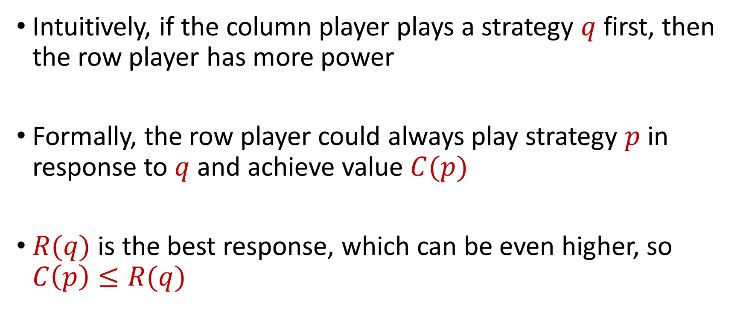
Best Strategies
Intuitively, if the column player plays a strategy $q$ first, then the row player has more power
Formally, the row player could always play strategy $p$ in response to $q$ and achieve value $C(p)$
$R(q)$ is the best response, which can be even higher, so $C\left(p\right)≤R(q)$

Slide 21
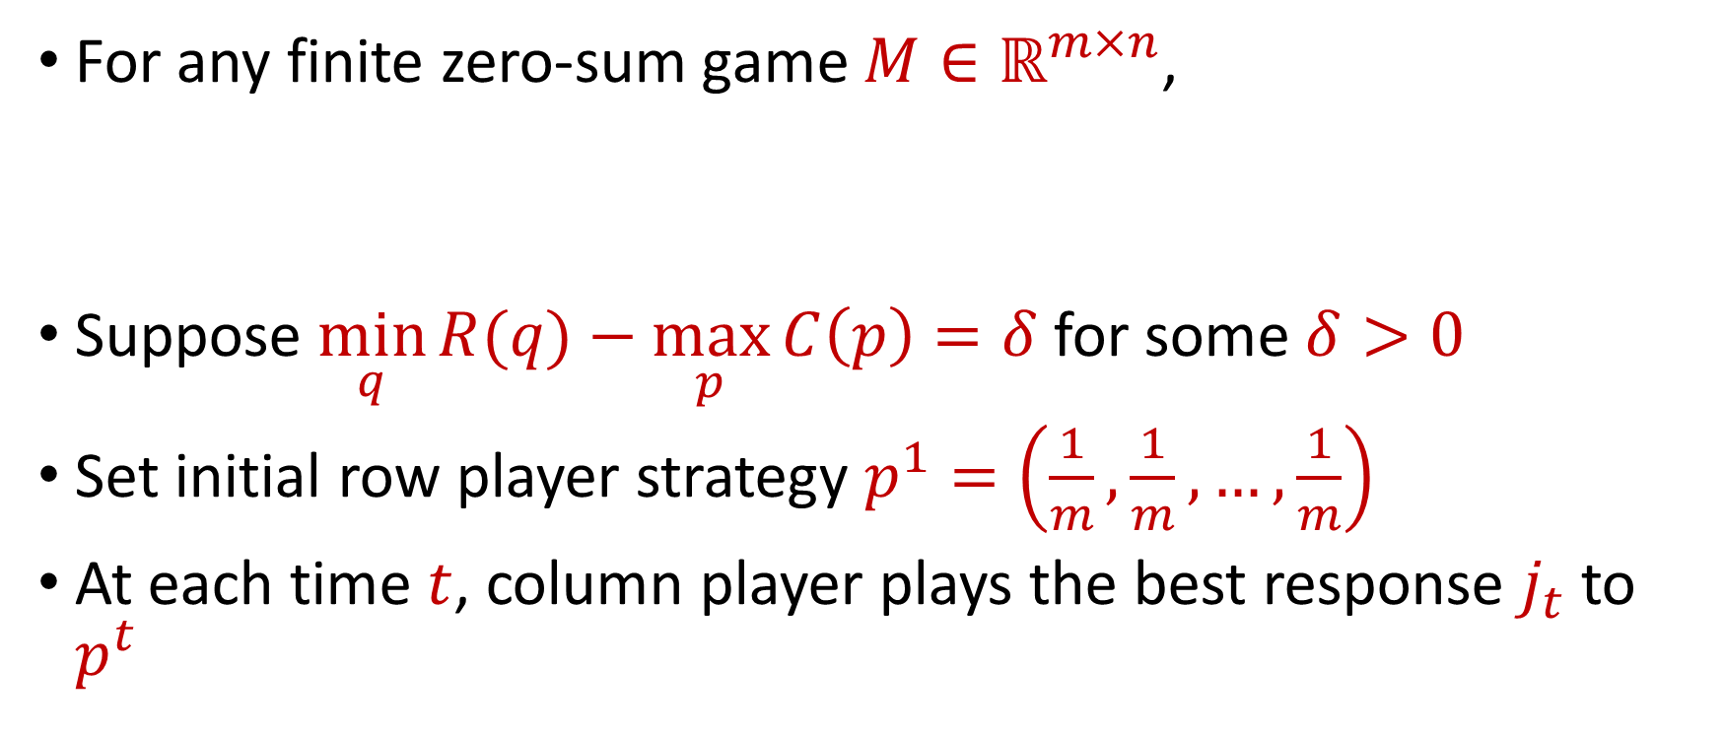

Von Neumann’s Minimax Theorem
For any finite zero-sum game $M∈ℝ^{m×n}$,
Suppose $\min_{q}{R(q)}−\max_{p}{C\left(p\right)}=δ$ for some $δ>0$
Set initial row player strategy $p^{1}=\left(\frac{1}{m},\frac{1}{m},…,\frac{1}{m}\right)$
At each time $t$, column player plays the best response $j_{t}$ to $p^{t}$
$$\max_{p}{C(p)}=\min_{q}{R(q)}$$

Slide 22
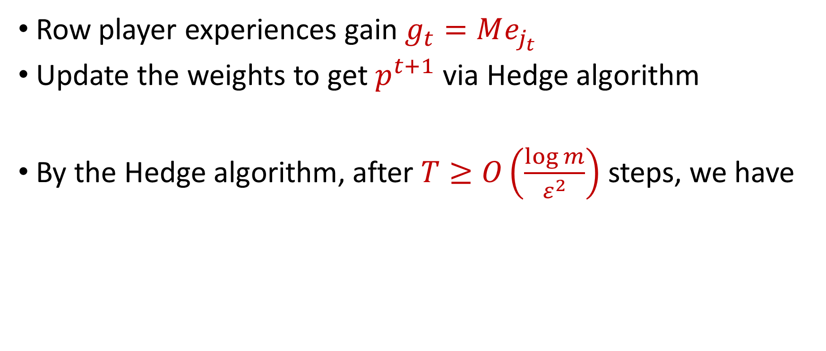
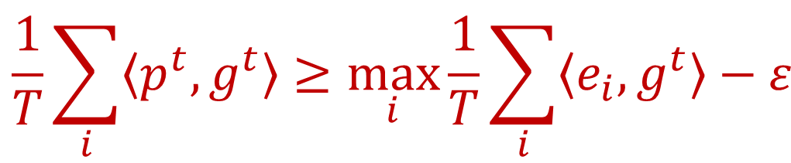
Von Neumann’s Minimax Theorem
Row player experiences gain $g_{t}=Me_{j_{t}}$
Update the weights to get $p^{t+1}$ via Hedge algorithm
By the Hedge algorithm, after $T≥O\left(\frac{\log{m}}{ε^{2}}\right)$ steps, we have
$$\frac{1}{T}\sum_{i}{\left\langle p^{t},g^{t}\right\rangle ≥\max_{i}{\frac{1}{T}\sum_{i}{\left\langle e_{i},g^{t}\right\rangle −ε}}}$$

Slide 23
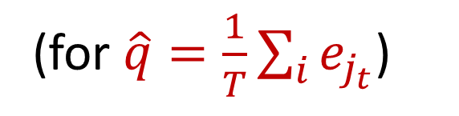
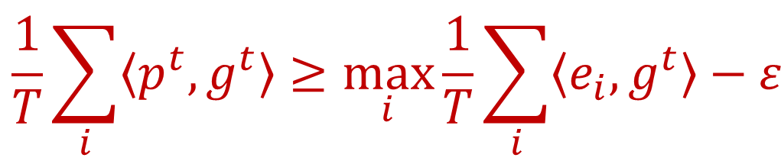
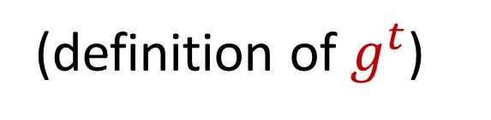
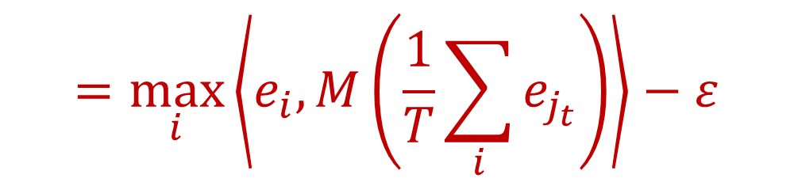
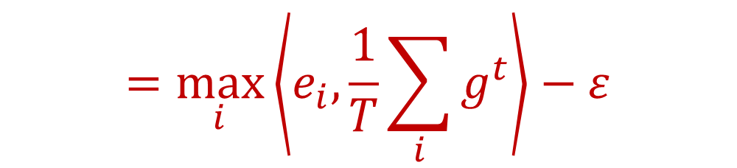
Von Neumann’s Minimax Theorem
$$\frac{1}{T}\sum_{i}{\left\langle p^{t},g^{t}\right\rangle ≥\max_{i}{\frac{1}{T}\sum_{i}{\left\langle e_{i},g^{t}\right\rangle −ε}}}$$
$$=\max_{i}\left\langle e_{i},\frac{1}{T}\sum_{i}{g^{t}}\right\rangle −ε$$
$$=\max_{i}\left\langle e_{i},M\left(\frac{1}{T}\sum_{i}{e_{j_{t}}}\right)\right\rangle −ε$$
(definition of $g^{t}$)
$$=R(\hat{q}){−ε}$$
(for $\hat{q}=\frac{1}{T}\sum_{i}{e_{j_{t}}}$)

Slide 24
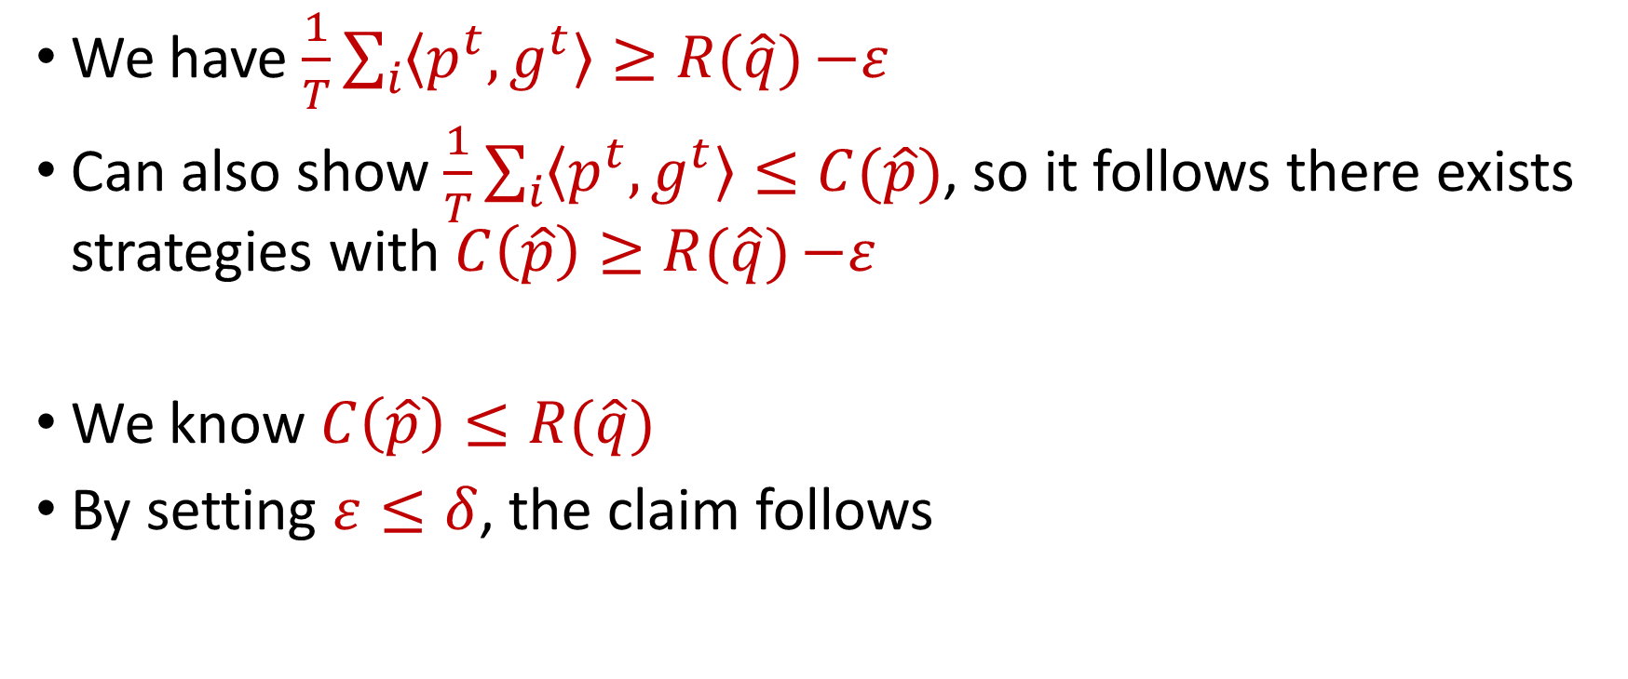
Von Neumann’s Minimax Theorem
We have $\frac{1}{T}\sum_{i}{\left\langle p^{t},g^{t}\right\rangle ≥R(\hat{q}){−ε}}$
Can also show $\frac{1}{T}\sum_{i}{\left\langle p^{t},g^{t}\right\rangle }≤C(\hat{p})$, so it follows there exists strategies with $C\left(\hat{p}\right)≥R(\hat{q}){−ε}$
We know $C\left(\hat{p}\right)≤R(\hat{q})$
By setting $ε≤δ$, the claim follows

Slide 25
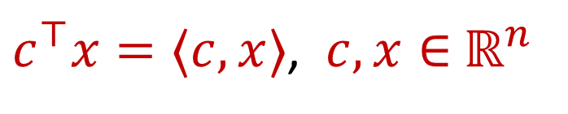
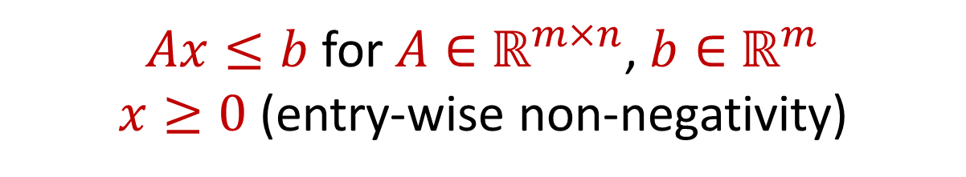
Previously: Linear Programming (Standard Form)
Maximize a linear objective function:
Subject to constraints:
$c^{⊤}x=⟨c,x⟩$, $c,x∈$ $ℝ^{n}$
$Ax≤b$ for $A∈$ $ℝ^{m×n}$, $b∈$ $ℝ^{m}$
$x≥0$ (entry-wise non-negativity)

Slide 26
Online Learning for Solving LP’s
Use learning with experts to solve LP
Assume we have any oracle that finds a point in feasible region that does not violate a certain constraint

Slide 27
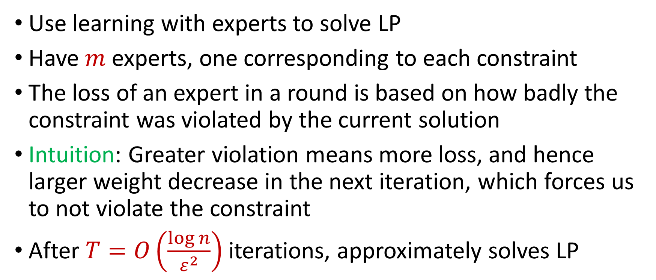
Online Learning for Solving LP’s
Use learning with experts to solve LP
Have $m$ experts, one corresponding to each constraint
The loss of an expert in a round is based on how badly the constraint was violated by the current solution
Intuition: Greater violation means more loss, and hence larger weight decrease in the next iteration, which forces us to not violate the constraint
After $T=O\left(\frac{\log{n}}{ε^{2}}\right)$ iterations, approximately solves LP

Slide 28


census.gov:

Slide 29


Private Data Analysis
Sensitive dataset
Analyst
Analysis of medical datasets to predict possible issues
Pattern detection for social networks or epidemic spread
US Census information for apportionment

Slide 30

Anonymization
Sensitive dataset
Anonymized dataset
Analyst

Slide 31
Anonymizing Data
Age | Zip Code | Employer | Has Pet
56 | 77005 | Apple | Yes
32 | 77005 | Microsoft | No
71 | 77005 | Amazon | Yes
44 | 77005 | Petsmart | Yes
25 | 77005 | Netflix | No
61 | 77005 | Google | No

Slide 32
Anonymizing Data
Age | Zip Code | Employer | Has Pet
56 | 77005 | Apple | Yes
32 | 77005 | Microsoft | No
71 | 77005 | Amazon | Yes
44 | 77005 | Petsmart | Yes
25 | 77005 | Netflix | No
61 | 77005 | Google | No
Name | Age | Gender | Employer
Alice | 56 | Female | Apple
Bob | 32 | Male | Microsoft
Carol | 71 | Female | Amazon
Dale | 44 | Male | Petsmart
Erin | 25 | Female | Netflix
Fred | 61 | Male | Google

Slide 33
Reconstruction Attack
Name | Age | Zip Code | Gender | Employer | Has Pet
Alice | 56 | 77005 | Female | Apple | Yes
Bob | 32 | 77005 | Male | Microsoft | No
Carol | 71 | 77005 | Female | Amazon | Yes
Dale | 44 | 77005 | Male | Petsmart | Yes
Erin | 25 | 77005 | Female | Netflix | No
Fred | 61 | 77005 | Male | Google | No

Slide 34
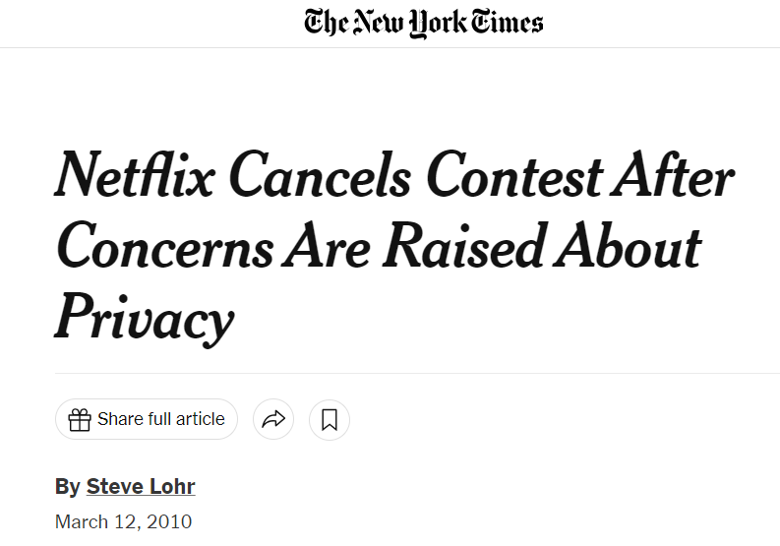
Anonymizing Data

Slide 35
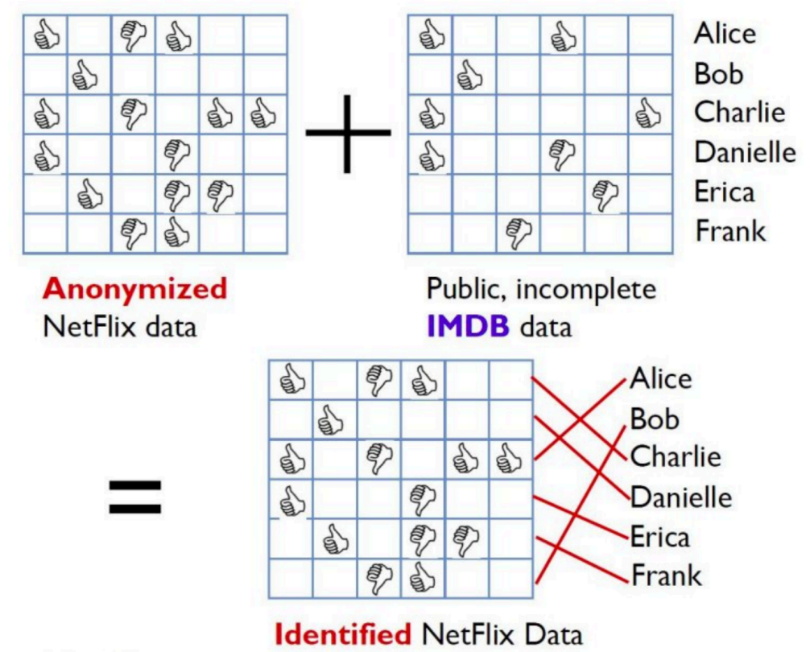
Image from Arvind Narayanan

Slide 36
Differencing Attacks
How many people in this classroom went to Kyle Field last weekend?
How many people in this classroom besides the instructor went to Kyle Field last weekend?

Slide 37
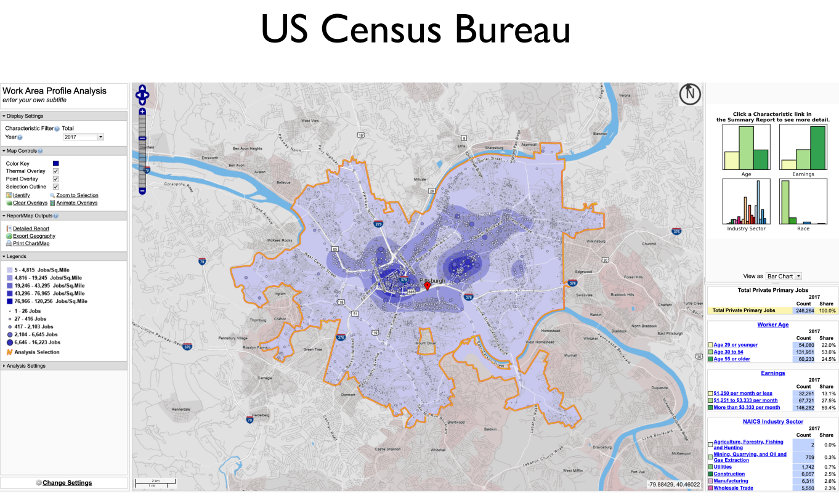
Slide from Steven Wu

Slide 38
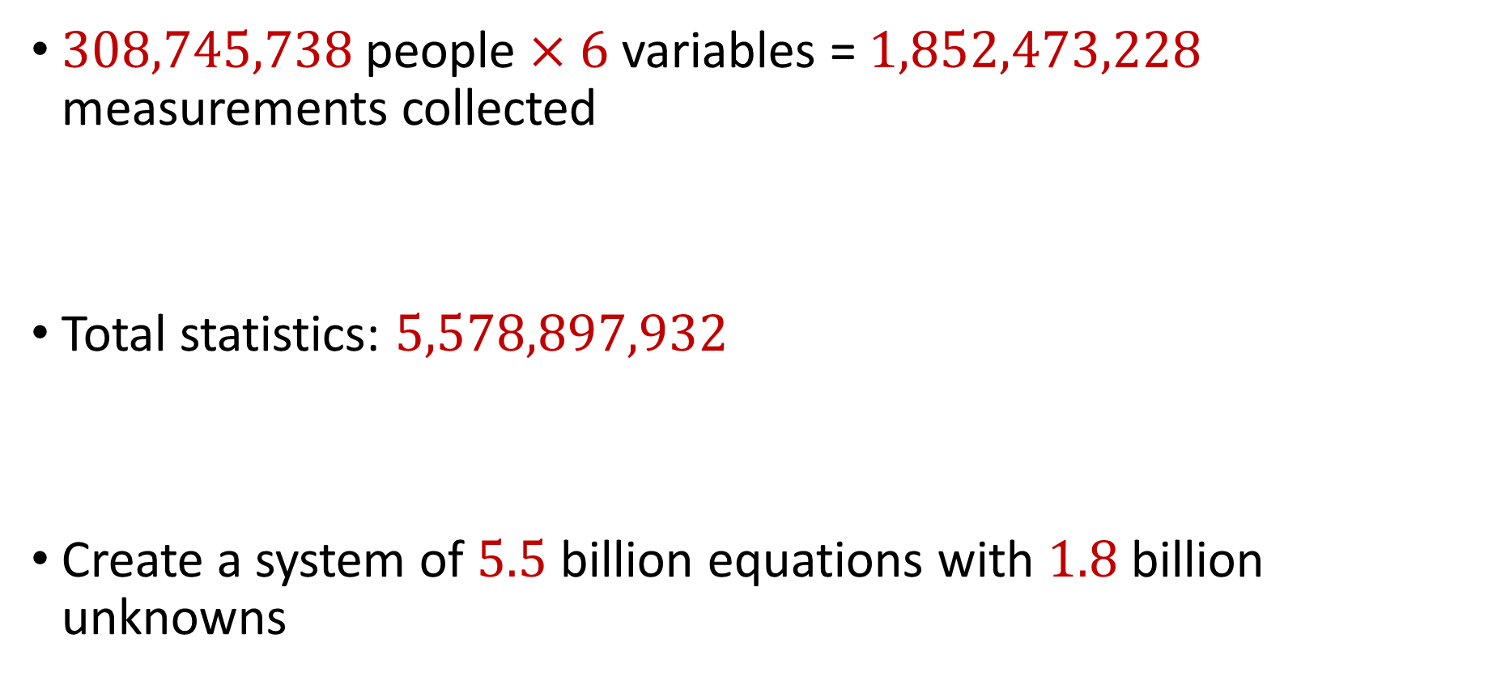
2010 US Census
$308,745,738$ people $×$ $6$ variables = $1,852,473,228$ measurements collected
Total statistics: $5,578,897,932$
Create a system of $5.5$ billion equations with $1.8$ billion unknowns

Slide 39
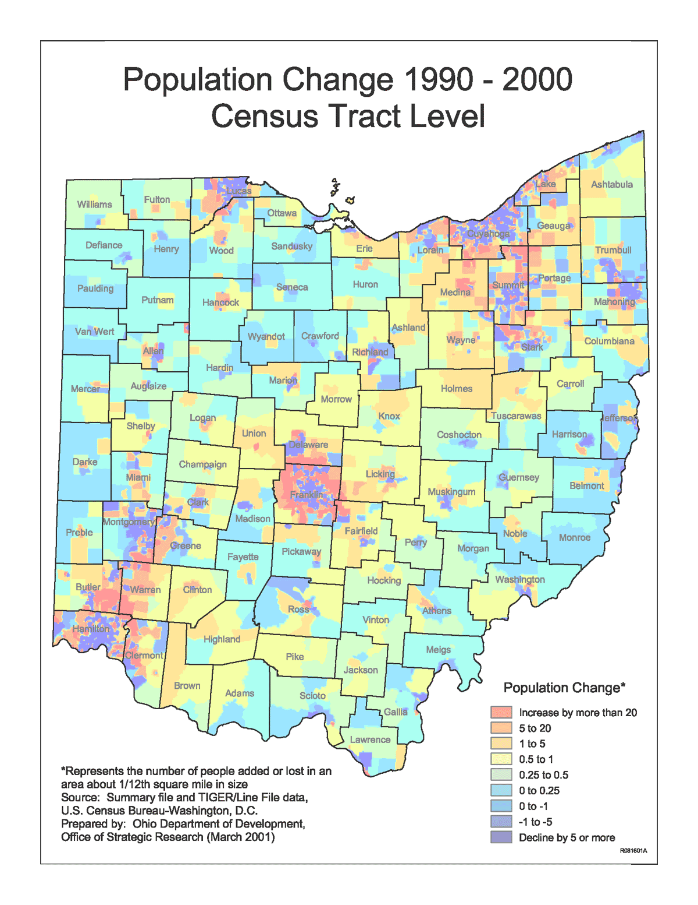
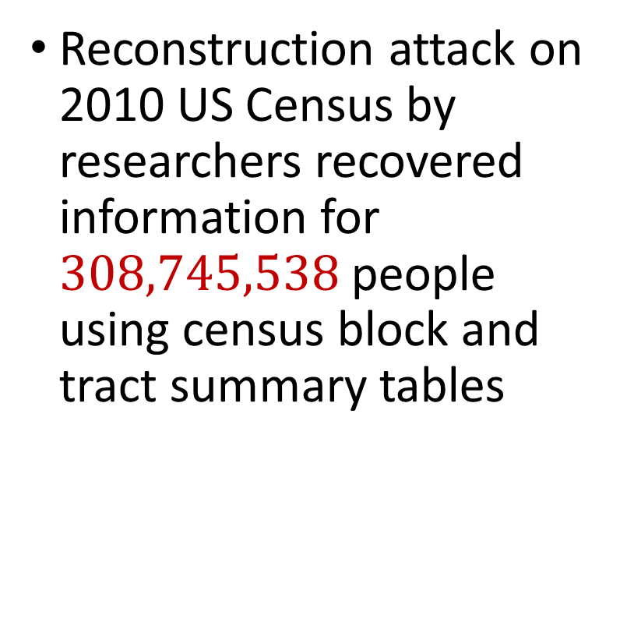
2010 US Census
Reconstruction attack on 2010 US Census by researchers recovered information for $308,745,538$ people using census block and tract summary tables

Slide 40
Summary
“Ad-hoc” privacy procedures like anonymization/deidentification often fails
Publishing too many queries on a sensitive database with too much accuracy can compromise the privacy of the database
Need a formal mathematical notion for measuring privacy

Slide 41

Possible Notion for Privacy #1
“The data analyst cannot learn anything about Alice”
Sensitive dataset
Analyst

Slide 42
Possible Notion for Privacy #1
“The data analyst cannot learn anything about Alice”
Most Aggies like Reveille
Alice is known to be an Aggie
Sensitive dataset
Analyst
Was Alice’s privacy violated?

Slide 43

Possible Notion for Privacy #1
“The data analyst cannot learn anything about Alice”
Most Aggies like Reveille
Bob participates in the survey
Sensitive dataset
Analyst
Even though Alice is not in the survey, it is still known that Alice is an Aggie

Slide 44
Possible Notion for Privacy #1
Suppose a survey is conducted on a sensitive dataset and concludes that “most Aggies like Reveille”
Alice is a known Aggie, and so a data analyst infers that Alice is more likely to be a dog owner and asks for higher apartment cleaning rates
Was Alice’s privacy violated by this study?

Slide 45
Possible Notion for Privacy #2
“A study is private…if the data analyst gains almost no additional information about Alice from the study than if the same study was performed without Alice’s data”

Slide 46

Possible Notion for Privacy #2
Stability: the data analyst reaches roughly similar conclusions if any individual data point is replaced by another data point of the population

Slide 47
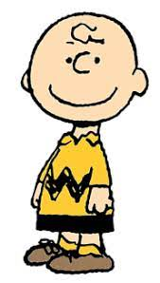

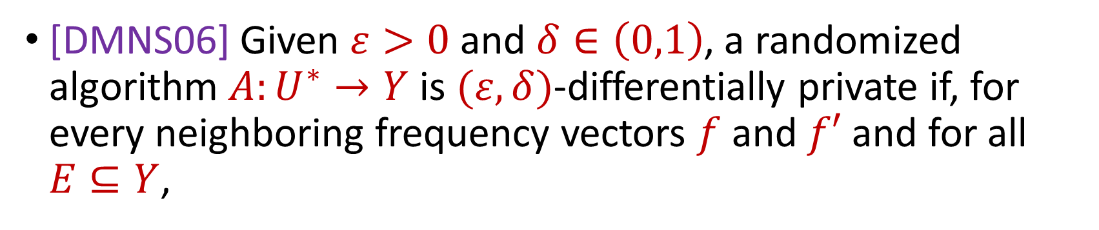

Differential Privacy
[DMNS06] Given $ε>0$and $δ∈\left(0,1\right)$, a randomized algorithm $A:U^{∗}→Y$ is $(ε,δ)$-differentially private if, for every neighboring frequency vectors $f$ and $f′$ and for all $E⊆Y$,
$$Pr\left[A\left(f\right)∈E\right]≤e^{ε}Pr\left[A\left(f^{′}\right)∈E\right]+δ$$
$$A\left( \right)≈A\left( \right)$$
Notes:
[DworkMcSherryNissimSmith06]

Slide 48
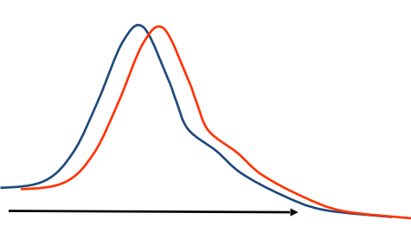
Differential Privacy
[DMNS06] Given $ε>0$and $δ∈\left(0,1\right)$, a randomized algorithm $A:U^{∗}→Y$ is $(ε,δ)$-differentially private if, for every neighboring frequency vectors $f$ and $f′$ and for all $E⊆Y$,
$$Pr\left[A\left(f\right)∈E\right]≤e^{ε}Pr\left[A\left(f^{′}\right)∈E\right]+δ$$
Sensitive dataset
Algorithm
Output distribution
Notes:
[DworkMcSherryNissimSmith06]

