Slide 1
CSCE 658: Randomized Algorithms
Lecture 3
Samson Zhou

Slide 2
Class Logistic Updates
Course materials: https://samsonzhou.github.io/CSCE658-S24/csce658-s24

Slide 3
Class Logistic Updates
Problem Set 1 posted, due next Thursday, February 1, 2024, 5 pm CT
PS1 groups sent via e-mail, please confirm receipt by reply-all
Submit PS1 via e-mail as a PDF, typeset in LaTeX
LaTeX template for PS1 available on class webpage, for your convenience

Slide 4
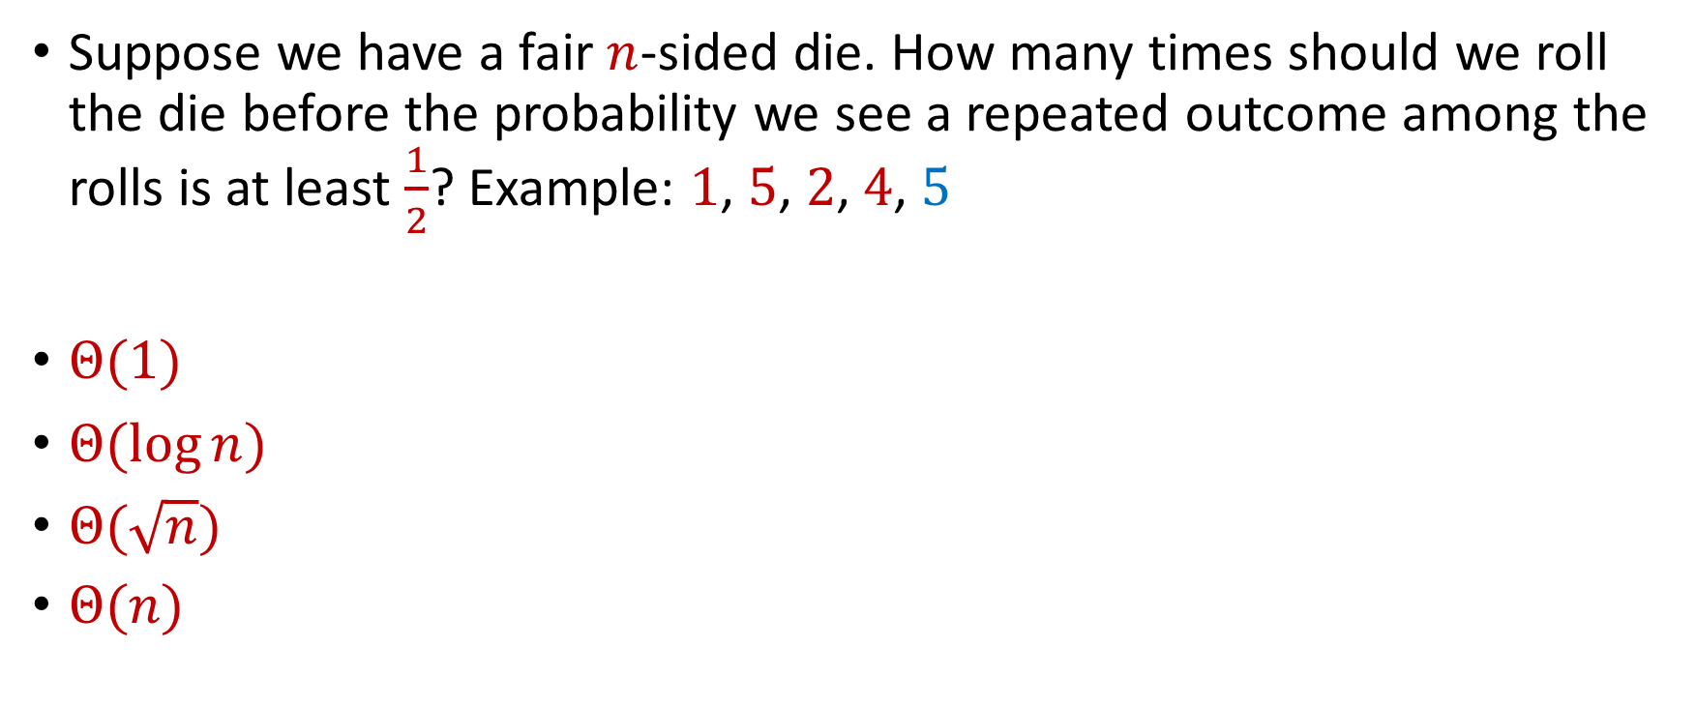
Trivia Question #1 (Birthday Paradox)
Suppose we have a fair $n$-sided die. How many times should we roll the die before the probability we see a repeated outcome among the rolls is at least $\frac{1}{2}$? Example: $1$, $5$, $2$, $4$, $5$
$Θ(1)$
$Θ(\log{n})$
$Θ(\sqrt{n})$
$Θ(n)$
Notes:
0, 1, 3, 6

Slide 5

Trivia Question #2 (Limits)
Let $c>0$ be a constant. What is $\lim_{n→∞}{\left(1−\frac{c}{n}\right)}^{n}$?
$0$
$\frac{1}{c}$
$\frac{1}{2c}$
$\frac{1}{e^{c}}$
$1$

Slide 6

Birthday Paradox
Suppose we have a room with $367$ people. What is the probability that two people share the same birthday?

Slide 7
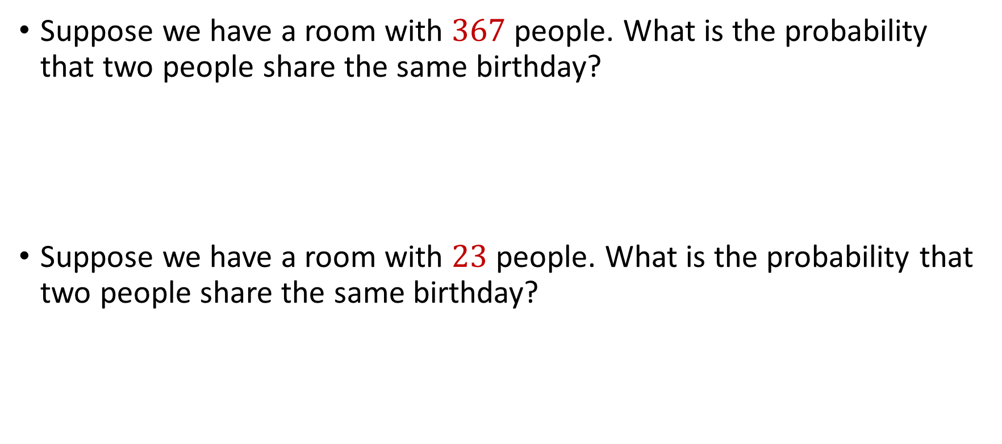
Birthday Paradox
Suppose we have a room with $367$ people. What is the probability that two people share the same birthday?
Suppose we have a room with $23$ people. What is the probability that two people share the same birthday?

Slide 8

Birthday Paradox
Suppose we have a fair $n$-sided die that we roll $k=1\text{,} 2\text{, }3\text{, }4\text{,}\text{...}$ times. What is the probability we DO NOT see a repeated outcome among the rolls?

Slide 9

Birthday Paradox
Suppose we have a fair $n$-sided die that we roll $k=1\text{, }2\text{, }3\text{, }4\text{,...}$ times. What is the probability we DO NOT see a repeated outcome among the rolls?
$$\left(1−\frac{0}{n}\right)$$

Slide 10

Birthday Paradox
Suppose we have a fair $n$-sided die that we roll $k=1\text{, }2\text{, }3\text{, }4\text{,...}$ times. What is the probability we DO NOT see a repeated outcome among the rolls?
$$\left(1−\frac{0}{n}\right)\left(1−\frac{1}{n}\right)$$

Slide 11
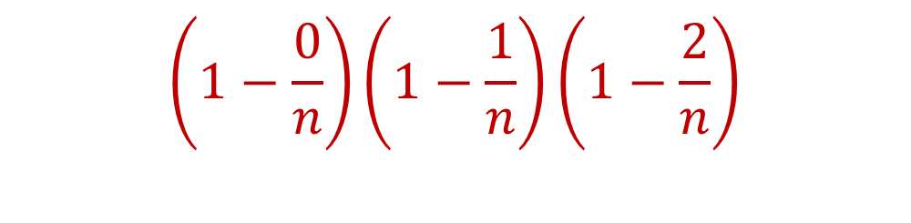
Birthday Paradox
Suppose we have a fair $n$-sided die that we roll $k=1\text{, }2\text{, }3\text{, }4\text{,...}$ times. What is the probability we DO NOT see a repeated outcome among the rolls?
$$\left(1−\frac{0}{n}\right)\left(1−\frac{1}{n}\right)\left(1−\frac{2}{n}\right)$$

Slide 12
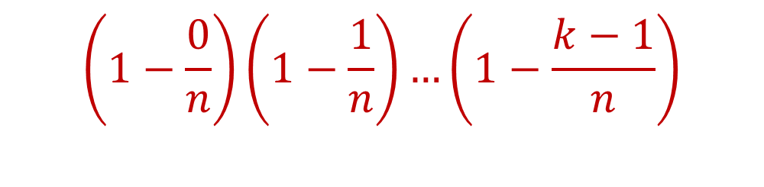
Birthday Paradox
Suppose we have a fair $n$-sided die that we roll $k=1\text{, }2\text{, }3\text{, }4\text{,...}$ times. What is the probability we DO NOT see a repeated outcome among the rolls?
$$\left(1−\frac{0}{n}\right)\left(1−\frac{1}{n}\right)…\left(1−\frac{k−1}{n}\right)$$

Slide 13
Birthday Paradox
Suppose we have a fair $n$-sided die that we roll $k=1\text{, }2\text{, }3\text{, }4\text{,...}$ times. What is the probability we DO NOT see a repeated outcome among the rolls?
$\left(1−\frac{0}{n}\right)\left(1−\frac{1}{n}\right)…\left(1−\frac{k−1}{n}\right)<\frac{1}{2}$

Slide 14
Birthday Paradox
Suppose we have a fair $n$-sided die that we roll $k=1\text{, }2\text{, }3\text{, }4\text{,...}$ times. What is the probability we DO NOT see a repeated outcome among the rolls?
$\left(1−\frac{0}{n}\right)\left(1−\frac{1}{n}\right)…\left(1−\frac{k−1}{n}\right)<\frac{1}{2}$ for $k=O(\sqrt{n})$

Slide 15
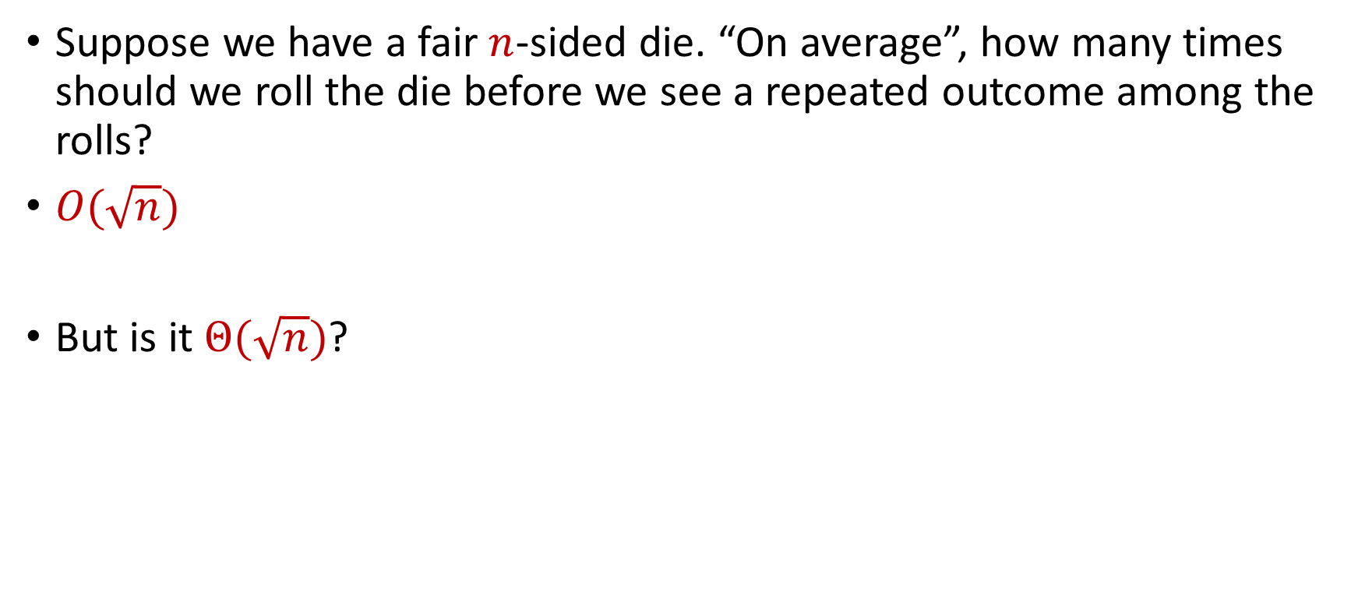
Birthday Paradox
Suppose we have a fair $n$-sided die. “On average”, how many times should we roll the die before we see a repeated outcome among the rolls?
$O(\sqrt{n})$
But is it $Θ(\sqrt{n})$?

Slide 16
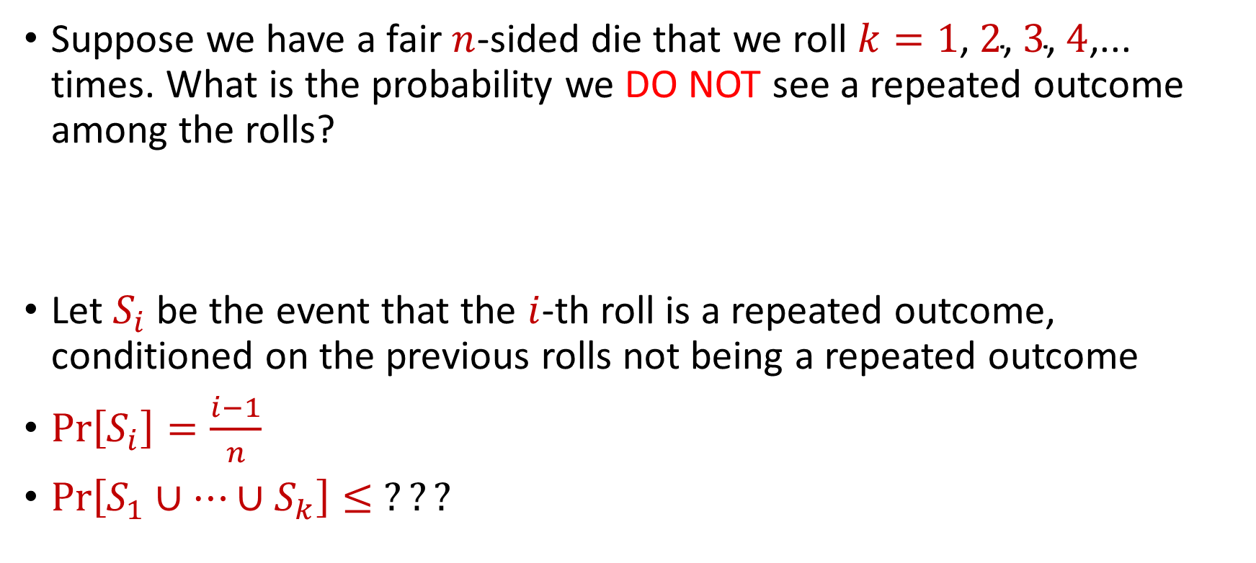
Birthday Paradox
Suppose we have a fair $n$-sided die that we roll $k=1\text{, }2\text{, }3\text{, }4\text{,...}$ times. What is the probability we DO NOT see a repeated outcome among the rolls?
Let $S_{i}$ be the event that the $i$-th roll is a repeated outcome, conditioned on the previous rolls not being a repeated outcome
$Pr\left[S_{i}\right]=\frac{i−1}{n}$
$Pr\left[S_{1}∪…∪S_{k}\right]≤$ $???$

Slide 17
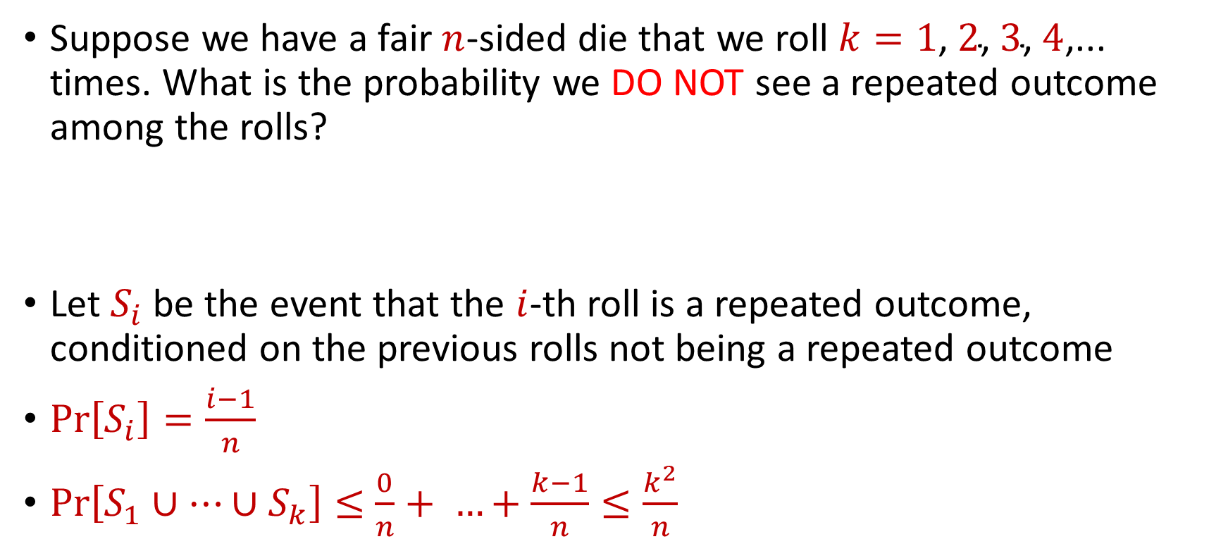
Birthday Paradox
Suppose we have a fair $n$-sided die that we roll $k=1\text{, }2\text{, }3\text{, }4\text{,...}$ times. What is the probability we DO NOT see a repeated outcome among the rolls?
Let $S_{i}$ be the event that the $i$-th roll is a repeated outcome, conditioned on the previous rolls not being a repeated outcome
$Pr\left[S_{i}\right]=\frac{i−1}{n}$
$Pr\left[S_{1}∪…∪S_{k}\right]≤$ $\frac{0}{n}+ …+\frac{k−1}{n}≤\frac{k^{2}}{n}$

Slide 18
Birthday Paradox
Suppose we have a fair $n$-sided die that we roll $k=1\text{, }2\text{, }3\text{, }4\text{,...}$ times. What is the probability we DO NOT see a repeated outcome among the rolls?
Let $S_{i}$ be the event that the $i$-th roll is a repeated outcome, conditioned on the previous rolls not being a repeated outcome
$Pr\left[S_{i}\right]=\frac{i−1}{n}$
$Pr\left[S_{1}∪…∪S_{k}\right]≤$ $\frac{0}{n}+ …+\frac{k−1}{n}≤\frac{k^{2}}{n}$
Union Bound

Slide 19

Birthday Paradox
Suppose we have a fair $n$-sided die. “On average”, how many times should we roll the die before we see a repeated outcome among the rolls?
$Θ(\sqrt{n})$

Slide 20
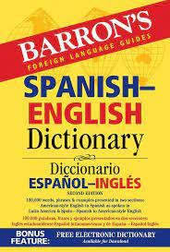

Case Study
We are trying to learn a new language on an app, which claims to have a database of 1 million words
Each time we ask the app, it gives us a random word in the database
We want to verify the claim

Slide 21
Case Study
We could use the app until we see 1 million unique words, but that would take at least 1 million checks
Instead, we use the app for 1000 times and count the number of pairwise duplicates
If there are many duplicates, the database is probably not very large

Slide 22
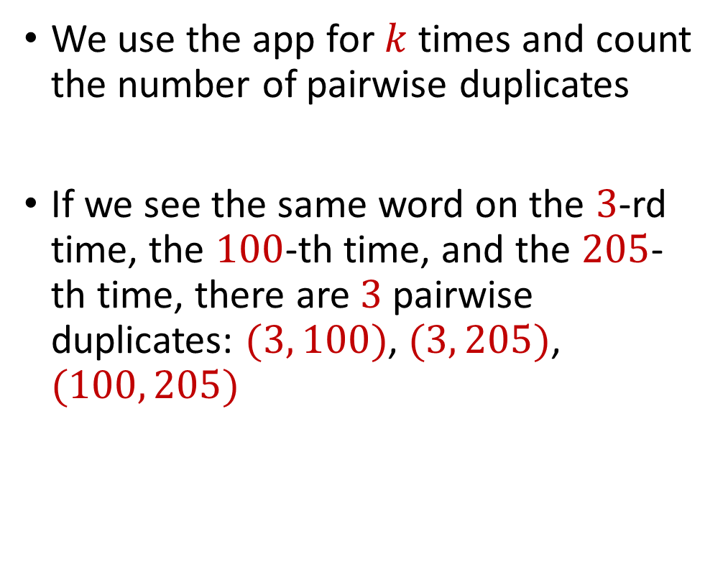
Case Study
We use the app for $k$ times and count the number of pairwise duplicates
If we see the same word on the $3$-rd time, the $100$-th time, and the $205$-th time, there are $3$pairwise duplicates: $(3, 100)$, $(3, 205)$, $(100, 205)$

Slide 23

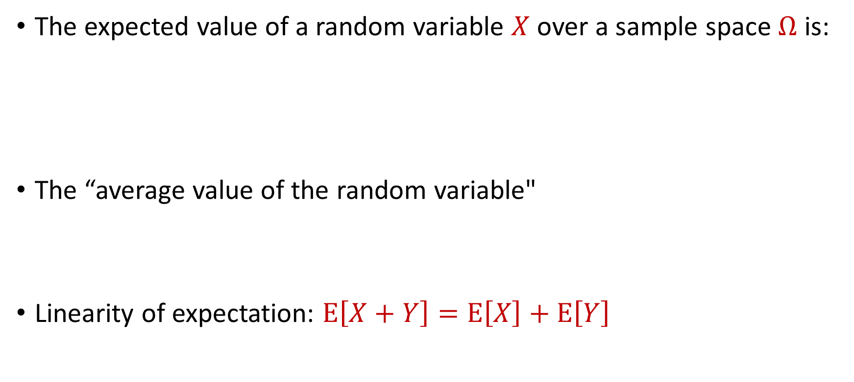
Expected Value
The expected value of a random variable $X$ over a sample space $Ω$ is:
The “average value of the random variable"
Linearity of expectation: $E\left[X+Y\right]=E\left[X\right]+E\left[Y\right]$
$$E\left[X\right]=\sum_{x∈Ω}{Pr\left[X=x\right]⋅x}$$

Slide 24

Expected Value
Suppose we roll a $6$-sided die
Let $X$ be the outcome of the roll
What is $E\left[X\right]$?

Slide 25

Linearity of Expectation
Linearity of expectation: $E\left[X+Y\right]=E\left[X\right]+E\left[Y\right]$
$$E\left[X+Y\right]=\sum_{x∈Ω_{X}}{\sum_{y∈Ω_{Y}}{Pr\left[X=x, Y=y\right]⋅(x+y)}}$$

Slide 26
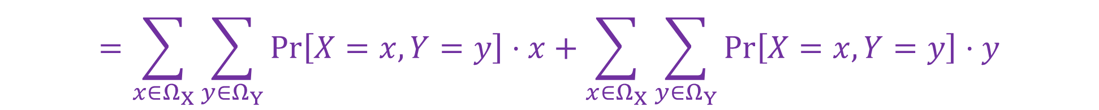
Linearity of Expectation
Linearity of expectation: $E\left[X+Y\right]=E\left[X\right]+E\left[Y\right]$
$$E\left[X+Y\right]=\sum_{x∈Ω_{X}}{\sum_{y∈Ω_{Y}}{Pr\left[X=x, Y=y\right]⋅(x+y)}}$$
$$=\sum_{x∈Ω_{X}}{\sum_{y∈Ω_{Y}}{Pr\left[X=x, Y=y\right]⋅x}}+\sum_{x∈Ω_{X}}{\sum_{y∈Ω_{Y}}{Pr\left[X=x, Y=y\right]⋅y}}$$

Slide 27

Linearity of Expectation
Linearity of expectation: $E\left[X+Y\right]=E\left[X\right]+E\left[Y\right]$
$$E\left[X+Y\right]=\sum_{x∈Ω_{X}}{\sum_{y∈Ω_{Y}}{Pr\left[X=x, Y=y\right]⋅(x+y)}}$$
$$=\sum_{x∈Ω_{X}}{\sum_{y∈Ω_{Y}}{Pr\left[X=x, Y=y\right]⋅x}}+\sum_{x∈Ω_{X}}{\sum_{y∈Ω_{Y}}{Pr\left[X=x, Y=y\right]⋅y}}$$
$$=\sum_{x∈Ω_{X}}{x\sum_{y∈Ω_{Y}}{Pr\left[X=x, Y=y\right]}}+\sum_{y∈Ω_{Y}}{y\sum_{x∈Ω_{X}}{Pr\left[X=x, Y=y\right]}}$$

Slide 28
Linearity of Expectation
Linearity of expectation: $E\left[X+Y\right]=E\left[X\right]+E\left[Y\right]$
$$E\left[X+Y\right]=\sum_{x∈Ω_{X}}{\sum_{y∈Ω_{Y}}{Pr\left[X=x, Y=y\right]⋅(x+y)}}$$
$$=\sum_{x∈Ω_{X}}{\sum_{y∈Ω_{Y}}{Pr\left[X=x, Y=y\right]⋅x}}+\sum_{x∈Ω_{X}}{\sum_{y∈Ω_{Y}}{Pr\left[X=x, Y=y\right]⋅y}}$$
$$=\sum_{x∈Ω_{X}}{x\sum_{y∈Ω_{Y}}{Pr\left[X=x, Y=y\right]}}+\sum_{y∈Ω_{Y}}{y\sum_{x∈Ω_{X}}{Pr\left[X=x, Y=y\right]}}$$
$$=\sum_{x∈Ω_{X}}{x⋅Pr\left[X=x\right]}+\sum_{y∈Ω_{Y}}{y⋅Pr\left[Y=y\right]}=E\left[X\right]+E\left[Y\right]$$

Slide 29
Birthday Paradox
Suppose we have a fair $n$-sided die that we roll $k=1\text{,} 2\text{, }3\text{, }4\text{,}\text{...}$ times. What is the probability we DO NOT see a repeated outcome among the rolls?
$$\left(1−\frac{0}{n}\right)\left(1−\frac{1}{n}\right)…\left(1−\frac{k−1}{n}\right)$$

Slide 30
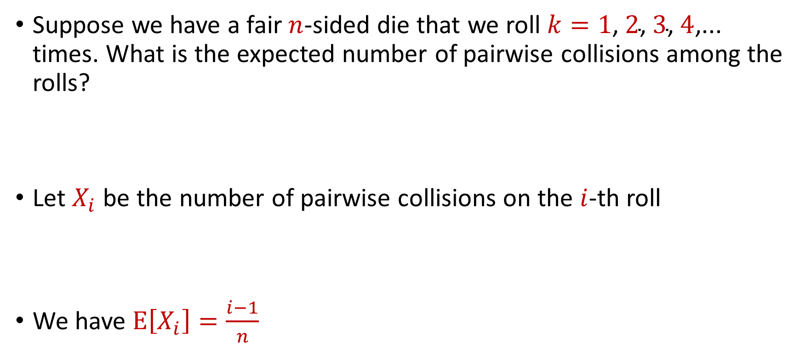
Birthday Paradox
Suppose we have a fair $n$-sided die that we roll $k=1\text{,} 2\text{, }3\text{, }4\text{,}\text{...}$ times. What is the expected number of pairwise collisions among the rolls?
Let $X_{i}$ be the number of pairwise collisions on the $i$-th roll
We have $E\left[X_{i}\right]=\frac{i−1}{n}$

Slide 31

Birthday Paradox
Let $X$ be the number of pairwise collisions after $k$ rolls
What is $E\left[X\right]$?

Slide 32



Birthday Paradox
Let $X$ be the number of pairwise collisions after $k$ rolls
$$E\left[X\right]=E\left[X_{1}+…+X_{k}\right]$$
$$=E\left[X_{1}]+…+E[X_{k}\right]$$
$$=\frac{0}{n}+…+\frac{k−1}{n}$$
$$=\frac{k\left(k−1\right)}{2n}$$

Slide 33

Birthday Paradox
$E\left[X\right]=\frac{k\left(k−1\right)}{2n}$
$\frac{{\left(k−1\right)}^{2}}{2n}≤E\left[X\right]≤\frac{k^{2}}{2n}$
$k=2\sqrt{n}+1$ implies $E\left[X\right]≥1$
$k=\frac{\sqrt{n}}{2}$ implies $E\left[X\right]≤\frac{1}{4}$

Slide 34
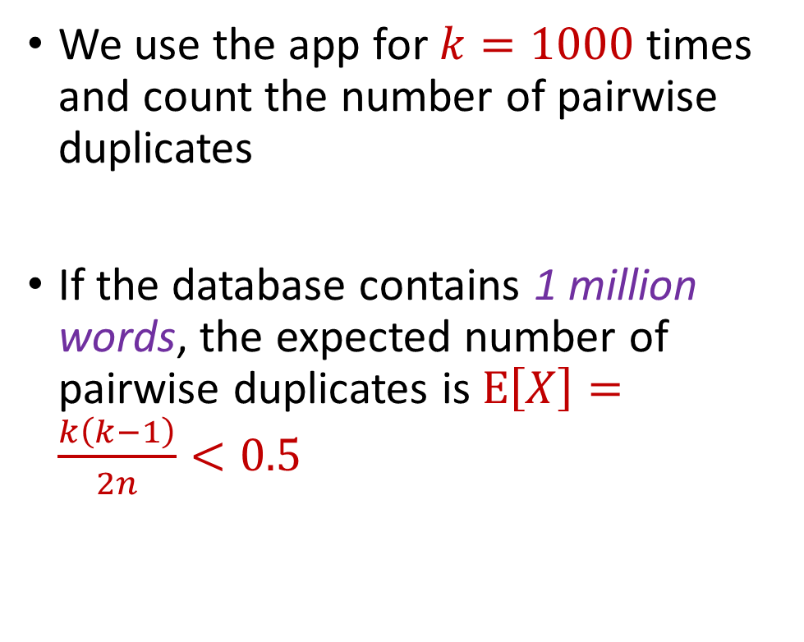
Case Study
We use the app for $k=1000$ times and count the number of pairwise duplicates
If the database contains 1 million words, the expected number of pairwise duplicates is $E\left[X\right]=\frac{k\left(k−1\right)}{2n}<0.5$

Slide 35
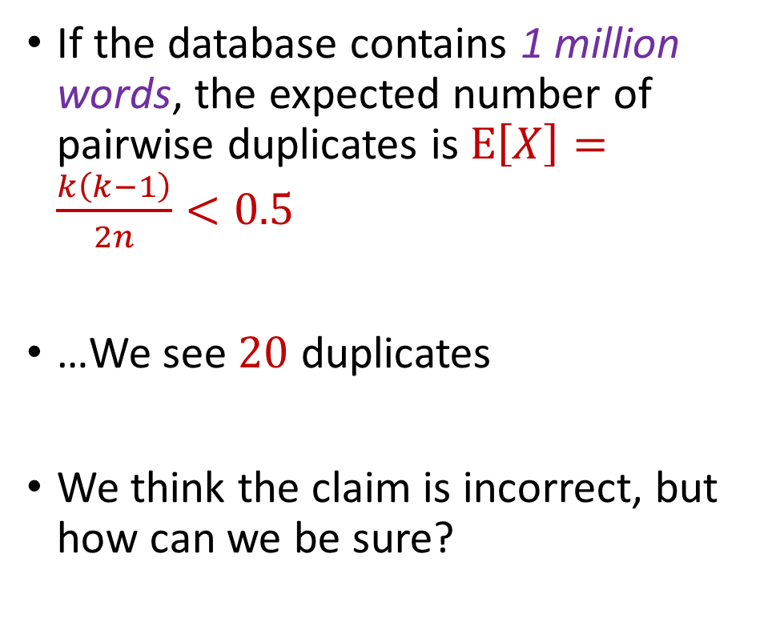
Case Study
If the database contains 1 million words, the expected number of pairwise duplicates is $E\left[X\right]=\frac{k\left(k−1\right)}{2n}<0.5$
…We see $20$ duplicates
We think the claim is incorrect, but how can we be sure?

Slide 36
Concentration Inequalities
Concentration inequalities bound the probability that a random variable is “far away” from its expectation
Often used in understanding the performance of statistical tests, the behavior of data sampled from various distributions, and for our purposes, the guarantees of randomized algorithms

Slide 37


Markov’s Inequality
Let $X≥0$be a non-negative random variable. Then for any $t>0$:
$$Pr\left[X≥t⋅E[X]\right]≤\frac{1}{t}$$

Slide 38


Proof of Markov’s Inequality
Let $X≥0$be a non-negative random variable. Then for any $t>0$:
$E\left[X\right]=\sum_{x∈Ω}{Pr\left[X=x\right]⋅x}$
$=\sum_{x≥t⋅E\left[X\right]}{Pr\left[X=x\right]⋅x}+\sum_{x<t⋅E[X]}{Pr\left[X=x\right]⋅x}$
$≥\sum_{x≥t⋅E[X]}{Pr\left[X=x\right]⋅x}$
$≥t⋅E[X]\sum_{x≥t⋅E[X]}{Pr\left[X=x\right]}$
$$=t⋅E\left[X\right]⋅Pr\left[X≥t⋅E[X]\right]$$

Slide 39
Birthday Paradox
Suppose we have a fair $n$-sided die that we roll $k=1\text{,} 2\text{, }3\text{, }4\text{,}\text{...}$ times. What is the probability we DO NOT see a repeated outcome among the rolls?
$$\left(1−\frac{0}{n}\right)\left(1−\frac{1}{n}\right)…\left(1−\frac{k−1}{n}\right)$$

Slide 40
Birthday Paradox
Suppose we have a fair $n$-sided die that we roll $k=1\text{,} 2\text{, }3\text{, }4\text{,}\text{...}$ times. What is the expected number of pairwise collisions among the rolls?
Let $X_{i}$ be the number of pairwise collisions on the $i$-th roll
We have $E\left[X_{i}\right]=\frac{i−1}{n}$

Slide 41
Birthday Paradox
$E\left[X\right]=\frac{k\left(k−1\right)}{2n}$
$\frac{{\left(k−1\right)}^{2}}{2n}≤E\left[X\right]≤\frac{k^{2}}{2n}$
$k=2\sqrt{n}+1$ implies $E\left[X\right]≥1$
$k=\frac{\sqrt{n}}{2}$ implies $E\left[X\right]≤\frac{1}{4}$

Slide 42

Birthday Paradox
$E\left[X\right]=\frac{k\left(k−1\right)}{2n}$
$\frac{{\left(k−1\right)}^{2}}{2n}≤E\left[X\right]≤\frac{k^{2}}{2n}$
$k=2\sqrt{n}+1$ implies $E\left[X\right]≥1$
$k=\frac{\sqrt{n}}{2}$ implies $E\left[X\right]≤\frac{1}{4}$, and by Markov’s inequality, $Pr\left[X≥1\right]≤\frac{1}{4}$

Slide 43
Case Study
If the database contains 1 million words, the expected number of pairwise duplicates is $E\left[X\right]=\frac{k\left(k−1\right)}{2n}<0.5$
…We see $20$ duplicates
We think the claim is incorrect, but how can we be sure?

Slide 44
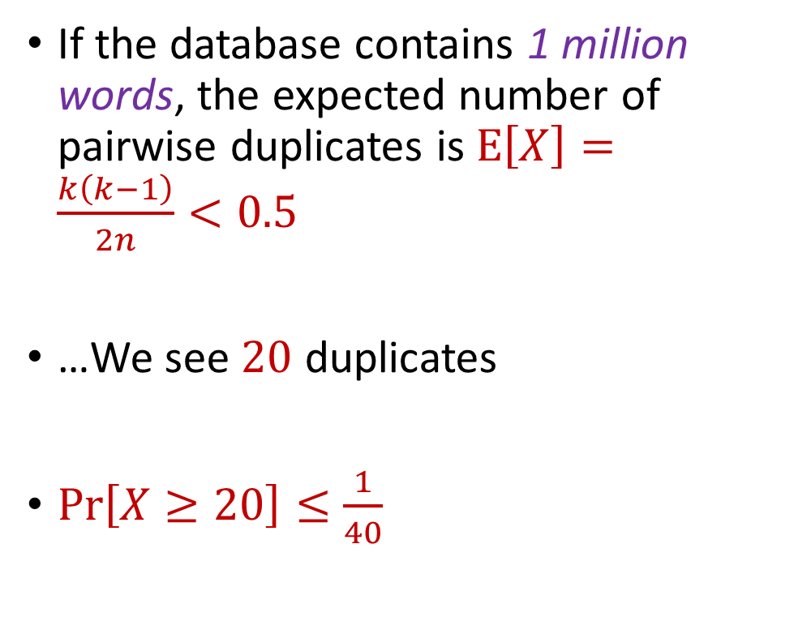
Case Study
If the database contains 1 million words, the expected number of pairwise duplicates is $E\left[X\right]=\frac{k\left(k−1\right)}{2n}<0.5$
…We see $20$ duplicates
$Pr\left[X≥20\right]≤\frac{1}{40}$

