Slide 1
CSCE 689: Special Topics in Modern Algorithms for Data Science
Lecture 24
Samson Zhou

Slide 2
Presentation Schedule
November 27: Chunkai, Jung, Galaxy AI
November 29: STMI, Anmol, Jason
December 1: Bokun, Ayesha, Dawei, Lipai

Slide 3
Previously: Coreset
Subset $X′$ of representative points of $X$ for a specific clustering objective
$Cost\left(X,C\right)≈Cost(X^{′},C)$ for all sets $C$ with $\left|C\right|=k$

Slide 4
Previously: Coreset
Given a set $X$ and an accuracy parameter $ε>0$, we say a set $X′$ with weight function $w$is an $(1+ε)$-multiplicative coreset for a cost function $Cost$, if for all queries $C$ with $\left|C\right|≤k$, we have
$$\left(1−ε\right)Cost(X,C)≤Cost(X′,C,w)≤\left(1+ε\right)Cost(X,C)$$
$(k,z)$-clustering: $Cost\left(X^{′},C,w\right)=\sum_{x∈X′}{{w\left(x\right)⋅\left(dist\left(x,C\right)\right)}^{z}}$

Slide 5


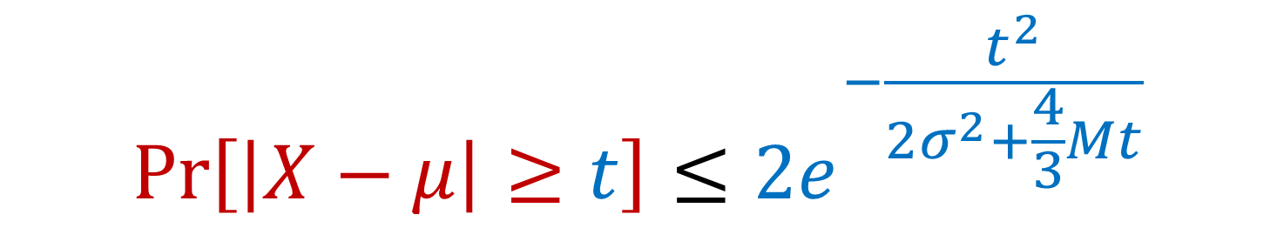
Previously: Bernstein’s Inequality
Bernstein’s inequality: Let $X_{1},…,X_{n}∈[−M,M]$ be independent random variables and let ${X=X}_{1}+…+X_{n}$ have mean $μ$ and variance $σ^{2}$. Then for any $t≥0$:
Example: Suppose $M=1$ and let $t=kσ$. Then
$$Pr\left[\left|X−μ\right|≥t\right]≤2e^{−\frac{t^{2}}{2σ^{2}+\frac{4}{3}Mt}}$$
$$Pr\left[\left|X−μ\right|≥kσ\right]≤2exp\left(−\frac{k^{2}}{4}\right)$$

Slide 6
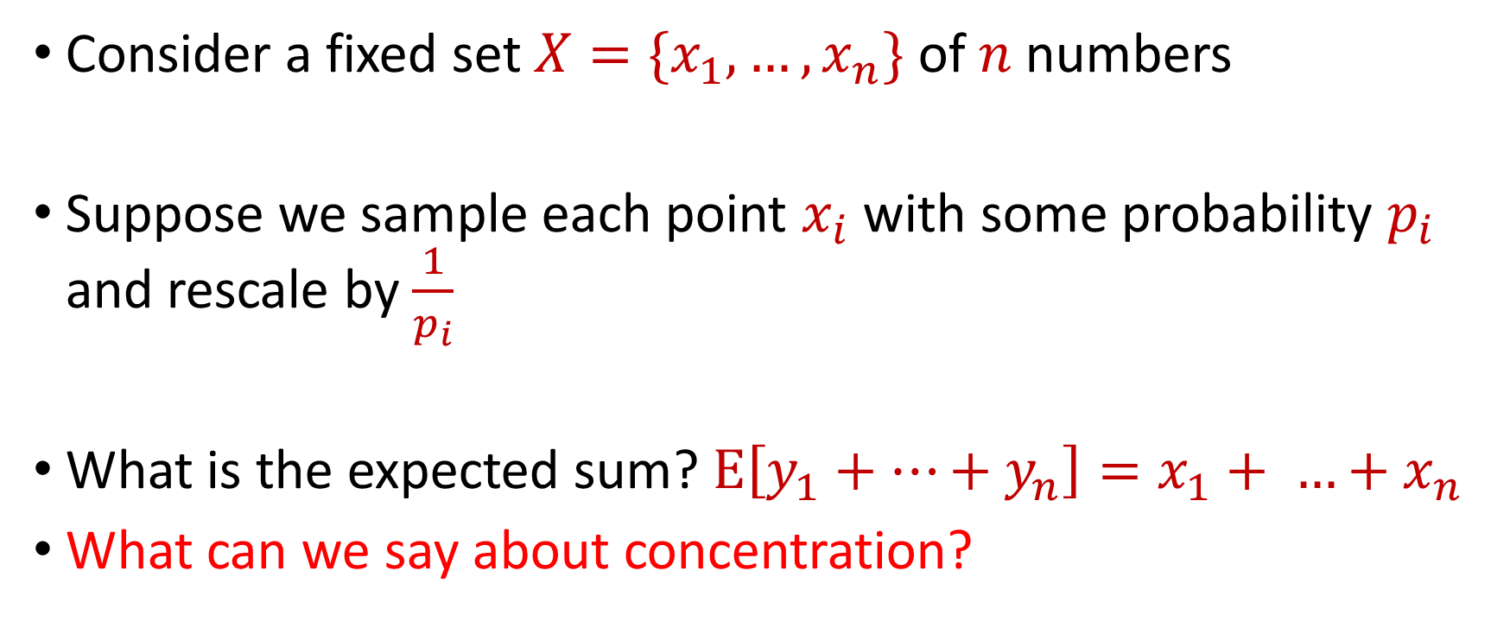
Last Time: Sampling for Sum Estimation
Consider a fixed set $X=\{x_{1},…,x_{n}\}$ of $n$ numbers
Suppose we sample each point $x_{i}$ with some probability $p_{i}$ and rescale by $\frac{1}{p_{i}}$
What is the expected sum? $E\left[y_{1}+…+y_{n}\right]=x_{1}+ …+x_{n}$
What can we say about concentration?

Slide 7
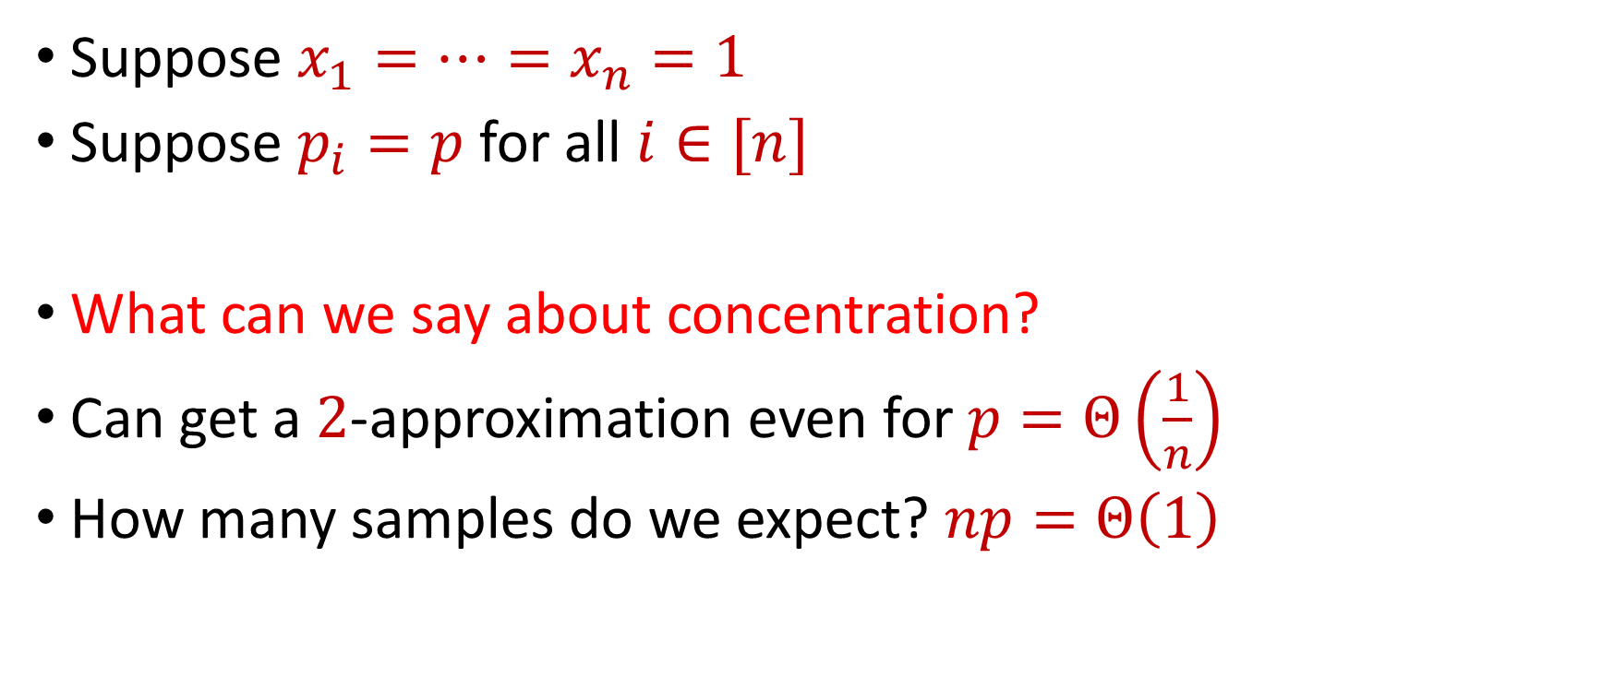
Last Time: Uniform Sampling for Sum Estimation
Suppose $x_{1}=…=x_{n}=1$
Suppose $p_{i}=p$ for all $i∈[n]$
What can we say about concentration?
Can get a $2$-approximation even for $p=Θ\left(\frac{1}{n}\right)$
How many samples do we expect? $np=Θ\left(1\right)$

Slide 8
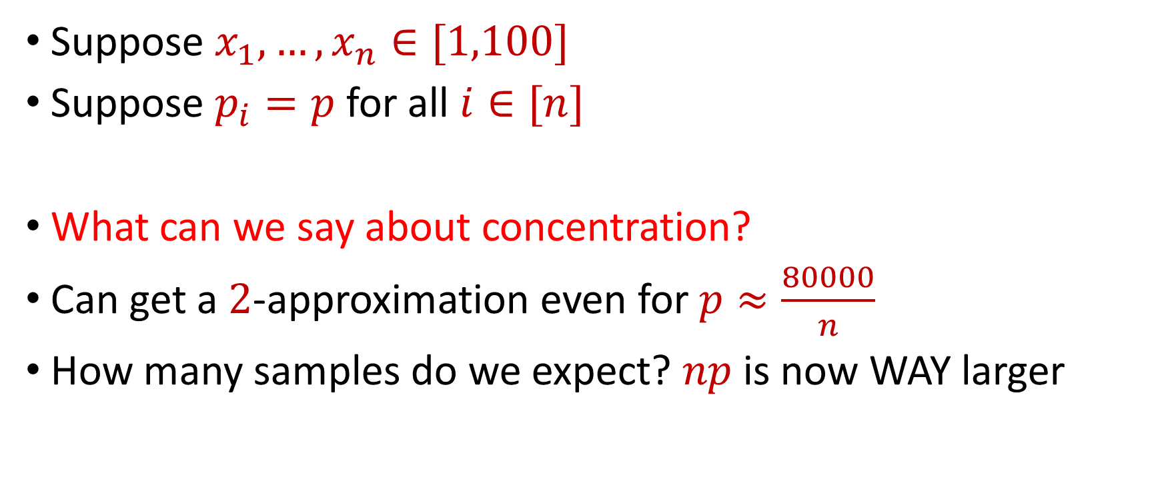
Last Time: Uniform Sampling for Sum Estimation
Suppose $x_{1},…,x_{n}∈[1,100]$
Suppose $p_{i}=p$ for all $i∈[n]$
What can we say about concentration?
Can get a $2$-approximation even for $p≈\frac{80000}{n}$
How many samples do we expect? $np$ is now WAY larger

Slide 9
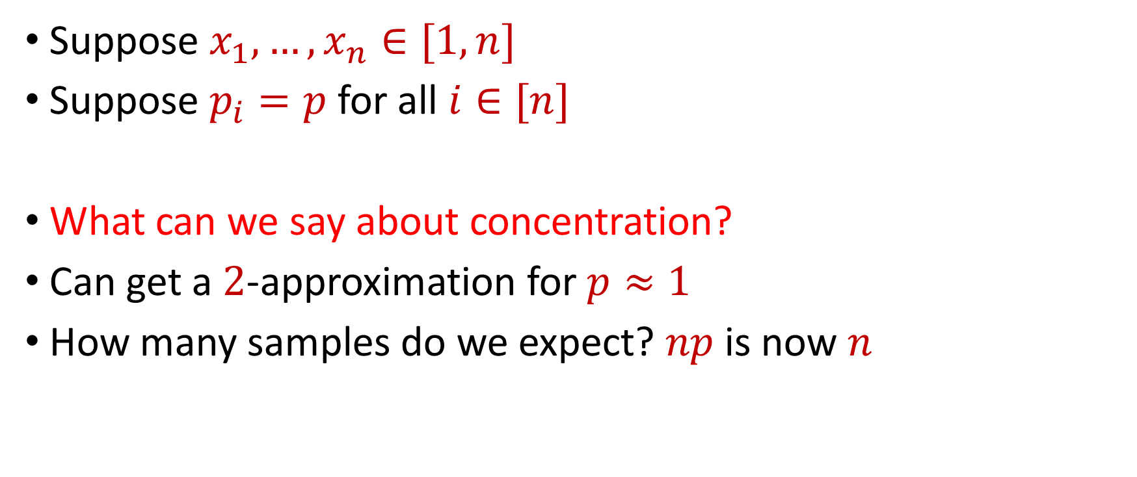
Last Time: Uniform Sampling for Sum Estimation
Suppose $x_{1},…,x_{n}∈[1,n]$
Suppose $p_{i}=p$ for all $i∈[n]$
What can we say about concentration?
Can get a $2$-approximation for $p≈1$
How many samples do we expect? $np$ is now $n$

Slide 10

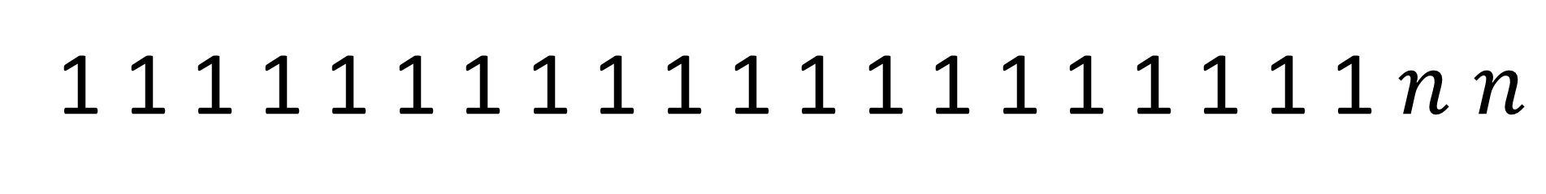
Uniform Sampling for Sum Estimation
Suppose $x_{1},…,x_{n}∈[1,n]$
Suppose $p_{i}=p$ for all $i∈[n]$
Do we really need $p$ to be a constant? YES!
1 1 1 1 1 1 1 1 1 1 1 1 1 1 1 1 1 1 1 1 $n$ $n$

Slide 11
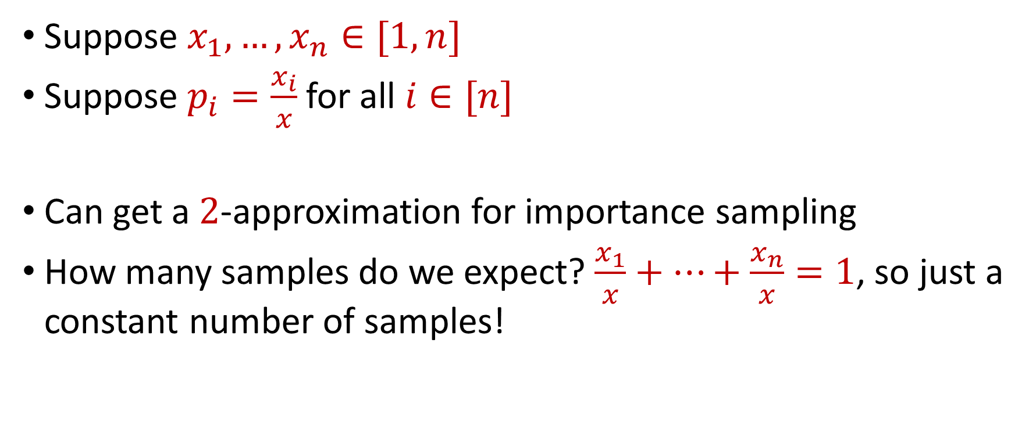
Last Time: Importance Sampling for Sum Estimation
Suppose $x_{1},…,x_{n}∈[1,n]$
Suppose $p_{i}=\frac{x_{i}}{x}$ for all $i∈[n]$
Can get a $2$-approximation for importance sampling
How many samples do we expect? $\frac{x_{1}}{x}+…+\frac{x_{n}}{x}=1$, so just a constant number of samples!

Slide 12
Coreset Construction and Sampling
Consider a fixed set $X$ and a fixed set $C$ of $k$ centers, which induces a fixed cost $Cost(X,C)$

Slide 13
Coreset Construction and Sampling
Consider a fixed set $X$ and a fixed set $C$ of $k$ centers, which induces a fixed cost $Cost(X,C)$
A simple way to obtain $X′$with $Cost\left(X^{′},C\right)≈Cost(X,C)$ is to uniformly sample points of $X$ into $X′$

Slide 14
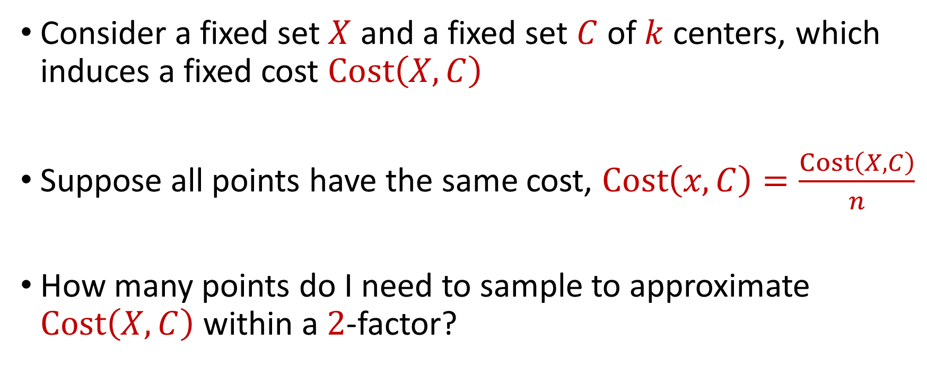
Coreset Construction and Uniform Sampling
Consider a fixed set $X$ and a fixed set $C$ of $k$ centers, which induces a fixed cost $Cost\left(X,C\right)$
Suppose all points have the same cost, $Cost\left(x,C\right)=\frac{Cost\left(X,C\right)}{n}$
How many points do I need to sample to approximate $Cost\left(X,C\right)$ within a $2$-factor?

Slide 15
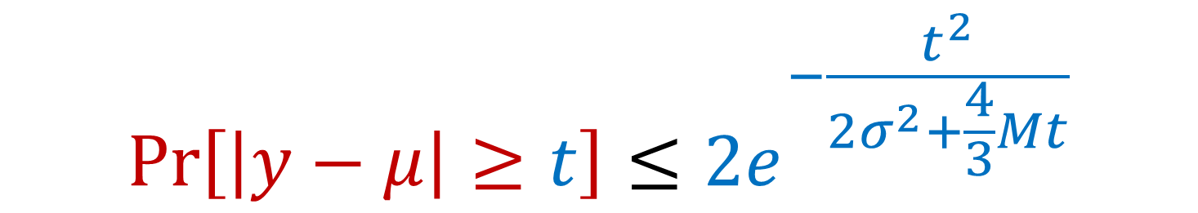

Bernstein’s Inequality
Bernstein’s inequality: Let $y_{1},…,y_{n}∈[−M,M]$ be independent random variables and let ${y=y}_{1}+…+y_{n}$ have mean $μ$ and variance $σ^{2}$. Then for any $t≥0$:
$$Pr\left[\left|y−μ\right|≥t\right]≤2e^{−\frac{t^{2}}{2σ^{2}+\frac{4}{3}Mt}}$$

Slide 16


Bernstein’s Inequality
Bernstein’s inequality: Let $y_{1},…,y_{n}∈[−M,M]$ be independent random variables and let ${y=y}_{1}+…+y_{n}$ have mean $μ$ and variance $σ^{2}$. Then for any $t≥0$:
Set $M=\frac{1}{p}$ , $t=\frac{1}{2}⋅Cost\left(X,C\right)$, and $σ^{2}≈\frac{n}{p}$. Then for $x=Cost\left(X,C\right)$,
$$Pr\left[\left|y−μ\right|≥t\right]≤2e^{−\frac{t^{2}}{2σ^{2}+\frac{4}{3}Mt}}$$
$$Pr\left[\left|y−μ\right|≥\frac{x}{2}\right]≤2exp\left(−\frac{{\left(x/2\right)}^{2}}{2\left(4n/p\right)+(4/3)(x/p)}\right)$$

Slide 17
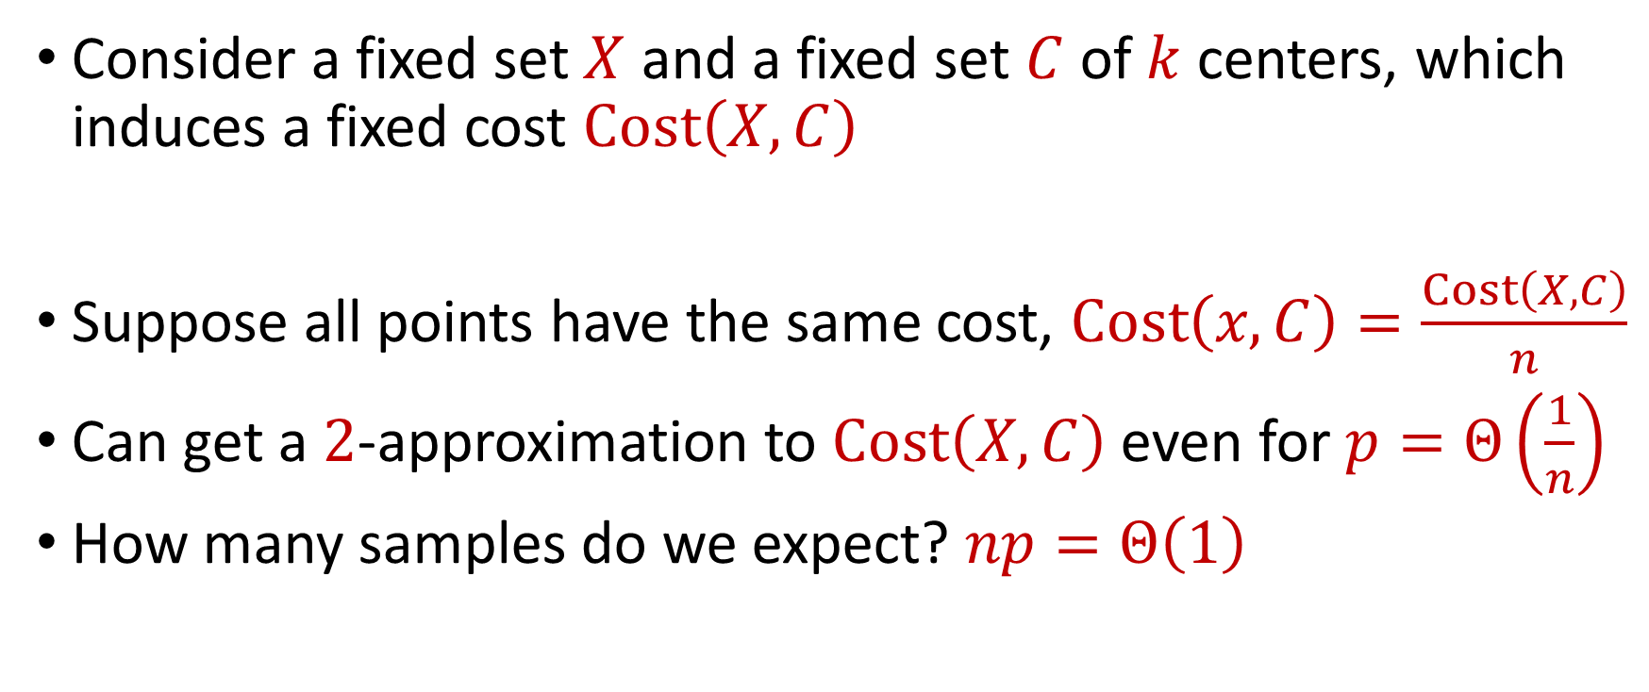
Coreset Construction and Uniform Sampling
Consider a fixed set $X$ and a fixed set $C$ of $k$ centers, which induces a fixed cost $Cost\left(X,C\right)$
Suppose all points have the same cost, $Cost\left(x,C\right)=\frac{Cost\left(X,C\right)}{n}$
Can get a $2$-approximation to $Cost\left(X,C\right)$even for $p=Θ\left(\frac{1}{n}\right)$
How many samples do we expect? $np=Θ\left(1\right)$

Slide 18

Coreset Construction and Uniform Sampling
Consider a fixed set $X$ and a fixed set $C$ of $k$ centers, which induces a fixed cost $Cost\left(X,C\right)$
Suppose all points have cost between $1$ and $100$
Suppose $p_{i}=p$ for all $i∈[n]$

Slide 19
Bernstein’s Inequality
Bernstein’s inequality: Let $y_{1},…,y_{n}∈[−M,M]$ be independent random variables and let ${y=y}_{1}+…+y_{n}$ have mean $μ$ and variance $σ^{2}$. Then for any $t≥0$:
$$Pr\left[\left|y−μ\right|≥t\right]≤2e^{−\frac{t^{2}}{2σ^{2}+\frac{4}{3}Mt}}$$

Slide 20
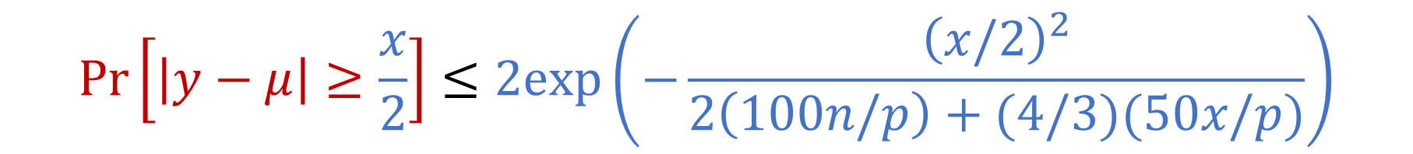

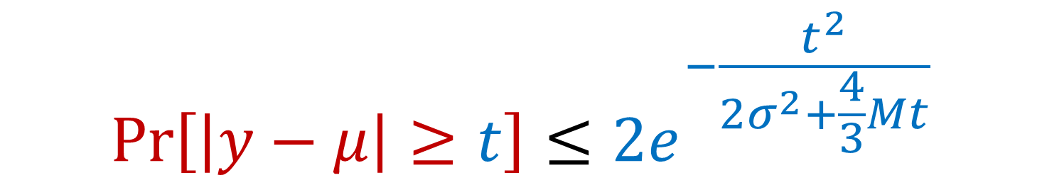
Bernstein’s Inequality
Bernstein’s inequality: Let $y_{1},…,y_{n}∈[−M,M]$ be independent random variables and let ${y=y}_{1}+…+y_{n}$ have mean $μ$ and variance $σ^{2}$. Then for any $t≥0$:
Set $M=\frac{100}{p}$ , $t=\frac{1}{2}⋅Cost\left(X,C\right)$, and $σ^{2}≈\frac{10000n}{p}$. Then for $x=Cost\left(X,C\right)$,
$$Pr\left[\left|y−μ\right|≥t\right]≤2e^{−\frac{t^{2}}{2σ^{2}+\frac{4}{3}Mt}}$$
$$Pr\left[\left|y−μ\right|≥\frac{x}{2}\right]≤2exp\left(−\frac{{\left(x/2\right)}^{2}}{2\left(100n/p\right)+(4/3)(50x/p)}\right)$$

Slide 21
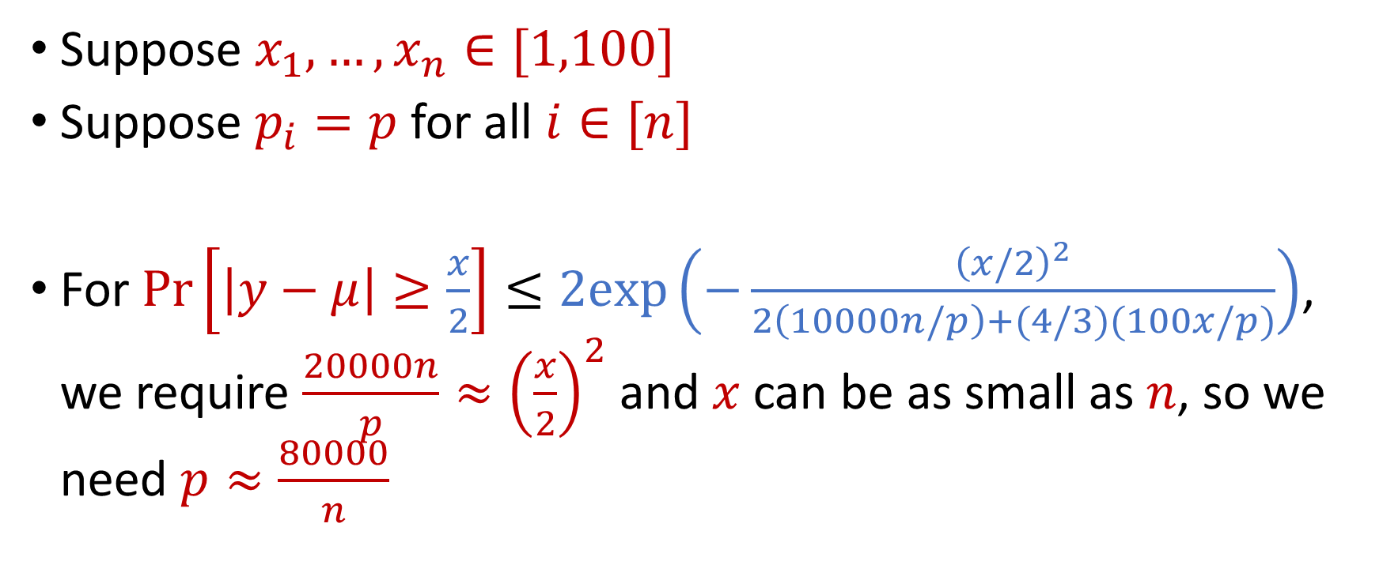
Coreset Construction and Uniform Sampling
Suppose $x_{1},…,x_{n}∈[1,100]$
Suppose $p_{i}=p$ for all $i∈[n]$
For $Pr\left[\left|y−μ\right|≥\frac{x}{2}\right]≤2exp\left(−\frac{{\left(x/2\right)}^{2}}{2\left(10000n/p\right)+(4/3)(100x/p)}\right)$, we require $\frac{20000n}{p}≈{\left(\frac{x}{2}\right)}^{2}$ and $x$ can be as small as $n$, so we need $p≈\frac{80000}{n}$

Slide 22
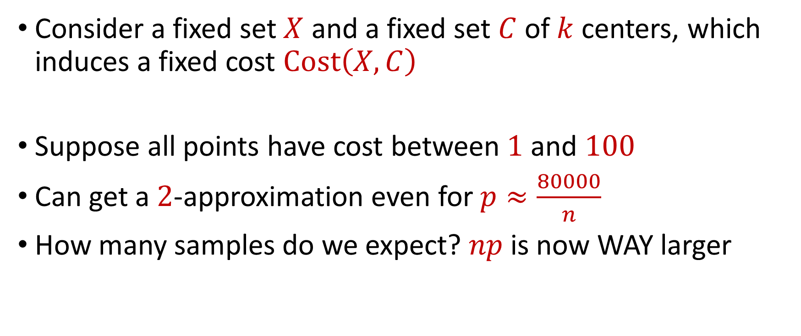
Coreset Construction and Uniform Sampling
Consider a fixed set $X$ and a fixed set $C$ of $k$ centers, which induces a fixed cost $Cost\left(X,C\right)$
Suppose all points have cost between $1$ and $100$
Can get a $2$-approximation even for $p≈\frac{80000}{n}$
How many samples do we expect? $np$ is now WAY larger

Slide 23
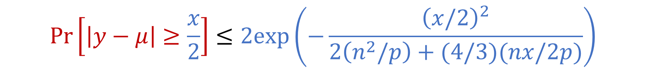

Coreset Construction and Uniform Sampling
Bernstein’s inequality: Let $y_{1},…,y_{n}∈[−M,M]$ be independent random variables and let ${y=y}_{1}+…+y_{n}$ have mean $μ$ and variance $σ^{2}$. Then for any $t≥0$:
Set $M=\frac{n}{p}$ , $t=\frac{1}{2}⋅Cost\left(X,C\right)$, and $σ^{2}≈\frac{n^{3}}{p}$. Then for $x=Cost\left(X,C\right)$,
$$Pr\left[\left|y−μ\right|≥t\right]≤2e^{−\frac{t^{2}}{2σ^{2}+\frac{4}{3}Mt}}$$
$$Pr\left[\left|y−μ\right|≥\frac{x}{2}\right]≤2exp\left(−\frac{{\left(x/2\right)}^{2}}{2\left(n^{2}/p\right)+(4/3)(nx/2p)}\right)$$

Slide 24
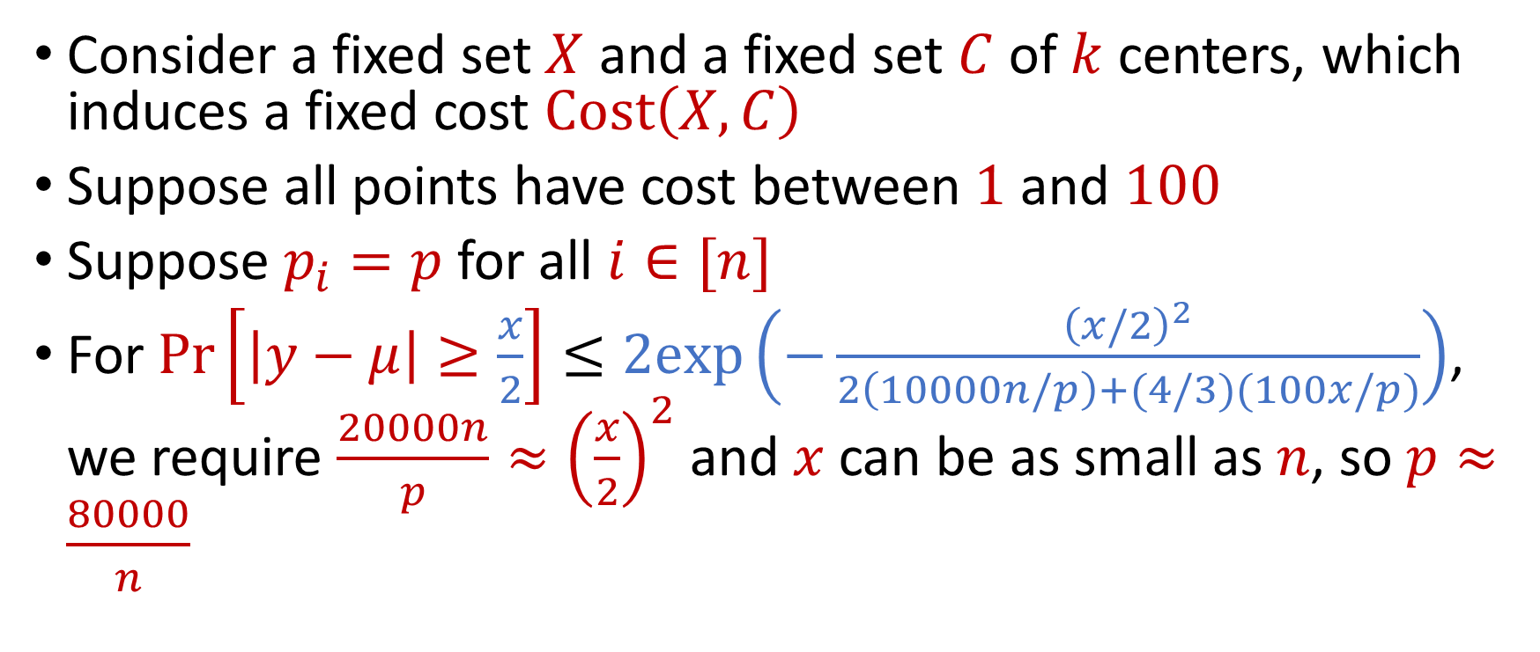
Coreset Construction and Uniform Sampling
Consider a fixed set $X$ and a fixed set $C$ of $k$ centers, which induces a fixed cost $Cost\left(X,C\right)$
Suppose all points have cost between $1$ and $100$
Suppose $p_{i}=p$ for all $i∈[n]$
For $Pr\left[\left|y−μ\right|≥\frac{x}{2}\right]≤2exp\left(−\frac{{\left(x/2\right)}^{2}}{2\left(10000n/p\right)+(4/3)(100x/p)}\right)$, we require $\frac{20000n}{p}≈{\left(\frac{x}{2}\right)}^{2}$ and $x$ can be as small as $n$, so $p≈\frac{80000}{n}$

Slide 25
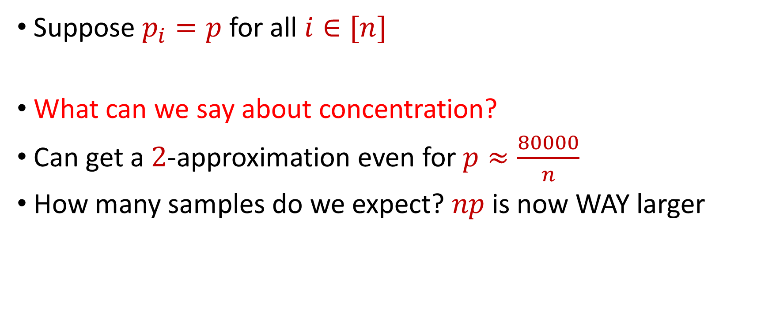
Coreset Construction and Uniform Sampling
Suppose $p_{i}=p$ for all $i∈[n]$
What can we say about concentration?
Can get a $2$-approximation even for $p≈\frac{80000}{n}$
How many samples do we expect? $np$ is now WAY larger

Slide 26
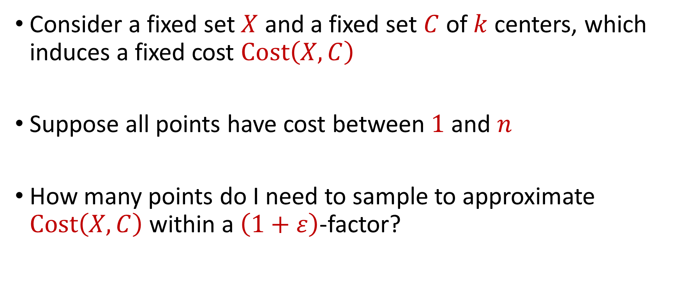
Coreset Construction and Uniform Sampling
Consider a fixed set $X$ and a fixed set $C$ of $k$ centers, which induces a fixed cost $Cost\left(X,C\right)$
Suppose all points have cost between $1$ and $n$
How many points do I need to sample to approximate $Cost\left(X,C\right)$ within a $\left(1+ε\right)$-factor?

Slide 27

Coreset Construction and Uniform Sampling
Bernstein’s inequality: Let $y_{1},…,y_{n}∈[−M,M]$ be independent random variables and let ${y=y}_{1}+…+y_{n}$ have mean $μ$ and variance $σ^{2}$. Then for any $t≥0$:
Set $M=\frac{n}{p}$ , $t=\frac{x}{2}$, and $σ^{2}≈\frac{n^{2}}{p}$. Then
$$Pr\left[\left|y−μ\right|≥t\right]≤2e^{−\frac{t^{2}}{2σ^{2}+\frac{4}{3}Mt}}$$
$$Pr\left[\left|y−μ\right|≥\frac{x}{2}\right]≤2exp\left(−\frac{{\left(x/2\right)}^{2}}{2\left(n^{2}/p\right)+(4/3)(nx/2p)}\right)$$

Slide 28
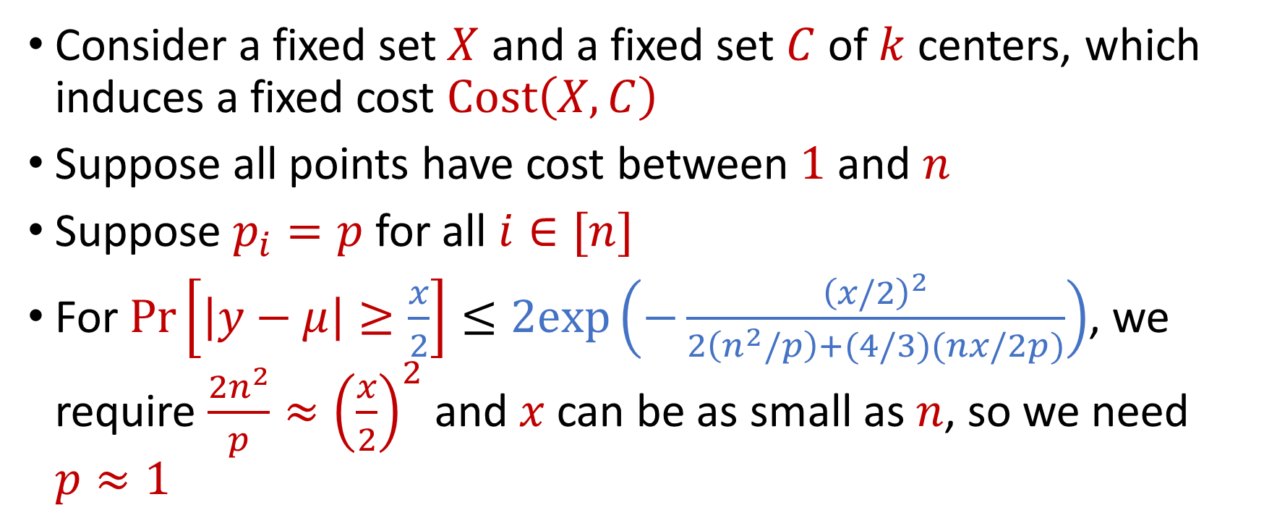
Uniform Sampling for Sum Estimation
Consider a fixed set $X$ and a fixed set $C$ of $k$ centers, which induces a fixed cost $Cost\left(X,C\right)$
Suppose all points have cost between $1$ and $n$
Suppose $p_{i}=p$ for all $i∈[n]$
For $Pr\left[\left|y−μ\right|≥\frac{x}{2}\right]≤2exp\left(−\frac{{\left(x/2\right)}^{2}}{2\left(n^{2}/p\right)+(4/3)(nx/2p)}\right)$, we require $\frac{2n^{2}}{p}≈{\left(\frac{x}{2}\right)}^{2}$ and $x$ can be as small as $n$, so we need $p≈1$

Slide 29
Coreset Construction and Sampling
Consider a fixed set $X$ and a fixed set $C$ of $k$ centers, which induces a fixed cost $Cost(X,C)$
Uniform sampling needs a lot of samples if there is a single point that greatly contributes to $Cost(X,C)$

Slide 30
Coreset Construction and Sampling
Fix: Importance sampling, sample each point $x∈X$ into $X′$ with probability proportional $Cost(x,C)$, i.e., $Cost(x,C)/Cost(X,C)$

Slide 31

Coreset Construction and Sampling
Fix: Importance sampling, sample each point $x∈X$ into $X′$ with probability proportional $Cost(x,C)$, i.e., $Cost(x,C)/Cost(X,C)$

Slide 32
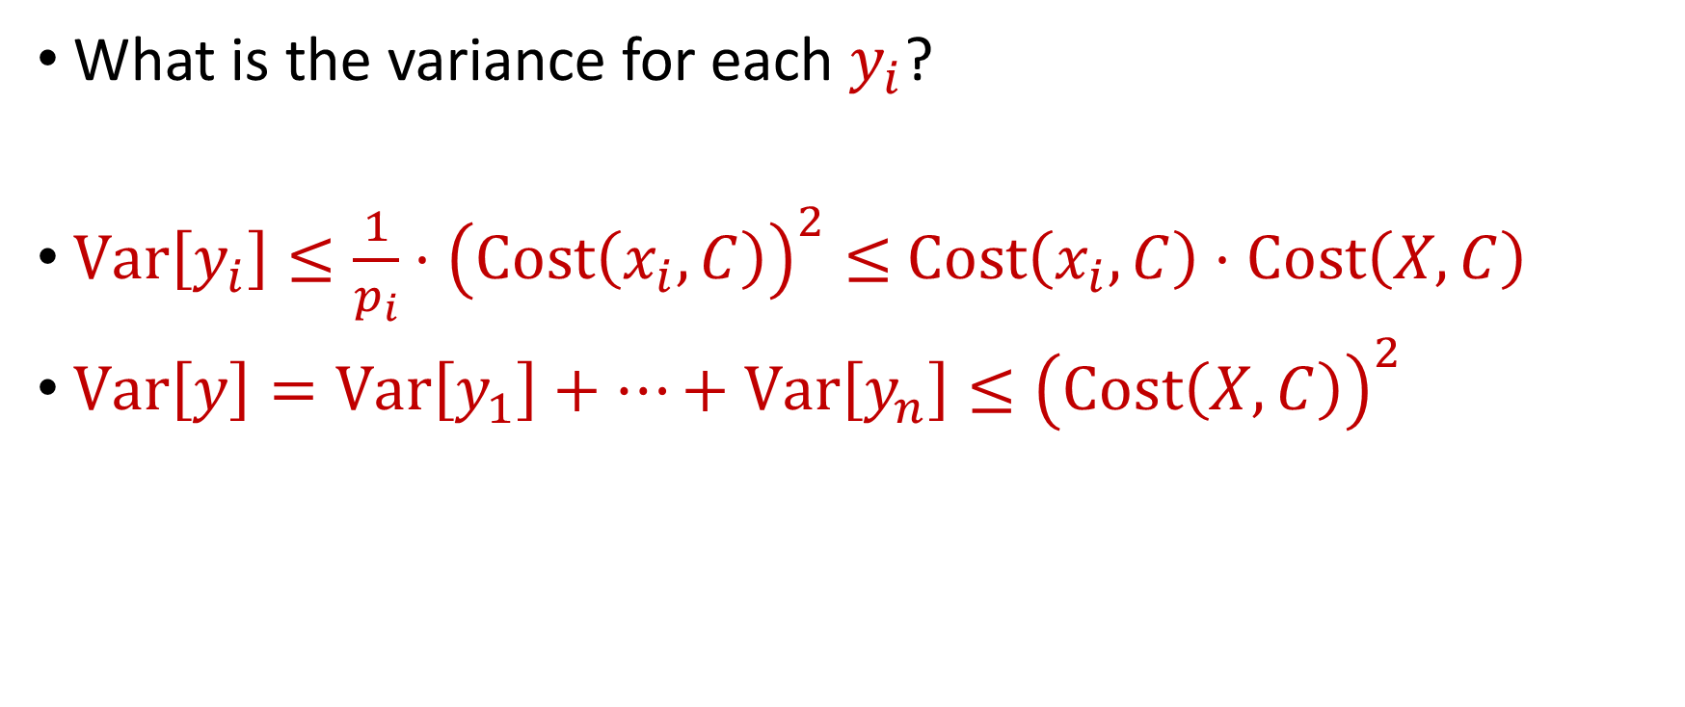
Importance Sampling for Coreset Construction
What is the variance for each $y_{i}$?
$Var\left[y_{i}\right]≤\frac{1}{p_{i}}⋅{\left(Cost\left(x_{i}, C\right)\right)}^{2}≤$ $Cost\left(x_{i}, C\right)⋅Cost\left(X, C\right)$
$Var\left[y\right]=Var\left[y_{1}\right]+…+Var\left[y_{n}\right]≤{\left(Cost\left(X, C\right)\right)}^{2}$

Slide 33
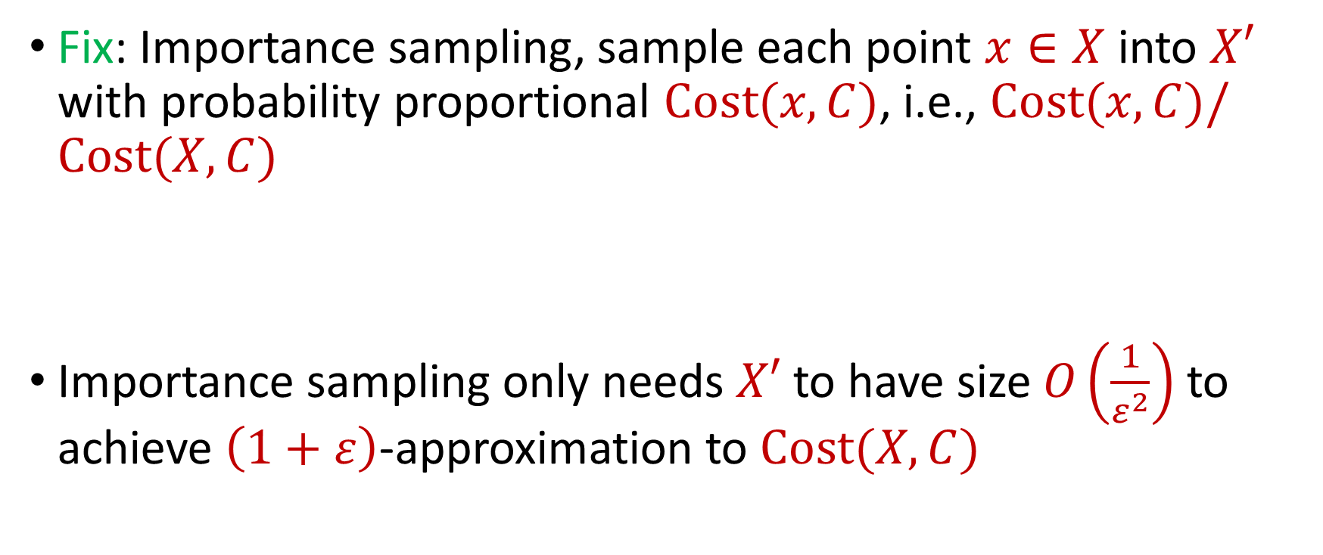
Coreset Construction and Sampling
Fix: Importance sampling, sample each point $x∈X$ into $X′$ with probability proportional $Cost(x,C)$, i.e., $Cost(x,C)/Cost(X,C)$
Importance sampling only needs $X′$ to have size $O\left(\frac{1}{ε^{2}}\right)$ to achieve $\left(1+ε\right)$-approximation to $Cost(X,C)$

Slide 34
Coreset Construction and Sampling
Importance sampling only needs $X′$ to have size $O\left(\frac{1}{ε^{2}}\right)$ to achieve $\left(1+ε\right)$-approximation to $Cost(X,C)$
What about a different choice $C$ of $k$ centers?

Slide 35
Coreset Construction and Sampling
Importance sampling only needs $X′$ to have size $O\left(\frac{1}{ε^{2}}\right)$ to achieve $\left(1+ε\right)$-approximation to $Cost(X,C)$
To handle all possible sets of $k$ centers:
Need to sample each point $x$ with probability $\max_{C}\frac{Cost\left(x,C\right)}{Cost\left(X,C\right)}$ instead of $\frac{Cost\left(x,C\right)}{Cost\left(X,C\right)}$
Need to union bound over a net of all possible sets of $k$ centers

Slide 36

Nets
A net $N$ is a set of sets $C$ of $k$ centers such that accuracy on $N$ implies accuracy everywhere

Slide 37
Coreset Construction and Sampling
Importance sampling only needs $X′$ to have size $O\left(\frac{1}{ε^{2}}\right)$ to achieve $\left(1+ε\right)$-approximation to $Cost(X,C)$
To handle all possible sets of $k$ centers:
Need to sample each point $x$ with probability $\max_{C}\frac{Cost\left(x,C\right)}{Cost\left(X,C\right)}$ instead of $\frac{Cost\left(x,C\right)}{Cost\left(X,C\right)}$
Need to union bound over a net of all possible sets of $k$ centers
Net with size ${\left(\frac{nΔ}{ε}\right)}^{O(kd)}$

Slide 38
Sensitivity Sampling
The quantity $s\left(x\right)=\max_{C}\frac{Cost\left(x,C\right)}{Cost\left(X,C\right)}$ is called the sensitivity of $x$ and intuitively measures how “important” the point $x$ is
The total sensitivity of $X$ is $\sum_{x∈X}{s(x)}$ and quantifies how many points will be sampled into $X′$ through importance/sensitivity sampling (before the union bound)

