Slide 1
TAMU Math Circle
Week 1: Advanced Quadratic Equations
Samson Zhou

Slide 2

Disclaimer
Material collected from Art of Problem Solving, Intermediate Algebra

Slide 3
Quadratic Equations
Though you are all familiar with the quadratic equation, you may not be familiar with every way in which it can be employed.
Today we will examine a number of problems that can be creatively attacked by a student with a solid understanding of the quadratic formula.
Some problems that require no math more difficult than the quadratic formula might be tougher than you think.

Slide 4

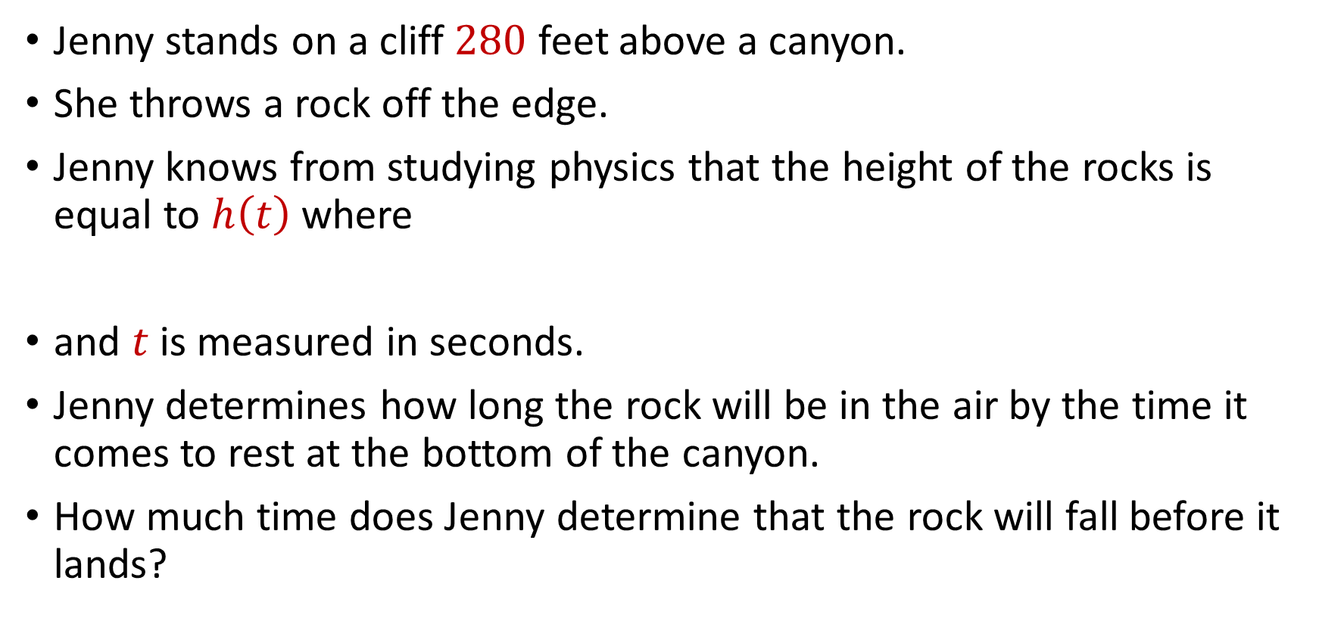
Quadratic Equations
Jenny stands on a cliff $280$ feet above a canyon.
She throws a rock off the edge.
Jenny knows from studying physics that the height of the rocks is equal to $h\left(t\right)$ where
and $t$ is measured in seconds.
Jenny determines how long the rock will be in the air by the time it comes to rest at the bottom of the canyon.
How much time does Jenny determine that the rock will fall before it lands?
$h\left(t\right)=280−5t−16t^{2}$

Slide 5


Quadratic Equations
We are looking for $t$ such that $h\left(t\right)=0$, where
$h\left(t\right)=280−5t−16t^{2}$

Slide 6

Quadratic Equations
We are looking for $t$ such that $h\left(t\right)=0$, where
$16t^{2}+5t−280=0$

Slide 7

Quadratic Equations
We are looking for $t$ such that $h\left(t\right)=0$, where
$$t=\frac{−5±\sqrt{25+17920}}{32}=\frac{−5±\sqrt{17945}}{32}$$

Slide 8
Quadratic Equations
The time after Jenny throws the rock CANNOT be less than 0. Only the positive solution works. For practical purposes a physicist would probably plug these numbers into a calculator or otherwise estimate the answer.
This problem demonstrates that it is important to pay attention to the restrictions on a problem. Work within the context of the problem and pay careful attention to the domain of the quadratic (in this case nonnegative reals).

Slide 9

Quadratic Equations
Determine the unique pair of real numbers $(x,y)$ such that
$$\left(3x^{2}+4x+8\right)\left(2y^{2}+10y+20\right)=50$$

Slide 10


Quadratic Equations
Determine the unique pair of real numbers $(x,y)$ such that
We can split
$$\left(3x^{2}+4x+8\right)\left(2y^{2}+10y+20\right)=50$$
$$3x^{2}+4x+8=c$$
$$2y^{2}+10y+20=50/c$$

Slide 11
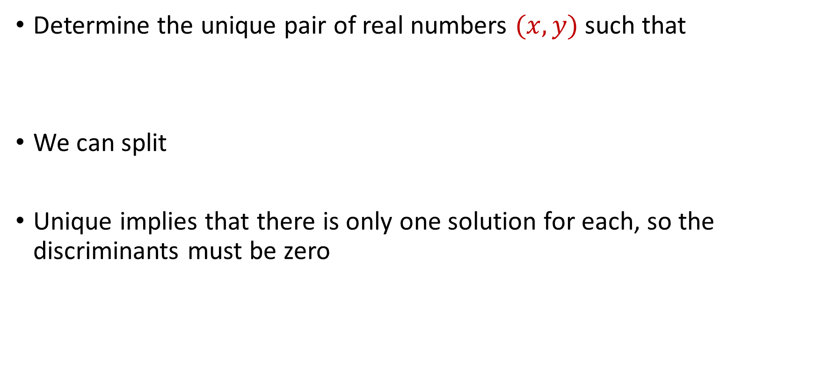
Quadratic Equations
Determine the unique pair of real numbers $(x,y)$ such that
We can split
Unique implies that there is only one solution for each, so the discriminants must be zero
$$\left(3x^{2}+4x+8\right)\left(2y^{2}+10y+20\right)=50$$
$$3x^{2}+4x+8=c$$
$$2y^{2}+10y+20=50/c$$

Slide 12
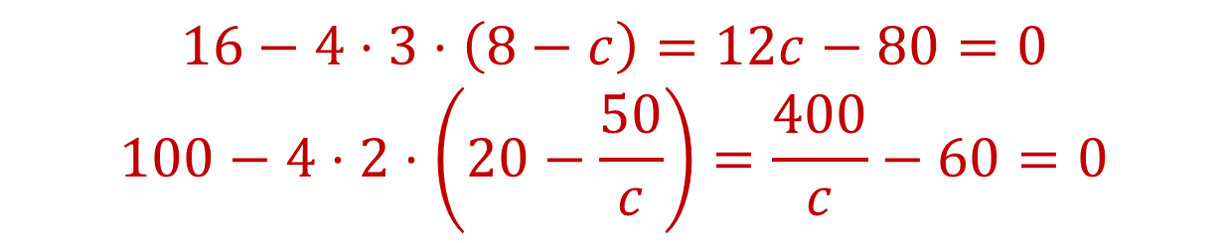
Quadratic Equations
Determine the unique pair of real numbers $(x,y)$ such that
We can split
Unique implies that there is only one solution for each, so the discriminants must be zero
$$\left(3x^{2}+4x+8\right)\left(2y^{2}+10y+20\right)=50$$
$$3x^{2}+4x+8=c$$
$$2y^{2}+10y+20=50/c$$
$$16−4⋅3⋅\left(8−c\right)=12c−80=0$$
$$100−4⋅2⋅\left(20−\frac{50}{c}\right)=\frac{400}{c}−60=0$$

Slide 13

Quadratic Equations
Determine the unique pair of real numbers $(x,y)$ such that
We can split
Unique implies that there is only one solution for each, so the discriminants must be zero
$$\left(3x^{2}+4x+8\right)\left(2y^{2}+10y+20\right)=50$$
$$3x^{2}+4x+8=c$$
$$2y^{2}+10y+20=50/c$$
$$16−4⋅3⋅\left(8−c\right)=12c−80=0$$
$$100−4⋅2⋅\left(20−\frac{50}{c}\right)=\frac{400}{c}−60=0$$
$$c=\frac{20}{3}$$

Slide 14

Quadratic Equations
Determine the unique pair of real numbers $(x,y)$ such that
We can split
$$\left(3x^{2}+4x+8\right)\left(2y^{2}+10y+20\right)=50$$
$$3x^{2}+4x+8=20/3$$
$$2y^{2}+10y+20=15/2$$

Slide 15

Quadratic Equations
Determine the unique pair of real numbers $(x,y)$ such that
We can split
Solving the above equation gives $x=−2/3$, $y=−5/2$
$$\left(3x^{2}+4x+8\right)\left(2y^{2}+10y+20\right)=50$$
$$3x^{2}+4x+8=20/3$$
$$2y^{2}+10y+20=15/2$$

Slide 16


Quadratic Equations
Solve the following system of equations for real $\left(a,b,c\right)$.
$$a^{2}+10b=−34$$
$$b^{2}+4c=17$$
$$c^{2}+8a=−28$$

Slide 17

Quadratic Equations
Solve the following system of equations for real $\left(a,b,c\right)$.
Adding the system together, we have
$$a^{2}+10b=−34$$
$$b^{2}+4c=17$$
$$c^{2}+8a=−28$$
$$a^{2}+8a+b^{2}+10b+c^{2}+4c=−45$$

Slide 18

Quadratic Equations
Solve the following system of equations for real $\left(a,b,c\right)$.
Adding the system together, we have
Completing the square,
$$a^{2}+10b=−34$$
$$b^{2}+4c=17$$
$$c^{2}+8a=−28$$
$$a^{2}+8a+b^{2}+10b+c^{2}+4c=−45$$
$$a^{2}+8a+16+b^{2}+10b+25+c^{2}+4c+4=−45+16+25+4=0$$

Slide 19

Quadratic Equations
Solve the following system of equations for real $\left(a,b,c\right)$.
Completing the square,
Thus we have $a=−4$, $b=−5$, $c=−2$
$$a^{2}+10b=−34$$
$$b^{2}+4c=17$$
$$c^{2}+8a=−28$$
$${\left(a+4\right)}^{2}+{\left(b+5\right)}^{2}+{\left(c+2\right)}^{2} =0$$

Slide 20
Quadratic Equations
The key to this problem was recognizing the having one unique solution meant that we could break the original equation up into two quadratics that each had only one solution.
We merely needed to manipulate the constant that each quadratic was equal to in order to make the discriminants equal to 0.

Slide 21
Special Algebraic Insights
Some algebra problems are not solved by looking for roots to equations or plugging into well-known formulas.
They simply require insight and experience and here will examine a couple of these types of problems.

Slide 22


Special Algebraic Insights
If $xy=a$, $xz=b$, and $yz=c$, and none of these quantities is $0$, what is the value of
$x^{2}+y^{2}+z^{2}$?

Slide 23


Special Algebraic Insights
If $xy=a$, $xz=b$, and $yz=c$, and none of these quantities is $0$, what is the value of
Multiplying two at a time:
$x^{2}+y^{2}+z^{2}$?
$ab=x^{2}yz$, $bc=xyz^{2}$, $ac=xy^{2}z$

Slide 24

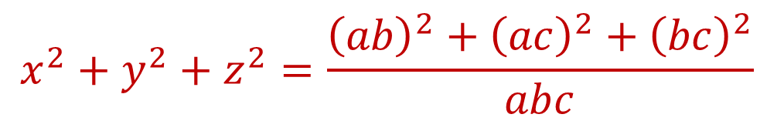
Special Algebraic Insights
If $xy=a$, $xz=b$, and $yz=c$, and none of these quantities is $0$, what is the value of
Multiplying two at a time:
We have $x^{2}=\frac{ab}{c}$, $y^{2}=\frac{ac}{b}$, $z^{2}=\frac{bc}{a}$, so
$x^{2}+y^{2}+z^{2}$?
$ab=x^{2}yz$, $bc=xyz^{2}$, $ac=xy^{2}z$
$$x^{2}+y^{2}+z^{2}=\frac{{\left(ab\right)}^{2}+{\left(ac\right)}^{2}+{\left(bc\right)}^{2}}{abc}$$

Slide 25
Special Algebraic Insights
Isolating variables often helps us get a grip on what we can do with them.
One of the most important lessons in algebraic problem solving.

Slide 26

Special Algebraic Insights
Solve for real values of $x$, $y$, and $z$, where
$$3x^{2}+y^{2}+z^{2}=2x(y+z)$$

Slide 27

Special Algebraic Insights
Solve for real values of $x$, $y$, and $z$, where
Collecting terms,
$$3x^{2}+y^{2}+z^{2}=2x(y+z)$$
$$3x^{2}+y^{2}+z^{2}−2xy−2xz=0$$

Slide 28

Special Algebraic Insights
Solve for real values of $x$, $y$, and $z$, where
Collecting terms,
Grouping terms,
$$3x^{2}+y^{2}+z^{2}=2x(y+z)$$
$$3x^{2}+y^{2}+z^{2}−2xy−2xz=0$$
$$x^{2}+x^{2}−2xy+y^{2}+x^{2}−2xz+z^{2}=0$$

Slide 29
Special Algebraic Insights
Solve for real values of $x$, $y$, and $z$, where
Collecting terms,
Grouping terms,
$$3x^{2}+y^{2}+z^{2}=2x(y+z)$$
$$3x^{2}+y^{2}+z^{2}−2xy−2xz=0$$
$$x^{2}+x^{2}−2xy+y^{2}+x^{2}−2xz+z^{2}=0$$
$$x^{2}+{\left(x−y\right)}^{2}+{\left(x−z\right)}^{2}=0$$

Slide 30

Special Algebraic Insights
Solve for real values of $x$, $y$, and $z$, where
Grouping terms,
We thus have $x=y=z=0$
$$3x^{2}+y^{2}+z^{2}=2x(y+z)$$
$$x^{2}+x^{2}−2xy+y^{2}+x^{2}−2xz+z^{2}=0$$
$$x^{2}+{\left(x−y\right)}^{2}+{\left(x−z\right)}^{2}=0$$

Slide 31
Special Algebraic Insights
When facing an equation that does not immediately look familiar, try rearranging the terms. Sometimes easier to work with expressions such as perfect squares will present themselves.
Of course, you must be able to recognize them when they are present. Recognition is largely a matter of experience.

Slide 32

Funky Numbers
Simplify
$$\sqrt{7+4\sqrt{3}}$$

Slide 33

Funky Numbers
Simplify
Write $x=\sqrt{7+4\sqrt{3}}$ so that $x^{2}=7+4\sqrt{3}$
$$\sqrt{7+4\sqrt{3}}$$

Slide 34

Funky Numbers
Simplify
Write $x=\sqrt{7+4\sqrt{3}}$ so that $x^{2}=7+4\sqrt{3}$
If $x=A+B$, then $x^{2}=A^{2}+2AB+B^{2}=7+4\sqrt{3}$
$$\sqrt{7+4\sqrt{3}}$$

Slide 35

Funky Numbers
Simplify
Write $x=\sqrt{7+4\sqrt{3}}$ so that $x^{2}=7+4\sqrt{3}$
If $x=A+B$, then $x^{2}=A^{2}+2AB+B^{2}=7+4\sqrt{3}$
Could guess $A^{2}+B^{2}=7$ and $2AB=4\sqrt{3}$
$$\sqrt{7+4\sqrt{3}}$$

Slide 36

Funky Numbers
Simplify
Write $x=\sqrt{7+4\sqrt{3}}$ so that $x^{2}=7+4\sqrt{3}$
If $x=A+B$, then $x^{2}=A^{2}+2AB+B^{2}=7+4\sqrt{3}$
Could guess $A^{2}+B^{2}=7$ and $2AB=4\sqrt{3}$
$A^{2}+B^{2}=7$ and $A^{2}B^{2}=12$
$$\sqrt{7+4\sqrt{3}}$$

Slide 37
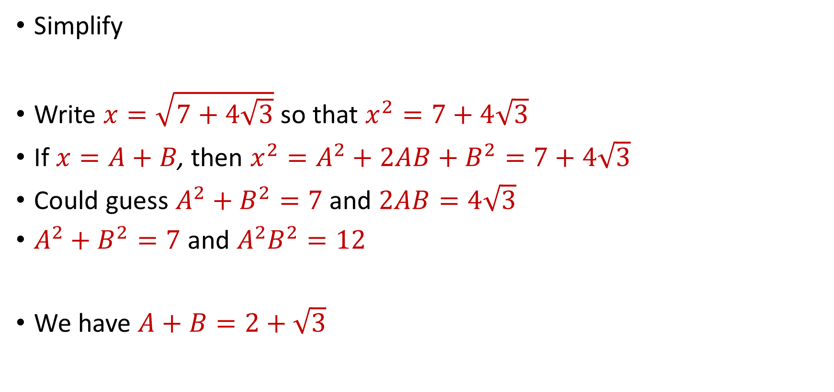
Funky Numbers
Simplify
Write $x=\sqrt{7+4\sqrt{3}}$ so that $x^{2}=7+4\sqrt{3}$
If $x=A+B$, then $x^{2}=A^{2}+2AB+B^{2}=7+4\sqrt{3}$
Could guess $A^{2}+B^{2}=7$ and $2AB=4\sqrt{3}$
$A^{2}+B^{2}=7$ and $A^{2}B^{2}=12$
We have $A+B=2+\sqrt{3}$
$$\sqrt{7+4\sqrt{3}}$$

Slide 38

Funky Numbers
Simplify
$$\sqrt{14+6\sqrt{5}}$$

Slide 39

Funky Numbers
Simplify
Write $x=\sqrt{14+6\sqrt{5}}$ so that $x^{2}=14+6\sqrt{5}$
$$\sqrt{14+6\sqrt{5}}$$

Slide 40

Funky Numbers
Simplify
Write $x=\sqrt{14+6\sqrt{5}}$ so that $x^{2}=14+6\sqrt{5}$
If $x=A+B$, then $x^{2}=A^{2}+2AB+B^{2}=14+6\sqrt{5}$
$$\sqrt{14+6\sqrt{5}}$$

Slide 41

Funky Numbers
Simplify
Write $x=\sqrt{14+6\sqrt{5}}$ so that $x^{2}=14+6\sqrt{5}$
If $x=A+B$, then $x^{2}=A^{2}+2AB+B^{2}=14+6\sqrt{5}$
$A^{2}+B^{2}=14$ and $A^{2}B^{2}=45$
$$\sqrt{14+6\sqrt{5}}$$

Slide 42
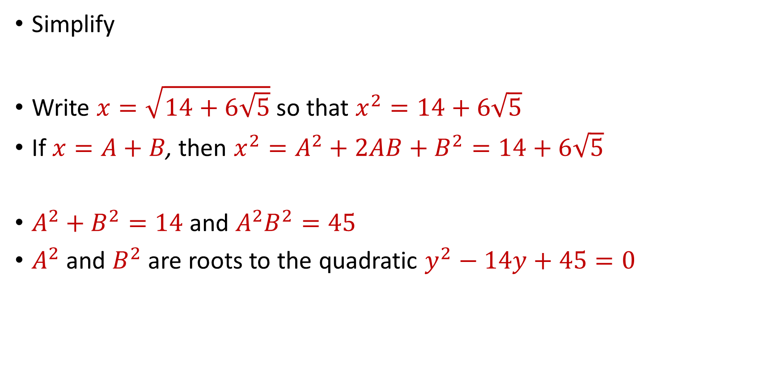
Funky Numbers
Simplify
Write $x=\sqrt{14+6\sqrt{5}}$ so that $x^{2}=14+6\sqrt{5}$
If $x=A+B$, then $x^{2}=A^{2}+2AB+B^{2}=14+6\sqrt{5}$
$A^{2}+B^{2}=14$ and $A^{2}B^{2}=45$
$A^{2}$ and $B^{2}$ are roots to the quadratic $y^{2}−14y+45=0$
$$\sqrt{14+6\sqrt{5}}$$

Slide 43
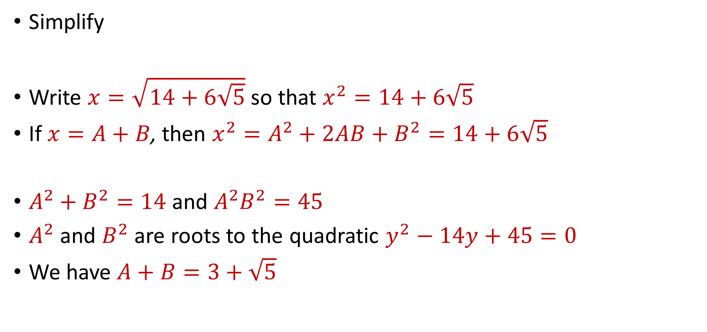
Funky Numbers
Simplify
Write $x=\sqrt{14+6\sqrt{5}}$ so that $x^{2}=14+6\sqrt{5}$
If $x=A+B$, then $x^{2}=A^{2}+2AB+B^{2}=14+6\sqrt{5}$
$A^{2}+B^{2}=14$ and $A^{2}B^{2}=45$
$A^{2}$ and $B^{2}$ are roots to the quadratic $y^{2}−14y+45=0$
We have $A+B=3+\sqrt{5}$
$$\sqrt{14+6\sqrt{5}}$$

Slide 44
Funky Numbers
Simplify
$$\sqrt{5+12i}$$

Slide 45

Funky Numbers
Simplify
Write $x=\sqrt{5+12i}$ so that $x^{2}=5+12i$
$$\sqrt{5+12i}$$

Slide 46

Funky Numbers
Simplify
Write $x=\sqrt{5+12i}$ so that $x^{2}=5+12i$
If $x=A+B$, then $x^{2}=A^{2}+2AB+B^{2}=5+12i$
$$\sqrt{5+12i}$$

Slide 47

Funky Numbers
Simplify
Write $x=\sqrt{5+12i}$ so that $x^{2}=5+12i$
If $x=A+B$, then $x^{2}=A^{2}+2AB+B^{2}=5+12i$
$A^{2}+B^{2}=5$ and $A^{2}B^{2}=−36$
$$\sqrt{5+12i}$$

Slide 48
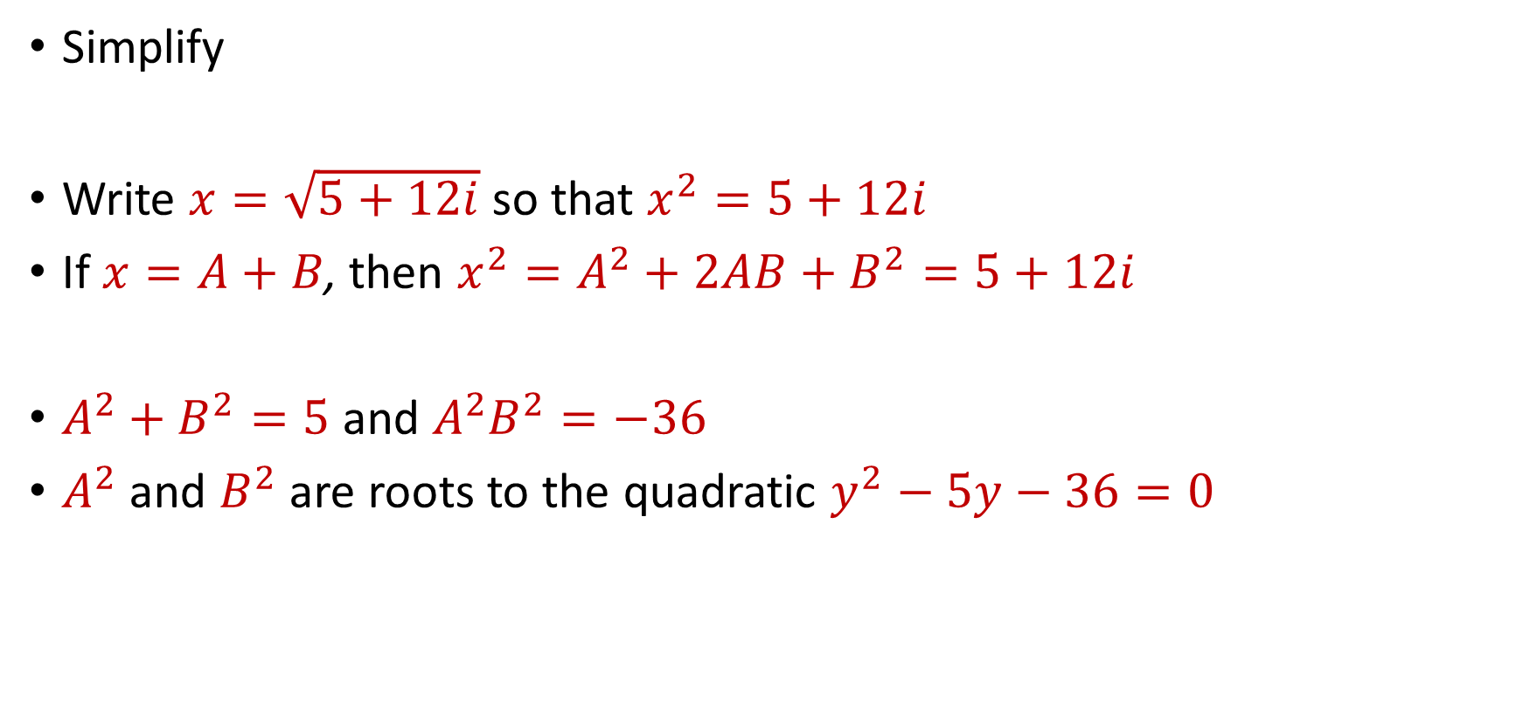
Funky Numbers
Simplify
Write $x=\sqrt{5+12i}$ so that $x^{2}=5+12i$
If $x=A+B$, then $x^{2}=A^{2}+2AB+B^{2}=5+12i$
$A^{2}+B^{2}=5$ and $A^{2}B^{2}=−36$
$A^{2}$ and $B^{2}$ are roots to the quadratic $y^{2}−5y−36=0$
$$\sqrt{5+12i}$$

Slide 49
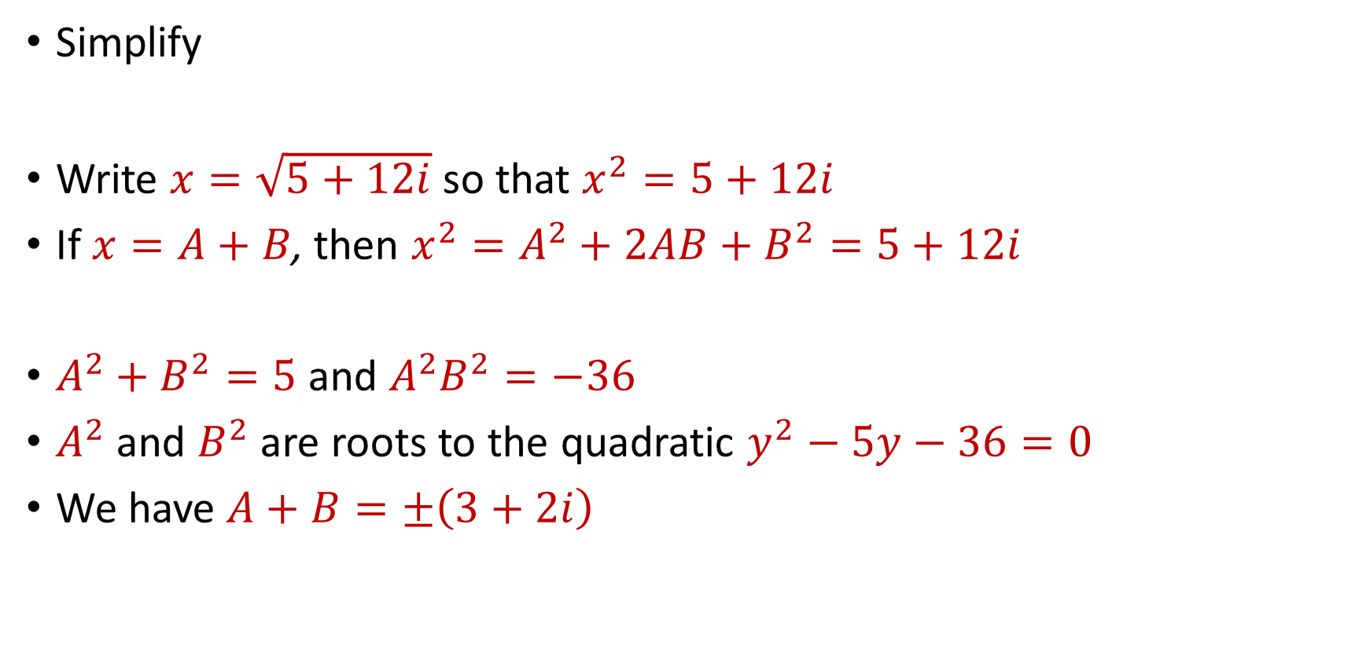
Funky Numbers
Simplify
Write $x=\sqrt{5+12i}$ so that $x^{2}=5+12i$
If $x=A+B$, then $x^{2}=A^{2}+2AB+B^{2}=5+12i$
$A^{2}+B^{2}=5$ and $A^{2}B^{2}=−36$
$A^{2}$ and $B^{2}$ are roots to the quadratic $y^{2}−5y−36=0$
We have $A+B=±\left(3+2i\right)$
$$\sqrt{5+12i}$$

Slide 50
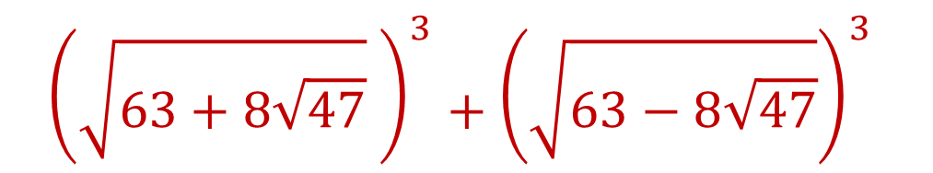
Funky Numbers
Find the value of
$${\left(\sqrt{63+8\sqrt{47}} \right)}^{3}+{\left(\sqrt{63−8\sqrt{47}}\right)}^{3}$$

Slide 51

Funky Numbers
Find the value of
Using our earlier techniques, we have $\sqrt{63+8\sqrt{47}}\text{=4+}\sqrt{47}$ and $\sqrt{63−8\sqrt{47}}\text{=4}−\sqrt{47}$
$${\left(\sqrt{63+8\sqrt{47}} \right)}^{3}+{\left(\sqrt{63−8\sqrt{47}}\right)}^{3}$$

Slide 52
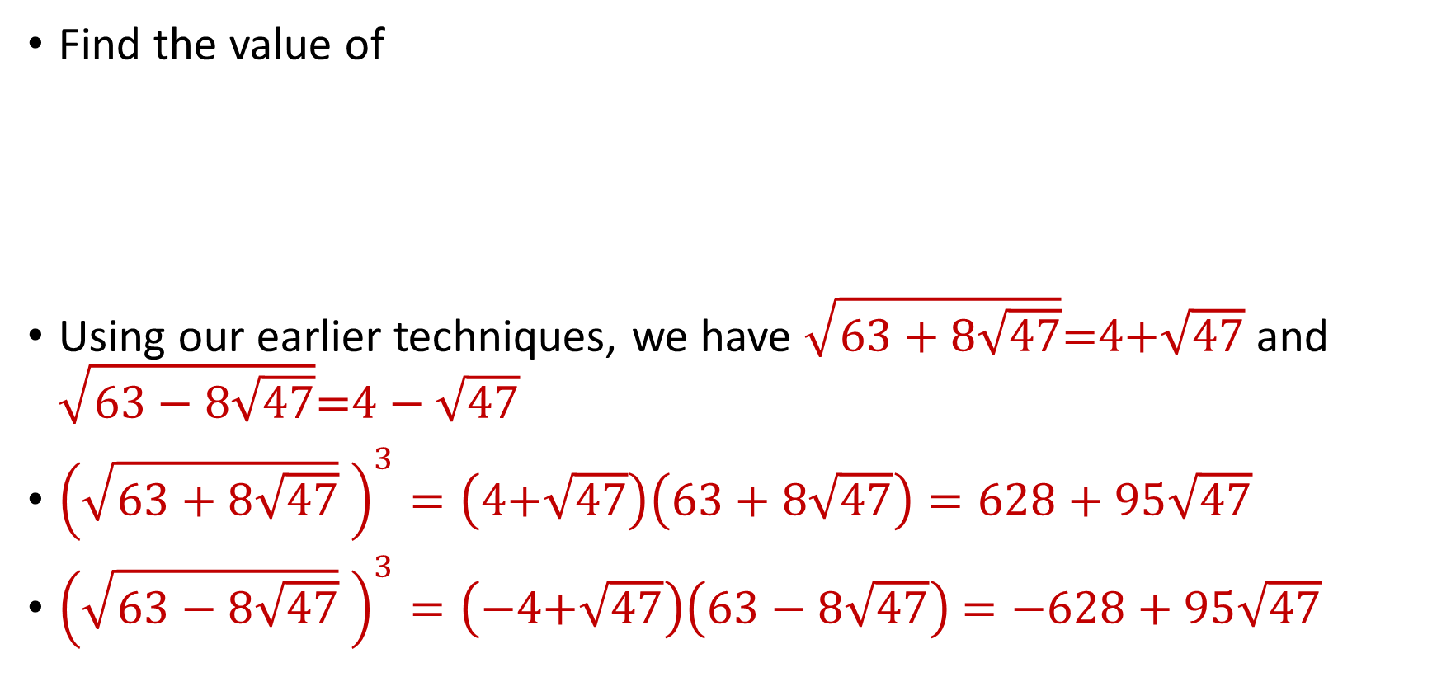
Funky Numbers
Find the value of
Using our earlier techniques, we have $\sqrt{63+8\sqrt{47}}\text{=4+}\sqrt{47}$ and $\sqrt{63−8\sqrt{47}}\text{=4}−\sqrt{47}$
${\left(\sqrt{63+8\sqrt{47}} \right)}^{3}=\left(\text{4+}\sqrt{47}\right)\left(63+8\sqrt{47}\right)=628+95\sqrt{47}$
${\left(\sqrt{63−8\sqrt{47}} \right)}^{3}=\left(−\text{4+}\sqrt{47}\right)\left(63−8\sqrt{47}\right)$ $=−628+95\sqrt{47}$
$${\left(\sqrt{63+8\sqrt{47}} \right)}^{3}+{\left(\sqrt{63−8\sqrt{47}}\right)}^{3}$$

Slide 53
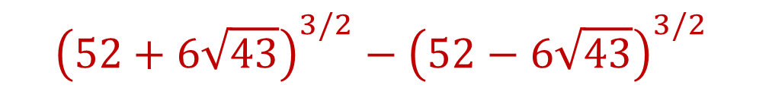
Funky Numbers
(AIME 1990 #2): Find the value of
$${\left(52+6\sqrt{43}\right)}^{3/2}−{\left(52−6\sqrt{43}\right)}^{3/2}$$

Slide 54
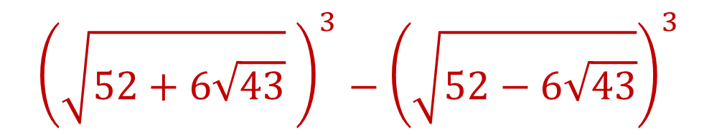

Funky Numbers
(AIME 1990 #2): Find the value of
Using our earlier techniques, we have $\sqrt{52+6\sqrt{43}}\text{=3+}\sqrt{43}$ and $\sqrt{52−6\sqrt{43}}\text{=}−3+\sqrt{43}$
$${\left(\sqrt{52+6\sqrt{43}} \right)}^{3}−{\left(\sqrt{52−6\sqrt{43}}\right)}^{3}$$

Slide 55
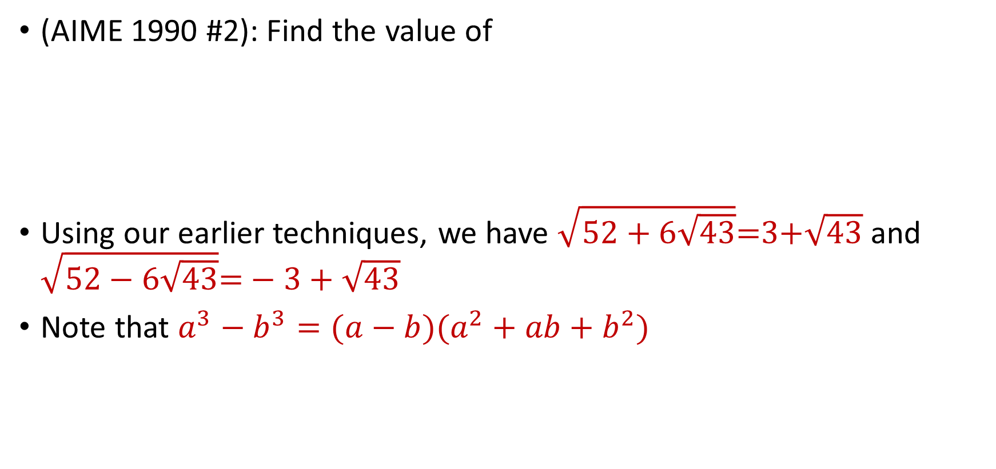
Funky Numbers
(AIME 1990 #2): Find the value of
Using our earlier techniques, we have $\sqrt{52+6\sqrt{43}}\text{=3+}\sqrt{43}$ and $\sqrt{52−6\sqrt{43}}\text{=}−3+\sqrt{43}$
Note that $a^{3}−b^{3}=(a−b)(a^{2}+ab+b^{2})$
$${\left(\sqrt{52+6\sqrt{43}} \right)}^{3}−{\left(\sqrt{52−6\sqrt{43}}\right)}^{3}$$

Slide 56
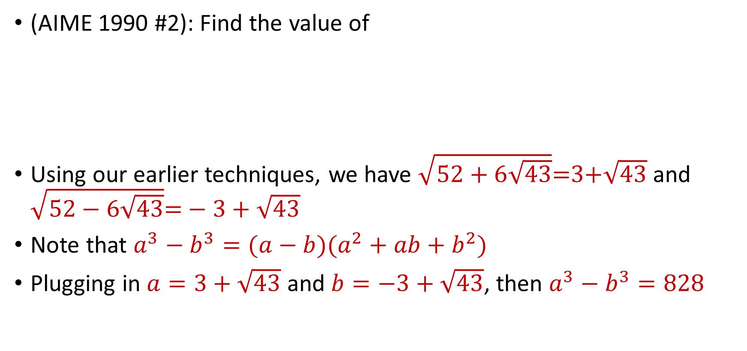
Funky Numbers
(AIME 1990 #2): Find the value of
Using our earlier techniques, we have $\sqrt{52+6\sqrt{43}}\text{=3+}\sqrt{43}$ and $\sqrt{52−6\sqrt{43}}\text{=}−3+\sqrt{43}$
Note that $a^{3}−b^{3}=(a−b)(a^{2}+ab+b^{2})$
Plugging in $a=3+\sqrt{43}$ and $b=−3+\sqrt{43}$, then $a^{3}−b^{3}=828$
$${\left(\sqrt{52+6\sqrt{43}} \right)}^{3}−{\left(\sqrt{52−6\sqrt{43}}\right)}^{3}$$

Slide 57

Graphing Quadratics
Consider the equation $y=x^{2}$
What does it look like on the plane?

Slide 58
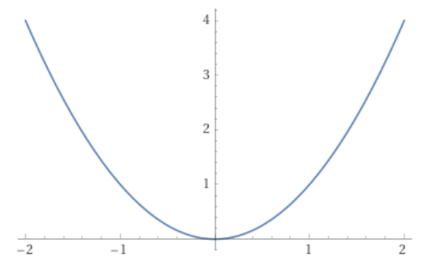
Graphing Quadratics
Consider the equation $y=x^{2}$
What does it look like on the plane?

Slide 59

Graphing Quadratics
What is the minimum value of
where $x$ can take on any real value?
$$f\left(x\right)=2x^{2}+12x+21$$

Slide 60

Graphing Quadratics
What is the minimum value of
where $x$ can take on any real value?
We have $2x^{2}+12x+21=2\left(x^{2}+6x+9\right)+3=2{\left(x+3\right)}^{2}+3$
$$f\left(x\right)=2x^{2}+12x+21$$

Slide 61
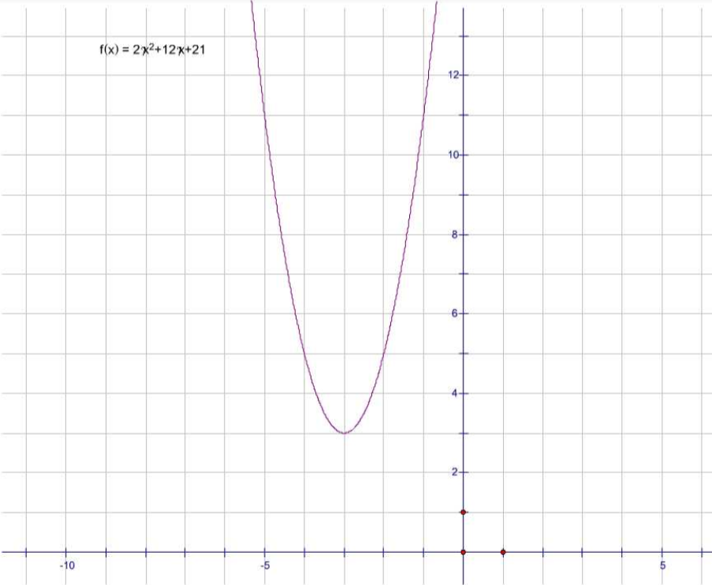

Slide 62
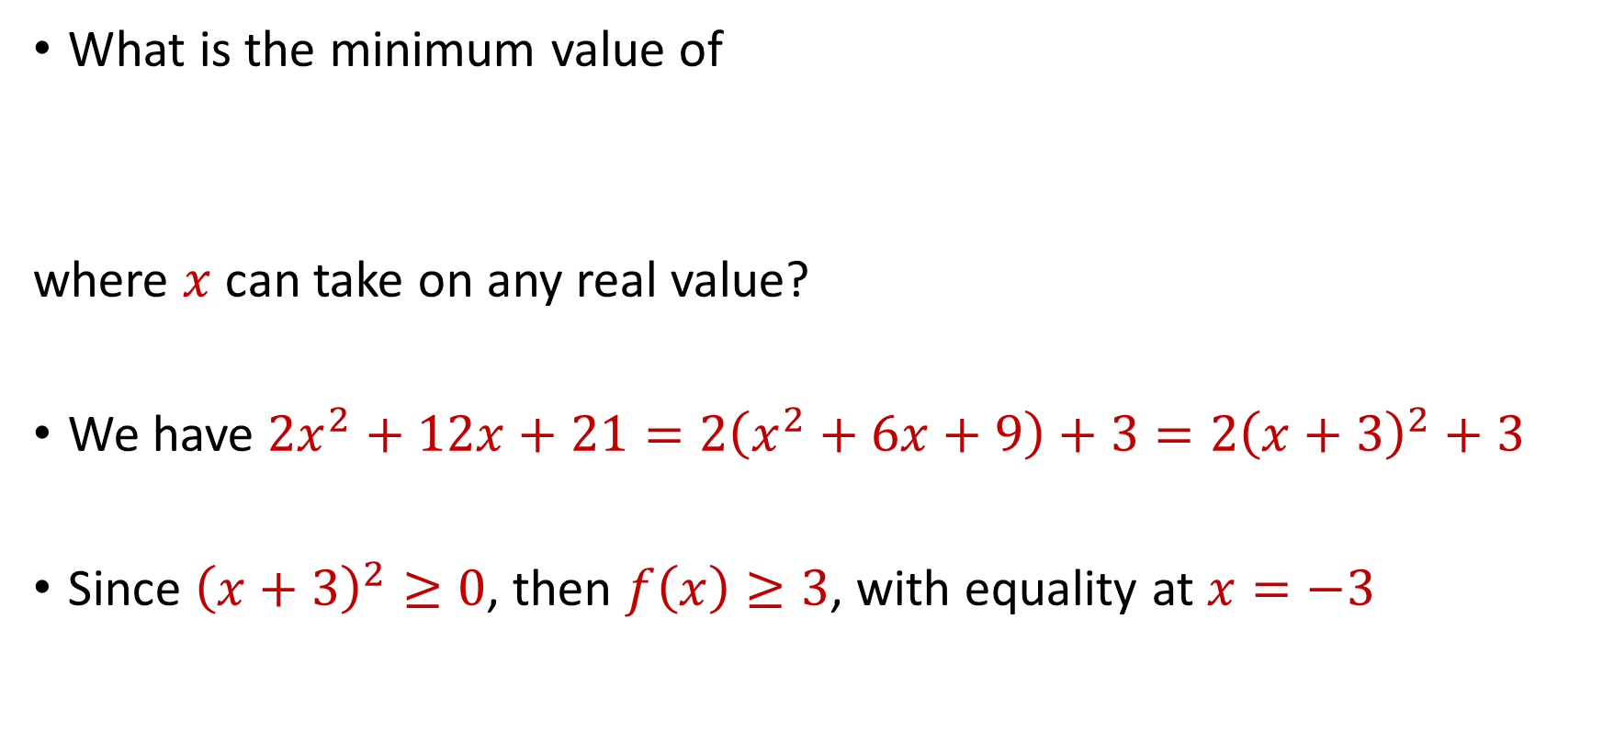
Graphing Quadratics
What is the minimum value of
where $x$ can take on any real value?
We have $2x^{2}+12x+21=2\left(x^{2}+6x+9\right)+3=2{\left(x+3\right)}^{2}+3$
Since ${\left(x+3\right)}^{2}≥0$, then $f\left(x\right)≥3$, with equality at $x=−3$
$$f\left(x\right)=2x^{2}+12x+21$$

Slide 63
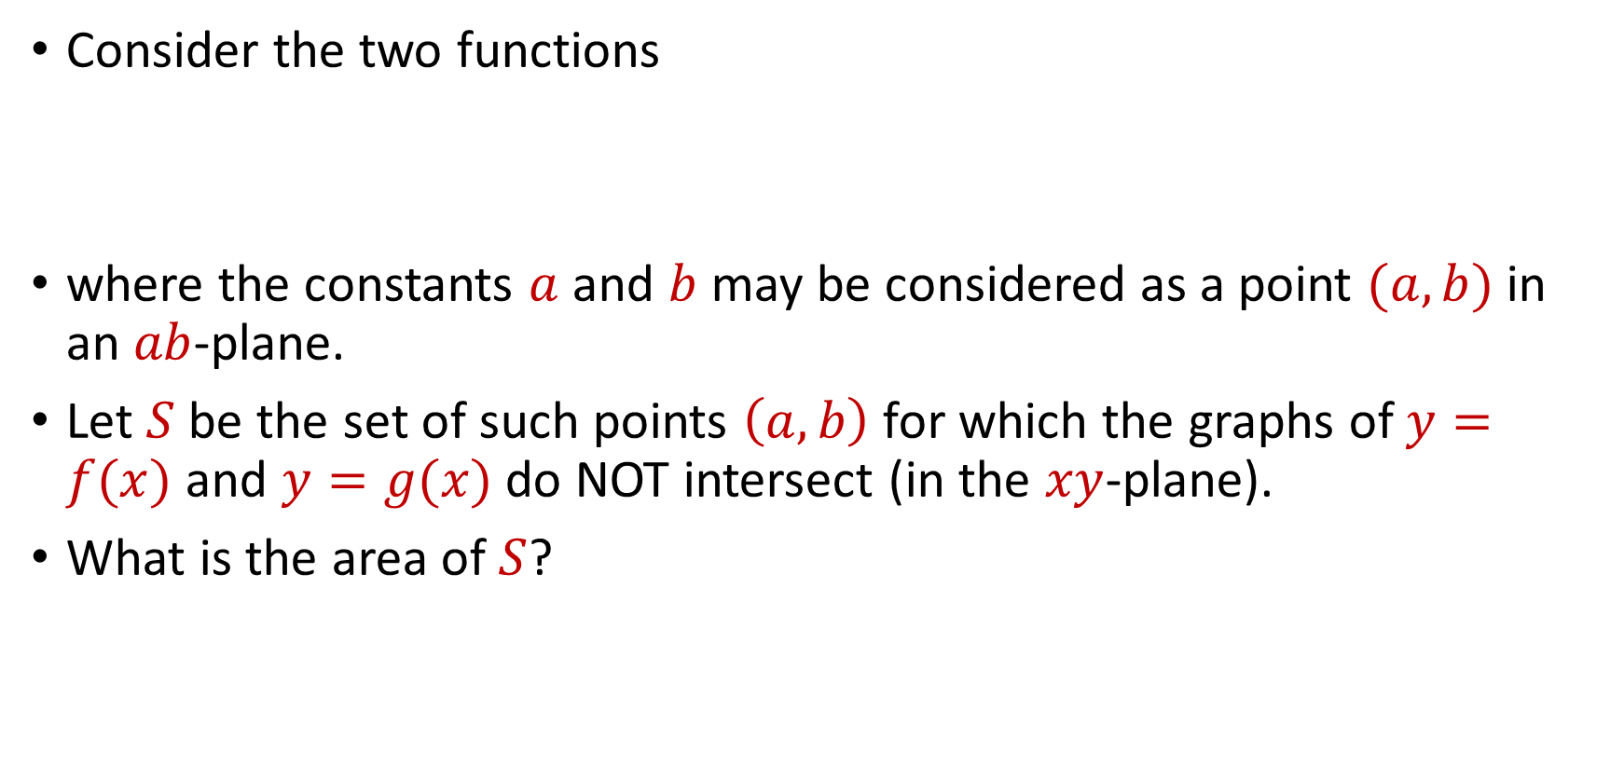
Graphing Quadratics
Consider the two functions
where the constants $a$ and $b$ may be considered as a point $(a,b)$ in an $ab$-plane.
Let $S$ be the set of such points $\left(a,b\right)$ for which the graphs of $y=f(x)$ and $y=g(x)$ do NOT intersect (in the $xy$-plane).
What is the area of $S$?
$f\left(x\right)=x^{2}+2bx+1$, $g\left(x\right)=2a(x+b)$,

Slide 64

Graphing Quadratics
Consider the two functions
where the constants $a$ and $b$ may be considered as a point $(a,b)$ in an $ab$-plane.
Let $S$ be the set of such points $\left(a,b\right)$ for which the graphs of $y=f(x)$ and $y=g(x)$ do NOT intersect (in the $xy$-plane).
What is the area of $S$?
Find conditions when $x^{2}+2bx+1=2a(x+b)$ has no solutions
$f\left(x\right)=x^{2}+2bx+1$, $g\left(x\right)=2a(x+b)$,

Slide 65

Graphing Quadratics
Find conditions when $x^{2}+2bx+1=2a(x+b)$ has no solutions

Slide 66

Graphing Quadratics
Find conditions when $x^{2}+2bx+1=2a(x+b)$ has no solutions
Implies discriminant is negative

Slide 67

Graphing Quadratics
Find conditions when $x^{2}+2bx+1=2a(x+b)$ has no solutions
Implies discriminant is negative:
$${\left(2b−2a\right)}^{2}−4\left(1−2ab\right)=4a^{2}+4b^{2}−4<0$$

Slide 68

Graphing Quadratics
Find conditions when $x^{2}+2bx+1=2a(x+b)$ has no solutions
Implies discriminant is negative:
What is the area of the points that satisfy $a^{2}+b^{2}<1$?
$${\left(2b−2a\right)}^{2}−4\left(1−2ab\right)=4a^{2}+4b^{2}−4<0$$

Slide 69

Graphing Quadratics
Find conditions when $x^{2}+2bx+1=2a(x+b)$ has no solutions
Implies discriminant is negative:
What is the area of the points that satisfy $a^{2}+b^{2}<1$?
Circle with radius $1$ $→$ Area is $πr^{2}$ with $r=1$
$${\left(2b−2a\right)}^{2}−4\left(1−2ab\right)=4a^{2}+4b^{2}−4<0$$

Slide 70
TAMU Math Circle
Week 2: Methods of Substitution
Samson Zhou

Slide 71


Substitution of Variables
Find all real values of $x$ such that
$$\sqrt{x+5}+\frac{6}{\sqrt{x+5} }=5$$

Slide 72

Substitution of Variables
Find all real values of $x$ such that
$$\sqrt{2x−9}=\frac{12}{\sqrt{2x−9} }−1$$

Slide 73
Substitution of Variables
Find all real values of $x$ such that
$$x^{4}−13x^{2}+36=0$$

Slide 74

Substitution of Variables
Find the maximum value of the ratio of $x$ to $y$ where $x$and $y$ are real numbers that satisfy the equation
$${\left(x−3\right)}^{2}+{\left(y−3\right)}^{2}=6$$

Slide 75

Substitution of Variables
(AIME 1983, #3): Find all real values of $x$ such that
$$\sqrt{4x^{2}−16x+19}+\sqrt{4x^{2}−16x+31}=6$$

Slide 76
Substitution of Variables
Find all real values of $x$ such that
$$2^{2x}−2^{x+2}=32$$

Slide 77

Substitution of Variables
Find all real values of $n$ such that
$$2^{2n+1}−2^{n+3}−2^{n}+36=2^{5}$$

Slide 78
Challenge Problems
Find all real values of $x$ such that
$$2^{2x}−2^{x+2}=32$$

Slide 79

Challenge Problems
Suppose that $x$, $y$, $z$ is a geometric progression with common ratio $r>1$. If $12x$, $14y$, $15z$ is an arithmetic sequence, what is the value of $r$?

