Slide 1
CSCE 658: Randomized Algorithms
Lecture 15
Samson Zhou

Slide 2
Relevant Supplementary Material
Chapter 29 in “Introduction to Algorithms”, by Thomas H. Cormen, Charles E. Leiserson, Ronald L. Rivest, and Clifford Stein
Chapters 5.1-5.5 in “The Design of Approximation Algorithms”, by David P. Williamson and David B. Shmoys

Slide 3
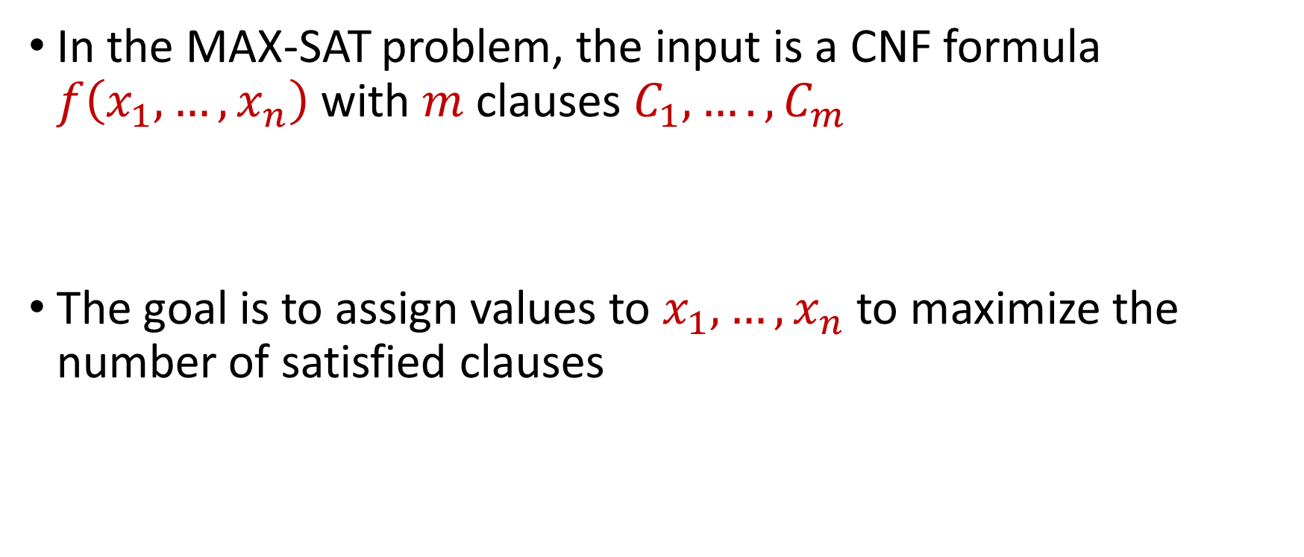
MAX-SAT
In the MAX-SAT problem, the input is a CNF formula $f\left(x_{1},…,x_{n}\right)$ with $m$ clauses $C_{1},….,C_{m}$
The goal is to assign values to $x_{1},…,x_{n}$ to maximize the number of satisfied clauses

Slide 4
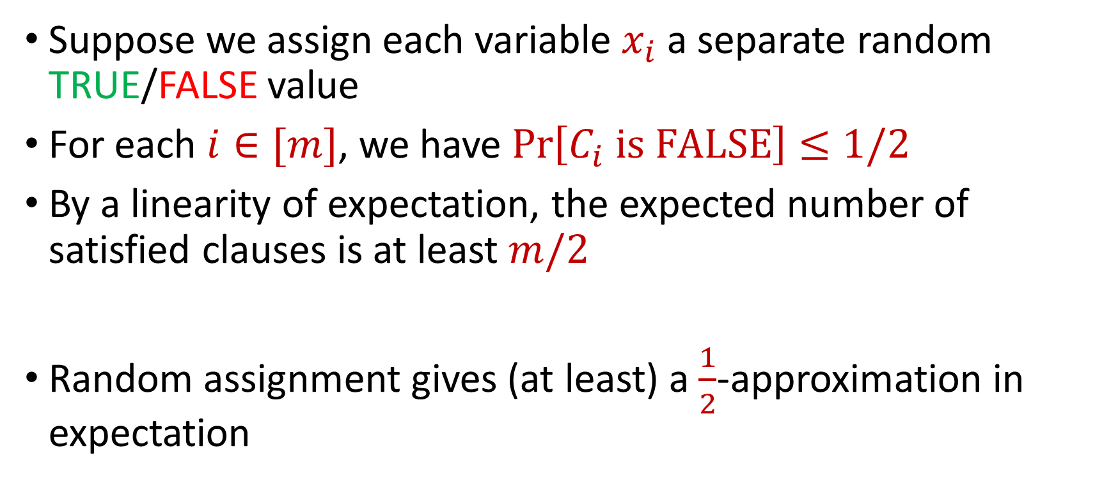
MAX-SAT
Suppose we assign each variable $x_{i}$ a separate random TRUE/FALSE value
For each $i∈[m]$, we have $\operatorname{Pr}\left[C_{i} is FALSE\right]≤1/2$
By a linearity of expectation, the expected number of satisfied clauses is at least $m/2$
Random assignment gives (at least) a $\frac{1}{2}$-approximation in expectation

Slide 5
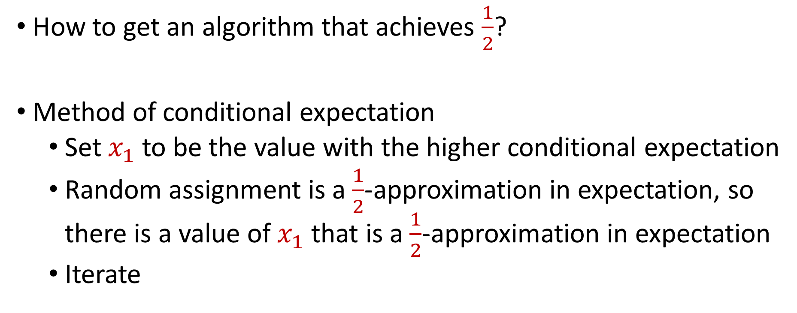
Derandomization of MAX-SAT
How to get an algorithm that achieves $\frac{1}{2}$?
Method of conditional expectation
Set $x_{1}$ to be the value with the higher conditional expectation
Random assignment is a $\frac{1}{2}$-approximation in expectation, so there is a value of $x_{1}$ that is a $\frac{1}{2}$-approximation in expectation
Iterate

Slide 6
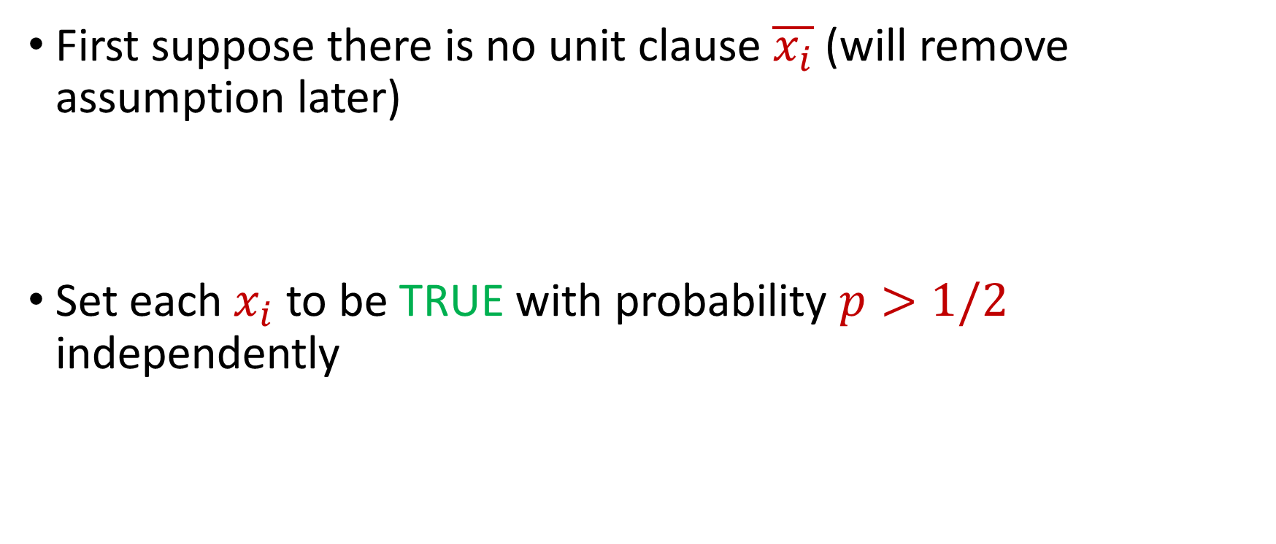
Better Algorithm for MAX-SAT
First suppose there is no unit clause $\overline{x_{i}}$ (will remove assumption later)
Set each $x_{i}$ to be TRUE with probability $p>1/2$ independently

Slide 7
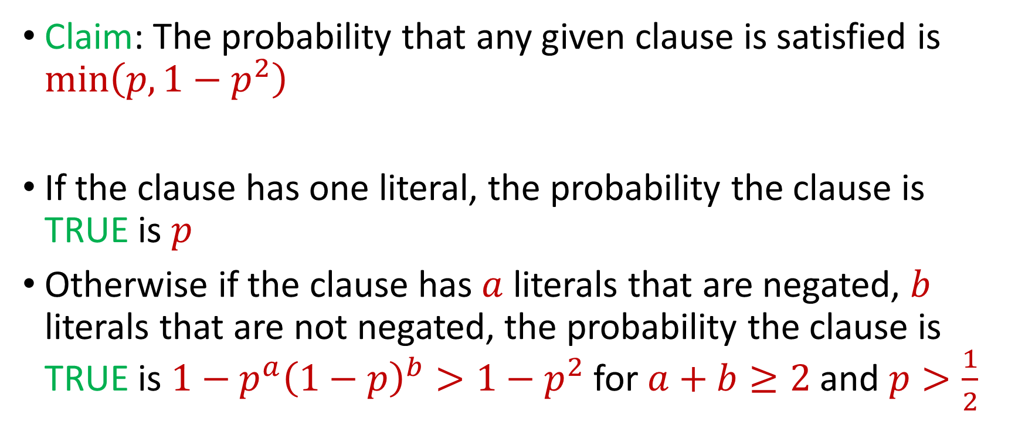
Better Algorithm for MAX-SAT
Claim: The probability that any given clause is satisfied is $\min\left(p,1−p^{2}\right)$
If the clause has one literal, the probability the clause is TRUE is $p$
Otherwise if the clause has $a$ literals that are negated, $b$ literals that are not negated, the probability the clause is TRUE is $1−p^{a}{\left(1−p\right)}^{b}>1−p^{2}$ for $a+b≥2$and $p>\frac{1}{2}$

Slide 8
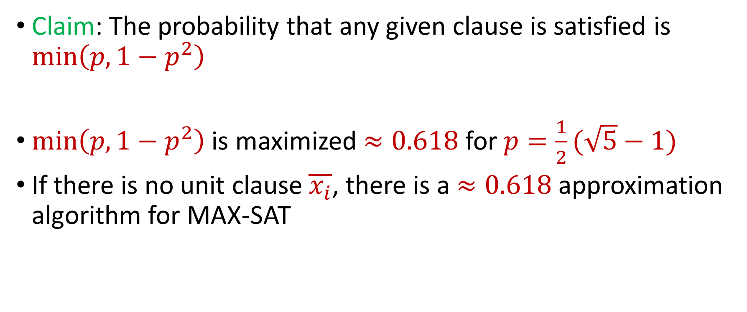
Better Algorithm for MAX-SAT
Claim: The probability that any given clause is satisfied is $\min\left(p,1−p^{2}\right)$
$\min\left(p,1−p^{2}\right)$ is maximized $≈0.618$for $p=\frac{1}{2}(\sqrt{5}−1)$
If there is no unit clause $\overline{x_{i}}$, there is a $≈0.618$ approximation algorithm for MAX-SAT

Slide 9
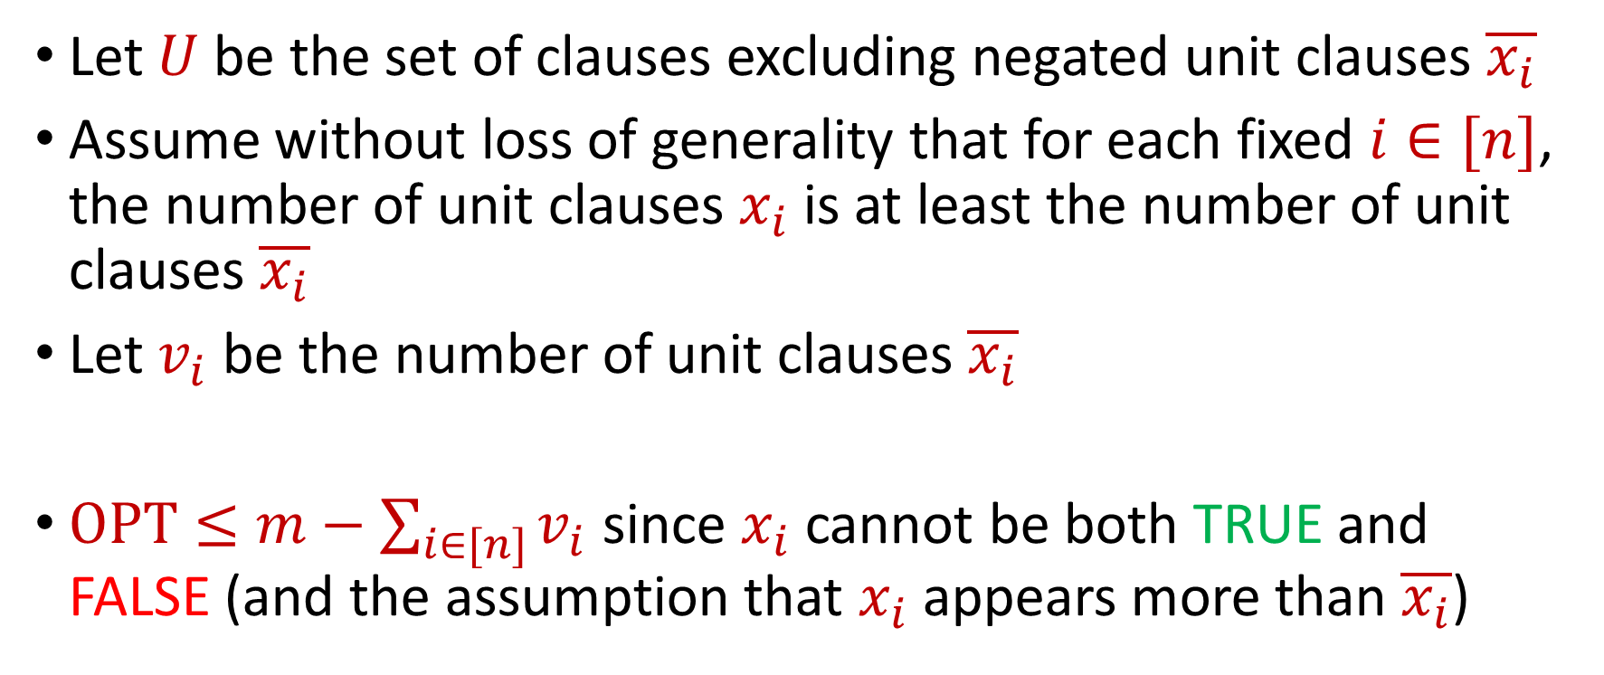
Better Algorithm for MAX-SAT
Let $U$be the set of clauses excluding negated unit clauses $\overline{x_{i}}$
Assume without loss of generality that for each fixed $i∈[n]$, the number of unit clauses $x_{i}$ is at least the number of unit clauses $\overline{x_{i}}$
Let $v_{i}$ be the number of unit clauses $\overline{x_{i}}$
$OPT≤m−\sum_{i∈[n]}{v_{i}}$ since $x_{i}$ cannot be both TRUE and FALSE (and the assumption that $x_{i}$appears more than $\overline{x_{i}}$)

Slide 10
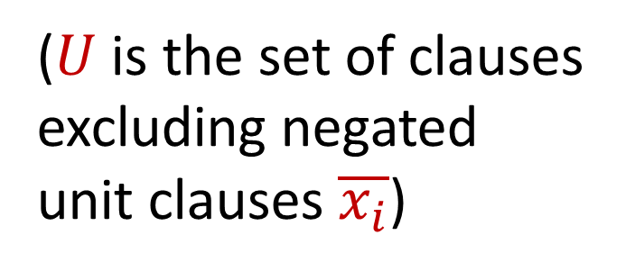
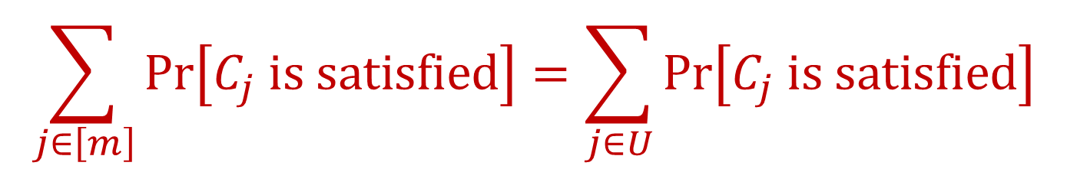
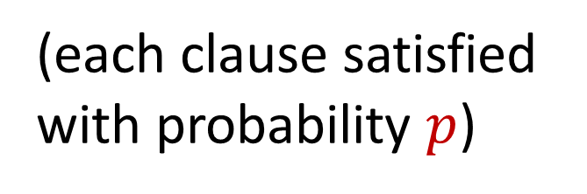

Better Algorithm for MAX-SAT
$$\sum_{j∈\left[m\right]}{Pr\left[C_{j} is satisfied\right]}=\sum_{j∈U}{Pr\left[C_{j} is satisfied\right]}$$
(each clause satisfied with probability $p$)
$$≥p|U|$$
($U$is the set of clauses excluding negated unit clauses $\overline{x_{i}}$)
$$=p\left(m−\sum_{i∈\left[n\right]}{v_{i}}\right)$$
$$≥p⋅OPT$$

Slide 11
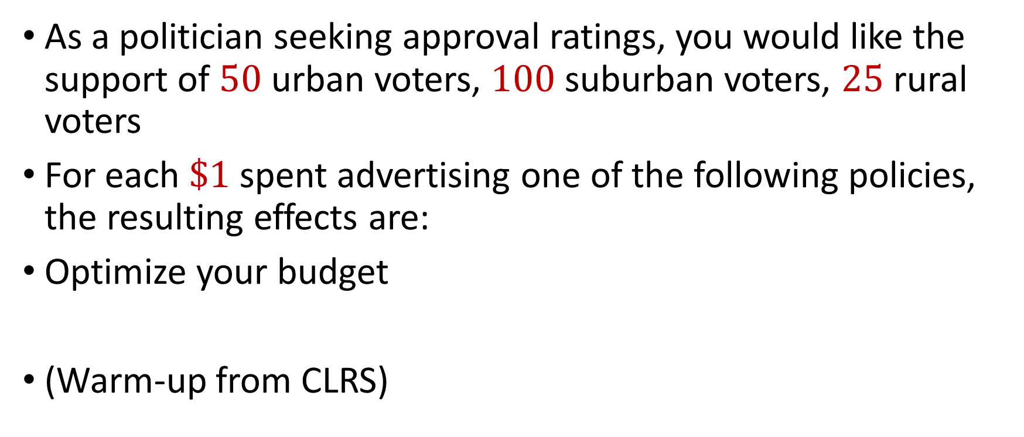
Political Problems…
As a politician seeking approval ratings, you would like the support of $50$ urban voters, $100$ suburban voters, $25$ rural voters
For each $\$1$ spent advertising one of the following policies, the resulting effects are:
Optimize your budget
(Warm-up from CLRS)
Policy | Urban | Suburban | Rural
Zombie apocalypse | -2 | +5 | -3
Sharks with lasers | +8 | +2 | -5
Flying cars roads | 0 | 0 | +10
Dolphins voting | +10 | 0 | -2

Slide 12

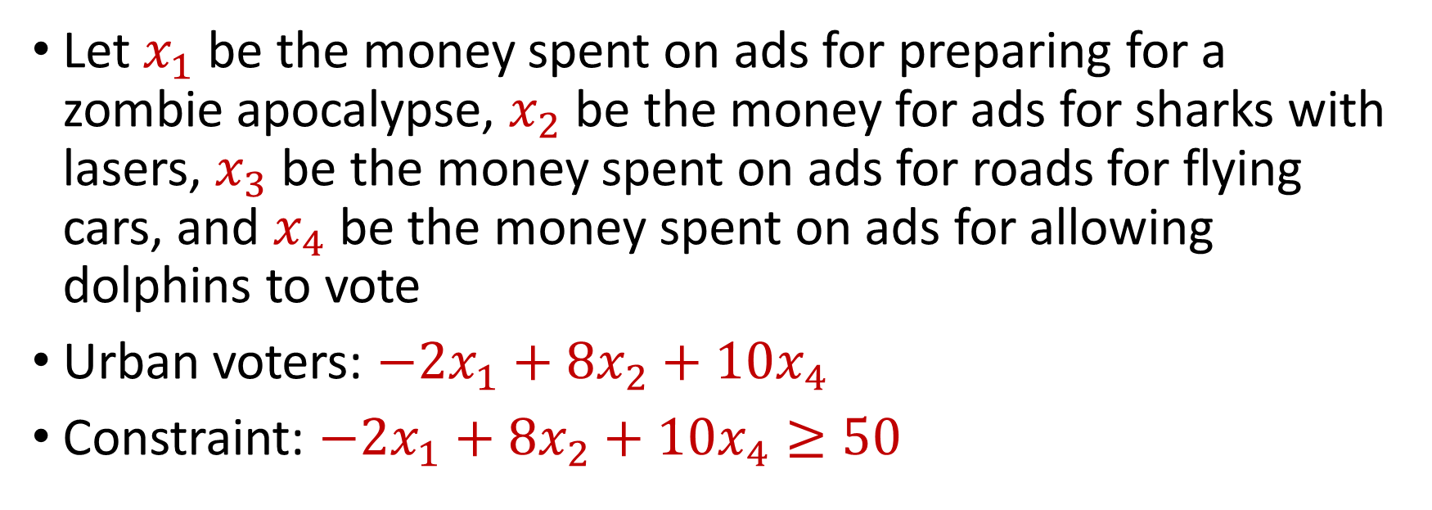
Political Problems…
Policy | Urban | Suburban | Rural
Zombie apocalypse | -2 | +5 | -3
Sharks with lasers | +8 | +2 | -5
Flying cars roads | 0 | 0 | +10
Dolphins voting | +10 | 0 | -2
You seek $50$ urban voters, $100$ suburban voters, $25$ rural voters
Let $x_{1}$ be the money spent on ads for preparing for a zombie apocalypse, $x_{2}$ be the money for ads for sharks with lasers, $x_{3}$ be the money spent on ads for roads for flying cars, and $x_{4}$ be the money spent on ads for allowing dolphins to vote
Urban voters: $−2x_{1}+8x_{2}+10x_{4}$
Constraint: $−2x_{1}+8x_{2}+10x_{4}≥50$

Slide 13
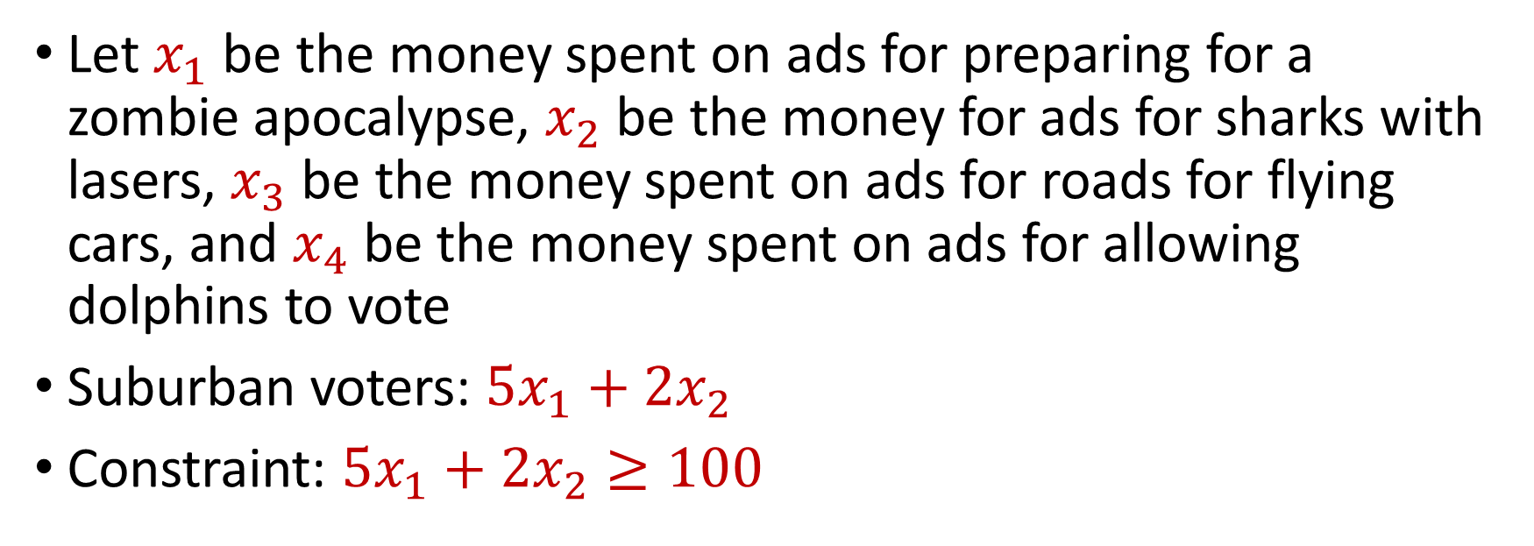
Political Problems…
Policy | Urban | Suburban | Rural
Zombie apocalypse | -2 | +5 | -3
Sharks with lasers | +8 | +2 | -5
Flying cars roads | 0 | 0 | +10
Dolphins voting | +10 | 0 | -2
You seek $50$ urban voters, $100$ suburban voters, $25$ rural voters
Let $x_{1}$ be the money spent on ads for preparing for a zombie apocalypse, $x_{2}$ be the money for ads for sharks with lasers, $x_{3}$ be the money spent on ads for roads for flying cars, and $x_{4}$ be the money spent on ads for allowing dolphins to vote
Suburban voters: $5x_{1}+2x_{2}$
Constraint: $5x_{1}+2x_{2}≥100$

Slide 14
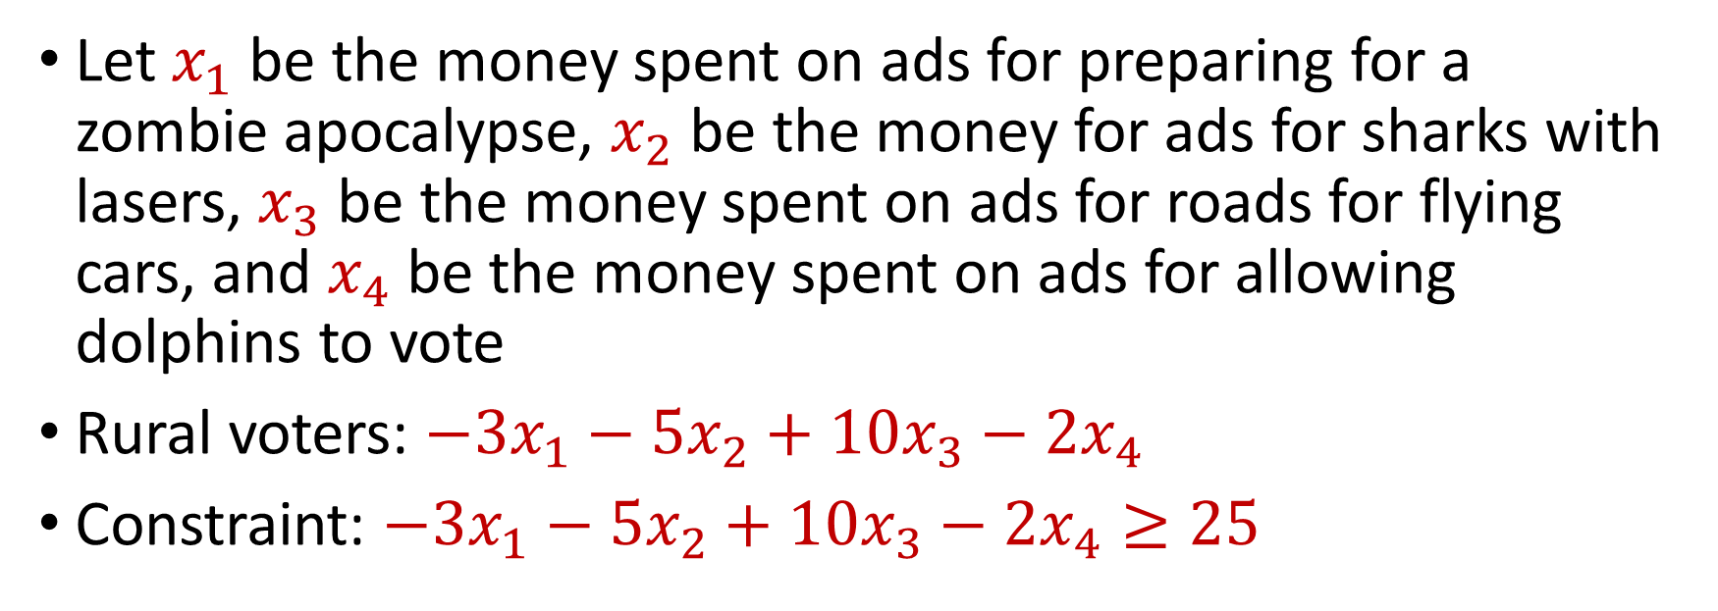
Political Problems…
Policy | Urban | Suburban | Rural
Zombie apocalypse | -2 | +5 | -3
Sharks with lasers | +8 | +2 | -5
Flying cars roads | 0 | 0 | +10
Dolphins voting | +10 | 0 | -2
You seek $50$ urban voters, $100$ suburban voters, $25$ rural voters
Let $x_{1}$ be the money spent on ads for preparing for a zombie apocalypse, $x_{2}$ be the money for ads for sharks with lasers, $x_{3}$ be the money spent on ads for roads for flying cars, and $x_{4}$ be the money spent on ads for allowing dolphins to vote
Rural voters: $−3x_{1}−5x_{2}+10x_{3}−2x_{4}$
Constraint: $−3x_{1}−5x_{2}+10x_{3}−2x_{4}≥25$

Slide 15
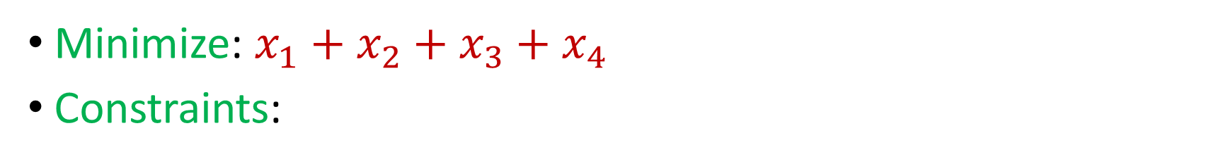
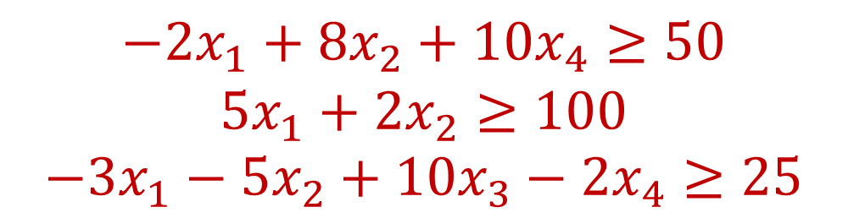
Minimization Problem
Policy | Urban | Suburban | Rural
Zombie apocalypse | -2 | +5 | -3
Sharks with lasers | +8 | +2 | -5
Flying cars roads | 0 | 0 | +10
Dolphins voting | +10 | 0 | -2
You seek $50$ urban voters, $100$ suburban voters, $25$ rural voters
Minimize: $x_{1}+x_{2}+x_{3}+x_{4}$
Constraints:
$$−2x_{1}+8x_{2}+10x_{4}≥50$$
$$5x_{1}+2x_{2}≥100$$
$$−3x_{1}−5x_{2}+10x_{3}−2x_{4}≥25$$

Slide 16
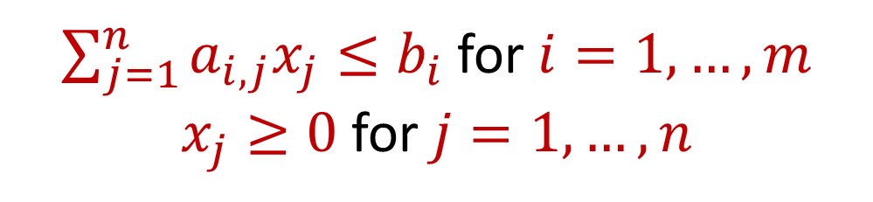
Linear Programming
Maximize a linear objective function:
Subject to constraints:
$$f\left(x_{1},…,x_{n}\right)=c_{1}x_{1}+…+c_{n}x_{n}$$
$\sum_{j=1}^{n}{a_{i,j}x_{j}≤b_{i}}$ for $i=1,…,m$
$x_{j}≥0$ for $j=1,…,n$

Slide 17
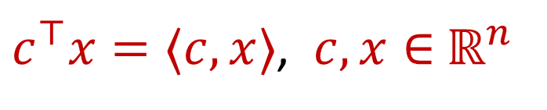
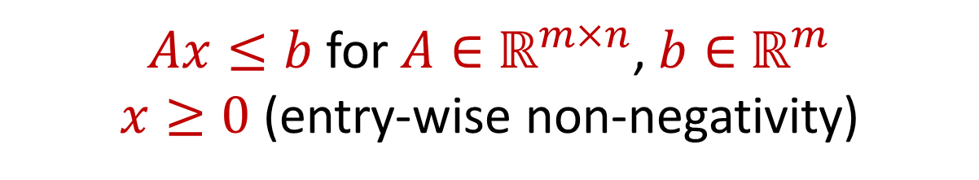
Linear Programming (Standard Form)
Maximize a linear objective function:
Subject to constraints:
$c^{⊤}x=⟨c,x⟩$, $c,x∈$ $ℝ^{n}$
$Ax≤b$ for $A∈$ $ℝ^{m×n}$, $b∈$ $ℝ^{m}$
$x≥0$ (entry-wise non-negativity)

Slide 18
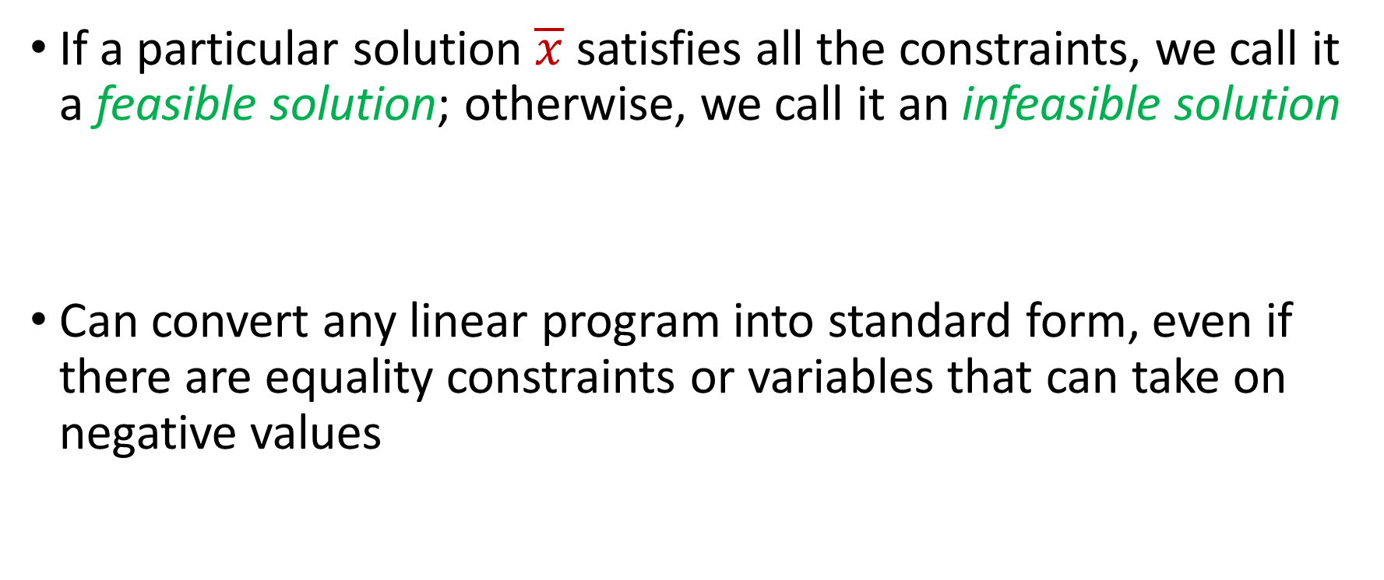
Linear Programming (Standard Form)
If a particular solution $\overline{x}$ satisfies all the constraints, we call it a feasible solution; otherwise, we call it an infeasible solution
Can convert any linear program into standard form, even if there are equality constraints or variables that can take on negative values

Slide 19


Linear Programming
Minimize: $x_{1}+x_{2}$
Subject to:
$$4x_{1}−x_{2}≤8$$
$$2x_{1}+x_{2}≤10$$
$$5x_{1}−{2x}_{2}≤−2$$
$$x_{1},x_{2}≥0$$

Slide 20
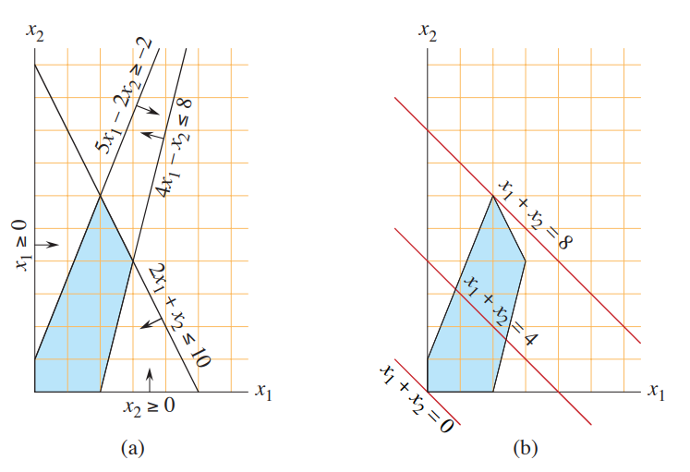
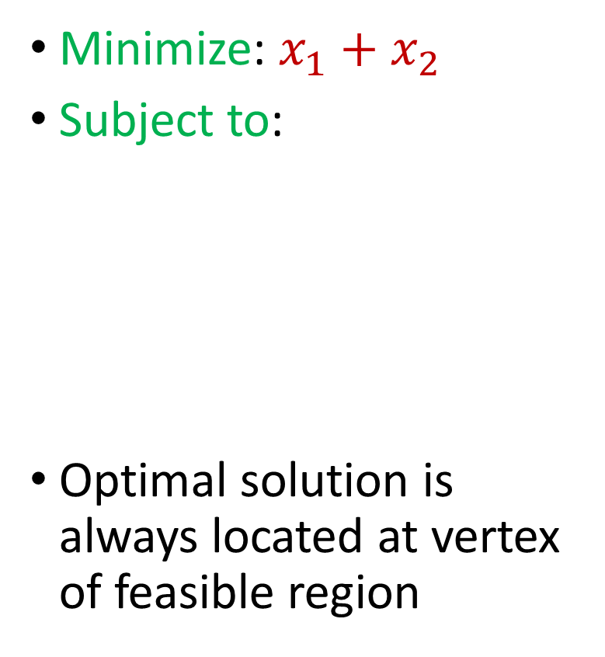
Linear Programming
Minimize: $x_{1}+x_{2}$
Subject to:
Optimal solution is always located at vertex of feasible region
$$4x_{1}−x_{2}≤8$$
$$2x_{1}+x_{2}≤10$$
$$5x_{1}−{2x}_{2}≤−2$$
$$x_{1},x_{2}≥0$$

Slide 21
Linear Programming
Simplex algorithm: finds a feasible solution at a vertex of the polytope and then searches along the edges to vertices with non-decreasing values
Good in practice but exponential time in the worst-case

Slide 22
Linear Programming
Ellipsoid algorithm: iterative algorithm that generates a sequence of smaller ellipsoids, each of which separate the current iterate with the optimal solution
Requires a separation oracle
Polynomial time algorithm in theory but inefficient in practice and can suffer from numerical instability

Slide 23


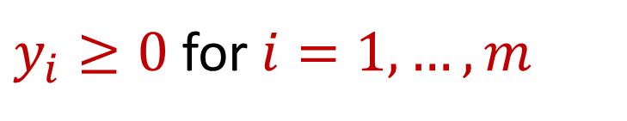
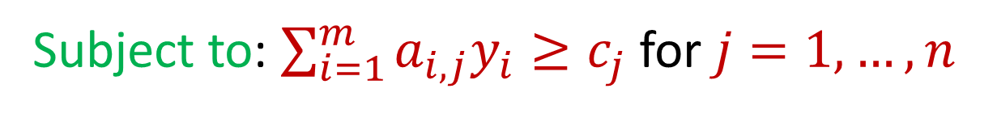
Duality
Maximize $c_{1}x_{1}+…+c_{n}x_{n}$ subject to $\sum_{j=1}^{n}{a_{i,j}x_{j}≤b_{i}}$ for $i=1,…,m$ and $x_{j}≥0$ for $j=1,…,n$
For the above linear program, its dual is
Minimize: $b_{1}y_{1}+…+b_{m}y_{m}$
Subject to: $\sum_{i=1}^{m}{a_{i,j}y_{i}≥c_{j}}$ for $j=1,…,n$
$y_{i}≥0$ for $i=1,…,m$

Slide 24

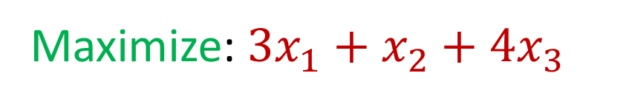



Duality
What is its dual program? (Williamson-Shmoys)
Maximize: $3x_{1}+x_{2}+4x_{3}$
Subject to: $x_{1}+x_{2}+3x_{3}≤30$
$$2x_{1}+2x_{2}+5x_{3}≤24$$
$$4x_{1}+x_{2}+2x_{3}≤36$$
$$x_{1},x_{2},x_{3} ≥0$$

Slide 25

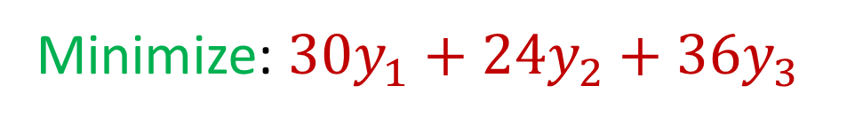



Duality
Minimize: $30y_{1}+24y_{2}+36y_{3}$
Subject to: $y_{1}+2y_{2}+4y_{3}≥3$
$$y_{1}+2y_{2}+y_{3}≥1$$
$$3y_{1}+5y_{2}+2y_{3}≥4$$
$$y_{1},y_{2},y_{3} ≥0$$

Slide 26

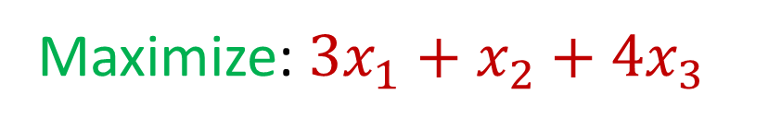



Duality
Intuition: What if we take the original constraints and add the first two constraints?
Maximize: $3x_{1}+x_{2}+4x_{3}$
Subject to: $x_{1}+x_{2}+3x_{3}≤30$
$$2x_{1}+2x_{2}+5x_{3}≤24$$
$$4x_{1}+x_{2}+2x_{3}≤36$$
$$x_{1},x_{2},x_{3} ≥0$$

Slide 27
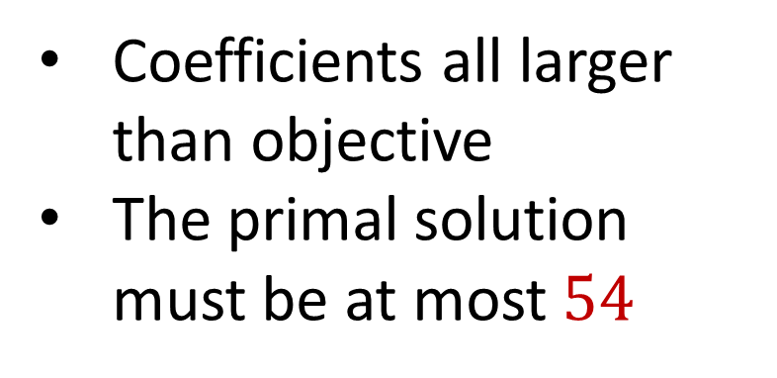

Duality
Intuition: What if we take the original constraints and add the first two constraints?
$$3x_{1}+3x_{2}+8x_{3}≤54$$
Maximize: $3x_{1}+x_{2}+4x_{3}$
Coefficients all larger than objective
The primal solution must be at most $54$
Subject to: $x_{1}+x_{2}+3x_{3}≤30$
$$2x_{1}+2x_{2}+5x_{3}≤24$$
$$4x_{1}+x_{2}+2x_{3}≤36$$
$$x_{1},x_{2},x_{3} ≥0$$

Slide 28
Duality
Intuition: What if we take the original constraints and add the first two constraints?
Maximize: $3x_{1}+x_{2}+4x_{3}$
Can we find a linear combination of the equations that exactly matches the objective?
Subject to: $x_{1}+x_{2}+3x_{3}≤30$
$$2x_{1}+2x_{2}+5x_{3}≤24$$
$$4x_{1}+x_{2}+2x_{3}≤36$$
$$x_{1},x_{2},x_{3} ≥0$$

Slide 29
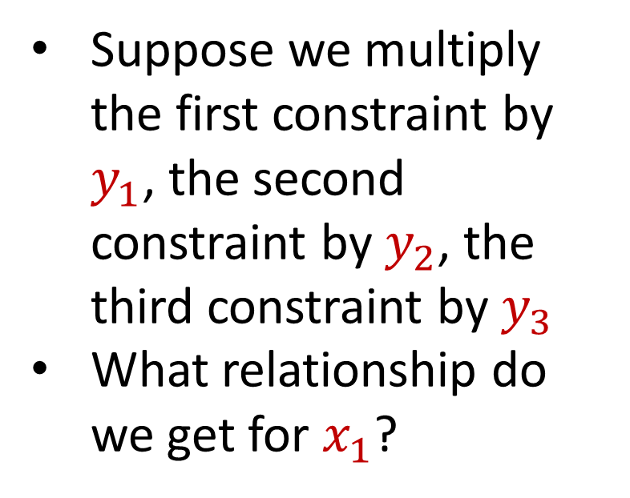
Duality
Intuition: What if we take the original constraints and add the first two constraints?
Suppose we multiply the first constraint by $y_{1}$, the second constraint by $y_{2}$, the third constraint by $y_{3}$
What relationship do we get for $x_{1}$?
Maximize: $3x_{1}+x_{2}+4x_{3}$
Subject to: $x_{1}+x_{2}+3x_{3}≤30$
$$2x_{1}+2x_{2}+5x_{3}≤24$$
$$4x_{1}+x_{2}+2x_{3}≤36$$
$$x_{1},x_{2},x_{3} ≥0$$

Slide 30
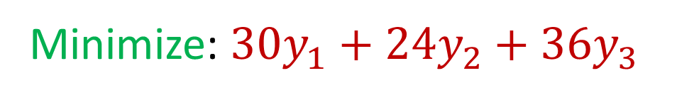
Duality
The dual is exactly this program
Minimize: $30y_{1}+24y_{2}+36y_{3}$
Subject to: $y_{1}+2y_{2}+4y_{3}≥3$
$$y_{1}+2y_{2}+y_{3}≥1$$
$$3y_{1}+5y_{2}+2y_{3}≥4$$
$$y_{1},y_{2},y_{3} ≥0$$
Notes:
https://cs.stackexchange.com/questions/128959/how-to-prove-that-the-dual-linear-program-of-the-max-flow-linear-program-indeed

Slide 31
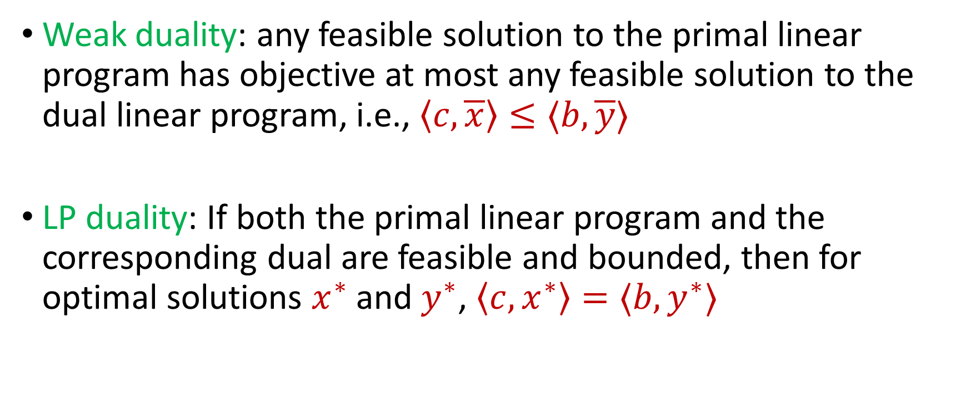
Duality
Weak duality: any feasible solution to the primal linear program has objective at most any feasible solution to the dual linear program, i.e., $\left\langle c, \overline{x}\right\rangle ≤⟨b,\overline{y}⟩$
LP duality: If both the primal linear program and the corresponding dual are feasible and bounded, then for optimal solutions $x^{∗}$ and $y^{∗}$, $\left\langle c, x^{∗}\right\rangle =⟨b, y^{∗}⟩$

