Slide 1
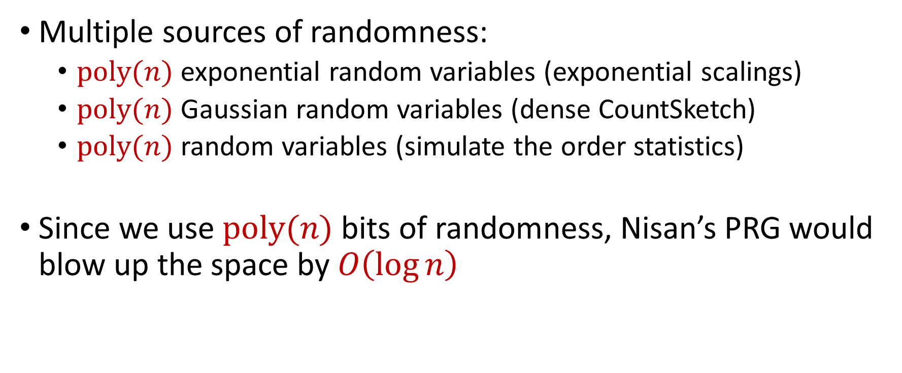
Derandomization
Multiple sources of randomness:
  $poly(n)$ exponential random variables (exponential scalings)
  $poly(n)$ Gaussian random variables (dense CountSketch)
  $poly(n)$ random variables (simulate the order statistics)
Since we use $poly(n)$ bits of randomness, Nisan’s PRG would blow up the space by $O\left(\log{n}\right)$
Notes:
Let’s start by breaking down each of the terms in the title. To understand the sliding window model, we first have to understand the streaming model of computation, in which elements of an underlying data set S, arrive sequentially and the goal is to evaluate or approximate some given function on this dataset, using space sublinear in S. In the sliding window model, only the W most recent updates form the underlying data set

Slide 2
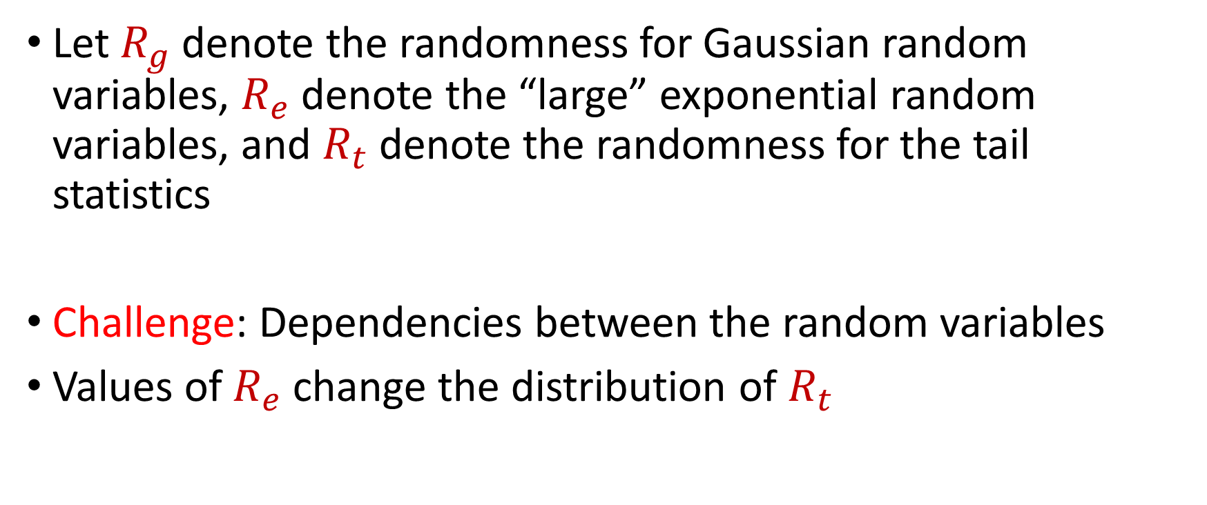
Derandomization
Let $R_{g}$ denote the randomness for Gaussian random variables, $R_{e}$ denote the “large” exponential random variables, and $R_{t}$ denote the randomness for the tail statistics
Challenge: Dependencies between the random variables
Values of $R_{e}$ change the distribution of $R_{t}$
Notes:
Let’s start by breaking down each of the terms in the title. To understand the sliding window model, we first have to understand the streaming model of computation, in which elements of an underlying data set S, arrive sequentially and the goal is to evaluate or approximate some given function on this dataset, using space sublinear in S. In the sliding window model, only the W most recent updates form the underlying data set

Slide 3
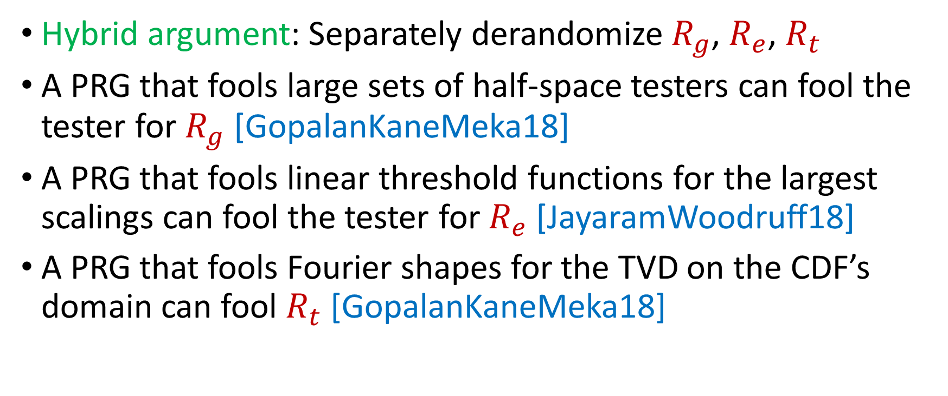
Derandomization
Hybrid argument: Separately derandomize $R_{g}$, $R_{e}$, $R_{t}$
A PRG that fools large sets of half-space testers can fool the tester for $R_{g}$ [GopalanKaneMeka18]
A PRG that fools linear threshold functions for the largest scalings can fool the tester for $R_{e}$ [JayaramWoodruff18]
A PRG that fools Fourier shapes for the TVD on the CDF’s domain can fool $R_{t}$ [GopalanKaneMeka18]
Notes:
Let’s start by breaking down each of the terms in the title. To understand the sliding window model, we first have to understand the streaming model of computation, in which elements of an underlying data set S, arrive sequentially and the goal is to evaluate or approximate some given function on this dataset, using space sublinear in S. In the sliding window model, only the W most recent updates form the underlying data set

