Slide 1

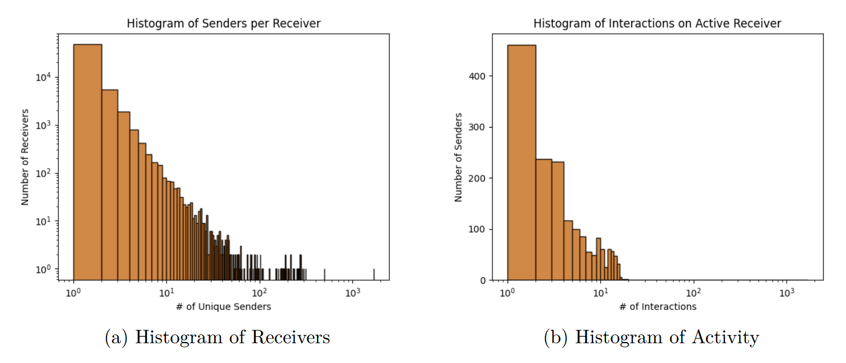
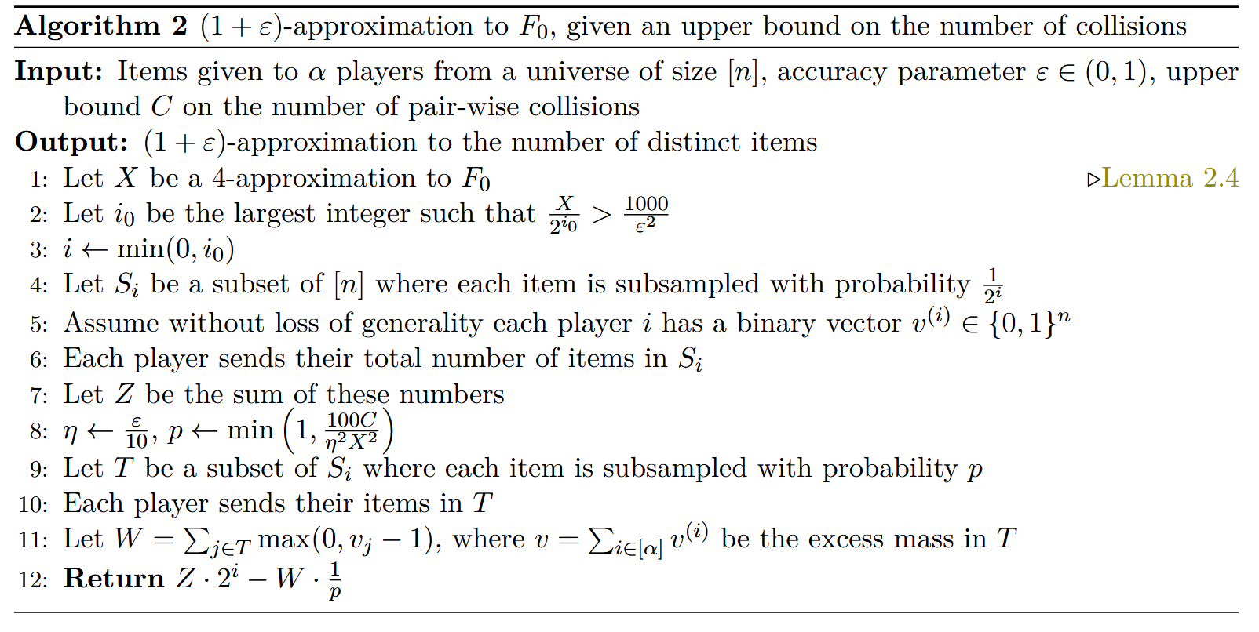
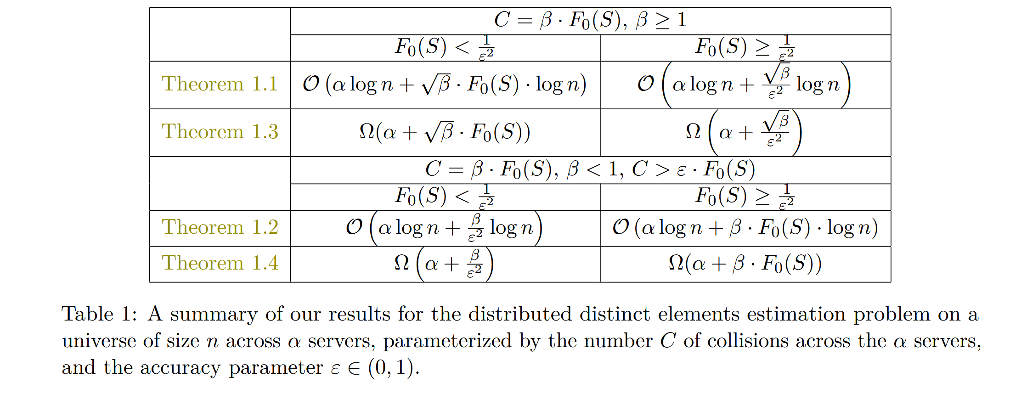
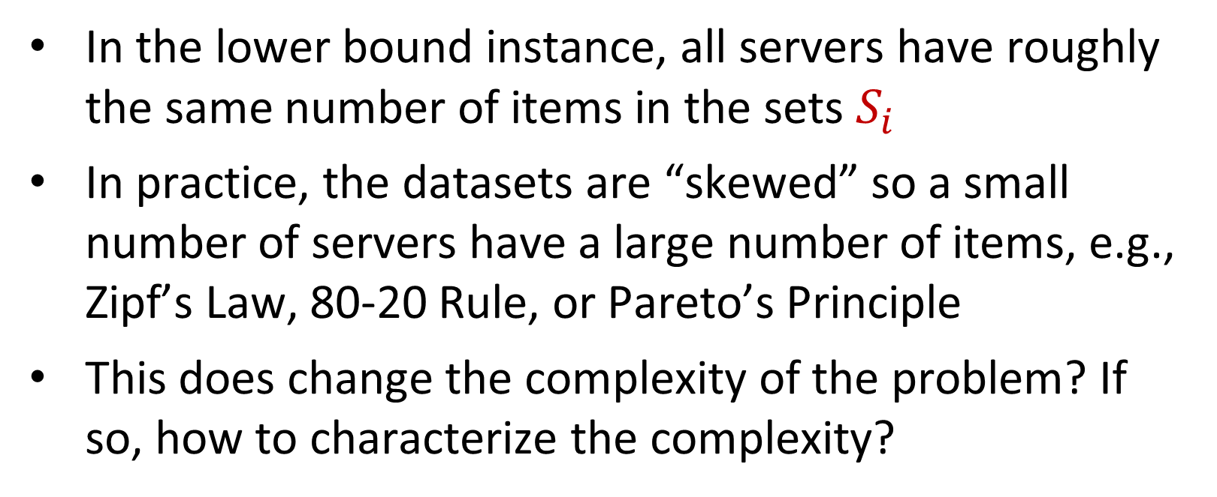
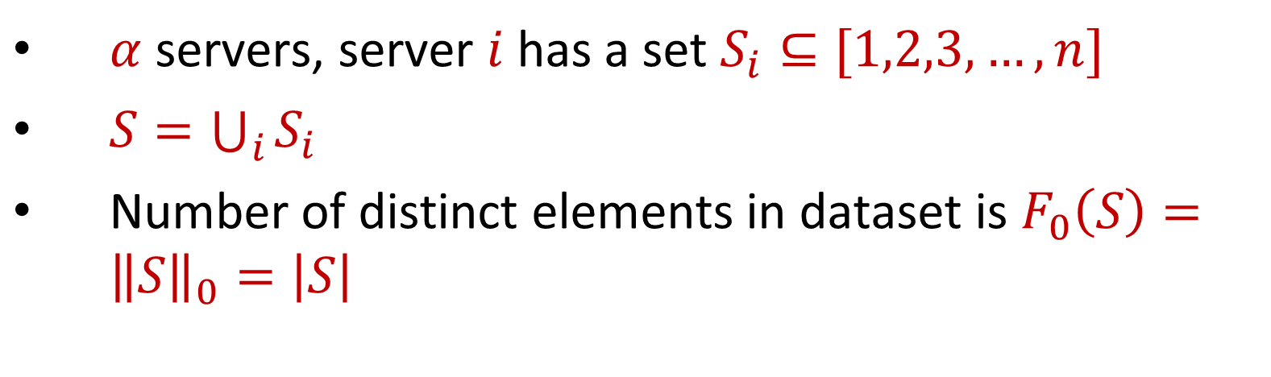
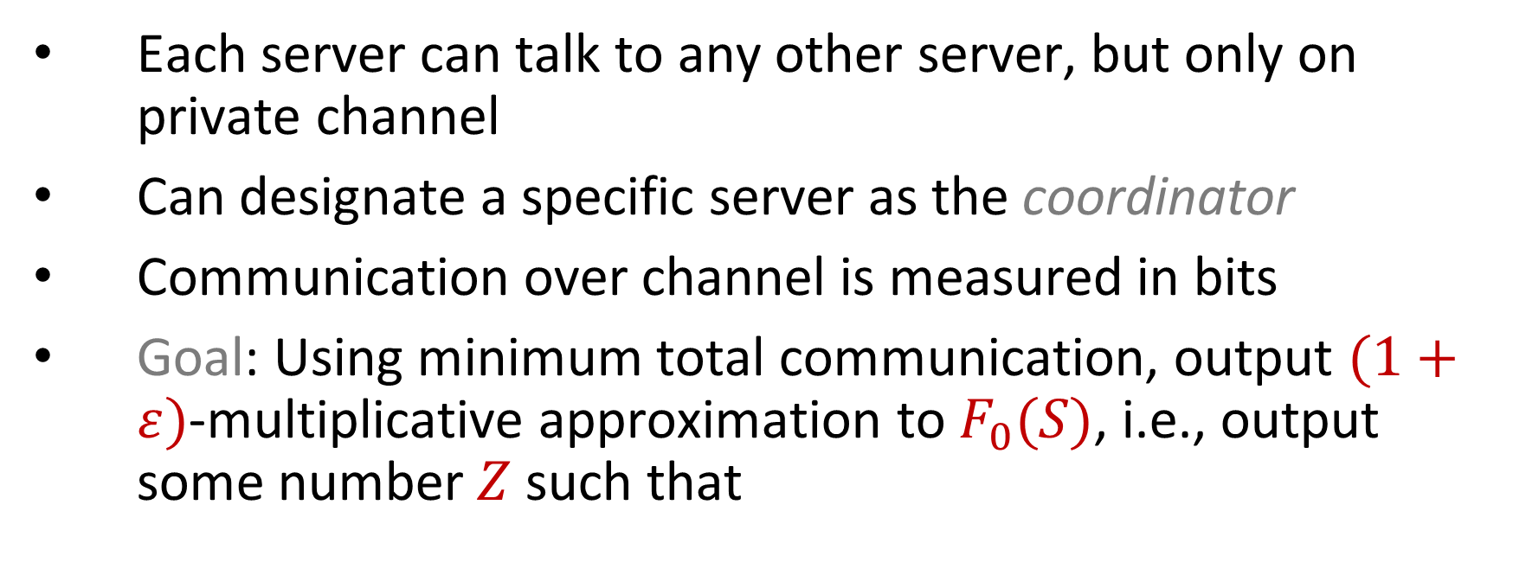
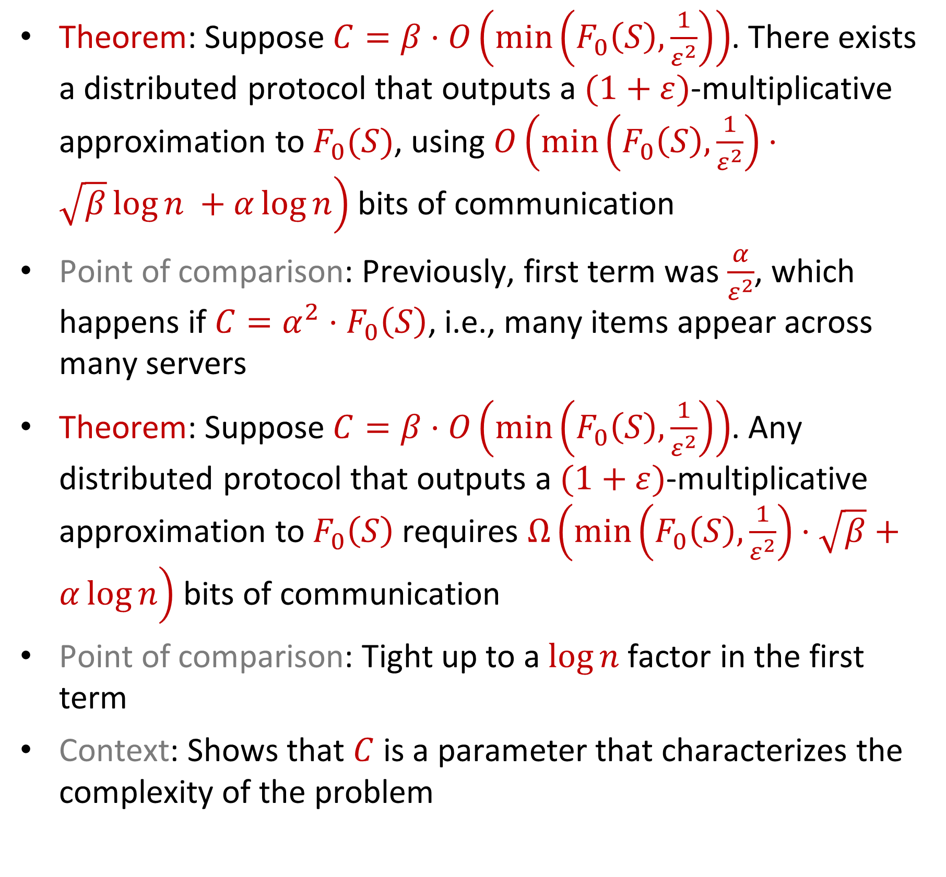
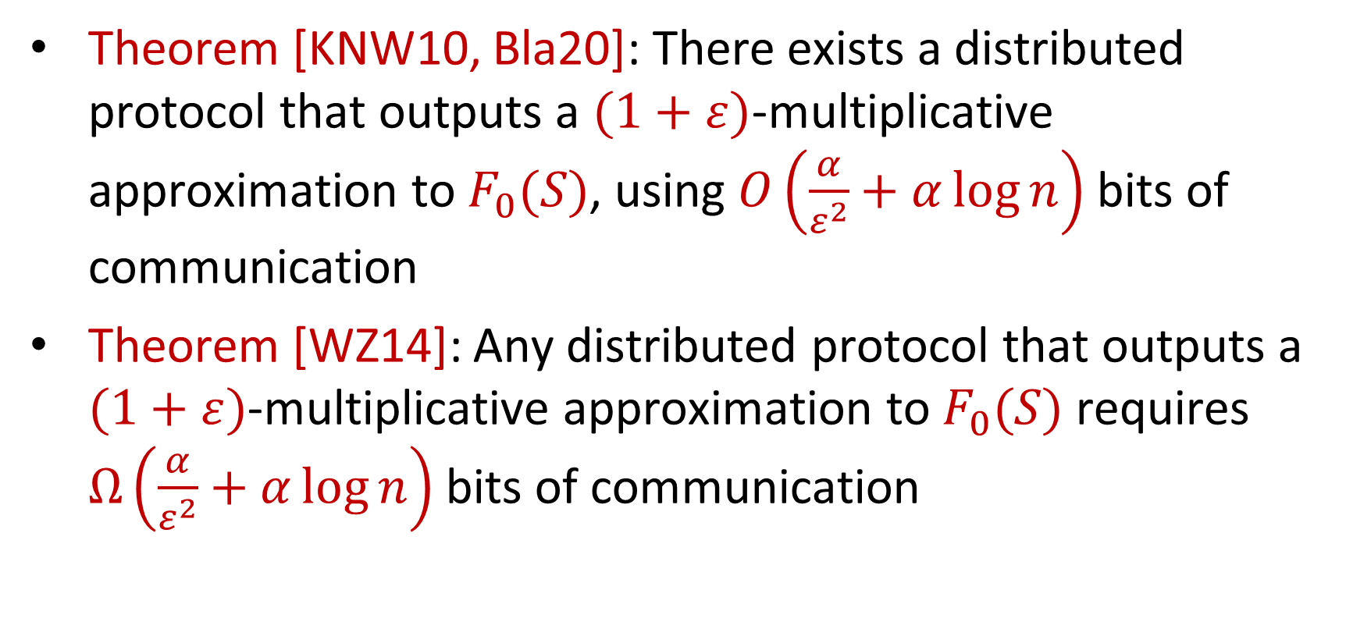
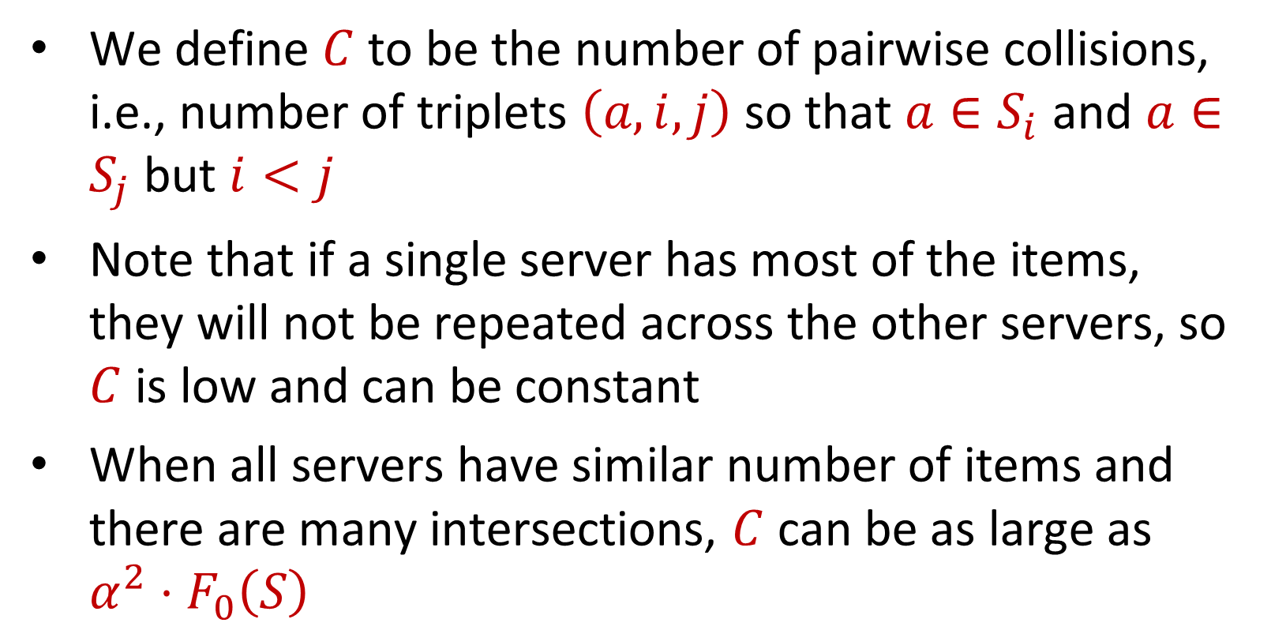
On Fine-Grained Distinct Element Estimation
Ilias Diakonikolas (UW Madison)
Daniel M. Kane (UC San Diego)
Jasper C.H. Lee (UC Davis)
Thanasis Pittas (UW Wisconsin)
David P. Woodruff (Carnegie Mellon University)
Samson Zhou (Texas A&M University)
Distinct Elements
Our Observations
In the lower bound instance, all servers have roughly the same number of items in the sets $S_{i}$
In practice, the datasets are “skewed” so a small number of servers have a large number of items, e.g., Zipf’s Law, 80-20 Rule, or Pareto’s Principle
This does change the complexity of the problem? If so, how to characterize the complexity?
Results
$α$ servers, server $i$ has a set $S_{i}⊆[1,2,3,…,n]$
$S=\bigcup_{i}{S_{i}}$
Number of distinct elements in dataset is $F_{0}\left(S\right)={\left\|S\right\|}_{0}=\left|S\right|$
Theorem: Suppose $C=β⋅O\left(\min\left(F_{0}\left(S\right),\frac{1}{ε^{2}}\right)\right)$. There exists a distributed protocol that outputs a $(1+ε)$-multiplicative approximation to $F_{0}(S)$, using $O\left(\min\left(F_{0}\left(S\right),\frac{1}{ε^{2}}\right)⋅\sqrt{β}\log{n }+α\log{n}\right)$ bits of communication
Point of comparison: Previously, first term was $\frac{α}{ε^{2}}$, which happens if $C=α^{2}⋅F_{0}\left(S\right)$, i.e., many items appear across many servers
Theorem: Suppose $C=β⋅O\left(\min\left(F_{0}\left(S\right),\frac{1}{ε^{2}}\right)\right)$. Any distributed protocol that outputs a $(1+ε)$-multiplicative approximation to $F_{0}\left(S\right)$ requires $Ω\left(\min\left(F_{0}\left(S\right),\frac{1}{ε^{2}}\right)⋅\sqrt{β}+α\log{n}\right)$ bits of communication
Point of comparison: Tight up to a $\log{n}$ factor in the first term
Context: Shows that $C$ is a parameter that characterizes the complexity of the problem
Communication Model
Each server can talk to any other server, but only on private channel
Can designate a specific server as the coordinator
Communication over channel is measured in bits
Goal: Using minimum total communication, output $(1+ε)$-multiplicative approximation to $F_{0}(S)$, i.e., output some number $Z$ such that
$$Z≤F_{0}\left(S\right)≤\left(1+ε\right)⋅Z$$
New Parameterization: Pairwise Collisions
Previous Results
Theorem [KNW10, Bla20]: There exists a distributed protocol that outputs a $(1+ε)$-multiplicative approximation to $F_{0}(S)$, using $O\left(\frac{α}{ε^{2}}+α\log{n}\right)$ bits of communication
Theorem [WZ14]: Any distributed protocol that outputs a $(1+ε)$-multiplicative approximation to $F_{0}(S)$ requires $Ω\left(\frac{α}{ε^{2}}+α\log{n}\right)$ bits of communication
We define $C$ to be the number of pairwise collisions, i.e., number of triplets $\left(a,i,j\right)$ so that $a∈S_{i}$ and $a∈S_{j}$ but $i<j$
Note that if a single server has most of the items, they will not be repeated across the other servers, so $C$ is low and can be constant
When all servers have similar number of items and there are many intersections, $C$ can be as large as $α^{2}⋅F_{0}\left(S\right)$
Bridging Theory and Practice
There is usually a large number of servers and we want good accuracy, so this means we should require a lot of communication!
Algorithms behave well in practice with little communication
What’s going on?

