Slide 1
CSCE 689: Special Topics in Modern Algorithms for Data Science
Lecture 21
Samson Zhou

Slide 2
Presentation Schedule
November 27: Chunkai, Jung, Galaxy AI
November 29: STMI, Anmol, Jason
December 1: Bokun, Ayesha, Dawei, Lipai

Slide 3
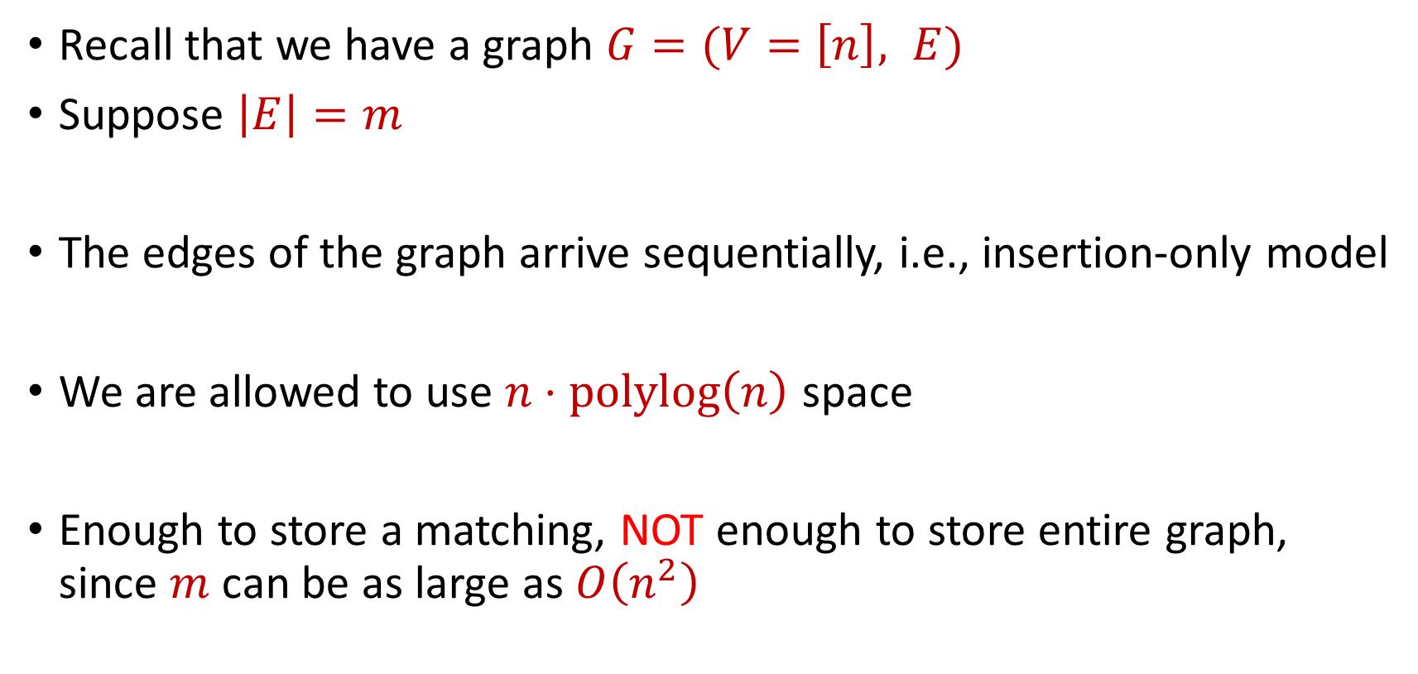
Previously: Semi-streaming Model
Recall that we have a graph $G=(V=\left[n\right], E)$
Suppose $\left|E\right|=m$
The edges of the graph arrive sequentially, i.e., insertion-only model
We are allowed to use $n⋅polylog\left(n\right)$ space
Enough to store a matching, NOT enough to store entire graph, since $m$ can be as large as $O\left(n^{2}\right)$

Slide 4
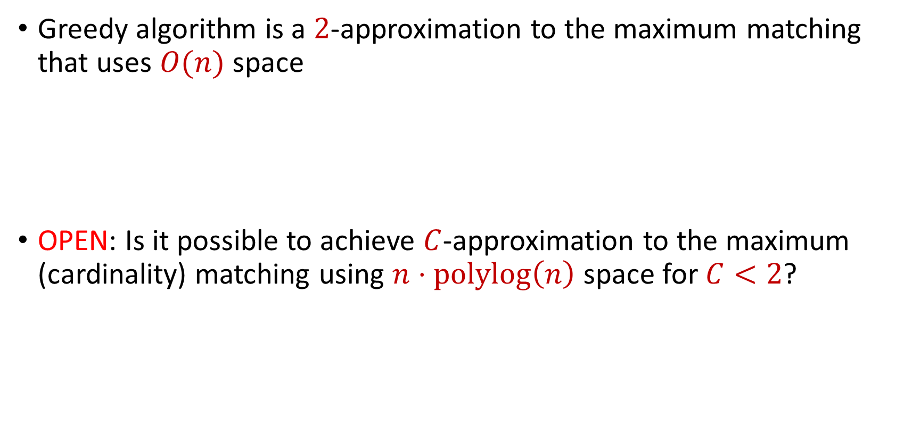
Last Time: Maximum Matching
Greedy algorithm is a $2$-approximation to the maximum matching that uses $O(n)$ space
OPEN: Is it possible to achieve $C$-approximation to the maximum (cardinality) matching using $n⋅polylog\left(n\right)$ space for $C<2$?

Slide 5
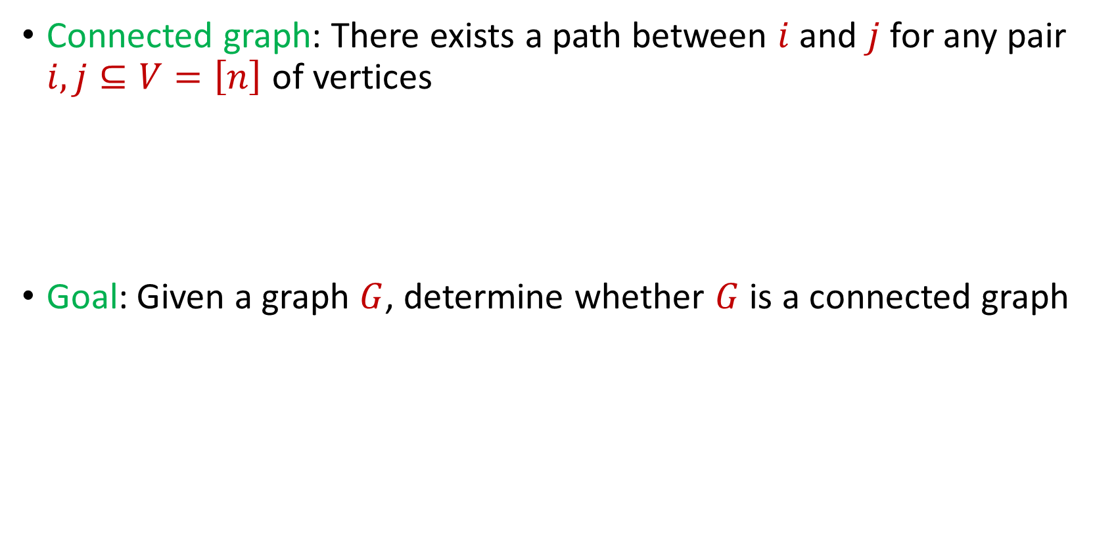
Last Time: Connectivity
Connected graph: There exists a path between $i$ and $j$ for any pair $i,j⊆V=\left[n\right]$ of vertices
Goal: Given a graph $G$, determine whether $G$ is a connected graph

Slide 6
Last Time: Spanning Tree
How to find a spanning tree in the offline setting?
Minimum spanning tree algorithms (Kruskal, Prim)
Kruskal: Greedily add minimum weight edge to spanning forest
Prim: Greedily grow minimum spanning tree

Slide 7
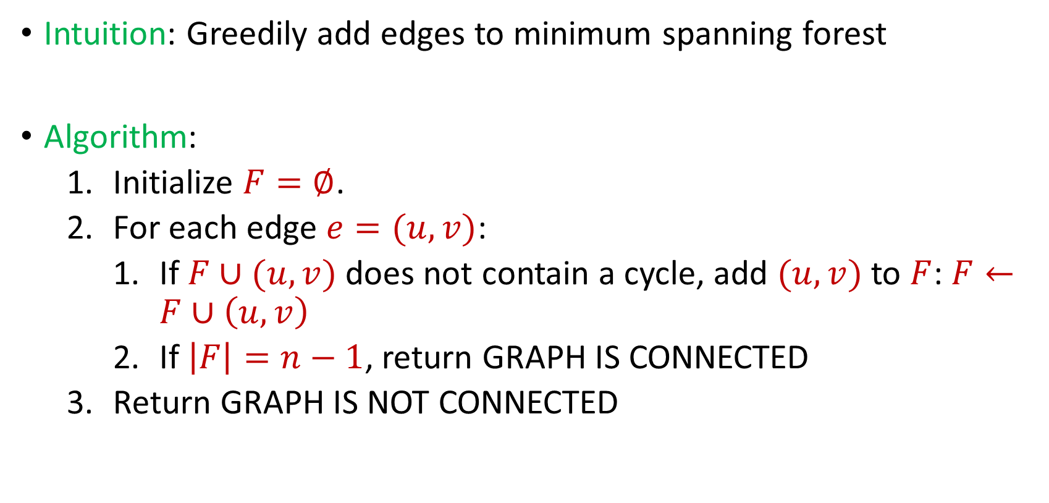
Last Time: Connectivity
Intuition: Greedily add edges to minimum spanning forest
Algorithm:
Initialize $F=∅$.
For each edge $e=(u,v)$:
If $F∪(u,v)$ does not contain a cycle, add $(u,v)$ to $F$: $F←F∪\left(u,v\right)$
If $\left|F\right|=n−1$, return GRAPH IS CONNECTED
Return GRAPH IS NOT CONNECTED

Slide 8

Last Time: Connectivity
Algorithm can keep at most $n$ edges, so the total space usage is $O(n)$ words of space.

Slide 9

Bipartiteness
Bipartite graph: Graph can be partitioned into two disjoint sets $L$ and $R$ so that every edge is between a vertex in $L$ and a vertex in $R$
Goal: Given a graph $G$, determine whether $G$ is a bipartite graph

Slide 10






$$1$$
$$2$$
$$5$$
$$6$$
$$4$$
$$3$$

Slide 11






$$2$$
$$1$$
$$6$$
$$4$$
$$5$$
$$3$$

Slide 12
$$1$$
$$2$$
$$5$$
$$6$$
$$4$$
$$3$$

Slide 13
$$1$$
$$2$$
$$5$$
$$6$$
$$4$$
$$3$$

Slide 14
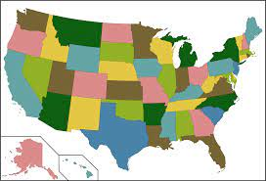
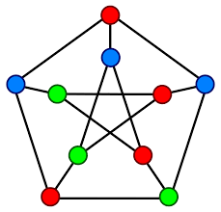
Applications for Bipartiteness Testing
Graph coloring: You want to color a graph such that no neighboring items share the same color

Slide 15

Applications for Bipartiteness Testing
Circuit Design: In electrical engineering and VLSI (Very Large Scale Integration) design, you may want to know if a circuit can be optimally partitioned into two complementary parts, which can be achieved by testing the bipartiteness of the circuit's dependency graph

Slide 16
Bipartiteness
What is a necessary and sufficient condition for bipartiteness?

Slide 17
Bipartiteness
What is a necessary and sufficient condition for bipartiteness?
A graph is bipartite if and only if it can be colored using two colors (a coloring of a graph is an assignment of colors to vertices such that no two vertices share the same color)
A graph is bipartite if and only if it has no odd cycles

Slide 18
Bipartiteness
How to perform bipartiteness testing in the central setting?

Slide 19
Bipartiteness
How to perform bipartiteness testing in the central setting?
Start at arbitrary vertex, run BFS, and assign alternating levels to different side until there is a contradiction

Slide 20
$$1$$
$$2$$
$$5$$
$$6$$
$$4$$
$$3$$

Slide 21
$$1$$
$$2$$
$$5$$
$$6$$
$$4$$
$$3$$

Slide 22






$$1$$
$$2$$
$$5$$
$$6$$
$$3$$
$$4$$

Slide 23
$$1$$
$$2$$
$$5$$
$$6$$
$$3$$
$$4$$

Slide 24
Bipartiteness in the Streaming Model
Bipartiteness is a monotone property, i.e., additional edges to a graph that is not bipartite will result in a graph that is not bipartite

Slide 25
Bipartiteness in the Streaming Model
Bipartiteness is a monotone property, i.e., additional edges to a graph that is not bipartite will result in a graph that is not bipartite

Slide 26
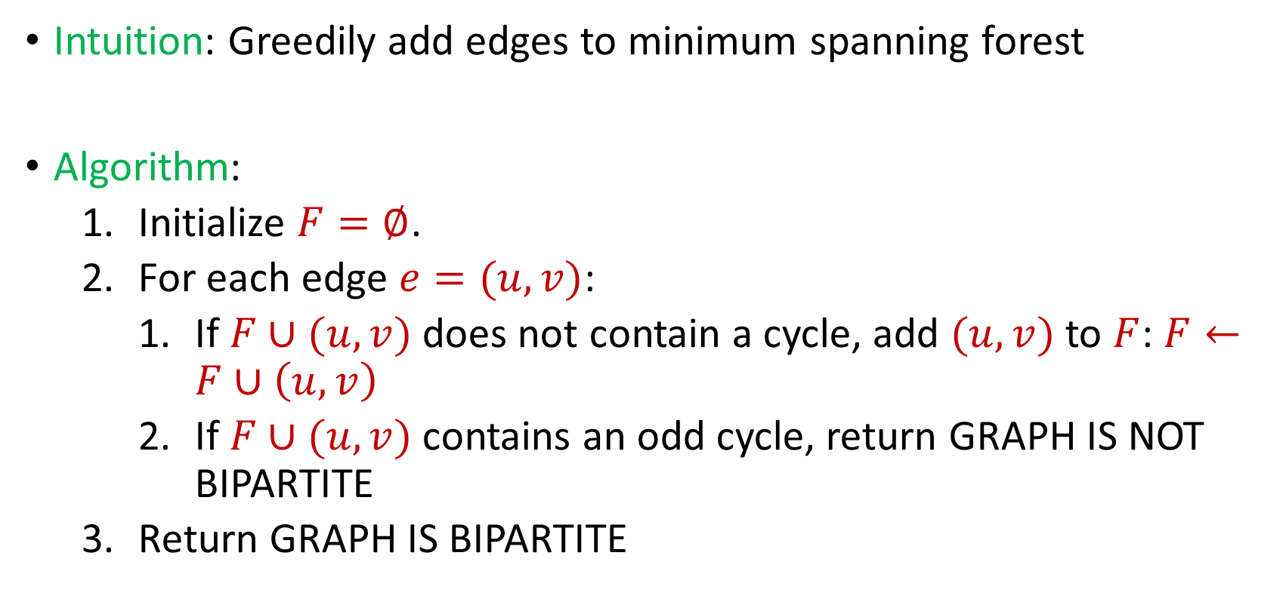
Bipartiteness in the Streaming Model
Intuition: Greedily add edges to minimum spanning forest
Algorithm:
Initialize $F=∅$.
For each edge $e=(u,v)$:
If $F∪(u,v)$ does not contain a cycle, add $(u,v)$ to $F$: $F←F∪\left(u,v\right)$
If $F∪(u,v)$ contains an odd cycle, return GRAPH IS NOT BIPARTITE
Return GRAPH IS BIPARTITE

Slide 27
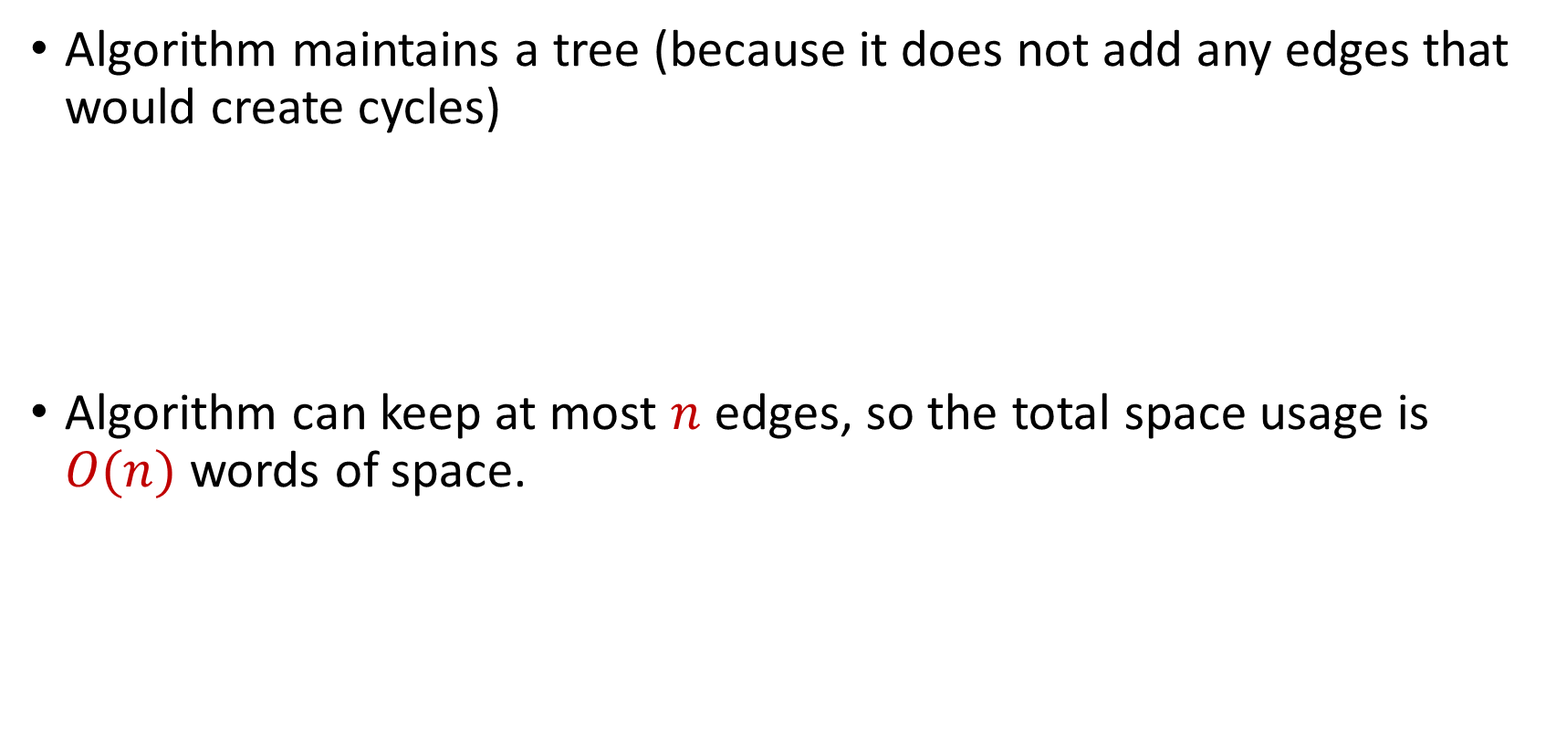
Bipartiteness in the Streaming Model
Algorithm maintains a tree (because it does not add any edges that would create cycles)
Algorithm can keep at most $n$ edges, so the total space usage is $O(n)$ words of space.

