Slide 1
CSCE 689: Special Topics in Modern Algorithms for Data Science
Lecture 13
Samson Zhou

Slide 2
Presentation Schedule
September 25: Team DAP, Team Bokun, Team Jason
September 27: Galaxy AI, Team STMI
September 29: Jung, Anmol, Chunkai

Slide 3
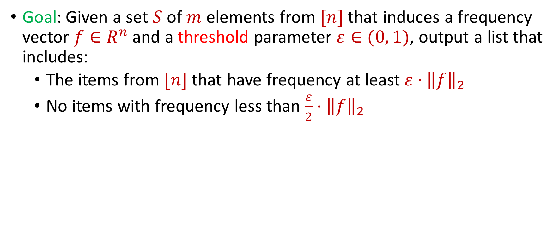

Last Time: $L_{2}$ Heavy-Hitters
Goal: Given a set $S$ of $m$ elements from $[n]$ that induces a frequency vector $f∈R^{n}$ and a threshold parameter $ε∈(0, 1)$, output a list that includes:
The items from $[n]$ that have frequency at least $ε⋅{\left\|f\right\|}_{2}$
No items with frequency less than $\frac{ε}{2}⋅{\left\|f\right\|}_{2}$

Slide 4
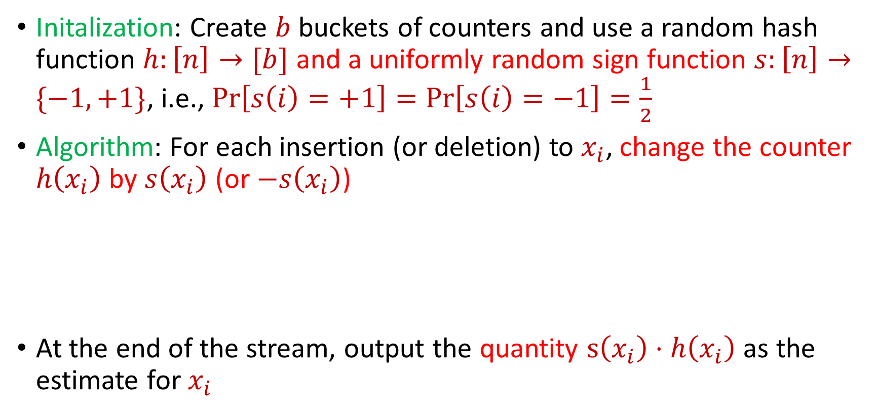
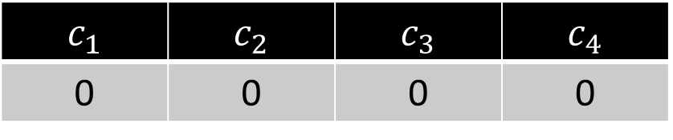
Last Time: CountSketch, i.e., CountMin and the Power of Random Signs
Initalization: Create $b$ buckets of counters and use a random hash function $h:\left[n\right]→[b]$ and a uniformly random sign function $s:\left[n\right]→\{−1,+1\}$, i.e., $Pr\left[s\left(i\right)=+1\right]=Pr\left[s\left(i\right)=−1\right]=\frac{1}{2}$
Algorithm: For each insertion (or deletion) to $x_{i}$, change the counter $h\left(x_{i}\right)$ by $s\left(x_{i}\right)$ (or $−s\left(x_{i}\right)$)
At the end of the stream, output the quantity $s\left(x_{i}\right)⋅h\left(x_{i}\right)$ as the estimate for $x_{i}$
$c_{1}$ | $c_{2}$ | $c_{3}$ | $c_{4}$
0 | 0 | 0 | 0

Slide 5
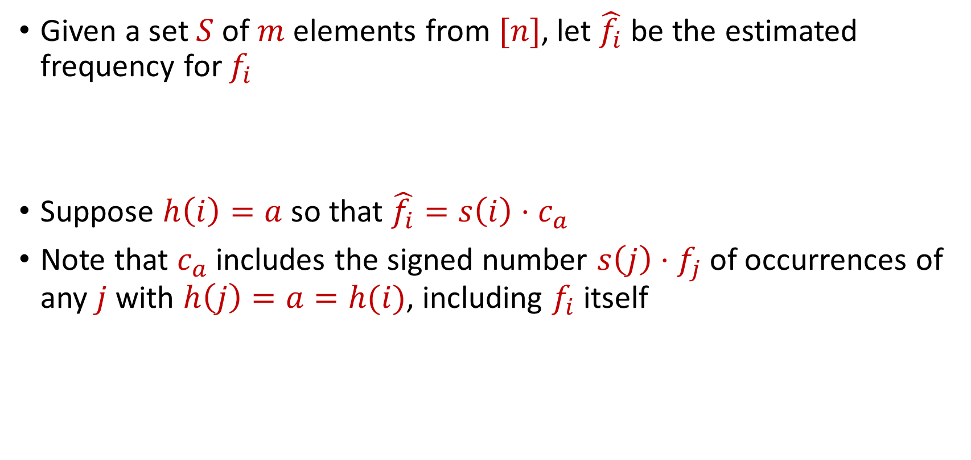
CountSketch
Given a set $S$ of $m$ elements from $[n]$, let $\hat{f_{i}}$ be the estimated frequency for $f_{i}$
Suppose $h\left(i\right)=a$ so that $\hat{f_{i}}=s\left(i\right)⋅c_{a}$
Note that $c_{a}$ includes the signed number $s\left(j\right)⋅f_{j}$of occurrences of any $j$ with $h\left(j\right)=a=h(i)$, including $f_{i}$ itself

Slide 6
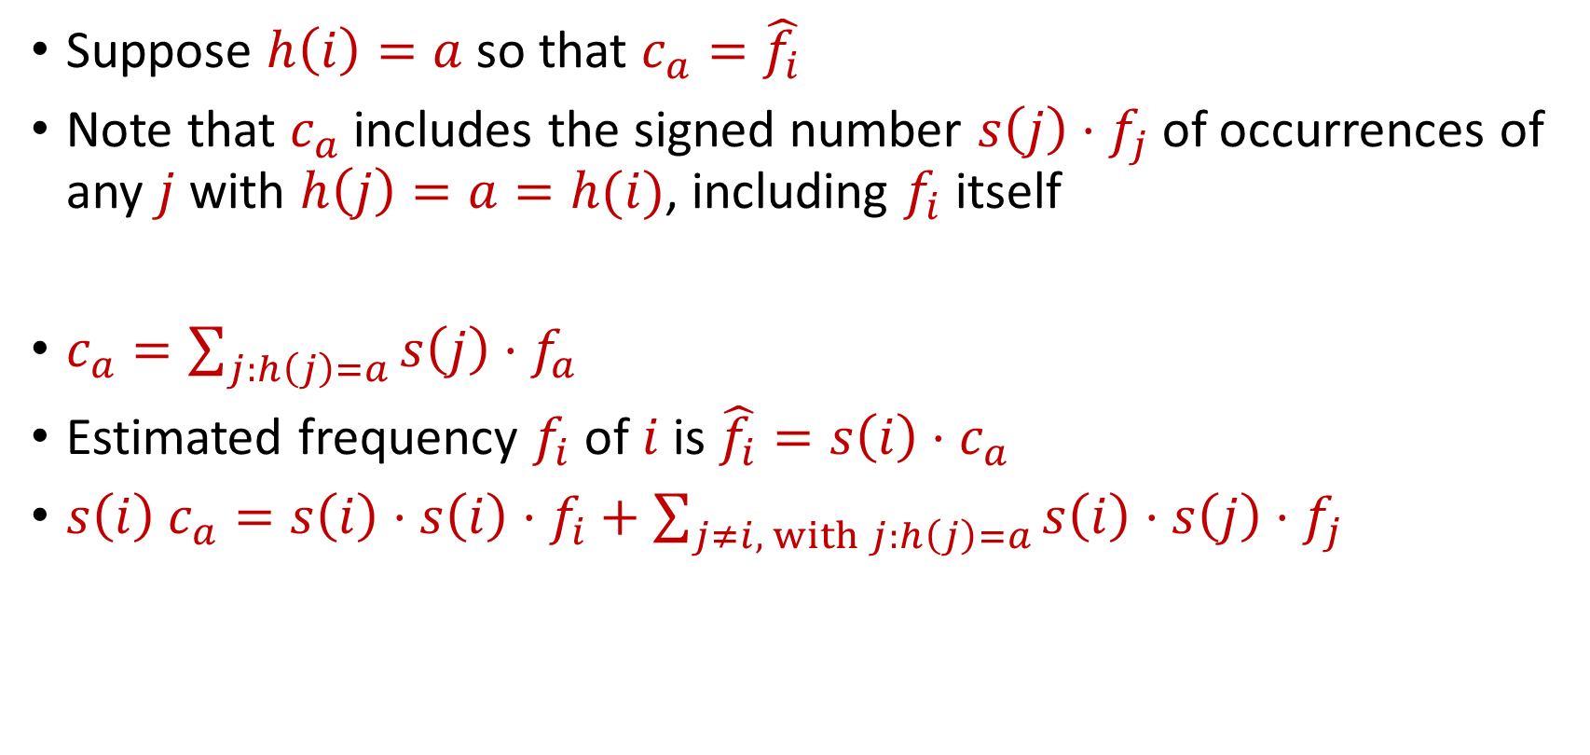
CountSketch
Suppose $h\left(i\right)=a$ so that $c_{a}=\hat{f_{i}}$
Note that $c_{a}$ includes the signed number $s\left(j\right)⋅f_{j}$of occurrences of any $j$ with $h\left(j\right)=a=h(i)$, including $f_{i}$ itself
$c_{a}=\sum_{j:h\left(j\right)=a}{s\left(j\right)⋅f_{a}}$
Estimated frequency $f_{i}$ of $i$ is $\hat{f_{i}}=s\left(i\right)⋅c_{a}$
$s\left(i\right) c_{a}=s\left(i\right)⋅s\left(i\right)⋅f_{i}+\sum_{j≠i, with j:h\left(j\right)=a}{s\left(i\right)⋅s\left(j\right)⋅f_{j}}$

Slide 7

CountSketch Error Analysis
$c_{a}=s\left(i\right)⋅s\left(i\right)⋅f_{i}+\sum_{j≠i, with j:h\left(j\right)=a}{s\left(i\right)⋅s\left(j\right)⋅f_{j}}$
Since $s\left(i\right)∈\{−1,+1\}$, we have $s\left(i\right)⋅s\left(i\right)=1$
What is the expected error for $f_{i}$?

Slide 8

CountSketch Error Analysis
$c_{a}=s\left(i\right)⋅s\left(i\right)⋅f_{i}+\sum_{j≠i, with j:h\left(j\right)=a}{s\left(i\right)⋅s\left(j\right)⋅f_{j}}$
What is the expectation of the error term for $f_{i}$?
$E\left[\sum_{j≠i, with j:h\left(j\right)=a}{{s\left(i\right)⋅s\left(j\right)⋅f}_{j}}\right]=Σ_{j≠i}E\left[{s\left(i\right)⋅s\left(j\right)⋅f}_{j}⋅I_{h\left(j\right)=h(i)}\right]$

Slide 9

CountSketch Error Analysis
$c_{a}=s\left(i\right)⋅s\left(i\right)⋅f_{i}+\sum_{j≠i, with j:h\left(j\right)=a}{s\left(i\right)⋅s\left(j\right)⋅f_{j}}$
What is the expectation of the error term for $f_{i}$?
$E\left[\sum_{j≠i, with j:h\left(j\right)=a}{{s\left(i\right)⋅s\left(j\right)⋅f}_{j}}\right]=0$

Slide 10

CountSketch Error Analysis
$c_{a}=s\left(i\right)⋅s\left(i\right)⋅f_{i}+\sum_{j≠i, with j:h\left(j\right)=a}{s\left(i\right)⋅s\left(j\right)⋅f_{j}}$
What is the expectation of the error term for $f_{i}$?
$E\left[\sum_{j≠i, with j:h\left(j\right)=a}{{s\left(i\right)⋅s\left(j\right)⋅f}_{j}}\right]=0$
What is the variance of the error term for $f_{i}$?

Slide 11

CountSketch Error Analysis
Variance is at most the 2nd moment of the error term
$E\left[{\left(\sum_{j≠i, with j:h\left(j\right)=a}{{s\left(i\right)⋅s\left(j\right)⋅f}_{j}}\right)}^{2}\right]$

Slide 12

CountSketch Error Analysis
Variance is at most the 2nd moment of the error term
$E\left[{\left(\sum_{j≠i, with j:h\left(j\right)=a}{{s\left(i\right)⋅s\left(j\right)⋅f}_{j}}\right)}^{2}\right]=Σ_{j≠i}E\left[{\left|f_{j}\right|}^{2}⋅I_{h\left(j\right)=h(i)}\right]$

Slide 13

CountSketch Error Analysis
Variance is at most the 2nd moment of the error term
$E\left[{\left(\sum_{j≠i, with j:h\left(j\right)=a}{{s\left(i\right)⋅s\left(j\right)⋅f}_{j}}\right)}^{2}\right]=Σ_{j≠i}E\left[{\left|f_{j}\right|}^{2}⋅I_{h\left(j\right)=h(i)}\right]$
$$=Σ_{j≠i}E\left[I_{h\left(j\right)=h(i)}\right]⋅{\left|f_{j}\right|}^{2}$$

Slide 14

CountSketch Error Analysis
Variance is at most the 2nd moment of the error term
$E\left[{\left(\sum_{j≠i, with j:h\left(j\right)=a}{{s\left(i\right)⋅s\left(j\right)⋅f}_{j}}\right)}^{2}\right]=Σ_{j≠i}E\left[{\left|f_{j}\right|}^{2}⋅I_{h\left(j\right)=h(i)}\right]$
$$=Σ_{j≠i}E\left[I_{h\left(j\right)=h(i)}\right]⋅{\left|f_{j}\right|}^{2}$$
$$=Σ_{j≠i}Pr\left[h\left(j\right)=h(i)\right]⋅{\left|f_{j}\right|}^{2}$$

Slide 15

CountSketch Error Analysis
Variance is at most the 2nd moment of the error term
$E\left[{\left(\sum_{j≠i, with j:h\left(j\right)=a}{{s\left(i\right)⋅s\left(j\right)⋅f}_{j}}\right)}^{2}\right]=Σ_{j≠i}E\left[{\left|f_{j}\right|}^{2}⋅I_{h\left(j\right)=h(i)}\right]$
$$=Σ_{j≠i}E\left[I_{h\left(j\right)=h(i)}\right]⋅{\left|f_{j}\right|}^{2}$$
$$=Σ_{j≠i}Pr\left[h\left(j\right)=h(i)\right]⋅{\left|f_{j}\right|}^{2}$$
$$=Σ_{j≠i}\frac{1}{b}⋅{\left|f_{j}\right|}^{2}=\frac{{\left\|f\right\|}_{2}^{2}}{b}$$

Slide 16
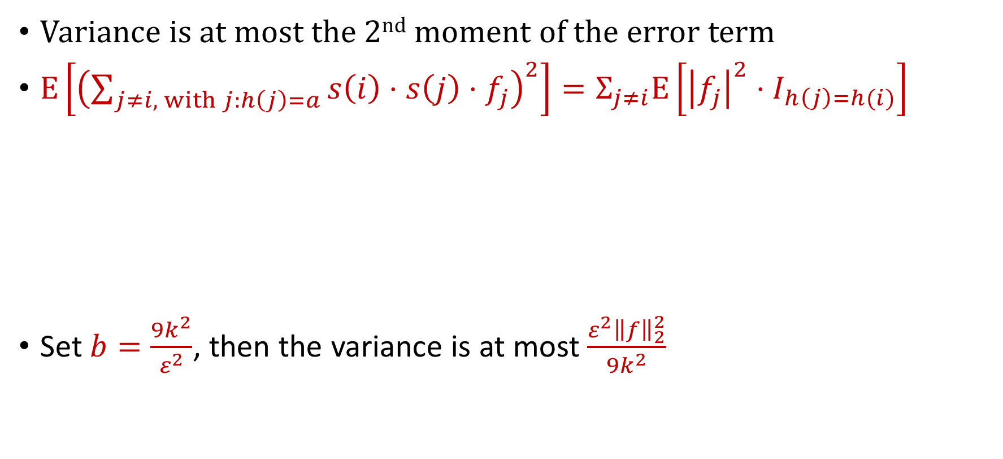
CountSketch Error Analysis
Variance is at most the 2nd moment of the error term
$E\left[{\left(\sum_{j≠i, with j:h\left(j\right)=a}{{s\left(i\right)⋅s\left(j\right)⋅f}_{j}}\right)}^{2}\right]=Σ_{j≠i}E\left[{\left|f_{j}\right|}^{2}⋅I_{h\left(j\right)=h(i)}\right]$
Set $b=\frac{9k^{2}}{ε^{2}}$, then the variance is at most $\frac{ε^{2}{\left\|f\right\|}_{2}^{2}}{9k^{2}}$
$$=Σ_{j≠i}E\left[I_{h\left(j\right)=h(i)}\right]⋅{\left|f_{j}\right|}^{2}$$
$$=Σ_{j≠i}Pr\left[h\left(j\right)=h(i)\right]⋅{\left|f_{j}\right|}^{2}$$
$$=Σ_{j≠i}\frac{1}{b}⋅{\left|f_{j}\right|}^{2}=\frac{{\left\|f\right\|}_{2}^{2}}{b}$$

Slide 17
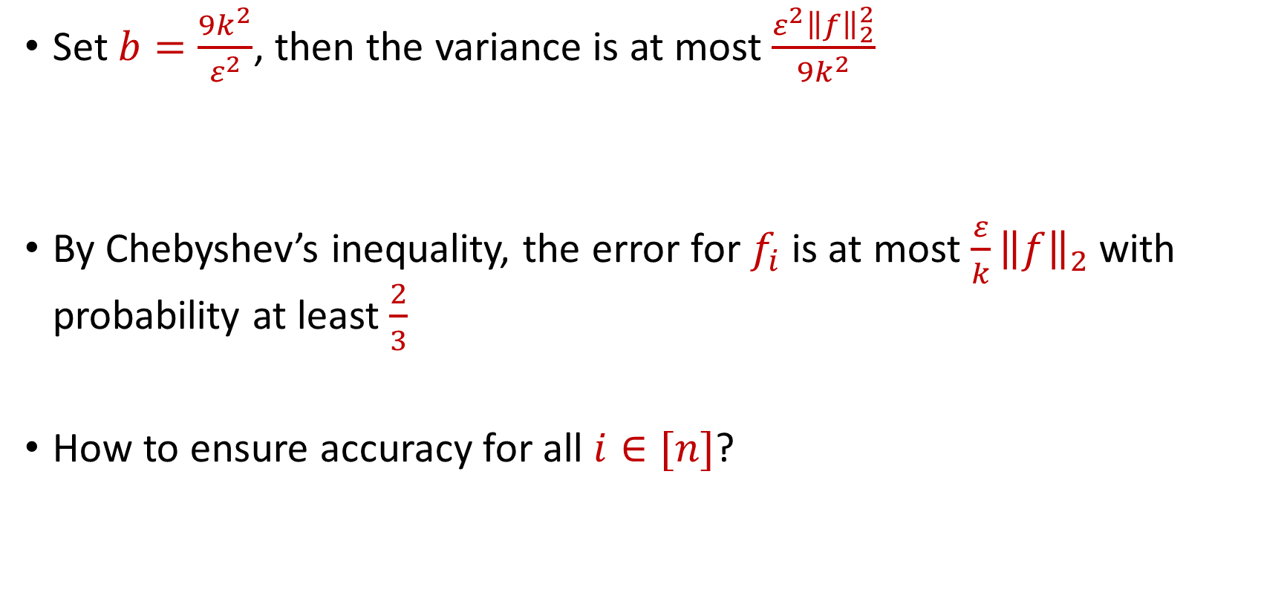
CountSketch Error Analysis
Set $b=\frac{9k^{2}}{ε^{2}}$, then the variance is at most $\frac{ε^{2}{\left\|f\right\|}_{2}^{2}}{9k^{2}}$
By Chebyshev’s inequality, the error for $f_{i}$ is at most $\frac{ε}{k}{\left\|f\right\|}_{2}$with probability at least $\frac{2}{3}$
How to ensure accuracy for all $i∈[n]$?

Slide 18
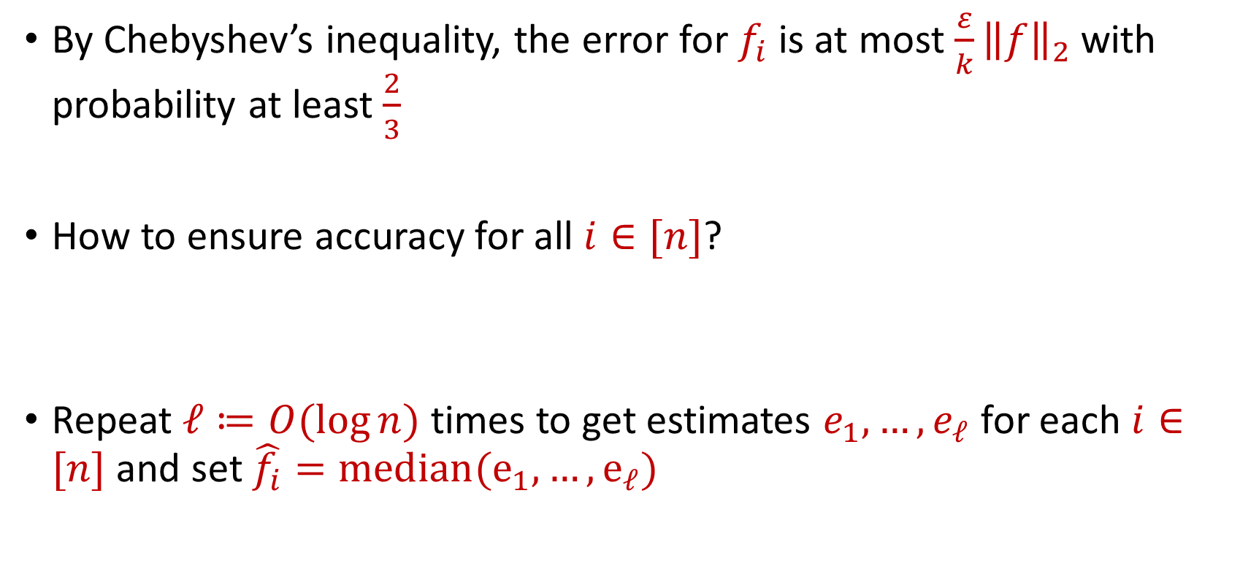
CountSketch Error Analysis
By Chebyshev’s inequality, the error for $f_{i}$ is at most $\frac{ε}{k}{\left\|f\right\|}_{2}$with probability at least $\frac{2}{3}$
How to ensure accuracy for all $i∈[n]$?
Repeat $ℓ≔O(\log{n)}$ times to get estimates $e_{1},…,e_{ℓ}$ for each $i∈[n]$ and set $\hat{f_{i}}=median(e_{1},…, e_{ℓ})$

Slide 19


CountSketch Error Analysis
Claim: For all estimated frequencies $\hat{f_{i}}$ by CountSketch, we have
$$f_{i}−\frac{ε{\left\|f\right\|}_{2}}{k}≤\hat{f_{i}}≤f_{i}+\frac{ε{\left\|f\right\|}_{2}}{k}$$

Slide 20

Sparse Recovery
Suppose we have an insertion-deletion stream of length $m=Θ\left(n\right)$ and at the end we are promised there are at most $k$ nonzero coordinates
Recover the $k$ nonzero coordinates and their frequencies

Slide 21
Applications of Sparse Recovery
Anomaly detection and network traffic analysis:
Noiseless sparse recovery can be used to identify anomalies or outliers in streaming data. By modeling normal behavior as a sparse signal, deviations from this model can be detected in real-time. This is valuable for cybersecurity, fraud detection, and monitoring network traffic for unusual patterns.
Noiseless sparse recovery can be applied to analyze network traffic in real-time, identifying patterns and trends, and helping in network management, intrusion detection, and quality of service (QoS) optimization

Slide 22
Applications of Sparse Recovery
Online Natural Language Processing (NLP): In real-time natural language processing tasks, noiseless sparse recovery can assist in extracting relevant features or patterns from streaming text data, making it useful for sentiment analysis, topic modeling, and summarization

Slide 23
Applications of Sparse Recovery
Real-time Compressive Imaging: Compressive imaging techniques can be applied to streaming video or image data. By capturing and processing fewer measurements, noiseless sparse recovery can provide real-time reconstruction of high-resolution images or videos.

Slide 24
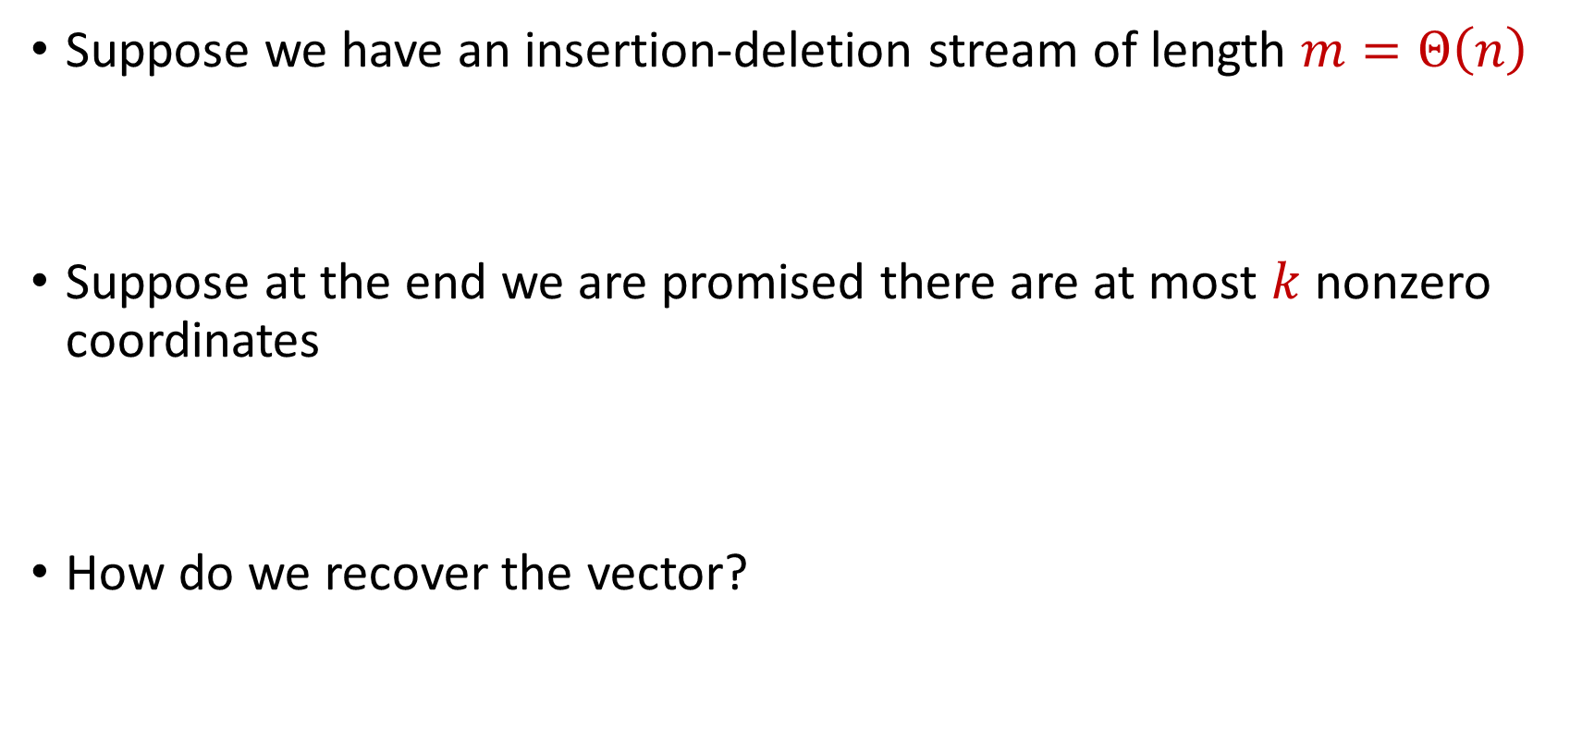
Sparse Recovery
Suppose we have an insertion-deletion stream of length $m=Θ\left(n\right)$
Suppose at the end we are promised there are at most $k$ nonzero coordinates
How do we recover the vector?

Slide 25

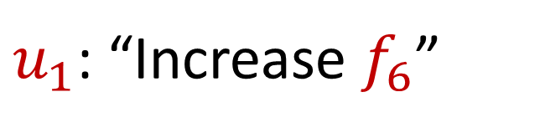
Sparse Recovery
Suppose at the end we are promised there are at most $k$ nonzero coordinates
Suppose $k=1$ and we are promised the coordinate has frequency $1$
$u_{1}$: “Increase $f_{6}$”

Slide 26
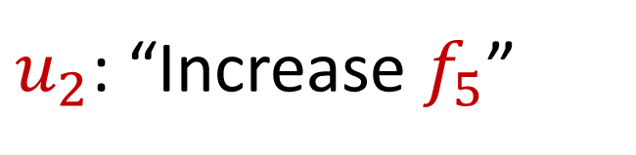
Sparse Recovery
Suppose at the end we are promised there are at most $k$ nonzero coordinates
Suppose $k=1$ and we are promised the coordinate has frequency $1$
$u_{2}$: “Increase $f_{5}$”

Slide 27
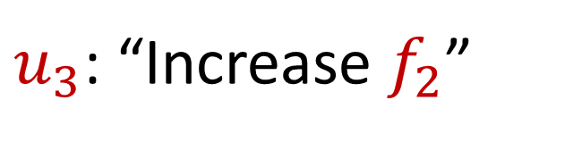
Sparse Recovery
Suppose at the end we are promised there are at most $k$ nonzero coordinates
Suppose $k=1$ and we are promised the coordinate has frequency $1$
$u_{3}$: “Increase $f_{2}$”

Slide 28
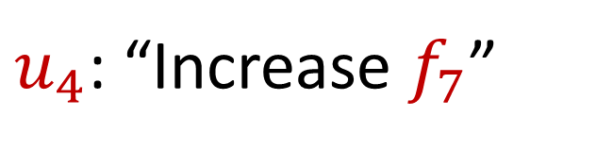
Sparse Recovery
Suppose at the end we are promised there are at most $k$ nonzero coordinates
Suppose $k=1$ and we are promised the coordinate has frequency $1$
$u_{4}$: “Increase $f_{7}$”

Slide 29
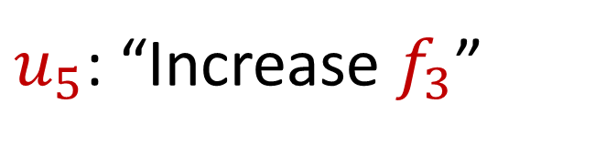
Sparse Recovery
Suppose at the end we are promised there are at most $k$ nonzero coordinates
Suppose $k=1$ and we are promised the coordinate has frequency $1$
$u_{5}$: “Increase $f_{3}$”

Slide 30
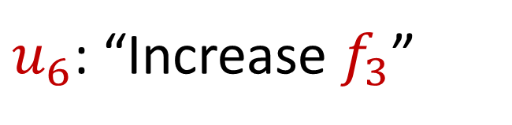
Sparse Recovery
Suppose at the end we are promised there are at most $k$ nonzero coordinates
Suppose $k=1$ and we are promised the coordinate has frequency $1$
$u_{6}$: “Increase $f_{3}$”

Slide 31
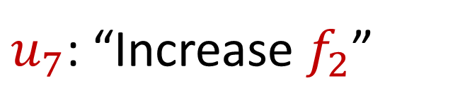
Sparse Recovery
Suppose at the end we are promised there are at most $k$ nonzero coordinates
Suppose $k=1$ and we are promised the coordinate has frequency $1$
$u_{7}$: “Increase $f_{2}$”

Slide 32
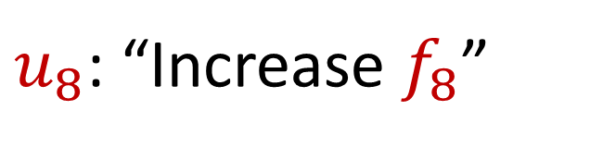
Sparse Recovery
Suppose at the end we are promised there are at most $k$ nonzero coordinates
Suppose $k=1$ and we are promised the coordinate has frequency $1$
$u_{8}$: “Increase $f_{8}$”

Slide 33
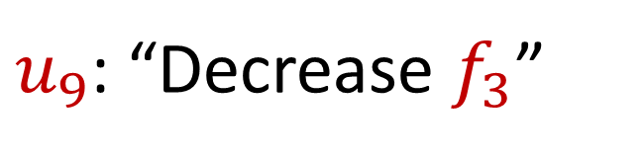
Sparse Recovery
Suppose at the end we are promised there are at most $k$ nonzero coordinates
Suppose $k=1$ and we are promised the coordinate has frequency $1$
$u_{9}$: “Decrease $f_{3}$”

Slide 34
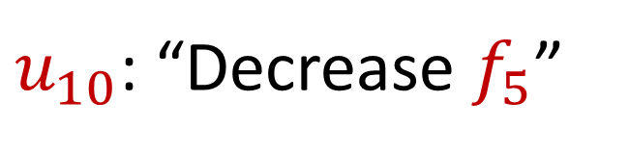
Sparse Recovery
Suppose at the end we are promised there are at most $k$ nonzero coordinates
Suppose $k=1$ and we are promised the coordinate has frequency $1$
$u_{10}$: “Decrease $f_{5}$”

Slide 35
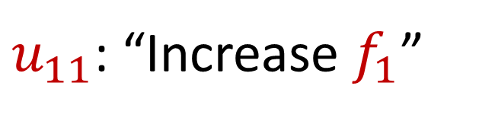
Sparse Recovery
Suppose at the end we are promised there are at most $k$ nonzero coordinates
Suppose $k=1$ and we are promised the coordinate has frequency $1$
$u_{11}$: “Increase $f_{1}$”

Slide 36
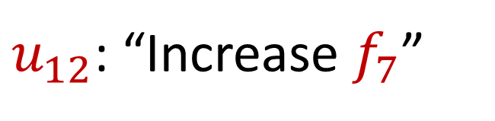
Sparse Recovery
Suppose at the end we are promised there are at most $k$ nonzero coordinates
Suppose $k=1$ and we are promised the coordinate has frequency $1$
$u_{12}$: “Increase $f_{7}$”

Slide 37
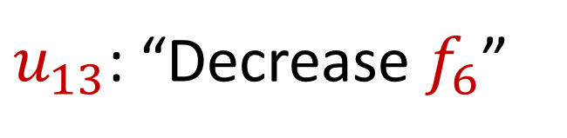
Sparse Recovery
Suppose at the end we are promised there are at most $k$ nonzero coordinates
Suppose $k=1$ and we are promised the coordinate has frequency $1$
$u_{13}$: “Decrease $f_{6}$”

Slide 38

Sparse Recovery
Suppose at the end we are promised there are at most $k$ nonzero coordinates
Suppose $k=1$ and we are promised the coordinate has frequency $1$
$u_{14}$: “Decrease $f_{8}$”

Slide 39
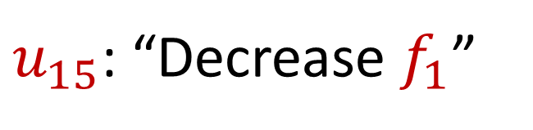
Sparse Recovery
Suppose at the end we are promised there are at most $k$ nonzero coordinates
Suppose $k=1$ and we are promised the coordinate has frequency $1$
$u_{15}$: “Decrease $f_{1}$”

Slide 40
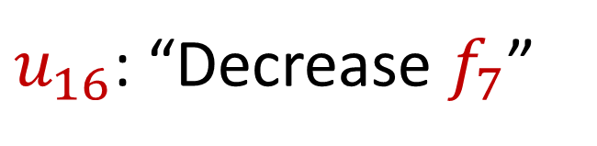
Sparse Recovery
Suppose at the end we are promised there are at most $k$ nonzero coordinates
Suppose $k=1$ and we are promised the coordinate has frequency $1$
$u_{16}$: “Decrease $f_{7}$”

Slide 41
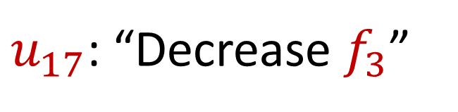
Sparse Recovery
Suppose at the end we are promised there are at most $k$ nonzero coordinates
Suppose $k=1$ and we are promised the coordinate has frequency $1$
$u_{17}$: “Decrease $f_{3}$”

Slide 42
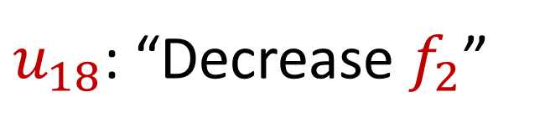
Sparse Recovery
Suppose at the end we are promised there are at most $k$ nonzero coordinates
Suppose $k=1$ and we are promised the coordinate has frequency $1$
$u_{18}$: “Decrease $f_{2}$”

Slide 43
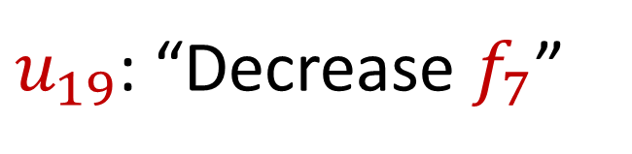
Sparse Recovery
Suppose at the end we are promised there are at most $k$ nonzero coordinates
Suppose $k=1$ and we are promised the coordinate has frequency $1$
$u_{19}$: “Decrease $f_{7}$”

Slide 44

Sparse Recovery
Suppose at the end we are promised there are at most $k$ nonzero coordinates
Suppose $k=1$ and we are promised the coordinate has frequency $1$
What is left?

Slide 45

Sparse Recovery
Suppose at the end we are promised there are at most $k$ nonzero coordinates
Suppose $k=1$ and we are promised the coordinate has frequency $1$
What is left?
$$f_{2}=1$$

Slide 46
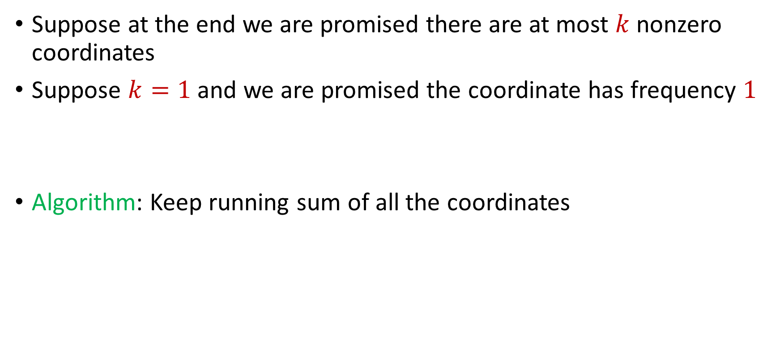
Sparse Recovery
Suppose at the end we are promised there are at most $k$ nonzero coordinates
Suppose $k=1$ and we are promised the coordinate has frequency $1$
Algorithm: Keep running sum of all the coordinates

Slide 47
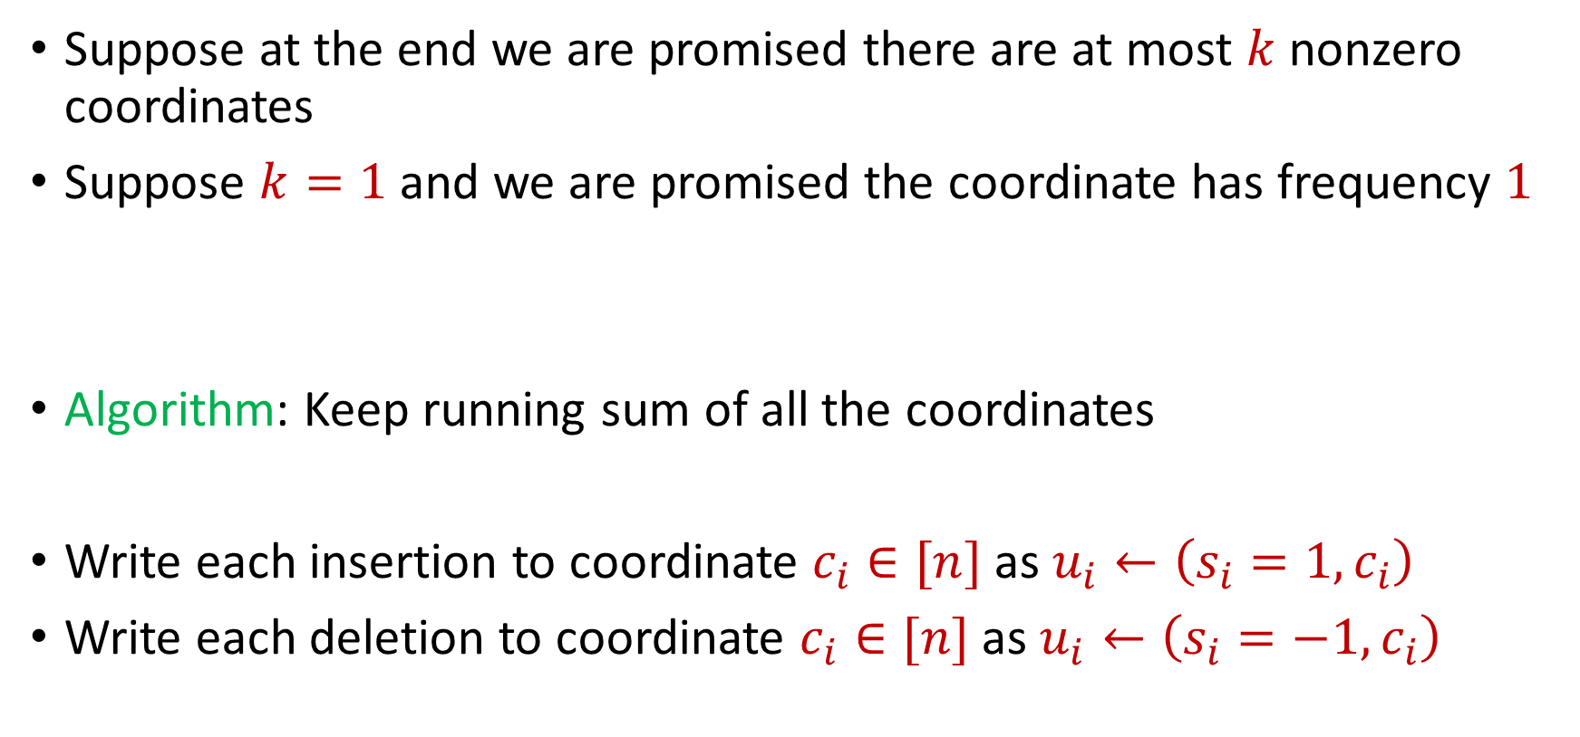
Sparse Recovery
Suppose at the end we are promised there are at most $k$ nonzero coordinates
Suppose $k=1$ and we are promised the coordinate has frequency $1$
Algorithm: Keep running sum of all the coordinates
Write each insertion to coordinate $c_{i}∈[n]$as $u_{i}←\left(s_{i}=1, c_{i}\right)$
Write each deletion to coordinate $c_{i}∈[n]$as $u_{i}←\left(s_{i}=−1, c_{i}\right)$

Slide 48
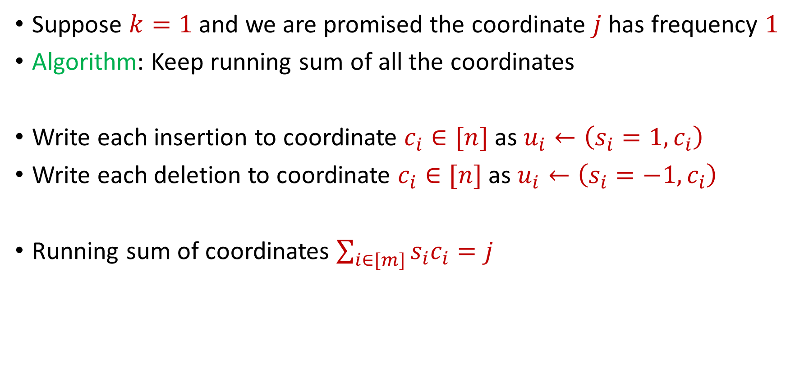
Sparse Recovery
Suppose $k=1$ and we are promised the coordinate $j$ has frequency $1$
Algorithm: Keep running sum of all the coordinates
Write each insertion to coordinate $c_{i}∈[n]$as $u_{i}←\left(s_{i}=1, c_{i}\right)$
Write each deletion to coordinate $c_{i}∈[n]$as $u_{i}←\left(s_{i}=−1, c_{i}\right)$
Running sum of coordinates $\sum_{i∈[m]}{s_{i}c_{i}}=j$

Slide 49
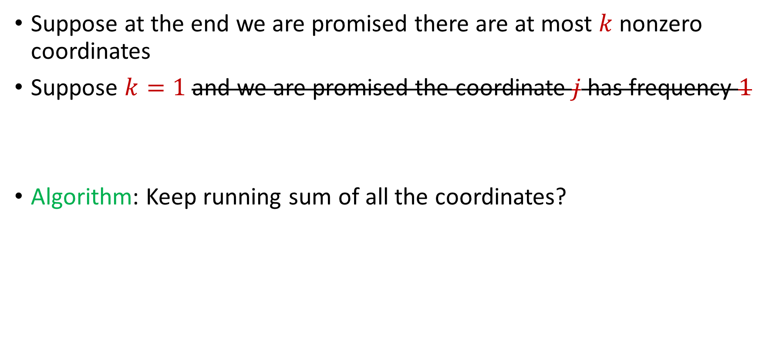
Sparse Recovery
Suppose at the end we are promised there are at most $k$ nonzero coordinates
Suppose $k=1$ and we are promised the coordinate $j$ has frequency $1$
Algorithm: Keep running sum of all the coordinates?

Slide 50
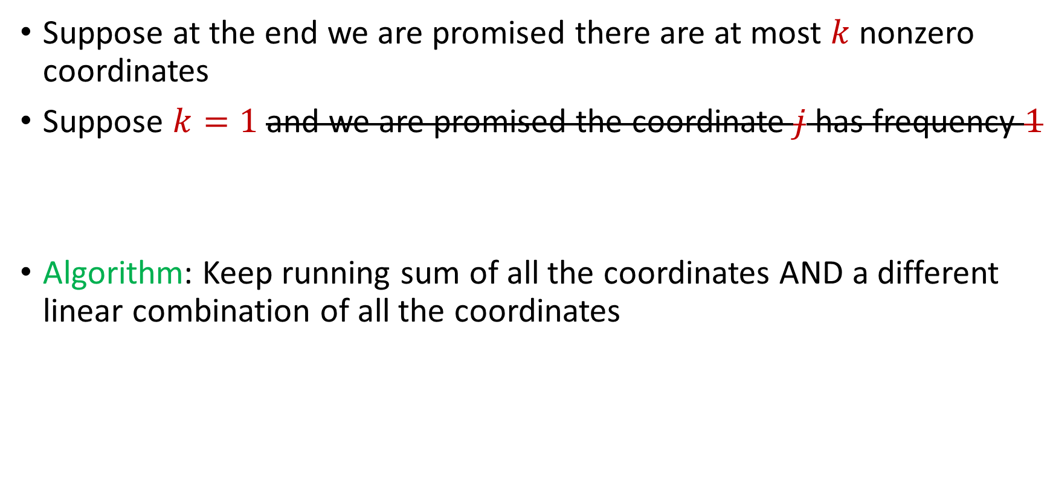
Sparse Recovery
Suppose at the end we are promised there are at most $k$ nonzero coordinates
Suppose $k=1$ and we are promised the coordinate $j$ has frequency $1$
Algorithm: Keep running sum of all the coordinates AND a different linear combination of all the coordinates

Slide 51
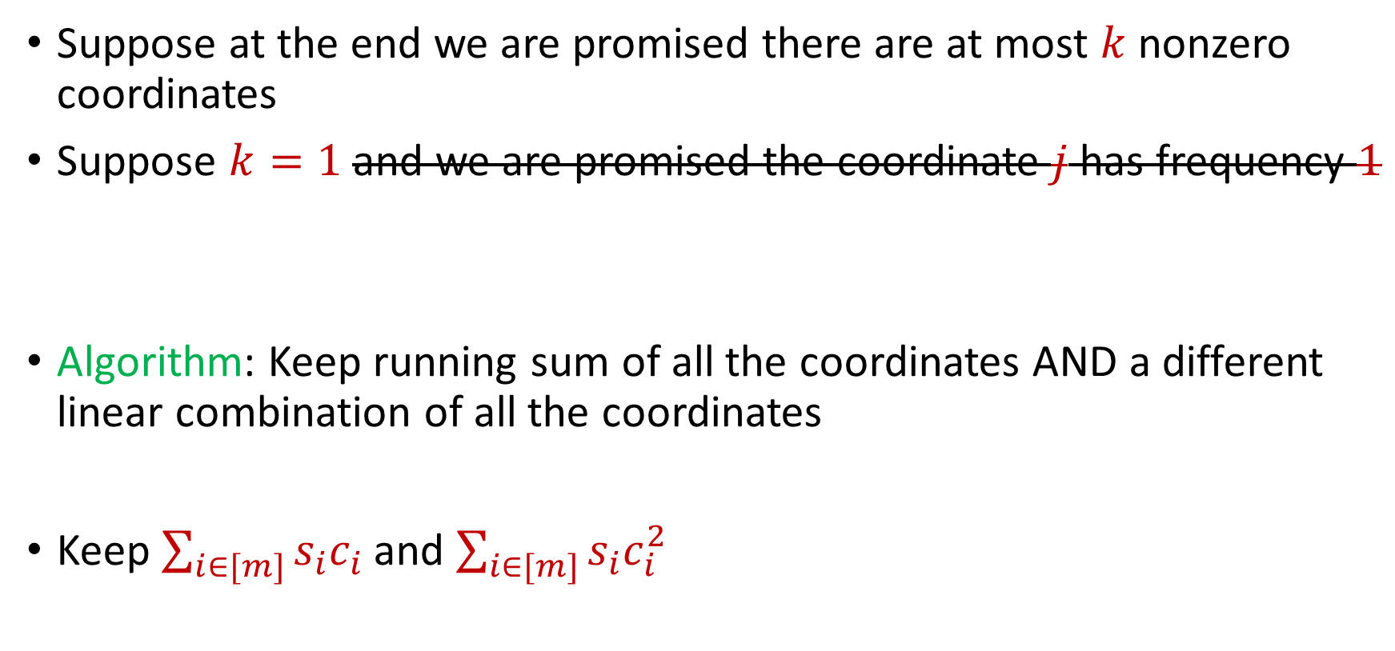
Sparse Recovery
Suppose at the end we are promised there are at most $k$ nonzero coordinates
Suppose $k=1$ and we are promised the coordinate $j$ has frequency $1$
Algorithm: Keep running sum of all the coordinates AND a different linear combination of all the coordinates
Keep $\sum_{i∈[m]}{s_{i}c_{i}}$ and $\sum_{i∈[m]}{s_{i}c_{i}^{2}}$

Slide 52

Sparse Recovery
Suppose at the end we are promised there are at most $k$ nonzero coordinates
Suppose $k=1$ and we are promised the coordinate $j$ has frequency $1$
$u_{1}$: “Increase $f_{6}$”

Slide 53
Sparse Recovery
Suppose at the end we are promised there are at most $k$ nonzero coordinates
Suppose $k=1$ and we are promised the coordinate $j$ has frequency $1$
$u_{2}$: “Increase $f_{5}$”

Slide 54
Sparse Recovery
Suppose at the end we are promised there are at most $k$ nonzero coordinates
Suppose $k=1$ and we are promised the coordinate $j$ has frequency $1$
$u_{3}$: “Increase $f_{2}$”

Slide 55
Sparse Recovery
Suppose at the end we are promised there are at most $k$ nonzero coordinates
Suppose $k=1$ and we are promised the coordinate $j$ has frequency $1$
$u_{4}$: “Increase $f_{7}$”

Slide 56
Sparse Recovery
Suppose at the end we are promised there are at most $k$ nonzero coordinates
Suppose $k=1$ and we are promised the coordinate $j$ has frequency $1$
$u_{5}$: “Increase $f_{3}$”

Slide 57
Sparse Recovery
Suppose at the end we are promised there are at most $k$ nonzero coordinates
Suppose $k=1$ and we are promised the coordinate $j$ has frequency $1$
$u_{6}$: “Increase $f_{3}$”

Slide 58
Sparse Recovery
Suppose at the end we are promised there are at most $k$ nonzero coordinates
Suppose $k=1$ and we are promised the coordinate $j$ has frequency $1$
$u_{7}$: “Increase $f_{2}$”

Slide 59
Sparse Recovery
Suppose at the end we are promised there are at most $k$ nonzero coordinates
Suppose $k=1$ and we are promised the coordinate $j$ has frequency $1$
$u_{8}$: “Increase $f_{8}$”

Slide 60
Sparse Recovery
Suppose at the end we are promised there are at most $k$ nonzero coordinates
Suppose $k=1$ and we are promised the coordinate $j$ has frequency $1$
$u_{9}$: “Decrease $f_{3}$”

Slide 61
Sparse Recovery
Suppose at the end we are promised there are at most $k$ nonzero coordinates
Suppose $k=1$ and we are promised the coordinate $j$ has frequency $1$
$u_{10}$: “Decrease $f_{5}$”

Slide 62
Sparse Recovery
Suppose at the end we are promised there are at most $k$ nonzero coordinates
Suppose $k=1$ and we are promised the coordinate $j$ has frequency $1$
$u_{11}$: “Increase $f_{1}$”

Slide 63
Sparse Recovery
Suppose at the end we are promised there are at most $k$ nonzero coordinates
Suppose $k=1$ and we are promised the coordinate $j$ has frequency $1$
$u_{12}$: “Increase $f_{7}$”

Slide 64
Sparse Recovery
Suppose at the end we are promised there are at most $k$ nonzero coordinates
Suppose $k=1$ and we are promised the coordinate $j$ has frequency $1$
$u_{13}$: “Decrease $f_{6}$”

Slide 65
Sparse Recovery
Suppose at the end we are promised there are at most $k$ nonzero coordinates
Suppose $k=1$ and we are promised the coordinate $j$ has frequency $1$
$u_{14}$: “Decrease $f_{8}$”

Slide 66
Sparse Recovery
Suppose at the end we are promised there are at most $k$ nonzero coordinates
Suppose $k=1$ and we are promised the coordinate $j$ has frequency $1$
$u_{15}$: “Decrease $f_{1}$”

Slide 67
Sparse Recovery
Suppose at the end we are promised there are at most $k$ nonzero coordinates
Suppose $k=1$ and we are promised the coordinate $j$ has frequency $1$
$u_{16}$: “Decrease $f_{7}$”

Slide 68
Sparse Recovery
Suppose at the end we are promised there are at most $k$ nonzero coordinates
Suppose $k=1$ and we are promised the coordinate $j$ has frequency $1$
$u_{17}$: “Decrease $f_{3}$”

Slide 69
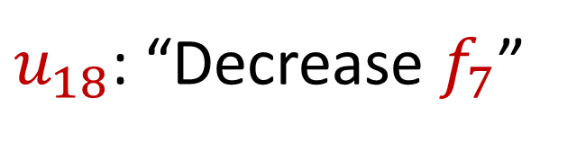
Sparse Recovery
Suppose at the end we are promised there are at most $k$ nonzero coordinates
Suppose $k=1$ and we are promised the coordinate $j$ has frequency $1$
$u_{18}$: “Decrease $f_{7}$”

Slide 70

Sparse Recovery
Suppose at the end we are promised there are at most $k$ nonzero coordinates
Suppose $k=1$ and we are promised the coordinate $j$ has frequency $1$
What is the state of our algorithm?

Slide 71
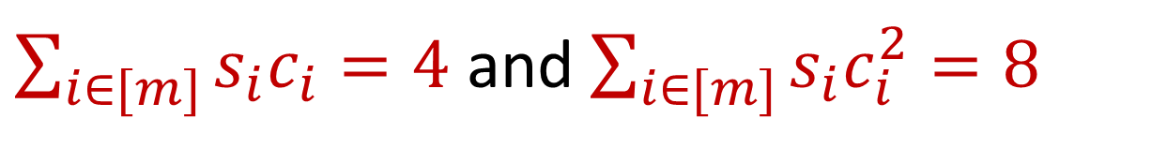
Sparse Recovery
Suppose at the end we are promised there are at most $k$ nonzero coordinates
Suppose $k=1$ and we are promised the coordinate $j$ has frequency $1$
What is the state of our algorithm?
$\sum_{i∈[m]}{s_{i}c_{i}}=4$ and $\sum_{i∈[m]}{s_{i}c_{i}^{2}=8}$

Slide 72
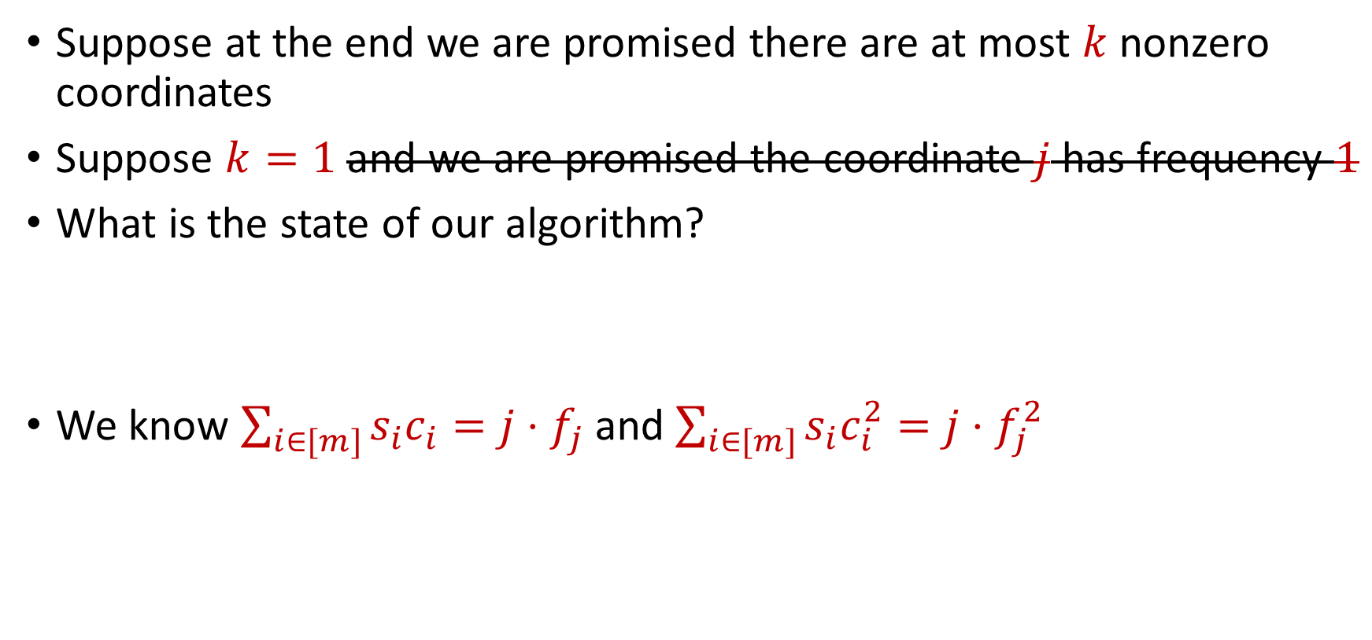
Sparse Recovery
Suppose at the end we are promised there are at most $k$ nonzero coordinates
Suppose $k=1$ and we are promised the coordinate $j$ has frequency $1$
What is the state of our algorithm?
We know $\sum_{i∈[m]}{s_{i}c_{i}}=j⋅f_{j}$ and $\sum_{i∈[m]}{s_{i}c_{i}^{2}=j⋅f_{j}^{2}}$
$\sum_{i∈[m]}{s_{i}c_{i}}=4$ and $\sum_{i∈[m]}{s_{i}c_{i}^{2}=8}$

Slide 73
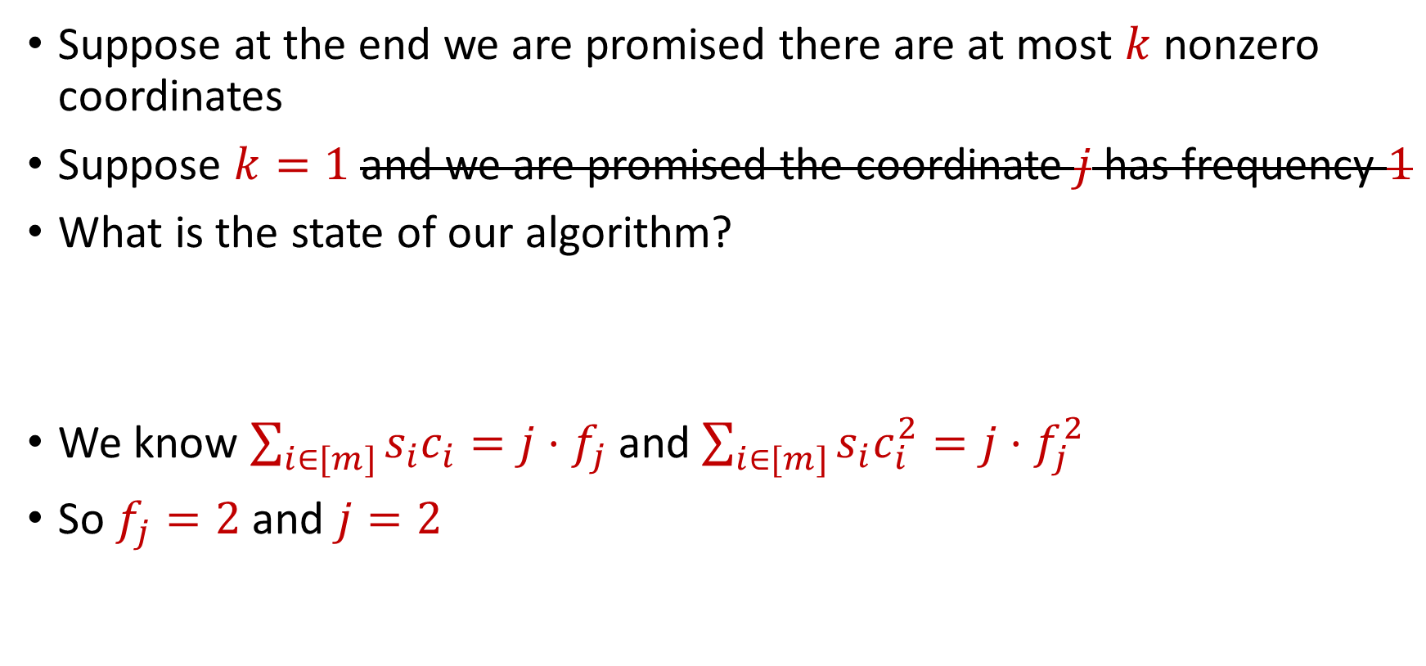
Sparse Recovery
Suppose at the end we are promised there are at most $k$ nonzero coordinates
Suppose $k=1$ and we are promised the coordinate $j$ has frequency $1$
What is the state of our algorithm?
We know $\sum_{i∈[m]}{s_{i}c_{i}}=j⋅f_{j}$ and $\sum_{i∈[m]}{s_{i}c_{i}^{2}=j⋅f_{j}^{2}}$
So $f_{j}=2$ and $j=2$
$\sum_{i∈[m]}{s_{i}c_{i}}=4$ and $\sum_{i∈[m]}{s_{i}c_{i}^{2}=8}$

Slide 74

Sparse Recovery
Suppose at the end we are promised there are at most $k$ nonzero coordinates
Suppose $k=1$ and we are promised the coordinate $j$ has frequency $1$
What is the state of our algorithm?
We know $\sum_{i∈[m]}{s_{i}c_{i}}=j⋅f_{j}$ and $\sum_{i∈[m]}{s_{i}c_{i}^{2}=j⋅f_{j}^{2}}$
So $f_{j}=2$ and $j=2$
$\sum_{i∈[m]}{s_{i}c_{i}}=4$ and $\sum_{i∈[m]}{s_{i}c_{i}^{2}=8}$
$f_{1}$ | $f_{2}$ | $f_{3}$ | $f_{4}$ | $f_{5}$ | $f_{6}$ | $f_{7}$
0 | 2 | 0 | 0 | 0 | 0 | 0

Slide 75

Sparse Recovery
Suppose at the end we are promised there are at most $k$ nonzero coordinates
Algorithm for $k=1$: Keep running sum of all the coordinates AND a different linear combination of all the coordinates

Slide 76

Sparse Recovery
Suppose at the end we are promised there are at most $k$ nonzero coordinates
Algorithm: Keep $2k$running sum of different linear combinations of all the coordinates
We have $2k$ equations and $2k$ unknown variables
Correctness can be shown from linear algebra

Slide 77

Sparse Recovery
Suppose at the end we are promised there are at most $k$ nonzero coordinates
Algorithm: Keep $2k$running sum of different linear combinations of all the coordinates
Space: $O(k)$ words of space

Slide 78


Heavy-Hitters (Frequent Items)
Given a set $S$ of $m$ elements from $[n]$, let $f_{i}$ be the frequency of element $i$. (How often it appears)
Let $L_{2}$ be the norm of the frequency vector:
Goal: Given a set $S$ of $m$ elements from $[n]$ and a threshold $ε$, output the elements $i$ such that $f_{i}>$ $ε L_{2}$...and no elements $j$ such that $f_{j}<$ $\frac{ε}{16} L_{2}$
Motivation: DDoS prevention, iceberg queries
$$L_{2}=\sqrt{f_{1}^{2}+f_{2}^{2}+…+f_{n}^{2}}$$

Slide 79



Frequency Moments ($L_{p}$ Norm)
Given a set $S$ of $m$ elements from $[n]$, let $f_{i}$ be the frequency of element $i$. (How often it appears)
Let $F_{p}$ be the frequency moment of the vector:
Goal: Given a set $S$ of $m$ elements from $[n]$ and an accuracy parameter $ε$, output a $(1+ε)$-approximation to $F_{p}$
Motivation: Entropy estimation, linear regression
$F_{p}=$ $f_{1}^{p}+f_{2}^{p}+…+f_{n}^{p}$

Slide 80


Distinct Elements ($F_{0}$ Estimation)
Given a set $S$ of $m$ elements from $[n]$, let $f_{i}$ be the frequency of element $i$. (How often it appears)
Let $F_{0}$ be the frequency moment of the vector:
Goal: Given a set $S$ of $m$ elements from $[n]$ and an accuracy parameter $ε$, output a $(1+ε)$-approximation to $F_{0}$
Motivation: Traffic monitoring
$F_{0}=$ $|\{i :f_{i}≠0\}|$

