Slide 1
CSCE 658: Randomized Algorithms
Lecture 15
Samson Zhou

Slide 2
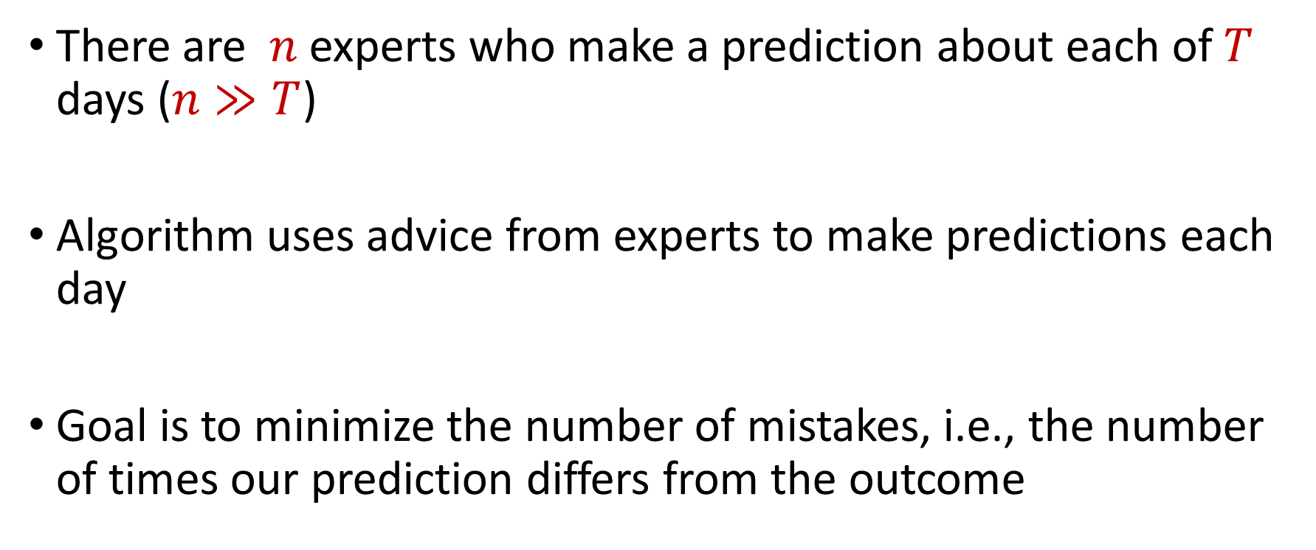
Online Learning
There are $n$ experts who make a prediction about each of $T$ days ($n≫T$)
Algorithm uses advice from experts to make predictions each day
Goal is to minimize the number of mistakes, i.e., the number of times our prediction differs from the outcome

Slide 3






Prediction with Expert Advice
a fundamental problem of sequential prediction
Day
You
Actual outcome
1
?
2
?
3
?
4
?

Slide 4
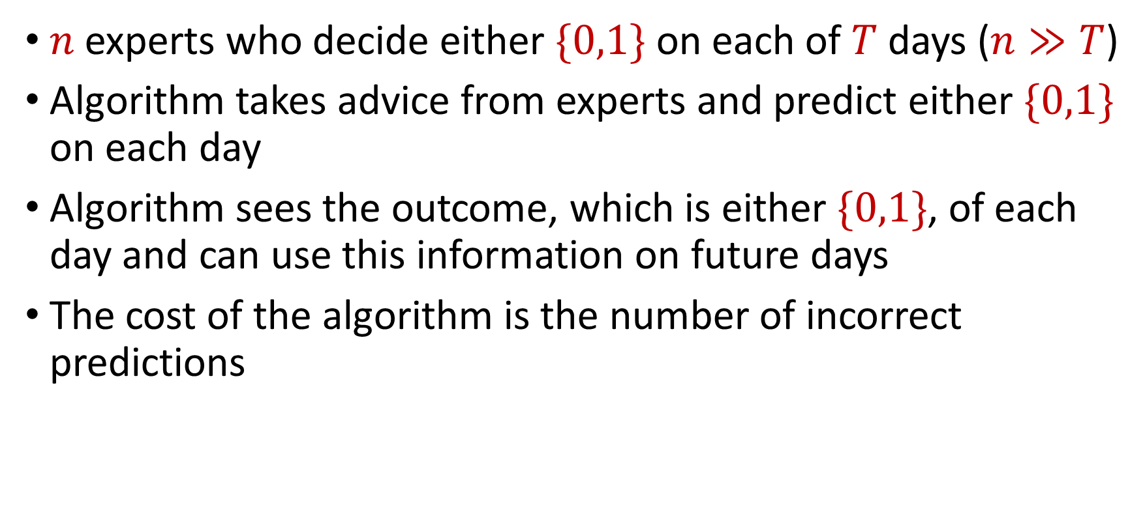
The Online Learning with Experts Problem
$n$ experts who decide either $\{0,1\}$ on each of $T$ days ($n≫T$)
Algorithm takes advice from experts and predict either $\{0,1\}$ on each day
Algorithm sees the outcome, which is either $\{0,1\}$, of each day and can use this information on future days
The cost of the algorithm is the number of incorrect predictions

Slide 5
Prediction with Expert Advice
a fundamental problem of sequential prediction
Day
You
Actual outcome
1
2
Algorithm makes 2 mistakes
3
Best expert makes 1 mistake
4

Slide 6
Applications of the Experts Problem
Ensemble learning, e.g., AdaBoost
Forecast and portfolio optimization
Special case of online convex optimization

Slide 7
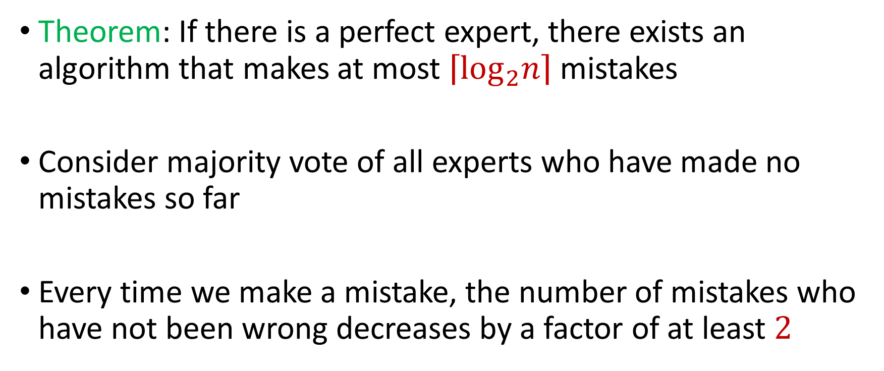
Perfect Expert
Theorem: If there is a perfect expert, there exists an algorithm that makes at most $\left\lceil \log_{2}n\right\rceil$ mistakes
Consider majority vote of all experts who have made no mistakes so far
Every time we make a mistake, the number of mistakes who have not been wrong decreases by a factor of at least $2$

Slide 8
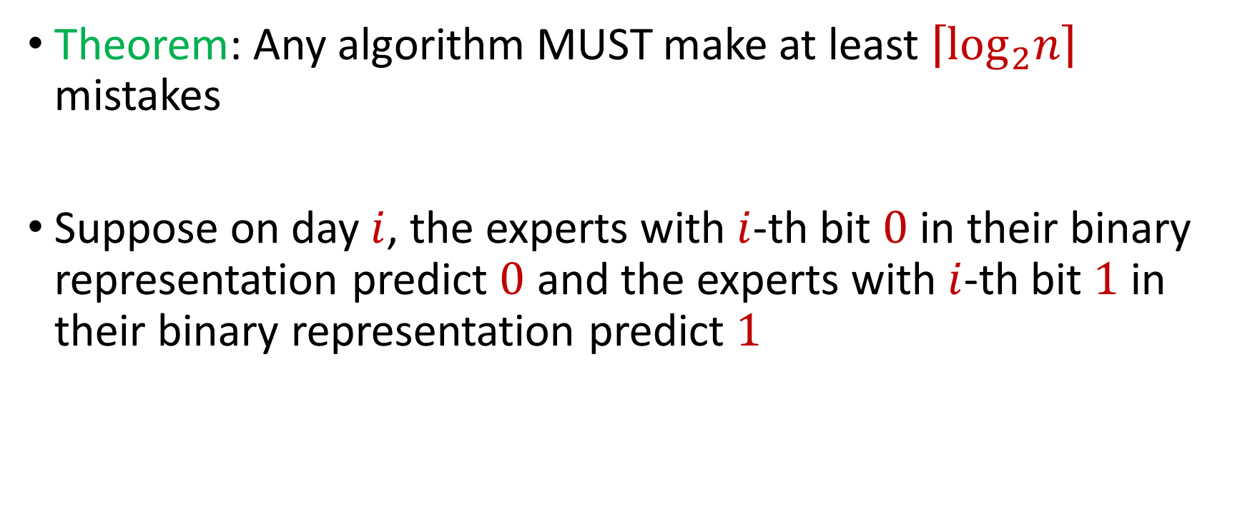
Errors by Algorithm
Theorem: Any algorithm MUST make at least $\left\lceil \log_{2}n\right\rceil$ mistakes
Suppose on day $i$, the experts with $i$-th bit $0$ in their binary representation predict $0$ and the experts with $i$-th bit $1$ in their binary representation predict $1$

Slide 9

Algorithms for Online Learning
Theorem: There exists an algorithm that makes $M≤m^{∗}\left(\left\lceil \log_{2}n\right\rceil +1\right)+\left\lceil \log_{2}n\right\rceil$ mistakes, where $m^{∗}$ is the number of mistakes made by the best expert

Slide 10
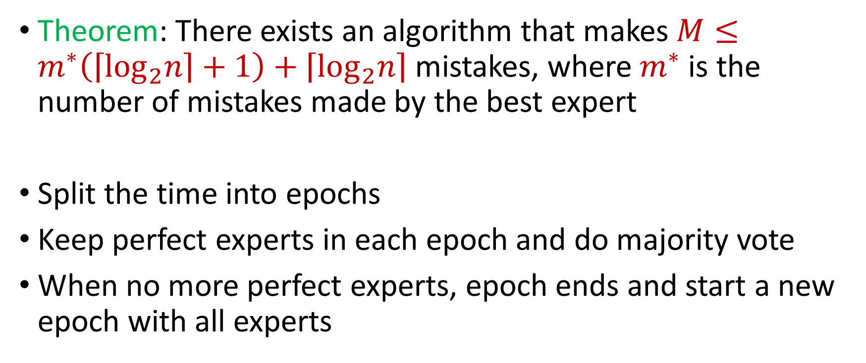
Algorithms for Online Learning
Theorem: There exists an algorithm that makes $M≤m^{∗}\left(\left\lceil \log_{2}n\right\rceil +1\right)+\left\lceil \log_{2}n\right\rceil$ mistakes, where $m^{∗}$ is the number of mistakes made by the best expert
Split the time into epochs
Keep perfect experts in each epoch and do majority vote
When no more perfect experts, epoch ends and start a new epoch with all experts

Slide 11
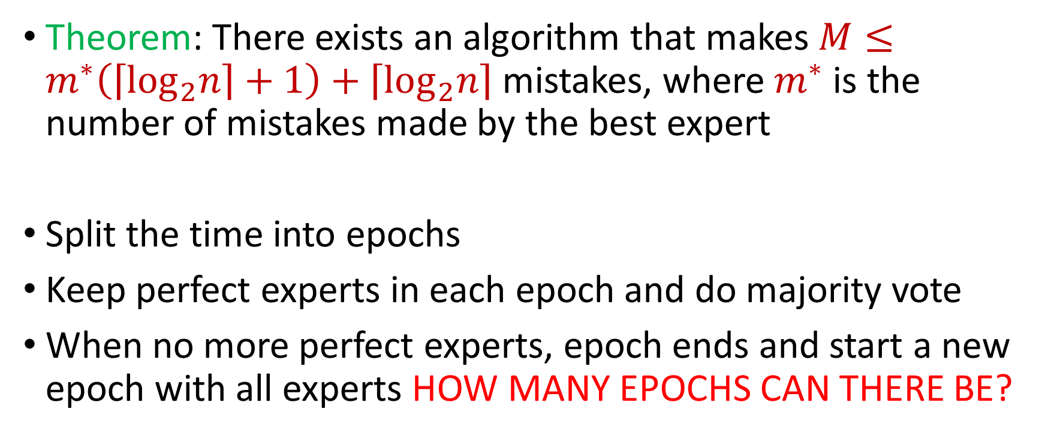
Algorithms for Online Learning
Theorem: There exists an algorithm that makes $M≤m^{∗}\left(\left\lceil \log_{2}n\right\rceil +1\right)+\left\lceil \log_{2}n\right\rceil$ mistakes, where $m^{∗}$ is the number of mistakes made by the best expert
Split the time into epochs
Keep perfect experts in each epoch and do majority vote
When no more perfect experts, epoch ends and start a new epoch with all experts HOW MANY EPOCHS CAN THERE BE?

Slide 12
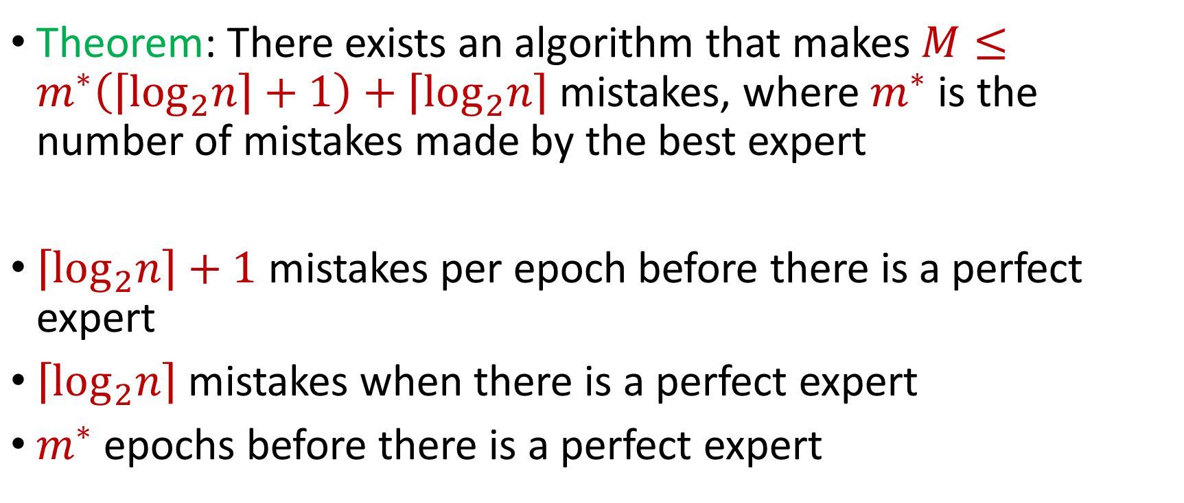
Algorithms for Online Learning
Theorem: There exists an algorithm that makes $M≤m^{∗}\left(\left\lceil \log_{2}n\right\rceil +1\right)+\left\lceil \log_{2}n\right\rceil$ mistakes, where $m^{∗}$ is the number of mistakes made by the best expert
$\left\lceil \log_{2}n\right\rceil +1$ mistakes per epoch before there is a perfect expert
$\left\lceil \log_{2}n\right\rceil$ mistakes when there is a perfect expert
$m^{∗}$ epochs before there is a perfect expert

Slide 13
Weighted Majority (Littlestone, Warmuth 89)
Day
Algorithm
Actual outcome
weights
1
1
1
1
1
1
1/2
1
1
2
1
1/2
1/2
1
3
1/2
1/2
1/4
1/2
4
1/2
1/4
1/4
1/4

Slide 14
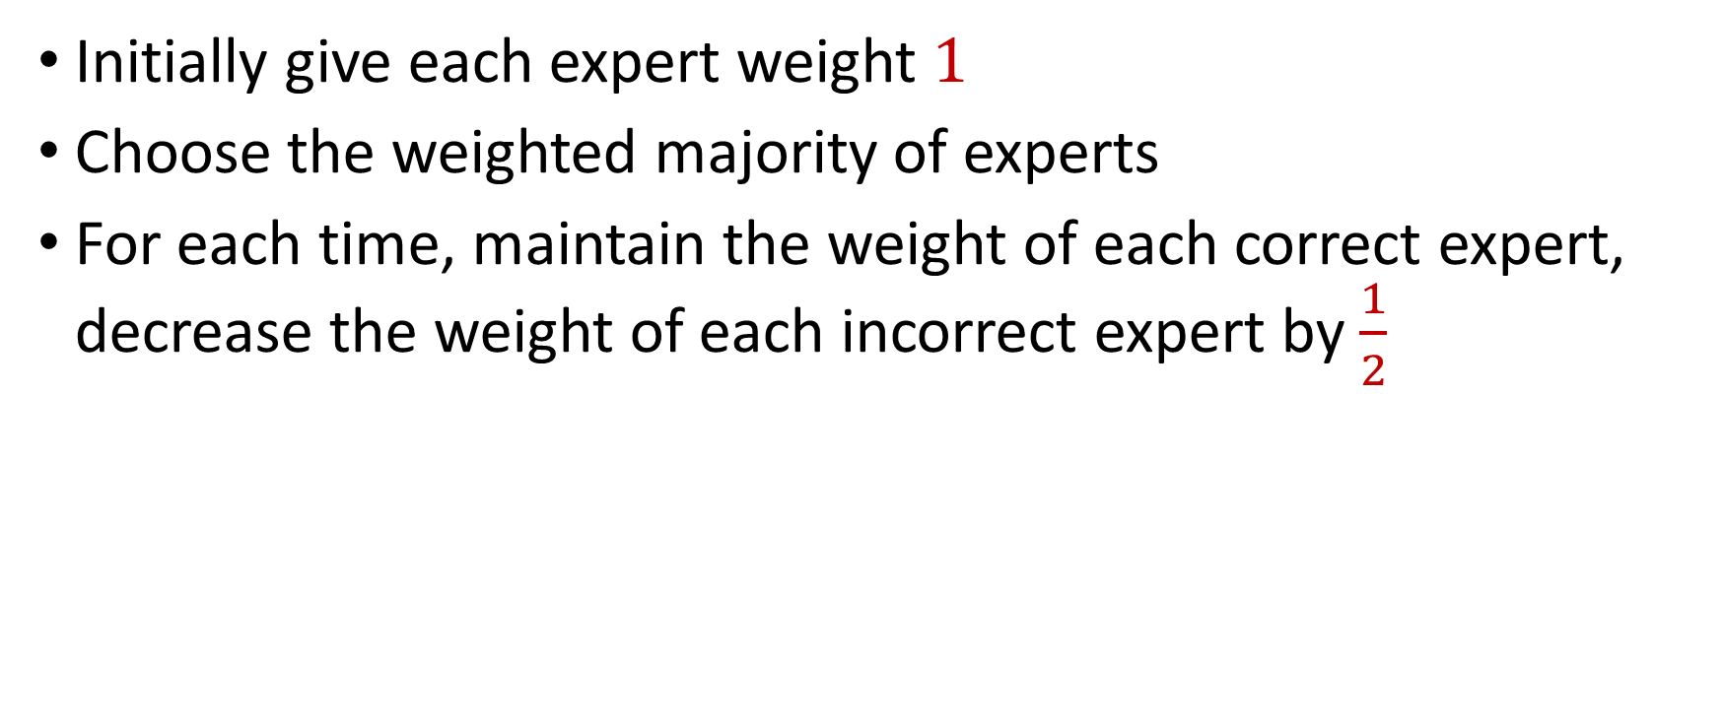
Weighted Majority (Littlestone, Warmuth 89)
Initially give each expert weight $1$
Choose the weighted majority of experts
For each time, maintain the weight of each correct expert, decrease the weight of each incorrect expert by $\frac{1}{2}$

Slide 15
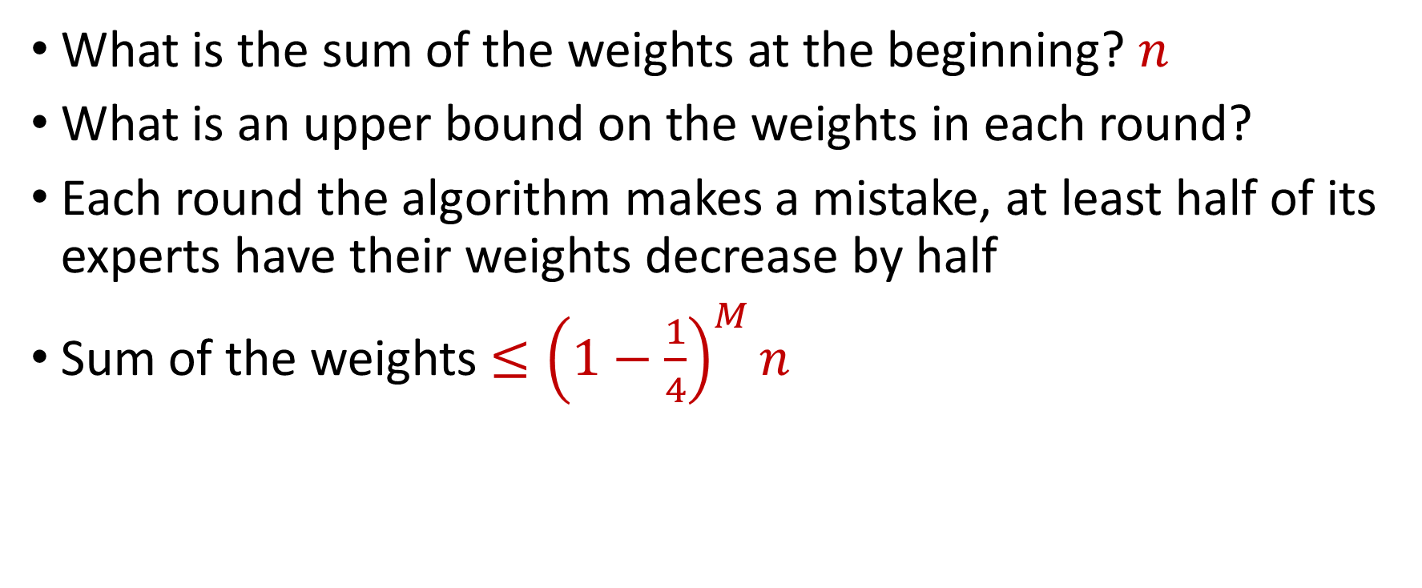
Guarantee for Weighted Majority
What is the sum of the weights at the beginning? $n$
What is an upper bound on the weights in each round?
Each round the algorithm makes a mistake, at least half of its experts have their weights decrease by half
Sum of the weights $≤{\left(1−\frac{1}{4}\right)}^{M}n$

Slide 16
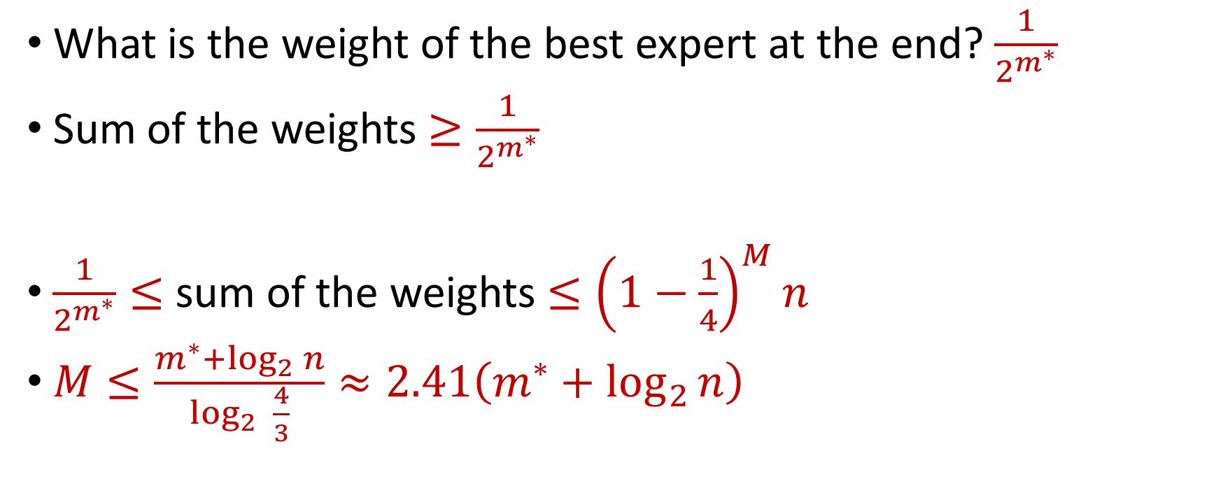
Guarantee for Weighted Majority
What is the weight of the best expert at the end? $\frac{1}{2^{m^{∗}}}$
Sum of the weights $≥\frac{1}{2^{m^{∗}}}$
$\frac{1}{2^{m^{∗}}}≤$ sum of the weights $≤{\left(1−\frac{1}{4}\right)}^{M}n$
$M≤\frac{m^{∗}+\log_{2}{n}}{\log_{2}{ \frac{4}{3}}}≈2.41\left(m^{∗}+\log_{2}{n}\right)$

Slide 17
Weighted Majority (Littlestone, Warmuth 89)
Day
Algorithm
Actual outcome
weights
1
1
1
1
1
1
1/2
1
1
2
1
1/2
1/2
1
3
1/2
1/2
1/4
1/2
4
1/2
1/4
1/4
1/4

Slide 18
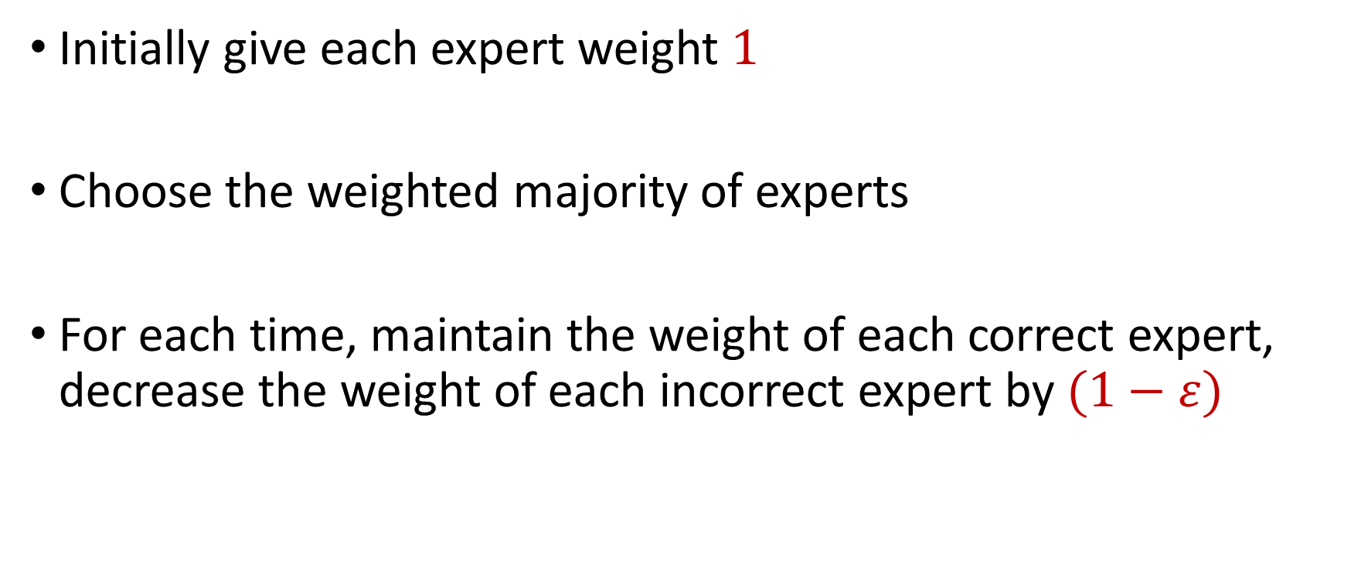
Weighted Majority (Littlestone, Warmuth 89)
Initially give each expert weight $1$
Choose the weighted majority of experts
For each time, maintain the weight of each correct expert, decrease the weight of each incorrect expert by $(1−ε)$

Slide 19











Weighted Majority (Littlestone, Warmuth 89)
Day
Algorithm
Actual outcome
weights
1
1
1
1
1
1
$$1−ε$$
1
1
2
1
$$1−ε$$
$$1−ε$$
1
3
$$1−ε$$
$$1−ε$$
$${\left(1−ε\right)}^{2}$$
$$1−ε$$
4
$$1−ε$$
$${\left(1−ε\right)}^{2}$$
$${\left(1−ε\right)}^{2}$$
$${\left(1−ε\right)}^{2}$$

Slide 20
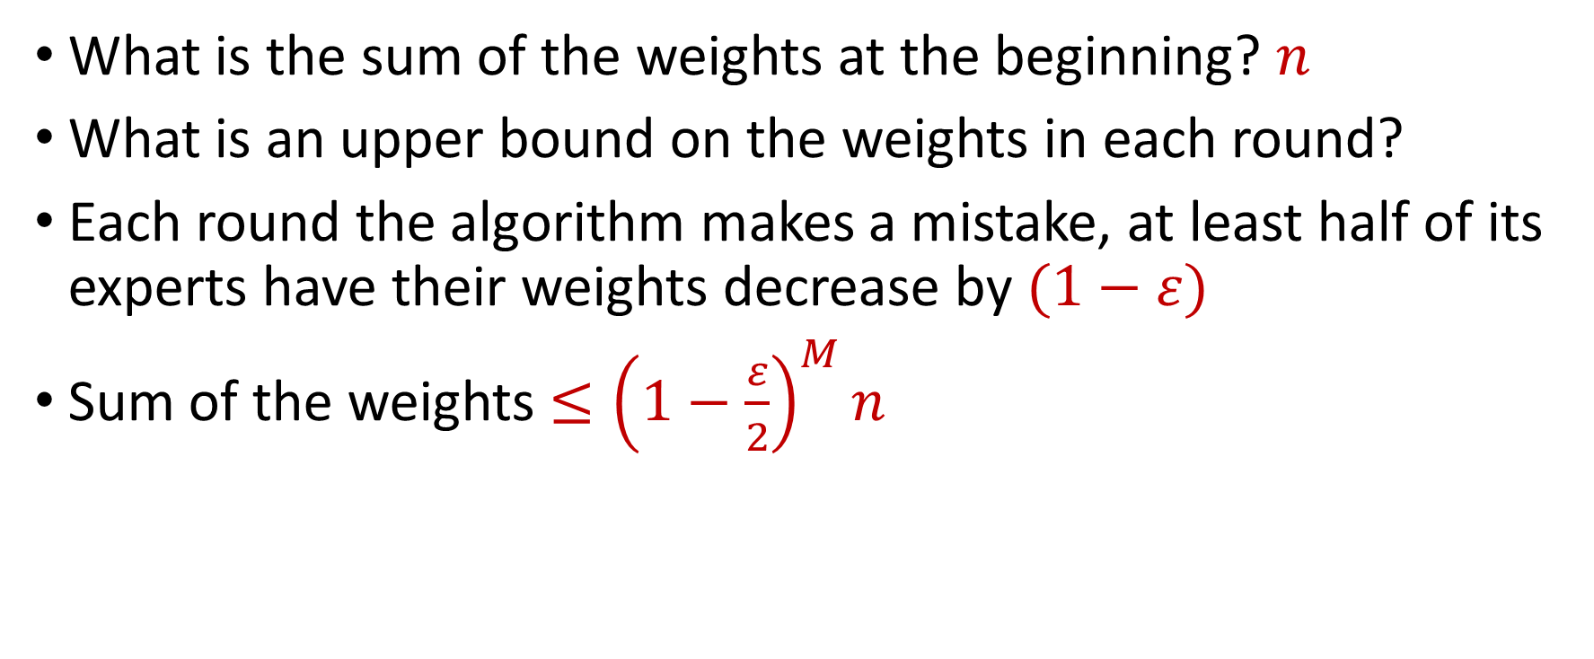
Guarantee for Weighted Majority
What is the sum of the weights at the beginning? $n$
What is an upper bound on the weights in each round?
Each round the algorithm makes a mistake, at least half of its experts have their weights decrease by $(1−ε)$
Sum of the weights $≤{\left(1−\frac{ε}{2}\right)}^{M}n$

Slide 21
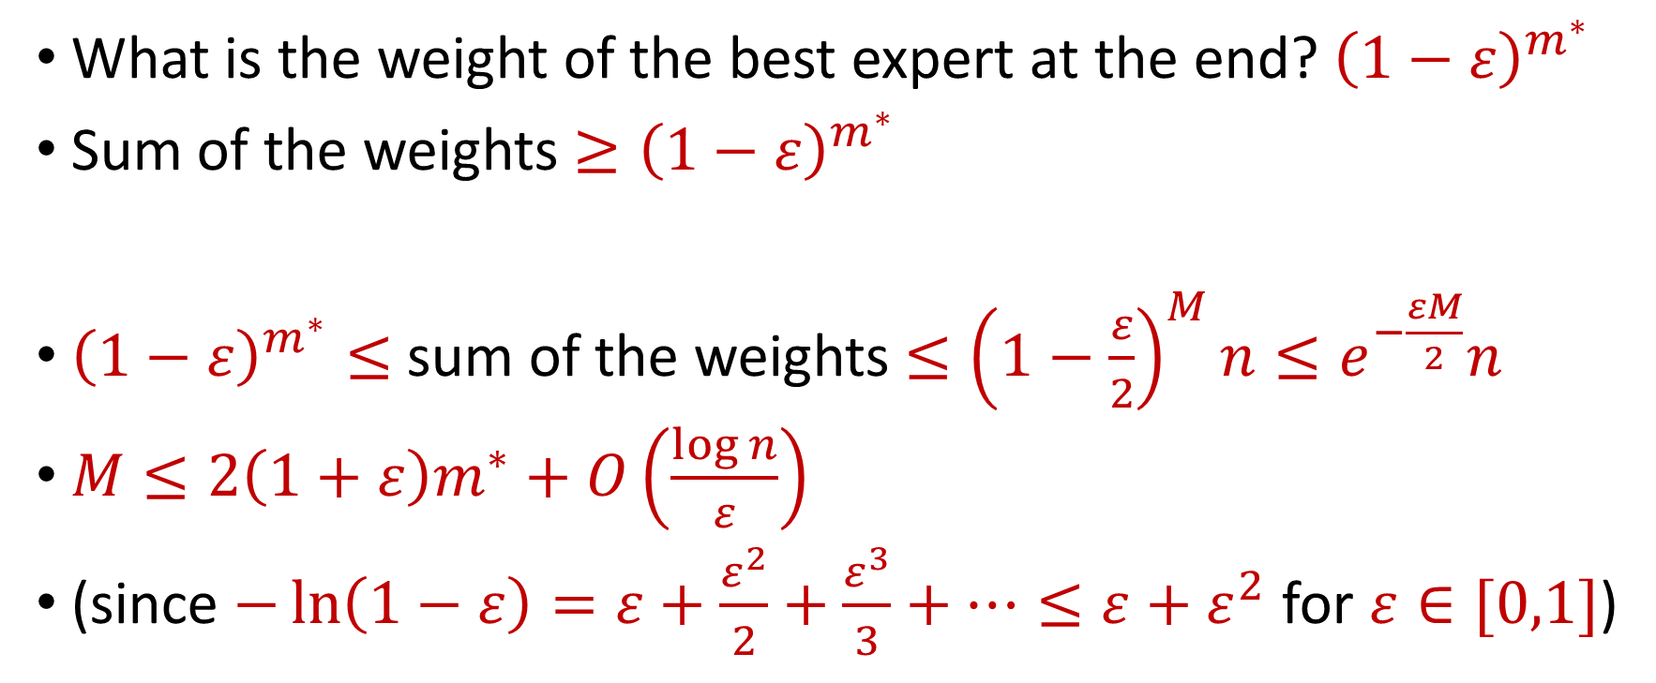
Guarantee for Weighted Majority
What is the weight of the best expert at the end? ${\left(1−ε\right)}^{m^{∗}}$
Sum of the weights $≥{\left(1−ε\right)}^{m^{∗}}$
${\left(1−ε\right)}^{m^{∗}}≤$ sum of the weights $≤{\left(1−\frac{ε}{2}\right)}^{M}n≤e^{−\frac{εM}{2}}n$
$M≤2\left(1+ε\right)m^{∗}+O\left(\frac{\log{n}}{ε}\right)$
(since $−\ln\left(1−ε\right)=ε+\frac{ε^{2}}{2}+\frac{ε^{3}}{3}+…≤ε+ε^{2}$ for $ε∈[0,1]$)

Slide 22
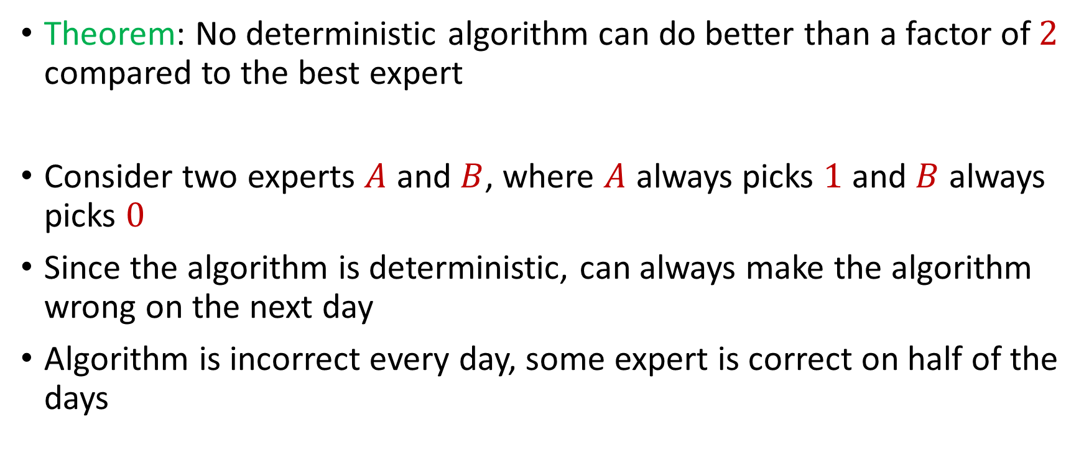
Deterministic Algorithm Error
Theorem: No deterministic algorithm can do better than a factor of $2$ compared to the best expert
Consider two experts $A$ and $B$, where $A$ always picks $1$ and $B$ always picks $0$
Since the algorithm is deterministic, can always make the algorithm wrong on the next day
Algorithm is incorrect every day, some expert is correct on half of the days

Slide 23
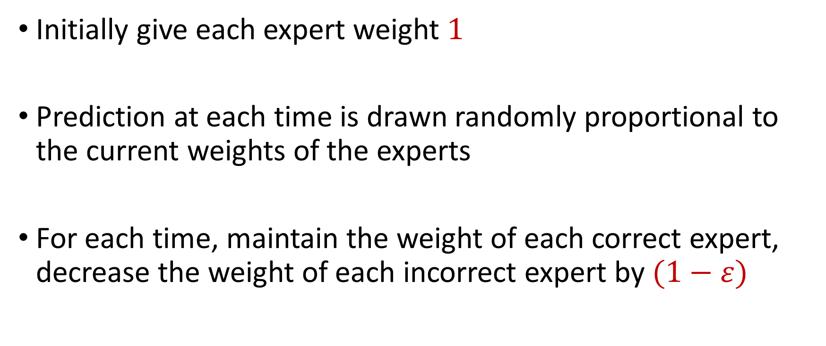
Randomized Weighted Majority (Littlestone, Warmuth 89)
Initially give each expert weight $1$
Prediction at each time is drawn randomly proportional to the current weights of the experts
For each time, maintain the weight of each correct expert, decrease the weight of each incorrect expert by $(1−ε)$

Slide 24
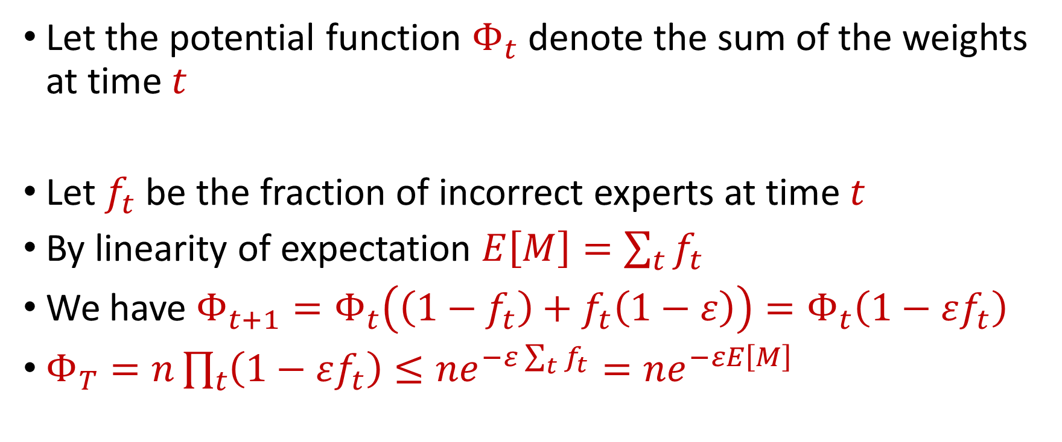
Randomized Weighted Majority (Littlestone, Warmuth 89)
Let the potential function $Φ_{t}$ denote the sum of the weights at time $t$
Let $f_{t}$ be the fraction of incorrect experts at time $t$
By linearity of expectation $E\left[M\right]=\sum_{t}{f_{t}}$
We have $Φ_{t+1}=Φ_{t}\left(\left(1−f_{t}\right)+f_{t}\left(1−ε\right)\right)=Φ_{t}\left(1−εf_{t}\right)$
$Φ_{T}=n\prod_{t}{\left(1−εf_{t}\right)}≤ne^{−ε\sum_{t}{f_{t}}}=ne^{−εE\left[M\right]}$

Slide 25

Randomized Weighted Majority (Littlestone, Warmuth 89)
We have $Φ_{T}≤ne^{−εE\left[M\right]}$
We also have ${\left(1−ε\right)}^{m^{∗}}≤Φ_{T}$
Then $E\left[M\right]≤m^{∗}\left(1+ε\right)+\frac{\ln{n}}{ε}$ by using $−\ln\left(1−ε\right)≤ε+ε^{2}$

Slide 26
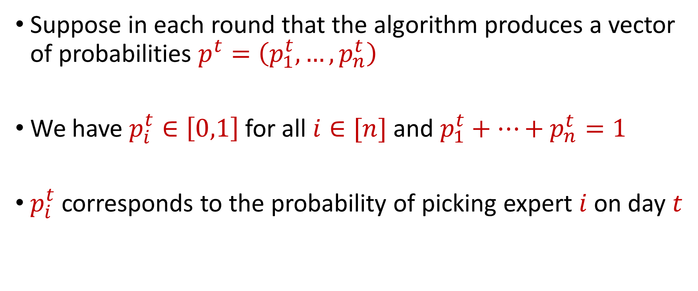
An Alternate Perspective
Suppose in each round that the algorithm produces a vector of probabilities $p^{t}=\left(p_{1}^{t},…,p_{n}^{t}\right)$
We have $p_{i}^{t}∈\left[0,1\right]$ for all $i∈[n]$ and $p_{1}^{t}+…+p_{n}^{t}=1$
$p_{i}^{t}$corresponds to the probability of picking expert $i$ on day $t$

Slide 27
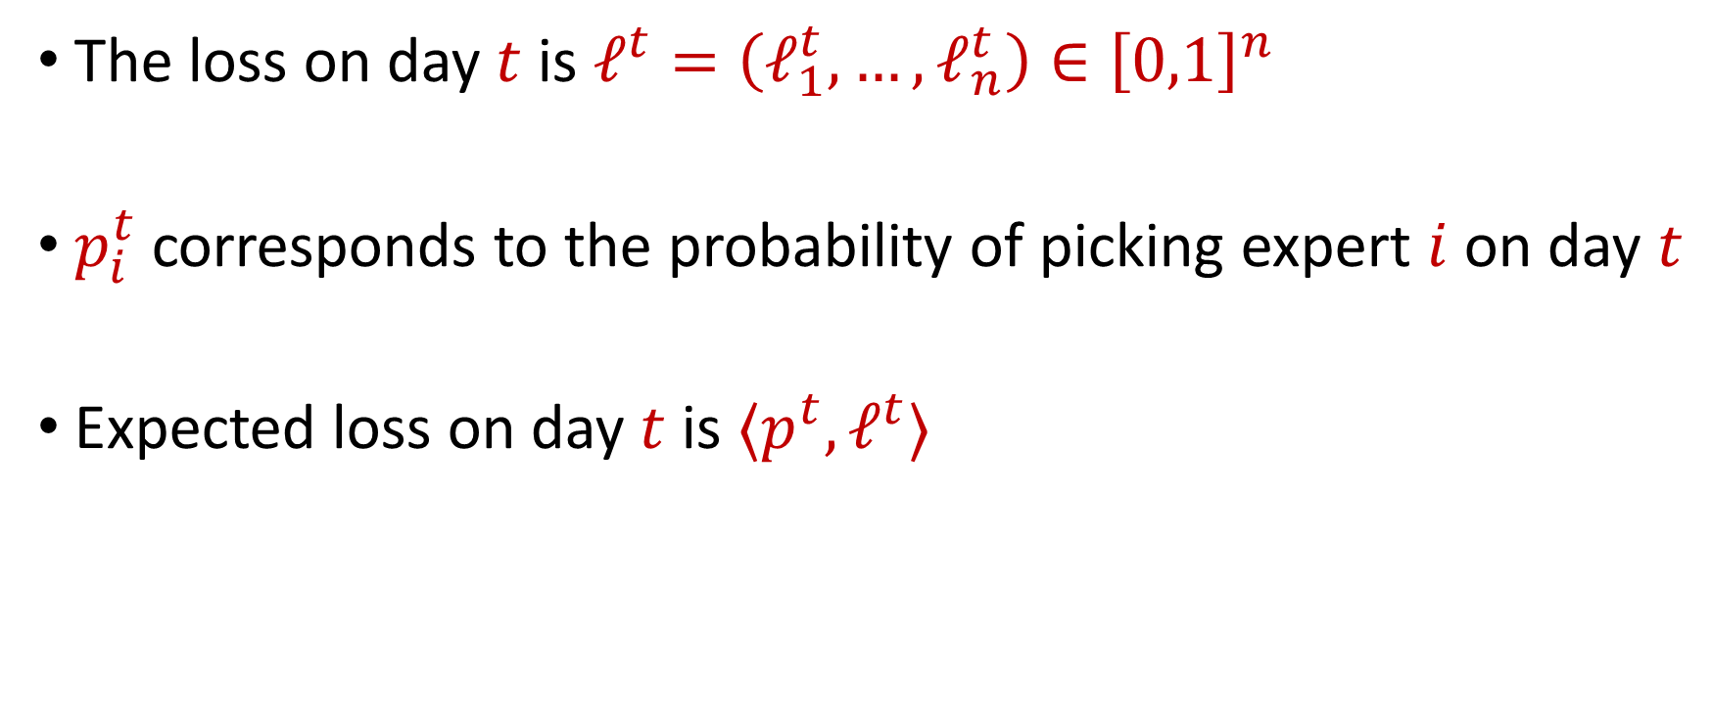
An Alternate Perspective
The loss on day $t$ is $ℓ^{t}=\left(ℓ_{1}^{t},…,ℓ_{n}^{t}\right)∈{\left[0,1\right]}^{n}$
$p_{i}^{t}$corresponds to the probability of picking expert $i$ on day $t$
Expected loss on day $t$ is $⟨p^{t}, ℓ^{t}⟩$

Slide 28
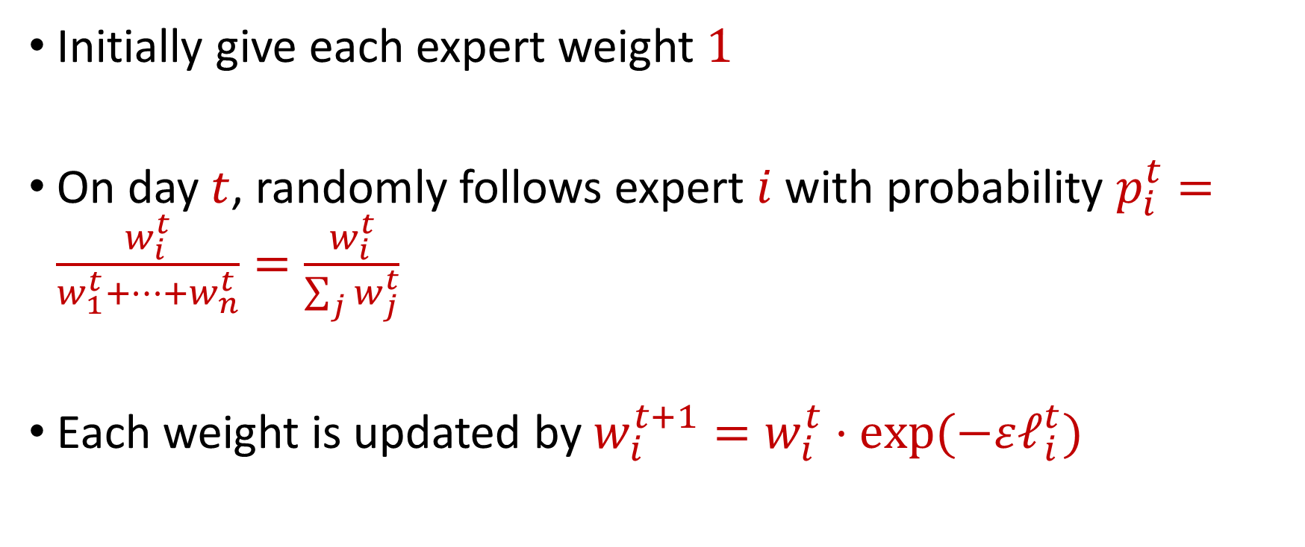
Hedge Algorithm
Initially give each expert weight $1$
On day $t$, randomly follows expert $i$ with probability $p_{i}^{t}=\frac{w_{i}^{t}}{w_{1}^{t}+…+w_{n}^{t}}=\frac{w_{i}^{t}}{\sum_{j}{w_{j}^{t}}}$
Each weight is updated by $w_{i}^{t+1}=w_{i}^{t}⋅exp⁡(−εℓ_{i}^{t})$

Slide 29
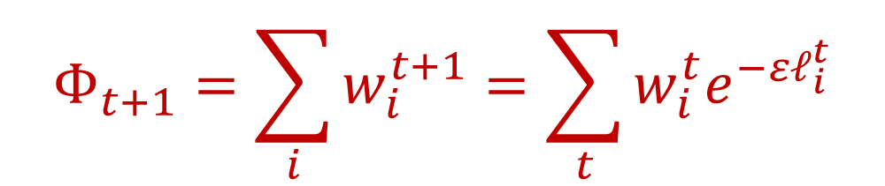


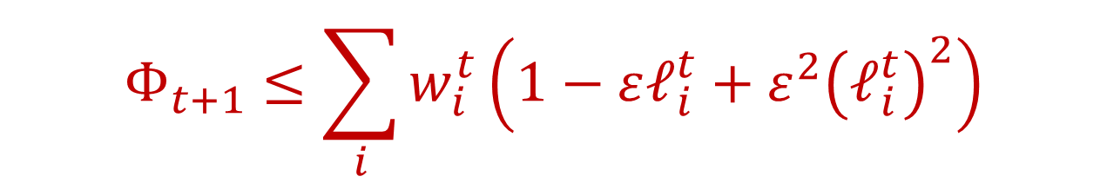
Hedge Algorithm
Let the potential function $Φ_{t}$ denote the sum of the weights at time $t$
We have:
Since $e^{x}≤1+x+x^{2}$ for $x∈[0,1]$ and also $\left|ℓ_{i}^{t}\right|≤1$, we have
$$Φ_{t+1}=\sum_{i}{w_{i}^{t+1}=\sum_{t}{w_{i}^{t}e^{−εℓ_{i}^{t}}}}$$
$$Φ_{t+1}≤\sum_{i}{w_{i}^{t}\left(1−εℓ_{i}^{t}+ε^{2}{\left(ℓ_{i}^{t}\right)}^{2}\right)}$$
$$≤\sum_{i}{w_{i}^{t}\left(1+ε^{2}\right)−ε\sum_{i}{w_{i}^{t}ℓ_{i}^{t}}}$$

Slide 30


Hedge Algorithm
$$Φ_{t+1}≤\sum_{i}{w_{i}^{t}\left(1+ε^{2}\right)−ε\sum_{i}{w_{i}^{t}ℓ_{i}^{t}}}$$
We have
Since $w_{i}^{t}=p_{i}^{t}⋅Φ^{t}$, then
since $1+x≤e^{x}$
$$Φ_{t+1}≤\left(1+ε^{2}\right)Φ^{t}−εΦ^{t}\left\langle p^{t},ℓ^{t}\right\rangle$$
$$=Φ^{t}\left(1+ε^{2}−ε\left\langle p^{t},ℓ^{t}\right\rangle \right)$$
$$≤Φ^{t}\exp\left(ε^{2}−ε\left\langle p^{t},ℓ^{t}\right\rangle \right)$$

Slide 31
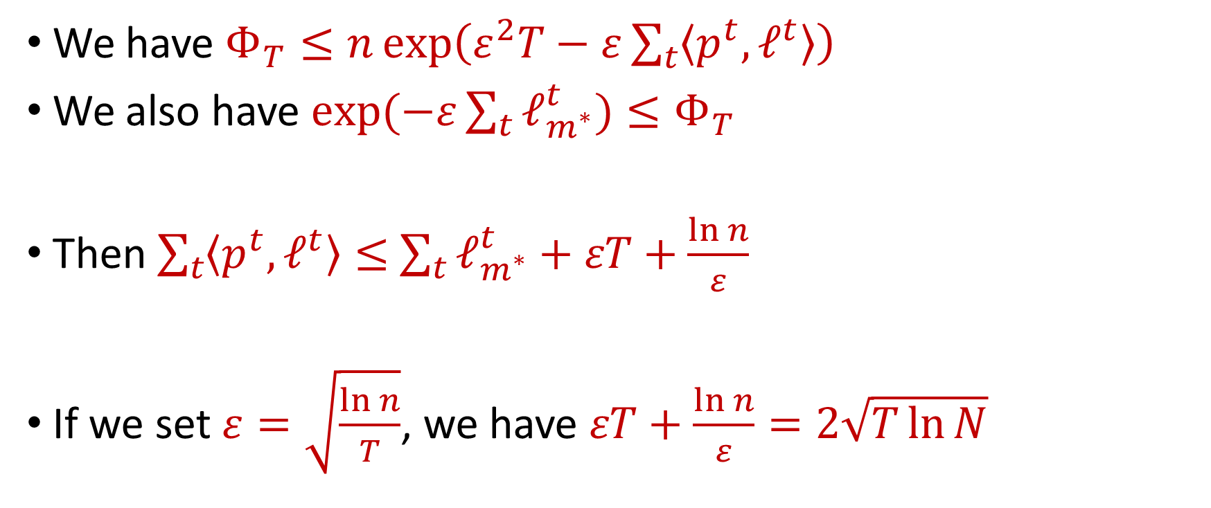
Hedge Algorithm
We have $Φ_{T}≤n\exp\left(ε^{2}T−ε\sum_{t}{\left\langle p^{t},ℓ^{t}\right\rangle }\right)$
We also have $\exp{(−ε\sum_{t}{ℓ_{m^{∗}}^{t})}}≤Φ_{T}$
Then $\sum_{t}{\left\langle p^{t},ℓ^{t}\right\rangle }≤$ $\sum_{t}{ℓ_{m^{∗}}^{t}}+εT+\frac{\ln{n}}{ε}$
If we set $ε=\sqrt{\frac{\ln{n}}{T}}$, we have $εT+\frac{\ln{n}}{ε}=2\sqrt{T\ln{N}}$

Slide 32
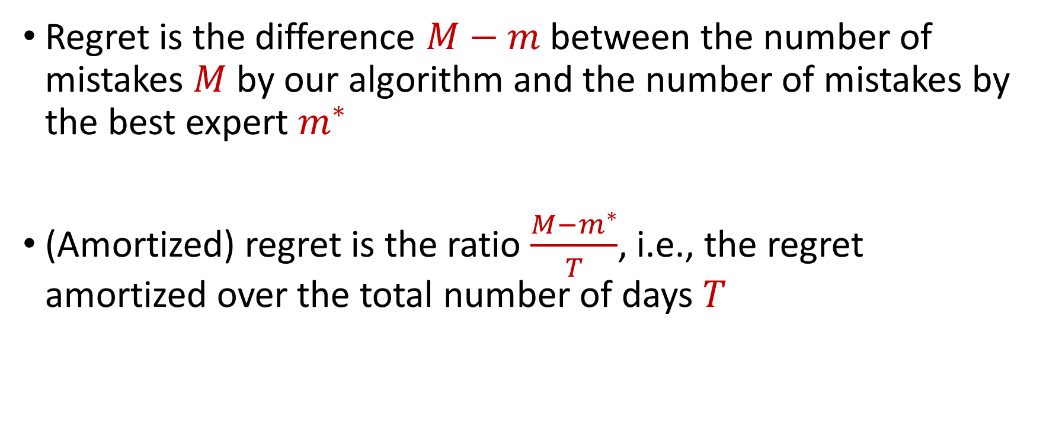
Regret
Regret is the difference $M−m$between the number of mistakes $M$by our algorithm and the number of mistakes by the best expert $m^{∗}$
(Amortized) regret is the ratio $\frac{{M−m}^{∗}}{T}$, i.e., the regret amortized over the total number of days $T$

Slide 33
Prediction with Expert Advice
a fundamental problem of sequential prediction
Day
You
Actual outcome
1
2
Algorithm makes 2 mistakes
3
Best expert makes 1 mistake
4

Slide 34
Prediction with Expert Advice
a fundamental problem of sequential prediction
Day
You
Actual outcome
1
1 Regret
2
Algorithm makes 2 mistakes
3
Best expert makes 1 mistake
4

Slide 35
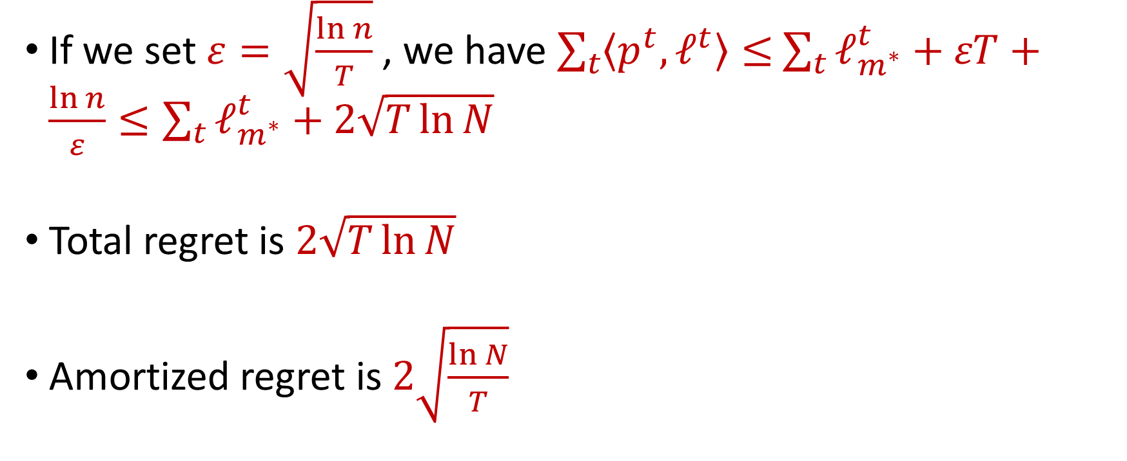
Hedge Algorithm
If we set $ε=\sqrt{\frac{\ln{n}}{T}}$, we have $\sum_{t}{\left\langle p^{t},ℓ^{t}\right\rangle }≤$ $\sum_{t}{ℓ_{m^{∗}}^{t}}+εT+\frac{\ln{n}}{ε}≤\sum_{t}{ℓ_{m^{∗}}^{t}}+2\sqrt{T\ln{N}}$
Total regret is $2\sqrt{T\ln{N}}$
Amortized regret is $2\sqrt{\frac{\ln{N}}{T}}$

