Slide 1
CSCE 658: Randomized Algorithms
Lecture 4
Samson Zhou

Slide 2

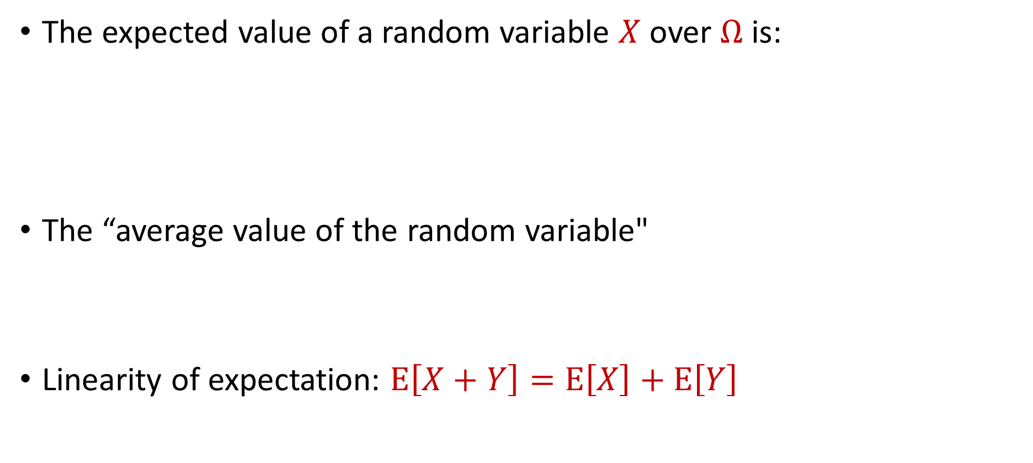
Last Time: Expected Value
The expected value of a random variable $X$ over $Ω$ is:
The “average value of the random variable"
Linearity of expectation: $E\left[X+Y\right]=E\left[X\right]+E\left[Y\right]$
$$E\left[X\right]=\sum_{x∈Ω}{Pr\left[X=x\right]⋅x}$$

Slide 3

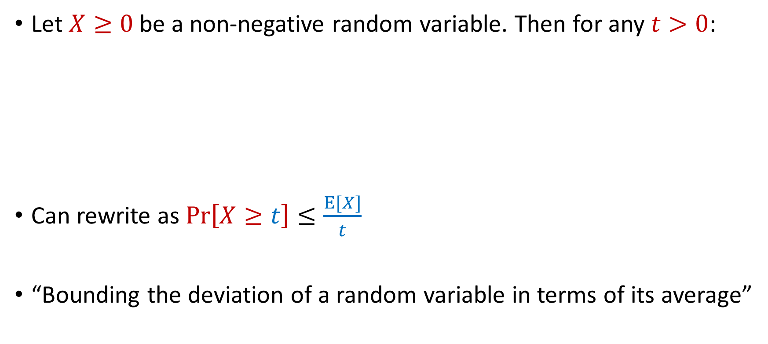
Last Time: Markov’s Inequality
Let $X≥0$be a non-negative random variable. Then for any $t>0$:
Can rewrite as $Pr\left[X≥t\right]≤\frac{E[X]}{t}$
“Bounding the deviation of a random variable in terms of its average”
$$Pr\left[X≥t⋅E[X]\right]≤\frac{1}{t}$$

Slide 4
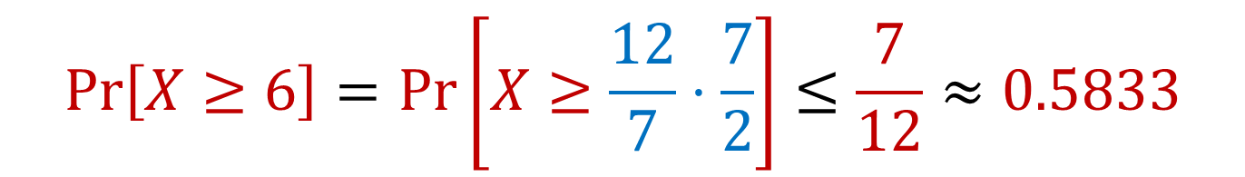

Limitations of Markov’s Inequality
Let $X$be the outcome of a roll of a die. Then $E\left[X\right]=3.5=\frac{7}{2}$
We know $Pr\left[X≥6\right]=\frac{1}{6}≈0.167$
$$Pr\left[X≥6\right]=Pr\left[X≥\frac{12}{7}⋅\frac{7}{2}\right]≤\frac{7}{12}≈0.5833$$

Slide 5


Moments
For $p>0$, the $p$-th moment of a random variable $X$ over $Ω$ is:
$$E\left[X^{p}\right]=\sum_{x∈Ω}{Pr\left[X=x\right]⋅x^{p}}$$

Slide 6
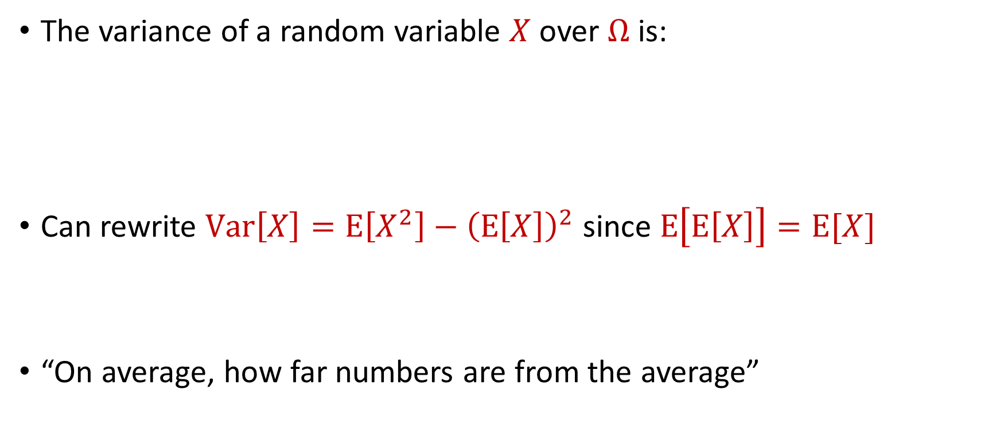
Variance
The variance of a random variable $X$ over $Ω$ is:
Can rewrite $Var\left[X\right]=E\left[X^{2}\right]−{\left(E\left[X\right]\right)}^{2}$ since $E\left[E\left[X\right]\right]=E[X]$
“On average, how far numbers are from the average”
$$Var\left[X\right]=E\left[{\left(X−E\left[X\right]\right)}^{2}\right]$$

Slide 7

Variance
Can rewrite $Var\left[X\right]=E\left[{\left(X−E\left[X\right]\right)}^{2}\right]$ since $E\left[E\left[X\right]\right]=E[X]$
$$E\left[{\left(X−E\left[X\right]\right)}^{2}\right]=E\left[X^{2}−2X⋅E\left[X\right]+{\left(E[X]\right)}^{2}\right]$$
$$=E\left[X^{2}\right]−2E\left[X\right]⋅E\left[E\left[X\right]\right]+{\left(E\left[X\right]\right)}^{2}$$
$$=E\left[X^{2}\right]−2E\left[X\right]⋅E\left[X\right]+{\left(E\left[X\right]\right)}^{2}$$
$$=E\left[X^{2}\right]−2{\left(E\left[X\right]\right)}^{2}+{\left(E\left[X\right]\right)}^{2}$$
$$=E\left[X^{2}\right]−{\left(E\left[X\right]\right)}^{2}=Var\left[X\right]$$

Slide 8

Variance
The variance of a random variable $X$ over $Ω$ is:
Linearity of variance for independent random variables: $Var\left[X+Y\right]=Var\left[X\right]+Var\left[Y\right]$
$$Var\left[X\right]=E\left[X^{2}\right]−{\left(E\left[X\right]\right)}^{2}$$

Slide 9
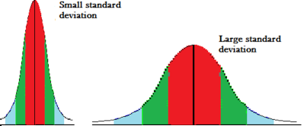
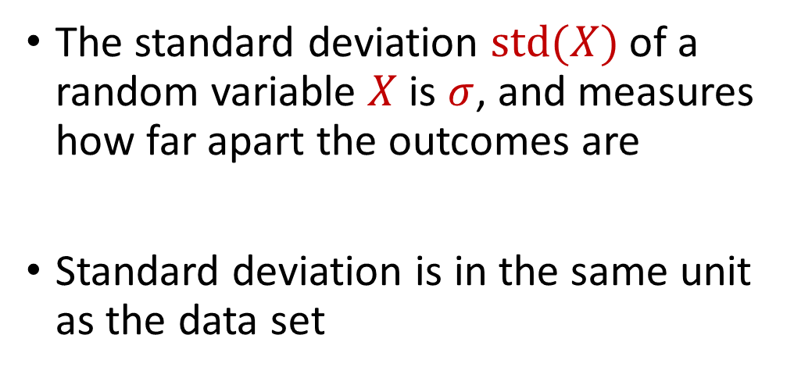
Variance and Standard Deviation
The variance of a random variable $X$ over $Ω$ is:
$$σ^{2}=Var\left[X\right]=E\left[X^{2}\right]−{\left(E\left[X\right]\right)}^{2}$$
The standard deviation $std(X)$ of a random variable $X$ is $σ$, and measures how far apart the outcomes are
Standard deviation is in the same unit as the data set

Slide 10
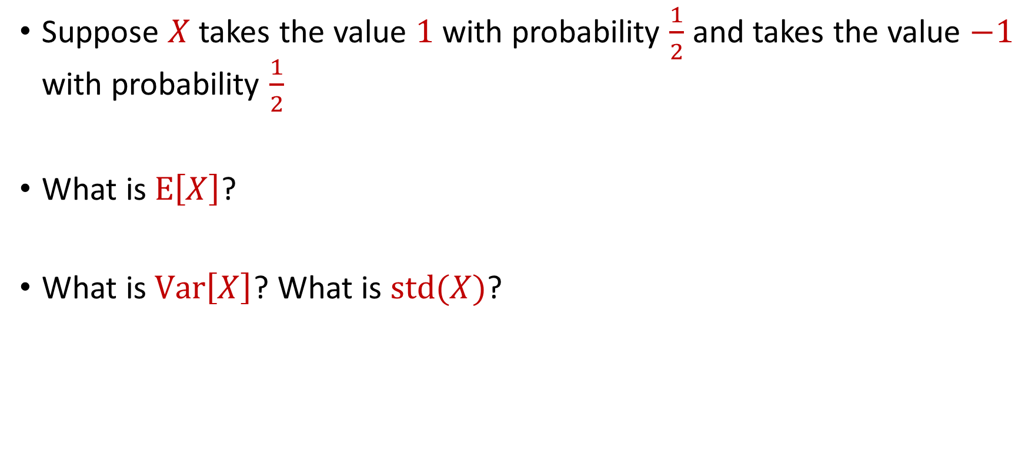
Variance
Suppose $X$ takes the value $1$ with probability $\frac{1}{2}$ and takes the value $−1$ with probability $\frac{1}{2}$
What is $E\left[X\right]$?
What is $Var\left[X\right]$? What is $std(X)$?

Slide 11
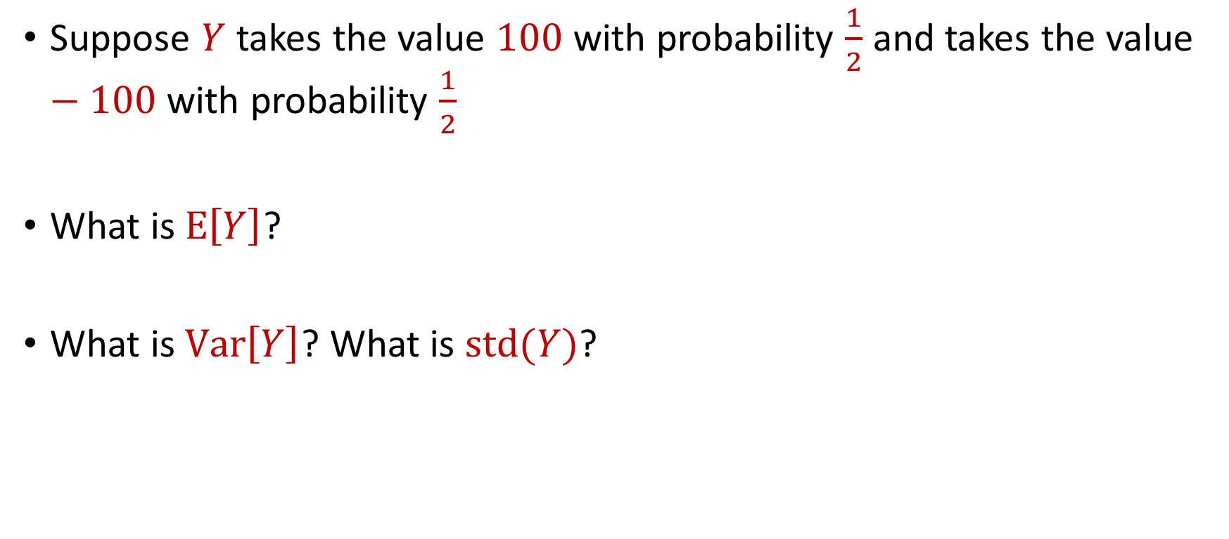
Variance
Suppose $Y$ takes the value $100$ with probability $\frac{1}{2}$ and takes the value $−100$ with probability $\frac{1}{2}$
What is $E\left[Y\right]$?
What is $Var\left[Y\right]$? What is $std(Y)$?

Slide 12

Markov’s Inequality
Let $X≥0$be a non-negative random variable. Then for any $t>0$:
Can rewrite as $Pr\left[X≥t\right]≤\frac{E[X]}{t}$
$$Pr\left[X≥t⋅E[X]\right]≤\frac{1}{t}$$

Slide 13

Markov’s Inequality
Let $X≥0$be a non-negative random variable. Then for any $t>0$:
Can rewrite as $Pr\left[X≥t\right]≤\frac{E[X]}{t}$
We have $Pr\left[\left|X\right|≥t\right]=Pr\left[X^{2}≥t^{2}\right]$
$$Pr\left[X≥t⋅E[X]\right]≤\frac{1}{t}$$

Slide 14



Using Markov’s Inequality
We have $Pr\left[\left|X\right|≥t\right]=Pr\left[X^{2}≥t^{2}\right]$
Plug in $X−E[X]$ for $X$
$$Pr\left[\left|X\right|≥t\right]=Pr\left[X^{2}≥t^{2}\right]≤\frac{E[X^{2}]}{t^{2}}$$
$$Pr\left[\left|X−E[X]\right|≥t\right]≤\frac{E[{(X−E\left[X\right])}^{2}]}{t^{2}}$$

Slide 15

Toward Chebyshev’s Inequality
$$Pr\left[\left|X−E[X]\right|≥t\right]≤\frac{E[{(X−E\left[X\right])}^{2}]}{t^{2}}$$

Slide 16

Chebyshev’s Inequality
Recall that $Var\left[X\right]=E\left[X^{2}\right]−{\left(E\left[X\right]\right)}^{2}=E\left[{\left(X−E\left[X\right]\right)}^{2}\right]$
$Pr\left[\left|X−E[X]\right|≥t\right]≤\frac{Var[X]}{t^{2}}$
$$Pr\left[\left|X−E[X]\right|≥t\right]≤\frac{E[{(X−E\left[X\right])}^{2}]}{t^{2}}$$

Slide 17

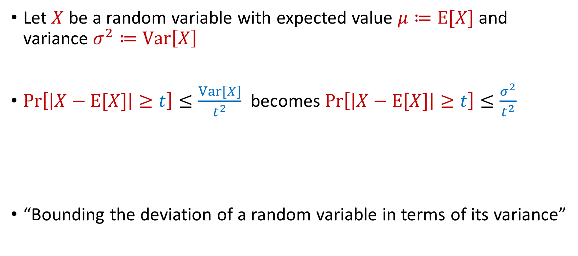
Chebyshev’s Inequality
Let $X$ be a random variable with expected value $μ≔E[X]$ and variance $σ^{2}≔Var\left[X\right]$
$Pr\left[\left|X−E[X]\right|≥t\right]≤\frac{Var[X]}{t^{2}}$ becomes $Pr\left[\left|X−E[X]\right|≥t\right]≤\frac{σ^{2}}{t^{2}}$
“Bounding the deviation of a random variable in terms of its variance”
$$Pr\left[\left|X−μ\right|≥kσ\right]≤\frac{1}{k^{2}}$$

Slide 18
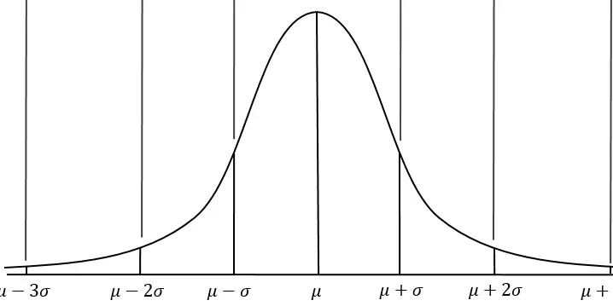


Chebyshev’s Inequality
Let $X$ be a random variable with expected value $μ≔E[X]$ and variance $σ^{2}≔Var\left[X\right]$
Do not require assumptions about $X$
$$Pr\left[\left|X−μ\right|≥kσ\right]≤\frac{1}{k^{2}}$$

Slide 19

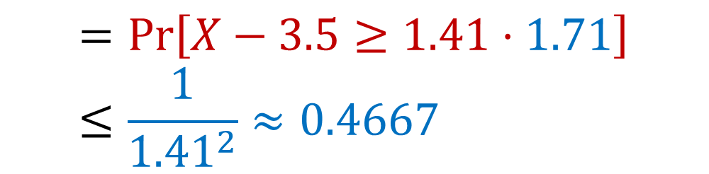
Chebyshev’s Inequality
Let $X$be the outcome of a roll of a die. Then $E\left[X\right]=3.5=\frac{7}{2}$ and $Var\left[X\right]=\frac{35}{12}≈2.92$ so $std(X)≈1.71$
Recall that Markov’s inequality bounded this $0.5833$
$$Pr\left[X≥6\right]=Pr\left[X−3.5≥2.5\right]$$
$$=Pr\left[X−3.5≥1.41⋅1.71\right]≤\frac{1}{{1.41}^{2}}≈0.4667$$

Slide 20
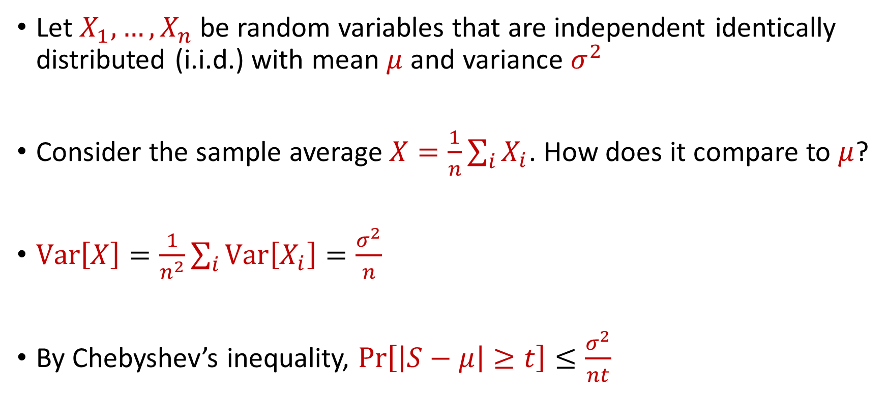
Law of Large Numbers
Let $X_{1},…,X_{n}$ be random variables that are independent identically distributed (i.i.d.) with mean $μ$ and variance $σ^{2}$
Consider the sample average $X=\frac{1}{n}\sum_{i}{X_{i}}$. How does it compare to $μ$?
$Var\left[X\right]=\frac{1}{n^{2}}\sum_{i}{Var\left[X_{i}\right]}=\frac{σ^{2}}{n}$
By Chebyshev’s inequality, $Pr\left[\left|S−μ\right|≥t\right]≤\frac{σ^{2}}{nt}$

Slide 21
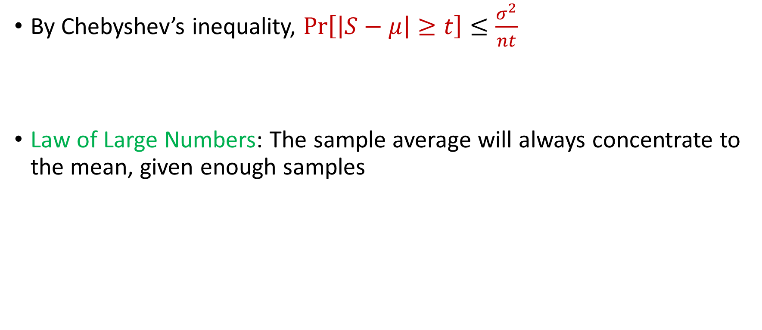
Law of Large Numbers
By Chebyshev’s inequality, $Pr\left[\left|S−μ\right|≥t\right]≤\frac{σ^{2}}{nt}$
Law of Large Numbers: The sample average will always concentrate to the mean, given enough samples

Slide 22
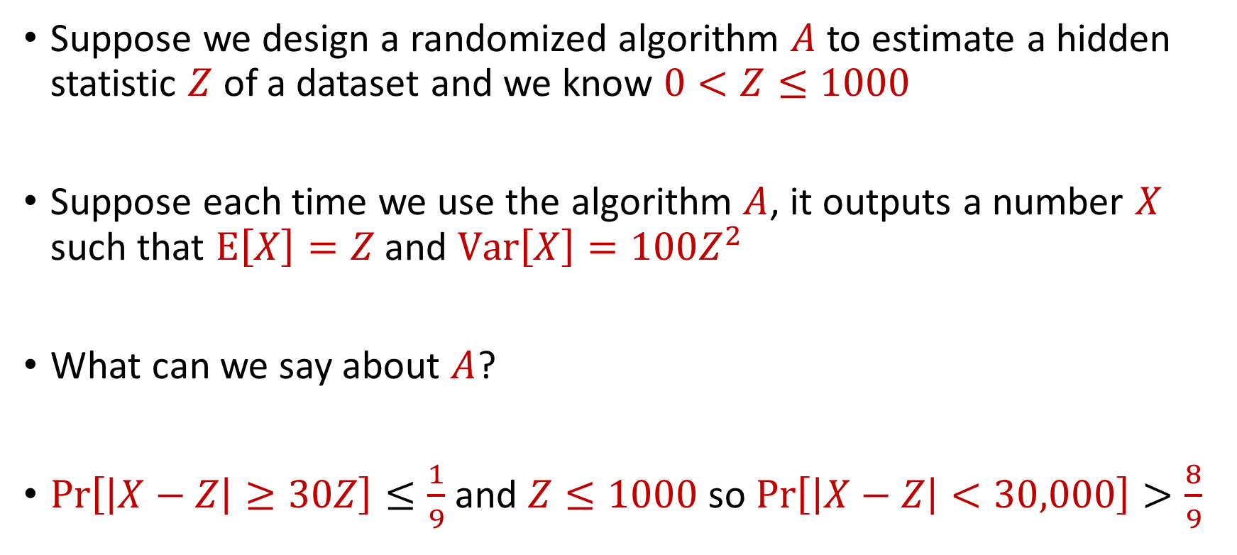
Use Case
Suppose we design a randomized algorithm $A$ to estimate a hidden statistic $Z$ of a dataset and we know $0<Z≤1000$
Suppose each time we use the algorithm $A$, it outputs a number $X$ such that $E\left[X\right]=Z$ and $Var\left[X\right]=100Z^{2}$
What can we say about $A$?
$Pr\left[\left|X−Z\right|≥30Z\right]≤\frac{1}{9}$ and $Z≤1000$ so $Pr\left[\left|X−Z\right|<30,000\right]>\frac{8}{9}$

Slide 23

Accuracy Boosting
How can we use $A$ to get additive error $ε$?

Slide 24
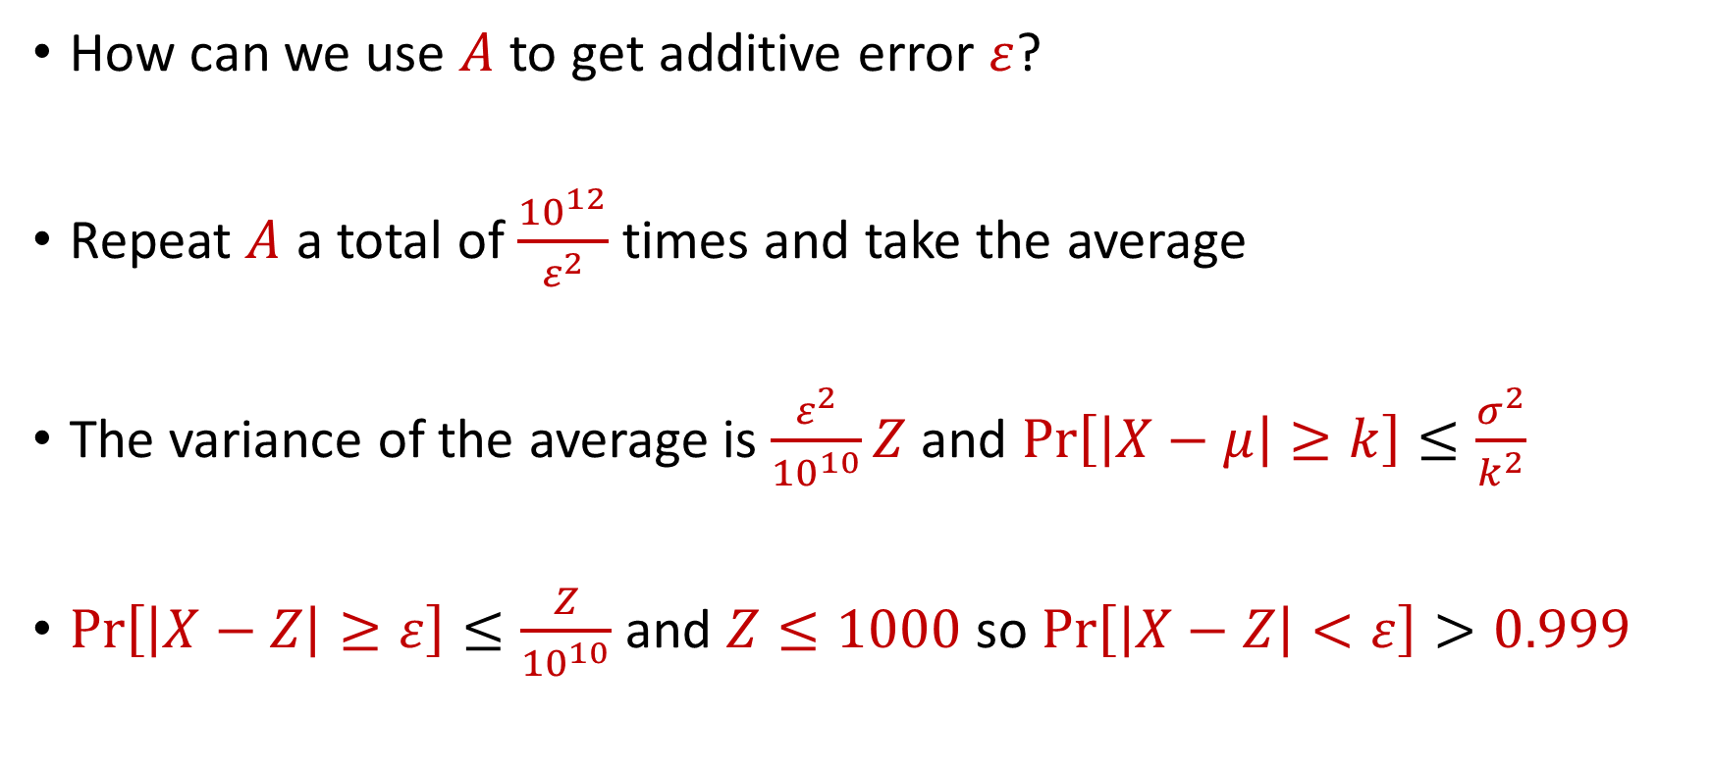
Accuracy Boosting
How can we use $A$ to get additive error $ε$?
Repeat $A$ a total of $\frac{{10}^{12}}{ε^{2}}$ times and take the average
The variance of the average is $\frac{ε^{2}}{{10}^{10}}Z$ and $Pr\left[\left|X−μ\right|≥k\right]≤\frac{σ^{2}}{k^{2}}$
$Pr\left[\left|X−Z\right|≥ε\right]≤\frac{Z}{{10}^{10}}$ and $Z≤1000$ so $Pr\left[\left|X−Z\right|<ε\right]>0.999$

Slide 25
Accuracy Boosting
Algorithmic consequence of Law of Large Numbers
To improve the accuracy of your algorithm, run it many times independently and take the average

Slide 26
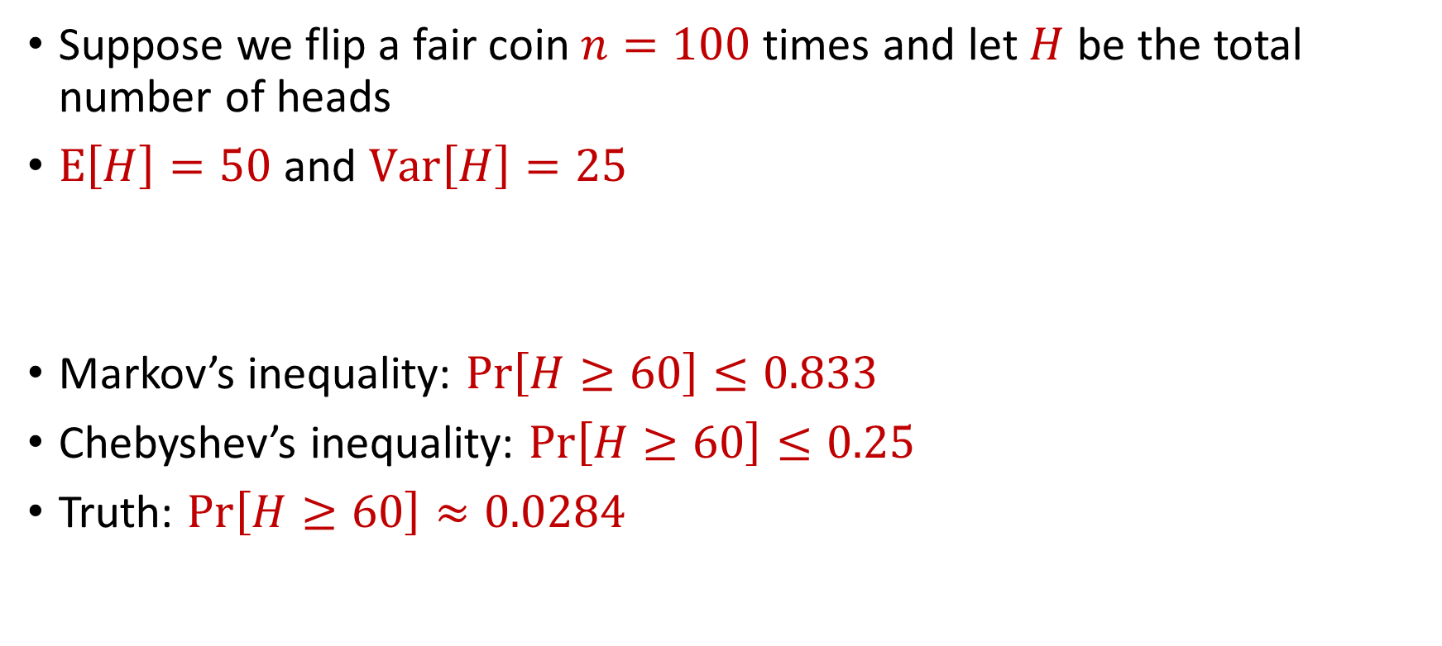
Limitations
Suppose we flip a fair coin $n=100$ times and let $H$ be the total number of heads
$E\left[H\right]=50$ and $Var\left[H\right]=25$
Markov’s inequality: $Pr\left[H≥60\right]≤0.833$
Chebyshev’s inequality: $Pr\left[H≥60\right]≤0.25$
Truth: $Pr\left[H≥60\right]≈0.0284$

Slide 27
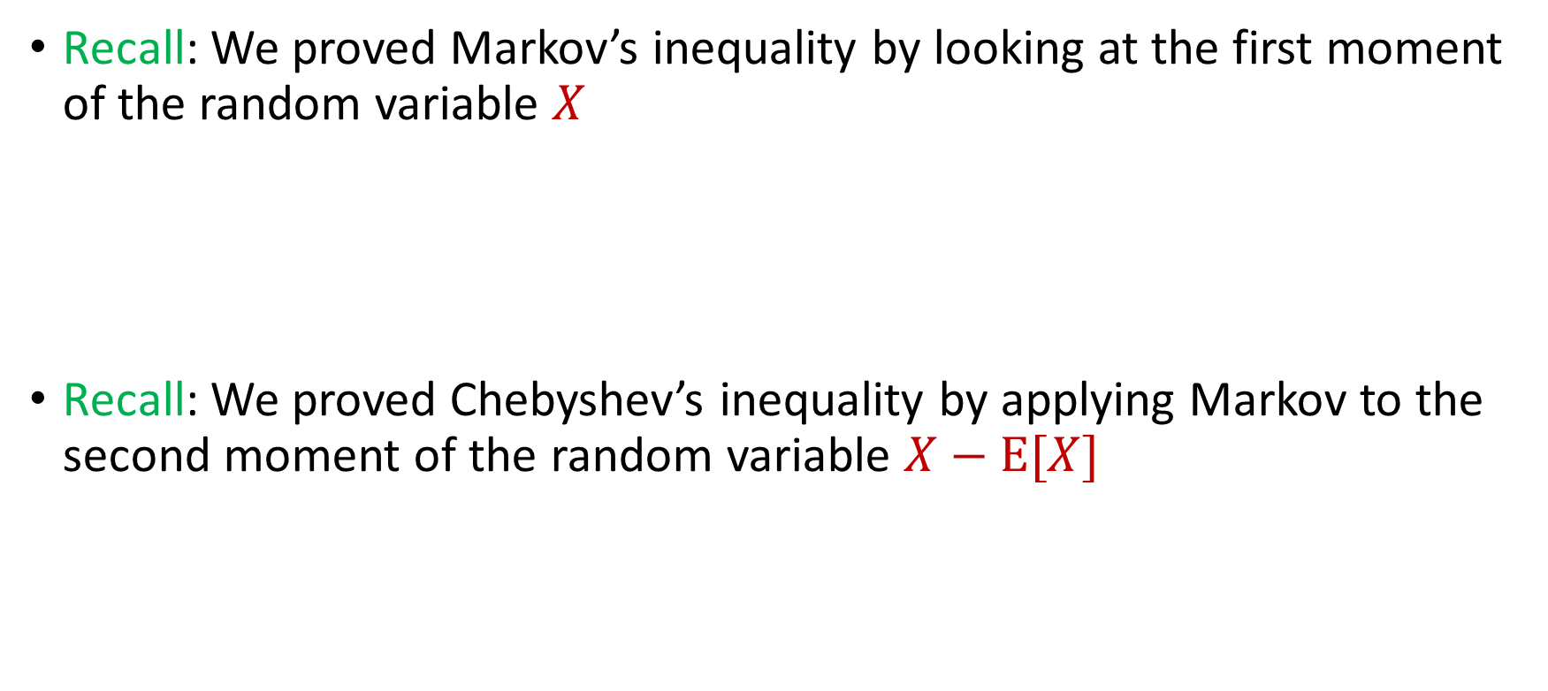

Intuition for Previous Inequalities
Recall: We proved Markov’s inequality by looking at the first moment of the random variable $X$
Recall: We proved Chebyshev’s inequality by applying Markov to the second moment of the random variable $X−E[X]$
$$Pr\left[X≥t⋅E[X]\right]≤\frac{1}{t}$$
$$Pr\left[\left|X−E[X]\right|≥t\right]=Pr\left[{\left|X−E\left[X\right]\right|}^{2}≥t^{2}\right]≤\frac{Var[X]}{t^{2}}$$

Slide 28
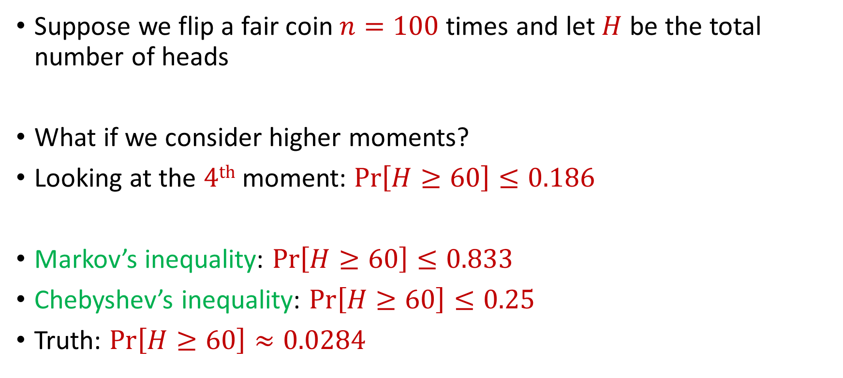
Generalizations
Suppose we flip a fair coin $n=100$ times and let $H$ be the total number of heads
What if we consider higher moments?
Looking at the $4th$ moment: $Pr\left[H≥60\right]≤0.186$
Markov’s inequality: $Pr\left[H≥60\right]≤0.833$
Chebyshev’s inequality: $Pr\left[H≥60\right]≤0.25$
Truth: $Pr\left[H≥60\right]≈0.0284$

Slide 29
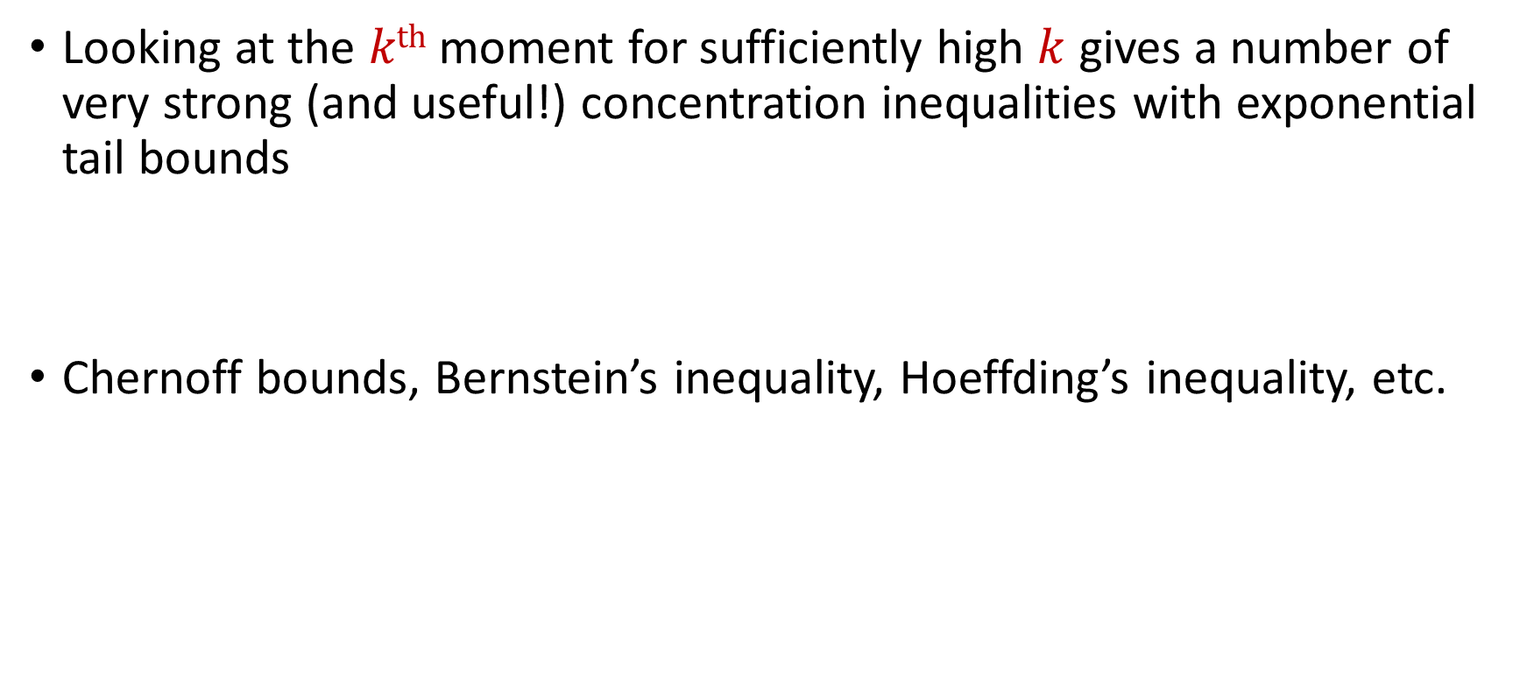
Concentration Inequalities
Looking at the $kth$ moment for sufficiently high $k$ gives a number of very strong (and useful!) concentration inequalities with exponential tail bounds
Chernoff bounds, Bernstein’s inequality, Hoeffding’s inequality, etc.

Slide 30
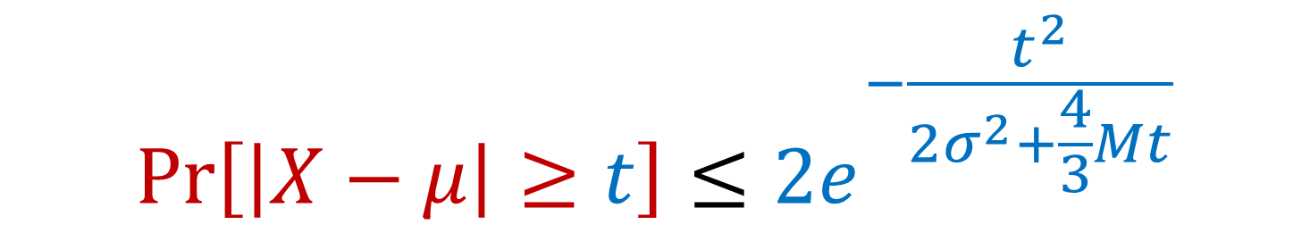

Bernstein’s Inequality
Bernstein’s inequality: Let $X_{1},…,X_{n}∈[−M,M]$ be independent random variables and let ${X=X}_{1}+…+X_{n}$ have mean $μ$ and variance $σ^{2}$. Then for any $t≥0$:
$$Pr\left[\left|X−μ\right|≥t\right]≤2e^{−\frac{t^{2}}{2σ^{2}+\frac{4}{3}Mt}}$$

Slide 31


Bernstein’s Inequality
Bernstein’s inequality: Let $X_{1},…,X_{n}∈[−M,M]$ be independent random variables and let ${X=X}_{1}+…+X_{n}$ have mean $μ$ and variance $σ^{2}$. Then for any $t≥0$:
Example: Suppose $M=1$ and let $t=kσ$. Then
$$Pr\left[\left|X−μ\right|≥t\right]≤2e^{−\frac{t^{2}}{2σ^{2}+\frac{4}{3}Mt}}$$
$$Pr\left[\left|X−μ\right|≥kσ\right]≤2exp\left(−\frac{k^{2}}{4}\right)$$

Slide 32



Bernstein’s Inequality
Suppose $M=1$ and let $t=kσ$. Then
Compare to Chebyshev’s inequality:
Exponential improvement!
$$Pr\left[\left|X−μ\right|≥kσ\right]≤2exp\left(−\frac{k^{2}}{4}\right)$$
$$Pr\left[\left|X−μ\right|≥kσ\right]≤\frac{1}{k^{2}}$$

Slide 33
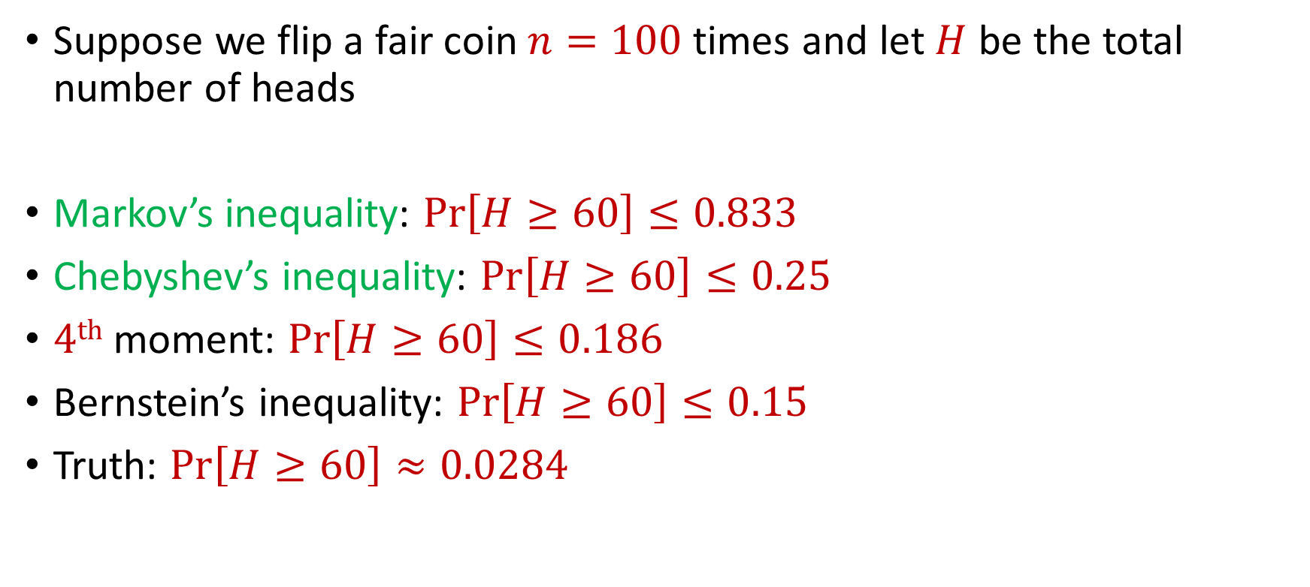
Bernstein’s Inequality
Suppose we flip a fair coin $n=100$ times and let $H$ be the total number of heads
Markov’s inequality: $Pr\left[H≥60\right]≤0.833$
Chebyshev’s inequality: $Pr\left[H≥60\right]≤0.25$
$4th$ moment: $Pr\left[H≥60\right]≤0.186$
Bernstein’s inequality: $Pr\left[H≥60\right]≤0.15$
Truth: $Pr\left[H≥60\right]≈0.0284$

Slide 34
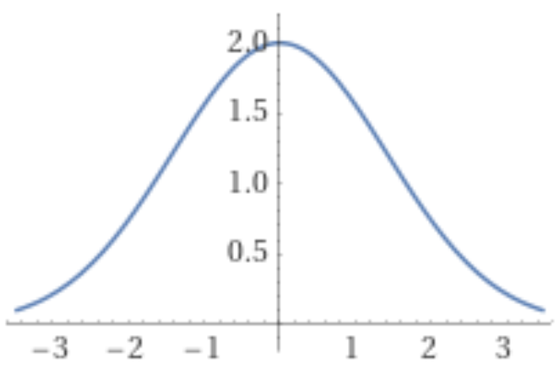
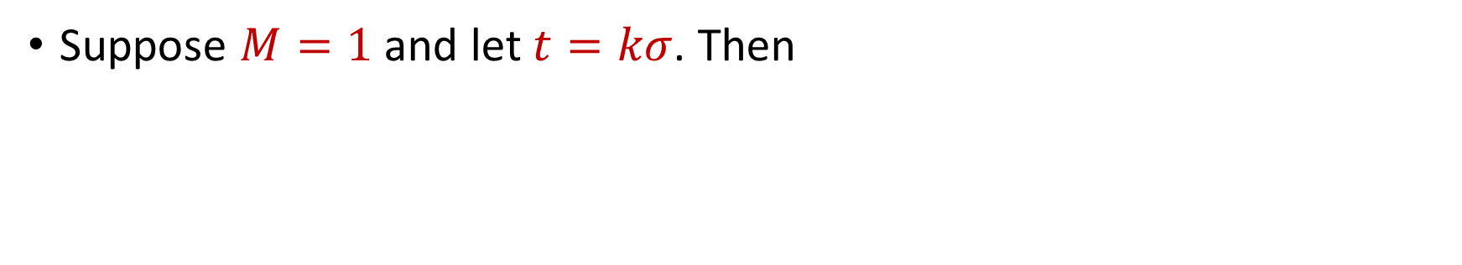
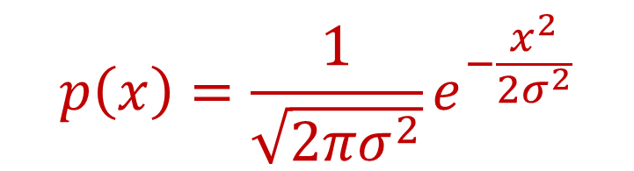
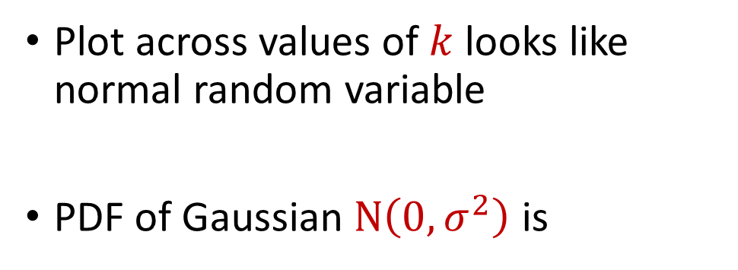
Bernstein’s Inequality
Suppose $M=1$ and let $t=kσ$. Then
$$Pr\left[\left|X−μ\right|≥kσ\right]≤2exp\left(−\frac{k^{2}}{4}\right)$$
Plot across values of $k$ looks like normal random variable
PDF of Gaussian $N\left(0,σ^{2}\right)$ is
$$p\left(x\right)=\frac{1}{\sqrt{2πσ^{2}}}e^{−\frac{x^{2}}{2σ^{2}}}$$

Slide 35
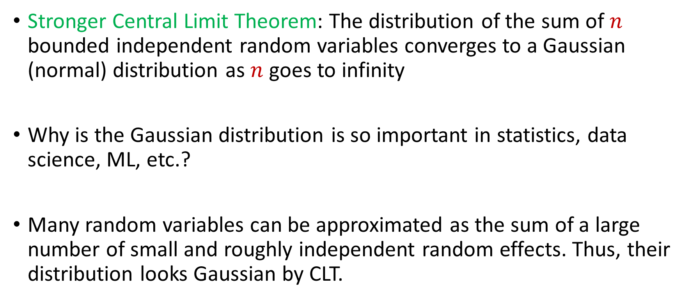
Central Limit Theorem
Stronger Central Limit Theorem: The distribution of the sum of $n$ bounded independent random variables converges to a Gaussian (normal) distribution as $n$ goes to infinity
Why is the Gaussian distribution is so important in statistics, data science, ML, etc.?
Many random variables can be approximated as the sum of a large number of small and roughly independent random effects. Thus, their distribution looks Gaussian by CLT.

