Slide 1
CSCE 658: Randomized Algorithms
Lecture 1
Samson Zhou

Slide 2
Randomized Algorithms
A randomized algorithm is any algorithm that makes random choices during its execution, i.e., it uses randomly generated values to decide the each step of its execution
The steps taken by a randomized algorithm might differ across multiple executions, even if the input remains the same
The output may differ across multiple executions

Slide 3

Why Randomized Algorithms?

Slide 4

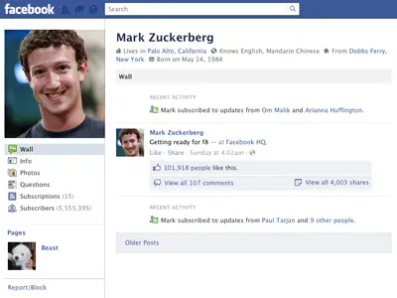

330 billion daily e-mails
3 billion monthly active users
8.5 billion daily Google searches

Slide 5
Randomized Algorithms
Efficiency and Speed: Randomized algorithms can provide better runtimes compared to deterministic algorithms
Random sampling and random projects are used to handle large datasets
Simplicity and Elegance: Randomized algorithms often offer solutions that are simpler and more elegant than deterministic counterparts
Primality testing can use randomization to efficiently determine whether a given number is like to be prime (Miller-Rabin primality testing)

Slide 6
Randomized Algorithms
Probabilistic Guarantees: Errors may be acceptable in practice, e.g., input may be noisy or exact solutions are hard to achieve
Failure probabilities can often be tuned to only occur negligibly
Avoiding Worst-Case Scenarios: Deterministic algorithms sometimes suffer from worst-case scenarios that might be unlikely to occur in practice. By introducing randomness, randomized algorithms can avoid being consistently unlucky and perform well on average.
Quicksort often performs better than deterministic counterparts, e.g., heapsort

Slide 7
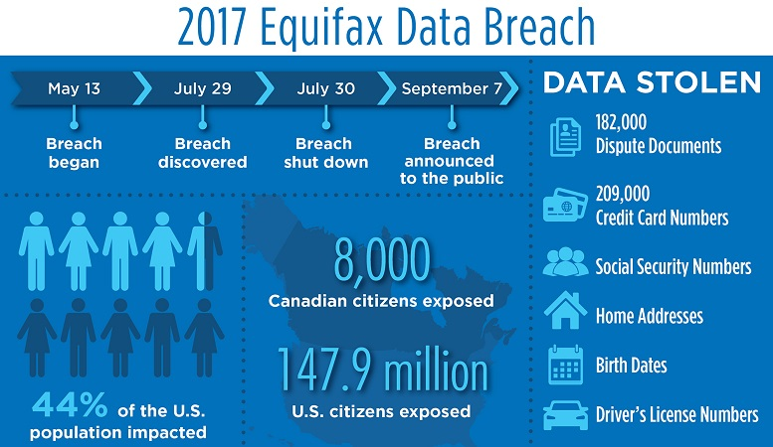
“Equifax agreed to a $700 million settlement over the privacy breach, but $425 million of that was set aside to repay consumers as a restitution fund.”
Notes:
Credit bureau company, delete $125?
Equifax Inc. is an American multinational consumer credit reporting agency headquartered in Atlanta, Georgia and is one of the three largest consumer credit reporting agencies, along with Experian and TransUnion (together known as the "Big Three"). With over 14,000 employees worldwide, Equifax has nearly US$5 billion in annual revenue and is traded on the New York Stock Exchange (NYSE) under the symbol EFX

Slide 8















Slide 9
Randomized Algorithms
Cryptography and Security: Randomized algorithms play a significant role in cryptography and security protocols.
They are used to generate random numbers, which is crucial for encryption, key generation, and other security-related processes.
Privacy: Randomization is used to add noise to datasets to protect the privacy of individuals, while still maintaining accuracy.
Fundamental mechanisms to guarantee differential privacy (DP)

Slide 10
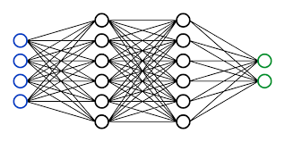
Randomized Algorithms
Machine Learning and Data Analysis: Randomization is commonly used in machine learning
Randomization is used to prevent overfitting, augment data to increase diversity, perform mini-batch training, efficient tune hyperparameters

Slide 11
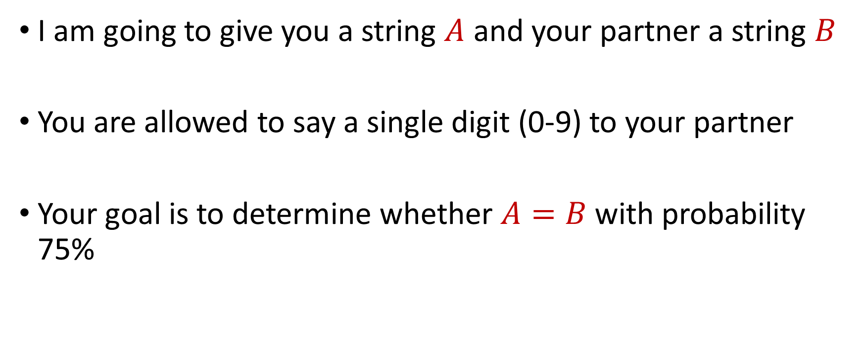
Toy Problem
I am going to give you a string $A$ and your partner a string $B$
You are allowed to say a single digit (0-9) to your partner
Your goal is to determine whether $A=B$ with probability 75%

Slide 12

Toy Problem
$A=7$

Slide 13

Toy Problem
$B=3$

Slide 14

Toy Problem
$A=7$, $B=3$
$A=24$

Slide 15

Toy Problem
$A=7$, $B=3$
$B=24$

Slide 16

Toy Problem
$A=7$, $B=3$
$A=24$, $B=24$
$A=7231$

Slide 17

Toy Problem
$A=7$, $B=3$
$A=24$, $B=24$
$B=7213$

Slide 18

Toy Problem
$A=7$, $B=3$
$A=24$, $B=24$
$A=7231$, $B=7213$
$A=11112111$

Slide 19

Toy Problem
$A=7$, $B=3$
$A=24$, $B=24$
$A=7231$, $B=7213$
$B=11111211$

Slide 20

Toy Problem
$A=7$, $B=3$
$A=24$, $B=24$
$A=7231$, $B=7213$
$A=11112111,$ $B=11111211$

Slide 21
Logistics
HRBB 126, TR, 5:30-6:45 pm CT
Office Hours: PETR 424, 4:15-5:15 pm CT on Thursdays, or by appointment
Course materials: https://samsonzhou.github.io/csce658-s24

Slide 22
Primary Goals
Understand common tools for randomized algorithms
Effectively and formally prove statements related to fundamental results in randomized algorithms, as measured by the homework problem sets
Either:
Demonstrate the ability to conduct state-of-the-art research on randomized algorithms through a final project
Demonstrate the ability to design and analyze algorithms by leveraging the power of randomness, evaluated by a final examination

Slide 23
Secondary Goals
Communicate technical ideas in a collaborative environment, as facilitated by the problem set groups (familiarity with LaTeX, practice communicating technical ideas)

Slide 24
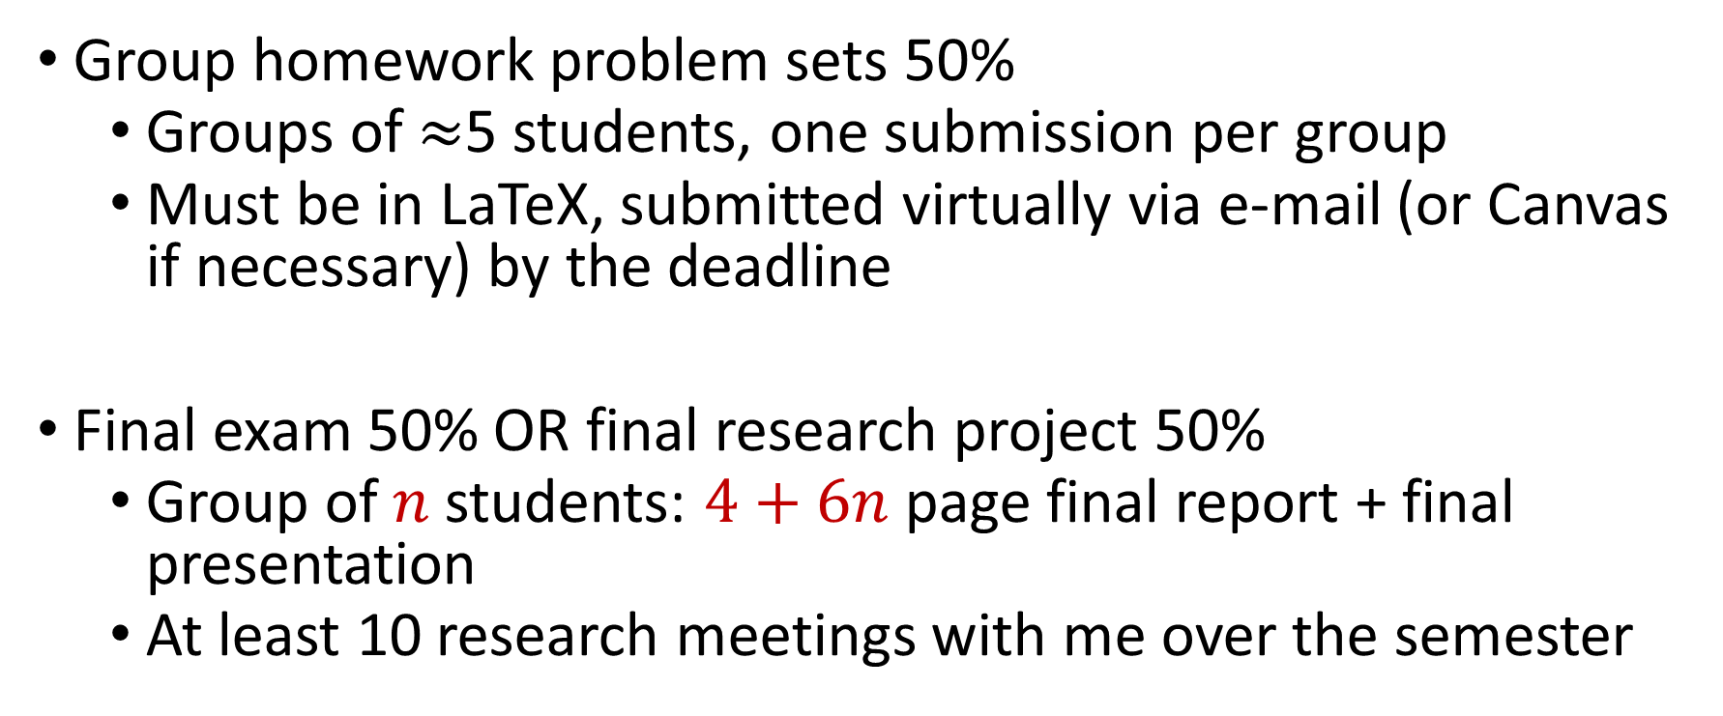
Grading
Group homework problem sets 50%
Groups of $≈$5 students, one submission per group
Must be in LaTeX, submitted virtually via e-mail (or Canvas if necessary) by the deadline
Final exam 50% OR final research project 50%
Group of $n$students: $4+6n$ page final report + final presentation
At least 10 research meetings with me over the semester

Slide 25
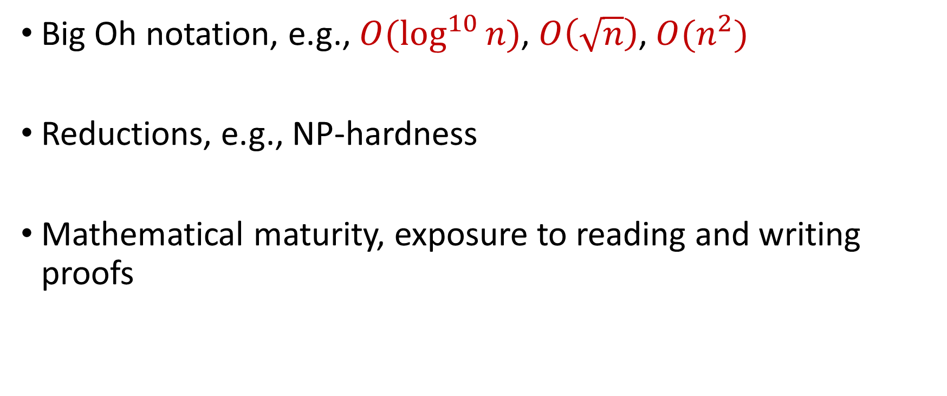
Useful Background
Big Oh notation, e.g., $O(\log^{10}{n)}$, $O\left(\sqrt{n}\right)$, $O(n^{2})$
Reductions, e.g., NP-hardness
Mathematical maturity, exposure to reading and writing proofs

Slide 26
Questions?

Slide 27
Probability Basics
Random variable ($X$)
Sample space ($Ω$): Set of possible values (discrete/continuous, finite/infinite)
Probability: $Pr[X=x]$ represents the probability that the random variable $X$ achieves value $x∈Ω$

Slide 28
Joint and Conditional Probability
Joint distribution: $Pr[X=x, Y=y]$ is the probability $X$ and $Y$ achieve values $x$ and $y$ respectively
Conditional distribution: $Pr\left[X=x|Y=y\right]$ is the probability that $X$ achieves the value $x$when $Y$ achieves the value $y$
Marginal distribution: $Pr\left[X=x\right]=\sum_{y∈Ω_{Y}}{Pr[X=x|Y=y]}$
$$Pr\left[X=x|Y=y\right]=\frac{Pr\left[X=x, Y=y\right]}{Pr\left[Y=y\right]}$$

Slide 29
Independence
Random variables $X$ and $Y$ are independent if $Pr\left[X=x\right]=Pr\left[X=x|Y=y\right]$ for all possible outcomes $x∈Ω_{X}$, $y∈Ω_{Y}$

Slide 30

Independence
Suppose we have a bag with $1$ red marble and $1$ blue marble.
We draw a marble randomly from the bag
We put the marble back in the bag
We randomly draw another marble from the bag
Let $X$ be the color of the first marble drawn
Let $Y$ be the color of the second marble drawn
Are $X$ and $Y$ independent?

Slide 31
Independence
Suppose we have a bag with $1$ red marble and $1$ blue marble.
We draw a marble randomly from the bag
We DO NOT put the marble back in the bag
We randomly draw another marble from the bag
Let $X$ be the color of the first marble drawn
Let $Y$ be the color of the second marble drawn
Are $X$ and $Y$ independent?

Slide 32
Boole’s Inequality (Union Bound)
Let $S_{1}$,…, $S_{k}$ be a set of events that occur with probability $p_{1}$,…, $p_{k}$
The probability that at least one of the events $S_{1}$,…, $S_{k}$ occurs is at most $p_{1}+…+p_{k}$
Implication: the probability that NONE of the events $S_{1}$,…, $S_{k}$ occur is at least $1−(p_{1}+…+p_{k})$

Slide 33
Boole’s Inequality (Union Bound)
$Pr\left[A∪B\right]=Pr\left[A\right]+Pr\left[B\right]−Pr\left[A∩B\right]$
Proof by induction
$$A$$
$$B$$
$$A∩B$$

Slide 34
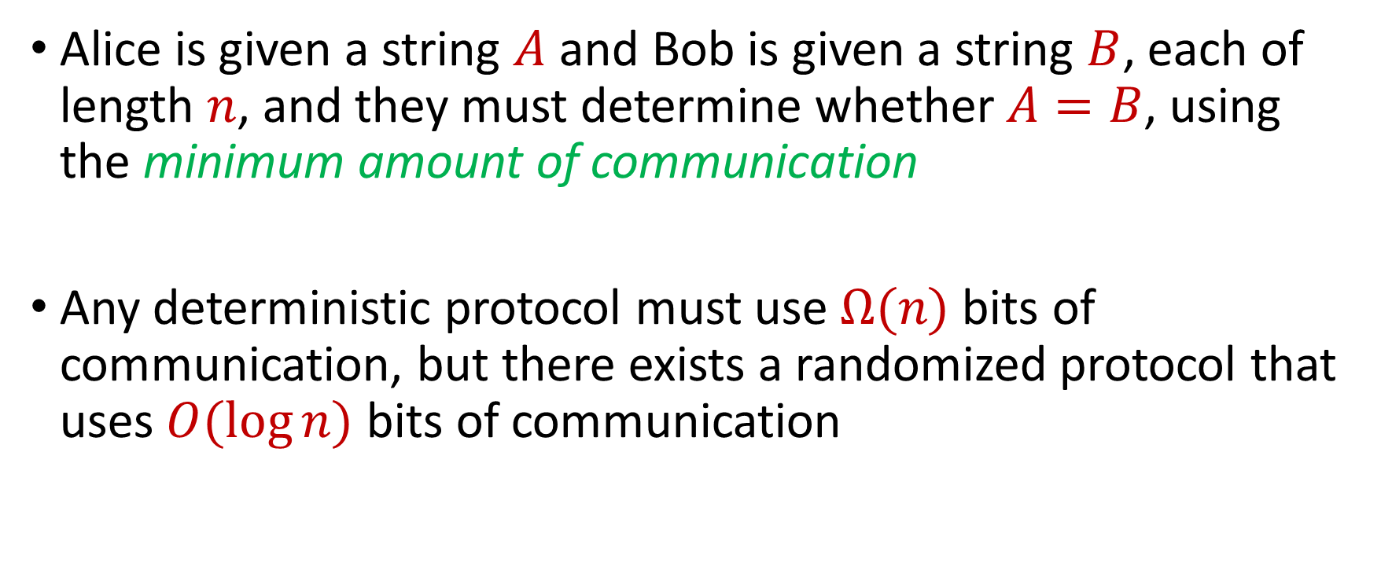
Equality Problem
Alice is given a string $A$ and Bob is given a string $B$, each of length $n$, and they must determine whether $A=B$, using the minimum amount of communication
Any deterministic protocol must use $Ω(n)$ bits of communication, but there exists a randomized protocol that uses $O(\log{n})$ bits of communication

Slide 35
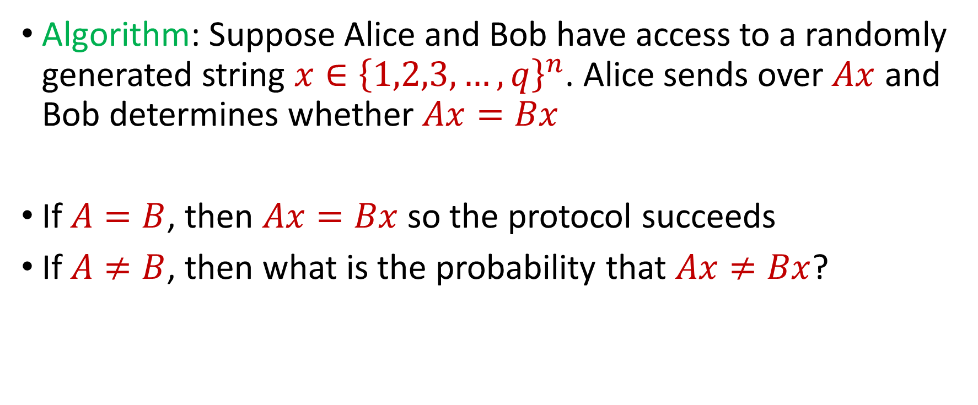
Equality Problem
Algorithm: Suppose Alice and Bob have access to a randomly generated string $x∈{\left\{1,2,3,…,q\right\}}^{n}$. Alice sends over $Ax$ and Bob determines whether $Ax=Bx$
If $A=B$, then $Ax=Bx$ so the protocol succeeds
If $A≠B$, then what is the probability that $Ax≠Bx$?

Slide 36

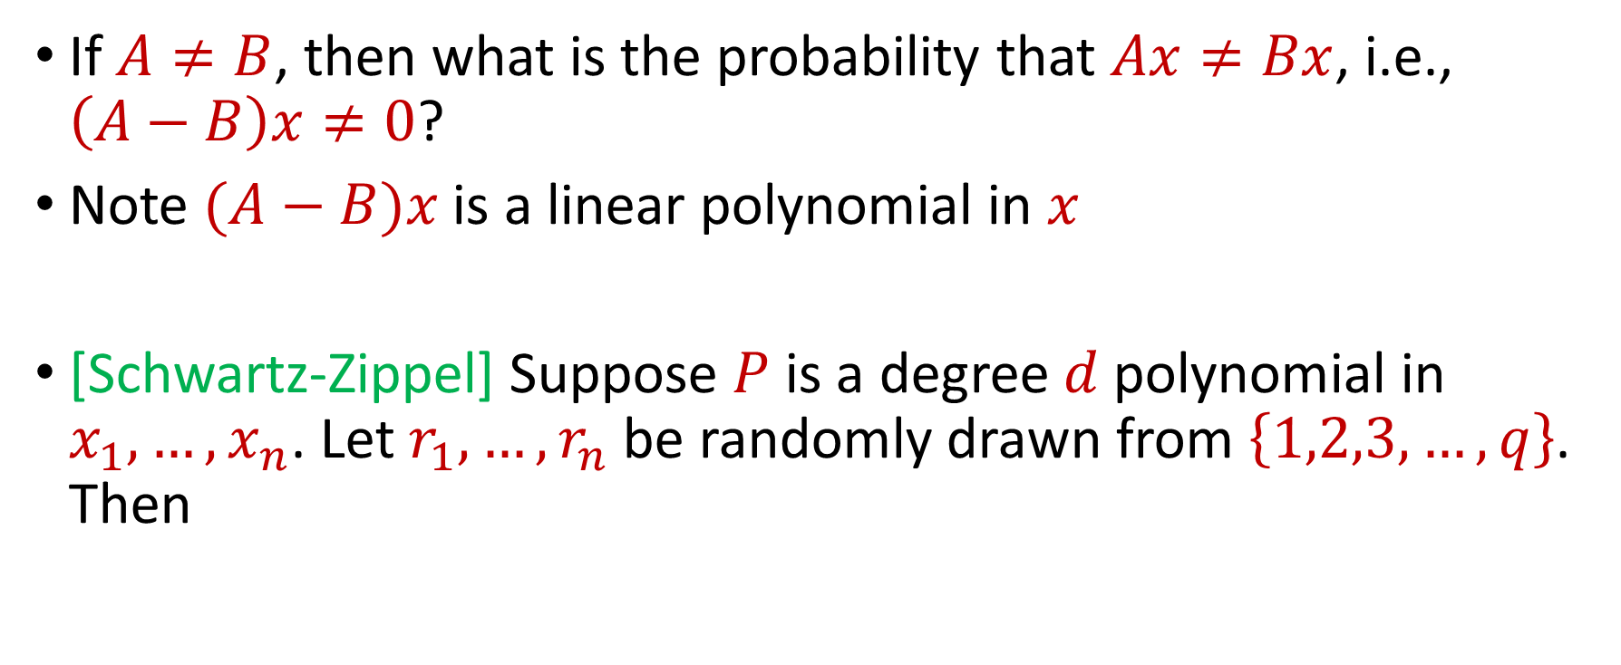
Schwartz-Zippel Lemma
If $A≠B$, then what is the probability that $Ax≠Bx$, i.e., $\left(A−B\right)x≠0$?
Note $(A−B)x$ is a linear polynomial in $x$
[Schwartz-Zippel] Suppose $P$ is a degree $d$polynomial in $x_{1},…,x_{n}$. Let $r_{1},…,r_{n}$ be randomly drawn from $\left\{1,2,3,…,q\right\}$. Then
$$\operatorname{Pr}\left[P\left(r_{1},…,r_{n}\right)=0\right]≤\frac{d}{q}$$

Slide 37

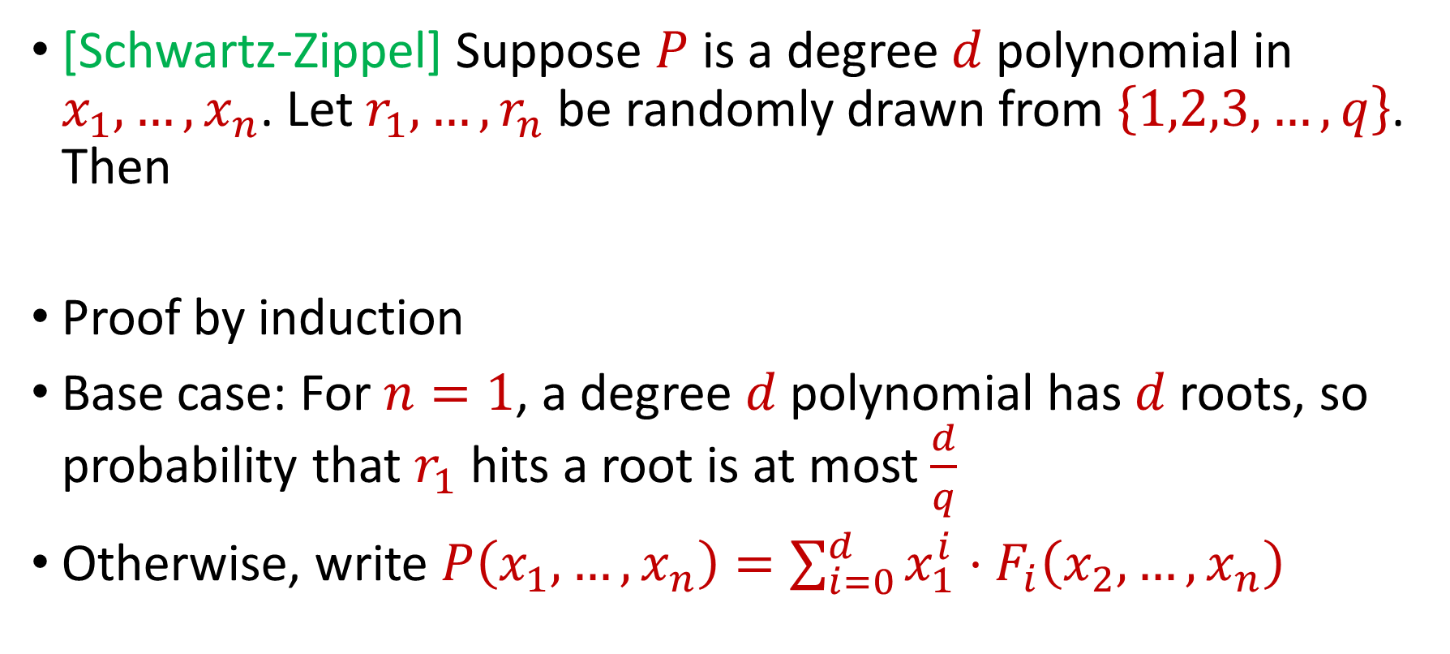
Schwartz-Zippel Lemma
[Schwartz-Zippel] Suppose $P$ is a degree $d$polynomial in $x_{1},…,x_{n}$. Let $r_{1},…,r_{n}$ be randomly drawn from $\left\{1,2,3,…,q\right\}$. Then
Proof by induction
Base case: For $n=1$, a degree $d$polynomial has $d$roots, so probability that $r_{1}$ hits a root is at most $\frac{d}{q}$
Otherwise, write $P\left(x_{1},…,x_{n}\right)=\sum_{i=0}^{d}{x_{1}^{i}}⋅F_{i}\left(x_{2},…,x_{n}\right)$
$$\operatorname{Pr}\left[P\left(r_{1},…,r_{n}\right)=0\right]≤\frac{d}{q}$$

Slide 38
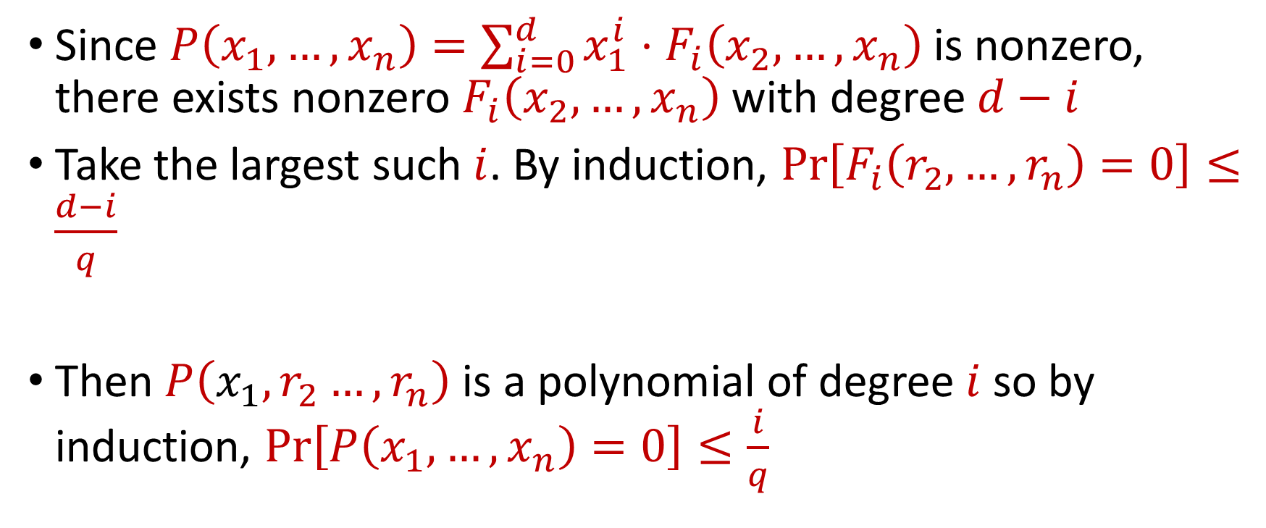
Schwartz-Zippel Lemma
Since $P\left(x_{1},…,x_{n}\right)=\sum_{i=0}^{d}{x_{1}^{i}}⋅F_{i}\left(x_{2},…,x_{n}\right)$is nonzero, there exists nonzero $F_{i}\left(x_{2},…,x_{n}\right)$ with degree $d−i$
Take the largest such $i$. By induction, $\operatorname{Pr}\left[F_{i}\left(r_{2},…,r_{n}\right)=0\right]≤\frac{d−i}{q}$
Then $P\left(x_{1},r_{2}…,r_{n}\right)$ is a polynomial of degree $i$ so by induction, $\operatorname{Pr}\left[P\left(x_{1},…,x_{n}\right)=0\right]≤\frac{i}{q}$

Slide 39
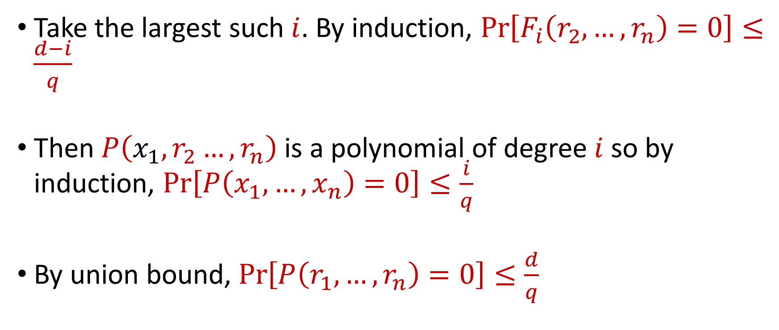
Schwartz-Zippel Lemma
Take the largest such $i$. By induction, $\operatorname{Pr}\left[F_{i}\left(r_{2},…,r_{n}\right)=0\right]≤\frac{d−i}{q}$
Then $P\left(x_{1},r_{2}…,r_{n}\right)$ is a polynomial of degree $i$ so by induction, $\operatorname{Pr}\left[P\left(x_{1},…,x_{n}\right)=0\right]≤\frac{i}{q}$
By union bound, $\operatorname{Pr}\left[P\left(r_{1},…,r_{n}\right)=0\right]≤\frac{d}{q}$

Slide 40
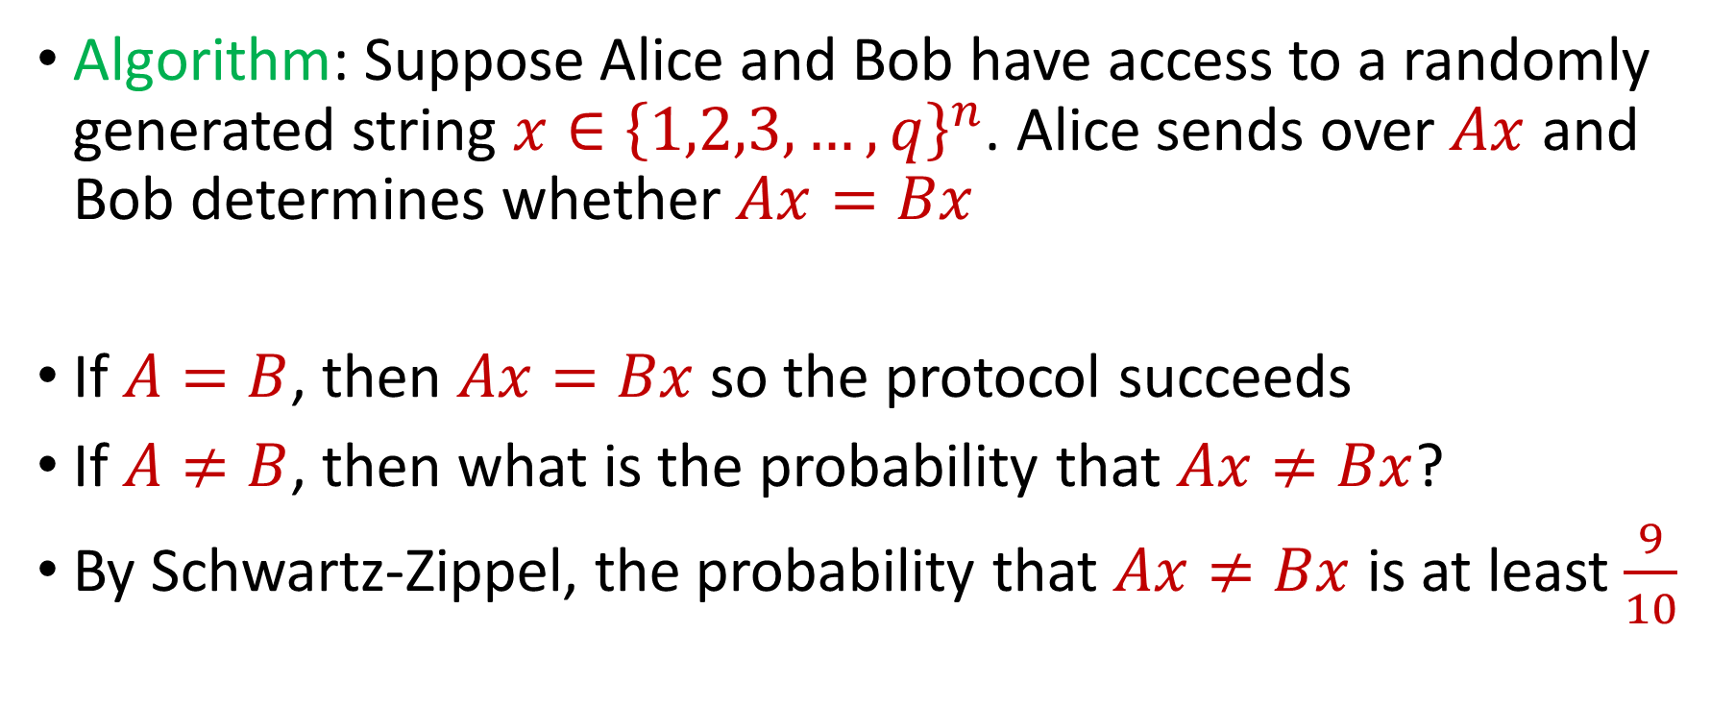
Equality Problem
Algorithm: Suppose Alice and Bob have access to a randomly generated string $x∈{\left\{1,2,3,…,q\right\}}^{n}$. Alice sends over $Ax$ and Bob determines whether $Ax=Bx$
If $A=B$, then $Ax=Bx$ so the protocol succeeds
If $A≠B$, then what is the probability that $Ax≠Bx$?
By Schwartz-Zippel, the probability that $Ax≠Bx$ is at least $\frac{9}{10}$

