Slide 1
CSCE 658: Randomized Algorithms
Lecture 15
Samson Zhou

Slide 2






Prediction with Expert Advice
a fundamental problem of sequential prediction
Day
You
Actual outcome
1
?
2
?
3
?
4
?

Slide 3
Quantifying Performance
Make no distributional assumptions
We judge our algorithm based on regret.
Definition (Regret)
# of mistakes algorithm makes more than the best expert
# of days

Slide 4
Prediction with Expert Advice
a fundamental problem of sequential prediction
Day
You
Actual outcome
1
?
2
?
3
?
4
?

Slide 5
Prediction with Expert Advice
a fundamental problem of sequential prediction
Day
You
Actual outcome
1
1/4 Regret
2
Algorithm makes 2 mistakes
3
Best expert makes 1 mistake
4

Slide 6
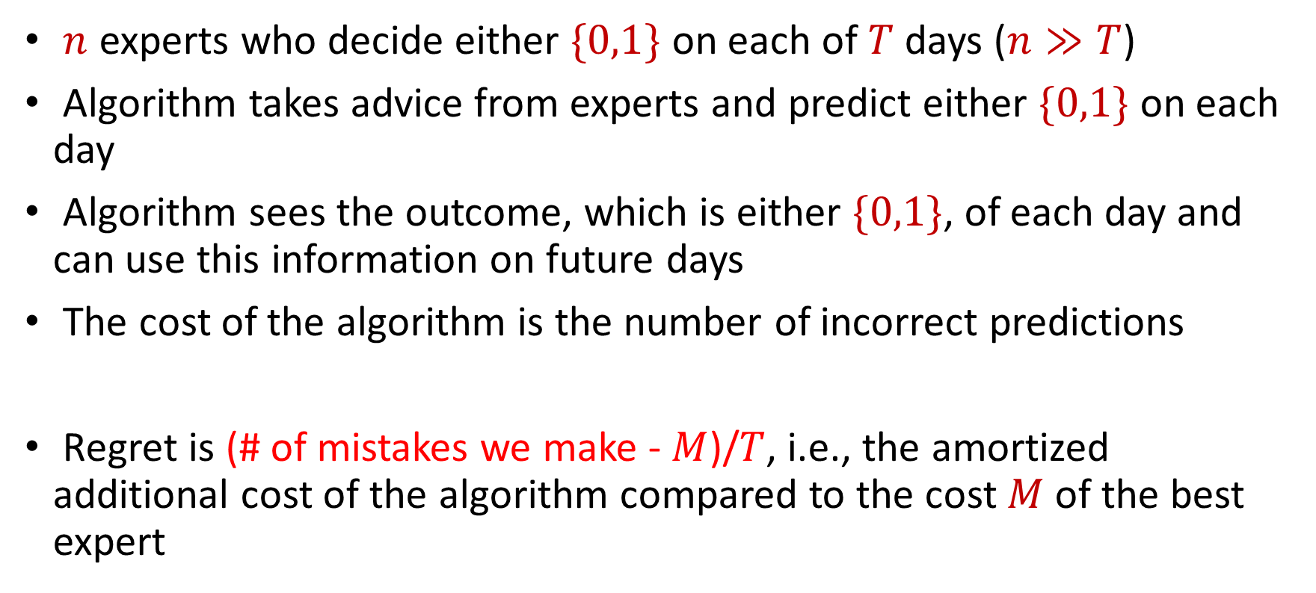
The Online Learning with Experts Problem
$n$ experts who decide either $\{0,1\}$ on each of $T$ days ($n≫T$)
Algorithm takes advice from experts and predict either $\{0,1\}$ on each day
Algorithm sees the outcome, which is either $\{0,1\}$, of each day and can use this information on future days
The cost of the algorithm is the number of incorrect predictions
Regret is (# of mistakes we make - $M$)/$T$, i.e., the amortized additional cost of the algorithm compared to the cost $M$of the best expert

Slide 7
Applications of the Experts Problem
Ensemble learning, e.g., AdaBoost
Forecast and portfolio optimization
Special case of online convex optimization

Slide 8
Weighted Majority (Littlestone, Warmuth 89)
Day
Algorithm
Actual outcome
weights
1
1
1
1
1
1
1/2
1
1
2
1
1/2
1/2
1
3
1/2
1/2
1/4
1/2
4
1/2
1/4
1/4
1/4

Slide 9











Weighted Majority (Littlestone, Warmuth 89)
Day
Algorithm
Actual outcome
weights
1
1
1
1
1
1
$$1−ε$$
1
1
2
1
$$1−ε$$
$$1−ε$$
1
3
$$1−ε$$
$$1−ε$$
$${\left(1−ε\right)}^{2}$$
$$1−ε$$
4
$$1−ε$$
$${\left(1−ε\right)}^{2}$$
$${\left(1−ε\right)}^{2}$$
$${\left(1−ε\right)}^{2}$$

Slide 10
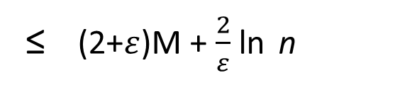
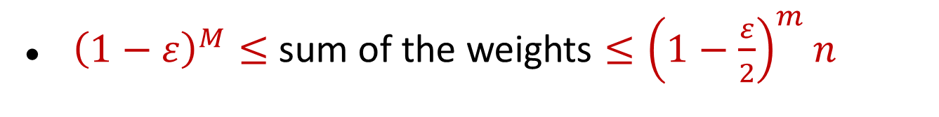
Guarantee for Weighted Majority
Theorem (Deterministic Weighted Majority)
where M is the # of mistakes the best expert makes, n is # of experts.
# of mistakes by deterministic weighted majority
≤ (2+$ε$)M + $\frac{2}{ε}$ ln n
${\left(1−ε\right)}^{M}≤$ sum of the weights $≤{\left(1−\frac{ε}{2}\right)}^{m}n$

Slide 11
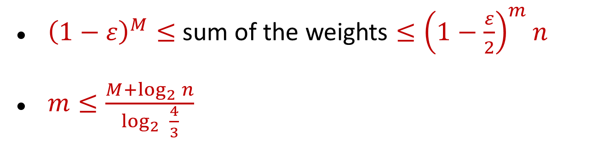
Guarantee for Weighted Majority
Theorem (Deterministic Weighted Majority)
where M is the # of mistakes the best expert makes, n is # of experts.
# of mistakes by deterministic weighted majority
≤ (2+$ε$)M + $\frac{2}{ε}$ ln n
${\left(1−ε\right)}^{M}≤$ sum of the weights $≤{\left(1−\frac{ε}{2}\right)}^{m}n$
$m≤\frac{M+\log_{2}{n}}{\log_{2}{ \frac{4}{3}}}$

Slide 12
Guarantee for Weighted Majority
Theorem (Deterministic Weighted Majority)
where M is the # of mistakes the best expert makes, n is # of experts.
# of mistakes by deterministic weighted majority
≤ (2+$ε$)M + $\frac{2}{ε}$ ln n
Theorem (Randomized Weighted Majority, i.e, Multiplicative Weights)
For ε > 0, can construct algorithm A such that
≤ (1 + ε) M +
O( ln n )
E[# of mistakes by A]
ε

Slide 13
Guarantee for Weighted Majority
Theorem (Deterministic Weighted Majority)
where M is the # of mistakes the best expert makes, n is # of experts.
# of mistakes by deterministic weighted majority
≤ 2.41 (M + log₂ n)
Theorem (Randomized Weighted Majority, i.e, Multiplicative Weights)
For ε > 0, can construct algorithm A such that
≤ (1 + ε) M +
ln n
E[# of mistakes by A]
ε

Slide 14
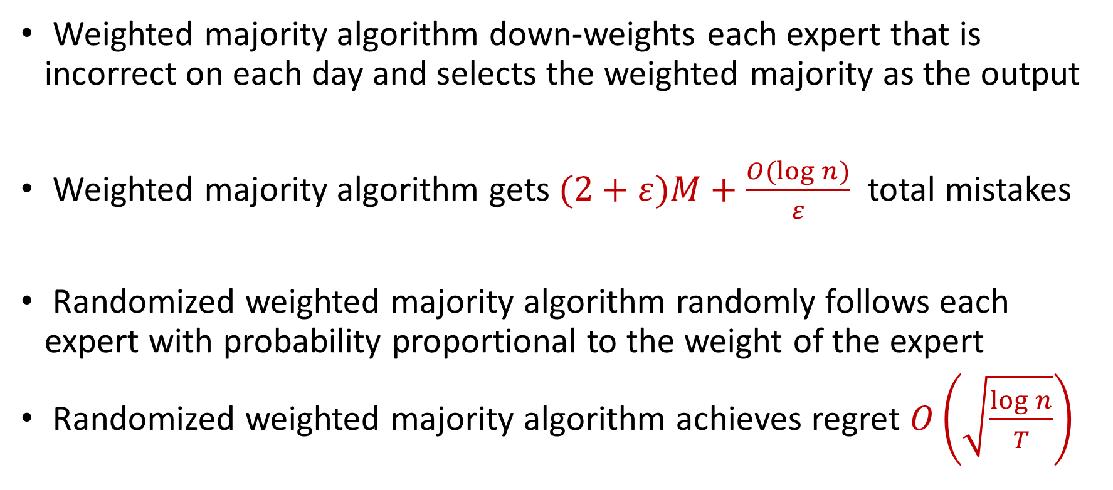
Previous Work
Weighted majority algorithm down-weights each expert that is incorrect on each day and selects the weighted majority as the output
Weighted majority algorithm gets $(2+ε)M+\frac{O(log n)}{ε}$ total mistakes
Randomized weighted majority algorithm randomly follows each expert with probability proportional to the weight of the expert
Randomized weighted majority algorithm achieves regret $O\left(\sqrt{\frac{\log{n}}{T}}\right)$

