Slide 1
CSCE 689: Special Topics in Modern Algorithms for Data Science
Lecture 10
Samson Zhou

Slide 2
Presentation Schedule
September 25: Team DAP, Team Bokun, Team Jason
September 27: Galaxy AI, Team STMI
September 29: Jung, Anmol, Chunkai

Slide 3

Last Time: The Streaming Model
Input: Elements of an underlying data set $S$, which arrive sequentially
Output: Evaluation (or approximation) of a given function
Goal: Use space sublinear in the size $m$of the input $S$
1 0 1 1 1 0 0 1

Slide 4

Last Time: Reservoir Sampling
Suppose we see a stream of elements from $[n]$. How do we uniformly sample one of the positions of the stream?
[Vitter 1985]: Initialize $s=⊥$
On the arrival of element $i$, replace $s$ with $x_{i}$ with probability $\frac{1}{i}$
47 72 81 10 14 33 51 29 54 9 36 46 10

Slide 5
Last Time: Reservoir Sampling
Suppose we see a stream of elements from $[n]$. How do we uniformly sample one of the positions of the stream?
[Vitter 1985]: Initialize $s=⊥$
On the arrival of element $i$, replace $s$ with $x_{i}$ with probability $\frac{1}{i}$
47 72 81 10 14 33 51 29 54 9 36 46 10

Slide 6
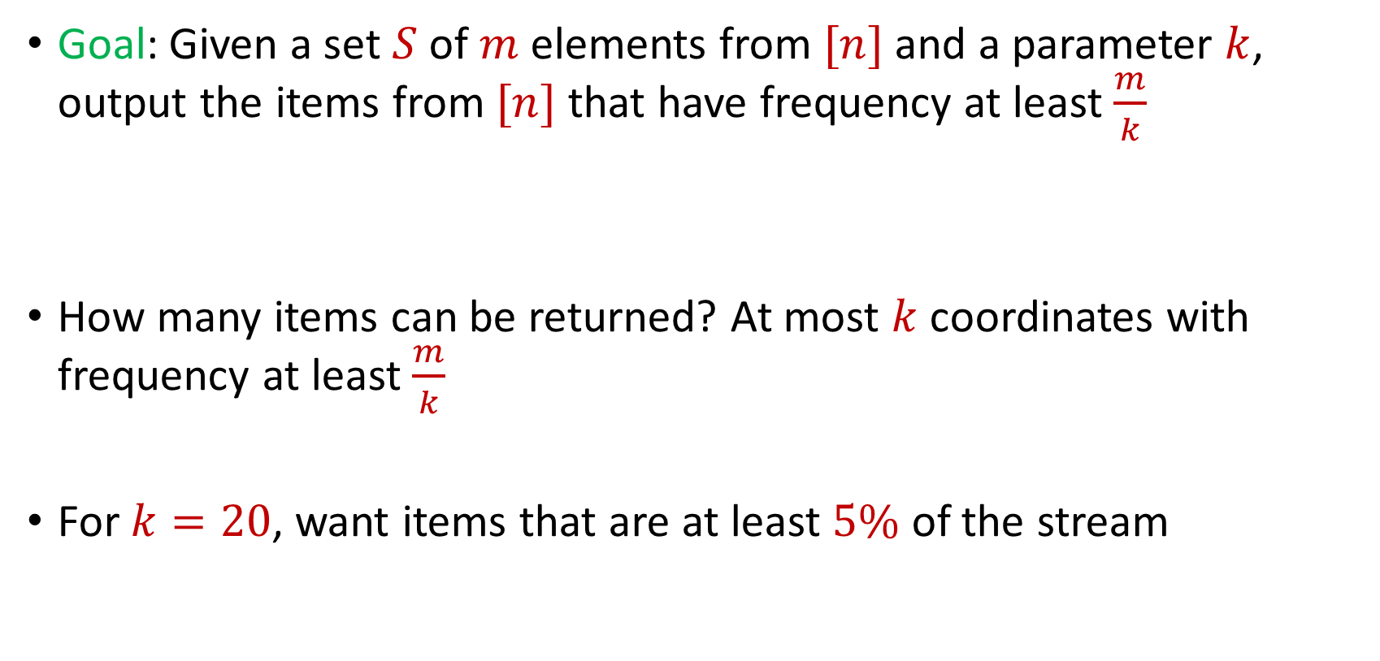
Last Time: Frequent Items
Goal: Given a set $S$ of $m$ elements from $[n]$ and a parameter $k$, output the items from $[n]$ that have frequency at least $\frac{m}{k}$
How many items can be returned? At most $k$ coordinates with frequency at least $\frac{m}{k}$
For $k=20$, want items that are at least $5\%$ of the stream
$f_{1}$ | $f_{2}$ | $f_{3}$ | $f_{4}$ | $f_{5}$ | $f_{6}$ | $f_{7}$
10 | 0 | 1 | 1 | 2 | 0 | 9

Slide 7
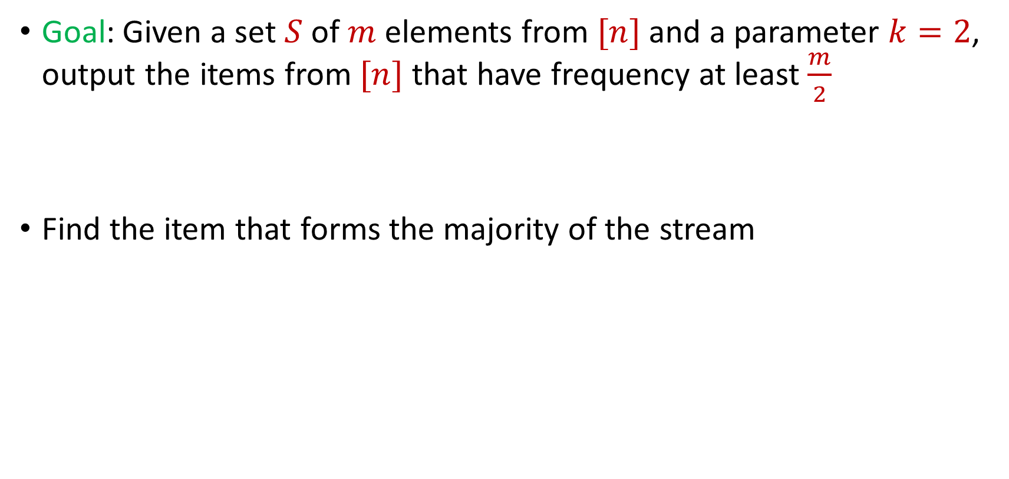
Last Time: Majority
Goal: Given a set $S$ of $m$ elements from $[n]$ and a parameter $k=2$, output the items from $[n]$ that have frequency at least $\frac{m}{2}$
Find the item that forms the majority of the stream

Slide 8
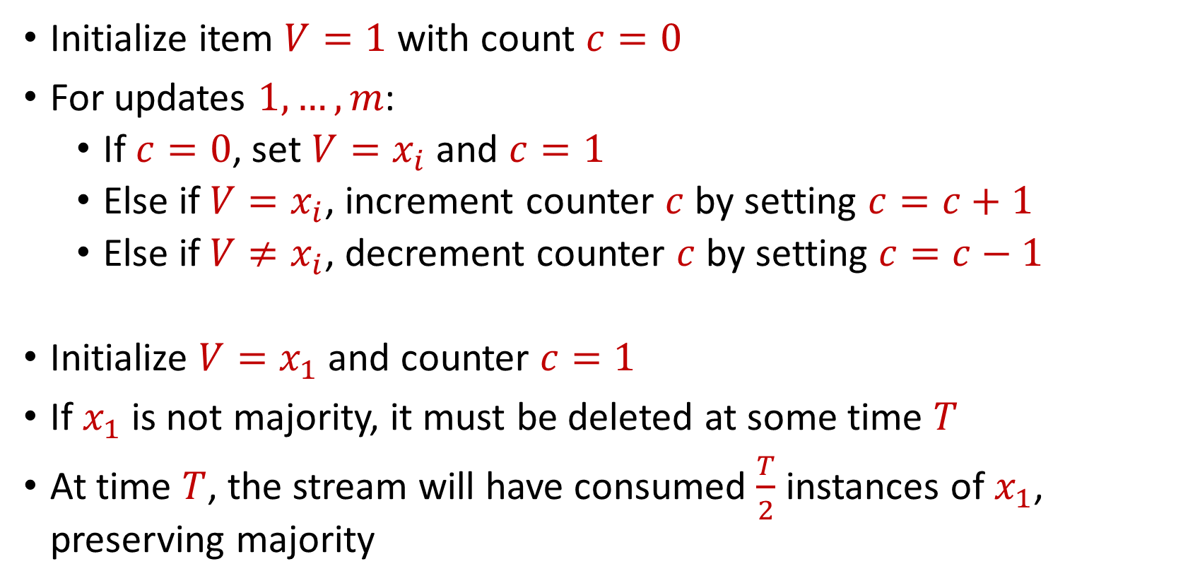
Last Time: Majority
Initialize item $V=1$ with count $c=0$
For updates $1,…,m$:
If $c=0$, set $V=x_{i}$ and $c=1$
Else if $V=x_{i}$, increment counter $c$ by setting $c=c+1$
Else if $V≠x_{i}$, decrement counter $c$ by setting $c=c−1$
Initialize $V=x_{1}$ and counter $c=1$
If $x_{1}$ is not majority, it must be deleted at some time $T$
At time $T$, the stream will have consumed $\frac{T}{2}$ instances of $x_{1}$, preserving majority

Slide 9

Frequent Items
Goal: Given a set $S$ of $m$ elements from $[n]$ and a parameter $k$, output the items from $[n]$ that have frequency at least $\frac{m}{k}$

Slide 10
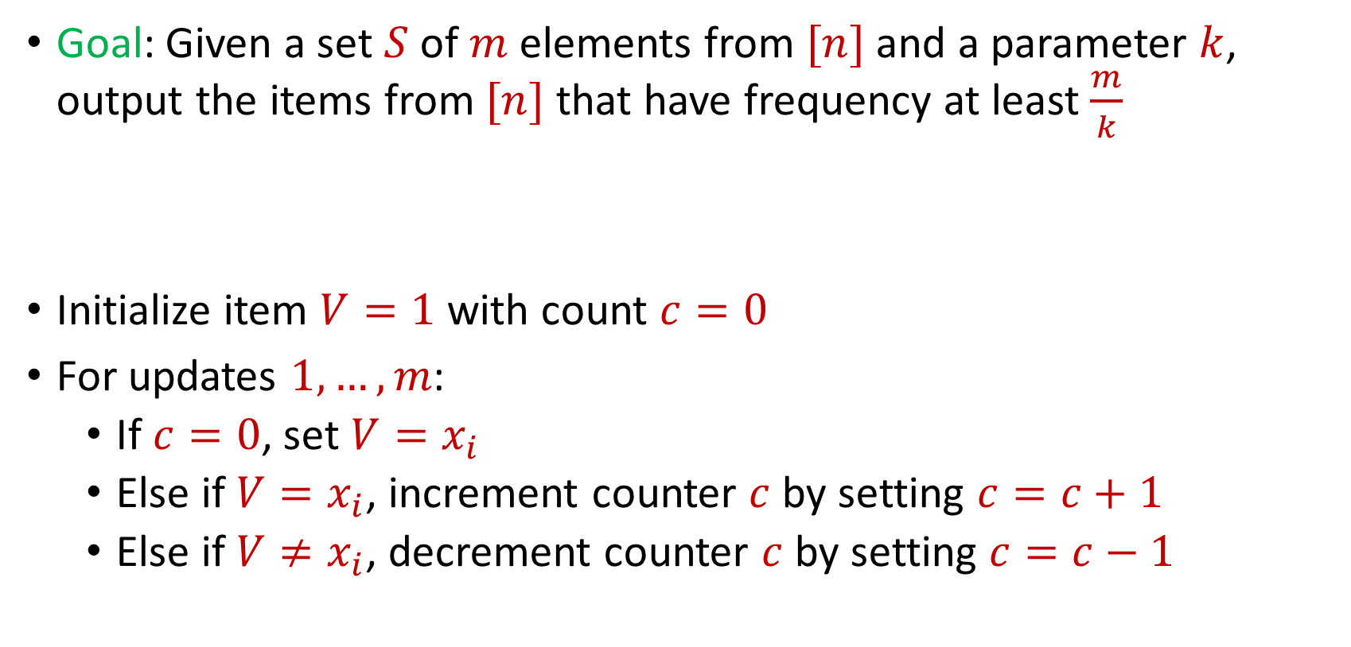
Frequent Items
Goal: Given a set $S$ of $m$ elements from $[n]$ and a parameter $k$, output the items from $[n]$ that have frequency at least $\frac{m}{k}$
Initialize item $V=1$ with count $c=0$
For updates $1,…,m$:
If $c=0$, set $V=x_{i}$
Else if $V=x_{i}$, increment counter $c$ by setting $c=c+1$
Else if $V≠x_{i}$, decrement counter $c$ by setting $c=c−1$

Slide 11
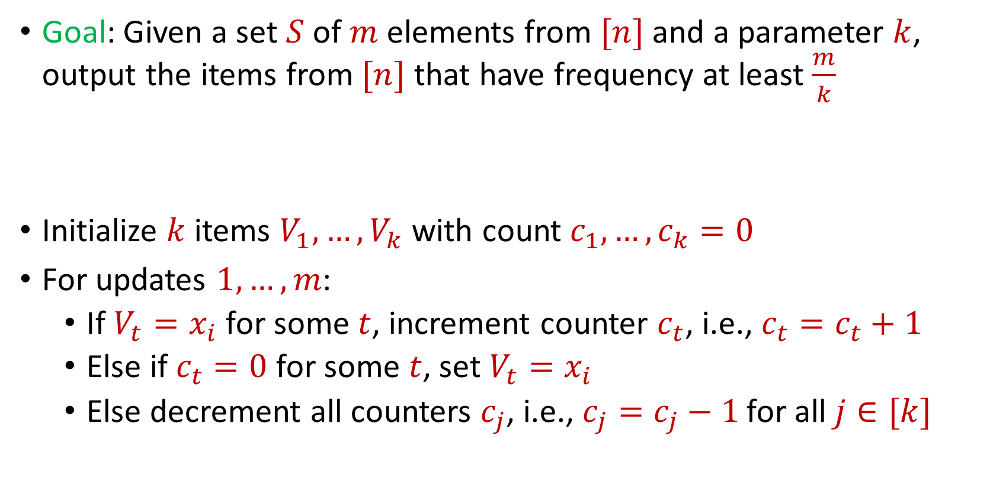
Misra Gries
Goal: Given a set $S$ of $m$ elements from $[n]$ and a parameter $k$, output the items from $[n]$ that have frequency at least $\frac{m}{k}$
Initialize $k$ items $V_{1},…,V_{k}$ with count $c_{1},…,c_{k}=0$
For updates $1,…,m$:
If $V_{t}=x_{i}$ for some $t$, increment counter $c_{t}$, i.e., $c_{t}=c_{t}+1$
Else if $c_{t}=0$ for some $t$, set $V_{t}=x_{i}$
Else decrement all counters $c_{j}$, i.e., $c_{j}=c_{j}−1$ for all $j∈[k]$

Slide 12

Misra Gries
$n=7$, $k=3$
$V_{1}= ⊥$, $c_{1}=0$
$V_{2}= ⊥$, $c_{2}=0$
$V_{3}= ⊥$, $c_{3}=0$
$f_{1}$ | $f_{2}$ | $f_{3}$ | $f_{4}$ | $f_{5}$ | $f_{6}$ | $f_{7}$
0 | 0 | 0 | 0 | 0 | 0 | 0

Slide 13


Misra Gries
$$3$$
$V_{1}= ⊥$, $c_{1}=0$
$V_{2}= ⊥$, $c_{2}=0$
$V_{3}= ⊥$, $c_{3}=0$
$f_{1}$ | $f_{2}$ | $f_{3}$ | $f_{4}$ | $f_{5}$ | $f_{6}$ | $f_{7}$
0 | 0 | 0 | 0 | 0 | 0 | 0

Slide 14

Misra Gries
$$3$$
$V_{1}=3$, $c_{1}=1$
$V_{2}= ⊥$, $c_{2}=0$
$V_{3}= ⊥$, $c_{3}=0$
$f_{1}$ | $f_{2}$ | $f_{3}$ | $f_{4}$ | $f_{5}$ | $f_{6}$ | $f_{7}$
0 | 0 | 1 | 0 | 0 | 0 | 0

Slide 15

Misra Gries
$$1$$
$V_{1}=3$, $c_{1}=1$
$V_{2}= ⊥$, $c_{2}=0$
$V_{3}= ⊥$, $c_{3}=0$
$f_{1}$ | $f_{2}$ | $f_{3}$ | $f_{4}$ | $f_{5}$ | $f_{6}$ | $f_{7}$
0 | 0 | 1 | 0 | 0 | 0 | 0

Slide 16

Misra Gries
$$1$$
$V_{1}=3$, $c_{1}=1$
$V_{2}=1$, $c_{2}=1$
$V_{3}= ⊥$, $c_{3}=0$
$f_{1}$ | $f_{2}$ | $f_{3}$ | $f_{4}$ | $f_{5}$ | $f_{6}$ | $f_{7}$
1 | 0 | 1 | 0 | 0 | 0 | 0

Slide 17

Misra Gries
$$2$$
$V_{1}=3$, $c_{1}=1$
$V_{2}=1$, $c_{2}=1$
$V_{3}= ⊥$, $c_{3}=0$
$f_{1}$ | $f_{2}$ | $f_{3}$ | $f_{4}$ | $f_{5}$ | $f_{6}$ | $f_{7}$
1 | 0 | 1 | 0 | 0 | 0 | 0

Slide 18

Misra Gries
$$2$$
$V_{1}=3$, $c_{1}=1$
$V_{2}=1$, $c_{2}=1$
$V_{3}=2$, $c_{3}=1$
$f_{1}$ | $f_{2}$ | $f_{3}$ | $f_{4}$ | $f_{5}$ | $f_{6}$ | $f_{7}$
1 | 1 | 1 | 0 | 0 | 0 | 0

Slide 19
Misra Gries
$$1$$
$V_{1}=3$, $c_{1}=1$
$V_{2}=1$, $c_{2}=1$
$V_{3}=2$, $c_{3}=1$
$f_{1}$ | $f_{2}$ | $f_{3}$ | $f_{4}$ | $f_{5}$ | $f_{6}$ | $f_{7}$
1 | 1 | 1 | 0 | 0 | 0 | 0

Slide 20

Misra Gries
$$1$$
$V_{1}=3$, $c_{1}=1$
$V_{2}=1$, $c_{2}=2$
$V_{3}=2$, $c_{3}=1$
$f_{1}$ | $f_{2}$ | $f_{3}$ | $f_{4}$ | $f_{5}$ | $f_{6}$ | $f_{7}$
2 | 1 | 1 | 0 | 0 | 0 | 0

Slide 21

Misra Gries
$$4$$
$V_{1}=3$, $c_{1}=1$
$V_{2}=1$, $c_{2}=2$
$V_{3}=2$, $c_{3}=1$
$f_{1}$ | $f_{2}$ | $f_{3}$ | $f_{4}$ | $f_{5}$ | $f_{6}$ | $f_{7}$
2 | 1 | 1 | 0 | 0 | 0 | 0

Slide 22

Misra Gries
$$4$$
$V_{1}=3$, $c_{1}=0$
$V_{2}=1$, $c_{2}=1$
$V_{3}=2$, $c_{3}=0$
$f_{1}$ | $f_{2}$ | $f_{3}$ | $f_{4}$ | $f_{5}$ | $f_{6}$ | $f_{7}$
2 | 1 | 1 | 1 | 0 | 0 | 0

Slide 23
Misra Gries
$$2$$
$V_{1}=3$, $c_{1}=0$
$V_{2}=1$, $c_{2}=1$
$V_{3}=2$, $c_{3}=0$
$f_{1}$ | $f_{2}$ | $f_{3}$ | $f_{4}$ | $f_{5}$ | $f_{6}$ | $f_{7}$
2 | 1 | 1 | 1 | 0 | 0 | 0

Slide 24

Misra Gries
$$2$$
$V_{1}=3$, $c_{1}=0$
$V_{2}=1$, $c_{2}=1$
$V_{3}=2$, $c_{3}=1$
$f_{1}$ | $f_{2}$ | $f_{3}$ | $f_{4}$ | $f_{5}$ | $f_{6}$ | $f_{7}$
2 | 2 | 1 | 1 | 0 | 0 | 0

Slide 25
Misra Gries
$$1$$
$V_{1}=3$, $c_{1}=0$
$V_{2}=1$, $c_{2}=1$
$V_{3}=2$, $c_{3}=1$
$f_{1}$ | $f_{2}$ | $f_{3}$ | $f_{4}$ | $f_{5}$ | $f_{6}$ | $f_{7}$
2 | 2 | 1 | 1 | 0 | 0 | 0

Slide 26

Misra Gries
$$1$$
$V_{1}=3$, $c_{1}=0$
$V_{2}=1$, $c_{2}=2$
$V_{3}=2$, $c_{3}=1$
$f_{1}$ | $f_{2}$ | $f_{3}$ | $f_{4}$ | $f_{5}$ | $f_{6}$ | $f_{7}$
3 | 2 | 1 | 1 | 0 | 0 | 0

Slide 27

Misra Gries
$$5$$
$V_{1}=3$, $c_{1}=0$
$V_{2}=1$, $c_{2}=2$
$V_{3}=2$, $c_{3}=1$
$f_{1}$ | $f_{2}$ | $f_{3}$ | $f_{4}$ | $f_{5}$ | $f_{6}$ | $f_{7}$
3 | 2 | 1 | 1 | 0 | 0 | 0

Slide 28

Misra Gries
$$5$$
$V_{1}=5$, $c_{1}=1$
$V_{2}=1$, $c_{2}=2$
$V_{3}=2$, $c_{3}=1$
$f_{1}$ | $f_{2}$ | $f_{3}$ | $f_{4}$ | $f_{5}$ | $f_{6}$ | $f_{7}$
3 | 2 | 1 | 1 | 1 | 0 | 0

Slide 29
Misra Gries
$$1$$
$V_{1}=5$, $c_{1}=1$
$V_{2}=1$, $c_{2}=2$
$V_{3}=2$, $c_{3}=1$
$f_{1}$ | $f_{2}$ | $f_{3}$ | $f_{4}$ | $f_{5}$ | $f_{6}$ | $f_{7}$
3 | 2 | 1 | 1 | 1 | 0 | 0

Slide 30

Misra Gries
$$1$$
$V_{1}=5$, $c_{1}=1$
$V_{2}=1$, $c_{2}=3$
$V_{3}=2$, $c_{3}=1$
$f_{1}$ | $f_{2}$ | $f_{3}$ | $f_{4}$ | $f_{5}$ | $f_{6}$ | $f_{7}$
4 | 2 | 1 | 1 | 1 | 0 | 0

Slide 31
Misra Gries
$$4$$
$V_{1}=5$, $c_{1}=1$
$V_{2}=1$, $c_{2}=3$
$V_{3}=2$, $c_{3}=1$
$f_{1}$ | $f_{2}$ | $f_{3}$ | $f_{4}$ | $f_{5}$ | $f_{6}$ | $f_{7}$
4 | 2 | 1 | 1 | 1 | 0 | 0

Slide 32

Misra Gries
$$4$$
$V_{1}=5$, $c_{1}=0$
$V_{2}=1$, $c_{2}=2$
$V_{3}=2$, $c_{3}=0$
$f_{1}$ | $f_{2}$ | $f_{3}$ | $f_{4}$ | $f_{5}$ | $f_{6}$ | $f_{7}$
4 | 2 | 1 | 2 | 1 | 0 | 0

Slide 33
Misra Gries
$$3$$
$V_{1}=5$, $c_{1}=0$
$V_{2}=1$, $c_{2}=2$
$V_{3}=2$, $c_{3}=0$
$f_{1}$ | $f_{2}$ | $f_{3}$ | $f_{4}$ | $f_{5}$ | $f_{6}$ | $f_{7}$
4 | 2 | 1 | 2 | 1 | 0 | 0

Slide 34

Misra Gries
$$3$$
$V_{1}=5$, $c_{1}=0$
$V_{2}=1$, $c_{2}=2$
$V_{3}=3$, $c_{3}=0$
$f_{1}$ | $f_{2}$ | $f_{3}$ | $f_{4}$ | $f_{5}$ | $f_{6}$ | $f_{7}$
4 | 2 | 2 | 2 | 1 | 0 | 0

Slide 35
Misra Gries
$$1$$
$V_{1}=5$, $c_{1}=0$
$V_{2}=1$, $c_{2}=2$
$V_{3}=3$, $c_{3}=0$
$f_{1}$ | $f_{2}$ | $f_{3}$ | $f_{4}$ | $f_{5}$ | $f_{6}$ | $f_{7}$
4 | 2 | 2 | 2 | 1 | 0 | 0

Slide 36

Misra Gries
$$1$$
$V_{1}=5$, $c_{1}=0$
$V_{2}=1$, $c_{2}=3$
$V_{3}=3$, $c_{3}=0$
$f_{1}$ | $f_{2}$ | $f_{3}$ | $f_{4}$ | $f_{5}$ | $f_{6}$ | $f_{7}$
5 | 2 | 2 | 2 | 1 | 0 | 0

Slide 37
Misra Gries
$$3$$
$V_{1}=5$, $c_{1}=0$
$V_{2}=1$, $c_{2}=3$
$V_{3}=3$, $c_{3}=0$
$f_{1}$ | $f_{2}$ | $f_{3}$ | $f_{4}$ | $f_{5}$ | $f_{6}$ | $f_{7}$
5 | 2 | 2 | 2 | 1 | 0 | 0

Slide 38

Misra Gries
$$3$$
$V_{1}=5$, $c_{1}=0$
$V_{2}=1$, $c_{2}=3$
$V_{3}=3$, $c_{3}=1$
$f_{1}$ | $f_{2}$ | $f_{3}$ | $f_{4}$ | $f_{5}$ | $f_{6}$ | $f_{7}$
5 | 2 | 3 | 2 | 1 | 0 | 0

Slide 39
Misra Gries
$$1$$
$V_{1}=5$, $c_{1}=0$
$V_{2}=1$, $c_{2}=3$
$V_{3}=3$, $c_{3}=1$
$f_{1}$ | $f_{2}$ | $f_{3}$ | $f_{4}$ | $f_{5}$ | $f_{6}$ | $f_{7}$
5 | 2 | 3 | 2 | 1 | 0 | 0

Slide 40

Misra Gries
$$1$$
$V_{1}=5$, $c_{1}=0$
$V_{2}=1$, $c_{2}=4$
$V_{3}=3$, $c_{3}=1$
$f_{1}$ | $f_{2}$ | $f_{3}$ | $f_{4}$ | $f_{5}$ | $f_{6}$ | $f_{7}$
6 | 2 | 3 | 2 | 1 | 0 | 0

Slide 41
Misra Gries
$$3$$
$V_{1}=5$, $c_{1}=0$
$V_{2}=1$, $c_{2}=4$
$V_{3}=3$, $c_{3}=1$
$f_{1}$ | $f_{2}$ | $f_{3}$ | $f_{4}$ | $f_{5}$ | $f_{6}$ | $f_{7}$
6 | 2 | 3 | 2 | 1 | 0 | 0

Slide 42

Misra Gries
$$3$$
$V_{1}=5$, $c_{1}=0$
$V_{2}=1$, $c_{2}=4$
$V_{3}=3$, $c_{3}=2$
$f_{1}$ | $f_{2}$ | $f_{3}$ | $f_{4}$ | $f_{5}$ | $f_{6}$ | $f_{7}$
6 | 2 | 4 | 2 | 1 | 0 | 0

Slide 43
Misra Gries
$$3$$
$V_{1}=5$, $c_{1}=0$
$V_{2}=1$, $c_{2}=4$
$V_{3}=3$, $c_{3}=2$
$f_{1}$ | $f_{2}$ | $f_{3}$ | $f_{4}$ | $f_{5}$ | $f_{6}$ | $f_{7}$
6 | 2 | 4 | 2 | 1 | 0 | 0

Slide 44

Misra Gries
$$3$$
$V_{1}=5$, $c_{1}=0$
$V_{2}=1$, $c_{2}=4$
$V_{3}=3$, $c_{3}=3$
$f_{1}$ | $f_{2}$ | $f_{3}$ | $f_{4}$ | $f_{5}$ | $f_{6}$ | $f_{7}$
6 | 2 | 5 | 2 | 1 | 0 | 0

Slide 45

Misra Gries
$$6$$
$V_{1}=5$, $c_{1}=0$
$V_{2}=1$, $c_{2}=4$
$V_{3}=3$, $c_{3}=3$
$f_{1}$ | $f_{2}$ | $f_{3}$ | $f_{4}$ | $f_{5}$ | $f_{6}$ | $f_{7}$
6 | 2 | 5 | 2 | 1 | 0 | 0

Slide 46

Misra Gries
$$6$$
$V_{1}=6$, $c_{1}=1$
$V_{2}=1$, $c_{2}=4$
$V_{3}=3$, $c_{3}=3$
$f_{1}$ | $f_{2}$ | $f_{3}$ | $f_{4}$ | $f_{5}$ | $f_{6}$ | $f_{7}$
6 | 2 | 5 | 2 | 1 | 1 | 0

Slide 47

Misra Gries
$$6$$
$V_{1}=6$, $c_{1}=1$
$V_{2}=1$, $c_{2}=4$
$V_{3}=3$, $c_{3}=3$
Report $1$, $3$, and $6$ as frequent items
$f_{1}$ | $f_{2}$ | $f_{3}$ | $f_{4}$ | $f_{5}$ | $f_{6}$ | $f_{7}$
6 | 2 | 5 | 2 | 1 | 1 | 0

Slide 48
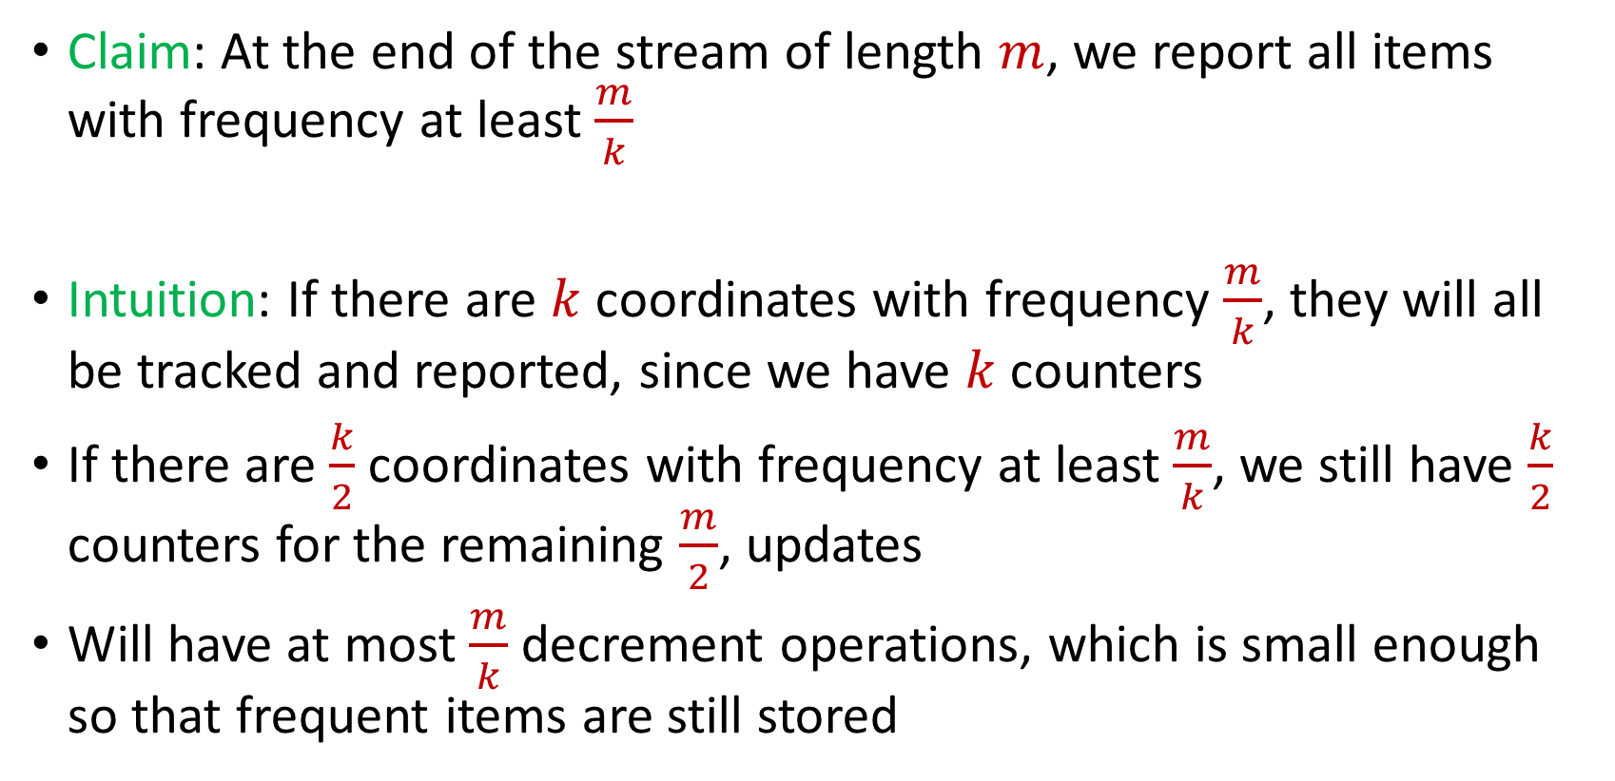
Misra Gries
Claim: At the end of the stream of length $m$, we report all items with frequency at least $\frac{m}{k}$
Intuition: If there are $k$ coordinates with frequency $\frac{m}{k}$, they will all be tracked and reported, since we have $k$counters
If there are $\frac{k}{2}$ coordinates with frequency at least $\frac{m}{k}$, we still have $\frac{k}{2}$ counters for the remaining $\frac{m}{2}$, updates
Will have at most $\frac{m}{k}$ decrement operations, which is small enough so that frequent items are still stored

Slide 49
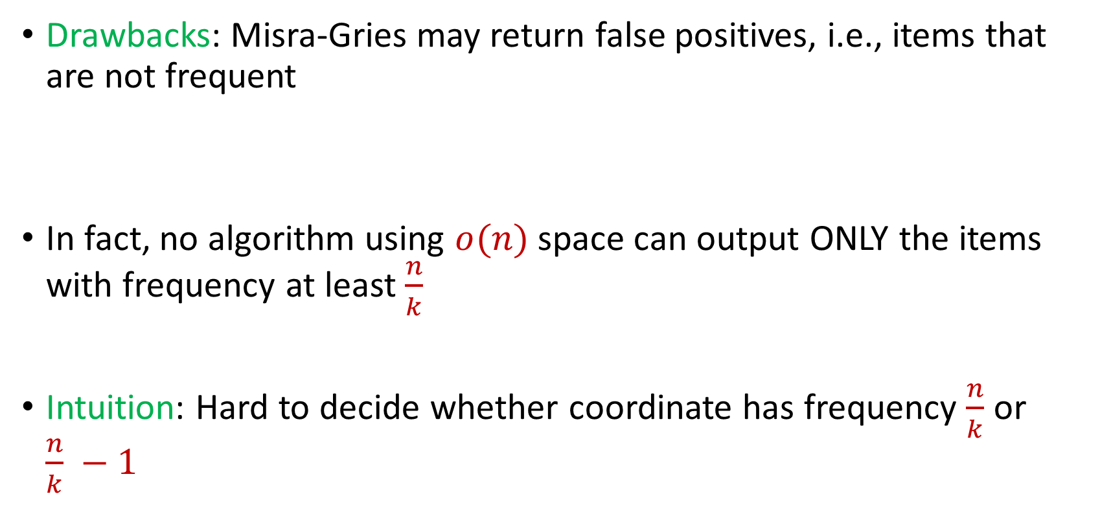
Misra Gries
Drawbacks: Misra-Gries may return false positives, i.e., items that are not frequent
In fact, no algorithm using $o(n)$ space can output ONLY the items with frequency at least $\frac{n}{k}$
Intuition: Hard to decide whether coordinate has frequency $\frac{n}{k}$ or $\frac{n}{k} −1$

Slide 50

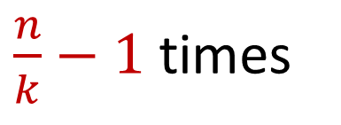
Misra Gries
Intuition: Hard to decide whether coordinate has frequency $\frac{n}{k}$ or $\frac{n}{k} −1$
$x_{1}=2$, $x_{2}=5$, $x_{3}=4$, $x_{4}=7$, $x_{5}=1$, $x_{6}=9$, …
$x_{n−\frac{n}{k}+1}=α$, $x_{n−\frac{n}{k}+2}=α$,…, $x_{n}=α$
$\frac{n}{k}−1$ times

Slide 51
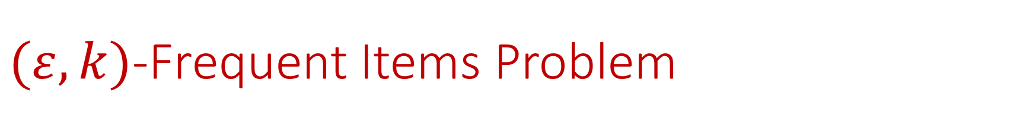

$(ε,k)$-Frequent Items Problem
Goal: Given a set $S$ of $m$ elements from $[n]$, an accuracy parameter $ε∈(0, 1)$, and a parameter $k$, output a list that includes:
The items from $[n]$ that have frequency at least $\frac{m}{k}$
No items with frequency less than $\left(1−ε\right)\frac{m}{k}$

Slide 52


Misra Gries for $(ε,k)$-Frequent Items Problem
Initialize $k$ items $V_{1},…,V_{k}$ with count $c_{1},…,c_{k}=0$
For updates $1,…,m$:
If $V_{t}=x_{i}$ for some $t$, increment counter $c_{t}$, i.e., $c_{t}=c_{t}+1$
Else if $c_{t}=0$ for some $t$, set $V_{t}=x_{i}$
Else decrement all counters $c_{j}$, i.e., $c_{j}=c_{j}−1$ for all $j∈[k]$

Slide 53
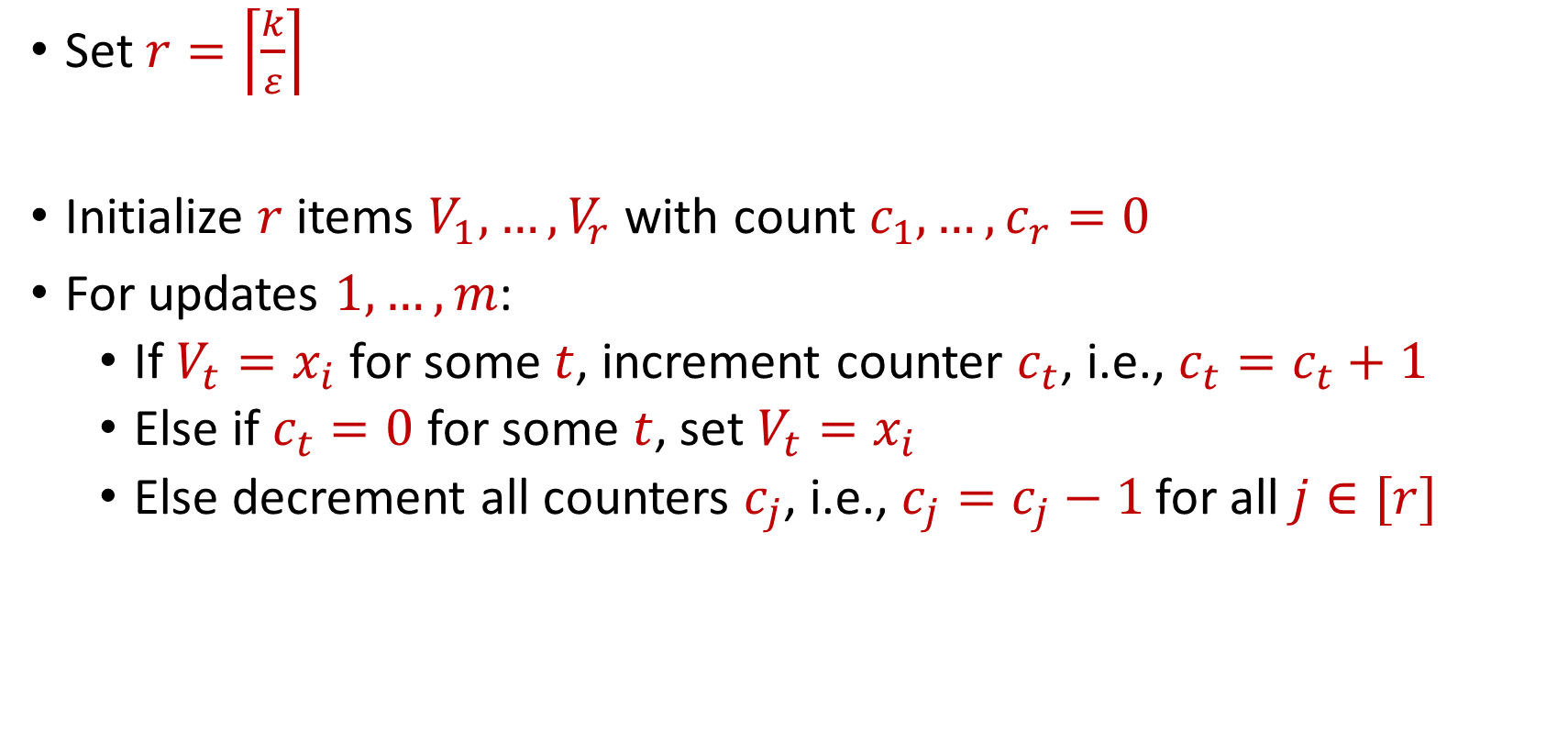
Misra Gries for $(ε,k)$-Frequent Items Problem
Set $r=\left\lceil \frac{k}{ε}\right\rceil$
Initialize $r$ items $V_{1},…,V_{r}$ with count $c_{1},…,c_{r}=0$
For updates $1,…,m$:
If $V_{t}=x_{i}$ for some $t$, increment counter $c_{t}$, i.e., $c_{t}=c_{t}+1$
Else if $c_{t}=0$ for some $t$, set $V_{t}=x_{i}$
Else decrement all counters $c_{j}$, i.e., $c_{j}=c_{j}−1$ for all $j∈[r]$

Slide 54


Misra Gries for $(ε,k)$-Frequent Items Problem
Claim: For all estimated frequencies $\hat{f_{i}}$ by Misra-Gries, we have
Intuition: Have a lot of counters, so relatively few decrements
$$f_{i}−\frac{εm}{k}≤\hat{f_{i}}≤f_{i}$$

Slide 55
$(ε,k)$-Frequent Items Problem
Goal: Given a set $S$ of $m$ elements from $[n]$, an accuracy parameter $ε∈(0, 1)$, and a parameter $k$, output a list that includes:
The items from $[n]$ that have frequency at least $\frac{m}{k}$
No items with frequency less than $\left(1−ε\right)\frac{m}{k}$

Slide 56
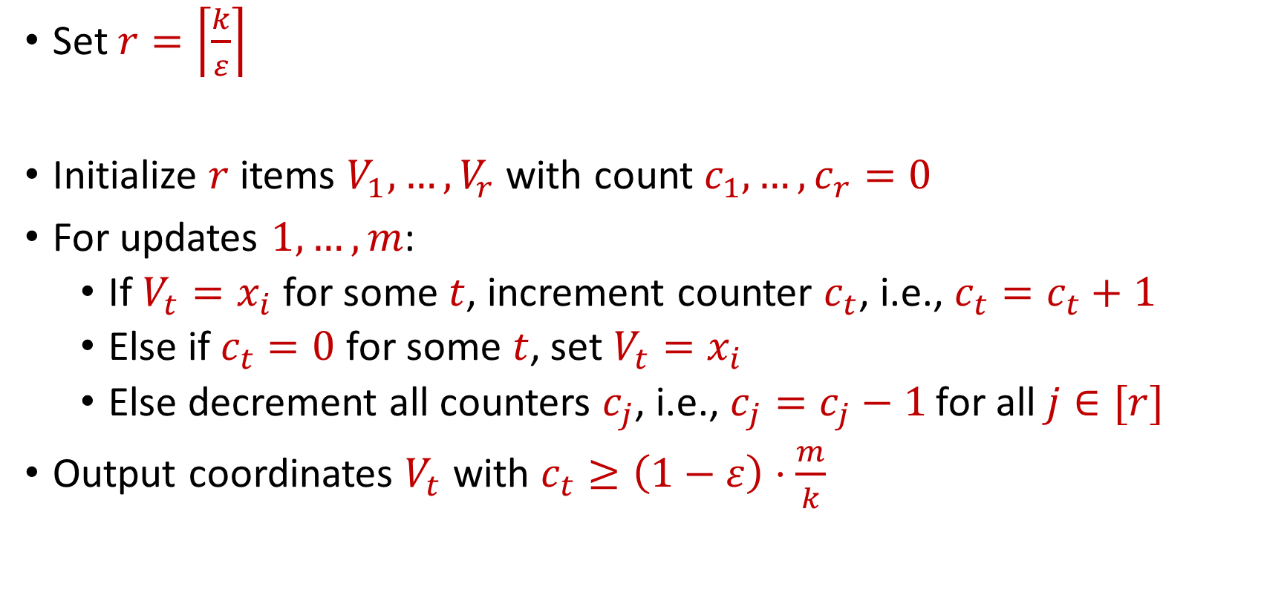
Misra Gries for $(ε,k)$-Frequent Items Problem
Set $r=\left\lceil \frac{k}{ε}\right\rceil$
Initialize $r$ items $V_{1},…,V_{r}$ with count $c_{1},…,c_{r}=0$
For updates $1,…,m$:
If $V_{t}=x_{i}$ for some $t$, increment counter $c_{t}$, i.e., $c_{t}=c_{t}+1$
Else if $c_{t}=0$ for some $t$, set $V_{t}=x_{i}$
Else decrement all counters $c_{j}$, i.e., $c_{j}=c_{j}−1$ for all $j∈[r]$
Output coordinates $V_{t}$ with $c_{t}≥\left(1−ε\right)⋅\frac{m}{k}$

Slide 57
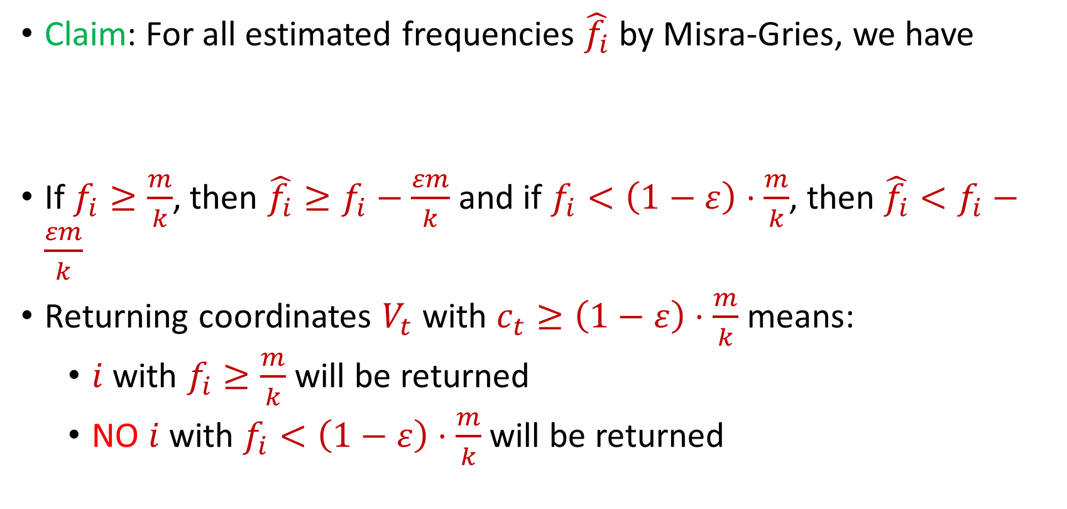
Misra Gries for $(ε,k)$-Frequent Items Problem
Claim: For all estimated frequencies $\hat{f_{i}}$ by Misra-Gries, we have
If $f_{i}≥\frac{m}{k}$, then ${\hat{f_{i}}≥f}_{i}−\frac{εm}{k}$ and if $f_{i}<\left(1−ε\right)⋅\frac{m}{k}$, then ${\hat{f_{i}}<f}_{i}−\frac{εm}{k}$
Returning coordinates $V_{t}$ with $c_{t}≥\left(1−ε\right)⋅\frac{m}{k}$ means:
$i$ with $f_{i}≥\frac{m}{k}$ will be returned
NO $i$ with $f_{i}<\left(1−ε\right)⋅\frac{m}{k}$will be returned
$$f_{i}−\frac{εm}{k}≤\hat{f_{i}}≤f_{i}$$

Slide 58
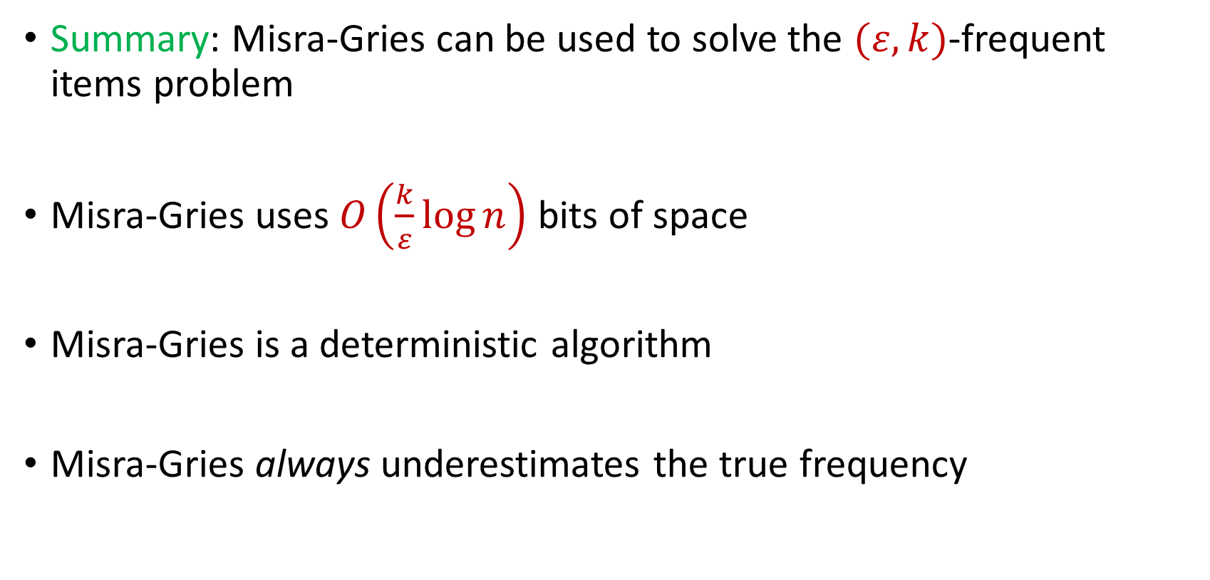
Misra Gries for $(ε,k)$-Frequent Items Problem
Summary: Misra-Gries can be used to solve the $(ε,k)$-frequent items problem
Misra-Gries uses $O\left(\frac{k}{ε}\log{n}\right)$ bits of space
Misra-Gries is a deterministic algorithm
Misra-Gries always underestimates the true frequency

Slide 59

Insertion-Deletion Streams
Stream of length $m=Θ\left(n\right)$
Universe of size $[n]$, underlying vector $x∈R^{n}$
Each update increases or decreases a coordinate in $x$
“Decrease $x_{6}$”
$f_{1}$ | $f_{2}$ | $f_{3}$ | $f_{4}$ | $f_{5}$ | $f_{6}$ | $f_{7}$
0 | 0 | 0 | 0 | 0 | 0 | 0
$f_{1}$ | $f_{2}$ | $f_{3}$ | $f_{4}$ | $f_{5}$ | $f_{6}$ | $f_{7}$
0 | 0 | 0 | 0 | 0 | -1 | 0

Slide 60

Frequent Items on Insertion-Deletion Streams
Misra-Gries on Insertion-Deletion Streams
“Increase $x_{1}$”
“Increase $x_{2}$”
“Increase $x_{2}$”
“Decrease $x_{2}$”
“Decrease $x_{2}$”

Slide 61
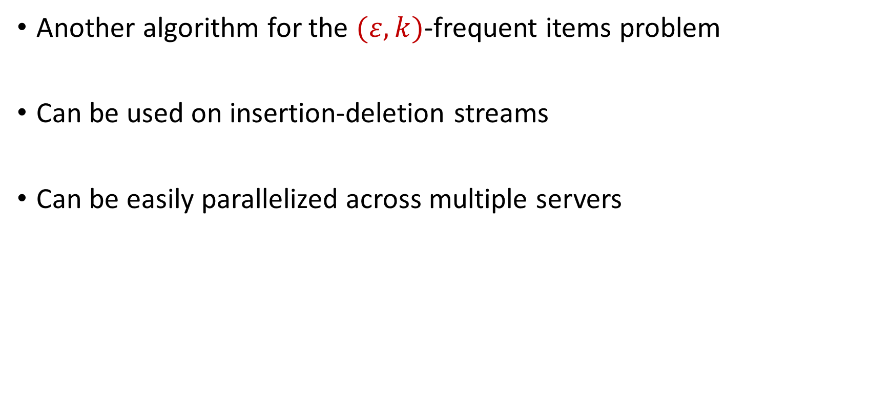
CountMin
Another algorithm for the $(ε,k)$-frequent items problem
Can be used on insertion-deletion streams
Can be easily parallelized across multiple servers

Slide 62
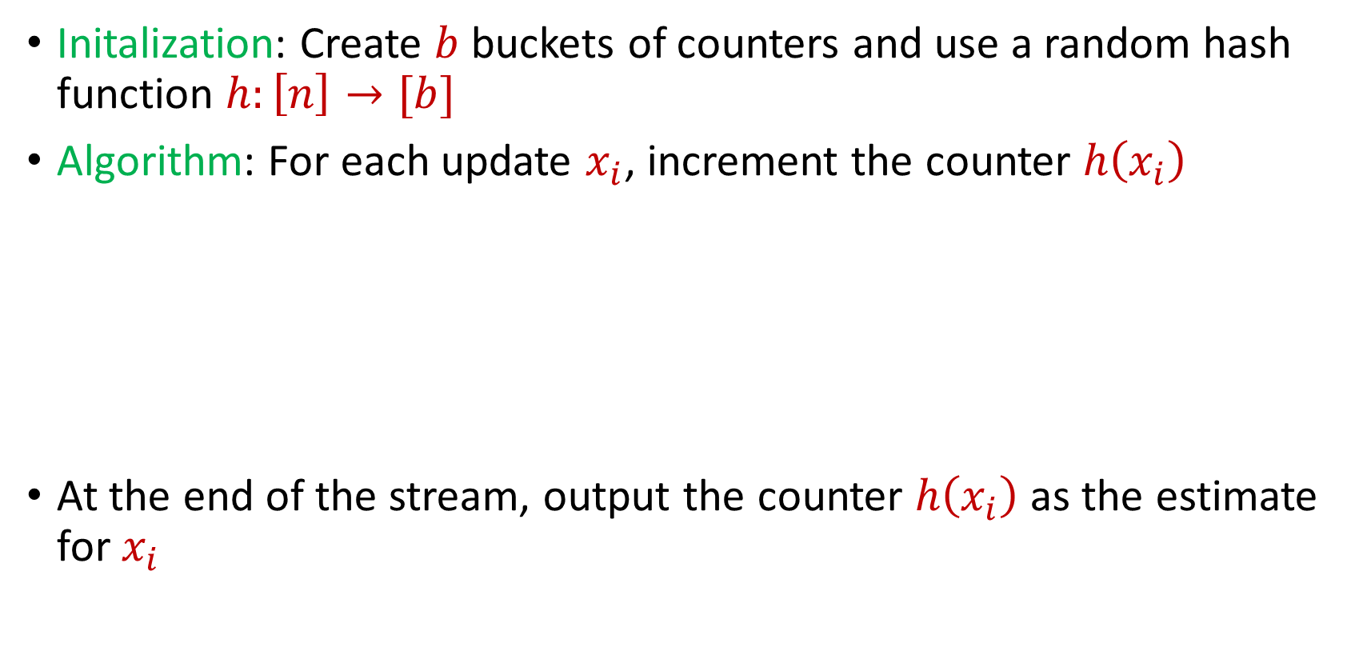
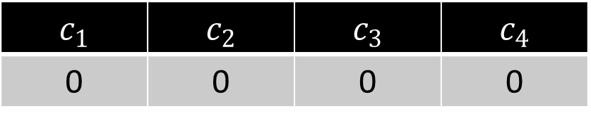
CountMin
Initalization: Create $b$ buckets of counters and use a random hash function $h:\left[n\right]→[b]$
Algorithm: For each update $x_{i}$, increment the counter $h\left(x_{i}\right)$
At the end of the stream, output the counter $h\left(x_{i}\right)$ as the estimate for $x_{i}$
$c_{1}$ | $c_{2}$ | $c_{3}$ | $c_{4}$
0 | 0 | 0 | 0

Slide 63
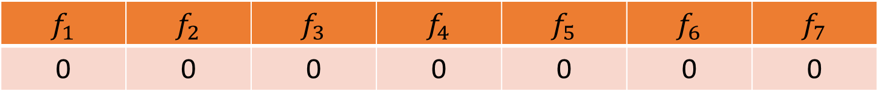


CountMin
$f_{1}$ | $f_{2}$ | $f_{3}$ | $f_{4}$ | $f_{5}$ | $f_{6}$ | $f_{7}$
0 | 0 | 0 | 0 | 0 | 0 | 0
$$1$$
$c_{1}$ | $c_{2}$ | $c_{3}$ | $c_{4}$
0 | 0 | 0 | 0

Slide 64
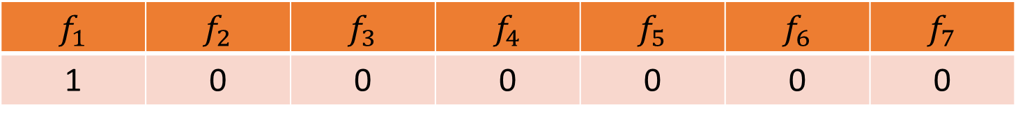

CountMin
$f_{1}$ | $f_{2}$ | $f_{3}$ | $f_{4}$ | $f_{5}$ | $f_{6}$ | $f_{7}$
1 | 0 | 0 | 0 | 0 | 0 | 0
$$1$$
$$h\left(x\right)=3x+2 (mod 4)$$
$c_{1}$ | $c_{2}$ | $c_{3}$ | $c_{4}$
0 | 0 | 0 | 0

Slide 65
CountMin
$f_{1}$ | $f_{2}$ | $f_{3}$ | $f_{4}$ | $f_{5}$ | $f_{6}$ | $f_{7}$
1 | 0 | 0 | 0 | 0 | 0 | 0
$$1$$
$$h\left(x\right)=3x+2 (mod 4)$$
$c_{1}$ | $c_{2}$ | $c_{3}$ | $c_{4}$
0 | 0 | 0 | 0

Slide 66
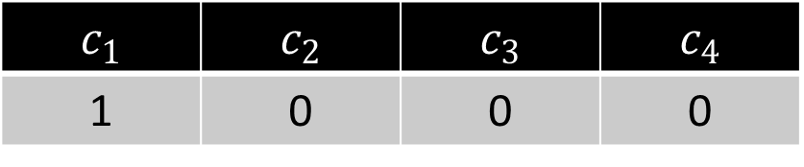
CountMin
$f_{1}$ | $f_{2}$ | $f_{3}$ | $f_{4}$ | $f_{5}$ | $f_{6}$ | $f_{7}$
1 | 0 | 0 | 0 | 0 | 0 | 0
$$1$$
$$h\left(x\right)=3x+2 (mod 4)$$
$c_{1}$ | $c_{2}$ | $c_{3}$ | $c_{4}$
1 | 0 | 0 | 0

Slide 67
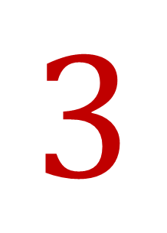
CountMin
$f_{1}$ | $f_{2}$ | $f_{3}$ | $f_{4}$ | $f_{5}$ | $f_{6}$ | $f_{7}$
1 | 0 | 0 | 0 | 0 | 0 | 0
$$3$$
$$h\left(x\right)=3x+2 (mod 4)$$
$c_{1}$ | $c_{2}$ | $c_{3}$ | $c_{4}$
1 | 0 | 0 | 0

Slide 68
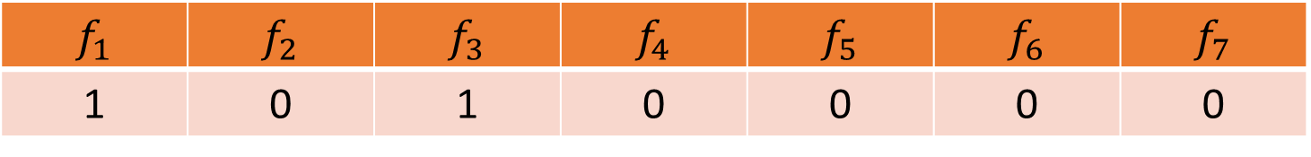
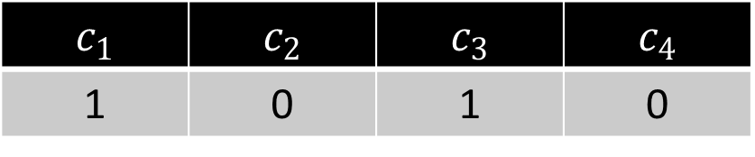
CountMin
$f_{1}$ | $f_{2}$ | $f_{3}$ | $f_{4}$ | $f_{5}$ | $f_{6}$ | $f_{7}$
1 | 0 | 1 | 0 | 0 | 0 | 0
$$3$$
$$h\left(x\right)=3x+2 (mod 4)$$
$c_{1}$ | $c_{2}$ | $c_{3}$ | $c_{4}$
1 | 0 | 1 | 0

Slide 69

CountMin
$f_{1}$ | $f_{2}$ | $f_{3}$ | $f_{4}$ | $f_{5}$ | $f_{6}$ | $f_{7}$
1 | 0 | 1 | 0 | 0 | 0 | 0
$$2$$
$$h\left(x\right)=3x+2 (mod 4)$$
$c_{1}$ | $c_{2}$ | $c_{3}$ | $c_{4}$
1 | 0 | 1 | 0

Slide 70
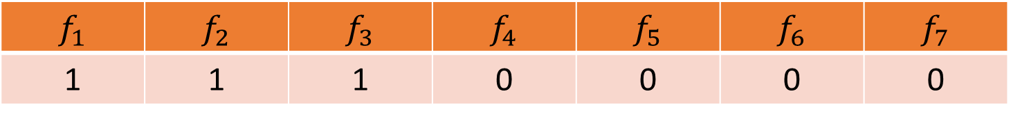
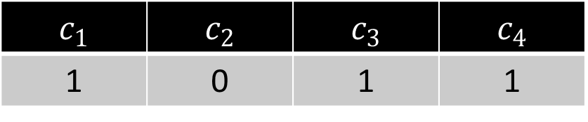
CountMin
$f_{1}$ | $f_{2}$ | $f_{3}$ | $f_{4}$ | $f_{5}$ | $f_{6}$ | $f_{7}$
1 | 1 | 1 | 0 | 0 | 0 | 0
$$2$$
$$h\left(x\right)=3x+2 (mod 4)$$
$c_{1}$ | $c_{2}$ | $c_{3}$ | $c_{4}$
1 | 0 | 1 | 1

Slide 71
CountMin
$f_{1}$ | $f_{2}$ | $f_{3}$ | $f_{4}$ | $f_{5}$ | $f_{6}$ | $f_{7}$
1 | 1 | 1 | 0 | 0 | 0 | 0
$$1$$
$$h\left(x\right)=3x+2 (mod 4)$$
$c_{1}$ | $c_{2}$ | $c_{3}$ | $c_{4}$
1 | 0 | 1 | 1

Slide 72
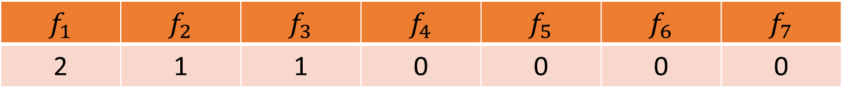
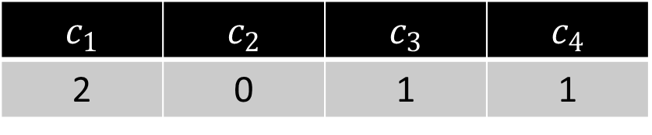
CountMin
$f_{1}$ | $f_{2}$ | $f_{3}$ | $f_{4}$ | $f_{5}$ | $f_{6}$ | $f_{7}$
2 | 1 | 1 | 0 | 0 | 0 | 0
$$1$$
$$h\left(x\right)=3x+2 (mod 4)$$
$c_{1}$ | $c_{2}$ | $c_{3}$ | $c_{4}$
2 | 0 | 1 | 1

Slide 73

CountMin
$f_{1}$ | $f_{2}$ | $f_{3}$ | $f_{4}$ | $f_{5}$ | $f_{6}$ | $f_{7}$
2 | 1 | 1 | 0 | 0 | 0 | 0
$$5$$
$$h\left(x\right)=3x+2 (mod 4)$$
$c_{1}$ | $c_{2}$ | $c_{3}$ | $c_{4}$
1 | 0 | 1 | 1

Slide 74
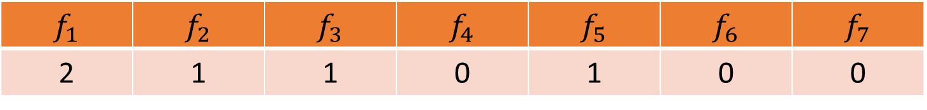
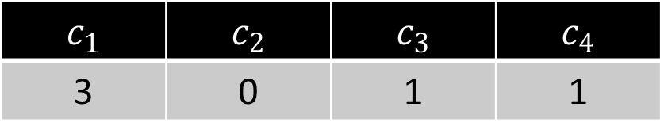
CountMin
$f_{1}$ | $f_{2}$ | $f_{3}$ | $f_{4}$ | $f_{5}$ | $f_{6}$ | $f_{7}$
2 | 1 | 1 | 0 | 1 | 0 | 0
$$5$$
$$h\left(x\right)=3x+2 (mod 4)$$
$c_{1}$ | $c_{2}$ | $c_{3}$ | $c_{4}$
3 | 0 | 1 | 1

Slide 75
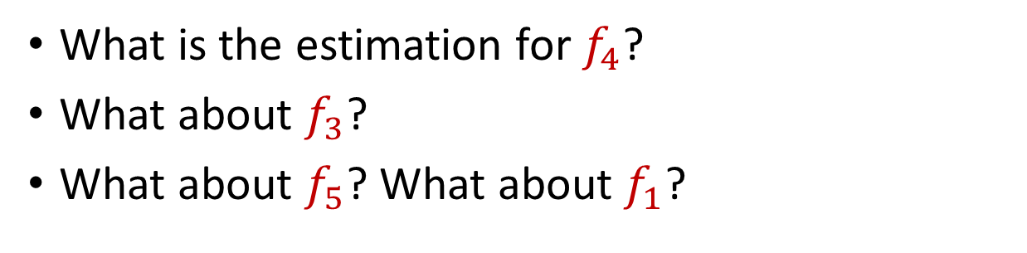
CountMin
$f_{1}$ | $f_{2}$ | $f_{3}$ | $f_{4}$ | $f_{5}$ | $f_{6}$ | $f_{7}$
2 | 1 | 1 | 0 | 1 | 0 | 0
What is the estimation for $f_{4}$?
What about $f_{3}$?
What about $f_{5}$? What about $f_{1}$?
$$h\left(x\right)=3x+2 (mod 4)$$
$c_{1}$ | $c_{2}$ | $c_{3}$ | $c_{4}$
3 | 0 | 1 | 1

Slide 76
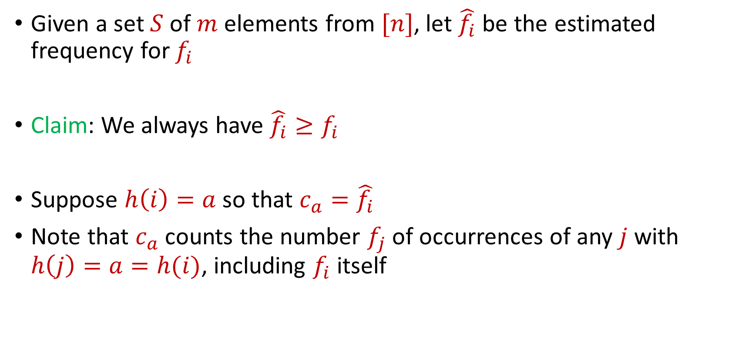
CountMin
Given a set $S$ of $m$ elements from $[n]$, let $\hat{f_{i}}$ be the estimated frequency for $f_{i}$
Claim: We always have $\hat{f_{i}}≥f_{i}$
Suppose $h\left(i\right)=a$ so that $c_{a}=\hat{f_{i}}$
Note that $c_{a}$counts the number $f_{j}$of occurrences of any $j$ with $h\left(j\right)=a=h(i)$, including $f_{i}$ itself

Slide 77
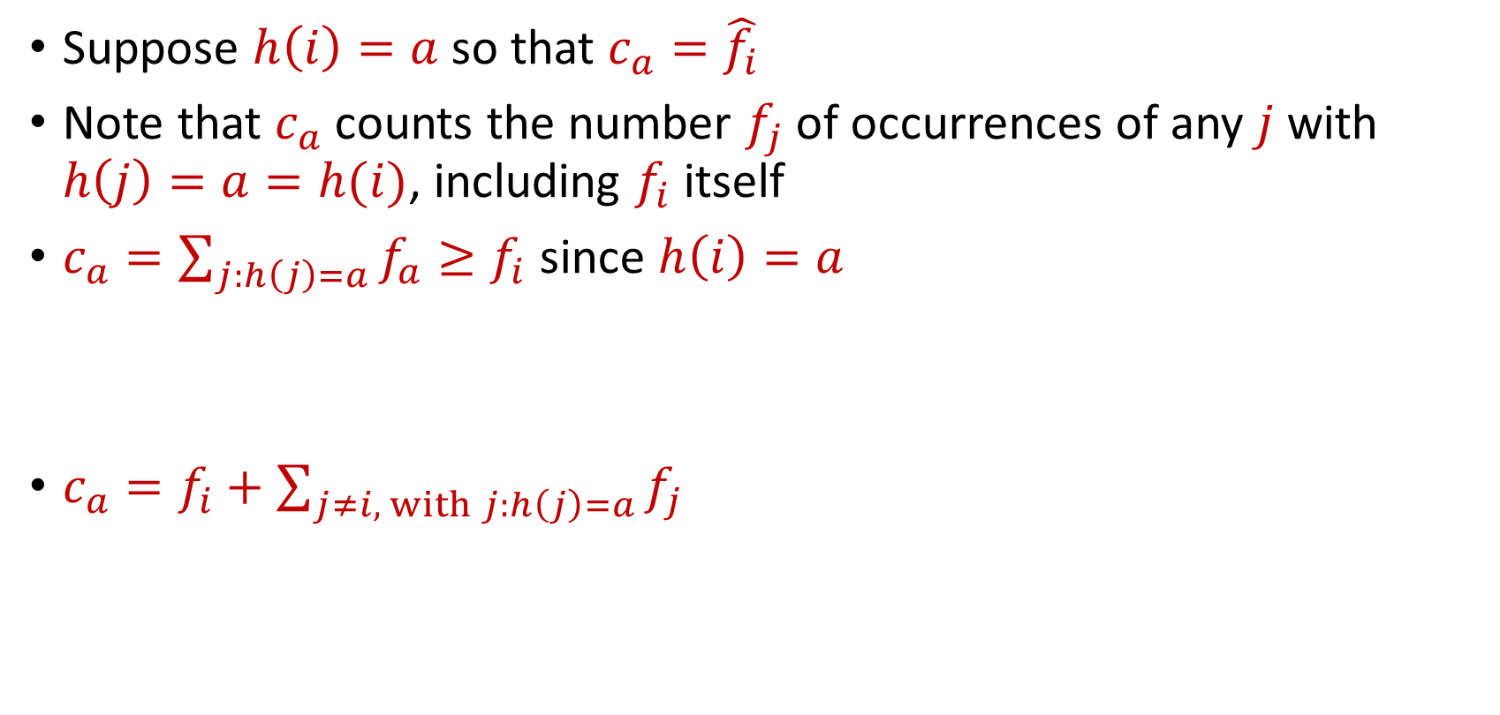
CountMin
Suppose $h\left(i\right)=a$ so that $c_{a}=\hat{f_{i}}$
Note that $c_{a}$counts the number $f_{j}$of occurrences of any $j$ with $h\left(j\right)=a=h(i)$, including $f_{i}$ itself
$c_{a}=\sum_{j:h\left(j\right)=a}{f_{a}}≥f_{i}$ since $h\left(i\right)=a$
$c_{a}=f_{i}+\sum_{j≠i, with j:h\left(j\right)=a}{f_{j}}$

Slide 78
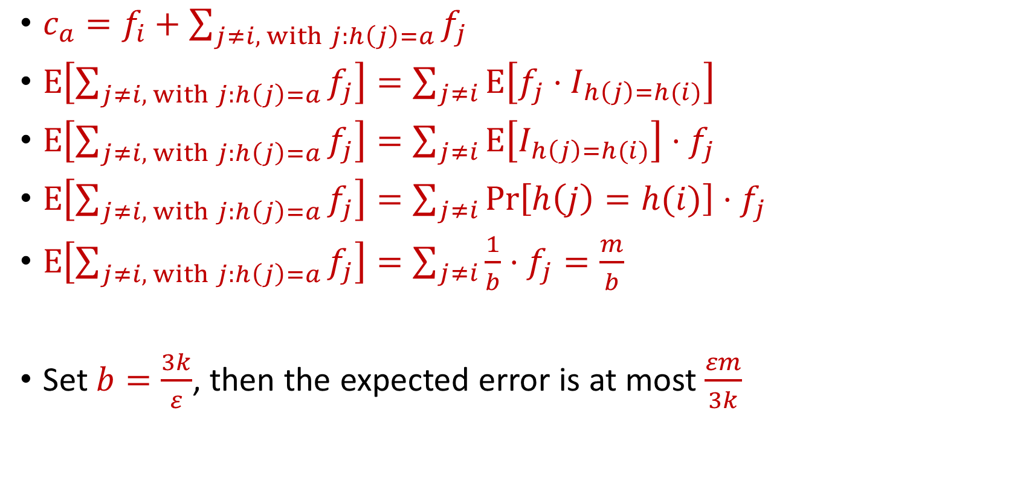
CountMin Error Analysis
$c_{a}=f_{i}+\sum_{j≠i, with j:h\left(j\right)=a}{f_{j}}$
$E\left[\sum_{j≠i, with j:h\left(j\right)=a}{f_{j}}\right]=\sum_{j≠i}{E\left[f_{j}⋅I_{h\left(j\right)=h(i)}\right]}$
$E\left[\sum_{j≠i, with j:h\left(j\right)=a}{f_{j}}\right]=\sum_{j≠i}{E\left[I_{h\left(j\right)=h(i)}\right]⋅f_{j}}$
$E\left[\sum_{j≠i, with j:h\left(j\right)=a}{f_{j}}\right]=\sum_{j≠i}{{Pr\left[h\left(j\right)=h(i)\right]⋅f}_{j}}$
$E\left[\sum_{j≠i, with j:h\left(j\right)=a}{f_{j}}\right]=\sum_{j≠i}{{\frac{1}{b}⋅f}_{j}=\frac{m}{b}}$
Set $b=\frac{3k}{ε}$, then the expected error is at most $\frac{εm}{3k}$

Slide 79
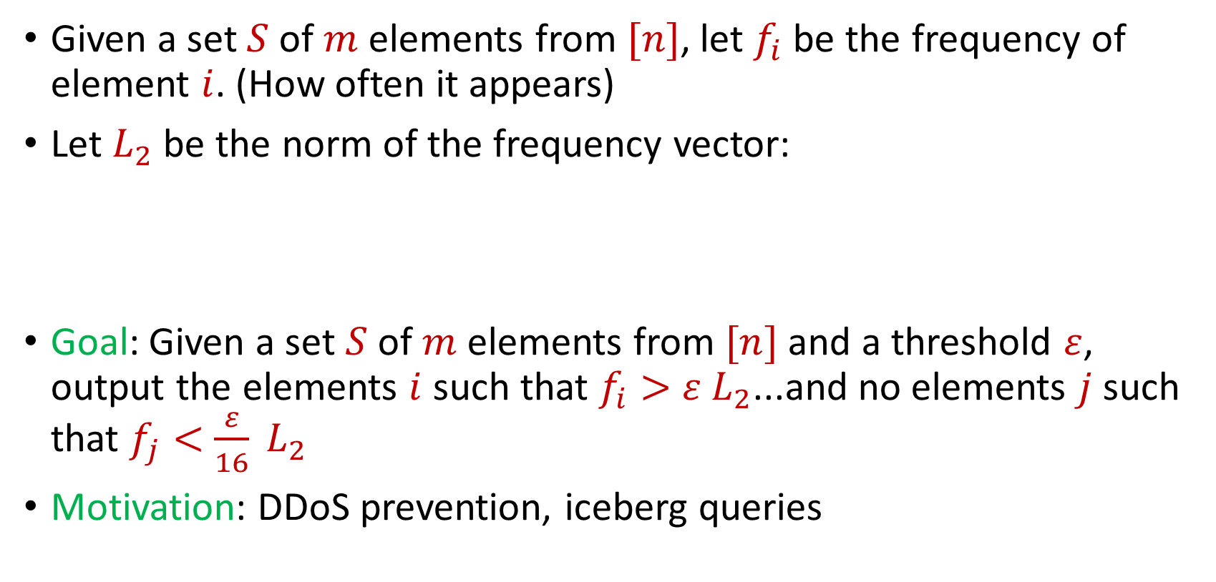

Heavy-Hitters (Frequent Items)
Given a set $S$ of $m$ elements from $[n]$, let $f_{i}$ be the frequency of element $i$. (How often it appears)
Let $L_{2}$ be the norm of the frequency vector:
Goal: Given a set $S$ of $m$ elements from $[n]$ and a threshold $ε$, output the elements $i$ such that $f_{i}>$ $ε L_{2}$...and no elements $j$ such that $f_{j}<$ $\frac{ε}{16} L_{2}$
Motivation: DDoS prevention, iceberg queries
$$L_{2}=\sqrt{f_{1}^{2}+f_{2}^{2}+…+f_{n}^{2}}$$

Slide 80



Frequency Moments ($L_{p}$ Norm)
Given a set $S$ of $m$ elements from $[n]$, let $f_{i}$ be the frequency of element $i$. (How often it appears)
Let $F_{p}$ be the frequency moment of the vector:
Goal: Given a set $S$ of $m$ elements from $[n]$ and an accuracy parameter $ε$, output a $(1+ε)$-approximation to $F_{p}$
Motivation: Entropy estimation, linear regression
$F_{p}=$ $f_{1}^{p}+f_{2}^{p}+…+f_{n}^{p}$

Slide 81


Distinct Elements ($F_{0}$ Estimation)
Given a set $S$ of $m$ elements from $[n]$, let $f_{i}$ be the frequency of element $i$. (How often it appears)
Let $F_{0}$ be the frequency moment of the vector:
Goal: Given a set $S$ of $m$ elements from $[n]$ and an accuracy parameter $ε$, output a $(1+ε)$-approximation to $F_{0}$
Motivation: Traffic monitoring
$F_{0}=$ $|\{i :f_{i}≠0\}|$

