Slide 1
CSCE 658: Randomized Algorithms
Lecture 13
Samson Zhou

Slide 2
Class Logistics
March 5: Lecture canceled, i.e., do NOT show up to HRBB 126 (unless you want to see an empty classroom)

Slide 3
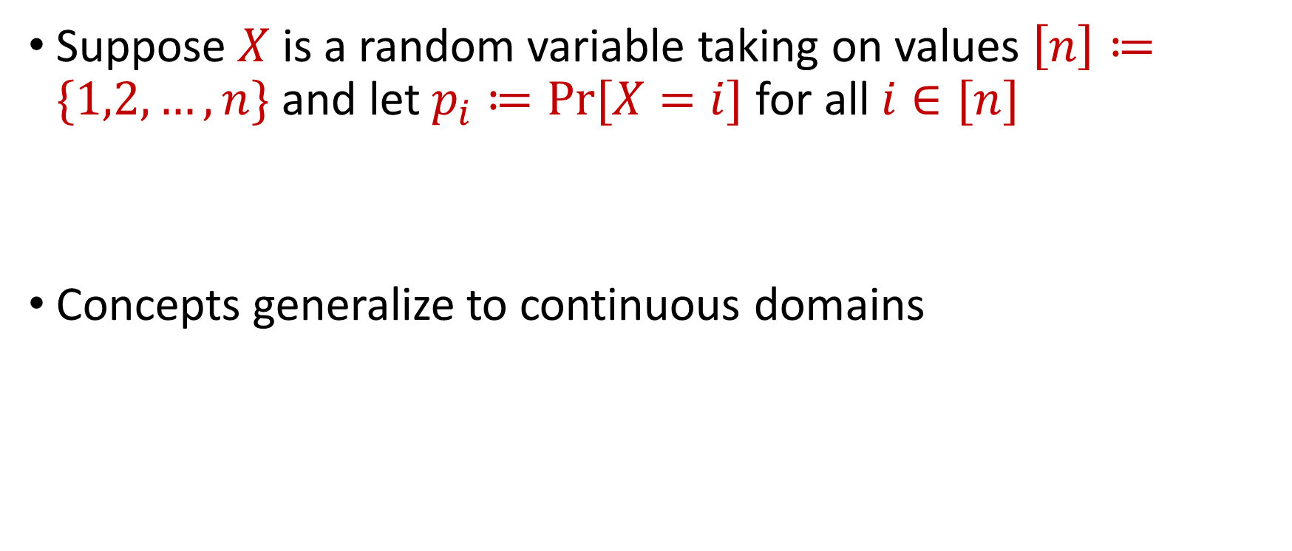
Information Theory
Suppose $X$ is a random variable taking on values $\left[n\right]≔\{1,2,…,n\}$ and let $p_{i}≔Pr⁡[X=i]$ for all $i∈[n]$
Concepts generalize to continuous domains

Slide 4
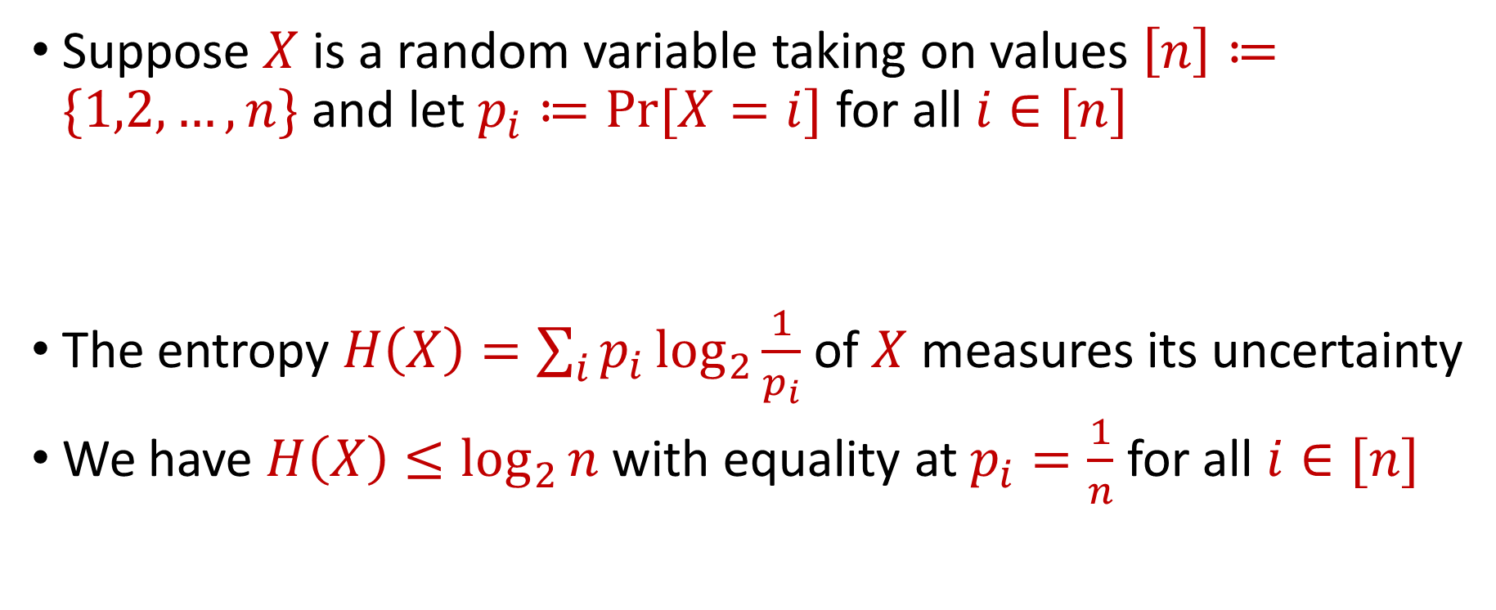
Entropy
Suppose $X$ is a random variable taking on values $\left[n\right]≔\{1,2,…,n\}$ and let $p_{i}≔Pr⁡[X=i]$ for all $i∈[n]$
The entropy $H\left(X\right)=\sum_{i}{p_{i}\log_{2}{\frac{1}{p_{i}}}}$ of $X$ measures its uncertainty
We have $H\left(X\right)≤\log_{2}{n}$ with equality at $p_{i}=\frac{1}{n}$ for all $i∈[n]$

Slide 5
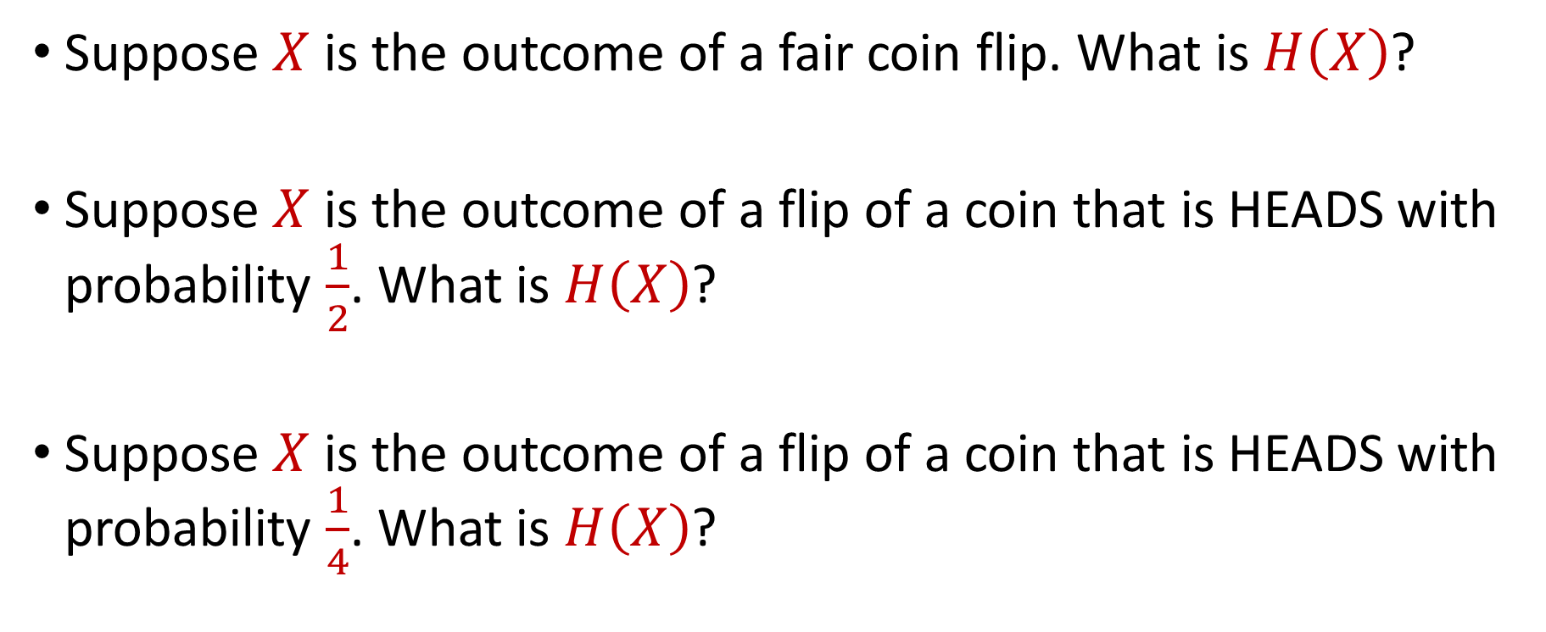
Entropy
Suppose $X$ is the outcome of a fair coin flip. What is $H\left(X\right)$?
Suppose $X$ is the outcome of a flip of a coin that is HEADS with probability $\frac{1}{2}$. What is $H\left(X\right)$?
Suppose $X$ is the outcome of a flip of a coin that is HEADS with probability $\frac{1}{4}$. What is $H\left(X\right)$?

Slide 6
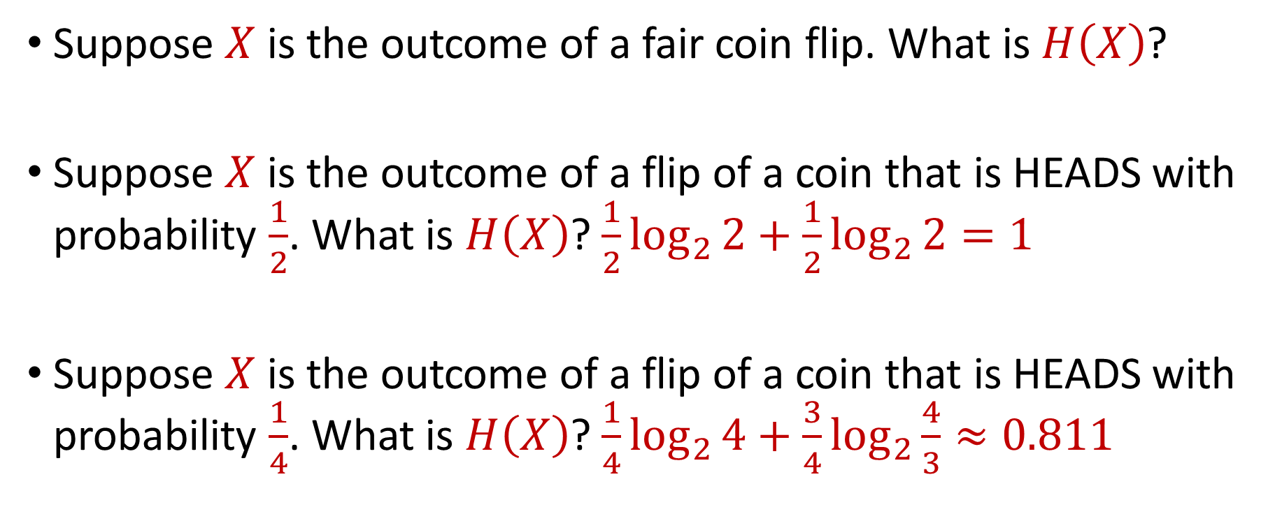
Entropy
Suppose $X$ is the outcome of a fair coin flip. What is $H\left(X\right)$?
Suppose $X$ is the outcome of a flip of a coin that is HEADS with probability $\frac{1}{2}$. What is $H\left(X\right)$? $\frac{1}{2}\log_{2}{2+\frac{1}{2}\log_{2}{2}}=1$
Suppose $X$ is the outcome of a flip of a coin that is HEADS with probability $\frac{1}{4}$. What is $H\left(X\right)$? $\frac{1}{4}\log_{2}{4+\frac{3}{4}\log_{2}{\frac{4}{3}}}≈0.811$

Slide 7
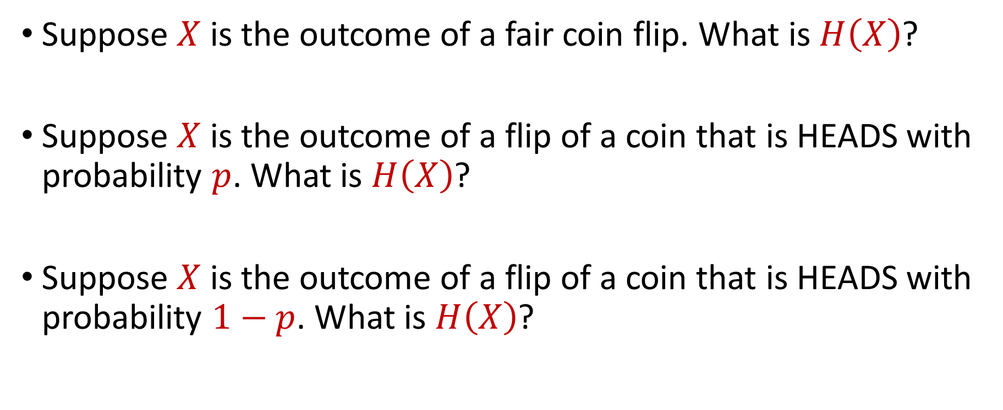
Entropy
Suppose $X$ is the outcome of a fair coin flip. What is $H\left(X\right)$?
Suppose $X$ is the outcome of a flip of a coin that is HEADS with probability $p$. What is $H\left(X\right)$?
Suppose $X$ is the outcome of a flip of a coin that is HEADS with probability $1−p$. What is $H\left(X\right)$?

Slide 8
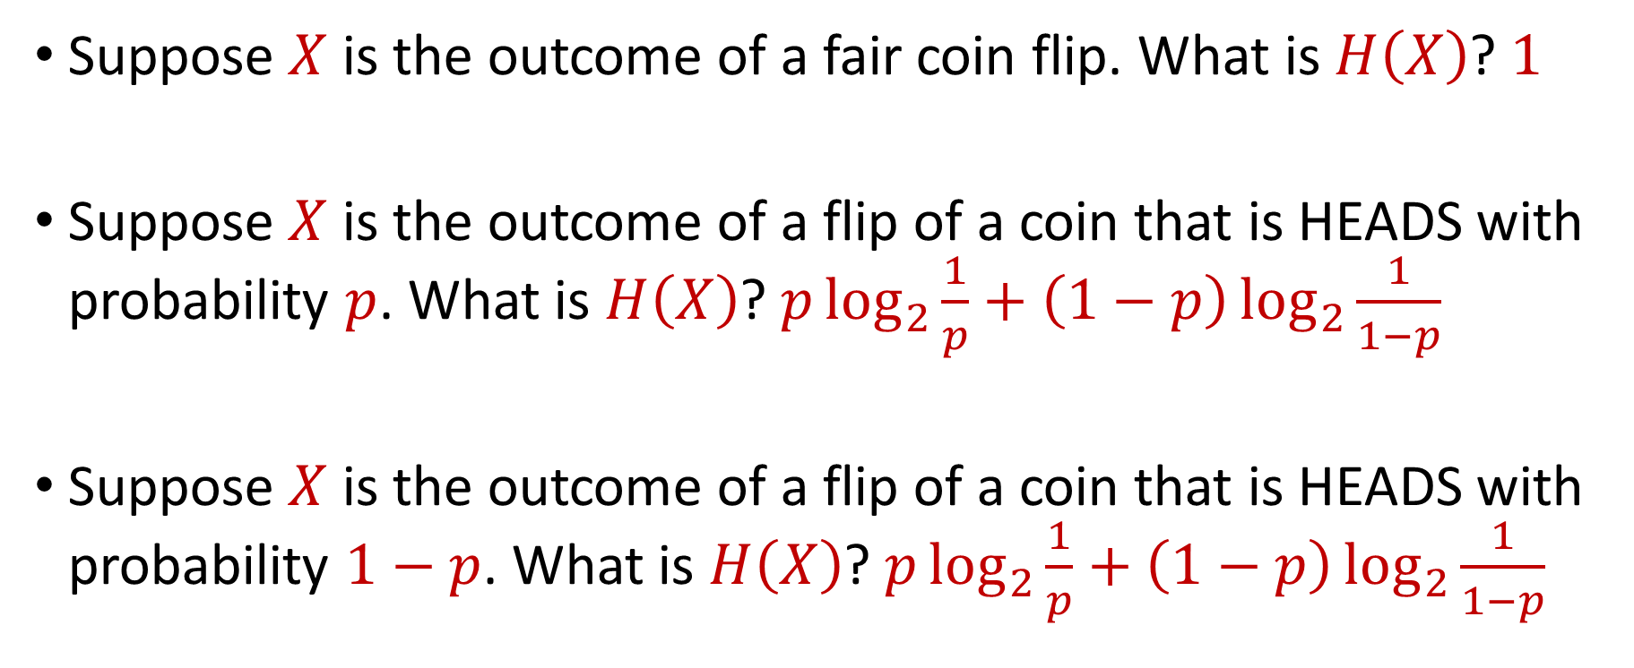
Entropy
Suppose $X$ is the outcome of a fair coin flip. What is $H\left(X\right)$? $1$
Suppose $X$ is the outcome of a flip of a coin that is HEADS with probability $p$. What is $H\left(X\right)$? $p\log_{2}{\frac{1}{p}+\left(1−p\right)\log_{2}{\frac{1}{1−p}}}$
Suppose $X$ is the outcome of a flip of a coin that is HEADS with probability $1−p$. What is $H\left(X\right)$? $p\log_{2}{\frac{1}{p}+\left(1−p\right)\log_{2}{\frac{1}{1−p}}}$

Slide 9
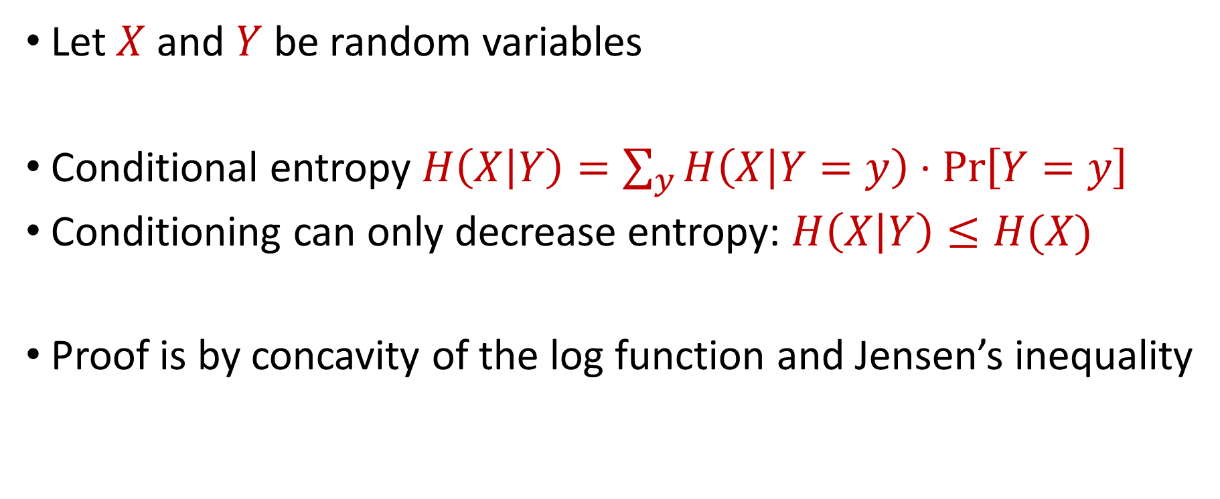
Conditional and Joint Entropy
Let $X$ and $Y$ be random variables
Conditional entropy $H\left(X | Y\right)=\sum_{y}{H\left(X | Y=y\right)}⋅\operatorname{Pr}\left[Y=y\right]$
Conditioning can only decrease entropy: $H\left(X | Y\right)≤H(X)$
Proof is by concavity of the log function and Jensen’s inequality

Slide 10
Joint Entropy
Joint entropy:
$H(X,Y)=\sum_{x,y}{\operatorname{Pr}\left[\left(X,Y\right)=\left(x,y\right)\right]}⋅\log_{2}{\frac{1}{\operatorname{Pr}\left[\left(X,Y\right)=\left(x,y\right)\right]}}$

Slide 11
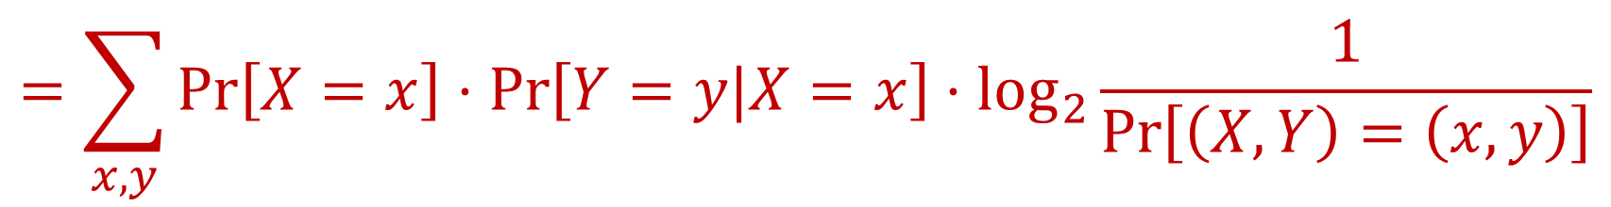

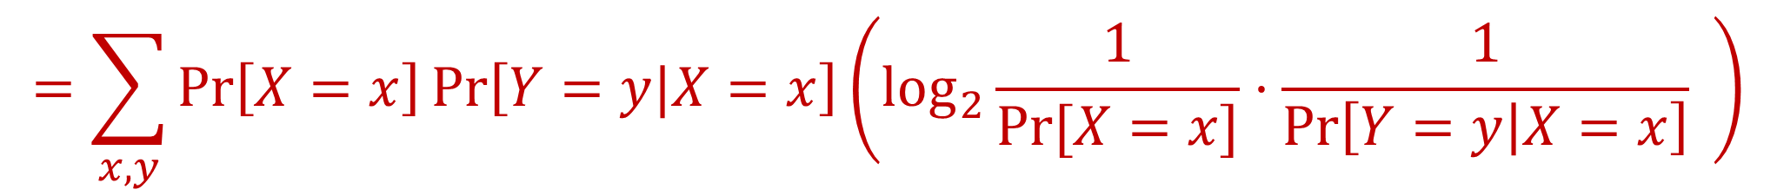
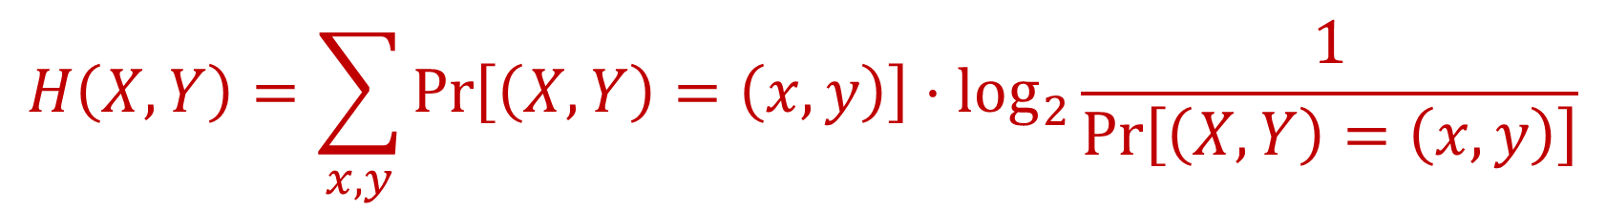
Chain Rule for Entropy
$H\left(X,Y\right)=H\left(X\right)+H(Y|X)$
$$H\left(X,Y\right)=\sum_{x,y}{\operatorname{Pr}\left[\left(X,Y\right)=\left(x,y\right)\right]}⋅\log_{2}{\frac{1}{\operatorname{Pr}\left[\left(X,Y\right)=\left(x,y\right)\right]}}$$
$$=\sum_{x,y}{\operatorname{Pr}\left[X=x\right]⋅\operatorname{Pr}\left[Y=y|X=x\right]}⋅\log_{2}{\frac{1}{\operatorname{Pr}\left[\left(X,Y\right)=\left(x,y\right)\right]}}$$
$$=\sum_{x,y}{\operatorname{Pr}\left[X=x\right]\operatorname{Pr}\left[Y=y|X=x\right]}\left(\log_{2}{\frac{1}{Pr⁡[X=x]}⋅\frac{1}{\operatorname{Pr}\left[Y=y | X=x\right]}} \right)$$

Slide 12
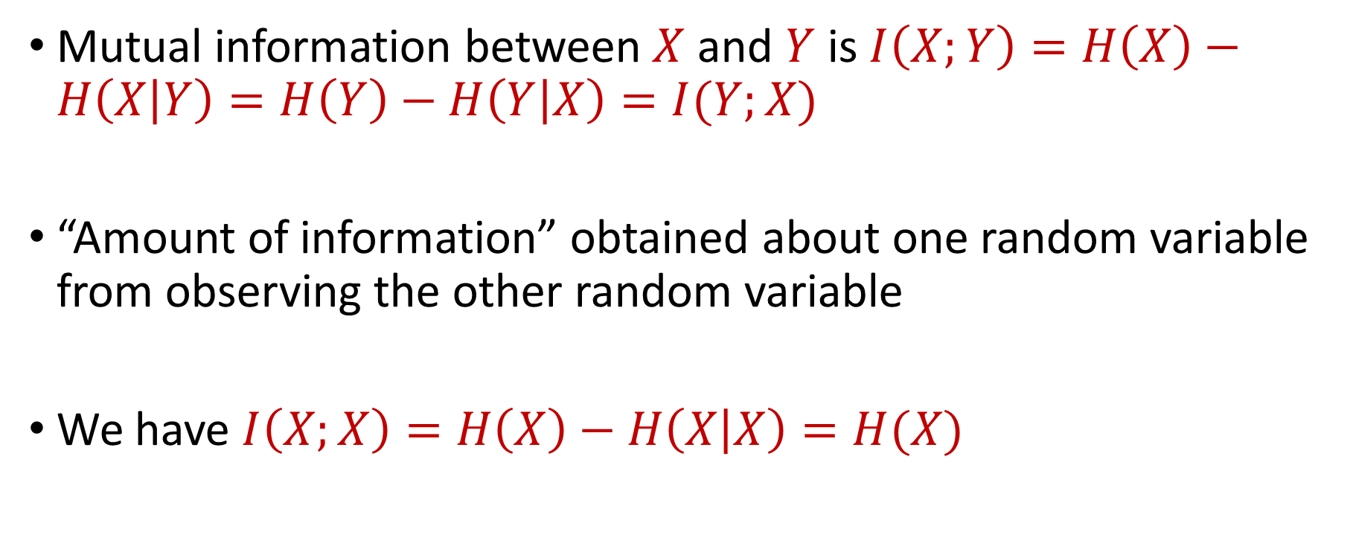
Mutual Information
Mutual information between $X$ and $Y$ is $I\left(X;Y\right)=H\left(X\right)−H\left(X | Y\right)=H\left(Y\right)−H\left(Y | X\right)=I(Y;X)$
“Amount of information” obtained about one random variable from observing the other random variable
We have $I\left(X;X\right)=H\left(X\right)−H\left(X | X\right)=H(X)$

Slide 13
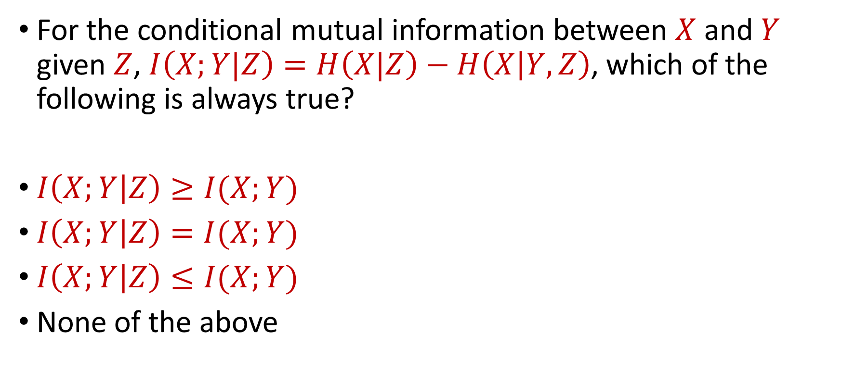
Trivia Question #9 (Conditional Mutual Information)
For the conditional mutual information between $X$ and $Y$ given $Z$, $I\left(X;Y|Z\right)=H\left(X|Z\right)−H\left(X | Y,Z\right)$, which of the following is always true?
$I\left(X;Y | Z\right)≥I(X;Y)$
$I\left(X;Y | Z\right)=I(X;Y)$
$I\left(X;Y | Z\right)≤I(X;Y)$
None of the above

Slide 14
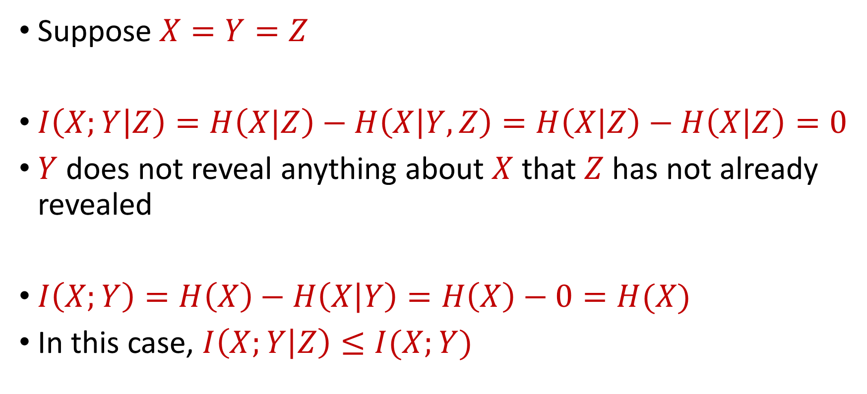
Conditional Mutual Information
Suppose $X=Y=Z$
$I\left(X;Y | Z\right)=H\left(X|Z\right)−H\left(X | Y,Z\right)=H\left(X | Z\right)−H\left(X | Z\right)=0$
$Y$ does not reveal anything about $X$ that $Z$ has not already revealed
$I\left(X;Y\right)=H\left(X\right)−H\left(X | Y\right)=H\left(X\right)−0=H(X)$
In this case, $I\left(X;Y | Z\right)≤I(X;Y)$

Slide 15
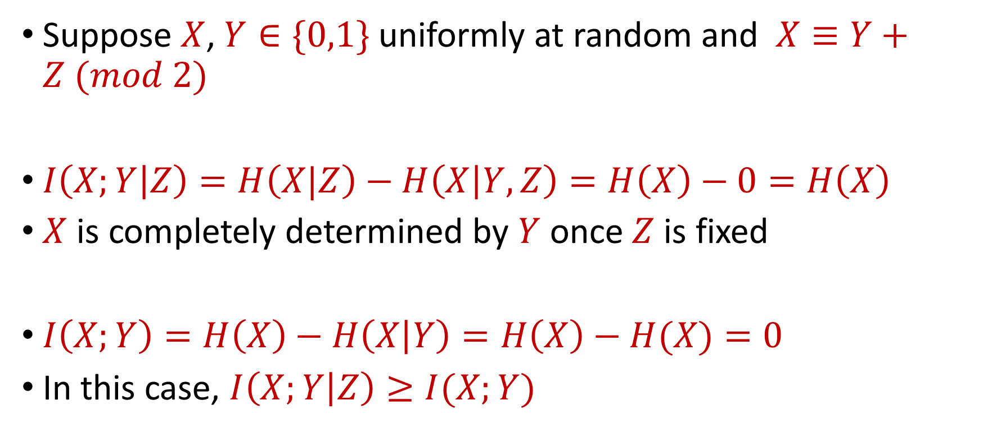
Conditional Mutual Information
Suppose $X$, $Y∈\{0,1\}$ uniformly at random and $X≡Y+Z (mod 2)$
$I\left(X;Y | Z\right)=H\left(X|Z\right)−H\left(X | Y,Z\right)=H\left(X\right)−0=H\left(X\right)$
$X$ is completely determined by $Y$ once $Z$ is fixed
$I\left(X;Y\right)=H\left(X\right)−H\left(X | Y\right)=H\left(X\right)−H(X)=0$
In this case, $I\left(X;Y | Z\right)≥I(X;Y)$

Slide 16


Chain Rule for Mutual Information
$I\left(X,Y;Z\right)=I\left(X;Z\right)+I(Y;Z|X)$
By induction, $I\left(X_{1},…X_{n};Z\right)=\sum_{i}{I(X_{i};Z|X_{1},…,X_{i−1})}$
$I\left(X,Y;Z\right)=H\left(X,Y\right) −H\left(X,Y | Z\right)$
(Chain Rule for Entropy)
$$=H\left(X\right)+H\left(Y | X\right)−H\left(X | Z\right)−H(Y|X,Z)$$
$$=I\left(X;Z\right)+I(Y;Z|X)$$

Slide 17
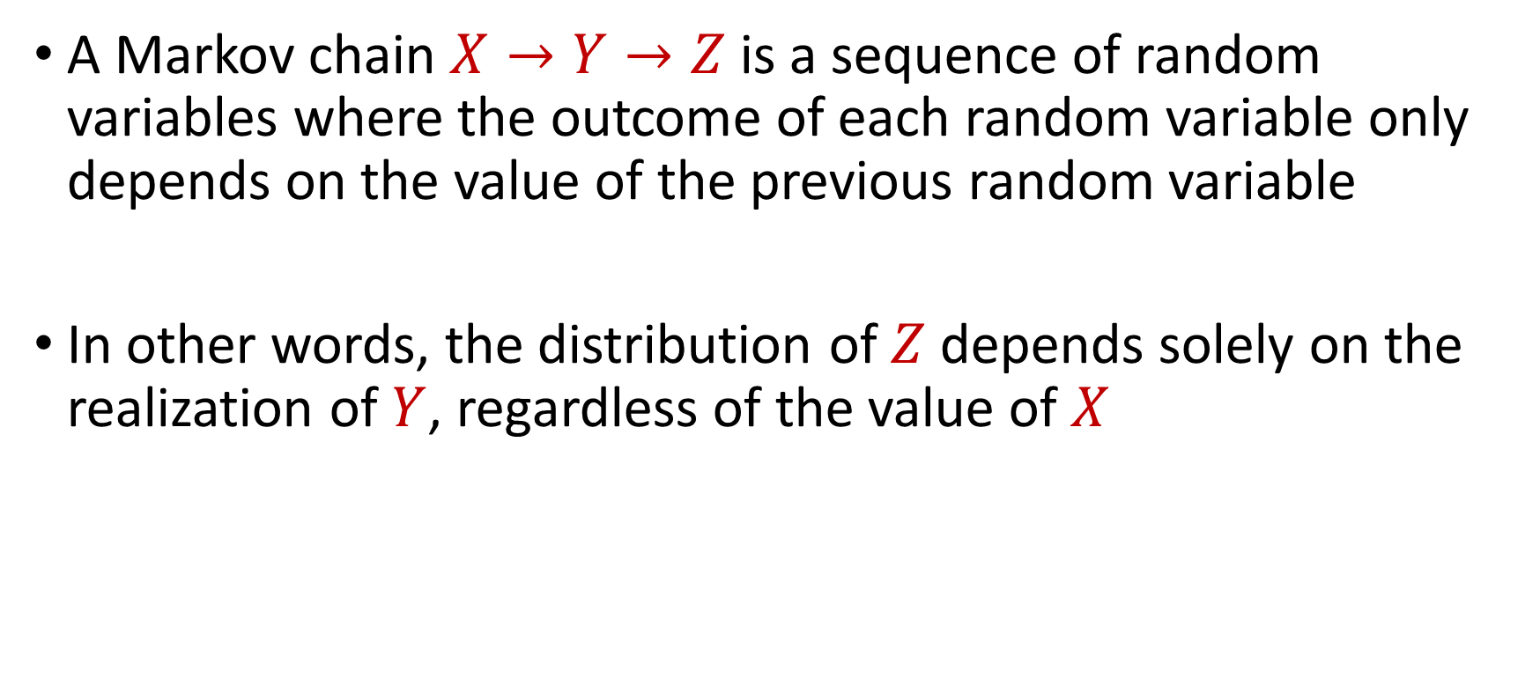
Markov Chain
A Markov chain $X→Y→Z$ is a sequence of random variables where the outcome of each random variable only depends on the value of the previous random variable
In other words, the distribution of $Z$ depends solely on the realization of $Y$, regardless of the value of $X$

Slide 18

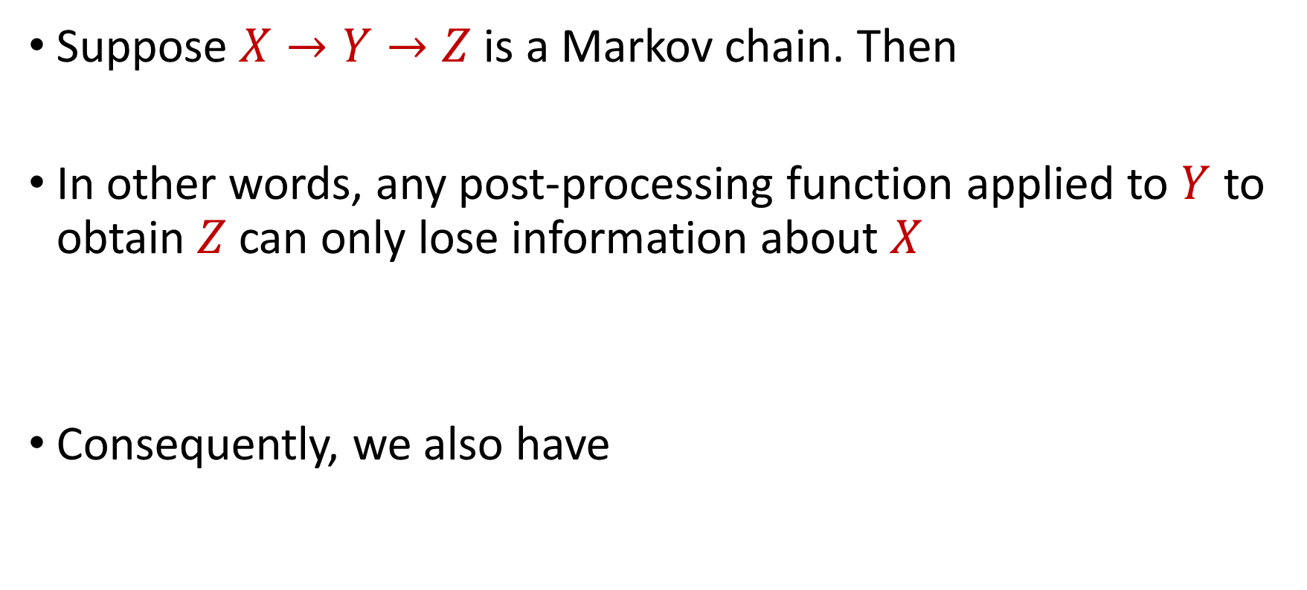

Data Processing Inequality
Suppose $X→Y→Z$ is a Markov chain. Then
In other words, any post-processing function applied to $Y$ to obtain $Z$ can only lose information about $X$
Consequently, we also have
$$I\left(X;Z\right)≤I(X;Y)$$
$$H\left(X | Y\right)≤H(X|Z)$$

Slide 19
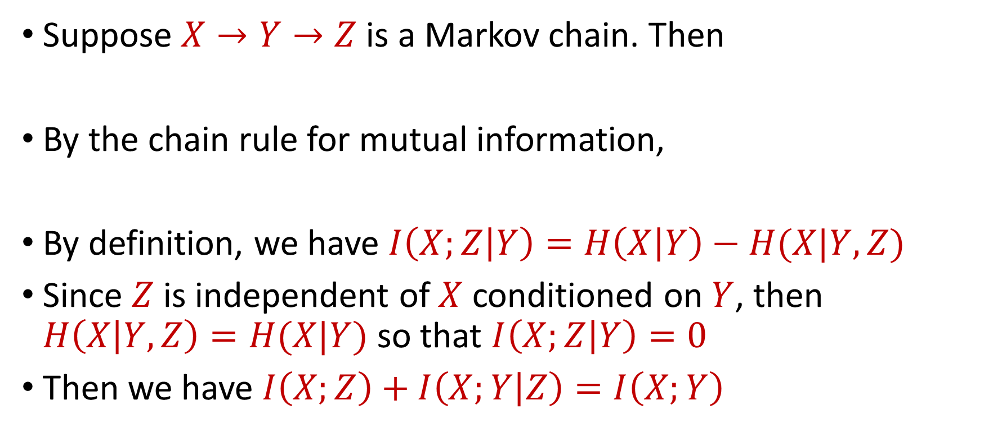
Data Processing Inequality
Suppose $X→Y→Z$ is a Markov chain. Then
By the chain rule for mutual information,
By definition, we have $I\left(X;Z | Y\right)=H\left(X | Y\right)−H(X|Y,Z)$
Since $Z$ is independent of $X$ conditioned on $Y$, then $H\left(X | Y,Z\right)=H(X|Y)$ so that $I\left(X;Z | Y\right)=0$
Then we have $I\left(X;Z\right)+I\left(X;Y | Z\right)=I\left(X;Y\right)$
$$I\left(X;Z\right)≤I(X;Y)$$
$$I\left(X;Y,Z\right)=I\left(X;Z\right)+I\left(X;Y | Z\right)=I\left(X;Y\right)+I\left(X;Z | Y\right)$$

Slide 20
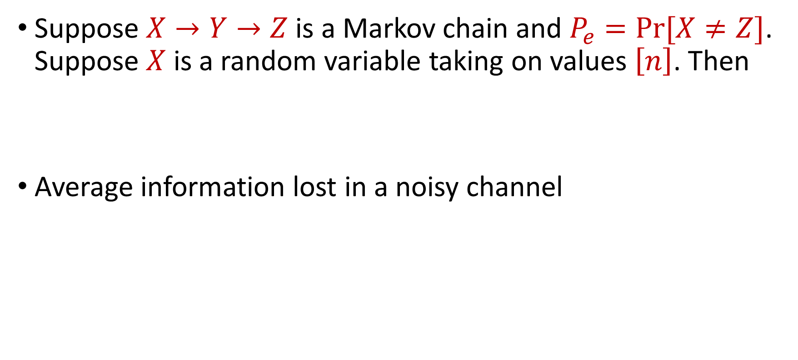
Fano’s Inequality
Suppose $X→Y→Z$ is a Markov chain and $P_{e}=Pr⁡[X≠Z]$. Suppose $X$ is a random variable taking on values $\left[n\right]$. Then
Average information lost in a noisy channel
$$H\left(X | Y\right)≤H\left(P_{e}\right)+P_{e}⋅\log_{2}(n−1)$$

Slide 21
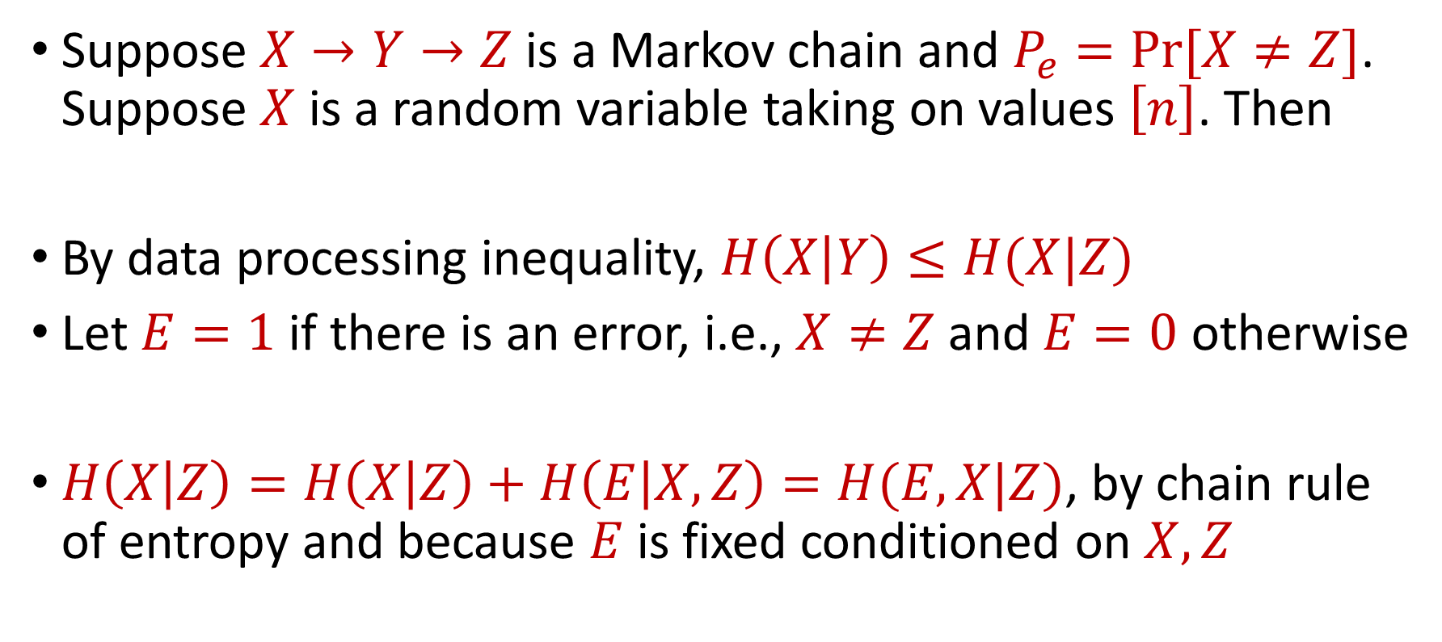
Fano’s Inequality
Suppose $X→Y→Z$ is a Markov chain and $P_{e}=Pr⁡[X≠Z]$. Suppose $X$ is a random variable taking on values $\left[n\right]$. Then
By data processing inequality, $H\left(X | Y\right)≤H(X|Z)$
Let $E=1$ if there is an error, i.e., $X≠Z$ and $E=0$ otherwise
$H\left(X | Z\right)=H\left(X | Z\right)+H\left(E | X,Z\right)=H(E,X|Z)$, by chain rule of entropy and because $E$ is fixed conditioned on $X,Z$
$$H\left(X | Y\right)≤H\left(P_{e}\right)+P_{e}⋅\log_{2}(n−1)$$

Slide 22
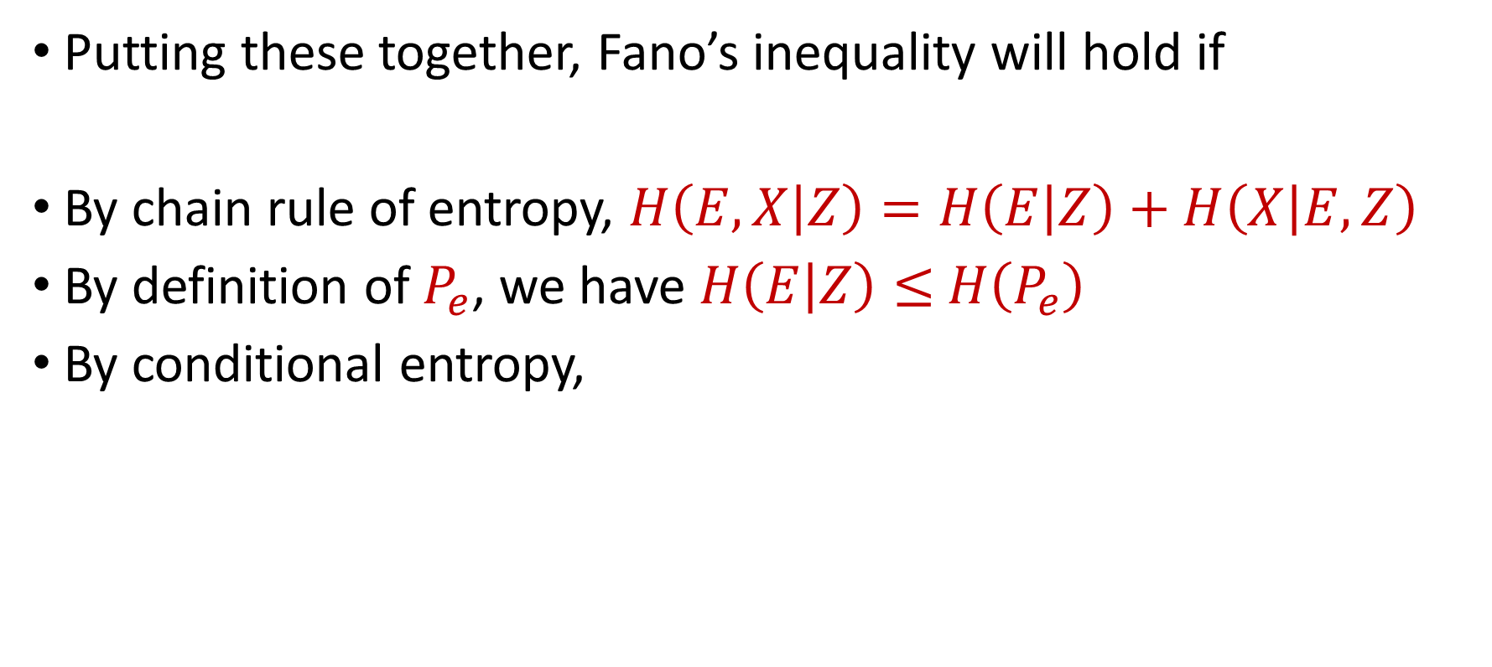

Fano’s Inequality
Putting these together, Fano’s inequality will hold if
By chain rule of entropy, $H\left(E,X | Z\right)=H\left(E | Z\right)+H\left(X | E,Z\right)$
By definition of $P_{e}$, we have $H\left(E | Z\right)≤$ $H\left(P_{e}\right)$
By conditional entropy,
$$H(E,X|Z)≤H\left(P_{e}\right)+P_{e}⋅\log_{2}(n−1)$$
$$H\left(X | E,Z\right)=\operatorname{Pr}\left[E=0\right]H\left(X | X^{′},E=0\right)+\operatorname{Pr}\left[E=1\right]H(X|X^{′},E=1)$$
$$=\left(1−P_{e}\right)⋅0+P_{e}⋅H(X|X^{′},E=1)$$
$$≤P_{e}⋅\log_{2}(n−1)$$

Slide 23
Communication Complexity
Multiple players each hold an input and are trying to solve a problem on the collection of their inputs
Multiple models: blackboard setting, number-on-forehead

Slide 24





Communication Complexity
Two-player communication problem
Alice holds some input $A$ and Bob holds some input $B$
One-way communication or total communication
$$A$$
$$B$$

Slide 25




Index Problem
Alice holds some input $A∈{\left\{0,1\right\}}^{n}$ and Bob holds some input $B≔i∈[n]$
Goal: Alice sends a message to Bob so that with probability at least $\frac{2}{3}$ (over the protocol’s randomness), Bob can determine $A_{i}$
$$A∈{\left\{0,1\right\}}^{n}$$
$$i∈[n]$$
$$M$$

Slide 26


Index Problem
Suppose $A∈{\left\{0,1\right\}}^{n}$ is drawn uniformly at random
Alice sends $M$ to Bob, so that for all $i∈[n]$, $\operatorname{Pr}\left[\hat{A_{i}}=A_{i}\right]≥\frac{2}{3}$
By Fano’s inequality, $H\left(A_{i} | M\right)≤H\left(\frac{2}{3}\right)+\frac{1}{3}\left(\log_{2}{2−1}\right)=H\left(\frac{2}{3}\right)$
$$A∈{\left\{0,1\right\}}^{n}$$
$$i∈[n]$$
$$Π$$

Slide 27
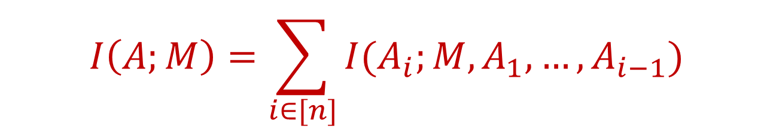

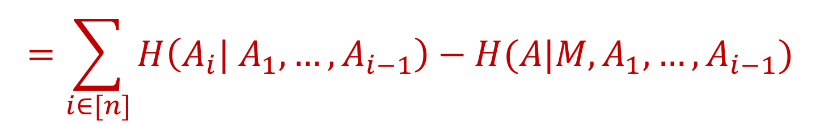
Index Problem
By the chain rule for mutual information,
Since the bits of $A$ are independent, $H\left(A_{i}| A_{1},…,A_{i−1}\right)=1$.
Since conditioning can only decrease entropy, $H\left(A | M,A_{1},…,A_{i−1}\right)≤H\left(A | M\right)≤H\left(\frac{2}{3}\right)$
$$I\left(A;M\right)=\sum_{i∈[n]}{I(A_{i};M,A_{1},…,A_{i−1})}$$
$$=\sum_{i∈[n]}{H\left(A_{i}| A_{1},…,A_{i−1}\right)−H(A|M,A_{1},…,A_{i−1})}$$

Slide 28


Index Problem
By the chain rule for mutual information,
Thus, we have that $\left|M\right|≥H\left(M\right)≥I\left(A;M\right)=Ω(n)$
$$I\left(A;M\right)=\sum_{i∈[n]}{I(A_{i};M,A_{1},…,A_{i−1})}$$
$$=\sum_{i∈[n]}{H\left(A_{i}| A_{1},…,A_{i−1}\right)−H(A|M,A_{1},…,A_{i−1})}$$
$$=\sum_{i∈[n]}{1−H\left(\frac{1}{3}\right)=Ω(n)}$$

Slide 29
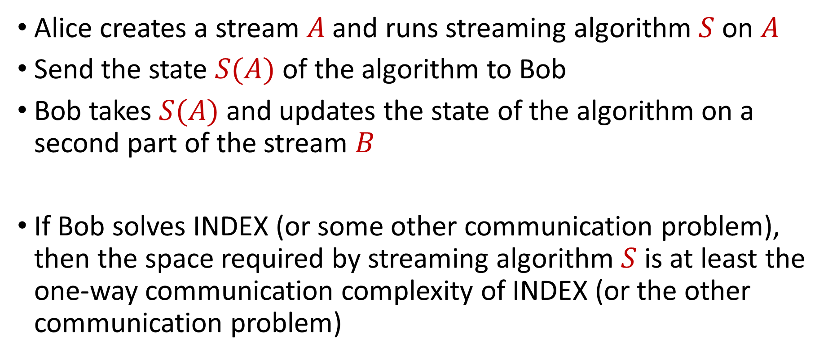
Streaming Lower Bounds
Alice creates a stream $A$and runs streaming algorithm $S$ on $A$
Send the state $S(A)$ of the algorithm to Bob
Bob takes $S(A)$ and updates the state of the algorithm on a second part of the stream $B$
If Bob solves INDEX (or some other communication problem), then the space required by streaming algorithm $S$ is at least the one-way communication complexity of INDEX (or the other communication problem)

Slide 30
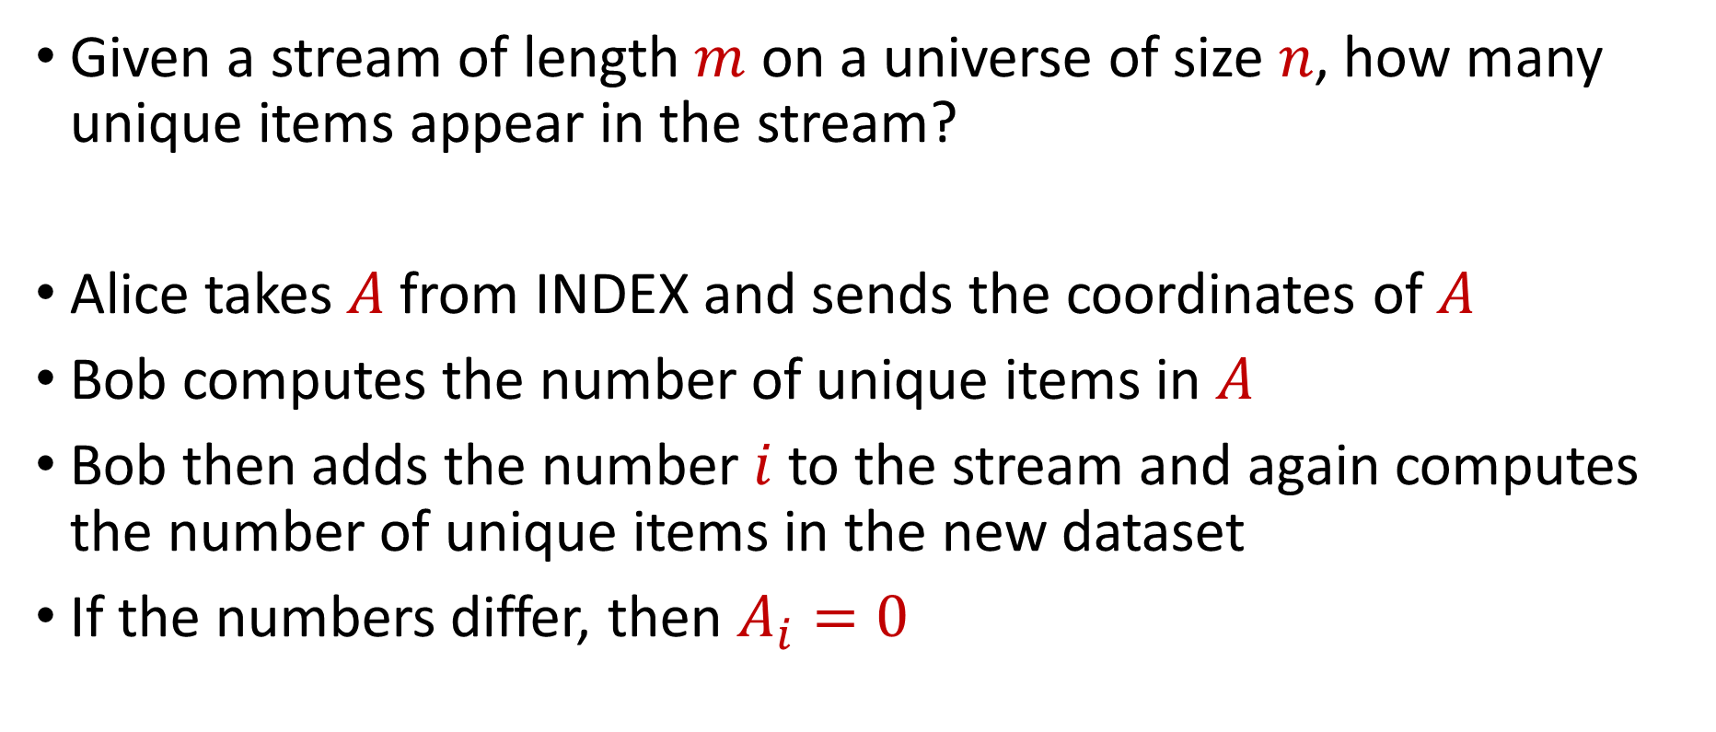
Streaming Lower Bounds, Example 1
Given a stream of length $m$ on a universe of size $n$, how many unique items appear in the stream?
Alice takes $A$from INDEX and sends the coordinates of $A$
Bob computes the number of unique items in $A$
Bob then adds the number $i$ to the stream and again computes the number of unique items in the new dataset
If the numbers differ, then $A_{i}=0$

Slide 31
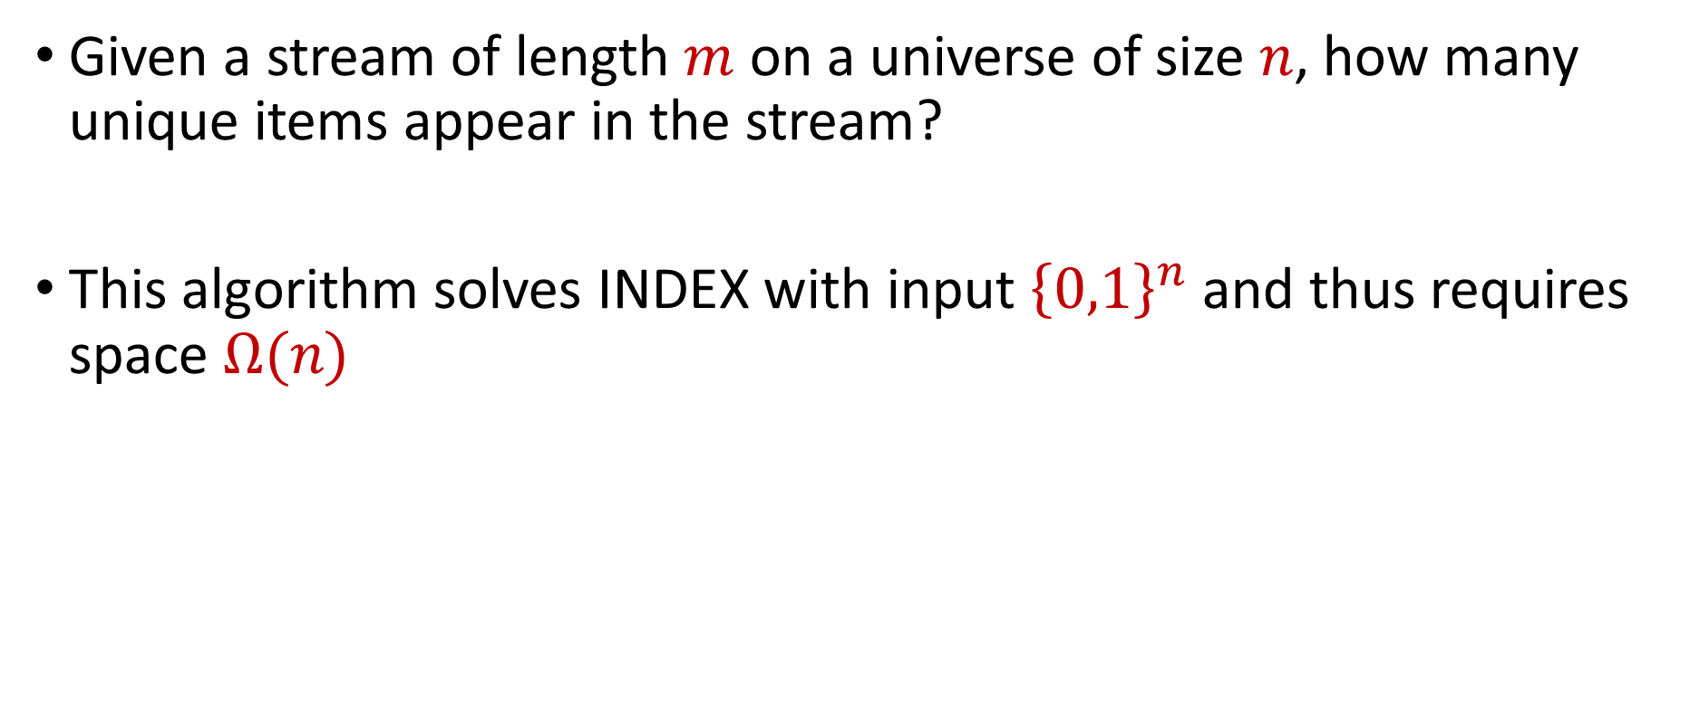
Streaming Lower Bounds, Example 1
Given a stream of length $m$ on a universe of size $n$, how many unique items appear in the stream?
This algorithm solves INDEX with input ${\left\{0,1\right\}}^{n}$ and thus requires space $Ω(n)$

Slide 32
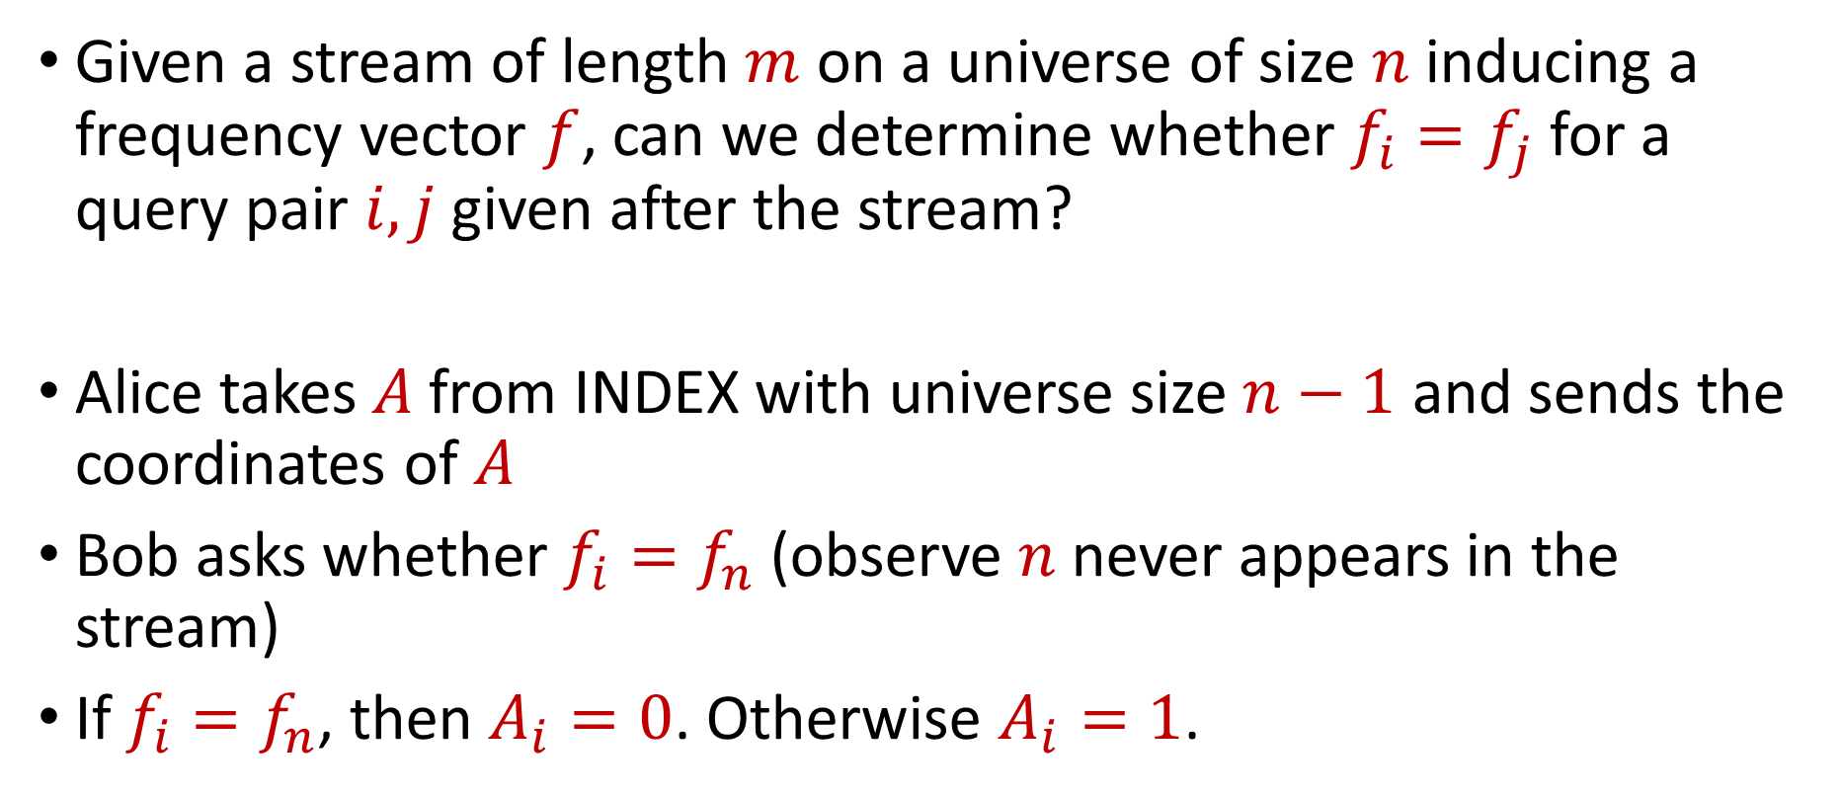
Streaming Lower Bounds, Example 2
Given a stream of length $m$ on a universe of size $n$ inducing a frequency vector $f$, can we determine whether $f_{i}=f_{j}$ for a query pair $i,j$ given after the stream?
Alice takes $A$from INDEX with universe size $n−1$ and sends the coordinates of $A$
Bob asks whether $f_{i}=f_{n}$ (observe $n$ never appears in the stream)
If $f_{i}=f_{n}$, then $A_{i}=0$. Otherwise $A_{i}=1$.

Slide 33
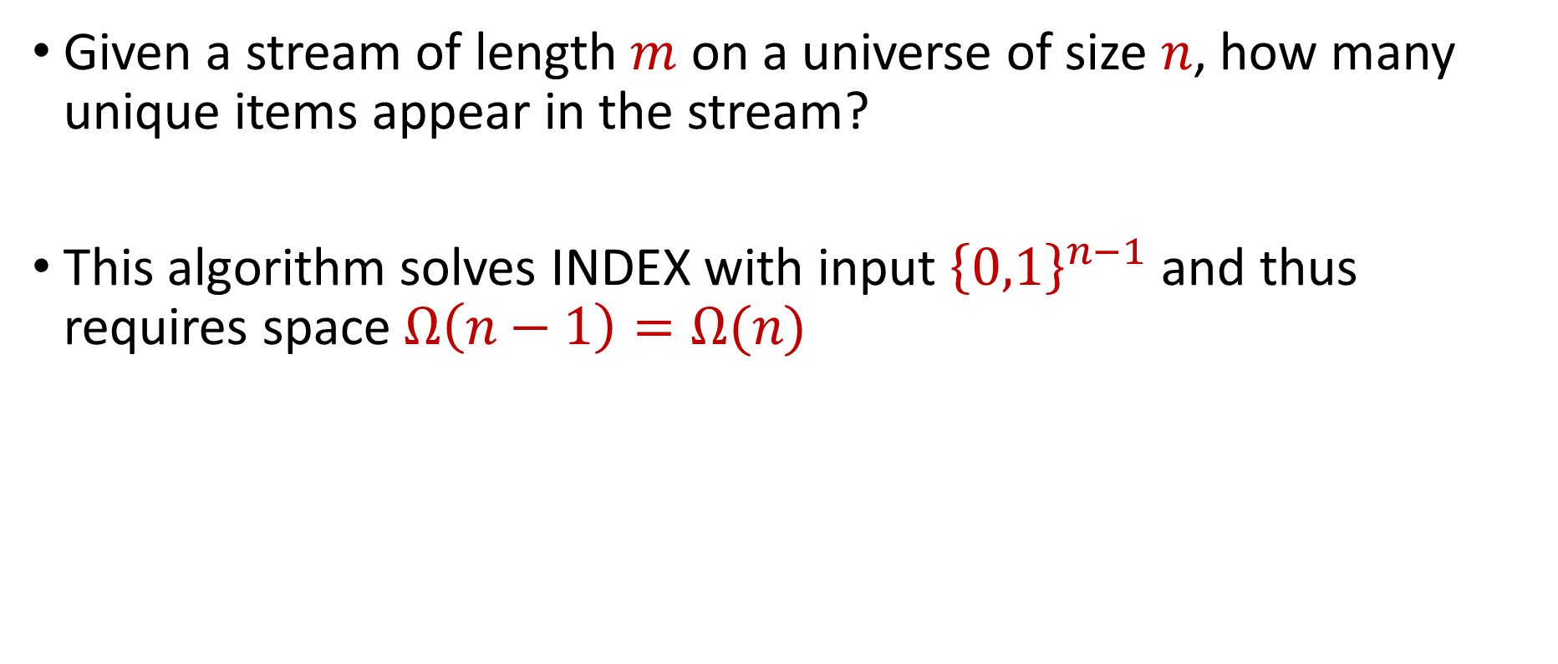
Streaming Lower Bounds, Example 2
Given a stream of length $m$ on a universe of size $n$, how many unique items appear in the stream?
This algorithm solves INDEX with input ${\left\{0,1\right\}}^{n−1}$ and thus requires space $Ω\left(n−1\right)=Ω(n)$

