Slide 1
CSCE 658: Randomized Algorithms
Lecture 16
Samson Zhou

Slide 2
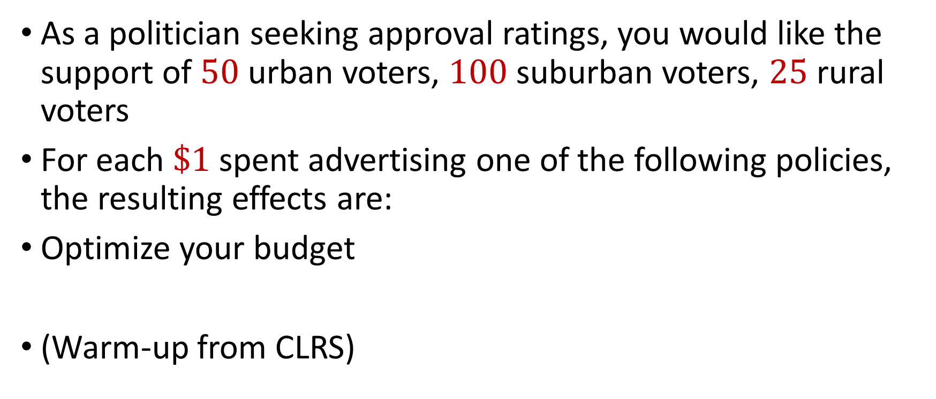
Political Problems…
As a politician seeking approval ratings, you would like the support of $50$ urban voters, $100$ suburban voters, $25$ rural voters
For each $\$1$ spent advertising one of the following policies, the resulting effects are:
Optimize your budget
(Warm-up from CLRS)
Policy | Urban | Suburban | Rural
Build roads | -2 | +5 | -3
Gun control | +8 | +2 | -5
Farm subsidies | 0 | 0 | +10
Gasoline tax | +10 | 0 | -2

Slide 3

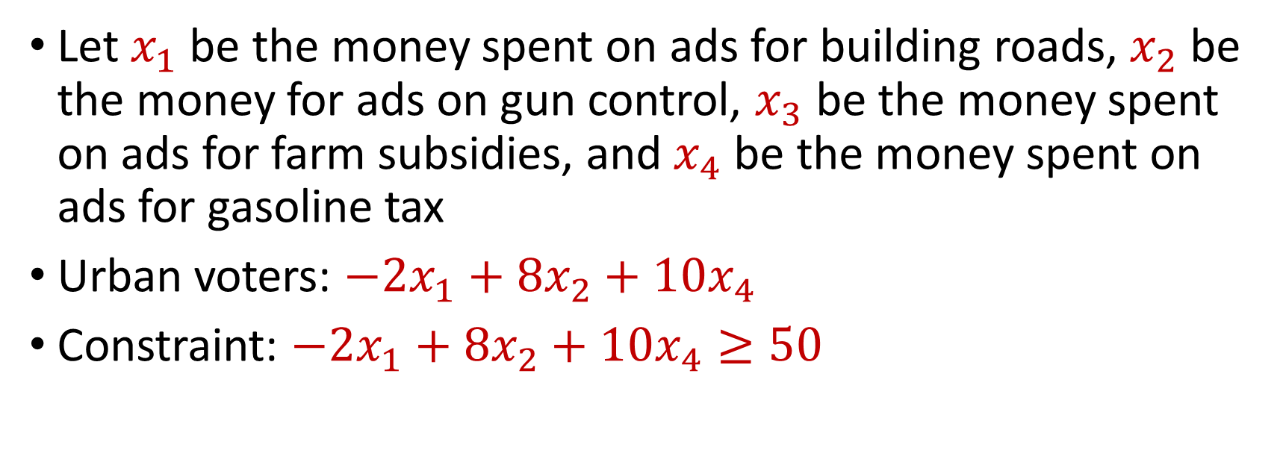
Political Problems…
Policy | Urban | Suburban | Rural
Build roads | -2 | +5 | -3
Gun control | +8 | +2 | -5
Farm subsidies | 0 | 0 | +10
Gasoline tax | +10 | 0 | -2
You seek $50$ urban voters, $100$ suburban voters, $25$ rural voters
Let $x_{1}$ be the money spent on ads for building roads, $x_{2}$ be the money for ads on gun control, $x_{3}$ be the money spent on ads for farm subsidies, and $x_{4}$ be the money spent on ads for gasoline tax
Urban voters: $−2x_{1}+8x_{2}+10x_{4}$
Constraint: $−2x_{1}+8x_{2}+10x_{4}≥50$

Slide 4
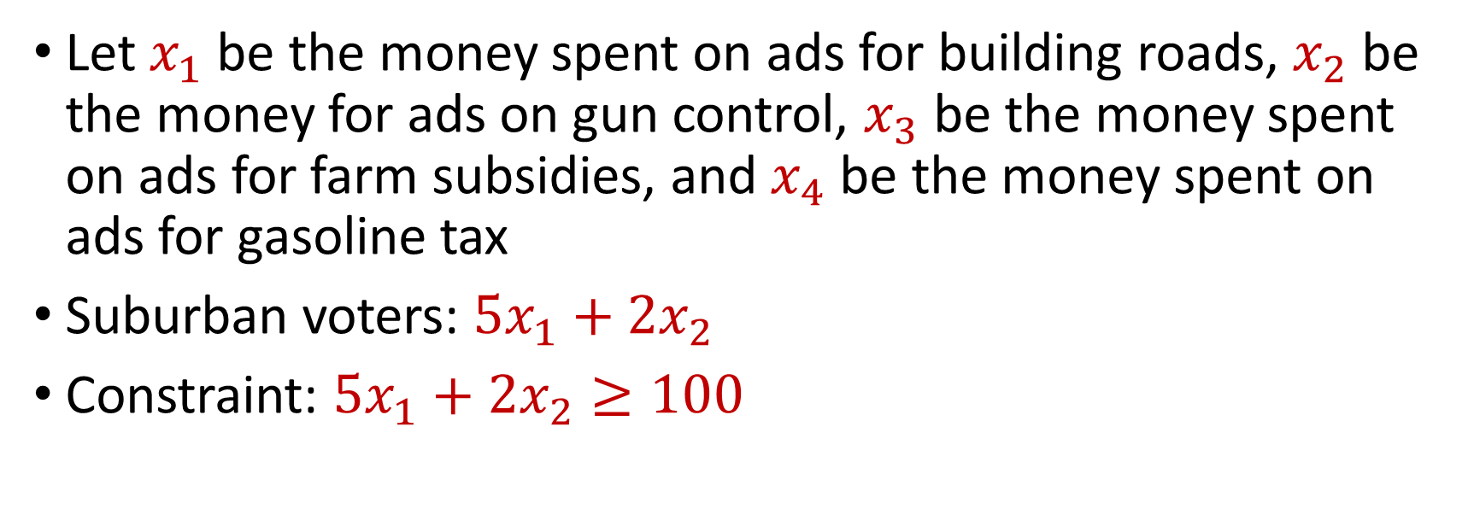
Political Problems…
Policy | Urban | Suburban | Rural
Build roads | -2 | +5 | -3
Gun control | +8 | +2 | -5
Farm subsidies | 0 | 0 | +10
Gasoline tax | +10 | 0 | -2
You seek $50$ urban voters, $100$ suburban voters, $25$ rural voters
Let $x_{1}$ be the money spent on ads for building roads, $x_{2}$ be the money for ads on gun control, $x_{3}$ be the money spent on ads for farm subsidies, and $x_{4}$ be the money spent on ads for gasoline tax
Suburban voters: $5x_{1}+2x_{2}$
Constraint: $5x_{1}+2x_{2}≥100$

Slide 5
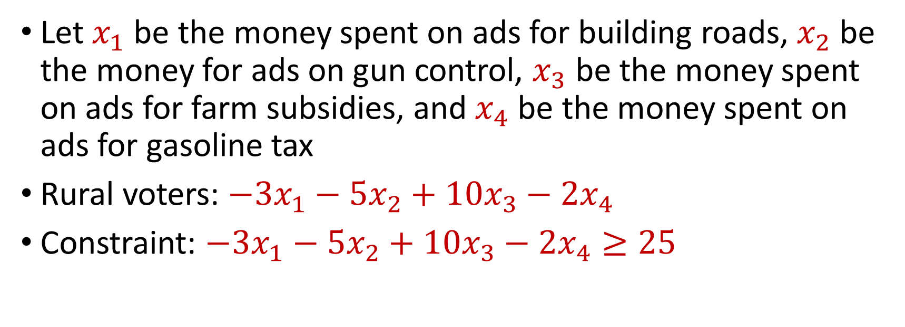
Political Problems…
Policy | Urban | Suburban | Rural
Build roads | -2 | +5 | -3
Gun control | +8 | +2 | -5
Farm subsidies | 0 | 0 | +10
Gasoline tax | +10 | 0 | -2
You seek $50$ urban voters, $100$ suburban voters, $25$ rural voters
Let $x_{1}$ be the money spent on ads for building roads, $x_{2}$ be the money for ads on gun control, $x_{3}$ be the money spent on ads for farm subsidies, and $x_{4}$ be the money spent on ads for gasoline tax
Rural voters: $−3x_{1}−5x_{2}+10x_{3}−2x_{4}$
Constraint: $−3x_{1}−5x_{2}+10x_{3}−2x_{4}≥25$

Slide 6
Minimization Problem
Policy | Urban | Suburban | Rural
Build roads | -2 | +5 | -3
Gun control | +8 | +2 | -5
Farm subsidies | 0 | 0 | +10
Gasoline tax | +10 | 0 | -2
You seek $50$ urban voters, $100$ suburban voters, $25$ rural voters
Let $x_{1}$ be the money spent on ads for building roads, $x_{2}$ be the money for ads on gun control, $x_{3}$ be the money spent on ads for farm subsidies, and $x_{4}$ be the money spent on ads for gasoline tax
Rural voters: $−3x_{1}−5x_{2}+10x_{3}−2x_{4}$
Constraint: $−3x_{1}−5x_{2}+10x_{3}−2x_{4}≥25$

Slide 7
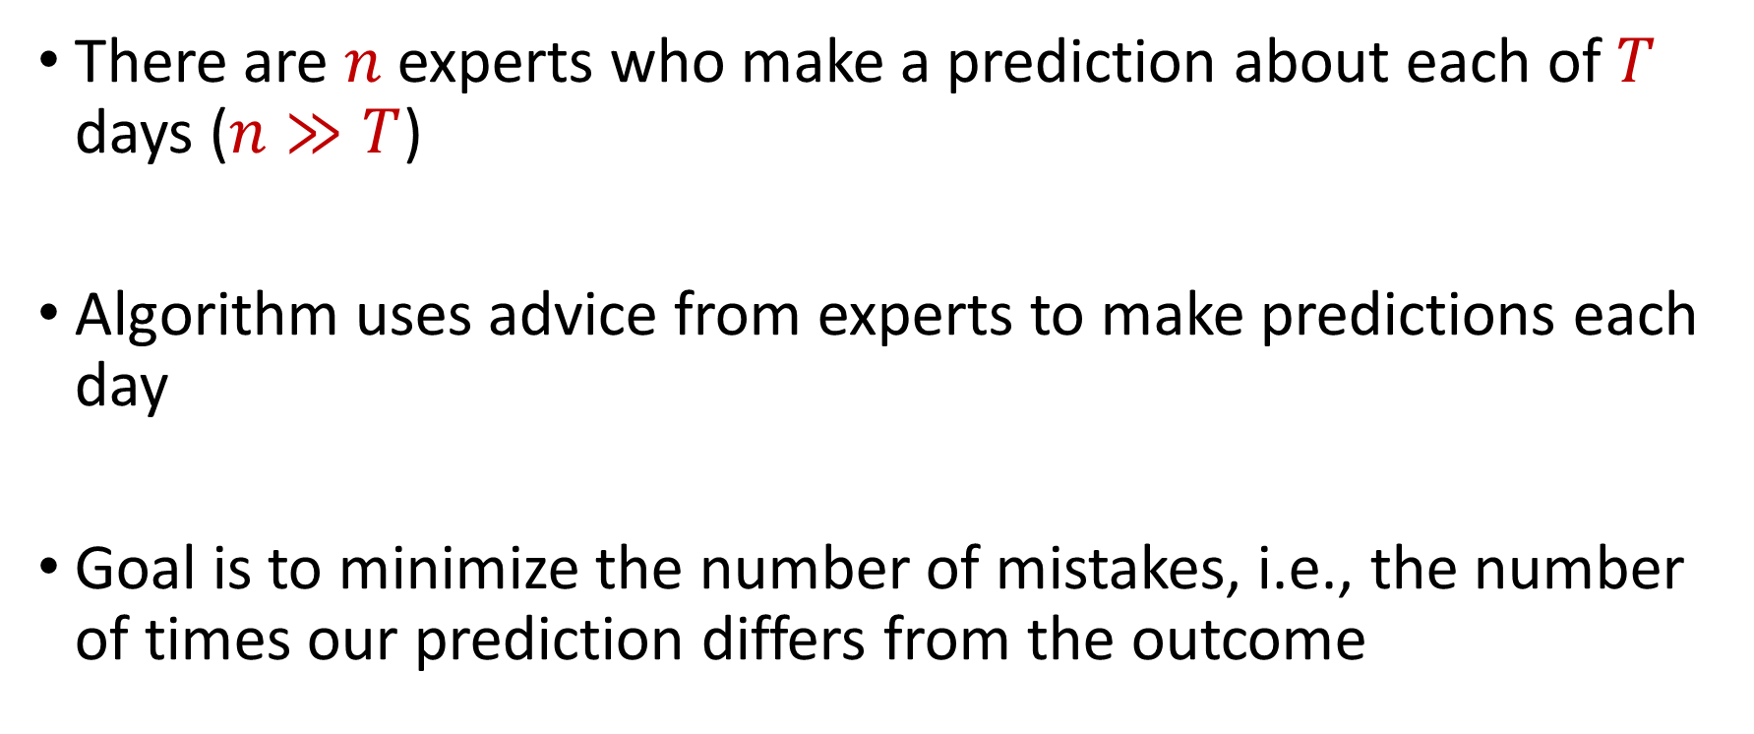
Linear Programming
There are $n$ experts who make a prediction about each of $T$ days ($n≫T$)
Algorithm uses advice from experts to make predictions each day
Goal is to minimize the number of mistakes, i.e., the number of times our prediction differs from the outcome

