Slide 1
CSCE 689: Special Topics in Modern Algorithms for Data Science
Lecture 15
Samson Zhou

Slide 2

Sparse Recovery
Suppose we have an insertion-deletion stream of length $m=Θ\left(n\right)$ and at the end we are promised there are at most $k$ nonzero coordinates
Recover the $k$ nonzero coordinates and their frequencies

Slide 3
Applications of Sparse Recovery
Anomaly detection and network traffic analysis:
Noiseless sparse recovery can be used to identify anomalies or outliers in streaming data. By modeling normal behavior as a sparse signal, deviations from this model can be detected in real-time. This is valuable for cybersecurity, fraud detection, and monitoring network traffic for unusual patterns.
Noiseless sparse recovery can be applied to analyze network traffic in real-time, identifying patterns and trends, and helping in network management, intrusion detection, and quality of service (QoS) optimization

Slide 4
Applications of Sparse Recovery
Online Natural Language Processing (NLP): In real-time natural language processing tasks, noiseless sparse recovery can assist in extracting relevant features or patterns from streaming text data, making it useful for sentiment analysis, topic modeling, and summarization

Slide 5
Applications of Sparse Recovery
Real-time Compressive Imaging: Compressive imaging techniques can be applied to streaming video or image data. By capturing and processing fewer measurements, noiseless sparse recovery can provide real-time reconstruction of high-resolution images or videos.

Slide 6
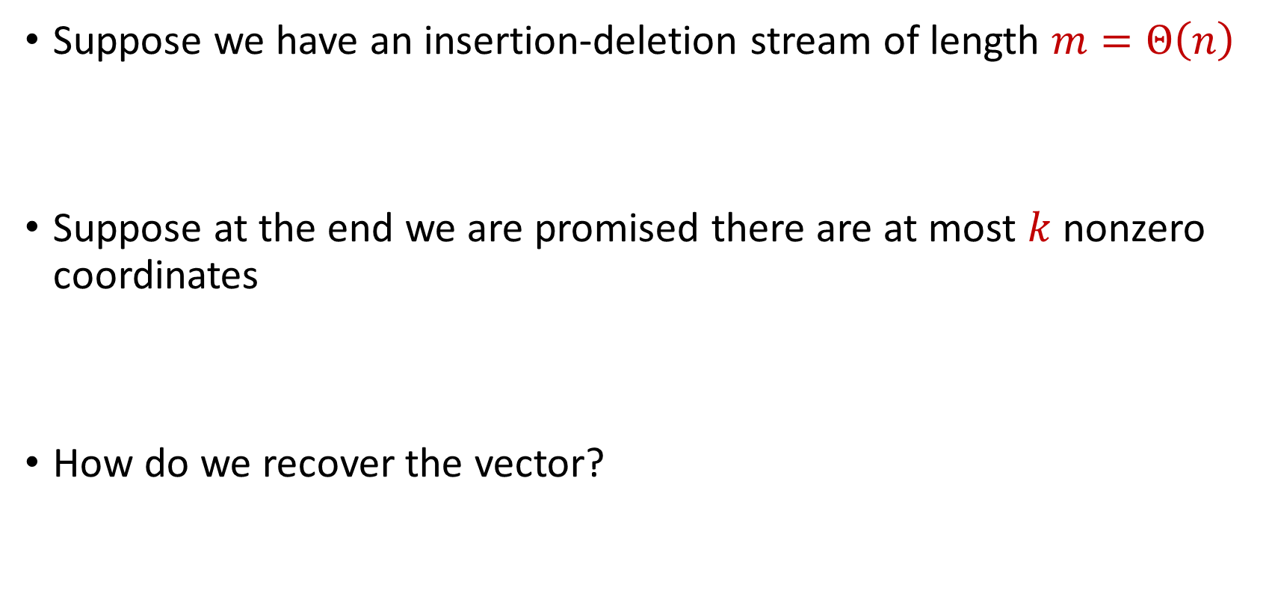
Sparse Recovery
Suppose we have an insertion-deletion stream of length $m=Θ\left(n\right)$
Suppose at the end we are promised there are at most $k$ nonzero coordinates
How do we recover the vector?

Slide 7

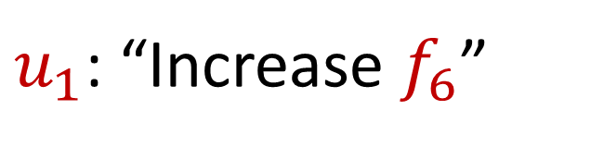
Sparse Recovery
Suppose at the end we are promised there are at most $k$ nonzero coordinates
Suppose $k=1$ and we are promised the coordinate has frequency $1$
$u_{1}$: “Increase $f_{6}$”

Slide 8
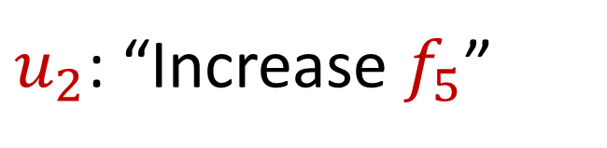
Sparse Recovery
Suppose at the end we are promised there are at most $k$ nonzero coordinates
Suppose $k=1$ and we are promised the coordinate has frequency $1$
$u_{2}$: “Increase $f_{5}$”

Slide 9
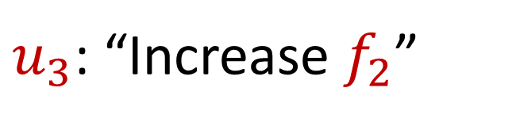
Sparse Recovery
Suppose at the end we are promised there are at most $k$ nonzero coordinates
Suppose $k=1$ and we are promised the coordinate has frequency $1$
$u_{3}$: “Increase $f_{2}$”

Slide 10
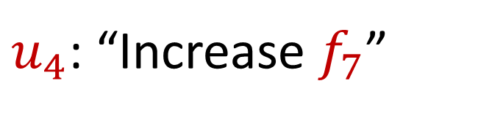
Sparse Recovery
Suppose at the end we are promised there are at most $k$ nonzero coordinates
Suppose $k=1$ and we are promised the coordinate has frequency $1$
$u_{4}$: “Increase $f_{7}$”

Slide 11
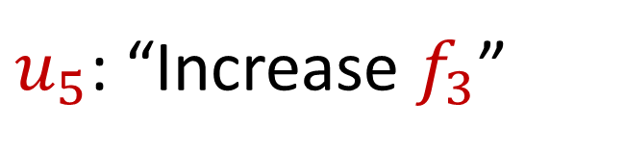
Sparse Recovery
Suppose at the end we are promised there are at most $k$ nonzero coordinates
Suppose $k=1$ and we are promised the coordinate has frequency $1$
$u_{5}$: “Increase $f_{3}$”

Slide 12
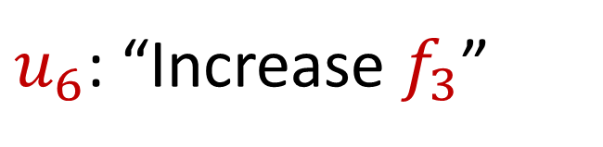
Sparse Recovery
Suppose at the end we are promised there are at most $k$ nonzero coordinates
Suppose $k=1$ and we are promised the coordinate has frequency $1$
$u_{6}$: “Increase $f_{3}$”

Slide 13
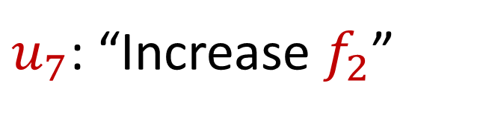
Sparse Recovery
Suppose at the end we are promised there are at most $k$ nonzero coordinates
Suppose $k=1$ and we are promised the coordinate has frequency $1$
$u_{7}$: “Increase $f_{2}$”

Slide 14
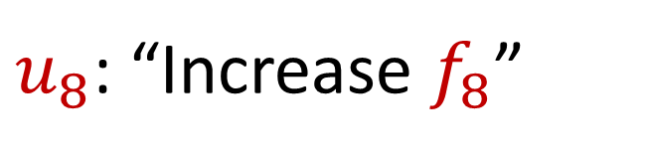
Sparse Recovery
Suppose at the end we are promised there are at most $k$ nonzero coordinates
Suppose $k=1$ and we are promised the coordinate has frequency $1$
$u_{8}$: “Increase $f_{8}$”

Slide 15
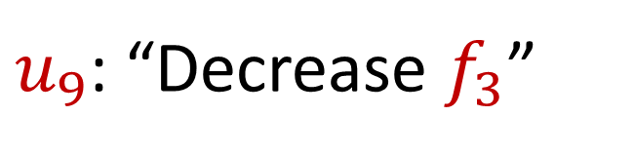
Sparse Recovery
Suppose at the end we are promised there are at most $k$ nonzero coordinates
Suppose $k=1$ and we are promised the coordinate has frequency $1$
$u_{9}$: “Decrease $f_{3}$”

Slide 16
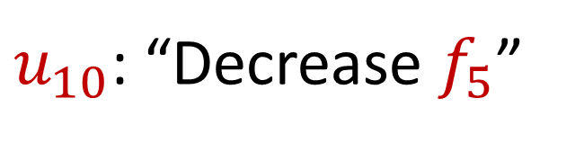
Sparse Recovery
Suppose at the end we are promised there are at most $k$ nonzero coordinates
Suppose $k=1$ and we are promised the coordinate has frequency $1$
$u_{10}$: “Decrease $f_{5}$”

Slide 17

Sparse Recovery
Suppose at the end we are promised there are at most $k$ nonzero coordinates
Suppose $k=1$ and we are promised the coordinate has frequency $1$
$u_{11}$: “Increase $f_{1}$”

Slide 18

Sparse Recovery
Suppose at the end we are promised there are at most $k$ nonzero coordinates
Suppose $k=1$ and we are promised the coordinate has frequency $1$
$u_{12}$: “Increase $f_{7}$”

Slide 19
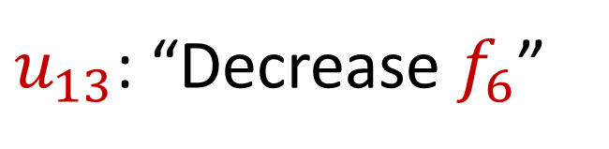
Sparse Recovery
Suppose at the end we are promised there are at most $k$ nonzero coordinates
Suppose $k=1$ and we are promised the coordinate has frequency $1$
$u_{13}$: “Decrease $f_{6}$”

Slide 20

Sparse Recovery
Suppose at the end we are promised there are at most $k$ nonzero coordinates
Suppose $k=1$ and we are promised the coordinate has frequency $1$
$u_{14}$: “Decrease $f_{8}$”

Slide 21

Sparse Recovery
Suppose at the end we are promised there are at most $k$ nonzero coordinates
Suppose $k=1$ and we are promised the coordinate has frequency $1$
$u_{15}$: “Decrease $f_{1}$”

Slide 22

Sparse Recovery
Suppose at the end we are promised there are at most $k$ nonzero coordinates
Suppose $k=1$ and we are promised the coordinate has frequency $1$
$u_{16}$: “Decrease $f_{7}$”

Slide 23
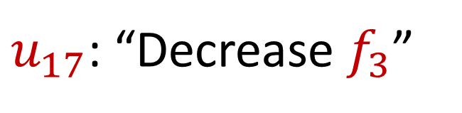
Sparse Recovery
Suppose at the end we are promised there are at most $k$ nonzero coordinates
Suppose $k=1$ and we are promised the coordinate has frequency $1$
$u_{17}$: “Decrease $f_{3}$”

Slide 24
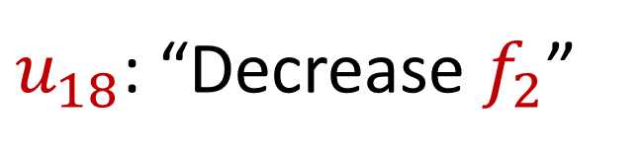
Sparse Recovery
Suppose at the end we are promised there are at most $k$ nonzero coordinates
Suppose $k=1$ and we are promised the coordinate has frequency $1$
$u_{18}$: “Decrease $f_{2}$”

Slide 25

Sparse Recovery
Suppose at the end we are promised there are at most $k$ nonzero coordinates
Suppose $k=1$ and we are promised the coordinate has frequency $1$
$u_{19}$: “Decrease $f_{7}$”

Slide 26

Sparse Recovery
Suppose at the end we are promised there are at most $k$ nonzero coordinates
Suppose $k=1$ and we are promised the coordinate has frequency $1$
What is left?

Slide 27

Sparse Recovery
Suppose at the end we are promised there are at most $k$ nonzero coordinates
Suppose $k=1$ and we are promised the coordinate has frequency $1$
What is left?
$$f_{2}=1$$

Slide 28
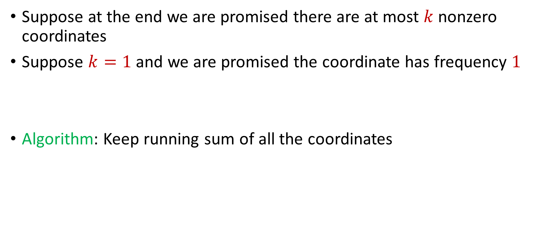
Sparse Recovery
Suppose at the end we are promised there are at most $k$ nonzero coordinates
Suppose $k=1$ and we are promised the coordinate has frequency $1$
Algorithm: Keep running sum of all the coordinates

Slide 29
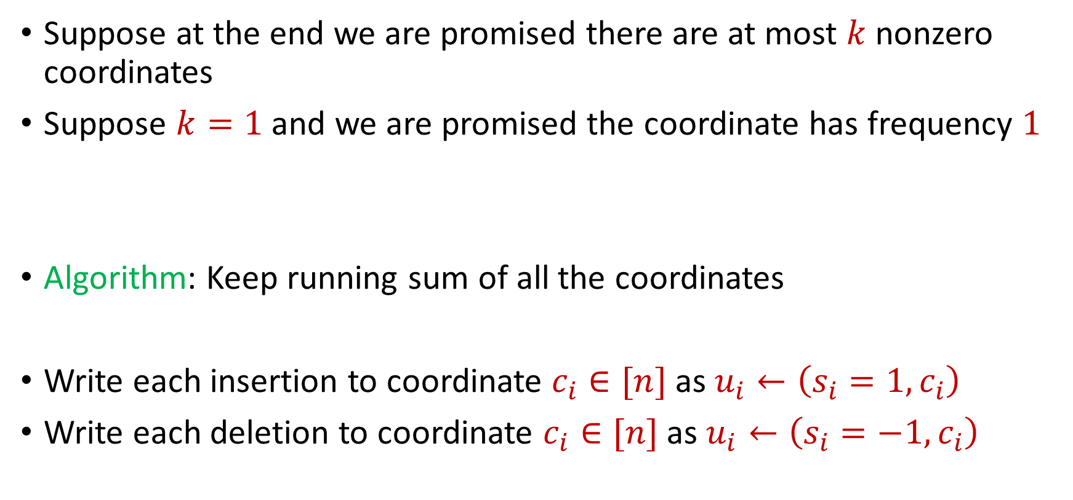
Sparse Recovery
Suppose at the end we are promised there are at most $k$ nonzero coordinates
Suppose $k=1$ and we are promised the coordinate has frequency $1$
Algorithm: Keep running sum of all the coordinates
Write each insertion to coordinate $c_{i}∈[n]$as $u_{i}←\left(s_{i}=1, c_{i}\right)$
Write each deletion to coordinate $c_{i}∈[n]$as $u_{i}←\left(s_{i}=−1, c_{i}\right)$

Slide 30
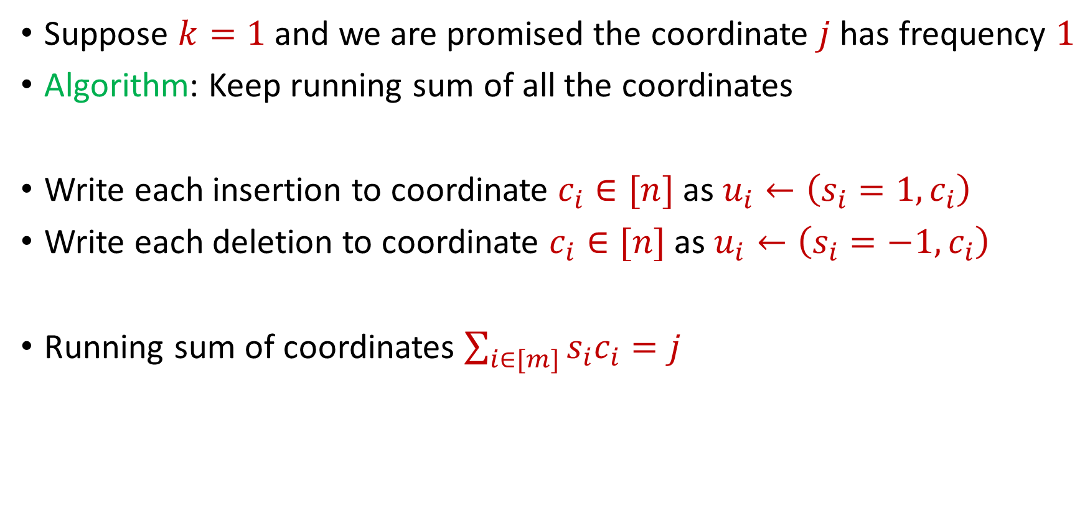
Sparse Recovery
Suppose $k=1$ and we are promised the coordinate $j$ has frequency $1$
Algorithm: Keep running sum of all the coordinates
Write each insertion to coordinate $c_{i}∈[n]$as $u_{i}←\left(s_{i}=1, c_{i}\right)$
Write each deletion to coordinate $c_{i}∈[n]$as $u_{i}←\left(s_{i}=−1, c_{i}\right)$
Running sum of coordinates $\sum_{i∈[m]}{s_{i}c_{i}}=j$

Slide 31
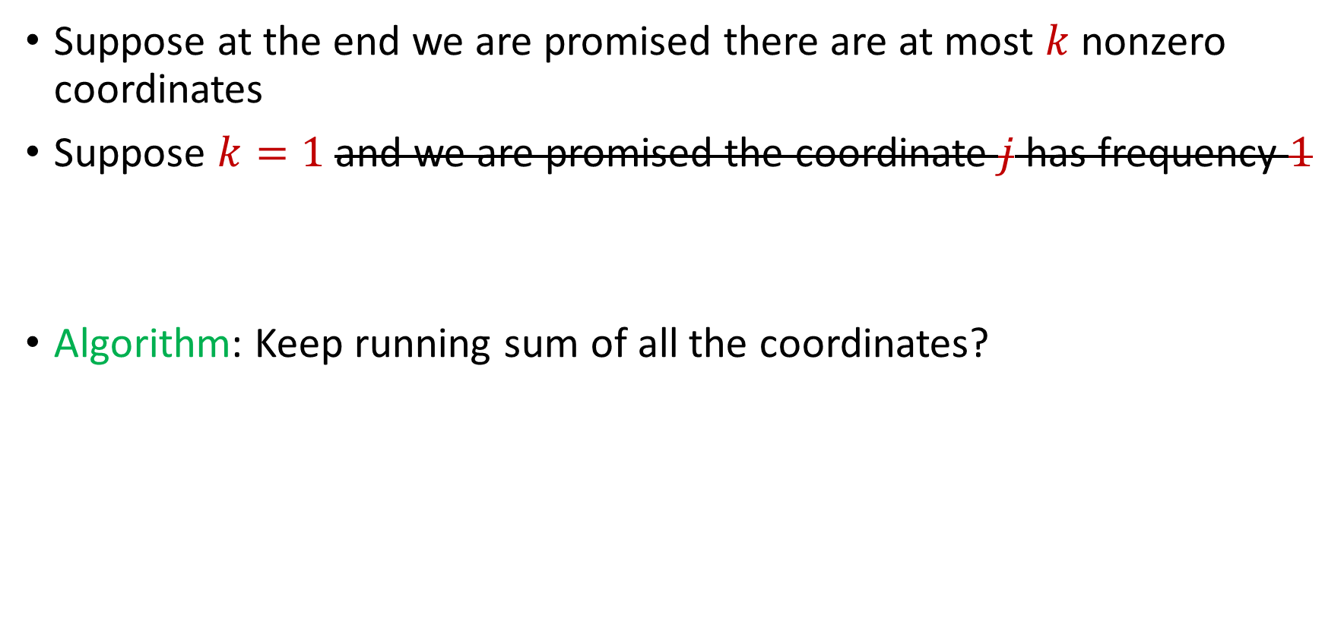
Sparse Recovery
Suppose at the end we are promised there are at most $k$ nonzero coordinates
Suppose $k=1$ and we are promised the coordinate $j$ has frequency $1$
Algorithm: Keep running sum of all the coordinates?

Slide 32
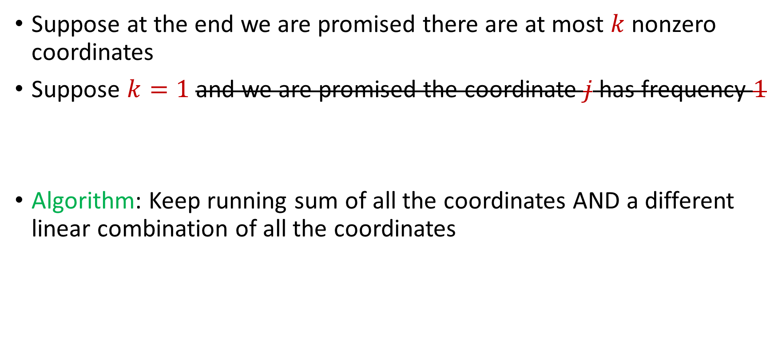
Sparse Recovery
Suppose at the end we are promised there are at most $k$ nonzero coordinates
Suppose $k=1$ and we are promised the coordinate $j$ has frequency $1$
Algorithm: Keep running sum of all the coordinates AND a different linear combination of all the coordinates

Slide 33
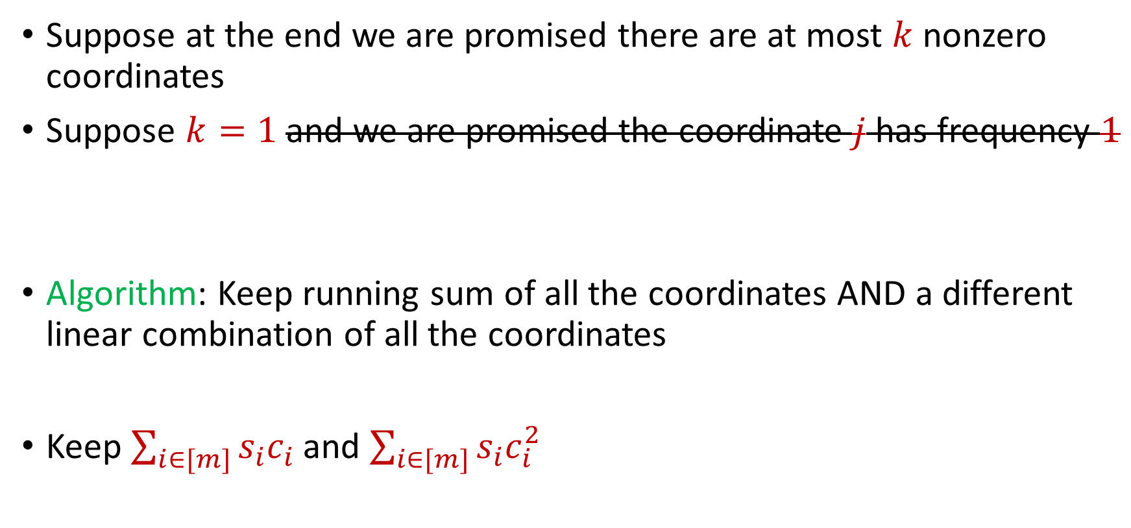
Sparse Recovery
Suppose at the end we are promised there are at most $k$ nonzero coordinates
Suppose $k=1$ and we are promised the coordinate $j$ has frequency $1$
Algorithm: Keep running sum of all the coordinates AND a different linear combination of all the coordinates
Keep $\sum_{i∈[m]}{s_{i}c_{i}}$ and $\sum_{i∈[m]}{s_{i}c_{i}^{2}}$

Slide 34

Sparse Recovery
Suppose at the end we are promised there are at most $k$ nonzero coordinates
Suppose $k=1$ and we are promised the coordinate $j$ has frequency $1$
$u_{1}$: “Increase $f_{6}$”

Slide 35
Sparse Recovery
Suppose at the end we are promised there are at most $k$ nonzero coordinates
Suppose $k=1$ and we are promised the coordinate $j$ has frequency $1$
$u_{2}$: “Increase $f_{5}$”

Slide 36
Sparse Recovery
Suppose at the end we are promised there are at most $k$ nonzero coordinates
Suppose $k=1$ and we are promised the coordinate $j$ has frequency $1$
$u_{3}$: “Increase $f_{2}$”

Slide 37
Sparse Recovery
Suppose at the end we are promised there are at most $k$ nonzero coordinates
Suppose $k=1$ and we are promised the coordinate $j$ has frequency $1$
$u_{4}$: “Increase $f_{7}$”

Slide 38
Sparse Recovery
Suppose at the end we are promised there are at most $k$ nonzero coordinates
Suppose $k=1$ and we are promised the coordinate $j$ has frequency $1$
$u_{5}$: “Increase $f_{3}$”

Slide 39
Sparse Recovery
Suppose at the end we are promised there are at most $k$ nonzero coordinates
Suppose $k=1$ and we are promised the coordinate $j$ has frequency $1$
$u_{6}$: “Increase $f_{3}$”

Slide 40
Sparse Recovery
Suppose at the end we are promised there are at most $k$ nonzero coordinates
Suppose $k=1$ and we are promised the coordinate $j$ has frequency $1$
$u_{7}$: “Increase $f_{2}$”

Slide 41
Sparse Recovery
Suppose at the end we are promised there are at most $k$ nonzero coordinates
Suppose $k=1$ and we are promised the coordinate $j$ has frequency $1$
$u_{8}$: “Increase $f_{8}$”

Slide 42
Sparse Recovery
Suppose at the end we are promised there are at most $k$ nonzero coordinates
Suppose $k=1$ and we are promised the coordinate $j$ has frequency $1$
$u_{9}$: “Decrease $f_{3}$”

Slide 43
Sparse Recovery
Suppose at the end we are promised there are at most $k$ nonzero coordinates
Suppose $k=1$ and we are promised the coordinate $j$ has frequency $1$
$u_{10}$: “Decrease $f_{5}$”

Slide 44
Sparse Recovery
Suppose at the end we are promised there are at most $k$ nonzero coordinates
Suppose $k=1$ and we are promised the coordinate $j$ has frequency $1$
$u_{11}$: “Increase $f_{1}$”

Slide 45
Sparse Recovery
Suppose at the end we are promised there are at most $k$ nonzero coordinates
Suppose $k=1$ and we are promised the coordinate $j$ has frequency $1$
$u_{12}$: “Increase $f_{7}$”

Slide 46
Sparse Recovery
Suppose at the end we are promised there are at most $k$ nonzero coordinates
Suppose $k=1$ and we are promised the coordinate $j$ has frequency $1$
$u_{13}$: “Decrease $f_{6}$”

Slide 47
Sparse Recovery
Suppose at the end we are promised there are at most $k$ nonzero coordinates
Suppose $k=1$ and we are promised the coordinate $j$ has frequency $1$
$u_{14}$: “Decrease $f_{8}$”

Slide 48
Sparse Recovery
Suppose at the end we are promised there are at most $k$ nonzero coordinates
Suppose $k=1$ and we are promised the coordinate $j$ has frequency $1$
$u_{15}$: “Decrease $f_{1}$”

Slide 49
Sparse Recovery
Suppose at the end we are promised there are at most $k$ nonzero coordinates
Suppose $k=1$ and we are promised the coordinate $j$ has frequency $1$
$u_{16}$: “Decrease $f_{7}$”

Slide 50
Sparse Recovery
Suppose at the end we are promised there are at most $k$ nonzero coordinates
Suppose $k=1$ and we are promised the coordinate $j$ has frequency $1$
$u_{17}$: “Decrease $f_{3}$”

Slide 51

Sparse Recovery
Suppose at the end we are promised there are at most $k$ nonzero coordinates
Suppose $k=1$ and we are promised the coordinate $j$ has frequency $1$
$u_{18}$: “Decrease $f_{7}$”

Slide 52

Sparse Recovery
Suppose at the end we are promised there are at most $k$ nonzero coordinates
Suppose $k=1$ and we are promised the coordinate $j$ has frequency $1$
What is the state of our algorithm?

Slide 53
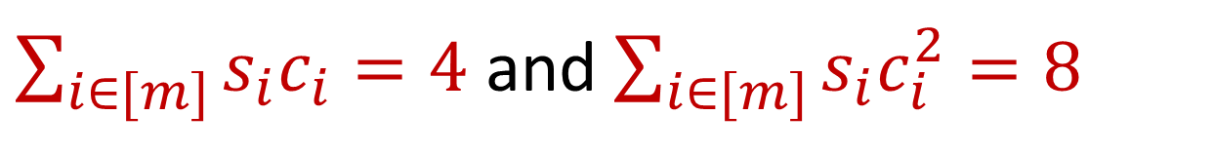
Sparse Recovery
Suppose at the end we are promised there are at most $k$ nonzero coordinates
Suppose $k=1$ and we are promised the coordinate $j$ has frequency $1$
What is the state of our algorithm?
$\sum_{i∈[m]}{s_{i}c_{i}}=4$ and $\sum_{i∈[m]}{s_{i}c_{i}^{2}=8}$

Slide 54
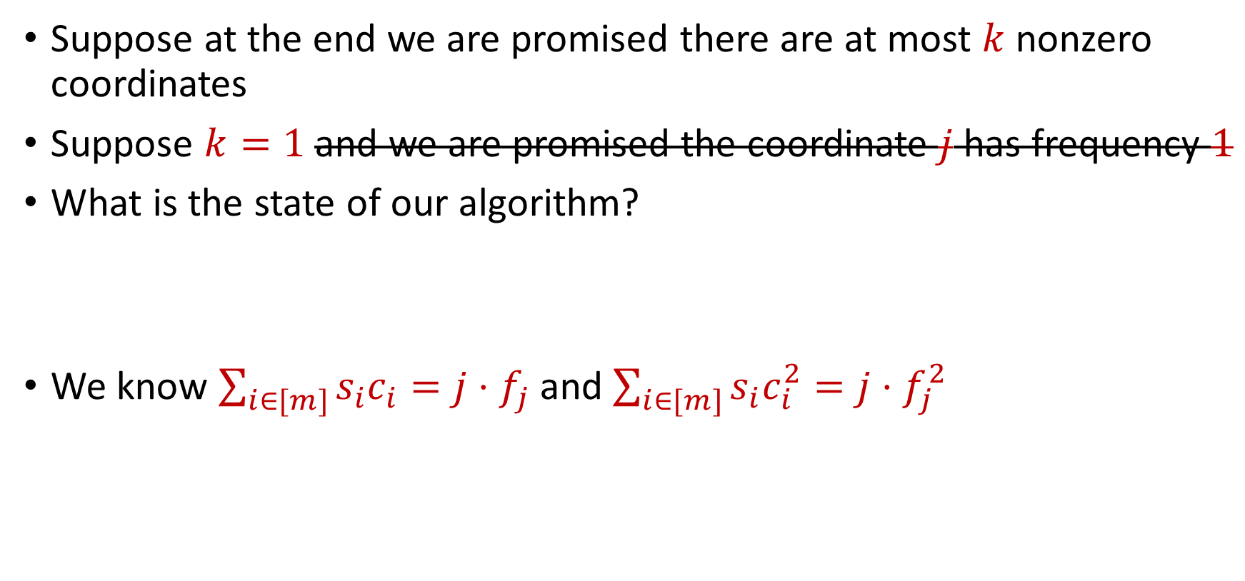
Sparse Recovery
Suppose at the end we are promised there are at most $k$ nonzero coordinates
Suppose $k=1$ and we are promised the coordinate $j$ has frequency $1$
What is the state of our algorithm?
We know $\sum_{i∈[m]}{s_{i}c_{i}}=j⋅f_{j}$ and $\sum_{i∈[m]}{s_{i}c_{i}^{2}=j⋅f_{j}^{2}}$
$\sum_{i∈[m]}{s_{i}c_{i}}=4$ and $\sum_{i∈[m]}{s_{i}c_{i}^{2}=8}$

Slide 55
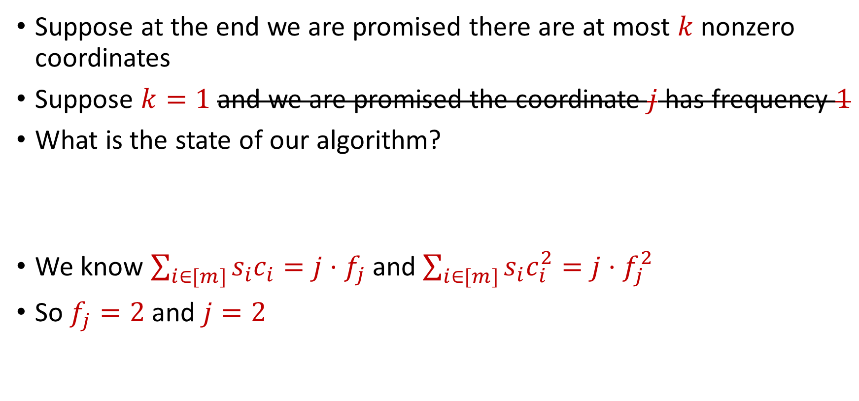
Sparse Recovery
Suppose at the end we are promised there are at most $k$ nonzero coordinates
Suppose $k=1$ and we are promised the coordinate $j$ has frequency $1$
What is the state of our algorithm?
We know $\sum_{i∈[m]}{s_{i}c_{i}}=j⋅f_{j}$ and $\sum_{i∈[m]}{s_{i}c_{i}^{2}=j⋅f_{j}^{2}}$
So $f_{j}=2$ and $j=2$
$\sum_{i∈[m]}{s_{i}c_{i}}=4$ and $\sum_{i∈[m]}{s_{i}c_{i}^{2}=8}$

Slide 56

Sparse Recovery
Suppose at the end we are promised there are at most $k$ nonzero coordinates
Suppose $k=1$ and we are promised the coordinate $j$ has frequency $1$
What is the state of our algorithm?
We know $\sum_{i∈[m]}{s_{i}c_{i}}=j⋅f_{j}$ and $\sum_{i∈[m]}{s_{i}c_{i}^{2}=j⋅f_{j}^{2}}$
So $f_{j}=2$ and $j=2$
$\sum_{i∈[m]}{s_{i}c_{i}}=4$ and $\sum_{i∈[m]}{s_{i}c_{i}^{2}=8}$
$f_{1}$ | $f_{2}$ | $f_{3}$ | $f_{4}$ | $f_{5}$ | $f_{6}$ | $f_{7}$
0 | 2 | 0 | 0 | 0 | 0 | 0

Slide 57

Sparse Recovery
Suppose at the end we are promised there are at most $k$ nonzero coordinates
Algorithm for $k=1$: Keep running sum of all the coordinates AND a different linear combination of all the coordinates

Slide 58
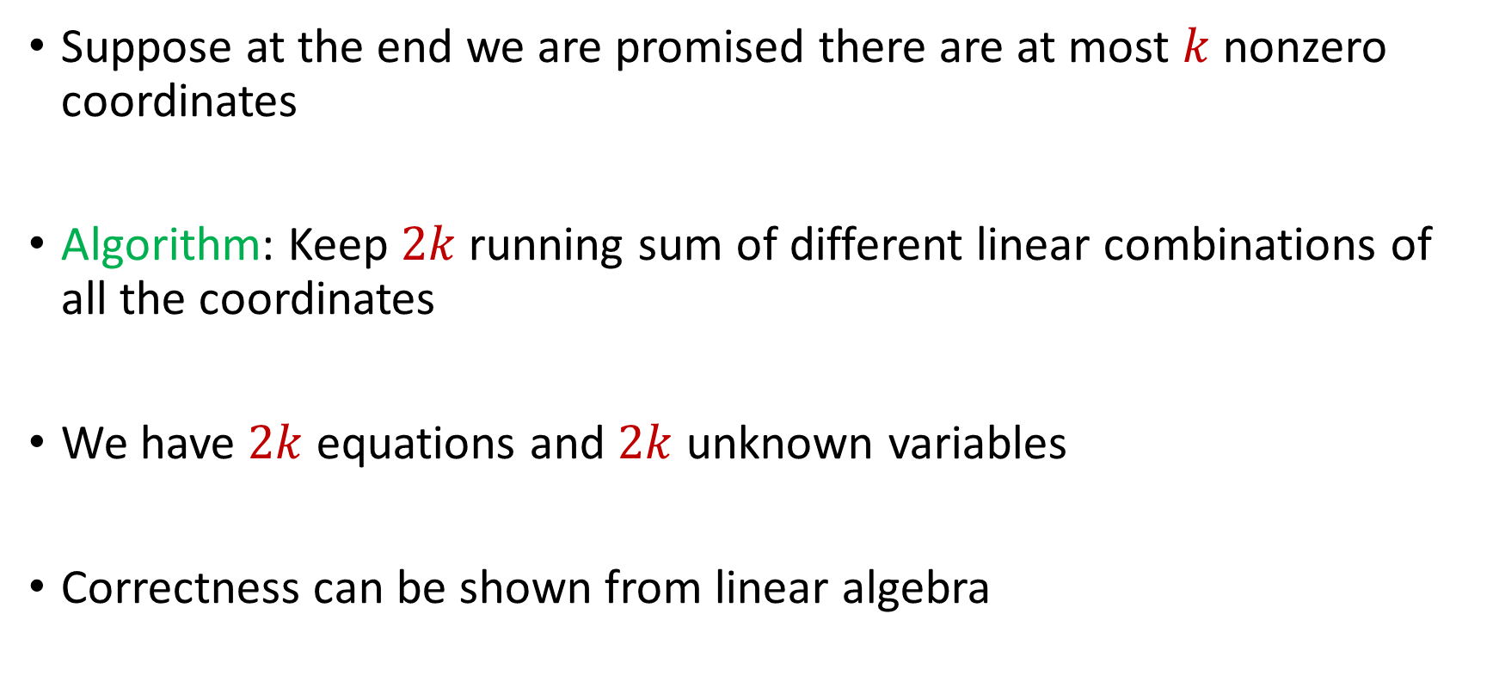
Sparse Recovery
Suppose at the end we are promised there are at most $k$ nonzero coordinates
Algorithm: Keep $2k$running sum of different linear combinations of all the coordinates
We have $2k$ equations and $2k$ unknown variables
Correctness can be shown from linear algebra

Slide 59
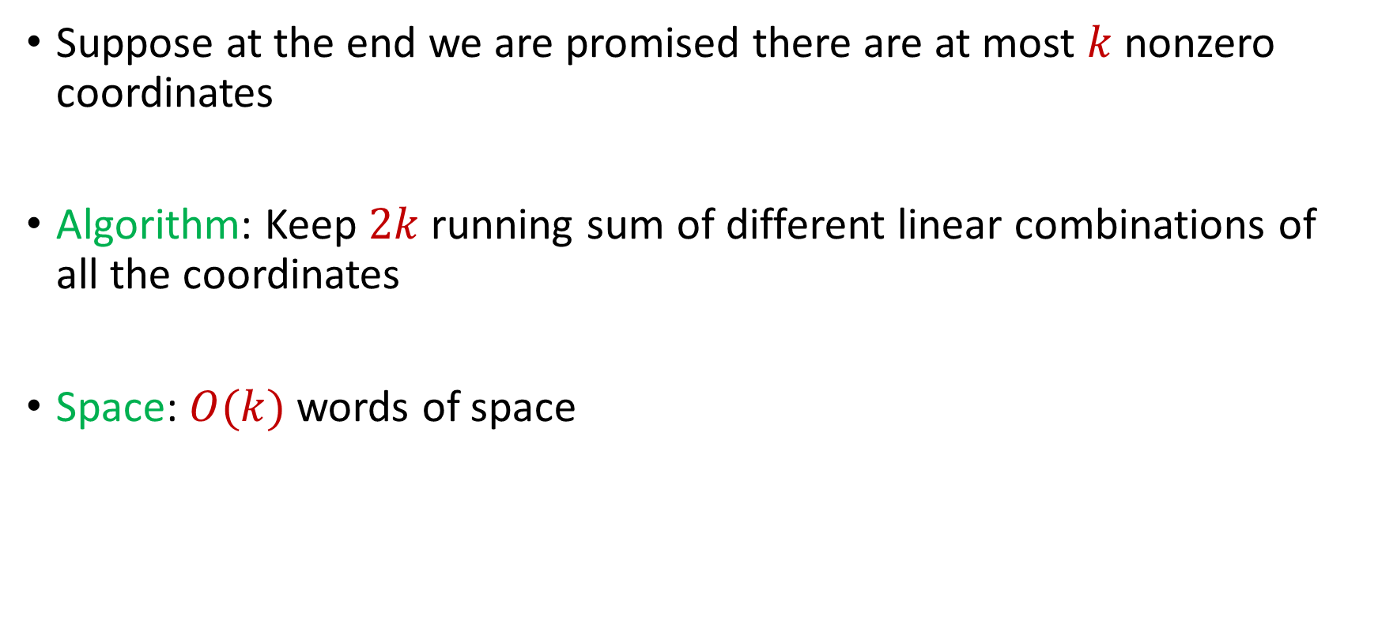
Sparse Recovery
Suppose at the end we are promised there are at most $k$ nonzero coordinates
Algorithm: Keep $2k$running sum of different linear combinations of all the coordinates
Space: $O(k)$ words of space

Slide 60
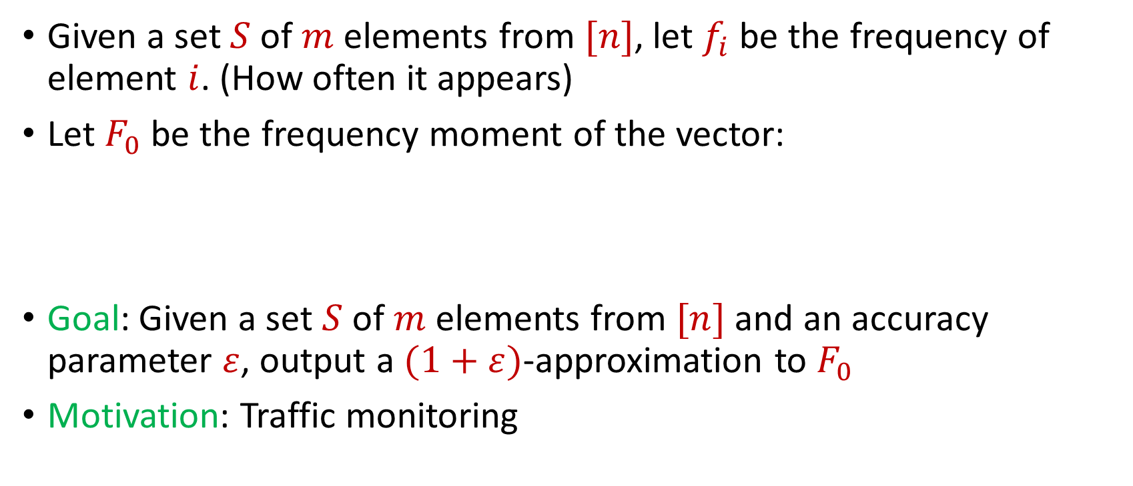

Distinct Elements ($F_{0}$ Estimation)
Given a set $S$ of $m$ elements from $[n]$, let $f_{i}$ be the frequency of element $i$. (How often it appears)
Let $F_{0}$ be the frequency moment of the vector:
Goal: Given a set $S$ of $m$ elements from $[n]$ and an accuracy parameter $ε$, output a $(1+ε)$-approximation to $F_{0}$
Motivation: Traffic monitoring
$F_{0}=$ $|\{i :f_{i}≠0\}|$

Slide 61

Distinct Elements ($F_{0}$ Estimation)
Let $S$ be a set of $N$ numbers
Suppose we form set $S′$ by sampling each item of $S$ with probability $\frac{1}{2}$
How many numbers are in $S′$?

Slide 62
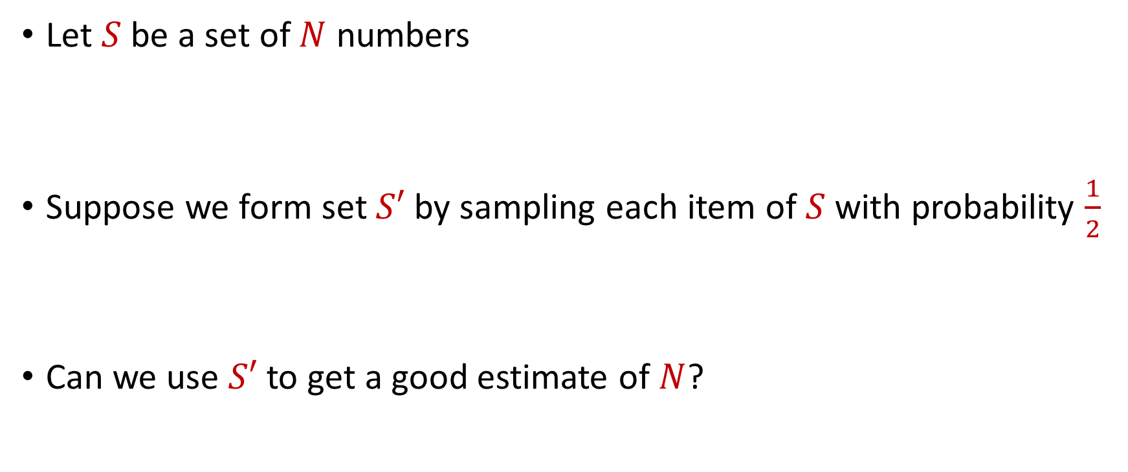
Distinct Elements ($F_{0}$ Estimation)
Let $S$ be a set of $N$ numbers
Suppose we form set $S′$ by sampling each item of $S$ with probability $\frac{1}{2}$
Can we use $S′$ to get a good estimate of $N$?

Slide 63
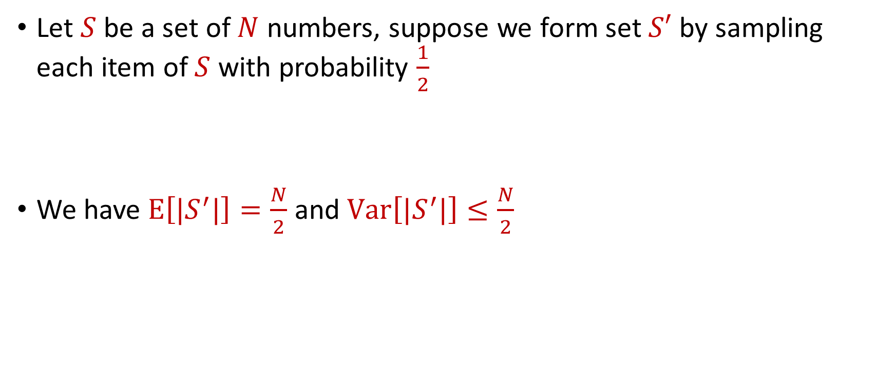
Distinct Elements ($F_{0}$ Estimation)
Let $S$ be a set of $N$ numbers, suppose we form set $S′$ by sampling each item of $S$ with probability $\frac{1}{2}$
We have $E\left[|S^{′}|\right]=\frac{N}{2}$ and $Var\left[|S^{′}|\right]≤\frac{N}{2}$

Slide 64

Distinct Elements ($F_{0}$ Estimation)
What can we say about $Pr\left[\left|\left|S^{′}\right|−\frac{N}{2}\right|≥t\right]$?
By Chebyshev’s inequality, we have $Pr\left[\left|\left|S^{′}\right|−\frac{N}{2}\right|≥100\sqrt{N}\right]≤\frac{1}{10}$

Slide 65
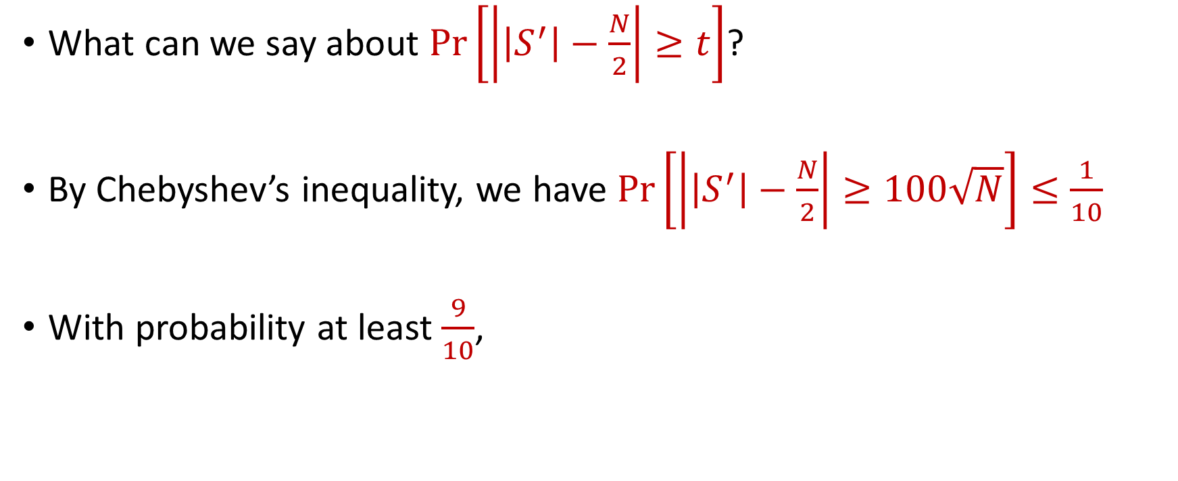
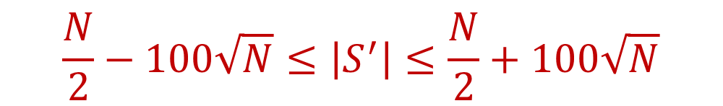
Distinct Elements ($F_{0}$ Estimation)
What can we say about $Pr\left[\left|\left|S^{′}\right|−\frac{N}{2}\right|≥t\right]$?
By Chebyshev’s inequality, we have $Pr\left[\left|\left|S^{′}\right|−\frac{N}{2}\right|≥100\sqrt{N}\right]≤\frac{1}{10}$
With probability at least $\frac{9}{10}$,
$$\frac{N}{2}−100\sqrt{N}≤\left|S^{′}\right|≤\frac{N}{2}+100\sqrt{N}$$

Slide 66

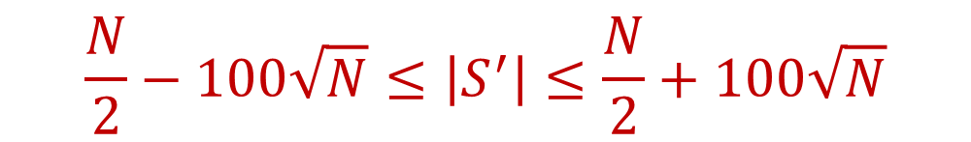
Distinct Elements ($F_{0}$ Estimation)
With probability at least $\frac{9}{10}$,
Thus with probability at least $\frac{9}{10}$,
$$\frac{N}{2}−100\sqrt{N}≤\left|S^{′}\right|≤\frac{N}{2}+100\sqrt{N}$$
$$N−200\sqrt{N}≤2\left|S^{′}\right|≤N+200\sqrt{N}$$

Slide 67

Distinct Elements ($F_{0}$ Estimation)
With probability at least $\frac{9}{10}$,
If $200\sqrt{N}≤\frac{N}{100}$, then $N−200\sqrt{N}≤2\left|S^{′}\right|≤N+200\sqrt{N}$ implies
Very good approximation to $N$
$$N−200\sqrt{N}≤2\left|S^{′}\right|≤N+200\sqrt{N}$$
$$0.99N≤2\left|S^{′}\right|≤1.01N$$

Slide 68
Distinct Elements ($F_{0}$ Estimation)
What algorithm does this suggest?

Slide 69
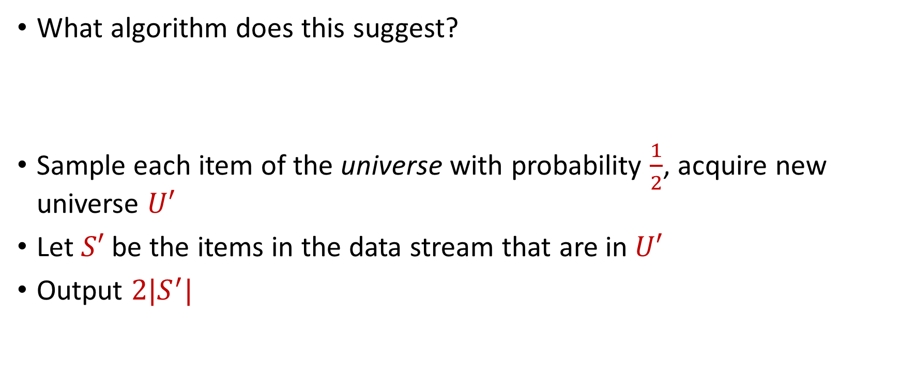
Distinct Elements ($F_{0}$ Estimation)
What algorithm does this suggest?
Sample each item of the universe with probability $\frac{1}{2}$, acquire new universe $U′$
Let $S′$ be the items in the data stream that are in $U′$
Output $2|S^{′}|$

Slide 70
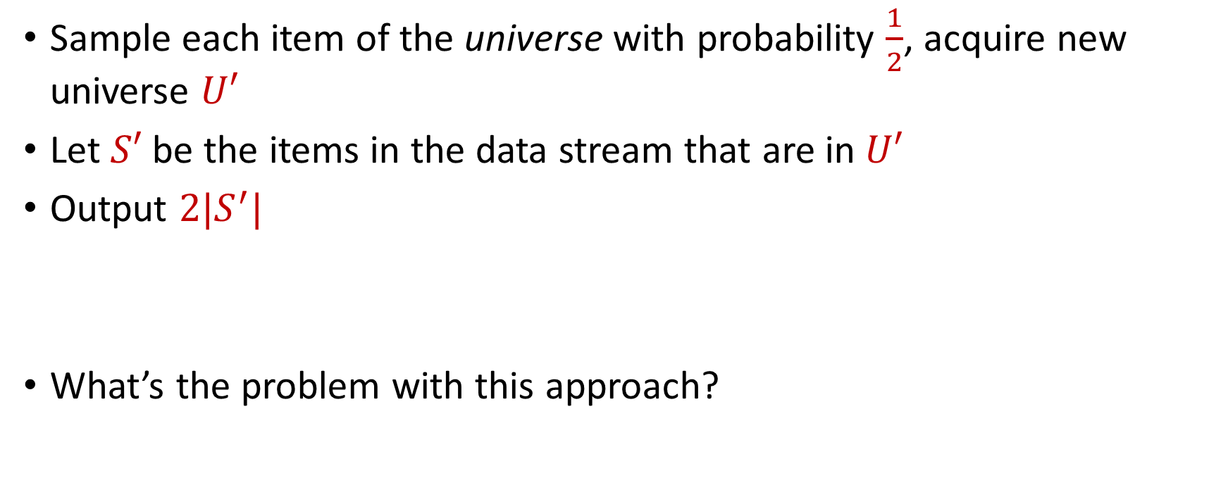
Distinct Elements ($F_{0}$ Estimation)
Sample each item of the universe with probability $\frac{1}{2}$, acquire new universe $U′$
Let $S′$ be the items in the data stream that are in $U′$
Output $2|S^{′}|$
What’s the problem with this approach?

Slide 71
Distinct Elements ($F_{0}$ Estimation)
Let $S$ be a set of $N$ numbers
Suppose we form set $S′$ by sampling each item of $S$ with probability $\frac{1}{2}$
Can we use $S′$ to get a good estimate of $N$?

Slide 72
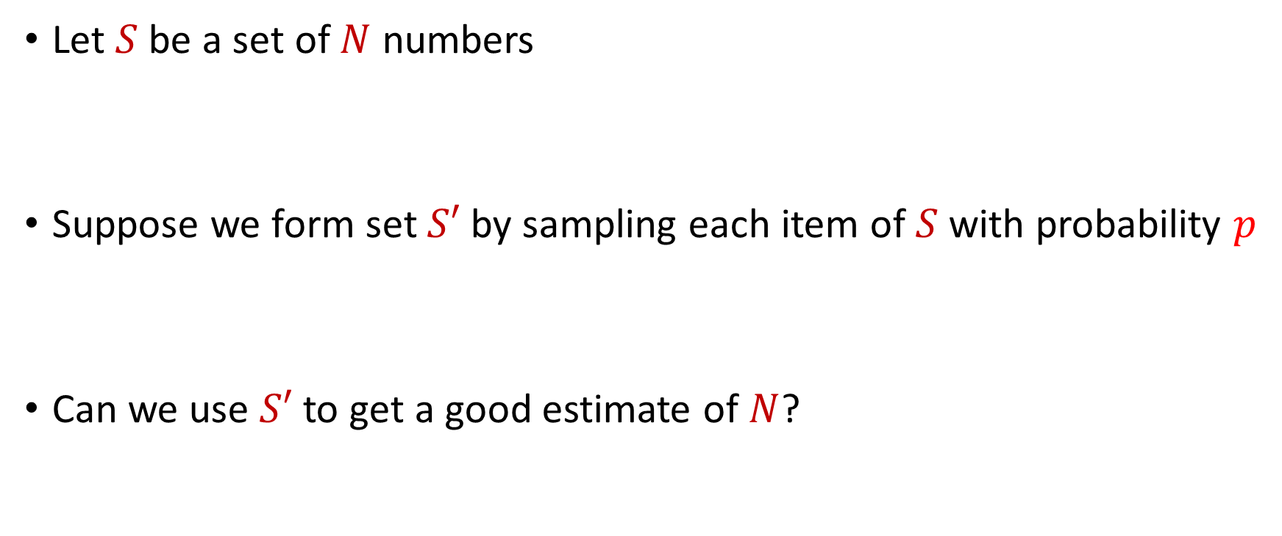
Distinct Elements ($F_{0}$ Estimation)
Let $S$ be a set of $N$ numbers
Suppose we form set $S′$ by sampling each item of $S$ with probability $p$
Can we use $S′$ to get a good estimate of $N$?

Slide 73
Distinct Elements ($F_{0}$ Estimation)
Let $S$ be a set of $N$ numbers, suppose we form set $S′$ by sampling each item of $S$ with probability $\frac{1}{2}$
We have $E\left[|S^{′}|\right]=\frac{N}{2}$ and $Var\left[|S^{′}|\right]≤\frac{N}{2}$

Slide 74
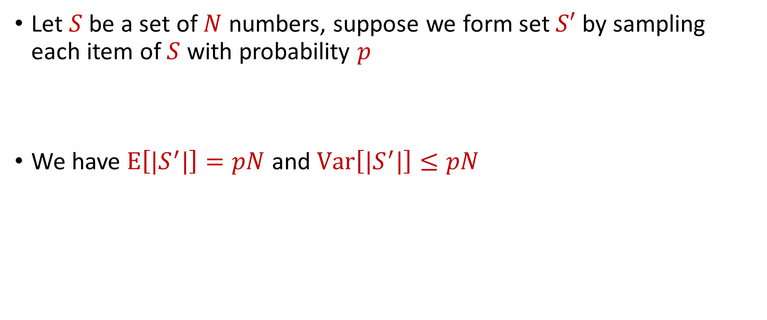
Distinct Elements ($F_{0}$ Estimation)
Let $S$ be a set of $N$ numbers, suppose we form set $S′$ by sampling each item of $S$ with probability $p$
We have $E\left[|S^{′}|\right]=pN$ and $Var\left[|S^{′}|\right]≤pN$

Slide 75

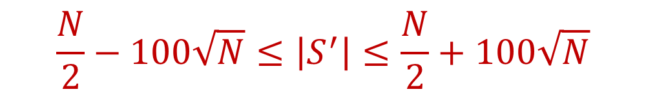
Distinct Elements ($F_{0}$ Estimation)
($S′$ is formed by sampling each item of $S$ with probability $\frac{1}{2}$ ) With probability at least $\frac{9}{10}$,
Thus with probability at least $\frac{9}{10}$,
$$\frac{N}{2}−100\sqrt{N}≤\left|S^{′}\right|≤\frac{N}{2}+100\sqrt{N}$$
$$N−200\sqrt{N}≤2\left|S^{′}\right|≤N+200\sqrt{N}$$

Slide 76

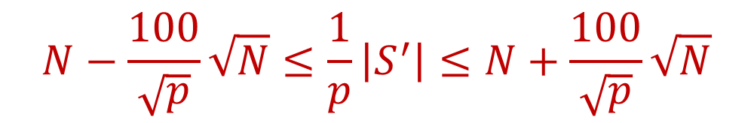
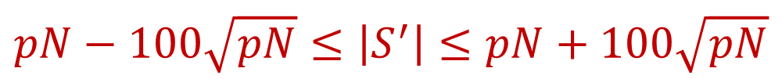
Distinct Elements ($F_{0}$ Estimation)
($S′$ is formed by sampling each item of $S$ with probability $p$) With probability at least $\frac{9}{10}$,
Thus with probability at least $\frac{9}{10}$,
$$pN−100\sqrt{pN}≤\left|S^{′}\right|≤pN+100\sqrt{pN}$$
$$N−\frac{100}{\sqrt{p}}\sqrt{N}≤\frac{1}{p}\left|S^{′}\right|≤N+\frac{100}{\sqrt{p}}\sqrt{N}$$

Slide 77



Distinct Elements ($F_{0}$ Estimation)
($S′$ is formed by sampling each item of $S$ with probability $p$) With probability at least $\frac{9}{10}$,
If $\frac{100}{\sqrt{p}}\sqrt{N}≤εN$, then $N−\frac{100}{\sqrt{p}}\sqrt{N}≤\frac{1}{p}\left|S^{′}\right|≤N+\frac{100}{\sqrt{p}}\sqrt{N}$ implies
$$N−\frac{100}{\sqrt{p}}\sqrt{N}≤\frac{1}{p}\left|S^{′}\right|≤N+\frac{100}{\sqrt{p}}\sqrt{N}$$
$$\left(1−ε\right)N≤\frac{1}{p}\left|S^{′}\right|≤\left(1+ε\right)N$$

Slide 78

Distinct Elements ($F_{0}$ Estimation)
In other words, with probability at least $\frac{9}{10}$, we have that $\frac{1}{p}\left|S^{′}\right|$ is a $\left(1+ε\right)$-approximation of $N$
What is $p$?

Slide 79

Distinct Elements ($F_{0}$ Estimation)
In other words, with probability at least $\frac{9}{10}$, we have that $\frac{1}{p}\left|S^{′}\right|$ is a $\left(1+ε\right)$-approximation of $N$
What is $p$?
Recall, we required $\frac{100}{\sqrt{p}}\sqrt{N}≤εN$

Slide 80

Distinct Elements ($F_{0}$ Estimation)
In other words, with probability at least $\frac{9}{10}$, we have that $\frac{1}{p}\left|S^{′}\right|$ is a $\left(1+ε\right)$-approximation of $N$
What is $p$?
Recall, we required $\frac{100}{\sqrt{p}}\sqrt{N}≤εN$, so $p≥\frac{1000}{ε^{2}N}$

Slide 81

Distinct Elements ($F_{0}$ Estimation)
In other words, with probability at least $\frac{9}{10}$, we have that $\frac{1}{p}\left|S^{′}\right|$ is a $\left(1+ε\right)$-approximation of $N$
What is $p$?
Recall, we required $\frac{100}{\sqrt{p}}\sqrt{N}≤εN$, so $p≥\frac{1000}{ε^{2}N}$
What is the problem here?

Slide 82

Distinct Elements ($F_{0}$ Estimation)
In other words, with probability at least $\frac{9}{10}$, we have that $\frac{1}{p}\left|S^{′}\right|$ is a $\left(1+ε\right)$-approximation of $N$
What is $p$?
Recall, we required $\frac{100}{\sqrt{p}}\sqrt{N}≤εN$, so $p≥\frac{1000}{ε^{2}N}$
What is the problem here?
Must know $N$ to set $p$,
but the goal is to find $N$!

Slide 83

Distinct Elements ($F_{0}$ Estimation)
Observation: We do not need $p=\frac{1000}{ε^{2}N}$, it is also fine to have $p=\frac{2000}{ε^{2}N}$
How do we find a “good” $p$?

Slide 84


Finding $p$
Observation: We do not need $p=\frac{1000}{ε^{2}N}$, it is also fine to have $p=\frac{2000}{ε^{2}N}$
How do we find a “good” $p$?
What is a “good” $p$?

Slide 85

Finding $p$
What is a “good” $p$?
Not too many samples, i.e., $S^{′}$ is small, but enough to find a good approximation to $N$
For $p=Θ\left(\frac{1}{ε^{2}N}\right)$:
$p$ is large enough to find a good approximation to $N$
We have $E\left[\left|S^{′}\right|\right]=pN=Θ\left(\frac{1}{ε^{2}}\right)$

Slide 86


Finding $p$
We want $p$ such that $E\left[\left|S^{′}\right|\right]=pN=Θ\left(\frac{1}{ε^{2}}\right)$
Intuition: Try $p=1,\frac{1}{2},\frac{1}{4},\frac{1}{8},\frac{1}{16},…,$ and see which one has
With high probability, one of these guesses will have $\frac{1000}{ε^{2}}≤\left|S^{′}\right|≤\frac{2000}{ε^{2}}$
$$\frac{1000}{ε^{2}}≤\left|S^{′}\right|≤\frac{2000}{ε^{2}}$$

Slide 87


Finding $p$
Intuition: Try $p=1,\frac{1}{2},\frac{1}{4},\frac{1}{8},\frac{1}{16},…,$ and see which one has
However, the wrong guesses will have too many samples
$$\frac{1000}{ε^{2}}≤\left|S^{′}\right|≤\frac{2000}{ε^{2}}$$

Slide 88

Finding $p$
Intuition: Try $p=1,\frac{1}{2},\frac{1}{4},\frac{1}{8},\frac{1}{16},…,$ and see which one has
However, the wrong guesses will have too many samples
Fix: Dynamically changing guess for $p$ and subsampling
$$\frac{1000}{ε^{2}}≤\left|S^{′}\right|≤\frac{2000}{ε^{2}}$$

Slide 89

Finding $p$
Algorithm: Set $U_{0}=[n]$ and for each $i$, sample each element of $U_{i−1}$ into $U_{i}$ with probability $\frac{1}{2}$
Start index $i=0$ and track the number $|S∩U_{i}|$ of elements of $S$ in $U_{i}$
If $\left|S∩U_{i}\right|>\frac{2000}{ε^{2}}\log{n}$, then increment $i=i+1$
At the end of the stream, output $2^{i}⋅\left|S∩U_{i}\right|$

Slide 90


Finding $p$
Algorithm: Set $U_{0}=[n]$ and for each $i$, sample each element of $U_{i−1}$ into $U_{i}$ with probability $\frac{1}{2}$
Start index $i=0$ and track the number $|S∩U_{i}|$ of elements of $S$ in $U_{i}$
If $\left|S∩U_{i}\right|>\frac{2000}{ε^{2}}\log{n}$, then increment $i=i+1$
At the end of the stream, output $2^{i}⋅\left|S∩U_{i}\right|$
$$\frac{1}{p}$$
$\left|S^{′}\right|$

Slide 91

Finding $p$
Recall that $\frac{1}{p}\left|S^{′}\right|$ is a $\left(1+ε\right)$-approximation of $N$
$2^{i}⋅\left|S∩U_{i}\right|$ is a $\left(1+ε\right)$-approximation of $N$
At the end of the stream, output $2^{i}⋅\left|S∩U_{i}\right|$
$$\frac{1}{p}$$
$\left|S^{′}\right|$

Slide 92

Distinct Elements ($F_{0}$ Estimation)
Summary: Algorithm stores at most $\frac{2000}{ε^{2}}\log{n}$ elements from the stream, uses $Θ\left(\frac{1}{ε^{2}}\log{n}\right)$ words of space

Slide 93


$L_{0}$ Sampling
Given a set $S$ of $m$ elements from $[n]$, let $N$ be the number of distinct elements in $S$
Goal: Return a random sample, so that each item from $S$ is chosen with probability $\frac{1}{N}±\frac{1}{poly(N)}$, say $\frac{1}{N}±\frac{1}{N^{1000}}$
Motivation: Data summarization

Slide 94
$L_{0}$ Sampling
Remember reservoir sampling? Does that work?

Slide 95
$L_{0}$ Sampling
Remember reservoir sampling? Does that work? NO!
1 2 2 2 2 2 2 2 2 2 2 2 2 2 2 2 2 2 2 2 2

Slide 96

$L_{0}$ Sampling
Algorithm: Modify $F_{0}$ estimation algorithm

Slide 97


Clustering
Goal: Given input dataset $P$, partition $P$ so that “similar” points are in the same cluster and “different” points are in different clusters

Slide 100





1 0 3 0 1 1
1 1 0 0 2 8
2 0 1 3 0 8
1 1 0 0 0 8
0 0 0 7 0 0
7 0 0 8 0 0
3 4 1 1 0 2
4 2 0 1 0 1
9 1 0 0 3 2
1 1 6 0 0 0
8 1 0 1 2 0
1
1
2
1
0
7
3
4
9
1
8
$$n$$
$$A$$
$$b$$
$$d$$
$$1$$

Slide 101




$$x$$
$$n$$
$$A$$
$$≈$$
$$b$$
$$d$$
$$1$$

Slide 102











Linear Regression
Find the vector $x$ that minimizes ${\left\|Ax−b\right\|}_{2}$
“Least squares” optimization
Find a vector $\hat{x}$ with ${\left\|A\hat{x}−b\right\|}_{2}≤(1+ε)\left(\min{{\left\|Ax−b\right\|}_{2}}\right)$
$$d$$
$$x$$
$$≈$$
$$n$$
$$A$$
$$n$$
$$b$$
$$1$$
$$d$$
$$1$$

Slide 103




Dimensionality Reduction
Reduce $d$
Reduce $n$
Application depends on task!
Sampling, Sketching, Johnson-Lindenstrauss, IsoMap
$$n$$
$$A$$
Sampling, Sketching
$$d$$

Slide 104






Coreset
Subset $A′$ of representative rows of $A$ for a given task with “score” function $f$
$f\left(A,⋅\right)≈f(A^{′},⋅)$
$$n$$
$$A$$
$$A′$$
$$d$$
$$d$$

Slide 105

Coreset (Formal Definition)
Given a set $X$ with weight function $u$ and an accuracy parameter $ε>0$, we say a set $Y$ with weight function $w$is an $(1+ε)$-multiplicative coreset for a function $f$, if for all queries $q$ in a query space $Q$, we have
$$\left(1−ε\right)f\left(Y,q,w\right)≤f\left(X,q,u\right)≤\left(1+ε\right)f(Y,q,w)$$

Slide 106
Coreset
Lots of different constructions with various tradeoffs
Size vs. accuracy
Size vs. computation time
Size vs. interpretability
Average-case vs. worst-case performance

Slide 107


Uniform Sampling
1 0 3 0 1 1
1 1 0 0 2 8
2 0 1 3 0 8
1 1 0 0 0 8
0 0 0 7 0 0
7 0 0 8 0 0
3 4 1 1 0 2
4 2 0 1 0 1
9 1 0 0 3 2
1 1 6 0 0 0
8 1 0 1 2 0
Repeat $m$ times:
Pick a row $A_{i}$ of $A$ uniformly at random and scale by $n/m$
Example with $n=11$ and $m=5$
$$n$$
$$A$$
1 0 3 0 1 1
1 1 0 0 0 8
3 4 1 1 0 2
8 1 0 1 2 0
3 4 1 1 0 2
$$\frac{11}{5}×$$
$$A′$$
$$d$$
$$d$$

Slide 108




Uniform Sampling
1 0 0 0 0 0
1 0 0 0 0 0
1 0 0 0 0 0
1 0 0 0 0 0
1 0 0 0 0 0
1 0 0 0 0 0
1 0 0 0 0 0
1 0 0 0 0 0
1 0 0 0 0 0
1 0 0 0 0 0
1 0 0 0 0 0
How big should $m$ be?
For uniform matrix, it suffices to set $m=1$
$$n$$
$$A$$
$$d$$

Slide 109
Uniform Sampling
1 0 0 0 0 0
1 0 0 0 0 0
1 0 0 0 0 0
1 0 0 0 0 0
1 0 0 0 0 0
1 0 0 0 0 0
1 0 0 0 0 0
1 0 0 0 0 0
1 0 0 0 0 0
1 0 0 0 0 0
1 0 0 0 0 0
How big should $m$ be?
For uniform matrix, it suffices to set $m=1$
$$n$$
$$A$$
1 0 0 0 0 0
1 0 0 0 0 0
1 0 0 0 0 0
1 0 0 0 0 0
1 0 0 0 0 0
$$\frac{11}{5}×$$
$$A′$$
$$d$$
$$d$$

Slide 110

Uniform Sampling
0 0 0 0 0 1
1 0 0 0 0 0
1 0 0 0 0 0
1 0 0 0 0 0
1 0 0 0 0 0
1 0 0 0 0 0
1 0 0 0 0 0
1 0 0 0 0 0
1 0 0 0 0 0
1 0 0 0 0 0
1 0 0 0 0 0
How big should $m$ be?
What is the probability the first row of $A$ is sampled?
Need $m=O(n\log{n})$ rows
$$n$$
$$A$$
$$d$$

Slide 111
Uniform Sampling
Pros: intuitively simple, simple to implement, fast, good on uniform or “average-case” data
Cons: bad on “worst-case” data

Slide 112
Importance Sampling
1 0 0 0 0 0
1 0 0 0 0 0
1 0 0 0 0 0
1 0 0 0 0 0
1 0 0 0 0 0
1 0 0 0 0 0
0 0 0 0 0 1
1 0 0 0 0 0
1 0 0 0 0 0
1 0 0 0 0 0
1 0 0 0 0 0
What if we do not sample uniformly at random?
What is the probability that each row should be sampled?
$$n$$
$$A$$

Slide 113

Importance Sampling
1 0 0 0 0 0
1 0 0 0 0 0
1 0 0 0 0 0
1 0 0 0 0 0
1 0 0 0 0 0
1 0 0 0 0 0
0 0 0 0 0 1
1 0 0 0 0 0
1 0 0 0 0 0
1 0 0 0 0 0
1 0 0 0 0 0
Have a measure $s_{i}$ of “importance” for each row $A_{i}$
$$n$$
$$A$$

Slide 114





Importance Sampling
1 0 0 0 0 0
1 0 0 0 0 0
1 0 0 0 0 0
1 0 0 0 0 0
1 0 0 0 0 0
1 0 0 0 0 0
0 0 0 0 0 1
1 0 0 0 0 0
1 0 0 0 0 0
1 0 0 0 0 0
1 0 0 0 0 0
Have a measure $s_{i}$ of “importance” for each row $A_{i}$
If there were just two different rows, each row should be “maximally” important, $s_{1}=s_{2}=1$
$$n$$
$$A$$
1 0 0 0 0 0
0 0 0 0 0 1
$$n$$
$$A$$

Slide 115

Importance Sampling
1 0 0 0 0 0
1 0 0 0 0 0
1 0 0 0 0 0
1 0 0 0 0 0
1 0 0 0 0 0
1 0 0 0 0 0
0 0 0 0 0 1
1 0 0 0 0 0
1 0 0 0 0 0
1 0 0 0 0 0
1 0 0 0 0 0
Have a measure $s_{i}$ of “importance” for each row $A_{i}$
Say $s_{7}=1$ and $s_{i}=\frac{1}{10}$ for $i≠7$
$$n$$
$$A$$

Slide 116

Importance Sampling
1 0 0 0 0 0
1 0 0 0 0 0
1 0 0 0 0 0
1 0 0 0 0 0
1 0 0 0 0 0
1 0 0 0 0 0
0 0 0 0 0 1
1 0 0 0 0 0
1 0 0 0 0 0
1 0 0 0 0 0
1 0 0 0 0 0
Say $s_{7}=1$ and $s_{i}=\frac{1}{10}$ for $i≠7$
What is the probability that each row should be sampled?
Proportional to importance!
Say $p_{7}=\frac{1}{2}$ and $p_{i}=\frac{1}{20}$ for $i≠7$
$$n$$
$$A$$

Slide 117

Importance Sampling
1 0 0 0 0 0
1 0 0 0 0 0
1 0 0 0 0 0
1 0 0 0 0 0
1 0 0 0 0 0
1 0 0 0 0 0
0 0 0 0 0 1
1 0 0 0 0 0
1 0 0 0 0 0
1 0 0 0 0 0
1 0 0 0 0 0
Have a measure $s_{i}$ of “importance” for each row $A_{i}$
Say $p_{7}=\frac{1}{2}$ and $p_{i}=\frac{1}{20}$ for $i≠7$
$$n$$
$$A$$

Slide 118



Importance Sampling
1 0 0 0 0 0
1 0 0 0 0 0
1 0 0 0 0 0
1 0 0 0 0 0
1 0 0 0 0 0
1 0 0 0 0 0
0 0 0 0 0 1
1 0 0 0 0 0
1 0 0 0 0 0
1 0 0 0 0 0
1 0 0 0 0 0
Repeat $m$ times:
Pick a row $A_{i}$ of $A$ with probability $p_{i}$and scale by $\frac{1}{mp_{i}}$
Example with $n=11$ and $m=5$
$$n$$
$$A$$
4 0 0 0 0 0
4 0 0 0 0 0
0 0 0 0 0 $\frac{2}{5}$
4 0 0 0 0 0
0 0 0 0 0 $\frac{2}{5}$
$$A′$$
$$d$$
$$d$$

Slide 119

Importance Sampling
0 0 0 0 0 1
1 0 0 0 0 0
1 0 0 0 0 0
1 0 0 0 0 0
1 0 0 0 0 0
1 0 0 0 0 0
1 0 0 0 0 0
1 0 0 0 0 0
1 0 0 0 0 0
1 0 0 0 0 0
1 0 0 0 0 0
How big should $m$ be?
Have a measure $s_{i}$ of “importance” for each row $A_{i}$
Need $m=O(T\log{n})$ rows, where $T=\sum{s_{i}}$
$$n$$
$$A$$
$$d$$

Slide 120

Sensitivity Sampling
Terminology: $s_{i}$ is called the sensitivity of the row $A_{i}$
$T=\sum{s_{i}}$ is called the total sensitivity of $A$
Need $m=O(T\log{n})$ rows, where $T$ can be much smaller than $n$

Slide 121


Sensitivity Sampling (Formal Theorem)
[Feldman, Schmidt, Sohler 2020] Let $C>1$ be a universal constant and for each $i∈[n]$, let $q\left(x_{i}\right)$ be a $C$-approximation to the sensitivity $s\left(x_{i}\right)$for any point $x_{i}$. Let $T=\sum_{i=1}^{n}{q\left(x_{i}\right)}$. Then sensitivity sampling
points with replacement, i.e., choosing each of the $m$ points to be $x_{i}$with probability proportional to $q\left(x_{i}\right)$ and then rescaling by the sampling probability, outputs a $(1+ε)$-coreset for $k$-means clustering with probability $\frac{2}{3}$ .
$$m=O\left(\frac{Tk}{ε^{2}}\log^{2}{k}\right)$$

Slide 122
Sensitivity Sampling
Pros: size is always better than uniform sampling and MUCH better on “worst-case” data
Cons: estimating the sensitivities can be a difficult design choice, computing the total sensitivity can be mathematically challenging, larger runtime

Slide 123
 | Uniform Sampling | Sensitivity Sampling
Average-case size | X | X
Worst-case size |  | X
Ease of implementation Computation of probabilities | X
Interpretability |  | X

Slide 124



Group / Stratified Sampling
0 0 0 0 0 1
1 0 0 0 0 0
1 0 0 0 0 0
1 0 0 0 0 0
1 0 0 0 0 0
1 0 0 0 0 0
1 0 0 0 0 0
1 0 0 0 0 0
1 0 0 0 0 0
1 0 0 0 0 0
1 0 0 0 0 0
Separate the data into “groups” and then perform uniform sampling on each group
If the data is uniform in each group, this is essentially sensitivity sampling
$$n$$
$$A$$
$$d$$

Slide 126
Coresets
Where to apply them?
Which sampling approach to use?
Worst-case mathematical bounds

Slide 127

Coresets
Where to apply them?

Slide 128


Coresets
Which sampling approach to use?

Slide 129

Coresets
Worst-case mathematical bounds

Slide 130


Heavy-Hitters (Frequent Items)
Given a set $S$ of $m$ elements from $[n]$, let $f_{i}$ be the frequency of element $i$. (How often it appears)
Let $L_{2}$ be the norm of the frequency vector:
Goal: Given a set $S$ of $m$ elements from $[n]$ and a threshold $ε$, output the elements $i$ such that $f_{i}>$ $ε L_{2}$...and no elements $j$ such that $f_{j}<$ $\frac{ε}{16} L_{2}$
Motivation: DDoS prevention, iceberg queries
$$L_{2}=\sqrt{f_{1}^{2}+f_{2}^{2}+…+f_{n}^{2}}$$

Slide 131



Frequency Moments ($L_{p}$ Norm)
Given a set $S$ of $m$ elements from $[n]$, let $f_{i}$ be the frequency of element $i$. (How often it appears)
Let $F_{p}$ be the frequency moment of the vector:
Goal: Given a set $S$ of $m$ elements from $[n]$ and an accuracy parameter $ε$, output a $(1+ε)$-approximation to $F_{p}$
Motivation: Entropy estimation, linear regression
$F_{p}=$ $f_{1}^{p}+f_{2}^{p}+…+f_{n}^{p}$

Slide 132
Distinct Elements ($F_{0}$ Estimation)
Given a set $S$ of $m$ elements from $[n]$, let $f_{i}$ be the frequency of element $i$. (How often it appears)
Let $F_{0}$ be the frequency moment of the vector:
Goal: Given a set $S$ of $m$ elements from $[n]$ and an accuracy parameter $ε$, output a $(1+ε)$-approximation to $F_{0}$
Motivation: Traffic monitoring
$F_{0}=$ $|\{i :f_{i}≠0\}|$

