Slide 1
CSCE 658: Randomized Algorithms
Lecture 16
Samson Zhou

Slide 2
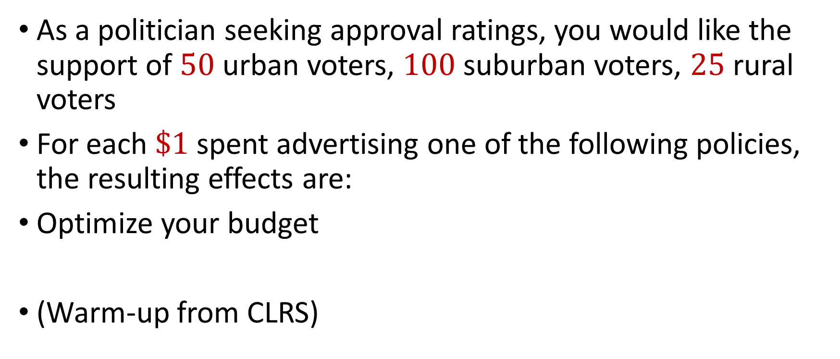
Political Problems…
As a politician seeking approval ratings, you would like the support of $50$ urban voters, $100$ suburban voters, $25$ rural voters
For each $\$1$ spent advertising one of the following policies, the resulting effects are:
Optimize your budget
(Warm-up from CLRS)
Policy | Urban | Suburban | Rural
Zombie apocalypse | -2 | +5 | -3
Sharks with lasers | +8 | +2 | -5
Flying cars roads | 0 | 0 | +10
Dolphins voting | +10 | 0 | -2

Slide 3

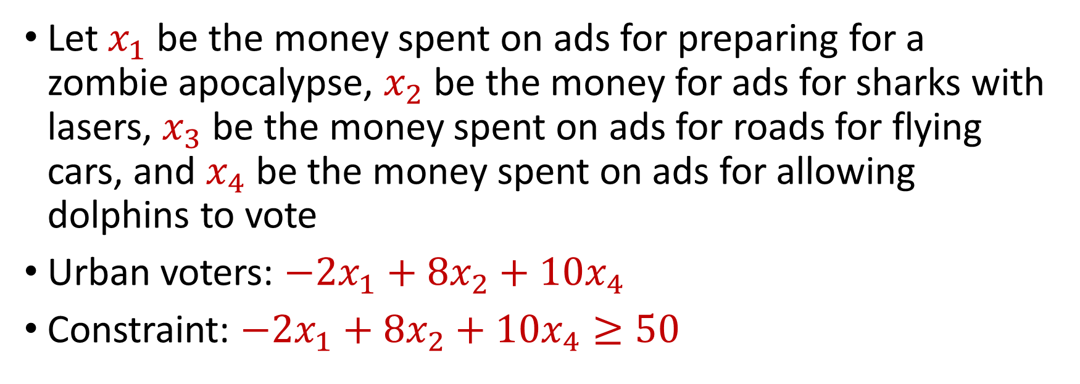
Political Problems…
Policy | Urban | Suburban | Rural
Zombie apocalypse | -2 | +5 | -3
Sharks with lasers | +8 | +2 | -5
Flying cars roads | 0 | 0 | +10
Dolphins voting | +10 | 0 | -2
You seek $50$ urban voters, $100$ suburban voters, $25$ rural voters
Let $x_{1}$ be the money spent on ads for preparing for a zombie apocalypse, $x_{2}$ be the money for ads for sharks with lasers, $x_{3}$ be the money spent on ads for roads for flying cars, and $x_{4}$ be the money spent on ads for allowing dolphins to vote
Urban voters: $−2x_{1}+8x_{2}+10x_{4}$
Constraint: $−2x_{1}+8x_{2}+10x_{4}≥50$

Slide 4
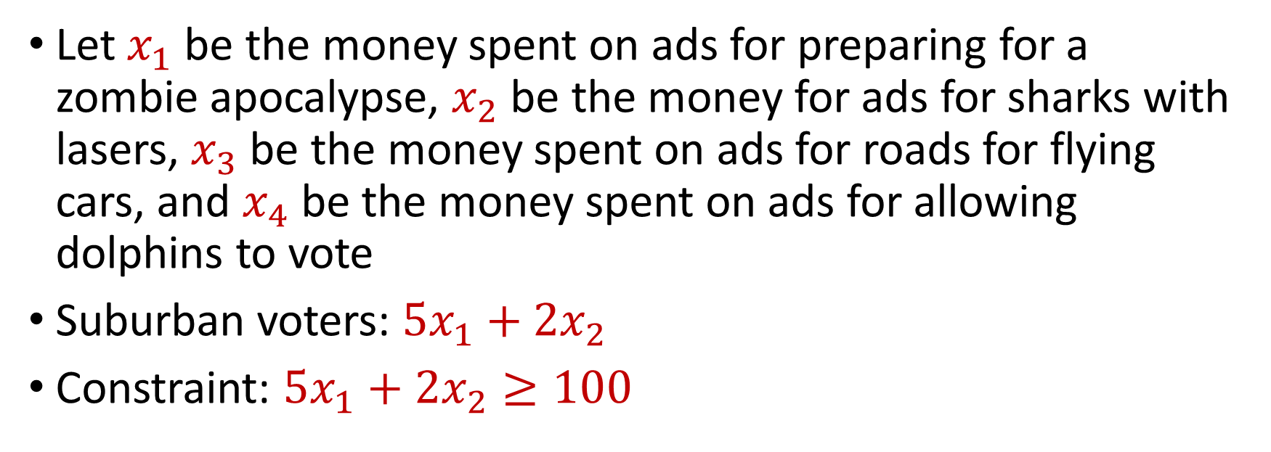
Political Problems…
Policy | Urban | Suburban | Rural
Zombie apocalypse | -2 | +5 | -3
Sharks with lasers | +8 | +2 | -5
Flying cars roads | 0 | 0 | +10
Dolphins voting | +10 | 0 | -2
You seek $50$ urban voters, $100$ suburban voters, $25$ rural voters
Let $x_{1}$ be the money spent on ads for preparing for a zombie apocalypse, $x_{2}$ be the money for ads for sharks with lasers, $x_{3}$ be the money spent on ads for roads for flying cars, and $x_{4}$ be the money spent on ads for allowing dolphins to vote
Suburban voters: $5x_{1}+2x_{2}$
Constraint: $5x_{1}+2x_{2}≥100$

Slide 5
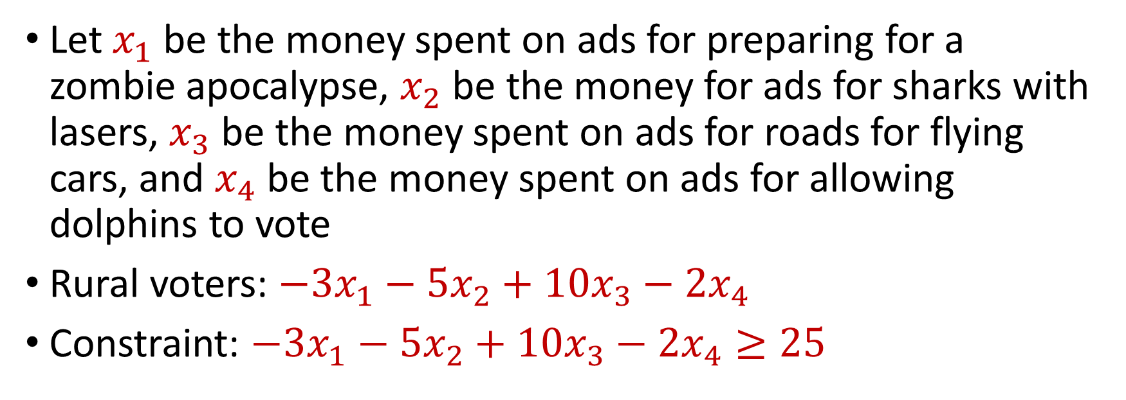
Political Problems…
Policy | Urban | Suburban | Rural
Zombie apocalypse | -2 | +5 | -3
Sharks with lasers | +8 | +2 | -5
Flying cars roads | 0 | 0 | +10
Dolphins voting | +10 | 0 | -2
You seek $50$ urban voters, $100$ suburban voters, $25$ rural voters
Let $x_{1}$ be the money spent on ads for preparing for a zombie apocalypse, $x_{2}$ be the money for ads for sharks with lasers, $x_{3}$ be the money spent on ads for roads for flying cars, and $x_{4}$ be the money spent on ads for allowing dolphins to vote
Rural voters: $−3x_{1}−5x_{2}+10x_{3}−2x_{4}$
Constraint: $−3x_{1}−5x_{2}+10x_{3}−2x_{4}≥25$

Slide 6
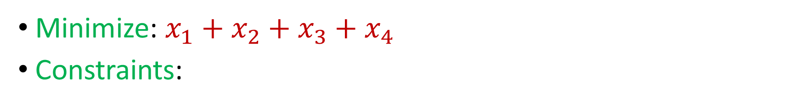
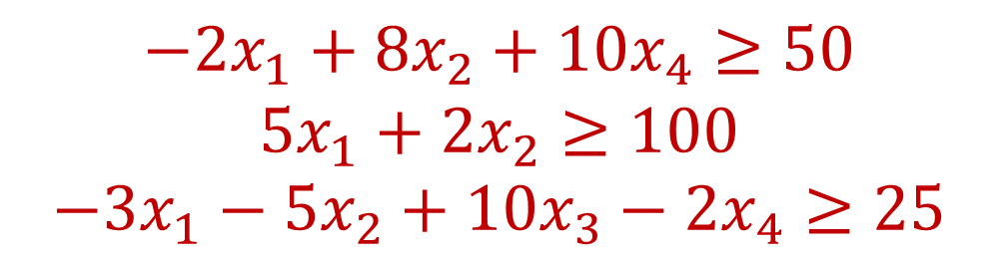
Minimization Problem
Policy | Urban | Suburban | Rural
Zombie apocalypse | -2 | +5 | -3
Sharks with lasers | +8 | +2 | -5
Flying cars roads | 0 | 0 | +10
Dolphins voting | +10 | 0 | -2
You seek $50$ urban voters, $100$ suburban voters, $25$ rural voters
Minimize: $x_{1}+x_{2}+x_{3}+x_{4}$
Constraints:
$$−2x_{1}+8x_{2}+10x_{4}≥50$$
$$5x_{1}+2x_{2}≥100$$
$$−3x_{1}−5x_{2}+10x_{3}−2x_{4}≥25$$

Slide 7
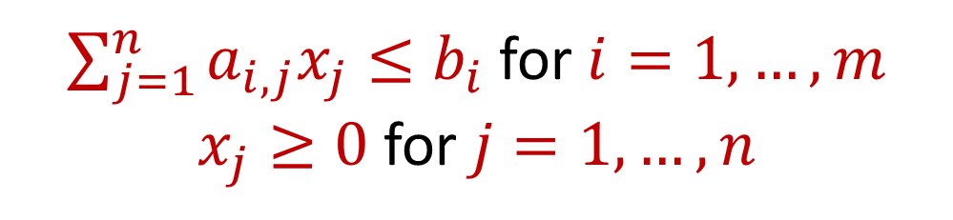
Linear Programming
Maximize a linear objective function:
Subject to constraints:
$$f\left(x_{1},…,x_{n}\right)=c_{1}x_{1}+…+c_{n}x_{n}$$
$\sum_{j=1}^{n}{a_{i,j}x_{j}≤b_{i}}$ for $i=1,…,m$
$x_{j}≥0$ for $j=1,…,n$

Slide 8
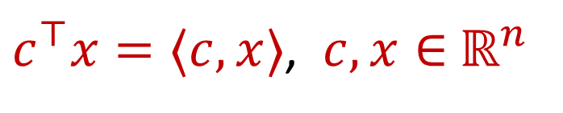
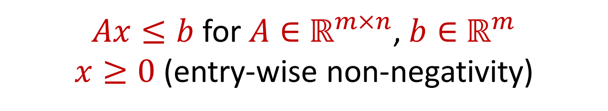
Linear Programming (Standard Form)
Maximize a linear objective function:
Subject to constraints:
$c^{⊤}x=⟨c,x⟩$, $c,x∈$ $ℝ^{n}$
$Ax≤b$ for $A∈$ $ℝ^{m×n}$, $b∈$ $ℝ^{m}$
$x≥0$ (entry-wise non-negativity)

Slide 9
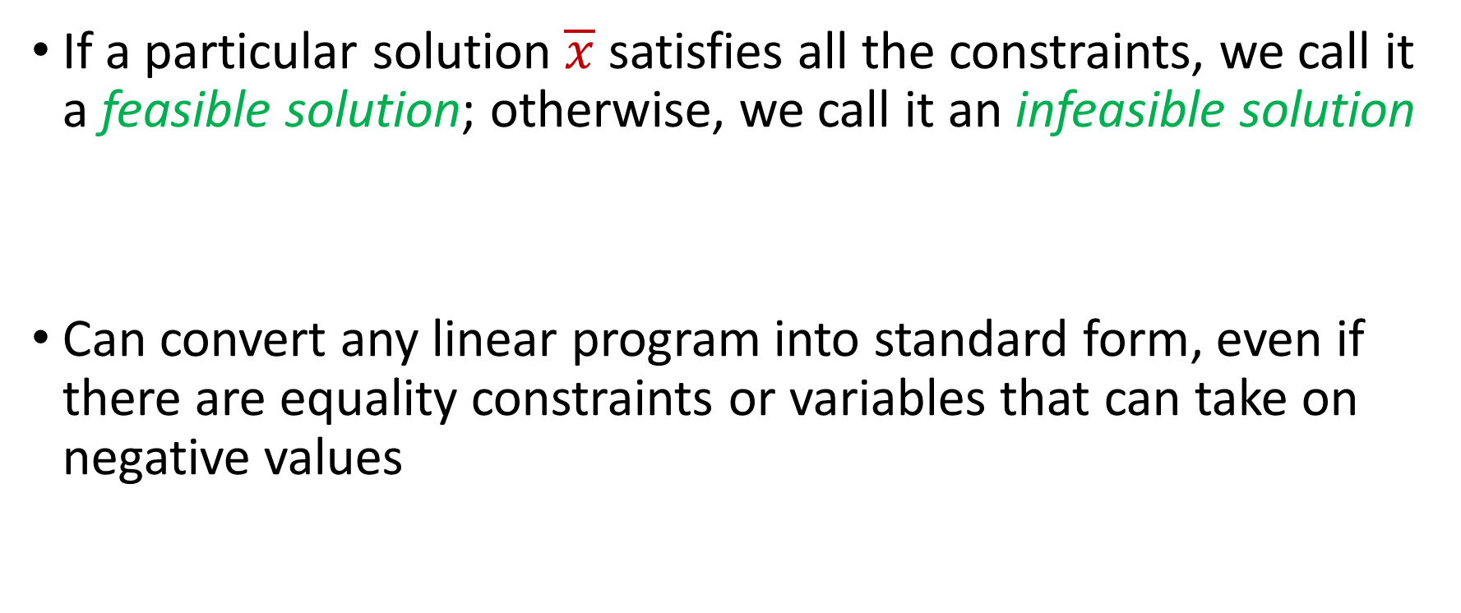
Linear Programming (Standard Form)
If a particular solution $\overline{x}$ satisfies all the constraints, we call it a feasible solution; otherwise, we call it an infeasible solution
Can convert any linear program into standard form, even if there are equality constraints or variables that can take on negative values

Slide 10


Linear Programming
Minimize: $x_{1}+x_{2}$
Subject to:
$$4x_{1}−x_{2}≤8$$
$$2x_{1}+x_{2}≤10$$
$$5x_{1}−{2x}_{2}≤−2$$
$$x_{1},x_{2}≥0$$

Slide 11
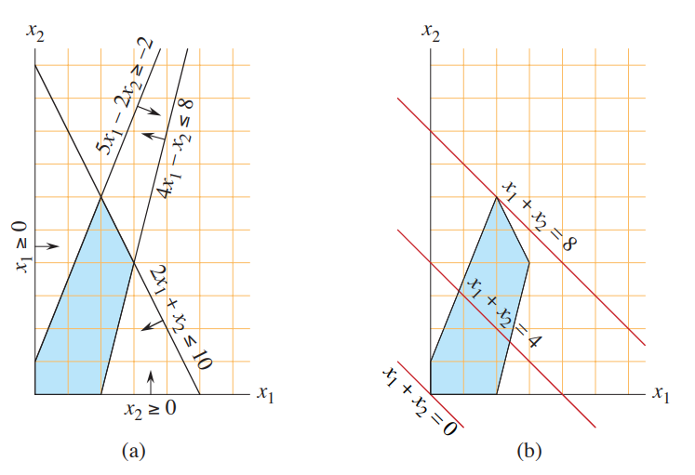
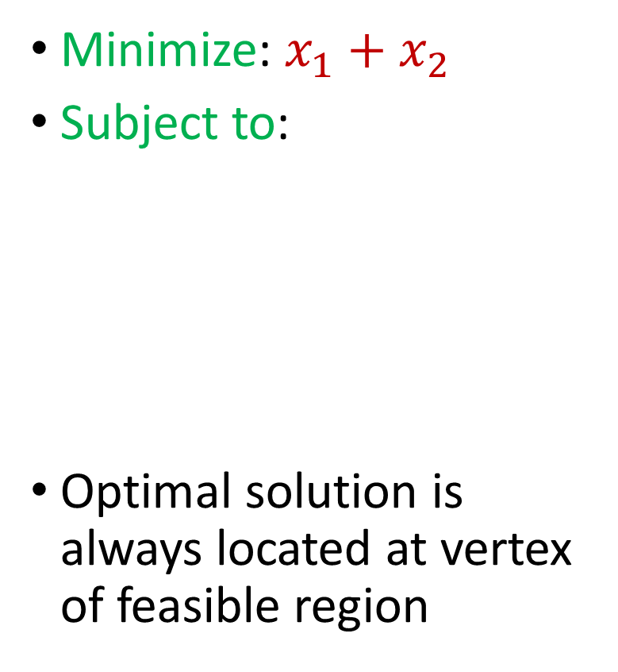
Linear Programming
Minimize: $x_{1}+x_{2}$
Subject to:
Optimal solution is always located at vertex of feasible region
$$4x_{1}−x_{2}≤8$$
$$2x_{1}+x_{2}≤10$$
$$5x_{1}−{2x}_{2}≤−2$$
$$x_{1},x_{2}≥0$$

Slide 12
Linear Programming
Simplex algorithm: finds a feasible solution at a vertex of the polytope and then searches along the edges to vertices with non-decreasing values
Good in practice but exponential time in the worst-case

Slide 13
Linear Programming
Ellipsoid algorithm: iterative algorithm that generates a sequence of smaller ellipsoids, each of which separate the current iterate with the optimal solution
Requires a separation oracle
Polynomial time algorithm in theory but inefficient in practice and can suffer from numerical instability

Slide 14


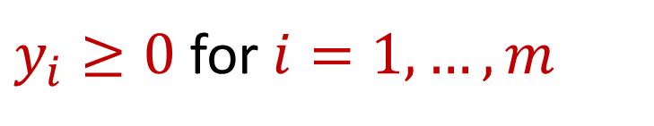
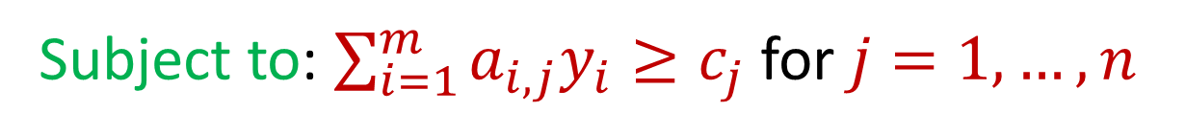
Duality
Maximize $c_{1}x_{1}+…+c_{n}x_{n}$ subject to $\sum_{j=1}^{n}{a_{i,j}x_{j}≤b_{i}}$ for $i=1,…,m$ and $x_{j}≥0$ for $j=1,…,n$
For the above linear program, its dual is
Minimize: $b_{1}y_{1}+…+b_{m}y_{m}$
Subject to: $\sum_{i=1}^{m}{a_{i,j}y_{i}≥c_{j}}$ for $j=1,…,n$
$y_{i}≥0$ for $i=1,…,m$

Slide 15

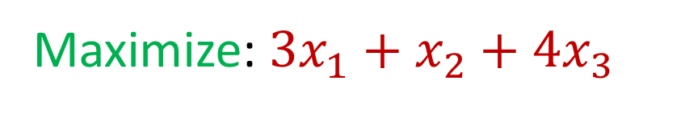



Duality
What is its dual program? (Williamson-Shmoys)
Maximize: $3x_{1}+x_{2}+4x_{3}$
Subject to: $x_{1}+x_{2}+3x_{3}≤30$
$$2x_{1}+2x_{2}+5x_{3}≤24$$
$$4x_{1}+x_{2}+2x_{3}≤36$$
$$x_{1},x_{2},x_{3} ≥0$$

Slide 16

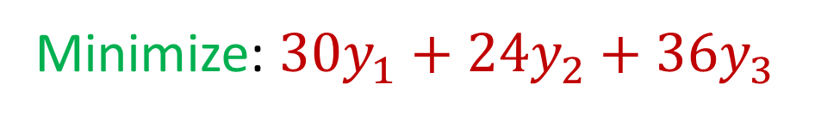



Duality
Minimize: $30y_{1}+24y_{2}+36y_{3}$
Subject to: $y_{1}+2y_{2}+4y_{3}≥3$
$$y_{1}+2y_{2}+y_{3}≥1$$
$$3y_{1}+5y_{2}+2y_{3}≥4$$
$$y_{1},y_{2},y_{3} ≥0$$

Slide 17

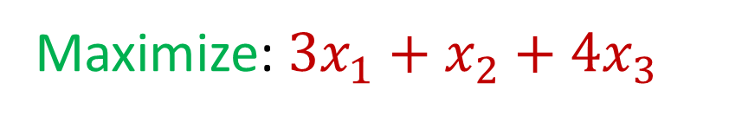



Duality
Intuition: What if we take the original constraints and add the first two constraints?
Maximize: $3x_{1}+x_{2}+4x_{3}$
Subject to: $x_{1}+x_{2}+3x_{3}≤30$
$$2x_{1}+2x_{2}+5x_{3}≤24$$
$$4x_{1}+x_{2}+2x_{3}≤36$$
$$x_{1},x_{2},x_{3} ≥0$$

Slide 18
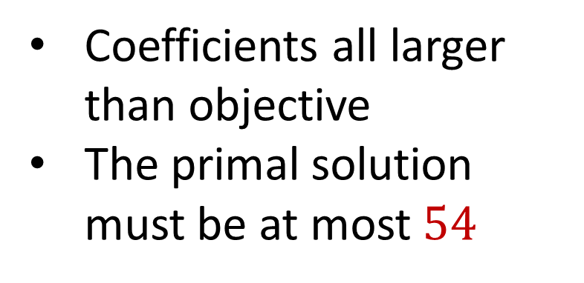

Duality
Intuition: What if we take the original constraints and add the first two constraints?
$$3x_{1}+3x_{2}+8x_{3}≤54$$
Maximize: $3x_{1}+x_{2}+4x_{3}$
Coefficients all larger than objective
The primal solution must be at most $54$
Subject to: $x_{1}+x_{2}+3x_{3}≤30$
$$2x_{1}+2x_{2}+5x_{3}≤24$$
$$4x_{1}+x_{2}+2x_{3}≤36$$
$$x_{1},x_{2},x_{3} ≥0$$

Slide 19
Duality
Intuition: What if we take the original constraints and add the first two constraints?
Maximize: $3x_{1}+x_{2}+4x_{3}$
Can we find a linear combination of the equations that exactly matches the objective?
Subject to: $x_{1}+x_{2}+3x_{3}≤30$
$$2x_{1}+2x_{2}+5x_{3}≤24$$
$$4x_{1}+x_{2}+2x_{3}≤36$$
$$x_{1},x_{2},x_{3} ≥0$$

Slide 20
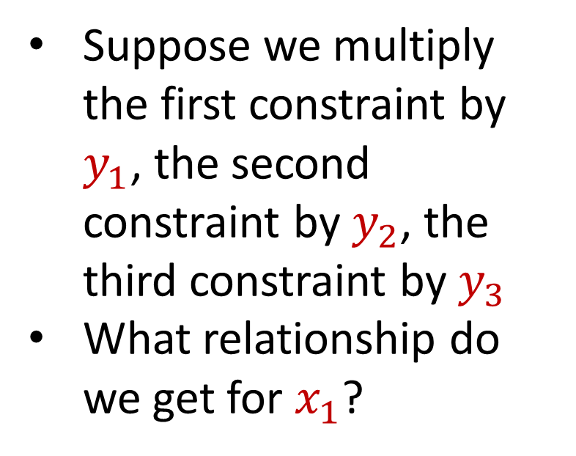
Duality
Intuition: What if we take the original constraints and add the first two constraints?
Suppose we multiply the first constraint by $y_{1}$, the second constraint by $y_{2}$, the third constraint by $y_{3}$
What relationship do we get for $x_{1}$?
Maximize: $3x_{1}+x_{2}+4x_{3}$
Subject to: $x_{1}+x_{2}+3x_{3}≤30$
$$2x_{1}+2x_{2}+5x_{3}≤24$$
$$4x_{1}+x_{2}+2x_{3}≤36$$
$$x_{1},x_{2},x_{3} ≥0$$

Slide 21
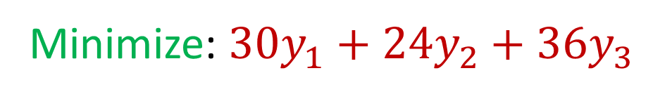
Duality
The dual is exactly this program
Minimize: $30y_{1}+24y_{2}+36y_{3}$
Subject to: $y_{1}+2y_{2}+4y_{3}≥3$
$$y_{1}+2y_{2}+y_{3}≥1$$
$$3y_{1}+5y_{2}+2y_{3}≥4$$
$$y_{1},y_{2},y_{3} ≥0$$
Notes:
https://cs.stackexchange.com/questions/128959/how-to-prove-that-the-dual-linear-program-of-the-max-flow-linear-program-indeed

Slide 22
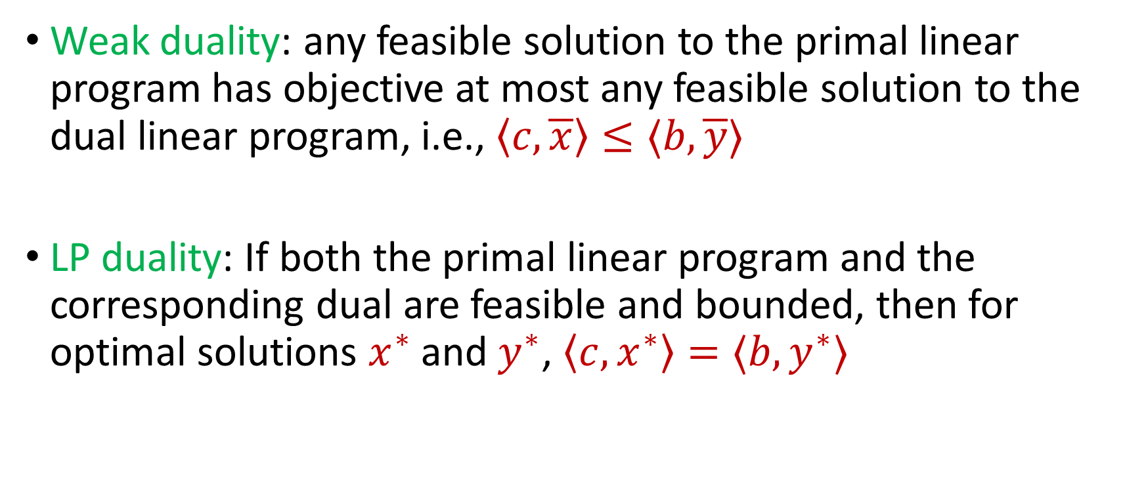
Duality
Weak duality: any feasible solution to the primal linear program has objective at most any feasible solution to the dual linear program, i.e., $\left\langle c, \overline{x}\right\rangle ≤⟨b,\overline{y}⟩$
LP duality: If both the primal linear program and the corresponding dual are feasible and bounded, then for optimal solutions $x^{∗}$ and $y^{∗}$, $\left\langle c, x^{∗}\right\rangle =⟨b, y^{∗}⟩$

Slide 23
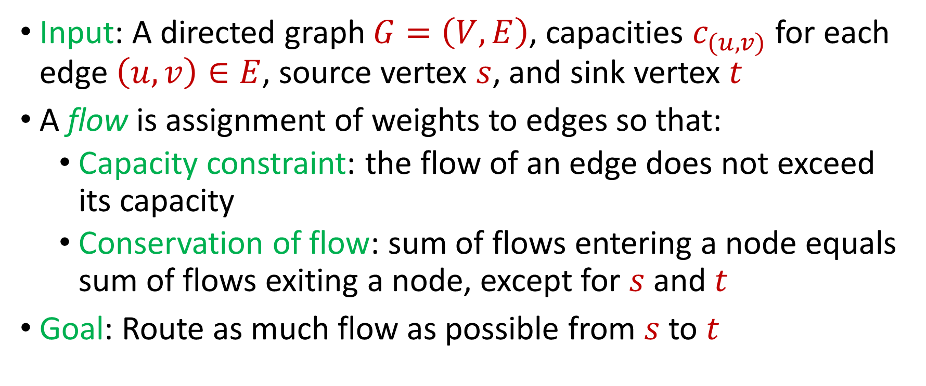

Max $s−t$Flow in a Directed Graph
Input: A directed graph $G=\left(V,E\right)$, capacities $c_{(u,v)}$ for each edge $\left(u,v\right)∈E$, source vertex $s$, and sink vertex $t$
A flow is assignment of weights to edges so that:
Capacity constraint: the flow of an edge does not exceed its capacity
Conservation of flow: sum of flows entering a node equals sum of flows exiting a node, except for $s$ and $t$
Goal: Route as much flow as possible from $s$ to $t$

Slide 24















Max $s−t$Flow in a Directed Graph
$$a$$
$$4$$
$$b$$
$$6$$
$$1$$
$$5$$
$$s$$
$$t$$
$$5$$
$$4$$
$$6$$
$$6$$
$$c$$
$$3$$
$$d$$

Slide 25

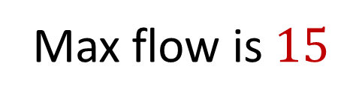








Max $s−t$Flow in a Directed Graph
$$a$$
$$4/4$$
$$b$$
$$6/6$$
$$1/1$$
$$5/5$$
$$s$$
$$t$$
$$5/5$$
$$3/4$$
$$2/6$$
$$5/6$$
Max flow is $15$
$$c$$
$$3/3$$
$$d$$

Slide 26
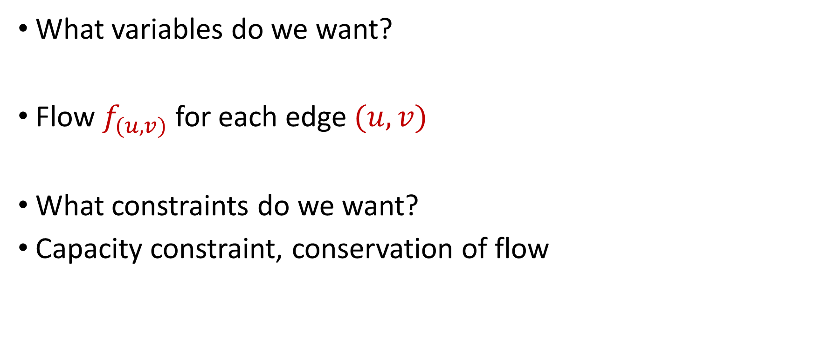
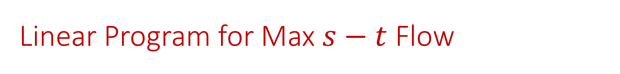
Linear Program for Max $s−t$ Flow
What variables do we want?
Flow $f_{(u,v)}$ for each edge $(u,v)$
What constraints do we want?
Capacity constraint, conservation of flow

Slide 27

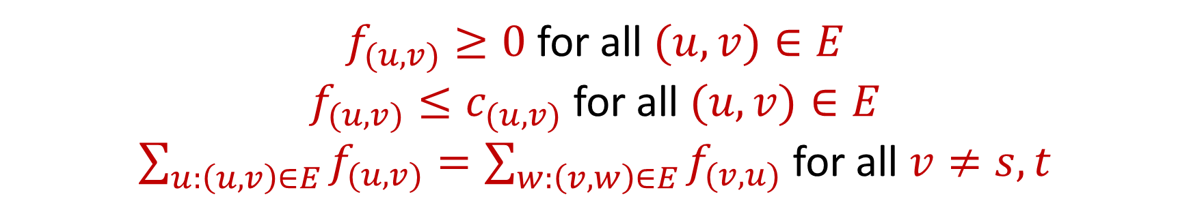
Linear Program for Max $s−t$ Flow
Maximize: $\sum_{v:\left(s,v\right)∈E}{f_{(s,v)}}−\sum_{v:\left(v,s\right)∈E}{f_{(v,s)}}$
Subject to:
$f_{(u,v)}≥0$ for all $(u,v)∈E$
$f_{(u,v)}≤c_{(u,v)}$ for all $(u,v)∈E$
$\sum_{u:\left(u,v\right)∈E}{f_{(u,v)}}=\sum_{w:\left(v,w\right)∈E}{f_{(v,u)}}$ for all $v≠s,t$

Slide 28


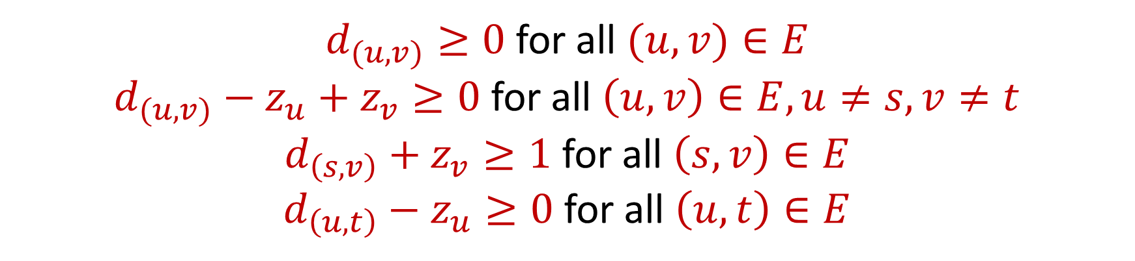
Dual Program for Max $s−t$ Flow
Minimize: $\sum_{v:\left(u,v\right)∈E}{c_{(u,v)}d_{(u,v)}}$, where $d_{(u,v)}$ indicates whether $\left(u,v\right)$crosses the cut, $c_{(u,v)}$ is the capacity of $\left(u,v\right)$
Subject to:
$d_{(u,v)}≥0$ for all $(u,v)∈E$
$d_{(u,v)}−z_{u}+z_{v}≥0$ for all $\left(u,v\right)∈E,u≠s,v≠t$
$d_{\left(s,v\right)}+z_{v}≥1$ for all $\left(s,v\right)∈E$
$d_{\left(u,t\right)}−z_{u}≥0$ for all $\left(u,t\right)∈E$

Slide 29
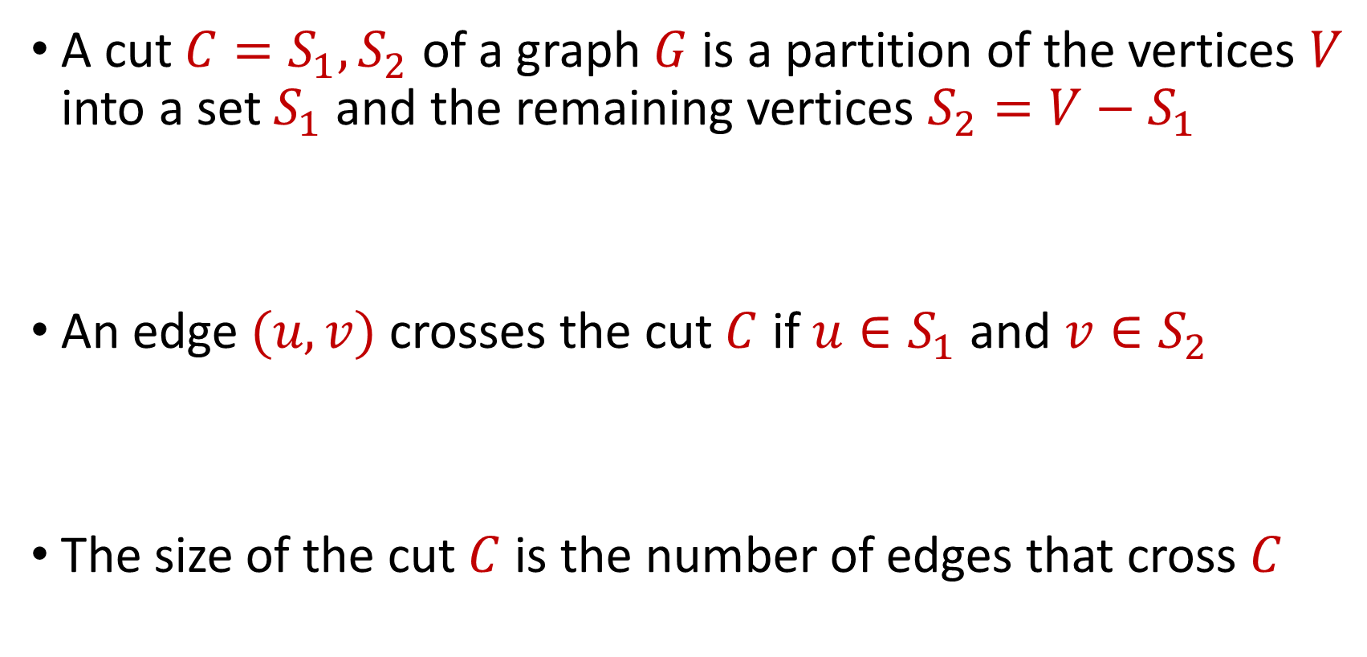
Cuts
A cut $C=S_{1},S_{2}$ of a graph $G$ is a partition of the vertices $V$ into a set $S_{1}$ and the remaining vertices $S_{2}=V−S_{1}$
An edge $(u,v)$ crosses the cut $C$ if $u∈S_{1}$ and $v∈S_{2}$
The size of the cut $C$ is the number of edges that cross $C$

Slide 30

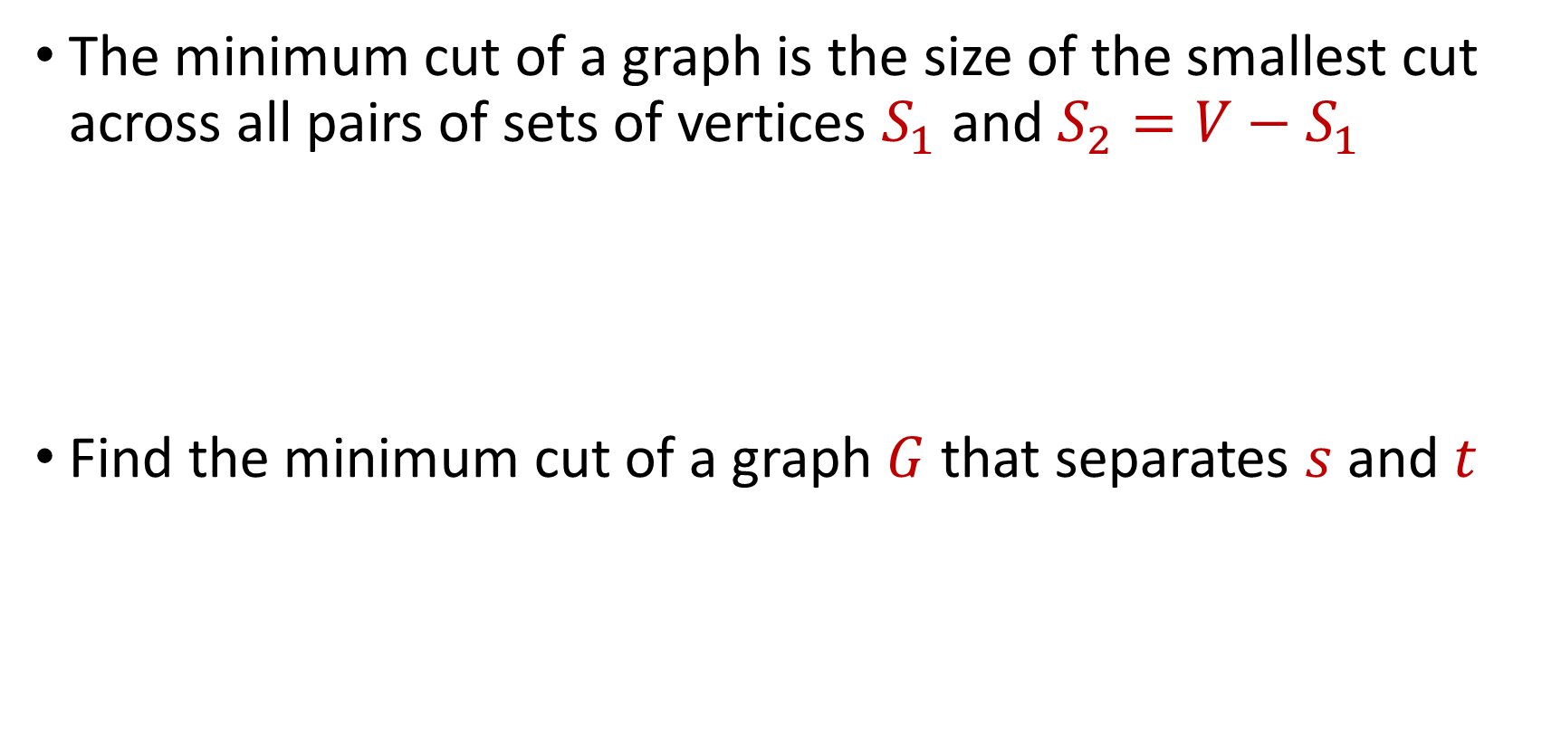
Minimum $s−t$ Cut
The minimum cut of a graph is the size of the smallest cut across all pairs of sets of vertices $S_{1}$ and $S_{2}=V−S_{1}$
Find the minimum cut of a graph $G$ that separates $s$ and $t$

Slide 31
What is the minimum $s−t$ cut of the graph?
$$a$$
$$4$$
$$b$$
$$6$$
$$1$$
$$5$$
$$s$$
$$t$$
$$5$$
$$4$$
$$6$$
$$6$$
$$c$$
$$3$$
$$d$$

Slide 32
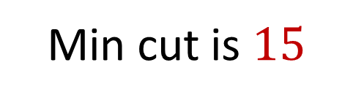

What is the minimum $s−t$ cut of the graph?
$$a$$
$$4$$
$$b$$
$$6$$
$$1$$
$$5$$
$$s$$
$$t$$
$$5$$
$$4$$
$$6$$
$$6$$
Min cut is $15$
$$c$$
$$3$$
$$d$$

Slide 33
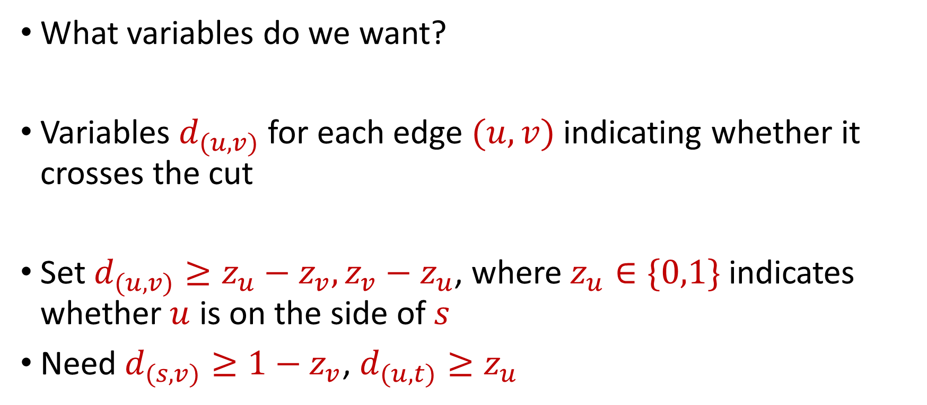
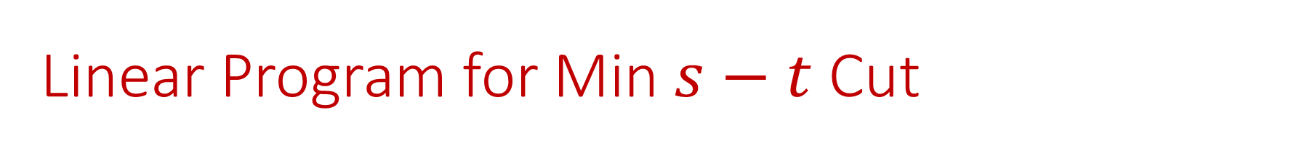
Linear Program for Min $s−t$ Cut
What variables do we want?
Variables $d_{(u,v)}$ for each edge $(u,v)$ indicating whether it crosses the cut
Set $d_{(u,v)}≥z_{u}−z_{v}, z_{v}−z_{u}$, where $z_{u}∈\{0,1\}$ indicates whether $u$ is on the side of $s$
Need $d_{(s,v)}≥1−z_{v}$, $d_{(u,t)}≥z_{u}$

Slide 34
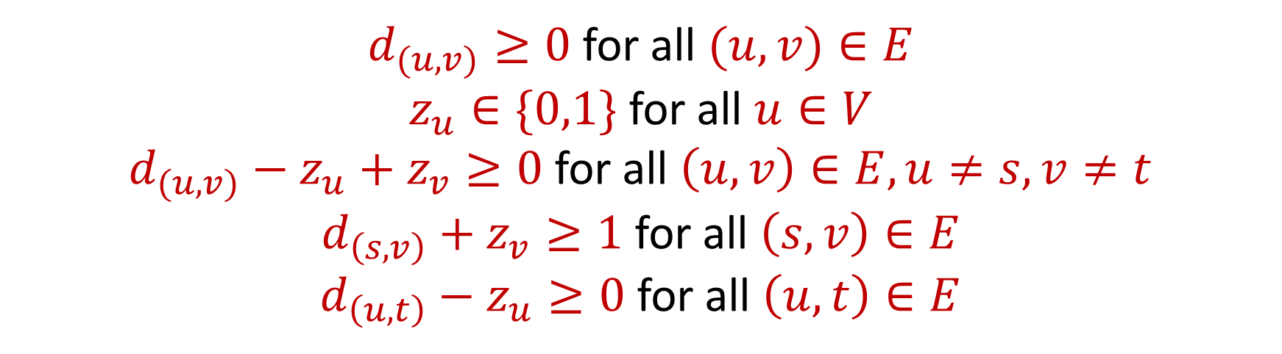
Linear Program for Min $s−t$ Cut
Minimize: $\sum_{v:\left(u,v\right)∈E}{c_{(u,v)}d_{(u,v)}}$, where $d_{(u,v)}$ indicates whether $\left(u,v\right)$crosses the cut, $c_{(u,v)}$ is the capacity of $\left(u,v\right)$
Subject to:
$d_{(u,v)}≥0$ for all $(u,v)∈E$
$z_{u}∈\{0,1\}$ for all $u∈V$
$d_{(u,v)}−z_{u}+z_{v}≥0$ for all $\left(u,v\right)∈E,u≠s,v≠t$
$d_{\left(s,v\right)}+z_{v}≥1$ for all $\left(s,v\right)∈E$
$d_{\left(u,t\right)}−z_{u}≥0$ for all $\left(u,t\right)∈E$

Slide 35
Dual Program for Max $s−t$ Flow
Minimize: $\sum_{v:\left(u,v\right)∈E}{c_{(u,v)}d_{(u,v)}}$, where $d_{(u,v)}$ indicates whether $\left(u,v\right)$crosses the cut, $c_{(u,v)}$ is the capacity of $\left(u,v\right)$
Subject to:
$d_{(u,v)}≥0$ for all $(u,v)∈E$
$d_{(u,v)}−z_{u}+z_{v}≥0$ for all $\left(u,v\right)∈E,u≠s,v≠t$
$d_{\left(s,v\right)}+z_{v}≥1$ for all $\left(s,v\right)∈E$
$d_{\left(u,t\right)}−z_{u}≥0$ for all $\left(u,t\right)∈E$

Slide 36
Min Cut-Max Flow Theorem?
Recall: the max-flow min-cut theorem states the maximum flow through any graph between any fixed source and sink is exactly equal to the minimum cut
However, the dual LP to the max-flow problem is a fractional problem, while the LP for the min-cut problem requires integral solutions

Slide 37
Linear Programming (Standard Form)
Maximize a linear objective function:
Subject to constraints:
$c^{⊤}x=⟨c,x⟩$, $c,x∈$ $ℝ^{n}$
$Ax≤b$ for $A∈$ $ℝ^{m×n}$, $b∈$ $ℝ^{m}$
$x≥0$ (entry-wise non-negativity)

Slide 38

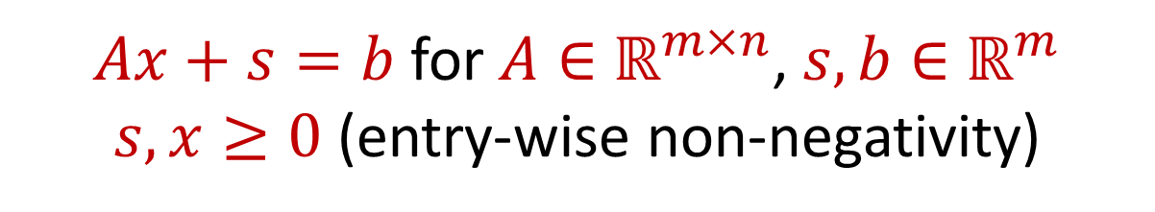
Integer Linear Programming (Standard Form)
Maximize a linear objective function:
Subject to constraints:
$c^{⊤}x=⟨c,x⟩$, $c∈ ℝ^{n}$, $x∈ℤ^{n}$
$Ax+s=b$ for $A∈$ $ℝ^{m×n}$, $s,b∈$ $ℝ^{m}$
$s,x≥0$ (entry-wise non-negativity)

Slide 39
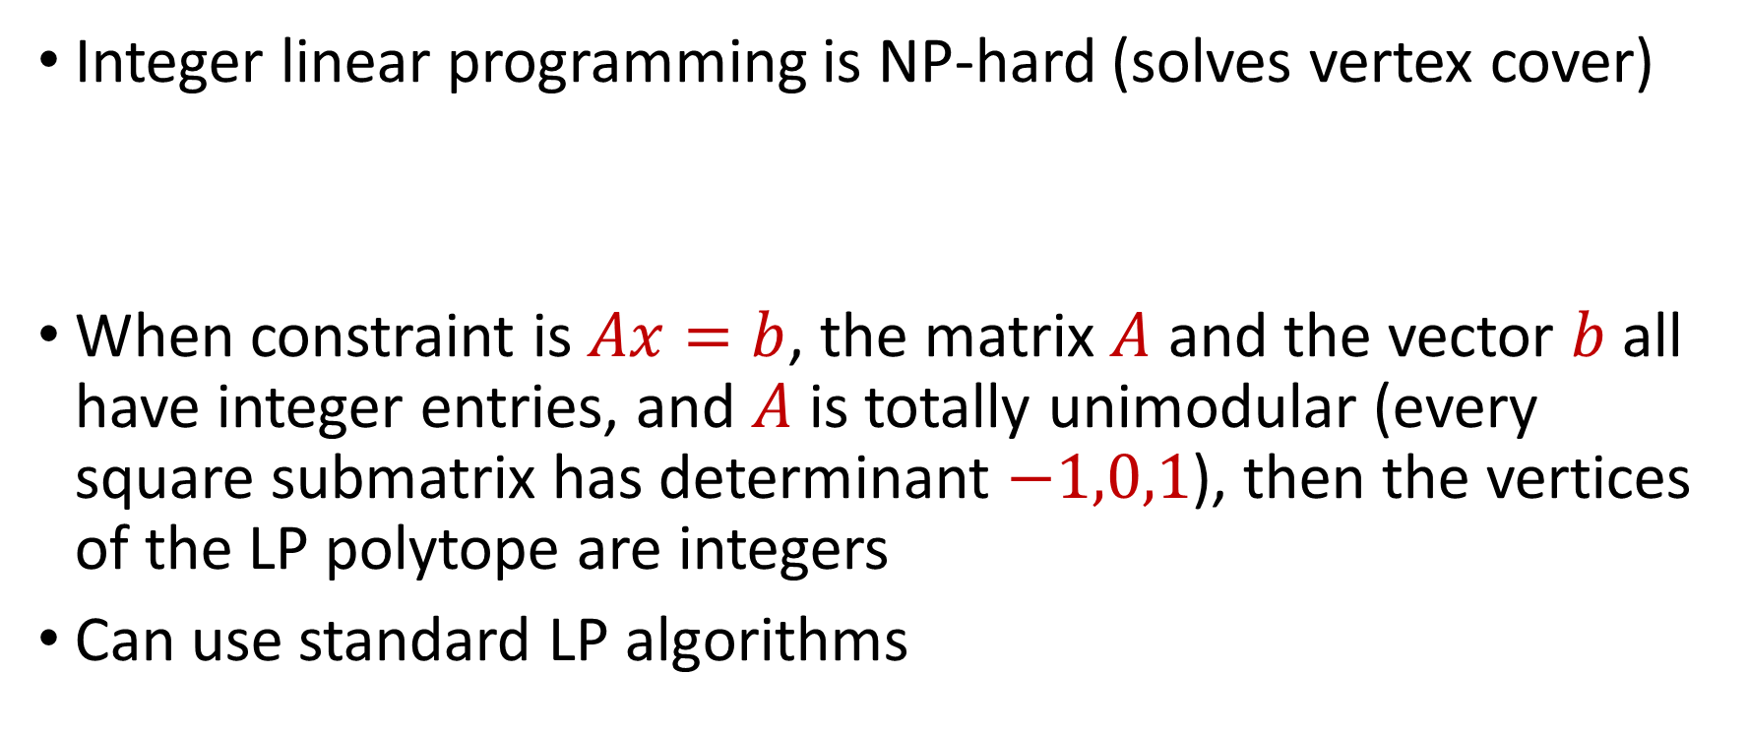
Integer Linear Programming (Standard Form)
Integer linear programming is NP-hard (solves vertex cover)
When constraint is $Ax=b$, the matrix $A$ and the vector $b$ all have integer entries, and $A$ is totally unimodular (every square submatrix has determinant $−1,0,1$), then the vertices of the LP polytope are integers
Can use standard LP algorithms

