Slide 1
CSCE 658: Randomized Algorithms
Lecture 22
Samson Zhou

Slide 2
Relevant Supplementary Material
Chapter 3-4 of “The Algorithmic Foundations of Differential Privacy”, by Cynthia Dwork and Aaron Roth (https://www.cis.upenn.edu/~aaroth/Papers/privacybook.pdf)

Slide 3




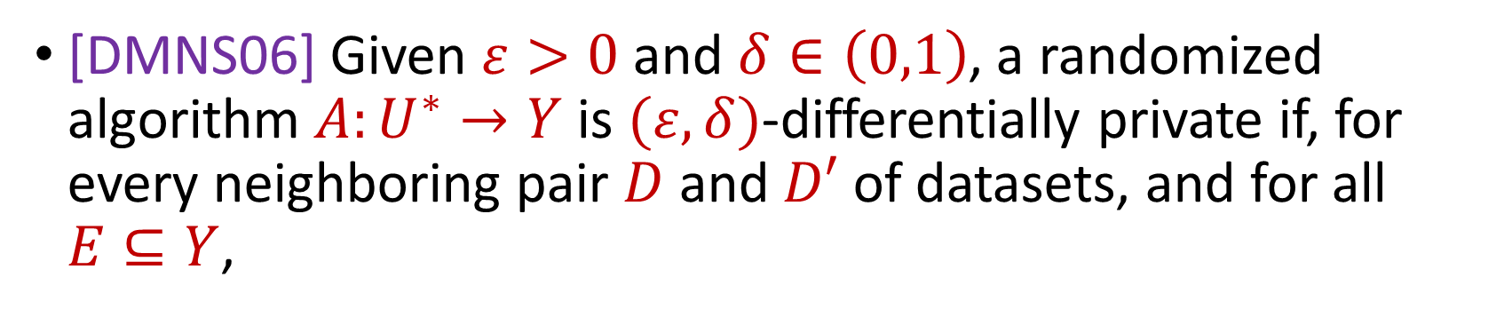

Last Time: Differential Privacy
[DMNS06] Given $ε>0$and $δ∈\left(0,1\right)$, a randomized algorithm $A:U^{∗}→Y$ is $(ε,δ)$-differentially private if, for every neighboring pair $D$ and $D′$ of datasets, and for all $E⊆Y$,
$$Pr\left[A\left(D\right)∈E\right]≤e^{ε}⋅Pr\left[A\left(D^{′}\right)∈E\right]+δ$$
$$A\left( \right)≈A\left( \right)$$
Notes:
[DworkMcSherryNissimSmith06]

Slide 4
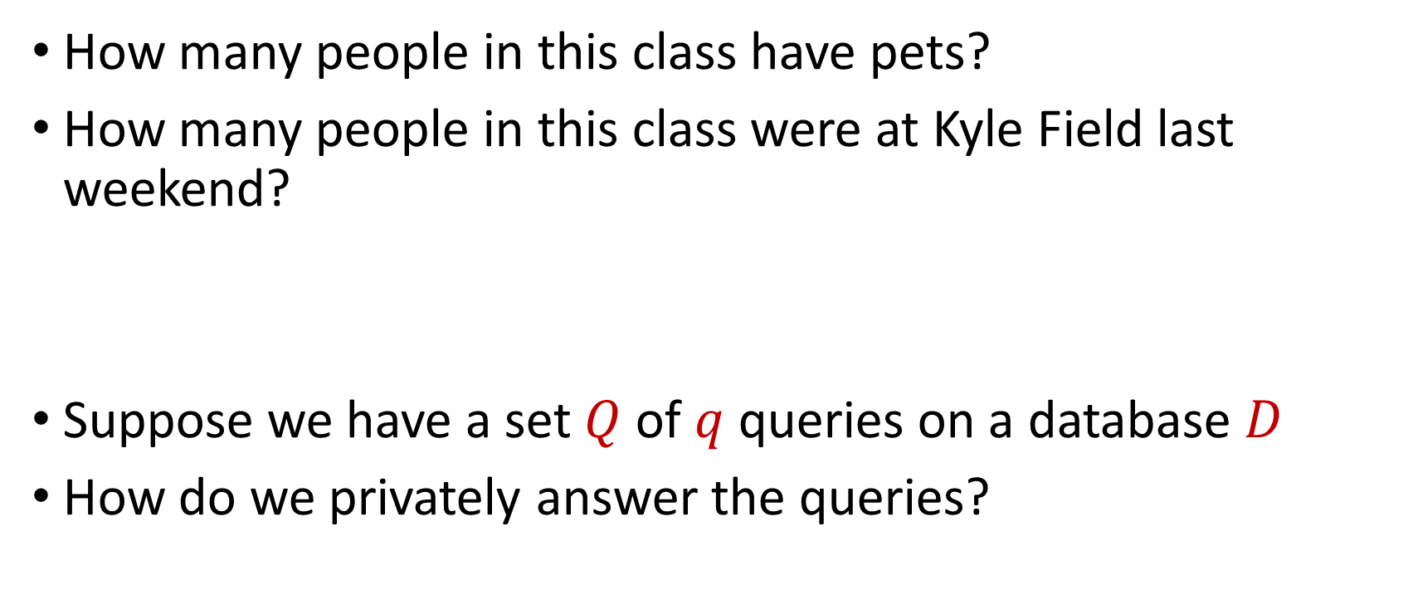
Counting Queries
How many people in this class have pets?
How many people in this class were at Kyle Field last weekend?
Suppose we have a set $Q$ of $q$ queries on a database $D$
How do we privately answer the queries?
Notes:
[DworkMcSherryNissimSmith06]

Slide 5
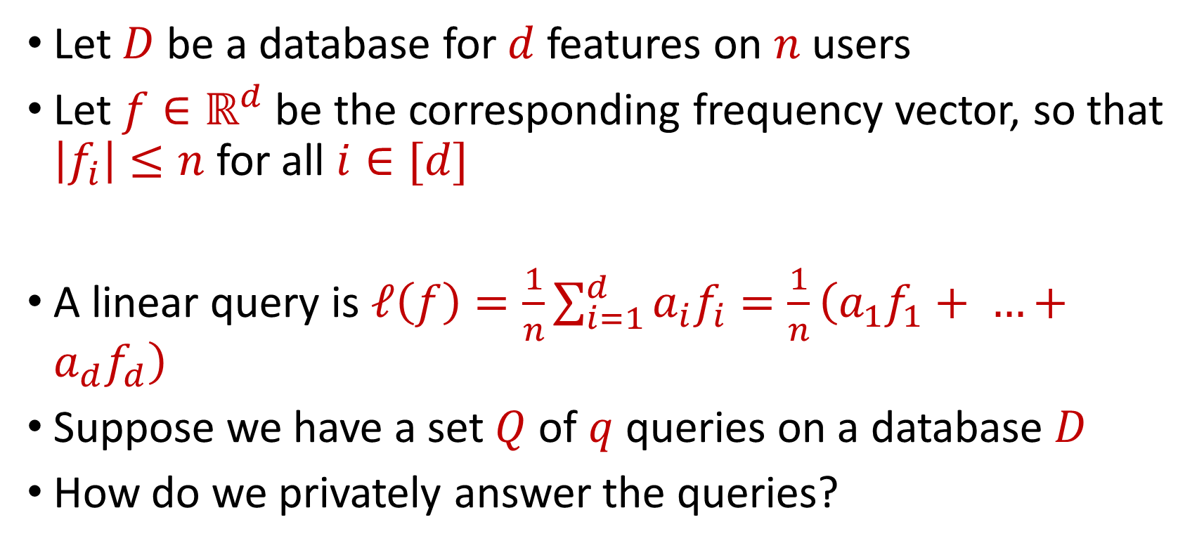
Linear Queries
Let $D$ be a database for $d$ features on $n$ users
Let $f∈ℝ^{d}$ be the corresponding frequency vector, so that $\left|f_{i}\right|≤n$ for all $i∈[d]$
A linear query is $ℓ\left(f\right)=\frac{1}{n}\sum_{i=1}^{d}{a_{i}f_{i}}=\frac{1}{n}\left(a_{1}f_{1}+ …+a_{d}f_{d}\right)$
Suppose we have a set $Q$ of $q$ queries on a database $D$
How do we privately answer the queries?
Notes:
[DworkMcSherryNissimSmith06]

Slide 6
Counting Queries
How many people in this class have pets?
How many people in this class besides the instructor have pets?
Intuition: we do not need to use additional privacy budget to answer the second query
Notes:
[DworkMcSherryNissimSmith06]

Slide 7
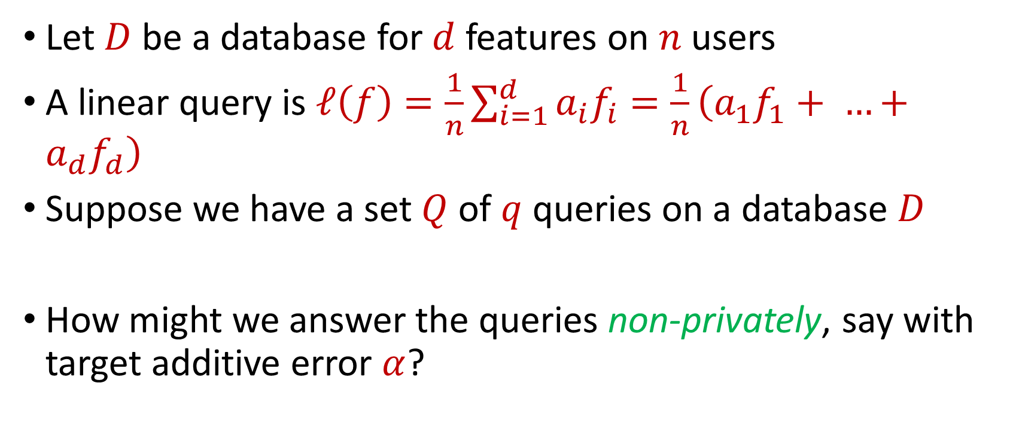
Linear Queries
Let $D$ be a database for $d$ features on $n$ users
A linear query is $ℓ\left(f\right)=\frac{1}{n}\sum_{i=1}^{d}{a_{i}f_{i}}=\frac{1}{n}\left(a_{1}f_{1}+ …+a_{d}f_{d}\right)$
Suppose we have a set $Q$ of $q$ queries on a database $D$
How might we answer the queries non-privately, say with target additive error $α$?
Notes:
[DworkMcSherryNissimSmith06]

Slide 8
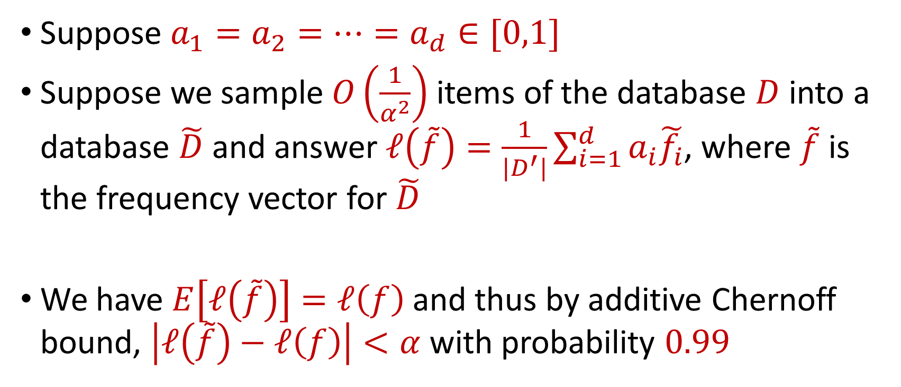
Linear Queries
Suppose $a_{1}=a_{2}=…=a_{d}∈[0,1]$
Suppose we sample $O\left(\frac{1}{α^{2}}\right)$ items of the database $D$ into a database $\tilde{D}$ and answer $ℓ\left(\tilde{f}\right)=\frac{1}{|D^{′}|}\sum_{i=1}^{d}{a_{i}\tilde{f_{i}}}$, where $\tilde{f}$ is the frequency vector for $\tilde{D}$
We have $E\left[ℓ\left(\tilde{f}\right)\right]=ℓ\left(f\right)$ and thus by additive Chernoff bound, $\left|ℓ\left(\tilde{f}\right)−ℓ\left(f\right)\right|<α$ with probability $0.99$
Notes:
[DworkMcSherryNissimSmith06]

Slide 9
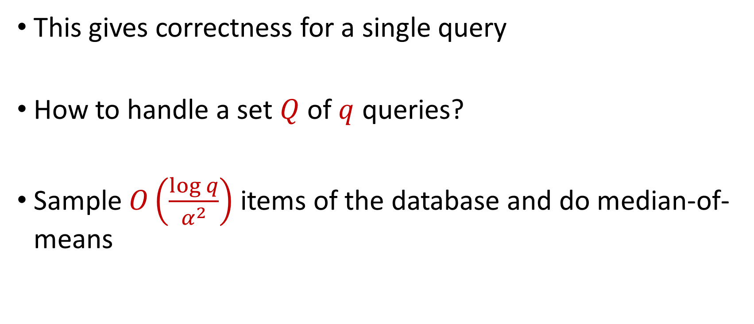
Linear Queries
This gives correctness for a single query
How to handle a set $Q$ of $q$ queries?
Sample $O\left(\frac{\log{q}}{α^{2}}\right)$ items of the database and do median-of-means
Notes:
[DworkMcSherryNissimSmith06]

Slide 10
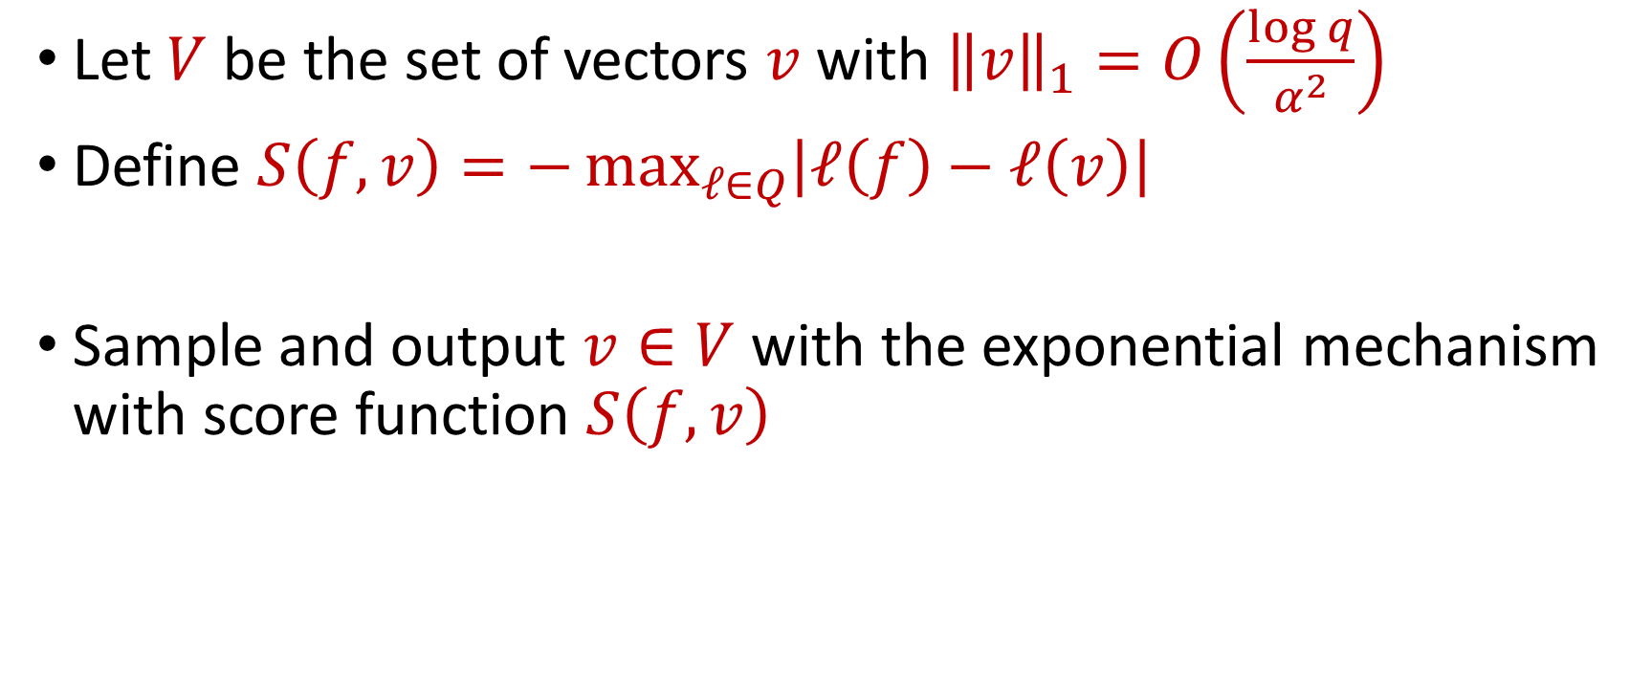
SmallDB Algorithm
Let $V$ be the set of vectors $v$with ${\left\|v\right\|}_{1}=O\left(\frac{\log{q}}{α^{2}}\right)$
Define $S\left(f,v\right)=−\max_{ℓ∈Q}\left|ℓ\left(f\right)−ℓ\left(v\right)\right|$
Sample and output $v∈V$ with the exponential mechanism with score function $S\left(f,v\right)$
Notes:
[DworkMcSherryNissimSmith06]

