Slide 1
An analysis of bid preference programs
By Samuel Spreen

Slide 2

background
The California Department of Transportation (Caltrans) procurement auctions are used to allocate highway construction contracts.
Descending auctions in which the bidder, a construction company, submits a bid that represents the cost it would charge the auctioneer, Caltrans, to complete the project.
Caltrans utilizes a bid preference program to assist small businesses in winning procurement auctions.
The bid preference comes in the form of a 5% bid discount applied to the bids of small businesses. This discount is only used in determining the winner of the auction and does not affect the payout.

Slide 3
Questions of interest
1
Does the bid preference program increase or decrease the total procurement cost for Caltrans and by how much?
2
3
Does the bid preference program increase competition between small and large businesses?
How much do large businesses lose because of this program?

Slide 4
Defining a SMALL BUSINESS
1
Must have no more than 100 employees.
2
Be independently owned, operated, and based in the state of California.
3
Have average annual gross receipts of no more than $10 million over the past 3 years.

Slide 5
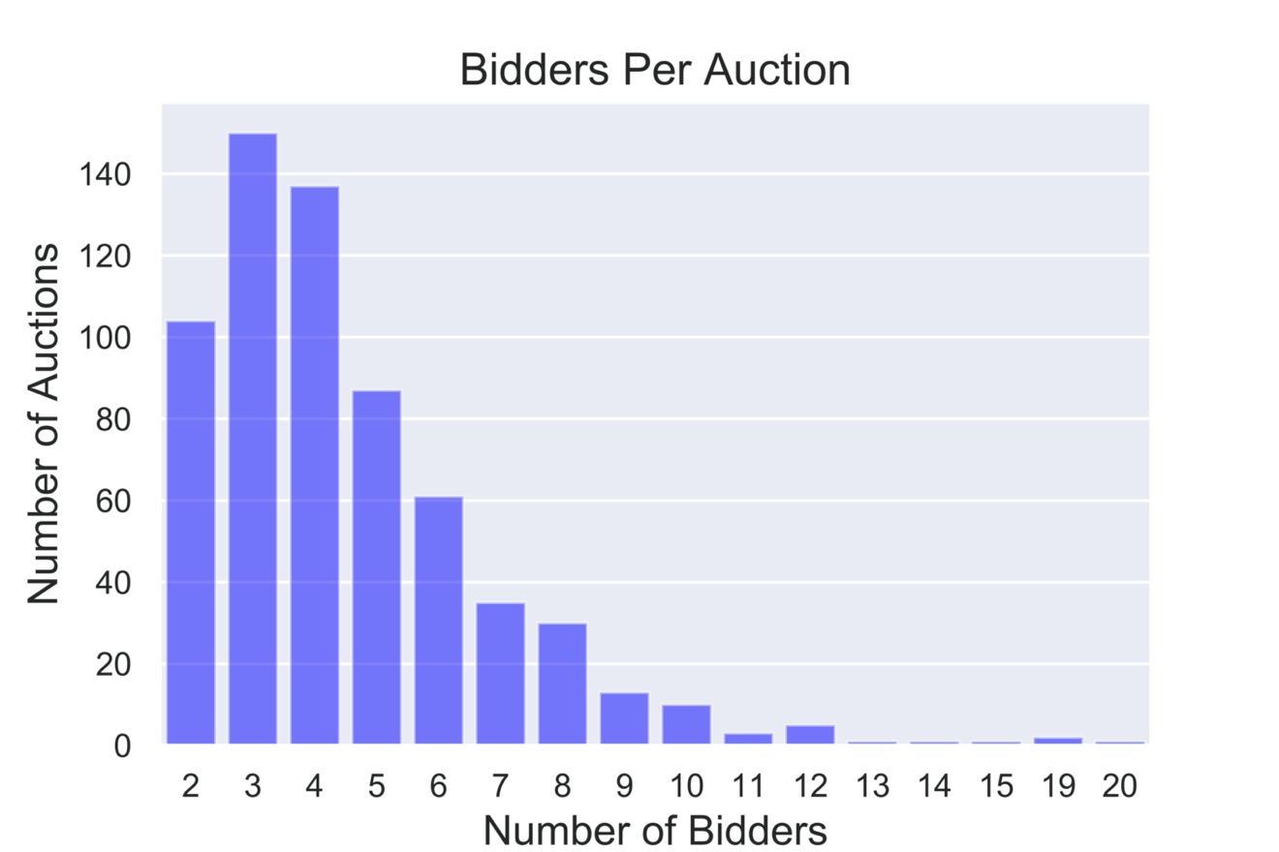
EXPLORATORY DATA ANALYSIS
Their are a total of 641 procurement auctions (project IDs) within the dataset after the removal of outliers and erroneous data.
Unique Bidders: 501
Small Business Bidders: 243
Large Business Bidders: 258
Number of Bidders
Min | Quartile 1 | Mean | Median | Quartile 3 | Max
2 | 4 | 4.53 | 5 | 7 | 20

Slide 6
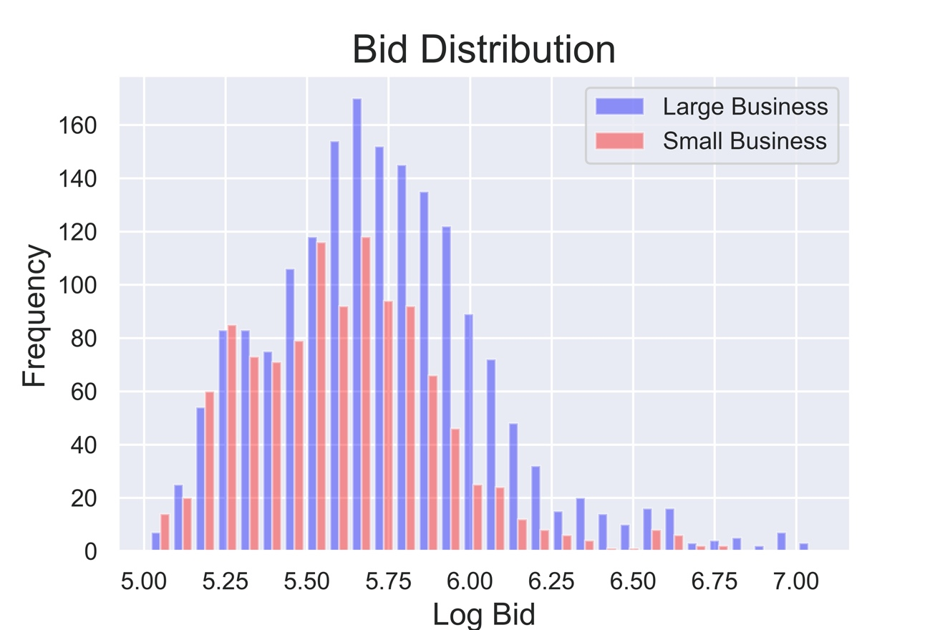
Exploratory data analysis (CONTINUED)
Distribution of All Bids
Min | Quartile 1 | Median | Quartile 3 | Max
103,845.00 | 288,362.25 | 467,452.50 | 738,929.13 | 11,777,770.0
Distribution of Small Business Bids
Min | Quartile 1 | Median | Quartile 3 | Max
103,845.00 | 245,786.00 | 395,526.00 | 601,299.00 | 5,965,853.00
Distribution of Large Business Bids
Min | Quartile 1 | Median | Quartile 3 | Max
106,210.00 | 318,227.00 | 514,209.00 | 846,282.00 | 11,777,770.00

Slide 7
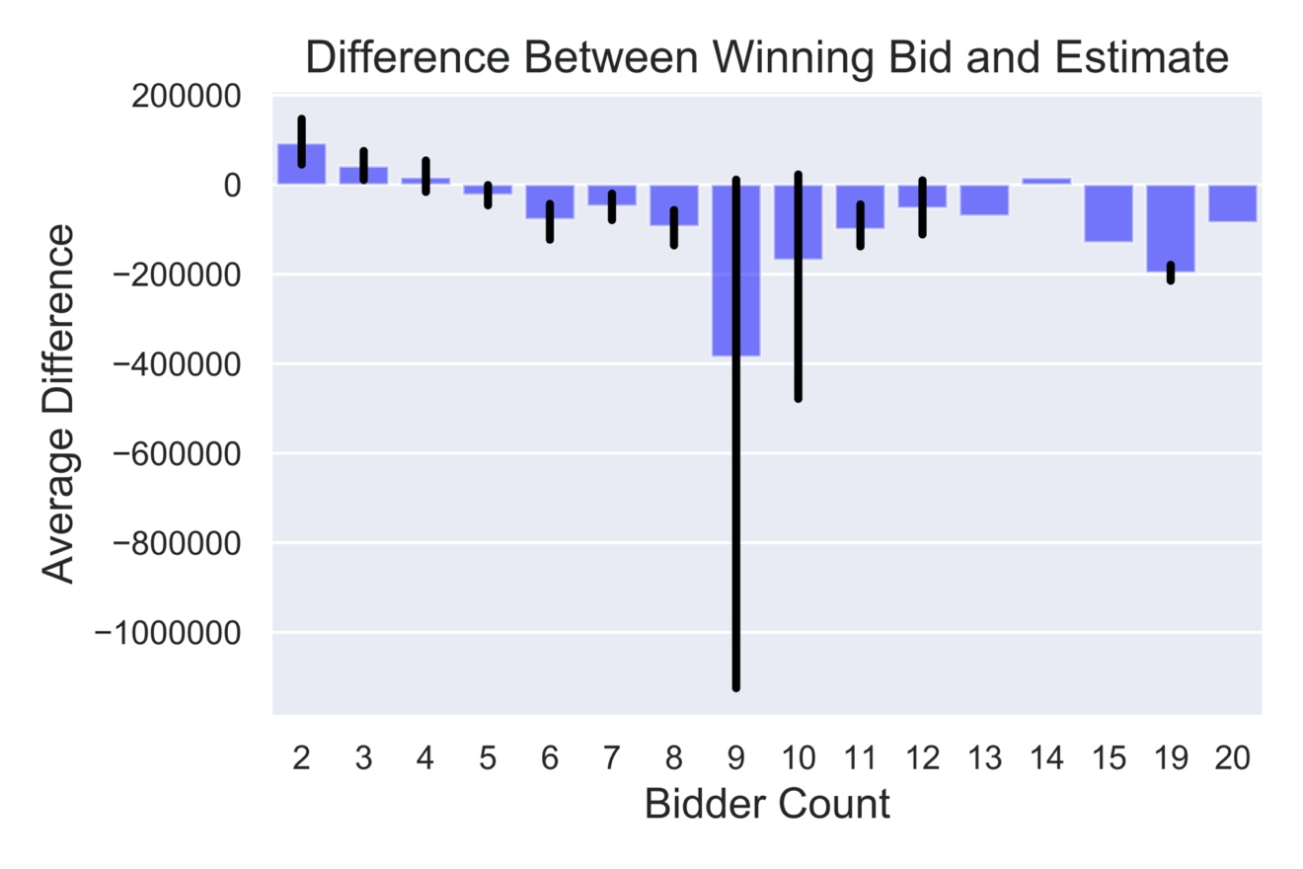
Exploratory data analysis (CONTINUED)
An increase in the number of auction participants decreases the procurement cost of Caltrans with respect to their engineers estimate.

Slide 8
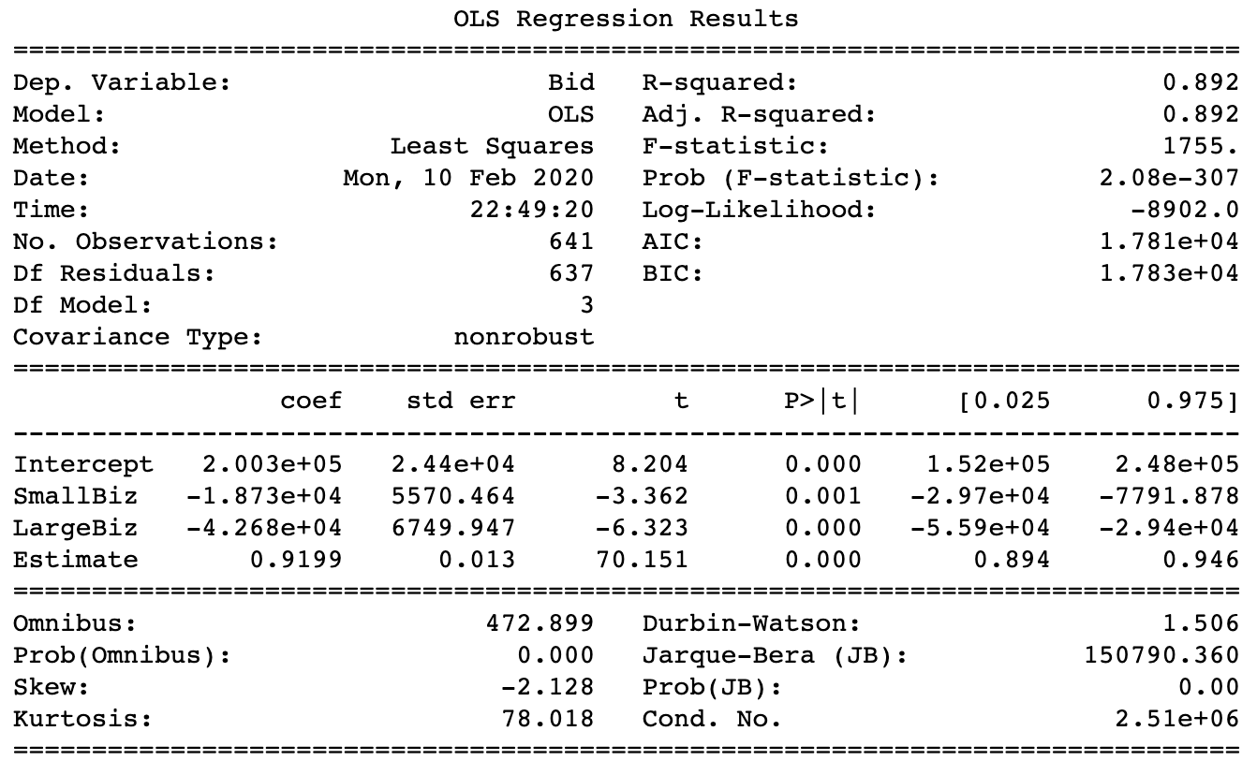
Exploratory data analysis (continued)
Regression of the number of small business bidders, large business bidders, and cost estimate on the winning bids.
Statistically significant coefficients of small business bidders (-18,730) and large business bidders (-42,680)

Slide 9
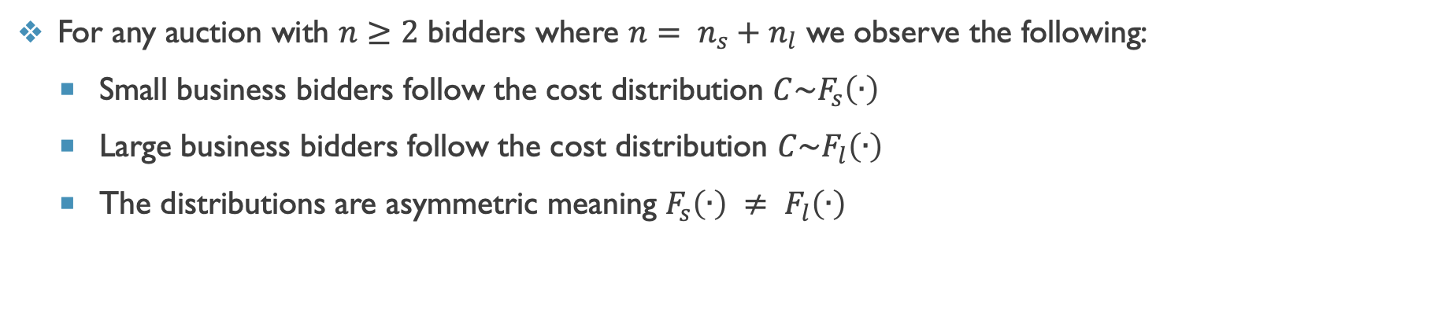
theoretical Model – environment
For any auction with $n≥2$ bidders where $n= n_{s}+n_{l}$ we observe the following:
Small business bidders follow the cost distribution $C\sim F_{s}\left(∙\right)$
Large business bidders follow the cost distribution $C\sim F_{l}\left(∙\right)$
The distributions are asymmetric meaning $F_{s}\left(∙\right) ≠ F_{l}\left(∙\right)$

Slide 10
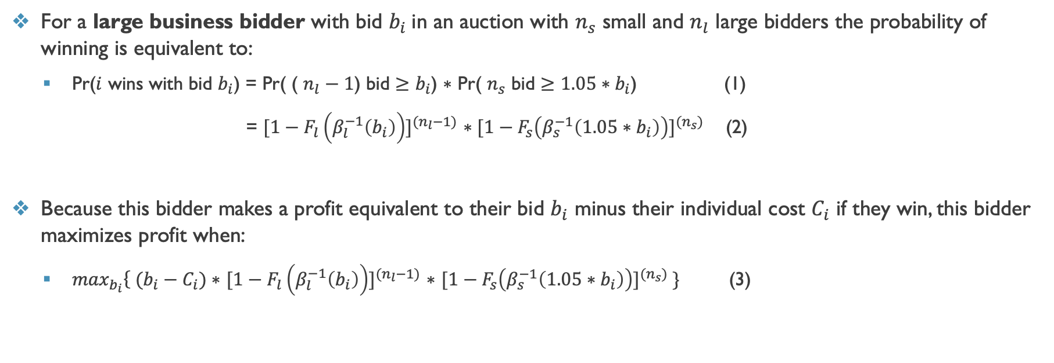
Theoretical model – Large Bidders
For a large business bidder with bid $b_{i}$in an auction with $n_{s}$ small and $n_{l}$ large bidders the probability of winning is equivalent to:
Pr($i$ wins with bid $b_{i}$) = Pr( ( $n_{l}−1$) bid $≥$ $b_{i}$) $∗$ Pr( $n_{s}$ bid $≥$ ${1.05∗b}_{i}$) (1)
= ${[1−F_{l}\left(β_{l}^{−1}\left(b_{i}\right)\right)]}^{(n_{l}−1)}$ $∗{[1−F_{s}\left(β_{s}^{−1}\left({1.05∗b}_{i}\right)\right)]}^{(n_{s})}$ (2)
Because this bidder makes a profit equivalent to their bid $b_{i}$ minus their individual cost $C_{i}$ if they win, this bidder maximizes profit when:
$\max_{b_{i}}\left\{ (b_{i}−C_{i})\right.∗$ ${[1−F_{l}\left(β_{l}^{−1}\left(b_{i}\right)\right)]}^{(n_{l}−1)}$ $∗$ ${[1−F_{s}\left(β_{s}^{−1}\left({1.05∗b}_{i}\right)\right)]}^{(n_{s})} \}$ (3)

Slide 11
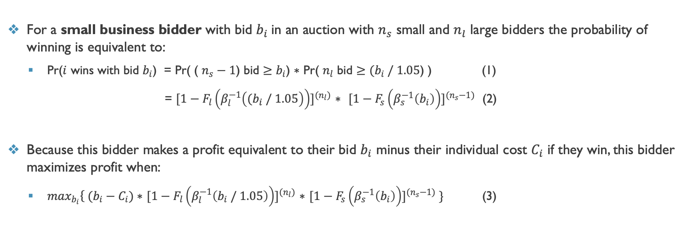
Theoretical model – Small Bidders
For a small business bidder with bid $b_{i}$in an auction with $n_{s}$ small and $n_{l}$ large bidders the probability of winning is equivalent to:
Pr($i$ wins with bid $b_{i}$) = Pr( ( $n_{s}−1$) bid $≥$ $b_{i}$) $∗$ Pr( $n_{l}$ bid $≥$ ${(b}_{i} / 1.05$) ) (1)
= ${[1−F_{l}\left(β_{l}^{−1}\left({(b}_{i} / 1.05\right)\right)]}^{(n_{l})}$ $∗$ ${[1−F_{s}\left(β_{s}^{−1}\left(b_{i}\right)\right)]}^{(n_{s}−1)}$ (2)
Because this bidder makes a profit equivalent to their bid $b_{i}$ minus their individual cost $C_{i}$ if they win, this bidder maximizes profit when:
$\max_{b_{i}}\left\{ (b_{i}−C_{i})\right.∗$ ${[1−F_{l}\left(β_{l}^{−1}\left(b_{i} / 1.05\right)\right)]}^{(n_{l})}$ $∗$ ${[1−F_{s}\left(β_{s}^{−1}\left(b_{i}\right)\right)]}^{(n_{s}−1)} \}$ (3)

Slide 12
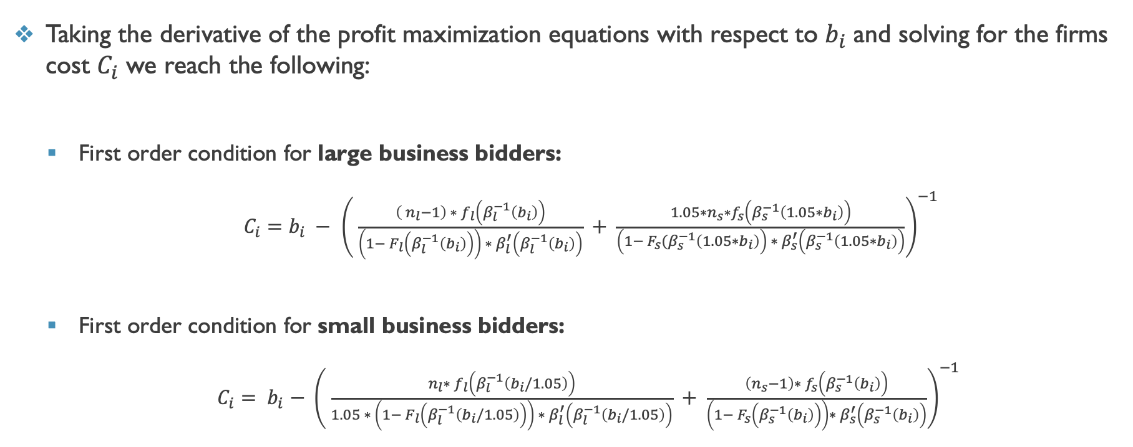
Theoretical model – PROFIT MAXIMIZATION
Taking the derivative of the profit maximization equations with respect to $b_{i}$ and solving for the firms cost $C_{i}$ we reach the following:
First order condition for large business bidders:
$C_{i}=b_{i} −$ ${\left( \frac{\left( n_{l}−1\right) ∗ f_{l}\left(β_{l}^{−1}\left(b_{i}\right)\right)}{\left(1− F_{l}\left(β_{l}^{−1}\left(b_{i}\right)\right)\right) ∗ β_{l}^{′}\left(β_{l}^{−1}\left(b_{i}\right)\right)} + \frac{{1.05∗n}_{s}∗f_{s}\left(β_{s}^{−1}\left({1.05∗b}_{i}\right)\right)}{\left(1− F_{s}(β_{s}^{−1}\left({1.05∗b}_{i}\right)\right) ∗ β_{s}^{′}\left(β_{s}^{−1}\left({1.05∗b}_{i}\right)\right)}\right)}^{−1}$
First order condition for small business bidders:
$C_{i}$ ${= b}_{i}− {\left( \frac{n_{l}∗ f_{l}\left(β_{l}^{−1}\left(b_{i}/1.05\right)\right)}{1.05 ∗ \left(1− F_{l}\left(β_{l}^{−1}\left(b_{i}/1.05\right)\right)\right) ∗ β_{l}^{′}\left(β_{l}^{−1}\left(b_{i}/1.05\right)\right)} + \frac{\left(n_{s}−1\right)∗ f_{s}\left(β_{s}^{−1}\left(b_{i}\right)\right)}{\left(1− F_{s}\left(β_{s}^{−1}\left(b_{i}\right)\right)\right)∗ β_{s}^{′}\left(β_{s}^{−1}\left(b_{i}\right)\right)}\right)}^{−1}$

Slide 13
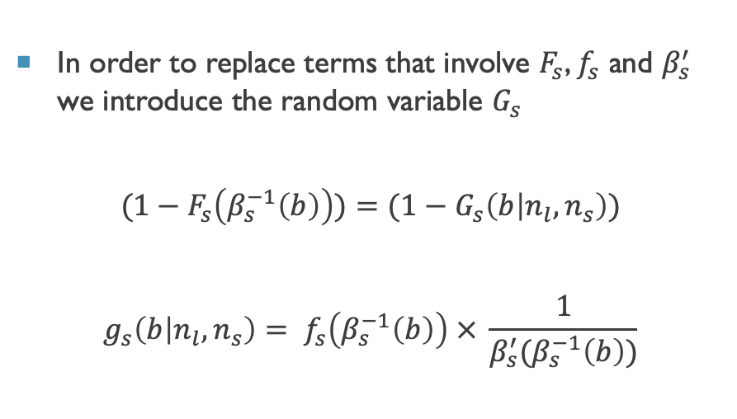
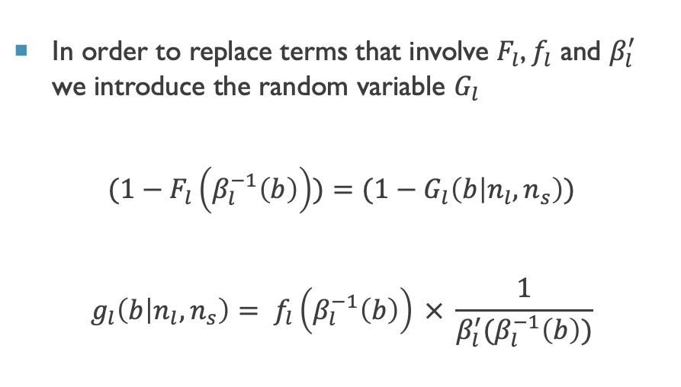

The Empirical model
In order to implement our model in the empirical setting we will make several changes to the theoretical model.
In order to replace terms that involve $F_{l}$, $f_{l}$ and $β_{l}^{′}$ we introduce the random variable $G_{l}$
$$(1−F_{l}\left(β_{l}^{−1}\left(b\right)\right))=(1−G_{l}\left(b | n_{l},n_{s}\right))$$
$$g_{l}\left(b | n_{l},n_{s}\right)= f_{l}\left(β_{l}^{−1}\left(b\right)\right) × \frac{1}{β_{l}^{′}(β_{l}^{−1}\left(b\right))}$$
In order to replace terms that involve $F_{s}$, $f_{s}$ and $β_{s}^{′}$ we introduce the random variable $G_{s}$
$$(1−F_{s}\left(β_{s}^{−1}\left(b\right)\right))=(1−G_{s}\left(b | n_{l},n_{s}\right))$$
$$g_{s}\left(b | n_{l},n_{s}\right)= f_{s}\left(β_{s}^{−1}\left(b\right)\right) × \frac{1}{β_{s}^{′}(β_{s}^{−1}\left(b\right))}$$
We can estimate both $G_{l,s}\left(b | n_{l},n_{s}\right)$ and $g_{l,s}\left(b | n_{l},n_{s}\right)$ by using the distribution of observed bids and kernel density estimation.

Slide 14
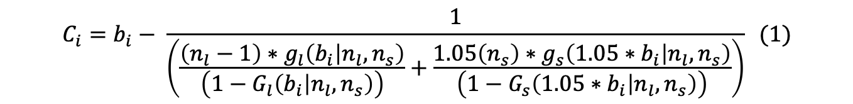


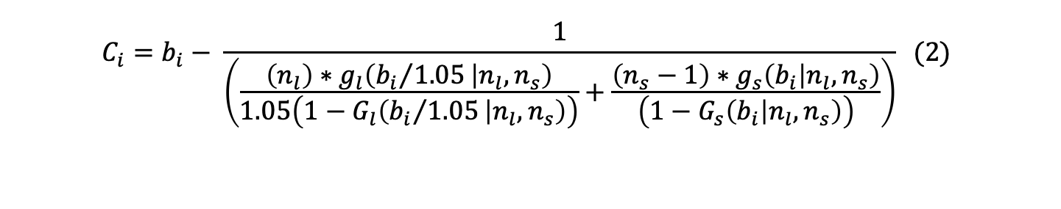
The Empirical model (Continued)
Substituting in $G$ and $g$into the theoretical model, we will now be applying equation (1) to large business bidders and equation (2) to small business to derive the cost distributions distributions $C\sim F_{l}\left(∙\right)$ and $C\sim F_{s}\left(∙\right)$.
$$C_{i}=b_{i}− \frac{1}{\left(\frac{\left(n_{l}−1\right)∗g_{l}\left(b_{i} | n_{l},n_{s}\right)}{\left(1−G_{l}\left(b_{i} | n_{l},n_{s}\right)\right)}+\frac{1.05\left(n_{s}\right)∗g_{s}\left({1.05∗b}_{i} | n_{l},n_{s}\right)}{\left(1−G_{s}\left({1.05∗b}_{i} | n_{l},n_{s}\right)\right)}\right)} (1)$$
$$C_{i}=b_{i}− \frac{1}{\left(\frac{\left(n_{l}\right)∗g_{l}\left({b_{i}}/{1.05} | n_{l},n_{s}\right)}{1.05\left(1−G_{l}\left({b_{i}}/{1.05} | n_{l},n_{s}\right)\right)}+\frac{\left(n_{s}−1\right)∗g_{s}\left(b_{i} | n_{l},n_{s}\right)}{\left(1−G_{s}\left(b_{i} | n_{l},n_{s}\right)\right)}\right)} (2)$$
Note: from now on we will be conditioning $G$ and $g$ on the engineers estimate $x$in addition to the number of bidders.

Slide 15
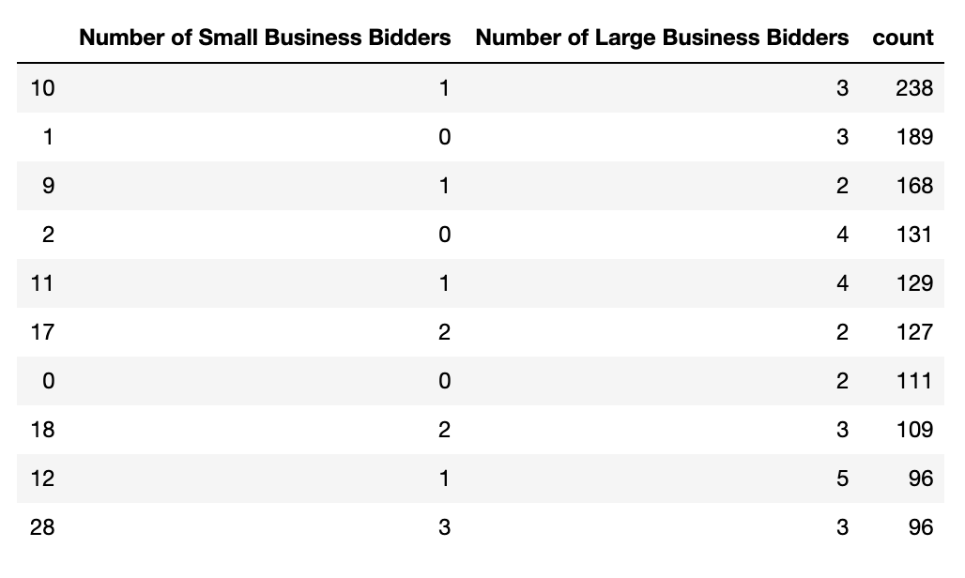
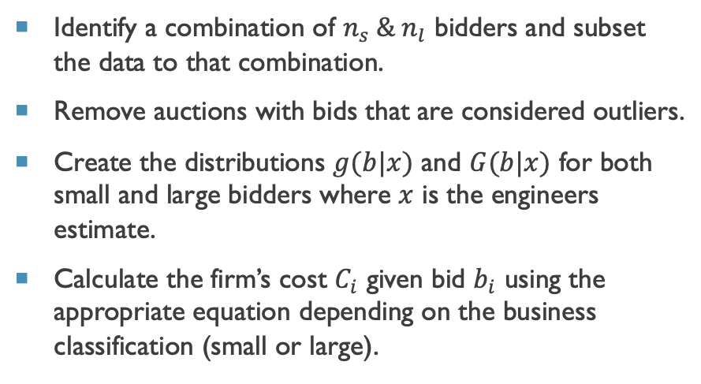
Algorithm Implementation
Steps:
Number of Bids per Bidder Combination:
Identify a combination of $n_{s} \& n_{l}$ bidders and subset the data to that combination.
Remove auctions with bids that are considered outliers.
Create the distributions $g(b|x)$ and $G(b|x)$ for both small and large bidders where $x$ is the engineers estimate.
Calculate the firm’s cost $C_{i}$ given bid $b_{i}$ using the appropriate equation depending on the business classification (small or large).

Slide 16
Estimation results
When carrying out estimation steps, I focused on auctions with 1 small bidder and 3 large bidders.
The auctions with this bidder combination had bid and cost distributions that were approximately normal after the removal of outliers allowing for easier estimation.
After the removal of outliers, there were only 26 auctions with 104 bids.
With the Bid Preference Program:
Without the Bid Preference Program:
The total procurement cost faced by Caltrans was $10,470,375
The total procurement cost faced by Caltrans was: $13,519,275
The average procurement cost decreased by $117,265 in the presence of the bid preference program.
Small businesses wins increased from 5 auctions without the discount to 9 auctions with the discount.

Slide 17
Conclusions and Next Steps
Conclusions:
The bid preference program appears to increase competition and decrease total procurement cost.
Next Steps:
Try more bidder combinations to generalize the results.
Rerun the simulations in log scale (or other transformation) to prevent errors in estimation such as negative values.
Due to the small sample size and single bidder combination I’d be hesitant to draw any concrete conclusions.

Slide 18
Questions?

