Slide 1






Slide 2
Max Flow
Ford-Fulkerson method
Sameer Subhedar
Tejus D

Slide 3
Max flow
Q: With an infinite input source, how much “flow” can we push through the network given that each edge has a certain capacity?
0
0/2
3
0/7
6
Source
0/7
Sink
0/4
0/3
0/1
0/4
0/1
s
0/2
1
4
7
0/3
t
0/5
0/8
0/4
0/8
0/3
0/1
2
0/6
5
8
0/3

Slide 4
Max flow
Q: With an infinite input source, how much “flow” can we push through the network given that each edge has a certain capacity?
0
0/2
3
0/7
6
Source
0/7
Sink
0/4
0/3
0/1
0/4
0/1
s
0/2
1
4
7
0/3
t
0/5
0/8
0/4
0/8
0/3
0/1
2
0/6
5
8
0/3
Suppose the edges are roads with cars, pipes with water or wires with electric current. Flow represents the volume of water allowed to flow through the pipes, the number of cars the roads can sustain in traffic and net electric current. Effectively, it’s the “bottleneck” value for the amount of flow that can pass through the network from source to sink under all the constraints.

Slide 5
Max flow
Q: With an infinite input source, how much “flow” can we push through the network given that each edge has a certain capacity?
0
2/2
3
1/7
6
Source
4/7
Sink
0/4
0/3
1/1
2/4
1/1
s
2/2
1
4
7
2/3
t
1/5
1/8
4/4
2/8
1/3
1/1
2
1/6
5
8
3/3
In this flow graph, the max flow is 7 since 1+2+4 = 7 is the sum of the flows entering the sink node. That’s the most that we can push through the network.

Slide 6
0
2
s
t
1
3
A flow graph (flow network) is a directed graph where each edge (also called an arc) has a certain capacity which can receive a certain amount of flow. The flow running through an edge must be less than or equal to the capacity.

Slide 7
0
2
0/10
0/25
0/6
s
0/10
t
0/10
1
3
0/10
0/15
Each edge in the flow graph has a certain flow and capacity specified by the fraction adjacent to each edge. Initially, the flow through each edge is 0 and the capacity is a non negative value.

Slide 8
0
2
0/10
0/25
0/6
s
0/10
t
0/10
1
3
0/10
0/15
To find the maximum flow the Ford-Fulkerson method repeatedly finds augmenting paths through the residual graph and augments the flow until no more augmenting paths can be found.

Slide 9
0
2
0/10
0/25
0/6
s
0/10
t
0/10
1
3
0/10
0/15
An augmenting path is a path of edges in the residual graph with unused capacity greater than zero from the source s to the sink t.
Notes:
Augmenting paths are key to network flow because a stopping condition for finding the maximum flow is that no more augmenting paths from s ->t exist.

Slide 10
0
2
0/10
0/25
0/6
s
0/10
t
Bottleneck of 6
0/10
1
3
0/10
0/15
In the augmenting path above, the bottleneck is the “smallest” edge on the path. We can use the bottleneck value to augment the flow along the path.
The smallest remaining capacity of any edge along the augmenting path is:
min(10-0, 15-0, 6-0, 25-0, 10-0) = min(10,15,6,25,10) = 6

Slide 11
0
2
0/10
6/25
6/6
s
6/10
t
0/10
1
3
6/10
6/15
Augmenting the flow means updating the flow values of the edges along the augmenting path.
For forward edges, this means increasing the flow by the bottleneck value.

Slide 12
0
-6/0
0
2
2
0/10
6/25
-6/0
6/6
s
6/10
s
t
t
-6/0
0/10
1
-6/0
-6/0
1
3
3
6/10
6/15
When augmenting the flow along the augmenting path, you also need to decrease the flow along each residual edge by the bottleneck value.

Slide 13
0
-6/0
0
2
2
0/10
6/25
-6/0
6/6
s
6/10
s
t
t
-6/0
0/10
1
-6/0
-6/0
1
3
3
6/10
6/15
Residual edges exist to “undo” bad augmenting paths which do not lead to a maximum flow.

Slide 14
0
-6/0
0
2
2
0/10
6/25
-6/0
6/6
s
6/10
s
t
0/0
t
-6/0
0/10
1
-6/0
-6/0
1
3
3
6/10
0/0
6/15
You can think of every edge in the original graph as having a residual edge with a flow/capacity of 0/0 which is not usually shown.
The residual graph is the graph which also contains residual edges. In general, when I mention the flow graph, I mean the residual graph.

Slide 15
0
-6/0
0
2
2
0/10
6/25
-6/0
6/6
s
6/10
s
t
t
-6/0
0/10
1
-6/0
-6/0
1
3
3
6/10
6/15
Q: Residual edges have a capacity of 0? Isn’t that forbidden? How does that work?

Slide 16
0
-6/0
0
2
2
0/10
6/25
-6/0
6/6
s
6/10
s
t
t
-6/0
0/10
1
-6/0
-6/0
1
3
3
6/10
6/15
Q: Residual edges have a capacity of 0? Isn’t that forbidden? How does that work?
A: Think of the remaining capacity of an edge e (residual or not) as: e.capacity - e.flow,
This ensures that the remaining capacity of an edge is always non-negative (even if the flow can be negative).

Slide 17
0
-6/0
0
2
2
0/10
6/25
-6/0
6/6
s
6/10
s
t
t
-6/0
0/10
1
-6/0
-6/0
1
3
3
6/10
6/15
The Ford-Fulkerson method continues finding augmenting paths and augments the flow until no more augmenting paths from s -> t exist.
A key realization to make at this point is that the sum of the bottlenecks found in each augmenting path is equal to the max-flow!

Slide 18
0
-6/0
0
2
2
0/10
6/25
-6/0
6/6
s
6/10
s
t
t
-6/0
0/10
1
-6/0
-6/0
1
3
3
6/10
6/15

Slide 19
0
-6/0
0
2
2
0/10
6/25
-6/0
6/6
s
6/10
s
t
t
-6/0
0/10
1
-6/0
-6/0
1
3
3
6/10
6/15
Bottleneck is 4 since the minimum of the remaining capacities on the augmenting path is 4:
min(10 - 6, 15 - 6, 10 - 0) = min(4, 9, 10) = 4

Slide 20
0
-6/0
0
2
2
0/10
6/25
-6/0
6/6
s
6/10
s
t
t
-10/0
4/10
1
-10/0
-6/0
1
3
3
10/10
-4/0
10/15
Augment the edges with bottleneck value of 4

Slide 21
0
-6/0
0
2
2
0/10
6/25
-6/0
6/6
s
6/10
s
t
t
-10/0
4/10
1
-10/0
-6/0
1
3
3
10/10
-4/0
10/15

Slide 22
0
-6/0
0
2
2
0/10
6/25
-6/0
6/6
s
6/10
s
t
t
-10/0
4/10
1
-10/0
-6/0
1
3
3
10/10
-4/0
10/15
The bottleneck value is 6 since the smallest remaining capacity amongst the edges of our augmenting path is:
min(10 - 0, 0 - -6, 10 - 4) = min(10, 6, 6) = 6

Slide 23
0
-6/0
0
2
2
6/10
6/25
-6/0
0/6
s
6/10
s
t
-6/0
t
-10/0
10/10
1
-10/0
0/0
1
3
3
10/10
-10/0
10/15
Augment the edges with bottleneck value of 6

Slide 24
0
-6/0
0
2
2
6/10
6/25
-6/0
0/6
s
6/10
s
t
-6/0
t
-10/0
10/10
1
-10/0
0/0
1
3
3
10/10
-10/0
10/15

Slide 25
0
-6/0
0
2
2
6/10
6/25
-6/0
0/6
s
6/10
s
t
-6/0
t
-10/0
10/10
1
-10/0
0/0
1
3
3
10/10
-10/0
10/15

Slide 26
0
-6/0
0
2
2
6/10
6/25
-6/0
0/6
s
6/10
s
t
-6/0
t
-10/0
10/10
1
-10/0
0/0
1
3
3
10/10
-10/0
10/15
The bottleneck value is 4 since the smallest remaining capacity amongst the edges of our augmenting path is:
min(10 - 6, 25 - 6, 10 - 6) = min(4, 19, 4) = 4

Slide 27
0
-10/0
0
2
2
10/10
10/25
-10/0
0/6
s
10/10
s
t
-10/0
t
-10/0
10/10
1
-10/0
0/0
1
3
3
10/10
-10/0
10/15
Augment the edges with bottleneck value of 4

Slide 28
0
-10/0
0
2
2
10/10
10/25
-10/0
0/6
s
10/10
s
t
-10/0
t
-10/0
10/10
1
-10/0
0/0
1
3
3
10/10
-10/0
10/15

Slide 29
0
-10/0
0
2
2
10/10
10/25
-10/0
0/6
s
10/10
s
t
-10/0
t
-10/0
10/10
1
-10/0
0/0
1
3
3
10/10
-10/0
10/15
No more augmenting paths can be found, so the algorithm terminates!
maximum flow = 6 + 4 + 6 + 4 = 20
bottleneck values

Slide 30
The time complexity of the Ford-Fulkerson method depends on the algorithm being used to find the augmenting paths, which is left unspecified.

Slide 31
Assuming the method of finding augmenting paths is by using a Depth First Search (DFS), the algorithm runs in O(fE), where f is the maximum flow and E is the number of edges.

Slide 32
Assuming the method of finding augmenting paths is by using a Depth First Search (DFS), the algorithm runs in O(fE), where f is the maximum flow and E is the number of edges.
0
0/100
0/0
0/0
0/100
s
0/0
t
0/100
0/0
0/100
0/1
1
0/0

Slide 33
Recall that a DFS traversal chooses edges in a random order, so it is possible to pick the middle edge every time when finding an augmenting path.
0
1/100
-1/0
0/0
0/100
s
-1/0
t
1/100
0/0
0/100
1/1
1
-1/0

Slide 34
Recall that a DFS traversal chooses edges in a random order, so it is possible to pick the middle edge every time when finding an augmenting path.
0
1/100
0/0
-1/0
1/100
s
-1/0
t
1/100
-1/0
1/100
0/1
1
-1/0

Slide 35
This results in flipping back and forth between the same two alternating paths for 200 iterations…
0
2/100
-1/0
-1/0
1/100
s
-2/0
t
2/100
-1/0
1/100
1/1
1
-2/0

Slide 36
This results in flipping back and forth between the same two alternating paths for 200 iterations…
0
2/100
0/0
-2/0
2/100
s
-2/0
t
2/100
-2/0
2/100
0/1
1
-2/0

Slide 37
This results in flipping back and forth between the same two alternating paths for 200 iterations…
0
3/100
-1/0
-2/0
2/100
s
-3/0
t
3/100
-2/0
2/100
1/1
1
-3/0

Slide 38
Other much faster algorithms and heuristics exist to find the maximum flow.
Edmonds-Karp: Uses a BFS as a method of finding augmenting paths, O(E²V)
Capacity scaling: Adds a heuristic on top of Ford-Fulkerson to pick larger paths first, O(E²log(U))
Dinic’s algorithm: Uses combination of BFS + DFS to find augmenting paths, O(V²E)
Push Relabel: Uses a concept of maintaining a "preflow" instead of finding augmenting paths to achieve a max-flow solution, O(V²E) or O(V²√E) variant.
NOTE: Be mindful that the time complexities for flow algorithms are very pessimistic. In practice, they tend to operate much faster, making it hard to compare the performance of flow algorithms solely based on complexity.

Slide 39
ADT Definition
structure graph is
objects: An array in which each element represents the starting vertex followed by a series of nodes joined by links which represent the neighbors of that vertex
Functions:
struct graph *create_graph(int n) ::= return a graph where all neighbors are initialized to 0
void add_edge(struct graph *g, int i, int j, int c) ::= adds an edge to the graph by linking vertices i and j
void display_graph ::= Displays the content of the graph

Slide 40
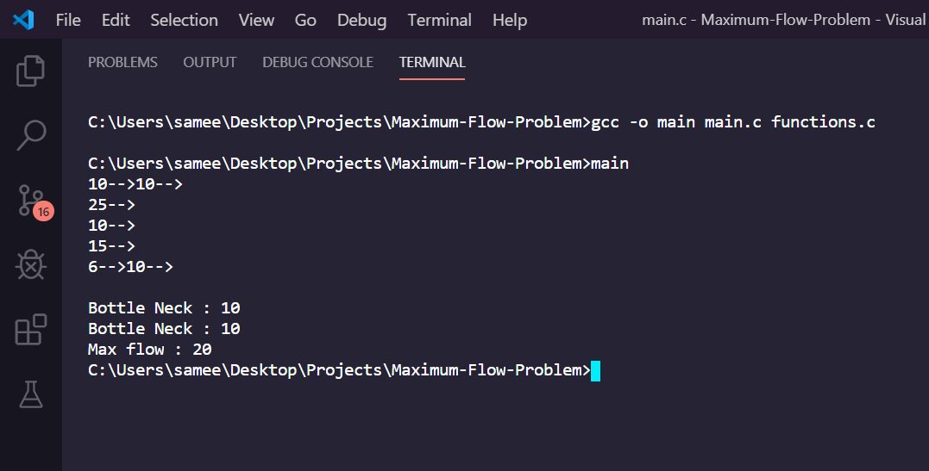

Slide 41
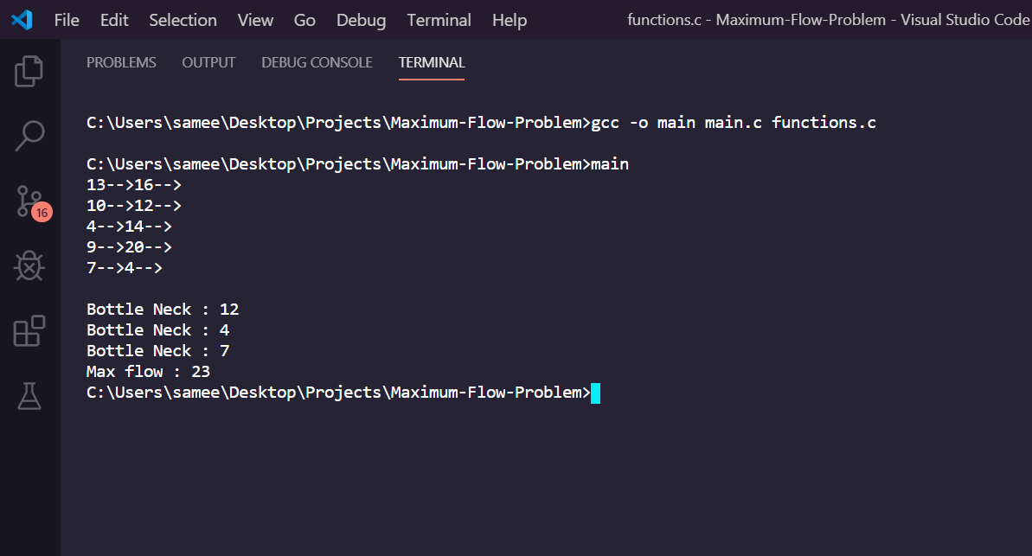

Slide 42
Link to Source Code
https://github.com/samsub18/Maximum-Flow-Problem

