Slide 1
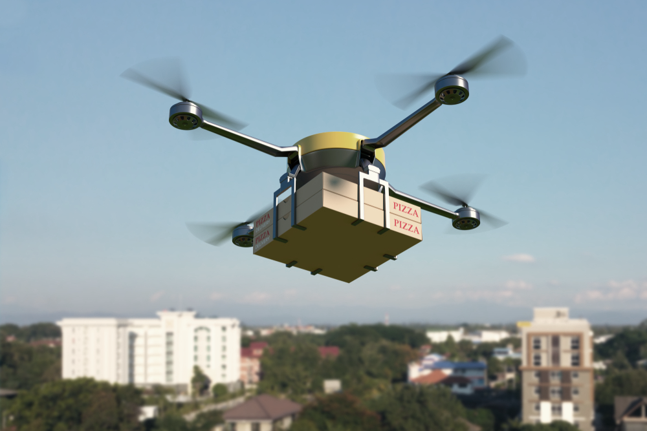

Battery Life and the Decorator Pattern
Section 010 Team 1
David, Hyunwoo, Conor, Carlos
CSCI 3081W - Spring 2021

Slide 2
Motivation
Until now, our simulation has dealt with many of the issues involved in scheduling the delivery of packages.
-We have dealt with scheduling issues to allow multiple entities to deliver packages to customers.
-We have implemented a variety of paths to the customer, so that packages can take different routes above and around buildings.
-We have allowed for different kinds of deliverer entities within the simulation, so that we can deliver a package by land or by air.
We do have batteries and allow for our drones to be idle, but we would like to be able to tell the battery life of the entities as they move through the simulation.
Notes:
However, while we have implemented batteries for our deliverer entities, and we stop the entities when they are out of battery, it would be helpful to have an element within the simulation to tell us the battery life of our different entities.

Slide 3
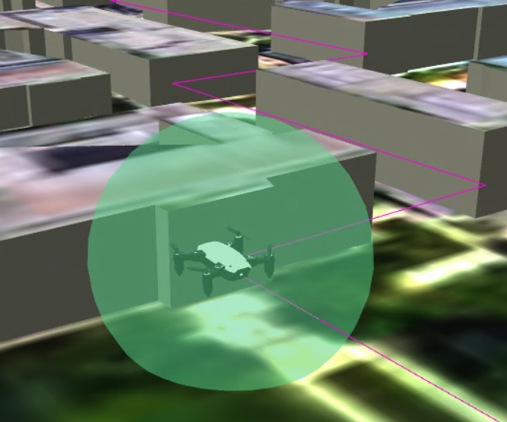
Background
We want to know when our entities are out of battery, and we want to be able to physically see the difference in the simulation.
A good way to display this information is to surround our entity with a different colors based on the charge of the battery.
We do not want to change how our code works, but we want to add extra functionality to just change the appearance of our deliverer entities.
How would we add this functionality, and could we use the decorator pattern to do so?

Slide 4
Non-Decorator Pattern Approach
Initial battery life implementation did not use the decorator pattern
Move to Points Function
Pros:
Simple implementation, took about twenty minutes to implement
Putting this within the move to points function allowed an easy way to tell when the battery life of a drone crosses a threshold.
Cons:
Creates more code within move to points function, violating the single responsibility principle and lowering cohesiveness

Slide 5
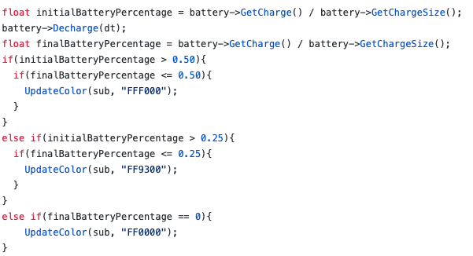
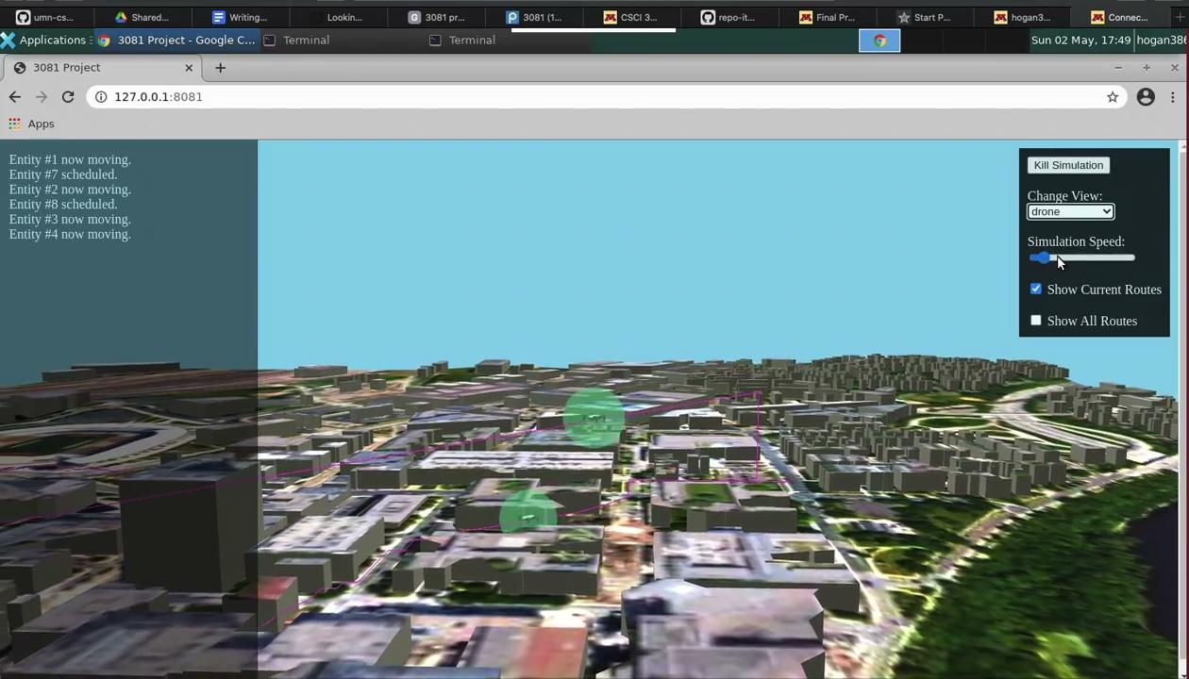
Non-Decorator Pattern Approach Code and Video

Slide 6
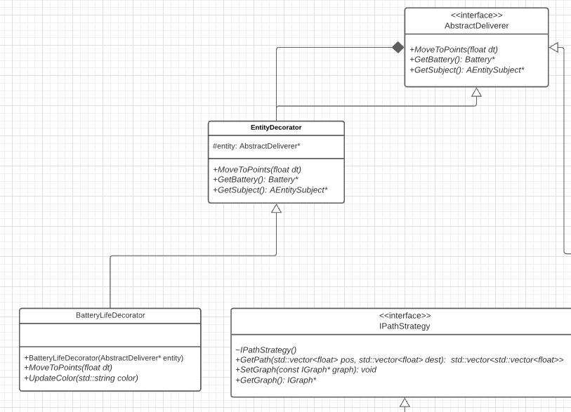
Decorator Approach Details/UML

Slide 7
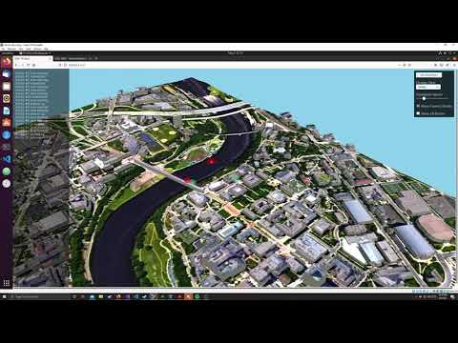
Demonstration

Slide 8
Results and Conclusions
The drone/robot now change color based on the battery charge
This is only if we are using the BatteryLifeDecorator
Adding the decorator pattern was difficult
If only adding one feature and no other feature ever, then it’s not worth it
Now that it is added it will be easier to add visual or other similar features
If we are adding multiple features that are similar in the future then using the pattern is worth it

Slide 9
Drone Pool/CSV Reader
We also created a Drone Pool and a CSV Reader in our presentation
Different attributes were given in the drone_models.csv file
Attributes included:
model #
mass
max speed
base acceleration
weight capacity
base battery capacity
However, due to time constraints and presentation limitations, we left more discussion out of our presentation.

Slide 10
Thank you for watching!
References
https://www.digitaltrends.com/cool-tech/drone-deliveries-step-closer-in-uk/
https://www.dofactory.com/net/facade-design-pattern/
https://www.dofactory.com/net/abstract-factory-design-pattern/
https://www.dofactory.com/net/observer-design-pattern/
https://www.dofactory.com/net/strategy-design-pattern/

