Slide 1
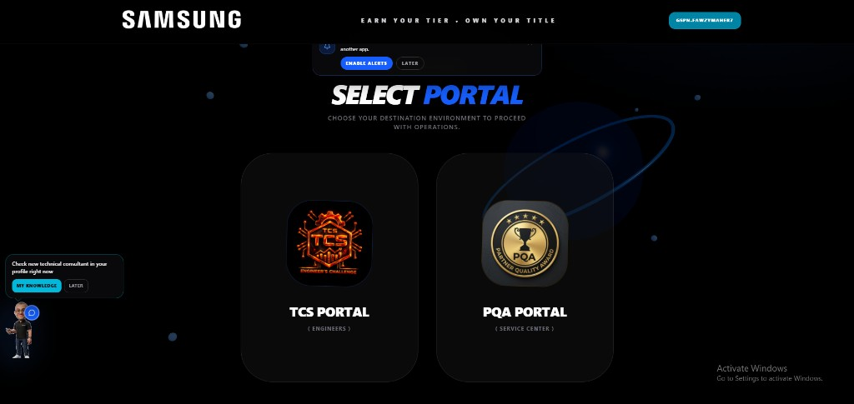
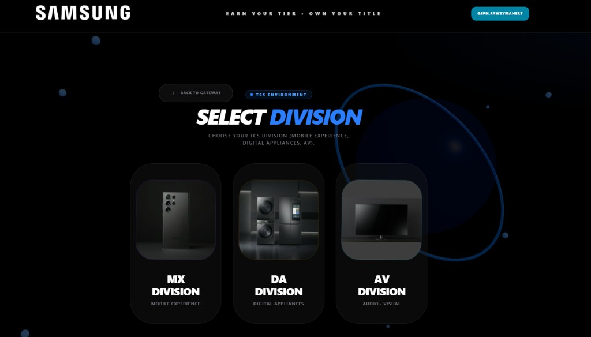
SAMSUNG
PLATFORM OVERVIEW · SCOPE OF IMPLEMENTATION
01 / 05
SCORA — Service Competency & Operational Readiness
An in-house platform that turns official service performance data into visible, self-service capability development for every colleague and every service partner.
SCOPE
TWO PORTALS · THREE DIVISIONS
PRODUCTS
Mobile Experience (MX) · Digital Appliances (DA) · Audio-Visual (AV)
POPULATIONS
Field service engineers · Front desk receptionists · Galaxy Consultants · Authorised service partners
ENVIRONMENTS
PORTAL GATEWAY
DIVISION GATEWAY
TCS MX · TCS DA · TCS AV · PQA MX Division · PQA CE Division
TCS portal for engineers, PQA portal for service centres.
MX, DA and AV each with their own KPI model.
LIVE PLATFORM TELEMETRY
300
3,393
5,297
56m 22s
155
ACTIVE RECORDS
VISITOR SESSIONS
SCREEN INTERACTIONS
AVG SESSION
ADMIN LOGINS
SCORA · AX Award Submission · Samsung Electronics Egypt — Customer Service · Confidential, internal use only

Slide 2
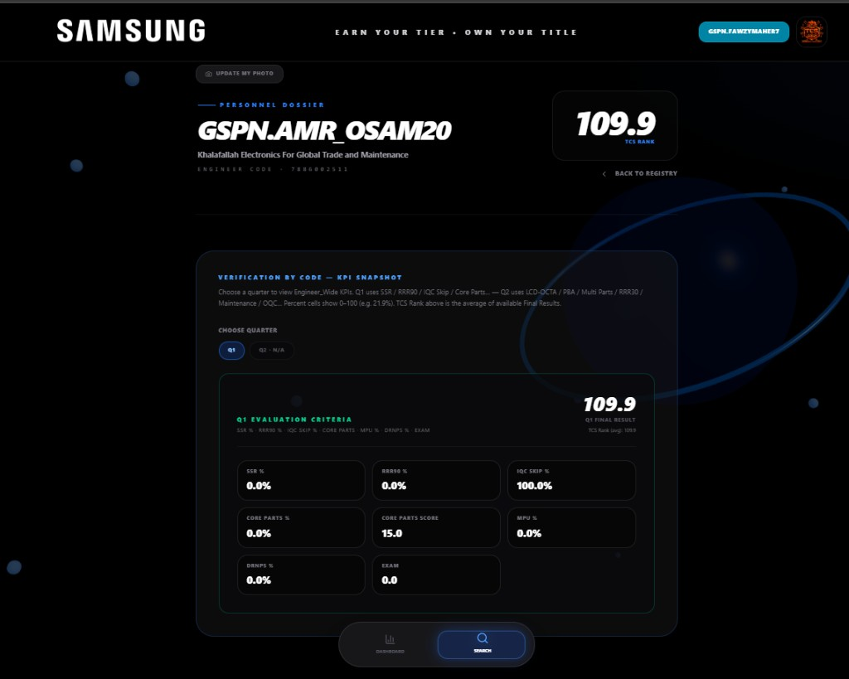
SAMSUNG
CURRENT SITUATION · IMPROVEMENT GOALS
02 / 05
From cycle announcement to continuous, personal visibility
The evaluation and PQA programs already produce trusted results each cycle. The opportunity was to carry them the last mile — to each individual, with the KPI detail behind them.
IMPROVEMENT GOALS · KEY IMPROVEMENT ITEMS
EVIDENCE · ENGINEER DOSSIER
01
Personal result on demand
Own score, full KPI breakdown and cycle history, per individual.
02
Continuous standing
Six tiers, Masters through Bronze, across the whole population.
03
Partner self-service
PQA by partner and by branch, monthly and accumulated.
04
Capability built in-house
Live competency quiz plus a knowledge base with verified completion.
05
A standing channel for voice
In-app survey feeding the improvement backlog directly.
VERIFICATION BY CODE — KPI SNAPSHOT
KPI MODEL HELD PER QUARTER
GSPN.AMR_OSAM20 · Khalafallah Electronics · engineer code 7886002511 · TCS Rank 109.9 · tier MASTERS · Q1 verified.
Q1 — SSR · RRR90 · IQC Skip · Core Parts · MPU · DRNPS · Exam
Q2 — LCD-OCTA · PBA · Multi Parts · RRR30 · Maintenance · OQC
SCORA · AX Award Submission · Samsung Electronics Egypt — Customer Service · Confidential, internal use only

Slide 3
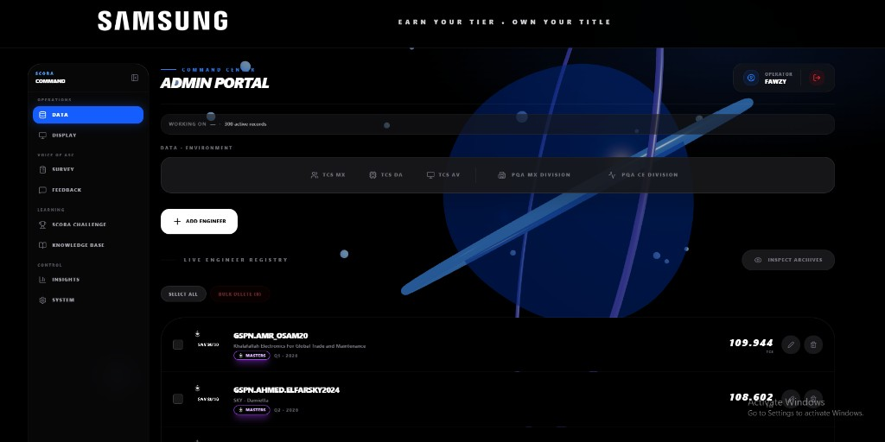
SAMSUNG
WORKFLOW BEFORE AND AFTER IMPROVEMENT
03 / 05
The cycle is unchanged. The delivery layer is new.
SCORA consumes the same official results, then extends how far they travel. Nothing in the established evaluation or PQA process was replaced.
ESTABLISHED CYCLE
EXTENDED WITH SCORA
Official results compiled and announced each cycle.
→
Unchanged — the same validated results feed the platform.
Result reaches the individual through announcement.
→
Personal dossier on demand, with the full KPI breakdown.
Top performers recognised each cycle.
→
Six tiers recognise the whole population, continuously.
KPI meaning conveyed in briefings and training.
→
Explained on demand by the assistant, linked to the knowledge item.
PQA outcomes shared with partners each cycle.
→
Self-service partner and branch views, monthly and accumulated.
Reinforcement on an external quiz tool; participation recorded.
→
In-house on SCORA Challenge; completion verified by presence, interaction and a closing quiz.
SINGLE INGESTION POINT
One administrative surface holds all five environments — TCS MX, TCS DA, TCS AV, PQA MX and PQA CE — over 300 active records. Results are loaded and validated once per cycle, then read by every downstream view, so no figure is re-keyed and every view reconciles to the same source.
Net effect: the same trusted data now reaches every individual continuously instead of once per cycle, and arrives with the means to act on it.
SCORA · AX Award Submission · Samsung Electronics Egypt — Customer Service · Confidential, internal use only

Slide 4
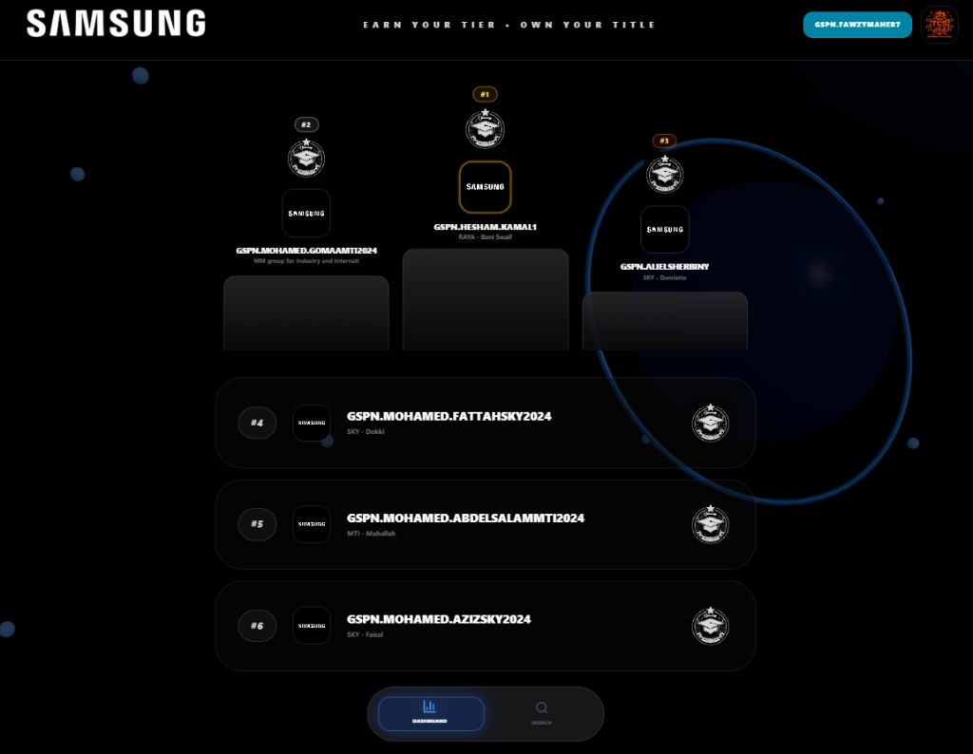
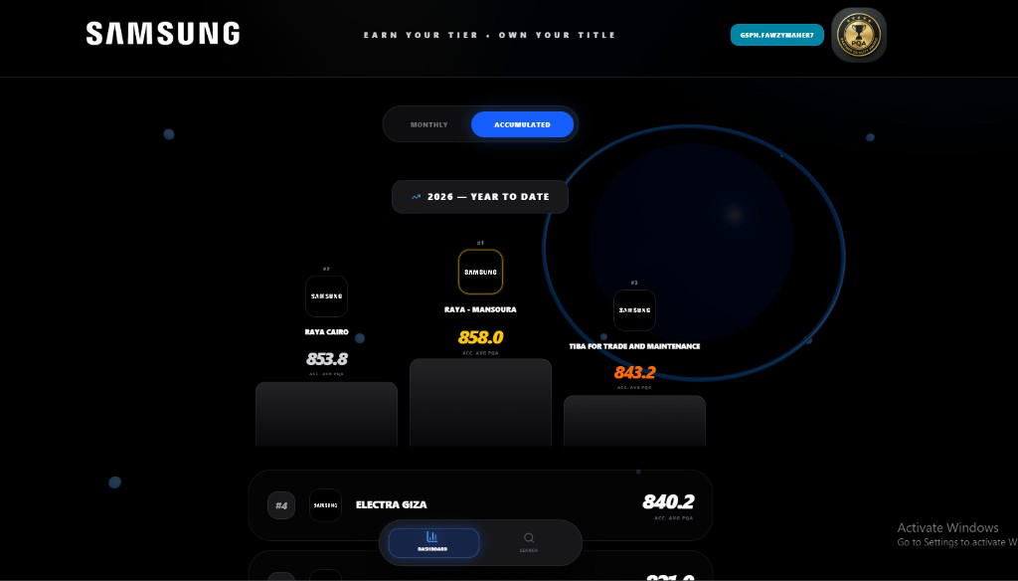
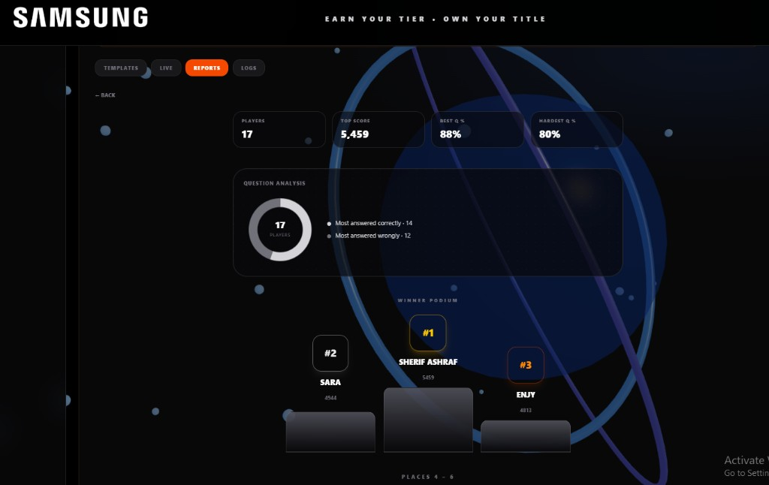
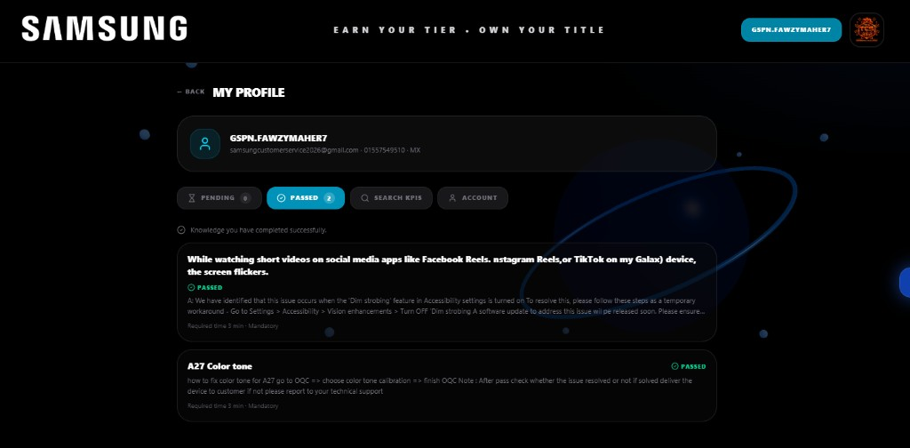
SAMSUNG
KEY FUNCTION DETAILS · READ FROM LIVE DATA
04 / 05
Four functions, each already carrying real results
RANKING & RECOGNITION
PARTNER QUALITY
TCS ranking — six tiers, Masters to Bronze
PQA — partner and branch, self-service
#1 GSPN.HESHAM.KAMAL1 (Raya · Bani Swaif) · #2 GSPN.MOHAMED.GOMAAMTI2024 · #3 GSPN.ALIELSHERBINY (SKY · Damietta). Ranked continuously across MX, DA and AV.
Accumulated 2026 year to date: Raya Mansoura 858.0 · Raya Cairo 853.8 · Tiba 843.2 · Electra Giza 840.2. Monthly and accumulated views on the same data.
SCORA CHALLENGE
KNOWLEDGE BASE
Competency quiz delivered in-house
Training completion verified, not assumed
Session report: 17 players · top score 5,459 · best question 88% · hardest 80%. Winners Sherif Ashraf 5,459 · Sara 4,944 · Enjy 4,813. Results retained internally.
Per-colleague pass state on mandatory items with a required reading time (5 min, 3 min) and a closing quiz. Presence, on-screen interaction and the quiz together prove completion.
SCORA · AX Award Submission · Samsung Electronics Egypt — Customer Service · Confidential, internal use only

Slide 5
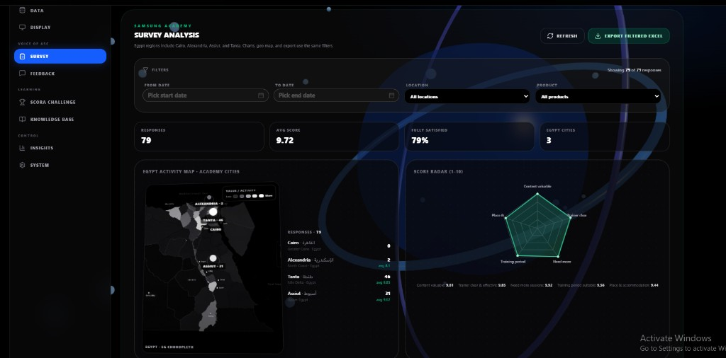
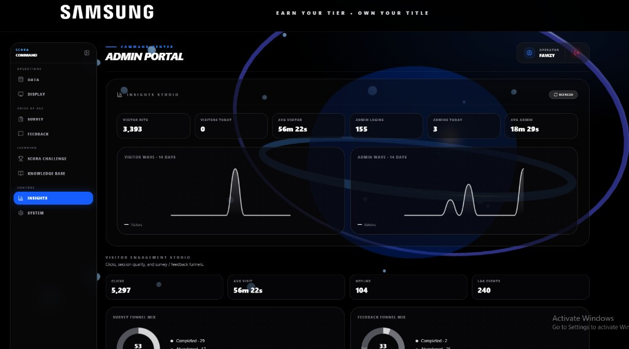
SAMSUNG
AI / DATA UTILISATION · RETURN · EXPANSION
05 / 05
AI and data utilisation, return, and where it goes next
AI & DATA UTILISATION PLAN
MEASURED, NOT ASSERTED
GoGo AI assistant
Guides colleagues through the platform, explains what each KPI means, answers in English and Egyptian Arabic with neural voice, and alerts users when new technical content is published.
One validated source, measured continuously
Official results are ingested once per cycle and fanned out to individual, tier, partner and branch views. Engagement and completion telemetry then drives the roadmap: 5,297 interactions · 240 lab events.
ACADEMY SURVEY — 79 RESPONSES
Governance
Average 9.72 · 79% fully satisfied · Tanta 46, Assiut 31, Alexandria 2. Trainer 9.85 · content 9.81 · more sessions requested 9.92.
No employee, evaluation or partner record is transmitted to an external AI provider in the current runtime configuration.
OBSERVED IMPACT
Partners now ask for the platform during onsite visits to Head Office; colleagues request extra sessions to raise their Challenge standing.
ECONOMIC RETURN
No external quiz licence, no vendor build, no translation cost — designed, built and operated by the same in-house team.
INSIGHTS STUDIO
EXPANSION
Visitor and admin waves over 14 days, click depth and funnel completion — 3,393 sessions, 56m 22s average, 155 admin logins.
External go-live on a Samsung-governed server; an approved generative API alongside GoGo, subject to RHQ review; configuration-driven reuse across subsidiaries.
SCORA · AX Award Submission · Samsung Electronics Egypt — Customer Service · Confidential, internal use only

