Slide 1
SCORA Admin Portal Training
Full walkthrough for trainer-led sessions
Audience: Super Admins / Operators · URL: /?portal=admin

Slide 2
Before training (trainer prep)
Item | Status needed
Firebase Email/Password | Required for admin Auth login
FIREBASE_SERVICE_ACCOUNT_JSON | Required to create admins from app
Firestore rules published | Required for Survey / Feedback / Reports / Insights
Sample tip + employee account | For Knowledge Base live demo

Slide 3
01
Admin login
Open http://localhost:3000/?portal=admin (or production URL).
See TERMINAL LOGIN (Secure Gateway).
Access ID: admin email or username.
Security Token: password → Execute Initialization.
Emergency unlock removed — Firebase Auth required.

Slide 4
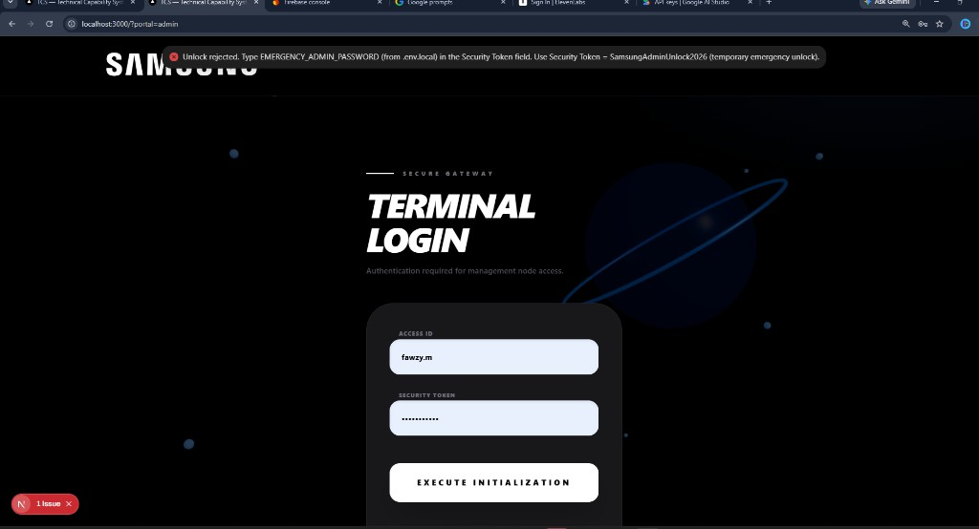
Admin login
After login you enter Command Center with the left sidebar.

Slide 5
Portal map (sidebar)
Section | Tab | Purpose
Operations | DATA | TCS / PQA data, Excel import
Operations | DISPLAY | Public toggles (survey, feedback, winners)
Voice of ASC | SURVEY | Samsung Academy survey analytics + export
Voice of ASC | FEEDBACK | Arabic feedback analytics + export
Learning | SCORA CHALLENGE | Quiz templates, live host, reports
Learning | KNOWLEDGE BASE | Technical tips for employees
Control | INSIGHTS | Engagement analytics + audit log
Control | SYSTEM | Admin accounts & permissions

Slide 6
03
SYSTEM — Manage Accounts
Add admin: Full name, Username, Email (Firebase Auth), Password, Role.
Set environment scope + module permissions → Add admin.
Creating users needs Admin SDK (FIREBASE_SERVICE_ACCOUNT_JSON).
Edit / delete accounts; Jimmy / George appear after rules published.

Slide 7
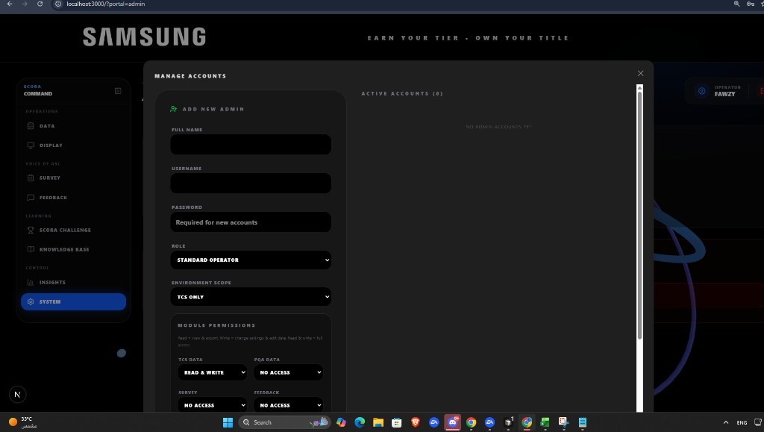
Manage Accounts
Email (Firebase Auth) field is required for new admins.

Slide 8
04
KNOWLEDGE BASE — Technical tips
Create tips that appear in employee My Knowledge.
Set Min dwell (minutes) — required reading time (e.g. 5).
Target product + Must complete for mandatory tips.
CREATE DRAFT → upload files → Publish & Push.
Employees see pushed tips under Pending.

Slide 9
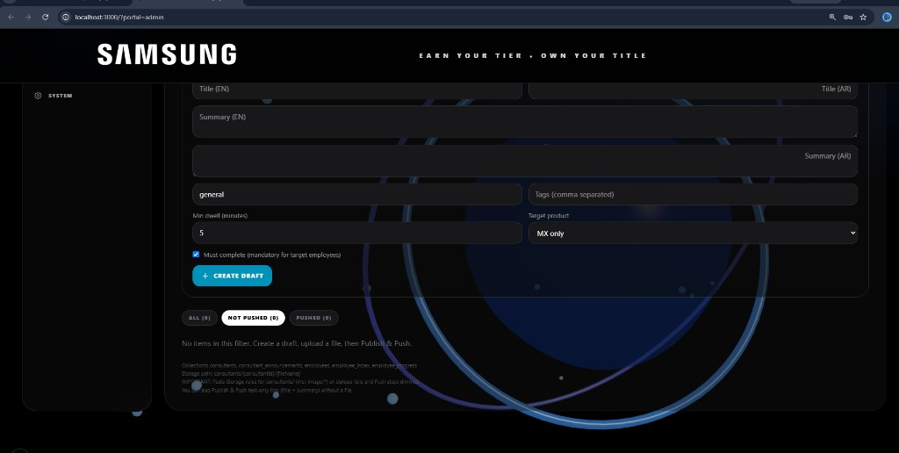
Knowledge Base / Technical Consultants
Pair with employee My Knowledge snap in live demo.

Slide 10
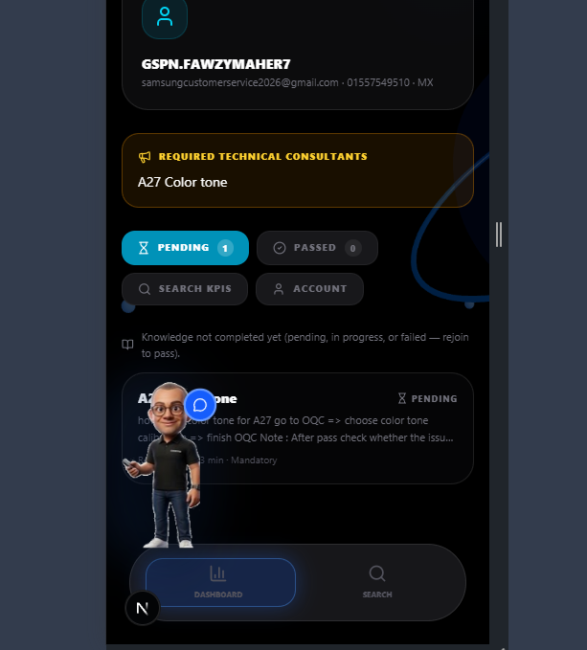
Employee view — same tip as Pending
Show both admin push and employee Pending in training.

Slide 11
05
SURVEY — Samsung Academy Survey
Filters: region / product / dates.
Refresh to reload responses.
Export Filtered Excel for offline review.
Enable public survey from Display if form is off.
Empty charts + permissions errors → publish Firestore rules.

Slide 12
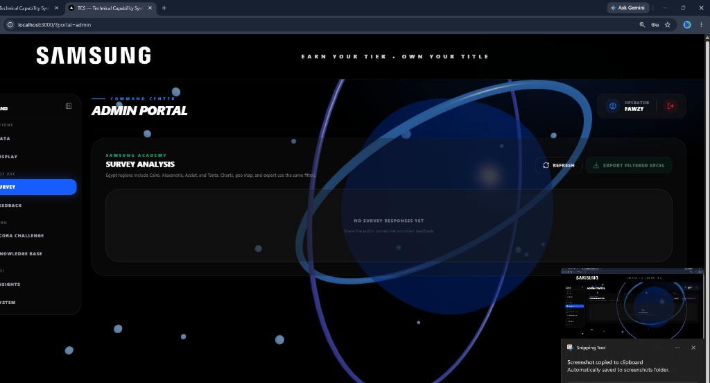
Survey analysis
Voice of ASC → Survey

Slide 13
06
FEEDBACK — TCS Feedback Analysis
Public form is Arabic; admin UI is English.
Refresh / Export Filtered Excel.
Enable form under Display if visitors cannot submit.

Slide 14
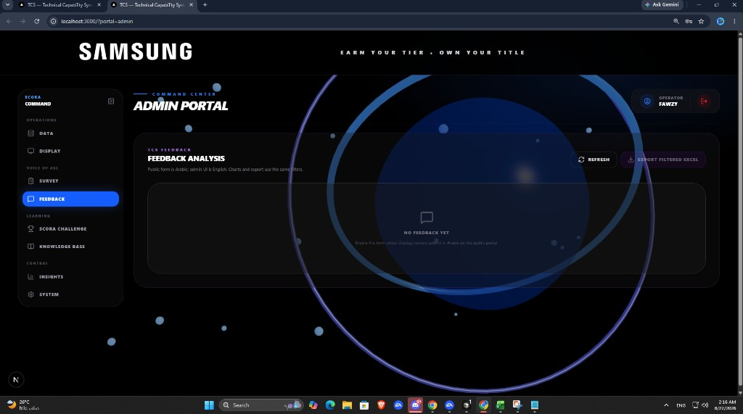
Feedback analysis
Voice of ASC → Feedback

Slide 15
07
SCORA CHALLENGE — Live quiz & reports
Templates — build / edit quiz templates.
Live — host game + QR / join link.
Reports — finished sessions and scores.
Logs — quiz activity history.

Slide 16
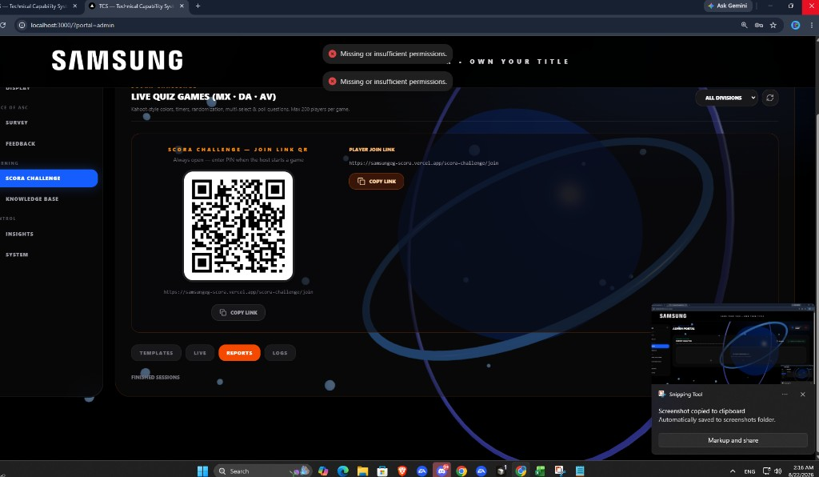
SCORA Reports / Live
Demo: template → Live session → Reports for scores.

Slide 17
08
INSIGHTS — Engagement & audit
Export Analytics (Excel) — visitor engagement.
Open Audit Log — admin action history.
Refresh if engagement data unavailable.

Slide 18
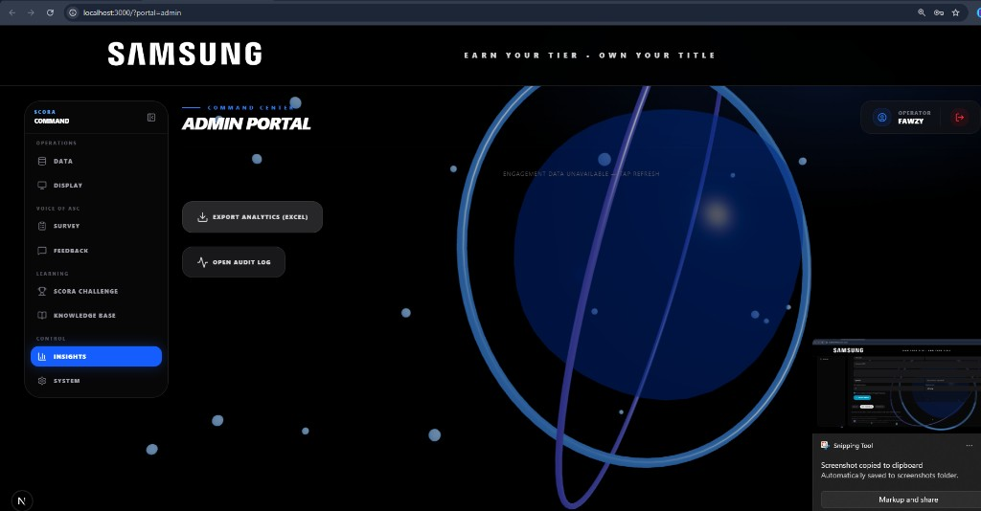
Insights
Control → Insights

Slide 19
09
DATA & DISPLAY (quick)
DATA — import / maintain TCS & PQA registries (Excel).
Use correct division (MX / DA / AV) and role tabs.
DISPLAY — toggle Academy Survey popup, Feedback promo, winners.
Show Display toggles before asking visitors to submit forms.

Slide 20
Admin vs Employee login
 | Admin portal | Employee (GSPN)
URL | /?portal=admin | Gateway Sign in
ID | Admin email / username | GSPN or email
Purpose | Manage system | My Knowledge / tips

Slide 21
Suggested admin training agenda (45–60 min)
Time | Topic | Snap
5 min | Login & sidebar map | 12-admin-login.png
10 min | SYSTEM — add admin + roles | 06-admin-manage-accounts.png
15 min | Knowledge Base — Min dwell, Push | 10 + 01 employee dashboard
5 min | Survey | 08-admin-survey.png
5 min | Feedback | 07-admin-feedback.png
10 min | SCORA Challenge Live + Reports | 09-admin-scora-reports.png
5 min | Insights | 11-admin-insights.png

Slide 22
Admin troubleshooting
Symptom | Likely cause | Fix
Empty Survey / Feedback / Insights | isAdmin() blocked | Publish firestore.rules
SCORA Reports permission toast | Same | Publish rules; re-login
Can't Add Admin | No service account | Set FIREBASE_SERVICE_ACCOUNT_JSON
Manage Accounts shows only you | admins list unreadable | Publish rules; migrate accounts
Employee can't Sign up | employee_index rules | Publish rules with public get

Slide 23
Trainer checklist
Admin can log in without emergency unlock
SYSTEM shows accounts
Can create tip with Min dwell and Push
Employee sees tip in Pending
Survey / Feedback / Insights load (not permission-denied)
SCORA Reports opens finished sessions
Training deck includes snaps from docs/training/snaps/

