Slide 1
SCORA User Training
Login · Profile · Technical Tips · Reading Time
Audience: Engineers / ASC staff (GSPN accounts)

Slide 2
01
Open the app (Gateway)
Open the SCORA website (or localhost:3000 in training).
You land on System Gateway → Select Portal.
SIGN IN (top right) — employee login & signup.
TCS Portal / PQA Portal — engineer & service center tools.
GOGO (bottom left) — tap to open assistant (does not auto-open).

Slide 3
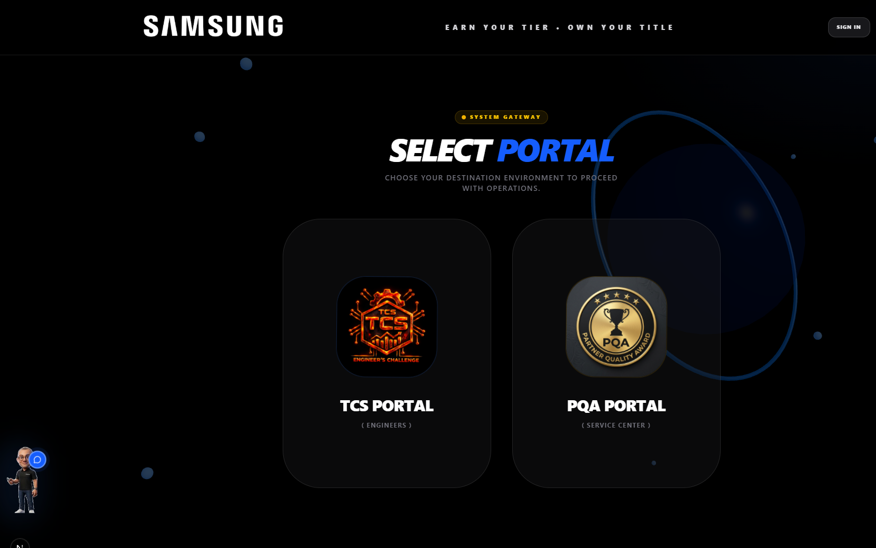
Gateway — Select Portal
Start here every day: choose portal or Sign in.

Slide 4
02
Create account (first time)
Click SIGN IN → open SIGN UP tab.
Fill fields in order: GSPN user ID → Email → Phone → Product line → Password.
Product line: MX or CE (DA & AV).
Click CREATE ACCOUNT.

Slide 5
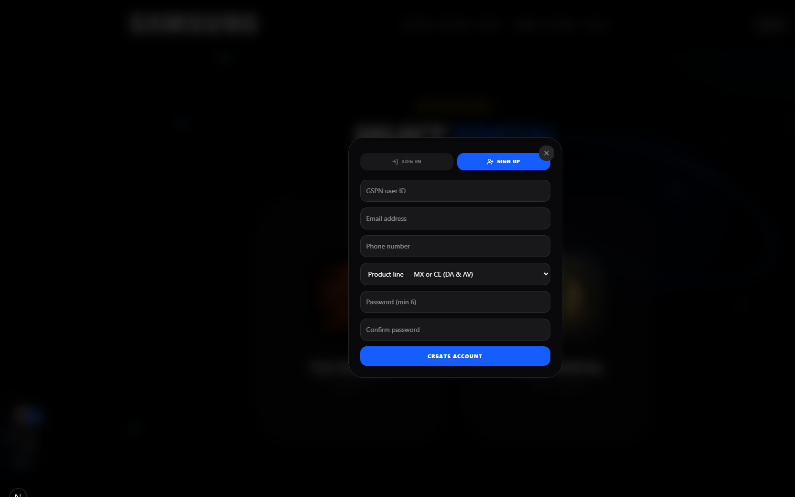
Sign up form
GSPN user ID must be entered first.

Slide 6
03
Log in (returning users)
Click SIGN IN → stay on LOG IN tab.
Enter GSPN user ID or email + password.
Click LOG IN — your name appears in the header.

Slide 7
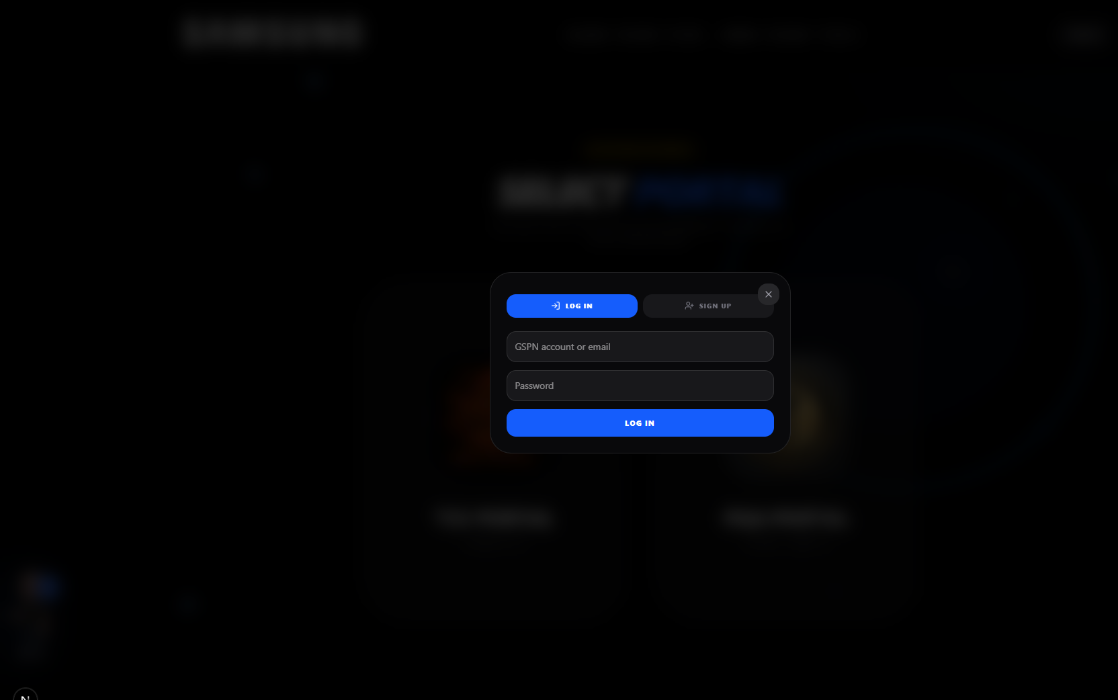
Log in form
Use GSPN ID or the email you signed up with.

Slide 8
04
Open profile & My Knowledge
From GOGO: tap GOGO → use My Knowledge / Open consultant chips.
From header: Sign in → open My Knowledge (employee dashboard).
See profile card, required consultants, tabs: Pending · Passed · Search KPIs · Account.

Slide 9
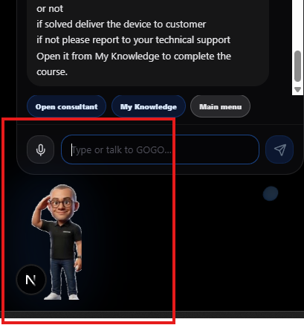
GOGO assistant
GOGO helps navigate — chat opens only when you tap.

Slide 10
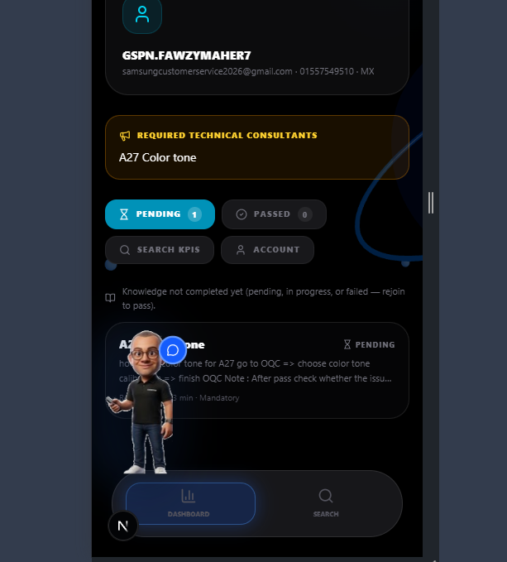
My Knowledge — employee dashboard
Mandatory tips appear under Pending.

Slide 11
05
Technical tips — how to complete
Open a tip card and read content / attachments.
Watch Active time timer (e.g. 02:15 / 05:00).
Stay on the page until required time is reached.
Click Complete when available.

Slide 12
Required reading time (Min dwell)
Concept | Meaning
Min dwell | Minimum active reading time set by admin (often 5 min)
Active time | Time counted while you keep the tip open
Must complete | Mandatory tip for your product line / target group

Slide 13
05
Avoid restarting from zero
If you leave before finishing, the app tries to resume your last attempt.
You usually do NOT restart from 00:00.
If you force-finish too early, reopen and finish remaining time.
Keep the tip tab open — long away periods may pause progress.

Slide 14
06
Using GOGO for tips & navigation
Tap GOGO → opens chat.
Close chat → GOGO stays as full-body helper on portal pages.
Chip: My Knowledge → employee dashboard (after login).
Chip: Open consultant → opens related tip if announced.
GOGO is hidden on My Knowledge / tip viewer for readability.

Slide 15
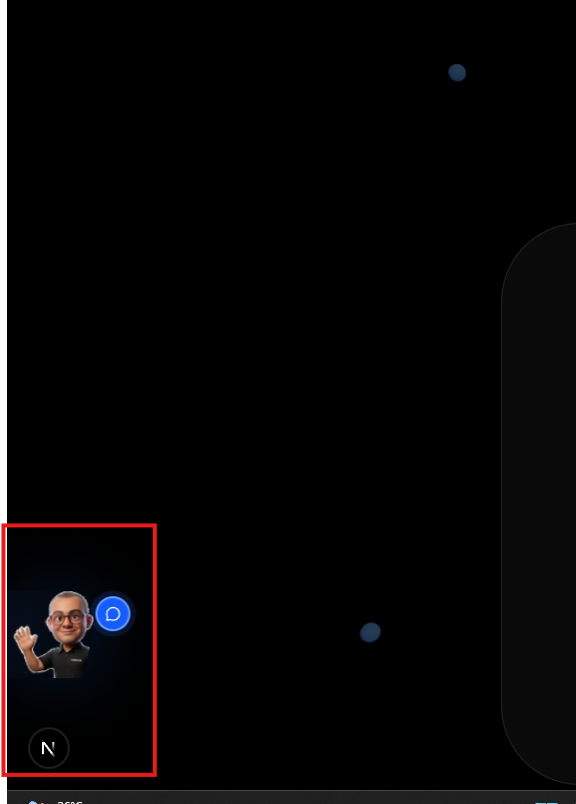
GOGO peek (optional)
GOGO stays visible on gateway pages when chat is closed.

Slide 16
Quick troubleshooting
Problem | What to try
Can't create account | Confirm Email/Password Auth; ask admin about Firestore rules
GSPN not found | Use signup email, or Sign up first
Tip won't complete | Stay until Active time ≥ required time
Lost progress | Re-open same tip — progress often resumes
Can't see tip text | Use My Knowledge (GOGO hidden there)

Slide 17
End-of-training checklist
I can open the Gateway
I can Sign up / Log in with GSPN + email
I can open My Knowledge
I understand Pending / Passed
I know Active time / Min dwell and why I must keep the tip open
I know progress can resume so I don't always restart
I can open GOGO and use My Knowledge chip

