Slide 1
Decision Tree

Slide 2
Outline
Introduction
Example
Principles
  Entropy
  Information gain
Algorithm:
  ID3
  CART
Demo

Slide 3
Introduction
Problem: Given a set of training objects and their attribute values, try to determine the target attribute value of new examples.
Key Requirements:
  Attribute-value description: object or case must be expressible in terms of a fixed collection of properties or attributes (e.g., hot, mild, cold).
  Predefined classes (target values): the target function has discrete output values (Boolean or multiclass)
  Sufficient data: enough training cases should be provided to learn the model.

Slide 4
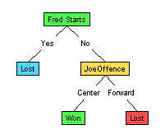
Illustration
(1) Which to start? (root)
(2) Which node to proceed?
(3) When to stop/ come to conclusion?

Slide 5
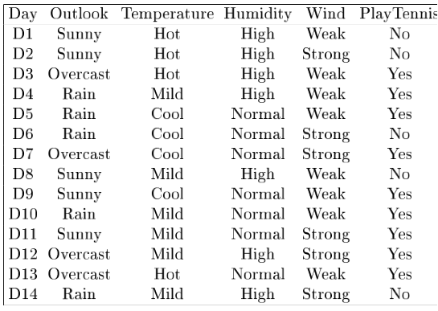
Example

Slide 6
Principle
Selection of an attribute to test at each node - choosing the most useful attribute for classifying examples.
Information gain
  measures how well a given attribute separates the training examples according to their target classification
  This measure is used to select among the candidate attributes at each step while growing the tree
Entropy
  A measure of homogeneity of the set of examples.
  Given a set S of positive and negative examples of some target concept (a 2-class problem), the entropy of set S relative to this binary classification is
E(S) = - p(P)log2 p(P) – p(N)log2 p(N)
Prunning

Slide 7
Algorithm – ID3
Calculate the entropy of every attribute from the data set.
Split the data set using the attribute which has maximum information gain.
Make the decision tree node containing that attributes
Recurse on the subset using the remaining attributes.
Stopping rule
  Every attribute has already been included along this path through the tree, or
  The training examples associated with this leaf node all have the same target attribute value (i.e., their entropy is zero - prunning).

Slide 8
Algorithm - CART
CART, a recursive partitioning method, builds classification and regression trees for predicting continuous dependent variables (regression) and categorical predictor variables (classification).
The CART algorithm is structured as a sequence of questions, the answers to which determine what the next question, if any should be.
The result of these questions is a tree like structure where the ends are terminal nodes at which point there are no more questions
Splitting the data will be done using Gini Impurity, Information Gain
The main elements of CART are:
  Rules for splitting data at a node based on the value of one variable;
  Stopping rules for deciding when a branch is terminal and can be split no more; and
  Finally, a prediction for the target variable in each terminal node.

Slide 9
Evaluation And Demo
Testing data: Given a number of new instances, how many of them can we correctly classify?
Accuracy

Slide 10
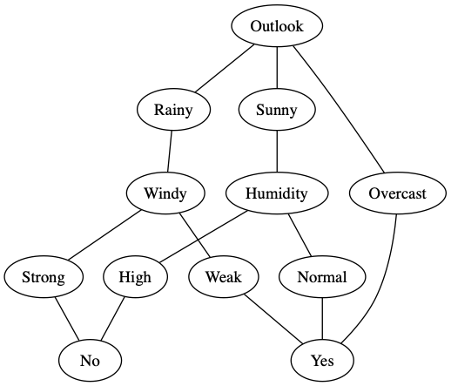
Decision Tree for Tennis Data Set

Slide 11
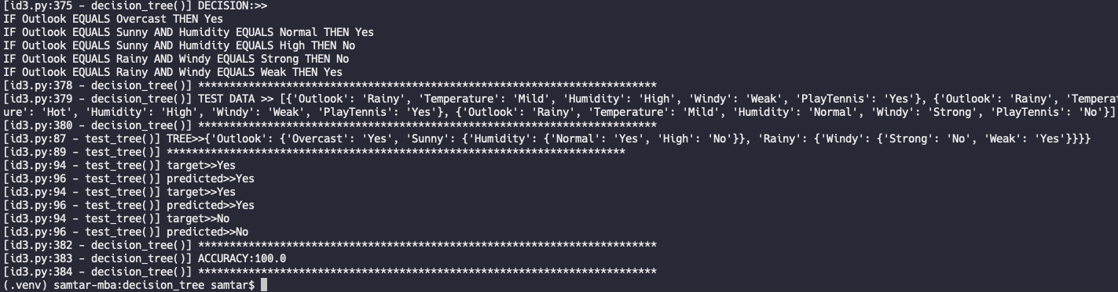
Result

Slide 12
Strength:
  can generate understandable rules
  can handle continuous and categorical variables
  provide a clear indication of which fields are most important for classification
Weakness:
  Not suitable for prediction of continuous attribute.
  Perform poorly with many class and small data.
  Computationally expensive to train.

Slide 13
The implementation along with the training data and testing data is in github for both (ID3 and CART) algorithm:
  https://github.com/samta/decision_tree

