Slide 1
Security Engineering and Security Objectives
UT CS361S
Spring 2021
Lecture Notes

Slide 2
What is it?
“[It] is about building systems to remain dependable in the face of …”
Malice
Error
Mischance.
“As a discipline, it focuses on the…”
Tools
Processes
Methods

Slide 3
The Goal
Confidentiality, Integrity, Availability (CIA Triad)
For new systems:
Design security
Implement security
Test security
For existing systems:
Adapt them for increased security
Adapt them as their environment evolves

Slide 4
Key Observation
Anderson, Ch 1, p. 4

Slide 5
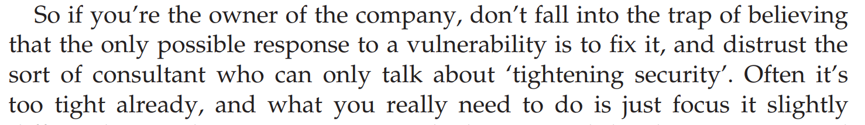

Understand This
Anderson, Ch 25, p. 816

Slide 6
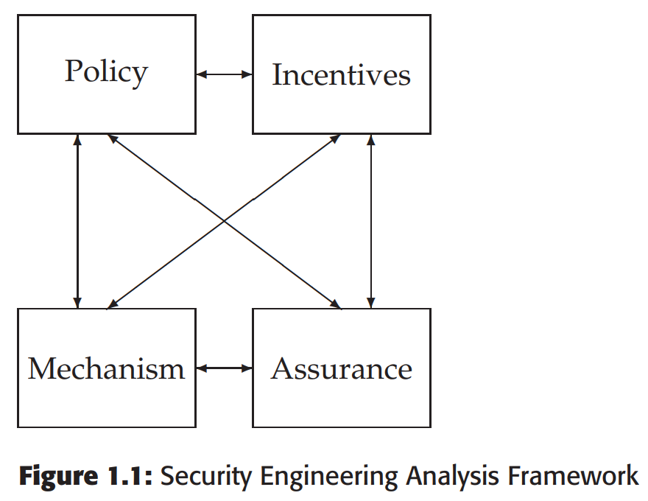
A Framework
Policy
Mechanism
Assurance
Incentives

Slide 7
Grasp the Context
SECURITY IS ABOUT CONTEXT (Repeat after me)
What does it mean when you say “system X is secure”?
Secure against whom?
Secure under what conditions?
Are we even protecting what matters?!
Take voting security
Who are the potential attackers?
How does the context change if a nation decides to be the attacker?

Slide 8
Anderson’s Examples
Bank
Military
Hospital
Home

Slide 9
Some Definitions
System – Tech + Auxiliary Tech + Staff + Users + etc.
Subject – Physical “person”
Principal – Entity in the system
Identity – Unique label attached to a unique principal
Trusted – Failure results in compromise
Trustworthy – Failure is unlikely

Slide 10
IAAA
Identity – Unique label for a unique principal
Authentication – Validation of the principal’s identity
Authorization – Permissions granted the prinicpal
Accountability – Metering and auditing of principal
(Message Authenticity – Integrity + Freshness)

Slide 11
Start with Policy
“…a succinct statement of a system’s protection strategy” (Anderson ch1 p. 15)
Examples:
Each credit must be matched by an equal and opposite debit
All transactions over $1,000 must be authorized by two managers
Practice:
What are the security policies for TLS?

Slide 12
CIA (Not the Spies)
Confidentiality – Cannot be read
Integrity – Cannot be altered
Availability – Cannot be interrupted

Slide 13
Then figure out mechanism
This is where most security people like to start
But really we only need mechanism to enforce policy
Some mechanisms aren’t even technical (e.g., legal)
MUST understand threat model

Slide 14
Assurance
Just how strong/resilient/comprehensive is the mechanism?
Requires a solid understanding of the threat model
Applications at every stage!
Design – solid security engineering principles
Implementation – coding practices, development processes
Testing – adversarial, comprehensive assessment

Slide 15
Software Quality: Therac 25
http://sunnyday.mit.edu/papers/therac.pdf
Computer controlled radiation medical therapy machine
Between 6/’85 and 1/’87, it overdosed 6 people (3 died)
The problems were primarily software failures

Slide 16
Race Condition Bug
Real time operating system gathers details from the UI
Setting the bending magnets takes 8 seconds
Checks for data edits (in real time) as it is setting the magnets
However, cleared variable mean subsequent edits are not recorded (but show up in UI)

Slide 17
Overflow bug
Error-checking and integrity checking code protects software
One variable would perform a check if the value was non-zero
But the variable was just 8 bit
Every 256th check would overflow back to zero
When the tech hit “set” when this overflow happened would allow full, maximum exposure

Slide 18
Understanding Failures
Everything fails.
Everything.
Don’t be like AECL (“It can’t fail that way…”)
I recently had engineers of a client say the exact same things
They couldn’t understand why I thought their software would fail
How will your software fail?
You have to ensure that you fail safely
Some failures can never be tolerated; those features may need to be removed
Related: Make sure you use fail safe defaults

Slide 19
Incentives
Anderson’s example of airport security
What motivates the behavior?
What is “Security Theater?”
Everyone should learn a little game theory
Read up on Prisoner’s dilemma
Understand “mechanism design”
Anderson’s “Moral Hazard” (Chapter 25)

Slide 20
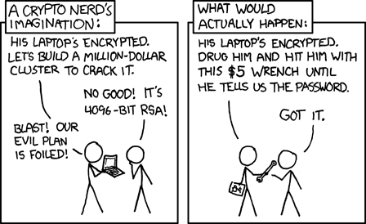
Illustrations
See http://xkcd.com/538/

Slide 21
Security Principles
Least privilege
Minimize attack surface
Defense in depth
Separation of duties and responsibilities
Crowdsourcing
Open systems
Fail Safe/Fail Secure

Slide 22
Psychology
Much of computer security rests on psychology
Phishing, email scams, etc all depend on user psych
Security mechanisms avoided because they clash with psych

Slide 23
Social Engineering: Pretexting
Pretexting: phone for info pretending to be someone else
The goal is to private information, credentials, etc
Attacks of this sort are often conducted in stages
Attacker starts by getting non-sensitive information
Attacker uses non-sensitive information to convince others of his deception
One health institution had 30 such calls a week!

Slide 24
Social Engineering: Phishing
Phishing: Sending an email that appears to be authentic to get private info
Easy to create an email that looks authentic.
Especially modern emails with HTML and media
The resources are often online, so the phishing email simply points to them
Email is easily forgible
Example attacks:
Tell user they need to change password (and enter old password first)
Tell user they need to update profile including SSN

Slide 25
Understanding Human Bias
Humans are not rational
Humans are designed with a bias toward action
If we thought about everything we’d never do anything
We’re programmed to act without thinking
Examples of bias:
We’re more afraid of dying in a plane crash than a car crash

Slide 26
When Emotion Takes Over
When human logic/thinking ends, emotions take over
If we don’t know explicitly what to do, we respond emotionally
So, sometimes education has limited value
Bad guys will always learn how to exploit what the users dont know
One solution is safe defaults (FAIL SAFE/FAIL SECURE!)
“Our bank will never, ever send email”

Slide 27
Abuses of Authority
Read carefully the book’s examples of how people behave
Under someone else’s authority
When they have authority
Also, people do not like to admit they make mistakes
“Hustlers” take advantage of this
AGAIN, you cannot design assuming the user is dispassionate and rational

Slide 28
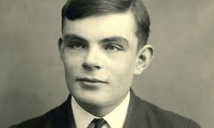
CAPTCHAs
Good case study!
Combine psychology, usability, and system design nicely
Designed around what humans do well that computers do not
“Completely Automated Public Turing Test to Tell Computers and Humans Apart”
Thanks Alan Turing!

Slide 29
Network Security
Everyone wants a secure network. But how?
“Whoever thinks his problem can be solved using cryptography, doesn’t understand his problem and doesn’t understand cryptography.”
— Attributed by Roger Needham and Butler Lampson to Each Other
This is what we’re going to study this semester!

