Slide 1
Host Vulnerabilities
UT CS361S
SpRing 2021
Lecture Notes

Slide 2
Vulnerabilities and NetSec
This class is “Network Security”
What do host vulnerabilities have to do with it?
Hosts are “nodes” in a network graph
Vulnerabilities can be exploited by remote attackers
Either to directly access resources on a particular host
Or, to penetrate network defenses and access a more valuable host

Slide 3
Brief Overview to Execution
Today: very brief overview of Control Flow Hijacking
There are other types of vulnerabilities (e.g misconfigured)
Control Flow Hijacking is probably the hardest to grasp
Critical Concepts:
The “normal” flow of control for authorized instructions
Inputs that change the flow to unauthorized instructions
ATTRIBUTION: Derived from slides by Dave Brumley, CMU

Slide 4
Basic Execution
File system
Process Memory
Binary
Fetch, decode, execute
Code
Processor
Data
...
Stack
Heap
read and write
Notes:
What is the name of the register that contains the address of the current instruction?

Slide 5
Seth’s Notes
Stack
For temporary static variables
Function call/return data
Linear
Generally, tightly managed
Heap
Global variables and dynamic variables
Hierarchical, “free floating”
Fragmented, not tightly managed

Slide 6
Seth’s Notes
Assembly “function calls” don’t really exist
Rather, jump to new location (“function”)
Save context of old location
Load context for new location
Include information for “returning”

Slide 7
Seth’s Notes
There are multiple ways to do this
“Calling Conventions”
Caller Cleanup – caller cleans stack
Callee Cleanup – called function cleans stack
Other convention variations:
Order that function data is loaded onto stack
Whether some data is put into registers instead

Slide 8
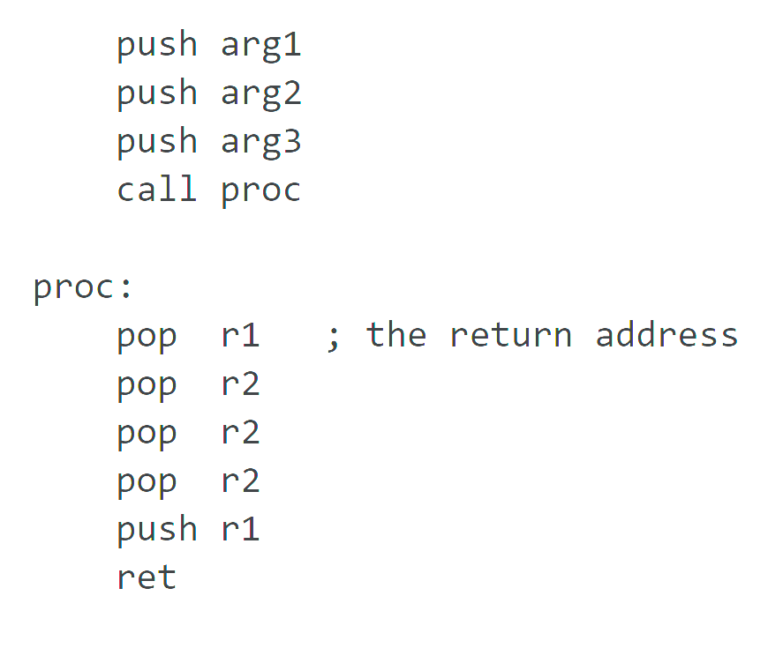
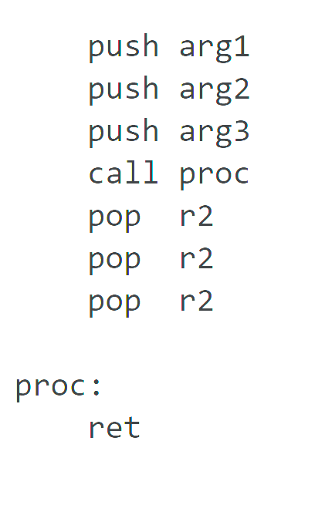
Seth’s Notes
Visualizing caller v callee cleanup
stdcall (callee) cdecl (caller)

Slide 9
EBP and ESP
EBP
Stack Base Pointer
Where the stack was when the routine started
ESP
Stack Pointer
Top of the current stack
EBP is a previous function’s saved ESP

Slide 10
cdecl – default for Linux & gcc
…
b
a
return addr
caller’s ebp
callee-save
locals (buf, c, d ≥ 28 bytes if stored on stack)
caller-save
buf
c
return addr
orange’s ebp
…
int orange(int a, int b)
{
char buf[16];
int c, d;
if(a > b) c = a;
else c = b;
d = red(c, buf);
return d;
}
parameter area (caller)
orange’s initial stack frame
%ebp
frame
%esp stack
to be created before calling red
grow
after red has been called

Slide 11
GDB Walkthrough
SRC: tenouk.com/Bufferoverflowc/Bufferoverflow3.html
Given C code, examine assembly via GDB
Uses cdecl calling convention

Slide 12
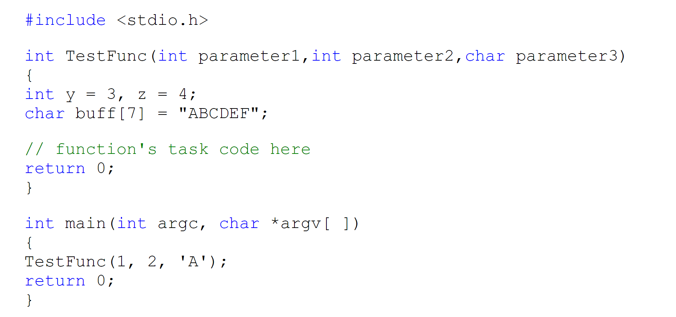
GDB Walkthrough – C Code

Slide 13

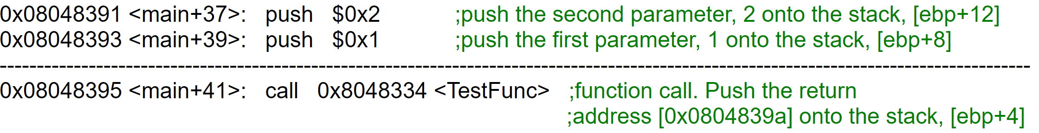
GDB Walkthrough – Call TestFunc
Register eax loaded with character ‘A’ (0x41), not shown

Slide 14
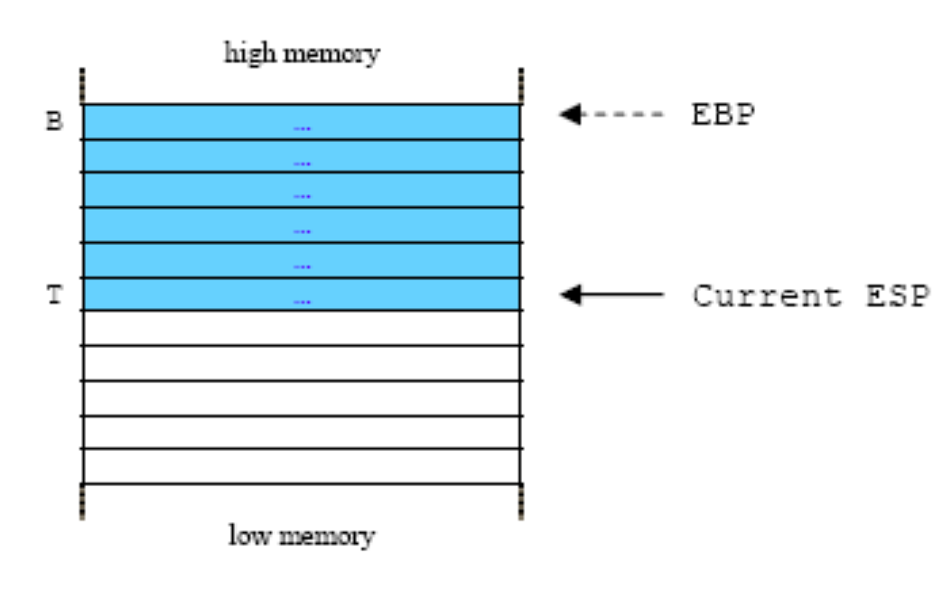

Slide 15
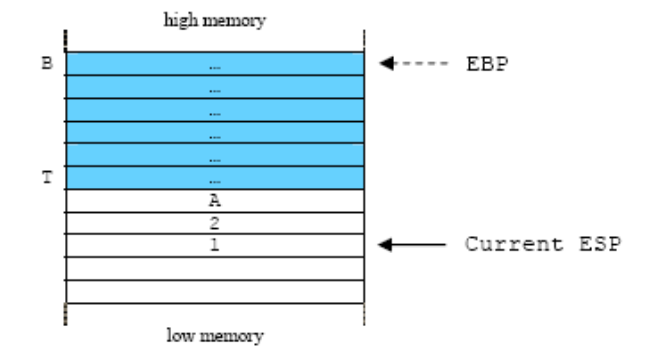

Slide 16
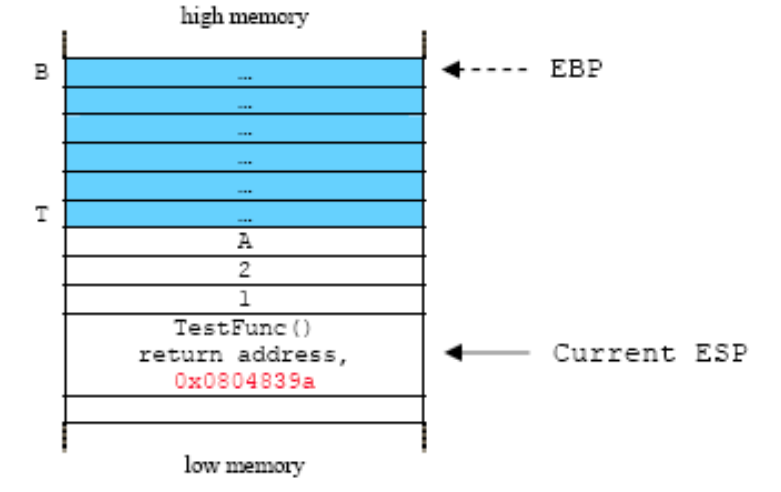

Slide 17
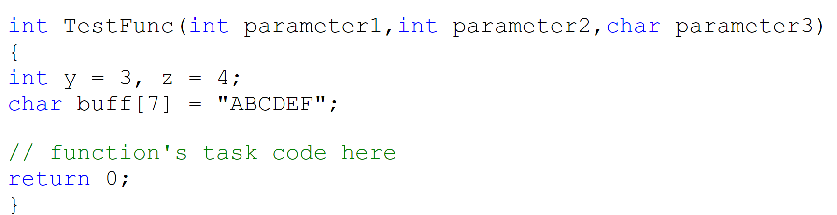
GDB Walkthrough – TestFunc() C Code

Slide 18
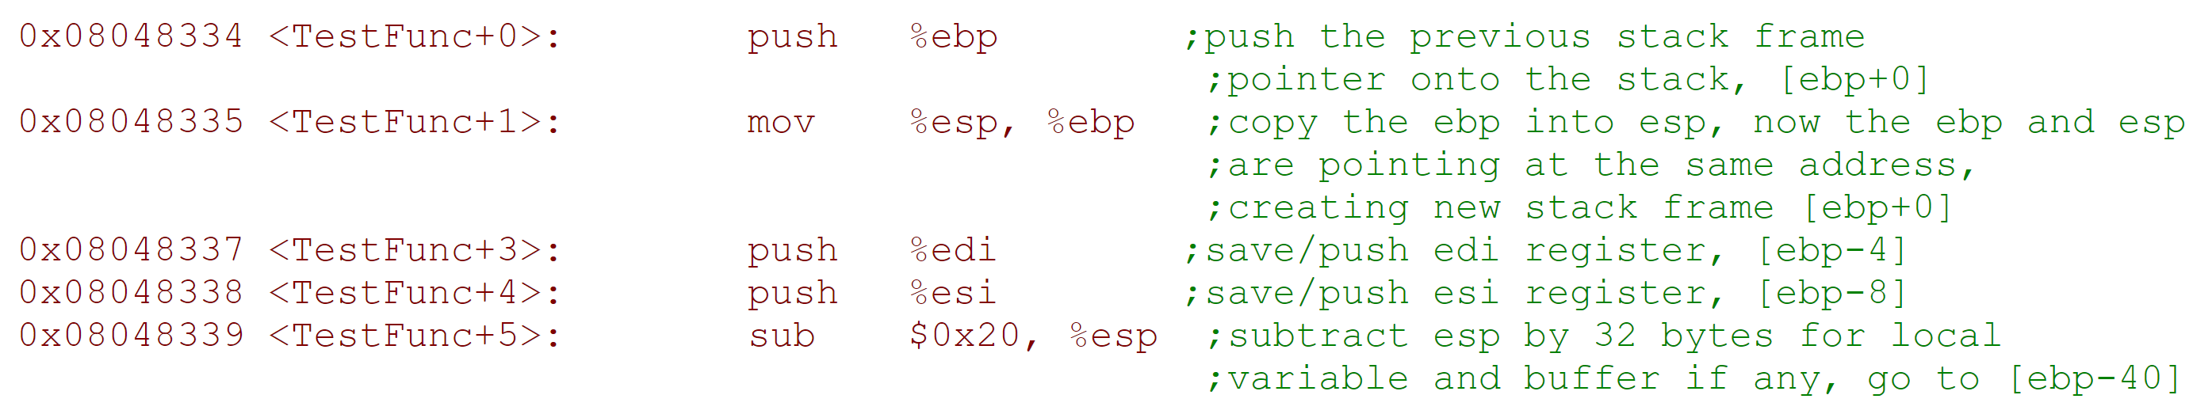
GDB Walkthrough – TestFunc() Assembly
32 bytes allocated on stack (0x20). Variables Loaded into this space (not shown).

Slide 19
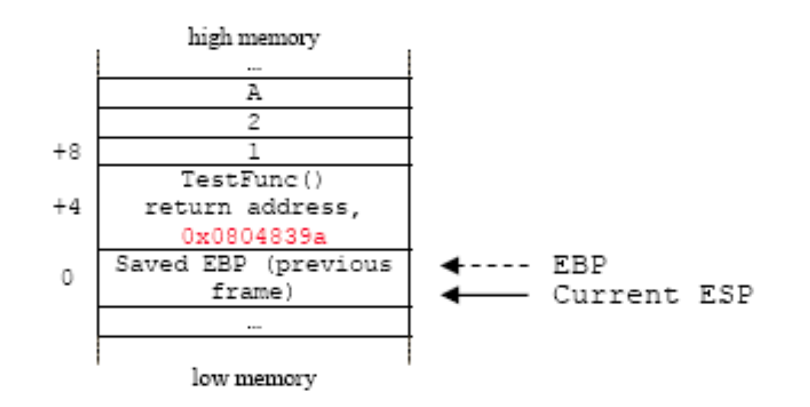

Slide 20
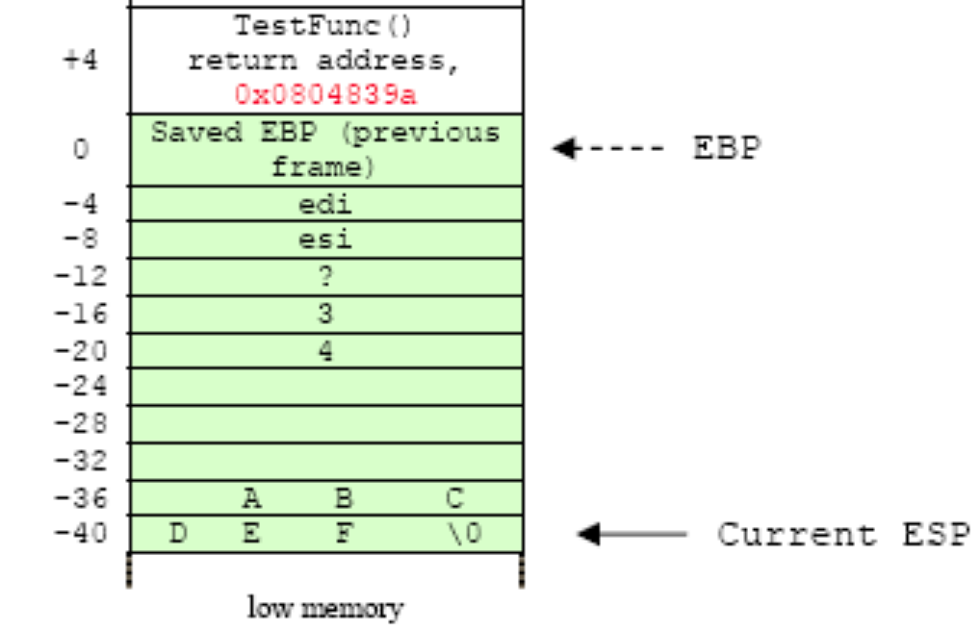
Save Registers
Local variables ‘y’ and ‘z’
buff[7] (note, more allocated)

Slide 21
GDB Walkthrough – TestFunc() Exit

Slide 22
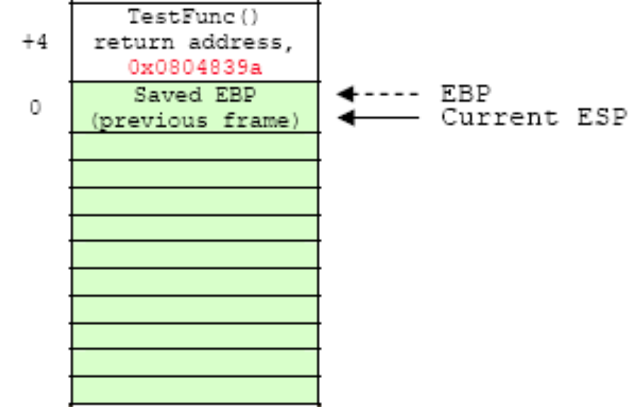

Slide 23
GDB Walkthrough – TestFunc() Exit, part 2

Slide 24
GDB Walthrough – Main() after TestFunc() return

Slide 25
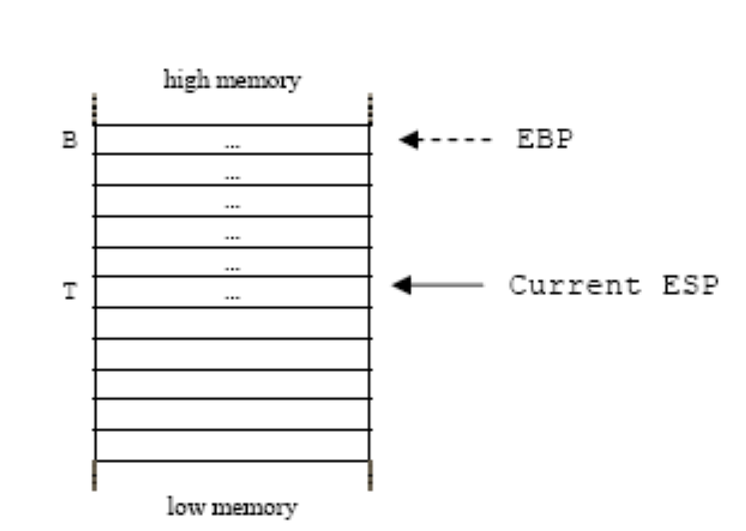
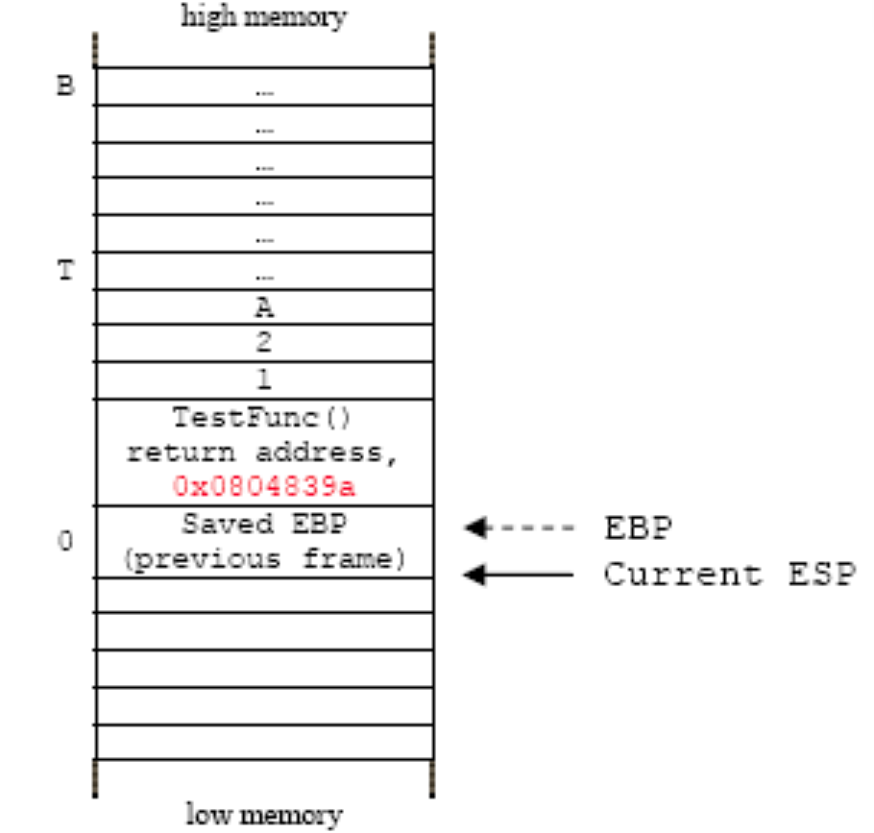

Slide 26
What are Buffer Overflows?
A buffer overflow occurs when data is written outside of the space allocated for the buffer.
C does not check that writes are in-bound
Stack-based
covered in this class
Heap-based
more advanced
very dependent on system and library version
Notes:
The key here is predetermined allocation.

Slide 27
Basic Example
#include <string.h>
int main(int argc, char **argv) {
char buf[64];
strcpy(buf, argv[1]);
}
Dump of assembler code for function main:
0x080483e4 <+0>: push %ebp
0x080483e5 <+1>: mov %esp,%ebp
0x080483e7 <+3>: sub $72,%esp
0x080483ea <+6>: mov 12(%ebp),%eax
0x080483ed <+9>: mov 4(%eax),%eax
0x080483f0 <+12>: mov %eax,4(%esp)
0x080483f4 <+16>: lea -64(%ebp),%eax
0x080483f7 <+19>: mov %eax,(%esp)
0x080483fa <+22>: call 0x8048300 <strcpy@plt>
0x080483ff <+27>: leave
0x08048400 <+28>: ret
…
argv
argc
return addr
caller’s ebp
buf (64 bytes)
argv[1]
buf
%ebp
%esp
27

Slide 28
“123456”
#include <string.h>
int main(int argc, char **argv) {
char buf[64];
strcpy(buf, argv[1]);
}
Dump of assembler code for function main:
0x080483e4 <+0>: push %ebp
0x080483e5 <+1>: mov %esp,%ebp
0x080483e7 <+3>: sub $72,%esp
0x080483ea <+6>: mov 12(%ebp),%eax
0x080483ed <+9>: mov 4(%eax),%eax
0x080483f0 <+12>: mov %eax,4(%esp)
0x080483f4 <+16>: lea -64(%ebp),%eax
0x080483f7 <+19>: mov %eax,(%esp)
0x080483fa <+22>: call 0x8048300 <strcpy@plt>
0x080483ff <+27>: leave
0x08048400 <+28>: ret
…
argv
argc
return addr
caller’s ebp
buf (64 bytes)
argv[1]
buf
return addr
caller’s ebp
123456\0
%ebp
%esp
28

Slide 29
“A”x68 . “\xEF\xBE\xAD\xDE”
#include <string.h>
int main(int argc, char **argv) {
char buf[64];
strcpy(buf, argv[1]);
}
Dump of assembler code for function main:
0x080483e4 <+0>: push %ebp
0x080483e5 <+1>: mov %esp,%ebp
0x080483e7 <+3>: sub $72,%esp
0x080483ea <+6>: mov 12(%ebp),%eax
0x080483ed <+9>: mov 4(%eax),%eax
0x080483f0 <+12>: mov %eax,4(%esp)
0x080483f4 <+16>: lea -64(%ebp),%eax
0x080483f7 <+19>: mov %eax,(%esp)
0x080483fa <+22>: call 0x8048300 <strcpy@plt>
0x080483ff <+27>: leave
0x08048400 <+28>: ret
…
argv
argc
return addr
caller’s ebp
buf (64 bytes)
argv[1]
buf
0xDEADBEEF
AAAA
AAAA… (64 in total)
corrupted
overwritten
overwritten
%ebp
%esp
29
Notes:
lowest byte of argc is 0; in little endian, that’s the least significant byte

Slide 30
Frame teardown—1
#include <string.h>
int main(int argc, char **argv) {
char buf[64];
strcpy(buf, argv[1]);
}
Dump of assembler code for function main:
0x080483e4 <+0>: push %ebp
0x080483e5 <+1>: mov %esp,%ebp
0x080483e7 <+3>: sub $72,%esp
0x080483ea <+6>: mov 12(%ebp),%eax
0x080483ed <+9>: mov 4(%eax),%eax
0x080483f0 <+12>: mov %eax,4(%esp)
0x080483f4 <+16>: lea -64(%ebp),%eax
0x080483f7 <+19>: mov %eax,(%esp)
0x080483fa <+22>: call 0x8048300 <strcpy@plt>
=> 0x080483ff <+27>: leave
0x08048400 <+28>: ret
…
argv
argc
0xDEADBEEF
AAAA
corrupted
overwritten
overwritten
%esp
and
%ebp
leave
mov %ebp,%esp
pop %ebp
%esp
30
Notes:
*argc is corrupted because of the null terminator

Slide 31
Frame teardown—2
#include <string.h>
int main(int argc, char **argv) {
char buf[64];
strcpy(buf, argv[1]);
}
Dump of assembler code for function main:
0x080483e4 <+0>: push %ebp
0x080483e5 <+1>: mov %esp,%ebp
0x080483e7 <+3>: sub $72,%esp
0x080483ea <+6>: mov 12(%ebp),%eax
0x080483ed <+9>: mov 4(%eax),%eax
0x080483f0 <+12>: mov %eax,4(%esp)
0x080483f4 <+16>: lea -64(%ebp),%eax
0x080483f7 <+19>: mov %eax,(%esp)
0x080483fa <+22>: call 0x8048300 <strcpy@plt>
0x080483ff <+27>: leave
0x08048400 <+28>: ret
…
argv
argc
0xDEADBEEF
corrupted
overwritten
%esp
%ebp = AAAA
leave
mov %ebp,%esp
pop %ebp
31
Notes:
What to put at 0xDEADBEEF? Or rather, what should we put?

Slide 32
Frame teardown—3
#include <string.h>
int main(int argc, char **argv) {
char buf[64];
strcpy(buf, argv[1]);
}
Dump of assembler code for function main:
0x080483e4 <+0>: push %ebp
0x080483e5 <+1>: mov %esp,%ebp
0x080483e7 <+3>: sub $72,%esp
0x080483ea <+6>: mov 12(%ebp),%eax
0x080483ed <+9>: mov 4(%eax),%eax
0x080483f0 <+12>: mov %eax,4(%esp)
0x080483f4 <+16>: lea -64(%ebp),%eax
0x080483f7 <+19>: mov %eax,(%esp)
0x080483fa <+22>: call 0x8048300 <strcpy@plt>
0x080483ff <+27>: leave
0x08048400 <+28>: ret
…
argv
argc
corrupted
%esp
%eip = 0xDEADBEEF
(probably crash)
32
Notes:
What to put at 0xDEADBEEF? Or rather, what should we put?

Slide 33
Shellcode
…
0x080483fa <+22>: call 0x8048300 <strcpy@plt>
0x080483ff <+27>: leave
0x08048400 <+28>: ret
…
argv
argc
&buf
…
shellcode…
argv[1]
buf
Traditionally, we inject assembly instructions for exec(“/bin/sh”) into buffer.
see “Smashing the stack for fun and profit” for exact string
or search online
%ebp
%esp

Slide 34
Recap
To generate exploit for a basic buffer overflow:
Determine size of stack frame up to head of buffer
Overflow buffer with the right size
computation + control
shellcode | padding | &buf

