Slide 1
Border Security
EN.600.444/644
Spring 2021
Dr. Seth James Nielson

Slide 2
“Spaces”
Space A
“Space” is not a technical term.
I use it to represent the concept of separation
Space B

Slide 3


Macro Physical Spaces
This Photo by Unknown Author is licensed under CC BY-NC-ND

Slide 4

Micro Physical Spaces

Slide 5
Why do we Separate Physical Things?
CONTEXT
Countries have different
Social Models
Legal Frameworks
Rights and Responsibilities
Binders, bins, and office “spaces”
Importance
Meaning

Slide 6

Access
Most physical spaces try to control the flow
from one space to another

Slide 7
Cyber Spaces
Often tied to a physical space and/or organization
All the people, equipment, data, etc. belonging to an entity
For example, a corporate network
But there are far more conceptual spaces
Media piracy
Hacking communities
Everything inbetween

Slide 8
LAN’s as Natural Spaces
LAN’s have historically creates cyber spaces very naturally
Typically tied to an entity, the LAN is
Hosted by the entity in physical space
Provides resources on behalf of the entity in cyber space
Access is typically limited to individuals with physical relationships to the entity
Insiders typically have increased access to resources across the LAN
Outsiders typically have limited access to published resources on specific servers

Slide 9
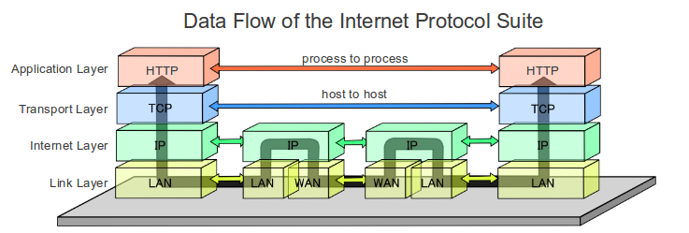
LAN’s create “Borders” on the Internet
This Photo by Unknown Author is licensed under CC BY-SA
ROUTER
(Gateway)
ROUTER
(Gateway)
LAN #1
LAN #2

Slide 10
Gateways: Natural Barriers
Data can only get into a LAN via router
We call the routers at the “edges” of a LAN gateways
Gateways are, therefore, natural chokepoints for data

Slide 11
Gateways: Space Transition
SPACE A
(LAN #1)
CONTEXT!
SPACE B
(LAN #2)
CONTEXT!

Slide 12
Context is EVERYTHING
Security is all about context (REPEAT AFTER ME!)
Security has no meaning without context
What is secure within one context may not be within another
Data on different networks is assumed to have a different contexts
It is reasonable and natural to examine data transitioning context

Slide 13
Gateways: Context Change
SPACE A
(LAN #1)
CONTEXT!
SPACE B
(LAN #2)
CONTEXT!
CONTEXT CHANGE!

Slide 14
Firewall: Gateway Security
What is a “firewall”?
Informally, it’s security within a network connector, such as a gateway

Slide 15
Firewall Marketing
If you read marketing, it’s Super Man.
Juniper: “control over applications, users, and content to stop advanced cyber-threats”
PAN: “Instantly find and stop attacks with a fully automated platform”
Cisco: “Prevent breaches, get deep visibility to detect and stop threats fast”

Slide 16
Ignore Marketing. Think ENGINEERING
Ross Anderson proposed a framework for Security Engineering
Policy: WHAT you’re supposed to achieve
Mechanism: HOW you’re supposed to achieve it
Assurance: RELIABILITY of the mechanism
Incentives: MOTIVES of defenders and attackers

Slide 17
Core Concepts: Policy and Mechanism
This is not a security engineering class
But we will use it to help us frame how we look at security
PAY SPECIAL ATTENTION TO POLICY vs. MECHANISM
Policy is WHAT you want
Mechanism is HOW you do it
Most “Policy” you see elsewhere, including CISSP, certifications, is different

Slide 18
Example: TLS
What is the POLICY?
Authentication: a party can claim an identity ONLY if they’re authorized to do so
Confidentiality: only authorized parties can READ the communications
What is the MECHANISM?
Authentication is enforced by certificates, signatures, and trusted authorities
Confidentiality is enforced by encryption
ENCRYPTION IS MECHANISM NOT POLICY

Slide 19
Firewalls: Policy and Mechanism
Firewalls are MECHANISMS for enforcing certain network security POLICIES
Borders are natural places to want a policy
Borders are also, conveniently, an easy place to enforce some policies
BUT DON’T CONFUSE THE TWO!

Slide 20
“Security” is a Meaningless Word
Firewalls, like every other mechanism, don’t “create security”
Consider the marketing descriptions
What is a “threat”?
What does it mean to “block”?
What is an “attack”?
As a security professional, how would you even evaluate these claims?

Slide 21
Enforcing Policy
Firewalls are ONLY useful to the extent they can enforce a policy
Corollary: Policies come BEFORE firewalls
What security policies might you like to have?
Example 1: No malware can enter the network
Example 2: No unauthorized external network services
Example 3: External network services accessible only by authorized users
Once you have a policy, you can start looking for enforcement mechanisms.

Slide 22
Common Policies: Access Control
Policy #1: Only authorized LAN services are accessible outside the LAN
Policy #2: Only authorized users from outside the LAN can access LAN resources
Policy #3: Only authorized users on the LAN can access authorized services outside the LAN

Slide 23
Early Firewalls: Layer-3 Mechanisms
The first firewalls were LAYER 3 (IP level)
Layer-3 filtering can partially enforce all three policies:
Policy #1 by blocking access to computers without authorized services
Policy #2 by blocking access from computers without authorized IP’s
Policy #3 by blocking outbound requests to unauthorized IP’s

Slide 24
How does Layer-3 Enforcement Work?
Router/Firewall
-> Has to inspect the IP packet for routing
-> Will drop packets from “bad” addresses

Slide 25
Layer-4 Firewall (Packet Filter Only)
Firewall developers quickly realized that IP-layer info was insufficient
Examining TCP packets made it policy enforcement better
TCP ports typically represented a specific service
Policy enforcement mechanism improvements:
Policy #1 by blocking access to ports not related to required services
Policy #3 by blocking outbound requests to unauthorized IP’s or ports.

Slide 26
Layer-4 Firewall (Stateful)
In addition to examining ports, layer-4 packets also reveal connection state
Some malicious packets violate TCP session rules, for example
Layer-4 firewalls could also keep track of TCP sessions
Better enforcement mechanism improvements:
Out-of-session packets almost certainly represent a violation of all three policies
Servers should not START an out-bound connection

Slide 27
Layer-4 Still Layer-3 Routing
Important.
Just because a router is doing L3 routing doesn’t mean it cant look at L4 data
Router/Firewall can examine any data,
not just data used for routing

Slide 28
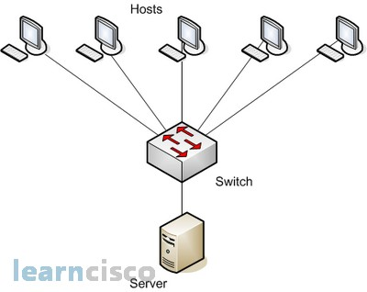
You can Also have an L2 Firewall
Firewalls can go here too!
In this case, L2 refers to the
routing, not the inspection!

Slide 29
Layer 2 Firewalls
Might be better for enforcing different policies
Insider threat policies
Different types of devices on the same LAN (e.g., wireless, wired)
Have some neat defensive properties
If only a switch, HAS NO IP ADDRESS!!! HARDER TO ATTACK!!!
Called “bump in the wire”

Slide 30
L7 Firewalls
Probably to confuse you personally, L7 refers to the inspection, not the routing
L7 firewalls examine application data
Even more “stateful”

Slide 31
Early Motivations for L7
Application firewalls go back to 1991!!
The idea was simple: Firewalls should understand application traffic.
Example: FTP
FTP has a control channel and a bulk data channel
To transfer a file, a new port is opened dynamically, and communicated over control
Even if FTP’s control channel port is open, how do you open the dynamic port?

Slide 32



Non FTP Aware Firewall
Connect to FTP Server on port 21
Announce FTP client is listening on port 9210
Connect to 9210
This Photo by Unknown Author is licensed under CC BY-SA
This Photo by Unknown Author is licensed under CC BY-NC

Slide 33

FTP Aware Firewall
Connect to FTP Server on port 21
Announce FTP client is listening on port 9210
OPEN 9210!
Connect to 9210
This Photo by Unknown Author is licensed under CC BY-SA
This Photo by Unknown Author is licensed under CC BY-NC

Slide 34
Tracking Users
Since the early 90’s, many firewalls also supported their own services
Users could connect to the firewall as a server and, for example, log-in
The logging-in process could map a
user-name to an IP address
Or even a point-to-point protocol with encryption (or VPN)
Combined with application scanning, far more granular policies enforced

Slide 35
L7+User Policy Enforcement
Policy #2: Only authorized users from outside the LAN can access LAN resources
Policy #3: Only authorized users on the LAN can access authorized services outside the LAN
LAN resources can now be application specific!
User X can only download on FTP
User Y can upload or download on FTP

Slide 36
More Motivation for L7
In the past decade, need for L7 scanning has increased
Consider policy #1 – controlling which services are available
Without L7, this can only be enforced by monitoring ports.
What stops a bad person from using an unconventional port number?
With L7 scanning, can verify the type of traffic

Slide 37
Tunnels
In the arms race, bad actors wrap one kind of traffic in another
Unsurprisingly, HTTP is popular
Modern firewalls can unpack the tunnel to see what’s inside.
One exception: encrypted tunnels (TLS/SSH)
Can’t see inside without “visibility” (we’ll discuss later)

Slide 38
IDS: Mitigation and Future PRevention
IDS stands for Intrusion Detection System
IPS is Intrusion Prevention System
IDS is far more common because IPS is just too hard (false positive and false negatives)
IDS assumes the attacker has already won
The attacker has already succeeded in his objective and left (forensics)
The attacker is in the system, but still moving toward a higher target (mitigation)

Slide 39
Signs of Bad Behavior
Anomalies: unusual network traffic
Port scanning (recon)
Unusually large data transmissions (buffer overflow, etc)
Unexpected traffic between machines
Surprisingly, this is still very much signature based
Various products have attempted to do statistics modeling but usually too noisy

Slide 40
IDS Types
Network Based IDS (NIDS)
Monitor traffic on the network (often using the gateways/routers)
Host Based IDS (HIDS)
Monitor traffic received at a host, and the effect thereof
Sometimes helpful in simply monitoring the encrypted traffic
Hybrid systems
Deploy host components and network componets
Report all data back to a central server/dashboard

Slide 41
Honeypots
An interesting IDS component
Create a fake system to draw attacker attention
Introduces components whose entire operation is an anomaly

Slide 42
Types of Honeypots
Low Interaction – port only, record traffic
Purpose: logging
Medium Interaction – simulated/emulated service
Purpose: delay/confuse
High Interaction – real services on real computers with real operating systems
Purpose: maximum analysis of attacker behavior
Honeynet – multiple honeypots working together
Specialized variants:
Malware Honeypots
Spam Honeypots

Slide 43
Deploying Honeypots
Now part of larger “Enterprise Deception Operations” initiatives
Which type of honeypot makes the most sense?
Perhaps counter-intuitively, “low interaction” for corporate
“high interaction” for research
In the corporate world, may be related to SLA (reaction time, not detail matters)
But all of this should come back to the security policy, should it not?

Slide 44
IDS and Security Policy
What policy does IDS (including honeypot) enforce?
For many (all?) ideal policies, none. The attacker has already violated a policy.
Perhaps you could think of it as a meta-level policy (policies about policies)
Or, you could think about it as “enforcement-after-the-fact”
That is, how quickly can we get back to compliance?

Slide 45
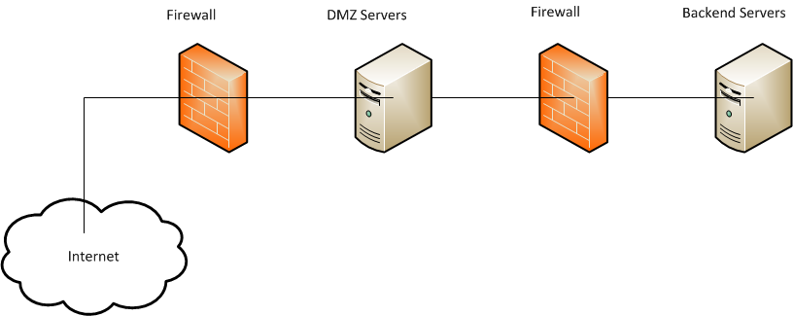
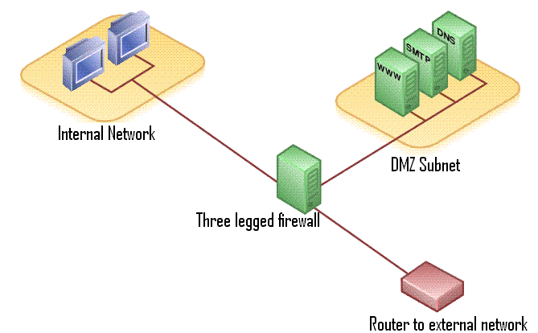
Network Architecture: DMZ
This Photo by Unknown Author is licensed under CC BY-SA
This Photo by Unknown Author is licensed under CC BY-SA
POLICY ENFORCEMENT

Slide 46
The Future
Later, we’ll talk about ZERO TRUST NETWORKS
Many believe that the “Firewall is Dead”, “DMZ’s are Dead”, etc
I doubt that they die, but we’ll talk later about how they’re no longer enough

