Slide 1
Overview of the World Wide Web
UT CS361S – Network Security and Privacy
Spring 2021
Lecture Notes

Slide 2
What is the World Wide Web?
Internet - globally interconnected network system
World Wide Web - HTTP-based content, apps, “ecosystem”

Slide 3
Key Tech: Domain Name System (DNS)
IPv4 addresses were hard to remember/use
IPv6 are worse
Humans need semantically meaningful addresses
DNS maps IP addresses to domain names

Slide 4
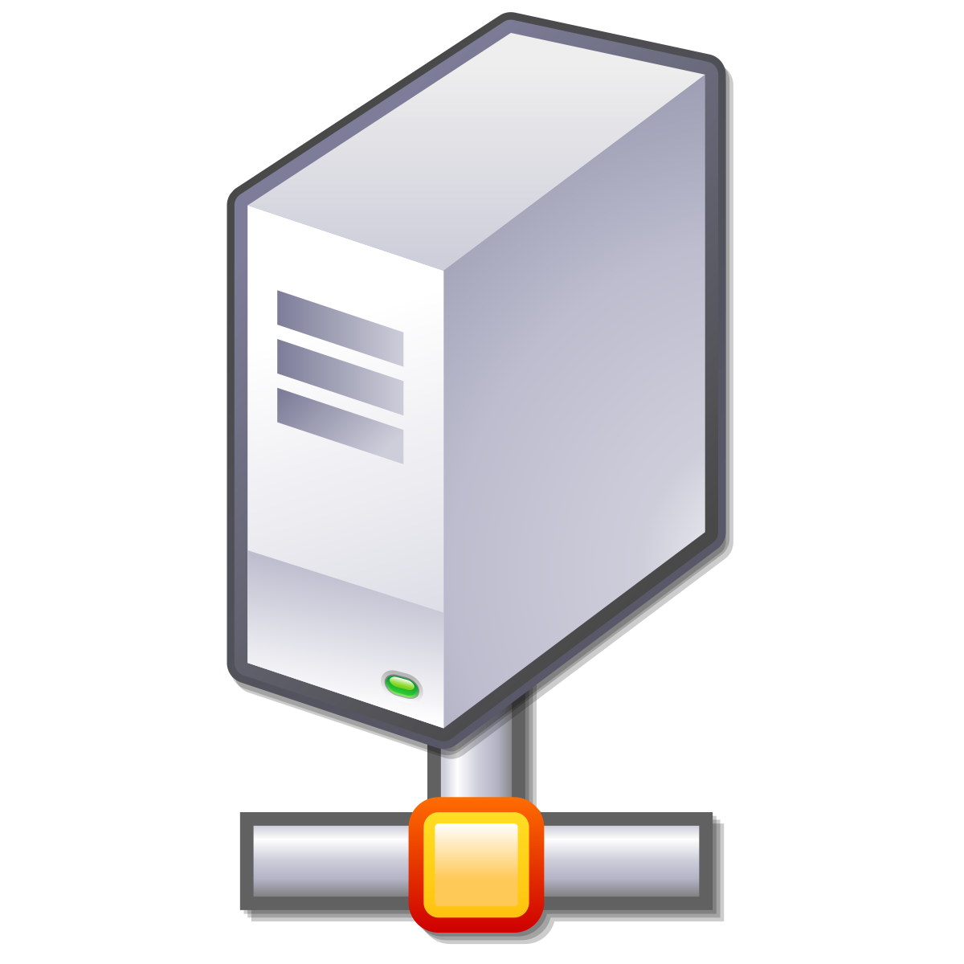
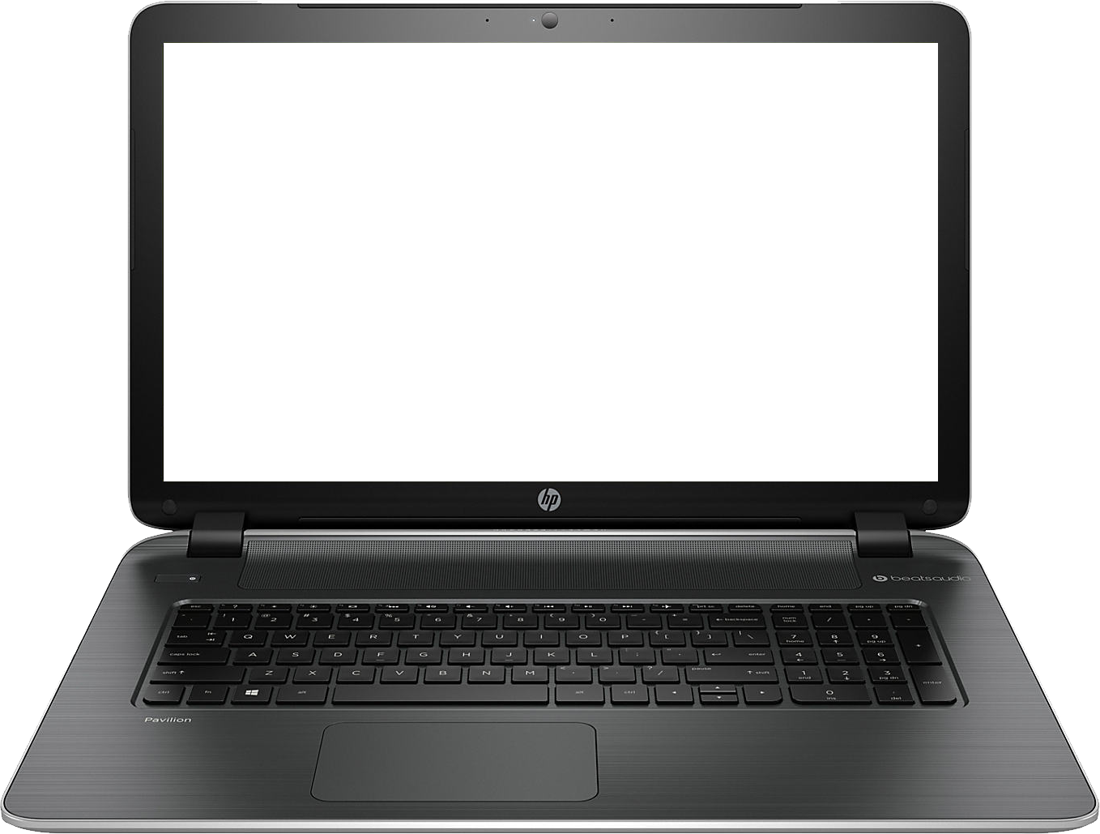

Basic Idea
Where is “google.com?”
142.250.138.138
DNS SERVER
http://google.com
GET / HTTP/1.1
142.250.138.138
(google.com)

Slide 5
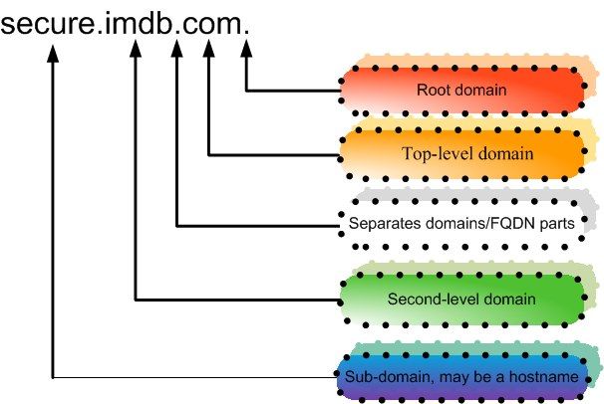

Slide 6
Top Level Domains (TLDs)
Generic Top Level Domain (gTLD) - .com, .net, et
Country code Top Level Domain (ccTLD) - .uk

Slide 7
TLD Name Management
Registrars administer TLDs
For gTLDs, this is a business with pros and cons
Registrars authorize “domain name registrars”

Slide 8
Domain Name Registration
Party requests SLD + TLD from domain name reseller
Party submits “whois” information (contact info)
Registrar verifies that name is available
Registrar stores relevant data in registry and DNS servers

Slide 9
DNS and Address Resolution
DNS is a recursive and hierarchical process
Recursive – DNS server searches another DNS server
Hierarchical –
Root Domain to TLD
TLD to Subdomain

Slide 10
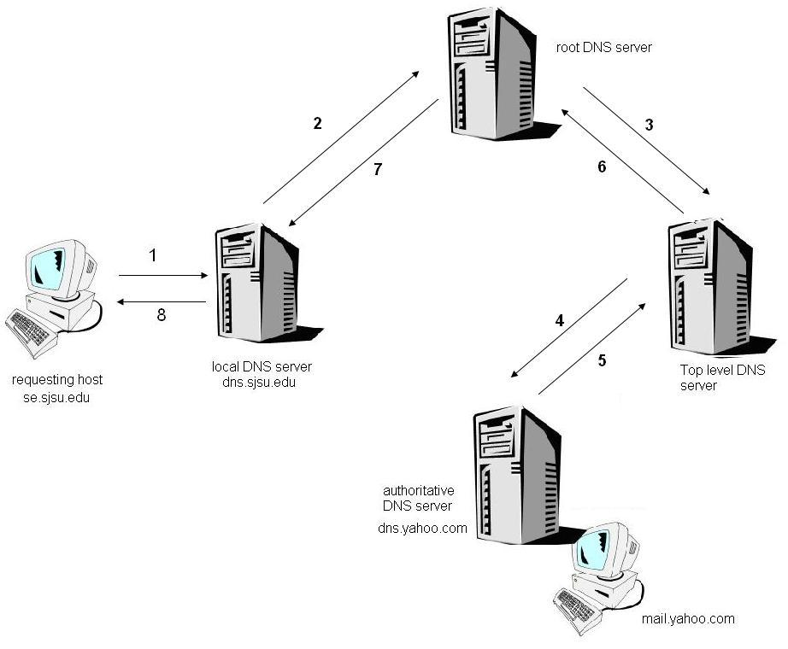

Slide 11
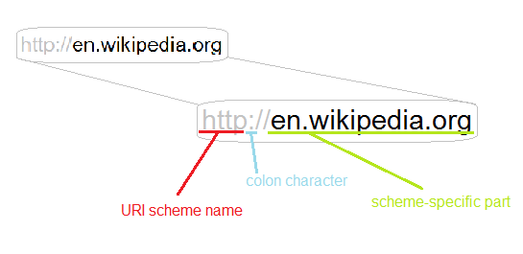
Uniform Resource Identifiers (URIs)

Slide 12
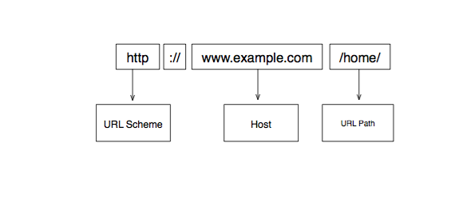

Slide 13
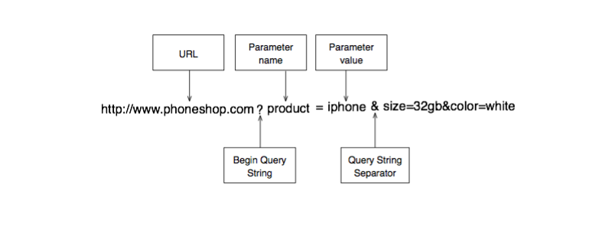

Slide 14
Absolute vs Relative URI
Absolute paths begin with <scheme>://host/
e.g., http://www.google.com/
Everything else is relative
e.g., /not/an/absolute/path
The scheme and host are determined by context

Slide 15
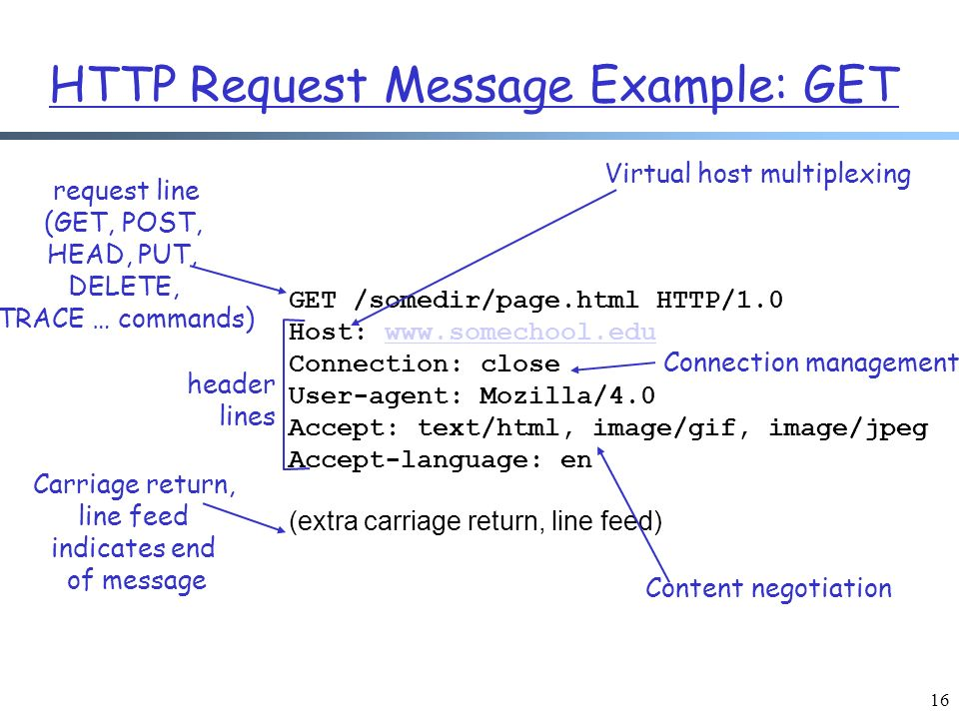
HTTP Request

Slide 16
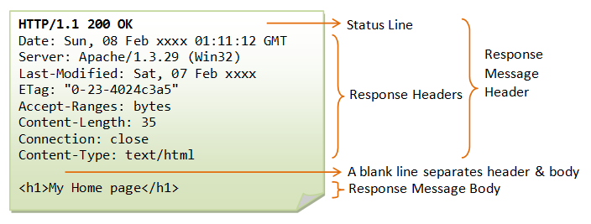
HTTP Response

Slide 17
Static Web Page Example
<HTML>
<BODY>
<H1>Simple Web Page</H1>
<IMG SRC=“/images/image1.jpg”>
</BODY>
</HTML>

Slide 18
Rendering a Web Page
Browser requests HTML “root” page
Root page has links for images, etc
Browser requests embedded objects
Browser integrates and renders objects

Slide 19
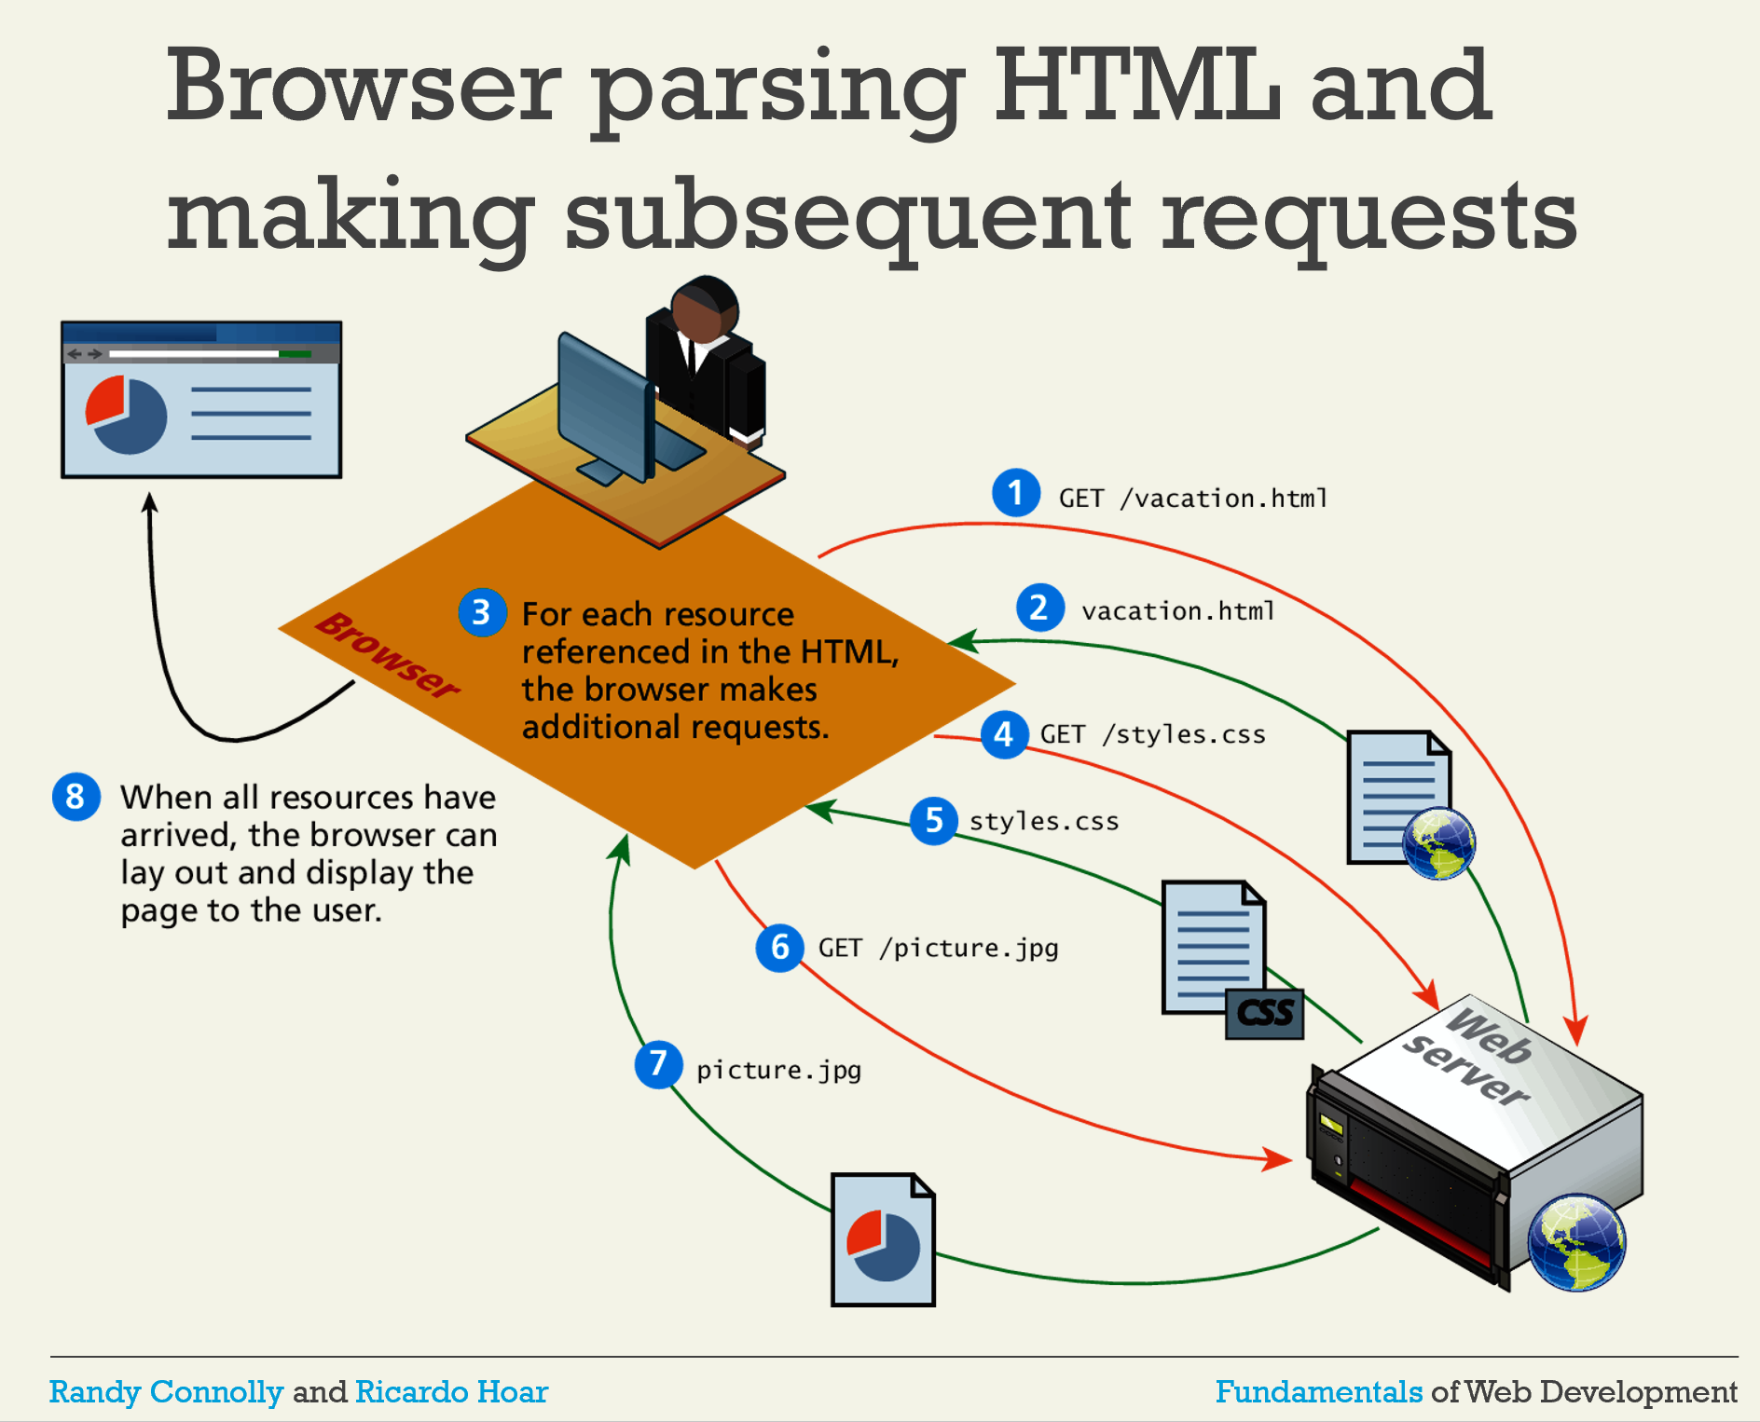

Slide 20
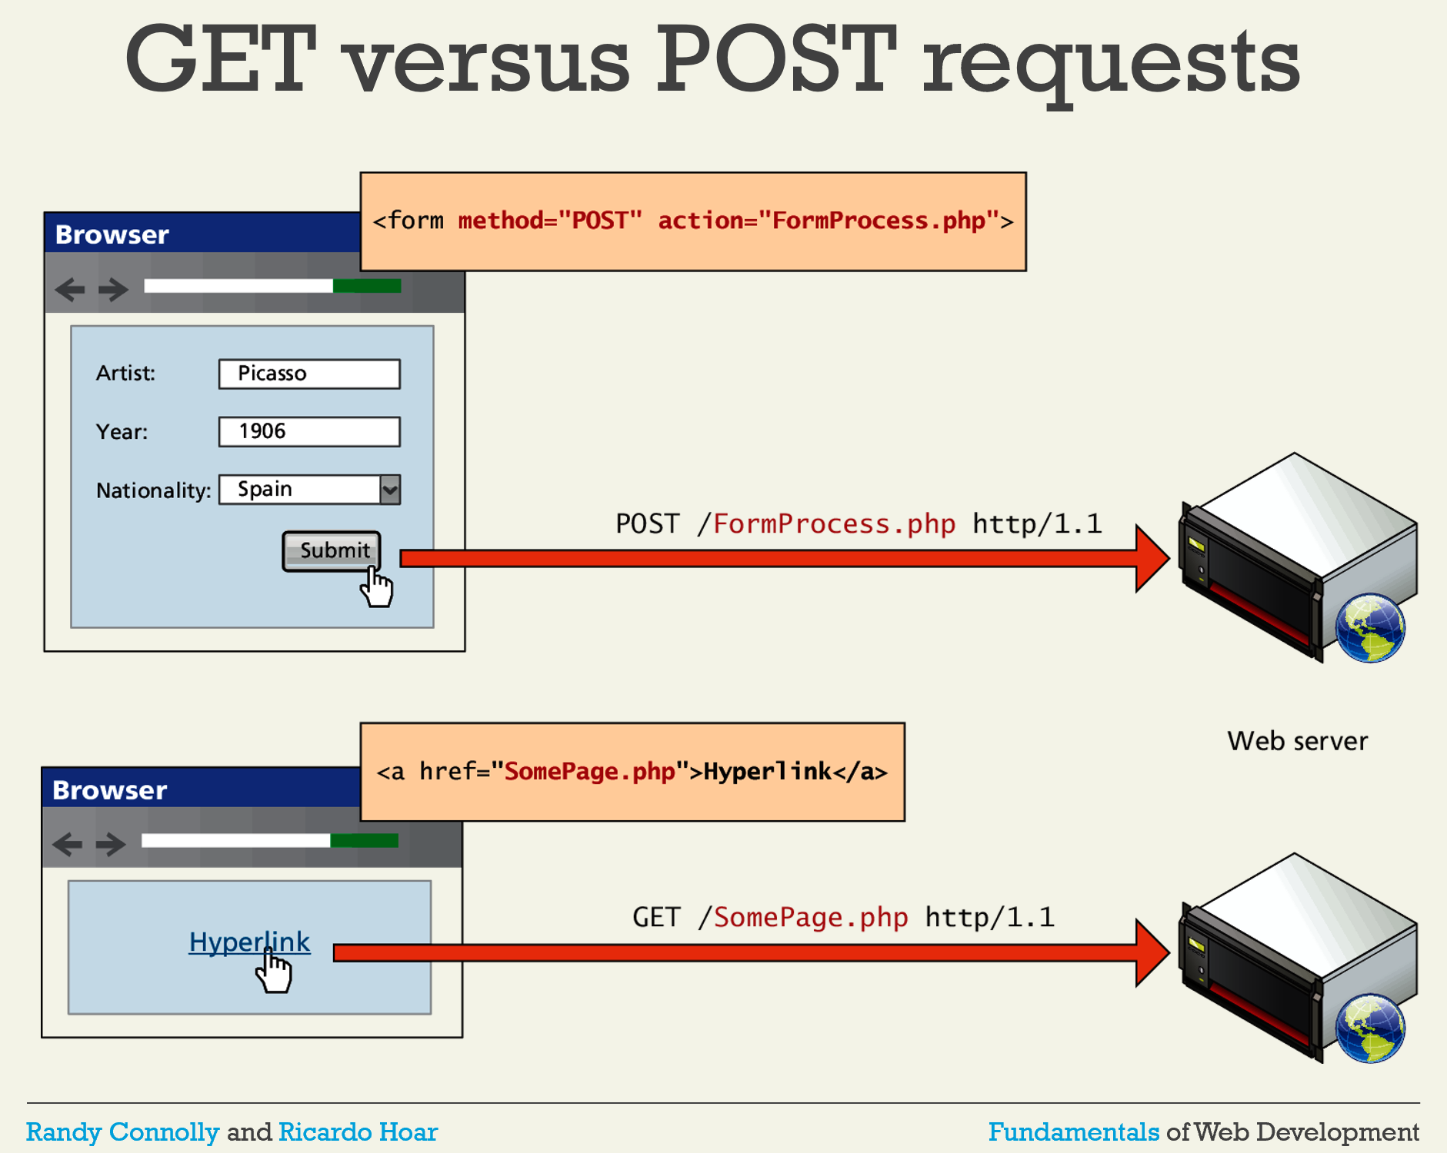

Slide 21
Web Stack
The “stack” of software needed to run a web server
Typically: O/S, web server, database, scripting engines, etc
Very Common: LAMP:
Linux
Apache
MySQL DB
PHP

Slide 22
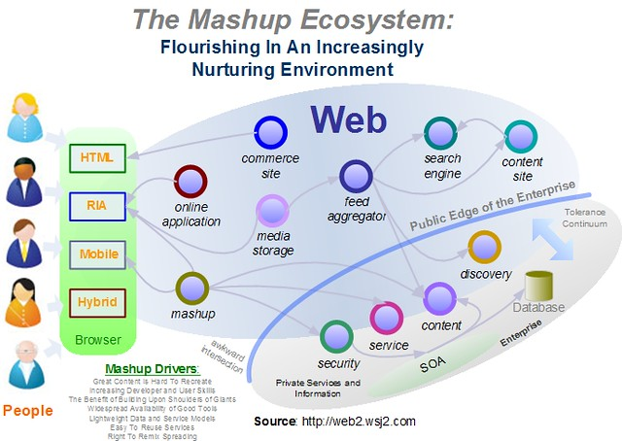
Web 2.0 and Beyond

Slide 23
Cookies
HTTP is STATELESS
A webserver doesn’t “connect” requests
To simulate a “session”, use cookies
Put “cookie: <session id>” in request/response header

Slide 24
Basic Idea
GET \ HTTP/1.1
Cookie: ac39f210ef120
Browser 1: google
Browser 2: google
Page 1
Page 2
GET \ HTTP/1.1
Cookie: 9b8dde1783ff3e

Slide 25
Cookies and Domains
Cookies are most assigned by domain
For example, “google.com” cookies
This is important for security and privacy

Slide 26
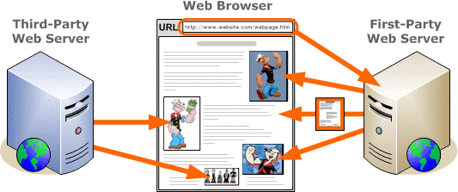
First-Party, Third Party

Slide 27
How do companies track?
First-party façade: advertising_company.amazon.com
Collusion: first-party, third-party share data
First-party can send data to third-party in URL
<IMG src=“http://third-party?cookie=stolen”>

